Slide 1
Shalva Bilanishvili
Domain Wall Model as Quantum Chromodyinamical Vacuum
Frascati 2018

Slide 2
Matter:
Quarks, Leptons.
Interaction:
Photons, W and Z Bosons, Gluons.
Higgs boson is responsible for spontaneous symmetry breaking and mass origin.

Slide 3

In Quantum Chromodynamics there is no fundamental scalar field , this is why we are studing effective potential dependence on scalar objects combined by quark and gluon fields. For example: quark condensate $\overline{ψ}ψ$ and gluon condensate $F_{μν}F^{μν}$
QCD vacuum has nontrivial structure:
vacuum systems ground state.
classical analogue potential minimum.
Quantum Field Theory effective potential.

Slide 4

Effective potential
$$Z=N\int_{ℱ}^{ }{D A}\int_{ }^{ }{DψD\overline{ψ}}exp⁡\{−S[A,ψ,\overline{ψ}]\}$$
Where S is Euclidean action
Effective potential is defined by Green’s function generating functional

Slide 5

$$U_{eff}\left(B\right)=U_{YM}\left(B\right)+U_{q}\left(B\right)$$
$U_{YM}\left(B\right)=Λ^{4}B^{2}aln\left({bB}^{2}\right)$
$U_{q}^{ }\left(B\right)=\frac{Λ^{4}}{{8π}^{2}}\int_{0}^{∞}{\frac{ds}{s^{3}}{Tre}^{−m^{2}s}\left[s^{2}\coth^{2}\left(s\hat{n}B\right)−1−\frac{2}{3}s^{2}{\hat{n}}^{2}B^{2}\right]}$

Slide 6
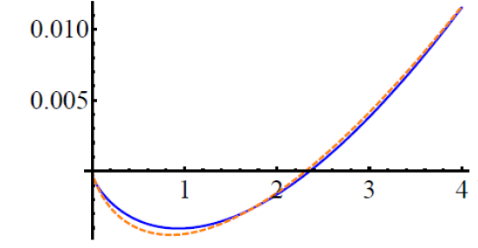

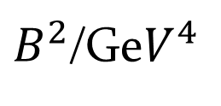

Effective potential and Gluon condensate
$$U(B^{2})=aB^{2}ln⁡(bB^{2})$$
$a=\text{0.00528} {GeV}^{−4}$
$b=\text{0.}\text{433} {GeV}^{−4}$
U${(B}^{2})$/Ge$V^{4}$
$B^{2}$/Ge$V^{4}$
arxiv.org/abs/1010.2153v2

Slide 7
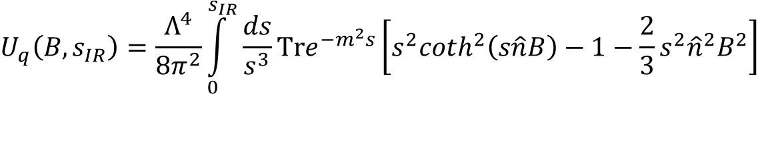
$$U_{q}^{ }\left(B,s_{IR}\right)=\frac{Λ^{4}}{{8π}^{2}}\int_{0}^{s_{IR}}{\frac{ds}{s^{3}}{Tre}^{−m^{2}s}\left[s^{2}\coth^{2}\left(s\hat{n}B\right)−1−\frac{2}{3}s^{2}{\hat{n}}^{2}B^{2}\right]}$$
Green: Gluon potential
Red: Potentials sum
Blue: Quark potential
$$U_{YM}\left(B,s_{IR}\right)=Λ^{4}B^{2}aln({bB}^{2}+s_{IR}^{−2})$$

Slide 9
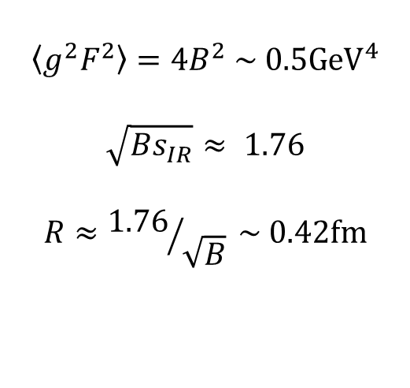
$$\left\langle g^{2}F^{2}\right\rangle =4B^{2} \sim 0.5{GeV}^{4}$$
$$\sqrt{{Bs}_{IR}}≈ 1.76$$
$$R≈{1.76}/{\sqrt{B}} \sim 0.42fm$$
Eur. Phys. J. A (2015) 51: 45
DOI 10.1140/epja/i2015-15045-8

Slide 10
Domain wall network as QCD vacuum
The three-dimensional spatial domain wall separates the four-dimensional regions filled with the self-dual (blue color) and anti-self-dual (red color) Abelian covariantly constant gluon fields.
Three-dimensional slices of the kink network —additive superposition of numerous four-dimensional lumps.
Eur. Phys. J. A (2015) 51: 45
DOI 10.1140/epja/i2015-15045-8

Slide 11
Thank for your attention

