Slide 1

Introduction to
Calorimetry
S.Miscetti
LNF/INFN Frascati, Italy

Slide 2
Outline of the lecture
A calorimeter primer
→ Calorimeter concept
→ Calorimeter kind: etherogeneous/homogeneous
→ Electromagnetic showers
→ Energy resolution terms
→ Hadronic showers
→ Compensating calorimeters
→ Homogenous calorimetry
→ Scintillation crystals
→ Photodetectors

Slide 3
What is a calorimeter ? (1)
The main usage of a calorimeter (HEP) is to measure the particle energy.
They typically do this by means of totally absorbing
energy in the calorimeter material (destructive measurement)
What kind of particle can be measured ?
neutral and charged
- em calorimeter (photons, π⁰, electrons)
- hadron calorimeters ( n, p, π^{+/−} ,K, Jets …..)
Basic assumption of the response → Linearity
Q (response pC) = a (Calib Constant) x Ep (Particle Energy)

Slide 4
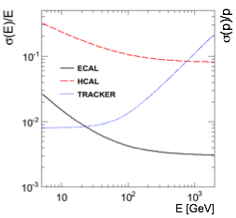
What is a calorimeter ? (2)
Calorimeter and trackers are complementary in HEP.
Many good reasons to have it one in your detector:
Energy resolution improves for increasing energy
(like k/sqrt(Ep), stochastic measurement)
Tracker momentum resolution deteriorates
for increasing momentum (larger sagitta errors)
Calorimeters can be extremely fast and
easy to be used for triggering.
Tracking + calorimeter helps:
→ PID (ex photons/e, e/pi-mu, …)
→ Energy flow
(i.e. tracking correction of energy deposits
to improve Jets determination ..
Started LEP-CDF , CMS-Atlas improved)
In 4−π detectors missing energy
becomes also very important (neutrinos)

Slide 5
How many calorimeter kinds ? (1)
Calorimeters have assumed any form since they were born but basic sub-division remains for dimension scale and methods of operation:
γ, π⁰,e
MIP
n,p,π^{+/- ,}K
Electromagnetic, Hadronic
E.M. …. well described shower γ, π⁰,e
radiation length (X₀)
Had .. not well described shower n,p,π^{+/- ,}K
interaction length (λ)

Slide 6
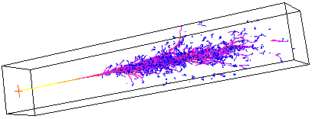
How many calorimeter kinds?
Heterogeneous: Sampling signal in active material, mostly absorbed in passive material. Possibility of longitudinal segmentation. Many choices.
Can be both EM and hadronic calorimeter. Can be fast.
Are cheap. Can be adapted to many situation → Poor resolution.
Homegeneous: signal is fully absorbed in active material.
Small longitudinal segmentation. Limited choice of material. Expensive.
Cannot be hadronic calorimeter. Very good resolution.
Timing can be great with some expedients.
Can be used also in other fields (PET).

Slide 7



Signal generation
A particle deposits its full energy in the calorimeter media
The energy is converted into a measurable signal
A particle deposits its full energy in the calorimeter media
The energy is converted into a measurable signal
(charge / light / sound / heat)
The most used materials → gases / semiconductors / scintillators ……
semiconductors: dE/dx or photon-absorption (Silicon Trackers/Vertex)
+ drift of e-h eV per e-hole pair
gases: dE/dx or photon-absorption (Trackers)
+ charge diffusion 20-40 eV per e-ion pair
scintillators: dE/dx or photon-absorption (Calorimeters )
+ light emission 400-1000 eV per photon
generated charges/photons yield the measurable signal:
statistical process = the more the better !
21/3/2018
S.Miscetti @ Frascati Detector School: Calorimeter Primer

Slide 8
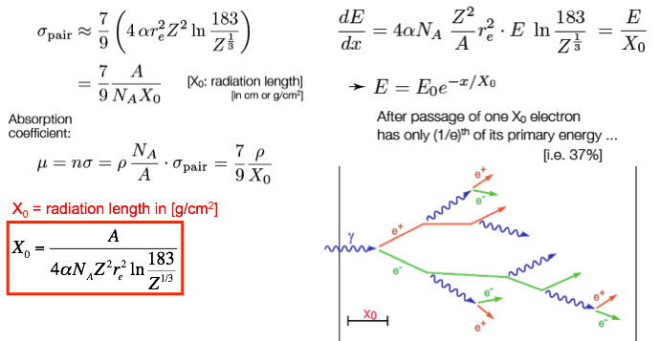
Primer of EM showers (1)
Dominant processes at high energies (E > few MeV) :
Photons : Pair production Electrons : Bremsstrahlung
21/3/2018
S.Miscetti @ Frascati Detector School: Calorimeter Primer

Slide 9


Primer of EM showers (2)
An alternating sequence of interactions
creates a cascade
Simplified shower model [Heitler]
E > Ec: shower development governed by X0
e⁻ loses energy via Bremsstrahlung
γ pair production with mean free
path 9/7 X0
N. particles doubles every X0 of material,
Energy gets reduced by 2 @ each iteration
Shower continues until the particles
energy reaches Ec
Shower max @ tmax = ln( E₀/E_{c})/ln2
After this point dE/dx, Compton and photoelectric effects take over. Shower energy deposition diminishes and then stops. It is referred as shower tail.
t (95 %)= [ t(max) + 0.008 Z + 9.6] in X₀ units
21/3/2018
S.Miscetti @ Frascati Detector School: Calorimeter Primer

Slide 10
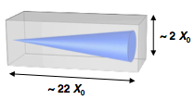
Primer of EM showers (3)
Cloud chamber photo of EM cascade between spaced lead plates.
GEANT-4 SHOWER event
Pic: MIT cosmic ray group
Shower
Max
2RM
Shower
Tail
Longitudinal development
Transverse development
Multiple scattering
dominates in
Transverse
development
21/3/2018
S.Miscetti @ Frascati Detector School: Calorimeter Primer
Notes:
Radiation length Xo is distance for electron to lose 1/e of its energy by Brem.

Slide 11
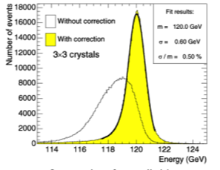



Energy Resolution terms
The energy resolution is parametrized as:
2σ
Leakage
or
Stochastic term a
      E ∝ N ➔ σ ∝ 1/√N : all statistical effects contribute
      i.e. intrinsic and sampling fluctuations, photoelectron statistics
    Noise term b (energy independent term) relevant at low E
      Electronic noise, radioactivity
  Constant term c (linearly dependent of energy) dominates at high E
      inhomogeneities, calibration uncertainties, radiation damage, (leakage), …
E

Slide 12
Calorimeter Types: homogeneous (1)
21/3/2018
S.Miscetti @ Frascati Detector School: Calorimeter Primer

Slide 13
Calorimeter Types: homogeneous(2)
21/3/2018
S.Miscetti @ Frascati Detector School: Calorimeter Primer

Slide 14
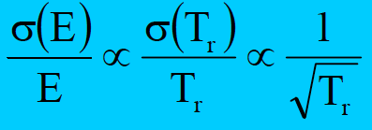
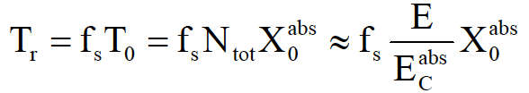
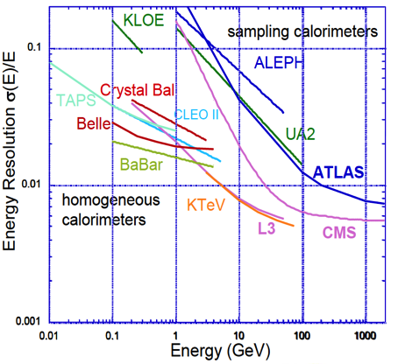
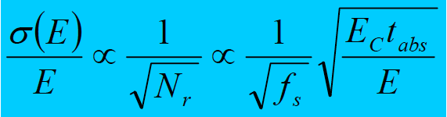
Calorimeter Types: Sampling
  A structure of passive and active material. Cheaper. Only a fraction (Sampling Fraction, fS) of the deposited energy is detected (1-5%)
Resolution scales with
absorber thickness tabs=d/X0
  σ(E)/E ~ 10-30% /✓(E)
  Notable exception: KLOE-like calorimeter (tomorrow)
21/3/2018
S.Miscetti @ Frascati Detector School: Calorimeter Primer

Slide 15

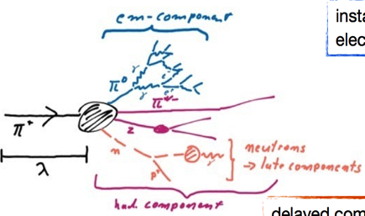
Hadronic showers
Hadron showers are more complicated than EM.
We need to consider the strong interaction with detector material.
In nuclear collisions, the following objects are produced:
high energetic secondary hadrons [O(GeV)]
electromagnetically decaying particles (π0,η ) initiate EM showers
spallation p/n and nuclear excitation from soft nuclear processes [O(MeV)]
part of the energy is invisible: binding energy of nuclei, ν, μ, soft γ’s
Different scale: hadronic interaction length
σtot = total cross section for nuclear processes
 | λI | X0
Polystyren | 81.7 cm | 43.8 cm
PbWO | 20.2 cm | 0.9 cm
Fe | 16.7 cm | 1.8 cm
W | 9.9 cm | 0.35 cm
π0 production .. all energy goes into EM
Compare X0 for high-Z materials, we see that the size needed for hadron calorimeters is
large compared to EM calorimeters.
21/3/2018
S.Miscetti @ Frascati Detector School: Calorimeter Primer

Slide 16
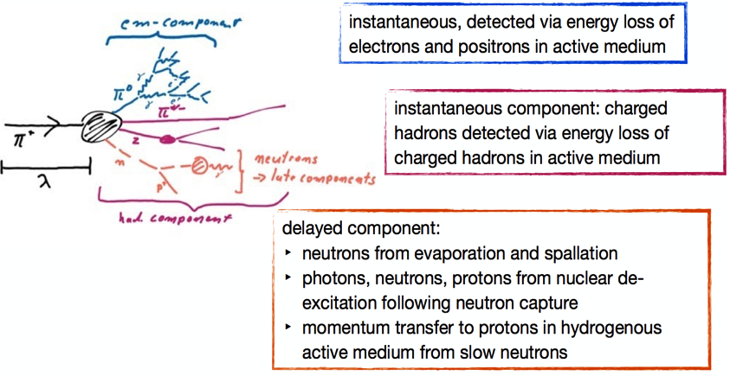

The structure of hadronic showers
hadronic showers have a complex structure also in time
Importance of delayed component strongly depends on target nucleus
Sensitivity to time structure depends on the choice of active medium
fEM = fraction of primary hadron energy deposited via EM processes
21/3/2018
S.Miscetti @ Frascati Detector School: Calorimeter Primer

Slide 17
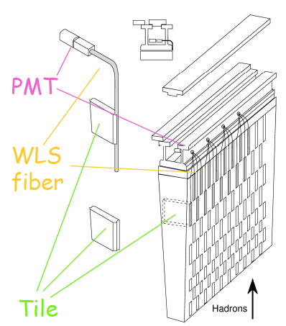
Example of hadronic calorimeters
Improvements
with WLS fibers
LESS cracks
CDF: Fe/scintillator with transversal orientation, WLS
bars and plexi-light guides
ATLAS: Fe/scintillator
vertical orientiation
21/3/2018
S.Miscetti @ Frascati Detector School: Calorimeter Primer

Slide 18


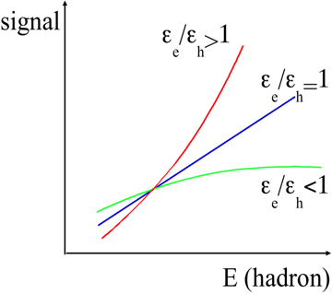




Hadronic Calo: Compensation (1)
A hadron calorimeter shows in general different response to hadronic and electromagnetic shower components
The fraction of the energy deposited hadronically depends on the energy
Calorimeter response to hadrons becomes not-linear
Energy resolution degrades
R. Wigmans NIM A 259 (1987) 389
21/3/2018
S.Miscetti @ Frascati Detector School: Calorimeter Primer

Slide 19
Hadronic calo: Compensation (2)
To “Compensate” a Hadronic Calorimeter means make e/h → 1
To do so .. there are typically 3 ways (example for common e/h >1)
→ A) enhance sensitivity to low neutrons → boost h (H-enriched)
→ B) add special absorbers for neutrons (Uranium)→ boost h
→ C) Reduce electron response → correcting sampling fraction
Magic Thumb Rule (Wigmans) Fs (Lead/Fiber= 4/1)
21/3/2018
S.Miscetti @ Frascati Detector School: Calorimeter Primer

Slide 20
Chorus example of compensation
The ZEUS Calorimeter with U plates
got a good compensation (e/h) and
similar resolution for Eh > 5 GeV:
σ(Ε)/E = 35%/sqrt(E/GeV)
More detailed discussion on compensation and nowadays trends and developments will be shown on Friday by Dr. Gabriella Gaudio → DREAM project
21/3/2018
S.Miscetti @ Frascati Detector School: Calorimeter Primer

Slide 21
Scintillators and photosensors

Slide 22
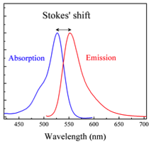
Scintillation process
Basic principle: a charged particle crossing a scintillator loses energy,
exciting atoms or molecules of the material
➪ photon emission (UV-visible) follows
Light emission:
can be instantaneous, <10⁻⁸ s, (fluorescence) or delayed, ms to hours(phosphorescence)
Has one or two exponential decay time t_{D} (fast, fast/slow)
λ_{em} > λ_{ex}
21/3/2018
S.Miscetti @ Frascati Detector School: Calorimeter Primer
Notes:
Salto UP-blu: livelli orbitali Salto DOWN-nero: livelli vibrazionali

Slide 23
Scintillators: characteristics
Relevant characteristics for particle detection:
Light Yield (LY) number of photons produced for a given absorbed energy
Transparency to the emitted radiation
Spectral emission compatible with light detectors (photosensors), where light is collected and then converted into electrons via photo-electric effect
Linearity of response
Time response
Density, X₀, Rm
21/3/2018
S.Miscetti @ Frascati Detector School: Calorimeter Primer

Slide 24
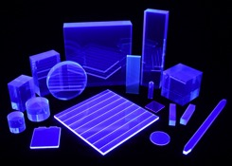
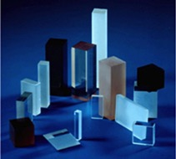
Types of scintillators
Organic scintillators
Complex organic molecules (typically soluted in plastics materials) where UV light is emitted after excitation of molecular levels. Other molecules (wave length shifters) are then added to transfer light into visible radiation
  Fast emission time (2.5-10 ns)
  Low scintillation efficiency (< 2 k photons / MeV)
  Low density (1 g/cm³)
  Can be easily machined to any shape (fibers)
Inorganic scintillators
Crystals (alkali, alkaline earth and rare earth), usually doped with impurities uniformly dispersed throughout the crystal lattice
  High scintillation efficiency ( 10-70 k photons / MeV)
  Slow emission time (100-600 ns)
  High density (4-7 g/cm³)
21/3/2018
S.Miscetti @ Frascati Detector School: Calorimeter Primer

Slide 25
Types of scintillators
Discovery and development of new scintillators driven by basic R&D in physics
HEP has played a major role in developing new scintillators at an industrial scale and affordable costs (CsI, BGO, PbWO)
21/3/2018
S.Miscetti @ Frascati Detector School: Calorimeter Primer

Slide 26
Crystals for HEP
Broad variety of scintillator parameters: relative importance depends on the application
Typical LY of NaI ∼ 40000 γ/MeV
21/3/2018
S.Miscetti @ Frascati Detector School: Calorimeter Primer

Slide 27
Emission Spectra
21/3/2018
S.Miscetti @ Frascati Detector School: Calorimeter Primer

Slide 28
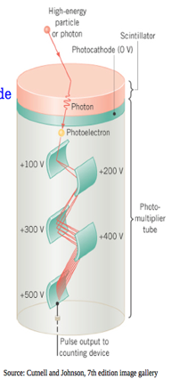
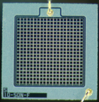
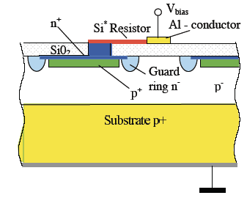
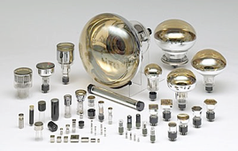
Detecting the light: Photosensors
Light is guided to a photo-detector (i.e. photomultiplier tube, silicon photomultiplier) and converted into charge:
  Conversion of a photon into electrons via photo-electric effect
  Amplification of the electron signal by factor 10⁵-10⁶ via secondary emissions on dynodes or avalanche in silicon
  Photo-detector requirements:
  cover a large range of wave lengths (UV to IR)
  good efficiencies, single photon detection possible
  cover large active areas (SuperKamiokande O 46cm)
  PMT (SiPM) are (not) sensitive to B-Field
Source: Cutnell and Johnson, 7th edition image gallery
21/3/2018
S.Miscetti @ Frascati Detector School: Calorimeter Primer

Slide 29
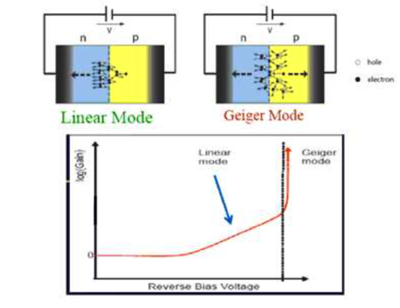
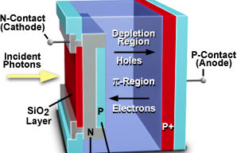
Silicon Photosensors
A silicon photo-sensor is “in practice” a reverse Silicon N-P junction with a photo
sensitive layer where “photo-electrons” are extracted.
The reverse bias helps to create a large depleted region and reduce to negligible
values the “dark current”, Id, i.e. the current seen without any signal in input
3 work regimes:
→ Photodiode (G=1) all e- produced in the photosensitive layer are collected at the anode.
→ APD (G=50-2000) , or Avalanche Photodiode, working in proportional regime and
→ Geiger APD (G=10⁵-10⁶) working in Geiger mode

Slide 30
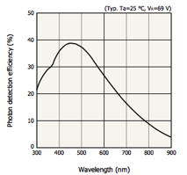
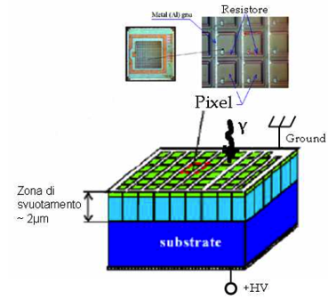
Silicon Photomultipliers (SiPM)
The basic SIPM element (pixel) is a combination of Geiger-APDs and quenching resistors
→ a large number of pixels are electrically connected and arranged in two dimensions;
→ Each pixel generates a pulse of the same amplitude when it detects a photon .
→ The output signal from multiple pixels is the superimposition of single pixel pulses.
depletion area
2 um
Single photon counting
Photon Detection Efficiency
“Intrinsic” not-linearity
on the response.

Slide 31
Photosensors & Scintillator matching
Coupling scintillator light emission spectrum to
Quantum Efficiency of photosensors is essential
Crystals with λ > 400 nm well match with standard bi-alcali PMT and APD
BaF₂
Fast and Slow components
21/3/2018
S.Miscetti @ Frascati Detector School: Calorimeter Primer

Slide 32
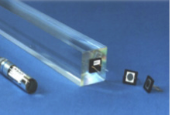

Forecast for tomorrow lesson
Tomorrow we will describe few practical example at low energy:
→ Electromagnetic , homogeneous!
Many possible “on-paper” solutions depending on requirements:
High sampling heterogeneous calorimeter (KLOE-like)
Homegeneous Liquid Xenon (MEG-like)
Homogeneous Crystal like detector (kTeV, BaBar, CMS …)
At low energy, Mu2e for the high intensity regime.
CMS
P_{b}W0₄+APD
MEG
No B-Field
UV ext 2” PMTs
70 ps @ 52 MeV
1.6% @ 52 MeV gammas
KLOE-like
B-Field at 0.5 T
Eres: 5%/sqrt(E/GeV)
Tres: 50 ps/sqrt(E/GeV)

Slide 33
ADDITIONAL
MATERIAL

Slide 34
Longitudinal development

Slide 35
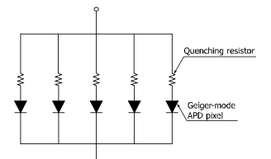
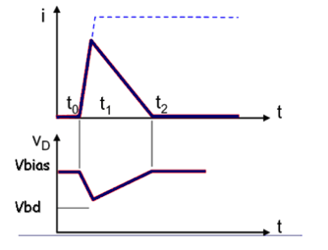
Silicon PMT : quenching
The MPPC (multi-pixel photon counter) is one of the devices called silicon photomultipliers (SiPM) or Geiger APD. It is a photon-counting device that uses multiple APD pixels operating in Geiger mode;
The Geiger mode allows obtaining a large output by the discharge even when detecting a single photon. Once the Geiger discharge begins, it continues as long as the electric field is maintained.
One specific example for halting the Geiger discharge is a technique using a so-called quenching resistor connected in series with each APD pixel. This quickly stops the multiplication in the APD since a voltage drop occurs when the output current flows.
MPPC Structure

