Slide 1
Trigger overview and early physics
E. Pasqualucci
INFN Roma

Slide 2
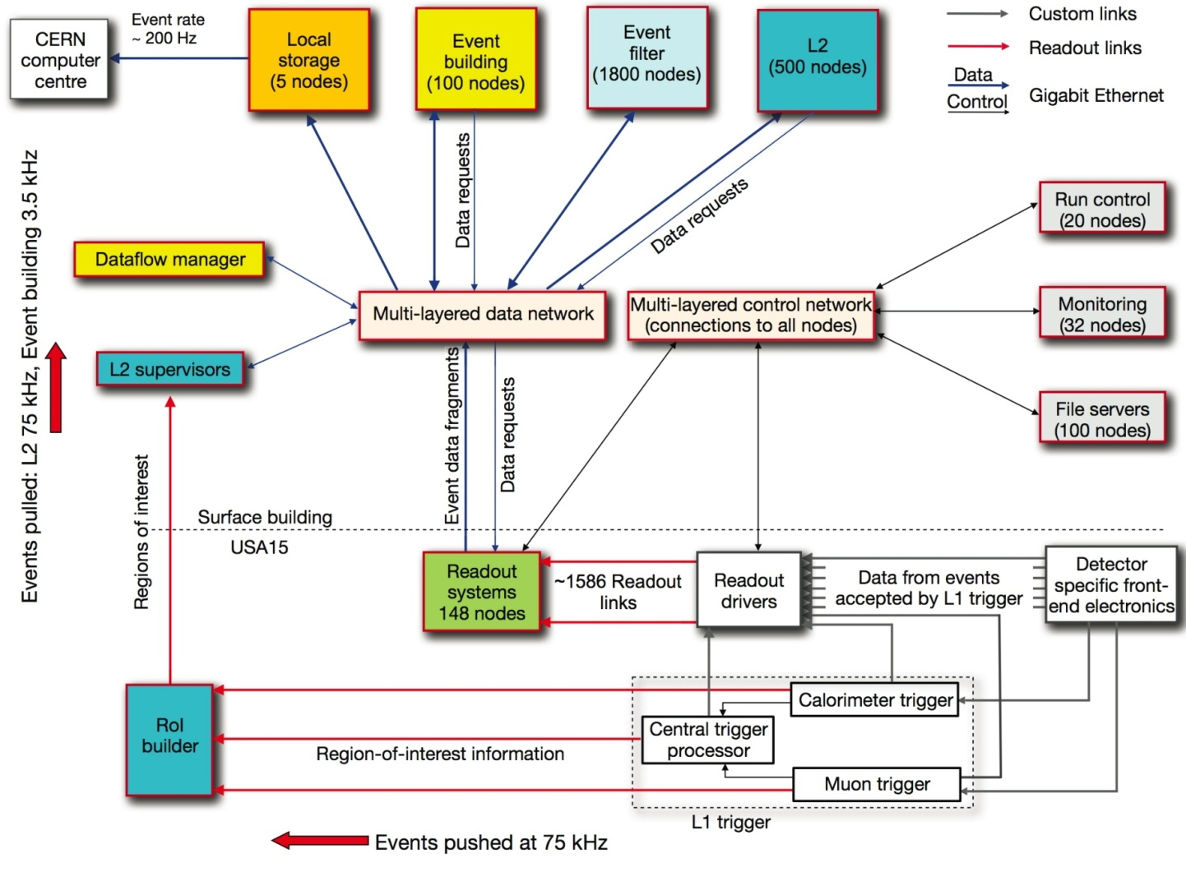
The Atlas TDAQ

Slide 3
Atlas triggers
Local L1 selection
  RoI selected through simple signatures
  HW
  Synchronous
  Pipelined, fixed latency (2.5 μs)
  40 MHz clock
RoI based L2
  Selection refined moving few % of data
  SW based
  Sequential
    Early rejection
  Asynchronous
EF based on full event

Slide 4
Trigger items and trigger menus
Trigger item
  A configuration which identifies a given signature
  Fully specifies threshold and selection criteria
Trigger menu
  Collection of trigger items
    Incorporates signatures for various objects
    At the three levels
  Must include additional trigger items
    Validation
    Monitoring
    Calibration
    Performance measurements

Slide 5
Level-1 preparation
Trigger HW is completely installed
Trigger prepared through
  Timing
    Critical point!
    Partially achieved through
      Delay measurements and adjustment
      Cosmic ray runs
      Pulse runs
  Threshold setup
    Roads for muons
    Energy calibration for calorimeter
  Commissioning runs

Slide 6
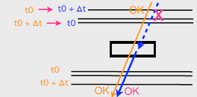
Muon trigger preparation (1)
Exclusive menu between barrel and end-cap
L1 RPC
  Timing alignment
    Fiber length measurement
    Local alignments
      Using data
      Correct internal tower misalignments
      Run on calibration data @ T2
    Global alignments
      Alignment between towers
      Alignment between sectors
      Cross checks with MDT, HLT and CTP
    Initially focused on bottom sectors
      Tools under preparation for alignment with collisions
    Developing tools for final calibration with collisions
Low PT
Low PT
1900
2800
100860
99524
105960
100860
High PT
High PT

Slide 7
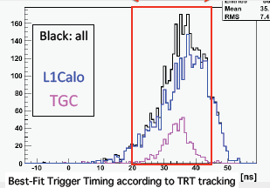
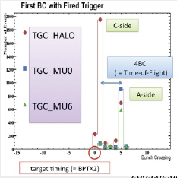
Muon trigger preparation (2)
L1 TGC
  Track emulation via test pulse
  Best alignment achieved with single beam
    < 1 BC
    Repeat in 2009
25 ns

Slide 8
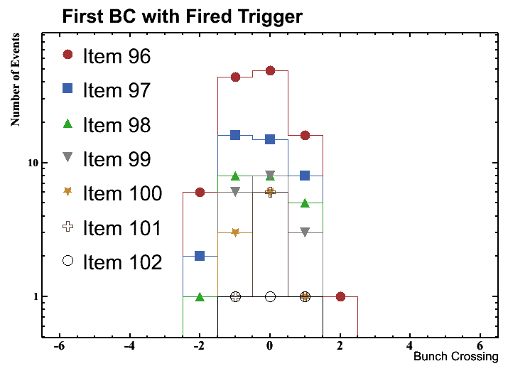
Calorimeter trigger preparation
L1 Calo
  Time and energy calibration
  Currently focused on timing
    Via pulse system
      Intra-partition calibration possible
    Tested during run with TRT trigger
  Cosmic timing is inevitably blurred
    Statistics low for high energy in calorimeter system
    Nevertheless useful for partition to partition timing
  Cosmics straddling partition boundaries useful
    Look at events with large deposits in adjacent towers
    Compare timings, especially across partition boundaries
First order timing for LHC beam
  10 TeV is far more useful than 900 GeV
    Timings should be improved within 1-2 weeks
  Note: timing is an iterative process
    Most critical is to get correct Bunch-Crossing
      BC timing should be available quickly
    To improve energy resolution need good fine timing calibration
      This may take some time to perfect

Slide 9
HLT preparation
During detector weeks:
  “Lay low”: offer service and no trouble!
  Provide streaming (revert to steering dummy if necessary)
  If harmless, run algorithms parasitically
Technical runs
  Integration tests
HLT week:
  Re‐establish status as of october 2008:
  HLT streams based on L1 trigger type
  Algorithms running parasitically
  Few additional cosmic‐specific algorithms performing selection
  Calibration streams & the likes
  Test new algorithms/menu variations/conditions
  DB access patterns
  Stability, stability, stability

Slide 10
HLT commissioning strategy
First collisions
  10²⁶-10²⁷ → MB rate 10 to 100 Hz
  Complete L1 commissioning and understanding
Phase 1 − phase already exercised in 2008 −:
  HLT not running
  The HLT menu (SM Key and cache) is validated in the CAF
  Output rate is adjusted by changing L1 pre-scales
Phase 2:
  HLT in pass-through mode
  Streaming according to L1 trigger type
  The HLT menu is validated offline in the CAF through:
    Tier0 monitoring
    Offline trigger aware analysis in ESD / AOD
  Output rate is adjusted by changing L1 and HLT pre-scales
Phase 3 − exercised for triggering cosmic rays in 2008 −:
  Only when the need comes (i.e. output rate to Tier0 too high):
  The HLT in active mode in a controlled and simple way first
    L2, EF priority ?
  Activating the chains going to reduce the L1 rate first
    pre-prepared according to rate calculations through the “enhanced” minimum bias sample)
  Output rate is adjusted by changing L1 and HLT pre-scales

Slide 11
Trigger classification
Primary triggers
  These are our selection triggers for physics analysis
  Generally not pre-scaled
Supporting triggers
  Efficiency/monitoring of primary triggers
  Tracking/isolation studies…
Calibration triggers
  Explicitly collect detector calibration data
Backup triggers
  Alternative primary triggers in case of rate/resource problems
  Only present during commissioning
    unless they replace a primary trigger
Commissioning triggers
  Present during initial running but not in the physics menu
Test triggers
  MC menu only

Slide 12
Trigger requirements
Menu preparation driven by requirements
  Establish priorities
  Pre-scale factors based on rate control
Trigger requirements in 2009-2010
  Different sources
    Detector requirements
    Combined performance requirements
    Early physics requirements

Slide 13
Detector requirements
Special triggers outside normal runs
  Outside the scope of this talk
    Example: calibration triggers
Special triggers during empty bunches
  Even for 25 ns operation, 2808/3564 fill fraction
    21% of the crossings empty
    It is possible to define “bunch groups”
  Possibility to accommodate empty bunch triggers
  Use partial EB and possibly HLT to reduce bandwidth
  Must not interfere with the normal colliding-beam triggers
Special Triggers during “filled” bunches (with collisions)
  Could be considered combined performance triggers

Slide 14
Special triggers during empty bunches
Pedestal and occupancy triggers (random level 1)
  Mainly used by pixel, ~10 Hz
Test pulse triggers
  Requested by tile calorimeter
Cosmic trigger
Beam triggers to look at background
  LArg and TileCal have requested to use L1Calo with low threshold
  Possible more systematic approach
    Look at physics triggers during empty bunches
Pile-up triggers:
  Specific trigger windows around the filled bunches to measure the “out of time” pile-up.

Slide 15
Special triggers during filled bunches
Random trigger
  “Zero bias” readout of ATLAS
    Requested by LArg and TileCal
  Useful to measure beam pickup or other effects
    To be compared with equivalent empty bunch trigger
Detector calibration trigger
  Mainly used by calorimeters
  Parasite on the general ensemble of physics triggers
  Use Partial Event Building to reduce bandwidths
  LArg community would include
    EM triggers to study and optimize pulse shapes
    “Single hadron” triggers for improved understanding of hadronic calibration
  TileCal would also like an isolated muon trigger for calibration

Slide 16
Combined performance triggers (1)
Understand and document performance
  Need enough data for each object type
Start with few and simple chains
  Avoid too much ambition in HLT algorithms
  Test track triggers against minimum bias data
Minimum bias data are very important
  Bandwidth mostly dedicated to MB in the beginning
    ~100 Hz ⇒ 1-2 M per fill
  Measure:
    basic detector efficiencies
    Track reconstruction efficiencies
    Material using photon conversion
  Critical for tracking and eγ slices
I only give some example in the following

Slide 17
Combined performance triggers (2)
Understanding jets
  Bootstrap from min. bias events:
    jet with ET > 20 GeV and |η| < 2.5 is ~ 6% in MB events
    ~ 10⁵ jets unbiased by any trigger for one fill
  Very high priority
    Understanding L1 (and HLT) biases on jet reconstruction
  In parallel, need to collect γ-jet events (g20 trigger):
    σ (γ + X, with E_{T} > 20 GeV and |η_{γ}| < 2.5) ~ 200 nb @ 10 TeV
    g20 would deliver ~ 2M events for 10 pb⁻¹ with purity of ~ 50%
    Main initial uncertainty due to ε_{γ}
Non-isolated leptons from un-pre-scaled e10 and mu10
  Main aims:
    Unbiased trigger (from tau viewpoint) for Z to ττ
    Inter-calibration of the EM calorimeter
    Detailed alignment of inner detector and muon spectrometer
  High signal rates expected are high
    3-5 M events for each lepton flavor with 10 pb⁻¹
  Reasonable purity for electrons.

Slide 18
Requirements from early physics
Assumptions
  Phase “A”:
    2-3 months
    ~10 pb⁻¹ of data @ 10 TeV
  Phase “B”:
    A few 100 pb⁻¹ of good data @ 10 TeV
What gap between A & B?
Main focus
  What do we do with ~10 pb⁻¹?
  Bear in mind that the “gap” may be short

Slide 19
Initial physics
Initial physics is nearly all
  Understanding detector, object triggering and performance
High priorities in the first data:
  Understand “simpler” object triggering, reco, ID & backgrounds
  e/γ
  μ
  Jets
At same time, start commissioning more complex signatures
  τ
  E_{Tmiss}
  Flavor tagging
Will be establishing physics signatures at the same time
  trigger, physics and performance are very intertwined
HLT is not really needed in the beginning
  Increase the usage with luminosity (and understanding)
  Keep it SIMPLE !

Slide 20
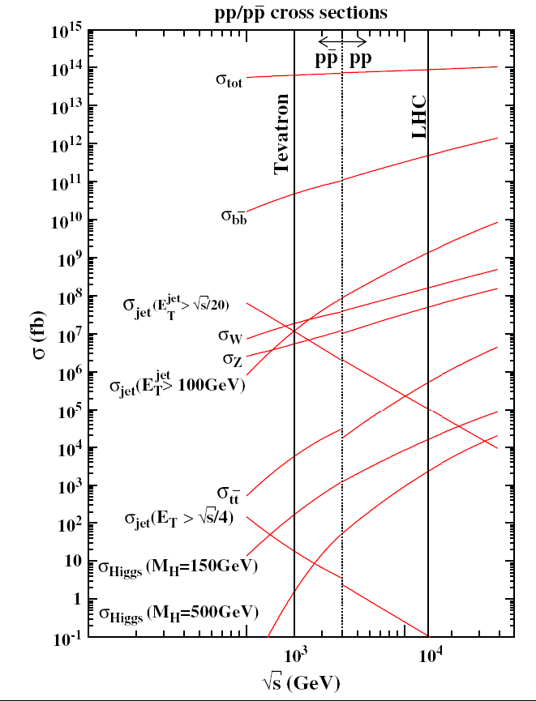
Early physics
For 10 pb⁻¹: (10³¹ = 0.036 pb⁻¹ h⁻¹)
  High cross section SM signatures
  Min bias σ ~ 70 mb
    Rate limited at a few 1027
    at 5 Hz ~ 100k in a 5 h fill
    or O(10 M) in 2-3 months
  Dijets with E_{T}>100 GeV σ ~ 1 μb
    O (10 M) in 10 pb⁻¹ (before prescale)
  J/ψ→μμ p_{T}
    μ > 6,4 |η|< 2.4 σ ~ 10 nb
    O (100 k) in 10 pb⁻¹
  W→ℓν ~ 20 k selected
  Z→ℓℓ ~ 4 k selected
    < 2% stat error!
  tt →qqℓνbb σ ~ 100 pb
    a search
Low p_{T} cut, loose selection criteria

Slide 21
Trigger for early physics (1)
Minimum bias
  Track multiplicity
  p_{T} distribution
  Rapidity distribution
Electronic and Muonic W and Z
  Early measurements:
    σ(W) / σ(Z)
    W, Z kinematic distributions
    W, Z cross-sections
  Single e/μ triggers essential:
    Loose inclusive electron
    Loose inclusive muon
    Threshold of 20 GeV suffices
    Stability, and looseness, matters more than the precise threshold
  Large (prescaled) j20 sample useful to study background
  Efficiency will need Z's
    Inclusive E_{Tmiss}

Slide 22
Trigger for early physics (2)
W/Z + jets
  W and Z provide triggers via leptons
  Avoid biases against activity where possible
    Loose lepton selections,
    Special care with isolation cuts
Di-bosons
  Cross-sections are small; relatively easy to trigger
  Wγ, Zγ
    just a few events with 10 pb⁻¹, even for low E_{Tγ} cuts
  Eventually (>~100 pb⁻¹) WW, WZ, ZZ

Slide 23
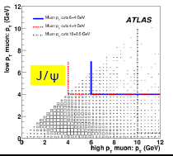
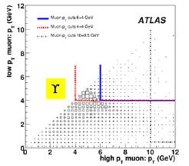
Trigger for early physics (3)
J/ψ and Υ→ μμ
  Very high statistics very fast
  p_{T}(μ₁)>6, p_{T}(μ₂)>4, |η| < 2.4 – 10 k J/ψ per pb⁻¹
  Measuring efficiency relies on (prescaled)
    single-μ trigger
  2μ4 trigger increases
    J/ψ statistics by ~25%,
    Υ by factor ~10
    gives access to zero p_{T}

Slide 24
Trigger for early physics (4)
Top Physics
  With ~10 pb⁻¹ at 10 TeV, expect:
    ~200 usable l+jets events
    ~50 usable lljj events
  Establishing signals
  High priority:
    Single lepton triggers which should be efficient by 20 GeV
    Early: measure efficiencies with Z events and map to ttbar
    Loose, or no, isolation requirements
    Later: tighten isolation rather than raising threshold
    Some other triggers for cross-checks
  Lower priority at start – commissioning studies:
  t to τ decays
    once tau triggering & ID understood on data
  Hadronic top – will always be tough
  Single top – tough signature (but single ℓ is the key trigger again)

Slide 25
Triggers for discovery (1)
Start studying new physics
  Possible after 10 pb⁻¹
    if data, detector, trigger well understood
  SUSY
    Discovery sensitivity beyond Tevatron with a few 10's of pb⁻¹
    First analyses: l+jets+E_{Tmiss}
      Require lepton until ETmiss understood in multijet events
    Eventual golden trigger: Jets • E_{Tmiss}
    Important to start understanding the multijet triggers early
      for commissioning and as an independent trigger
    Multi-lepton channels generally easier
    Single lepton triggers give redundancy

Slide 26
Triggers for discovery (2)
Start studying new physics (2)
  W’, Z’
    High pT single ℓ (e or μ), single γ, single jet trigger
    Sum-ET trigger could be a useful complement
    How to check high p_{T} efficiency?
  SM Higgs
    A few 100’s pb⁻¹ to start competing with Tevatron on exclusion
    H→WW→ℓνℓν channel sensitive first, assuming ℓ-ID, ETmiss understood
    Single lepton triggers
    Commission more complex triggers
      Single photon trigger , tau trigger, E_{Tmiss}, forward jet…

Slide 27
Trigger rates
Trigger bandwidth is a limited resource
  Gets worse with increasing luminosity
  Need to justify where bandwidth is spent
  Ensure that triggers in menu will be used
  Designing a trigger menu requires iterations
    Several iterations of selection optimization
    Ensure that output rate is within allowed bandwidth
We need:
  Trigger motivation studies
  Trigger rate control

Slide 28
Rate control
Output rate within allowed bandwidth
  Avoiding DAQ dead-time
Fill the bandwidth
  As luminosity decreases during the fill
How to use it?
  As the physics analysis needs stability
    Short term
      Via pre-scaling
      Tower masking in case of problems
    Long term
      Via threshold and menu adjustment

Slide 29
Level-1 rate @ 10³¹ (14.4.0)
Trigger Group | Rate (Hz)
Multi EM | 6400
Multi Object | 5500
Single EM | 5500
Single Muon | 1700
Multi Tau | 470
Single Tau | 150
Jets | 80
Multi Muon | 70
XE | 50
TOTAL | 20000
Removing overlaps between single+multi EM gives 18 kHz
Total estimated L1 rate with all overlaps removed is ~ 12 kHz

Slide 30
Level-2 rate @ 10³¹ (14.4.0)
Trigger Group | Rate (Hz)
Electrons | 310
Muons | 210*
Taus+X | 180
XE+ | 82
Photons | 46
B Phys | 43
Jets | 22
TOTAL | 900
X=anything;
+ includesJE,
TE, anything
with MET
except taus;
Bphys includes
Bjet
* Manually pre-scaled off pass-through triggers mu4_tile, mu4_mu6
Total estimated L2 rate with all overlaps removed is 840 Hz

Slide 31
EF rates @ 10³¹ (14.4.0)
Trigger Group | Rate (Hz)
Muons | 80
Electrons | 67
Tau+X | 56
B Phys | 37
Jets | 25
Photons | 18
XE+ | 13
Misc | 13
TOTAL | 310
91 Hz total is in pre-scaled triggers;
51 Hz of pre-scaled triggers is unique rate
Total estimated EF Rate with overlaps removed is 250 Hz
Evaluations with different pre-scales give the required 200 Hz

Slide 32
10³¹ menu
https://twiki.cern.ch/twiki/bin/view/Atlas/L31TriggerMenu

Slide 33
Towards 10³¹ physics menu
Backup and primary triggers will be consolidated after behaviour/rates of various triggers are understood with real data
Choices will (hopefully) be made between competing algorithms (SiTrack, IDScan…) leading to fewer chains
Physics streams will be enabled gradually (minbias, jets muons..)

Slide 34
General comments (1)
Many weeks or even months between first collisions and 10³¹ operation
  Time to understand the trigger and its performance
  Reduce the number of chains for simpler commissioning
  Focused on the balance of data samples needed at each luminosity
Commissioning is a messy and non-linear business:
  Many parallel activities, lots of iteration, and many surprises
  Flexibility required
  Prepare a broad set of tools, and don’t expect to get it right the first time
Validation tends to focus on checking for the expected
  Need to constantly look in areas where nothing is expected
    empty bunches
  Look for the unexpected before declaring commissioning complete...

Slide 35
General comments (2)
Understanding ATLAS detector performance
  Leads to clear strategy on how to assign bandwidth
    Versus evolution of luminosity and of trigger commissioning
    Versus requirements of collecting large samples of certain datasets
  Examples:
    Large datasets required to understand basic performance
      Calibration, fake rates
    Large datasets required, if well justified, to measure efficiencies and backgrounds from data
Early trigger
  Level 1 stable after commissioning
  HLT trigger studies and rate adjustment
    ⇒ flexibility
  Data analysis
    ⇒ HLT stability both in menus and algorithms
  Both require simple and well understood starting points
Triggers for discovery
  To be sensitive it is crucial
    Having simple, stable triggers
    Measuring performance and backgrounds with data
    Key triggers stable as early as possible

Slide 36
Backup

Slide 37
Central trigger and distribution
CTP: minor firmware changes
  CTPIN: enabling/disabling inputs in the CTPIN
  CTPCORE: measurement of the 40 MHz BC frequency with a precision of better than 1 Hz (using GPS as time reference) (done)
  CTPCORE: trigger type handling for calibration requests (under development)
  CTPCORE: 16-bit simple dead-time for LAr 32-samples (under development)
MuCTPI
  BCID alignment of the trigger path is in progress (not critical). Started with the TGC, defining the procedure. RPC will follow in the following weeks.
  Status of new boards: (16xMIOCT: final version ; 1 MIROD + 1 MICTP, fully functional prototypes, will be replaced by newer versions with the same functionality)
    MIROD/MICTP board production: 2 modules available and tested, 2 more being assembled (2 weeks). 2 more will follow once the MICTP tests are completed.
    MIROD firmware: done.
    MIROD software: low-level done, controller under development.
    MICTP firmware: currently being tested.
    MICTP software: to be done.
TTC:
  TTC distribution to sub-detectors is complete
  Clock phase test ongoing
  LTPi parallel links for muons and ID still need to be commissioned.
  Calo loops are working.
  ZDC and LUCID integrated

Slide 38
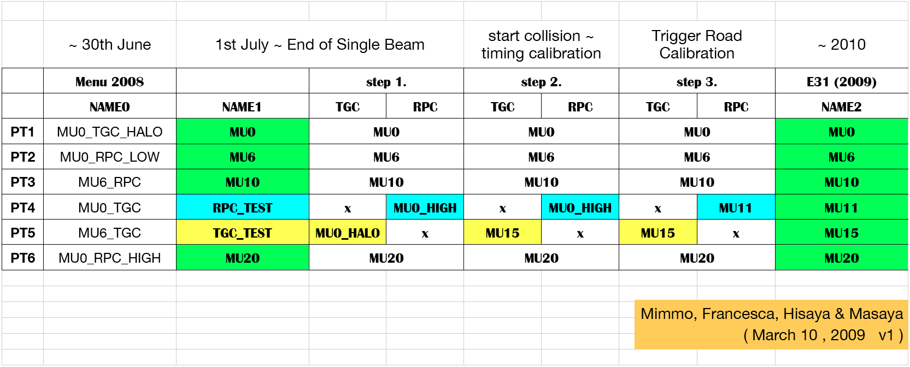
Level-1 trigger evolution
Two different cosmic setups
Conceptually few changes
Four physics thresholds
Two test thresholds

Slide 39
Combined performance triggers
2mu4/mu4mu6 and 2e5 triggers
  Provide the first and most abundant source of isolated lepton pairs
  Understand the detector performance in certain areas, …
  Critical to
    early performance measurements
  Initial physics results for muons and electrons
tau16(i) + xe30 and XE40
  for 10 pb-1, the first one will be the only source any significant sample of hadronic τ-decays (a thousand signal events with limited purity)
  the second one, if proven to be viable once detector tails have been cleaned up, is presumably the best example of possible orthogonal triggers for early physics in ATLAS: it can serve to verify both the electron and tau trigger streams through the extraction of W to eν and W to τν decays (again here we speak of about one thousand events)

