Slide 1

FOOT calorimeter
Status Report
Crystals
Photodetector
Readout
Mechanics
Contributions by:
S. Argiro’
R. Arteche Diaz
N. Bartosik
G. Giraudo
N. Pastrone
L. Scavarda
P.P. Trapani
Piergiorgio Cerello

Slide 2
FOOT calorimeter
Status Report
Crystals
Photodetector
Readout
Mechanics

Slide 3
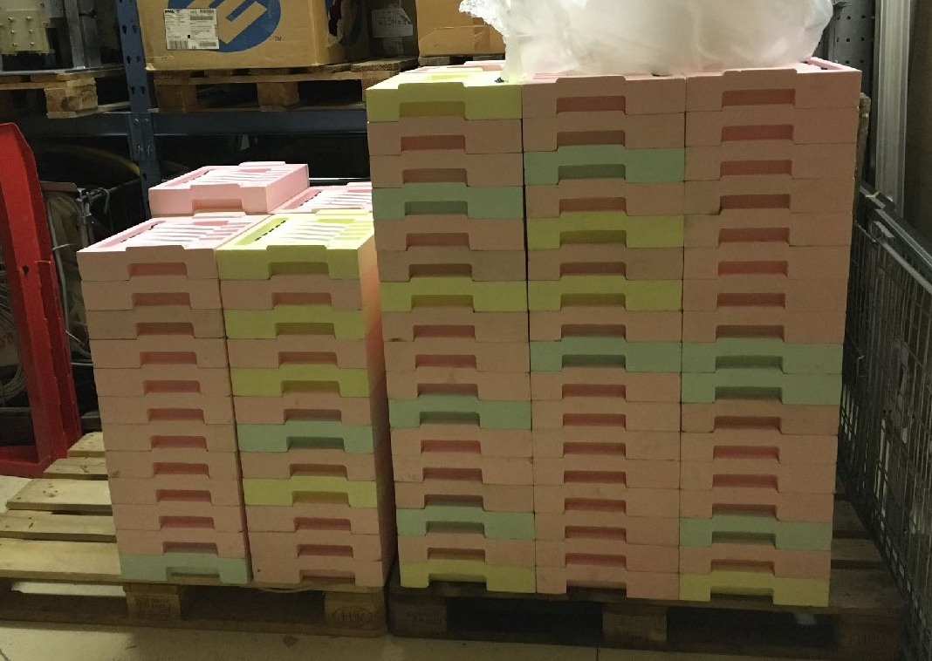
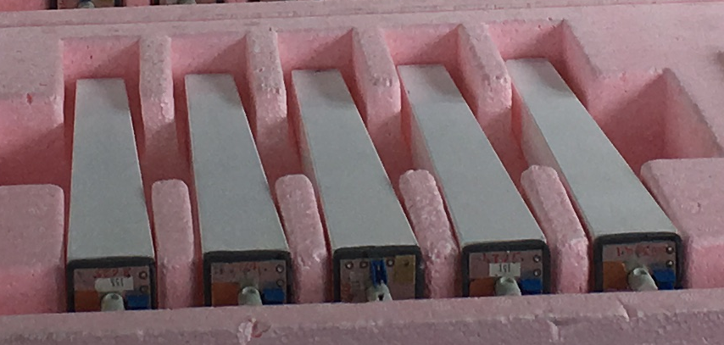
BGO Crystals
BGO crystals now available
As many as we need
Stored in polystyrol boxes
at CERN (5 crystals/box)
Crystal dimensions:
  Approx. 2.0 ⨉ 24 ⨉ 2.9 cm3
Crystal transmission curves:
  Ongoing Measurement at CERN
2
24
3

Slide 4
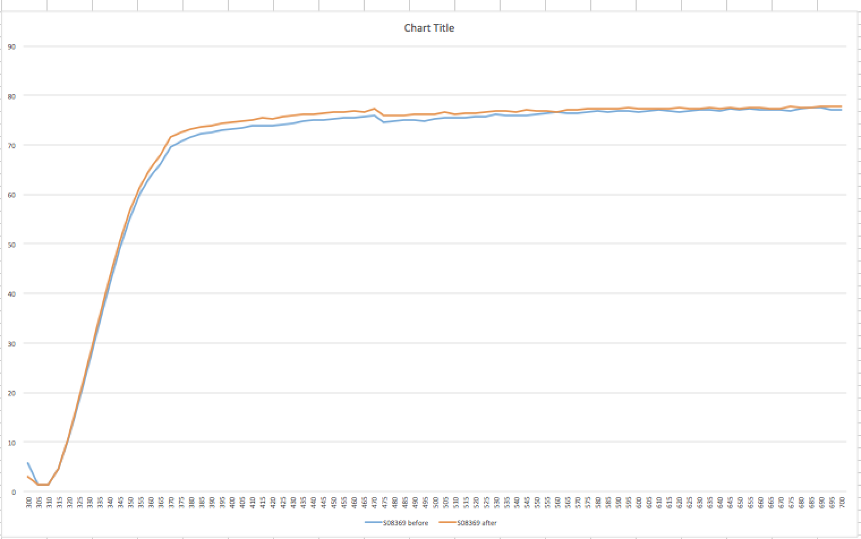
BGO Crystals
S08369 Transmission curve – pre/post annealing

Slide 5
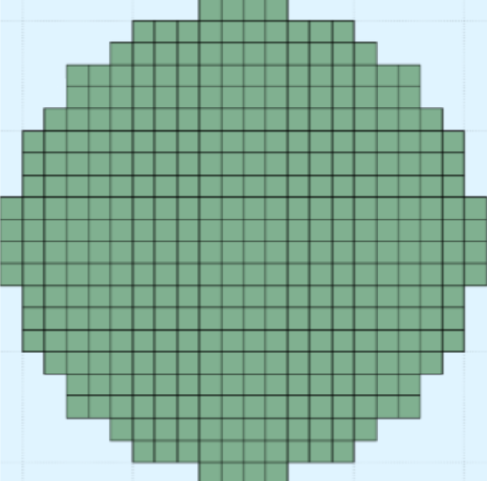


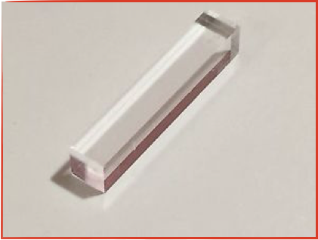
FOOT calorimeter
4 quarters of 80 BGO crystals each
2.9 cm
24 cm
2.9 cm
20 cm
2.0 cm
2.0 cm
Weight: 1027 g
Total weight: 329 Kg

Slide 6
FOOT calorimeter
Status Report
Crystals
Photodetector
Readout
Mechanics

Slide 7
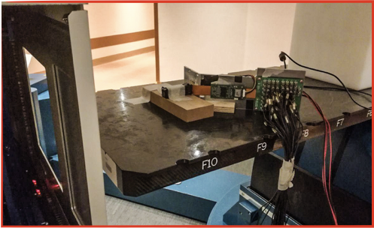

Calorimeter preliminary test at CNAO
70 MeV
120 MeV
SiPM
Proton beam
170 MeV
Crystal 7 cm long
400 MeV
120 MeV/u
Carbon beam
190 MeV/u
400 MeV/u

Slide 8


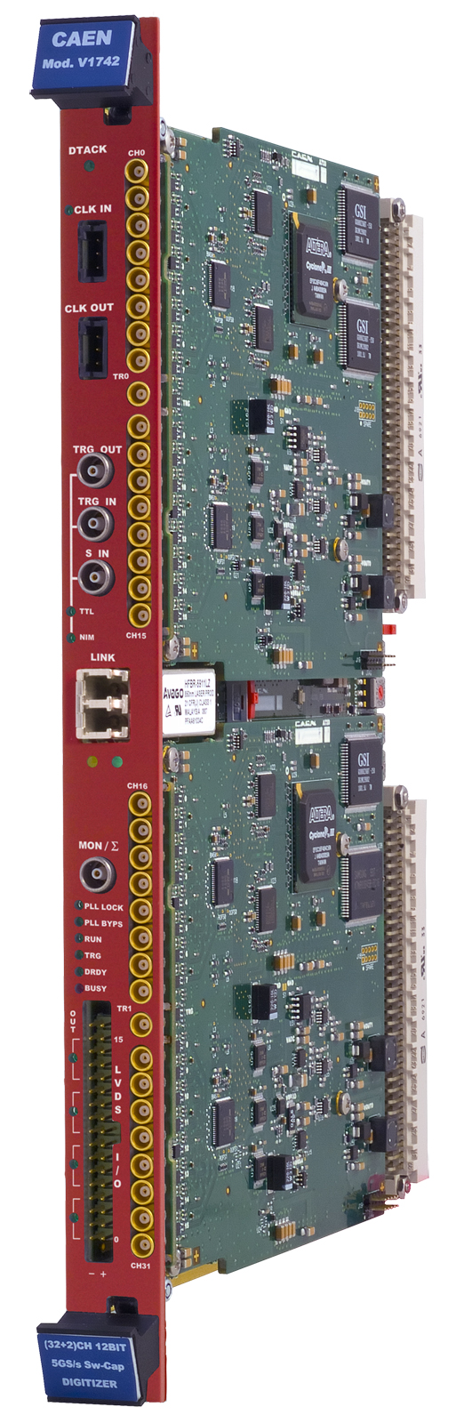
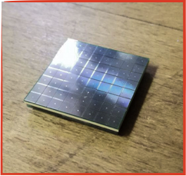
SiPM test setup
Power supply
± 1.75 V
53 V
FAN OUT
Digitizer
Crystal (7 cm)
Beam
32 channels
8 channels
SiPM
Amplifier
Digitizer CAEN
V1742
SiPM Hamamatsu
pitch: 50 μm
voltage breakdown: 52 V

Slide 9
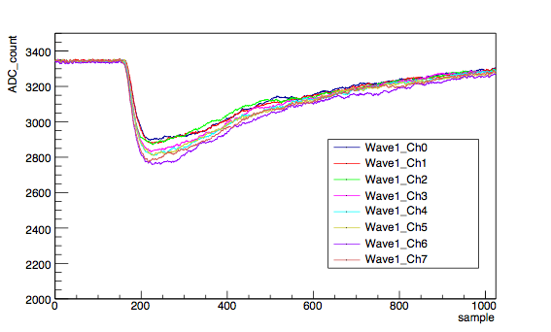



Proton beam, 170 MeV, 7 cm crystal long
Wave Form
Ratio between the sigma and average value of the amplitude distribution of 8 signal channels acquired in one event. Then the distribution is plotted for all events.
Same event acquired in the 8 channels of Digitizer
Same wave form for all channels
No position dependency
sum over of the whole Tile

Slide 10

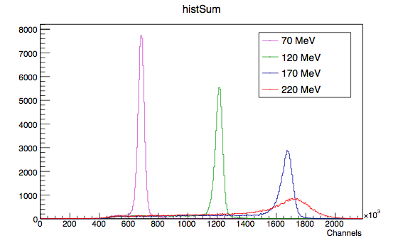
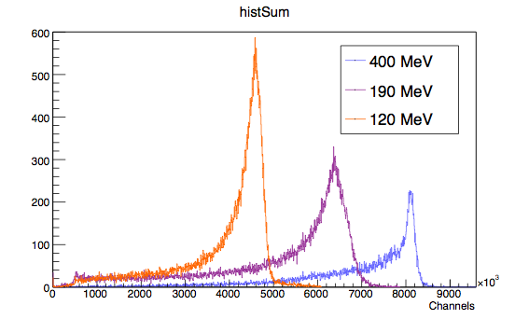
Signal Integration
Protons
Important result: Mean value of signal integrations increases with energy
Carbons
Anomalous behaviour for proton beams at 220 MeV: what happened?

Slide 11
Signal Amplitude
Protons
Important result: Mean value of signal amplitude increase with energy up to 120 MeV/A carbon
Carbons
Anomalous behaviour for proton beams at 220 MeV: what happened?

Slide 12
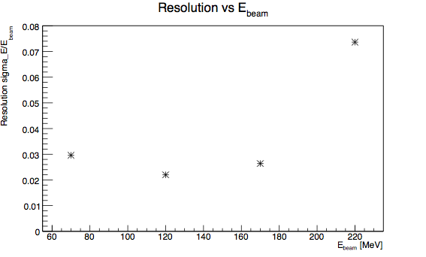

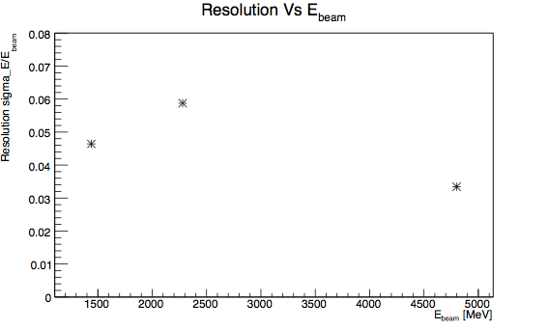
Energy Resolution - Integration
Protons
Carbons

Slide 13
Energy Resolution - Amplitude
Protons
Carbons

Slide 14

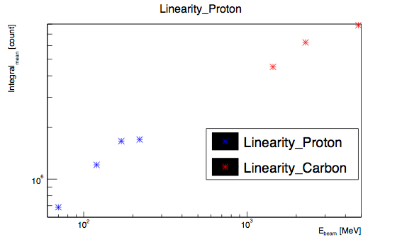
Linearity
Linearity between the beam energy and the mean value of the signal
Integration
Amplitude

Slide 15
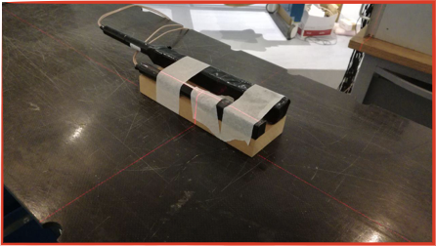
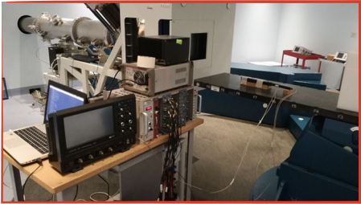
Calorimeter preliminary test at CNAO
PMT
120 MeV/u
Crystal 24 cm long
190 MeV/u
Carbon beam
260 MeV/u
Crystal 7 cm long
330 MeV/u
400 MeV/u

Slide 16
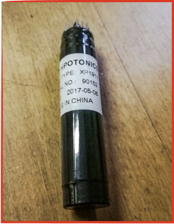
PMT test setup
High Voltage Power Supply
+1200V
Digitizer
Crystal (7 cm)
Attenuator
Beam
1 channels
1 channels
PMT

Slide 17
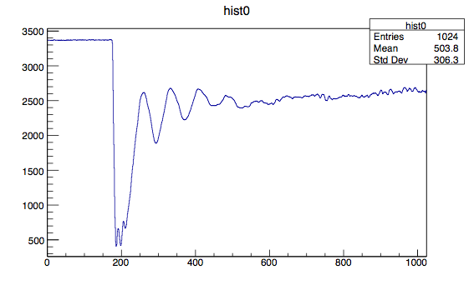

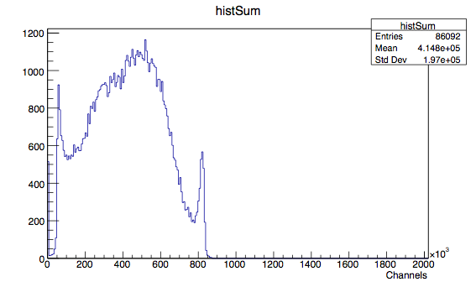
Carbon beam, 120 MeV, Crystal 7 cm long
PMT Signal Integration
Integration on all range
1 µs
Integration of all signals

Slide 18

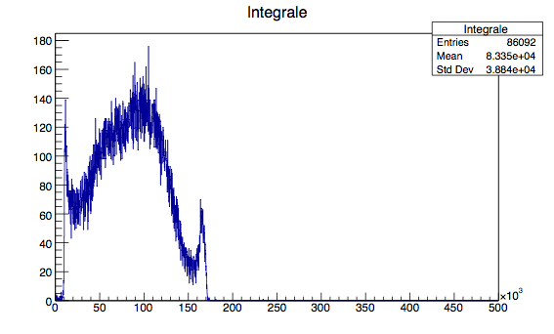

Carbon beam, 120 MeV, Crystal 7 cm long
PMT Signal Integration
Fluctuations
maybe attenuator?
Channels
!
Other tests will have to be performed …

Slide 19
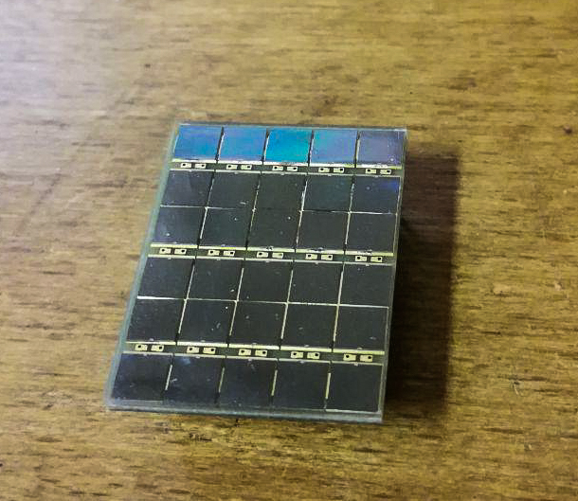
SiPM readout board scheme
Next tests at CNAO:
Test on SiPMs with 15-20 μm pitch with 15 cm and 24 cm long crystals
Readout board for SiPM with 15 um microcell size
will be available in about 2 weeks
Test at CNAO most likely on Jume 24th-25th

Slide 20
FOOT calorimeter
Status Report
Crystals
Photodetector
Readout
Mechanics

Slide 21
Readout
Likely readout scheme, if 15 μm SiPM prove to be linear – as expected
3x3 readout boards with 9 output channels (1/crystal)
Amplification to be defined
Output to Digitizers
It’s the simplest solution

Slide 22
FOOT calorimeter
Status Report
Crystals
Photodetector
Readout
Mechanics

Slide 23
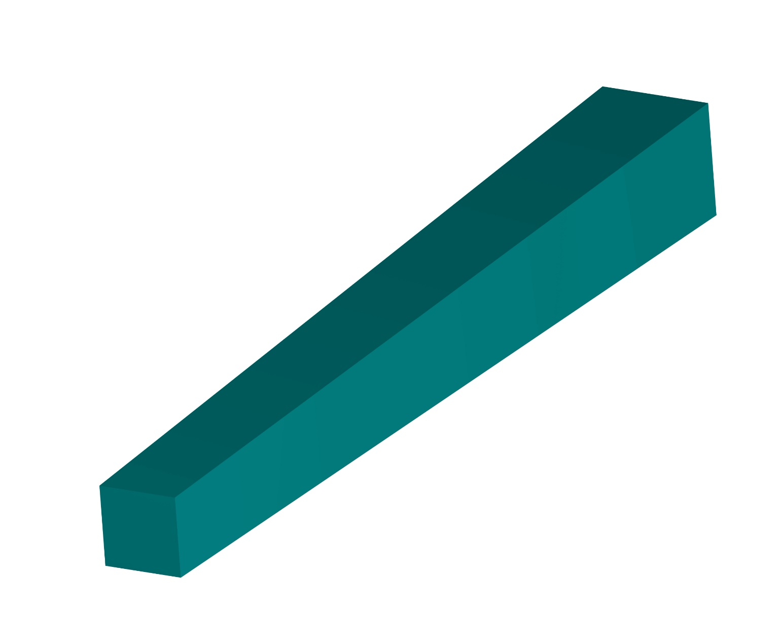
The crystals
29 (28.8)
29 (29.1)
240 (239.9)
20 (20.2)
20 (20.3)

Slide 24

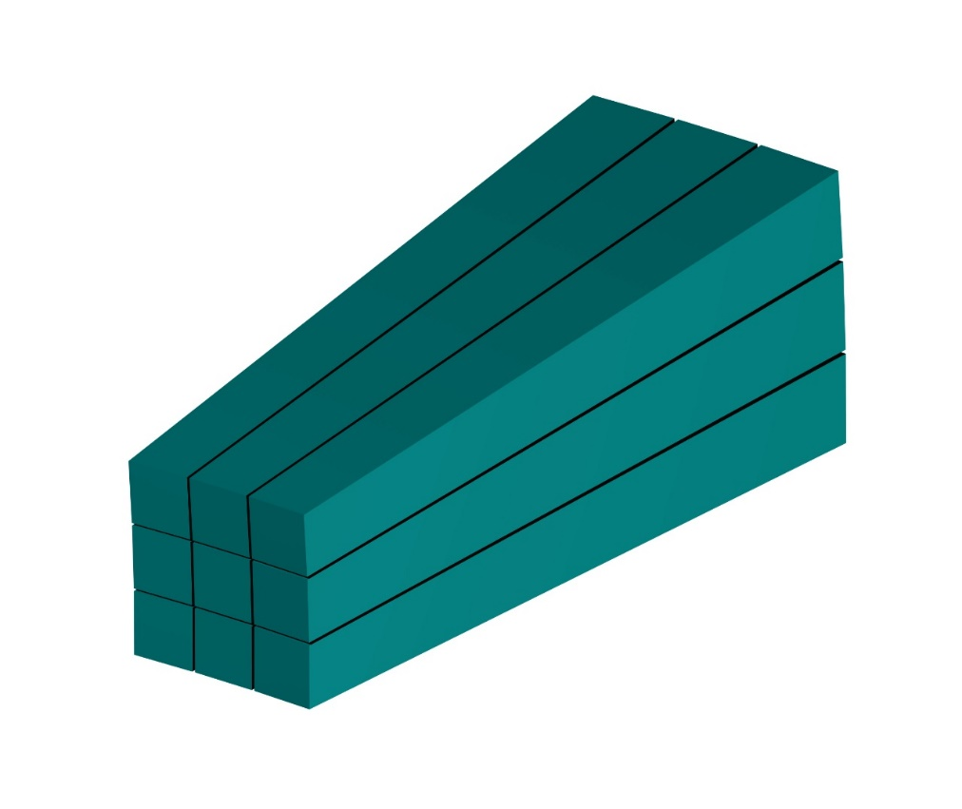
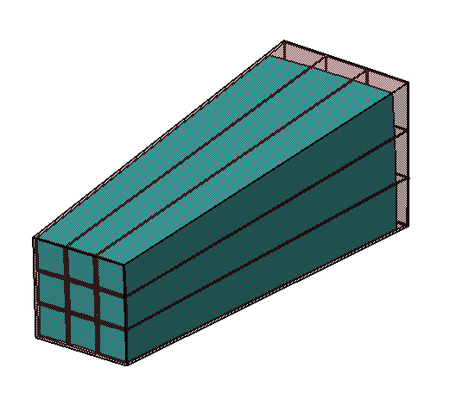
Module definition
Plastic box
Matrix 3x3 crystals

Slide 25
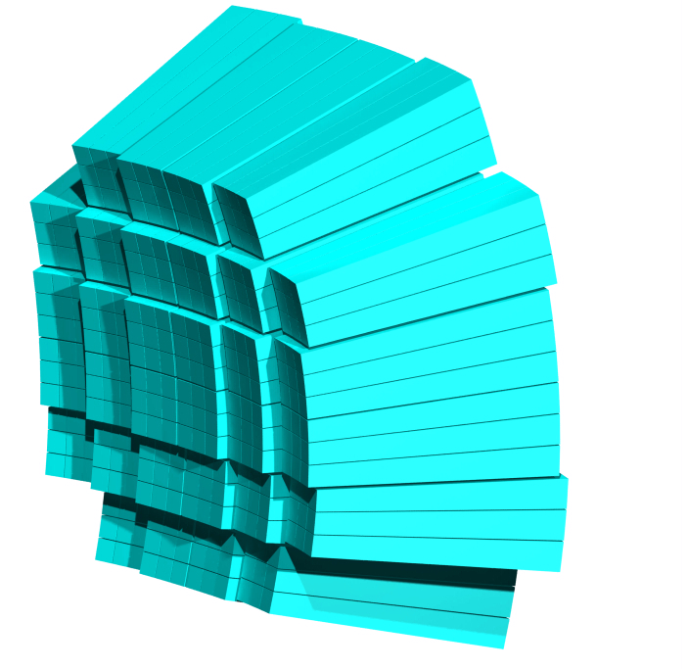
Modules layout – option 1
arrangement of 32 modules
1 plastic box design

Slide 26
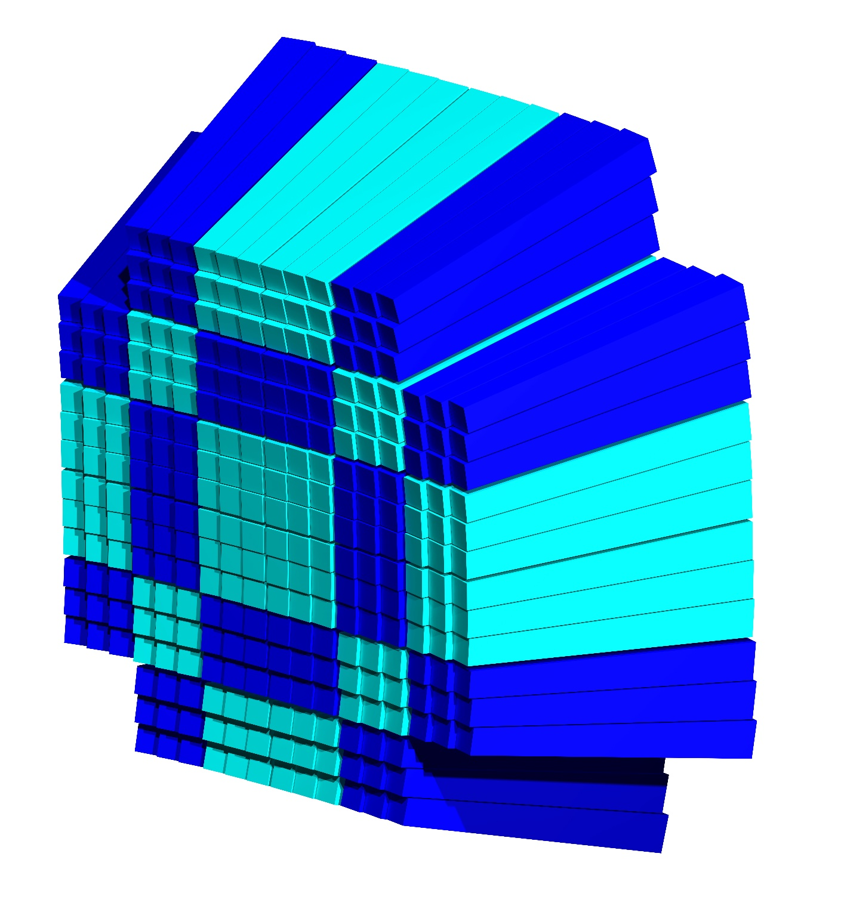
Modules layout – option 2
Single arrangement of 288 crystals
16 plastic box designs

Slide 27
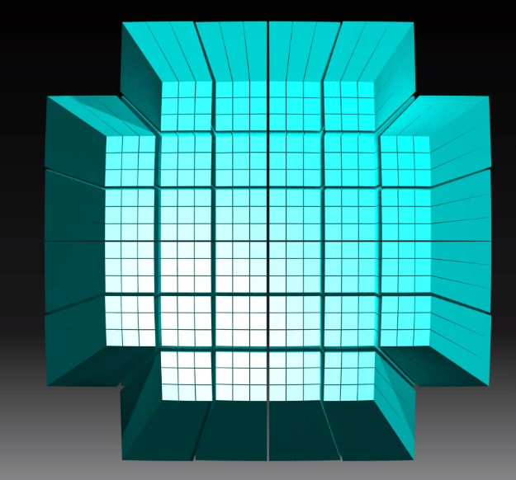
Modules layout – front view
397 mm

Slide 28
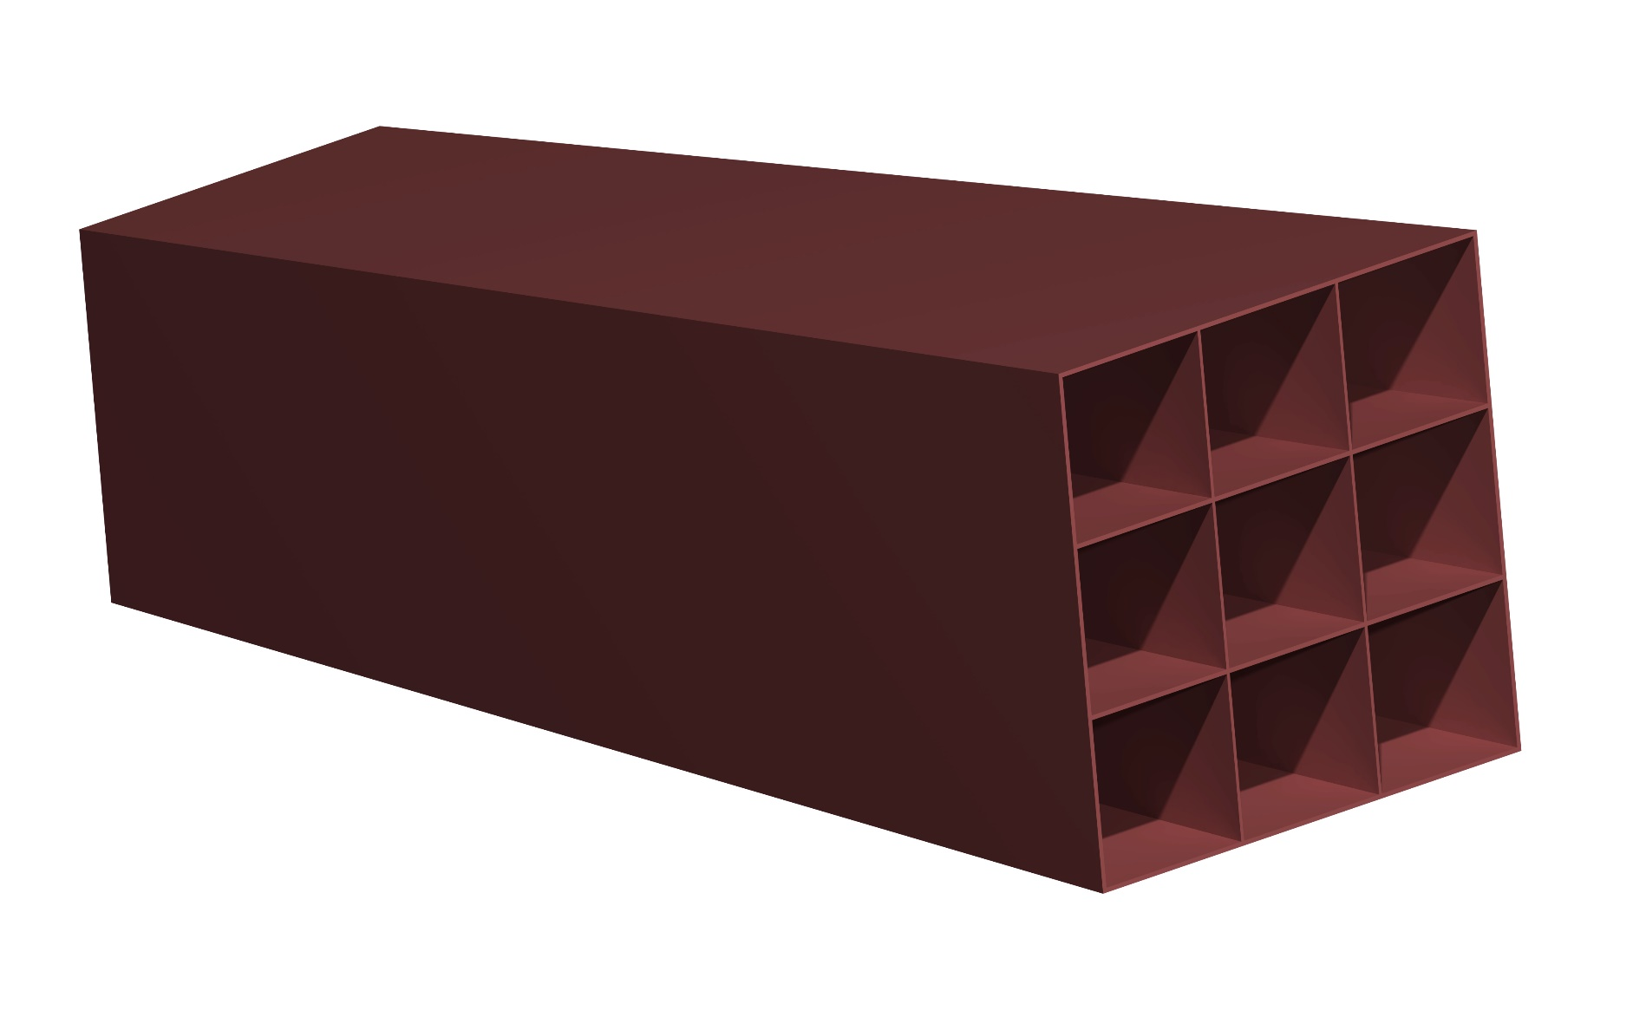
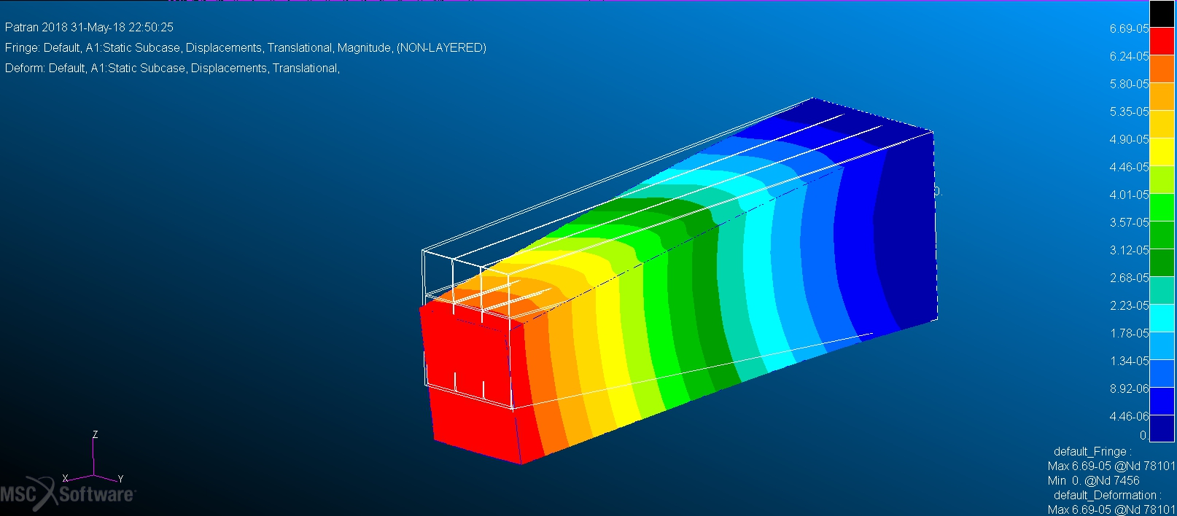
Module case
The box houses 9 crystals
ABS reinforced or similar material
E≈4 GPa
3D printing (?)
Max displacement ≈ 70μm
Max stress 9,5∙10⁵ Pa
(ABS Tensile strength ≈ 25∙10⁶)

Slide 29
FOOT calorimeter
Status Report
Plans
complete crystal transparency measurements
test at CNAO with 15 um SiPM (end of June)
freeze crystal size (test + simulation)
build prototype of 9 modules case
freeze readout chain
start procurement
start crystal calibration
R/O + calibration sw development

