Slide 1
Status of FOOT pixel tracker detector
Last december 5th 2017 Bologna FOOT GM slide
Overview of the FOOT tracker mechanical setup
Status of the Pixel Vertex detector - Venelin Kozhuharov talk at PADME meeting
Magnet system
Status of the Inner Tracker pixel detector - Options and main parameters
A proposal to improve the pixel tracker max rate
Conclusions

Slide 2
Status of FOOT pixel tracker detectors

Slide 3
FOOT tracker mechanical setup
Main characteristics needed
Relatively small dimensions (table top experiment)
Portable
Stable (also during transportation) support for micrometer precision tracker
Flexible for magnets dismount for alignment of detector
Reasonable cost
Previous project solution reutilization
ELI-NP support to transport LINAC elements
Girder structure with new dimensions
Mechanical suspensions for transportation
Similar mechanical structure for holding and packing
Mechanical support with different possible heigths to be designed

Slide 4
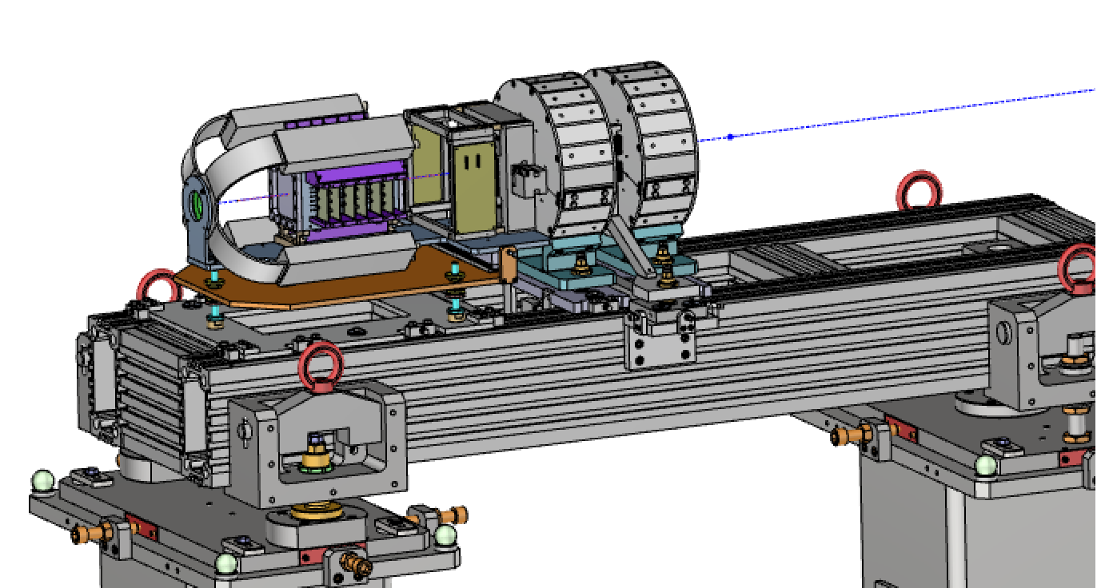
FOOT tracker mechanical setup
Girder easy to redesign
Support structure (different heigth selectable) under design

Slide 5
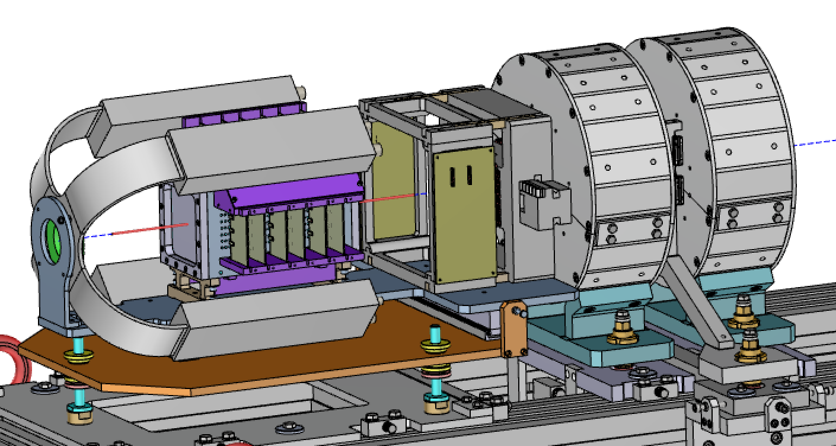
FOOT tracker mechanical setup
Inner Tracker
MSD
FIRST exepriment used start counter and beam monitor chamber
Target and Vertex support
Permanent Halbach magnets

Slide 6
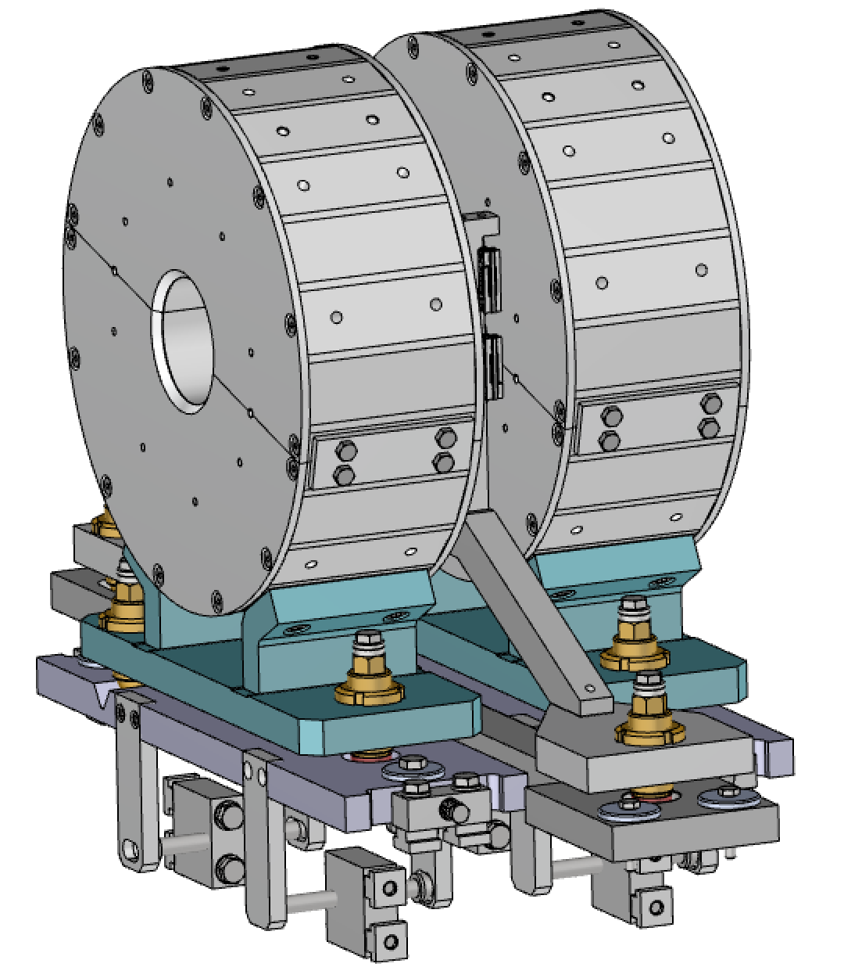
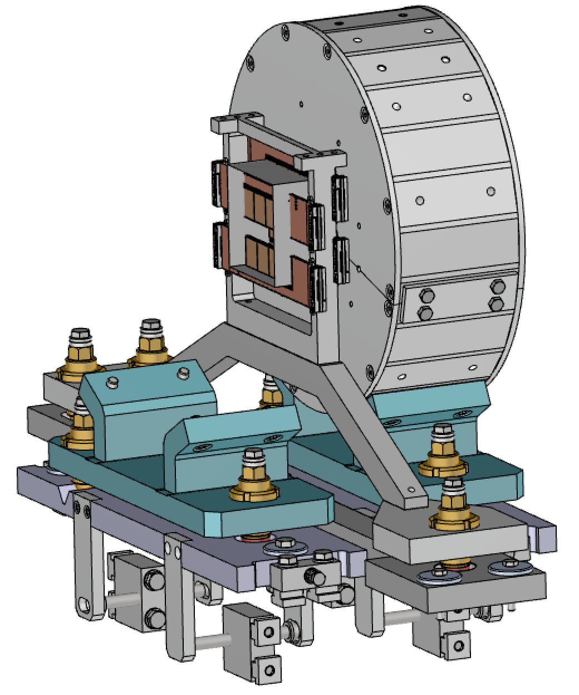
FOOT tracker mechanical setup
Six degree selectable orientation systems, one per each element:
first magnet
Inner Tracker
second magnet
MSD
Independently removable

Slide 7
FOOT tracker mechanical setup
Draft of the drawing for the magnets bid.

Slide 8
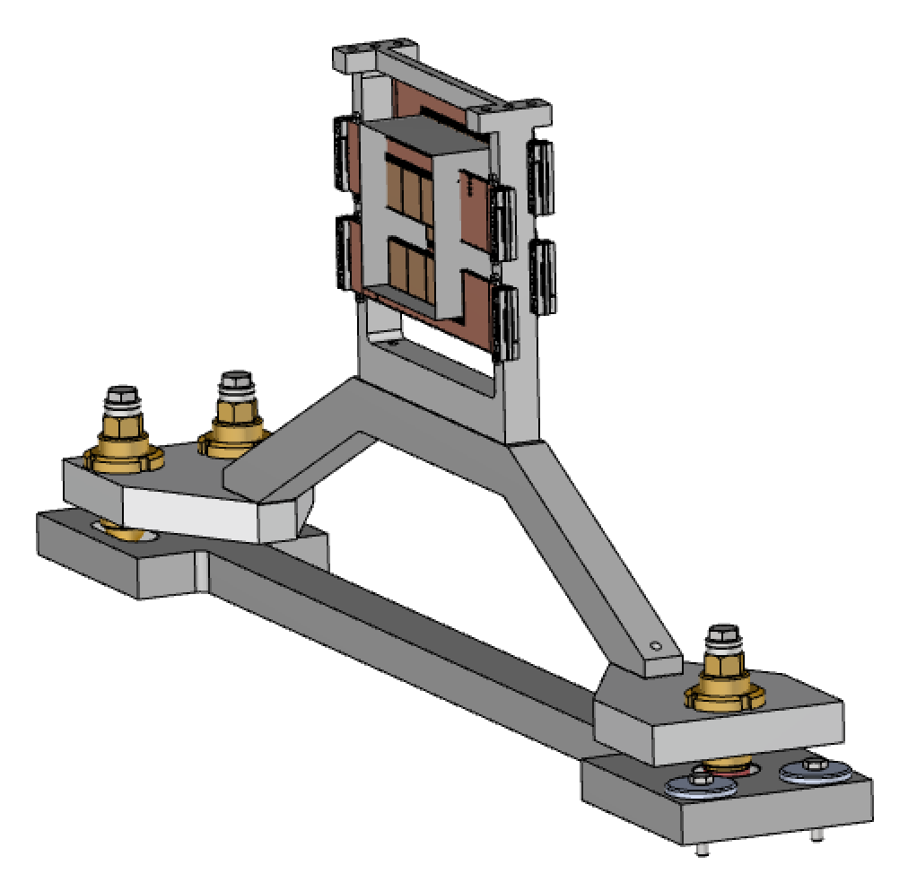
FOOT tracker mechanical setup

Slide 9
Status of the Pixel Vertex detector
The following slides are a presentation by Venelin Kozhuharov at the may 25th PADME meeting
PADME ( Dark matter searches at the Frascati BTF - Beam Test Facility) will use a Mimosa28 pixel sensor vertex detector ( four planes ) thinned to 50 µm to monitor the beam profile and multiplicity.
Only, not trivial, difference with the FOOT vertex is that it will be operated in vacuum!
The main difficulty is the heat ( M28 dissipate about 0.7 Watt) removal.
The results of the first test of the M28 (never done before) in vacuum is presented.

Slide 10





Venelin Kozhuharov
may 25th PADME meeting
Thermal dissipation test of MIMOSA sensor
C. Capoccia, V. Kozhuharov, E. Spiriti
LNF–INFN, University of Rome „La Sapienza, Sofia University*
25.05.2018
* partially supported by BG NSF, DN08-14/14.12.2016
& LNF-SU 70-06-497/07-10-2014

Slide 11
Recall from last week
Venelin Kozhuharov
may 25th PADME meeting
MIMOSA initial thermal checks in air performed – sensor temperature ~37° C
Using FLIR 335 IR camera, thanks to Fabio Ferrarotto and LABE, Roma 1
Attempt to use the on-chip diode to monitor the temperature change - successful
  Open anode diode realized in the Si substrate
  However, cathode is connected to the “ground”
  Measure the voltage, necessary to induce current of 100 μA
  Dependence V-T observed, but influenced by the operational status of the chip (off, initialized, running)
    Induced by the shift of the “ground” potential when changing the power state
A manometer found and attached to the chamber (after some machining) for rough pressure control (~0.05 bar resolution)

Slide 12
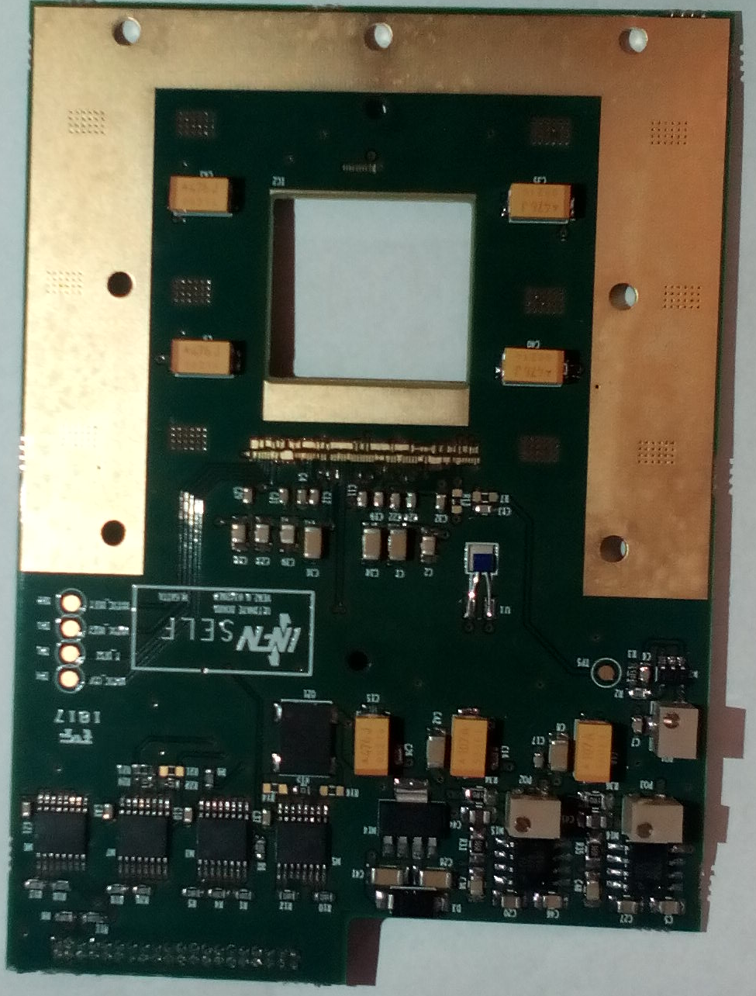
Thermal dissipation
Venelin Kozhuharov
may 25th PADME meeting
MIMOSA chip power consumption – of the order of 0.7 W
Three paths for thermal dissipation
  Thermal conductance
  Dissipation through air
  Radiation
Which one is the dominant for the MIMOSA chip?
Radiation:
  2 cm x 2 cm surface (x 2, up and down)
  Emission: P = 2*S*σT⁴ = 0.4 W @ 40° C
  But also absorption from the nearby surroundings, so a better estimator is Δ(T⁴) ⇒ 140 – 180 mW, depending on temperature (0 – 10 degrees C)
  Not bad as a start, but the thermal conductance is clearly necessary and critical for the MIMOSA cooling, or the chip will go above 100° C
    Also because the radiative value would be for the two chips together, since they are looking at each other with one of the surfaces….

Slide 13
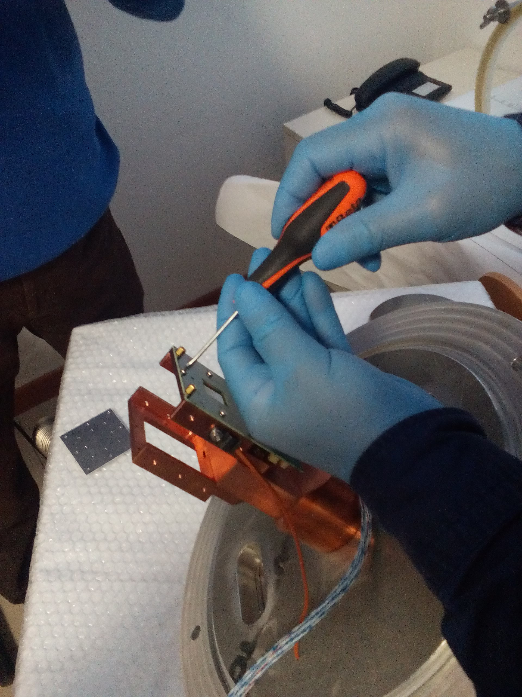
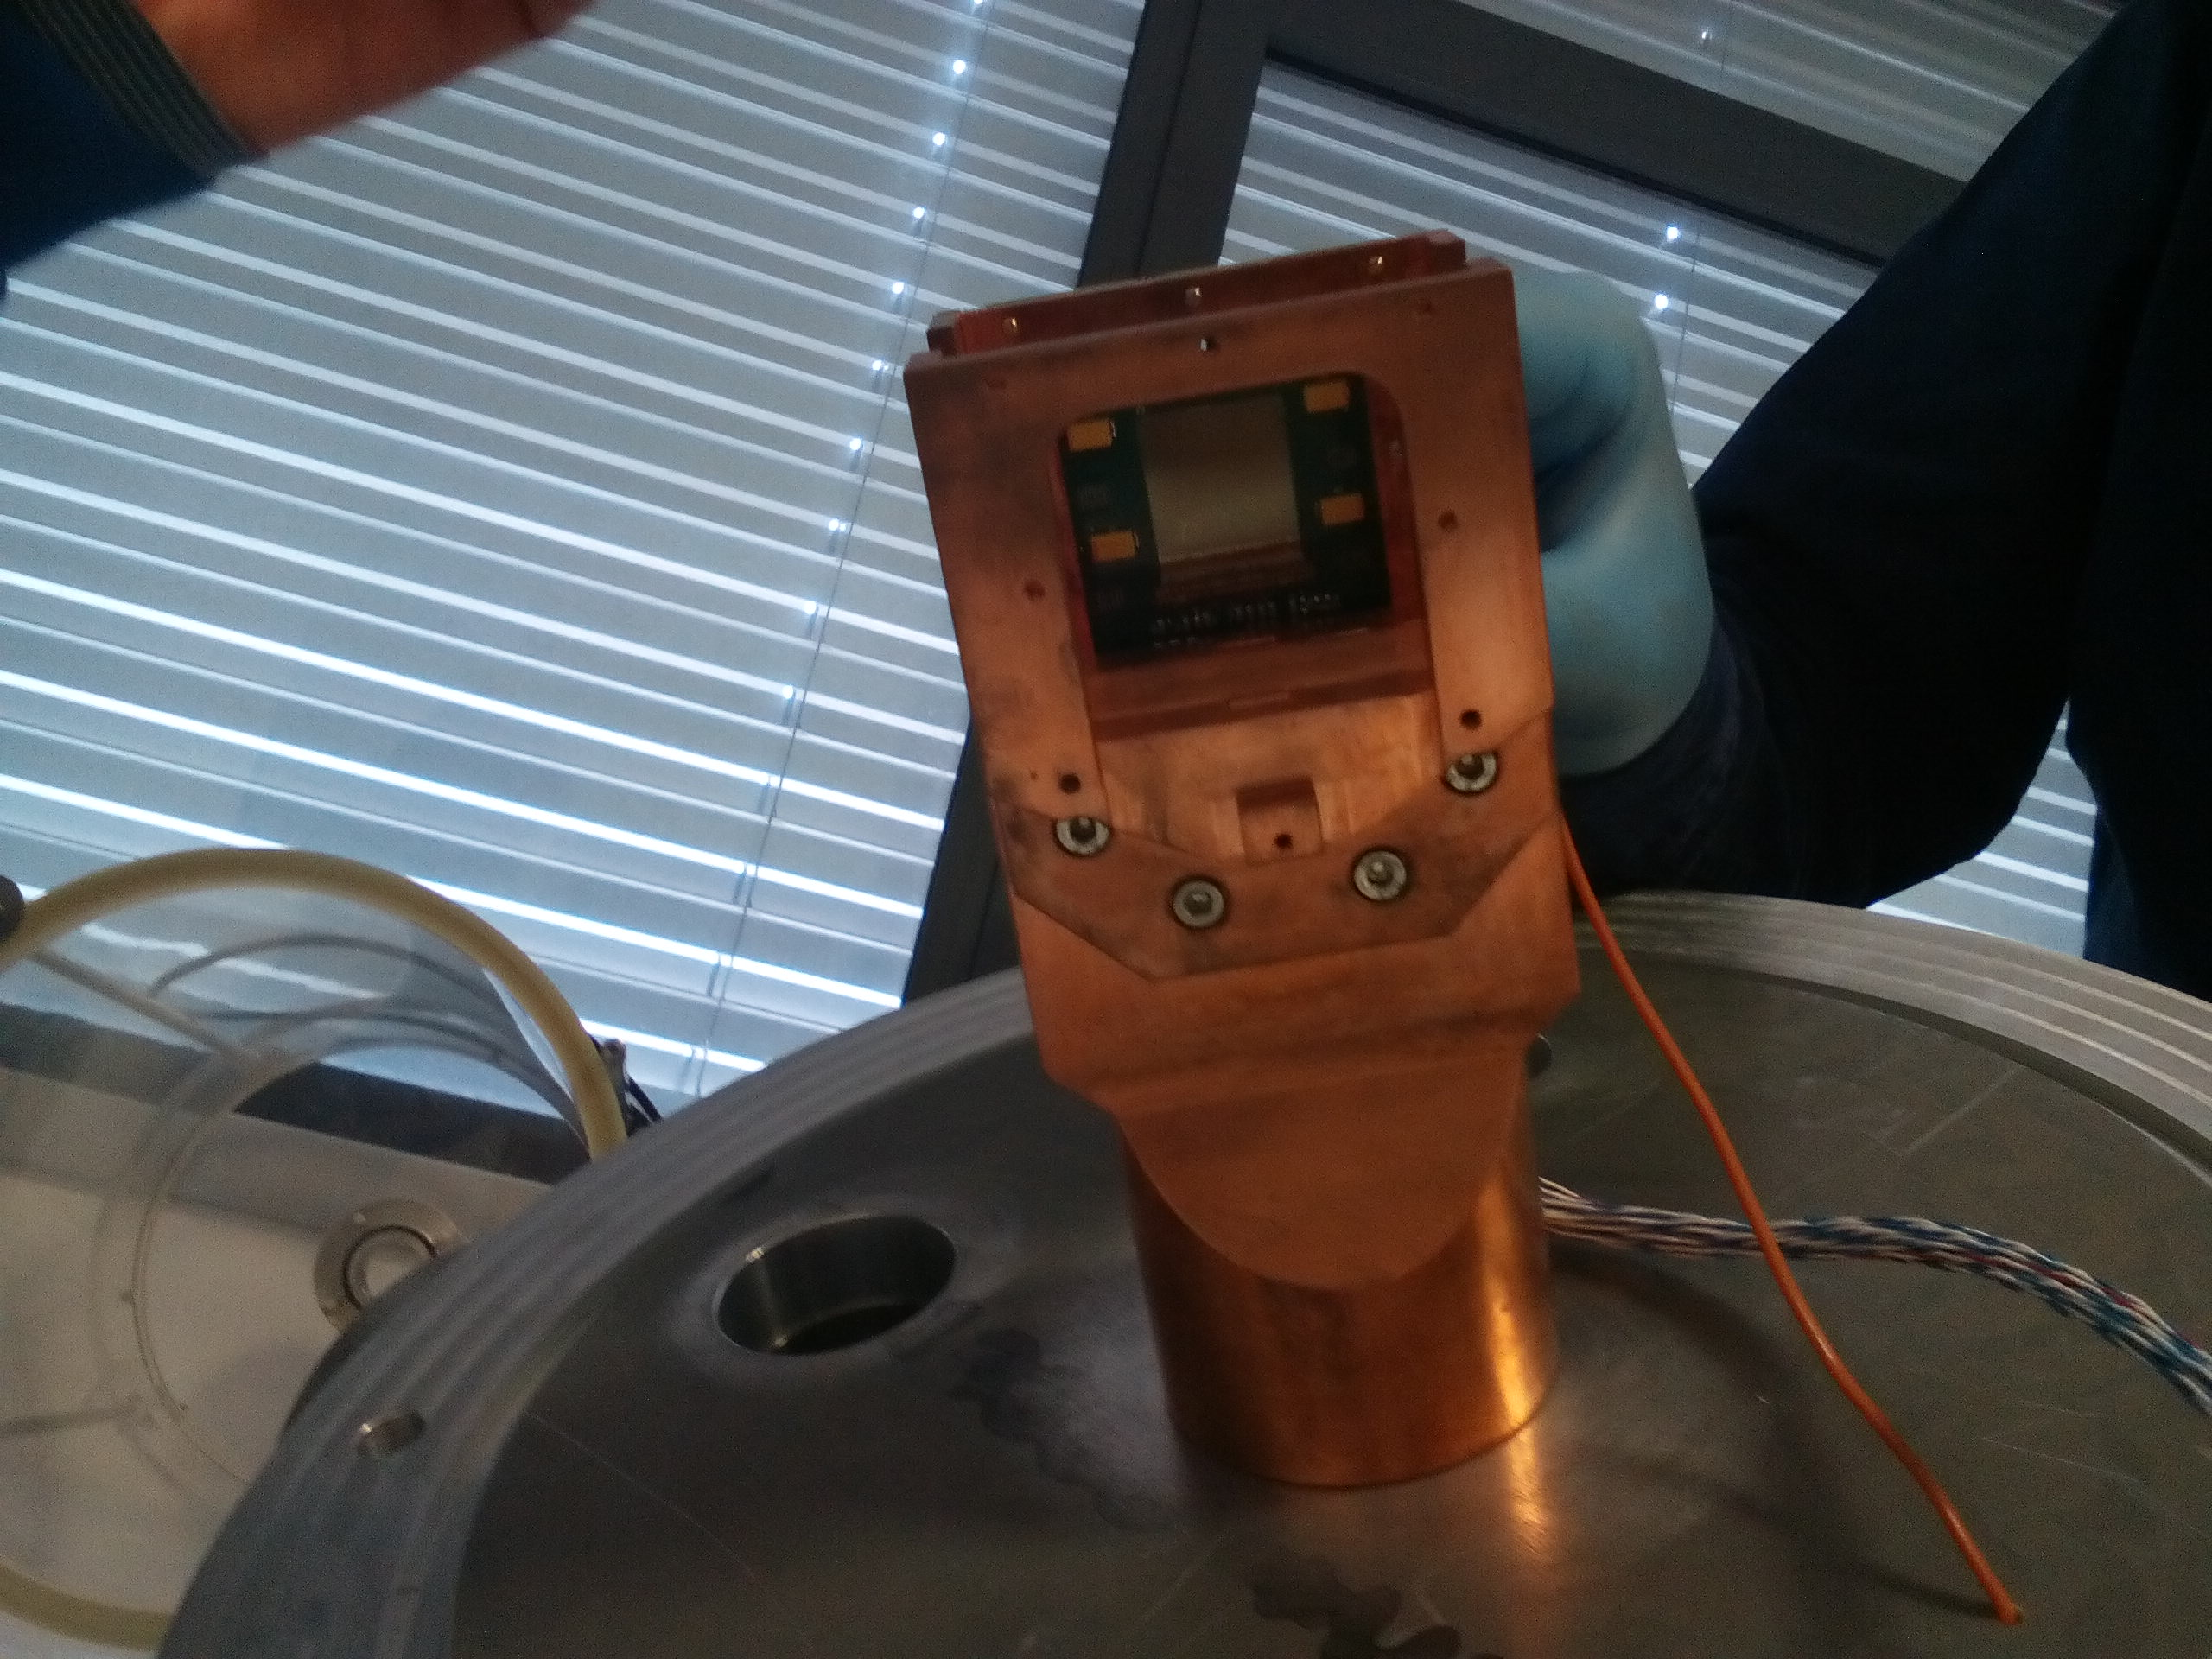
Mounting MIMOSA
Venelin Kozhuharov
may 25th PADME meeting
Carefully attached to the copper support frame
  Note: chip is only 50 μm thick!
  The protective metal plate was placed on top
  Surfaces were cleaned with alcohol

Slide 14
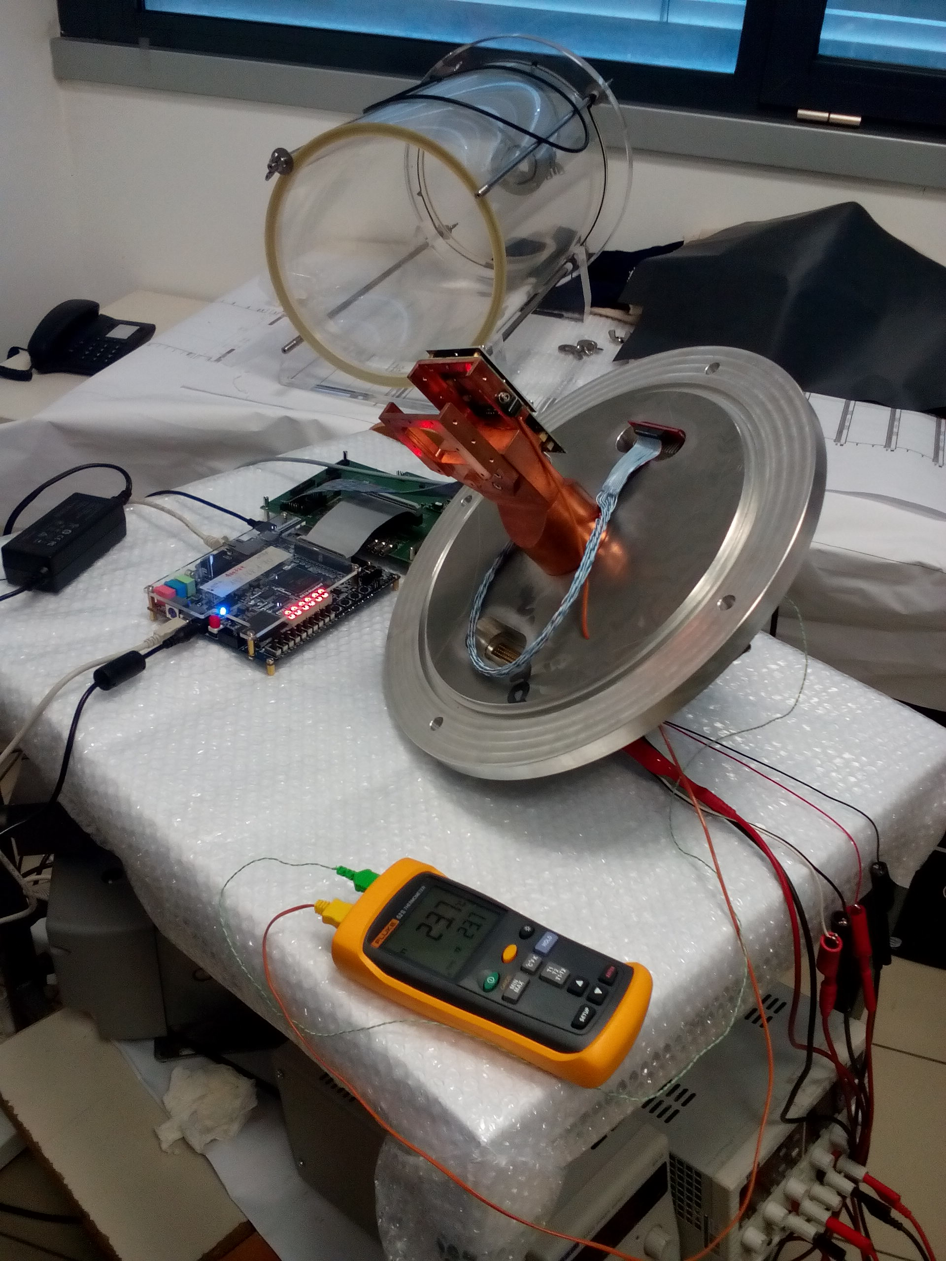
MIMOSA in air
Venelin Kozhuharov
may 25th PADME meeting
Using the Peltier cooler, attached to the copper arm
Goal of the test: to see if and how the sensor follows the temperature on the copper arm
Measuring:
  Temperature on the inner part of the copper arm - T_{IN}
  Temperature of the outside part of the arm (close to the Peltier) - T_{OUT}
  Temperature of the hottest part of the sensor (using the thermocamera) - T_{MIMOSA}
  The voltage on the on-chip diode (100 μA current generator applied) - U

Slide 15
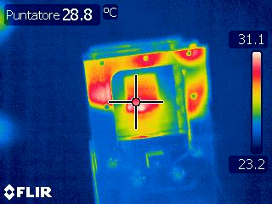
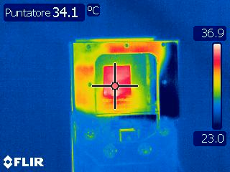
MIMOSA in air
Venelin Kozhuharov
may 25th PADME meeting
MIMOSA initialized
MIMOSA ON
Reaching stable running condition (thermal equilibrium) @ 37° C
  As expected
Diode voltage: 854 mV
Temperature in the room (and of the copper bar) ~24° C
Next step: switch on the Peltier

Slide 16
MIMOSA in air
Venelin Kozhuharov
may 25th PADME meeting
T [°C]
T_{OUT}
T_{IN}
T_{MIMOSA}
U
U [mV]
MIMOSA chip temperature followed the temperature on the copper bar!
The copper bar went into equilibrium at about 12 degrees (and got condense…)
About 30 min necessary for the system to stabilize
Temperature of the chip equalized with the ambient air temperature (gas started to warm the chip)

Slide 17
MIMOSA in air
Venelin Kozhuharov
may 25th PADME meeting
ΔT [°C]
T_{IN} - T_{OUT}
ΔT [°C]
T_{MIMOSA} - T_{IN}
After the initial jump (when switching on the Peltier) the temperature difference stabilized (indication of equilibrium)
The MIMOSA temperature was within ~12-13 degrees above the copper temperature!

Slide 18
Temperature calibration
Venelin Kozhuharov
may 25th PADME meeting
T_{MIMOSA} [°C]
U [mV]
The presence of IR camera allowed “precise” calibration of the Keitley voltage measurement → Chip temperature
The curve is very much close to linear with slope of 0.53°C per mV
  Gave optimism that we can actually have a temperature information for the MIMOSA chip in vacuum!
  NOTE: calibration is unique to the setup, if something changes, the calibration should be repeated!

Slide 19
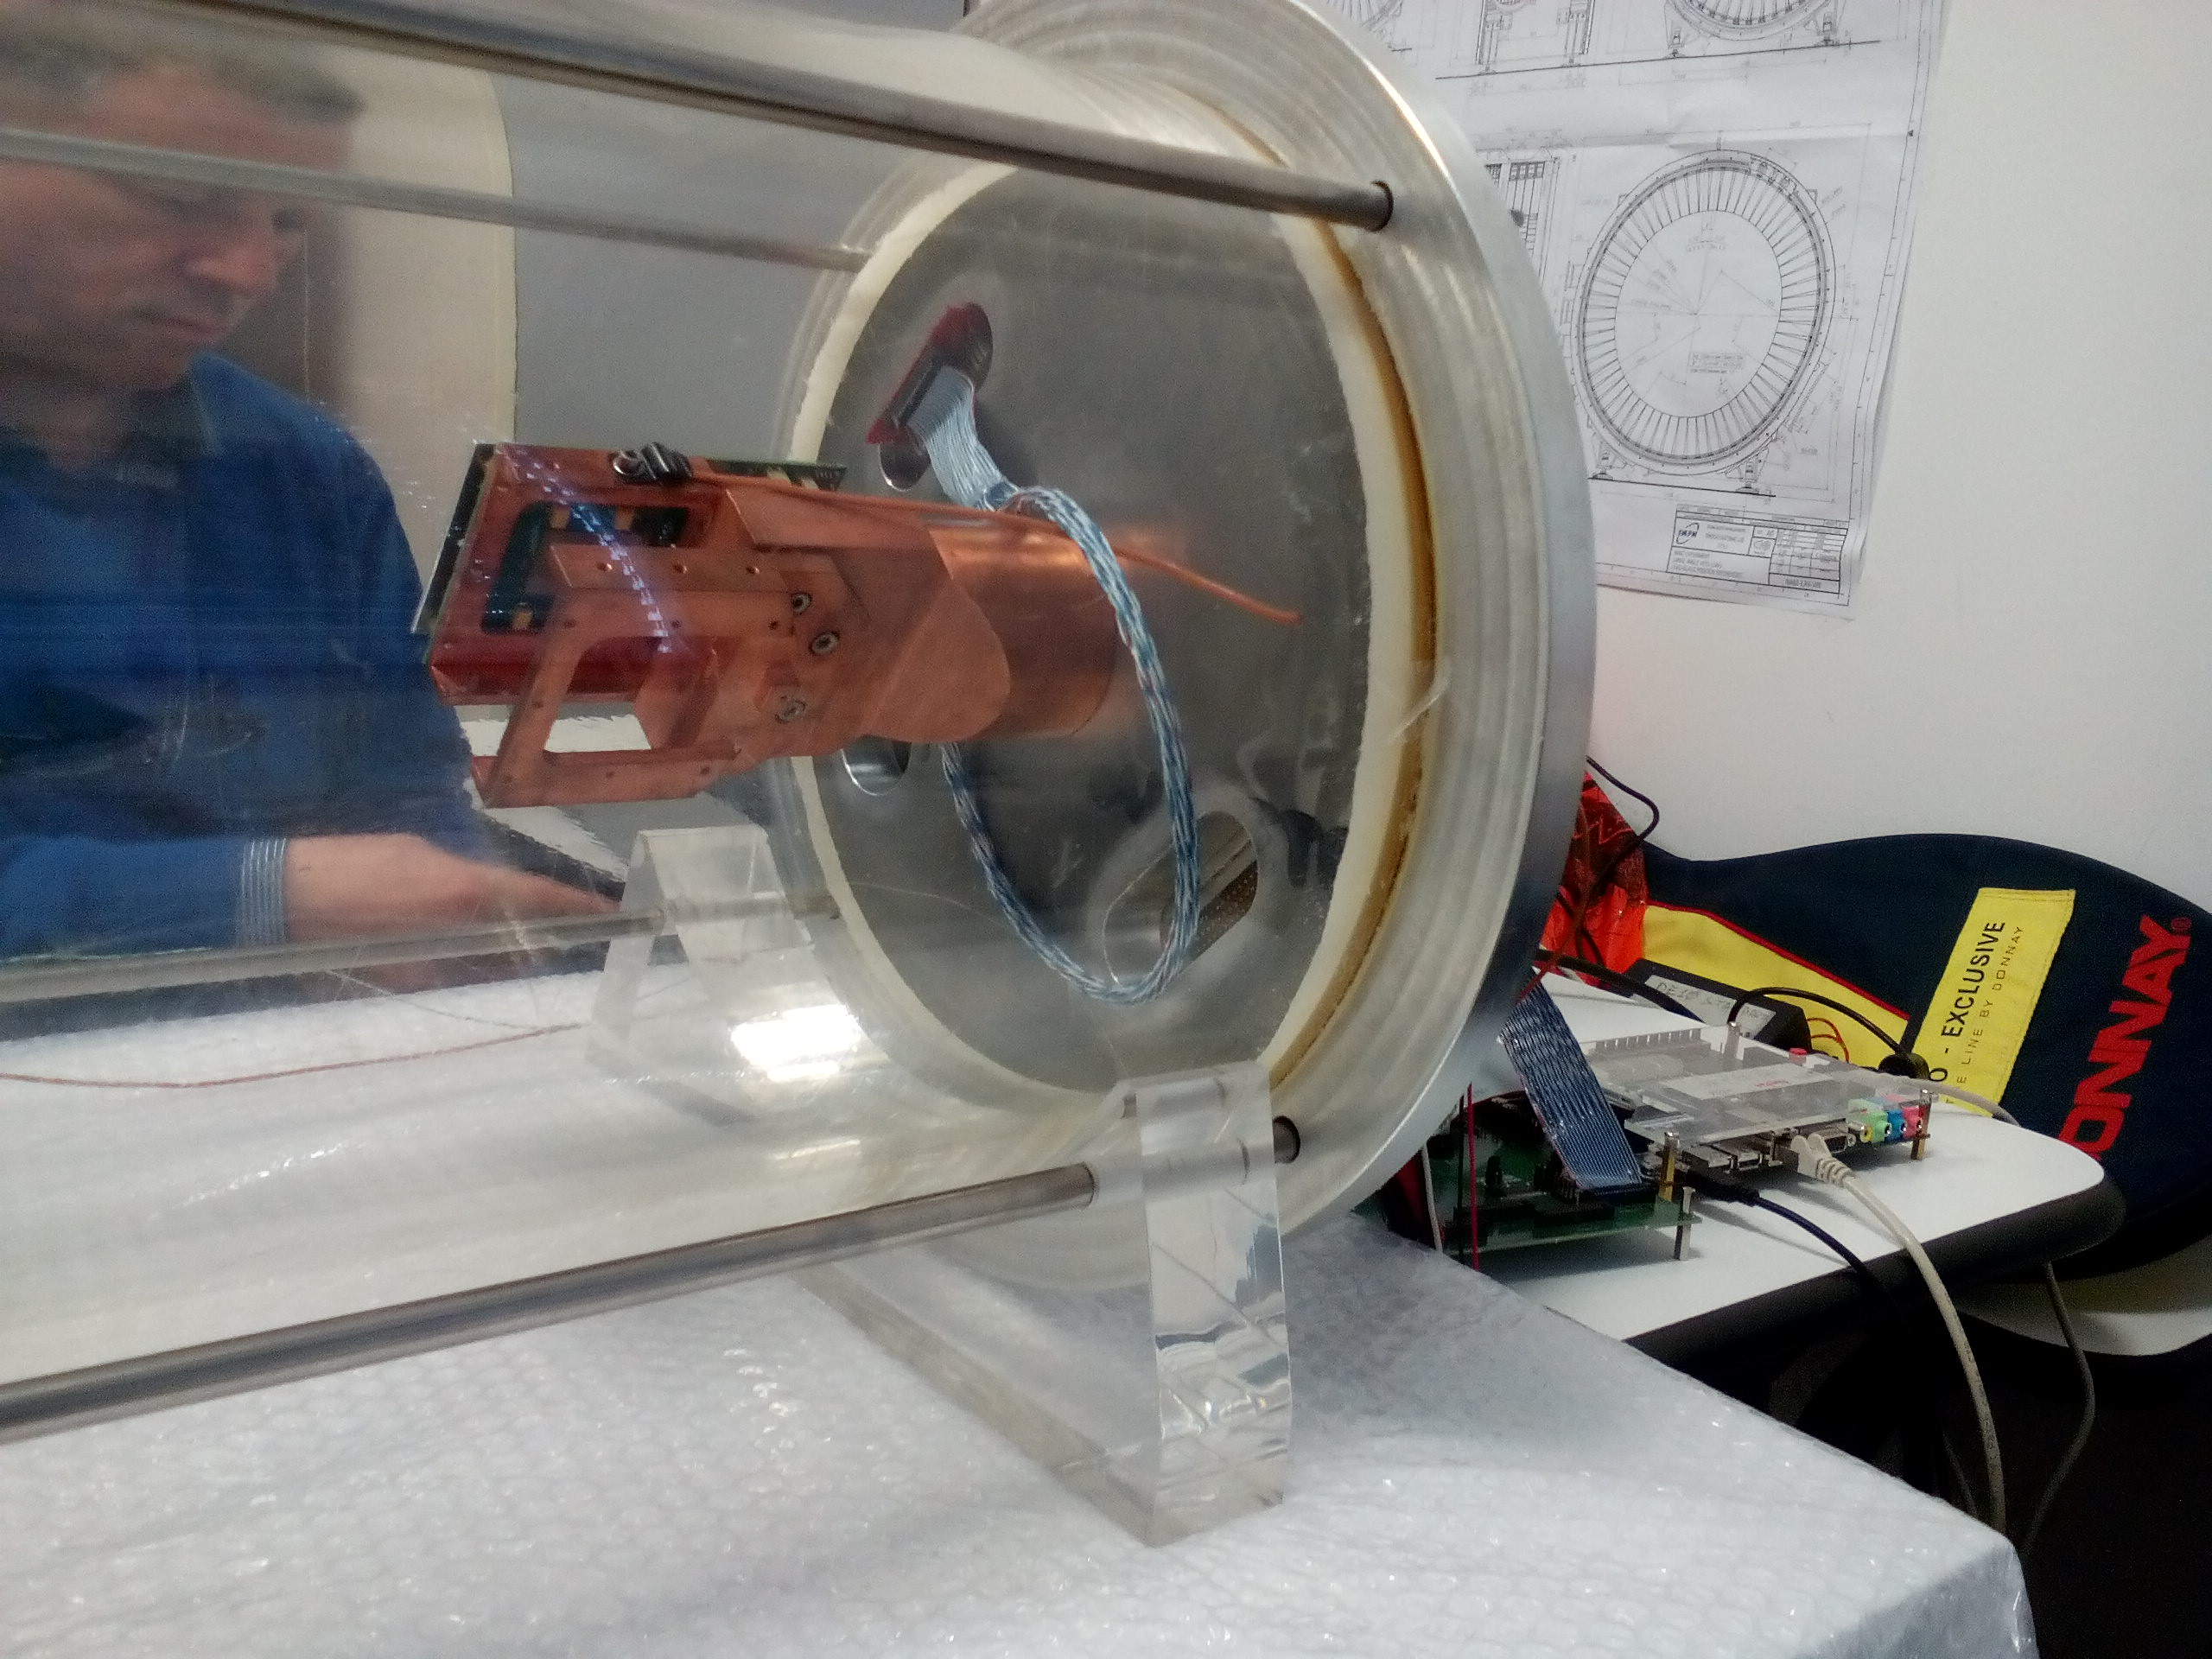
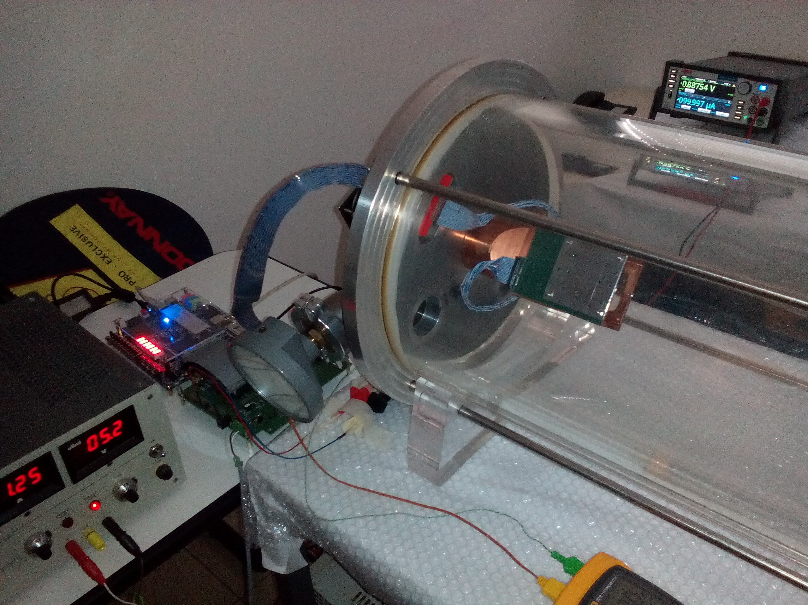
MIMOSA in vacuum
Venelin Kozhuharov
may 25th PADME meeting
Two rounds of evacuation of the chamber performed
  First to remove the condensation from the in-air test
  Second, step evacuation – the nominal test of MIMOSA
With a lot of optimism due to the very good results from in-air test

Slide 20
MIMOSA in vacuum
Venelin Kozhuharov
may 25th PADME meeting
T[°C]
T_{OUT}
T_{IN}
U
T_{MIMOSA} [°C]
P [bar]
P[bar]
ΔT[°C]
The calibration of the U_{DIOD} allowed to follow the temperature
  The chip stayed cool during the tests
  Difference chip – copper ~ 10°C
  Difference IN – OUT: ~ 2°C (an indication of the thermal flow)
T_{MIMOSA} – T_{IN}
T_{IN} – T_{OUT}
P[bar]

Slide 21
Conclusions
Venelin Kozhuharov
may 25th PADME meeting
The test of the MIMOSA thermal dissipation in vacuum performed
  After the necessary and very important preparatory work
The internal diode, if properly calibrated, is extremely useful for the knowledge of the operating conditions
The thermal dissipation through the
chip → 3 mm wide thermal contact with PCB → PCB metal strips →
copper bar → Peltier
is more than adequate solution for MIMOSA
The work performed on the MIMOSA support and the PCB design and manufacturing is really wonderful
  Congratulations to the mechanical and electronics services employed in the design of the system
  MIMOSA works in vacuum and it works very very well :)
  for the first time!

Slide 22
The FOOT tracker magnetic region
Initial design: C.Sanelli, “Studio di fattibilità dei magneti in configurazione “Halbach” dello spettrometro dell’esperimento FOOT”, INFN-17-10/LNF
Halbach permanent magnet configurations - Transversal dipole magnetic field in the 8 and 12 single
Permanent Magnet Hallbach configurations

Slide 23
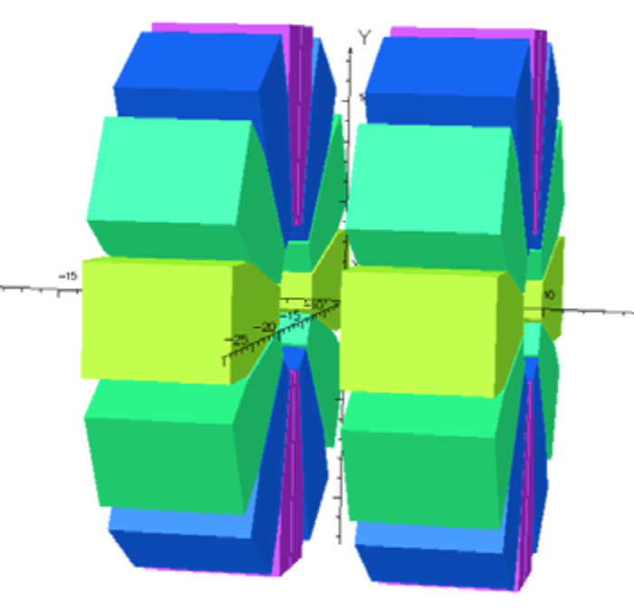
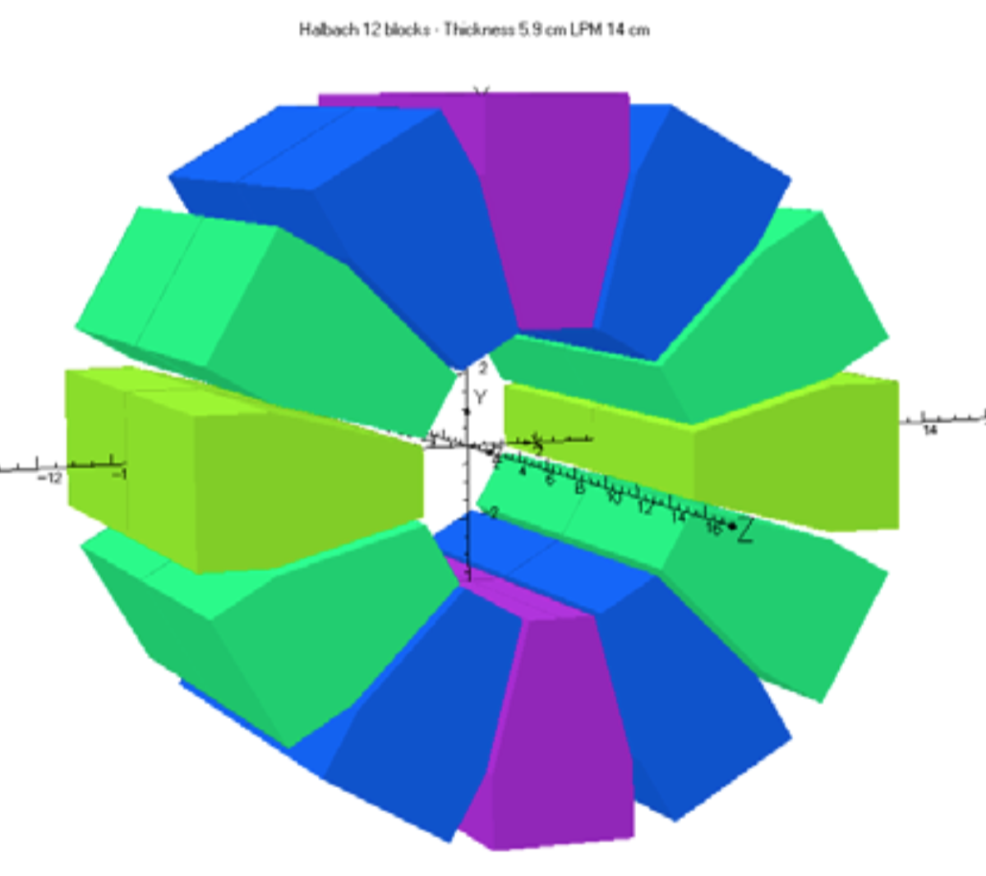
The FOOT tracker magnetic region
Halbach configuration
Double magnet structure

Slide 24
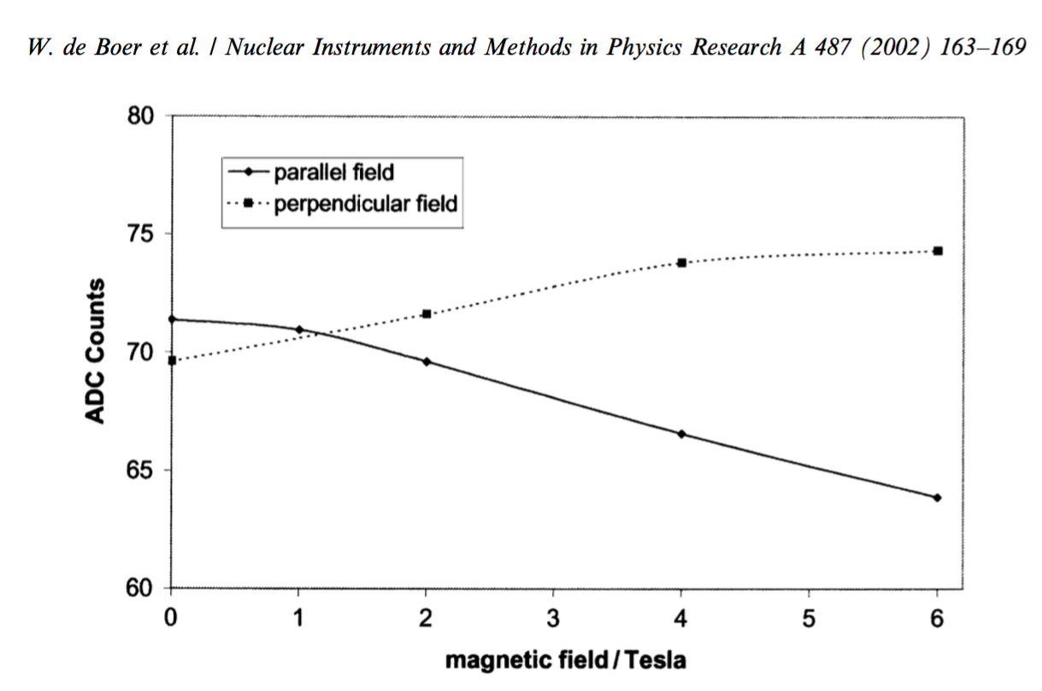
The FOOT tracker magnetic region
Most probable pulse height of the central pixel as function of the magnetic field parallel and perpendicular to the surface of MIMOSA.

Slide 25
Magnet system
Target
Inner Tracker
MSD
Vertex
Magnet
aperture
Bmax = 0.8 Tesla
Magnet length = 10 cm
Magnet aperture = 10,6 cm
5 cm
Magnet length
5 cm
Magnet length
Different size magnets (aperture mainly) will reduce the overall cost?
Original design magnet aperture = 7 cm

Slide 26
Magnet system
Cost estimation has been done for 7 cm long magnets, 0.8 T field and 7 cm aperture
Market survey
Kyma Undulators ( Trieste )
Danfysik ( Denmark )
ANTEC, S.A., (Vizcaya) SPAIN
EEC - Electron Energy Corporation ( USA )
RadiaBeam Technologies, LLC ( USA )
SABR Enterprises, LLC ( USA )
Large cost variation ( factor 2)
New proposed dimensions ( 10 cm long
and 10,6 cm internal diameter ) even if
possible could be expensive. The magnetic material could double and so the overall cost.
Final design for bid waiting our decision

Slide 27

Status of the Inner Tracker pixel detector
A long list of questions:
Material budget???????
${0.3\% x/X}_{0}$, ${0.5\% x/X}_{0}$, ${0.8\% x/X}_{0}$, ….....
Distance of the 2 planes?
Planarity of the planes?
Uniformity of material budget distribution?
...................................
Characteristics of kapton PCBs:
Low thickness ( 26 µm coverlayer
12 µm copper, 25 µm kapton )?
Should we try Aluminium intead of Copper?
CERN PCB workshop needed!
Should we consider even more advanced options?
Kapton thicknesses of 9 µm….......
Material to be used for the interposer:
SiC (Plume,…)?
RVC (many times used)?
Carbon fiber (STAR, ALICE,….)?
TPG (CBM,…)?
Diamonds (CBM,…)?

Slide 28
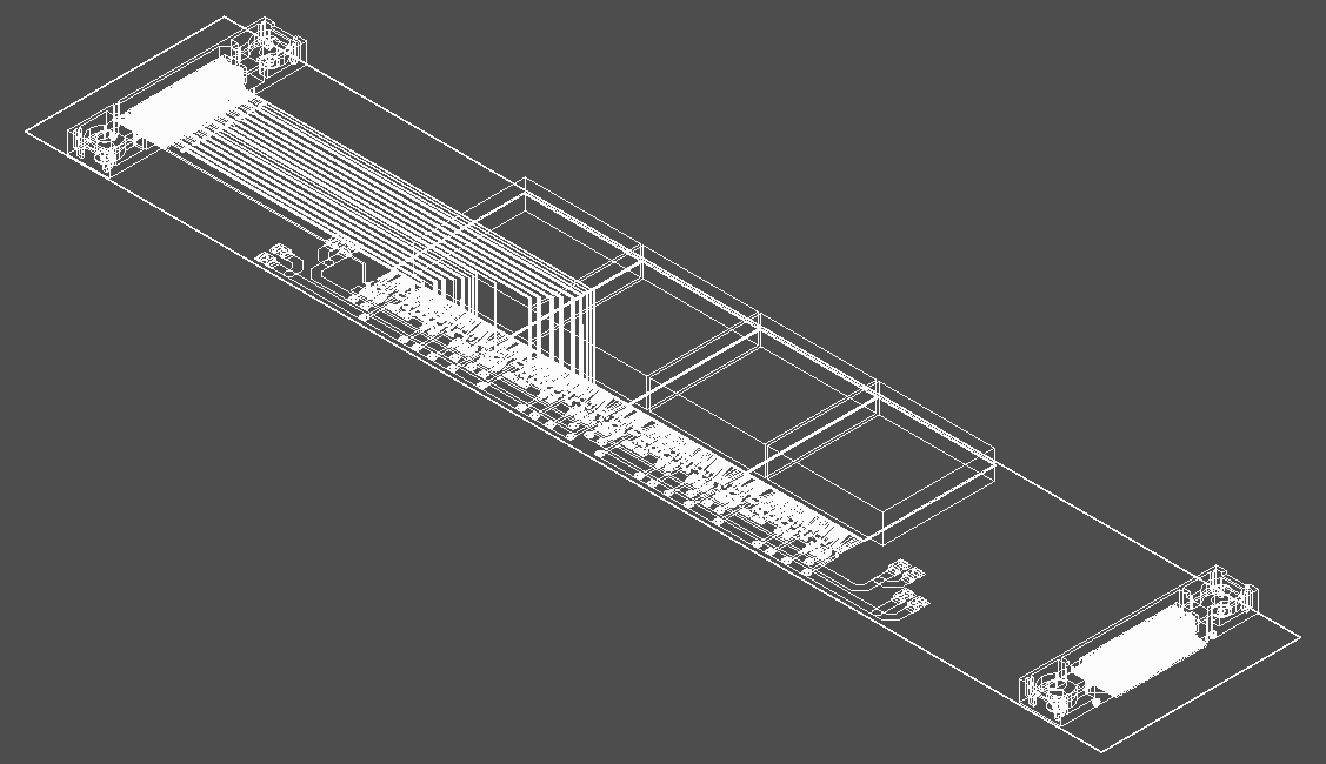
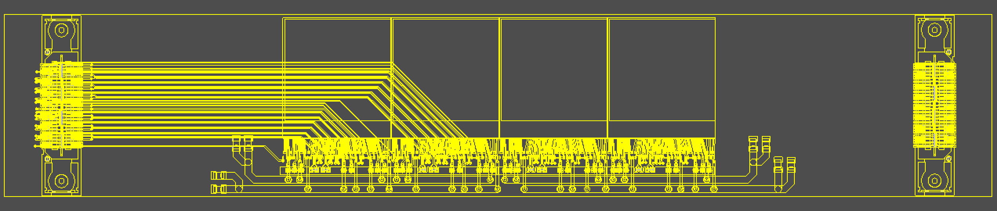
Status of the Inner Tracker pixel detector
First draft of the PlumeM28 module:
4 M28 sensors
2 connectors (one per side)
Horizontal sensor position un-centered!
Still many open questions:
Kapron tickness
Design for heat removal?
Mechanical fixed on both side?
What kind of adapter board?
Copper or aluminum?
Design by SEA (Servizio Elettronica ed Automazione) LNF

Slide 29
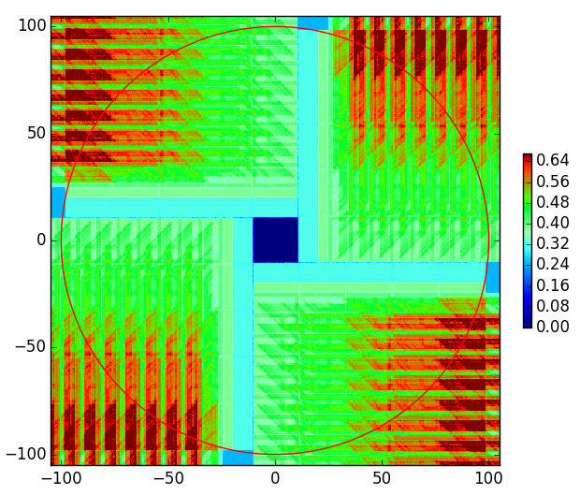
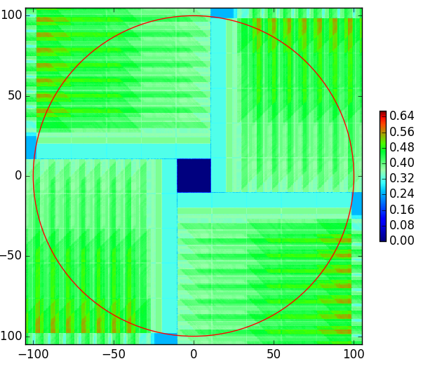
“Status of the vertex detector program of the CBM experiment at FAIR”, Philipp Klaus (Goethe University Frankfurt),
2018 14th Pisa meeting
Status of the Inner Tracker pixel detector
CBM @ FAIR example: Aluminium versus copper PCB solution $X_{0}$ values.

Slide 30
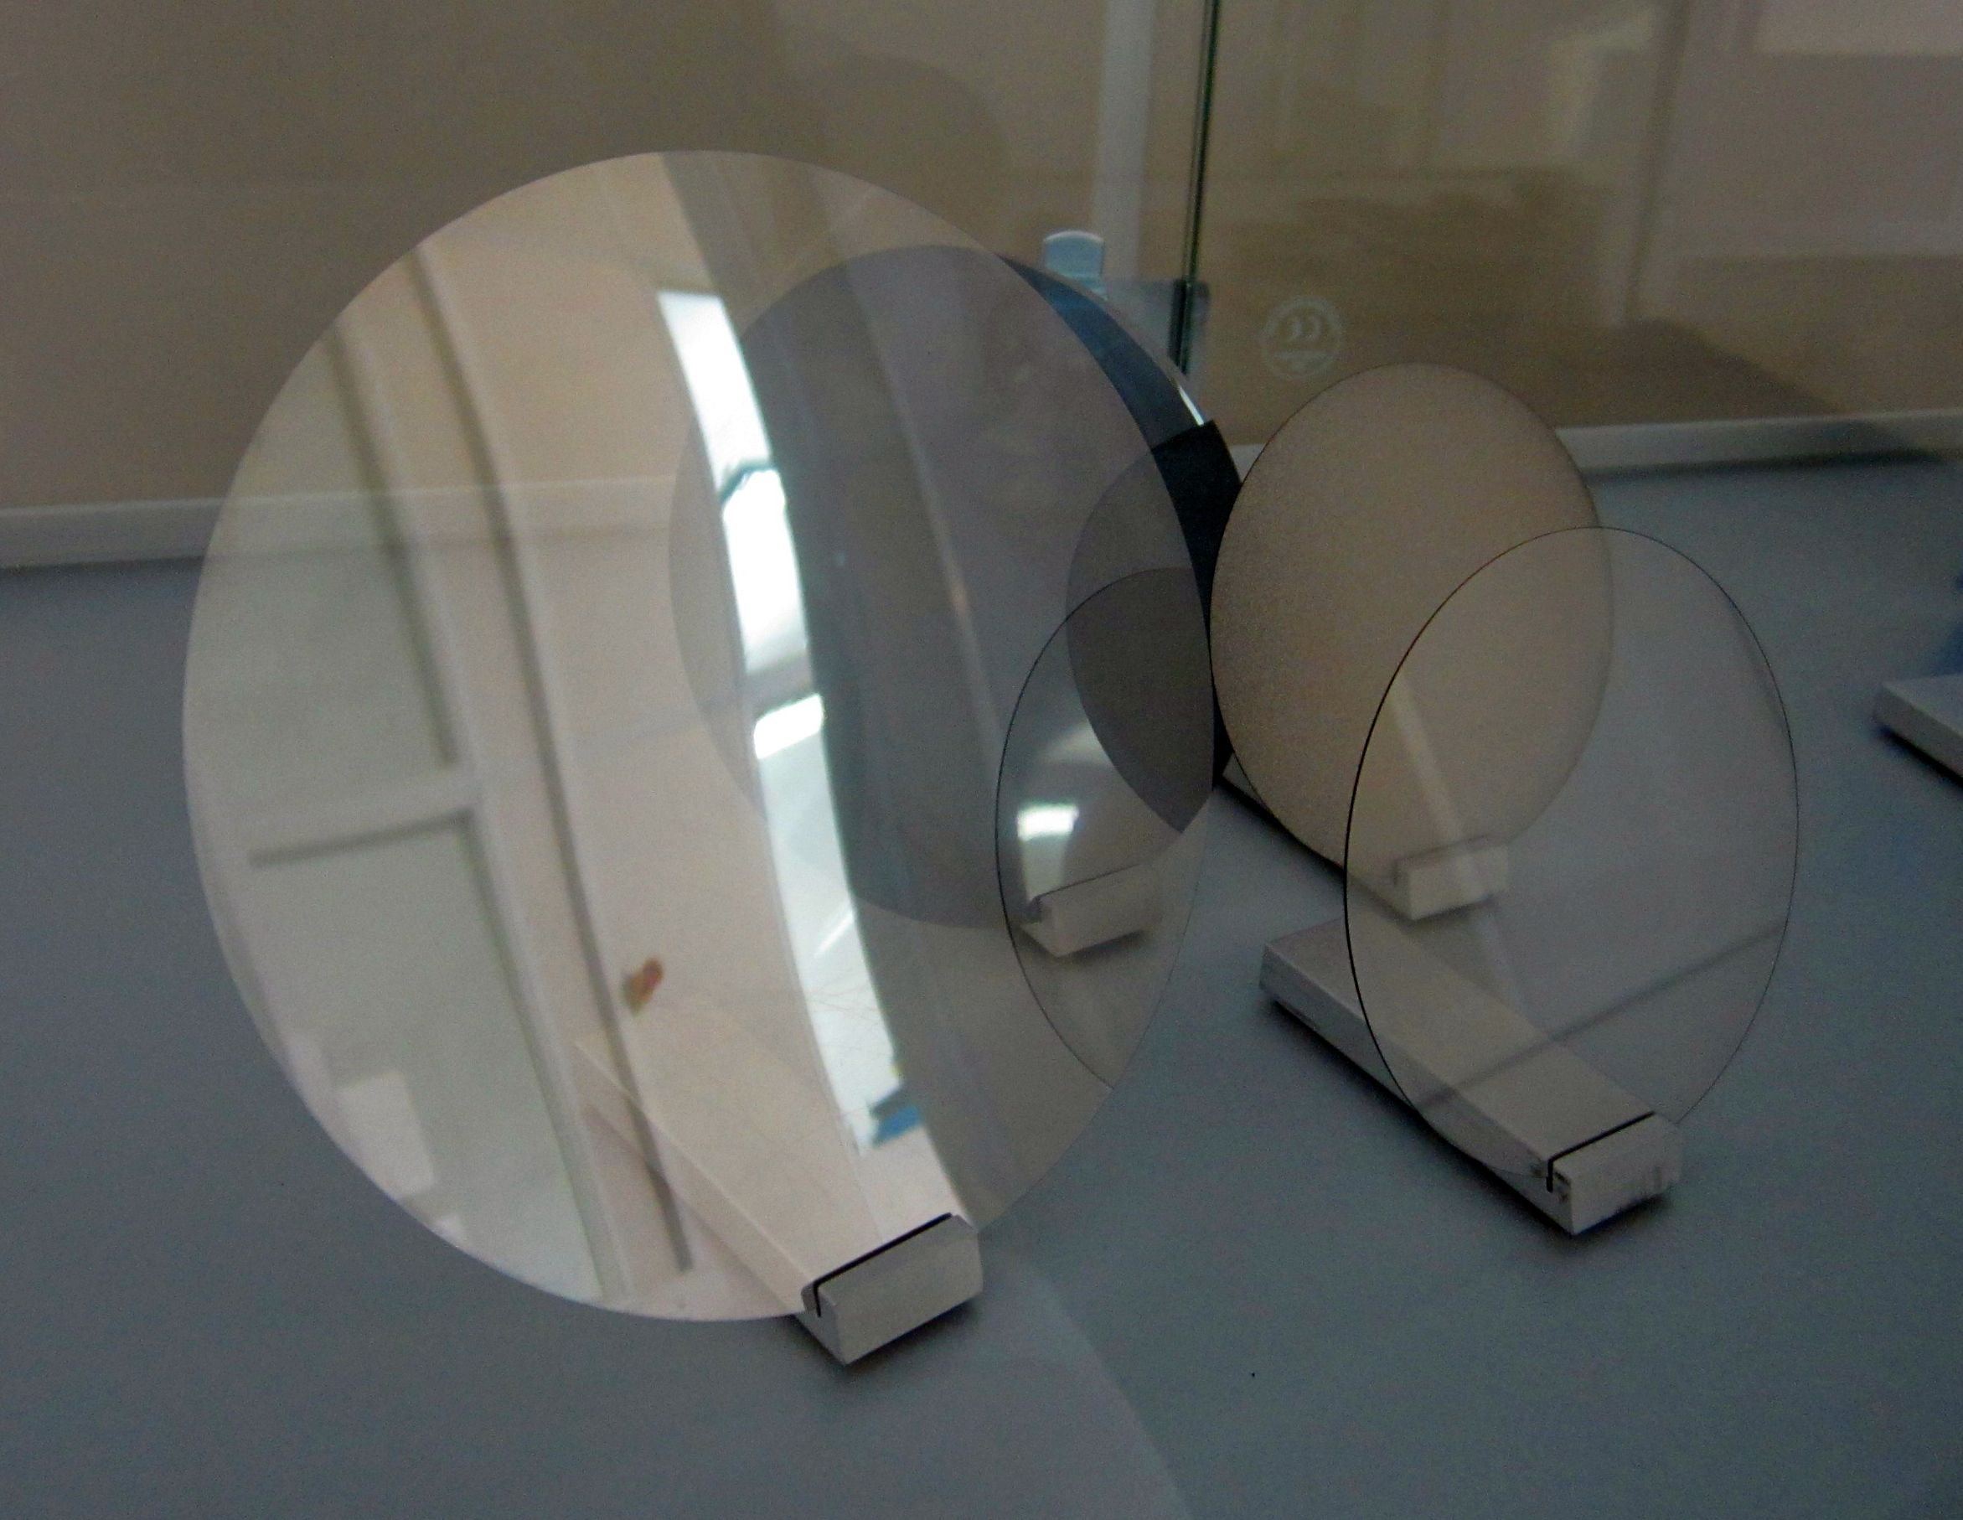
Status of the Inner Tracker pixel detector
Examples of material for interposer (support sheet to glue the two modules)
Industrial diamond wafers:
size 4 inches
Thickness 100 µm

Slide 31
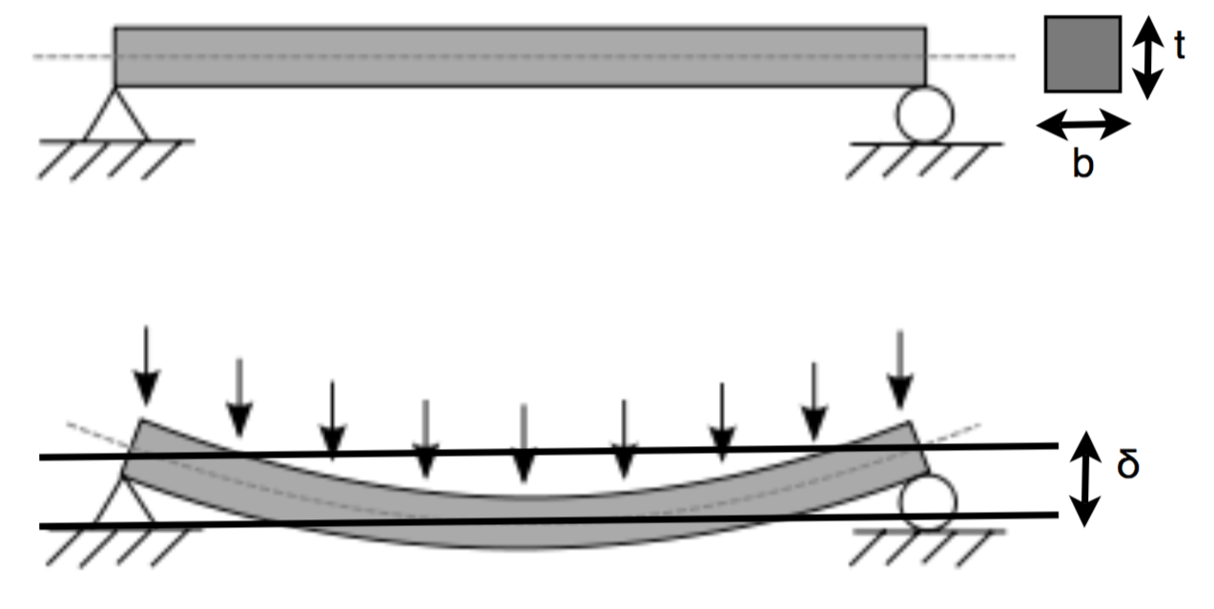
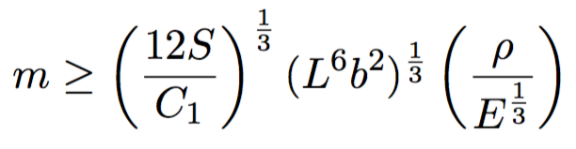
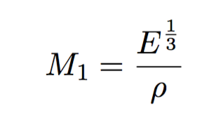
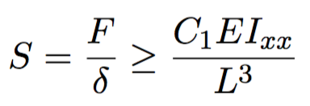
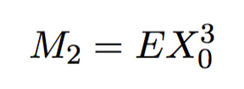
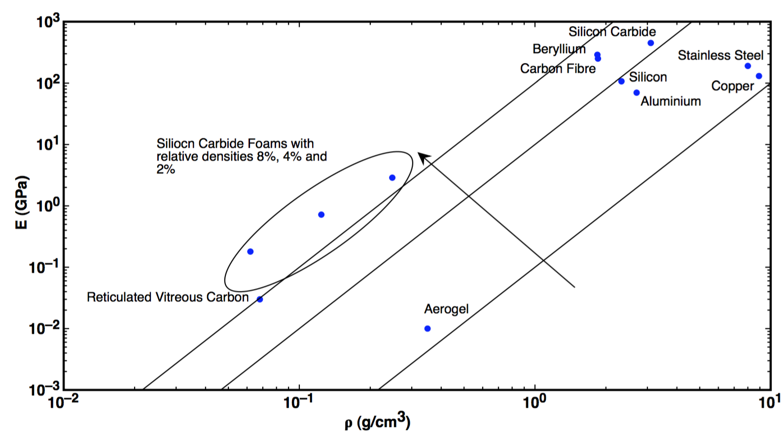
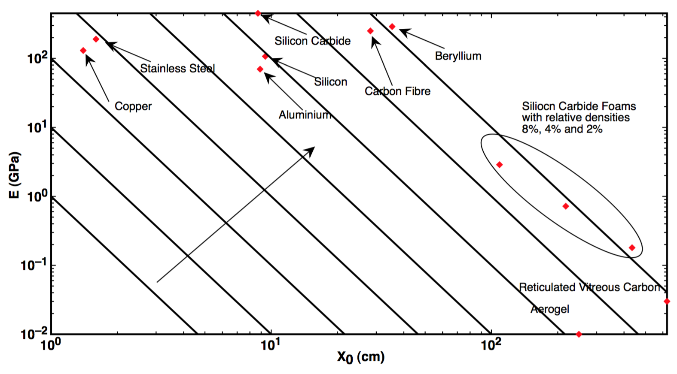
Status of the Inner Tracker pixel detector
The material is trade off choice among different requirements:
Stiffness of the structure
Material budget ( mass or radiation length)
CTE ( Thermal Expansion Coefficient )
Availability
Cost
...............................
S = Stiffness
E = Elastic Module
I = Second moment
L = Length

Slide 32
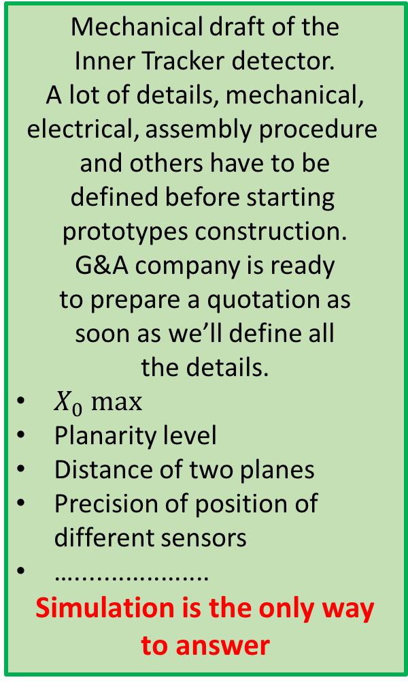
FOOT tracker mechanical setup
Mechanical draft of the
Inner Tracker detector.
A lot of details, mechanical,
electrical, assembly procedure
and others have to be
defined before starting
prototypes construction.
G&A company is ready
to prepare a quotation as
soon as we’ll define all
the details.
$X_{0} max$
Planarity level
Distance of two planes
Precision of position of
different sensors
…...................
Simulation is the only way
to answer

Slide 33
A possible pixel tracker improvement
M28 pixel architecture limit:
Rolling shutter full frame readout (～180µs)
No timing information
NO WAY TO ASSIGN TRACKS FROM DIFFERENT EVENTS OCCURRED IN THE SAME FRAME
Recent result from FBK ( Fondazione Bruno Kessler )
“Large area” LGAD sensor (～ 1 cm2)
Thickness 50 µm
Possible solution
Easily implementable a coarse “pixellated” version with limited number of readout channels ( order 10-20 ).
One additional mask probably sufficient!
One or two plane before or after the target could solve the problem

Slide 34
Conclusions
FOOT tracker mechanical setup:
A realistic solution has been envisaged
Construction foreseen for next year
Financial request to “commissione III” under definition
Magnet system:
Final decision underway (next weeks)
Needed simulations almost completed
Market search accomplished
Funding upgrade “agreed” with Comm. III
All elements to start the bid prepared
Pixel vertex detector:
The basic block holding PCB constructed and tested
Test in vacuum successful
New daq system ready
Firmware for threshold scan to be debugged
Inner tracker:
A draft of the module organization defined
The overall mechanical solution still under definitio
A lot of simulation work still needed to define
the final specs

