Slide 1
Emulsion Cloud Chamber Status
A. Alexandrov, G. De Lellis, A. Di Crescenzo, G. Galati, A. Lauria, M.C. Montesi, A. Pastore, V. Tioukov
Napoli University and INFN
FOOT General Meeting
Isola d’Elba, 4⁻5 June 2018

Slide 2
Outline
1) Test beams results
Test beam at LNS in July 2017
Test beam at Trento in December 2017
Refreshing procedure for charge separation
P measurement and isotopic identification
2) Preliminary simulation results for GSI exposure
⁴He (700 MeV/u) beam on emulsion chamber
Energy and angle distribution of fragments by Fluka simulation

Slide 3
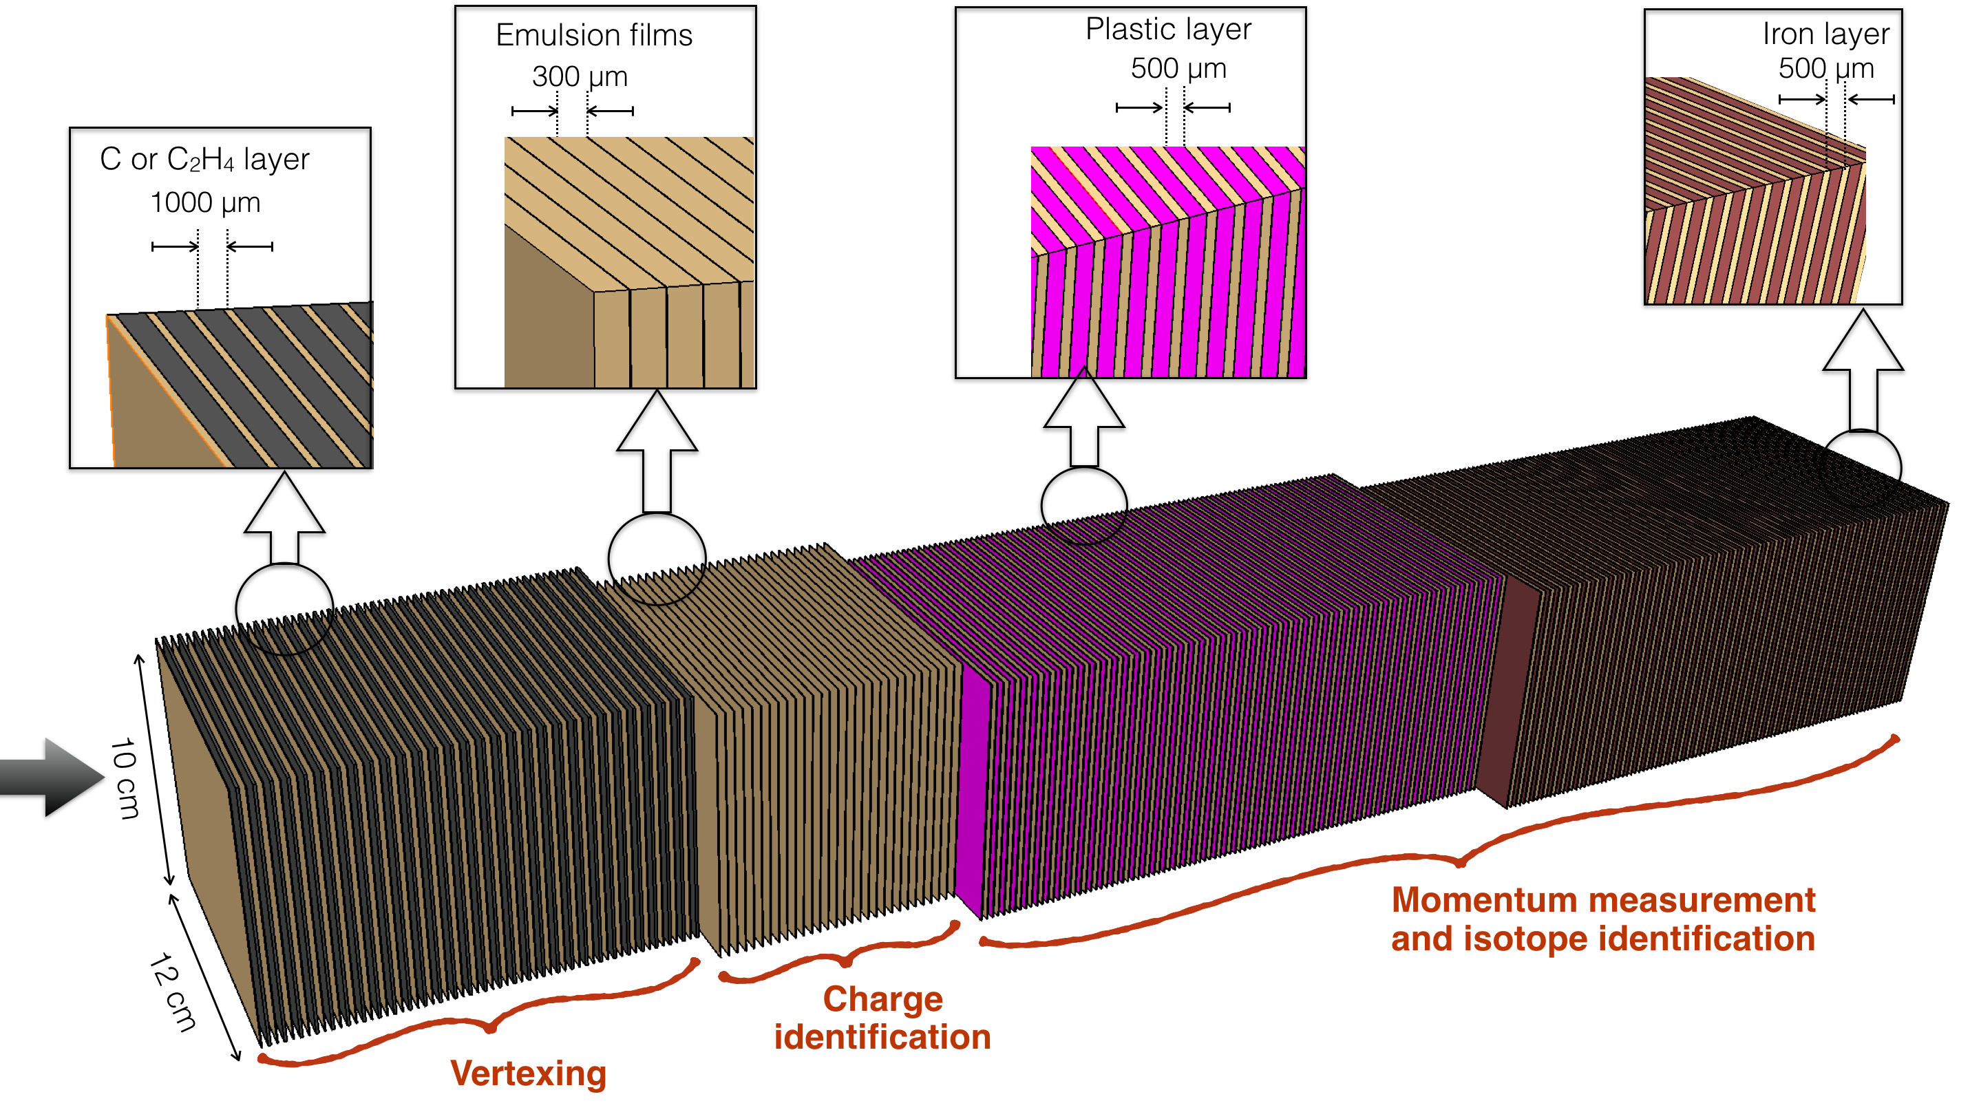
Detector structure
The Emulsion Cloud Chamber detector is made of three sections:
SECTION 1: alternated layers of emulsion films and target (C/C2H4)
Vertex detector
Tracking of all charged particles
SECTION 2: emulsion films only
Charge identification for low Z fragments
SECTION 3: alternated layers of emulsion films and passive material (Plastic/Steel/Lead)
Momentum measurement by range and Multiple Coulomb Scattering (MCS)
Isotopic identification

Slide 4
Emulsion Test Beam
Why:
New nuclear emulsions (Nagoya production) will be used in the FOOT experiment, never used for particle identification
Exposure of nuclear emulsion to calibrate the response at different ioninizing beams (charge identification)
Exposure of two ECC for isotopic identification
What:
1)LNS: Incident beam: P, D, He and C @80 MeV
2)Trento: Incident beam: P @50, 80, 200 MeV
Exposure:
Surface of exposed emulsion samples: 5x4 cm² (1/6 of emulsion film surface)
Beam particles orthogonal to emulsion surface
Five exposures per beam, each treated with different refreshing procedure
One sample made of 2 consecutive emulsions enveloped in laminated tissue under vacuum

Slide 5
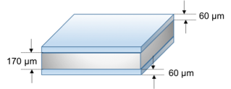
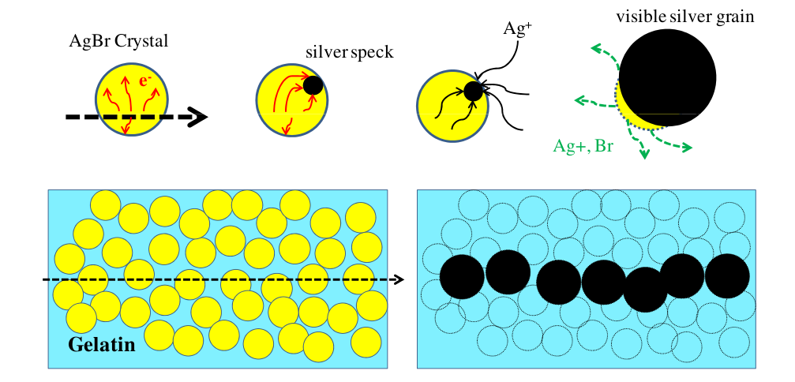
Emulsions characteristics
Emulsion films produced in Nagoya University in May 2017
Film dimensions:
Surface: 125 mm x 100 mm
Total thickness: 380 μm
Emulsion Layers: 2x100 μm
Plastic Base: polystyrene: 180 μm
sensitivity: 50 grains/100 μm
100
180
100

Slide 6
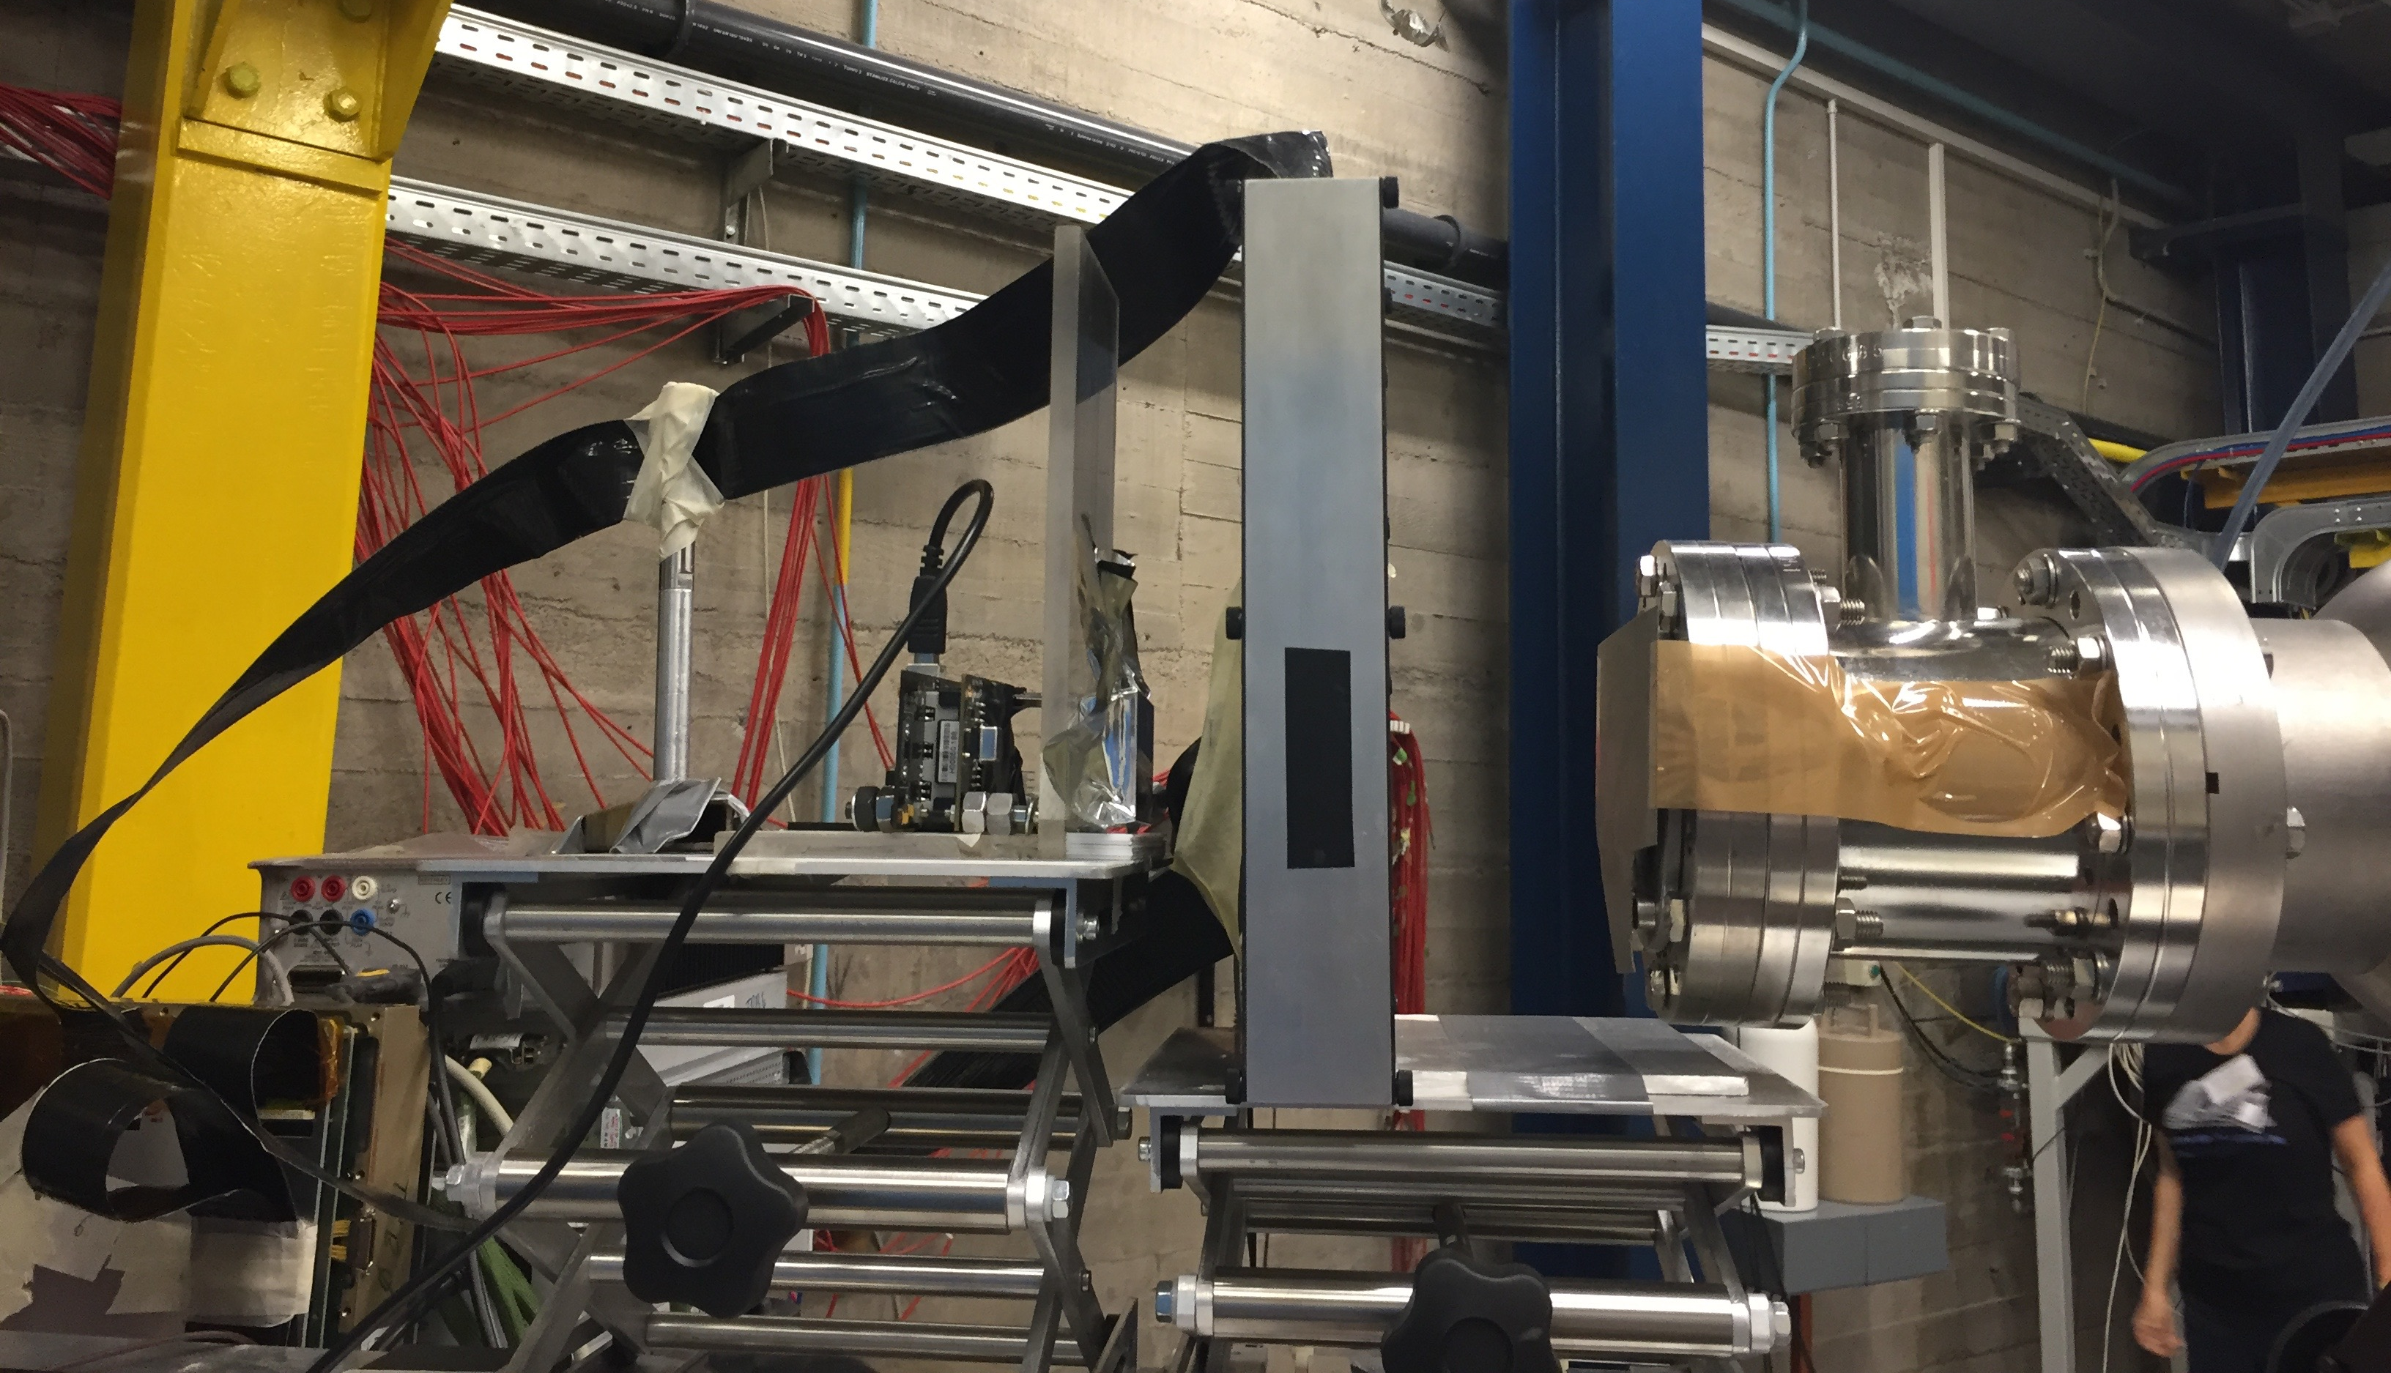
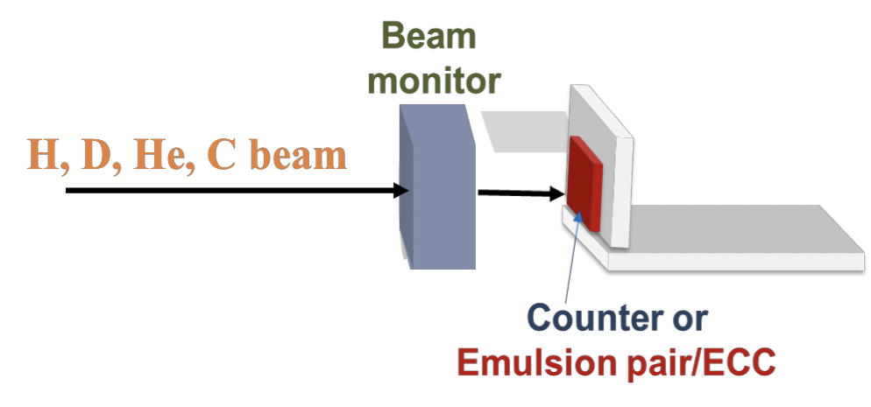
Test beam @LNS: charge separation
Incident beam: P, D, He and C @80 MeV
Beam Monitor by the Perugia group: silicon microstrip detector (strip pitch 250 μm, thickness 350 μm, total area 8x8cm²)
Emulsion doublet
Si Microstrip
CMOS
Main difficulties coped with:
Make the beam uniform over the emulsion surface
Reduce the beam intensity down to 10 particles/mm²
No online monitoring, needed for normalization
Counter by the Perugia group: beam intensity registered by a CMOS detector (up to 3 MHz)

Slide 7
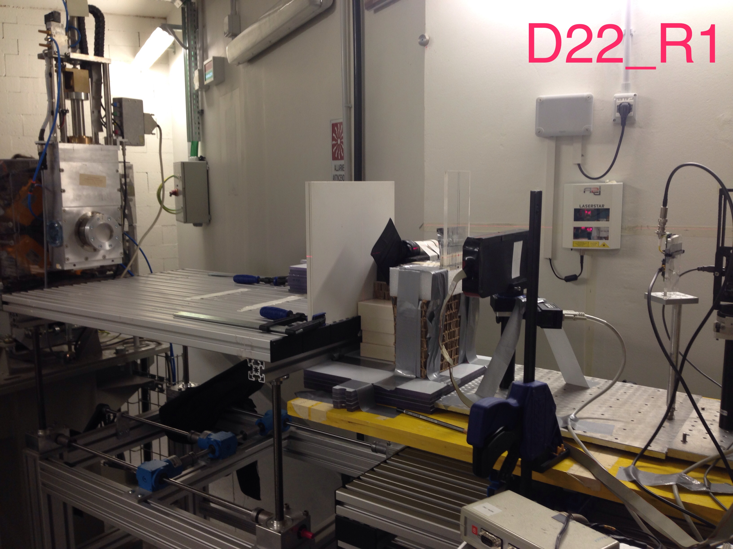
Test beam @Trento: charge separation
Incident beam: P@50 (same ionization as He@250 MeV), 80 , 200 MeV
Emulsion doublet
Beam Monitor by the Trento group: scintillator counter
Detector by the Perugia group: beam intensity registered by a CMOS detector

Slide 8
Exposed emulsions
LNS
TRENTO
 | H (80 MeV/u) | D (80 MeV/u) | He (80 MeV/u) | C (80 MeV/u) | H (50 MeV/u) | H (80 MeV/u) | H (200 MeV/u)
EQUIVALENT TO |  |  | Li (200 MeV/u) |  | He (250 MeV/u)
NOT REFRESHED R0 | D1 | D16 | D6 | D11 | D21 | D25 | D29
28°C R1 | D2 | D17 | D7 | D12 | D22 | D26 | D30
34°C R2 | D3 | D18 | D8 | D13 | D23 | D27 | D31
36°C R3 | D4 | D19 | D9 | D14 | D24 | D28 | D32
38°C R4 | D5 | D20 | D10 | D15
NOT REFRESHED | ECC1 | ECC2
D = doublet of emulsions
ECC = 21 emulsions
74 emulsions (5x4) cm² scanned and analysed
total scanned area: 1480 cm²

Slide 9
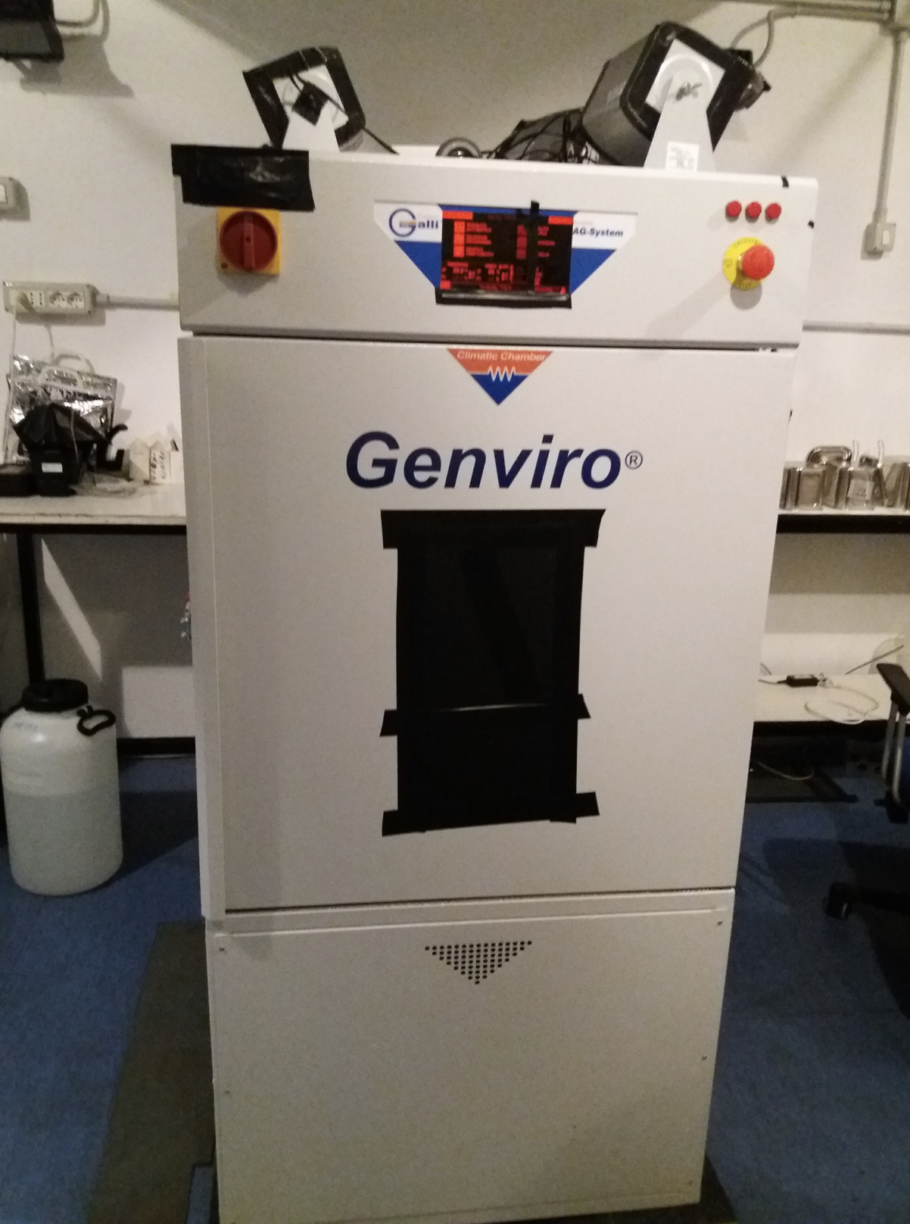
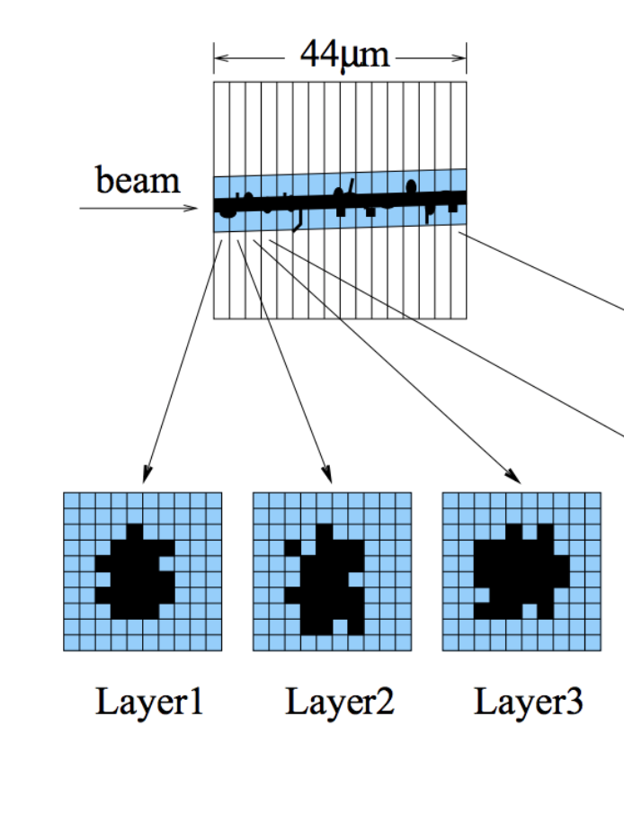
Emulsion Films: thermal treatment
Refreshing and chemical treatment @LNGS
Treatments performed in the Emulsion Facility in Underground Gran Sasso Laboratories
Climatic chamber GENVIRO 120L used for refreshing procedure
Refreshing conditions used:
Temperatures ranges from 28°C to 38°C
Relative humidity: 98%
Refreshing time: 24h
Volume of the track
Sum of the number of pixels associated with each recognised tracks
VR0
100 um

Slide 10
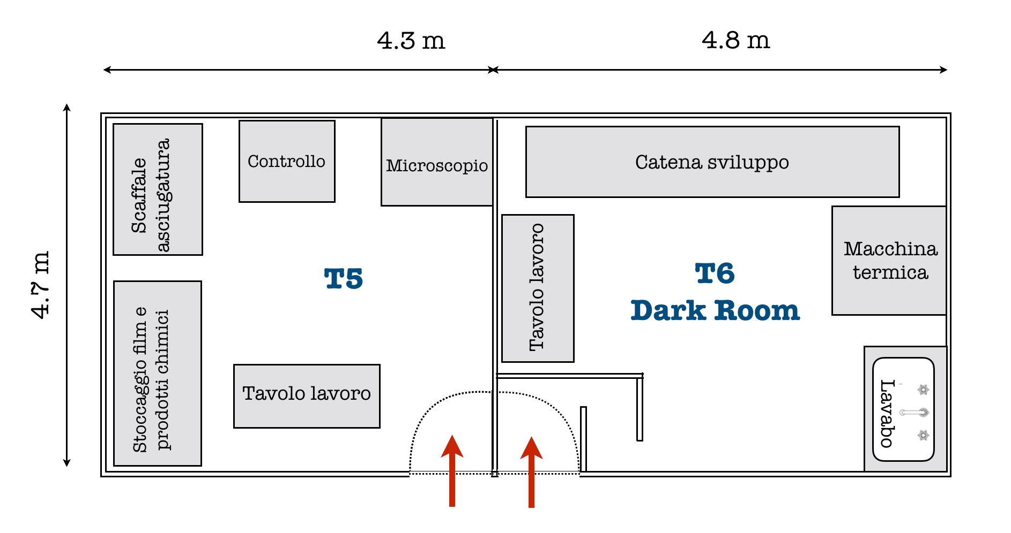
New Neapolitan laboratory
New development laboratory (>40m²) in our Physics Department
It will be equipped with:
Dark room for emulsion development
Assembly and development of the film will be done in near future in Naples

Slide 11
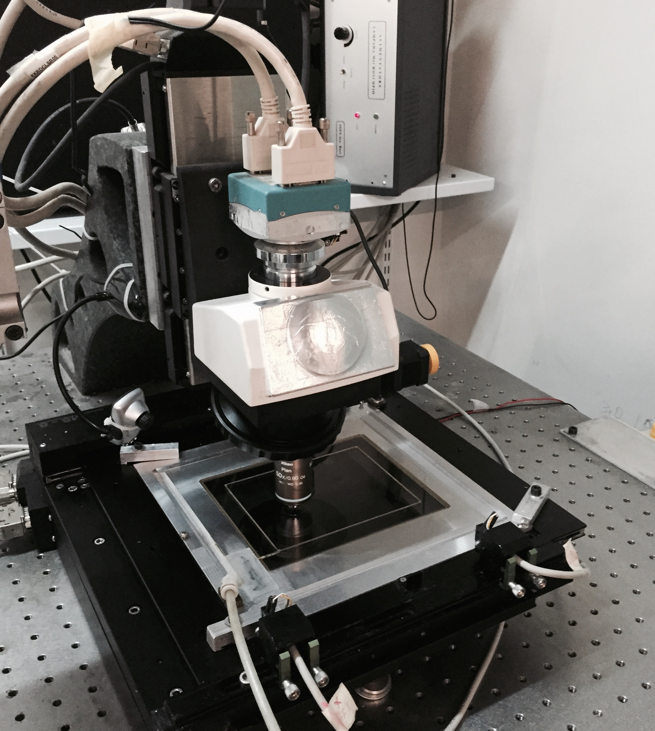
Emulsion Films: Data acquisition
Scanning with optical microscope @Napoli
Data acquisition performed with fully automated optical microscopes
SCANNING SYSTEM CHARACTERISTICS
New reconstruction software to extend track recognition angular acceptance from θ = 30° to θ = 72°
Software: LASSO in Continuous Motion mode [1]
Development a new generation Scanning System with new hardware. Extension of the scanning speed from 20 cm²/h to 190 cm²/h [2]
[1] A. Alexandrov et al., JINST 10 (2015) no.11 P1100
[2] A. Alexandrov et al., Nature Scientific Reports 7 (2017) 7310
Notes:
Nuclear emulsions are made by silver bromine crystals immersed in organic gelatine. The passage of a charged particle ionizes the crystal along its path, after the development treatment they will appear as aligned black clusters in a transparent medium. We have about

Slide 12
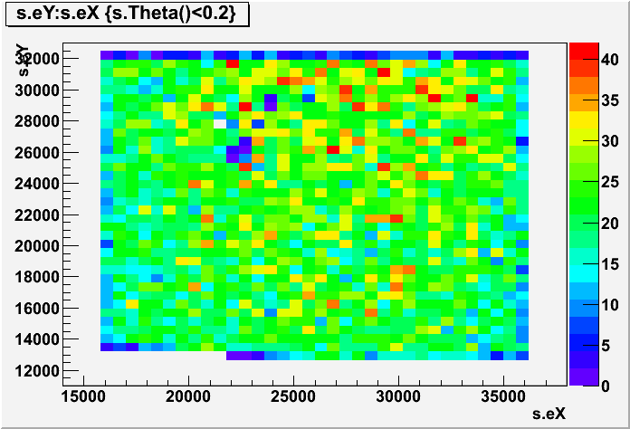
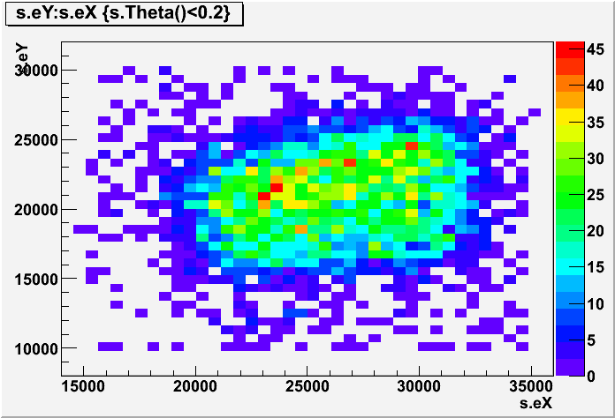
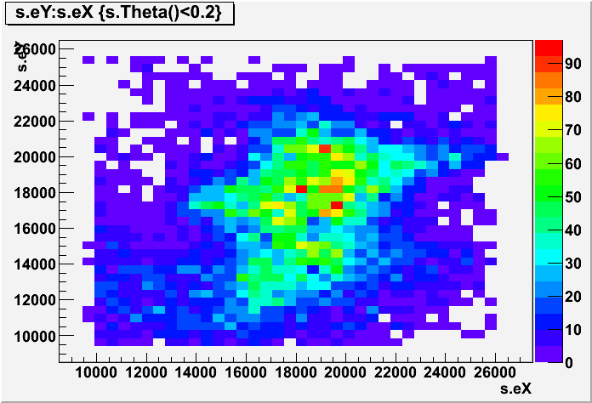
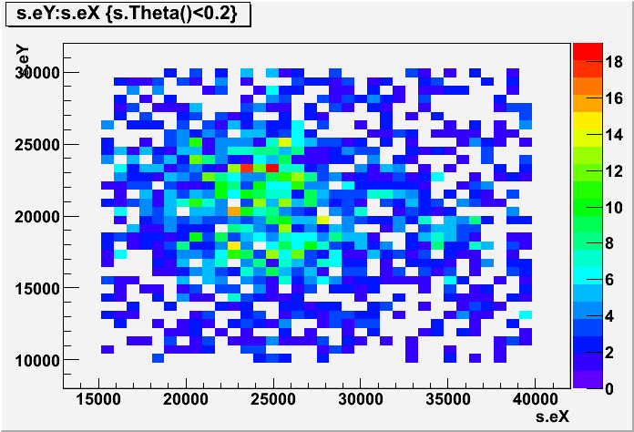
beam spatial distribution (LNS)
Films without any thermal treatment
x (μm)
x (μm)
x (μm)
x (μm)

Slide 13
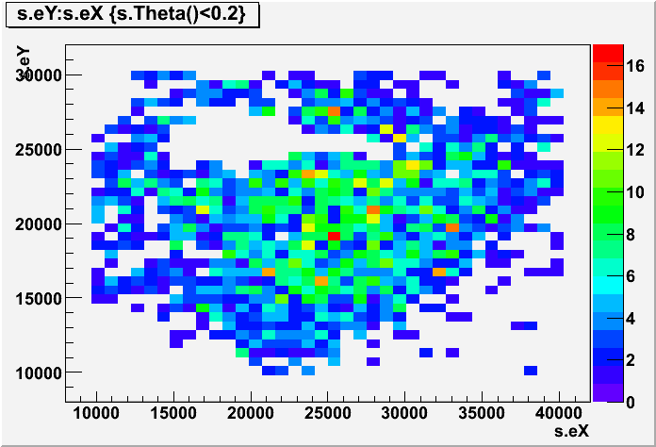
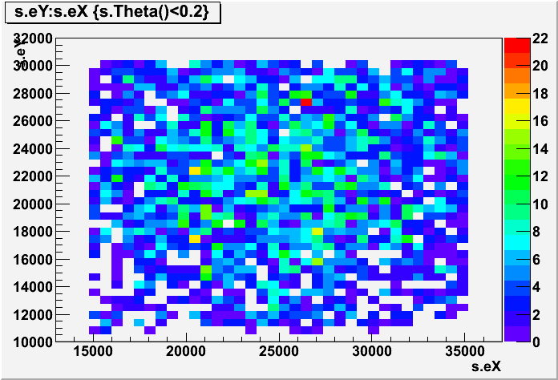
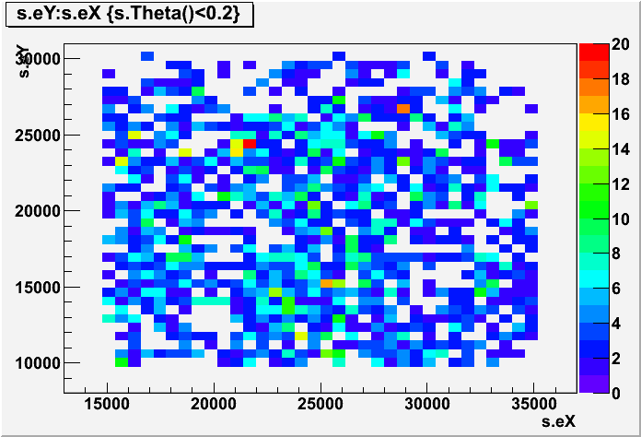
beam spatial distribution (Trento)
Films without any thermal treatment
x (μm)
x (μm)
x (μm)

Slide 14
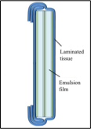
Emulsion Analysis: Signal selection
Emulsion films integrates cosmic rays passing through them from production to development (~2 and ~6 months, respectively, for emulsions exposed to CT e TR)
Signal tracks perpendicular to emulsion films (tgθ<0.2)
Cosmic rays tracks: tgθ>0.2
Angular acceptance in the reconstruction after the scanning processes: tgθ<1
Cosmic rays
Beam

Slide 15
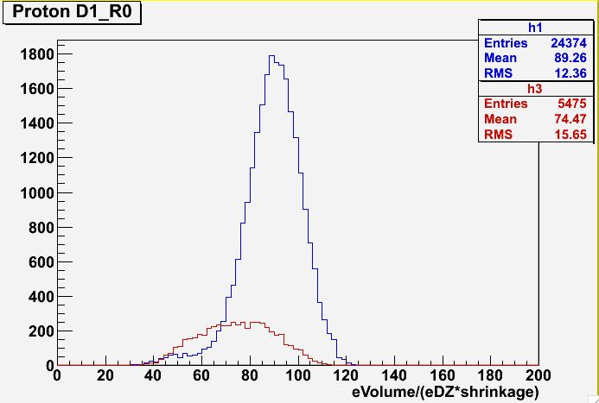
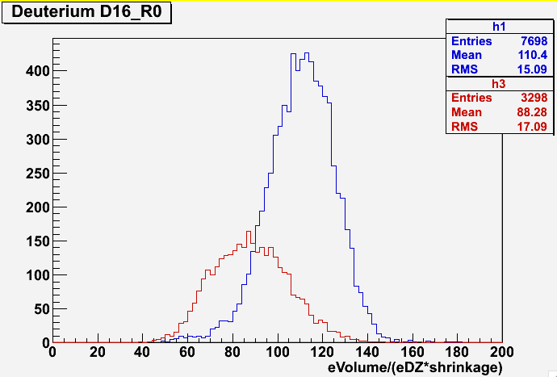
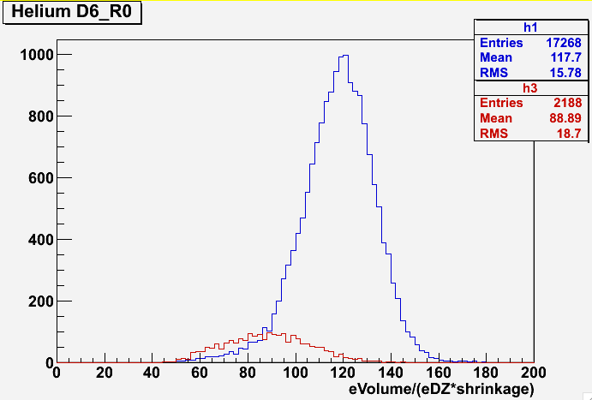
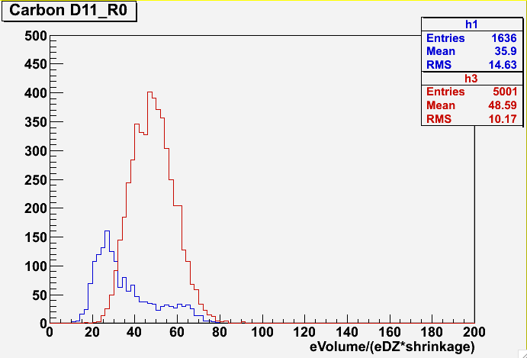
Not Refreshed emulsions from LNS
Data taking soon after the test beam
Signal
Cosmic rays
signal ionisation response is less than that of cosmic rays

Slide 17
Tracks in emulsion

Slide 18
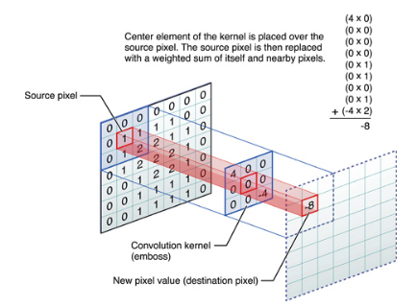
Convolution filter
Image processing based on a 5x5 convolution filter
For carbon: needed to change convolution filter size because of carbon ions produce a lot of ionisation

Slide 19
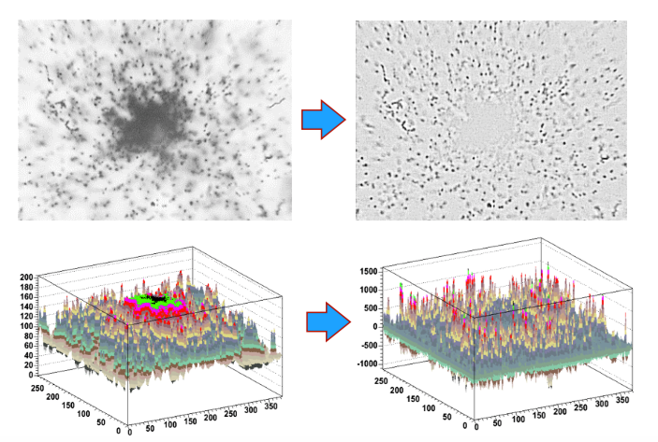
Convolution filter

Slide 20
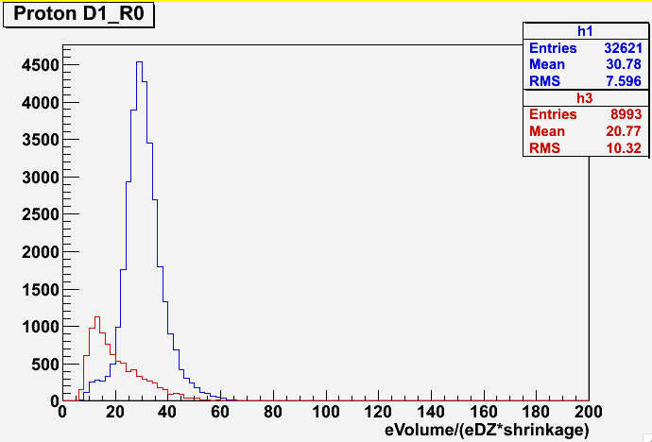
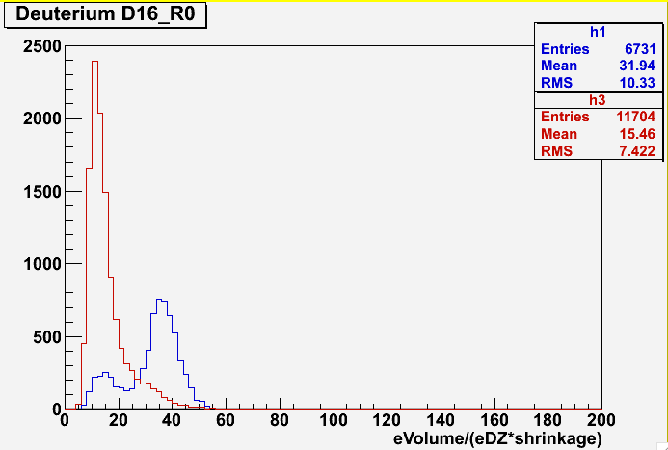
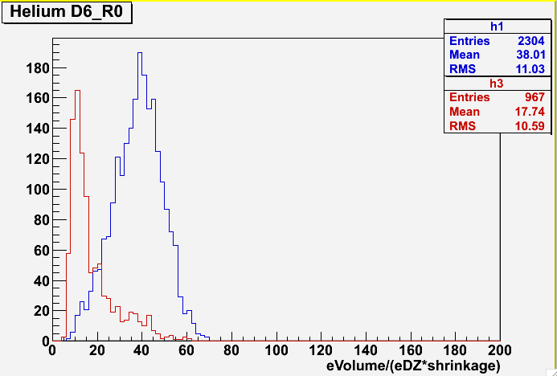
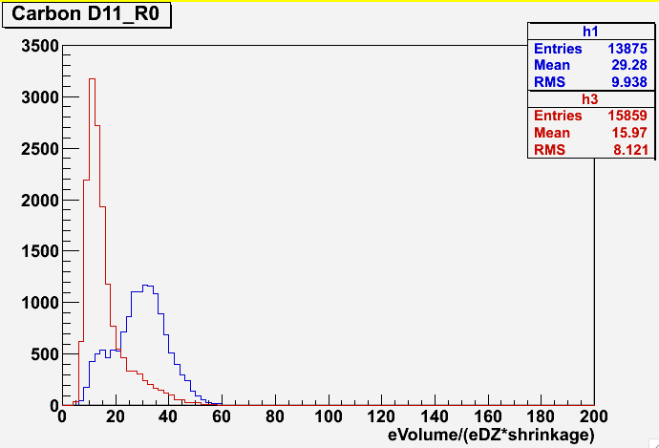
Not Refreshed emulsions from LNS
filter
9x9
New data taking: saturation
Signal
Cosmic rays
Signal
Cosmic rays

Slide 21
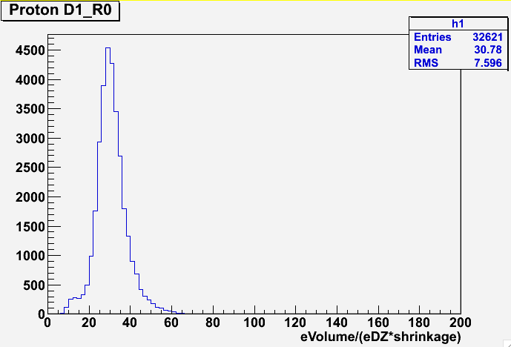
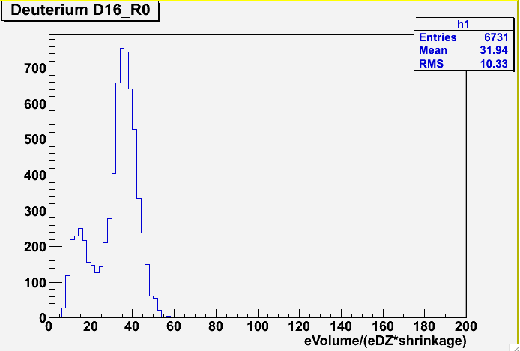
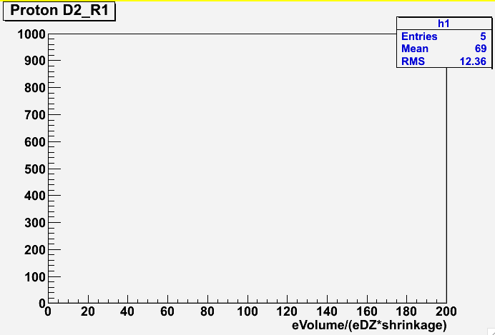
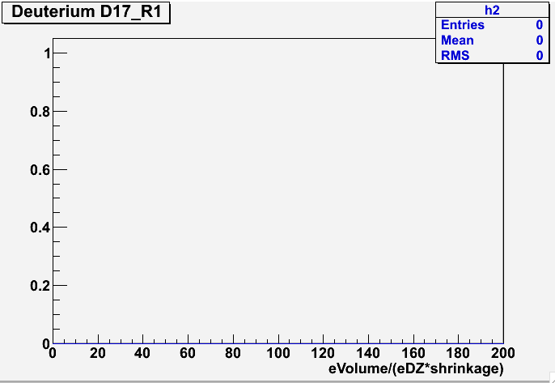
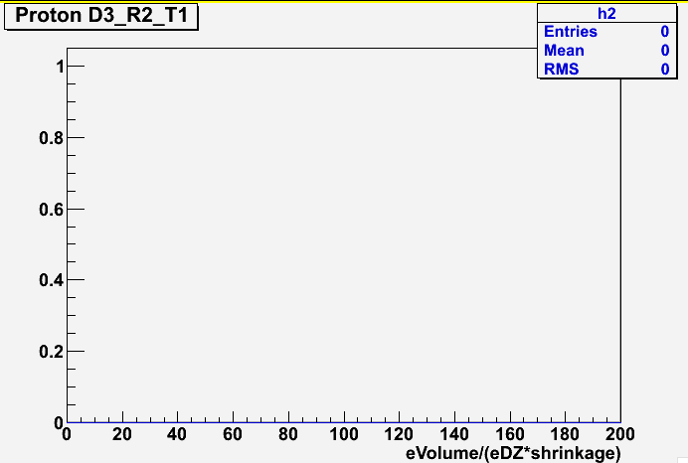
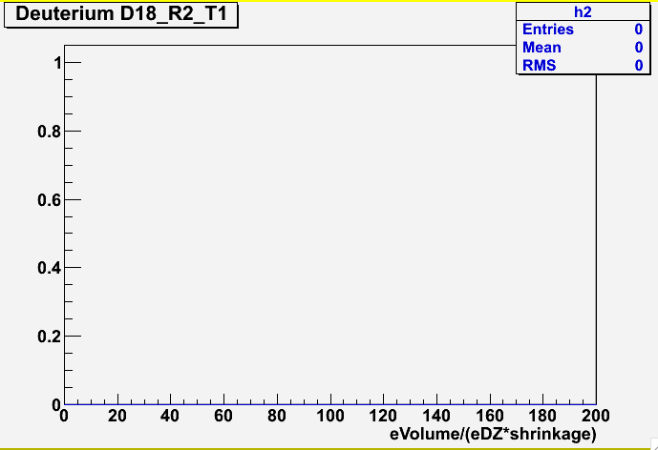
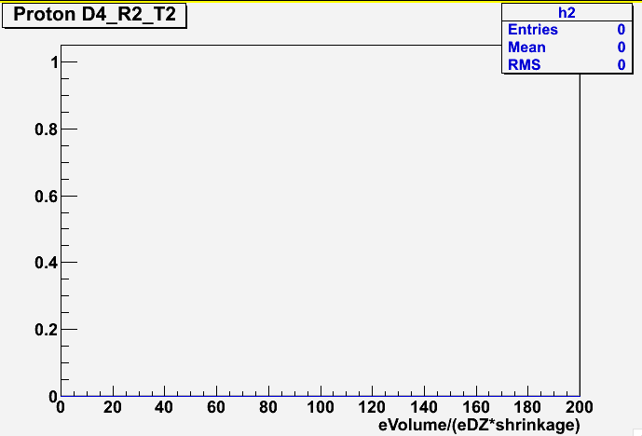
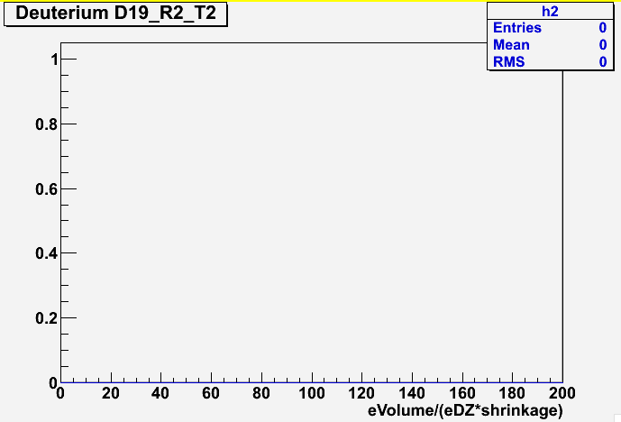
Refreshing@lns
filter
9x9
No refreshing
Refreshing 28°C
ERASED
ERASED
Refreshing 34°C
ERASED
ERASED
Refreshing 36°C
ERASED
ERASED

Slide 22
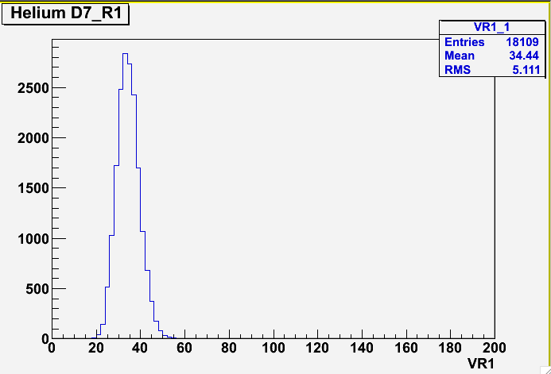
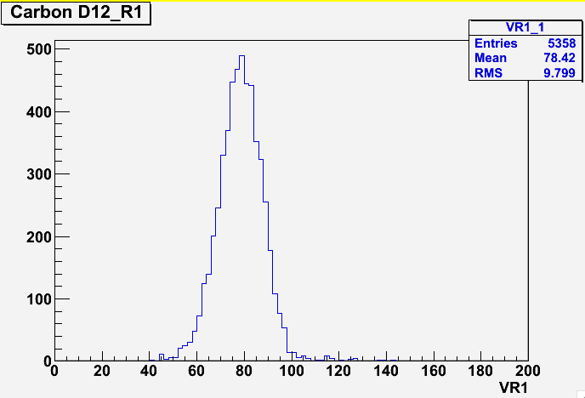
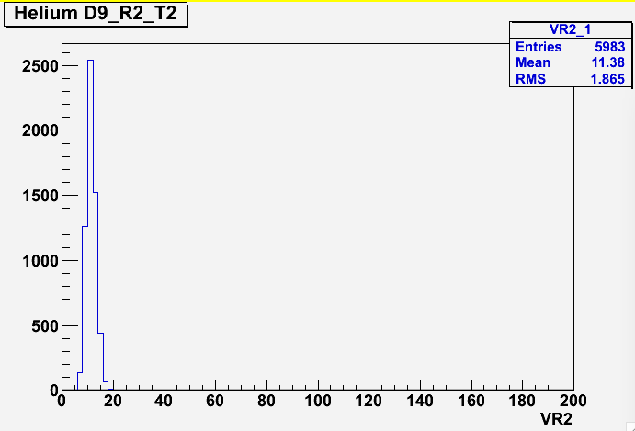
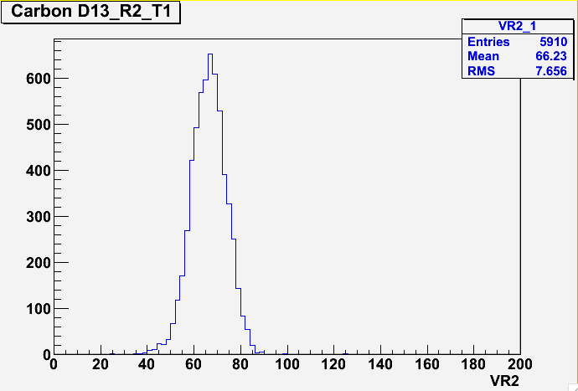
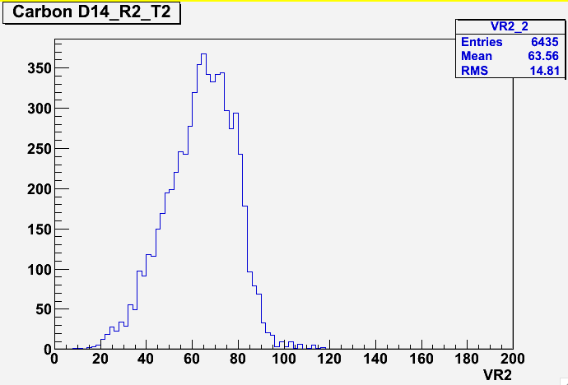
Refreshing@lns
filter
5x5
Refreshing 28°C
Refreshing 34°C
Refreshing 36°C

Slide 23
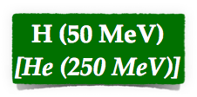
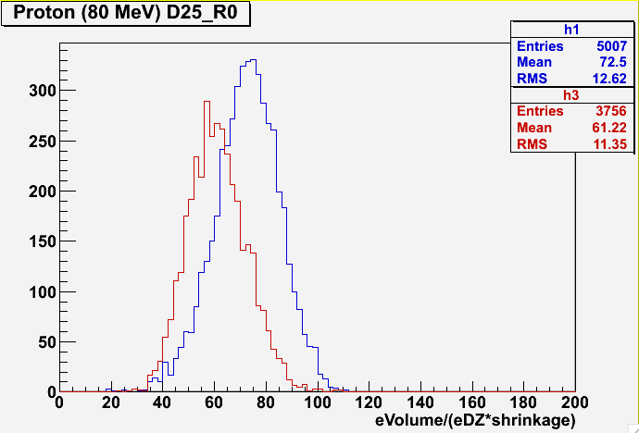
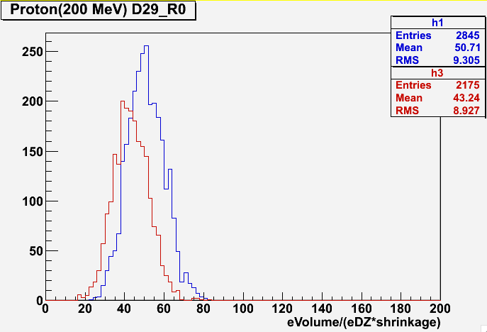
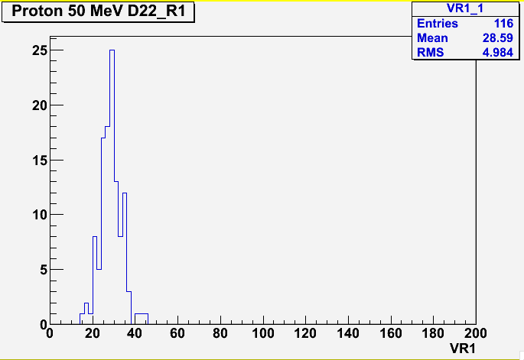
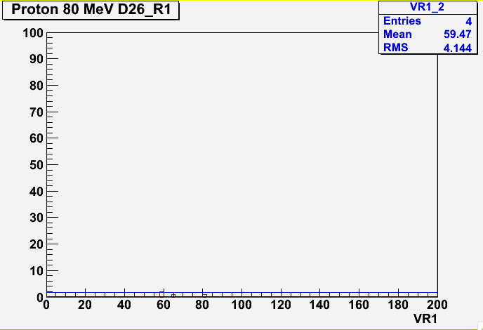
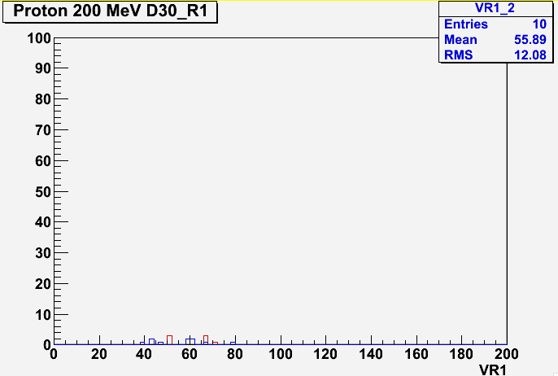
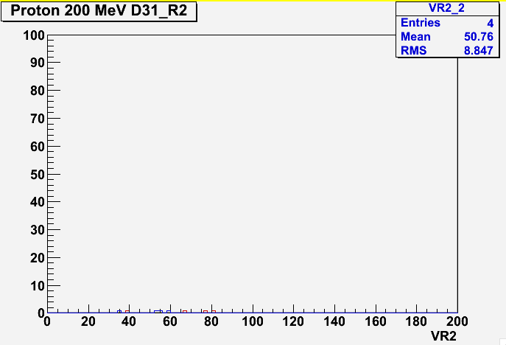
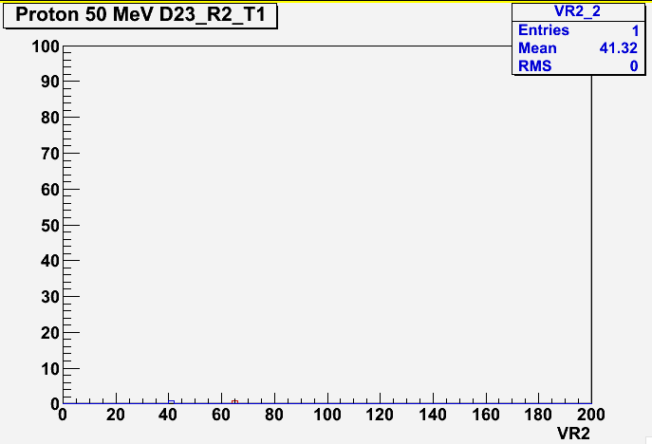
filter
5x5
Refreshing@tn
Signal
No refreshing
Cosmic rays
Refreshing 28°C
ERASED
ERASED
Refreshing 34°C
ERASED
ERASED
ERASED

Slide 24
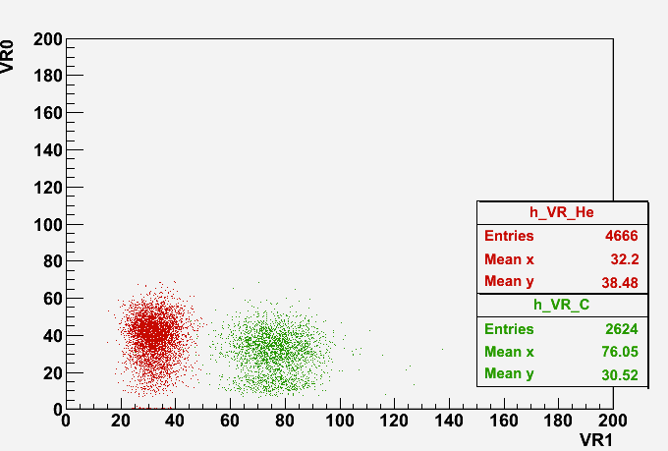
Charge separation at 80 MeV/n
VR0: volume with no refreshing
VR1: volume with refreshing at 28°C
VR2: volume with refreshing a 34°C
He
C
C
He
to be
published

Slide 25
Test beam @LNS: isotopic identification
Motivation:
Develop and test with data an algorithm for isotopic identification
Exposure of two ECC chambers to H and D at the same energy (80 MeV)
ECC1
H
(80 MeV/u)
21 nuclear emulsion films
20 stainless steel planes 0.5 mm-thick (X0 = 1.76 cm)
Surface: 5x4 cm²
ECC1 exposed to H (80 MeV/u)
ECC2 exposed to He (80 MeV/u)
ECC2
D
(80 MeV/u)

Slide 26
Emulsion analysis: P measurement
Angular deflections in passive layers due to Multiple Coulomb Scattering show a gaussian distribution centered in zero with a sigma
Proportional to 1/pβ
H
(80 MeV/u)
D
(80 MeV/u)

Slide 27
risultato sul fascio, non sulle particelle(DA FARE)
Emulsion analysis: P measurement
Preliminary estimation of pβ from “standard” OPERA algorithm [1] that assumes the fitted track not to lose energy during its path
Expected 1/pβ: 0.0068 MeV⁻¹
Measured 1/pβ: 0.008±0.003 MeV⁻¹
Expected 1/pβ: 0.0034 MeV⁻¹
Measured 1/pβ: 0.004±0.002 MeV⁻¹
Combination of momentum measurement by range and MCS (both dependent on the mass of the particle) could provide isotope identification
[1] N. Agafonova et al. Momentum measurement by the Multiple Coulomb Scattering method in the OPERA lead emulsion target. New J. Phys., 14:013026, 2012

Slide 28
Next step: Exposure@GSI
When: November 2018
Beam: He @700 MeV/u
Exposure:
ECC with stacks 1, 2 and 3
Surface of exposed emulsion samples: 12x10 cm²
Shift along x and y axes to have the beam uniformity distributed on the ECC surface (particle density < 1000 particles/cm²)
Beam particles orthogonal to emulsion surface
front view
He Beam
sliding up to touch the beam monitor

Slide 29
Exposure@GSI: movement
Exposure Movement:
The emulsion set up will be XY remotely controlled to avoid pile-up
The emulsion movement must be tuned according to the beam parameters (impact point, rate, beam width) measured by the start counter and the beam monitor
The distance ∆y between two raws, covered during the inter-spill time, must be 3 times the size of the beam spot
stage speed along the x axis
moving pattern in the xy plane
vx
y
ramp
up
spill
ramp
down
∆y=3 σbeam spot
tearly start
tstop
t
x
tspill start
tspill stop

Slide 30
Exposure@GSI: simulation studies
Simulation: beam and detector set-up
optimization of the number of films in each section/stack of the ECC
He
Start Counter
Beam Monitor
ECC detector

Slide 31
Simulation: tentative ECC detector set-up
Fluka driven
⁴He, 700 MeV/u, 2000 events
Start Counter and Beam Monitor as for FOOT “standard” set-up
Stack 1: 30 emulsion films interleaved with 29 carbon layers 1 mm thick
Stack 2: 27 emulsion films
Stack 3: 30 emulsion films interleaved with 29 lead layers 1 mm thick
to be optimised
He
SECTION 1
SECTION 3
SECTION 2

Slide 32
Simulation: beam particle characterisation
N° ⁴He absorbed before ECC=0.2%
N° ⁴He absorbed in stack1=15.2%
N° ⁴He absorbed in stack2=2.3%
N° ⁴He absorbed in stack3=18.9%
stack 1
stack 2
stack 3

Slide 33
Simulation: particle fragmentation
N° protons = 81%
N° ³He = 4%
N° ³H = 4%
N° ²H = 2%
𝝅^{+ ,}𝝅— = 9%

Slide 34
Simulation: secondary from He
Energy distribution and angular distribution of secondary particles from He beam (contained inside ECC)
nuclear evaporation

Slide 35
Simulation: proton component
from beam fragmentation
nuclear evaporation

Slide 36
Materials
Carbon 1 mm thick
25 foils
Other to buy
2) Poliethilene
50 foils
Bent: maybe 2 mm thick?

Slide 37
Conclusions
Results from test beam exposures
Test beam @LNS in July 2017
Test beam @Trento in December 2017
Saturation effects established thanks to a new filter
Charges separation
Momentum measurement by MCS compatible with expectations
Simulation
Preliminary analysis for exposure at He beam (700 MeV/u @GSI)
Next step
Detector optimisation for exposure at He beam (700 MeV/u @GSI)
New algorithms for isotope identification to be developed

Slide 38
Simulation: proton characterisation
proton x-y position in S3

Slide 39
Refreshing effects: summary
LNS
TN
DELIVERED | H (80 MeV/u) | D (80 MeV/u) | He (80 MeV/u) | C (80 MeV/u) |  | H (50 MeV/u) | H (80 MeV/u) | H (200 MeV/u)
EQUIVALENT TO |  |  | Li (200 MeV/u) |  |  | He (200 MeV/u)
R0
R1 28°C
R2 34°C
Definition of working point for R1:
28°C,
98% relative humidity,
24 h
VISIBLE
VISIBLE
partial degradation
Definition of working point for R2:
34°C,
98% relative humidity,
24 h
NOT VISIBLE

