Slide 1
IV FOOT COLLABORATION MEETING
June 4-5/2018, La Biodola, Isola D’Elba, Italy
http://agenda.infn.it/event/FOOT4
foot@pi.infn.it

Slide 2
Aknowledgments
Lucia Lilli, INFN Pisa, meeting secretariat
Mauro Giannini, INFN Pisa, computing and network
Giacomo Betti, INFN Pisa, web site management

Slide 3
Network
An eduroam wifi network will be available in all meeting areas
As an alternative, you can access to the INFN WiFi internet connection. Please, ask Lucia Lilli at the registration desk for credentials.

Slide 4
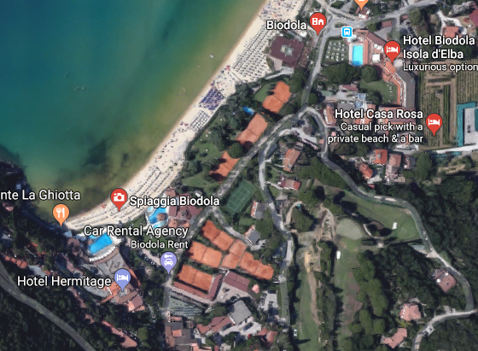
Lunch Tuesday 5th, Grill Restaurant «Fuoco di Bosco»
Social Dinner, Hotel Biodola, 8:30 PM
Coffee Breaks, Bonaparte Room terrace

