Slide 1


Some issues on magnets
G. Battistoni
On behalf of many others

Slide 2
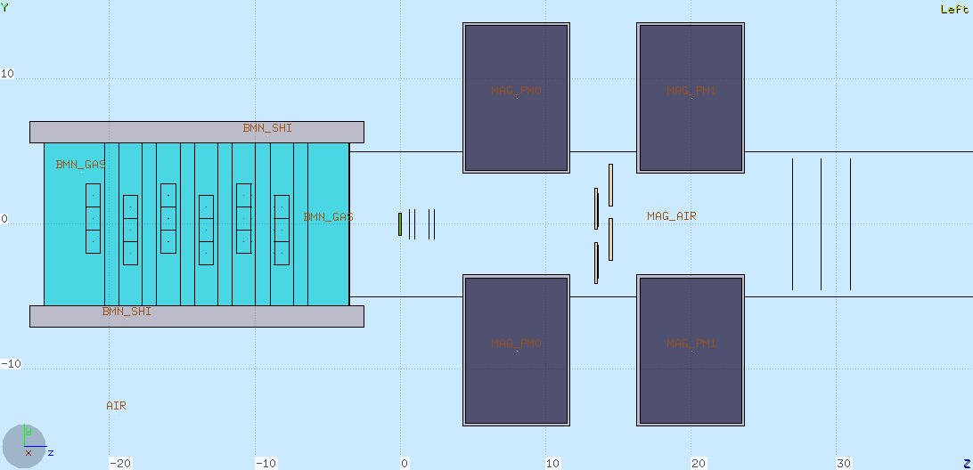
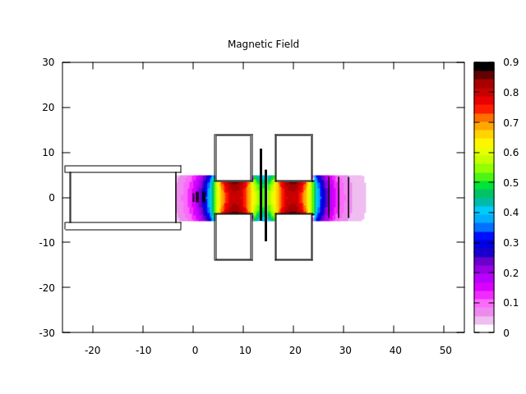
Studies in view of magnet definition: V14.0
- Single magnes length 7 cm
- Center-to-center distance of magnetes: 12 cm

Slide 3
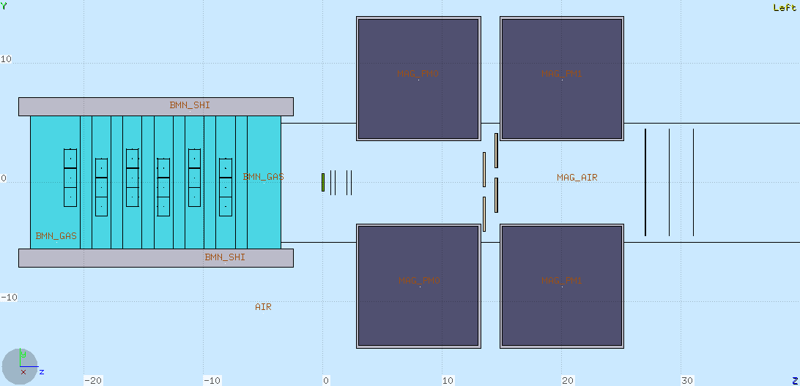
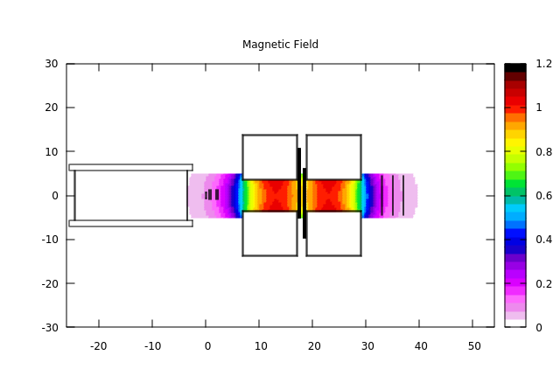
V14.1
- Single magnet length 10 cm
- Center-to-center distance of magnetes: 12 cm (gap btw magnets ~2cm, not realistic)

Slide 4
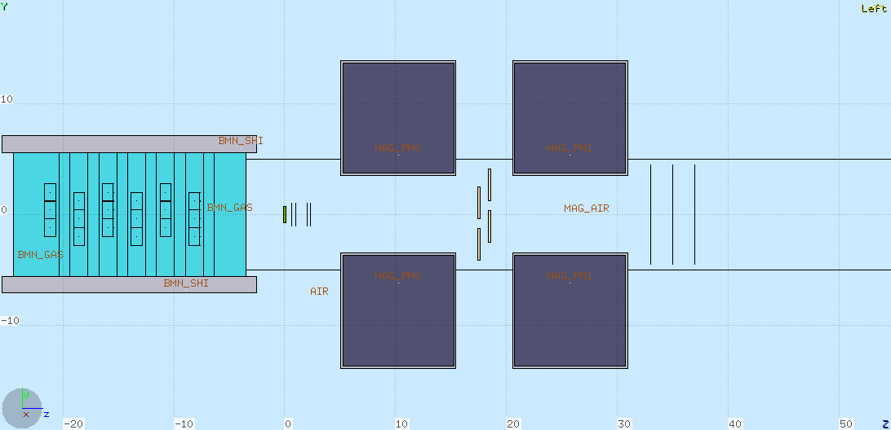
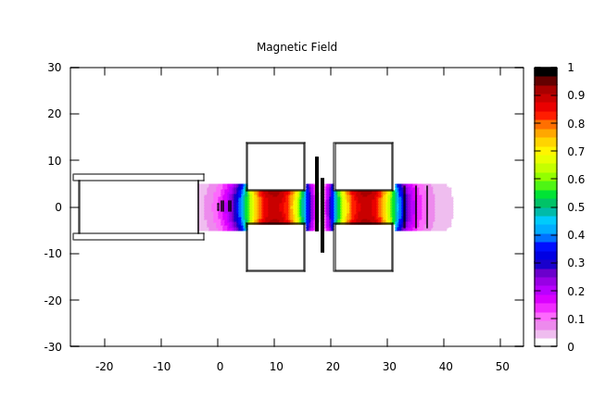
V14.2
- Single magnet length 10 cm
- Center-to-center distance of magnetes: 15 cm, gap ~5 cm, as recommended after FOOT Mech Meeting
- ITR and MSD shifted downstream

Slide 5
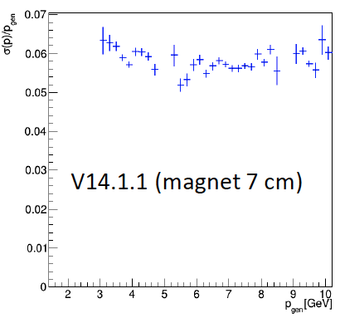
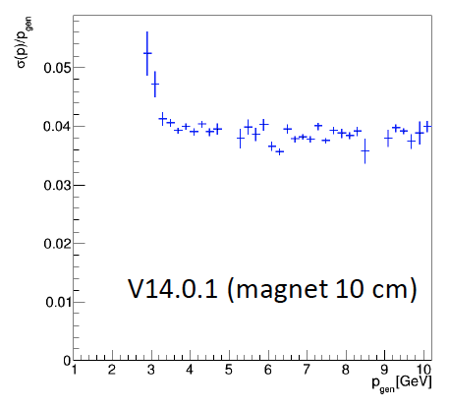
Importance of B•dl: improvement in p resolution with 10 cm magnet (M. Franchini et al.)

Slide 6
Momentum resolution for higher energies

Slide 7
Some issues recently emerged which could affect the expected performance:
Magnetic deflection and possible loss of detector acceptance in the downstream region
Longer magnets: how to recover angular acceptance
Effect of uncertainties in the knowledge of magnetic map (position, alignement,…)
Stability of B field of permanent magnets and radiation damage
Actual resolution along z coordinate of Intermediate Tracker

Slide 8
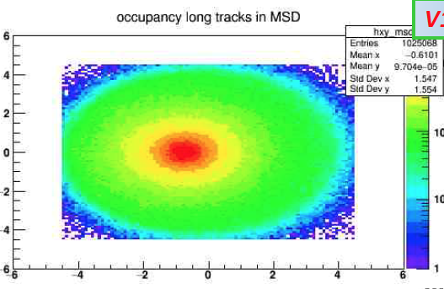
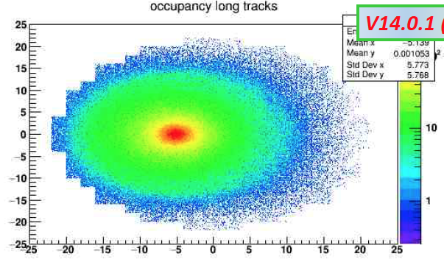
Deflection in the case of 2 magnets with aligned B: possible loss of efficiency (R. Spighi)
MSD: Shift -0.7 cm
Calo: Shift -5.1 cm

Slide 9
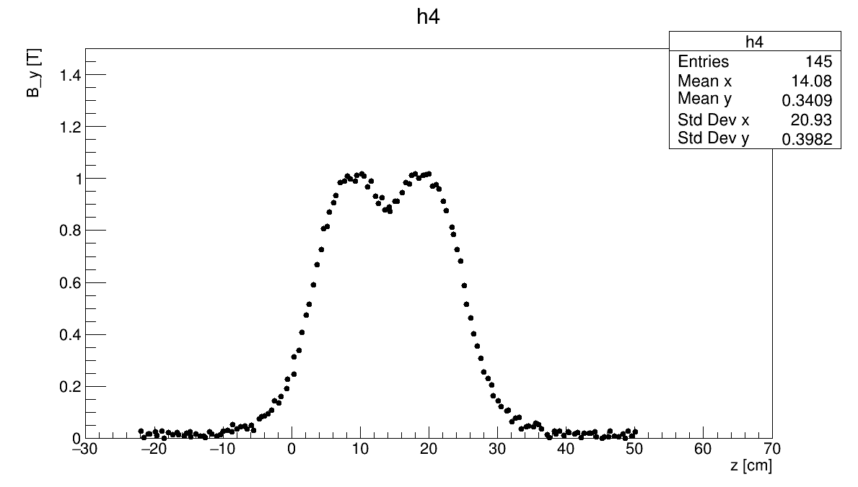
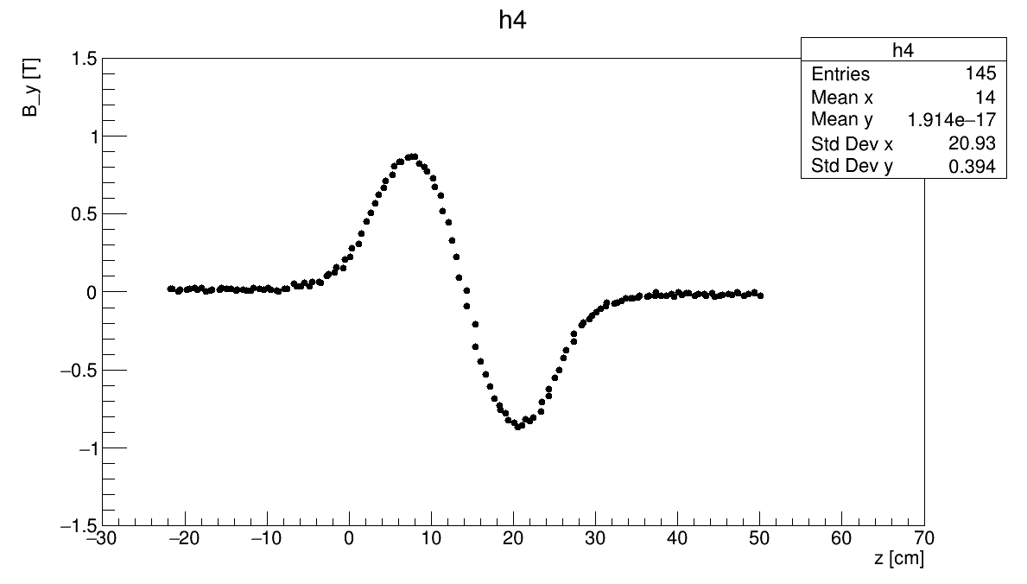
Possible alternatives for the field orientation of the two magnets
2nd magnet with same magnetic field orientation as 1st magnet
2nd magnet with opposite magnetic field orientation with respect to 1st magnet
On TIER3:
/gpfs_data/local/foot/Simulation/V14.2
16O_C2H4_200_1.root (10⁷ primaries)
Under investigation
On TIER3:
/gpfs_data/local/foot/Simulation/V14.2inv
16O_C2H4_200_1.root (10⁷ primaries)

Slide 10
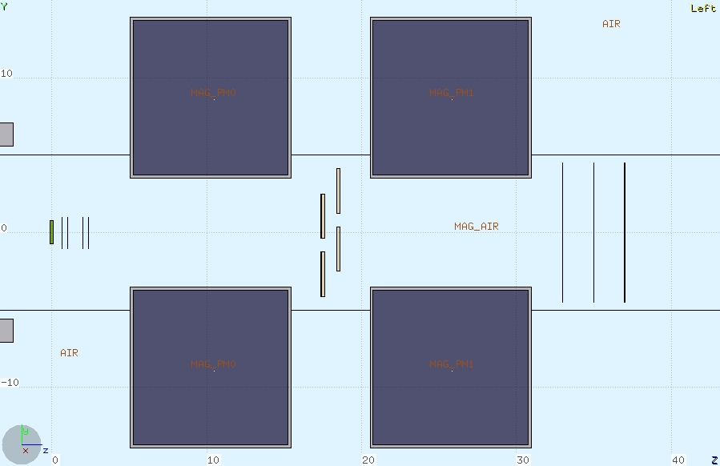
Angular acceptance vs Magnetic Lenght vs Tracking Detector Size
Having kept constant to r~3.5 cm the radius of the magnet bore reduces semi-aperture of the cone to ~ 6.4°
In order to recover 10°
semi-aperture we would need r~ 5.5 cm
But this would be useless with MSD size of 9x9 cm²
d ~7 cm
L ~31 cm

Slide 11
A possible suggestions for MSD in case of larger diameter of magnet bore:
Increase number of detector layers from 3 to 4, alternating the following 45° rotation (L. Servoli):
2 point coverage
4 point coverage
The mimimum diameter of the circle covering at least 2 points is ~10.6 cm

Slide 12
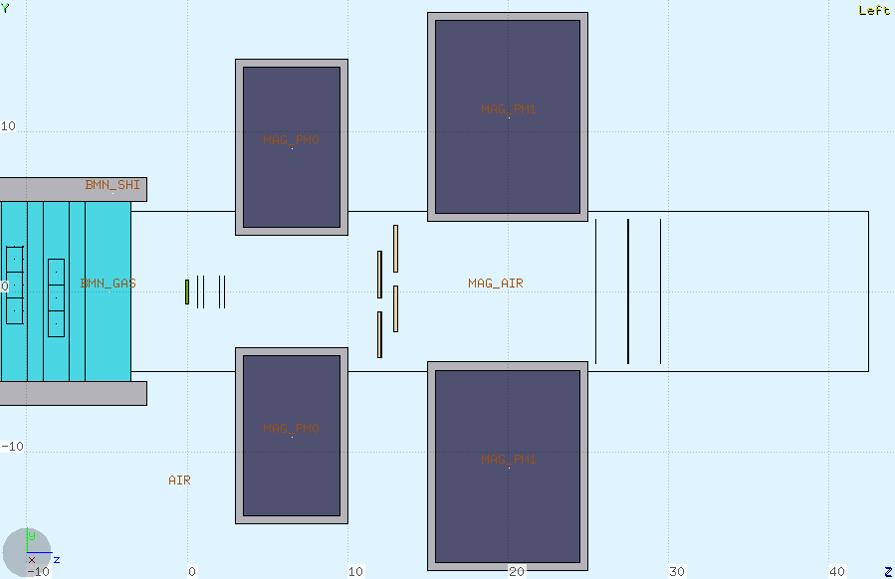
Alternative magnet design:
Here the gap can be even made smaller!
Two different magnets
Warning:
maybe we loose something in B•dl
L ~25 cm
d ~8.8 cm
Reduced material and cost
Reduced extension of fringe field
MSD can be placed as close as possible to the exit of magnets

Slide 13
Initial studies on the uncertainties on mag field (Mi+Bo)
500 µm uncertainty on Intermediate Tracker long coordinate: no significant effect on resolution. A small bias in momentum reconstruction
1 degree disalignment between the two magnets: no significant effect
Alternate alignement of magnets
Systematic error in magnetic map coordinates
Different studies still in progress

Slide 14
Smearing tests (M. Franchini)
Gaussian random smearing on the magnetic field
components read from the magnetic map
Position not smeared

Slide 15
Radiaton Damage in Permanent Magnets
We have been recently made aware that permanent magnet may suffer magnetization variations under irradiation (For ex.: M. Schanz et al «High energy proton induced radiation damage of rare earth permanent magnet quadrupoles», Rev. Sci. Instr. 88 (2017) 125103)
Some literature available: mostly related to e.m. radiation but also to neutrons and in few cases to protons
Apparently the damage is ~independent from the nature of radiation. It is of course related to dose/fluence in the magnet
Mainly two different materials: Nd-Fe-B and Sm-Co. The latter (our initial choice) is reported to be much more radiation resistant
For a review: A.J. Samin «A review of radiation induced demagnetization of permanent magnets», Journal of Nuclear Materials 503 (2018) 42-55
Specific paper on 200 MeV protons: Ito et al, NIM B183 (2001) 323)

Slide 16
SmCo magnet
Neutron fluence:
it seems that SmCo magnets can tolerate up to 10²⁰ n/cm²
NdFeB magnets
A more careful study is however recommended
Should we organize an irradiation test on a sample?

Slide 17
Dose in the magnets. Preliminary simulation study
¹⁶O beam @ 200 MeV/u, (SmCo magnets)
Dose maps in cylindrical coordinates (integrated in Phi)
All hadrons
Neutron contribution
Scale is in GeV/g/primary. To get Gy multiply by 1.602 10⁻⁷
The integral is 8.8 10⁻¹¹ Gy/primary in the first magnet and 1.2 10⁻¹⁰ Gy/primary in the second. Neutron contribution is ~4%
Considering runs with 10⁷ - 10⁸ primaries we shoul be on the safe side…
However: not fully realistic environment, no beam halo has been considered!

Slide 18
Fluence in the magnets. Preliminary simulation study
All hadrons
Neutron contribution
Scale is in particles/cm²/primary.

