Slide 1
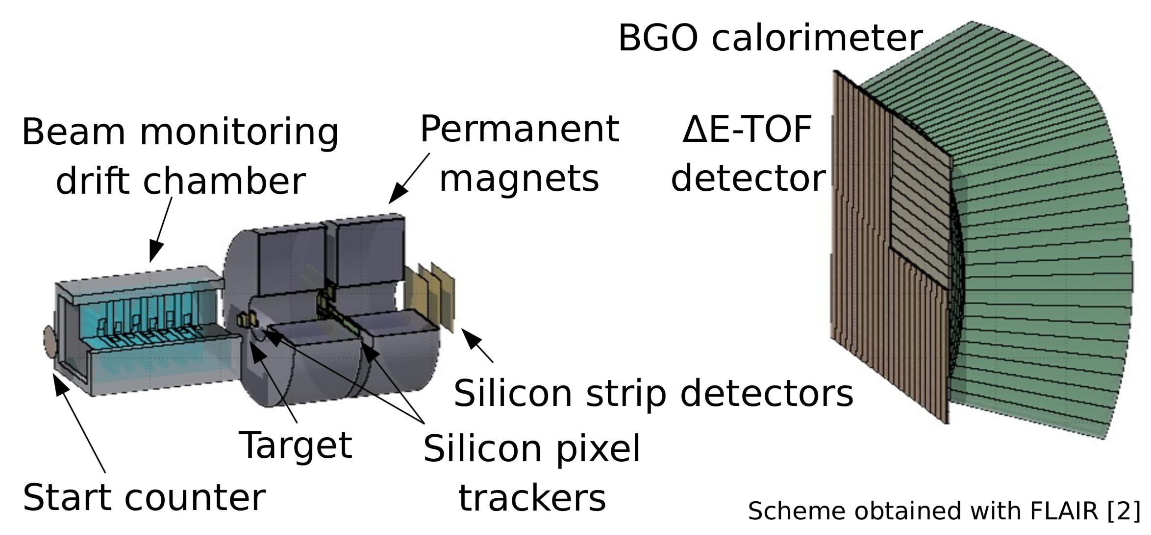
ΔE-TOF analysis check and updates on TDAQ
Luca Galli and Patrizia De Maria,
INFN Sezione di Pisa and Pisa University
La Biodola 04-06-201

Slide 2
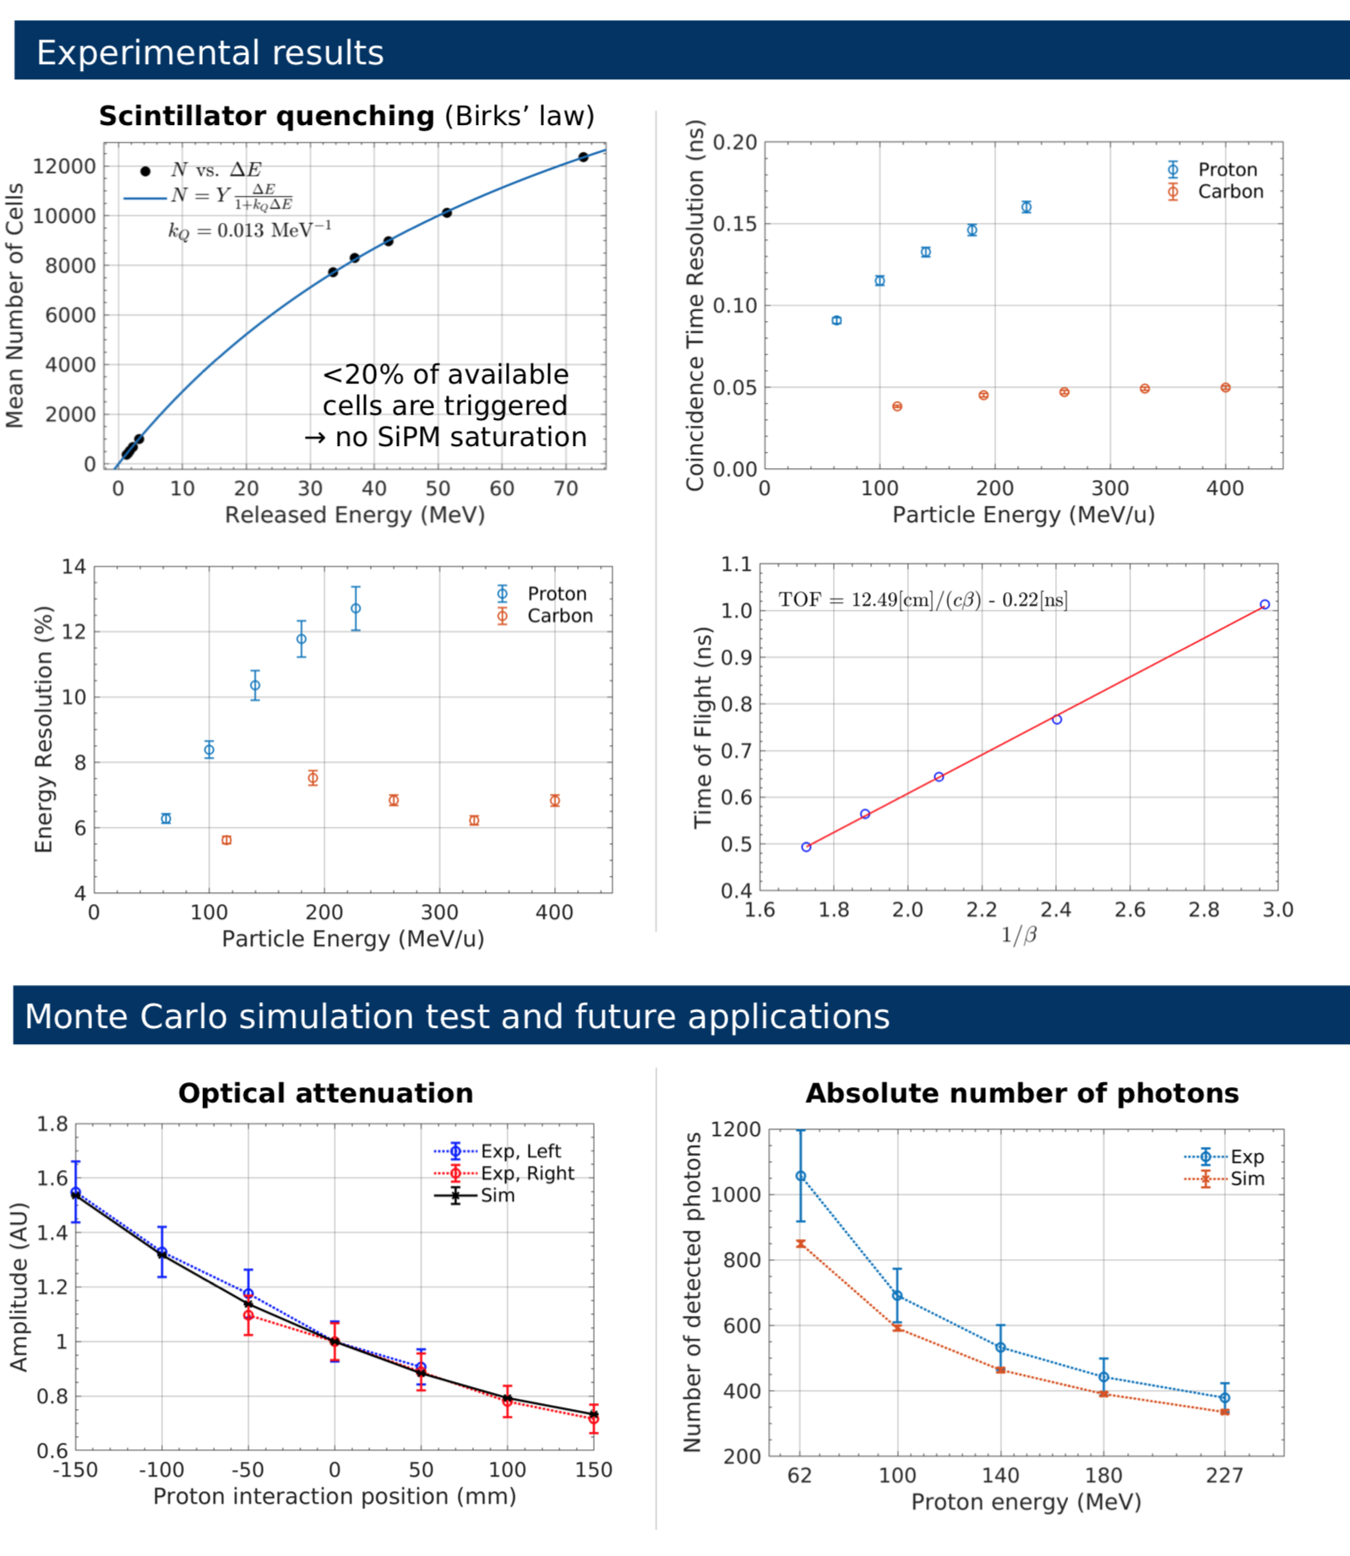
Aim
Double check of previous results
“different” people and reconstruction algorithms
Reconstruction code implementation in C++/ROOT
Ciarrocchi’s
poster at
Pisa Meeting 2018

Slide 3
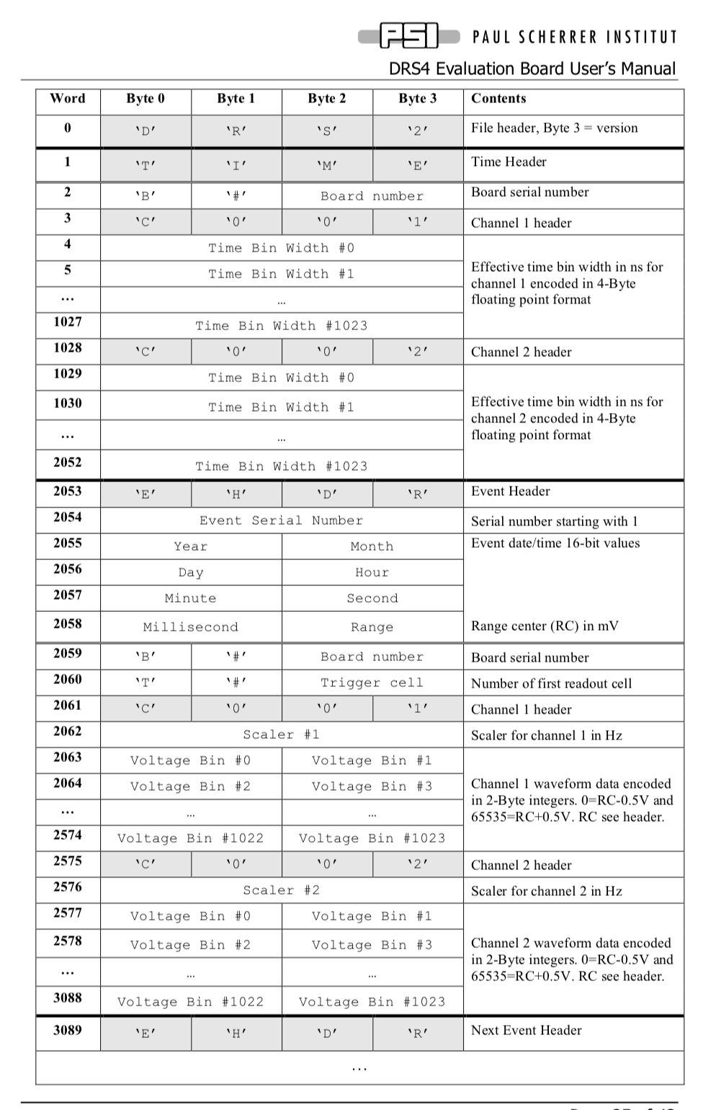
Data format
C++ macro to decode to waveforms in root format
to be copied and adjusted in SHOE
#include <string.h>
#include <stdio.h>
#include "TFile.h"
#include "TTree.h"
#include "TString.h"
#include "TGraph.h"
#include "TCanvas.h"
#include "Getline.h"
typedef struct {
char tag[3];
char version;
} FHEADER;
typedef struct {
char time_header[4];
} THEADER;
typedef struct {
char bn[2];
unsigned short board_serial_number;
} BHEADER;
typedef struct {
char event_header[4];
unsigned int event_serial_number;
unsigned short year;
unsigned short month;
unsigned short day;
unsigned short hour;
unsigned short minute;
. . . .

Slide 4
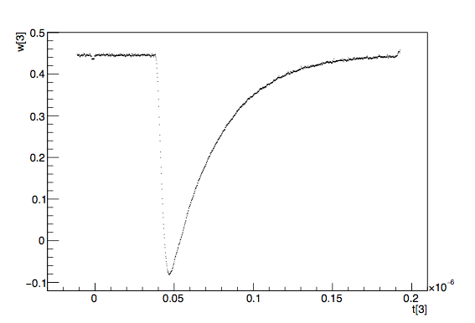
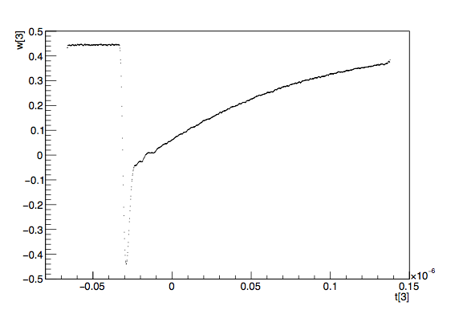
Waveform processing
A waveform is two arrays
an array of double for voltages
an array of double for times
charge (energy )and times (CTR, beta…) from WFM processing
HAMAMATSU
ADVANSID

Slide 5
Charge
pedestal

Slide 6
Charge
charge from full
wfm integration

Slide 7
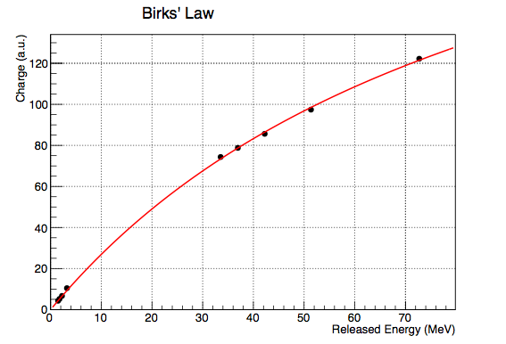
Saturation curve
Measured energy corrected for the saturation
k ~1.3 10^-2
Charge linearised to compensate for saturation accordingly

Slide 8
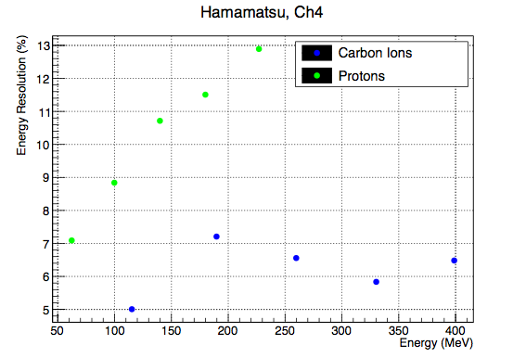
Energy resolutions
Compatible with previous results

Slide 9
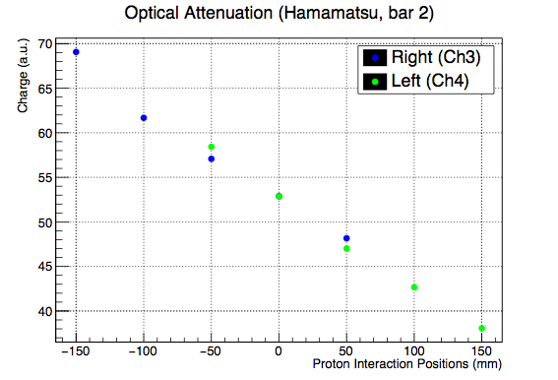
L/R light propagation

Slide 10
Raw time estimator
fixed threshold 5 sigma larger than noise
time from the first sample lower than the threshold
suffers from several issues:
time walk
binning quantisation (see next slide)
…

Slide 11
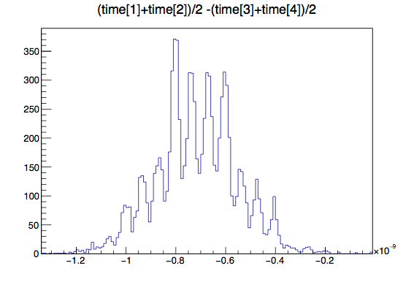
Binning quantisation
definition

Slide 12
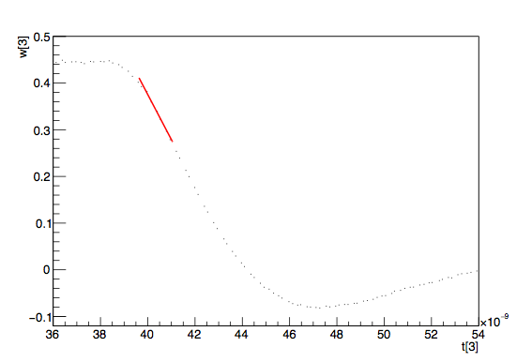
Best time estimator
Time walk —> constant fraction discriminator
Bin quantisation —> linear fit around crossing point

Slide 13
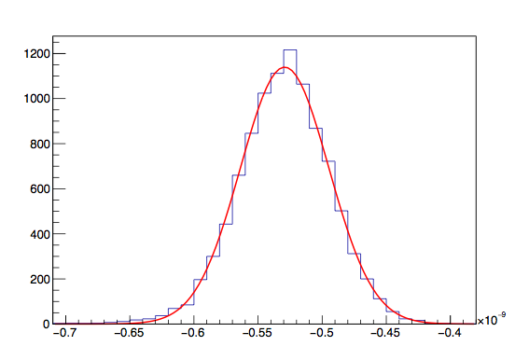
“New” gaussian
more stable gaussian
looks a good estimator (without asymmetric tails)

Slide 14
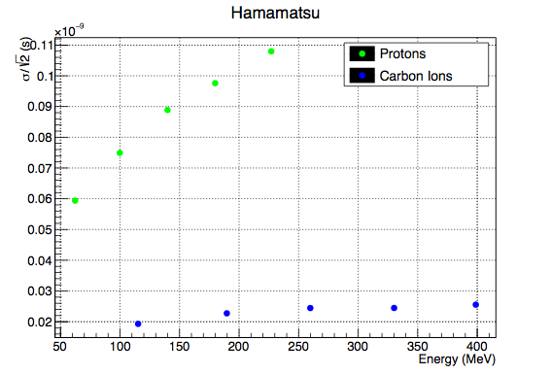
Time resolution @CNAO

Slide 15
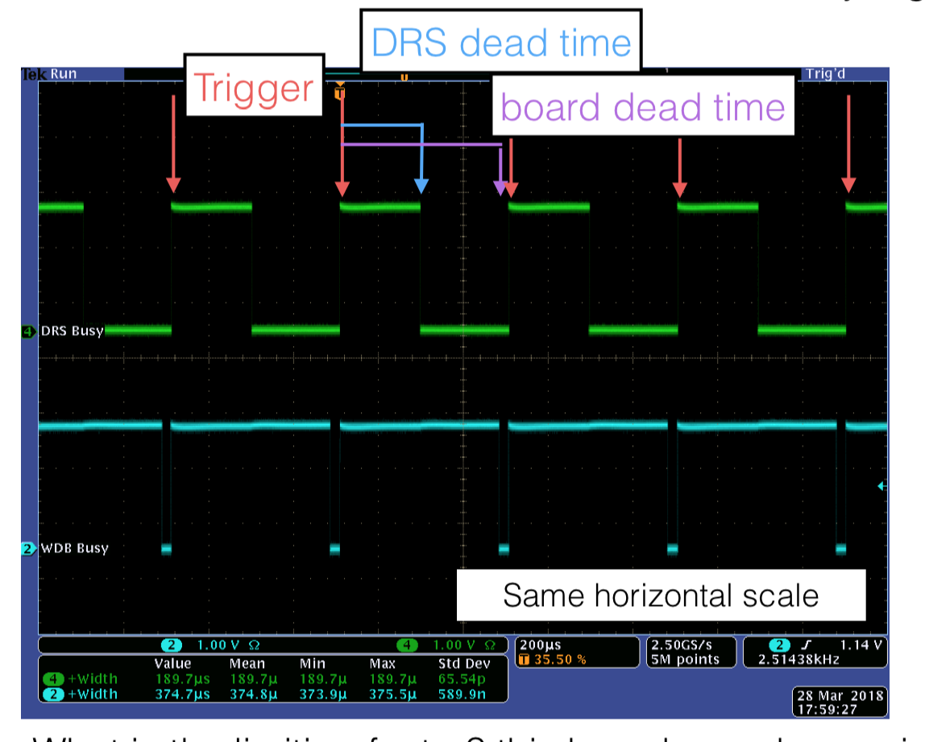
Stand alone DAQ performance
Stand alone DAQ to manage two WDBs and one TCB
2 sources of deatime
DRS read out: ~180µsec
WFMs packaging: ~200µsec
total: ~380 spec —> 2.5kHz
In our test we had a full read out of 32 DRS WFMs, not far from FOOT situation (with 0 suppression)
the goal of 1 kHz DAQ with minimum bis trigger looks OK

Slide 16
Conclusions
a C++/root based reconstruction SW has been developed
compatible performance w.r.t. to other code
ready for being implemented in SHOE
Stand alone DAQ SW for the WDAQ readout developed
read out speed OK
to be implemented in the FOOT TDAQ
both HW and SW optimisation needed

