Slide 1


Status of Simulation and
Physics Performances Studies
G. Battistoni
On behalf of many others

Slide 2
Simulation Update: V14
Geometry of Electronic Setup fully handled by the SHOE software: (S. Valle + M. Franchini)
in /Simulation/foot_geo.h → constants, positions, distances, etc
in /libs/src/TADETbase/TADETparGeo.cxx and .h → methods to write geometry for each detector (both root and FLUKA geo)
/Simulation/MakeGeo.cxx → main code that produces FLUKA geo (recalls methods described in the libraries).
In this way the reconstruction software is ready to reconstruct the events with the same geo used to produce simulations
Of course from now on the management of simulation geometry is less immediate and some dedicated training is necessary

Slide 3
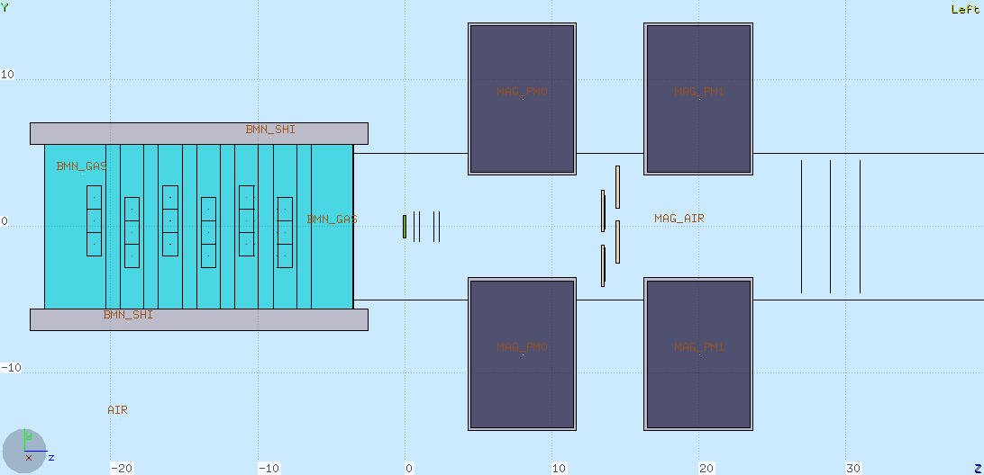
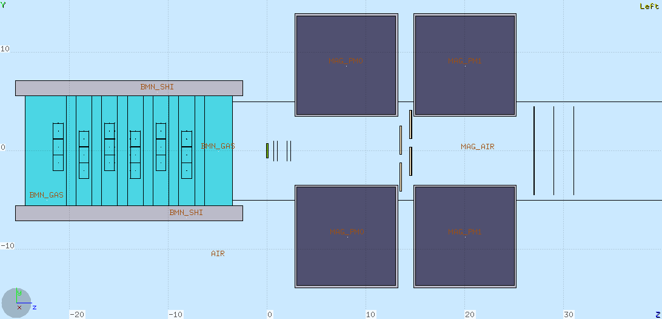
Studies in view of magnet definition
V14.0
- Single magnes length 7 cm
- Center-to-center distance of magnetes: 12 cm
V14.1
Single magnet length 10 cm
Center-to-center distance of magnets: 12 cm (gap btw magnets ~2cm, not realistic)

Slide 4
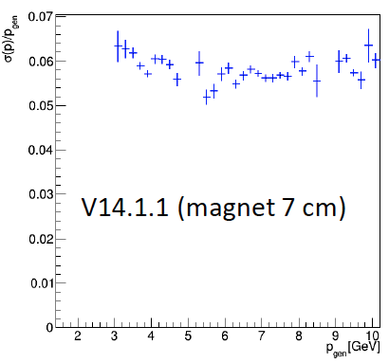
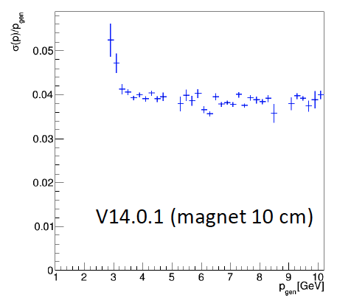
Importance of B•dl: improvement in p resolution with 10 cm magnet (M. Franchini et al.)

Slide 5
Momentum resolution for higher energies

Slide 7
Impact of detector resolution

Slide 8
Impact of detector resolution

Slide 9
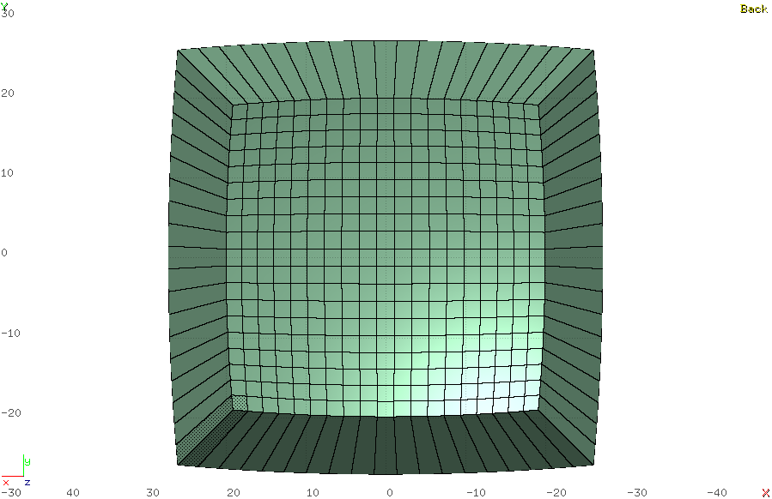
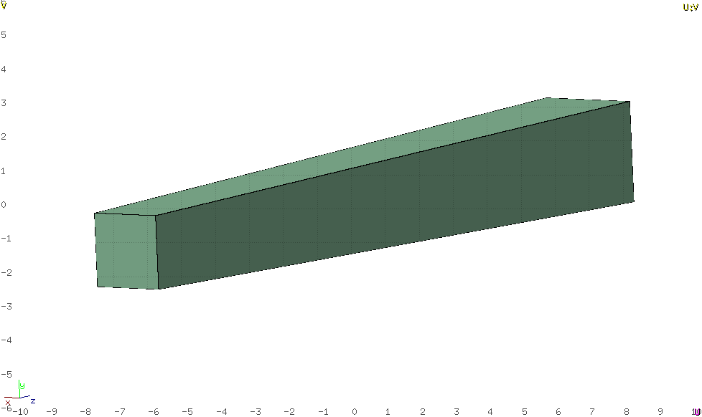
New BGO Crystals (truncated pyramid)
Initial guess: to be modified!!!
(see yesterdays’s talk about calo)
3.0 x 3.0 cm²
The most simple Calorimeter Design:
19x19 crystal matrix
24 cm
2.2 x 2.2 cm²
Some specific simulation study is in progress in view of next test beam activity to be performed at CNAO

Slide 10
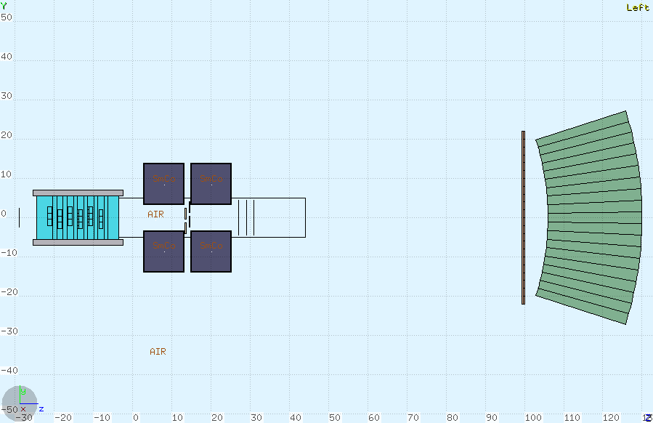
V14.1.2: very first implementation of new calorimeter design in FLUKA geometry
More difficult job: it’s not a simple body in FLUKA, it has
to be built using planes in space.
Mechanical boxes to be considered.
See yesterday’ talk about calo
Classes for SHOE not yet implemented!
On TIER3:
/gpfs_data/local/foot/Simulation/V14.1.2
16O_C2H4_200_1.root (10⁷ primaries)
Aachen prototype @HIT (145 crystals)

Slide 11
Analysis of Aachen prototype results (as presented on May 8, M.Emde & R. Hetzel)

Slide 12
Some issues recently emerged which could affect the expected performance:
Magnetic deflection and possible loss of detector acceptance in the downstream region
Longer magnets: how to recover angular acceptance
Effect of uncertainties in the knowledge of magnetic map (position, alignement,…)
Stability of B field of permanent magnets and radiation damage
Actual resolution along z coordinate of Intermediate Tracker

Slide 13
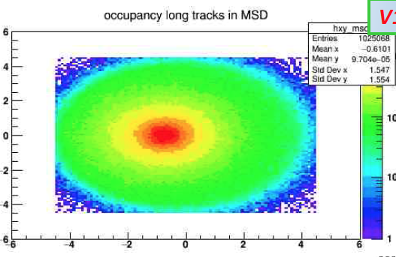
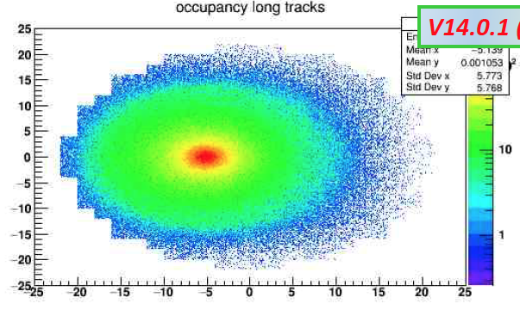
Deflection in the case of 2 magnets with aligned B: possible loss of efficiency (R. Spighi)
MSD: Shift -0.7 cm
Calo: Shift -5.1 cm

Slide 14
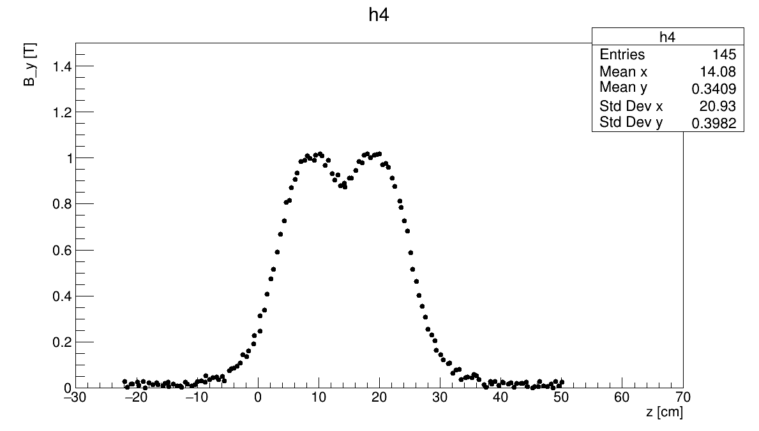
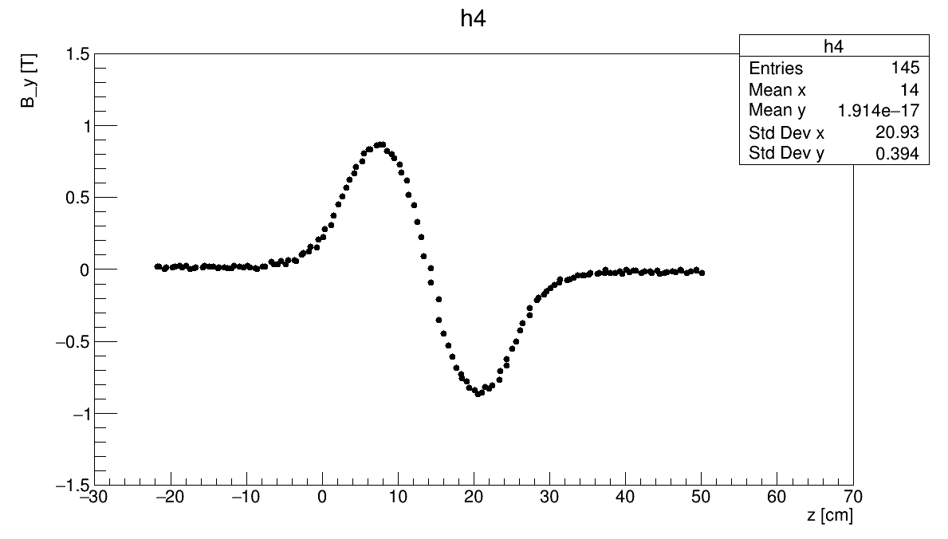
Possible alternatives for the field orientation of the two magnets
2nd magnet with same magnetic field orientation as 1st magnet
2nd magnet with opposite magnetic field orientation with respect to 1st magnet
On TIER3:
/gpfs_data/local/foot/Simulation/V14.2
16O_C2H4_200_1.root (10⁷ primaries)
Under investigation
On TIER3:
/gpfs_data/local/foot/Simulation/V14.2inv
16O_C2H4_200_1.root (10⁷ primaries)

Slide 15
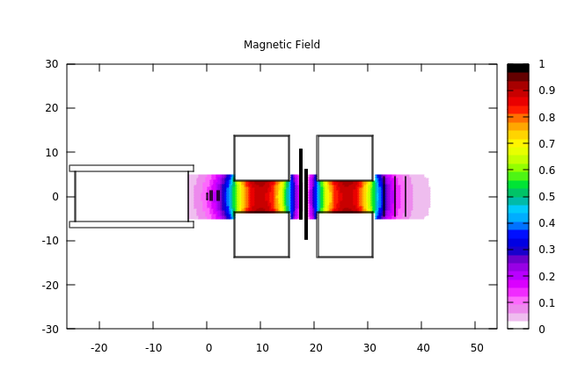
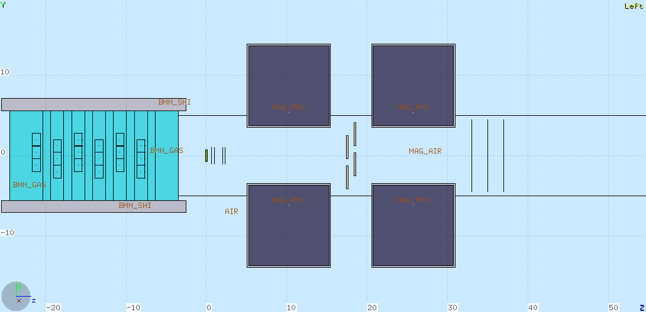
V14.2
- Single magnet length 10 cm
- Center-to-center distance of magnetes: 15 cm, gap ~5 cm, as recommended after FOOT Mech Meeting
- ITR and MSD shifted downstream
Suddenly we realize a problem…

Slide 16
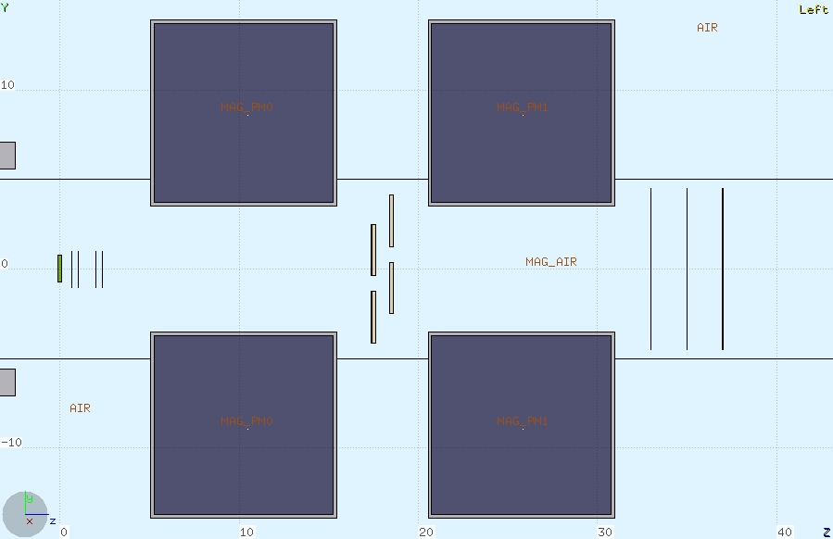
Angular acceptance vs Magnetic Lenght vs Tracking Detector Size
Having kept constant to r~3.5 cm the radius of the magnet bore reduces semi-aperture of the cone to ~ 6.4°
In order to recover 10°
semi-aperture we would need r~ 5.5 cm
But this would be useless with MSD size of 9x9 cm²
d ~7 cm
L ~31 cm

Slide 17
A possible suggestions for MSD in case of larger diameter of magnet bore:
Increase number of detector layers from 3 to 4, alternating the following 45° rotation (L. Servoli):
2 point coverage
4 point coverage
The mimimum diameter of the circle covering at least 2 points is ~10.6 cm

Slide 18
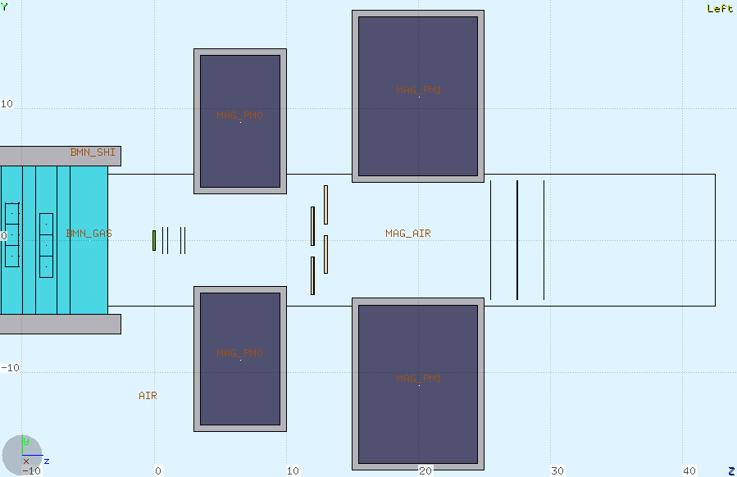
Alternative magnet design:
Here the gap can be even made smaller!
Two different magnets
Warning:
maybe we loose something in B•dl
L ~25 cm
d ~8.8 cm
Reduced material and cost
Reduced extension of fringe field
MSD can be placed as close as possible to the exit of magnets

Slide 19
Initial studies on the uncertainties on mag field (Mi+Bo)
500 µm uncertainty on Intermediate Tracker long coordinate: no significant effect on resolution. A small bias in momentum reconstruction
1 degree disalignment between the two magnets: no significant effect
Alternate alignement of magnets
Systematic error in magnetic map coordinates
Different studies still in progress

Slide 20
Smearing tests (M. Franchini)
Gaussian random smearing on the magnetic field
components read from the magnetic map
Position not smeared

Slide 21
Radiaton Damage in Permanent Magnets
We have been recently made aware that permanent magnet may suffer magnetization variations under irradiation (For ex.: M. Schanz et al «High energy proton induced radiation damage of rare earth permanent magnet quadrupoles», Rev. Sci. Instr. 88 (2017) 125103)
Some literature available: mostly related to e.m. radiation but also to neutrons and in few cases to protons
Apparently the damage is ~independent from the nature of radiation. It is of course related to dose/fluence in the magnet
Mainly two different materials: Nd-Fe-B and Sm-Co. The latter (our initial choice) is reported to be much more radiation resistant
For a review: A.J. Samin «A review of radiation induced demagnetization of permanent magnets», Journal of Nuclear Materials 503 (2018) 42-55
Specific paper on 200 MeV protons: Ito et al, NIM B183 (2001) 323)

Slide 22
SmCo magnet
Neutron fluence:
it seems that SmCo magnets can tolerate up to 10²⁰ n/cm²
NdFeB magnets
A more careful study is however recommended
Should we organize an irradiation test on a sample?

Slide 23
Dose in the magnets. Preliminary simulation study
¹⁶O beam @ 200 MeV/u, (SmCo magnets)
Dose maps in cylindrical coordinates (integrated in Phi)
All hadrons
Neutron contribution
Scale is in GeV/g/primary. To get Gy multiply by 1.602 10⁻⁷
The integral is 8.8 10⁻¹¹ Gy/primary in the first magnet and 1.2 10⁻¹⁰ Gy/primary in the second. Neutron contribution is ~4%
Considering runs with 10⁷ - 10⁸ primaries we shoul be on the safe side…
However: not fully realistic environment, no beam halo has been considered!

Slide 24
Fluence in the magnets. Preliminary simulation study
All hadrons
Neutron contribution
Scale is in particles/cm²/primary.

Slide 25
Study of Fragmentation in Scintillator (A. Kraan)
Z=5, A=10
Z=6, A=12
Plane 1
Fragmentation vs bar thickness
Plane 2
Plane 1 or 2
Fragmentation grows with thickness
Small thickness (3 mm):
+ less fragmentation
Landau shape for Z=1, 2, 3 at all energies (not shown)
Large thickness (6 mm):
More fragmentation
More expensive
+ More gaussian shape: Z=4 already ok
Z=7, A=14
Z=8, A=16

Slide 26
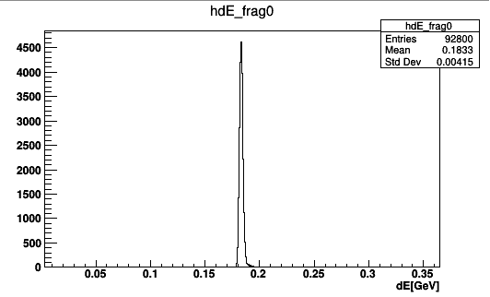
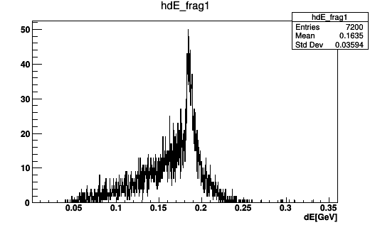
Fragmentation vs bar thickness
Compare energy deposition in scintillator for events with and without primary fragmentation
Z=8, A=16, E=200 MeV/n, d=6 mm
Events with primary fragmentation
Events with no primary fragmentation
Deposits are much more variable, can be up to 250 MeV (but rare)

Slide 27
Fragmentation vs energy
Z=5, A=10
Z=6, A=12
Plane 1
Plane 2
Plane 1 or 2
Z=7, A=14
Z=8, A=16

Slide 28
Simulation of the optical transport in the scintillator bars (E. Ciarrocchi)
Comparison with experimental data:
● Optical attenuation with proton interaction position along the bar
● Absolute number of detected photons
● Exp data for two scintillator bars and for two types of SiPMs
● Comparison only for protons

Slide 29
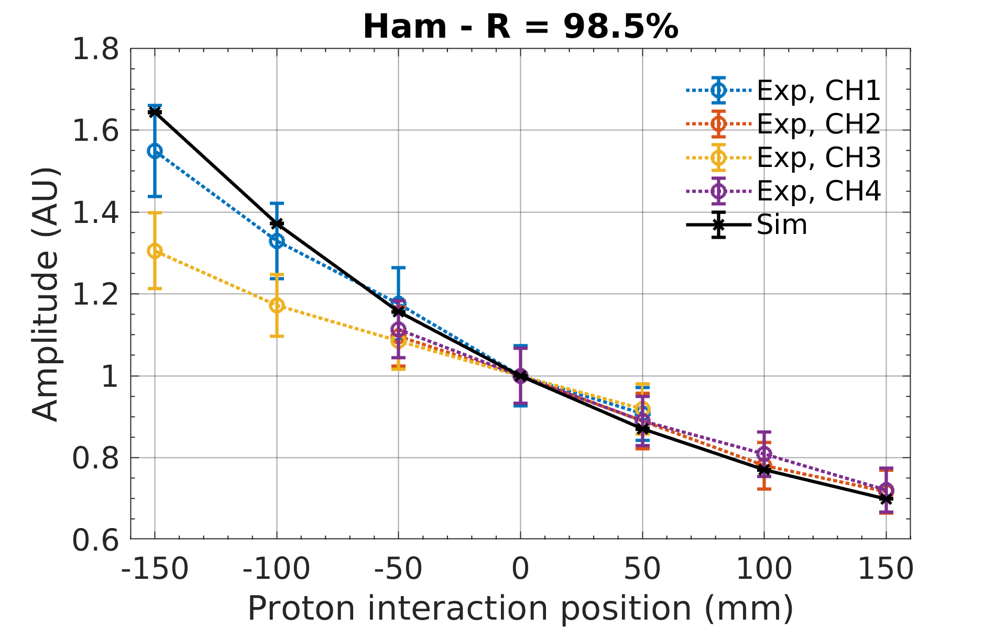
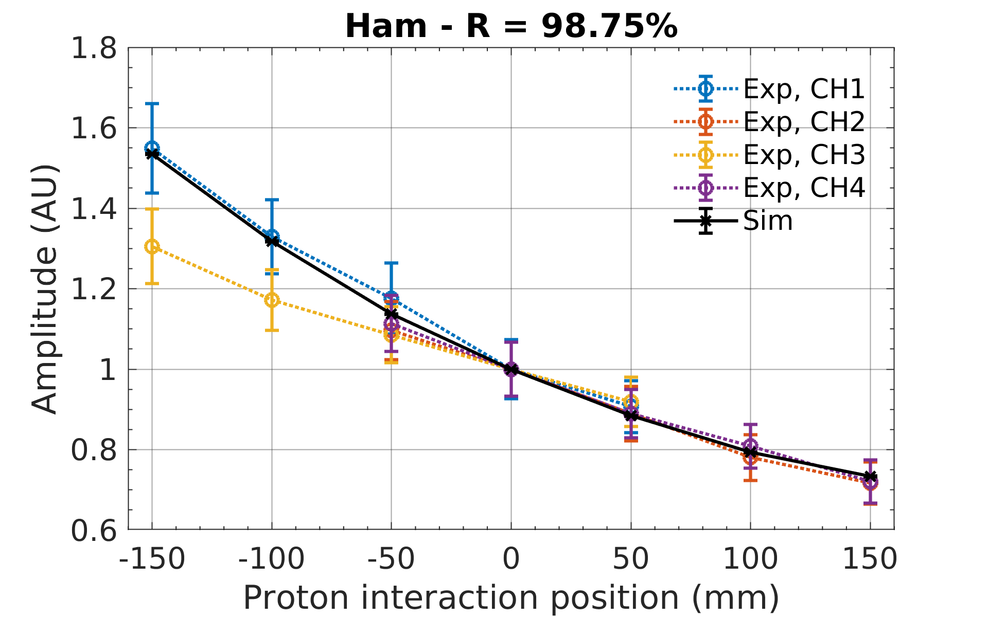
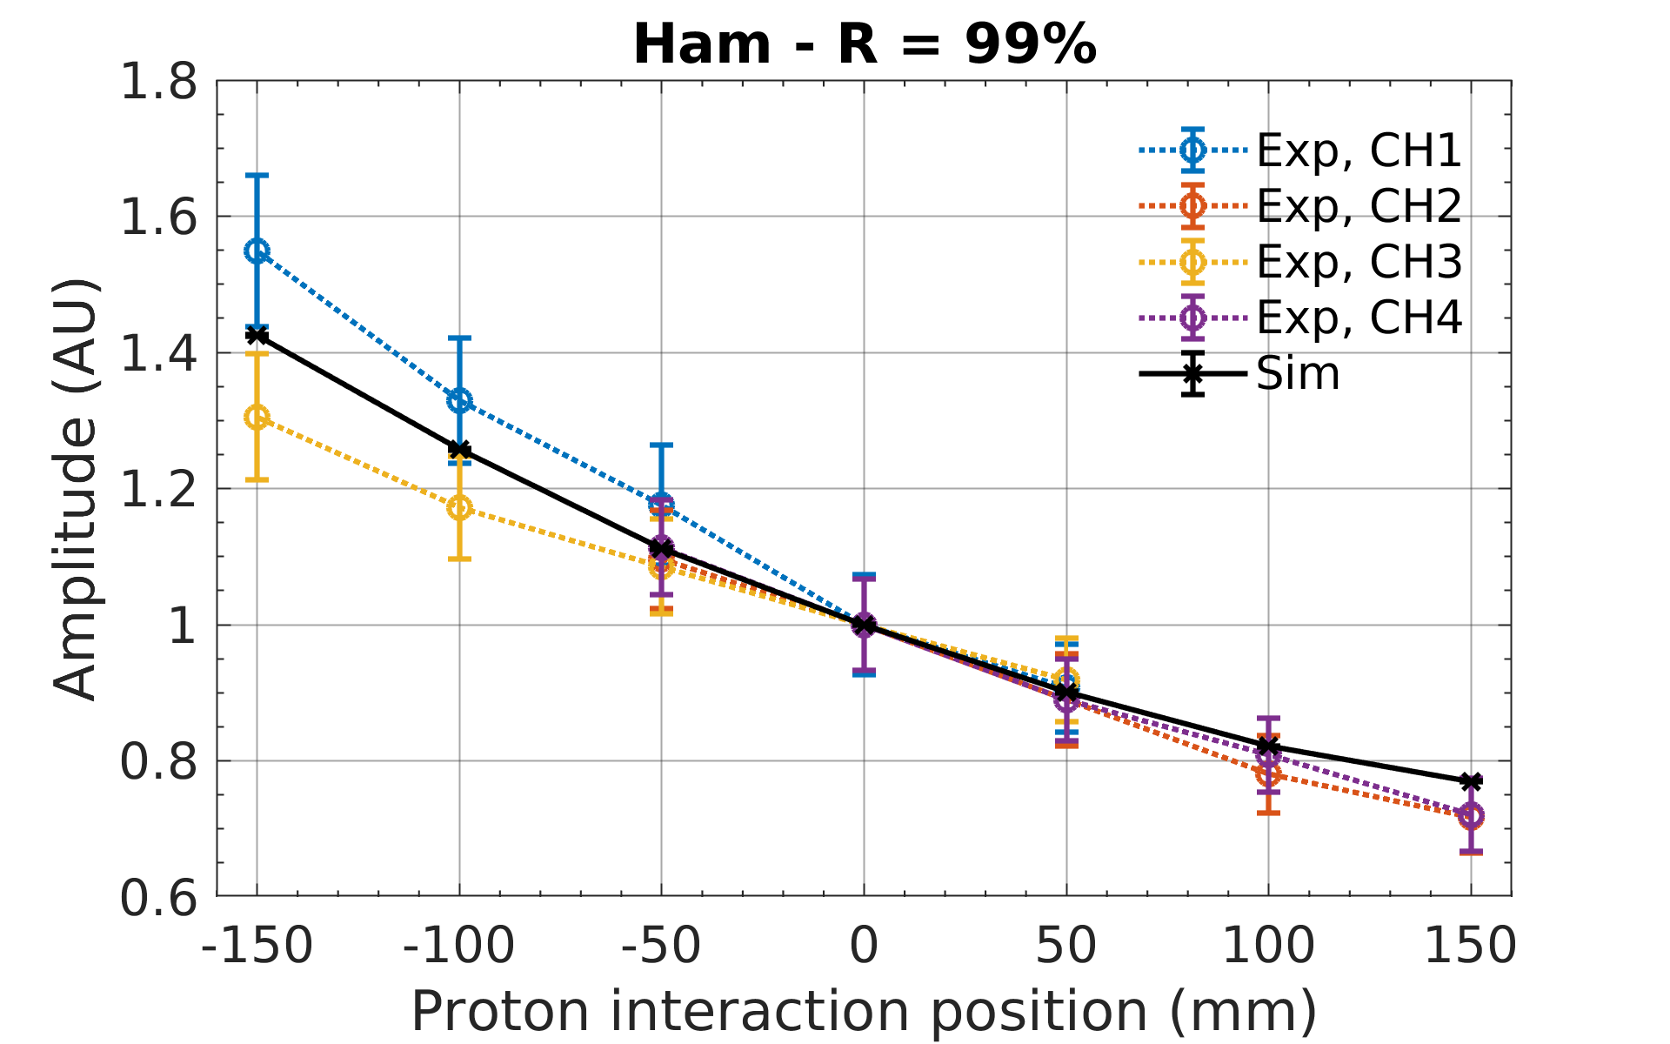
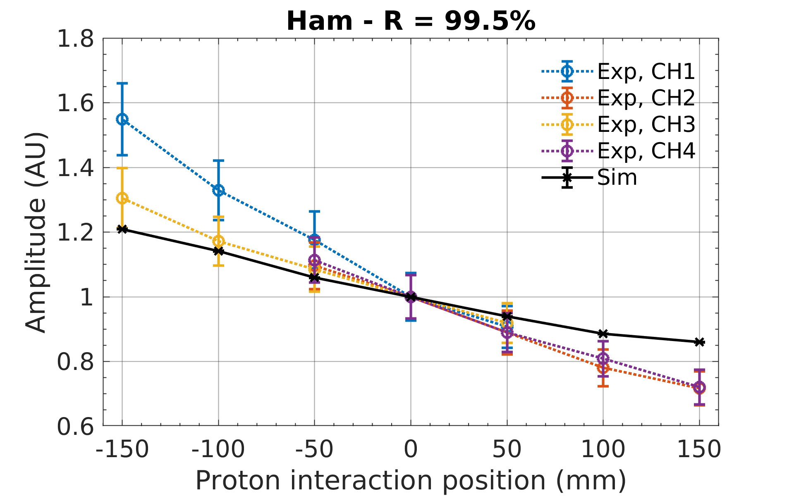
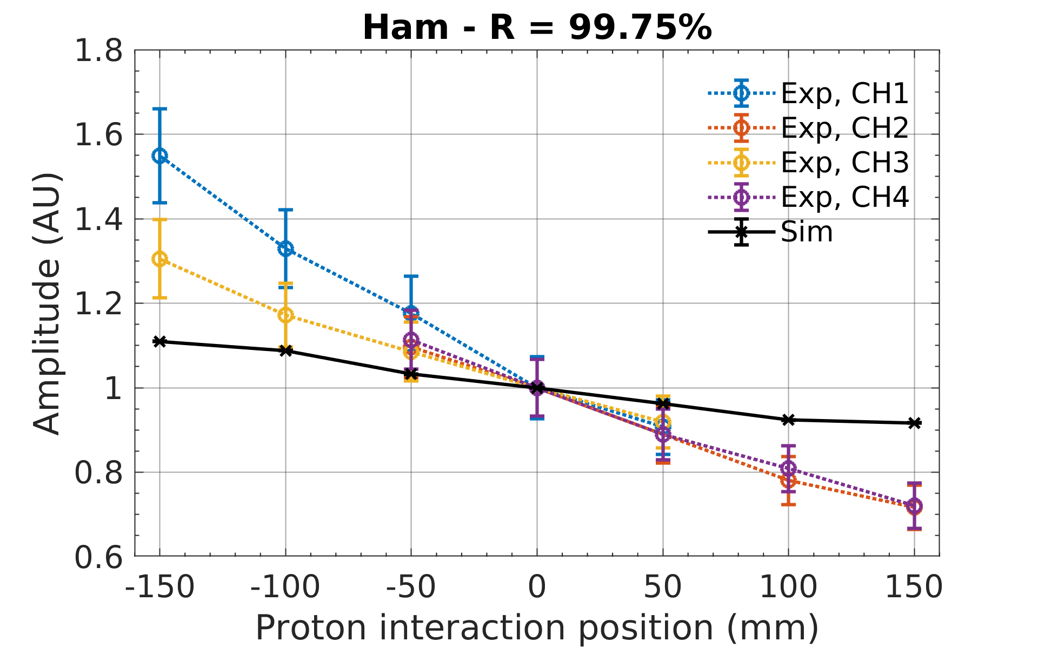
Optical attenuation: Hamamatsu
R = bar reflection coefficient

Slide 30
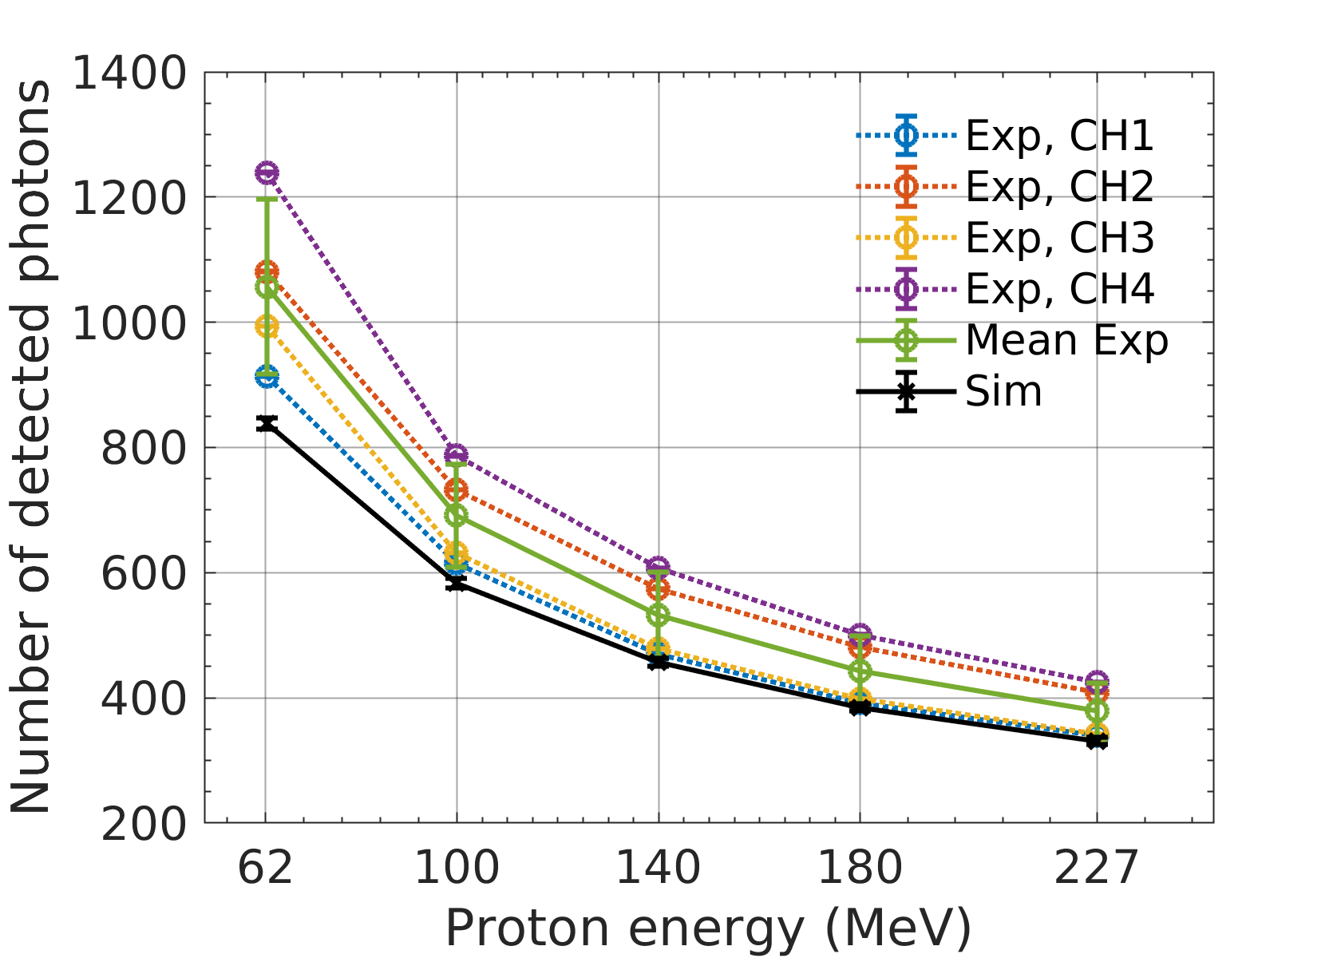
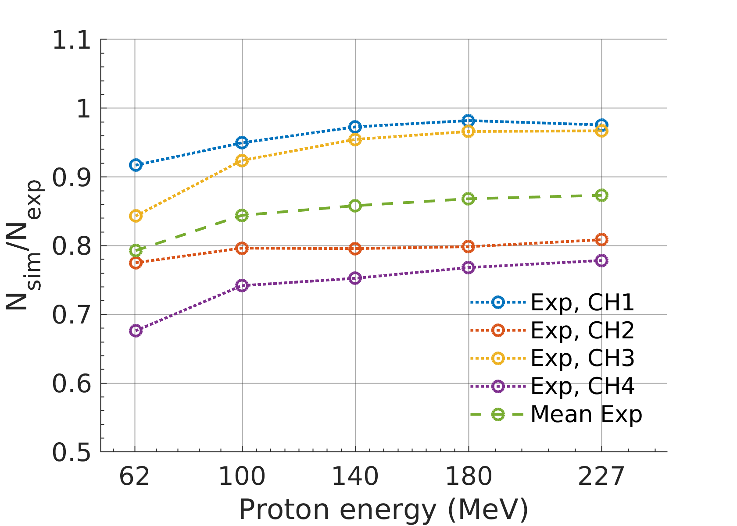
Absolute number of photons (Hamamatsu)
Only Hamamatsu
Simulation does not account for noise factors
High uncertainty on gain used to determine exp nr of photons

Slide 31
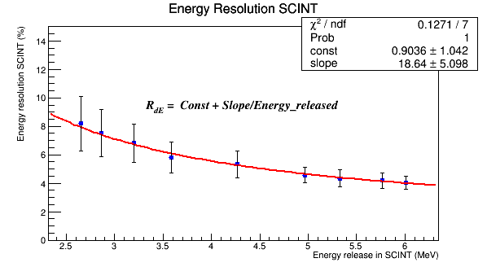
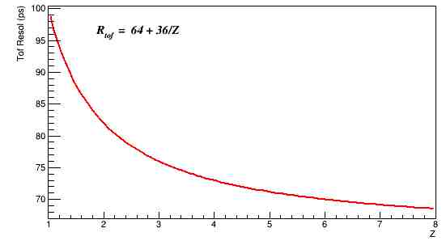
Summary of Studies of FOOT Performance on charge reconstruction and Fragment Identification
(R. Spighi et al.)
INPUT DATA
  4x10⁷ primaries
  Projectile: ¹⁶O (200 MeV/u)
  Target: C₂H₄ (2mm)
  Selected tracks that pass all the subdetectors
INPUT RESOLUTIONS:
  Momentum (tracking) → 4.5%
  Kinetic Energy (Calo) → 1.5%
  Tof : [70:100] ps depending on Z
  ΔE (scint): [3:10]% depending on energy released
Tof
ΔE

Slide 32
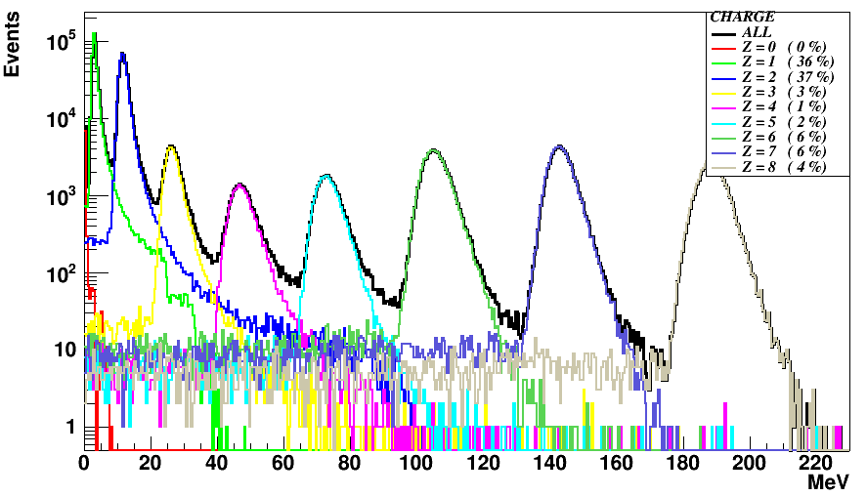
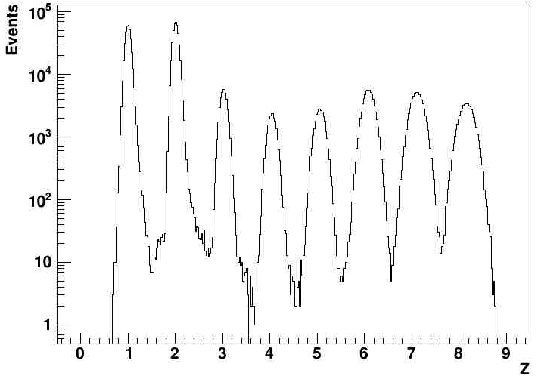
SCN
Z reconstruction
TOF
energy deposited in SCN
reconstructed Z
Z Resolution
¹H | ⁴He | ⁷Li | ⁹Be | ¹¹B | ¹²C | ¹⁴N | ¹⁶O
1 | 2 | 3 | 4 | 5 | 6 | 7 | 8
1.01±0.06 | 2.01±0.06 | 3.02±0.07 | 4.05±0.09 | 5.06±0.10 | 6.09±0.12 | 7.11±0.14 | 8.15±0.16
Resol: 6% 3% 2.0%
Z Resolution: [2-6%] << minimum distance between charges (~10% between 7 and 8)
Charge completely identified (wrong assignment < %), possible to improve with MSD

Slide 33

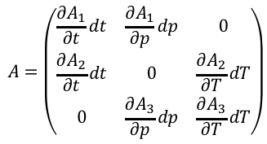


A Identification
TRACKER
TRACKER
CALO
RECO
$$A_{1}=\frac{m}{U}=\frac{p}{U β γ}$$
$$A_{2}=\frac{m}{U}=\frac{E_{kin}}{U\left(γ−1\right)}$$
$$A_{3}=\frac{m}{U}=\frac{p^{2}−{E_{kin}}^{2}}{2E_{kin}}$$
TOF
TOF
FITS
CALO
Standard χ2
$$f= {\left(\frac{\left(tof_{reco}−t\right)}{σ{tof}_{reco}}\right)}^{2}+{\left(\frac{\left(p_{reco}−p\right)}{σp_{reco}}\right)}^{2}+{\left(\frac{\left(T_{reco}−T\right)}{σT_{reco}}\right)}^{2}+ \left(\begin{matrix}A_{1}−A & A_{2}−A & A_{3}−A\end{matrix}\right)\left(\begin{matrix}C_{00} & C_{01} & C_{02} \\ C_{10} & C_{11} & C_{12} \\ C_{20} & C_{21} & C_{22}\end{matrix}\right)\left(\begin{matrix}A_{1}−A \\ A_{2}−A \\ A_{3}−A\end{matrix}\right)$$
$$A=\left(\begin{matrix}\frac{∂A_{1}}{∂t}dt & \frac{∂A_{1}}{∂p}dp & 0 \\ \frac{∂A_{2}}{∂t}dt & 0 & \frac{∂A_{2}}{∂T}dT \\ 0 & \frac{∂A_{3}}{∂p}dp & \frac{∂A_{3}}{∂T}dT\end{matrix}\right)$$
$$C={\left(A∙A^{T}\right)}^{−1}$$
Augmented Lagrangian Method
 | ¹H | ⁴He | ⁷Li | ⁹Be | ¹¹B | ¹²C | ¹⁴N | ¹⁶O
Z | 1 | 2 | 3 | 4 | 5 | 6 | 7 | 8
A | 1 | 4 | 7 | 9 | 11 | 12 | 14 | 16
Studied fragments, one per charge

Slide 34
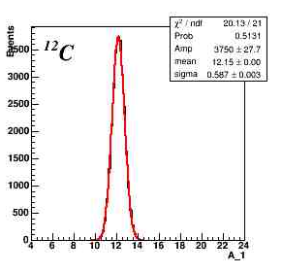
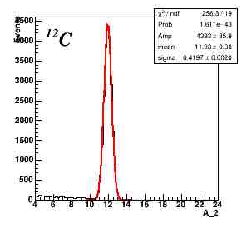
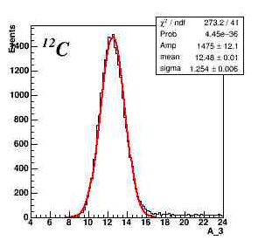
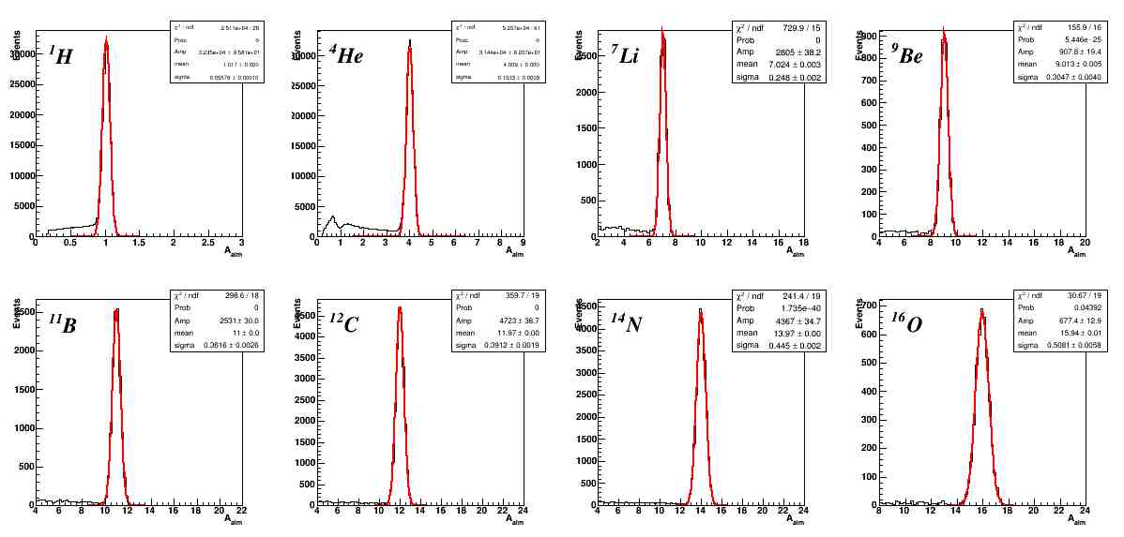
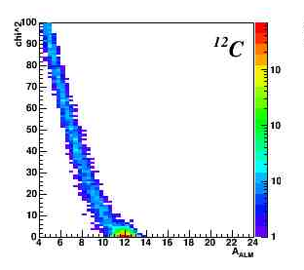
Reconstruction methods
Example: A of ¹²C
A₁
Tof + Tracker:
12.15 ± 0.59
A₂
Tof + Calo
11.93 ± 0.42
A³
Tracker + Calo
12.5 ± 1.3
Fit methods
Cal: Tail due to energy taken away off the calo in nuclear interactins
Χ²
Χ² fit
11.97 ± 0.39
ALM fit
11.97 ± 0.39
Possibility to eliminate the tail with a χ² cut

Slide 35
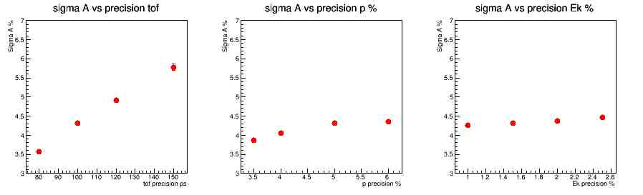
Systematic on A resolution (example ¹²C)
σ_{A} (%) vs Tof precision
σ_{A} (%) vs p precision
σ_{A} (%) vs E_{kin} precision
Resolutions
p = 5%
Ekin = 1.5%
Resolutions
Tof = 100 ps
Ekin = 1.5%
Resolutions
Tof = 100 ps
p = 5%
Tof precision (ps)
p precision (%)
E_{kin} precision (%)
A Resolution
  Large dependence on the Tof Resolution
  Week dependence on the p and E_{kin} resolution

Slide 36
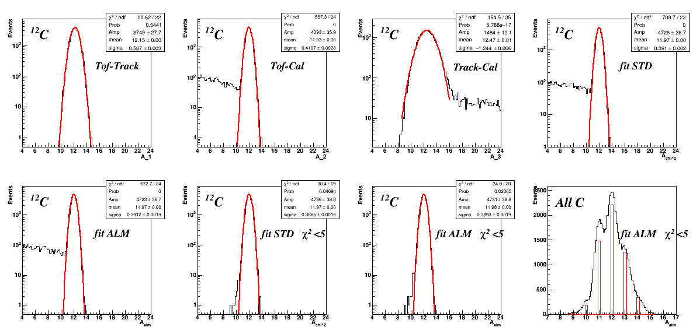
A identification: example on Carbon (cut on χ² )
Χ² fit (χ²<5)
11.97 ± 0.39
ALM fit (χ²<5)
11.98 ± 0.39
With these resolution we begin to disentangle the various isotopes

Slide 37
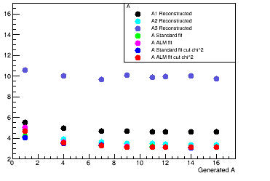
A Resolution (%)
 | ¹H | ⁴He | ⁷Li | ⁹Be | ¹¹B | ¹²C | ¹⁴N | ¹⁶O
Z | 1 | 2 | 3 | 4 | 5 | 6 | 7 | 8
A | 1 | 4 | 7 | 9 | 11 | 12 | 14 | 16
Studied fragments
Resolution (%)
Tracker + Calo (high → square terms in p and T)
Tof + Tracker
Tof + Calo
Fit methods superimposed
Generated A
Mass Number (A) resolution with Fit methods at level of 3%
Reconstruction → best performance from Tof + Calo
Fit → slightly improvement of the performances, remove tails

Slide 38
Elastic scattering in the target
In C_{n}H_{m} targets the primary nucleus can undergo elastic scattering on H (reversed kinematics of p-C or p-O elastic scattering)
This results in the following pattern:
  The primary undergoes a small deflection
  The recoiling proton has very low energy and is generally absorbed in the target
Can be easily confused with a reaction like, for instance, ¹²C ➞¹¹C + n
A preliminary study yields ~1.3 10⁻³ elastic ev/primary in C₂H₄ against ~10⁻² ev/primary inelastic interactions
Not an issue in pure C targets

Slide 39
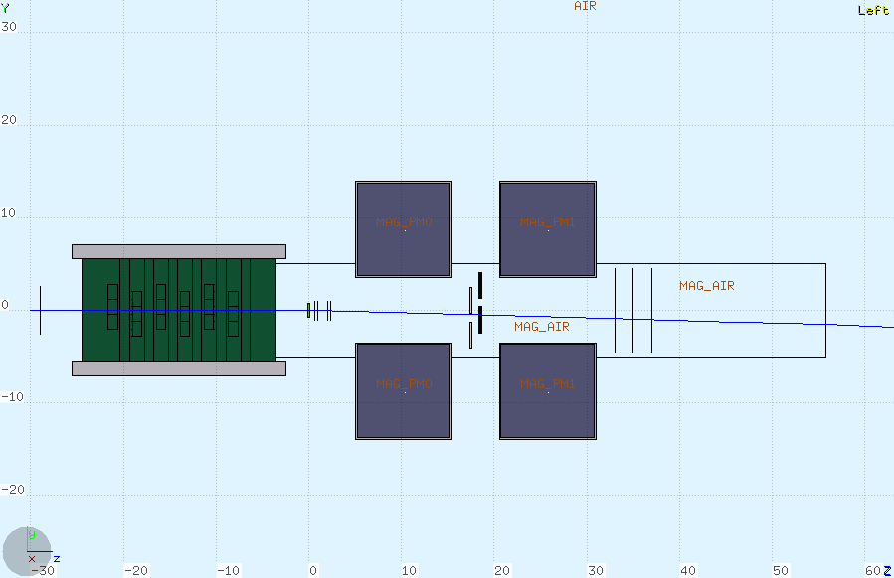
Elastic scattering in the target
Event example (notice that this view is the non bending one):

Slide 40
A lot of work has been done but there is a lot more still to do…
Different distances, materials and parameters for Intermediate Tracker (see talk by E. Spiriti)
Gap between scintillator bars (see talk by M. Morrocchi)
New geometry of calorimeter, plastic boxes,… (see talk by P. Cerello)
Different thickness of MSD, spacing, layout… (see talk by L. Servoli)
Soon we shall hopefully have a new magnetic system layout
…
Man power with the proper training is unsufficient. This is now a bottleneck
Tutorial about basic handling of simulation of FOOT: 13-14 June in Milano (two days are not enough anyway). Only 2 people are surely coming…

