Slide 1
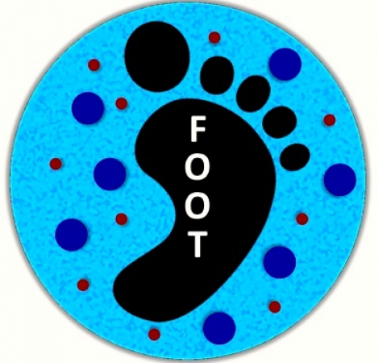
FOOT TDAQ:
status and plans
Silvia Biondi, Mauro Villa
University & INFN of Bologna
FOOT General Meeting - Elba
04-05.06.2018

Slide 2
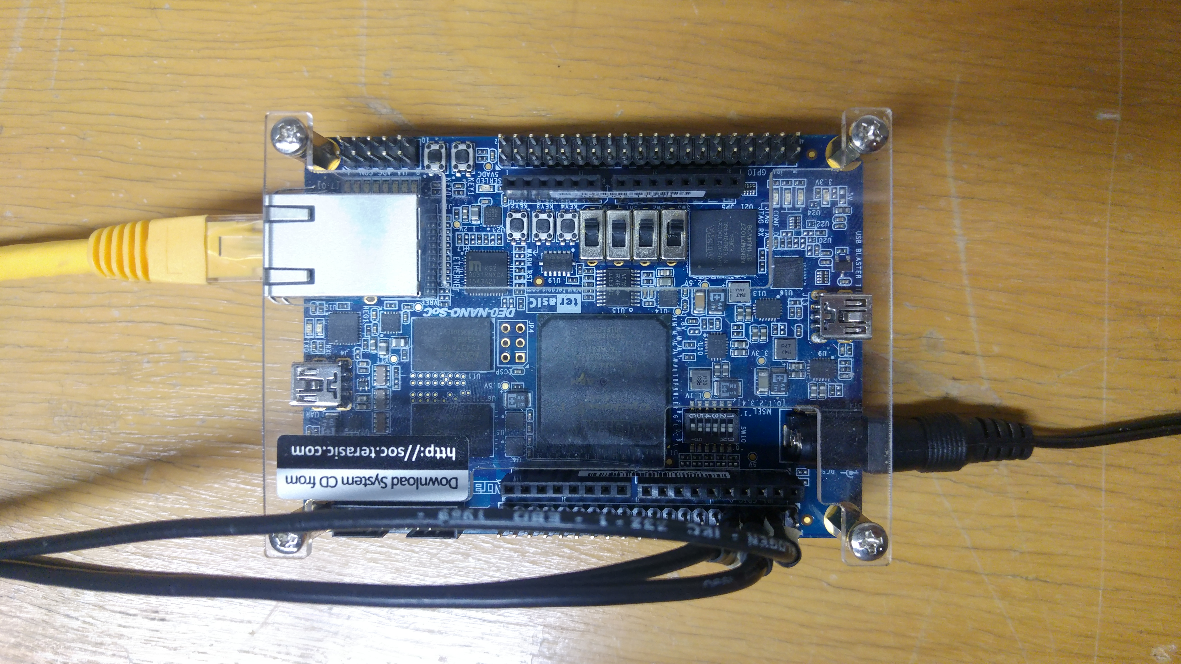
Intro
Goal of the work:
interface between the central DAQ and a remote device
a flexible software, able to connect to different devices if needed
Details of the work:
Readout Module of a generic detector;
connections to a remote device for many purposes:
transmission of configuration and monitoring parameters;
flux of data from the device;
tested with the board (de0_nano) in laboratory.

Slide 3
FOOT TDAQ System
PC
CONTROL DAQ
steering the acquisition process
VME
PC
Readout Module
PC STORAGE
N PC
PC MONITOR
SBC
reading of electronic boards
receiving via fiber or ethernet
and storing data
monitoring sub-detectors
general monitoring process
for non-integrated sub-detectors
EXTERNAL
DISK
data
Wave
Dream
SoC
det 1
det 2
det 3
…
…
Experiment

Slide 4
FOOT TDAQ System
PC
CONTROL DAQ
steering the acquisition process
VME
PC
Readout Module
PC STORAGE
N PC
PC MONITOR
SBC
reading of electronic boards
receiving via fiber or ethernet
and storing data
monitoring sub-detectors
general monitoring process
for non-integrated sub-detectors
EXTERNAL
DISK
data
Wave
Dream
SoC
det 1
det 2
det 3
…
…
Experiment

Slide 5
FOOT TDAQ Panel
A FOOT TDAQ Software has been setup
able to handle the data stream
able to show the significant information of the run

Slide 6
FOOT TDAQ Panel
A FOOT TDAQ Software has been setup
able to handle the data stream
able to show the significant information of the run
provide online monitor

Slide 7
Project idea
PC
Readout Module
SOCKET
for non-integrated sub-detectors
CLIENT
SOCKET
Wave
Dream
SERVER
SoC
Socket uses a TCP connection, which is defined by two endpoints (sockets);
all C++ Standard Template Library based;
provide reliable two-way communication.
det 1
det 2
det 3
…
…
Transmission Control Protocol/Internet Protocol (TCP/IP):
requires little central management and makes networks reliable;
IP is compatible with all operating systems and with all types of computer hardware and networks.
Experiment

Slide 8
Project scheme
connections going from the same client to the same server
Readout module = CLIENT
send configuration parameters to server
request monitoring parameters from server
tell the server when to send data
put the data in the relative DataChannel through parallel threads
Sub-detector = SERVER
receive configuration from client
send monitoring parameter to client
set a device parameter to “run” status and prepare itself for the data flux
send the data to the client
“Slow” connection
starts when “configure” mode and uses > 1 fork to handle different simultaneous activities
“Fast” connection
only if the system goes in “RUN” mode, stops when “stopDC” mode

Slide 9
Conclusions and future proposal
SUMMARISING:
a generic and flexible Readout Module has been set up;
reliable two-end-points connection between TDAQ software and a generic sub-detector;
validated with final test with the board
Linux environment totally outside the TDAQ software.
will provide (on Git) the skeleton code to implement for each sub-detector;
full documentation and assistance guaranteed.

Slide 10
Central DAQ status
Sub-detector | What we will use | What we need | From which institute | What we have now
Start Counter | Wave Dream | ? | Roma+Pisa | -
Beam Monitor | TDC | parameters for board configuration | Milano+Roma | TDC (V1190B)
Vertex/IT | Achille Board | front-end electronics for board tests | Frascati | Achille Board
MSD | de0_nano (?) | software for Pg board-de0_nano connection | Perugia | de0_nano
TOF | Wave Dream | ? | Roma+Pisa | -
Calorimeter | ? | ? | Torino | -
Whatever the deadline is, we need any piece to be integrated
in the DAQ system 5 months before!

Slide 11
Supporting material

Slide 12
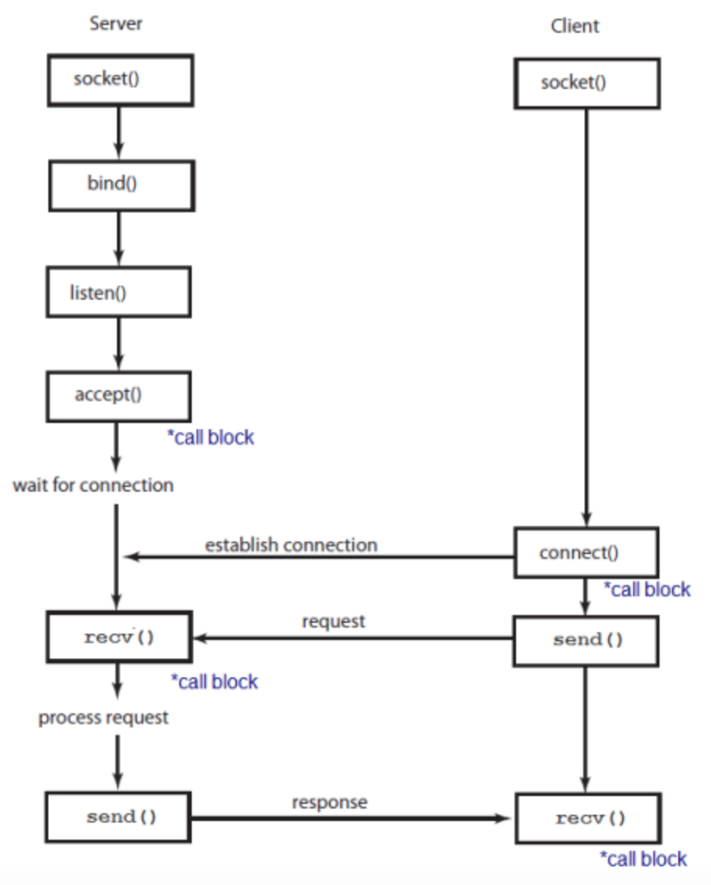
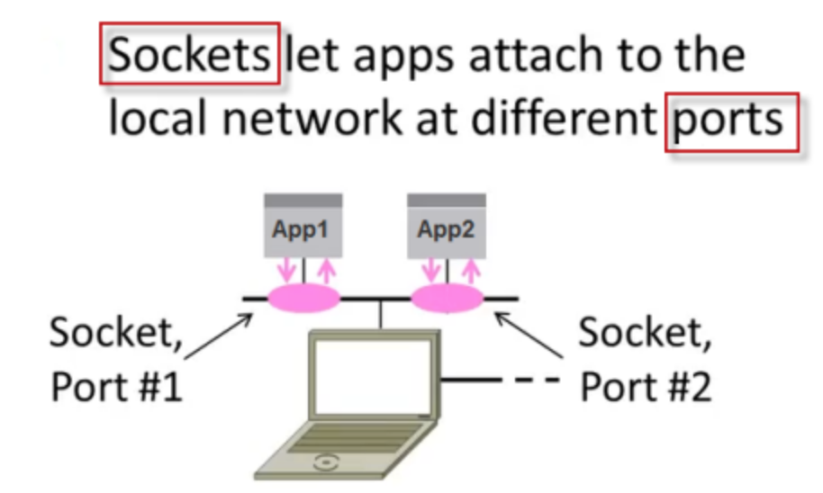
Sockets and client/server

Slide 13
TCP/IP connection
TCP/IP model layers
TCP/IP functionality is divided into four layers, each of which include specific protocols.
The application layer provides applications with standardised data exchange.
The transport layer is responsible for maintaining end-to-end communications across the network. TCP handles communications between hosts and provides flow control, multiplexing and reliability.
The network layer, also called the internet layer, deals with packets and connects independent networks to transport the packets across network boundaries.
The physical layer consists of protocols that operate only on a link - the network component that interconnects nodes or hosts in the network.

Slide 14
Code hierarchy
FOOT Partition
segment (1 block)
segment (1 block, i.e. VME)
RCD/ROS
Readout Module
etc…
segment (1 block)
etc…
Used tools
database OKS
C++ classes and objects

Slide 15
Tools used in the project
SOCKETS
A way of speaking to other programs using standard file descriptors:
make a call to the socket() system routine;
after the socket() returns the socket descriptor, start communicate through it using the specialised send()/recv() socket API calls.
Socket uses a TCP connection, which is defined by two endpoints (sockets);
It is the socket pair (the 4-tuple consisting of the client IP address, client port number, server IP address and server port number) that specifies the two endpoints that uniquely identifies each TCP connection in an internet;
The purpose of ports is to differentiate multiple endpoints on a given network address.
Why using the socket:
all C++ Standard Template Library based;
provide reliable two-way communication;
immediate confirmation that what has been sent actually reached its destination;
ensure that data are not lost or duplicated and that the order is the same from the sender to the receiver.

Slide 16
Tools used in the project
CONNECTIONS
Transmission Control Protocol/Internet Protocol (TCP/IP):
providing end-to-end communications that identify how it should be broken into packets, addressed, transmitted, routed and received at the destination.
It uses the client/server model of communication in which a user or machine (a client) is provided a service (like sending a message) by another computer (a server) in the network
Why using the TCP/IP:
requires little central management;
designed to make networks reliable, with the ability to recover automatically from the failure of any device on the network;
IP is compatible with all operating systems and with all types of computer hardware and networks.

