Slide 1



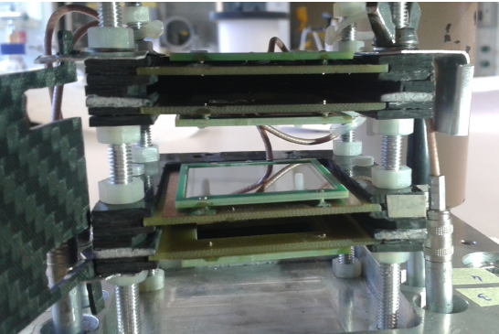
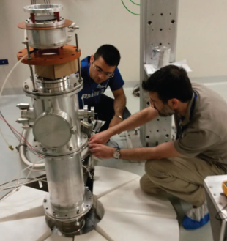
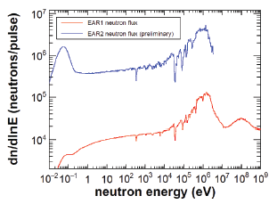
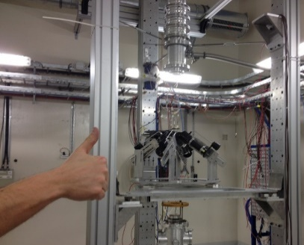
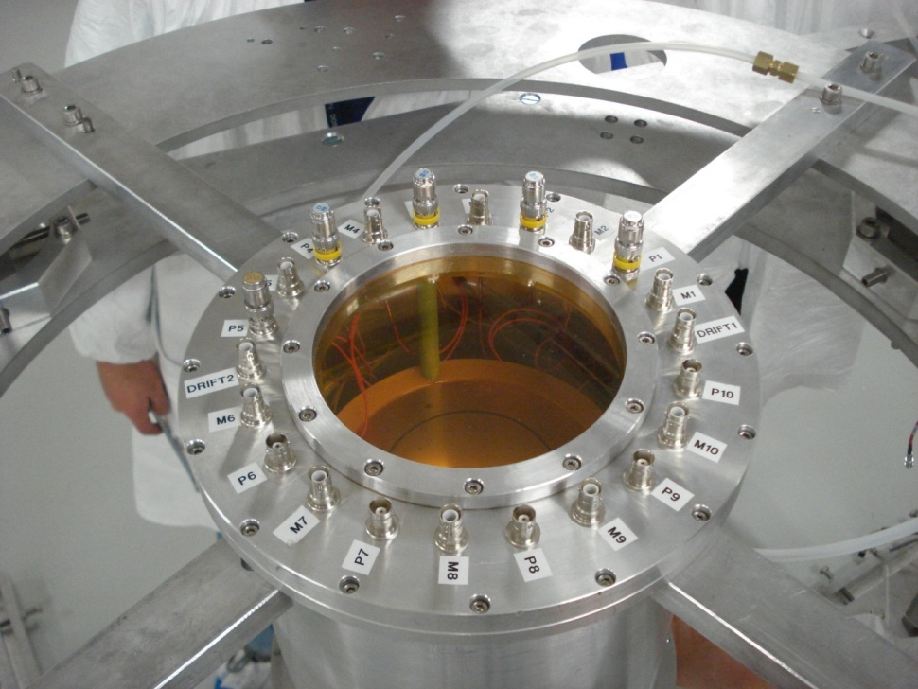
ISPUN17
Recent results in Nuclear Astrophysics at the n_TOF facilty
(CERN)
Giuseppe Tagliente
Istituto Nazionale Fisica Nucleare, Sezione di Bari, Italy
on behalf of n_TOF Collaboration

Slide 2
The n_TOF Collaboration

Slide 3

The n_TOF Collaboration
(~100 Researchers from 30 Institutes)
CERN
Technische Universitat Wien Austria
IRMM EC-Joint Research Center, Geel Belgium
Charles Univ. (Prague) Czech Republic
IN2P3-Orsay, CEA-Saclay France
KIT – Karlsruhe, Goethe University, Frankfurt Germany
Univ. of Athens, Ioannina, Demokritos Greece
INFN Bari, Bologna, LNL, LNS, Trieste, ENEA – Bologna Italy
Univ. of Tokio Japan
Univ. of Lodz Poland
ITN Lisbon Portugal
IFIN – Bucarest Rumania
CIEMAT, Univ. of Valencia, Santiago de Compostela,
University of Cataluna, Sevilla Spain
University of Basel, PSI Switzerland
Univ. of Manchester, Univ. of York UK
Notes:
Motivazioni Zr, Mg / Misure precedenti Os (orela ’80) / Proprietà nucleari (average level spacing, average radiative width, average neutron strength) / ISO 2919

Slide 4
Neutrons in Nuclear Astrophysics
Gap
B,Be,Li
α-nuclei
¹²C,¹⁶O,²⁰Ne,²⁴Mg, …. ⁴⁰Ca
Elements heavier than Fe are the result of neutron capture processes
NEUTRONS
H 30 000
C 10
Fe 1
Au 2 10⁻⁷
r-process peaks (nuclear shell closures)
s-process peaks (nuclear shell closures)
Fe peak
Th, U
Au
Pb

Slide 5
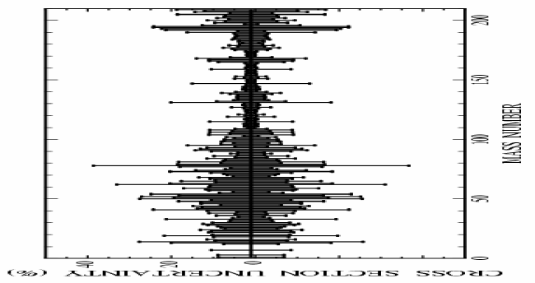
Neutron Cross Sections
Over the past, huge amount of data collected at various neutron facilities, mostly for stable. Main features of s-process are now well understood.
However, cross-section uncertainties in some cases remain high
For three classes of nuclei data are lacking or need substantial improvements:
  1. Nuclei with low cross-section, in particular neutron magic nuclei (s-process bottleneck)
  Isotopes available in small amount, such as rare or expensive isotopes
3. Radioactive branching points isotopes

Slide 6

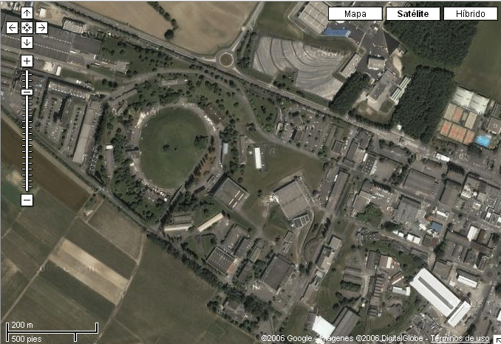

The n_TOF facility at CERN
n_TOF is a spallation neutron source based on the 20 GeV/c proton beam from the CERN PS hitting a massive Pb block.
185 m flight path
Nominal proton Intensity:
7x10¹² p/pulse
Proton pulse width:
7 ns (r.m.s.)
Low repetition rate:
< 0.8 Hz
Wide energy spectrum:
< 25 meV – 1 GeV
High instantaneous flux:
10⁵-10⁷ n/cm²/pulse
Booster
1.4 GeV
PS 20 GeV
Linac
50 MeV
The innovative features of n_TOF come from the characteristics of the proton beam: high energy, high peak current (50 A over 20 ns), low duty cycle (< 1 Hz).

Slide 7
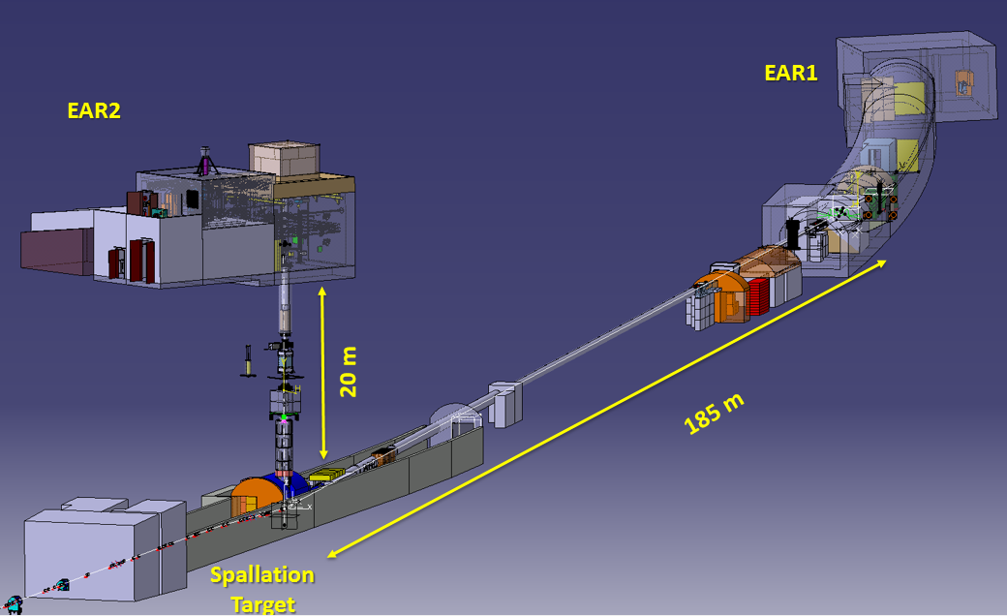
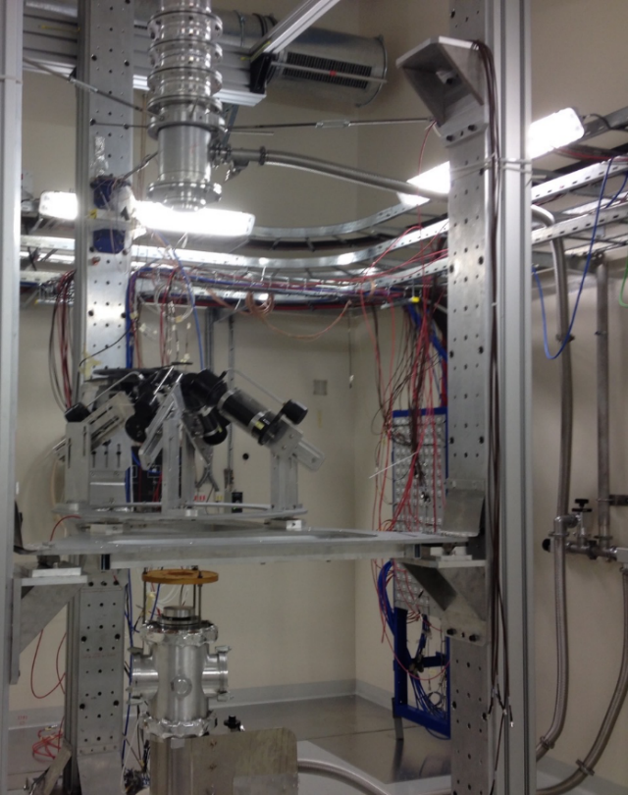
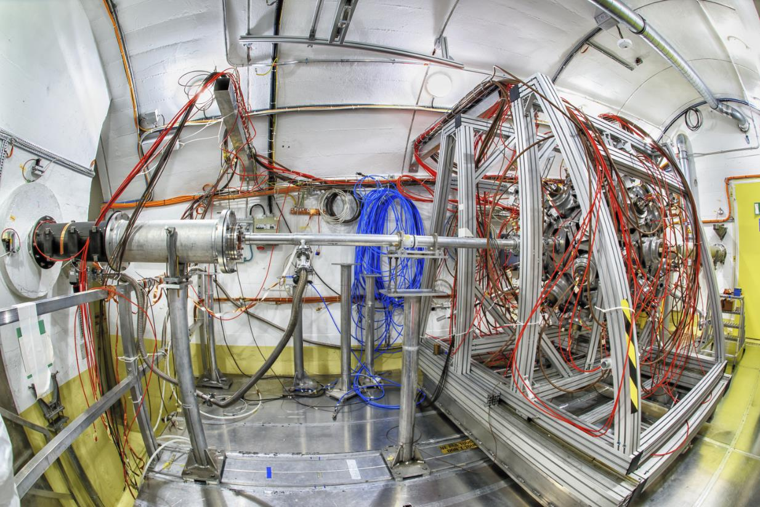
The experimental areas
Proton beam line
The main advantage over other facilities is the high instantaneous neutron flux, allowing to measure reactions on radioactive isotopes (such as branching points).
Notes:
With greater accuracy

Slide 8
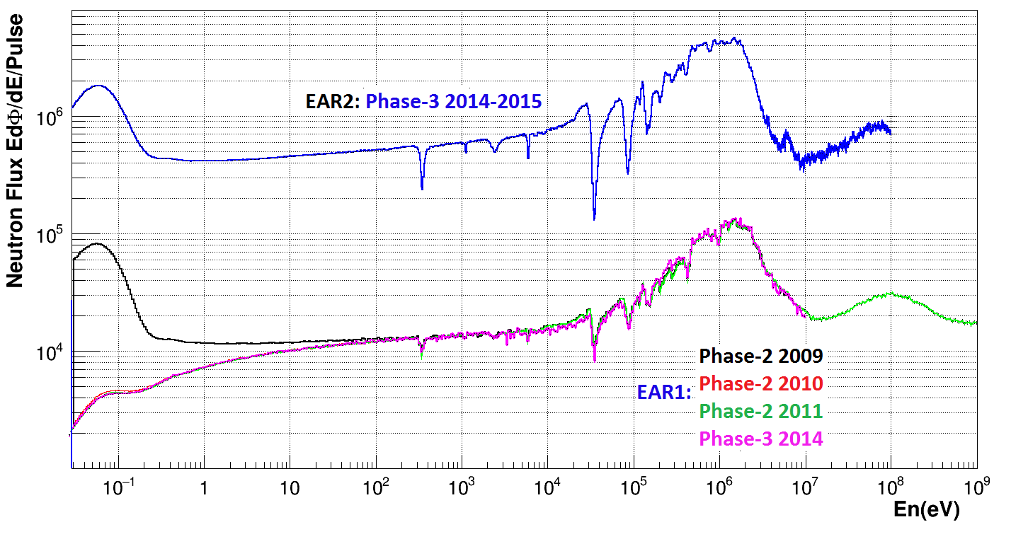
The n_TOF neutron beams
EAR1
EAR1 (185 m)
In operation since 2001.
Measure radionuclides with half-life down to a few hundred years
High resolution in energy allows to study resolved resonances up to several keV.
EAR2 (19 m)
In operation since 2014.
Neutron intensity increased by a factor 40, relative to EAR1.
Possible to measure sub-mg samples, and radionuclides with half-life of a few years.

Slide 9

High accuracy results
Together with innovative neutron beams, accurate nuclear data for Nuclear Astrophysics require:
  High performance detectors
  High purity and well characterized samples (targets)
  Improvements in analysis and simulation techniques
Background
Efficiency
Neutron flux
Sample
It is better to be roughly right
… than precisely wrong !!
John Maynard Keynes

Slide 10
Measurements at n_TOF
Phase 1 (2001-2004)
Phase 2 (2009-2012)
Phase 3
(2014-2016)
Capture
¹⁵¹Sm
^{204,206,207,208}Pb, ²⁰⁹Bi
^{24,25,26}Mg
^{90,91,92,94,96}Zr, ⁹³Zr
^{186,187,188}Os
²³²Th, ^{233,234}U
²³⁷Np,²⁴⁰Pu,²⁴³Am
Fission
^{233,234,235,236,238}U
²³²Th, ²⁰⁹Bi, ²³⁷Np
^{241,243}Am, ²⁴⁵Cm
Capture
²⁵Mg, ⁸⁸Sr
^{58,60,62}Ni,⁶³Ni
^{54,56,57}Fe
^{236,238}U, ²⁴¹Am
Fission
^{240,242}Pu
²³⁵U(n,γ/f)
²³²Th, ²³⁴U
²³⁷Np (FF ang.distr.)
(n,α)
³³S,⁵⁹Ni
Capture
¹⁷¹Pm EAR2
….Ge EAR1
¹⁷¹Tm EAR1
^{203,204}Tl EAR2
Fission
²⁴⁰Pu EAR2
²³⁷Np EAR1&2
Reactions (n,cp)
⁷Be(n,α) EAR2
⁷Be(n,p) EAR2
³³S(n,α) EAR2
Stellar Nucleosynthesis
Stellar Nucleosynthesis
Stellar Nucleosynthesis
BIG BANG Nucleosynthesis

Slide 11
The n_TOF Astrophysics program
The combination of excellent resolution, unique brightness and low background has allowed to collect high-accuracy data, in some cases for the first time ever.
n_TOF measurements relevant for Nuclear Astrophysics
    Capture cross sections (s-process)
    branching point isotopes
      ¹⁵¹Sm, ⁶³Ni, ¹⁴⁷Pm, ¹⁷¹Tm, ²⁰⁴Tl
    magic nuclei and s-process end-point
      ^{91,92, 93,94,96}Zr,¹³⁹La, ^{204,206,207,208}Pb^{,209}Bi
    s-process seeds nuclei
      ^{54,56,57}Fe, ^{58,60,62}Ni
    Nuclear cosmocronometer, neutron poison, etc.
      ^{186,187,188}Os, ^{24,25,26}Mg
    (n,cp) reactions
    Big Bang Nucleosynthesis
      ⁷Be(n,a) and ⁷Be(n,p)
    Various
      ⁵⁹Ni(n,a), ²⁶Al(n,α), ³³S(n,α)

Slide 12
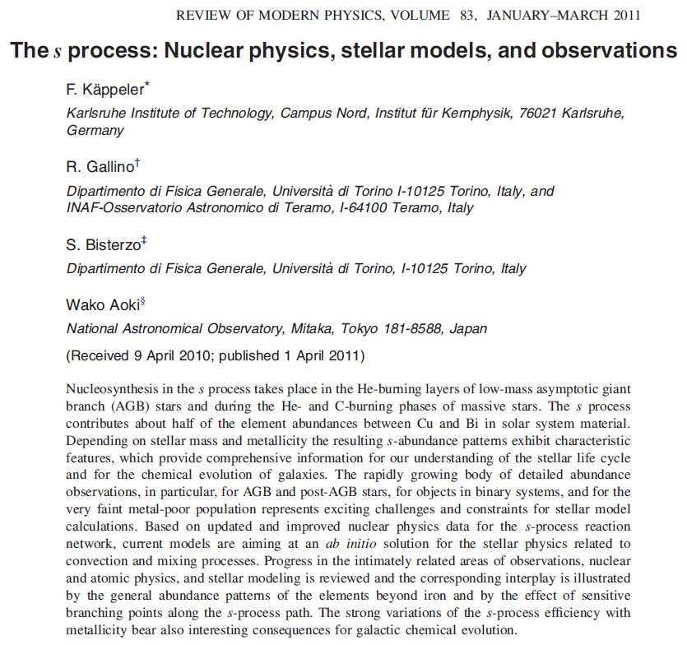
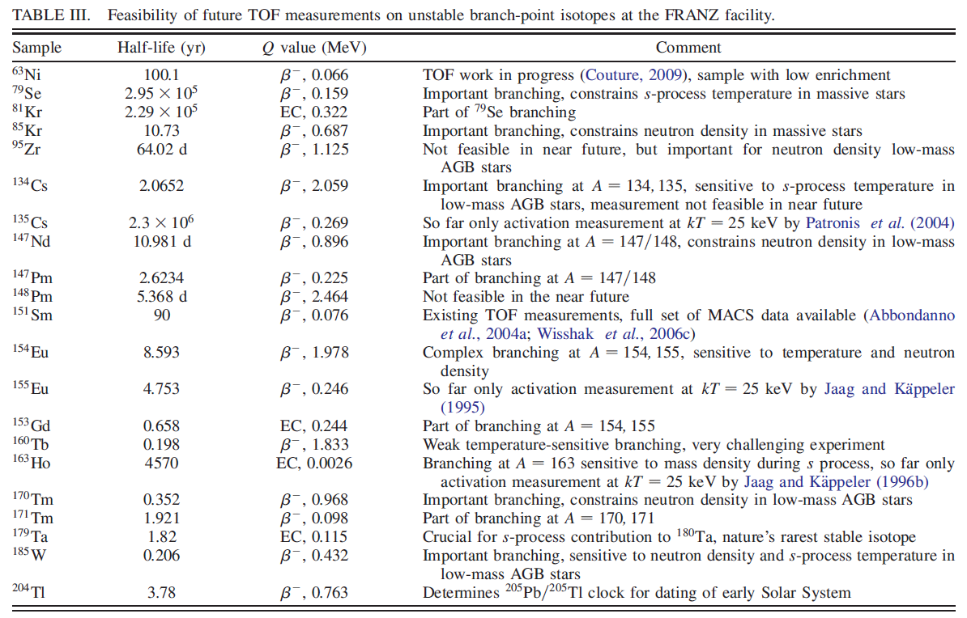
Branching points isotopes

Slide 13
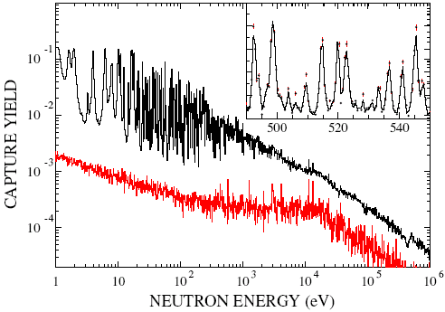
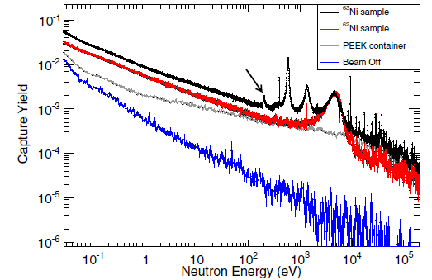
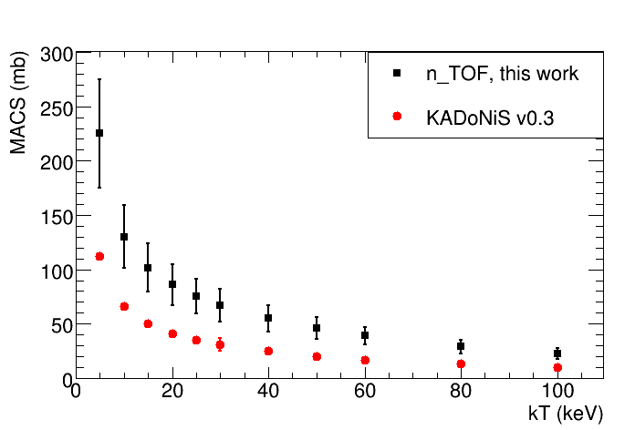
Branching points at n_TOF, the past: ¹⁵¹Sm and ⁶³Ni
¹⁵¹Sm (t_{1/2}=93 y), determines abundance of ^{152,154}Gd
⁶³Ni (t_{1/2}=100 y) first branching point determines abundance of ^{63,65}Cu
200 mg
130 mg
3500
First, strong evidence of thermal pulsing in AGB stars
U. Abbondanno et al., PRL 93, 161103 (2004)
S. Marrone et al., PRC 73, 036604 (2006)
Strong constraints on Cu, Ni and Zn production in massive stars and subsequent supernovae
C. Lederer et al., PRL 110, 022501 (2013)
3000
n_TOF
Models
MACS [mb]
2500
2000
1500
1000
1970
1975
1980
1985
1990
1995
2000
2005
Year

Slide 14
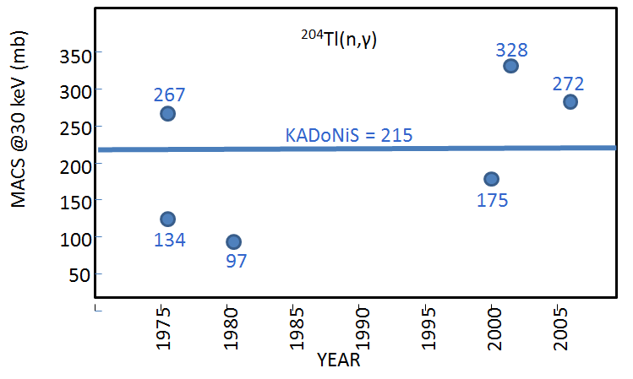
Branching points, the present: ¹⁴⁷Pm, ¹⁷¹Tm, ²⁰⁴Tl
²⁰⁴Tl(n,γ)
Short-lived branching isotopes (a few years) have either never been measured before or have been measured only by activation (a few tens of ng) at a fixed temperature.
¹⁷¹Tm(n,γ)
¹⁴⁷Pm(n,γ)
Theoretical predictions scattered all over the place.

Slide 15
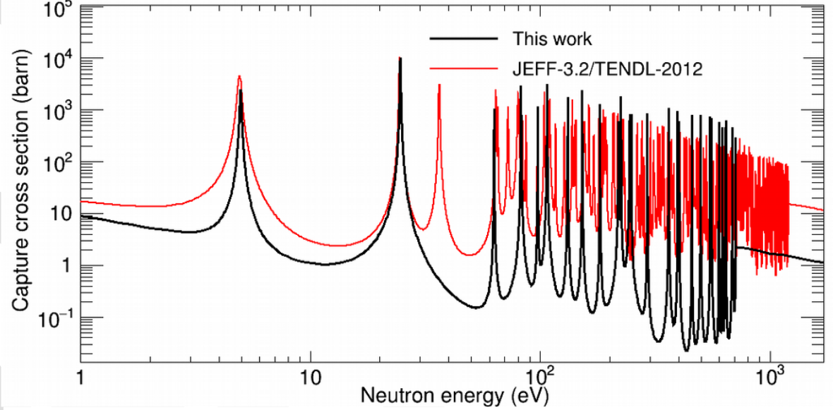
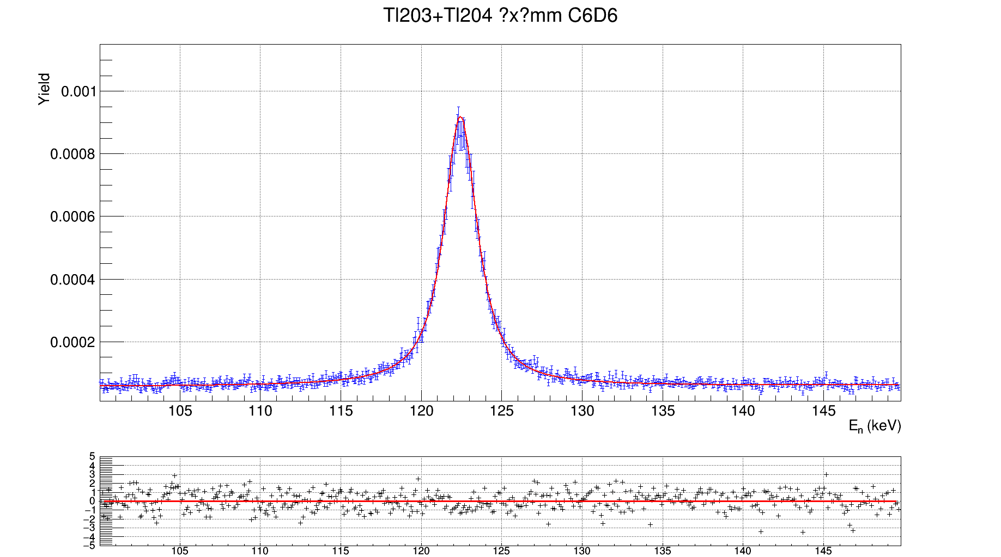
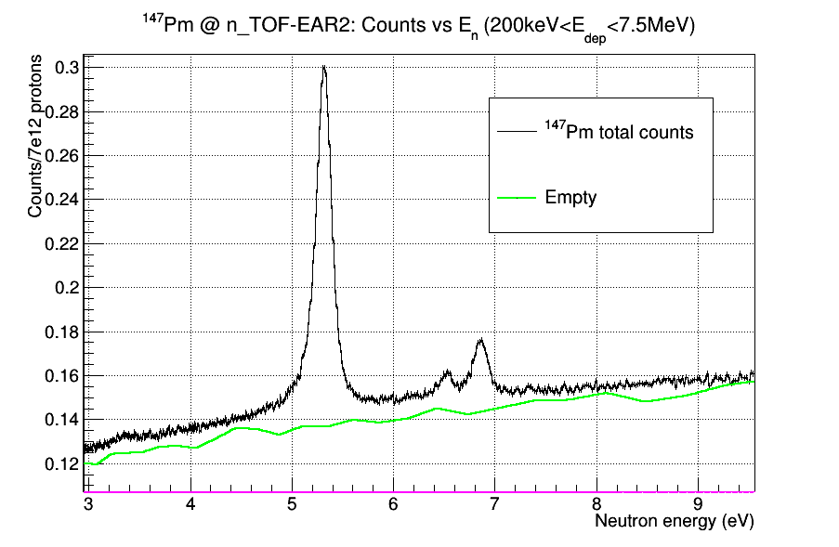
Branching points, the present: ¹⁴⁷Pm, ¹⁷¹Tm, ²⁰⁴Tl
Isotope production by neutron irradiation at @ ILL (Grenoble)
Chemical separation and sample preparation by AC group @ PSI
¹⁷¹Tm (1.9 y) - 3.6 mg sample
²⁰⁴Tl (3.8 y) – 11 mg sample
Preliminary
A. Casanovas et al., in preparation
C. Guerrero et al., in preparation
¹⁴⁷Pm (2.6 y) - 80 μg sample
Preliminary results indicate important differences in the MACS relative to calculations and (very few) previous integral measurements (confirmed by complementary measurements at SARAF).
J. Lerendegui et al., in preparation

Slide 16
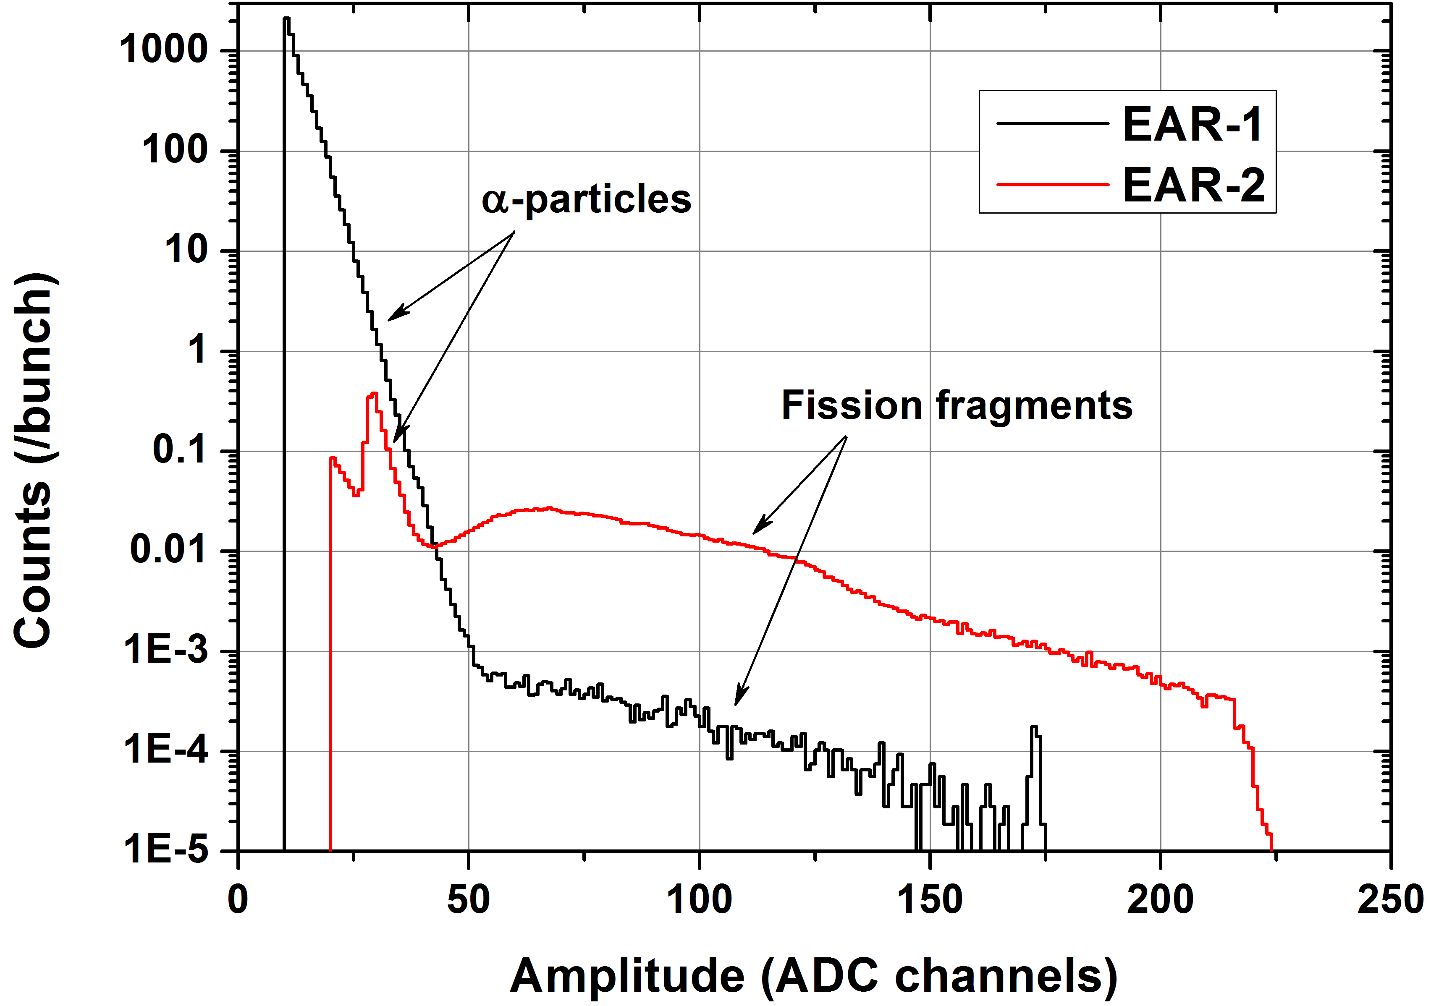
Measurements of (n,cp) reactions in EAR2
²⁴⁰Pu(n,f)
EAR2 flux 40 times larger than in EAR1, but reaction rate 400 times higher (due to shorter TOF).
For radioactive samples, huge gain in signal-to-background ratio.
Possible to measure isotopes with half-life of a few years.
Thanks to the very high flux, small-mass samples (< 1mg) can be used:
  Very thin deposits => minimal energy loss of emitted charged particles
  short-lived radionucleides with still reasonable total activity (low background and meneagible radioprotection issues)
Ideal for measuring (n,cp) reactions on short-lived radioisotopes, available in small amount, with low cross section.
The ⁷Be(n,cp) reactions are all of the above => very challenging measurements

Slide 17
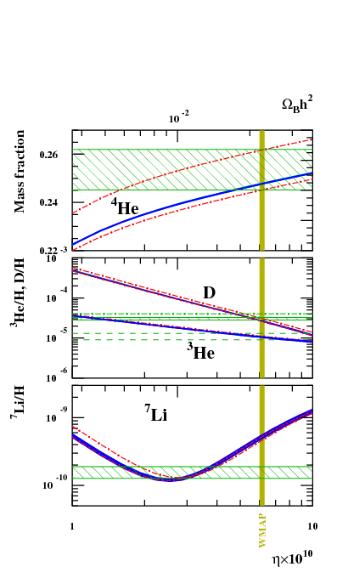
The Cosmological Lithium Problem (CLIP)
The model of Big Bang Nucleosynthesis reproduces fairly well the abundances of all primordial isotopes (D, ³He, ⁴He, etc...), except ⁷Li, whose production is overestimated.
Large discrepancy (a factor of 2-4) between the ⁷Li abundance inferred from observations and the one calculated within BBN theory.
Primordial ⁷Li is produced by electron capture of ⁷Be (after atom formation).
Over the years, different hypotesis have been put forward to explain this difference:
  a systematic underestimate of the observed primordial ⁷Li abundance
  unkown resonances in charged particle induced reactions on ⁷Be
  new physics beyond the Standard Model
?

Slide 18
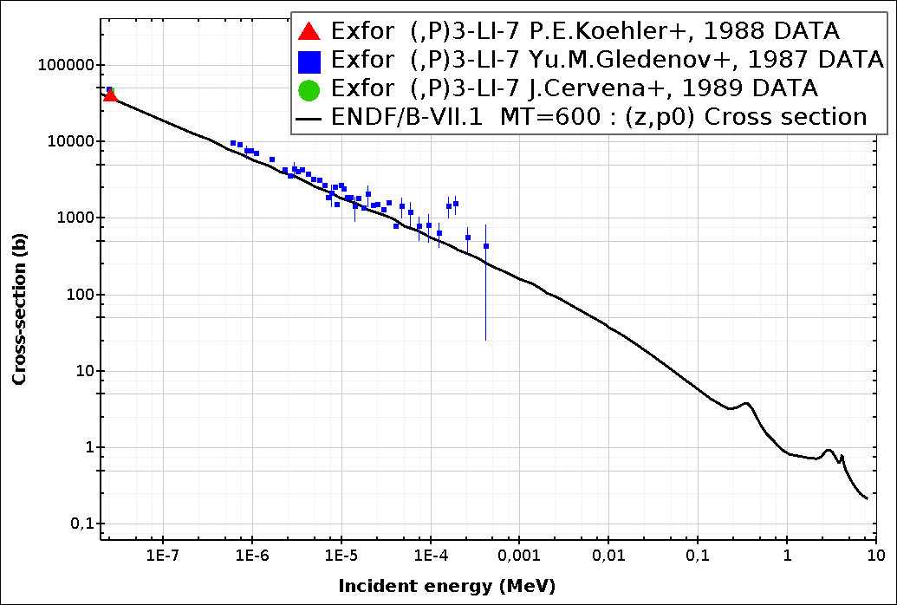
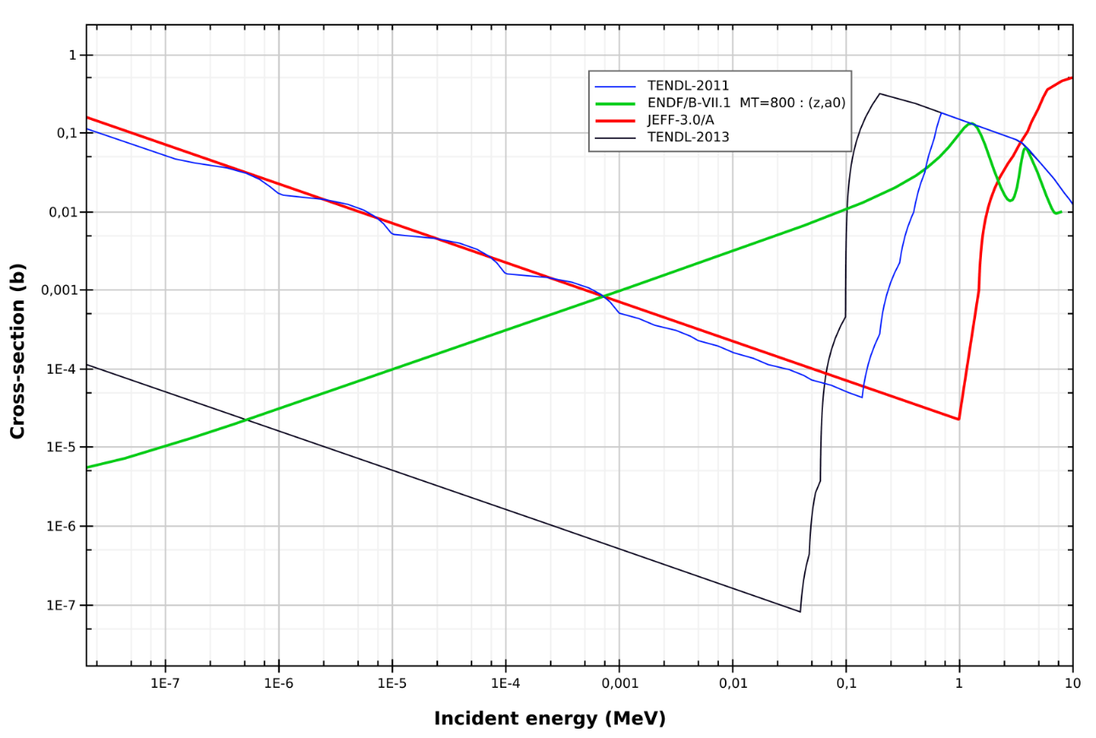
⁷Be(n,p), (n,α)
Approximately 95% of primordial ⁷Li is produced from the electron capture decay of ⁷Be (T_{1/2}=53.2 d)
⁷Be is destroyed via (n,p) (≈97%) and (n, α) (≈2.5%) reactions
A higher destruction rate of ⁷Be can solve or at least partially explain the Cosmological Lithium Problem
Only one direct measurement
(P. Bassi et al., 1963, @ 0.025 eV)
⁷Be(n, p)
⁷Be(n, α)

Slide 19
The ⁷Be(n,α) reactions
The (n,α) reaction produces two α-particles emitted back-to-back with several MeV energy (Q-value=19 MeV !!)
Sandwich of silicon detectors with ⁷Be sample in between directly inserted in the beam.
Coincidence technique => strong background rejection
Si 2
Si 1
⁷Be sample
neutrons
Biggest challenge related to the sample:
  For a reasonable count-rate, a few μg of ⁷Be are needed
  The short half-life of ⁷Be (53.2 d) very large specific activity (∼13 GBq/μg of 478 keV γ-rays)
  Difficult to find and handle
At n_TOF:
  Up to 10 μg of ⁷Be from cooling water of SINQ spallation target at PSI (Zurich)
  chemically purified before depositing (on polyethilene and Al backings)
  Complex mechanics and procedure for mounting in the hot-cell
A complementary integral measurement done at SARAF

Slide 20
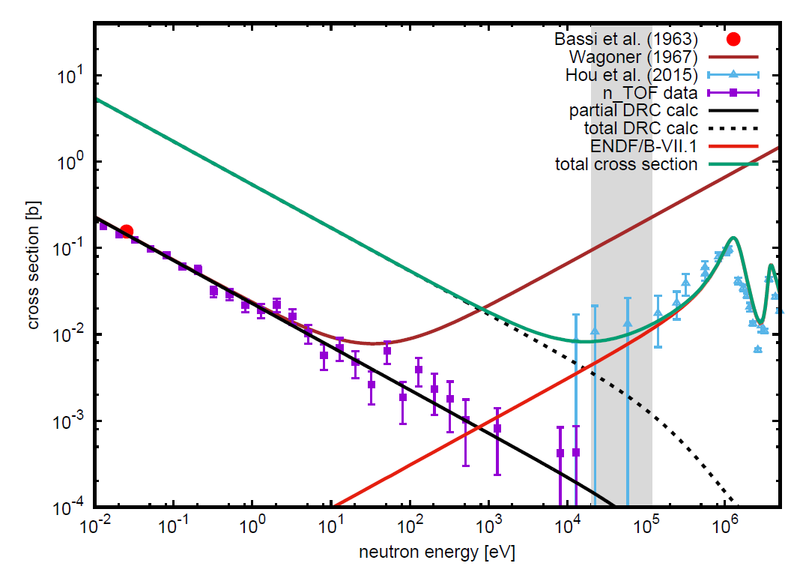
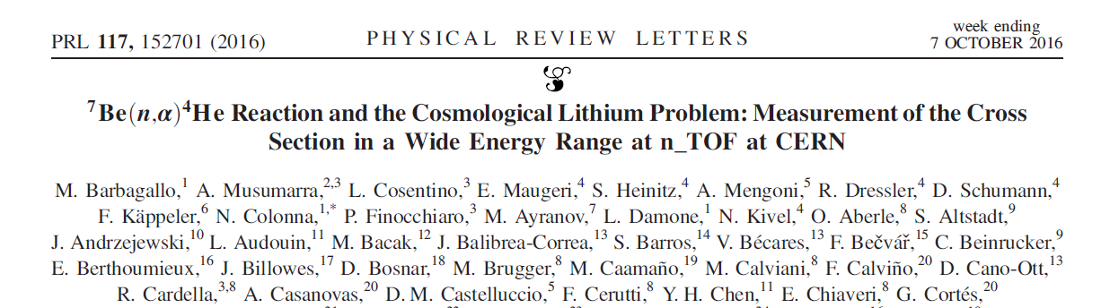
The ⁷Be(n.α) results
At low energy cross section 20 times higher than assumed.
Up to 10 keV no evidence of p-wave contribution.
At 10 keV consistent with the indirect measurements (but higher accuracy).
Completely different shape than Wagoner evaluation, currently used in BBN calculations.

Slide 21
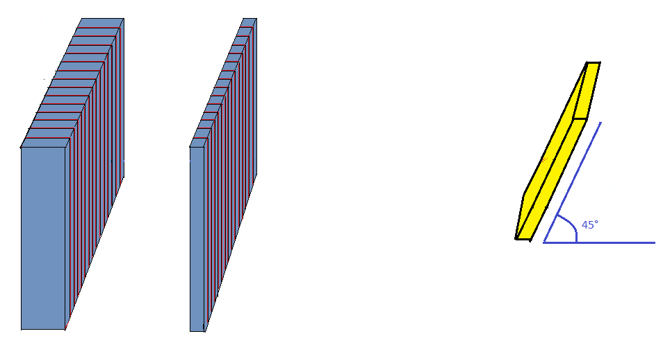
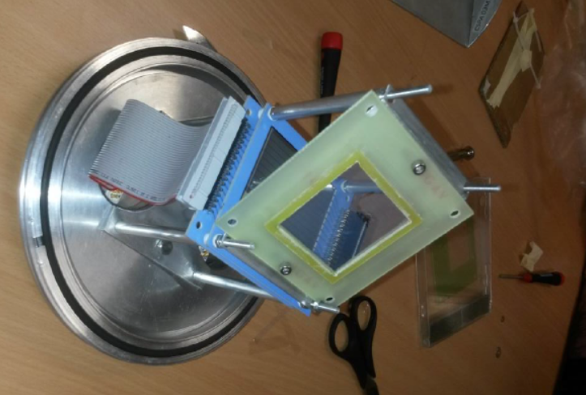
The ⁷Be(n,p) measurement
Need to detect and identify 1.4 MeV protons => Sillicon telescope (outside the beam)
⁷Be sample
1.5x1.5 cm²
p
E
5x5 cm²
300 mm
16 stips
ΔE
5x5 cm2
20 mm
16 stips
Neutron beam

Slide 22


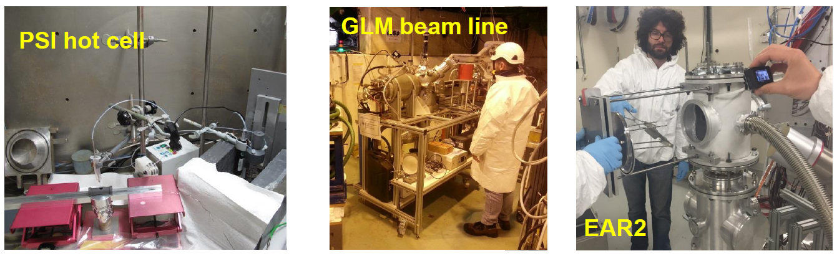

The ⁷Be sample preparation
High purity sample needed. Several steps to get it:
  200 GBq of ⁷Be extracted from SINQ cooling water at PSI
  Nitrate solution inserted in the source of the ISOLDE separator
  Source shipped to CERN and mounted on the ISOLDE-GLM off line separator (with RILIS laser ionization system)
  Implantation of 30 keV ⁷Be beam onto 18 μm Al backing, for 12 hours
  1.1 GBq sample transported in EAR2 and mounted inside vacuum chamber (with telescope already in place).

Slide 23
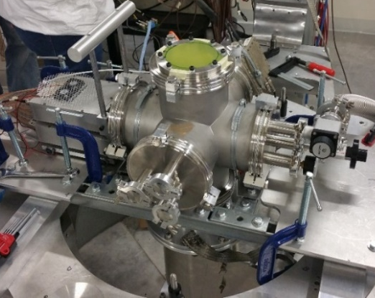
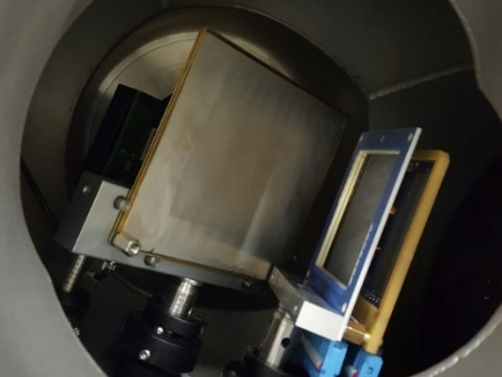
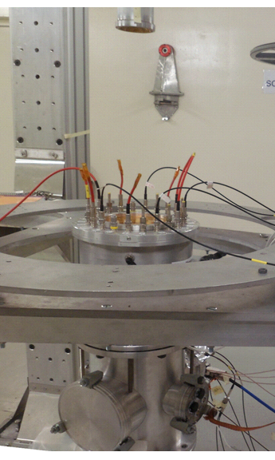
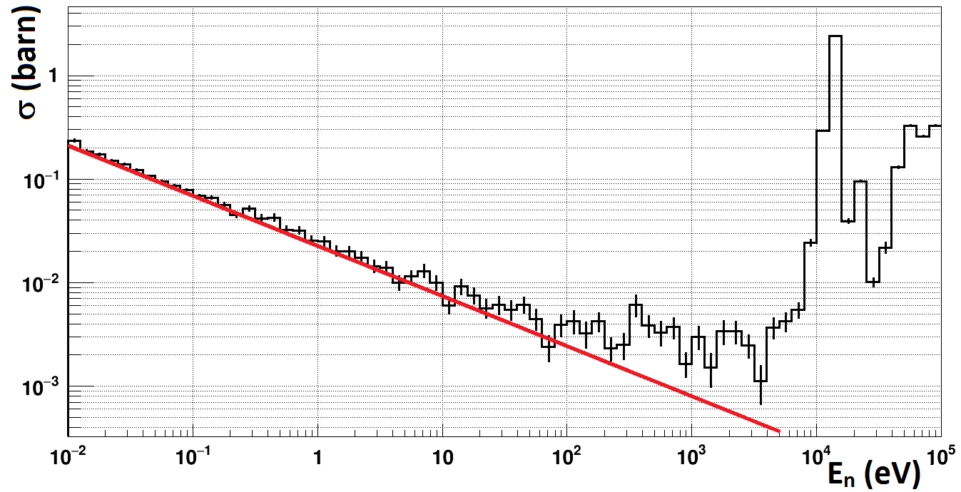
More (n,cp) reaction
Measurement of the ²⁶Al(n,p) and (n,α) reaction in EAR2@n_TOF
(production and ejection from massive stars)
University of Edinburgh
  Sample:
  2.58x10¹⁷ atoms of ²⁶Al (1 My)
  Detectors
5x5 cm² ΔE-E telescope
double-sided silicon-strip detectors (DSSD) 5 mm pitch
θ_{lab} ~ 30-110 degrees
Measurement of the ³³S(n,α) in EAR2 (production of ³⁶S)
Measured with MicroMegas gas detector
M. Sabate, Univ. of Seville/Granada

Slide 24
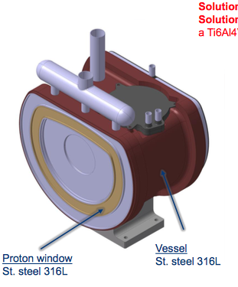
The n_TOF long-range plan
Several measurements already in the pipe-line (approved by INTC), to be performed in 2017-2018 (before CERN accelerator shut-down):
^{69,71}Ga (n,γ) weak s-process in massive stars Goethe Univ., Frankfurt
⁸⁸Sr, ⁸⁹Y (n,γ) bottleneck nuclei INFN, Bari
^{152,154,156}Gd (n,γ) s-only isotopes INFN and Univ., Bologna
¹⁴N (n,p) neutron poison / ¹⁹F prod. Univ. of Granada
³⁵Cl (n,p) ³⁶S and ³⁵Cl/³⁷Cl in C-rich AGB Univ. of Granada
^{77,78}Se, ⁶⁸Zn (n,γ) weak s-process in massive stars Univ. of Edinburgh
During the shut-down (2019-2020) replacement of spallation target (designed to operate for 10 years):
proposals for new measurements
detector developments
sample procurement

Slide 25
Conclusions
There is need of accurate new data on neutron cross-section for Nuclear Astrophysics.
The combination of excellent resolution, unique brightness and low background allows to collect at n_TOF high-accuracy data, in some cases for the first time ever.
Since 2001, n_TOF@CERN has provided an important contribution on capture cross section measurements for stellar nucleosynthesis.
A second experimental area (EAR2) at 20 m flight path has recently made possible to perform very challenging measurements of interest for Nuclear Astrophysics, on short-lived radionuclides, on sub-mg samples, and on low cross section reactions.
For the ⁷Be(n,p), first neutron measurement on a sample produced at a radioactive beam facility (in this case ISOLDE).
A new spallation target will be installed before 2020, for the experimental program in Nuclear Astrophysics (and more) in the next decade.

