Slide 1
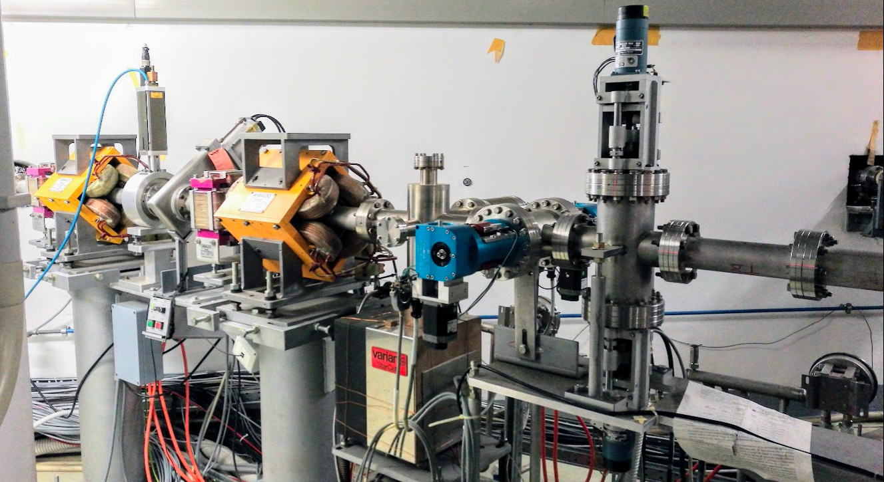
Beam for PADME run 2018
PADME collaboration meeting
9 marzo 2018
BTF + LINAC team

Slide 2
Sparse thougths on setup and diagnostics
No action on LINAC and DA$Φ$NE complex in general until March, 30
LINAC maintenance will follow, for 2 or 3 weeks
This brings us to the beginning of April, at the start of BTF upgraded beam line AND of the PADME setup installation
This implies no beam in BTF before the setup is ready
Some work on the LINAC optimization can be done, with transport dipole off
But this implies very limited diagnostics
Most probably, no MIMOSA will be available, at least until summer, so no tracking in vacuum
Some information on beam spot, at lower resolution, from PADME active target
Beam imaging by FitPIX Silicon pixel detectors downstream the PADME vessel can be provided (PADME dipole dispersion + multiple scattering on windows and air)
Timing information with quick feedback can come from PbF₂ small angle calorimeter

Slide 3
Things to do: high priority
Prepare beam with minimal requirements for PADME in at least 2 configurations
Configuration 1
LINAC electron mode, maximum possible energy: >600 MeV
BTF target in, 2 x₀
Energy selection: >500 MeV
Configuration 2
LINAC positron mode, maximum possible energy: >500 MeV
BTF target out
Energy selection = E LINAC
In both configurations:
Long pulse: $∆t=$150 ns or longer
Beam spot at target $σ_{x,y}\sim$1 mm
SLTTB02 aperture < 1 mm, SLTTB04 aperture < few mm
SLTTB01, SLTTB03 and LINAC current tuned to get required intensity:
$\sim$10² positrons*$∆t$ /pulse

Slide 4
Things to do: lower priority
Prepare beam with minimal requirements for PADME in at least one of the 2 main configurations, and in addition:
Tune selected energy with similar positron beam pulse length, spot size and intensity at different values, at least:
300 MeV
250 MeV
Prepare electron beam configurations, with as much as possible same parameters of positron beam

Slide 5
Some considerations: running mode
Configuration 2 (positrons produced at positron converter and accelerated by the LINAC to required energy, no BTF target) should be better from the point of view of:
Lower background (beam-related), due low energy photons in the BTF hall, coming from the production target
Allows running the LINAC at lower current for getting the required intensity:
Maybe even to loo: need to cut the beam with collimators anyhow (again background…) and stability issues
Allow running at much higher positron intensity (for “special runs” aimed at checking pile-up or dump mode)

Slide 6
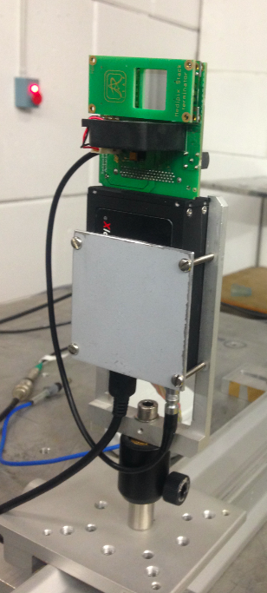
Some considerations: beam-setup
Need one or more configurations for setting up the beam?
PADME target in, PADME dipole on (i.e. normal configuration):
Can monitor the spot with limited resolution on the target, and monitor the spot after magnet dispersion with a FitPIX in the beam path at the exit of the vacuum vessel
PADME target out, PADME dipole off:
Beam on SAC. Can provide beam timing but not the spot and the intensity
Add a FitPIX in front of SAC?
Leave now some more space (at least 10 cm) in the design stage

Slide 7
Some considerations: operations
Changing and optimizing the beam in different configurations requires TIME and can spoil stability
Not enough experience for having an estimate of needed time for setup
Basic beam requirements should be clearly stated and monitored
Adequate feedback to machine staff has to be provided

