Slide 1
Trigger status
Fan-out
Trigger processor
P. Albicocco, P.B., P. Ciambrone, E. Leonardi, D. Tagnani

Slide 2
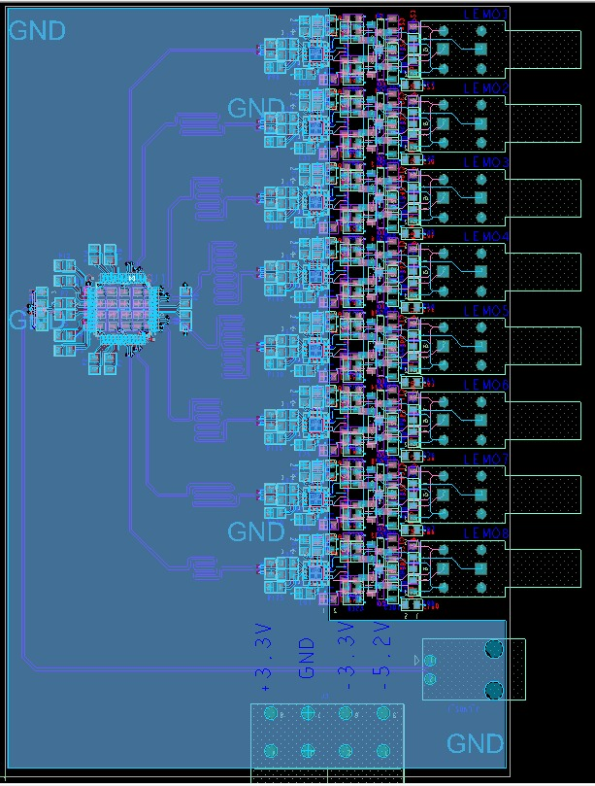
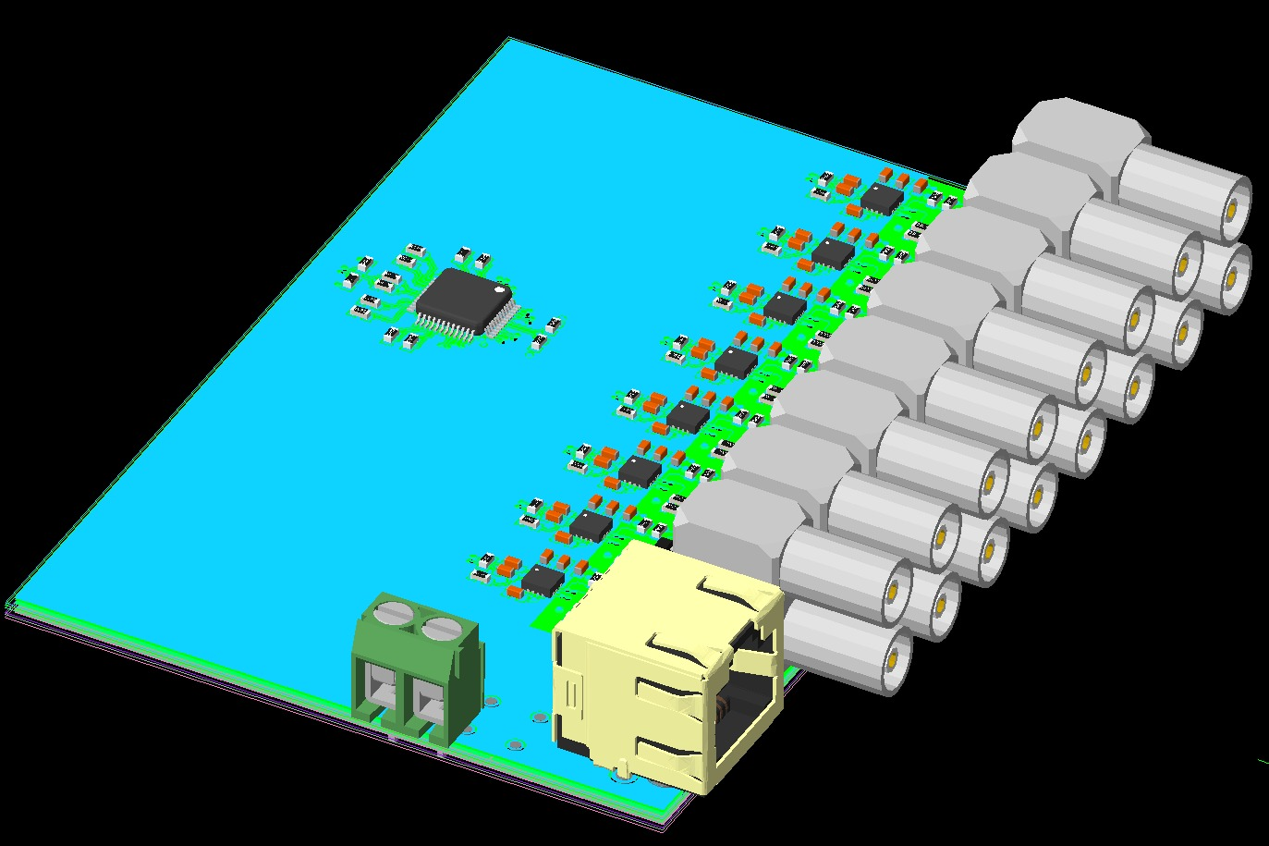
Fan out
OK its timing properties are good enough for the experiment ARTEL has produced them!

Slide 3
Timing studies
After studing timing properties when sampling@1GHz we understood that as far as the trigger time and the EMC are concerned the precision we get on the measurement is fine.
but we need to be more accurate when dealing with Cherekov

Slide 4
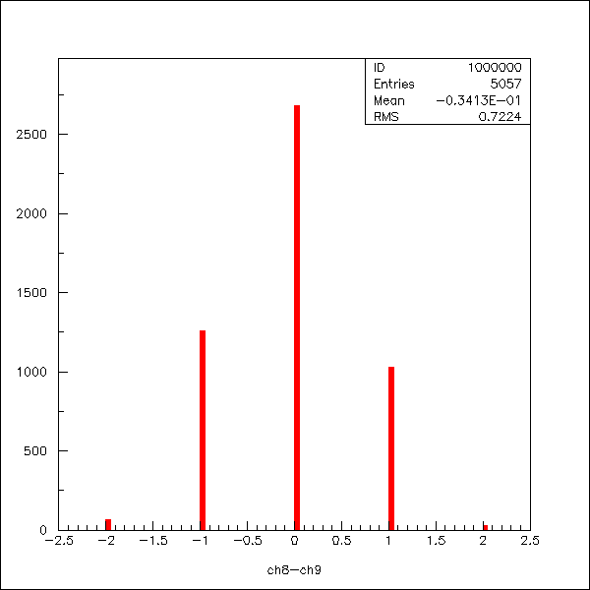
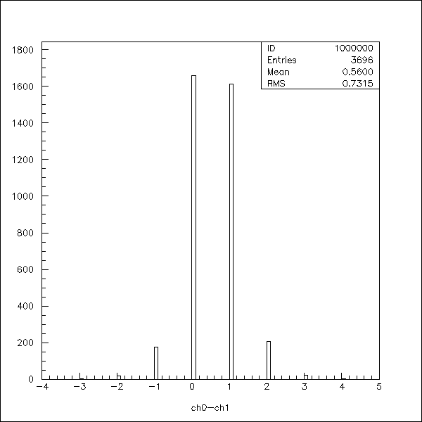
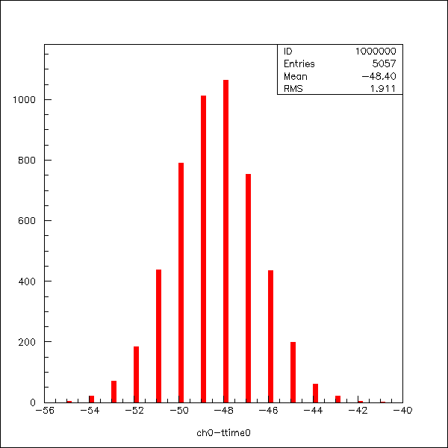
2.5 GHz studies
A factor 16 in Oversampling shows a resolution of 0.7/16*0.4 ns (16 ps).
We could do even better but we do not care
Left side ch0-ch1 right side ch8-ch9
Average value: 0
Same oversampling factor resolution
About 2/16 *0.4 ns (50 ps).
Left side ch0-tr0 right side:ch8-tr1
Average value: 3

Slide 5
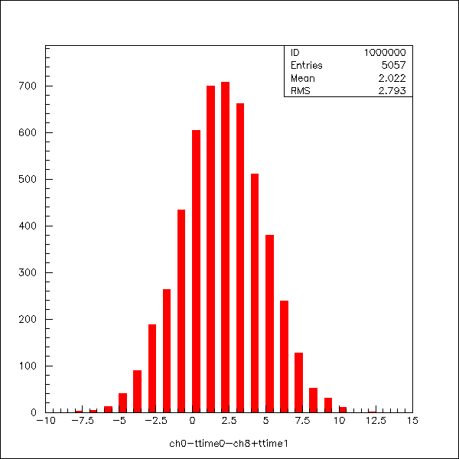
2.5 GHz combining different channel from different mezz cards
Each Channel w/r to its own trigger.
Resolution: 3/16*0.4 ns = 75 ps

Slide 6
2.5 GHz
The flash adc is based on domino ring architecture.
this fact has several implication:
a) its behaviour is determined but internal delay lines which
must be calibrated
b) different physical reagion of the chip can behave differently
this fact can have impact on time resolution at different time.

Slide 7
2.5 GHz studies inserting external delay lines
2 delay lines have been added to ch1 input and ch2 input in order to get about 2ns delay and 5 ns delay so that we can stimulate different physical reagion of the chip delay lines.

Slide 8
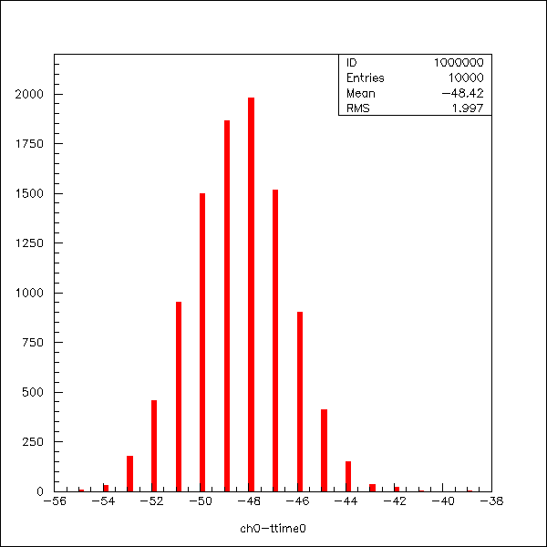
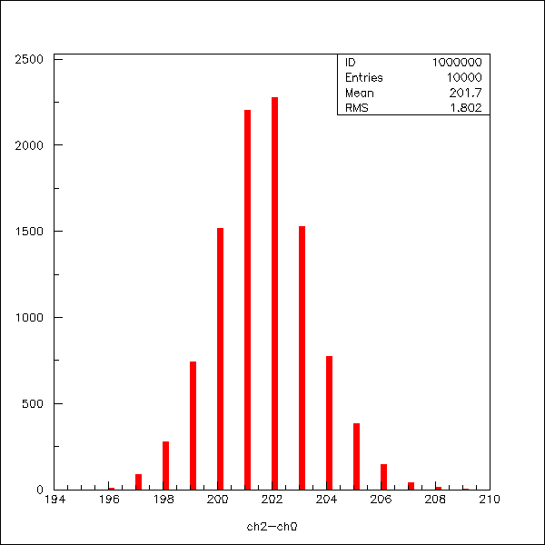
2.5 GHz final
Just to remember the problem: ch0-tr0 different from ch0-ch1 rms = 2/16*0.4 ns
RMS = 1.9
Delay=81.77/16*0.4=2,04ns
RMS = 1.8
Delay=201,7/16*0.4=5,04ns

Slide 9
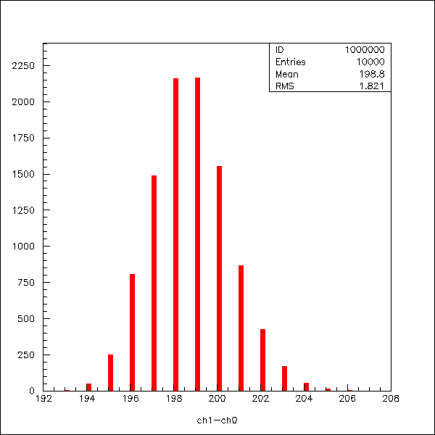
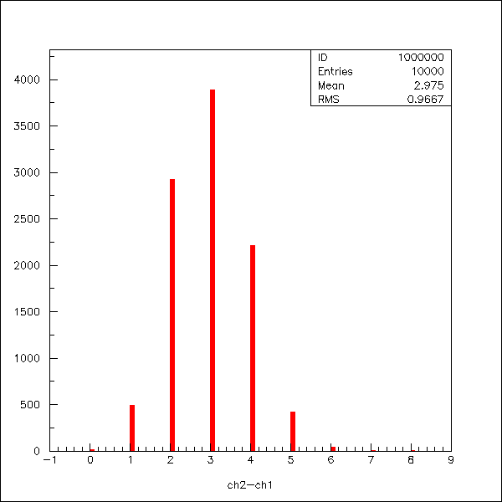
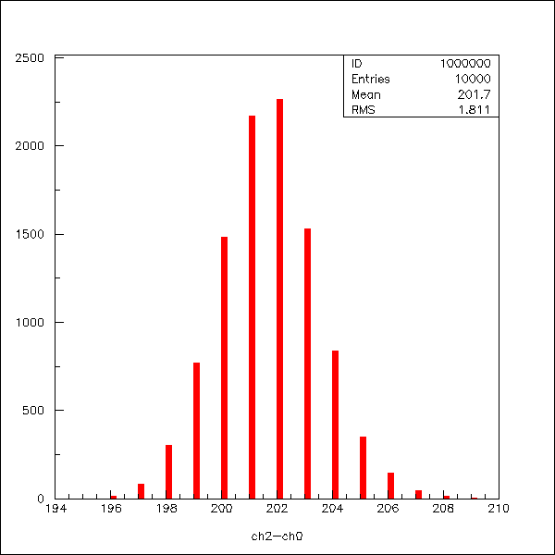
2.5 further check
Ch1 and Ch2 both delayed by 5 ns to see if the problem was induced by the external delay or by the chip delay lines.
RMS = 50 ps
RMS = 25 ps!!!
CH2-Ch0
RMS=50 ps
My conclusios: the problem is in the chip delay line.

Slide 10
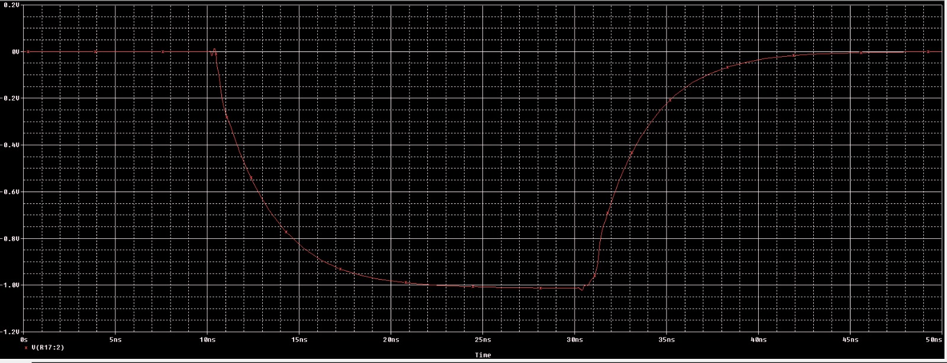
Fan-out signal output simulation

Slide 11
Fan-out
protoype timing properties checked.
They closely follow experiment specs.
ARTEL has produced 7 boards.
We have received them yesterday.
The boards will be checked one by one. interaction with daq is trivial.

Slide 12
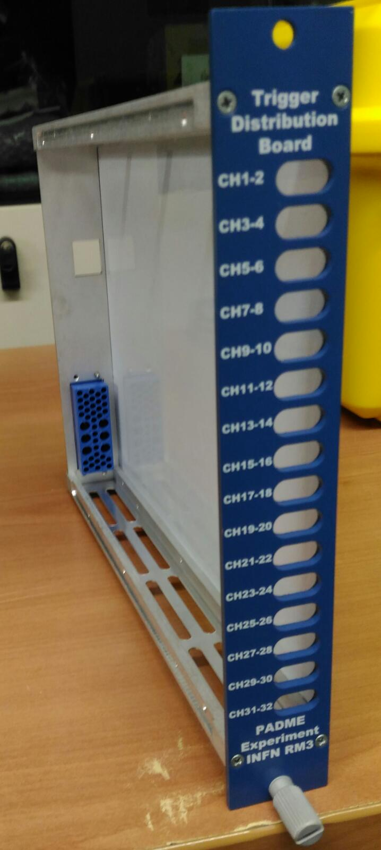
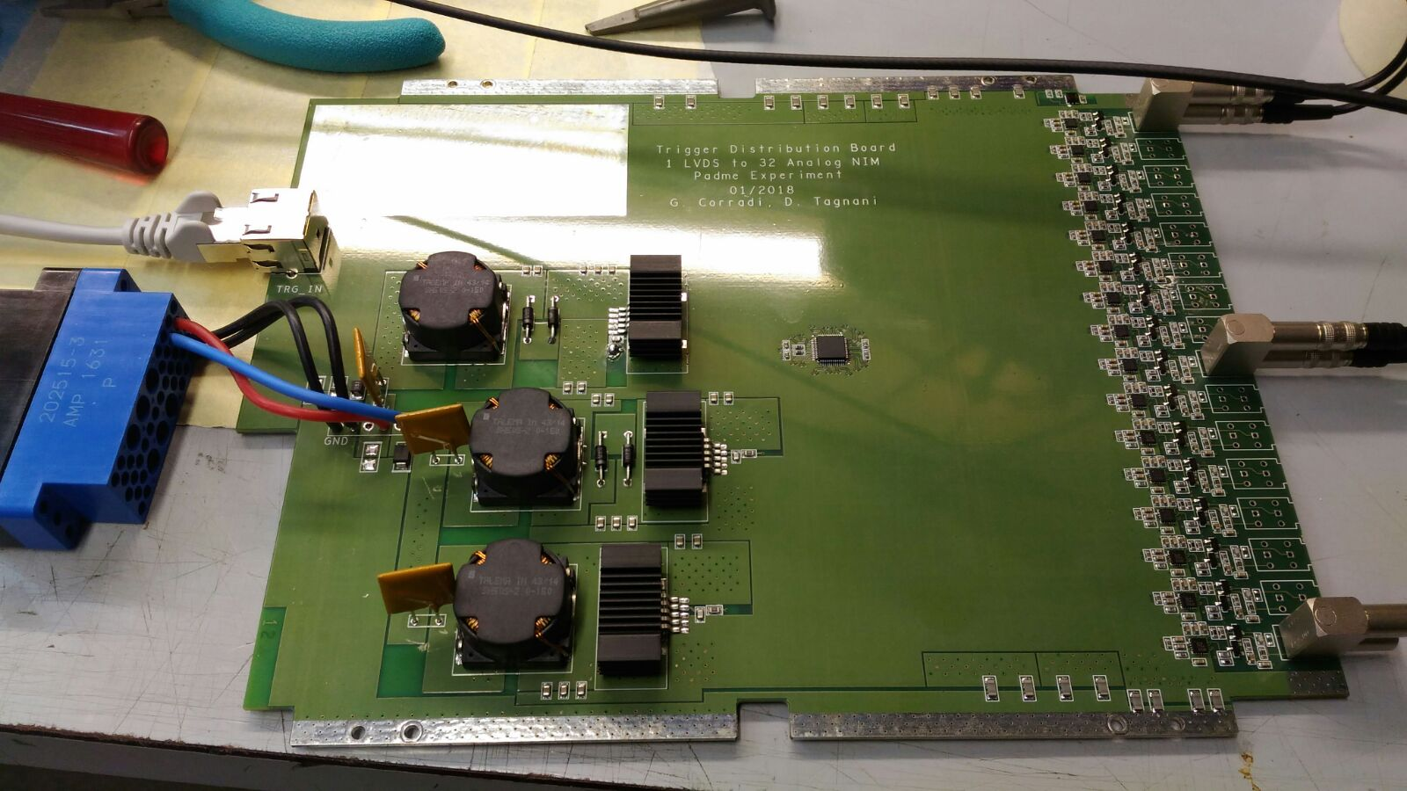
Fan-out trigger distribution board
Mechanics and pcb integration board will occur starting on Monday 12° march 2018@RomaTre

Slide 13
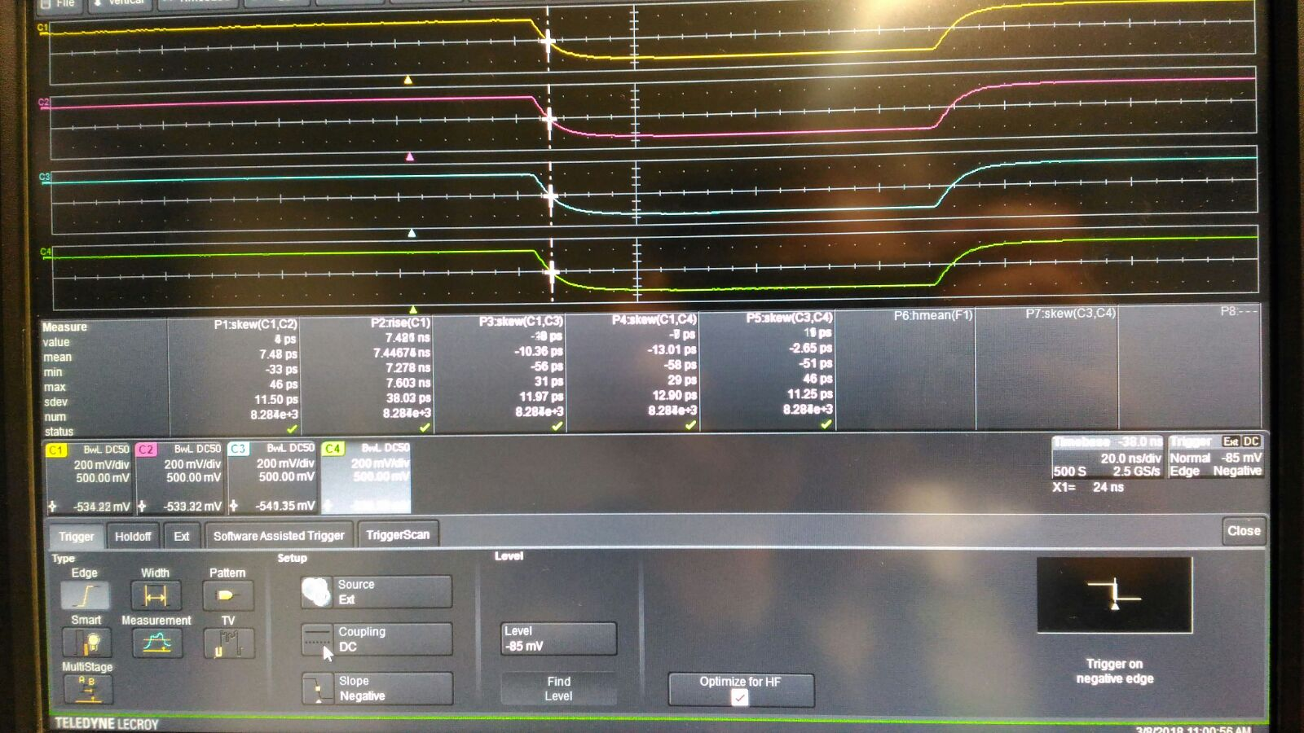
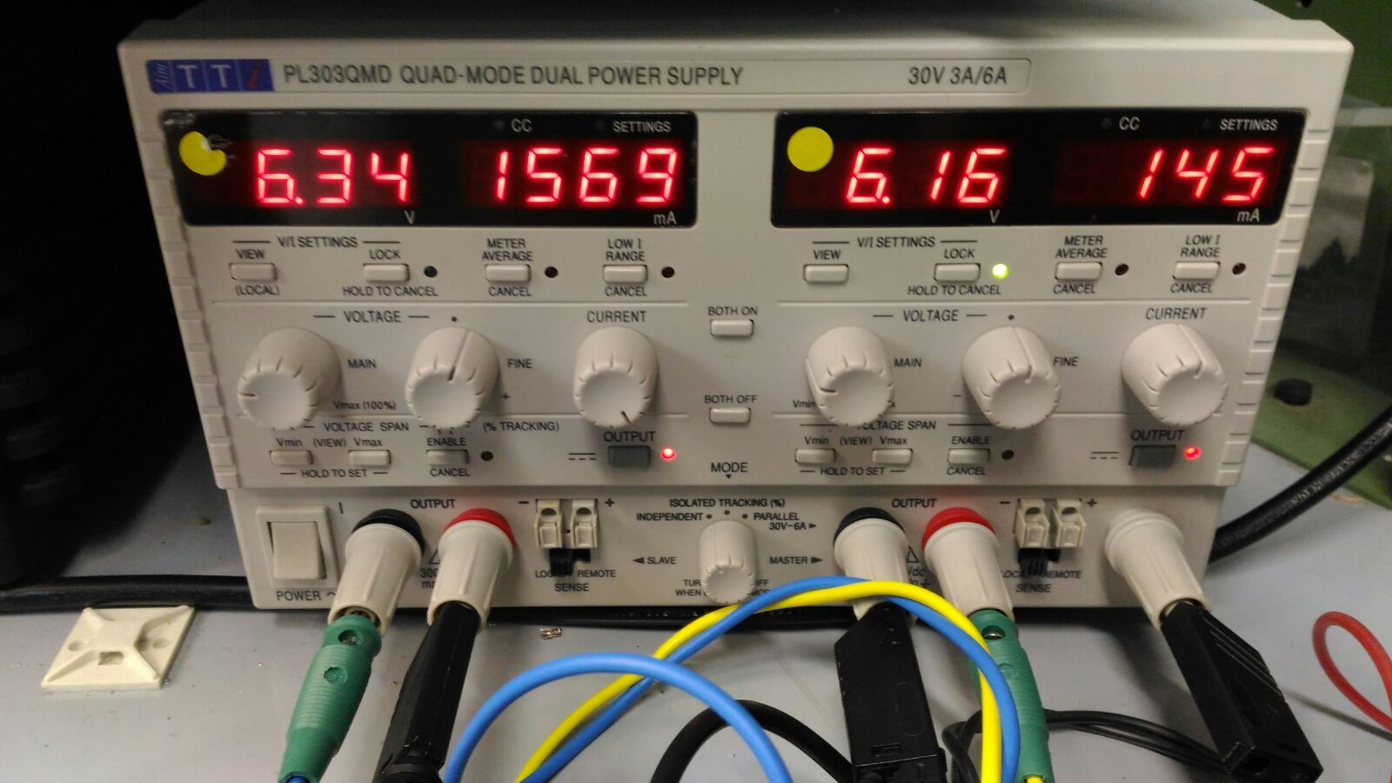
Fan-out tests
Current absorption@6V
time resolution measured: 12 ps

Slide 14
RF
50Hz
Cosmic
Random
Silicon chip
???
1) 1 LVDS to 2 ECL Trigger Distributor
ICS853S9252
Skew 15ps,
Skew Part to Part 50ps,
Propagation Delay 175ps
Jitter 45fs RMS
Fmax 122MHz
Rise/fall Time 135ps -3.3V
1) ECL to Analog Trigger.
Jitter max 150ps RMS
Tbase ~30ns
Rise/fall Time 10ns at
-1V
CPU TRIGGER
LVDS Trigger Low Active ~20ns
1 to 16 LVDS Trigger Distributor
ICS8516
Skew 90ps,
Skew Part to Part 90ps,
Propagation Delay 2,4ns
Jitter 148fs RMS
Fmax 700MHz
Rise/fall Time 100/500ps 3.3V
CAEN ADC CONTROL
1 to 2 LVDS Trigger Distributor
ICS8516
Skew 90ps,
Skew Part to Part 90ps,
Propagation Delay 2,4ns
Jitter 148fs RMS
Fmax 700MHz
Rise/fall Time 100/500ps 3.3V
SILICON Chip
.
.
16) 1 LVDS to 2 ECL Trigger Distributor
ICS853S9252
Skew 15ps,
Skew Part to Part 50ps,
Propagation Delay 175ps
Jitter 45fs RMS
Fmax 122MHz
Rise/fall Time 135ps -3.3V
Board 1
1 LVDS to 32 Analog Trigger Distributor
Jitter max 150ps RMS
Tbase ~30ns
Rise/fall Time 10ns -1V
Board 2
1 LVDS to 32 Analog Trigger Distributor
Jitter max 150ps RMS
Tbase ~30ns
Rise/fall Time 10ns -1V
32) ECL to Analog Trigger.
Jitter max 150ps RMS
Tbase ~30ns
Rise/fall Time 10ns at -1V

Slide 15
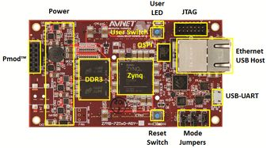
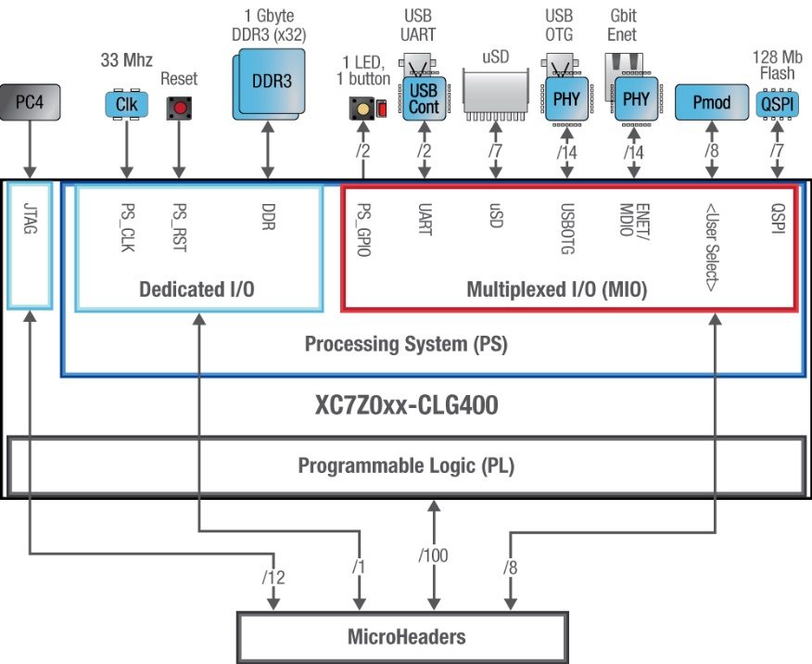
CPU TRIGGER
Ethernet for PC comunicator
Possibility to have Linux sistem with server machine, in ARM processor.
Possibility to have SPI I2C JTAG USB protocol interface
AES-Z7MB-7Z020-SBC-I-G
FPGA on-board for integrate trigger logic.
4 or more LEMO
TRIGGER
INPUT
AES-Z7MB-7Z020-SBC-I-G
TRIGGER OUT Silicon
1 to 2 LVDS Trigger Distributor
ICS8516
Skew 90ps,
Skew Part to Part 90ps,
Propagation Delay 2,4ns
Jitter 148fs RMS
Fmax 700MHz
Rise/fall Time 100/500ps 3.3V
LVDS IO CONTROL
RJ45 Trigger LVDS OUT1
RJ45 Trigger LVDS OUT1

Slide 16
CPU trigger -> TIMEPIX3
We had a meeting on the 23° november 2017
The following things were discussed and decided:
The interaction with TIMEPIX3 occurs via 4 signal
CLK (common to EMC fe), T2TP3, TSHUTTER, BUSY
The CLK is common to the EMC (same chip 40 MHz CLK)
The BUSY signal is asseterd by the TIMEPIX3 fe and delivered to the
CPU trigger.

Slide 17
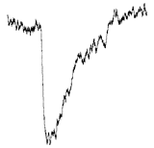
Trigger timing diagram
Stanford (BTF master trigger signal)
Physics
Trigger cal programmable delay
ΔV
T0
Trigger timepix3 programmable delay
Programmable shutter window signal size
shutter timepix3 programmable delay

Slide 18
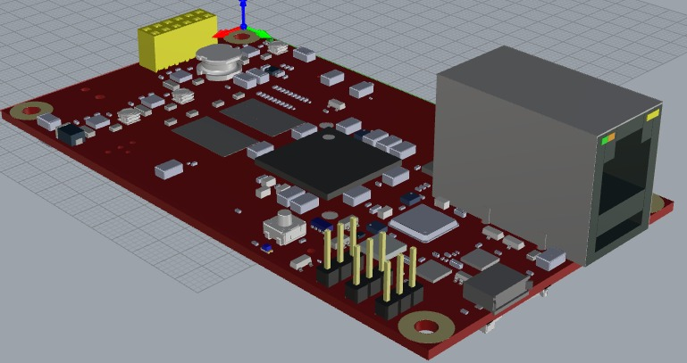
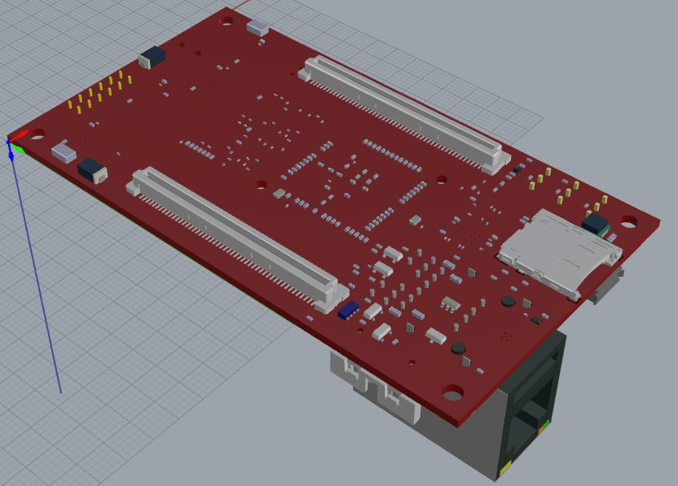
CPU trigger (brain) 3D model
This is the brain of the CPU-trigger

Slide 19
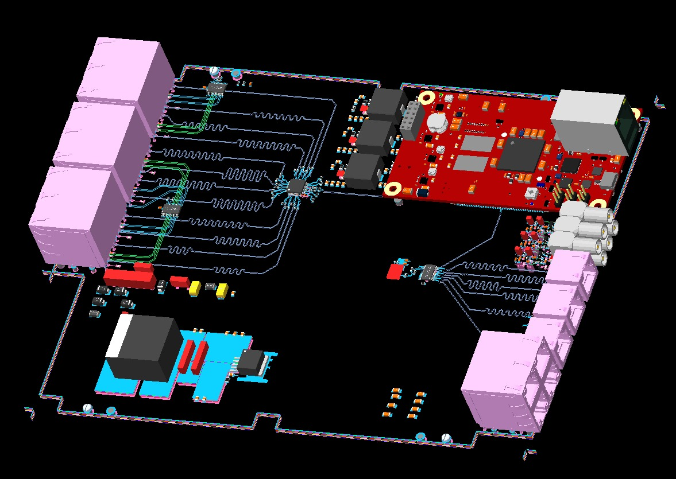
CPU-trigger full design
The real «brain» of
the system.
Slave trigger
Distribution
for fan-out
units
Ethernet
Interface to daq
system
Trigger input lines
NIM std
Busy clk and
Signal handling
for timepix3

Slide 20
CPU-trigger 40 MHz test
A protype of the CPU-trigger arrived yesterday. Unfortunately the 40 MHz quartz (DSC1123AE2-040.0000) did not arrive we are waiting for it. Arrow is the only provider we are in contact with them. However to be faster we assumed test is fine and already ordered all the quartzs (3) we need to mount all the boards (should we be wrong we’ll have to design the board again).
We need some hw check and then we’ll test the 40 MHz
distribution as soon as we have it and its impact on time accuracy.

Slide 21
Trigger production status
Fan-out produced
CPU-trigger first test board delivered (no 40 MHz quartz).
We are striving to have the full system by march 31°.

Slide 22
To be done
The fw of the CPU-trigger is being written right now.
We can already exchange data through a tcp/ip socket.
We must test and validate it.
CPU-trigger must be handled by the daq system therefore we must write and debug the needed sw.
And after….we must test test test test test!!!!!!!!!!!!!!!

Slide 23
Therefore….
We can guarantee we’ll do our best to match 31/3/2018 we cannot guarantee we’ll not be late.

