Slide 1

Enrico Nardi
Dark photons production in e⁺ beam dump experiments via resonant e⁺e⁻ annihilation
Based on arXiv:1802.04756 with C.D.R.Carvajal, A. Ghoshal, D. Meloni, M. Raggi
PADME meeting LNF – March 9, 2018

Slide 2
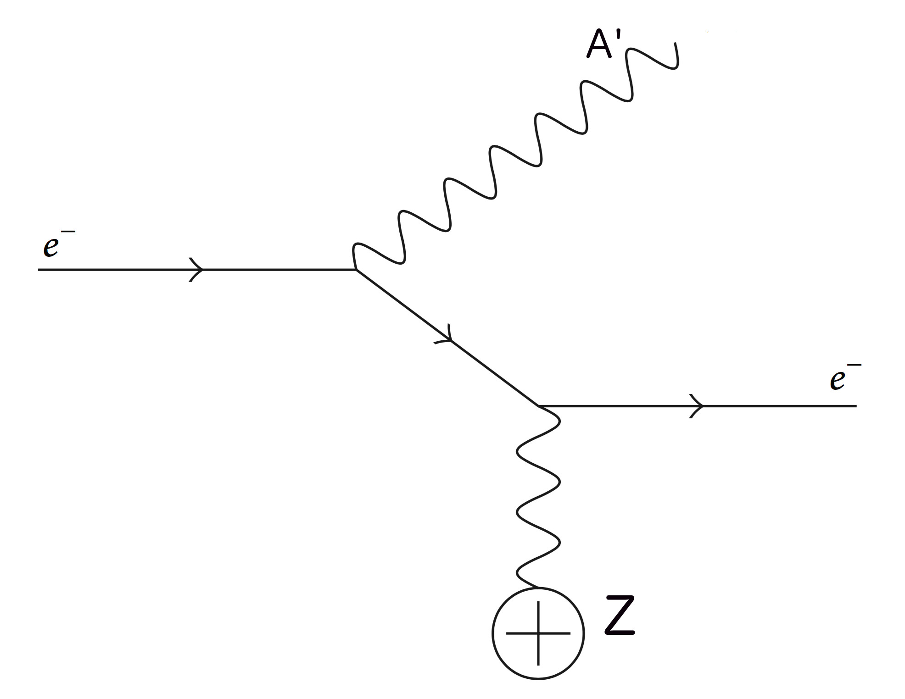
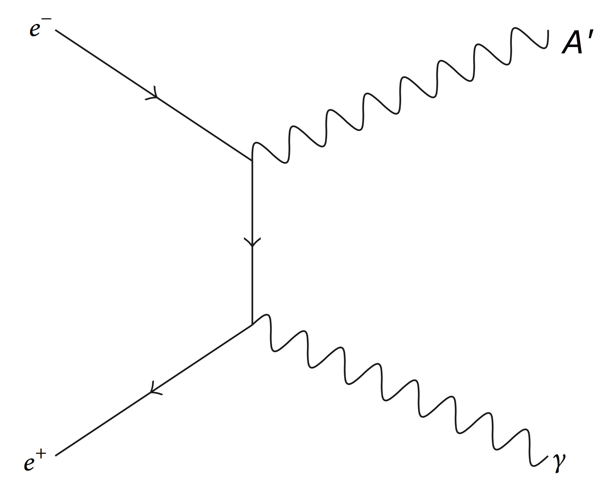
Fixed target experiments for DP searches
Electron beams fixed target experiments:
Electron scattering off nuclei: A’ bremsstrahlung
O(α³) process
A’ production via electron bremsstrahlung:
APEX,HPS,DarkLight (JLab) A1, MAGIX (Mainz),
NA64 (CERN), (SLAC), (Cornell)…
Positron beams fixed target experiments:
Positron-electron 2-body annihilation e⁺ e⁻ → A’ γ
[analogous of e⁺ e⁻ → γ γ] O(α²) process
Positron beam experiments [proposed]:
VEPP3 (BINP), PADME (LNF), [MMAPS (Cornell)]

Slide 3
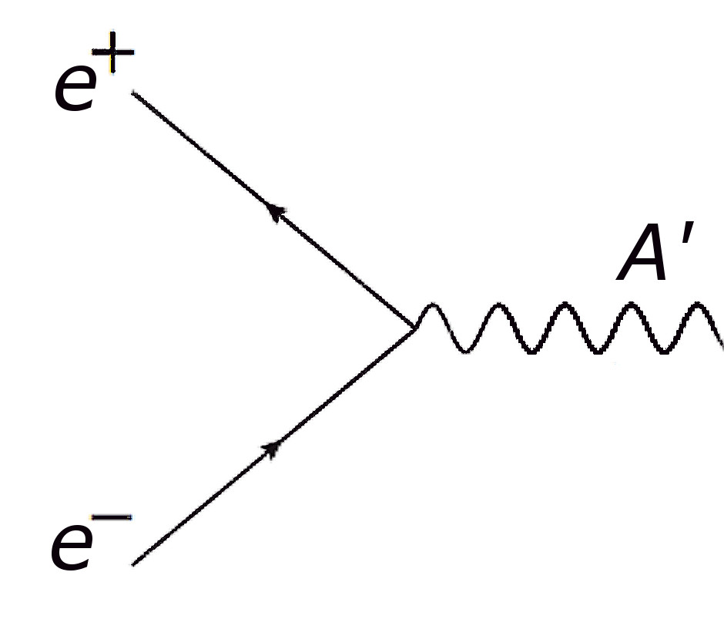
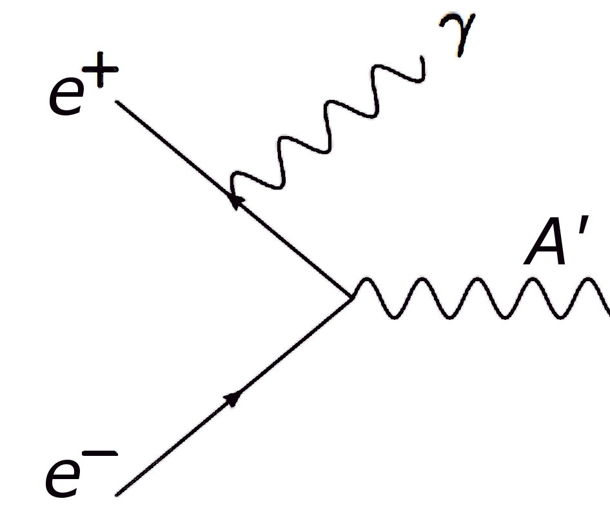
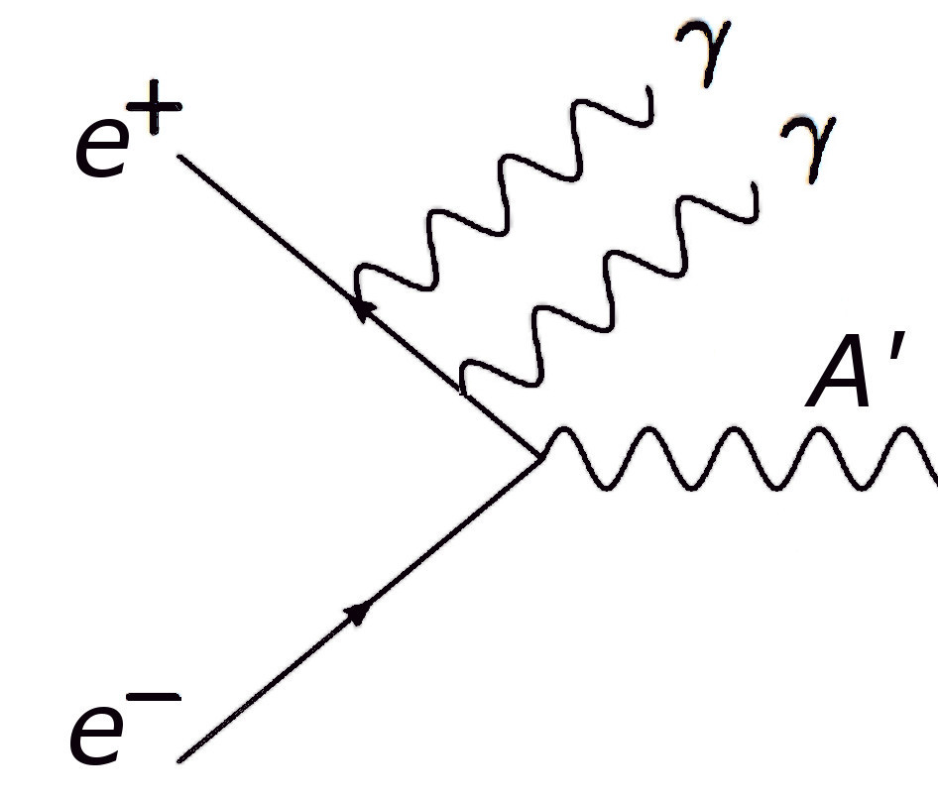
Fixed target experiments for DP searches
PROPOSAL:
Positron-electron resonant annihilation e⁺ e⁻ → A’
[analogous of e⁺ e⁻ → Z ] O(α) process
ε
However: Γ_{Z} = 2.5 GeV, Γ_{A’} ~10⁻³ – 10⁻⁴ eV
Because of the continuous energy loss of positrons
when propagating through matter, positrons “scan”
downward in energy until hitting the resonance, enhancing the production rate.
“Radiative return” also helps enhancing the x-section by “widening” the resonance:
+
+
+ ….

Slide 4
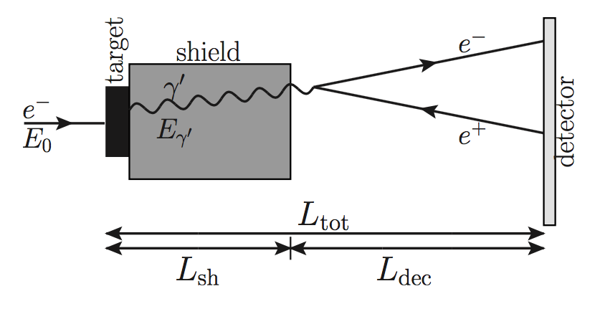
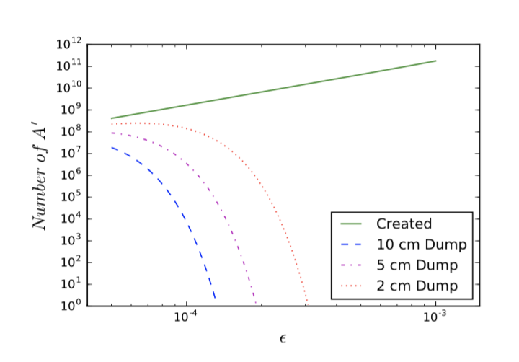
Sketch of the setup of a positron beam dump experiment
(Adapted from electron bremsstrahlung A’ production)
|
S. Andreas et al. PRD86,095019 (2012)
|
To be detectable A’ must decay
to e+ e- outside the dump.
ε ~ 10⁻⁴ ==> L_{decay} ~ 8.5 mm

Slide 5
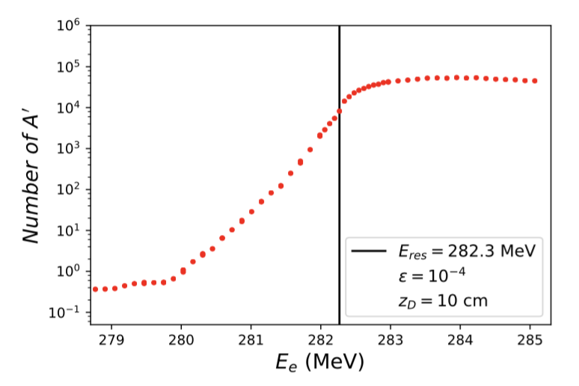
Resonant A’ production: peculiarity & advantages
Resonant e⁺ e⁻ → e⁺ e⁻ production is only
quadratically dependent on ε: σ_{res} ~ ε²/m²_{A’}
(good sensitivity at small ε)
10¹⁸ e⁺/yr
- To an excellent approx. decay length L_{D} = γ c τ
independent of m_{A’}: L_{D}=(m_{A’}/2m_{e})(1/Γ_{A’})∝1/m_{e}
(constant sensitivity for different A’ masses)
- Background can be directly obtained from data
collected below the resonance (above almost constant)
Suppression of A’ production rates from momentum distribution of target electrons (which are not at rest)
e⁺ energy distribution vs. radiation length t
- Compensated by scan in energy: ΔE~10 eV per
single ionization (ΔE~10 MeV for 1X₀ in ₇₄W)
- Slight reduction of A’ production due to loss
of positrons via e⁺ e⁻ → γ γ (neglected)

Slide 6
Comparing A' production modes
Frascati DAΦNE BTF: number of e⁻⁽⁺⁾/yr: 10¹⁸ (LNF site authorization limited)
2x10²⁰ (1.2 x 10¹¹ x 50 x 3.15 x 10⁷ technically faisable)
m_{A’} ≤ 24 MeV E_{max} (e⁻/e+): 800 MeV/550 MeV
m_{A’} ≥ 16 (14) MeV E_{min} (e⁻/e+): 250 MeV (in-matter e+ energy losses)
Comparison: A’ produced for m_{A’} = 17 MeV; ε = √α’/α=10⁻⁴; E_{b} = 550 MeV
Production mode | E_{beam} (MeV) | T [integration] | A’ produced
Bremsstrahalung (e⁻) | 550 | 0.5 | 4.1 x 10⁷
Annihilation (e⁺) | 550 | 0.5 | 8.7 x 10⁸
Resonant (e⁺) | E_{res}=282 MeV | [0 – 0.5] | 8.1 x 10⁹
Resonant (e⁺) | E_{res} + 2σ_{beam} | [0 – 0.5] | 13.2 x 10⁹

Slide 7
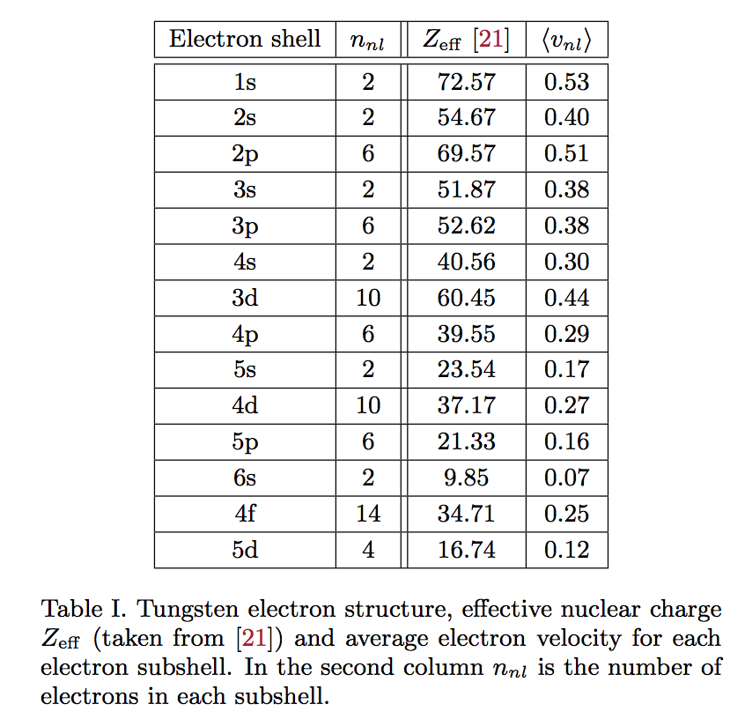
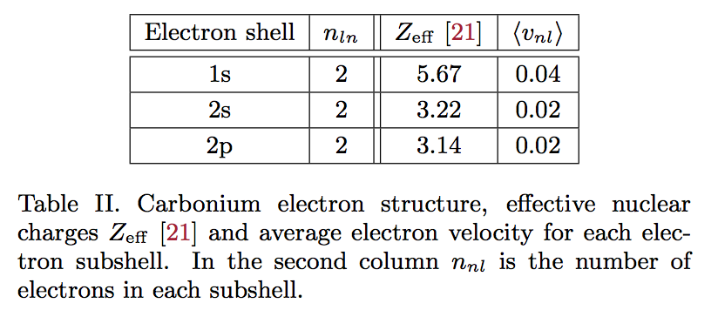
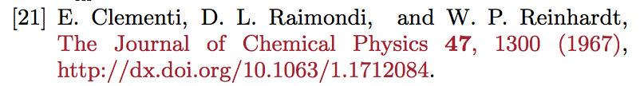
Momentum distribution of electrons in tungsten
The average velocities for each subshell are estimated here via the virial theorem. This gives an indication of the relevance of including target electrons momentum. A detailed momentum distribution function is needed.

Slide 8
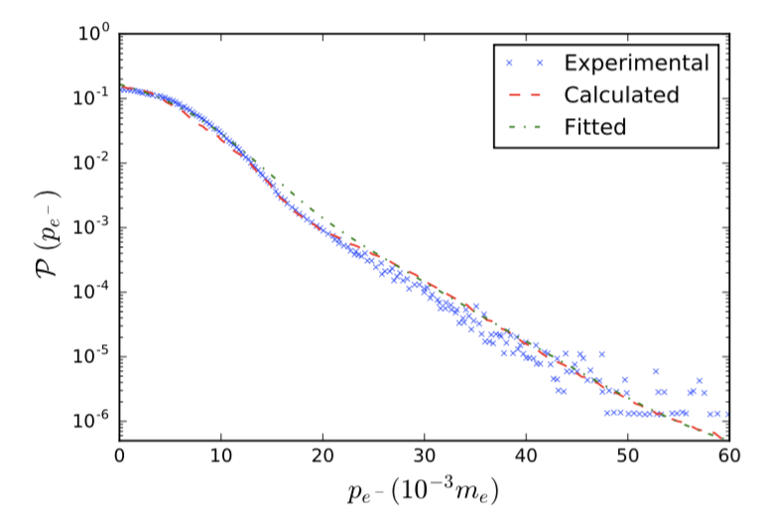
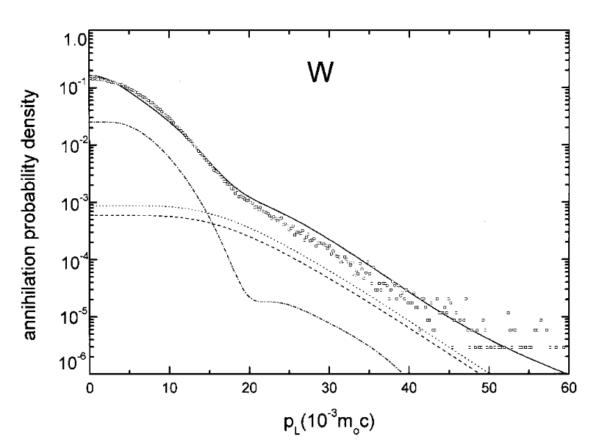
P(p_{e-}) distribution is directly measured in the
Doppler broadening of the e⁺e⁻→ γ γ radiation
Our interpolation (blue dashed line)
V.J.Ghosh et al., Phys.Rev.B 61 no.15 (2000)
5d⁴ shell☝ 4f¹⁴ shell☝ core electrons (∼1/p)☝
P(p_{e-}) measured with e⁺ at rest. Can this be good also for E(e⁺) ∼ 100 MeV ?
In principle, probably not. But N(A’)_{obs} = N(A’)_{prod} Exp[-c⋅ε²] (Small effect on ε)

Slide 9
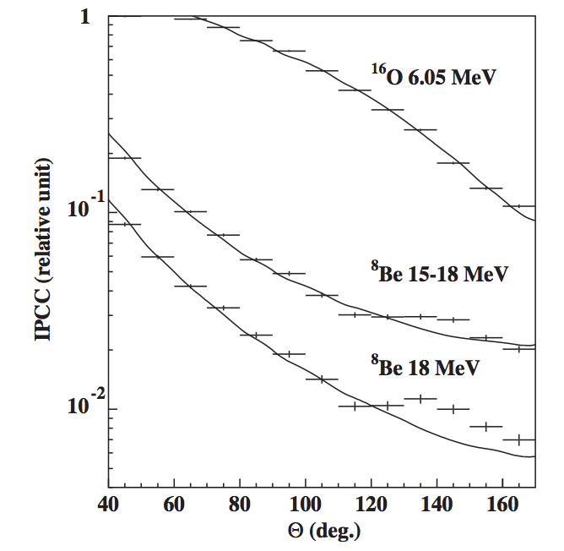
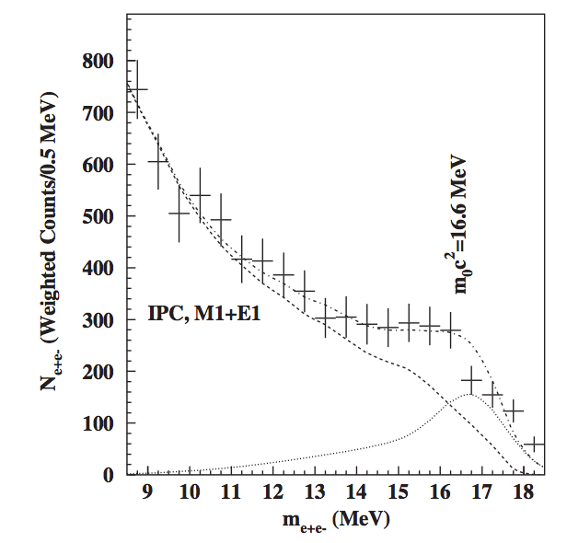
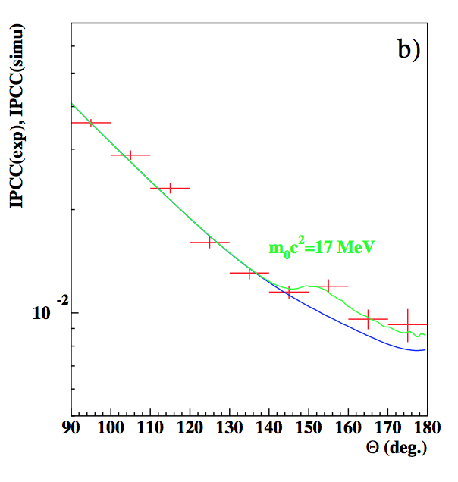
The Atomki anomaly in ⁸Be nuclear decays (6.8 σ)
A. Krasznahorkay et al. PRL117,071803,2016
The Atomki collab. has observed unexpected bumps in ⁸Be* ➞ ⁸Be e⁺ e⁻ decays:
e⁺e⁻ opening angles θ ≈ 135º θ ≈ 155º
e⁺e⁻ invariant masses m_{e+e−}≈16.7 ± 0.35 ± 0.5 MeV m_{e+e−}≈17.0 ± 0.2 ± 0.5 MeV
18.15 MeV ⁸Be* state
17.64 MeV ⁸Be* state

Slide 10
Anomaly consistent with decays via A’ gauge boson
⁸Be* ➞ ⁸Be A’ ➞ ⁸Be e⁺ e⁻
Summary of the (constrained) A’ parameters:
Mass: m_{A’} ≈ 17.0 ± 0.5 MeV
Coupling strengths (× √4πα): ε_{n} ≈ (2–10) × 10⁻³
ε_{p} ≲ 1.2 × 10⁻³ [constrained by π ➞ Α’ γ]
[Beam dump E141] 2 × 10⁻⁴
[ ORSAY ] 6 × 10⁻⁵ ≲ ε_{e} ≲ 1.4 × 10⁻³ [(g-2)_{e} and KLOE (e⁺ e⁻ → A’ γ)]
[ KEK ] 5 × 10⁻⁵
J.L.Feng et al., PRD95, 035017 (2017)
}
S.Andreas, C.Niebuhr, A.Ringwald, PRD86,095019 (2012)

Slide 11
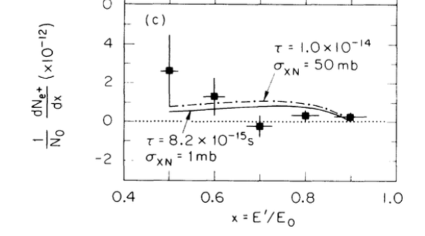
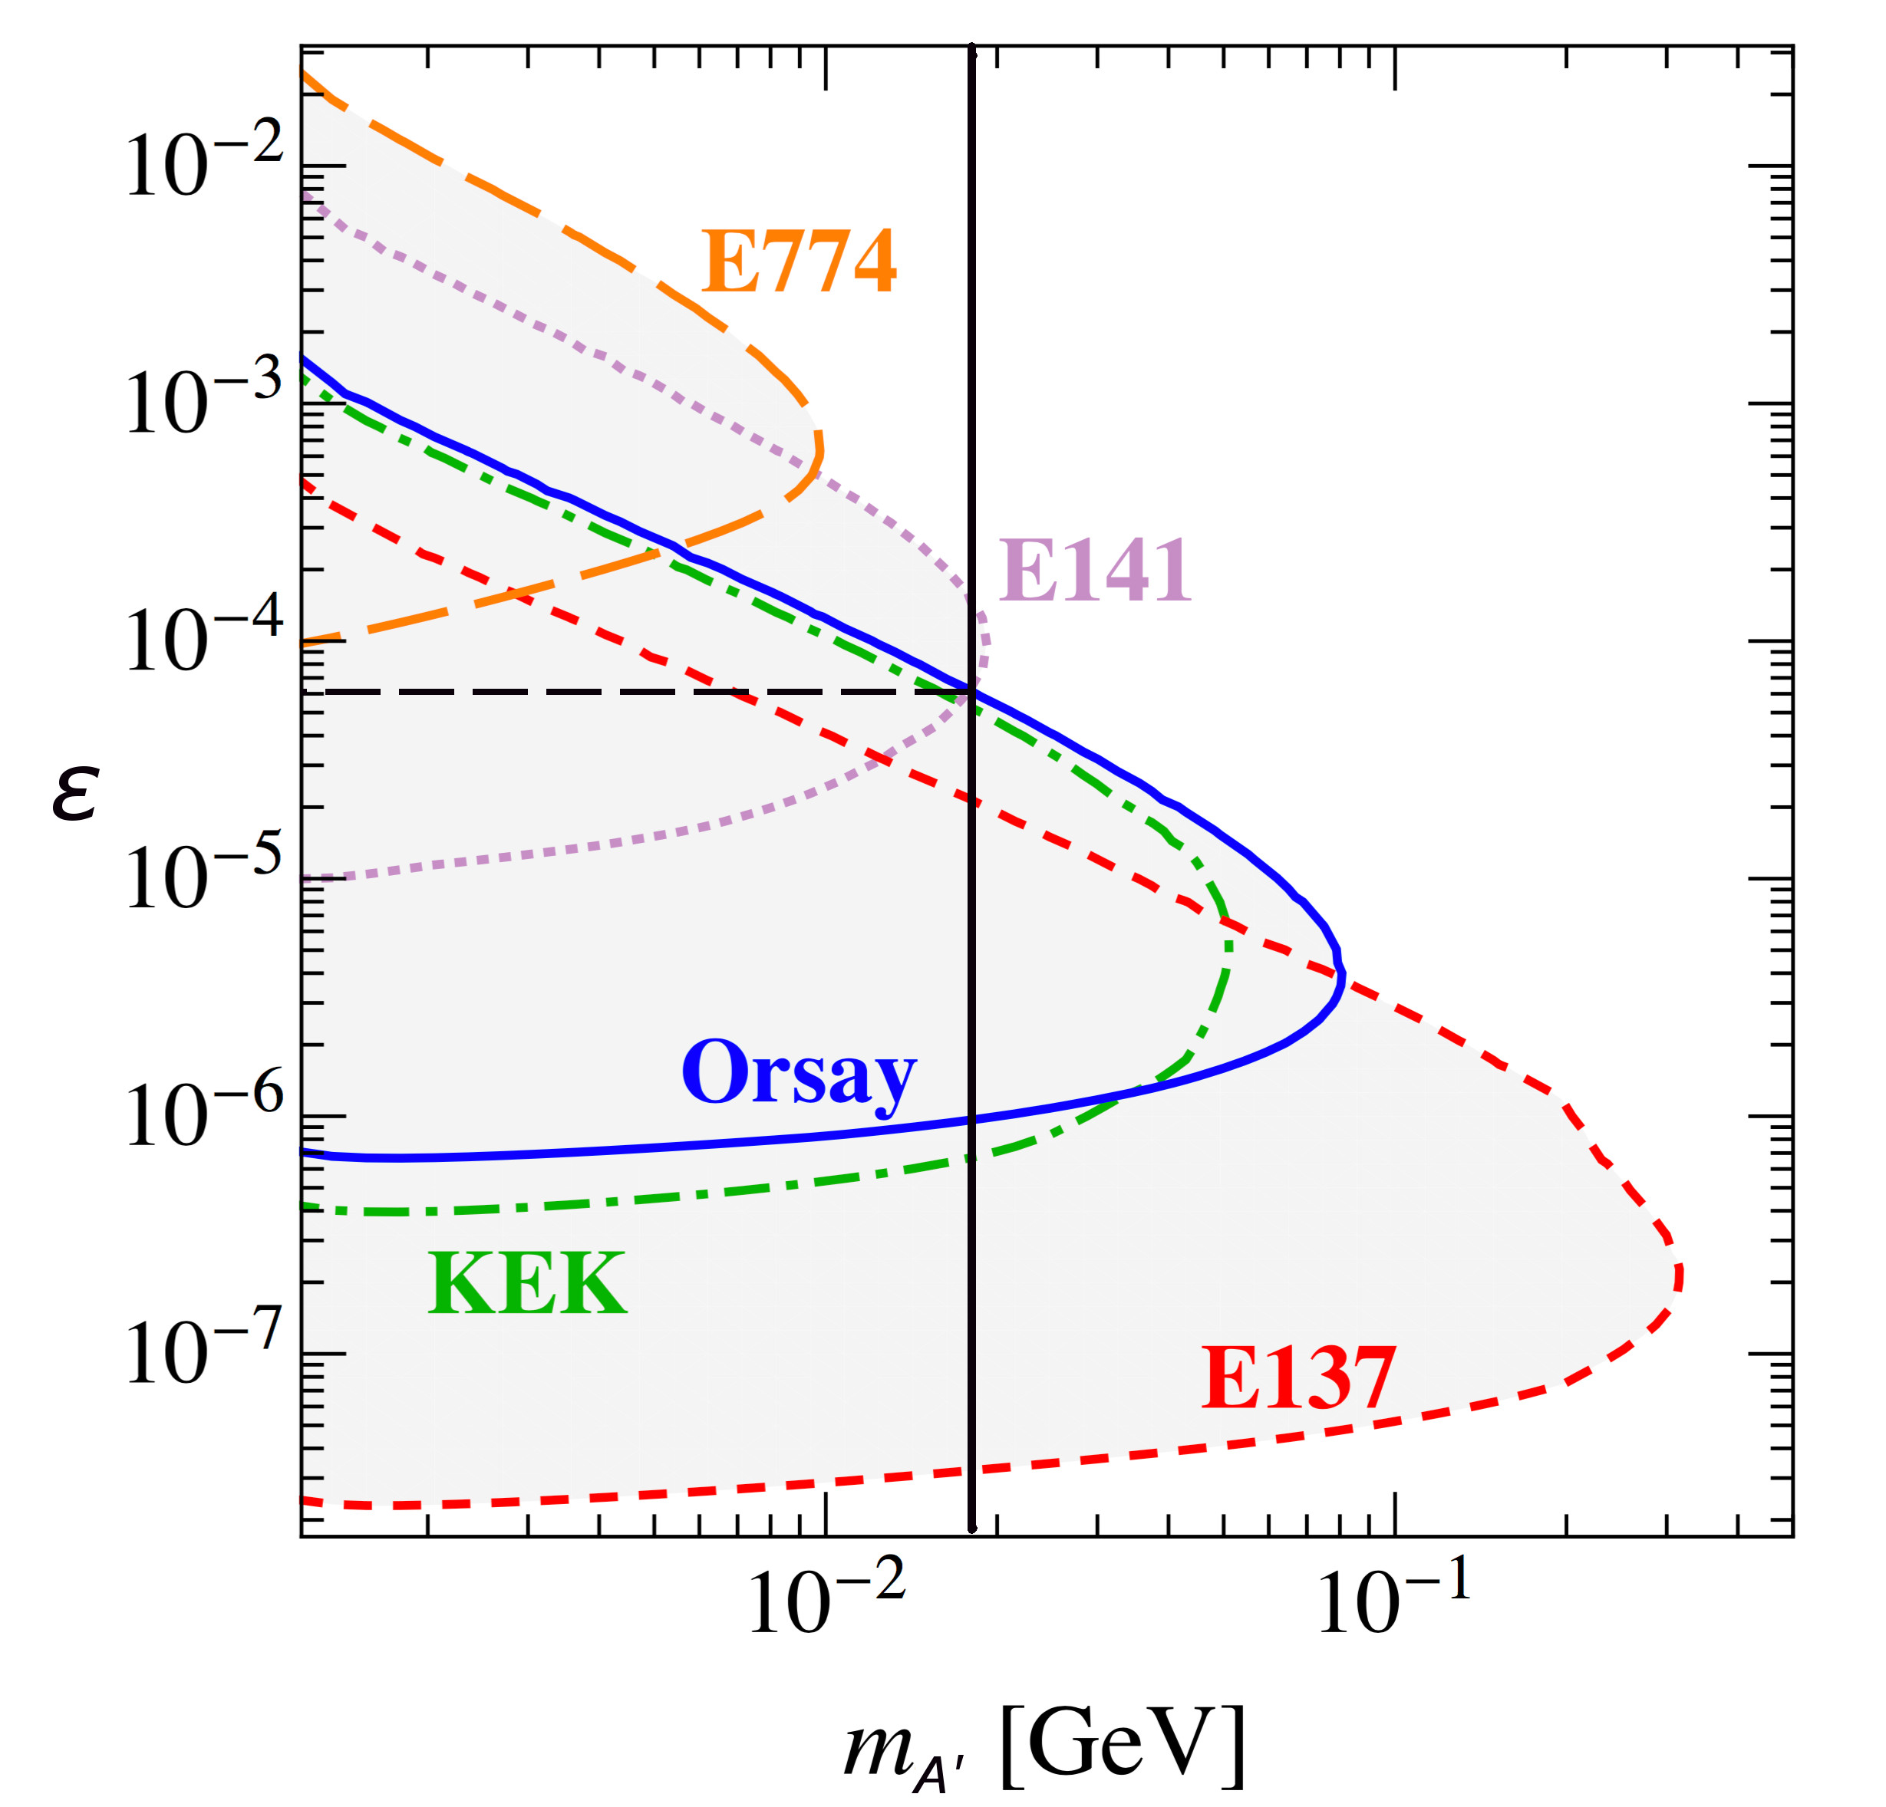
Questioning the limit from E141
Limit derived in S. Andreas et al. PRD86,095019 (2012) confronting data from the E141 paper
(E.M. Riordan et al.. RL59 7,755 - 1987)
and with cross-sections computed adopting the Weizsacker-Williams approximation.
For m_{A’}≈17 MeV the E141 constraint
is close to the mass reach limit, and
thus sensitive to any approximations in the phase space integrations
S. Andreas et al. PRD86,095019 (2012)

Slide 12
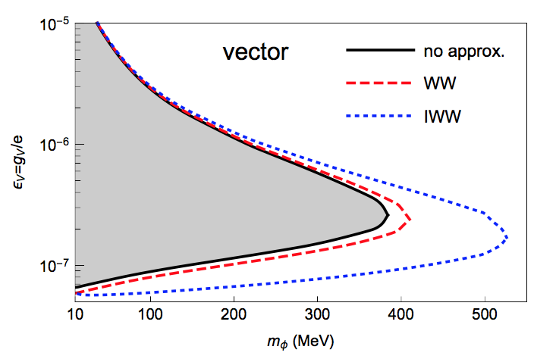
Questioning the limit from E141
The validity of the WW approximation has been recently studied in Yu-Sheng Liu and G. A. Miller PRD96 (2017) 1, 016004. Results have been applied to the E137 limit (E_{b}=20 GeV)
E137 (E_{b}=20 GeV) (Plot is linear)
Yu-Sheng Liu and G.A. Miller
PRD96 (2017) 1, 016004
The allowed range of A’-electron couplings is likely:
(ORSAY) 6 × 10⁻⁵ ≲ ε_{e} ≲ 1.4 × 10⁻³ (g-2)_{e}

Slide 13
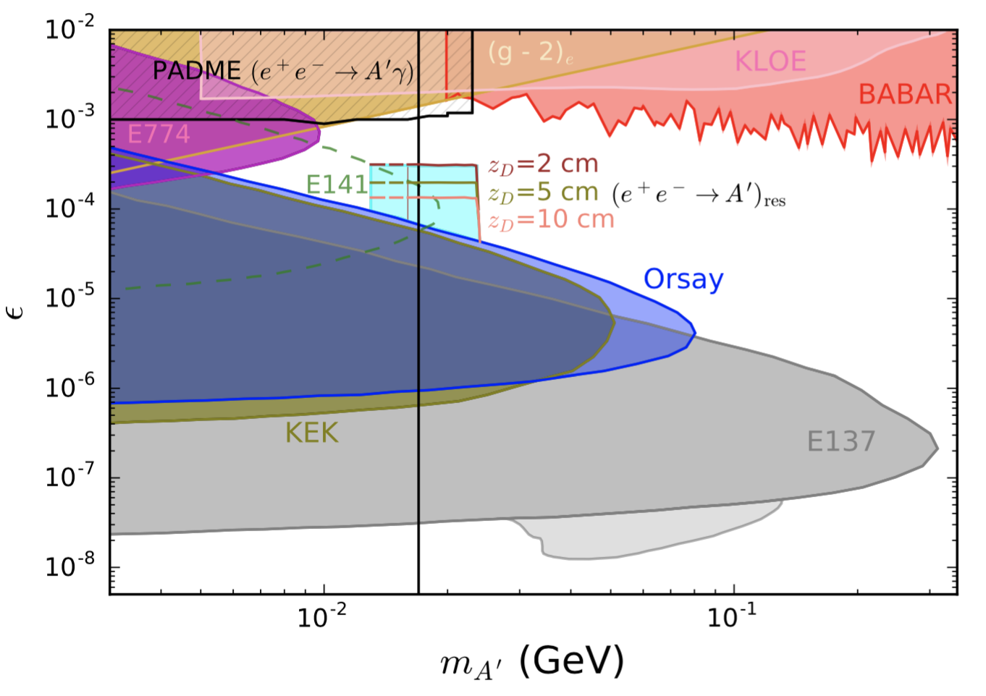
PADME reach with e⁺ e⁻ resonant annihilation
PADME exclusion reach in original e⁺ e⁻ → A’ γ mode is shown in the top left corner
Reach in mass:
14 (16) MeV < m_{A’} < 24 MeV
ε_{e} ≳ 1.6 × 10⁻⁴
With 10 cm tungsten-dump
(presumably background free)
ε_{e} ≳ 2.0 × 10⁻⁴
With 5 cm tungsten-dump
(controllable background ?)
ε_{e} ≳ 3.0 × 10⁻⁴
With 2 cm tungsten-dump
(optimistic)
Contribution to E137 exclusion after including resonant e⁺ e⁻ → A’ annihilation in EM showers [arXiv:1802.03794 L. Marsicano, M. Battaglieri, M. Bondi', C.D.R. Carvajal, A. Celentano, M. De Napoli, R. De Vita, E. Nardi, M. Raggi, P. Valente]

Slide 14
The way to go to close the gap upwards to
ε_{e} ≲ 1.0 × 10⁻³, that is L_{decay} ~ 85 μm :
Thin targets of size L ≲ few 100 μm - 1 mm
+
- Ingenious strategies to control background, among which:
- Invariant mass reconstruction to ensure: m_{e+e−}≈17 MeV (bump searches)
- Veto to eliminate e+e- originating from inside the target
- Reconstruction of the displaced vertex occurring outside the target
Scanning in energy for a knee in e+e- production remains
a promising technique also for thin targets.

Slide 15
In conclusion:
(Quotes in color are from the “New directions in dark matter and neutrino physics” PI workshop webpage
Perimeter Institute, Ontario CA – July 2017)
We want to propose a new creative use of a planned facility (PADME@LNF) and an alternative method of probing new physics (DP) at high-intensity accelerators (BTF@LNF)
Thanks for your attention
Comments/suggestions are most welcome

Slide 16
Additional slides

Slide 17
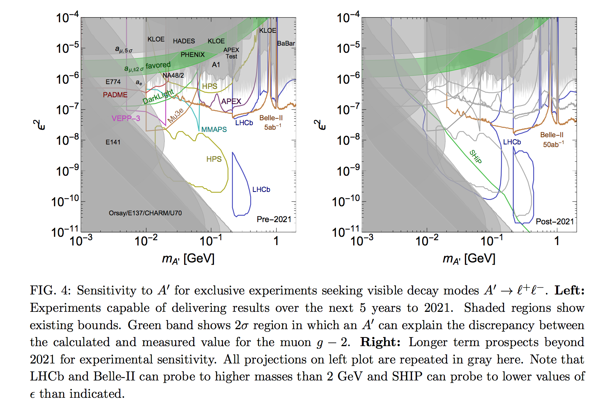
Dark Sectors 2016 Workshop: Community Report arXiv:1608.08632

Slide 18
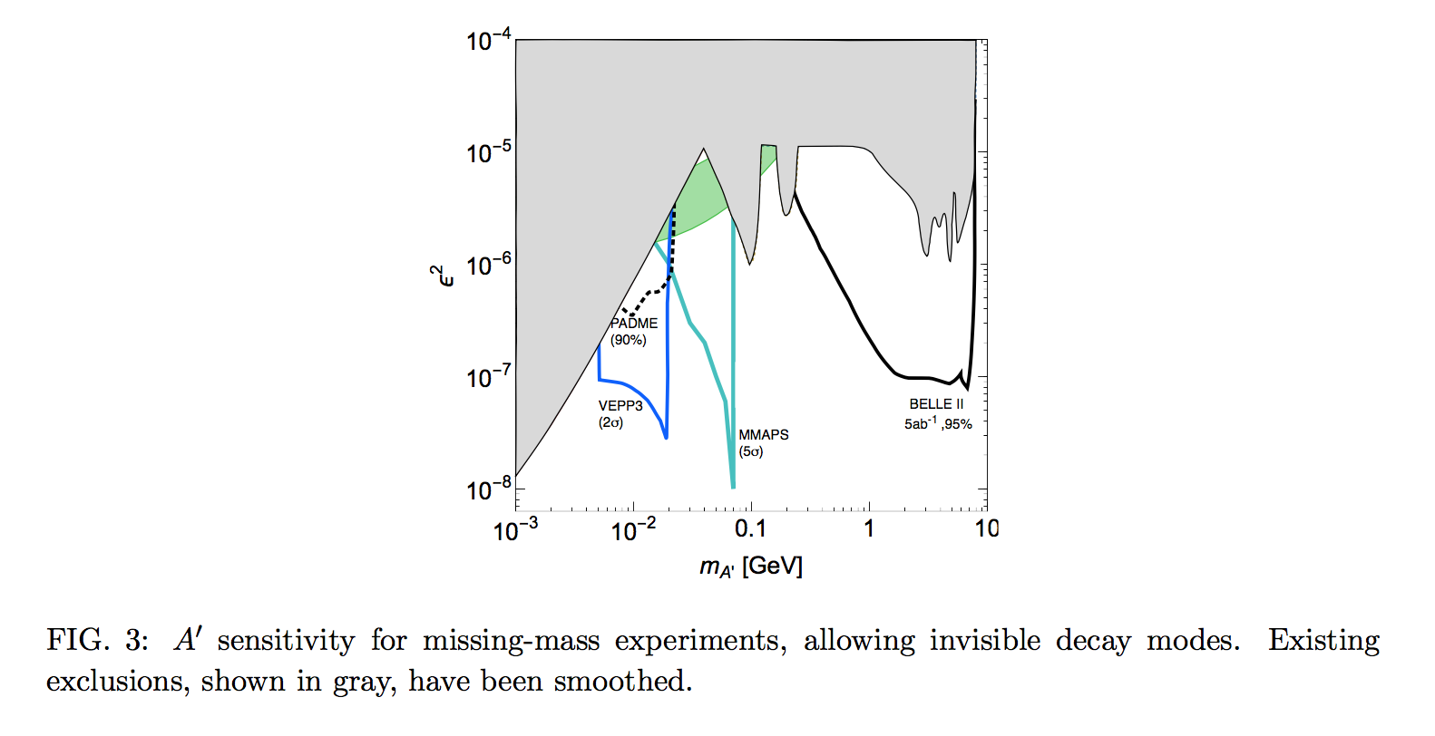
Dark Sectors 2016 Workshop: Community Report arXiv:1608.08632

Slide 19
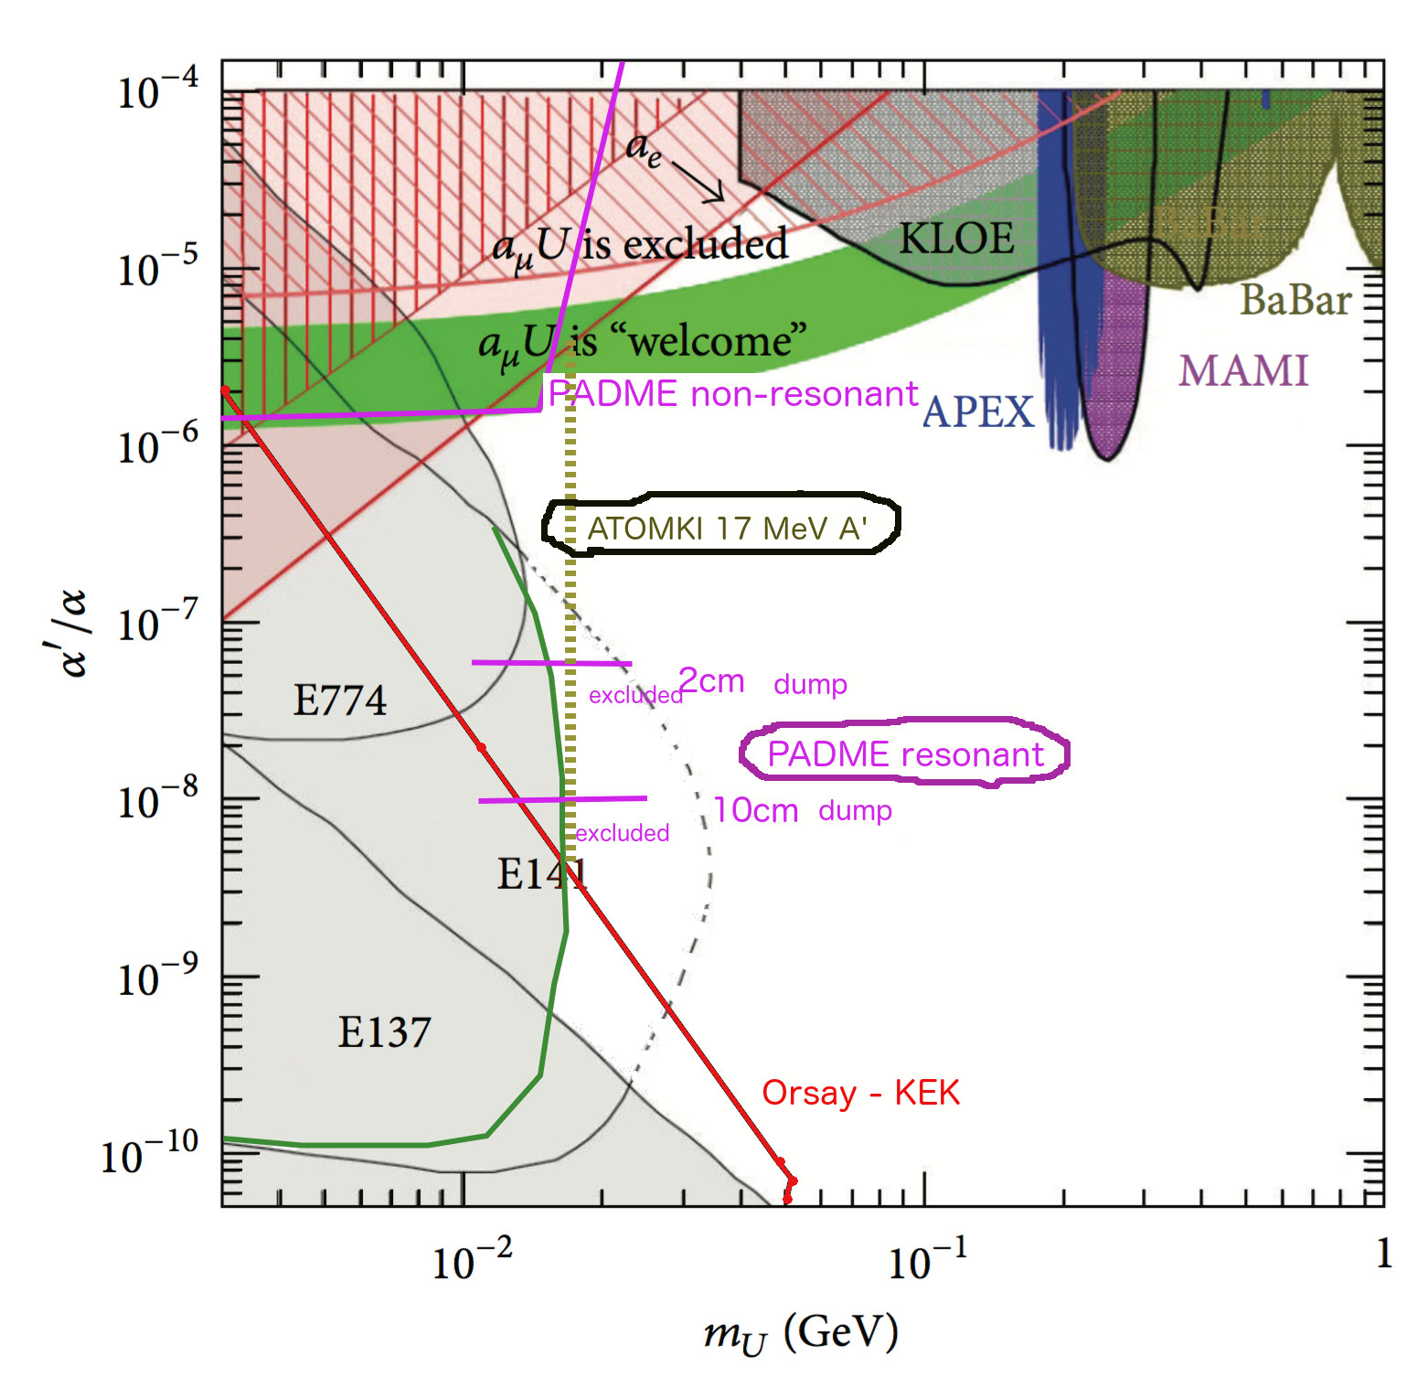
Adapted from M. Raggi

Slide 20
Enrico Nardi
Dark photons production in e⁺ beam dump experiments via resonant e⁺e⁻ annihilation
“New directions in dark matter and neutrino physics” Perimeter Institute – July 20-22, 2017

