Slide 1
Computing and Software
Emanuele Leonardi
on behalf of the Computing Working Group
PADME General Meeting - LNF March 8th-9th, 2018

Slide 2
Summary
On-line Computing
DAQ Hardware
Crates, Servers, Network
DAQ Software
Data flow, zero suppression, data formats
DCS → Georgi’s talk
Off-line Computing
GRID resources
Off-line software services
Simulation and Reconstruction → my talk tomorrow

Slide 3
Crates and Boards
2 VME crates CAEN 8100
21 slots, 15/14 used by V1742, 6/7 available (2 trigger boards, etc.)
1 VME mini-crate CAEN 8004 (for Target)
Currently in use for crystal tests
V1742: 30 mounted in crates (15+14+1) and 3 spares
1 spare has ch0-3 with 2Vpp dynamics and is «in visione» from CAEN
1 spare (first board acquired by PADME) is a VX1742
1 spare is in use for crystal tests

Slide 4
Optical fibers
Short (30 cm) single optical fibers (daisy chain within crate)
23 (12+11) needed, only 14 available
20 additional ordered from CAEN
Long dual optical fibers (crate to server connection)
7 (3+3+1) needed, 14 available
Length is 5m: not enough for the new BTF area layout!
8 new 20m dual fibers ordered from CAEN

Slide 5
Other cables
Clock short cables: 28 available, all used, no spares
Order 3 spares from CAEN
LVDS cables for DAQ control signals distribution
S-in, Run start/stop, Busy, …
Still to define what is exactly needed

Slide 6
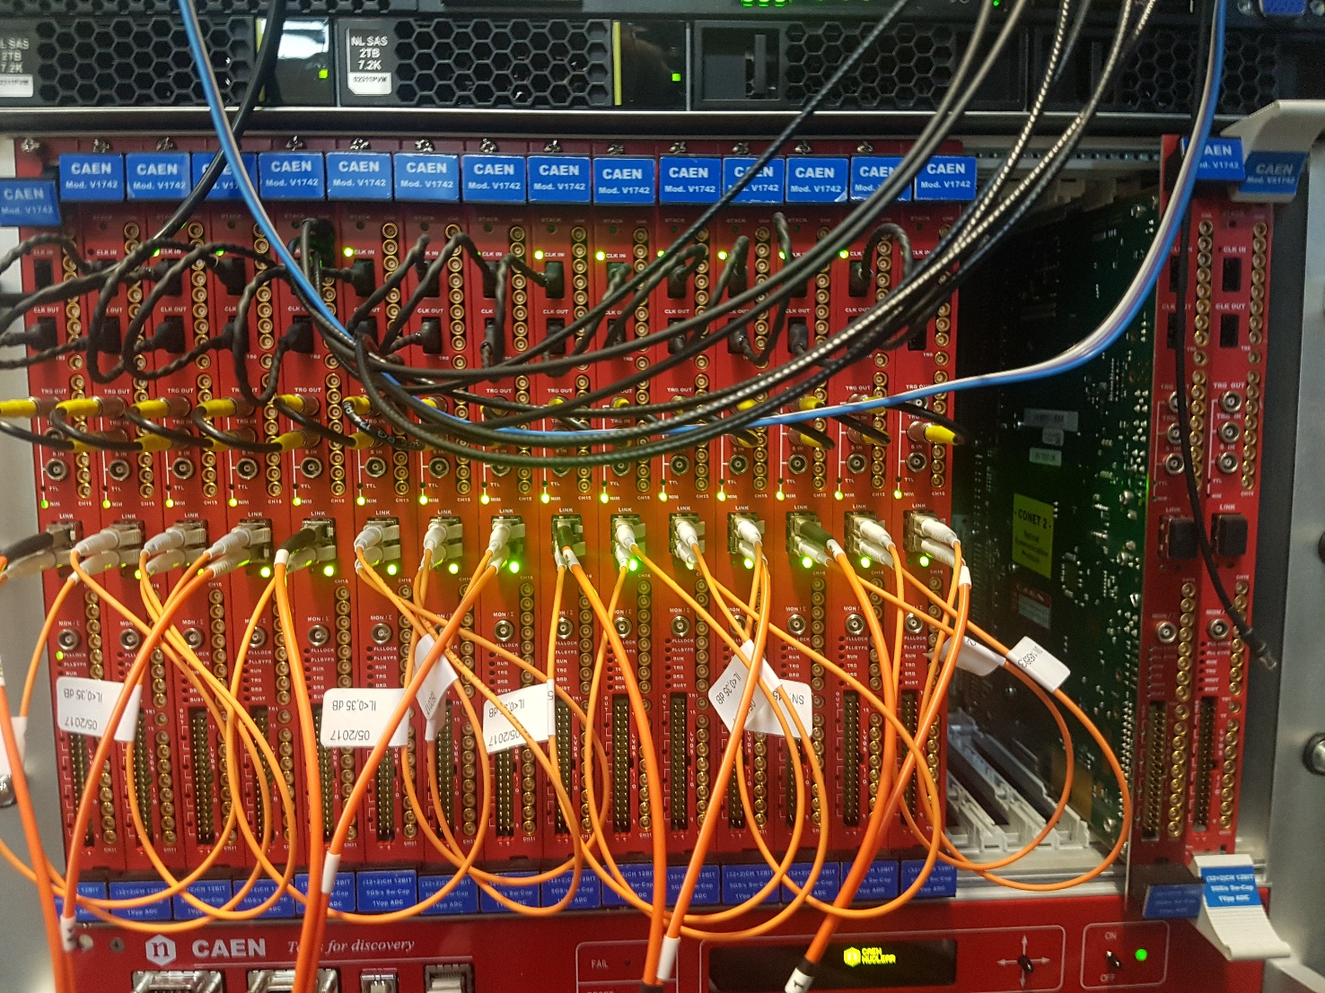
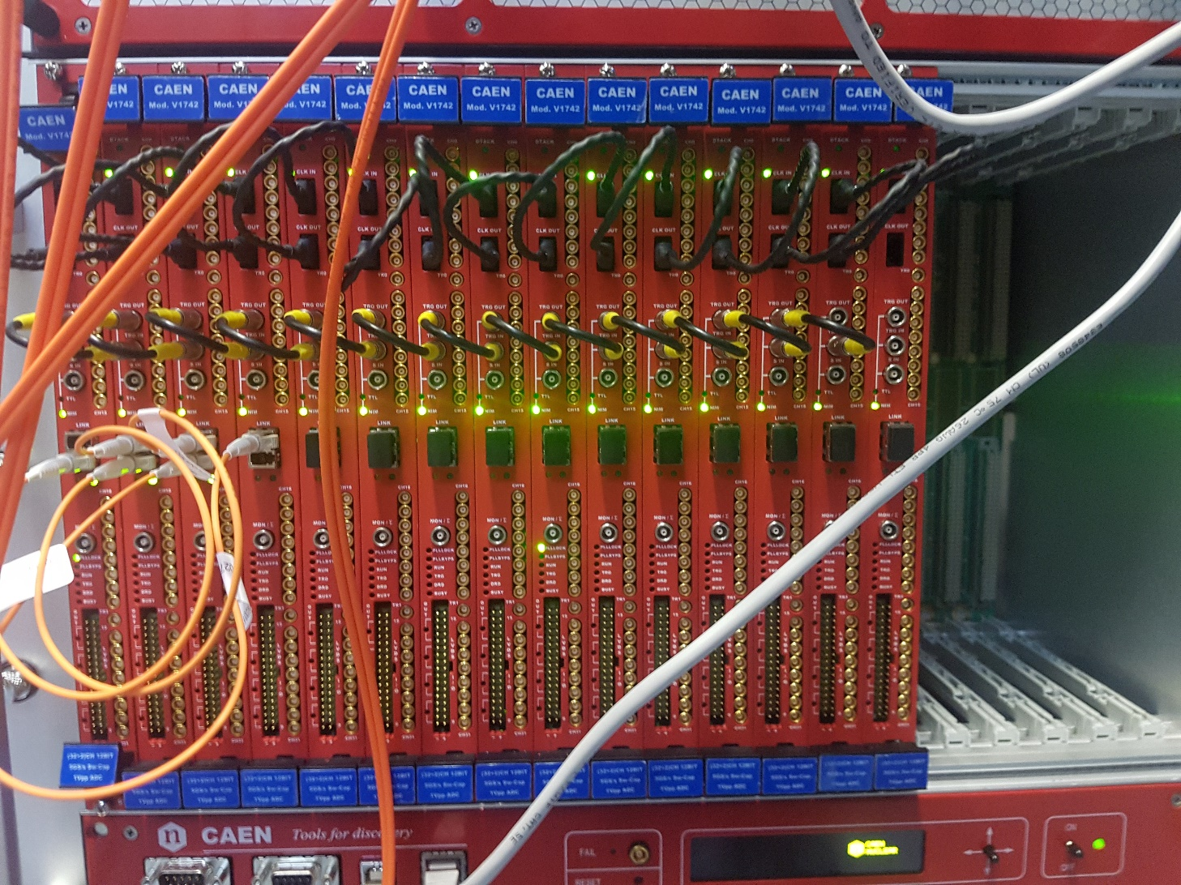
Current crate status
15/14 boards per crate: 5+5+(5/4) dist to 3 ports of A3818
1 board on VME mini-crate for Target to 1 port of A3818

Slide 7
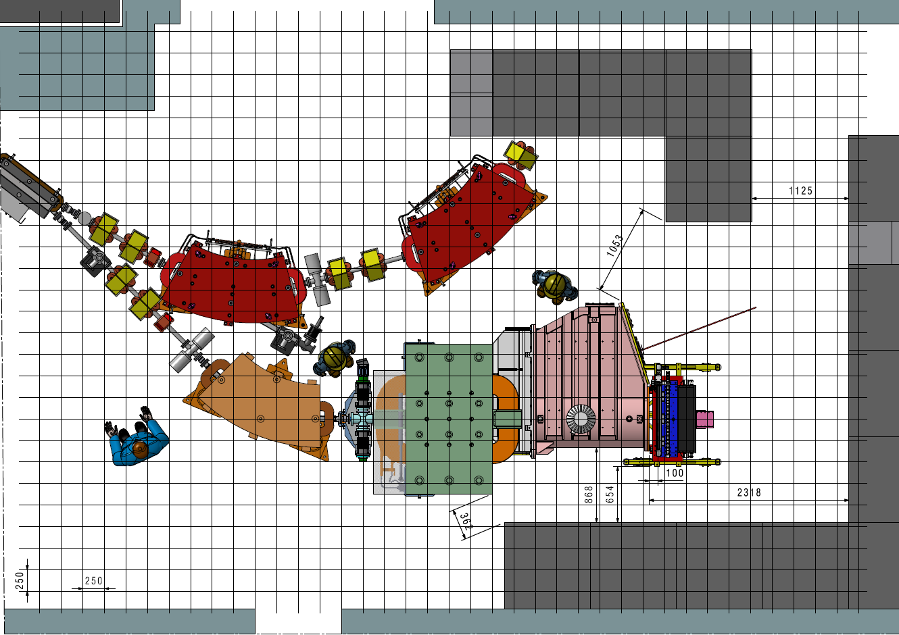
Server Rack
HV
HV
VME Rack
HV
VME Rack
VME Rack

Slide 8
On-line Servers
First server already in use, second server available at Tier2: to be added next week.
3 x Cisco 2960x
2 x Huawei FusionServer RH1288 v3
Stackable
2 ports 10Gbps fiber LR
4 ports 10Gbps fiber SR
144 ports 1Gbps copper
2 ports 1Gbps copper
Slot for 4 ports 1Gbps copper
DAQ + L0
1 Dell PowerEdge moved to Tier2 as off-line manager. 10Gbps board added.
2 x Dell PowerEdge R730xd
2 x Dell PowerEdge R630
2 ports 10Gbps fiber SR
4 ports 1Gbps copper
4 ports 1Gbps copper
Free PCI slot for 10Gbps
RC, DCS, services
L1 + data buffer

Slide 9
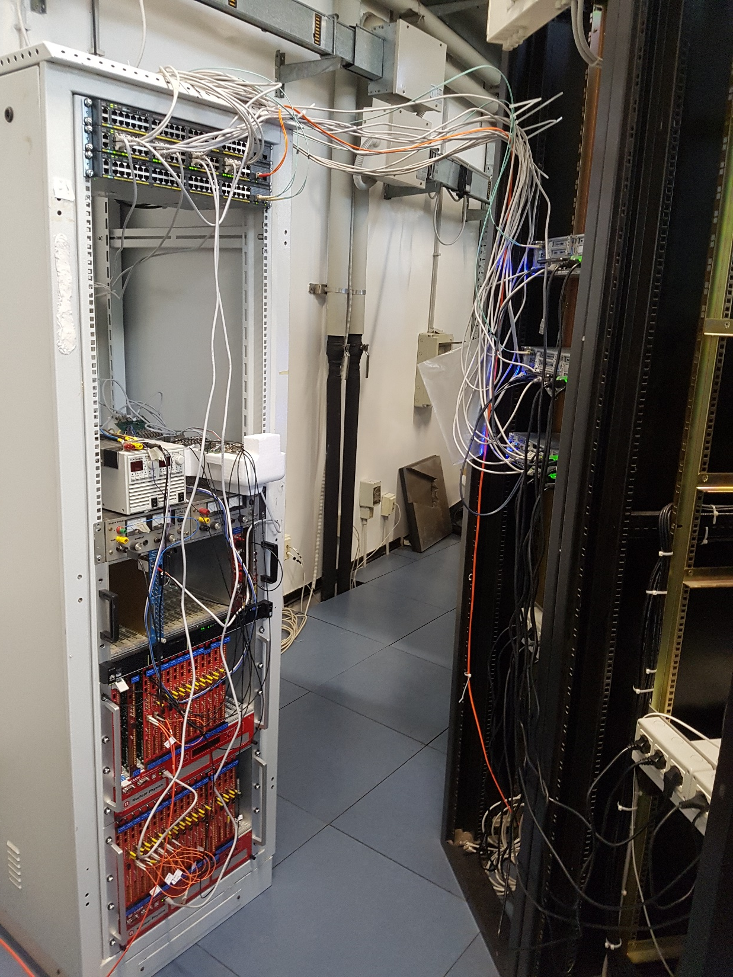
This setup will be moved to BTF as soon as the new experimental hall is ready
PADME central switch
L1 and disk storage servers
RC, DB, DCS server
Trigger system
Online Monitor server
DAQ node (l0padme4)
DAQ VME crates

Slide 10
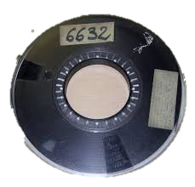
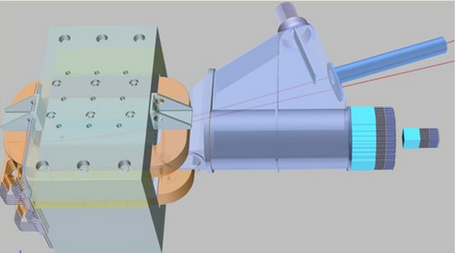
Networking
10 Gbps
1 Gbps
CNAF
L1_1
Experimental Area
L0_1
Tier2
L1_2
L0_2
LNF Net
Experimental data
IT
TimePix
Mimosa
OM
LNF IT Building
IPMI VLAN
Online VLAN
KLOE2
RC+DB+DCS
Trigger
…
Display
HV
CTRL
Probe
Control Room
DCS VLAN

Slide 11
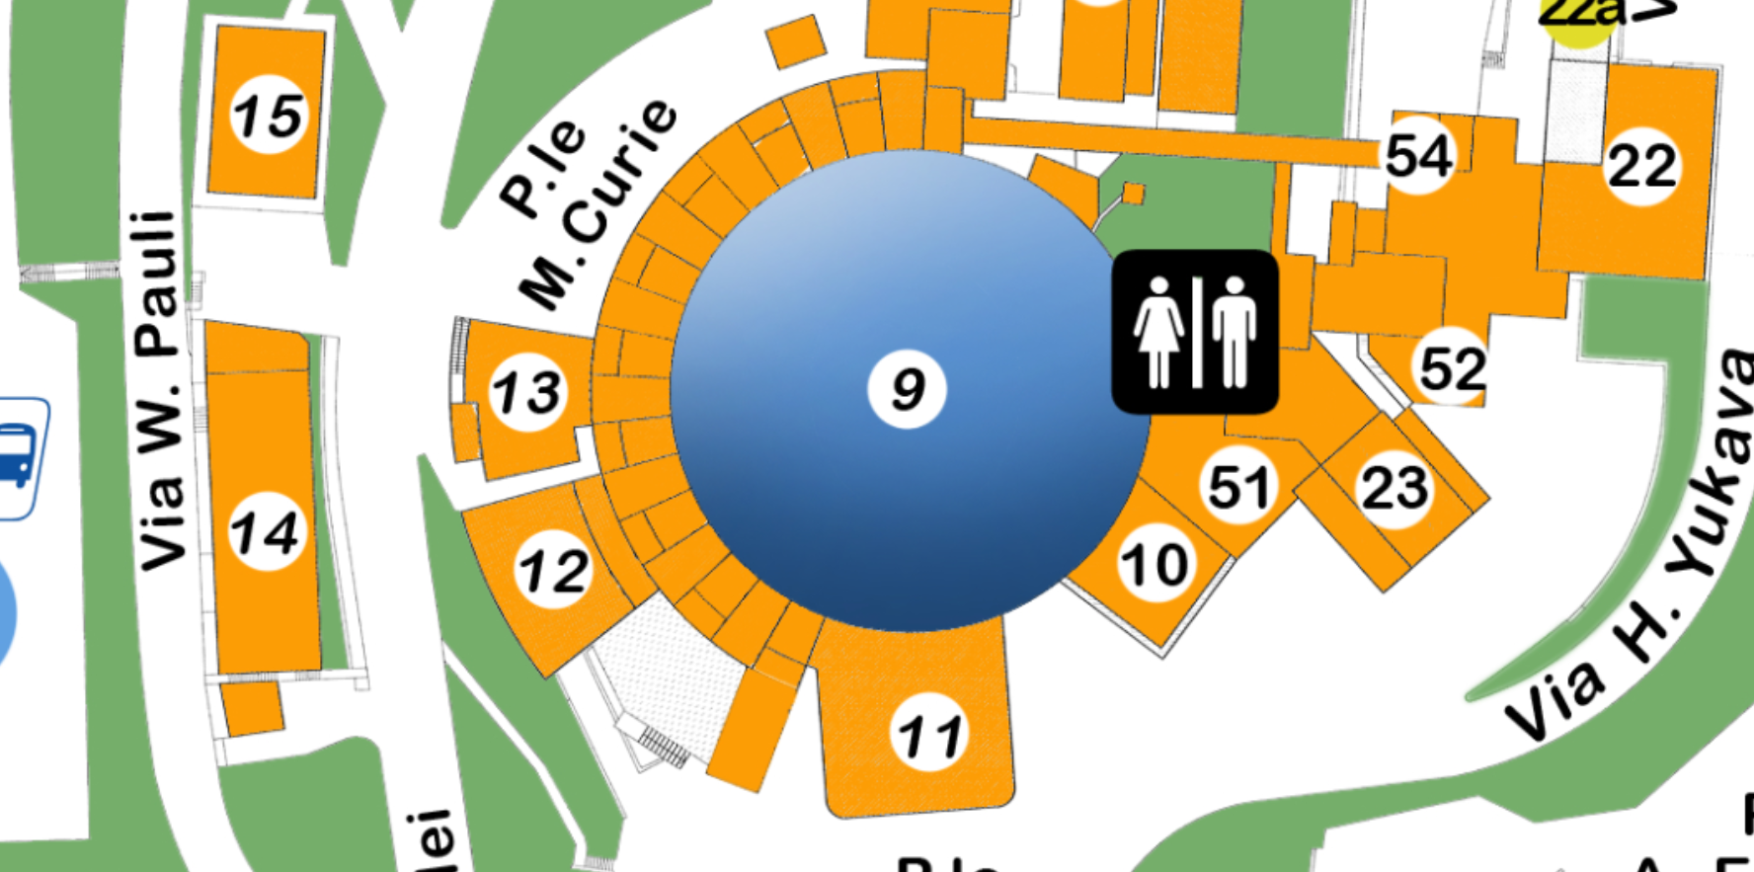
Optical link between IT and BTF
LAT
BTF
CR
T2
IT
Available now
10 Gbps
1 Gbps
To be installed

Slide 12
Data Flow
L0/L1 modules based on existing software
L0: PadmeDAQ (read data from V1742, apply 0-suppression)
L1: PadmeLevel1 (merge data from all sources, write ROOT file)
Modifications needed:
PadmeDAQ: split data reading from 0-suppression to optimize CPU usage efficiency
PadmeLevel1: include data from Trigger and Control system
later also from TimePix

Slide 13
I/O Infrastructure
New I/O infrastructure (in GO language)
DARC: Data Acquisition Resource Controller
Start/Stop of module
Module control
Connects to standard ports of module and handles passage of data from one module to another
Can send data from one module to multiple modules
E.g. Output of L0 can be sent to L1 and to Online Monitor
(Almost) no modifications needed to current programs
The new infrastructure is seen as standard I/O to file
See Franz’s presentation of last December for details.

Slide 14
DARC wrapper
Online Monitor
DARC wrapper
PadmeDAQ
Padme0Supp
DARC wrapper
…
PadmeLevel1

Slide 15
0 Suppression
Need 0 suppression to reduce data from 100MB/s to O(10MB/s)
Can take advantage of multiple CPU cores in L0 servers
For each board: DAQ on one core, 0 suppression on another
Can implement several different 0sup algorithms
Optimized for specific detectors (ECal, SAC, Veto, Target)
(32ch + 4trg) × 1024smpl × 12bit × 50Hz = 22.1184 Mbps = 2.6MiB/s
Core 1
Core 2
2.6MiB/s
3.5MiB/s
PadmeDAQ
Padme0Supp
PadmeLevel1
× 30 = 78MiB/s
× 30 = 105MiB/s
O(10MB/s)

Slide 16
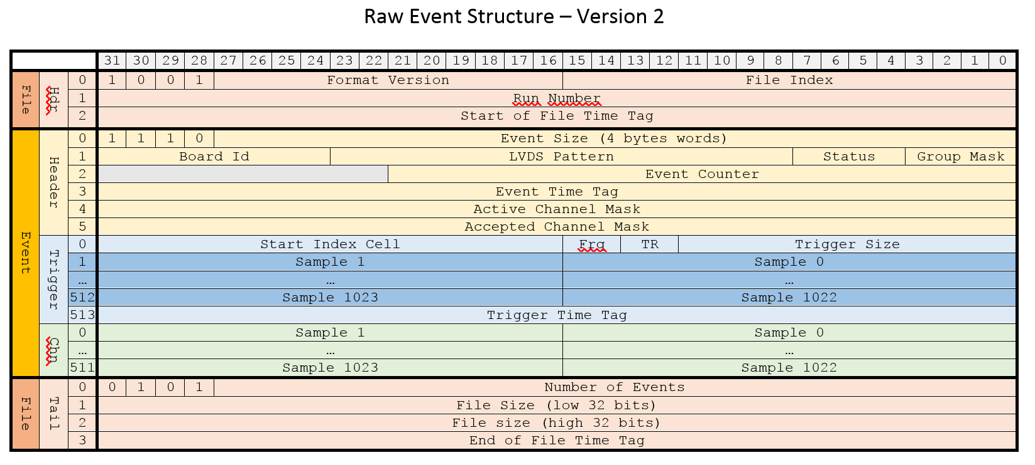
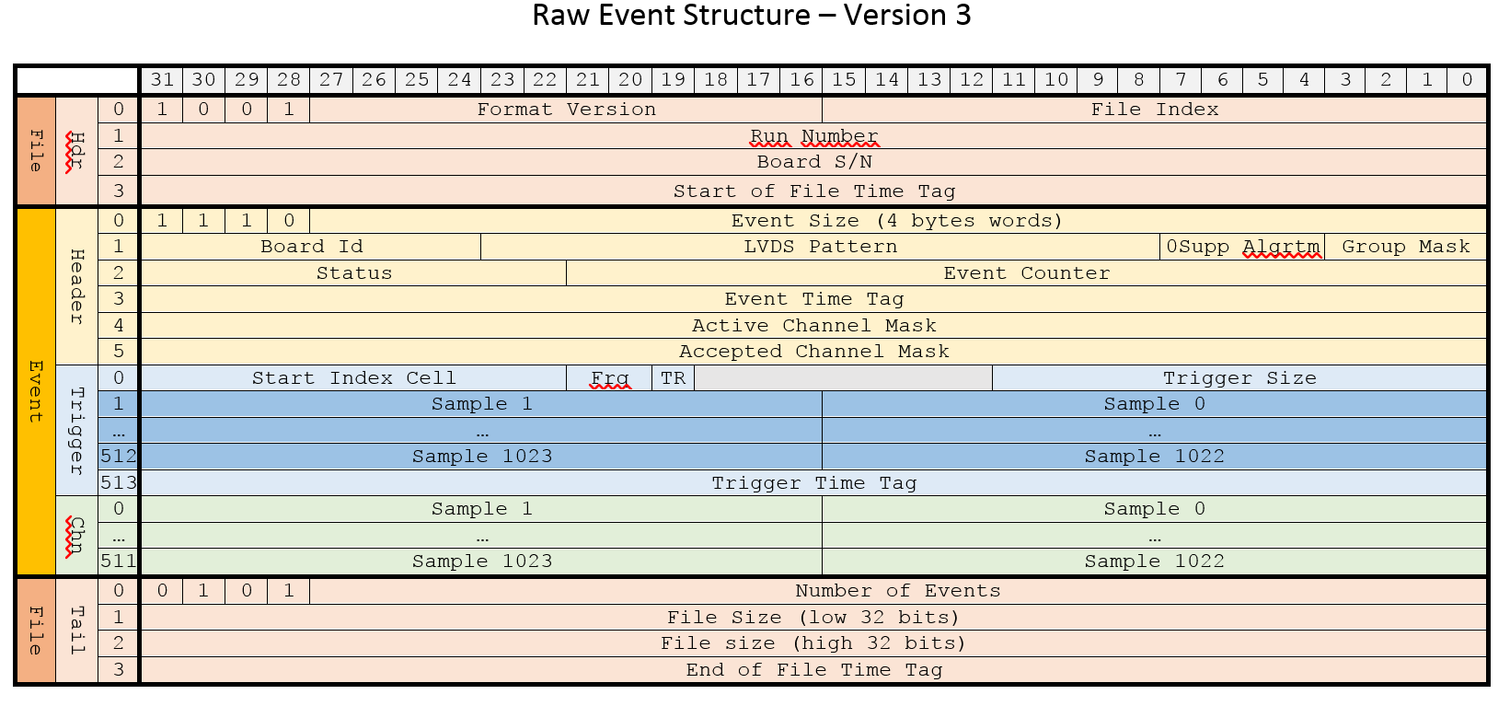
DAQ data format
Added board serial number to file header
Enlarged event status bit pattern
Added code of 0-suppression algorithm used
Status pattern
b0: [0=event is empty|1=event has data]
b1: [DRS4 corrections 0=not applied|1=applied]
(b2,b3): [0-suppression 00=off, 01=flagging, 10=rejection, 11=reserved])
b4: board fail (BF) flag
(b5-b9): reserved

Slide 17
RAW data format
TADCBoard
UChar_t | fBoardId
UInt_t | fBoardSN
UShort_t | fLVDSPattern
UInt_t | fBoardStatus
UChar_t | fGroupMask
UInt_t | fEventCounter
UInt_t | fEventTimeTag
UChar_t | f0SuppAlgrtm
UInt_t | fActiveChannelMask
UInt_t | fAcceptedChannelMask
UChar_t | fNADCChannels
TClonesArray* | fADCChannels
UChar_t | fNADCTriggers
TClonesArray* | fADCTriggers
TADCChannel
UChar_t | fChannelNumber
Short_t | fSamples[1024]
TRawEvent
UInt_t | fRunNumber
UInt_t | fEventNumber
TTimeStamp | fEventAbsTime
UInt_t | fEventRunTime
UInt_t | fEventTrigMask
UInt_t | fEventStatus
UChar_t | fNADCBoards
TClonesArray* | fADCBoards
TADCTrigger
UChar_t | fGroupNumber
UShort_t | fStartIndexCell
UChar_t | fFrequency
Bool_t | fTriggerSignal
UInt_t | fTriggerTimeTag
Short_t | fSamples[1024]
fBoardSN, fBoardStatus, and f0SuppAlgrtm are copyed from the DAQ data format
fEventAbsTime is the global UTC time on the L1 server when the event is merged. Servers use NTP so timing should be good down to the ms level.
fEventRunTime is the time from the start of the run. It is computed taking into account the timing information of all the boards (which should in principle be well synchronized).
fEventTrigMask and fEventStatus are 32 bits patterns reserved for future use.
As the new format is a superset of the previous format and the old class interfaces are respected, all code currently in use for analysis should in principle work with files in the new format (need to recompile using the new libraries, of course).
I am now studying how to create code that can use both old and new format (possible according to ROOT).

Slide 18
GRID Resources
CPU: 4000 HEPSpec financed by INFN (2017+2018)
2500 HS at LNF Tier2 (1000 HS available)
1500 HS at CNAF Tier1
Disk: 90 TB net disk storage financed by INFN (2017)
80 TB at LNF Tier2 (available)
10 TB at CNAF Tier1 (available)
Tapes: 500 TB at the CNAF Tier1 tape library
300 TB at the KLOE2 tape library in LNF for the emergency backup of experimental data

Slide 19
Off-line setup
CNAF Tier1
Tape Library
CNAF Tier1
Cluster
LNF Tier2
Cluster
LNF Tier2
Disk System
PADME
Offline Manager
PADME DAQ
CNAF
LNF
GARR Backbone
KLOE2
Tape Library

Slide 20
Data Acquisition
CNAF Tier1
Tape Library
CNAF Tier1
Cluster
LNF Tier2
Cluster
LNF Tier2
Disk System
1
PADME
Offline Manager
PADME DAQ
CNAF
2
3
LNF
GARR Backbone
KLOE2
Tape Library

Slide 21
Simulation
2
CNAF Tier1
Tape Library
CNAF Tier1
Cluster
LNF Tier2
Cluster
LNF Tier2
Disk System
Job submission and control
1
PADME
Offline Manager
PADME DAQ
CNAF
3
LNF
GARR Backbone
KLOE2
Tape Library

Slide 22
Reconstruction
2
3
CNAF Tier1
Tape Library
CNAF Tier1
Cluster
LNF Tier2
Cluster
LNF Tier2
Disk System
1
Job submission and control
PADME
Offline Manager
PADME DAQ
CNAF
4
5
LNF
GARR Backbone
KLOE2
Tape Library

Slide 23
Off-line Software
Data mover already available
Used to automatically backup all test beam data
Some adjustments needed after water flood at CNAF last October
Some data were lost but full dataset still on disk system at LNF
Job submission system at (working) prototype level
Some basic services still under development
File Library, Calibration DB, etc.

