Slide 1
Simulation and Reconstruction
Emanuele Leonardi
PADME General Meeting - LNF March 8th-9th, 2018

Slide 2
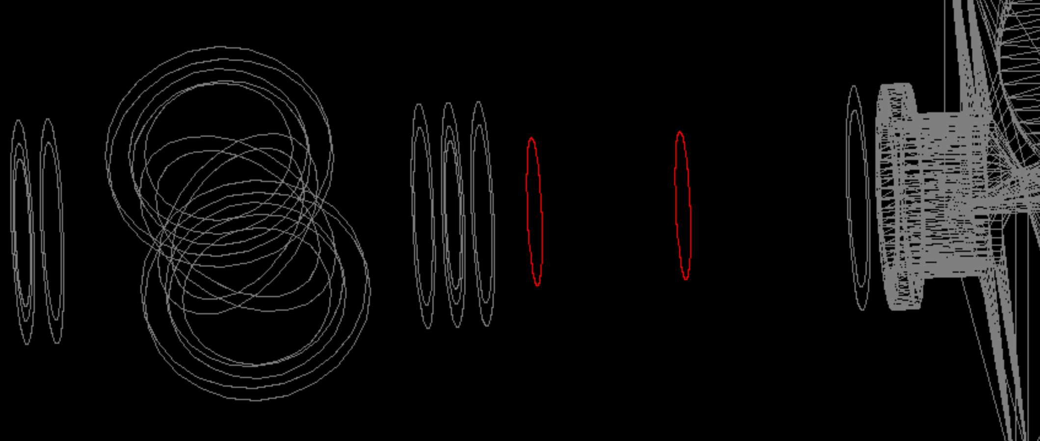
10cm thick tungsten cylinder on request
Need Tungsten?

Slide 3
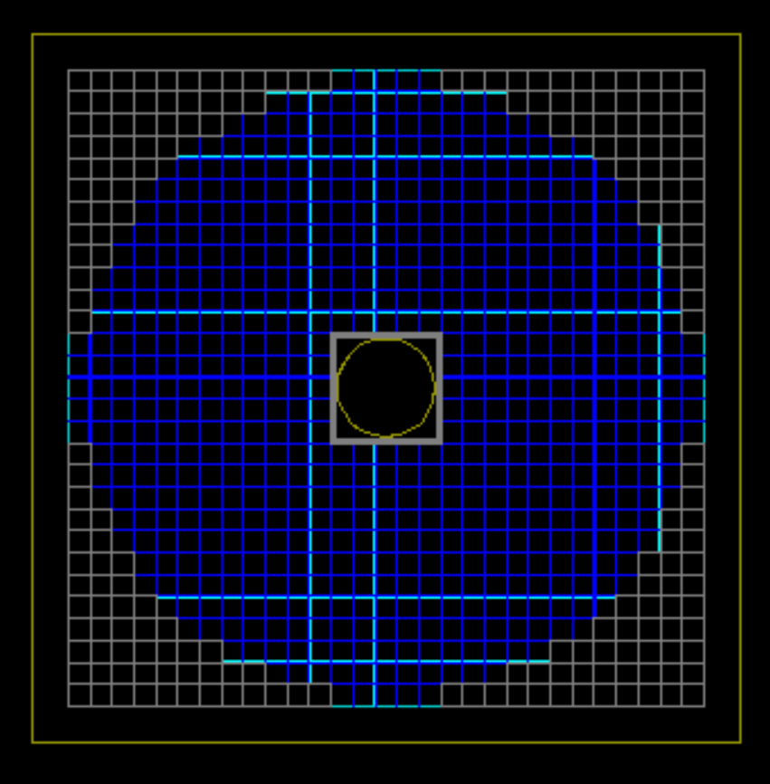
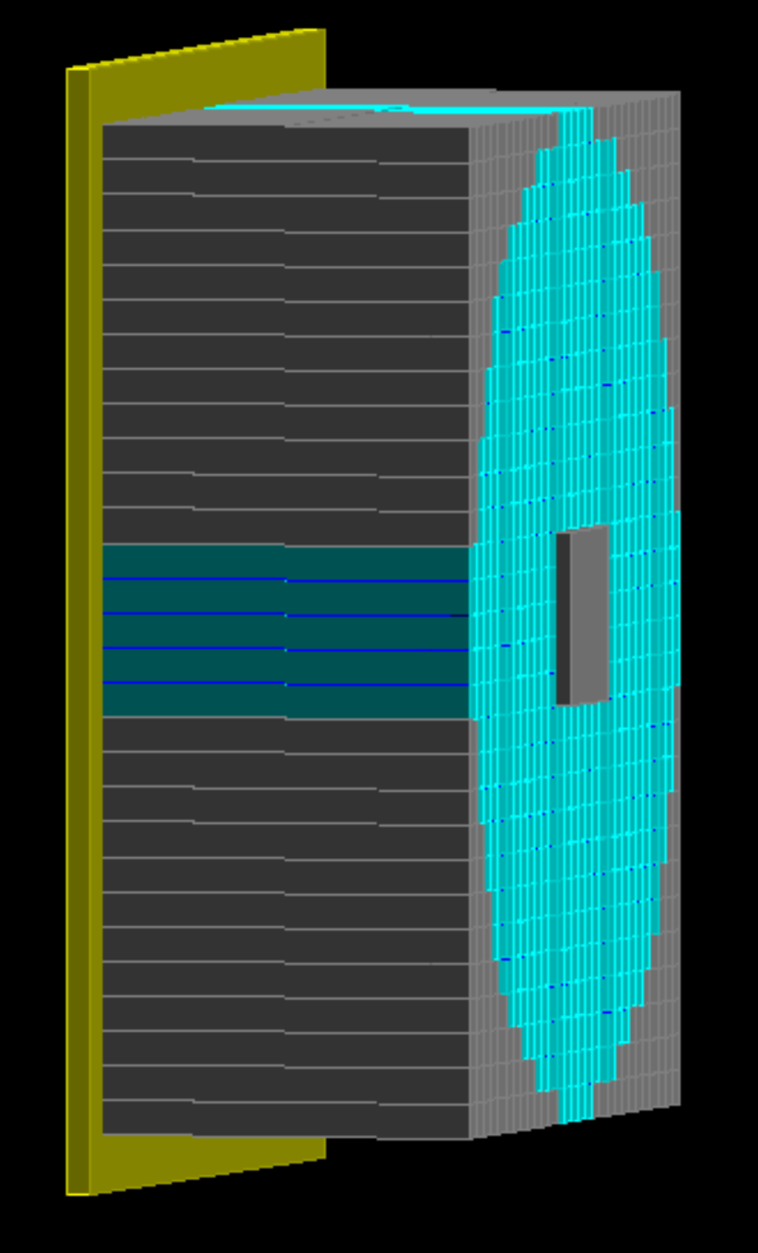
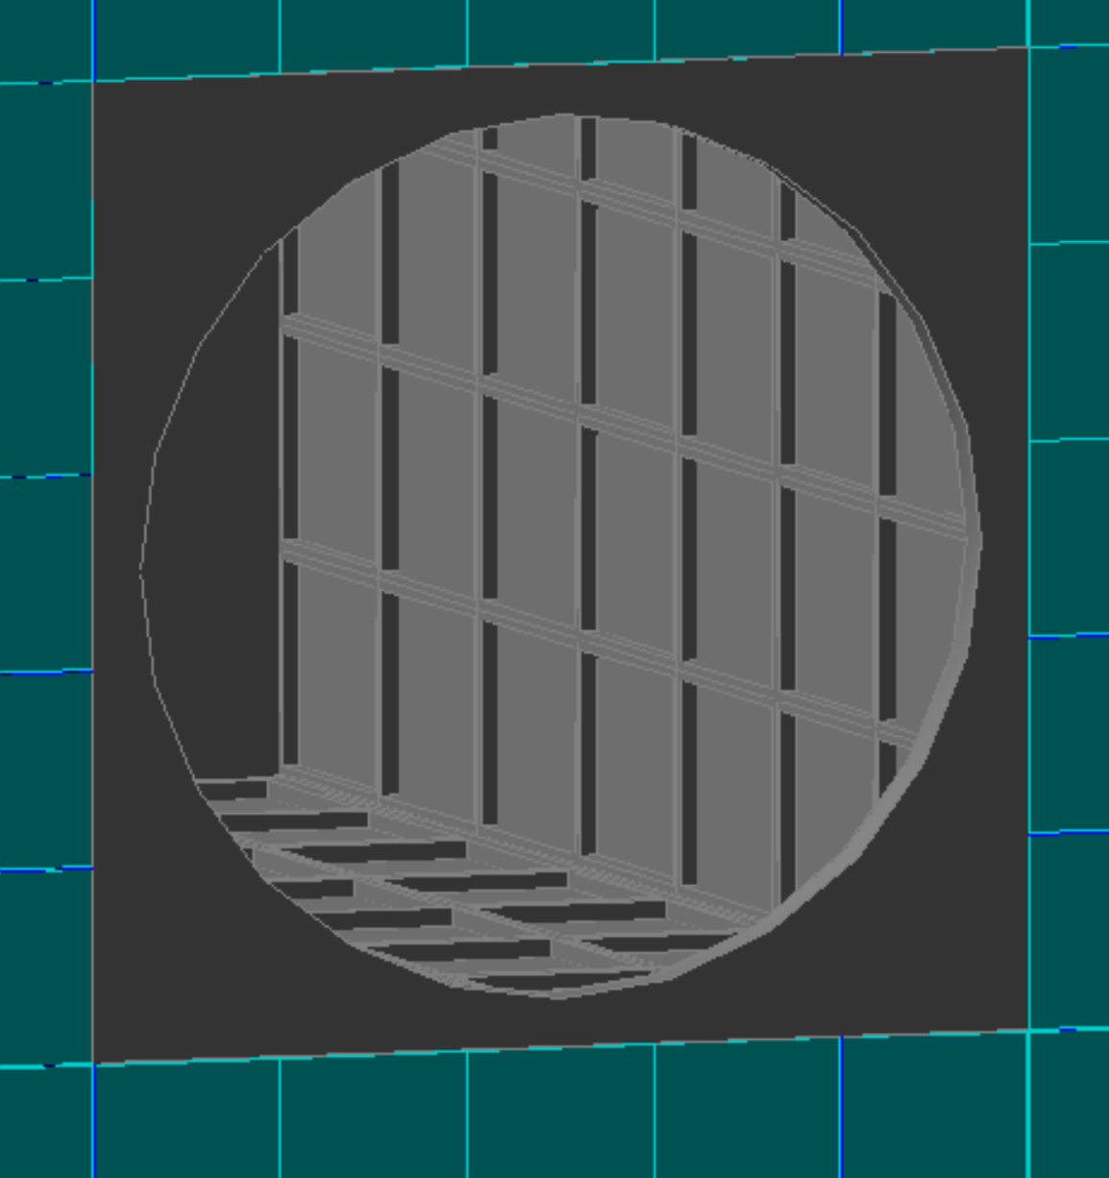
ECal
Crystals with tedlar strips and support structure.
Front Alustep panel.
Preliminary digitization.
Missing:
PMTs and back panel
Final design of center

Slide 4
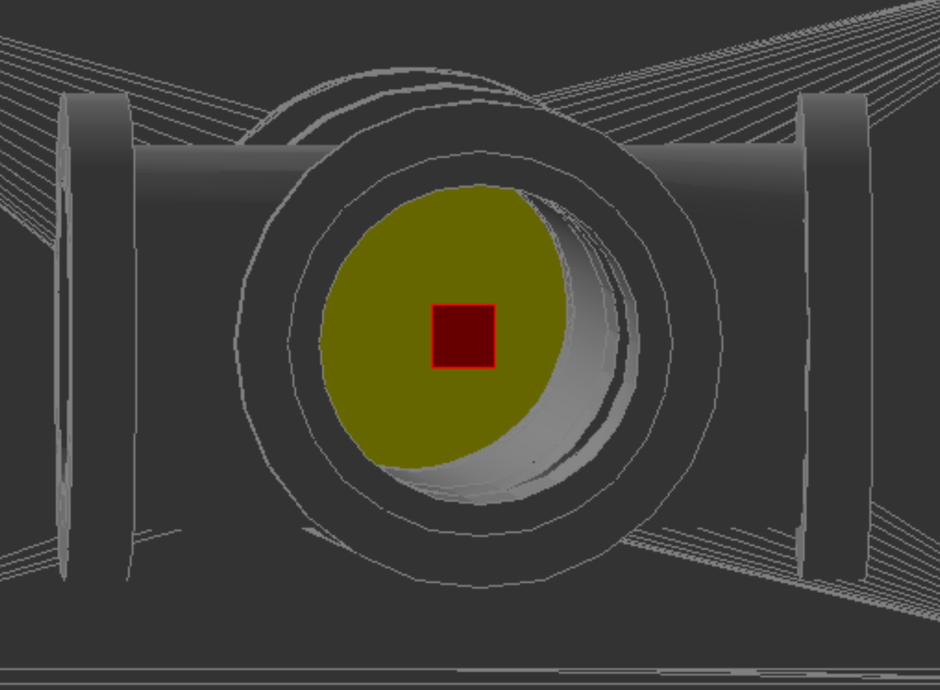
Target
Homogeneous diamond target.
Digitization well defined.
Missing:
AuCr readout layer
Support structure

Slide 5
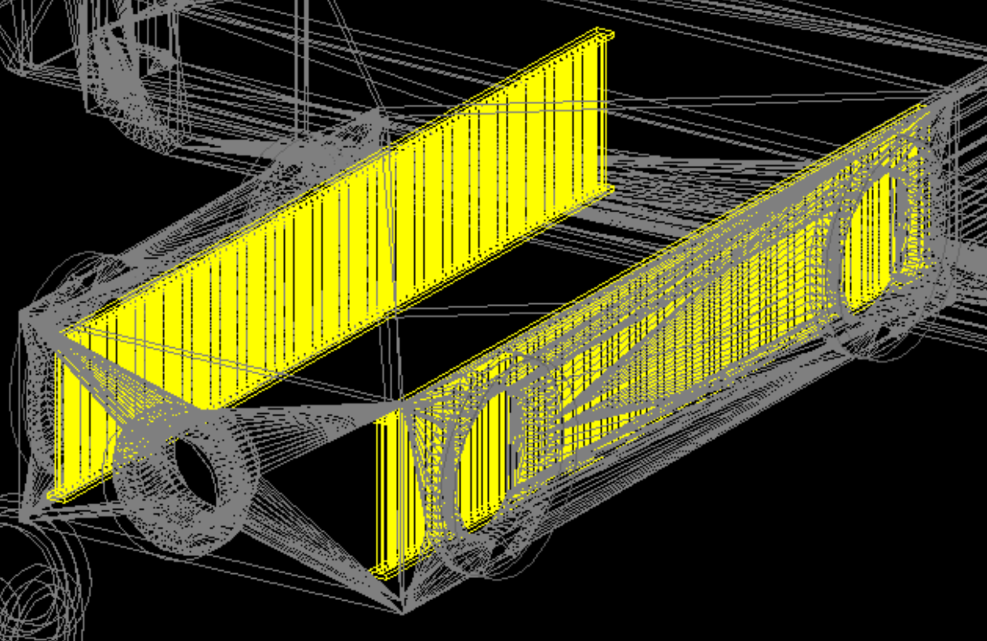
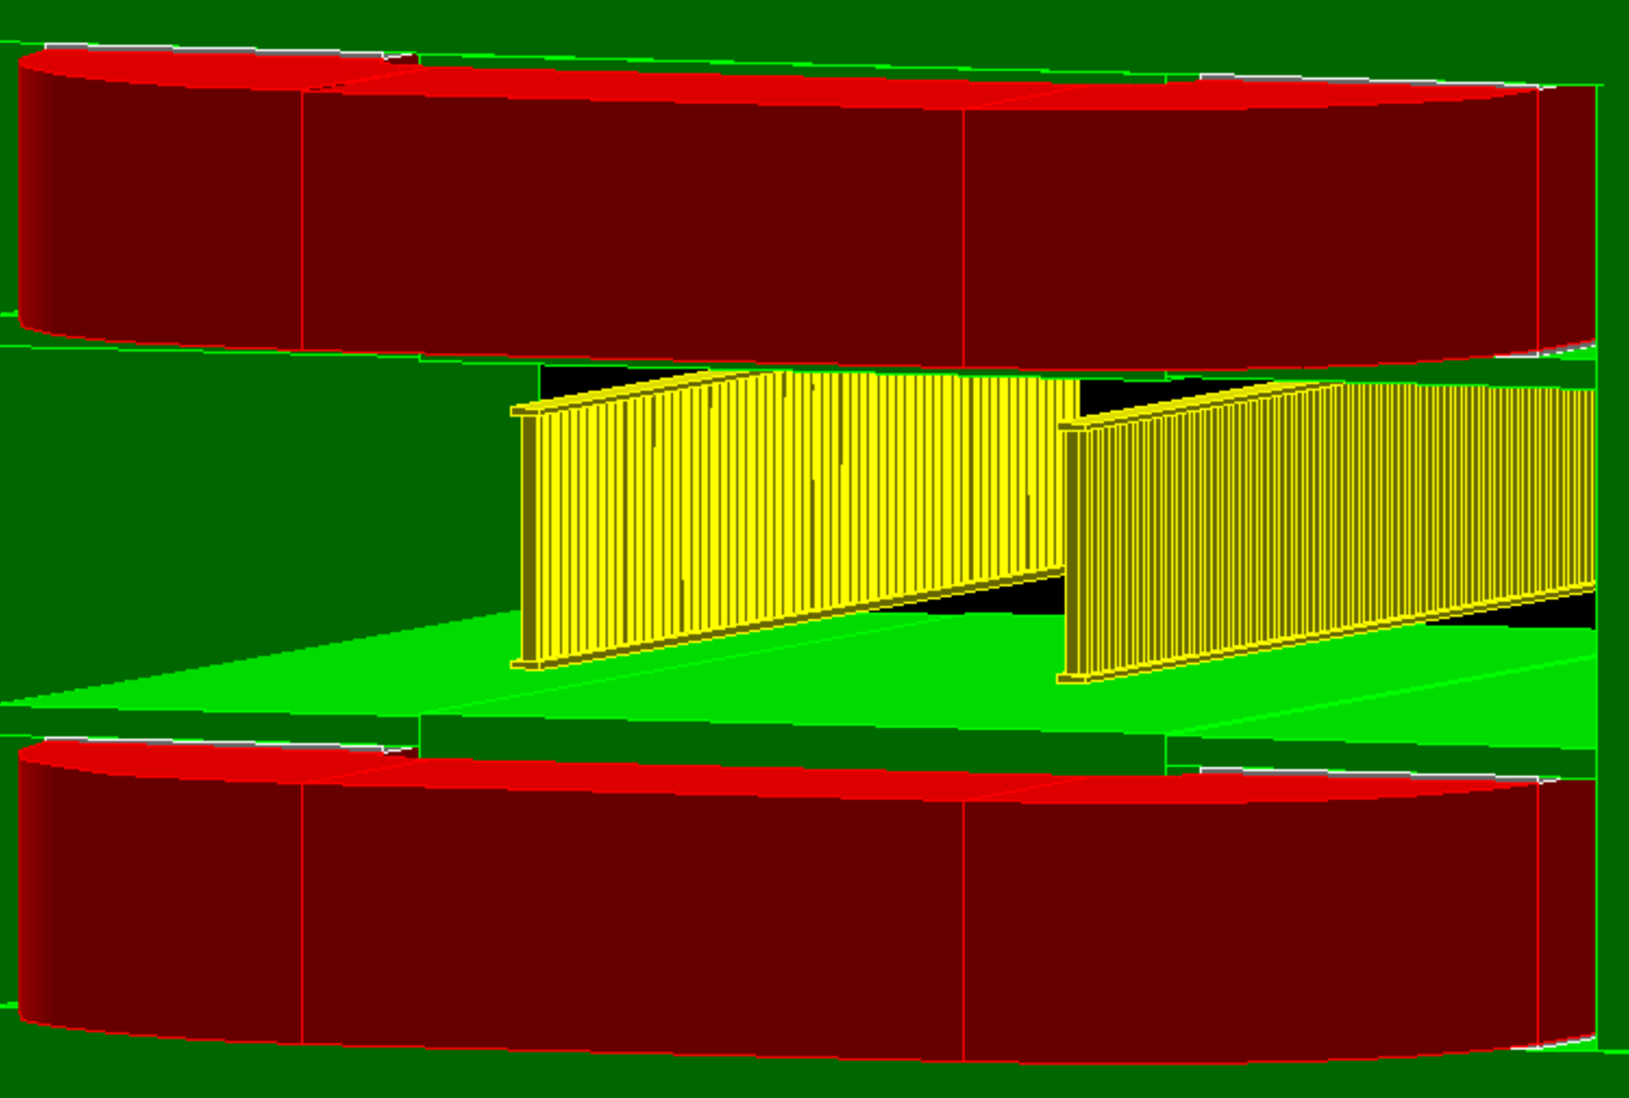
P/E Veto
Plastic scintillator fingers
160mm → 190mm
Verify rotation and pitch
Update support structure
Preliminary digitization
Quite old: need some review

Slide 6
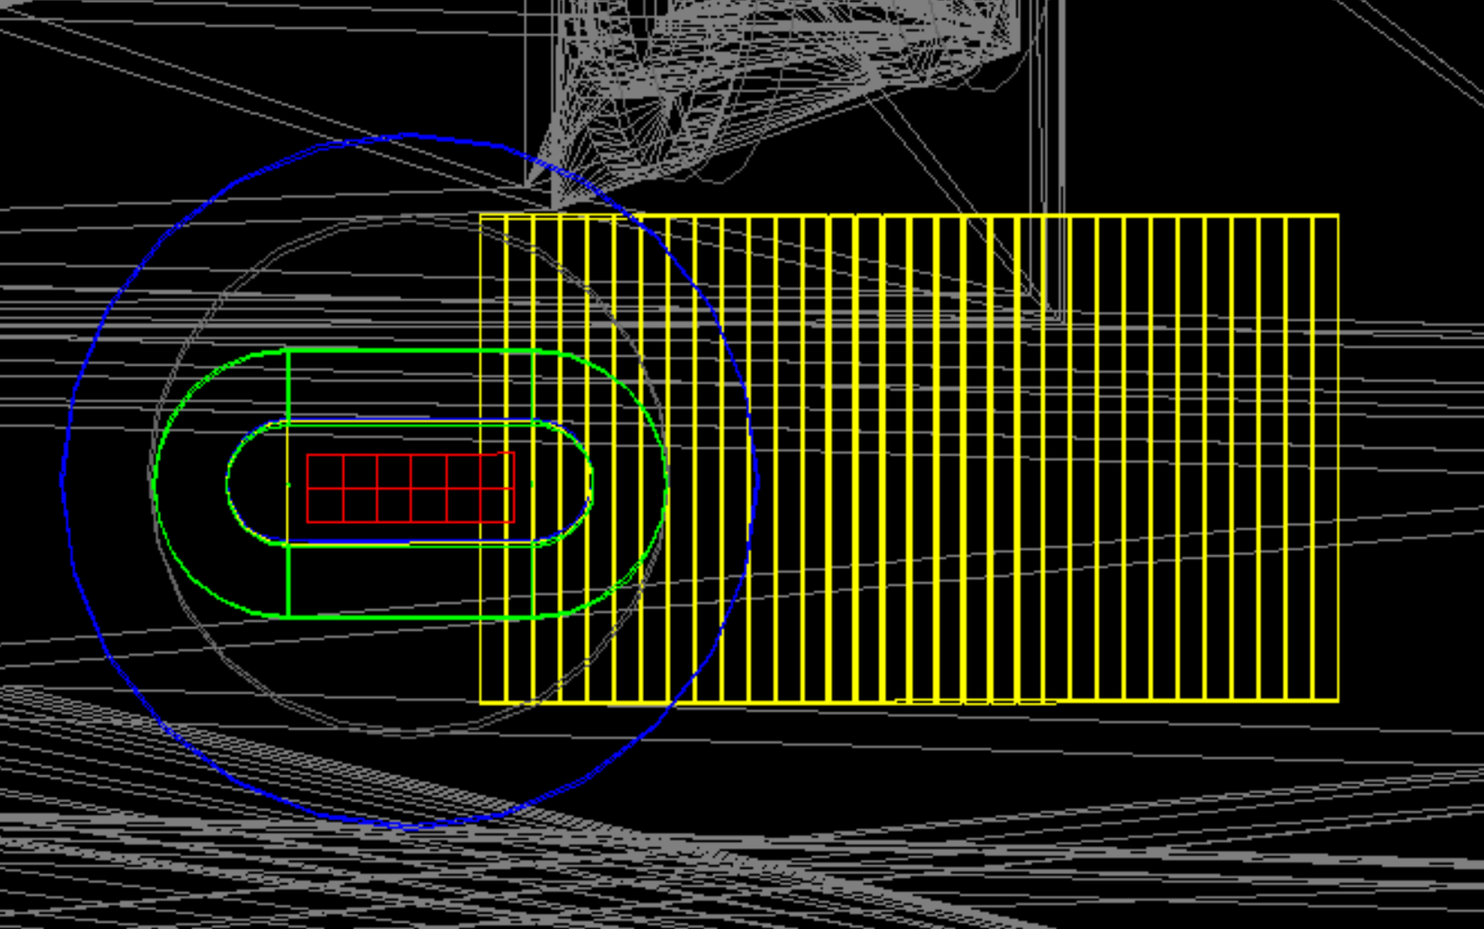
HEP Veto
Same as P/E Veto
TimePix
6x2 Si chips
Missing:
Support structure
Digitization

Slide 7
SAC
Matrix of 5×5 PbF₂ Crystals 3×3×14cm³
Waiting for the final design (Paint? Tedlar? Support structure?)
Preliminary digitization.

Slide 8
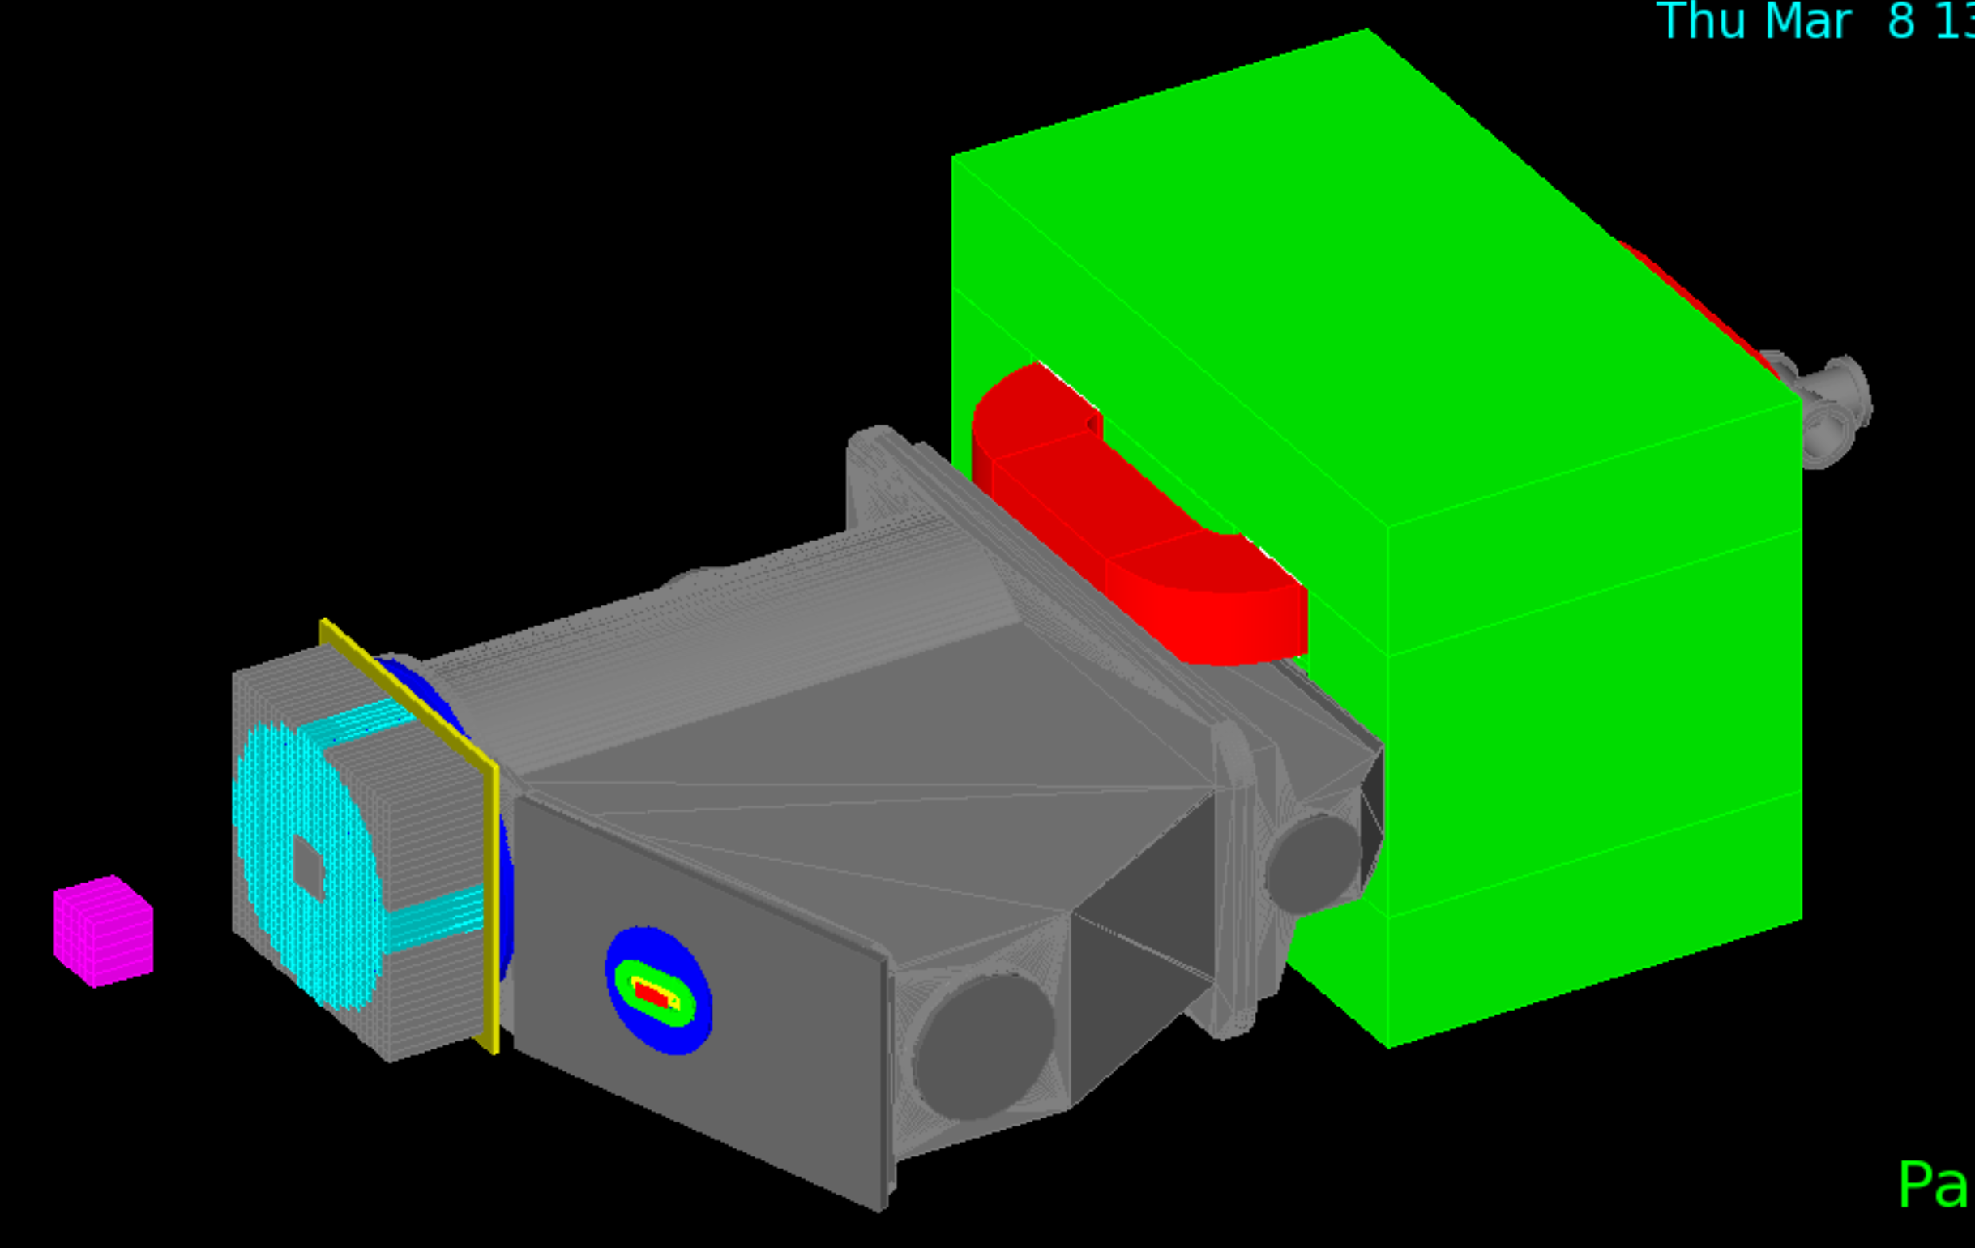
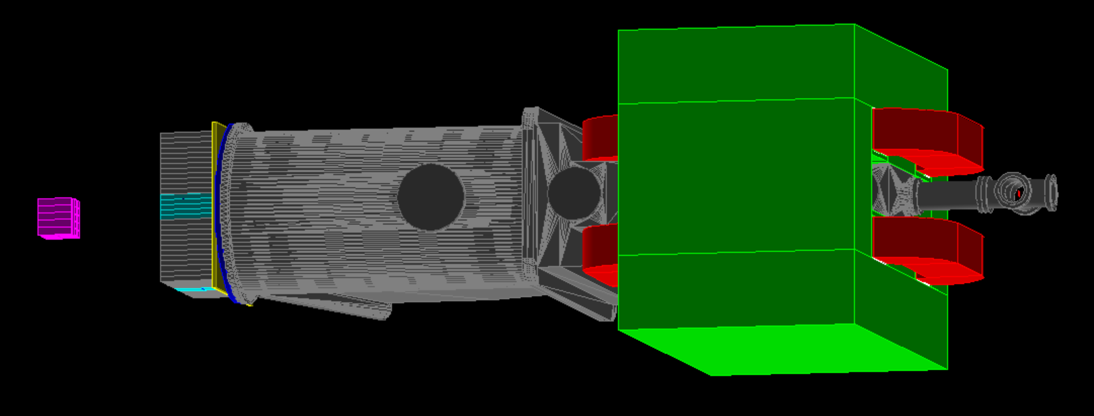
Vacuum Chamber
Main shells directly imported from CAD projects (Cesidio).
Portholes in place.
Beam exit and ECal membranes fully modeled.
Magnet
Fully modeled.
Need to update the magnetic field map

Slide 9
Final remarks
All sensitive detectors are described.
Magnet and vacuum chamber are described.
Some support structures are missing (Vetoes, SAC, Target).
Magnetic field map must be revised.
Digitization procedures must be revised and updated.
Please give a look to the materials in use.
PadmeMC/src/DetectorConstruction.cc

Slide 10
Reconstruction
An (almost empty) Reconstruction program exists.
Can read data (ADC waveforms) and MC (digi) events.
Some reconstruction algorithms exist for ECal.
Need contributions from detector experts.
Lots of work to be done here.

