Slide 1
Status of CMS-PPS timing detectors
PPS spectrometer
Pixel detectors
Timing detectors
Summary and conclusions

Slide 2
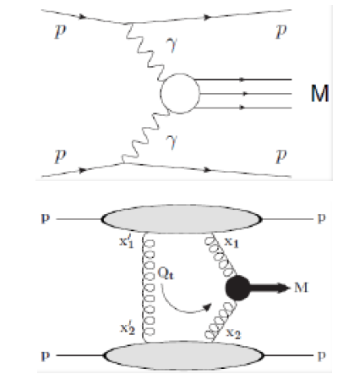
[1],[2]
Timing detector
Tracking detector:
proton dp/p &
pointer to timing detector

Slide 3
CMS PPS spectrometer
2017: 1 3D pixel station 1 Si strip station 3 Diamond planes 1 UFSD plane
2018: 2 3D pixel stations 4 Diamond planes (2 double)

Slide 4
26 Roman Pots installed in LHC tunnel at ip5 PPS (standard optics) & TOTEM (special optics)
View in LHC
tunnel

Slide 5
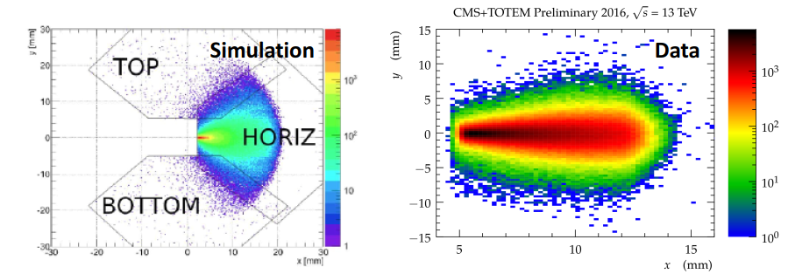
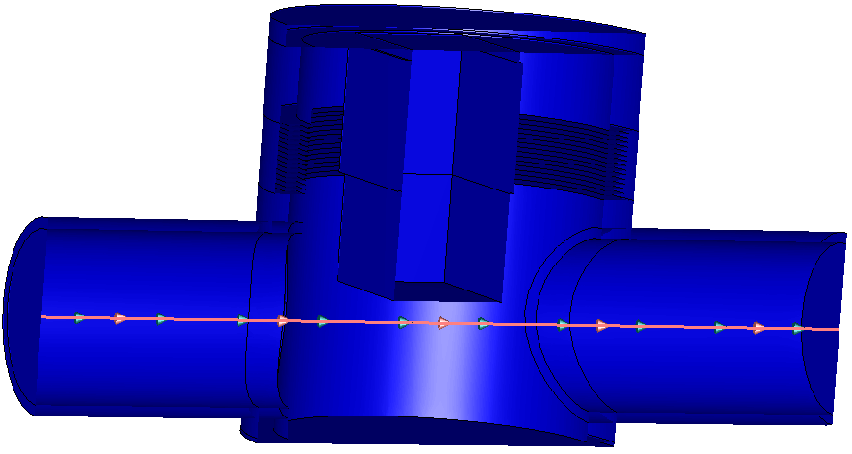
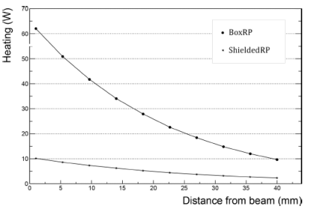
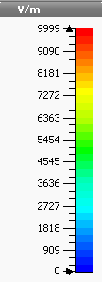
PPS -> Extreme conditions to operate detectors close to the beam of LHC
Significant irradiation
gradient
~ 5*10¹⁵ p/cm² for 100 fb⁻¹
flange
16/05/2018
1.5 mm distance from LHC beam in 2017
Beam optics defines the irradiation profile
RP Impedance -> LHC acts as heater Secondary particles by RP material interaction

Slide 6
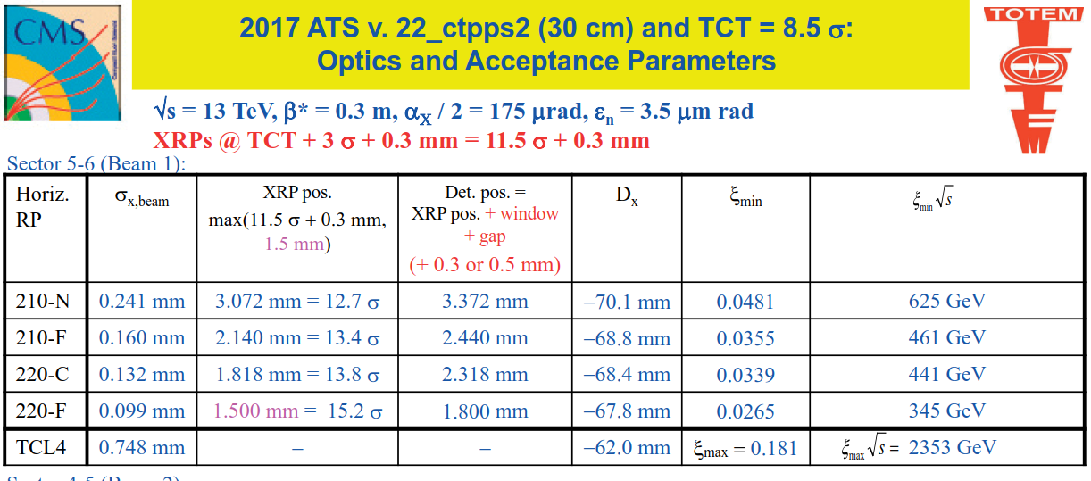
LHC and CT-PPS operation during 2017
CT-PPS horizontal RPs were inserted on a regular base: RP210 far – RP cylindrical – RP220 far -> closest distance to LHC beam ~ 1.5 mm
During all insertion (2017) 1 single beam dump was initiated by RP movement/interlock system before TS1
tracking
timing
tracking

Slide 7
Precision Proton measurement at LHC forward physics -> main components:
Tracking detector 4 planes (housed in Tracking RP close to LHC beam)
-> proton trajectory -> pointer to timing detector & dp/p of proton -> small pixel size (~ 0.015 mm²) track resolution < 30 um
Timing detector (housed in Timing RP close to LHC beam) -> proton time of arrival with 4 detector planes -> bigger pixel size several mm² optimized for occupancy + time resolution per plane ~ 90 ps (test beam)
Timing electronics for PPS ->NINO [6]+HPTDC[7] (in LHC tunnel close to RPs)
Clock -> synchronization of timing electronics installed at each side of CMS - two arms ~ 500 m distance (USC55 and LHC tunnel) -> jitter < 2ps

Slide 8
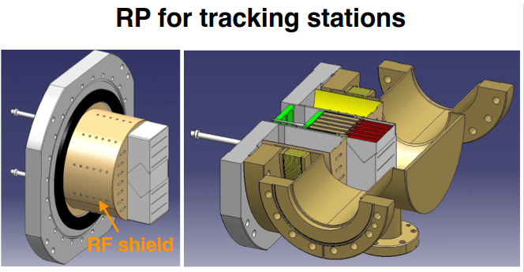
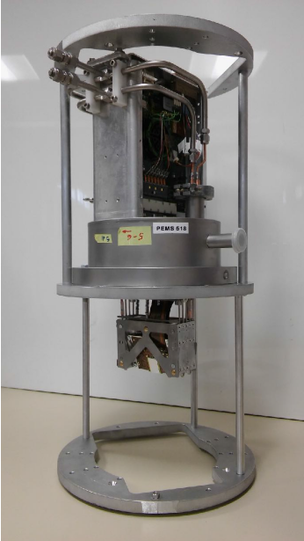
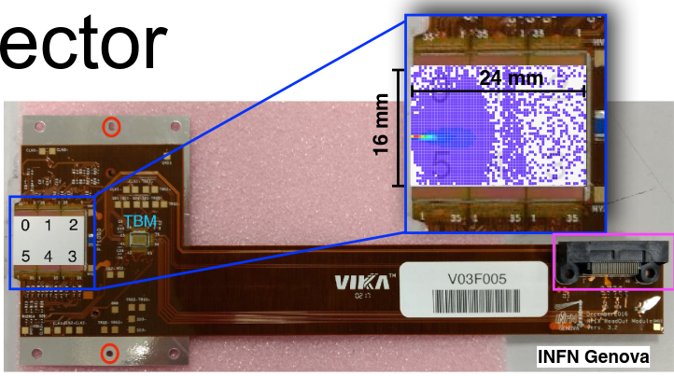
RP pixel detector integrated in RP box type [2]
LHC vacuum
LHC beam
thin window (~ 150 um) to separate detectors from LHC vacuum
Detector package operated at 10 mbar(a), -20 C⁰

Slide 9
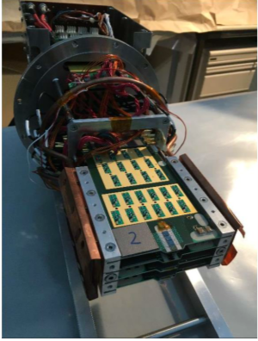
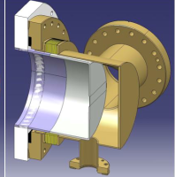
Timing detector: Diamond detector [3],[4]
scCVD diamond = 500 um thickness
Radiation hard ~ 5*10¹⁵ p/cm²
Area: 2.5 - 16 mm²
Spatial resolution ~ 150 um
C varies from 0.2 to 2 pF
Time resolution/plane ~ 90 ps at test beam [4]
FE electronics integrated in RP :
3 stage amplification chain adopted from
HADES collaboration amplifier.
Rise time ~ 1.7 ns
Vmax ~ 2.7 V [3]
Integrated in low imp. cylindrical RP [1]
~ 300 um thickness of thin window
LHC vacuum
Timing electronics NINO+HPTDC [5],[6]
~ 2m distance to detector in LHC tunnel
Thin window
Pixel size optimized to obtain ~ equal rate per pixel
sensor is ~ 50 um close to thin window
LHC beam
Detector package operated at 100 mbar(a), +5 C⁰

Slide 10
Single plane diamond detector [4]
Measurement at LHC with RP in parking
position with SAMPIC chip

Slide 11
Double layer diamonds of CT-PPS [5] installed in RP timing during YETS2017 -> operational with start of LHC runs 2018

Slide 12
1 plane installed in RP timing (2017)

Slide 13
Hit Distribution in the Timing Detector (LHC standard optics)
The geometry of the timing detector was optimized to have a uniform occupancy and a good spatial precision with a limited number of channels

Slide 15
Timing at CMS-PPS -> clock distribution
Universal Pico Second Timing System [8]
adopted to CT-PPS [2],[3] Optical clock: Dense Wavelength Division Multiplexing technique (DWDM ) via single mode fiber
[2]

Slide 16
Summary and conclusions:
The CMS - PPS timing and tracking detector system integrated in the Roman Pots at ip5 fully operational with more than 40 fb⁻¹ collected data during 2016 and 2017 LHC operation.
3 planes of diamond detectors and 1 plane of UFSD (2017) (per arm)
4 planes of diamonds -> 2 planes with double layer (2018)(per arm)
Efficiency -> based on matching with Si-pixel detector show 90 % efficiency for timing detectors
Time resolution per plane single layer diamond ~ 90 ps and 50 ps per plane with double layer (test beam)
Jitter of optical clock installed in LHC tunnel and CMS ~ 2 ps
Specific irradiation profile on sensor due to LHC optics ~ 10¹⁵ p/cm² for 100 fb⁻¹

Slide 17
References:
[1]TOTEM upgrade proposal https://cds.cern.ch/record/1554299?ln=en
[2]CT-PPS TDR https://cds.cern.ch/record/1753795/files/TOTEM-TDR-003.pdf
[3]TOTEM Timing measurement in the vertical RP of the TOTEM exp.
http://cds.cern.ch/record/1753189?ln=en
[4]Diamond detectors for the TOTEM timing upgrade http://iopscience.iop.org/article/10.1088/1748-0221/12/03/P03007
[5]Timing performance of a double layer diamond detector
http://iopscience.iop.org/article/10.1088/1748-0221/12/03/P03026
[6] ] NINO : an ultrafast low-power front-end amplifier discriminator for the time-of-flight detector in the ALICE experiment http://cds.cern.ch/record/818530?ln=en
[7] HPTDC High Performance Time to Digital Converter https://cds.cern.ch/record/1067476?ln=en
[8]Universal Pico Second Timing System https://journals.aps.org/prab/abstract/10.1103/PhysRevSTAB.12.042801
… Slides from CT-PPS presentations: M.Berretti, M. Deile, N. Minafra, T. Naaranoja, F. Ravera, V.Sola, M. Quinto, ….

