Slide 1

Totem Timing detector:
SAMPIC and UFSD at the LHC
Nicola Minafra on behalf of the TOTEM Collaboration
WORKSHOP ON PICO-SECOND TIMING DETECTORS FOR PHYSICS AND APPLICATIONS
16-18 May 2018 Torino

Slide 2
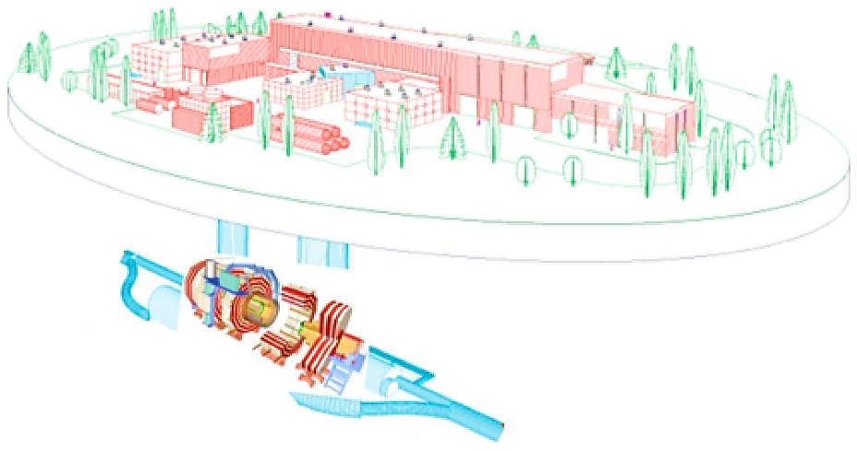

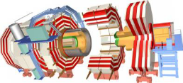
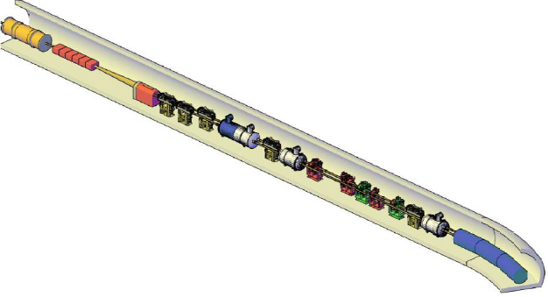
The TOTEM Experiment at the LHC
TOTEM RPs
Central Diffraction at LHC
Totem Roman Pot system
Timing detector in the vertical Roman Pots
  Ultra Fast Silicon Detectors
  SAMPIC
Commissioning: LHC preliminary results
CMS
TOTEM RPs
1

Slide 3





Central Diffraction at LHC
TOTEM RPs
CMS
$$p_{1}(ξ_{1})$$
TOTEM RPs
$$X$$
Central system
$$p_{2}(ξ_{2})$$
Leading proton detected by TOTEM

Slide 4
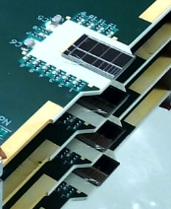
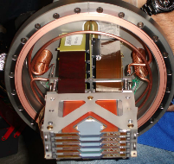

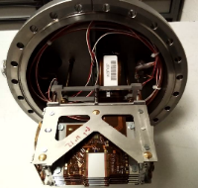
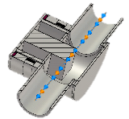
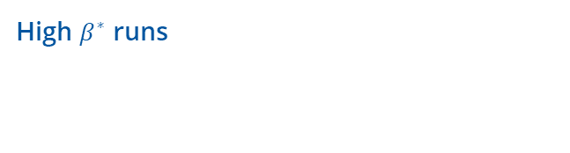
The TOTEM Roman Pot system
High $β^{∗}$ runs
2015
  6 Vertical RPs
  2 Horizontal RPs (only alignment)
  4 Tracking (strip)
  2 Timing (UFSD)
  Tracking (pixel)
PER ARM
Expected after TS1 (July)

Slide 5
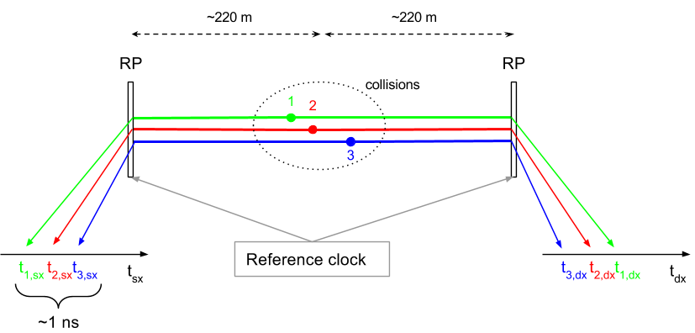
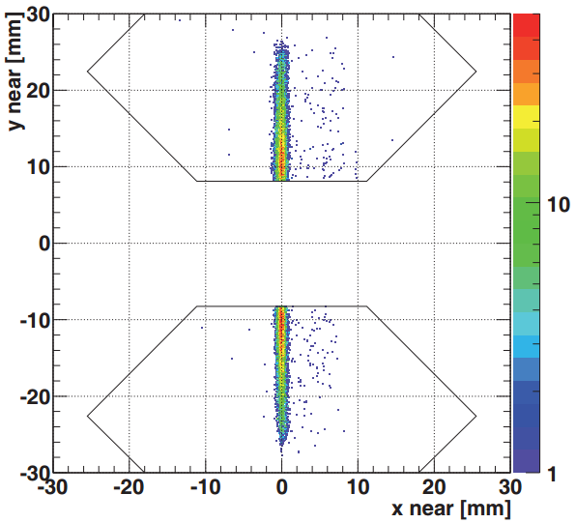


The TOTEM Timing Detector
Timing detector
To associate the detected protons to the correct vertex, when there are multiple interactions per bunch crossing (pile-up) it is possible to measure the time difference between the arrival instants.
With a time resolution of 50 ps ( |Z_{CMS} − Z_{RP}| < 2 cm ) the impurity of the selected events equal to 5% (instead of 22% without the timing information).
$\sqrt{s}=7 TeV$, $β^{∗}=90$ m

Slide 6
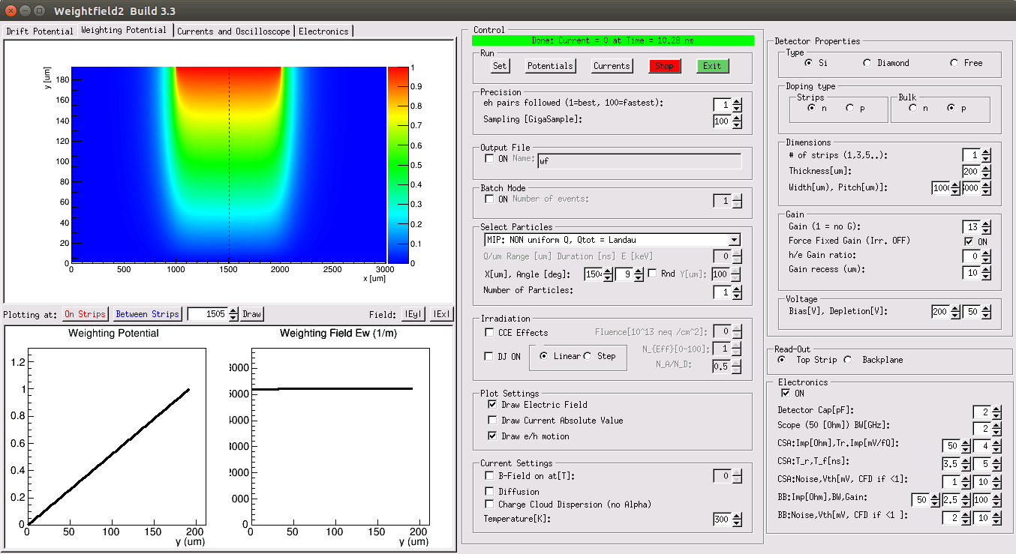
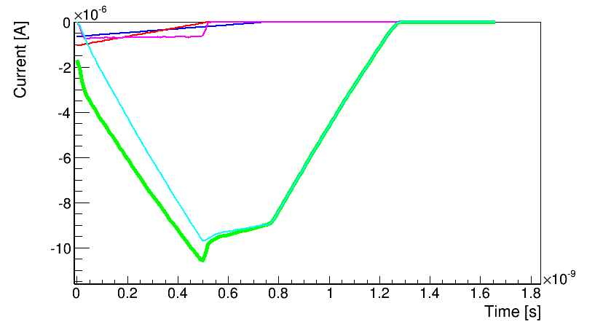
Ultra Fast Silicon Detectors (LGADs)
Ultra Fast Silicon Detectors (UFSD) are Low Gain Avalanche Detectors optimized for timing measurements employing a thin multiplication layer to increase the output signal at the passage of a particle of a factor ~10.
The signal generated at the passage of a MIP by a 50 μm UfSD can be simulated using Weightfield2*.
arXiv:1608.08681
Timing capabilities of Ultra-Fast Silicon Detector
The signal is “amplified” by a gain layer inside the sensor itself, but the leading edge is slower and depends on the charge that is collected by the gain layer
Time precision: as good as 30 ps…
Holes
Electrons
Multiplied Electrons
Multiplied Holes
Total
50 μm UfSD at 200V with a gain 15
*: http://personalpages.to.infn.it/~cartigli/Weightfield2/Main.html

Slide 7
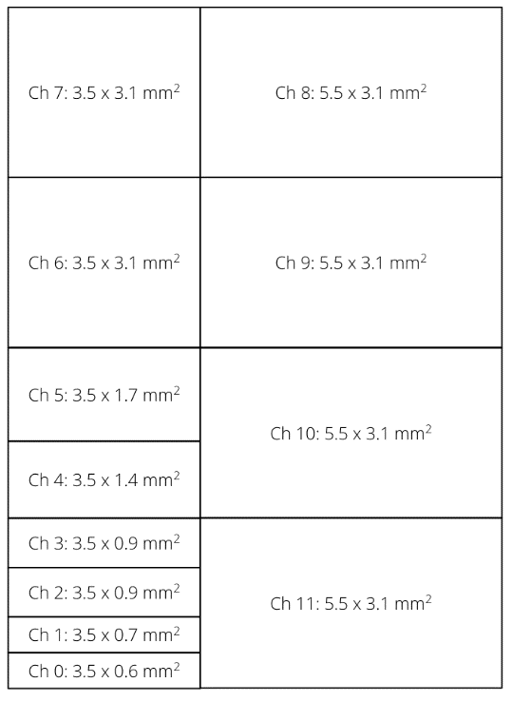



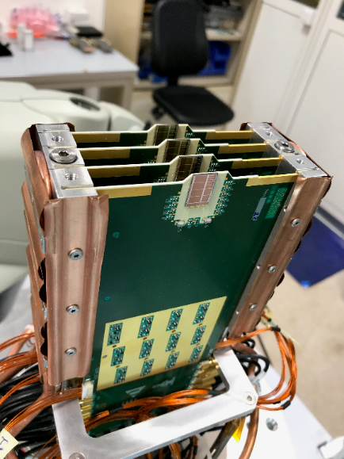
Geometry of the detectors
12 channels per plane
4 planes per package
2 packages per arm (top and bottom)
Time precision better than 50 ps per plane

Slide 8
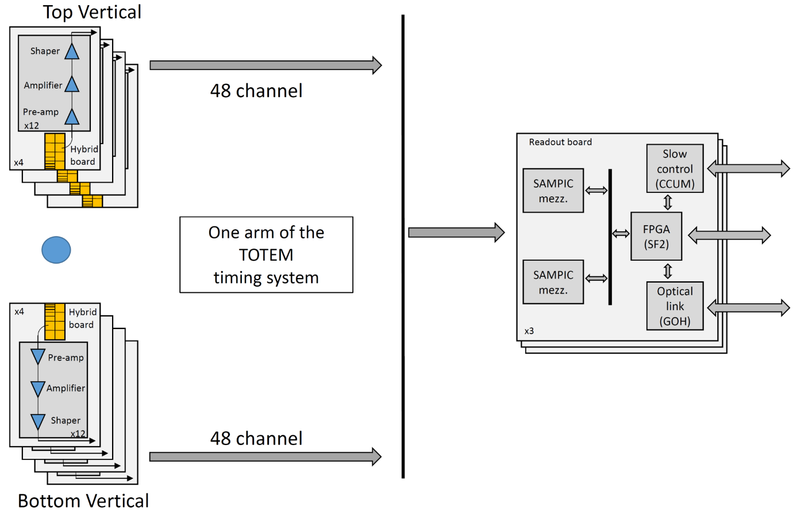
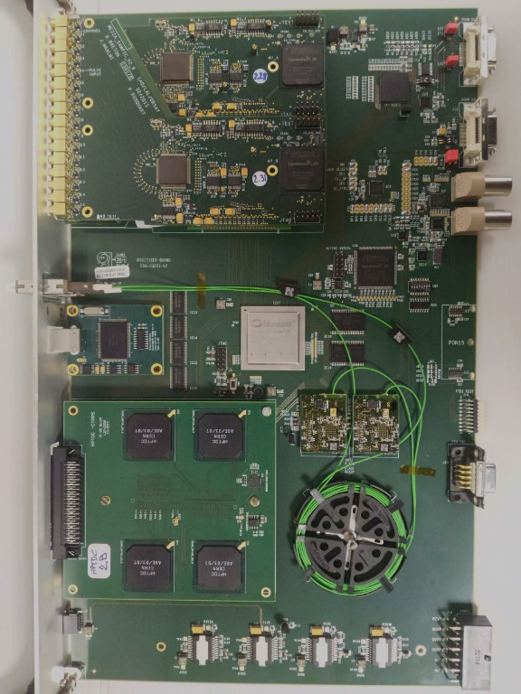
Read-out chain
SAMPIC
16 channels/chip
Up to 64 samples/hit @ 10 GSa/s
1.5 GHz bandwidth
8-11 bit resolution
0.2-1.6 µs channel dead time
Trigger matching and frame building done in the Digitizer Board

Slide 9
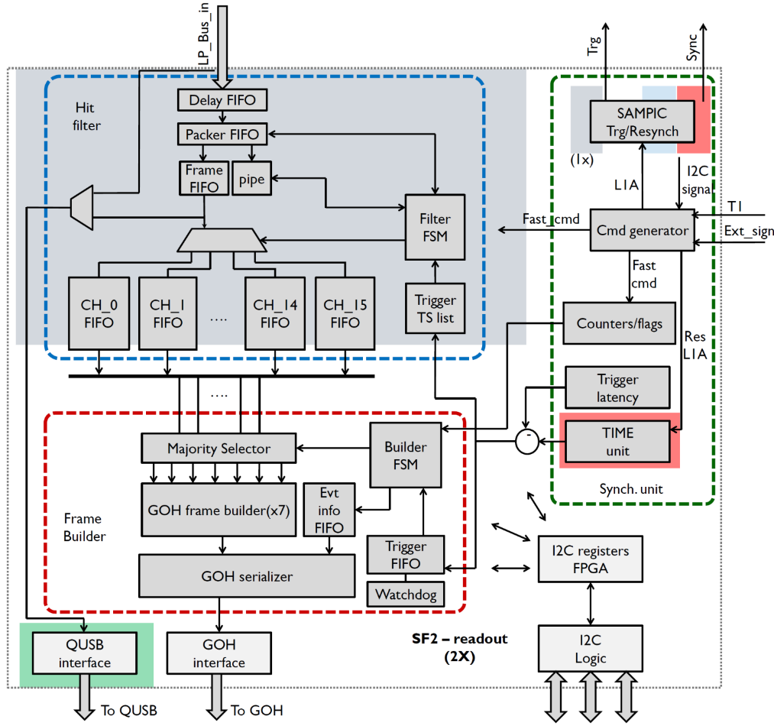
Frame Building in the FPGA
Frame Filtering:
Delay of incoming frames
Check frame integrity (header, trailer, …)
Timestamp reconstruction and matching with trigger list
Event rejected or send to channel FIFO
USB readout available
Trigger latency ~ 6 us
1 Frame for each trigger
Max frame size ~ 350 B
Trigger rate up to 100kHz
USB readout
Fibre readout
Slow Control
E. Bossini

Slide 10
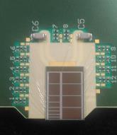
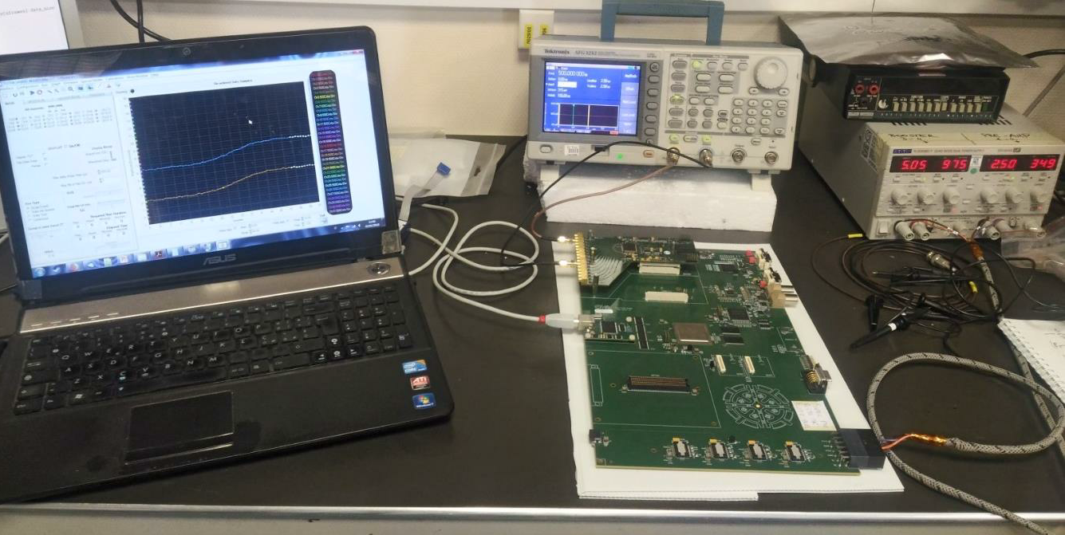
Test in the lab
UFSDs were tested (IV, noise, Sr90, …)
SAMPIC and firmware were tested in the lab thanks to the possibility to configure and read the Digitizer Board using USB.

Slide 11
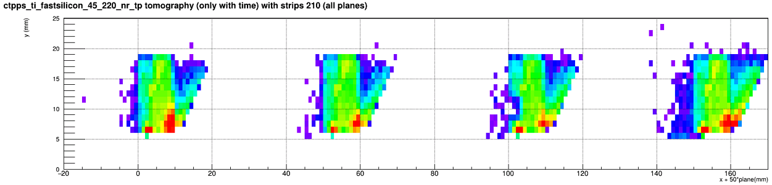
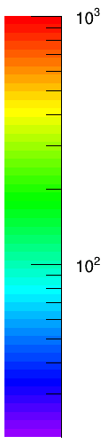
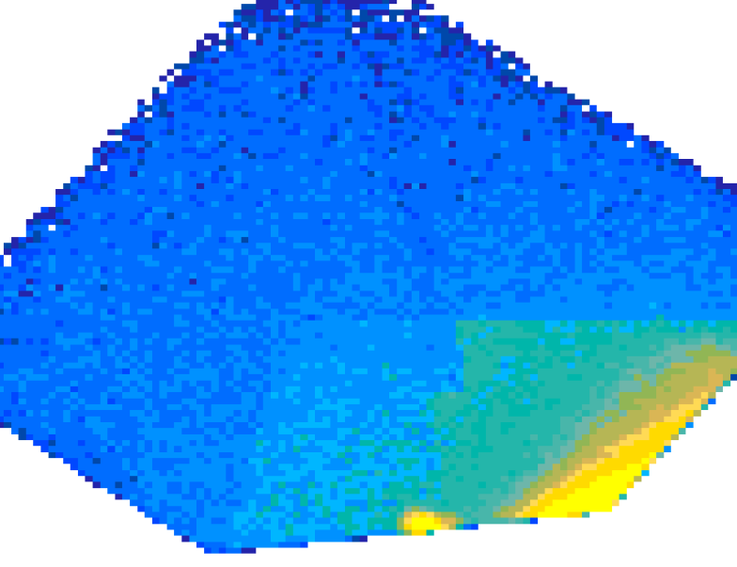
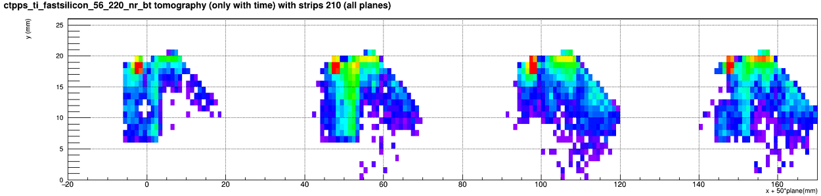
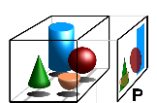
Preliminary results from LHC tests
Tomography
Timing Detector
Strip Tracking
Detector
Tomography is imaging by sections or sectioning, through the use of any kind of penetrating wave.
en.wikipedia.org/wiki/Tomography

Slide 12
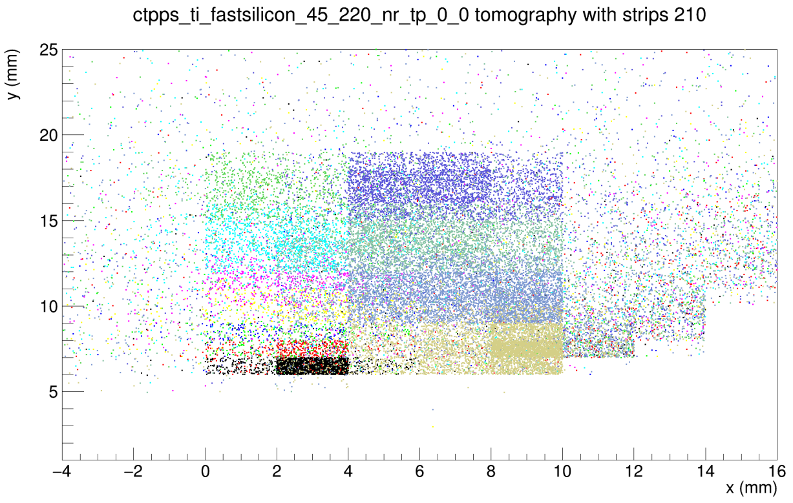
Preliminary results from LHC tests
Tomography
Ch 7
Ch 6
Ch 5
Ch 4
Ch 3
Ch 2
Ch 1
Ch 0
Ch 8
Ch 9
Timing Detector
Strip Tracking
Detector
Ch 10
Ch 11
Very low statistics….
… just enough to double check the mapping!

Slide 13
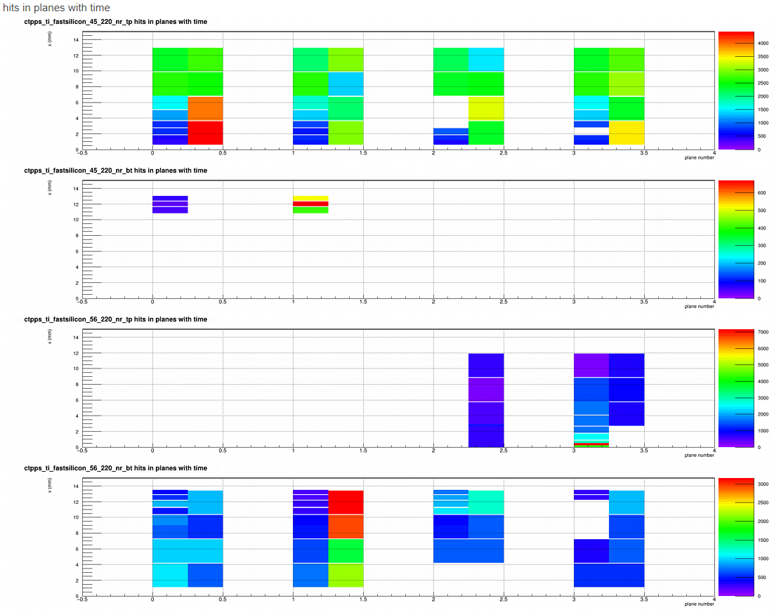
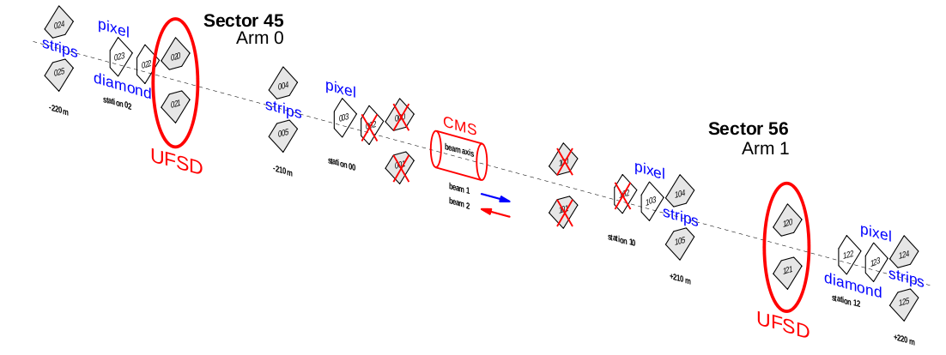
Preliminary results from LHC tests
Hit Maps
Sector 45
Sector 56
Only 2/3 of channels connected!

Slide 14
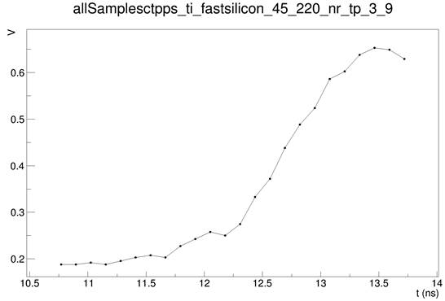
Time of Arrival measurement
Baseline: linear fit on the first baselinePoints
Baseline is subtracted
If max < saturationLimit
Smoothing: sinc convolution using (smoothingPoints points) low pass filter with frequency lowPassFrequency
Constant Fraction Discriminator, using cfdFraction and hysteresis
ADC and INL calibrations to be done…
Other algorithms tested, better performance with CFD

Slide 15
Conclusions
Detector packages installed and tested during End of Year Technical Stop
2/3 of channels connected to the CMS DAQ
Detector hardware tested and installed in the RPs
Firmware developed and tested
Software developed and included in CMS official framework
Optimization and characterization in progress….
  … physics coming with dedicated run at end of June…
… stay tuned!

Slide 16

totem.web.cern.ch

