Slide 1
ATLAS Forward Proton (AFP) time-of-flight (ToF) detector: construction & existing experiences
WORKSHOP ON PICO-SECOND TIMING DETECTORS FOR PHYSICS AND MEDICAL APPLICATIONS
16-18 May 2018, Turin
Tomáš Sýkora
on behalf of the ATLAS collaboration
Institute of Particle and Nuclear Physics
Faculty Mathematics and Physics
Charles University
Notes:
Good evening ladies s and gentlemen, it is my pleasure to be here with you in Valparaiso and to have an opportunity to show you several new results on behalf of the ATLAS collaboration.

Slide 2
outline
ATLAS-AFP Collaboration: Technical Design Report for the ATLAS Forward Proton Detector, CERN-LHCC-2015-009; ATLAS-TDR-024-2015
ATLAS IBL Collaboration, Prototype ATLAS IBL modules using the FE-I4A front-end readout chip, JINST 7 (2012) P11010
J. Lange et al., 3D silicon pixel detectors for the ATLAS Forward Physics experiment, JINST 10 (2015) C03031
LANGE, J. et al., Beam tests of an integrated prototype of the ATLAS Forward Proton detector, JINST 11 (2016), no. 09, P09005
NOZKA, L. et al., Design of Cherenkov bars for the optical part of the time-of-flight detector in Geant4, Optics Express, 2014, vol 22(23), pp 28984-28996
NOZKA, L. et al., Construction of the optical part of a time-of-light detector prototype for the AFP detector, Optics Express, 2016, vol 24(24), pp 27951- 27960
CHYTKA, L. et al., Timing resolution studies of the optical part of the AFP time-of-flight detector, Optics Express, 2018, vol. 26, Issue 7, pp. 8028-8039
CHYTKA, L. et al., Time resolutions of FBK NUV3S and STMicroelectronics SiPMs, to be submitted
KOMAREK, T., AFP Time-of-Flight detector, Challenges in Photon Induced Interactions, 5-8 September 2017
motivation
AFP ToF detector
principle
schema & construction
beam & lab tests
raw data results
RCE data results
installation & commissioning
low trigger efficiency
summary

Slide 3
motivation

Slide 4
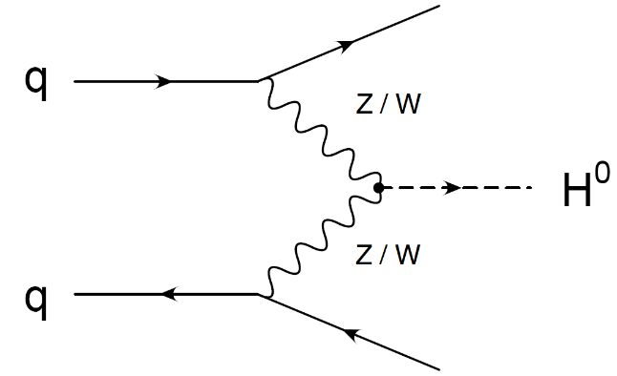
ToF & Higgs particle
originally pp -> p + H + p, Forward Proton 420 (FP420), arXiv:0806.0302 [hep-ex]
ATLAS
beamline
Interaction Point
beamline
p
p
H⁰
p – forward proton

Slide 5
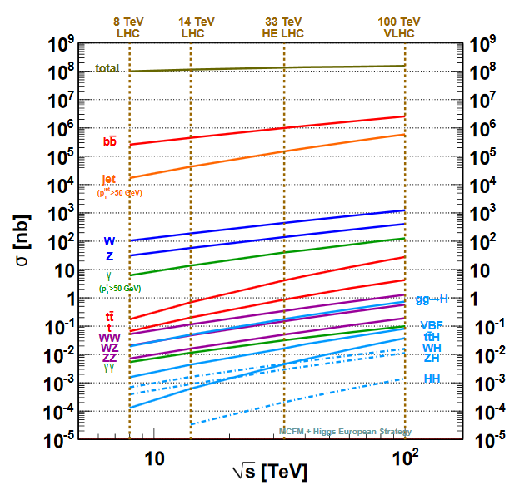
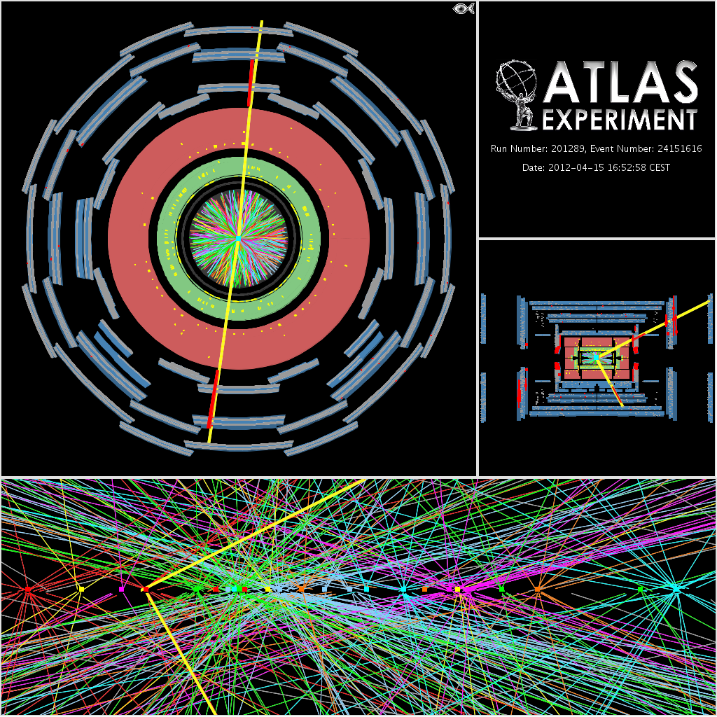
cross section -> pile-up
~ 0.05 nb ATLAS 2017 ~ 50 fb⁻¹
arXiv:1310.5189v1 [hep-ph]
pile-up is inevitable consequence of needed luminosity increase

Slide 6
AFP ToF detector

Slide 7
ToF – principle (z-smearing only)
A-side
$$L$$
C-side
t_{A}
t_{C}
ct_{A}
ct_{C}
δ
${∆t=t}_{A}−$ $t_{C }, L=c(t_{A}+$ $t_{C})$
$δ ≡L/2−$ $ct_{L}=\frac{c∆t }{2}$

Slide 8
ToF – requirements (original)
long term goal 10 ps resolution, 30 ps at the beginning (10 ps corresponds to the spatial resolution of 2.12mm; see the next slide)
radiation hardness (forward region, very close to the beam)
full overlap with the AFP tracker detector
segmentation (multi-proton capability), rate 5 MHz per channel
usability as L1 trigger

Slide 9
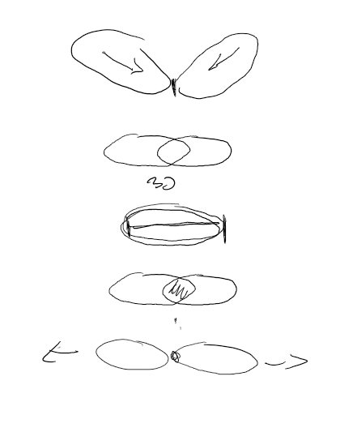
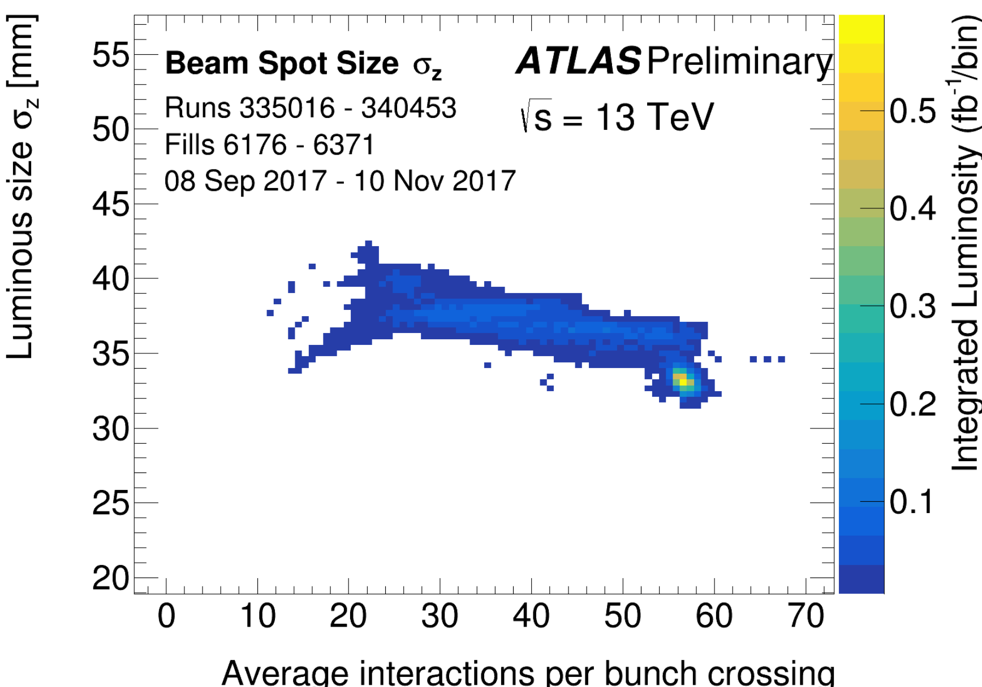
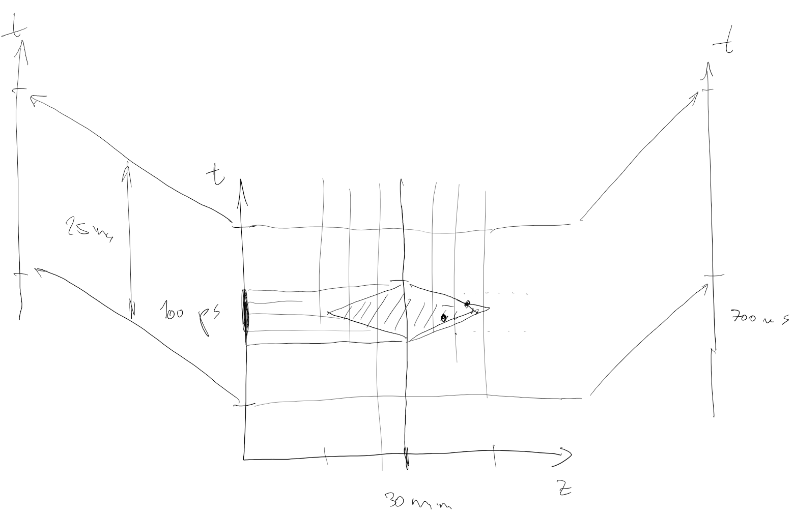
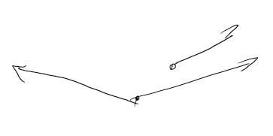
ToF – vertex, z & t smearing, time resolution estimate
z & t smearing
need to effectively select correct event -> need to select correct vertex N vertices in Δ mm -> (assuming flat distribution & only z smearing) δ=Δ/(N-1) per vertex
-> needed time resolution
$$δt=δ/{√2c}{\left.→δt\right|}_{ATLAS, μ=55}=1.4 ps$$
(conditions close to HL-LHC!)

Slide 10
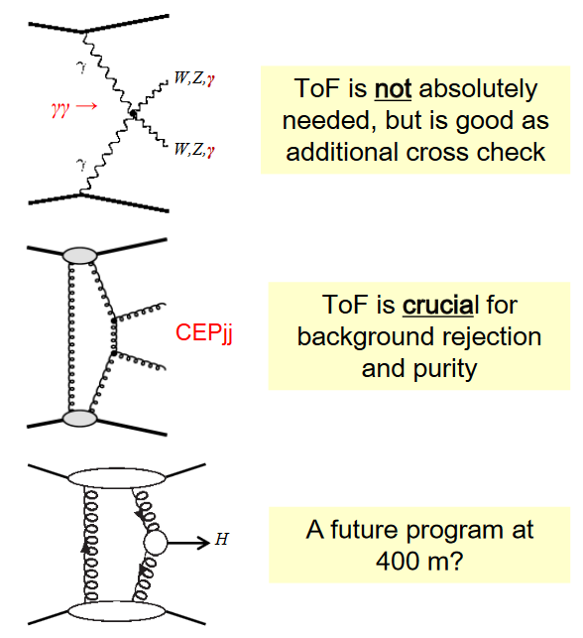
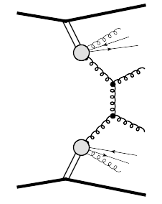
ToF & diffraction
A-side
ATLAS
C-side
AFP 217
AFP 205
beamline
beamline
AFP 205
AFP 217
p
p
Interaction Point
Roman Pots at ~ 205 & 217 m; at both sides of the IP
central diffraction, DPE
exclusive processes
low x-sections -> high μ
ToF is NOT needed
but good for additional cross checks
high backgrounds -> low μ
ToF is crucial
ToF is crucial for purity and background rejection
ToF future…?

Slide 11
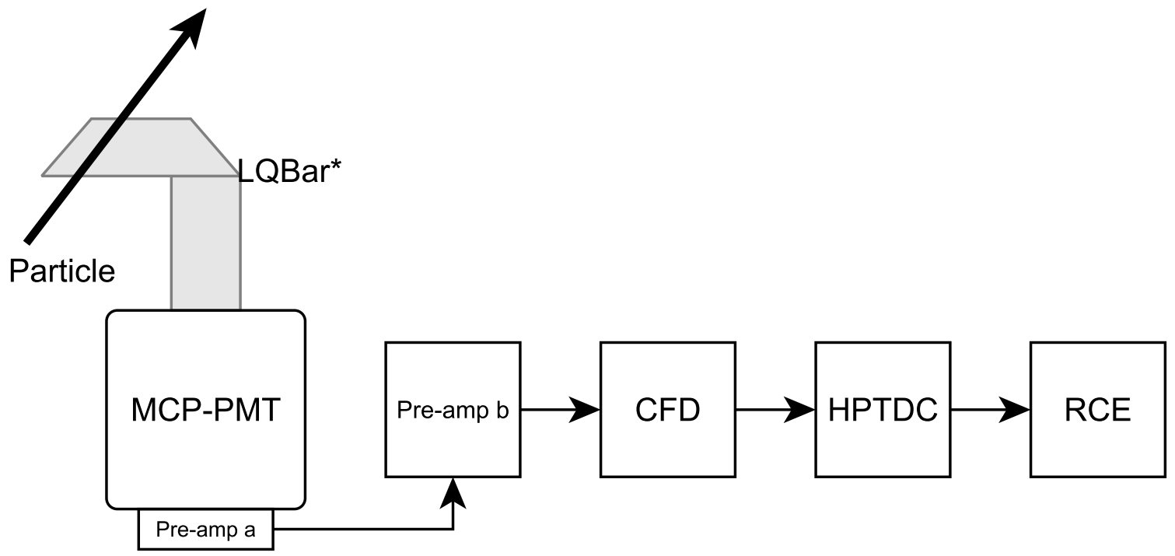
AFP ToF construction – schematic view
C-side
A-side
reference clock

Slide 12
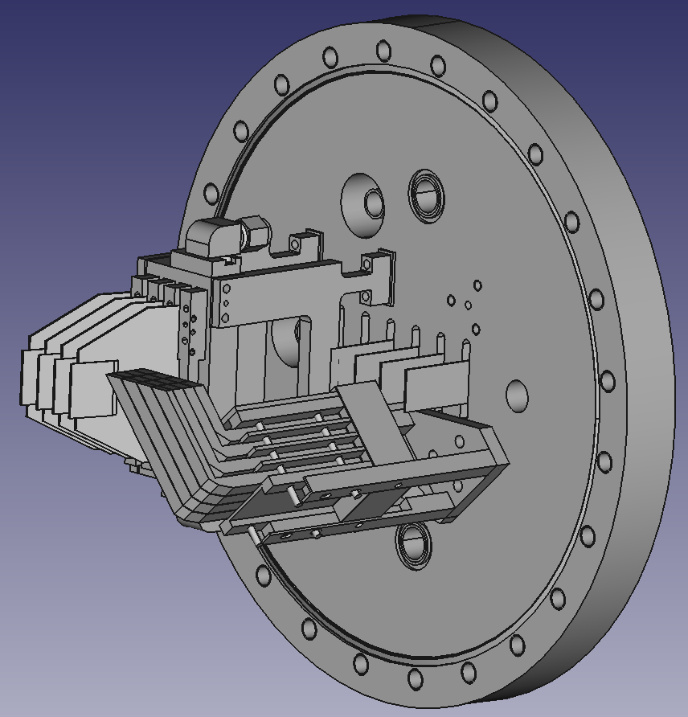
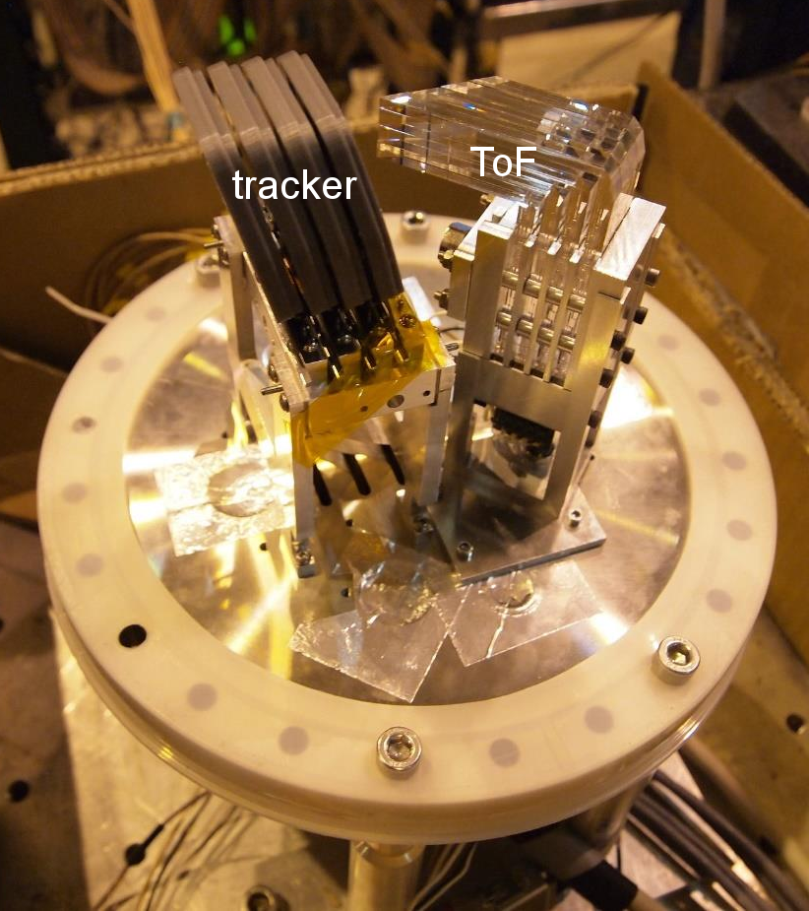
AFP – detector
flange
tracker
ToF
p
flange prototype
ToF = 4 “trains”
1 train = 4 bars

Slide 13
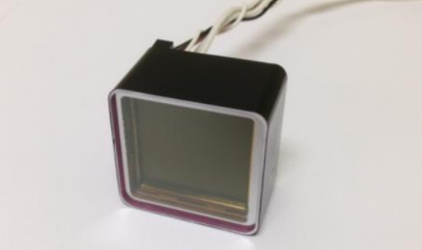
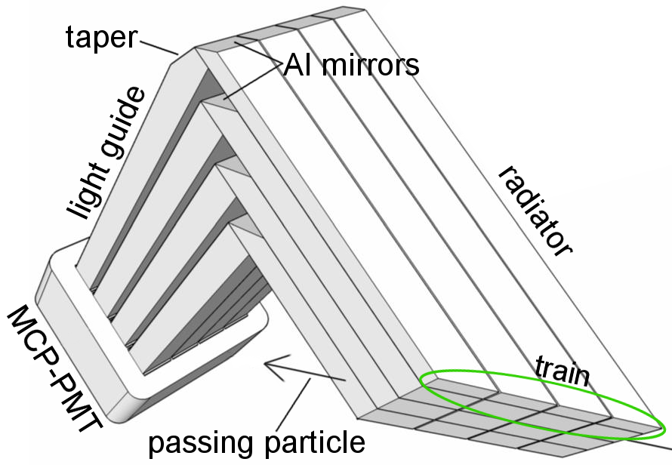
ToF construction – opto-electronic part
Photonis miniPlanacon XPM85112 MCP-PMT, one inch, 16 channels
4x4 matrix of fused silica bars (Suprasil), L-shaped
bars are rotated 48◦ w.r.t. the LHC beam by Cherenkov angle θ in Suprasil
each bar glued from two parts using Epotek 305
typically ∼ 100 photons reach the PMT per bar
⇒ ∼ 30 photoelectrons
particle passes through a train (= 4 bars)
→ 4 “independent” measurements
→ 1/√4 σ^{single measurement}
for train made of n bars -> 1/√n
https://www.photonis.com/uploads/datasheet/pd/Mini-PLANACON-4x4-datasheet.pdf
join
θ
edge

Slide 14
AFP ToF detector beam tests

Slide 15
Beam tests performed at the H6 beamline, CERN SPS North Area (120 GeV pion/muon beam)
2014 (Photonis PMTs)
November – integration with tracker and readout test
2015 (Photonis PMTs)
September – 2 bars per train resolution and basic crosstalk studies
2016 (Photonis PMTs)
July – two ToF detectors, several full trains measurement, cross talk, LGADs measurement
September – ﬁnal integration test, full 4x4 ToF, irradiated LGADs measurement
October – interference related measurement
2017 (Photonis PMTs)
June/July – ALD coated MCP- PMTs tested, vacuum test, crosstalk, analog-digital trigger module test
September – re-measurement of new PMTs, test of digital trigger module
2018 (Photonis & Hamamatsu PMTs)
May/June – measurement of new ALD coated PMT (Photonis), of Hamamastu PMTs, of 3rd stage of PA, interference reduction & shielding, irradiated PMTs, irradiated bars, rad hard TDC (see J. Pinfold talk) & integration test,
July/August – measurement of glue-less bars, Hamamatsu PMT tests, new ToF signal path test
September – new (3ps) TDC tests, digital trigger tests

Slide 16
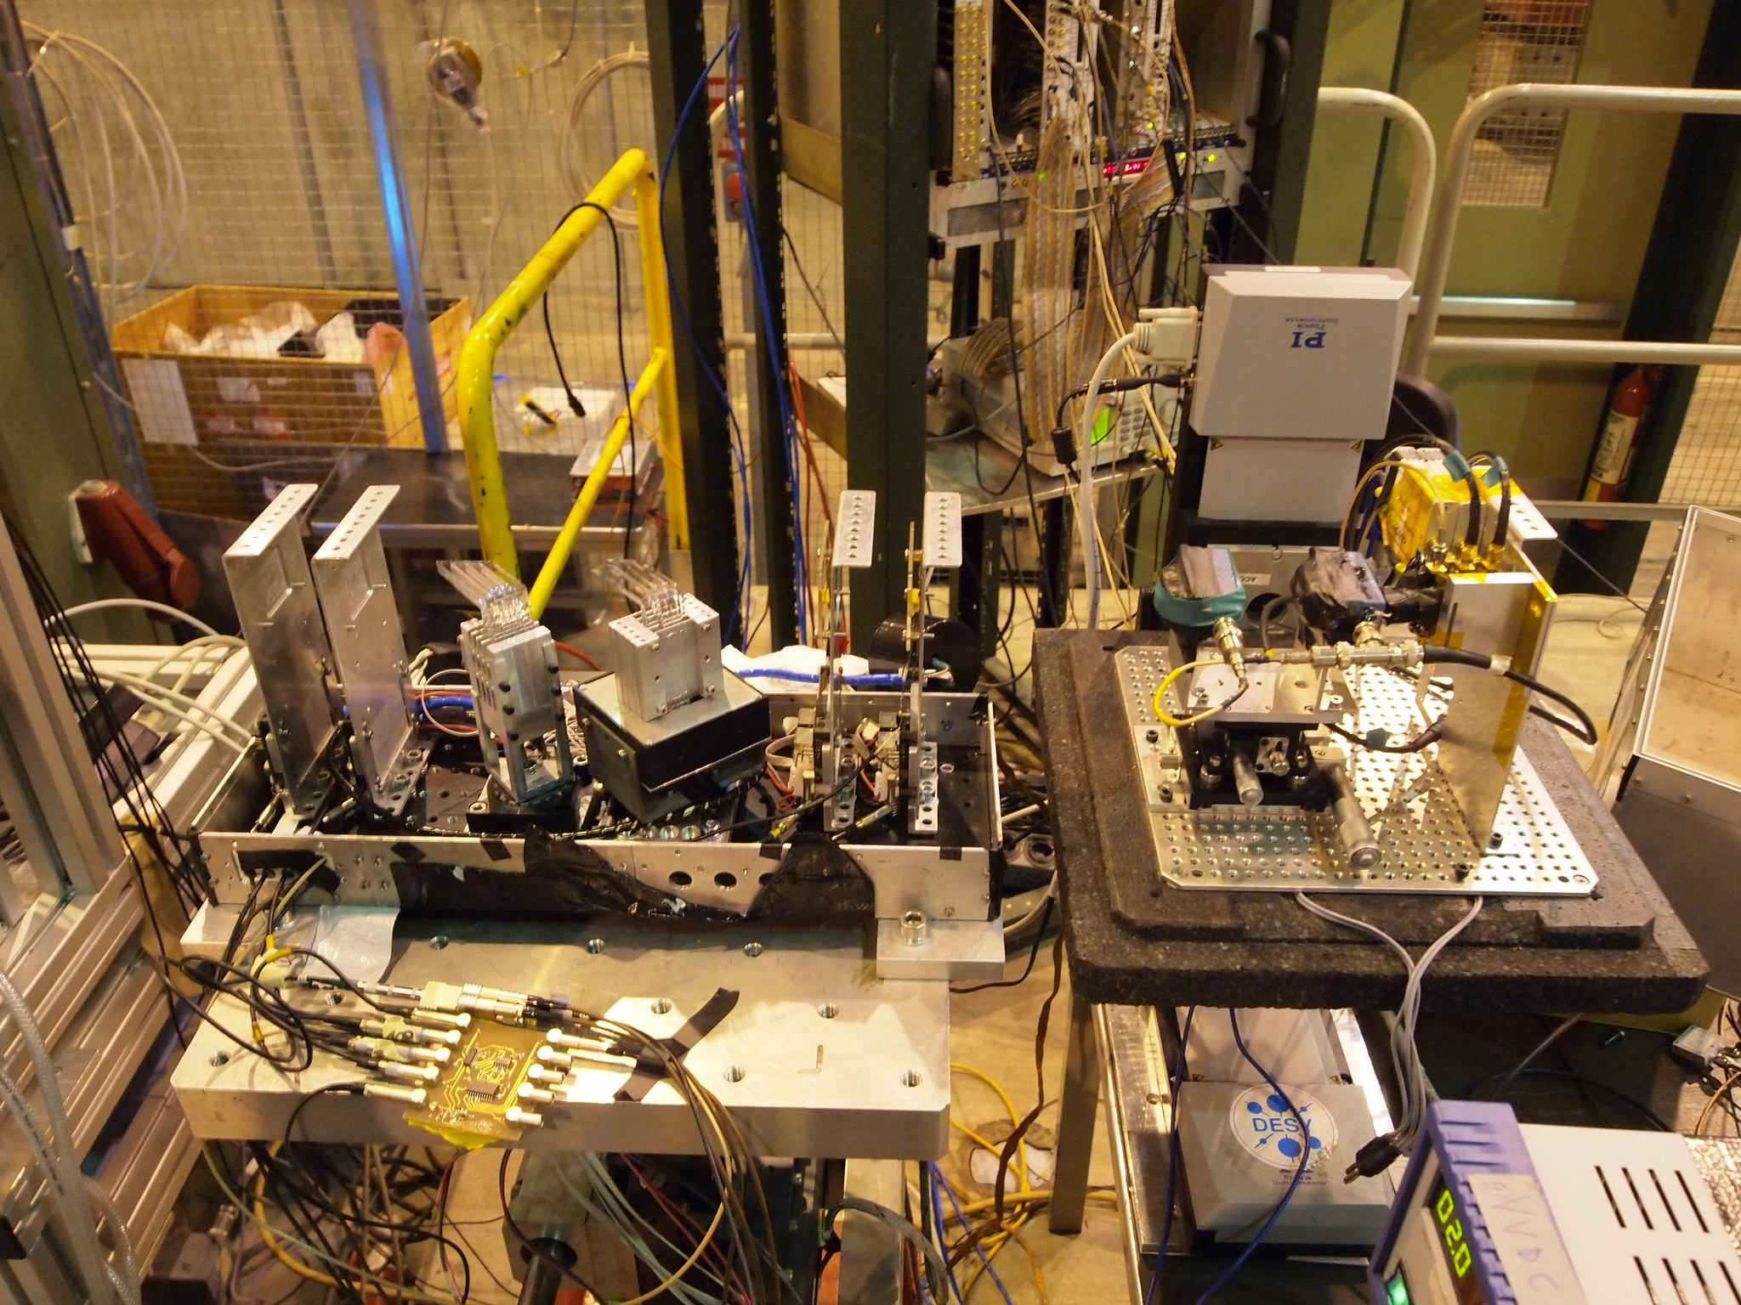
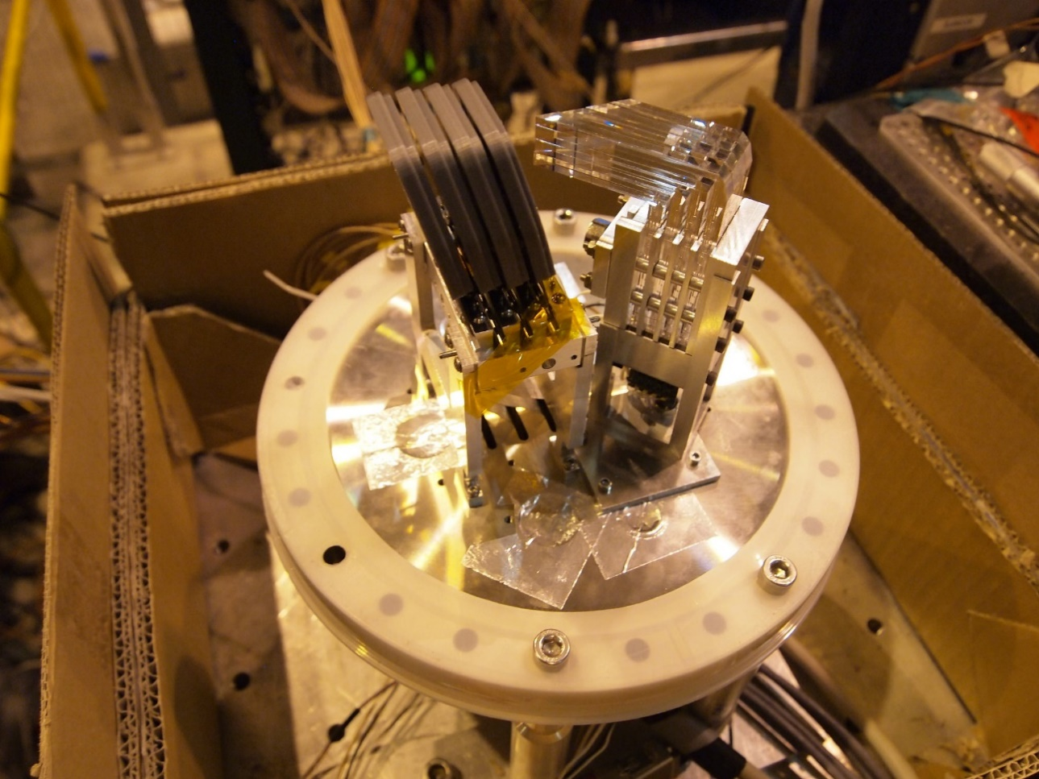
beam tests 2016
June/July 2016 - box
September 2016, 2017 flange & RP

Slide 17
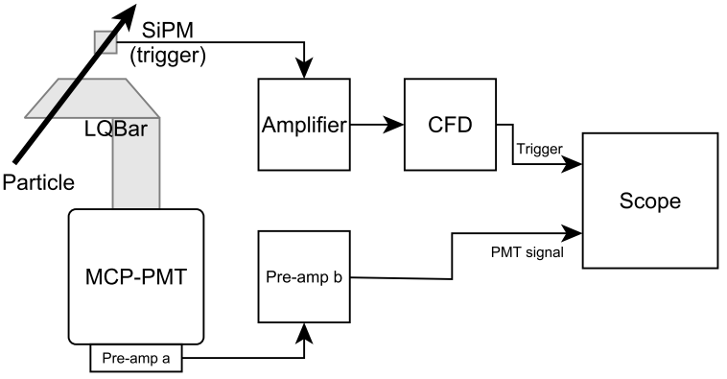
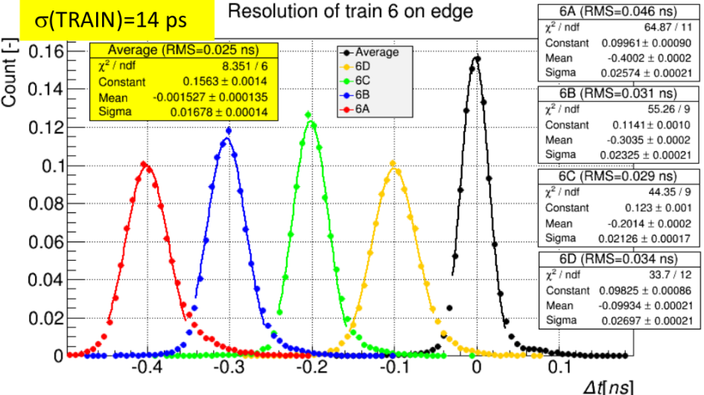
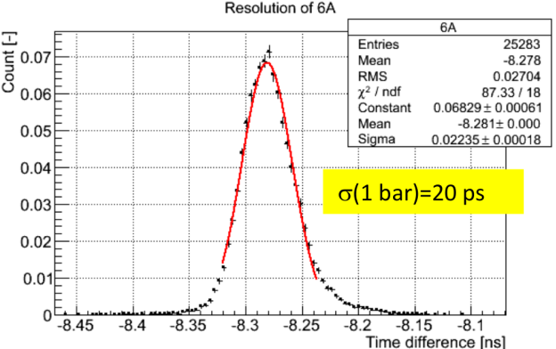
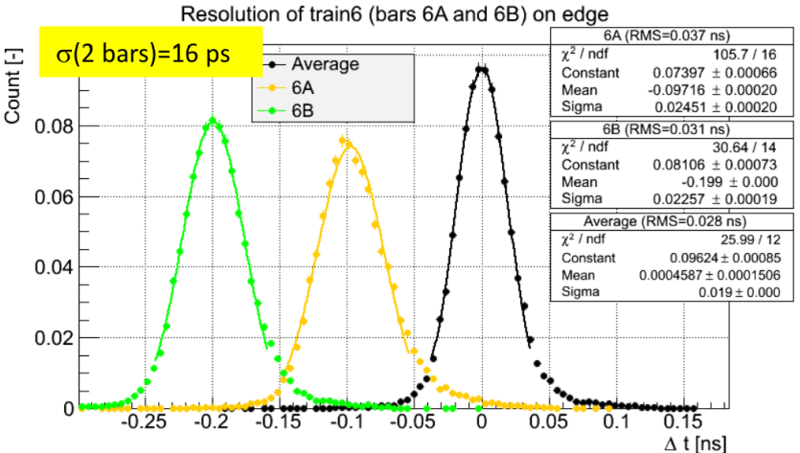
beam & lab tests – raw data results (2016 June-July data)
*STMicroelectronics NRD09 1
PMT’ = PMT + PAa + PAb + scope + trigger (SiPM*) – lab measurements (Olomouc) – σ_{PMT’} < 20 ps/channel laser signal, directly into a PMT channel, signal amplitude to correspond to a minimally ionizing particle
PMT’ + 1 train
trigger subtracted
PMT’ + 2 bars
PMT’ + 1 bar
uncertainty ± 1 ps in σ_{fit}, ± 2 ps in FWHM

Slide 18
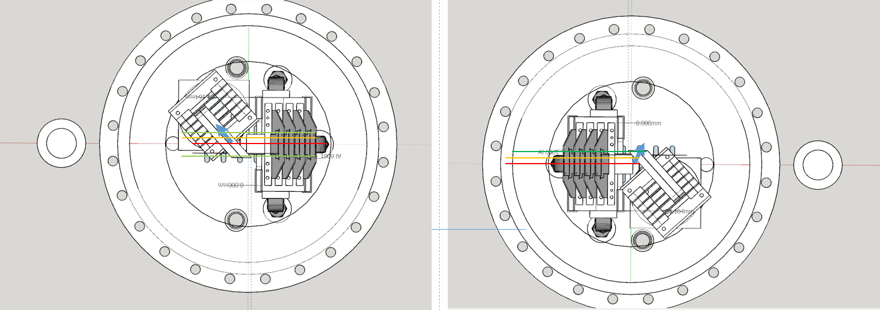
resolution vs distance from the edge (2016 June-July data)
the position of edge is different on the A & C sides

Slide 19
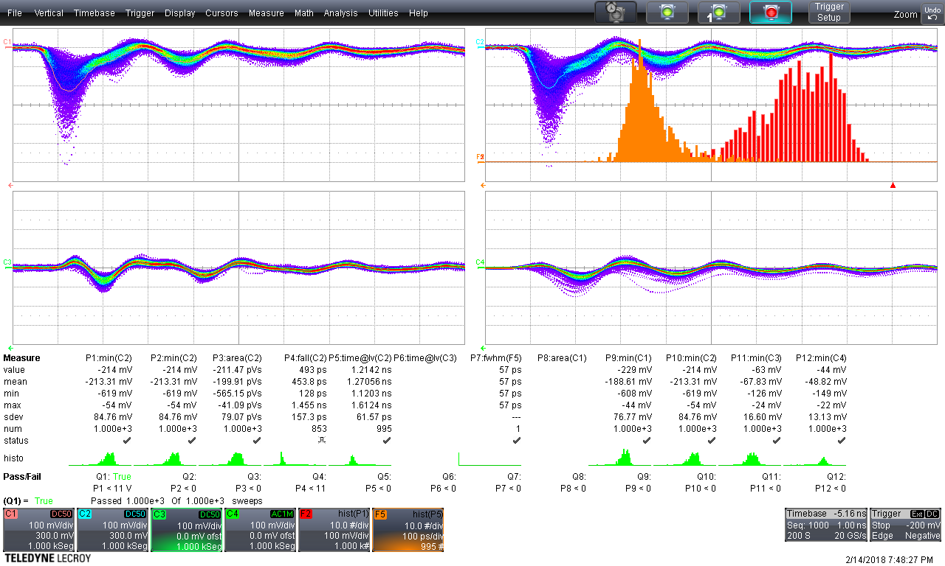
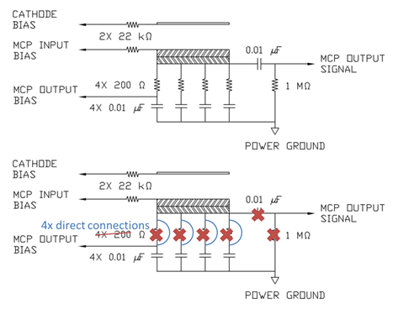
beam & lab tests – raw data results (2017 vs 2016) I
observed effects: 1) ringing
2) (much) higher cross talk between channels
3) worse time resolution per bar, comparable per train
new PMTs – ALD coated, coax cable removed & resistors removed, sapphire window, vacuum tight sealing
original
modified
Serge Duarte Pinto, Photonis

Slide 20
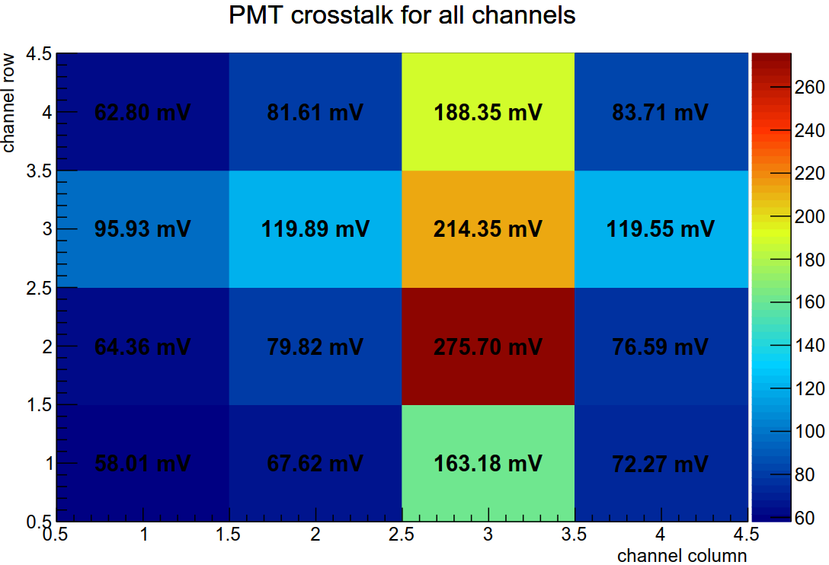
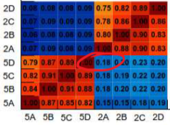
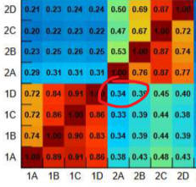
beam & lab tests – raw data results (2017 vs 2016) II
cross talk 2017 (UTA)
another comparison
cross talk 2016
cross talk 2017
cross talk does represent a problem if
time resolution is affected (next slide)
there is channel rate limitation, e.g. 8 MHz due to TDC; at μ = 50 we expect 32 MHz across the detector but now signal is NOT spread across, rather goes everywhere -> rate will be exceeded
> 50% of signal!
signal train

Slide 21
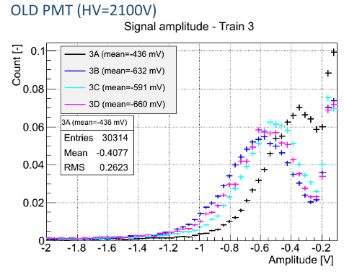
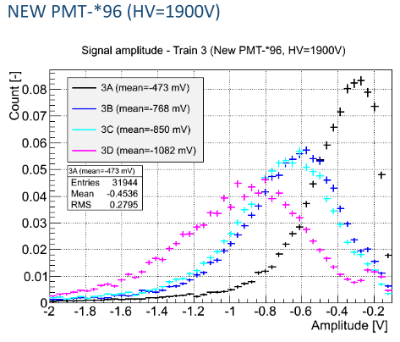
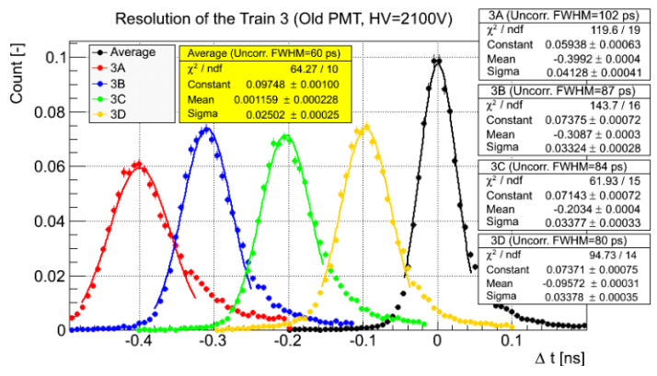
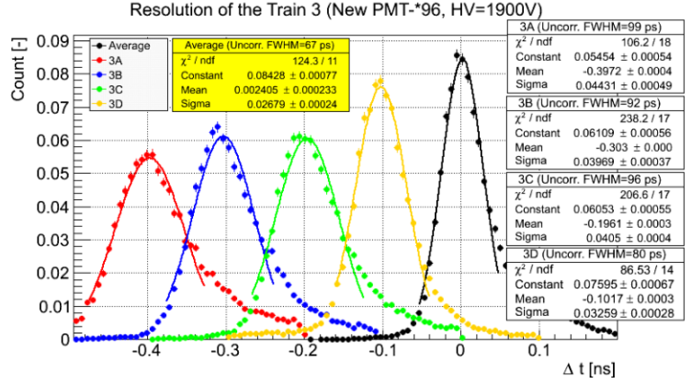
beam & lab tests – raw data results (2017 vs 2016 September) III
both RP+flange
note worse resolutions
w.r.t. slide 13 RP & flange! ->
resolution deterioration

Slide 22
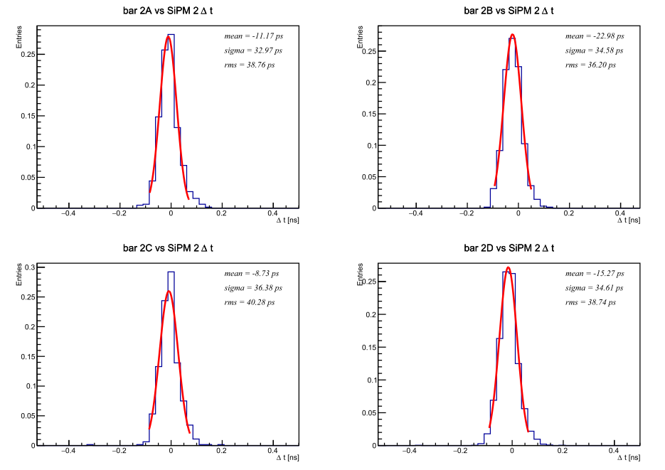
beam & lab tests – RCE data results, flange & RP (2016)
20.6 ps
] σ^{HPTDC} = 17 ps & σ^{MCP’} = 17 ps -> expected value ~ 24 ps; consistent

Slide 23
contributions to ToF detector resolution
PA a & b: 3 − 4 ps (each)
CFD: 5 ps
HPTDC: 15 − 17 ps
reference clock: 6 ps (conservative)
SiPM resolution (for beam test): 11-13 ps
for full system we expect(ed) resolution better than 25 ps

Slide 24
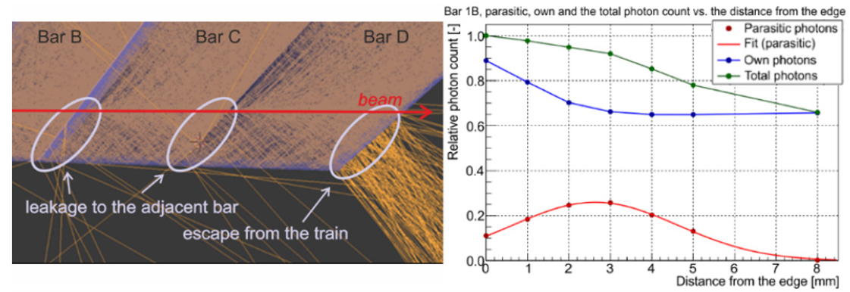
scaling √N & cross talks
optical “cross talk”
train 6
based on slide 16
ratio ¼=1.43
PMT charge sharing
√N
e⁻
photons
RCE, train 2, slide 21,
single bar (av.) 33 ps, full train 21 ps, ratio ¼=1.57
optical crosstalk
+
pe rebound
both processes – optical cross talk & charge
sharing, by their natures, cannot spoil √N scaling
it is electrical coupling of channels, what causes violation of √N scaling
electrical
crosstalk
(charge
sharing)
+
+
anode 1
anode 2

Slide 25
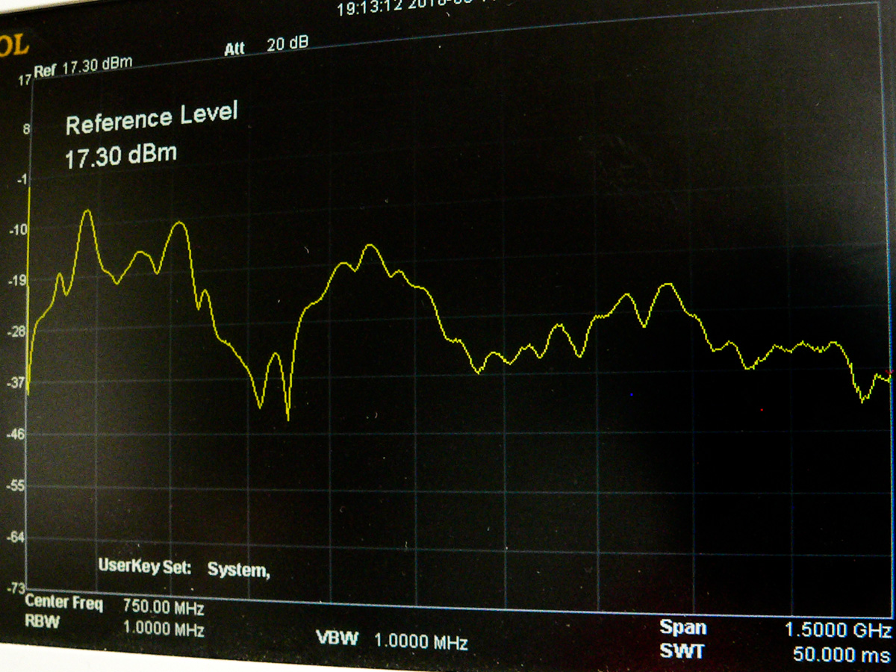
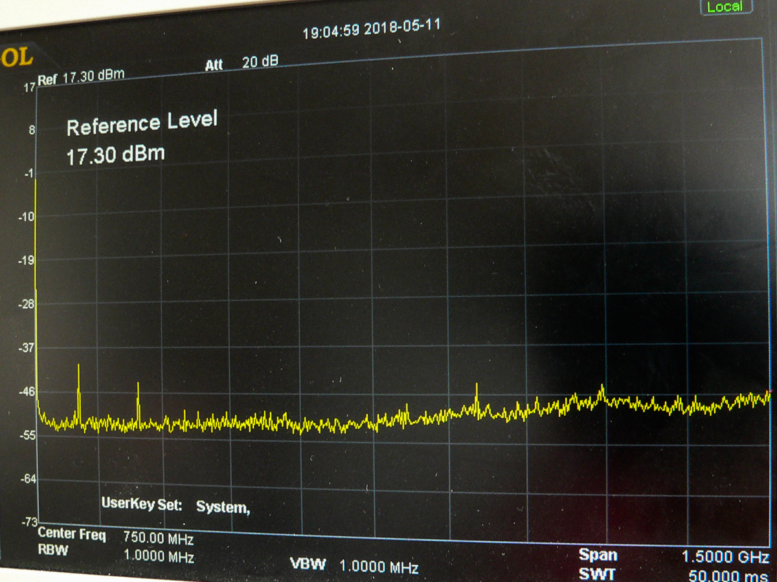
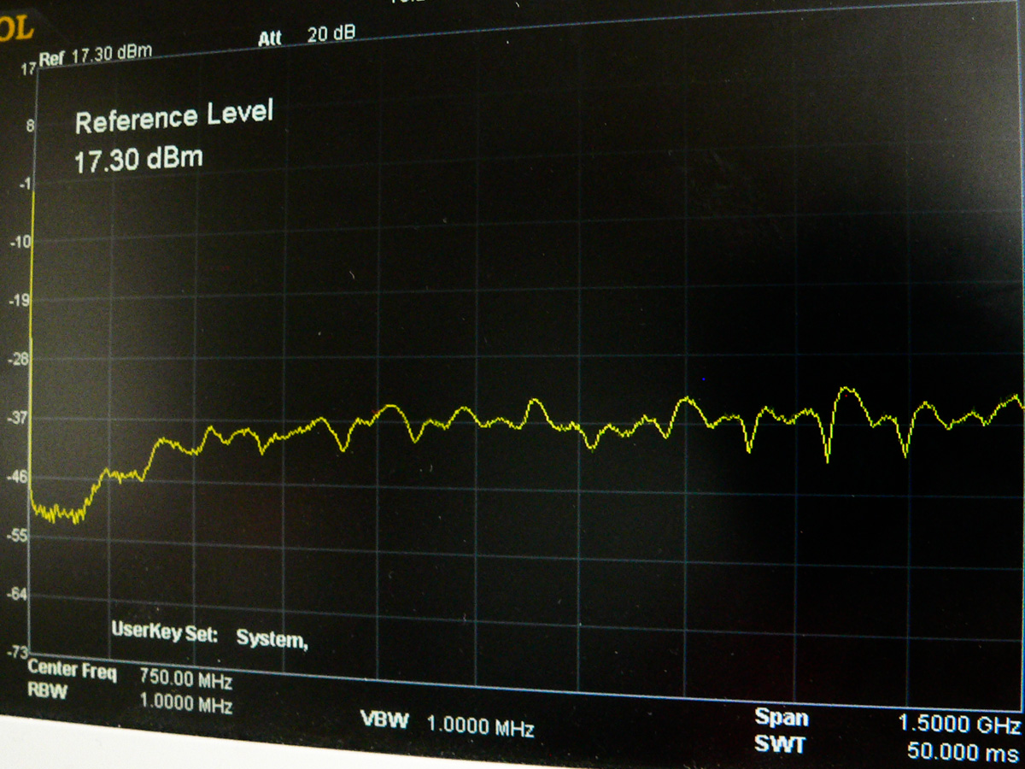
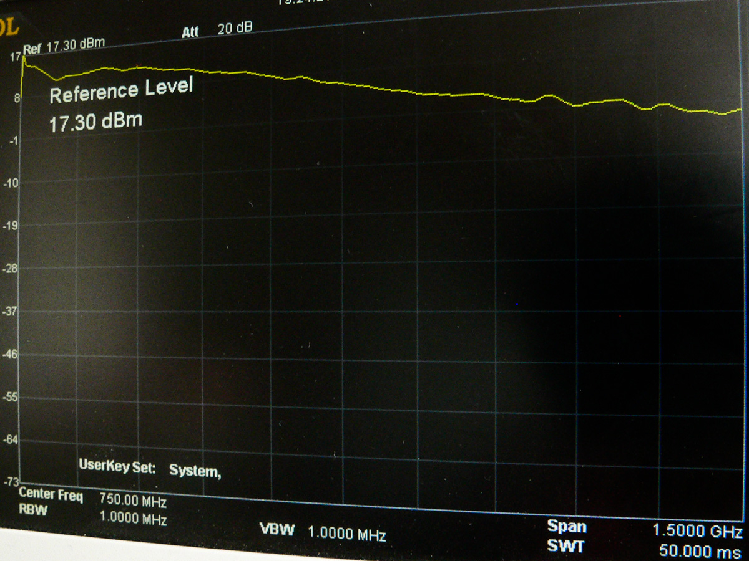
scaling √N & electronics
TDC
cross talk presented when channels on the same TDC chip -> cure = mapping channels from the same train to different chips
still, a signal in one channel influences another channel -> software corrections of data
final cure (hope) – new “pico” TDC
PAb
crosstalk between channels; minimized by improvement of grounding of powering part
cables & connectors
part of the signal path not optimized for transport of an analog -> reflections, cross talk (c.f. plots)
background
not optimized signal path
signal
signal
no signal
optimized signal path

Slide 26
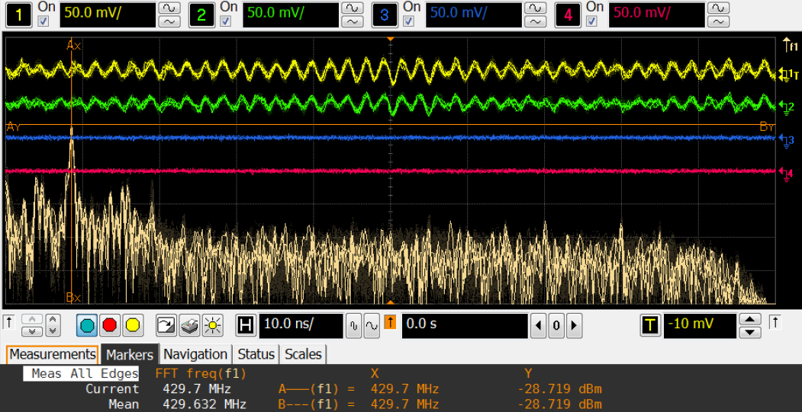
interference I
moving ToF into a RP lead to deterioration of time resolution
we tried to find source, one of them was interference coming from the (LHC safety) TETRA system (429.6 MHz) [different frequencies on surface and in the tunnel] the estimate, made based on real data noise shape + real signal -> worsening by < 1 ps
will be tested
attempts to shield it; additional aluminum sheet, ferrites on cables

Slide 27
installation & commissioning

Slide 28
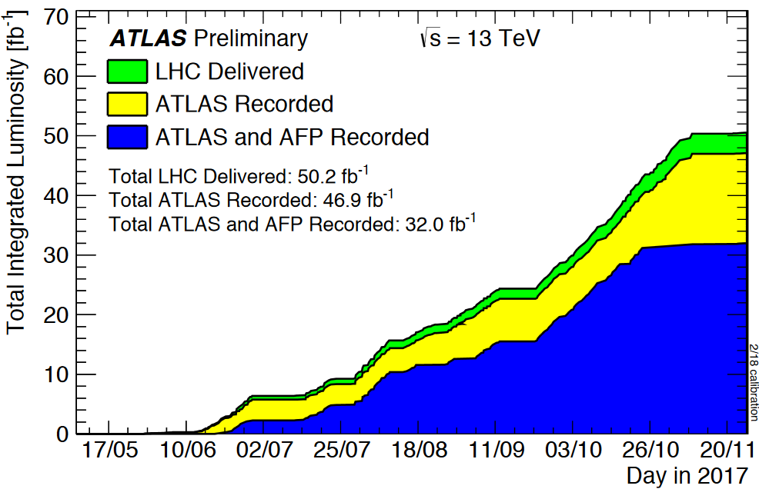
complete AFP
EYETS: 12 Dec 2016 – 30 Apr 2017

Slide 29
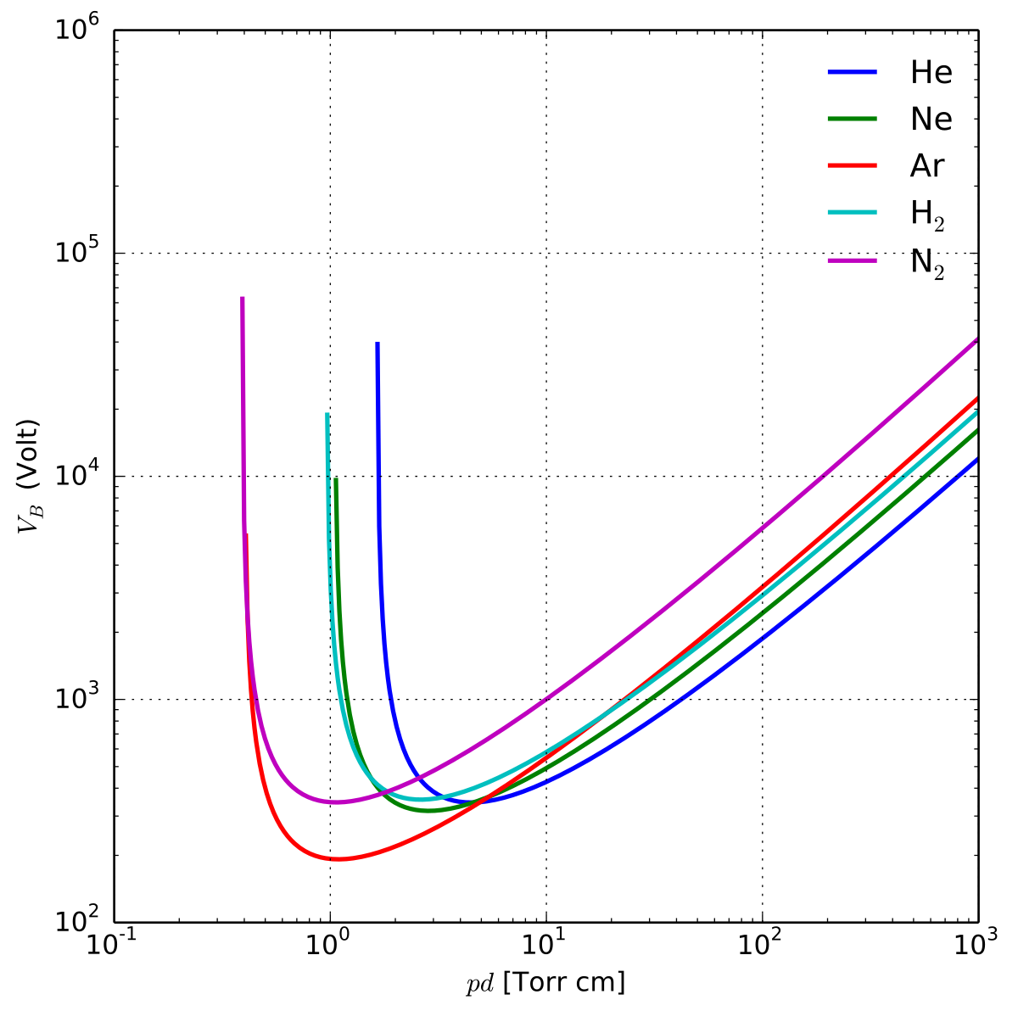
MCP-PMT and vacuum
https://en.wikipedia.org/wiki/Paschen's_law
in the AFP ToF detector construction a MCP-PMT is placed in vacuum; it is not LHC vacuum, but rather rough vacuum (10-40 mbar), which puts us in worse location of Paschen’s curve
PMT HV connections were tested to be safe in vacuum (Olomouc & CERN)
during one of the tests, just before the installation, one of the tested PMT tripped and it was not possible to operate it under vacuum anymore; Photonis provided us a solution
new, fully (under vacuum) sealed PMTs were produced by Photonis for our experiment
0.13
1.33
13.33
133.32
1333.22
pd [mbar cm]

Slide 30
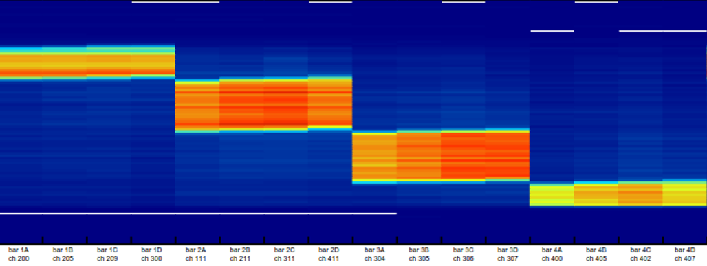
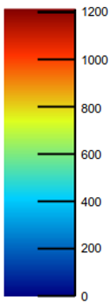
SiT – ToF correlation
beam test

Slide 31
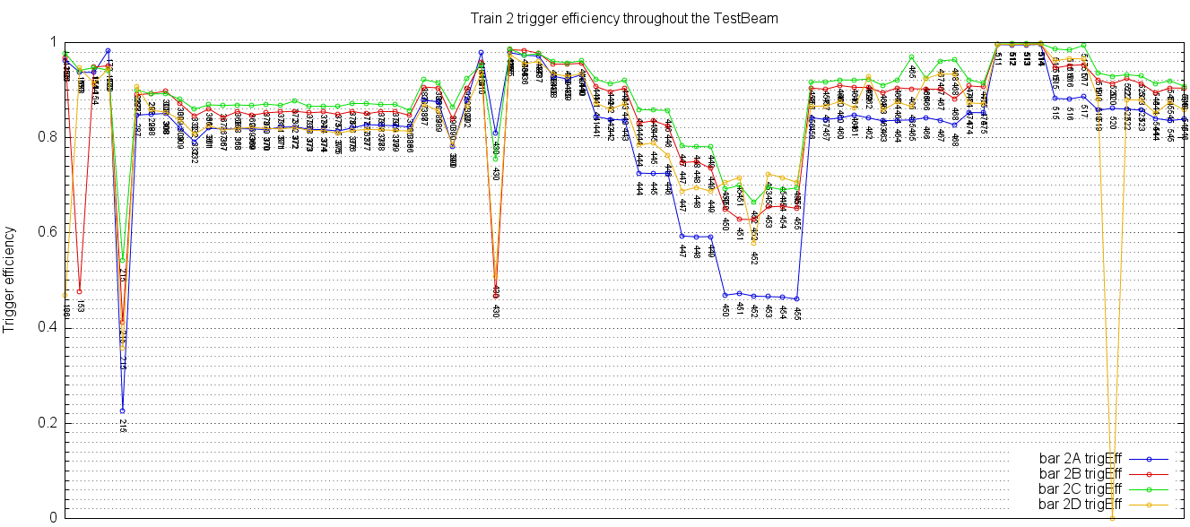
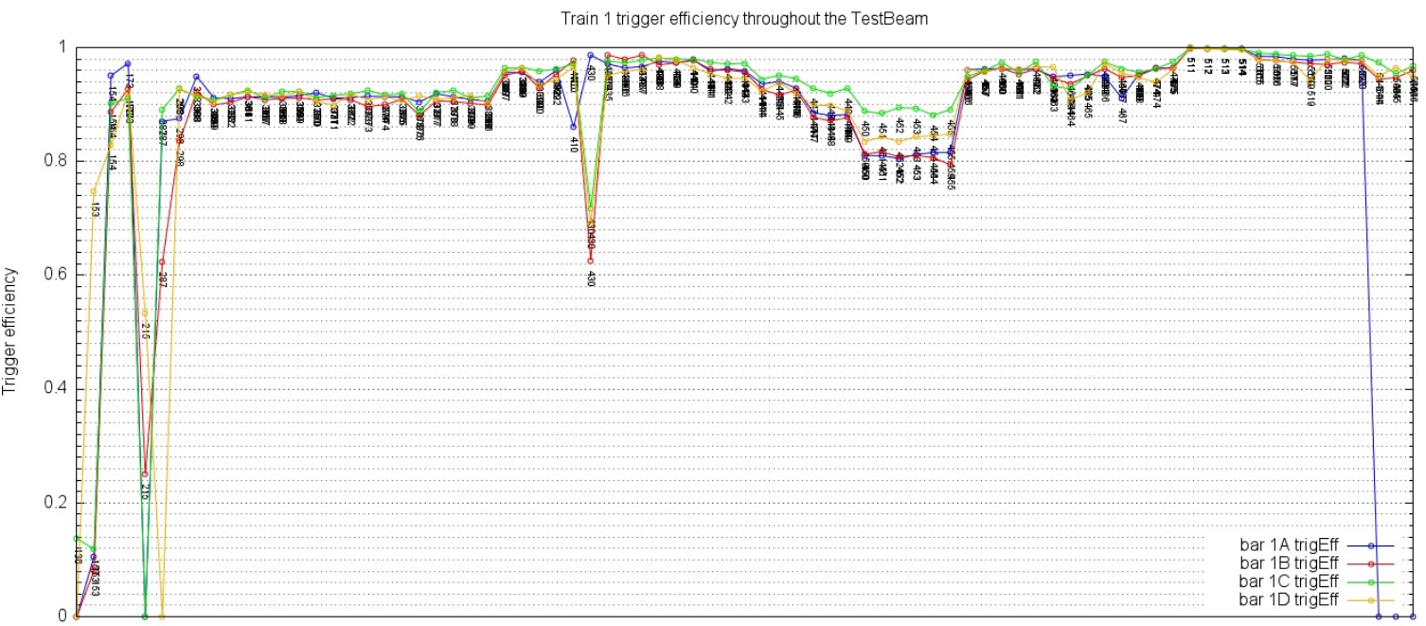
SiT trigger efficiency – beam test (2016)
beam test September 2016, CFD threshold dependence, similar values during October 2017 BT single bar for the threshold 250 mV (max in tunnel) > ~60 % -> minimal expected efficiency of the trigger 2/4 (tunnel) 80%

Slide 32
ToF bar efficiency (trigger by SiT)

Slide 33
SiT – ToF trigger efficiency

Slide 34
possible reasons (as considered historically)
rate vs PMT
glue/bars deterioration due to irradiation
voltage
PMT lifetime (cumulated charge)

Slide 35
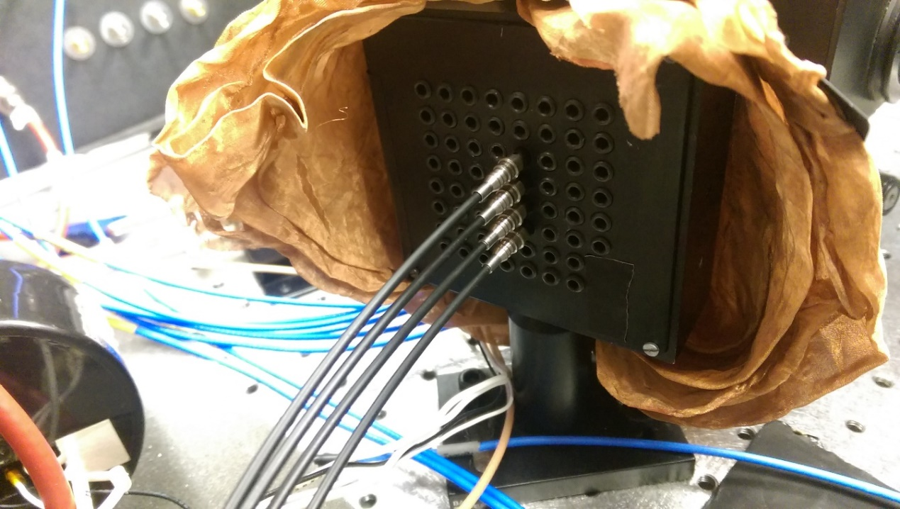
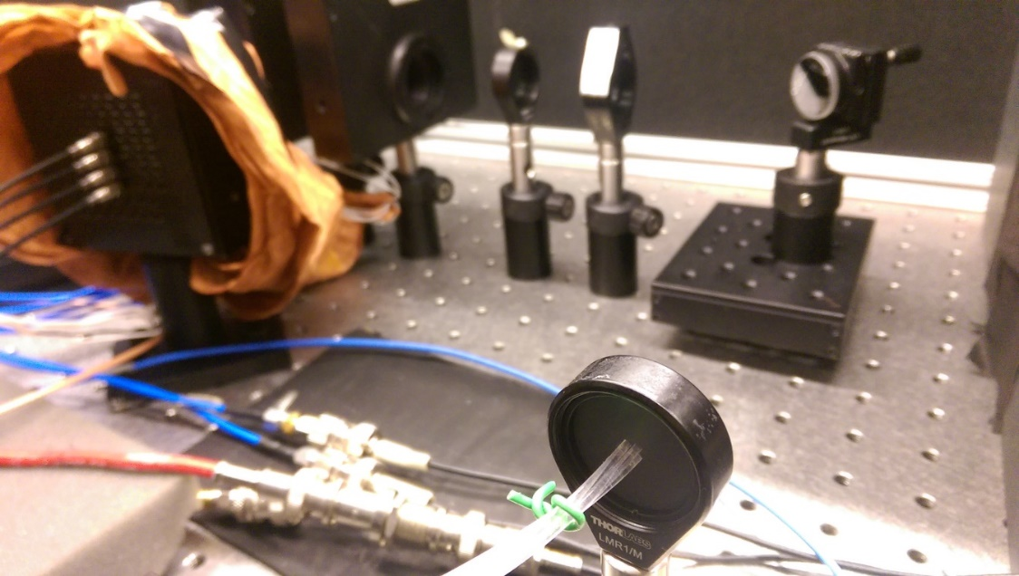
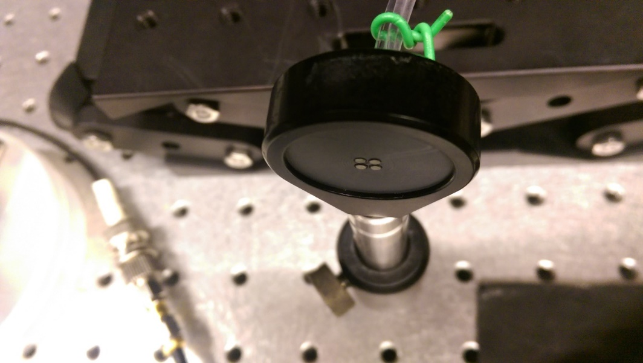
tests at UTA
all except for Photonis *97 performed at 20p.e.,
Photonis *97 at 10 p.e.
35

Slide 36
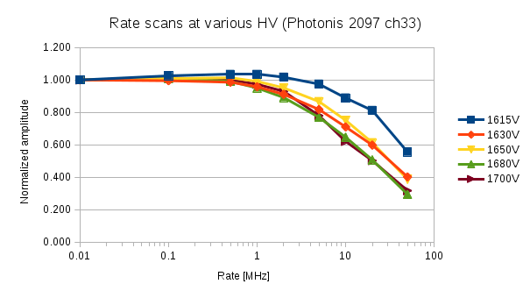
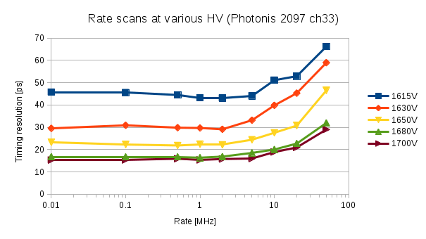
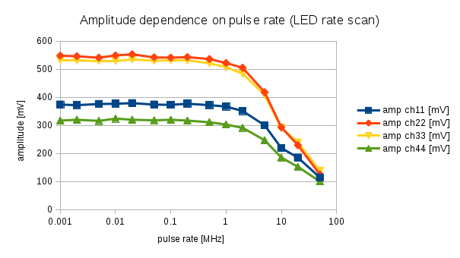
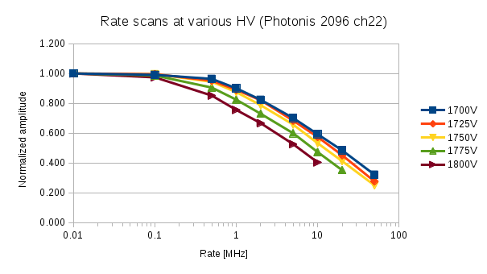
3 x PA
HV & rate scans
Photonis
LED test Photonis 2097
PMT behavior different, as expected (R is different)
36

Slide 37
3 x PA
HV & rate scans
Hamamatsu
PMT behavior very similar, as expected (R is the same)
37

Slide 38
conclusion high rate measurements
to be able to operate we need to go with gain/HV lower
we have to use 3rd stage of PA
we need to reduce noise & interference
ad 3) so far the campaign in Pilsen was successful, reduction of interference by 15 dB, noise to 5mV (P2P)

Slide 39
glue & bar irradiation
in 2017 we got ~ 50 fb⁻¹
measured (irradiated) bar transmissivity at λ = 280 nm showed drop to 62% it corresponds to less than 20 kGy
at 20 kGy, estimate is we should not loose more than 1/5 of light;
absorption length should not play a significant role
-> the trigger efficiency was not caused by irradiated optical detector parts

Slide 40
PMT voltage
PMTs gain goal was 5×10⁴: actual gain was 1×10⁴ ➔ CFD threshold inefficiency …
 |  | gain vs HV from spec. sheets |  | required gain - extrapolated HV
Ser No. | R_{MCP} [MΩ] | 1.00E+05 | 1.00E+06 | 7.00E+03 | 1.00E+04 | 5.00E+04 | Comment
2069 | 17 | 2320 | 2650 | 1939 | 1990 | 2221 | A/C-Far 2017
2086 | 48 | 2230 | 2530 | 1884 | 1930 | 2140 | A/C-Far 2017
2090 | 33 | 2290 | 2630 | 1897 | 1950 | 2188
2097 | 29 | 1920 | 2165 | 1637 | 1675 | 1846 | ALD PMT 2017
2096 | 36 | 2005 | 2310 | 1653 | 1700 | 1913 | ALD PMT 2017
2110 | 40 | 2065 | 2365 | 1719 | 1765 | 1975 | New ALD PMT 2018

Slide 41
PMT lifetime
PMT life time (~1 C/cm²) was exceeded: ~3 C/cm² -> gain deterioration
-> ALD needed
AFP, CERN, 10.5.2018

Slide 42
summary
AFP ToF detector installed at the beginning of 2017
its time resolution, based on results of several beam & lab tests, expected to be better than 25 ps
very low trigger efficiency observed in 2017
several possible sources considered and studied, it led to addition of another stage of PA (requesting noise & interference suppression)
AFP ToF should be re-installed (after May/June beam test) during TS1 period (June 21-24 2018)
we expect improvement in future – pico TDC (<=3 ps), glue-less bars, improvement in signal path

