Slide 1
RMU
Status
INFN Roma Tre Group
Stefano Mari, Andrea Fabbri, Paolo Branchini, Domenico Riondino, Cristina Martellini

Slide 2
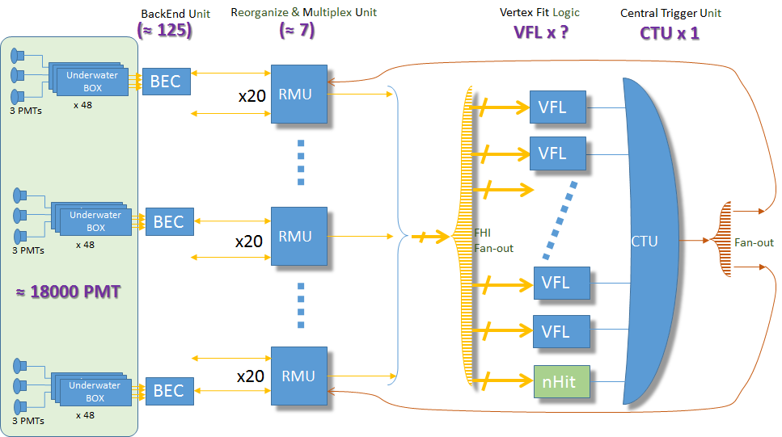
CD trigger block schematic
Data for DAQ without trigger > 2 TByte/sec

Slide 3
RMU Reorganize & Multiplexing Unit
RMU board
K7 Board
supply
100 pin connector
Supply, slow control
Specification:
125 input link from BEC organized in 7 RM Unit:
18x 1 Gb/s input link each
3x 6.25 Gb/s output link each
Each RMU has 3 separate FPGA board with 7x input link and 1x output link
Fanout can be improved with passive 2x or 4x splitter. Dedicated test can will be performed before next general meeting.
Splitters with calibrated propagation delay will be needed to ensure isosynchronous transmission.
100 pin connector
WR Node
(TTIM from Tsinghua)
K7 Board
supply
100 pin connector
slow control
ethernet link
Supply, slow control
100 pin connector
K7 Board
supply
100 pin connector
Supply, slow control
100 pin connector

Slide 4
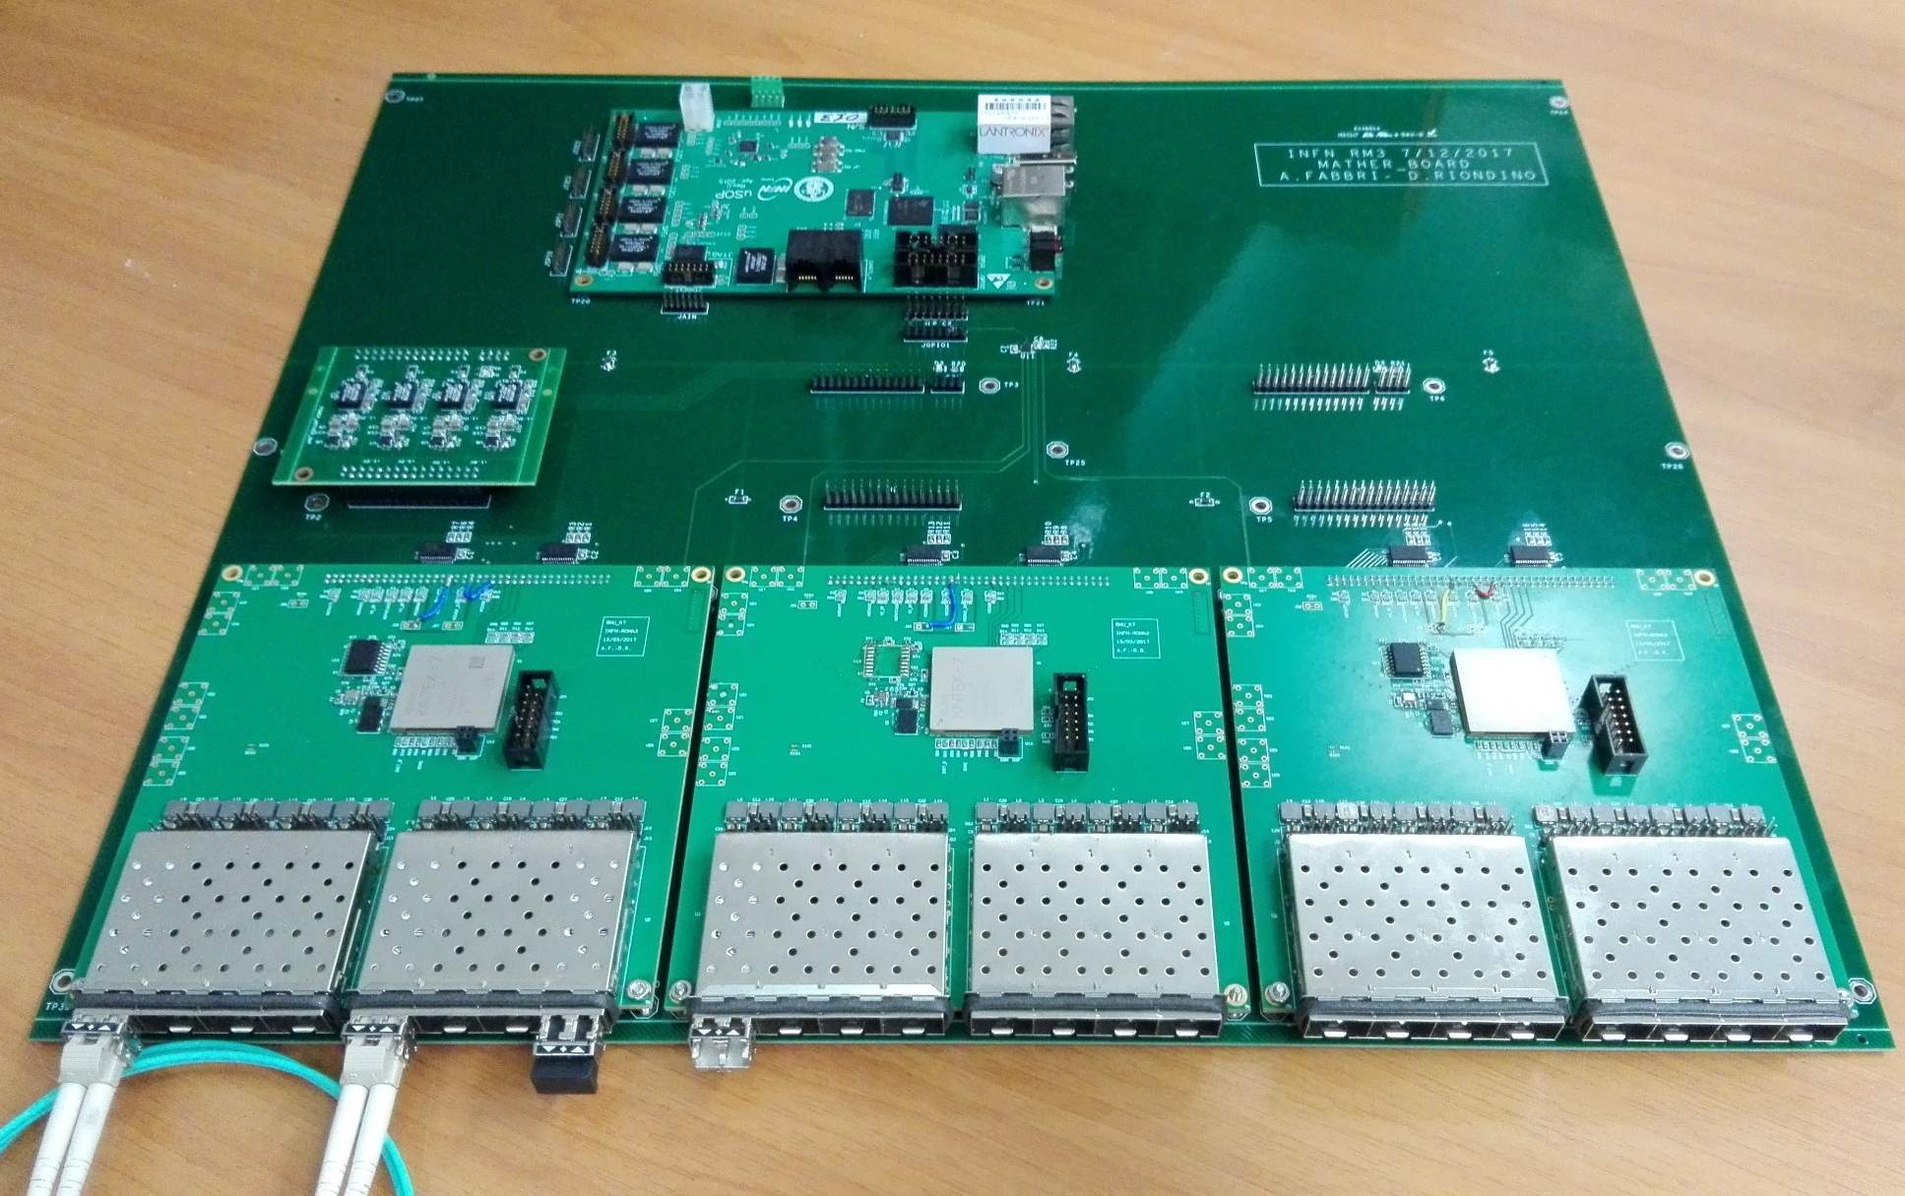
RMU status

Slide 5
RMU status
Mother Board v1.0
Mainly works as docking for K7, Power and USOP boards.
Fit commercial 2U case for 19’’ racks.
Supplies and control signals routing between different boards.
I2C bus allows USOP slow control of the system
A v2.0 is in design phase to implement WR functionality, especially reference clock distribution.
V1.0 is equipped with clock fan-out from USOP to allow clock distribution test.

Slide 6
RMU status
Power Board v1.0
Four DCDC modules for FPGA supplies. Each one is followed by a power monitor (I/V measurement).
Minor issue with capacitor footprint will be corrected on the v2.
Control signals
+5V In
1.2V
3.3V
1.0V
1.8V
Output Voltages
Power board block schematics

Slide 7
RMU status
USOP v2.0
Developed by INFN Roma Tre and INFN Napoli for Belle II experiment.
Ten boards on-line at KEKB since 2016 without any failures.
Redundant ethernet link for remote control/diagnostic.
Development of FW for RMU slow control is started:
Power supply monitor
Transciever monitor
Temperature monitor
….

Slide 8
RMU status
K7 Board v1.0
First prototype debug started on July 2017:
FPGA ok
Measured BER (with Xilinx IBERT) on each link is less than 10⁻¹³ @ 6.25 Gbit/s (no bit error when 10¹³ is trasmitted)
No measurable cross talk
FW development for isosyncrhonous is ongoing
v2.0 gerber file is ready to be realized with fixes:
Supply routing fix
Added bulk capacitors for FPGA
Minor footprint correction (thermal pad on clock IC…)

Slide 9
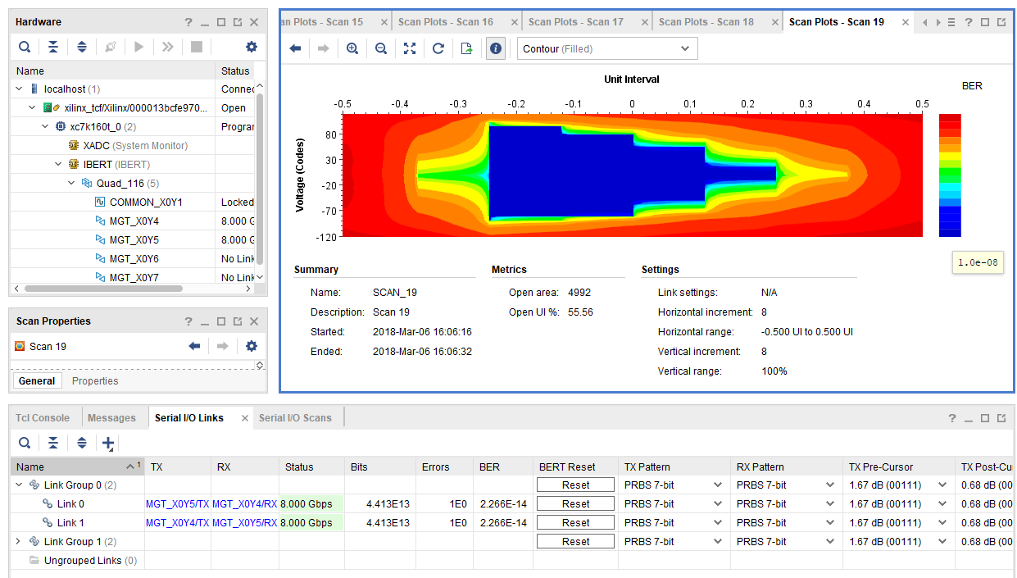
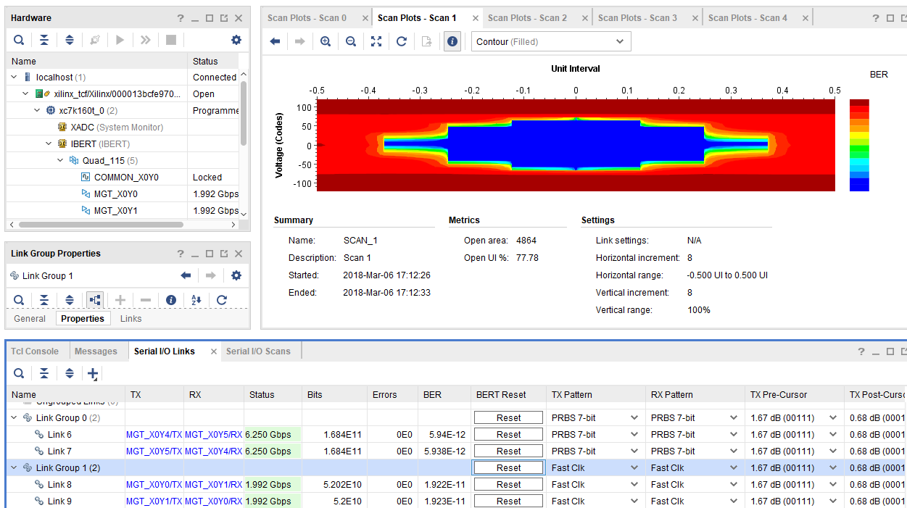
Ongoing test
Up to 8 Gbps rate with no error
With a 8 Gbps output link data reduction
on the RMU will be
Different speed is possibile only for different quad
with Xilinx IBER Tool. A custom FW is under development
to test the final setup (7x 1.25 Gbps, 1x 6.25 Gbps)

Slide 10
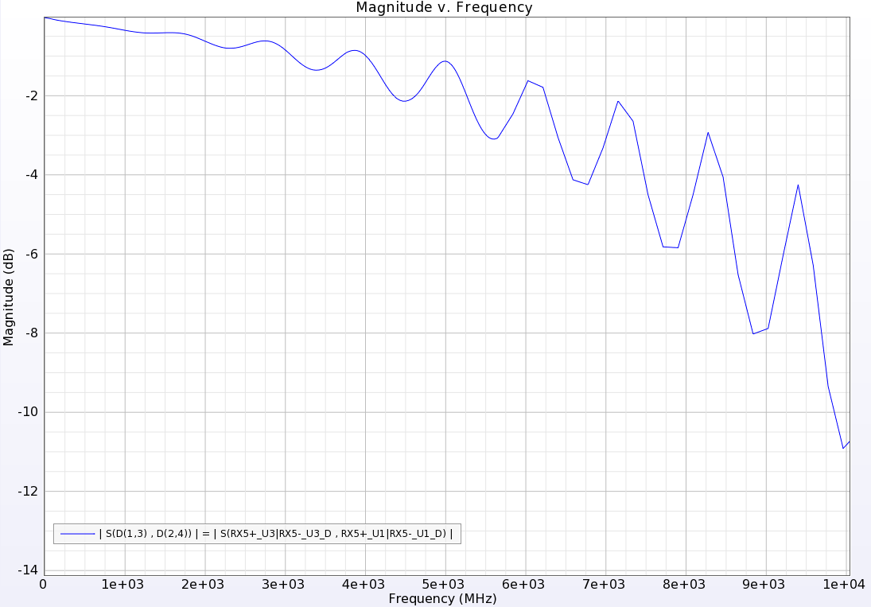
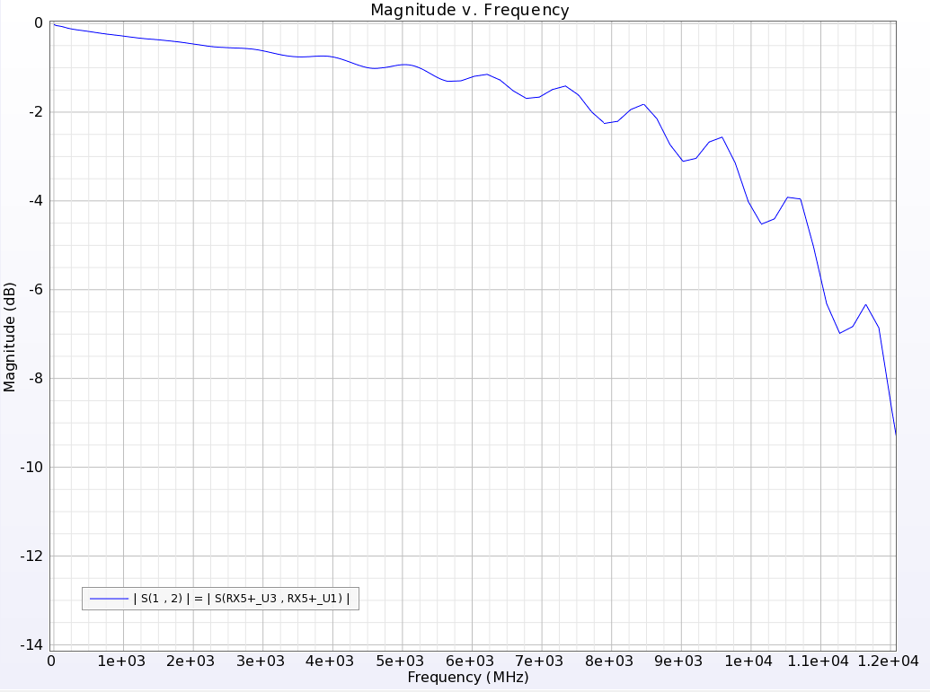
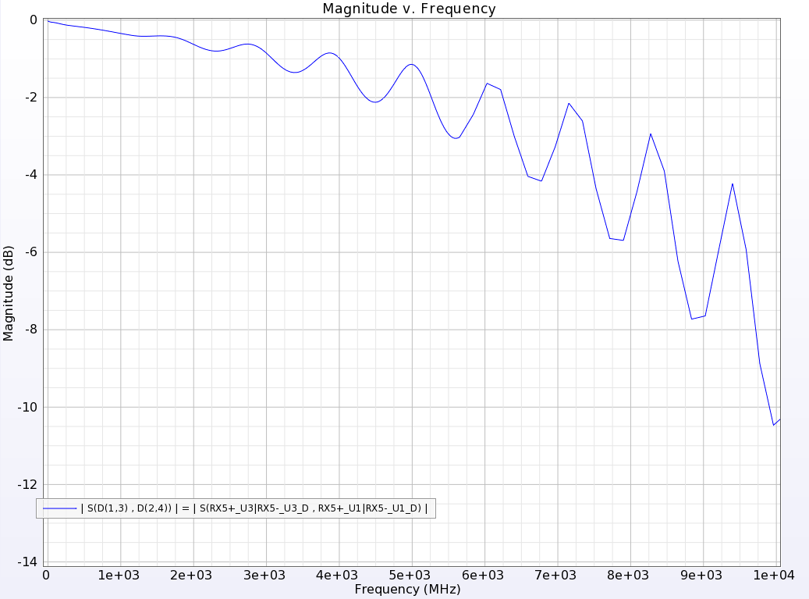
Simulation for differential line improvement
- Standard Via
- No Shield
- Blind Via
- No shield
- Standard Via
- Shielded

Slide 11
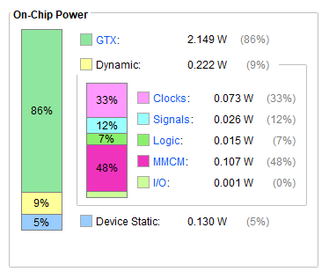
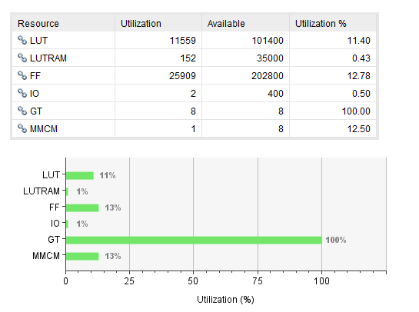
FPGA Resources
FPGA Resources
Total = 2,501 W
A lot of resources are available for preliminary trigger analysis …
Power consumption estimation for an RMU ≈ 30 W

Slide 12
Schedule
Performances of the system will be evaluated in the next three months as function of specification.
Open point:
Optical link fanout (how many CTU?)
Slow control protocol
AC supply in the experimental hall
All RMUs in a single rack / RMUs distributed in the experimental hall
Needed for AC/DC supply modules develpoment and WR switches provision

Slide 13
Thank you!

