Slide 1
An Arc Compressor
for MariX
Marcello Rossetti Conti
on behalf of WG5 (Beamlines)

Slide 2
The Arc Compressor
How we started

Slide 3
How it all started
A synchrotron inspired (Elettra @ Trieste) lattice can be used in a «linear» machine to:
Compress longitudinally
Curve significantly (180°)
Preserve high beam quality.
S. Di Mitri and
M. Cornacchia (2015) ^{[1]}:
[1] "Transverse emittance-preserving arc compressor for high-brightness electron beam-based light sources and colliders” S. Di Mitri, M. Cornacchia- EPL, 109 (2015)

Slide 4
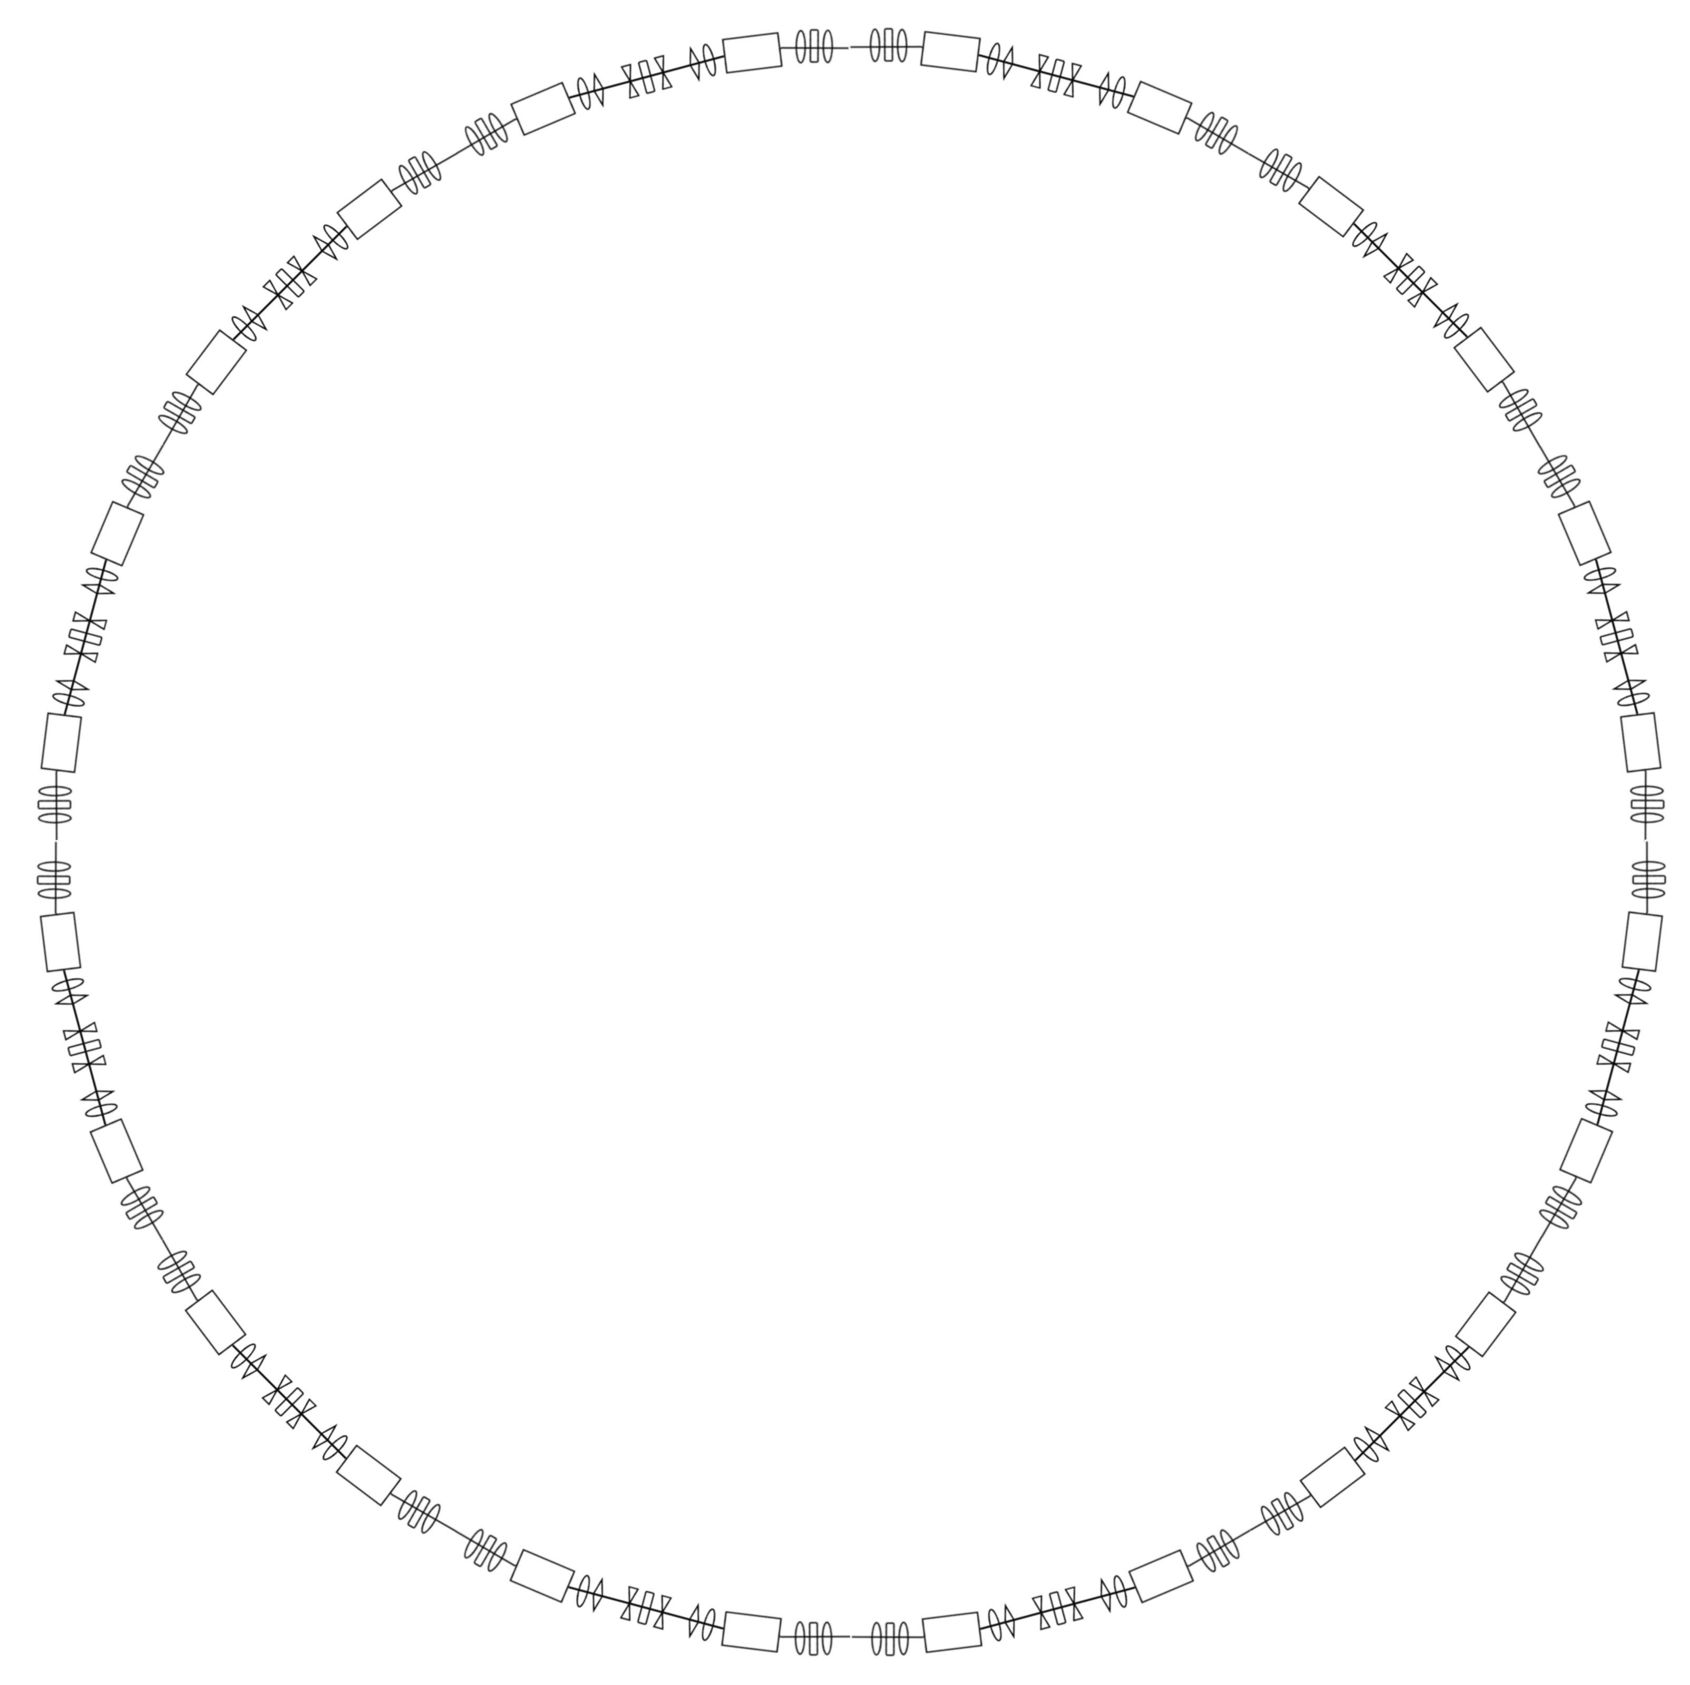
12
1
11
2
10
3
9
4
8
5
7
6
Elettra’s storage ring

Slide 5
Double-Bend Achromat
A Chasman-Green cell ^{[1]}
BENDING MAGNETS: Trajectory deviation (15°), opens dispersion
QUADRUPOLES: Transverse dimensions control, invert dispersion trend
SEXTUPOLES: Compensation of chromatic aberrations
[1] "Preliminary Design of a Dedicated Synchrotron Radiation Facility” R. Chasman, G. Green, et al. - IEEE Trans. Nucl. Sci. 22, 1765 (1975)

Slide 6
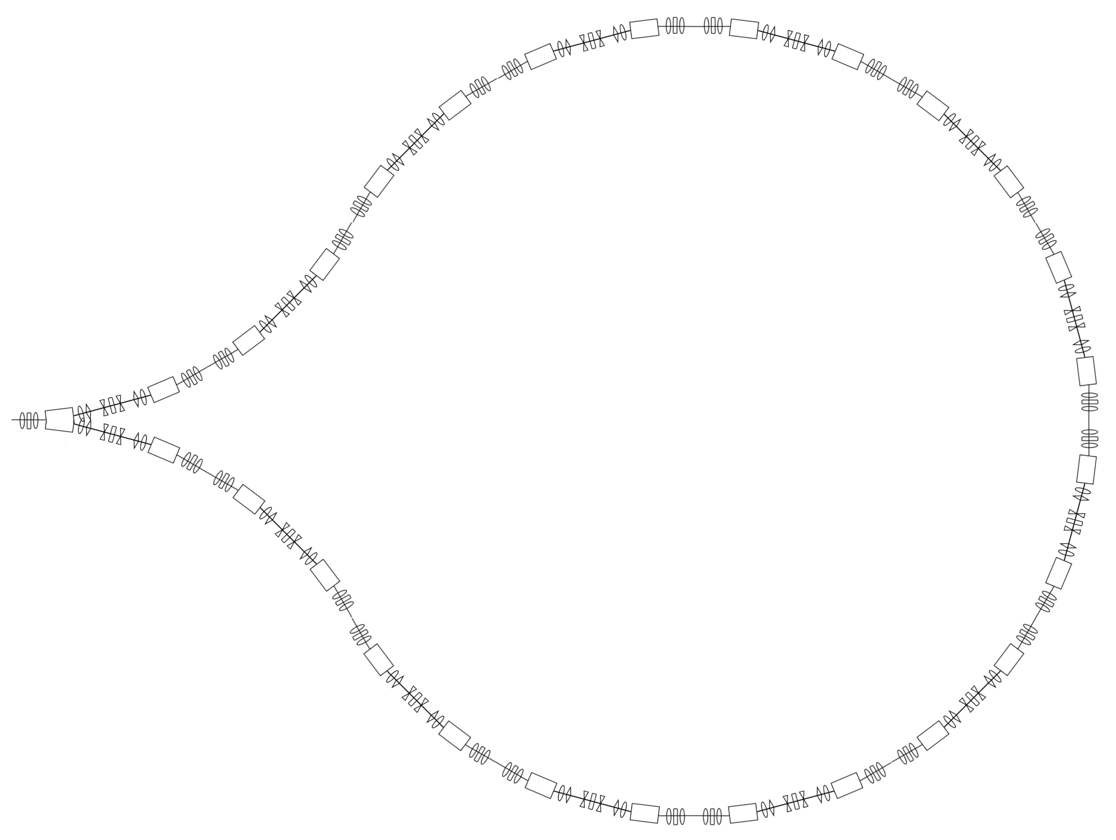
4
5
3
6
2
1
7
14
8
13
12
9
11
10
MariX Arc
Elettra’s storage ring

Slide 7
Simulations
Build of the lattice

Slide 8
Simulation
The simulations of the Arc have been performed with Elegant ^{[1]} (ELEctron Generation ANd Tracking)
R-DBA
10 Cells
4 L-DBA
MariX
Bubble
Cell to the right
Cell to the left
Incoherent Synchrotron Radiation ON
Optimized compression factor (C_{F}= $\frac{σ_{s_{0}}}{σ_{s}}$)
[1] “Elegant: A flexible sdds-compliant code for accelerator simulation”, M. Borland. Technical report, Argonne National Laboratory (2000)

Slide 9
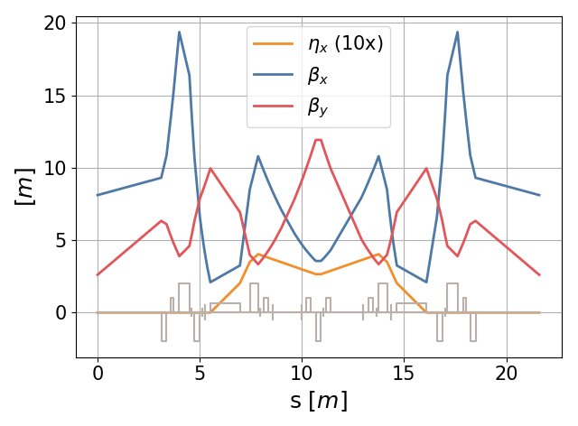
1-DBA cell
Beam matched to the cell

Slide 10
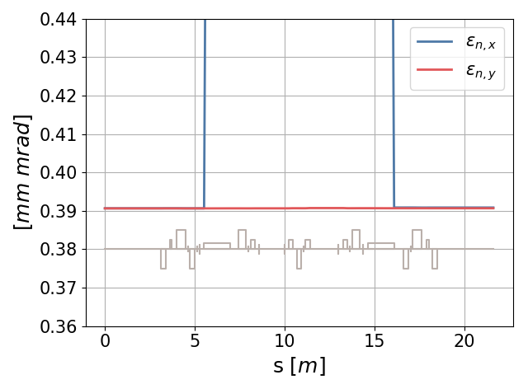
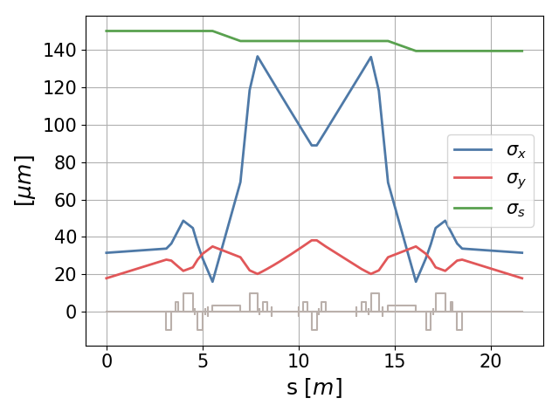
1-DBA cell
10,000 Macro-particles
Q_{tot} = 50 pC, γ = 3200
ε_{n,x} = 0.39 mm mrad, ε_{n,y} = 0.39 mm mrad
σ_{s} = 150 μm, σ_{x} = 31.5 μm, σ_{y} = 17.8 μm
Beam Parameters:

Slide 11
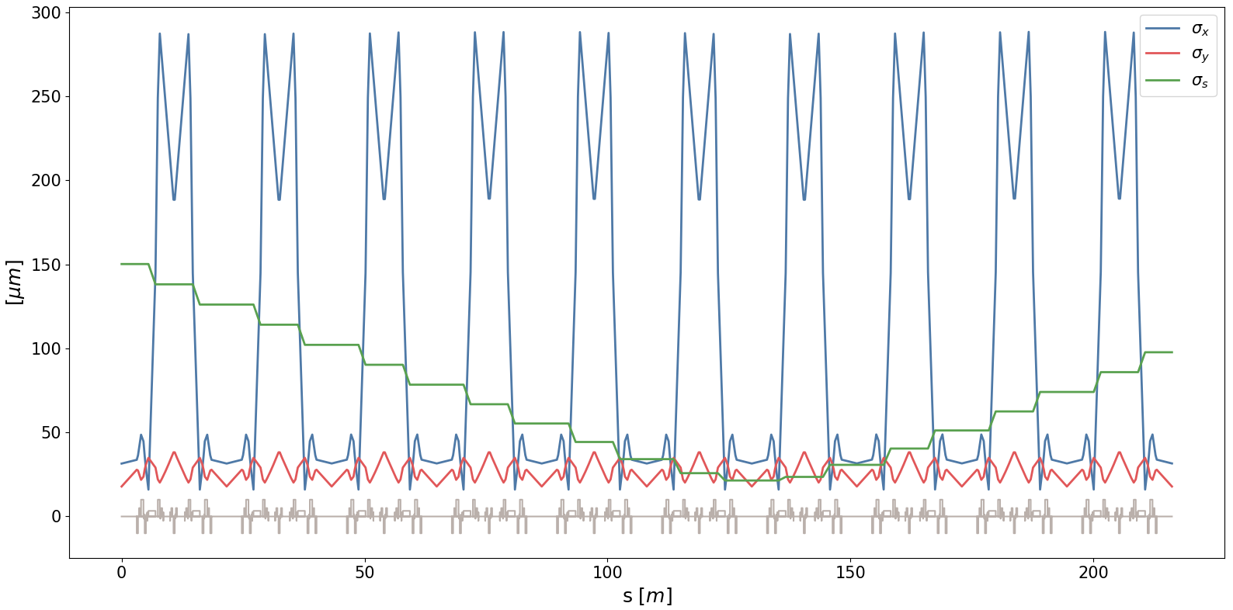
2-10 Cells
What happens with more cells?

Slide 12
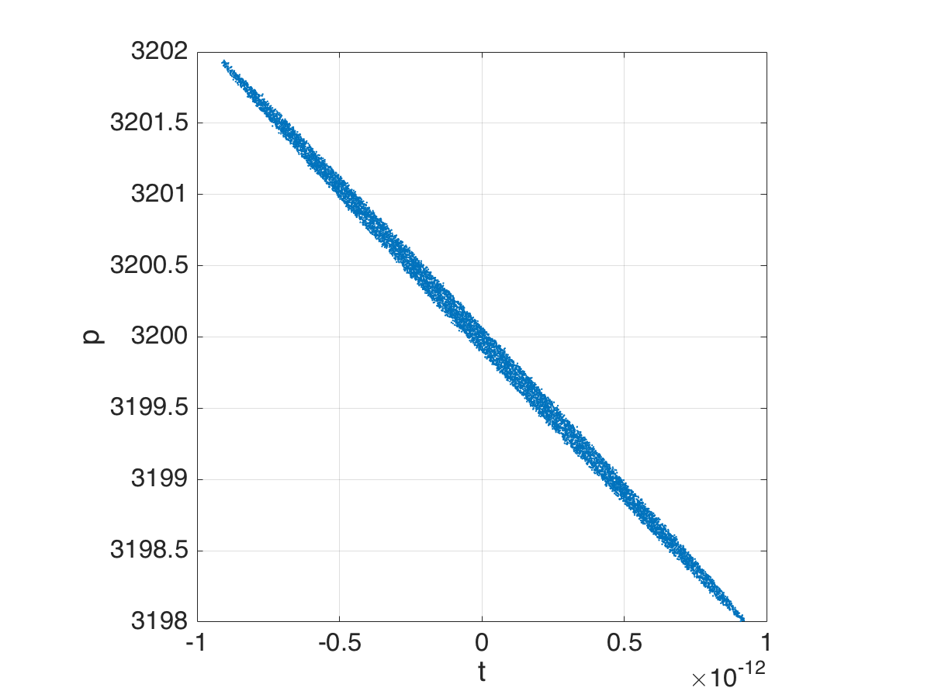
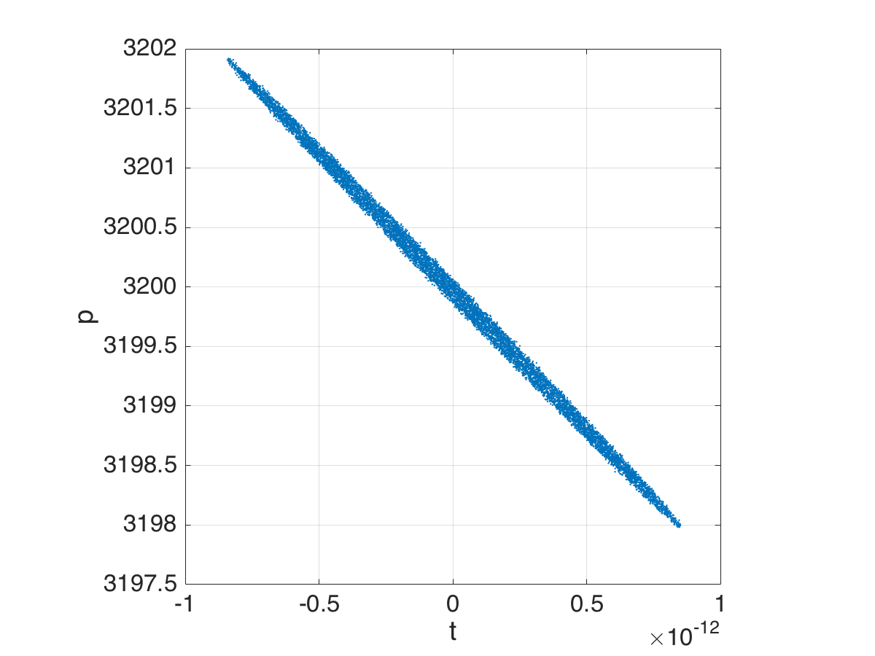
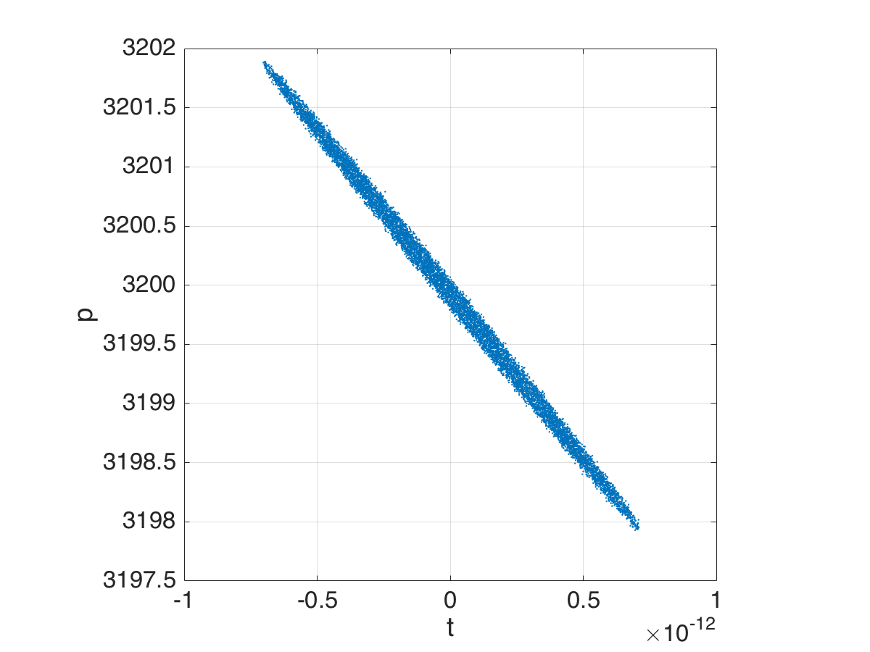
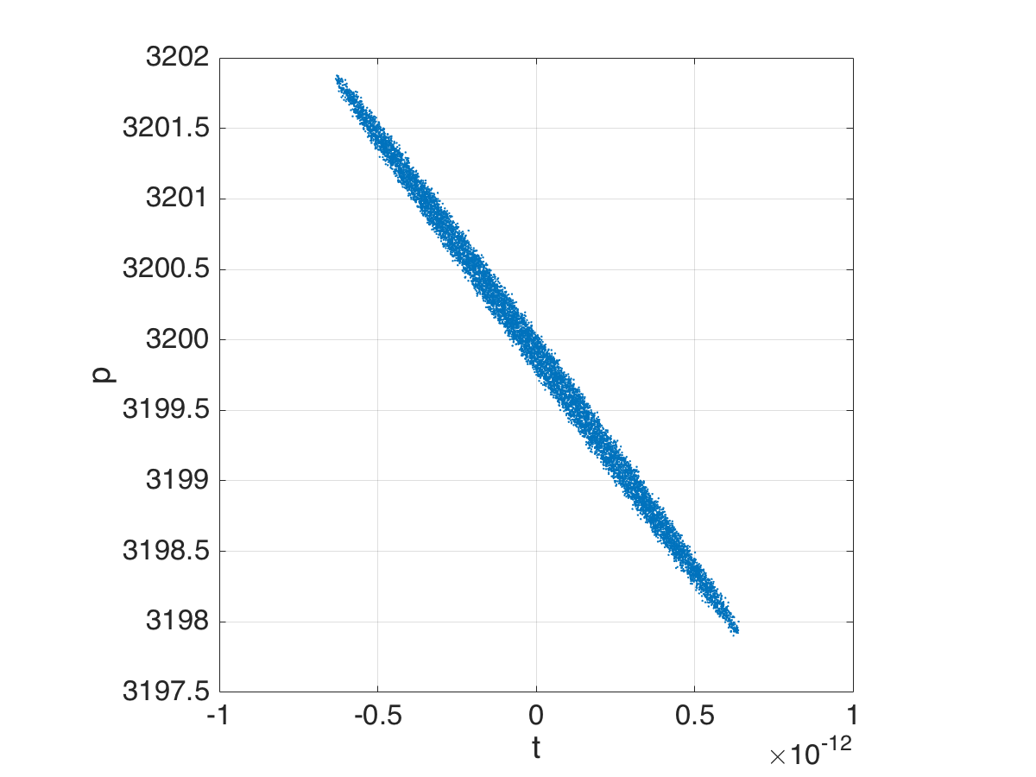
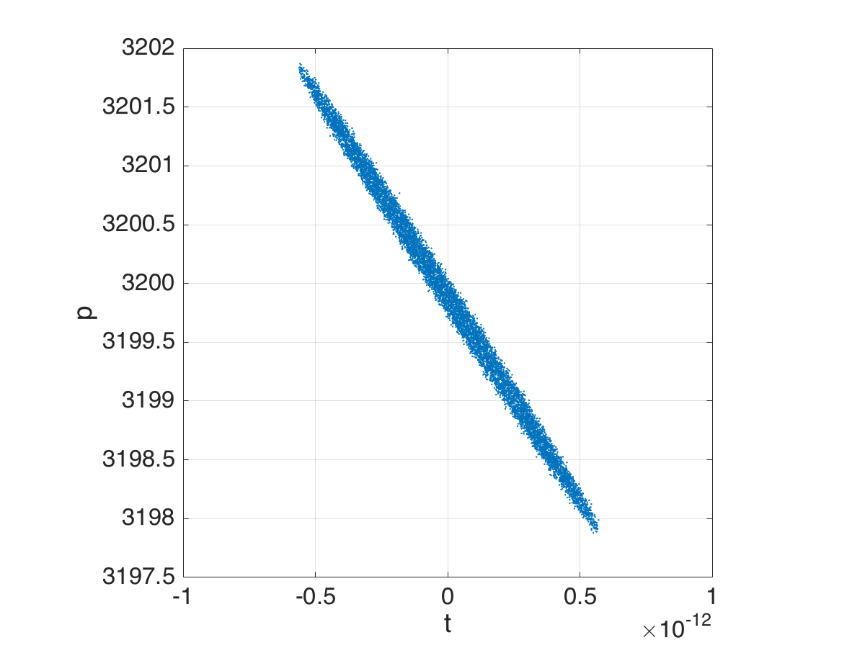
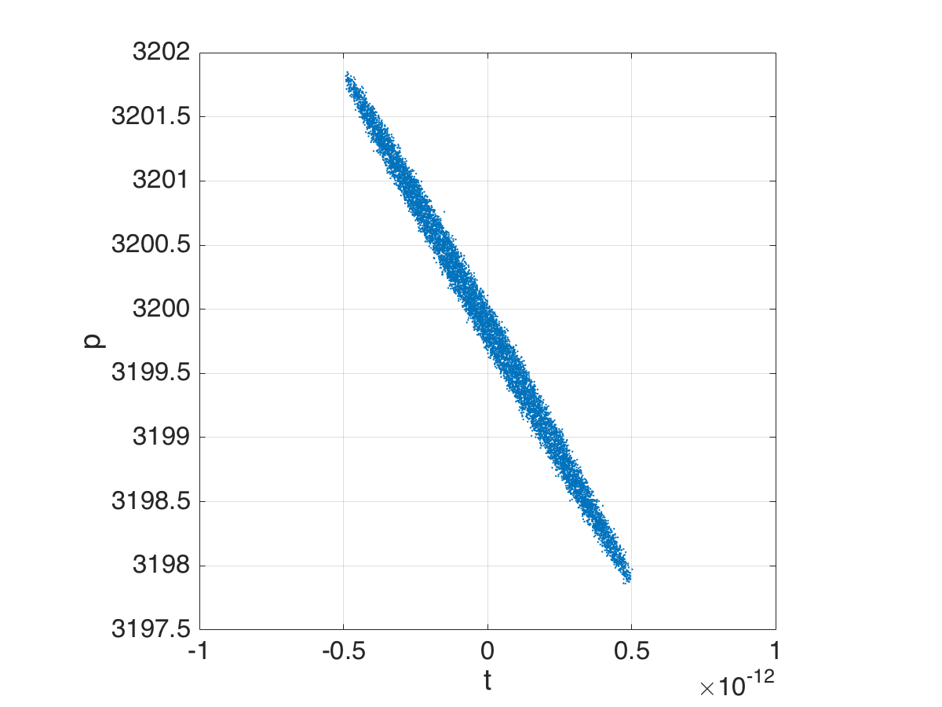
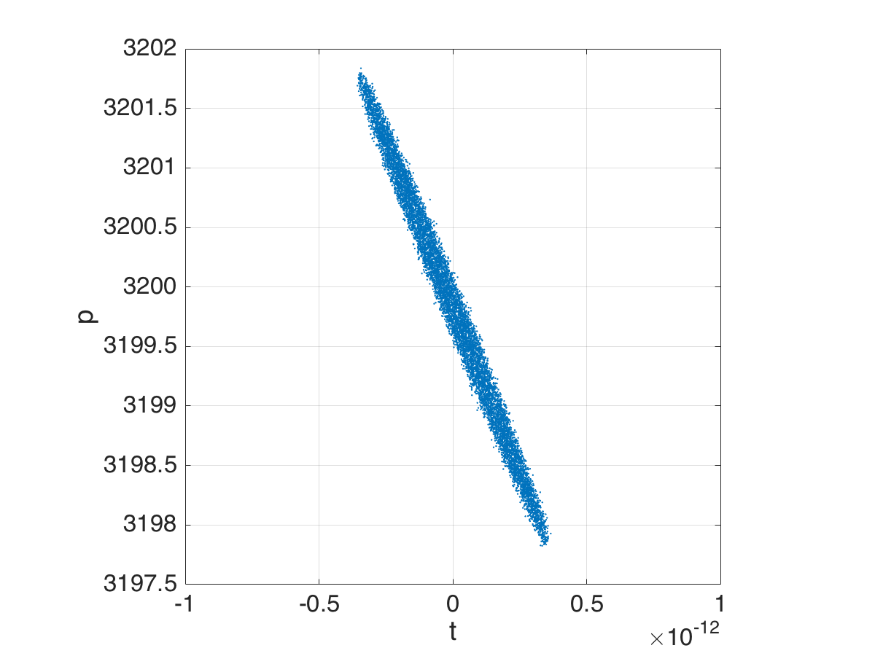
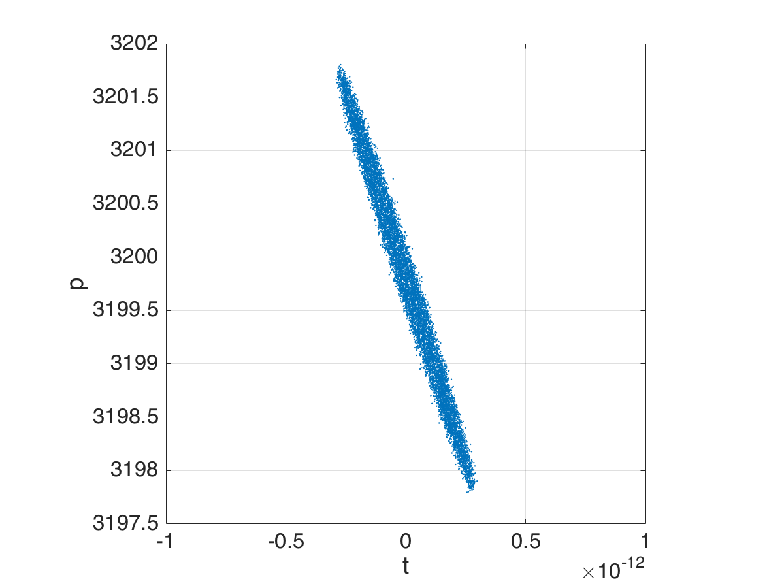
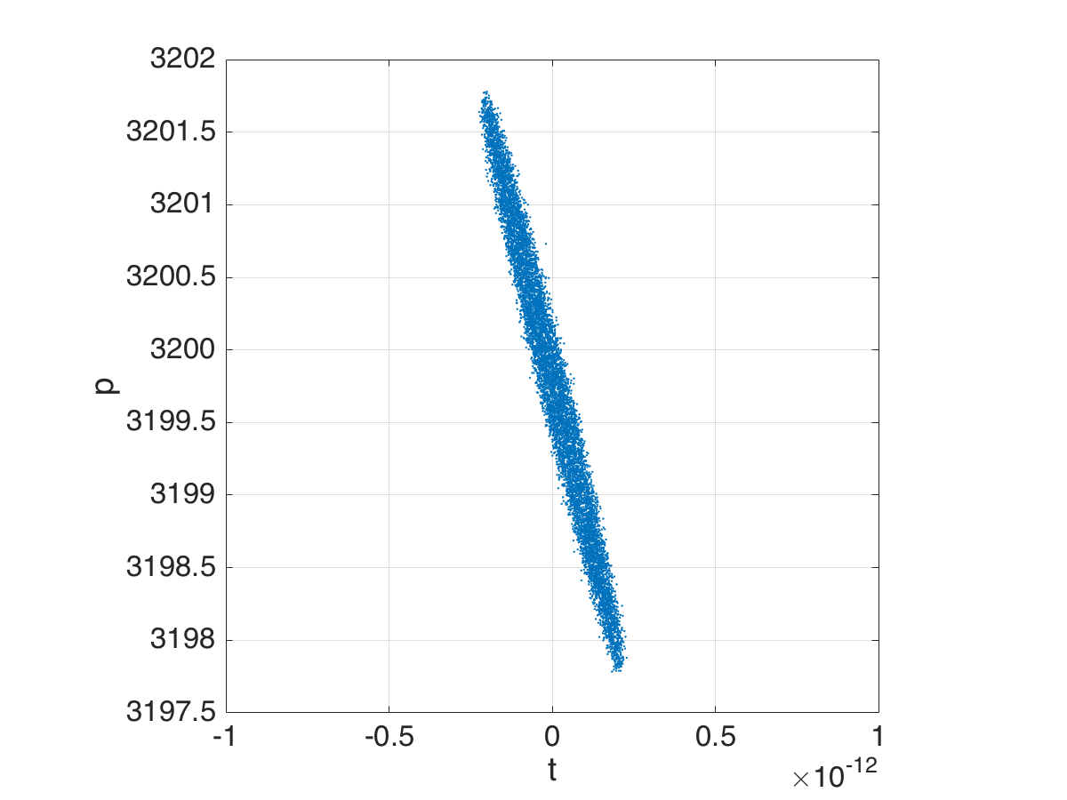
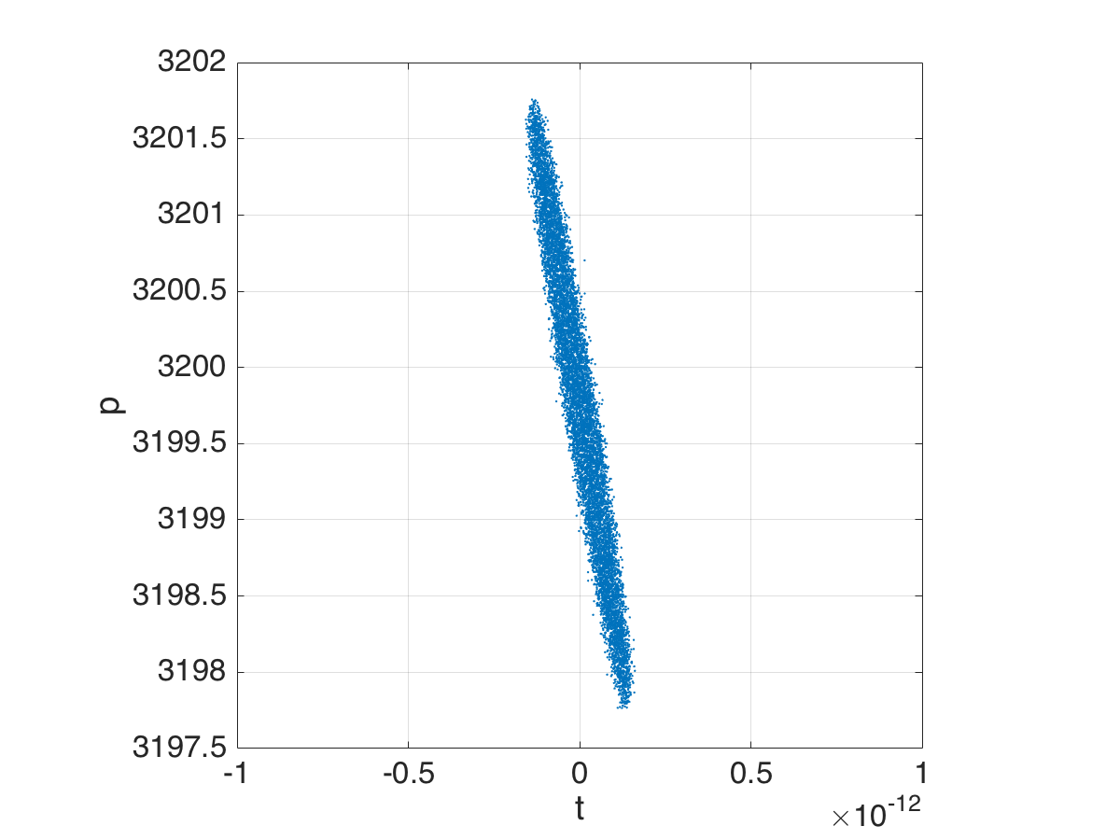
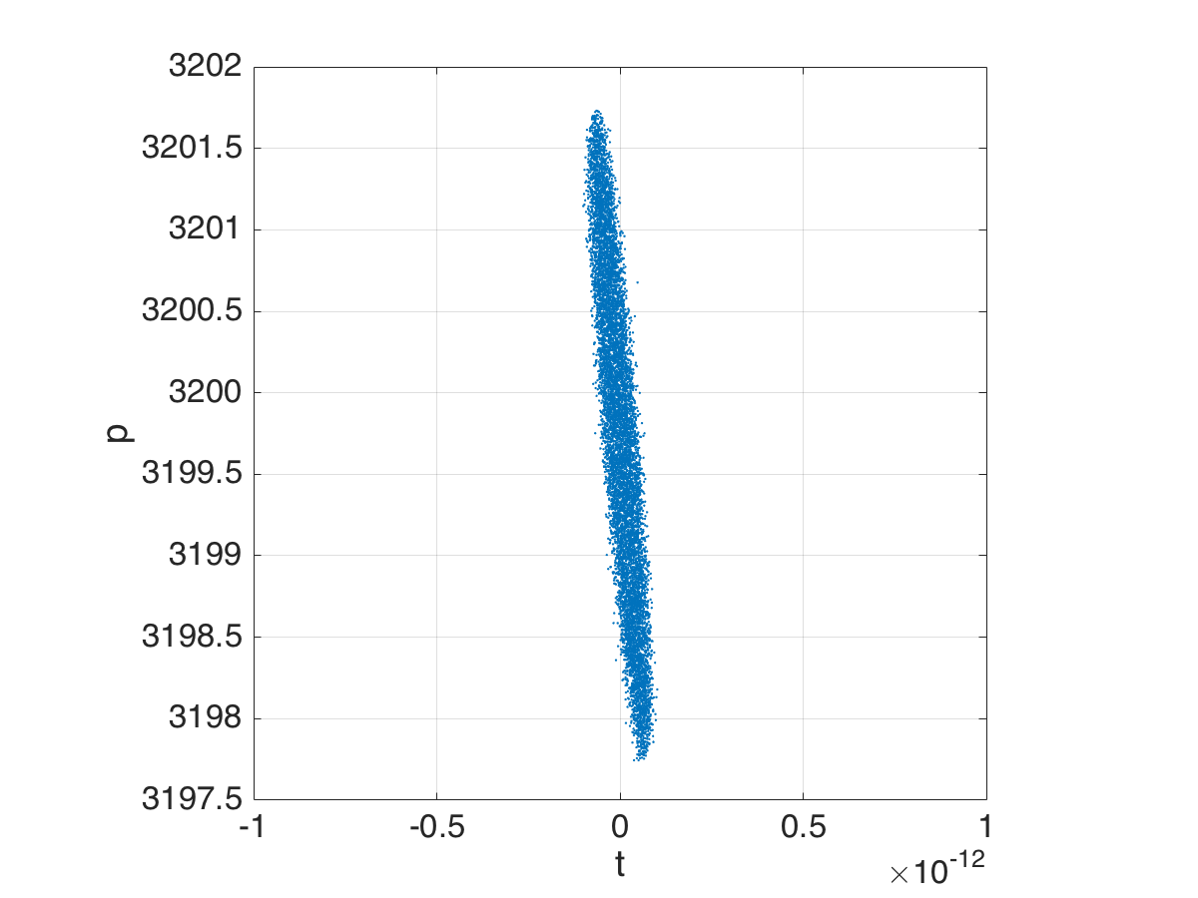
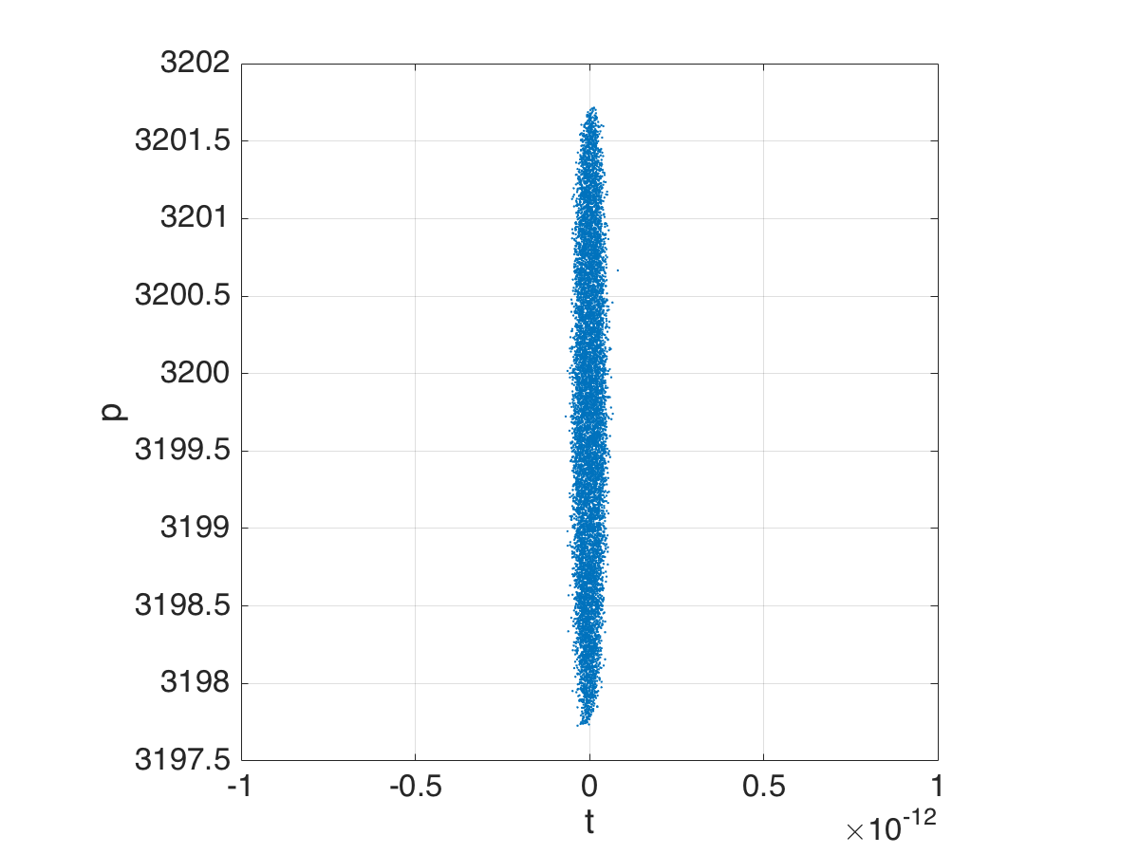
Compression mechanism
Courtesy of
I. Drebot
Final longitudinal dimensions depends on energy spread and longitudinal chirp!

Slide 13
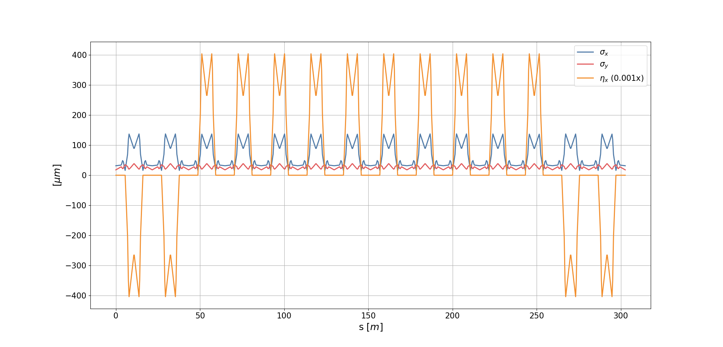
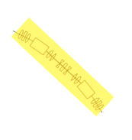
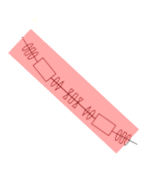
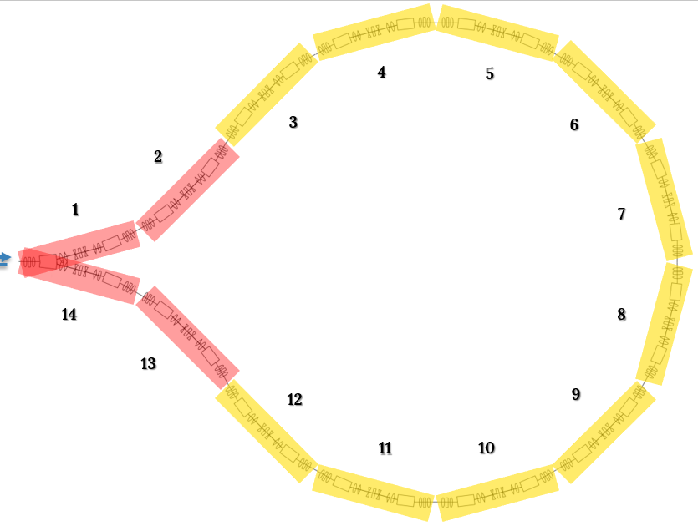
3-4 MariX Bubble
Inversion of Bend and Sext fields
Conservation of Quad fields

Slide 14
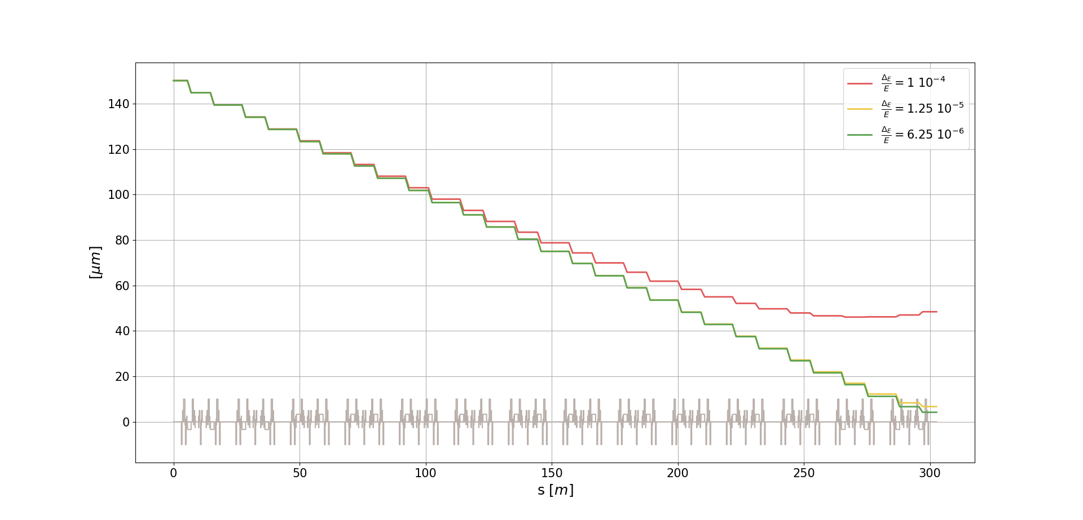
Compression performances
Expected absolute energy spread, $σ_{E}$, @ the arc entrance ≤ 20 KeV (relative energy spread $\frac{σ_{E}}{E}$ ≈ 1.25 10⁻⁵ @ 1.6 GeV)
This value can be decreased to 10 KeV with high armonic compensation ($\frac{σ_{E}}{E}$ ≈ 6.25 10⁻⁶ ).
Chirp optimized to shift the minimum @ arc exit (-2.072 m⁻¹)
σ_{s} = 48.4μm
(C_{f} ≈ 3.6)
σ_{s} = 6.72μm
(C_{f} ≈ 22)
σ_{s} = 4.22μm
(C_{f} ≈ 35.5)

Slide 15
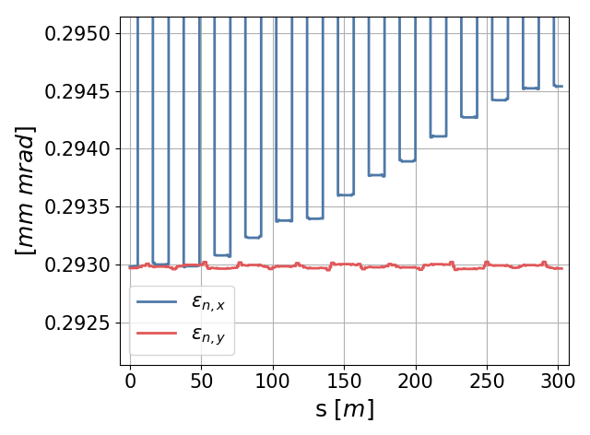
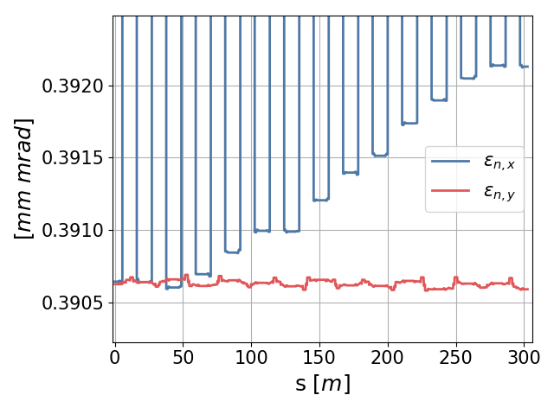
Beam quality
Considering ISR:
Final normalized horizontal emittance increase is < 5‰

Slide 16
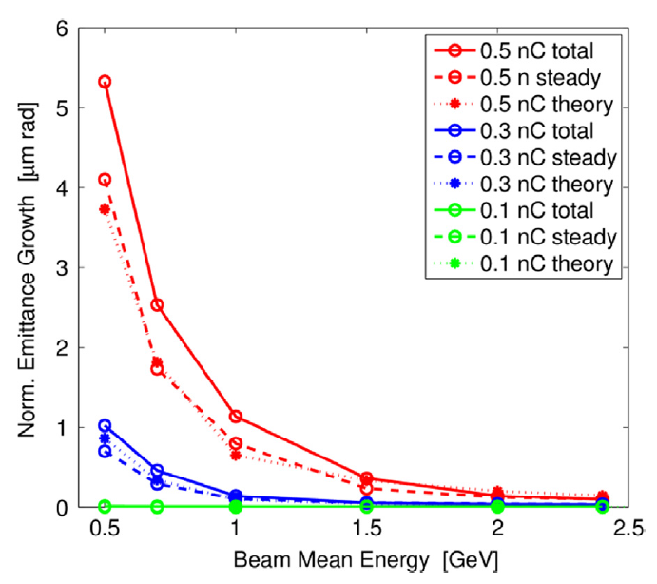
Template
CSR effects evaluation will be done soon.
However the effect is expected to be negligible!
Source: "Feasibility study of a periodic arc compressor in the presence of coherent synchrotron radiation”, S. Di Mitri – NIM A, 806 (2016)

Slide 17
Thanks!
Any questions ?
You can find me at
marcello.rossetti@mi.infn.it

Slide 18
Template

Slide 19
Template 2

Slide 20
First of All
Why an Arc Compressor?
MariX dimensions must consider the total costs of the machine and the space available
To increase the beam energy means to decrease FEL radiation wavelegth
A smaller longitudinal dimension give high peak current that…

Slide 21
Template

Slide 22
Template 2

Slide 23
Ricerca della traiettoria
Si è svolto un campionamento casuale variando le correnti degli steering:
Il sistema simulato è quello precedente
I_steering mantengono il fascio in cavità (± 700 micron alla targhetta)
640 traiettorie random
6 differenti energie
Una volta terminato il campionamento si analizza la posizione dei centroidi sulla targhetta

