Slide 1
POSSIBILE PRIN GIOVANI
L. Bandiera, INFN Ferrara

Slide 2
Experiment at cern
Crystal selection;
Experimental setup;
Measurement with 120 GeV/c electrons.

Slide 3
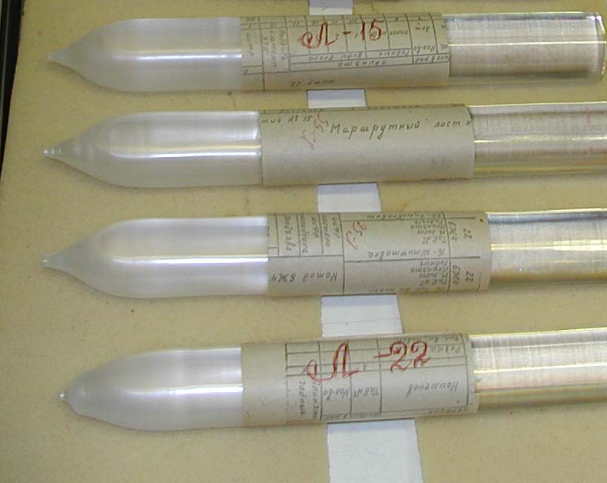
PWO as high-Z scintillator
PbWO₄ (PWO) scintillation crystals introduced by INP team in 1994 are currently used by CMS, ALICE, PANDA collaborations in EM calorimeters, about 100000 crystals in total is produced.
PWO propreties:
  Short radiation lenght (8.9 mm);
  small Moliere Radius;
  emission in visible;
  cheap;
  low light yield;
  temperature dependent.
  The small Moliere radius of PWO crystals make them ideal for use in a compact detector and their light yield outperforms that of other heavy crystals.

Slide 4
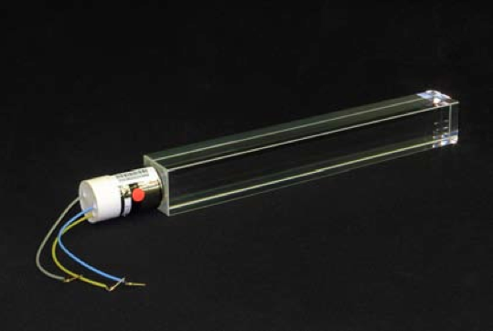
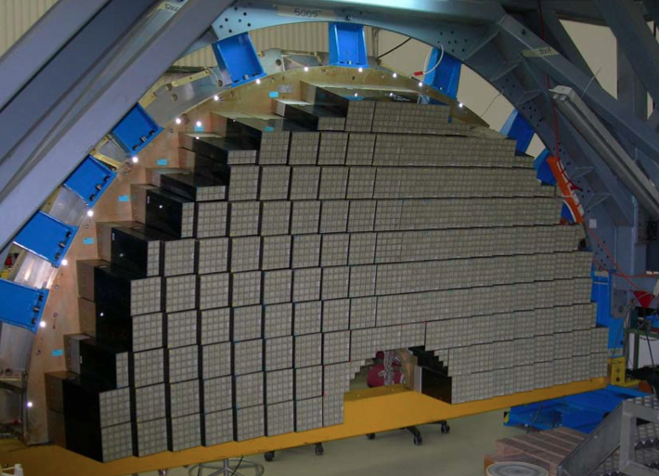
CMS ECAL PWO crystals
Picture of a PbWO₄ 23 cm-long crystal (left) used in the CMS ECAL with its photomultiplier, and of the endcap ECAL (right) showing the crates in which the crystals are placed.

Slide 5
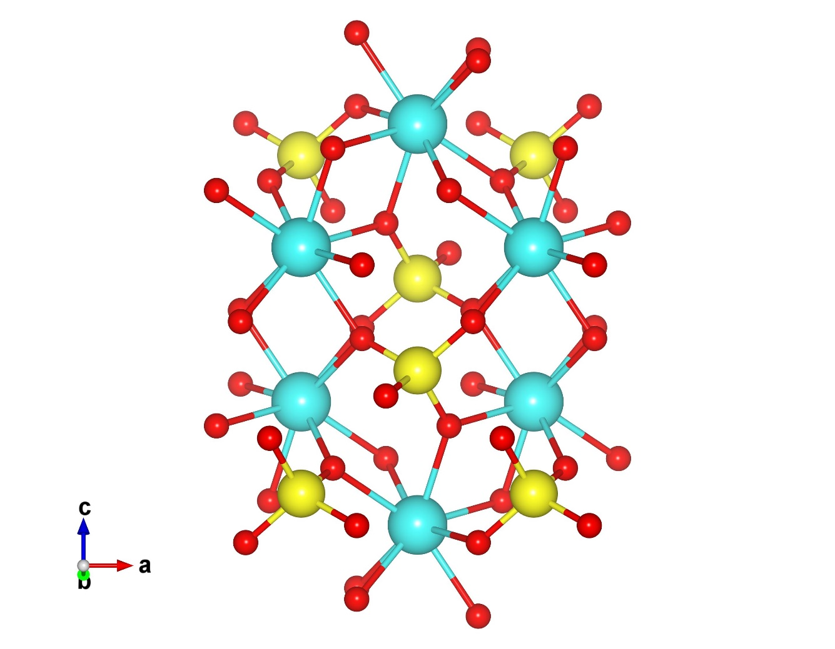
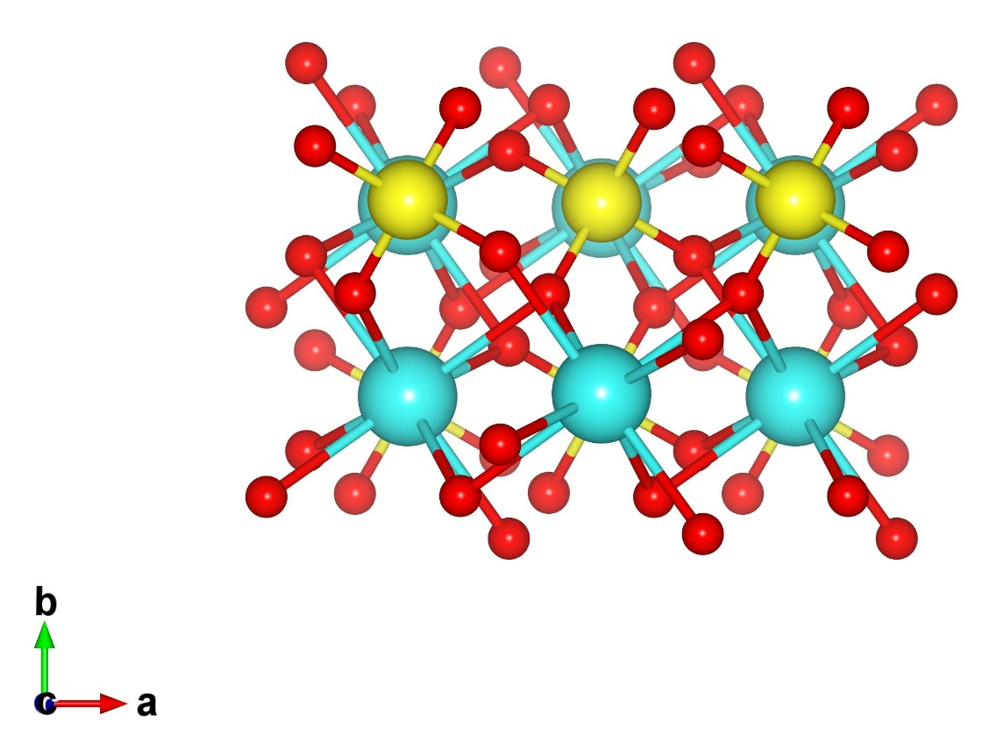
PWO crystralline structure
Structural characterization of PWO single crystal by x-ray diffraction showed scheelite type structure
(tetragonal, a=5.456, c=12.020 Å).

Slide 6
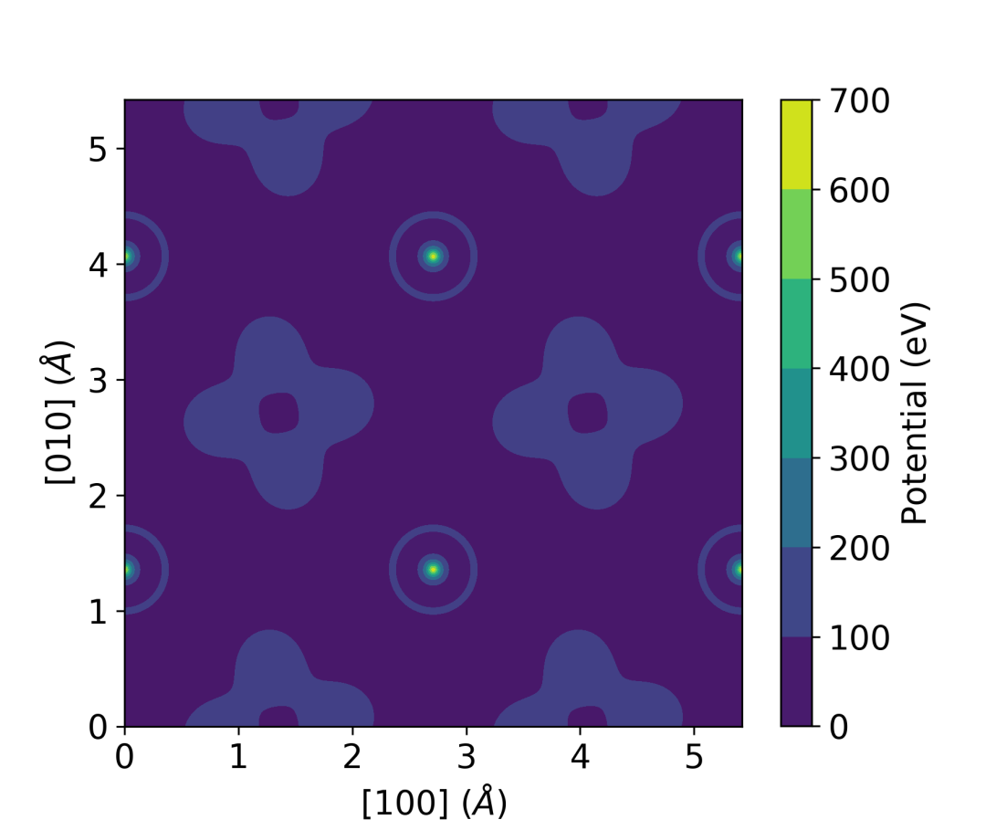
PWO crystralline structure
Structural characterization of PWO single crystal by x-ray diffraction showed scheelite type structure
(tetragonal, a=5.456, c=12.020 Å).

Slide 7

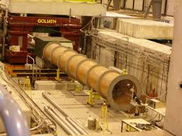
Experimental test at CERN SPS
On the extracted beamline H4 from the Super Proton Synchrotron, tertiary “clean” beams of electrons and positrons are available up to 200 GeV/c.
7

Slide 8
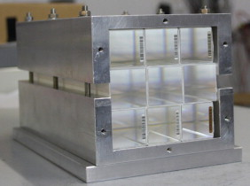
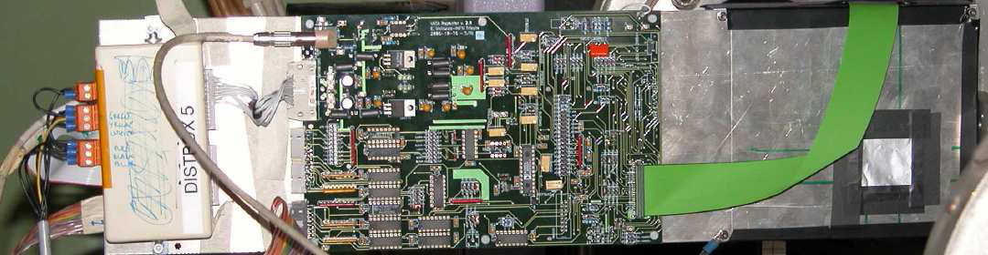
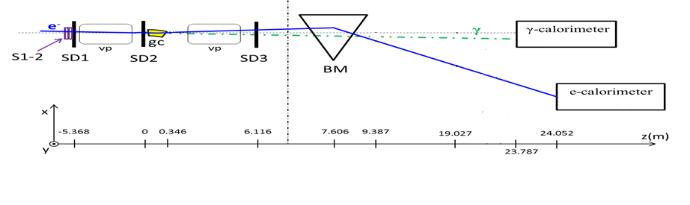
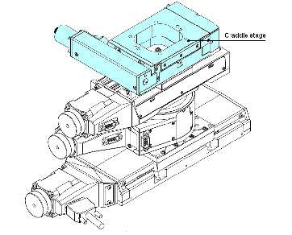
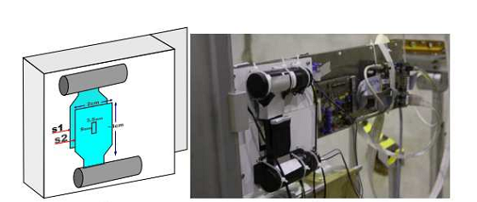
Setup on H4
Double sided silicon detectors 1.92x1.92 cm^2 SDi
(300μm thick)
[6-11 μm spatial resolution]
γ-beam (photo) and
e-beam calorimeters to measure the emitted photons and to discriminate e± from impurities (µ±,π±)
vp = vacuum pipe
A bending magnet (BM) to separate the charged and the neutral beam
BL=1.041 T m
Scintillator Trigger: S2 has an hole (3x9mm^2)
Ainticoincidence
High precision goniometer to align the crystals on the beam.
[Few µrad of resolution]

Slide 9
EXPERIMENTAL CONFIGURATION
Particle type | Electron
Momentum | 120 GeV/c
Intensity | 10⁴/10⁵ particles/spill
Purity | close to 100%
Spot dimension | few mm in both directions
Spot divergence | ≈ 100 μrad in x and y directions
.
Notes:
Crystal quality unkhown.

Slide 10
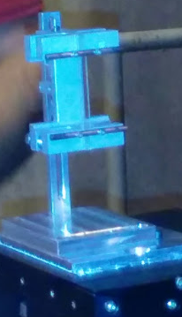
EXPERIMENTAL CONFIGURATION
Particle type | Electron
Momentum | 120 GeV/c
Intensity | 10⁴/10⁵ particles/spill
Purity | close to 100%
Spot dimension | few mm in both directions
Spot divergence | ≈ 100 μrad in x and y directions
.
55 mm
electron beam
2 mm
4 mm
A 2x55x4 mm³ strip-like PWO crystal with the largest faces oriented parallel to the (100) planes was selected for the experiment. 4 mm length along the beam direction corresponds to about 0.45 X₀.
Notes:
Crystal quality unkhown.

Slide 11
Increase of secondaries in oriented crystal
S1-2
e⁺
e⁻
Multiple Tracks
γ
SD1
SD2
SD3
Scintillators S1-S2 are used for the trigger.
We selected single events on SD1-2 and measured the hits at the SD3 detector.
(100)
<001>
We measured a strong increment of multi-hits at the third detector, depending on crystal-to-beam orientation

Slide 12
Increase of secondaries in oriented crystal
S1-2
e⁺
e⁻
Multiple Tracks
γ
SD1
SD2
SD3
An electromagnetic shower has been initiated
Effective reduction of the radiation length
in the oriented cases.
(100)
<001>

Slide 13
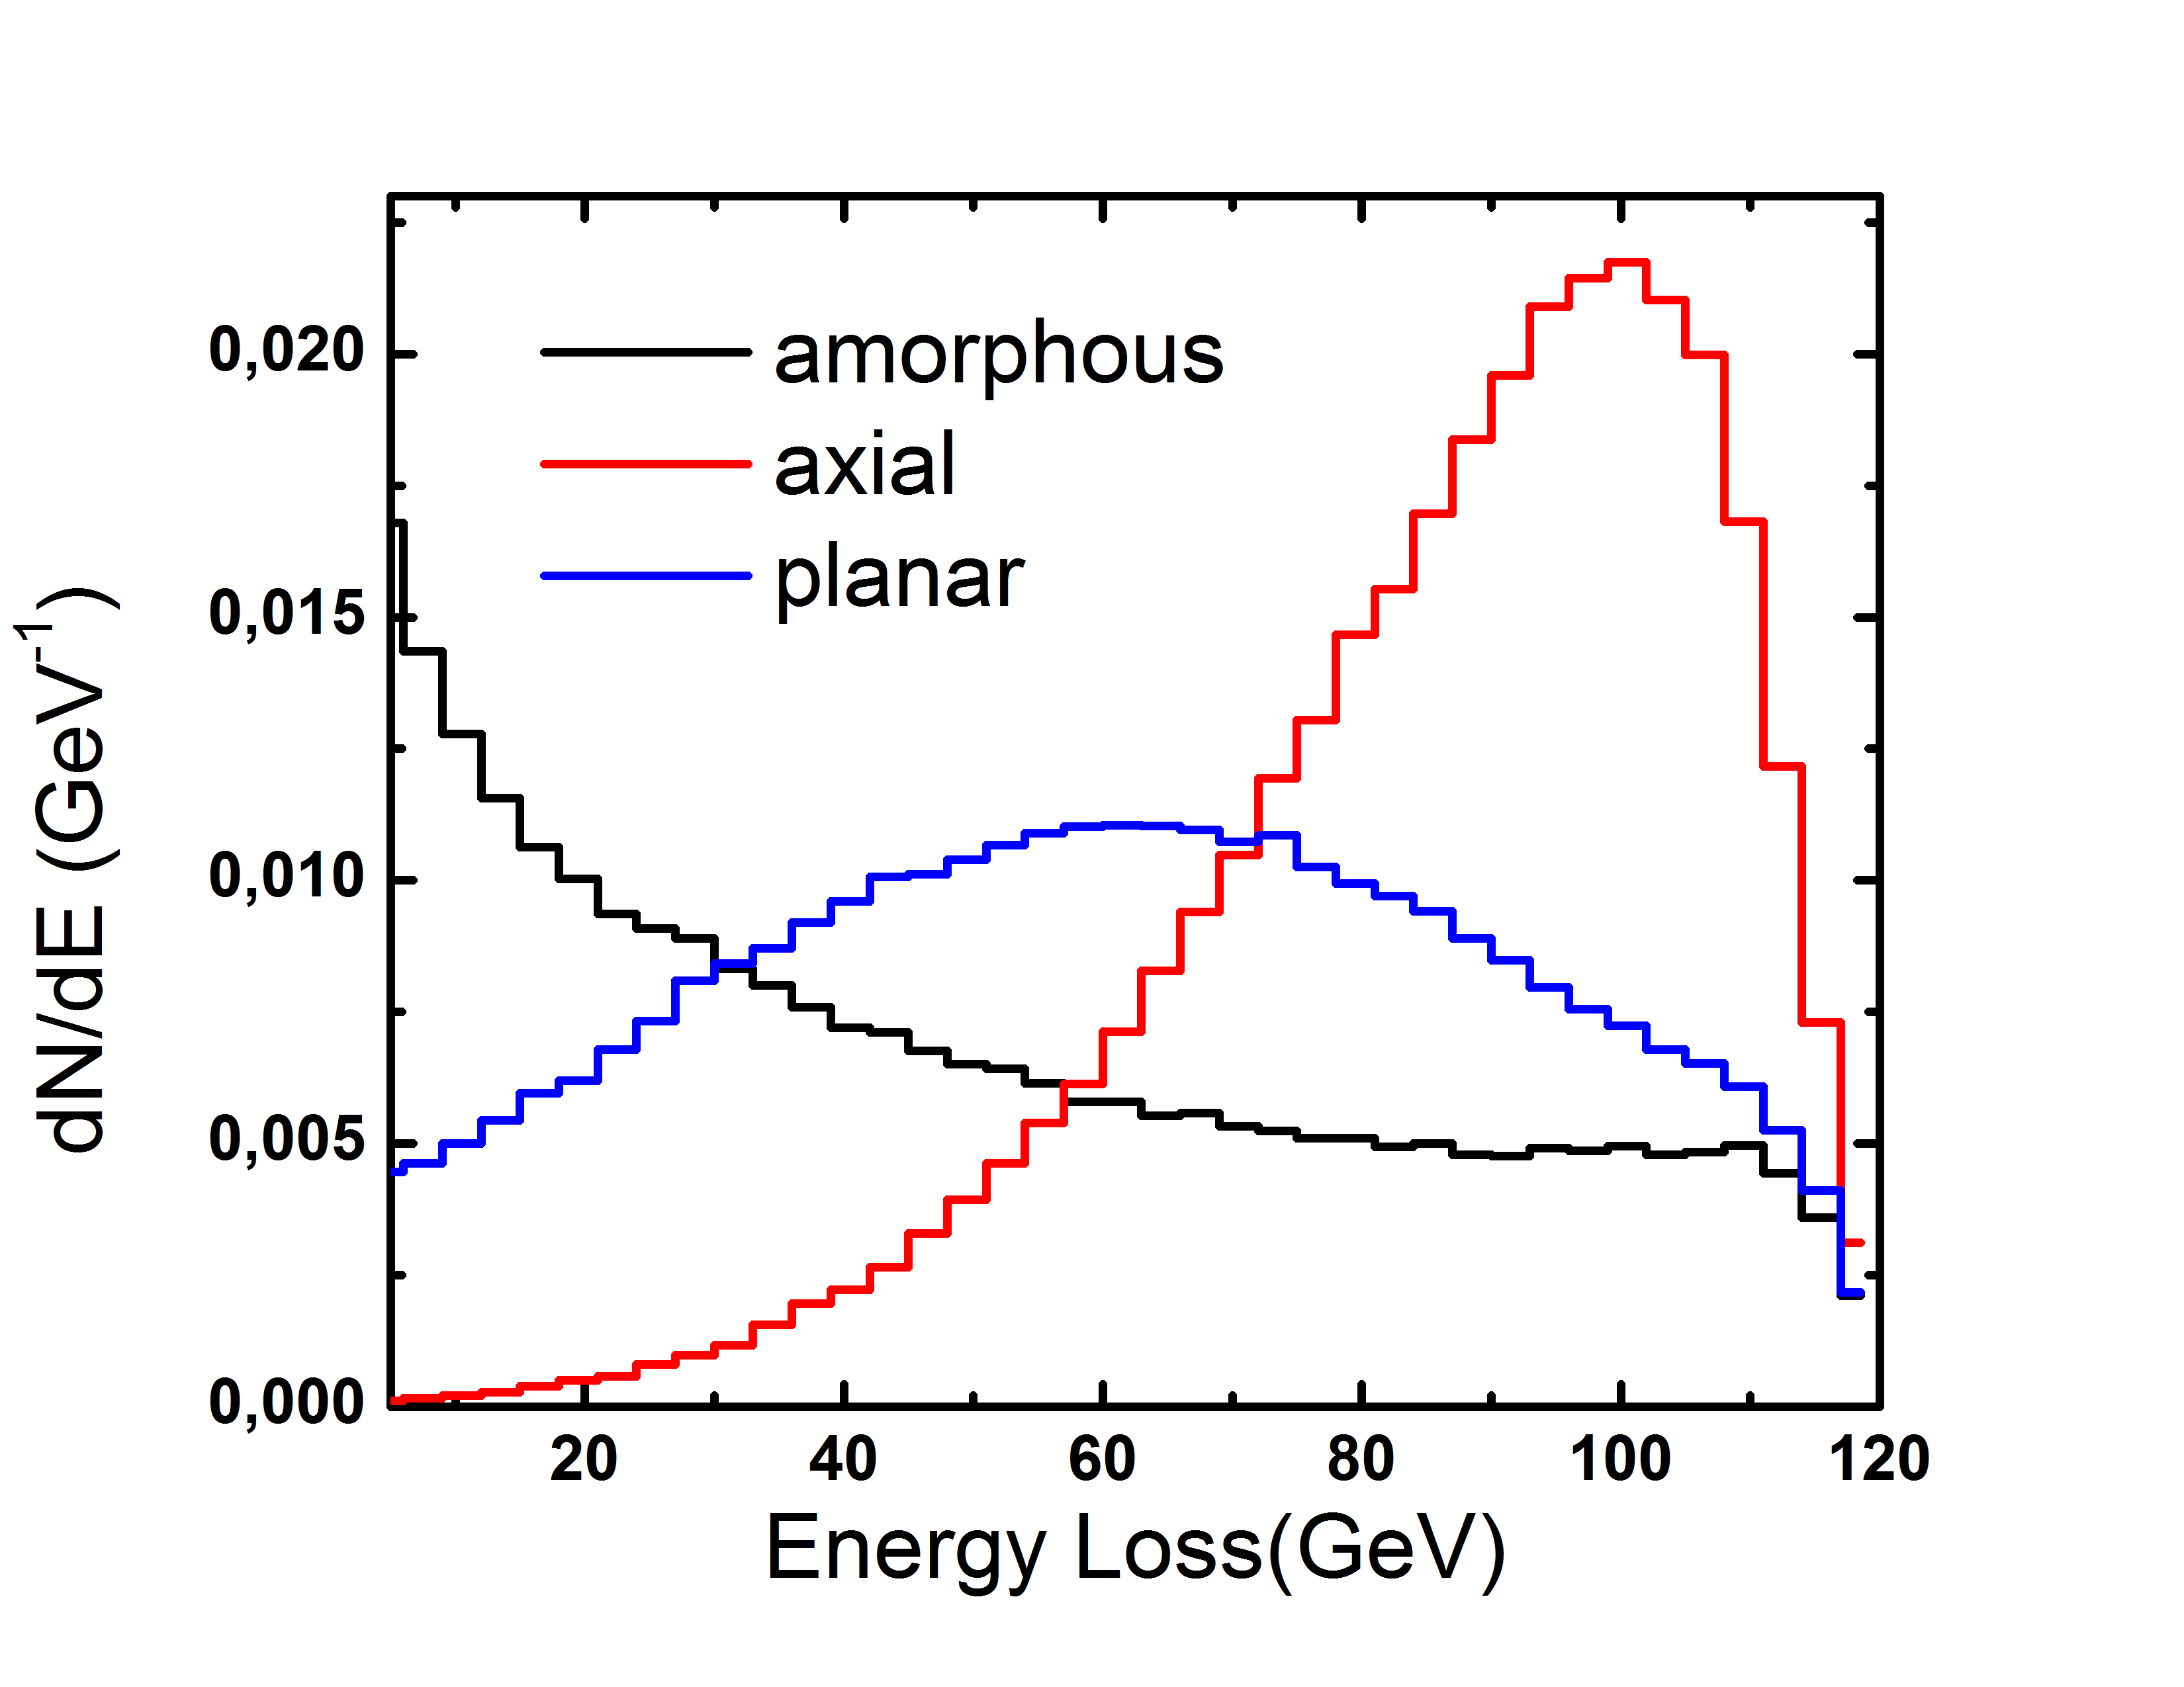
ENERGY LOSS RADIATED
S1-2
e⁺
e⁻
γ
γ-cal
SD1
SD2
SD3
We selected single events on SD1-2 and collected the energy loss at the gamma-calorimeter.
Mean energy loss:
~ 40 GeV not-aligned;
~ 85 GeV axial.
The energy lost into pairs cannot be measured, since the magnet swiped away not only the primary particles but also the secondary electrons and positrons.

Slide 14
ENERGY LOSS RADIATED
S1-2
e⁺
e⁻
γ
γ-cal
SD1
SD2
SD3
We selected single events on SD1-2 and collected the energy loss at the gamma-calorimeter.
Mean energy loss:
~ 40 GeV not-aligned;
~ 85 GeV axial.
Just a rough estimation of the strength of the effect
E₀(1-e^{-x/X0,eff}) ≈ 85 GeV
X_{0,eff} ≈ 1/3 X₀
E₀=120 GeV, x=4 mm, X₀=8.9 mm

Slide 15
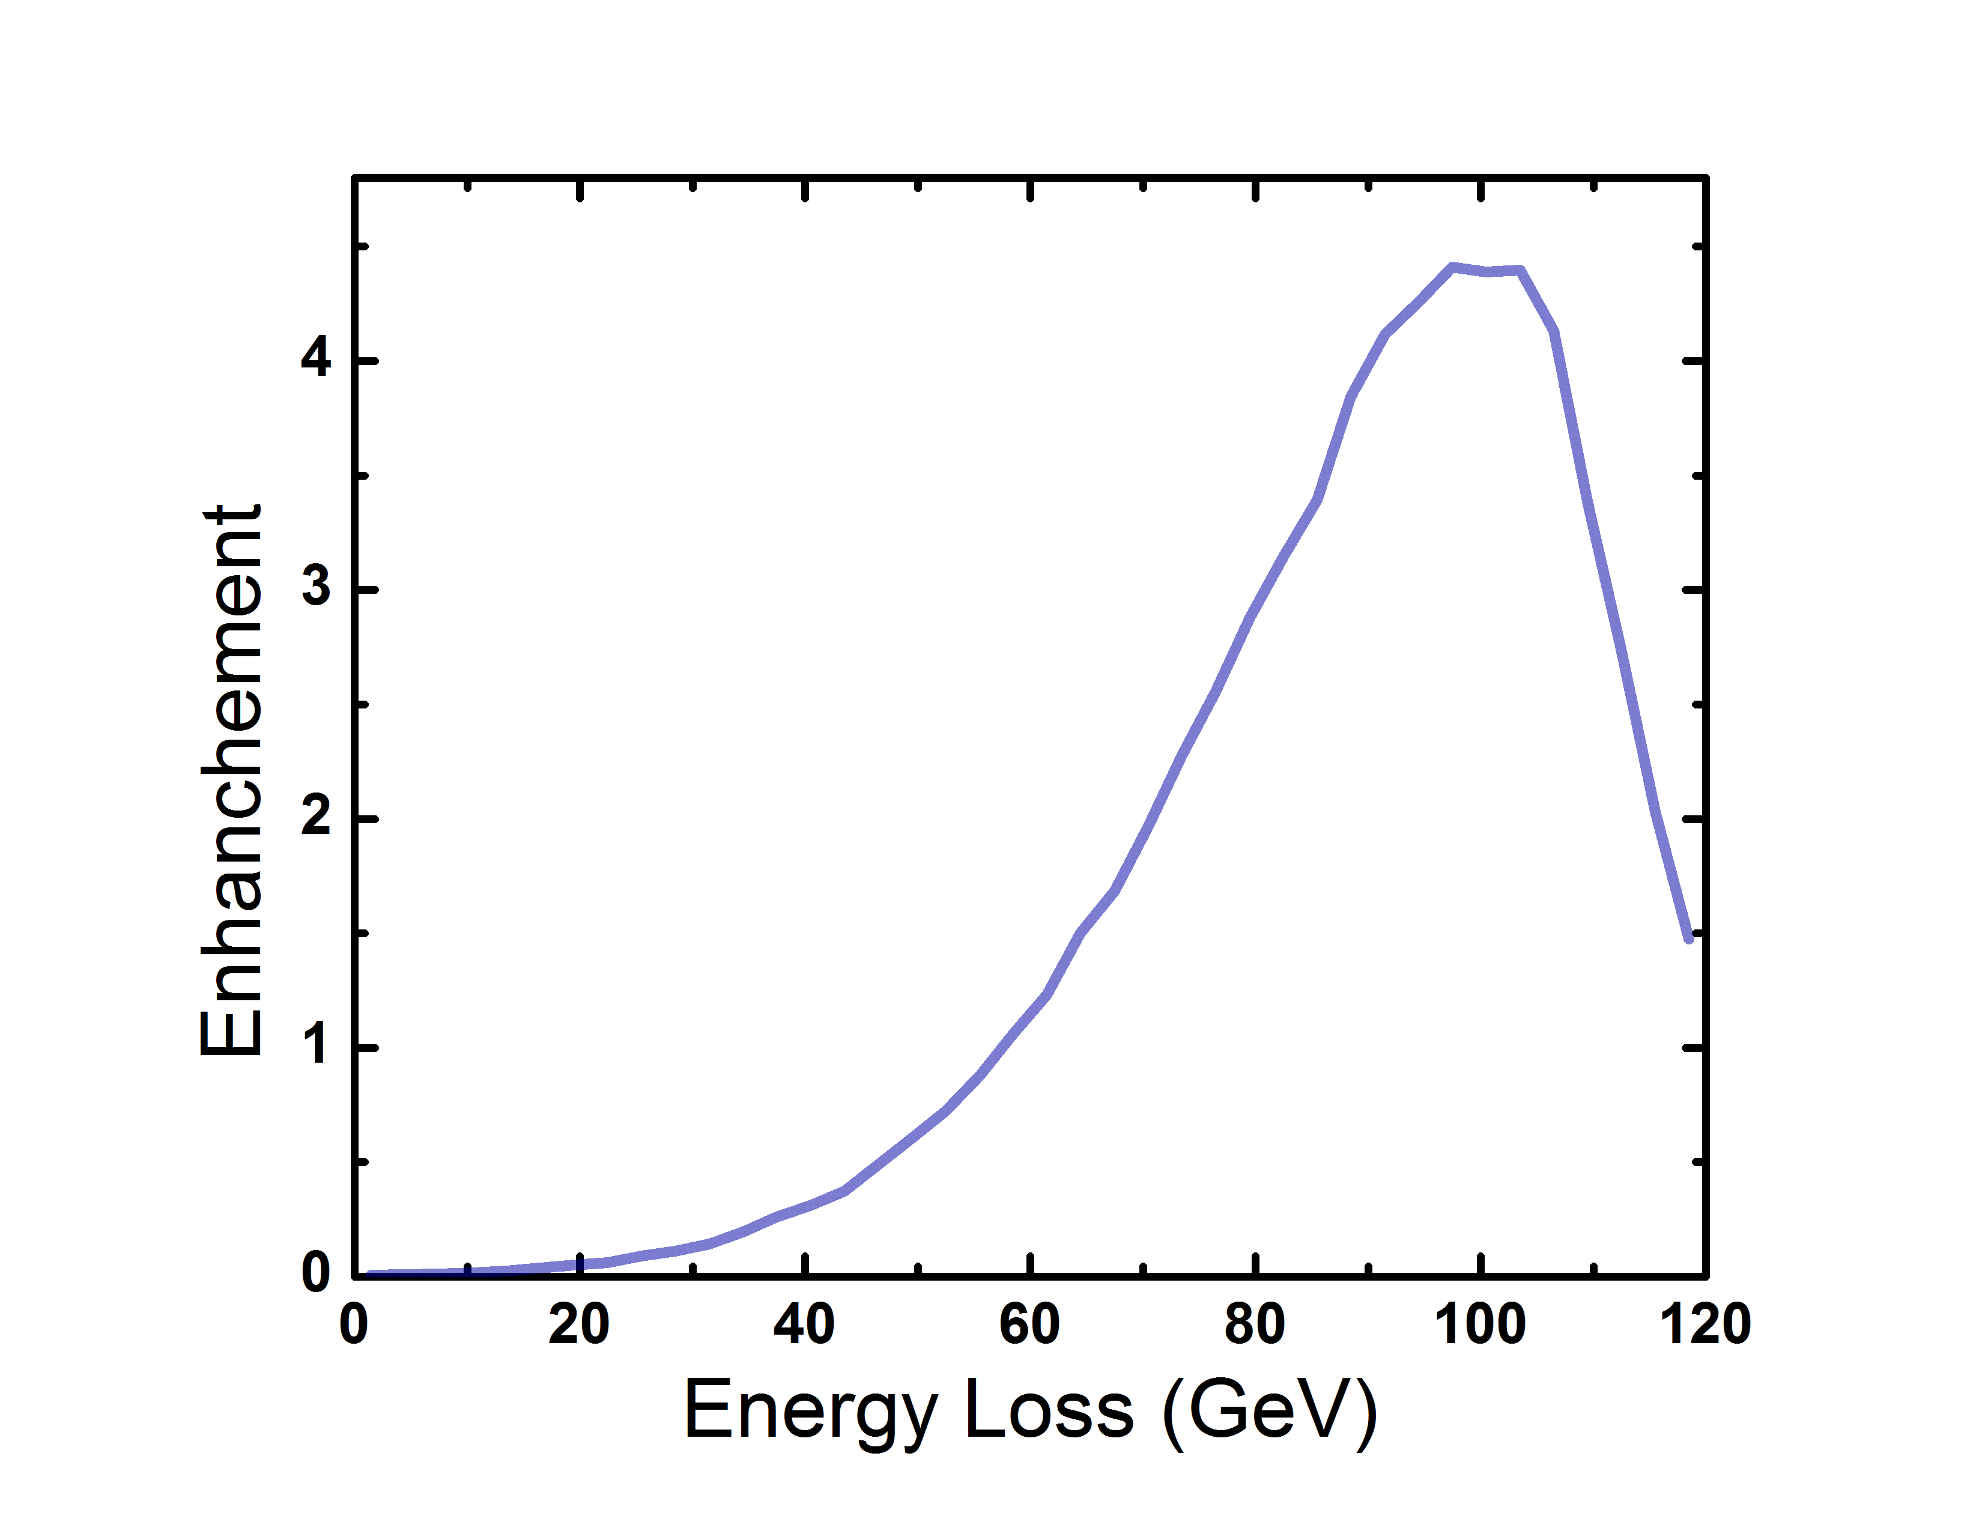
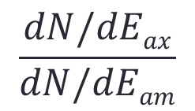
Energy loss spectrum modification
$$\frac{dN/dEax}{dN/dEam}$$
Ratio between Energy loss distribution in axial and amorphous cases.
We notice a decrease in the soft part of the spectrum, while strong enhancement in the hard part.

Slide 16
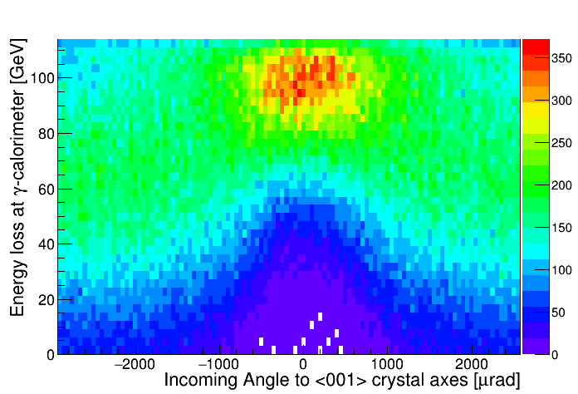
Angular acceptance of radiation enhancement
Rotational scan around the <001> axes – along the (100) planes

Slide 17
Angular acceptance of radiation enhancement
The axial influence is strong in ±1 mrad angular range and it is maintained up to almost ±2 mrad (±0.12 deg). At larger angles one passes to planar case, which is still higher than amorphous

Slide 18
Comparison with simulation

Slide 19
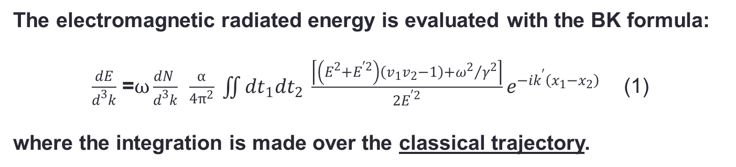
Baier-Katkov quasiclassical operator method (1967-1968)
General method for calculation of radiation generated by e± in an external field
The electromagnetic radiated energy is evaluated with the BK formula:
$\frac{dE}{d^{3}k}$ =$ω\frac{dN }{d^{3}k}$ $\frac{α}{4π^{2}} \iint{{dt}_{1}{dt}_{2} \frac{\left\lceil \left(E^{2}+E^{′2}\right)\left(v_{1}v_{2}−1\right)+{ω^{2}}/{γ^{2}}\right\rceil }{2E^{′2}}e^{−ik^{′}\left(x_{1}−x_{2}\right)}}$ (1)
where the integration is made over the classical trajectory.
Why classical trajectory?
2 types of quantum effects :
the quantization of particle motion ~ℏω₀/E
In crystals: negligible for electron/positron energy >10-100 MeV
the quantum recoil of the particle when it radiates a photon with energy ℏω~E NOT negligible for electron/positron energy >50 GeV
Notes:
This method has the advantage to be applicable in the whole photon energy range, except for the extreme limit where ℏω ∼ ε.
Aggiungi parte sulla formula.

Slide 20
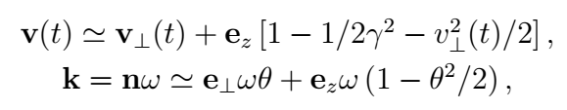

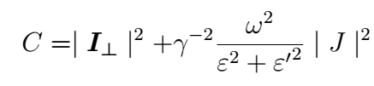
An algorithm for radiation in crystals
Integration of the Baier-Katkov formula
SMALL ANGLE APPROXIMATION: Since the angle between particle trajectories and crystal planes or axes is small and at ultrarelativistic energies the radiation angle 1/γ is much smaller than unity the particle velocity v and photon momentum k can be
represented in the form :
where the angle θ ≪ 1 represents the radiation angle. The formula (1) can be rewritten as:
(2)
where (3)
V. Guidi, L. Bandiera, V. Tikhomirov, Phys. Rev. A 86 (2012) 042903]
L. Bandiera, et al., Nucl. Instrum. Methods Phys. Res., Sect. B 355, 44 (2015).

Slide 21
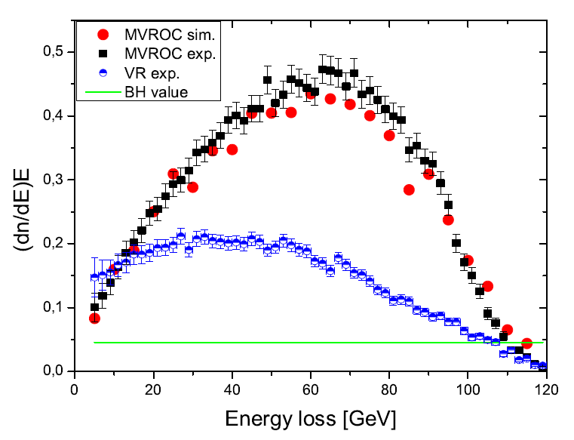
Simulation vs previous experimental results of axial multi-volume reflection in a 2 mm Si bent crystal
Axial MVR
Planar VR
amorphous
Energy loss spectral intensities: (dn/dE)*E
of 120 GeV/c single and multi-reflected electrons
L. Bandiera et al., Phys. Rev. Lett. 111(2013) 255502
Notes:
Sure, follow the particle is followed further.
The length (~ 100 um) is short enough both red. prob, and angle change not mach. Than I choose a part of it with 5-10-20 typical trajectory semiperiods.

Slide 22
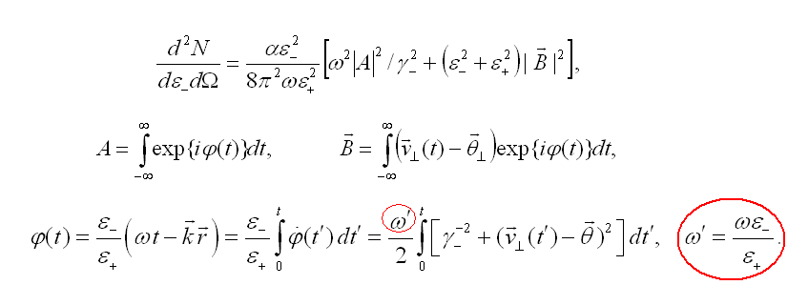
Baier-Katkov quasiclassical operator method (1967-1968)
General method for calculation of radiation pair production by a HE photon in an external field
The Constant Field Approximation (CFA) is applied to evaluate the pair production process when high-energy photons enters a crystal along the major crystal axis. However, CFA does not explain the angular dependence of the pair production rate.
The BK method has the advantage to be applicable in the whole angular region.
Notes:
This method has the advantage to be applicable in the whole photon energy range, except for the extreme limit where ℏω ∼ ε.
Aggiungi parte sulla formula.

Slide 23
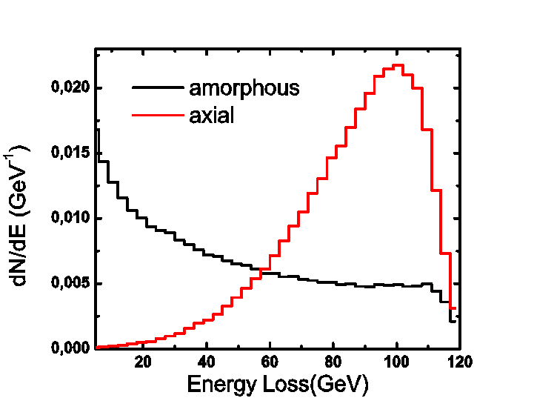
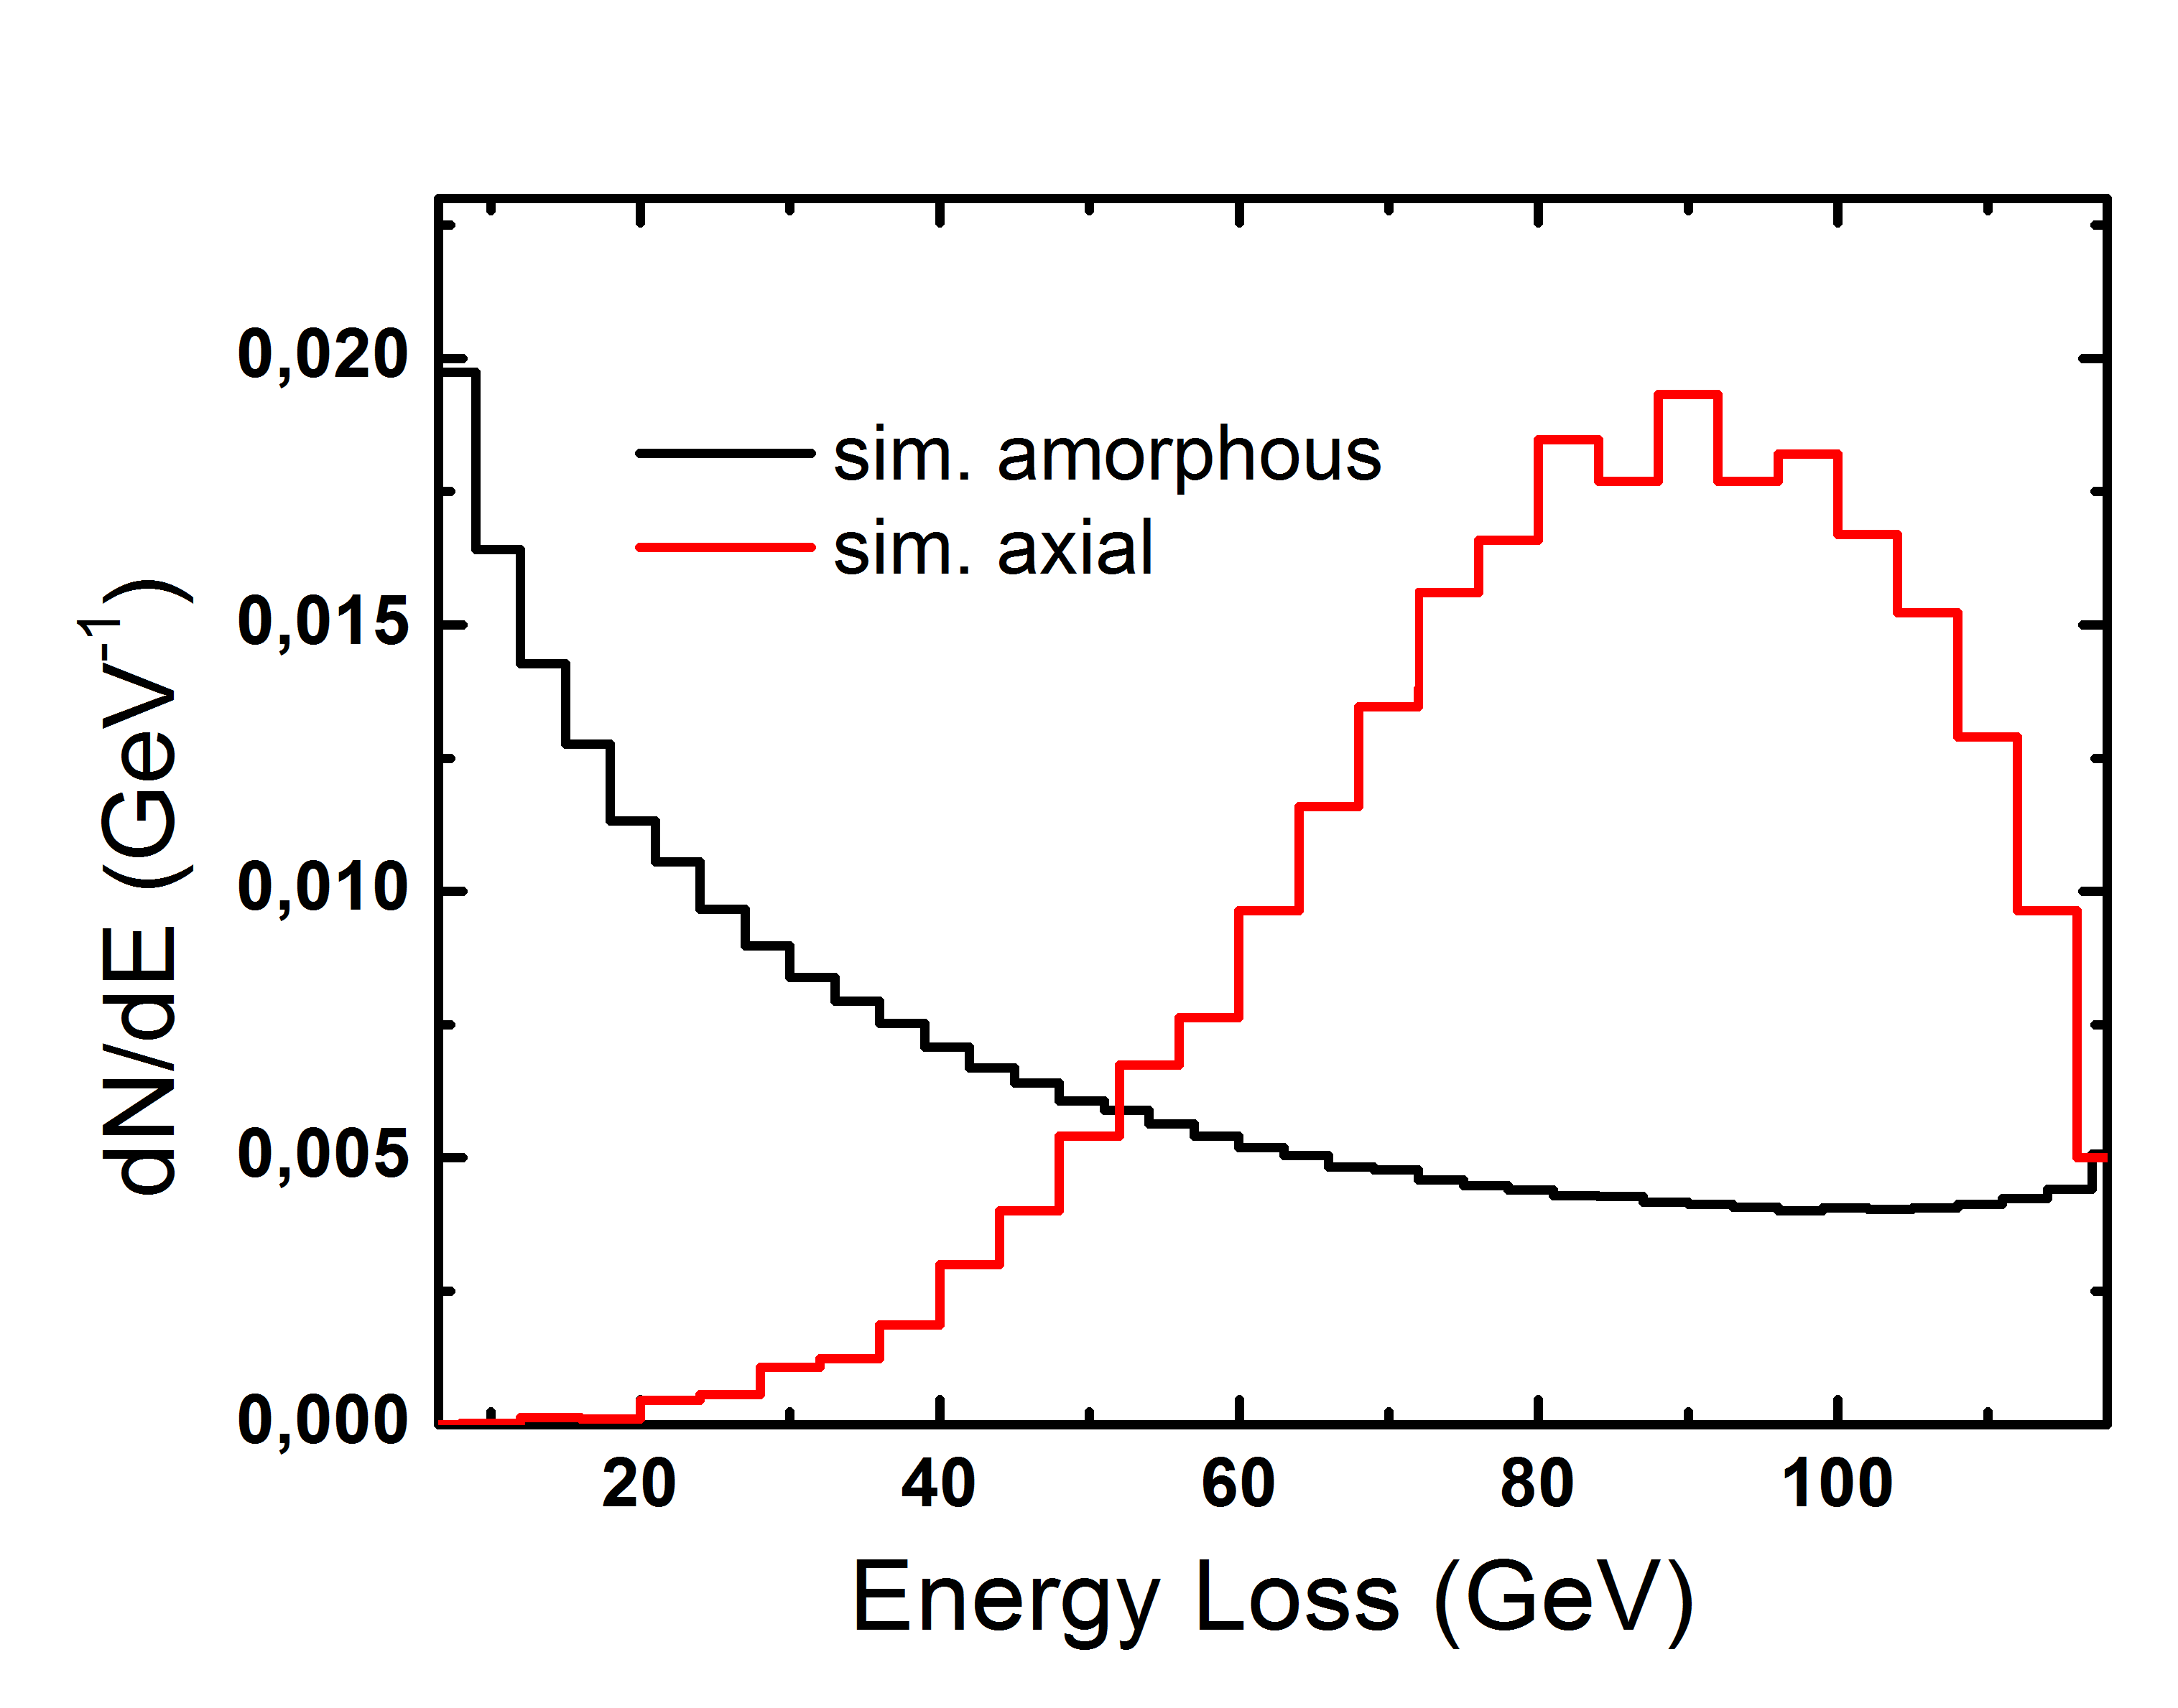
COMPARISON WITH SIMULATION
preliminary
Good agreement!
Difference can be ascribed to continuous potential choice (thermal vibration and other unknown characteristics), crystal quality and so on..
But also to the difficulties to simulate the e.m. shower development, tracking many low energy secondary particles at large angles.
Notes:
Shower simulation – many low energy particles at large angle. Simulation should be improved.

Slide 24
COMPARISON WITH SIMULATION
preliminary
In any case, the qualitative experimental behavior is well reproduced, thereby the developed code can be exploited to design future experiments and possible applications.
Notes:
Shower simulation – many low energy particles at large angle. Simulation should be improved.

Slide 25
Possible PRIN giovani - obiettivi
Studio della modifica della shower elettromagnetica in un cristallo ad alto Z orientato; sia in cristalli standard (tungsteno o silicio per esempio) che scintillatori (PWO, CsI, BGO, LYSO, ect..). In quest’ultimo caso, studiandone in particolare l’emissione di luce di scintillazione, e definendo così in che modo si modifica la radiation length in funzione dell’energia del fascio e dell’angolo di incidenza rispetto all’asse cristallografico e come o se cambia il raggio di Moliere. Nella fase preliminare servirà anche capire il tipo di struttura cristallina e la qualità cristallografica dei vari materiali da studiare, per capire quali sono i best candidate per un calorimetro a cristalli orientati.

Slide 26
Possible PRIN giovani - obiettivi
Realizzazione di un Monte Carlo che includa questi effetti. Un codice che riproduca l’aumento di bremsstrahlung è già stato realizzato [1,2] dal gruppo di L. Bandiera ed ha ben riprodotto risultati di esperimenti realizzati con cristalli di silicio ed elettroni da 0.855 [3] a 120 GeV [4].
Realizzazione di un prototipo/modulo di calorimetro orientato da testare a DESY (c’è un gruppo interessato a queste tematiche ed un test beam approvato per il 2018 di cui L. Bandiera è responsabile) con fasci di circa 5 GeV o FERMILAB con 35 GeV, e poi nell’ultimo anno del progetto al CERN sulle linee estratte di SPS (tipo H4 o H2, dove sono presenti fasci di elettroni/positroni terziari ed eventualmente fotoni).

Slide 27
Impatto
Nuove conoscenze di fisica sui processi e.m. in cristalli orientati ed in particolare in scintillatori, usati normalmente in fisica delle particelle.
Questi effetti sono già proposti in applicazioni:
  Converter (già studiato da NA48)-> nuove conoscenze sono richieste per sviluppi futuri;
  Sorgenti di positroni innovative (CLIC, muon collider)

Slide 28
Possible PRIN giovani – possibili applicazioni innovative
Studio di possibili applicazioni per calorimetri forward in fisica delle particelle, in particolare come smart converter di fotoni, elettroni e gamma (es: KLEVER). Un occhio di riguardo potrebbe essere quello di studiare se la diminuzione della lunghezza di radiazione può essere utile nelle applicazioni di ricerca di materia oscura leggera tipo missing energy/momentum (es: NA64, LDMX) o beam dump (tipo SHIP). Tali esperimenti sono infatti tutti forward.
Studiare le possibilità di applicazione in fisica astroparticellare - poiché con la nascita dell’astrofisica multimessenger si può pensare di puntare un telescopio verso la sorgente. Se un satellite avesse un modulo gamma a cristalli orientati, potrebbe contenere la shower di raggi gamma >100 GeV (ma anche a più bassa energia) senza dover aumentare il peso rispetto a quelli usati attualmente. Inoltre, in assenza di puntamento, continuerebbe a funzionare in maniera standard.

