Slide 1
Meeting 31 /1 /2018
MSD performance on dE/dx between different Geometries
  Geometry V13.0.X and Geometry V13.1.X
General Papers from the CDR

Slide 2
2 geometries
MAGNETS
MSD
6 layers of 50 μm
(300 μm)
Geometry V13.0.0
10 cm
6 layers of 50 μm
(300 μm)
Geometry V13.0.1
7 cm
3 layers of 150 μm
(450 μm)
Geometry V13.1.0
10 cm
Geometry V13.1.1
3 layers of 150 μm
(450 μm)
7 cm

Slide 3
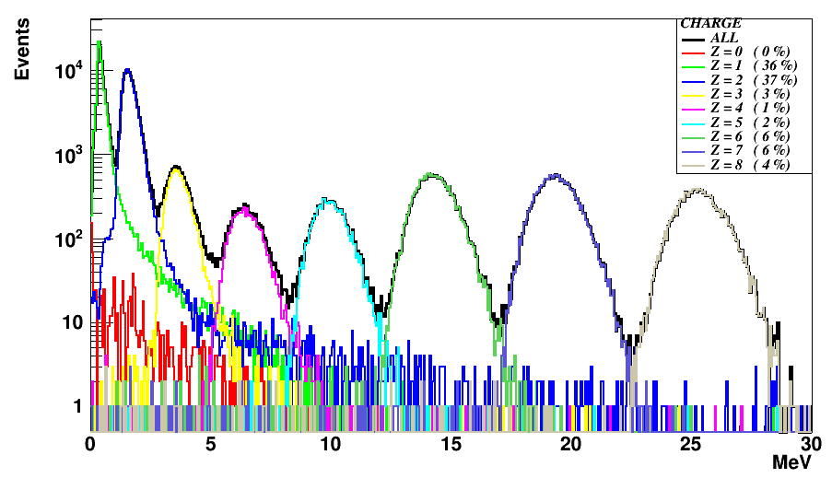
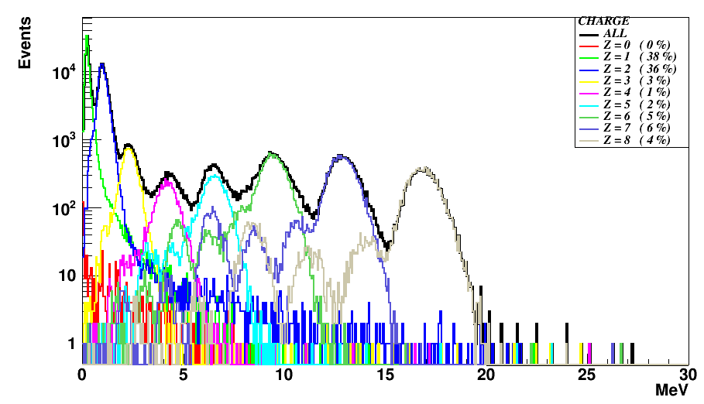
MSD comparison, 1
MSD V13.1.0 and V13.1.1
450 μm of Silicon
MSD V13.0.0 and V13.0.1
300 μm of Silicon
hole of Silicon → peaks that give wrong charge evaluation

Slide 4
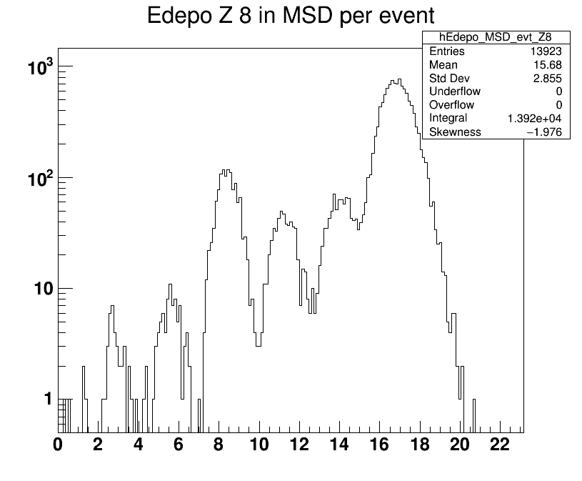
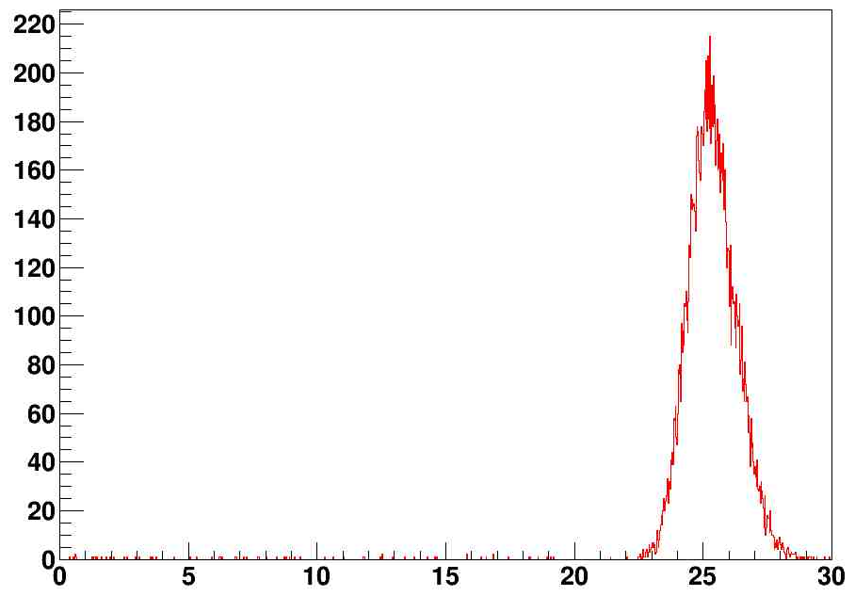
MSD comparison, 2
MSD V13.0.0 and V13.0.1
Oxygen
20% of events release less energy
3
5
4
V13.1.1
1
2
6 layers crossed
Due to the geometry
MeV
5 mm of hole over 90mm in x and y → for 3 times
Roughly → 0.95⁶ = 0.73 →
25% of fragments travel less than 450 μm

Slide 5
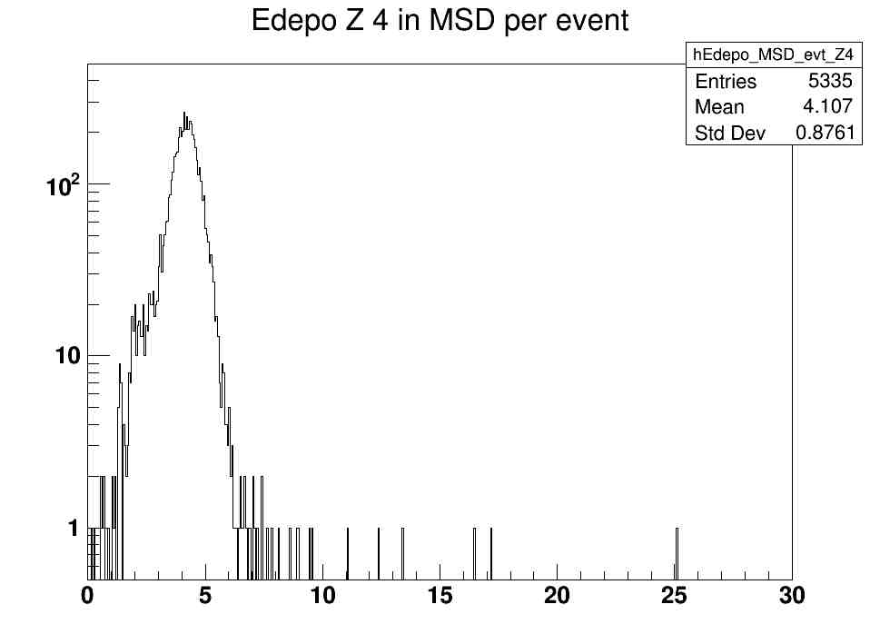
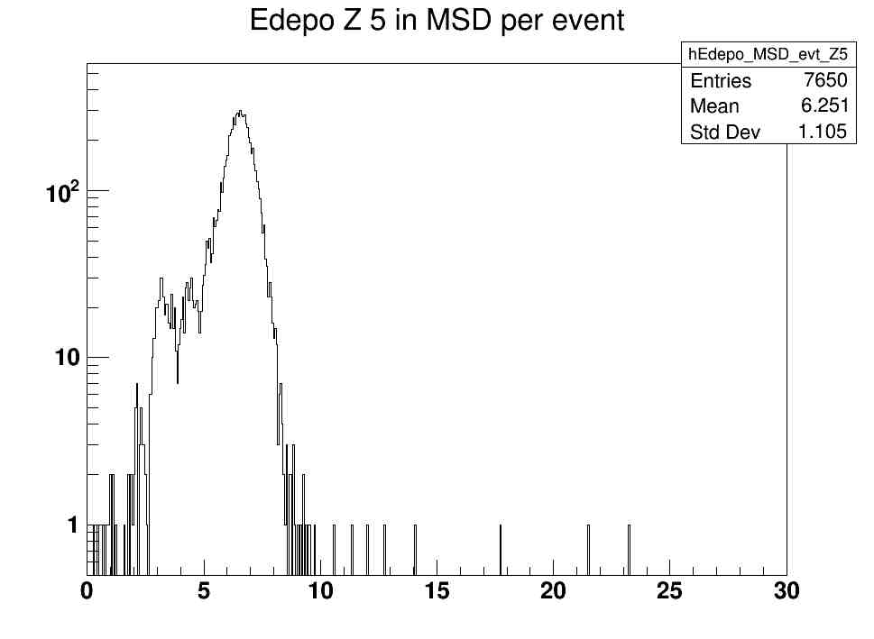
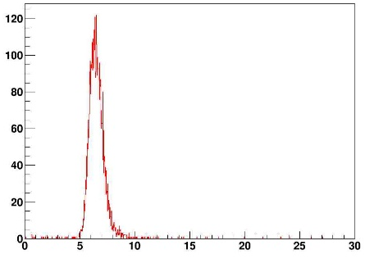
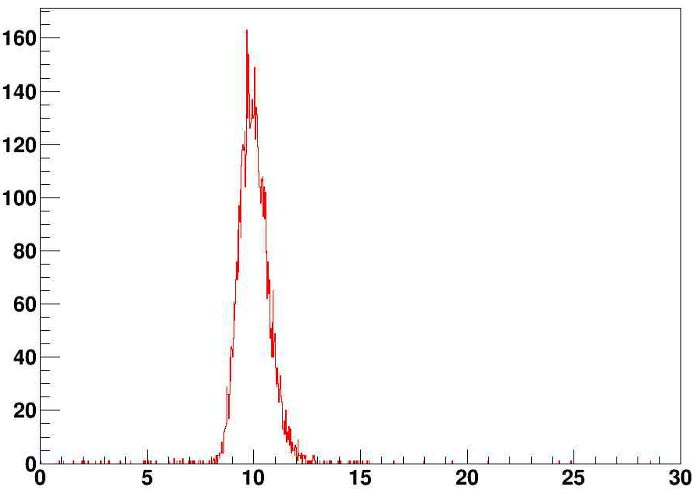
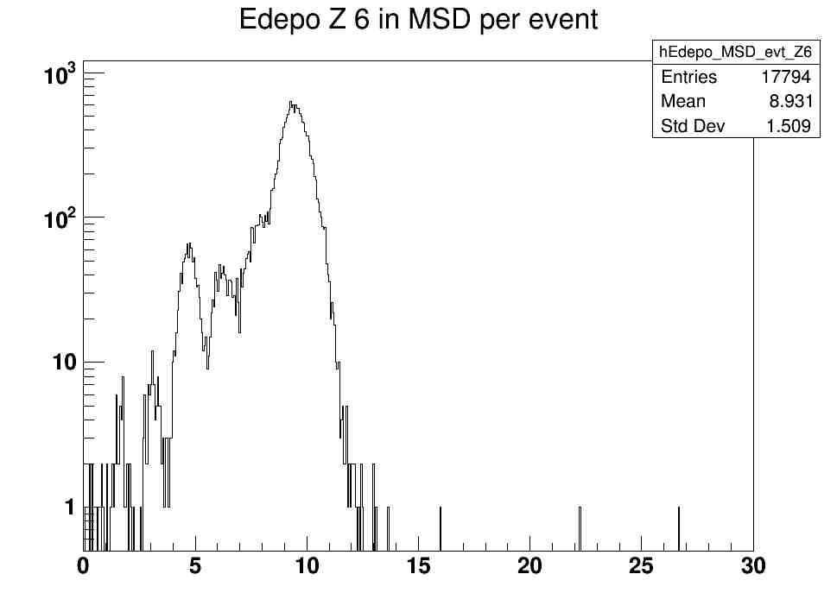
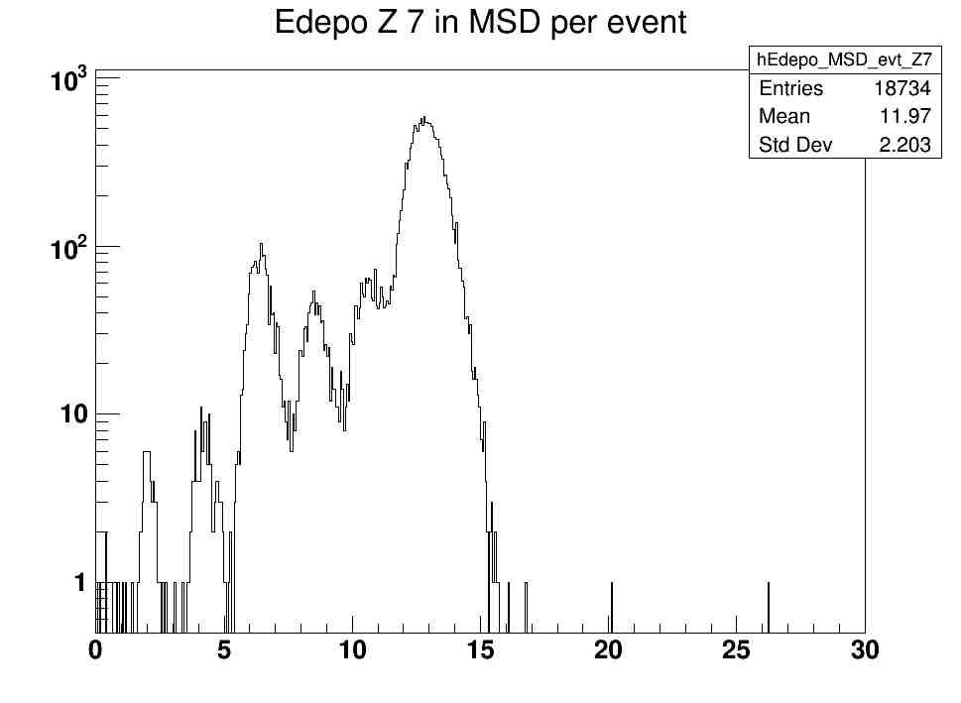
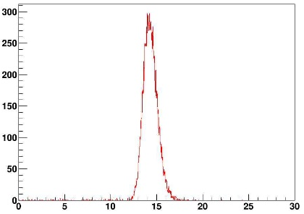
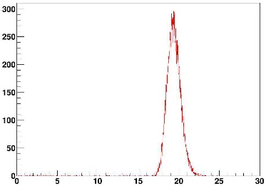
MSD comparison, 3
MSD V13.0.0 and V13.0.1
Beryllium
Boron
V13.1.1
V13.1.1
Carbon
Nitrogen
V13.1.1
V13.1.1
V13.0.X geometry should be optimized to avoid this problem

Slide 6
FOOT Papers
God new: we have the draft of the first paper in FOOT: «Development and Characterization of a ΔE-TOF detector prototype for the FOOT experiment»
Important to have other papers
Possibility to extract two papers from the CDR:
  The FOOT detector (NIM, JINST,…)
  The FOOT experiment (EPJC, J. Phys. G,…)
Giuseppe contacted the Journal of Physics G and European Journal of Physics C → possibility to publish paper of order of 40 pages
Same possibility for JINST (Journal of Instrumentation), but better to contact Marzio Nessi

Slide 7
FOOT Papers from CDR
Possibility to extract two papers from the CDR:
  The FOOT detector
    Detector description meaning :
      chapter 3: Design criteria;
      Chapter 4: Electronic detector Setup;
      Chapter 5: Emulsion Chamber;
      Chapter 6: DAQ and Trigger;
  The FOOT experiment
      Chapter 1: Introduction;
      Chapter 2: Motivation;
      Chapter 7: Reconstruction Software;
      Chapter 8: Performances;
Persons involved are at least the ones involved for the CDR

