Slide 1
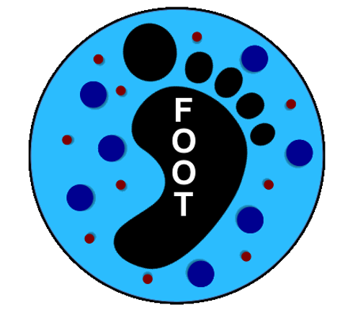
Version 13 of FOOT Simulation: changes and first data production
G. Battistoni, Y. Dong, A. Embriaco, F. Gargano, I. Mattei, S.M. Valle

Slide 2
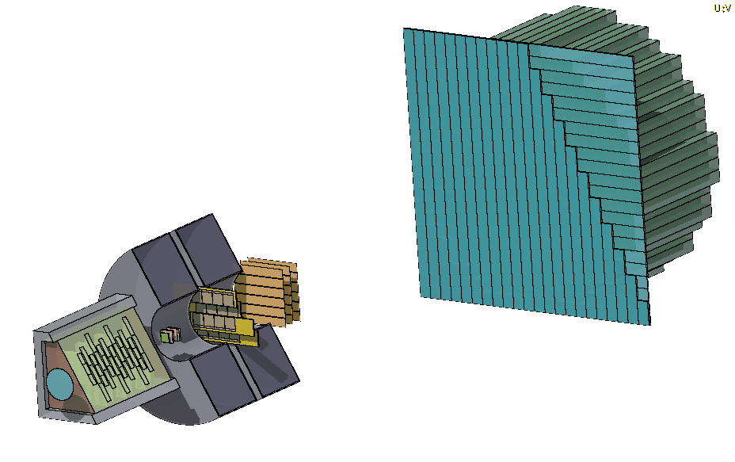
From Bologna Meeting: V13

Slide 3
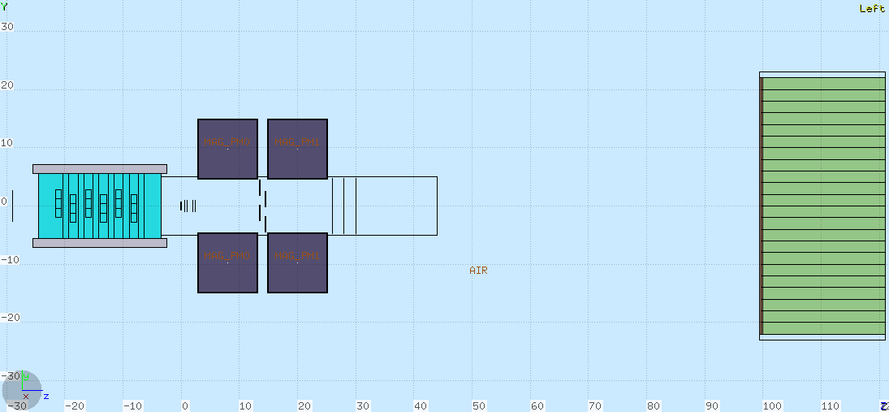
V13: what’s new?
two identical magnets (cheaper)
Calorimeter BGO crystals have been lengthened from 14 to 21 cm since, hopefully, we will inherit ~21 cm long crystals from L3 experiment at LEP
2 diffirent MSD configurations
Vertex spatial configuration
More realistic staggered layout of PLUME

Slide 4
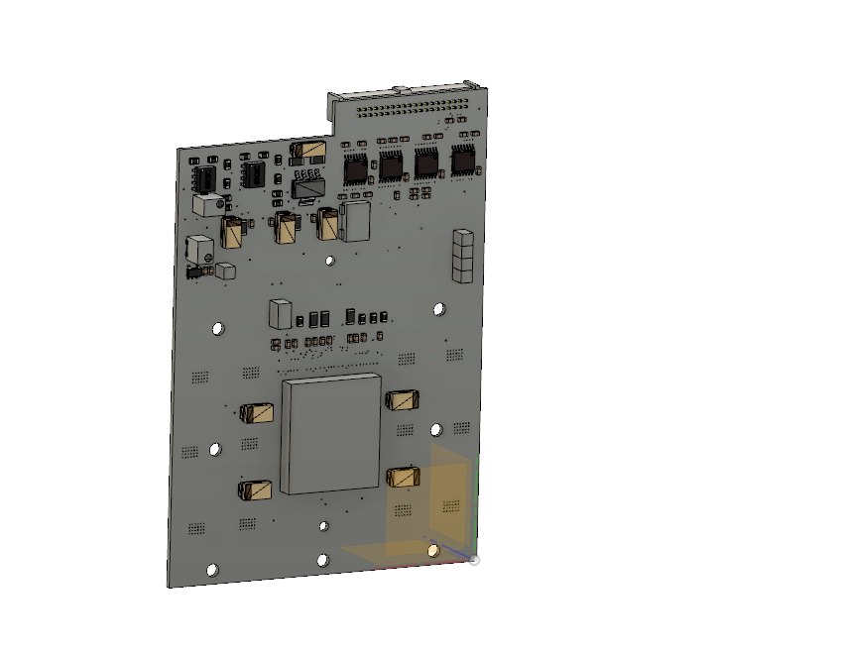
Vertex
DONE
Due to the spatial configuration of the readout regions, the vertex layers have been coupled and distances between them have been modified as depicted in figure
TO DO
Distance from the target still has to be optimized
Introduce the electronic boards that will surround the sensors
1 cm
6,5 mm
3,5 mm

Slide 5
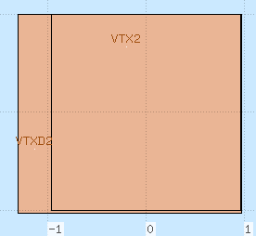
Vertex
Readout side for VTX0 and VTX1
DONE
Real MIMOSA28 geometry has been implemented:
Total area: 20,22 x 22,71 mm²
Active area: ~19,21 x 19,87
928 rows x 960 columns
Pixel pitch: 20,7 μm
Thickness: 50 μm
The two planes in the same couple will be read from the same side, while the others from the opposite
Improved management of simulated hits in pixels
VTX0
Sensitive region
VTX2
Readout side for VTX2 and VTX3

Slide 6
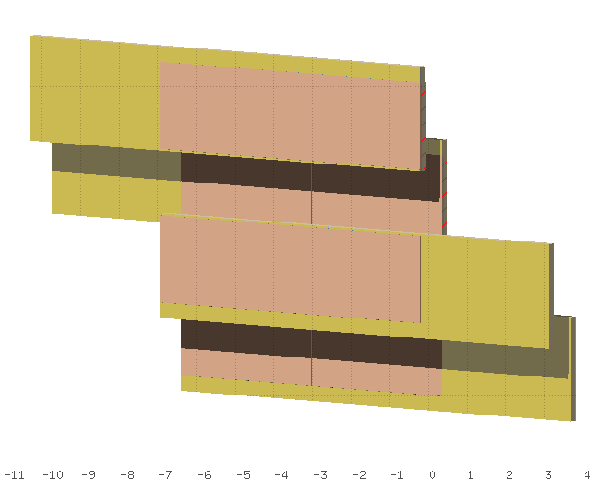
Inner Tracker
DONE
The Inner Tracker has been split in 4: the PLUME geometry has been implemented, along with real MIMOSA28 geometry (4 M28 in each PLUME)
TO DO
Distances between PLUMEs (in z and y) have to be optimized
y
z

Slide 7
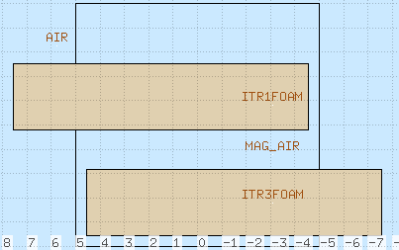
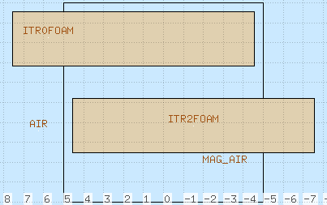
Inner Tracker

Slide 8
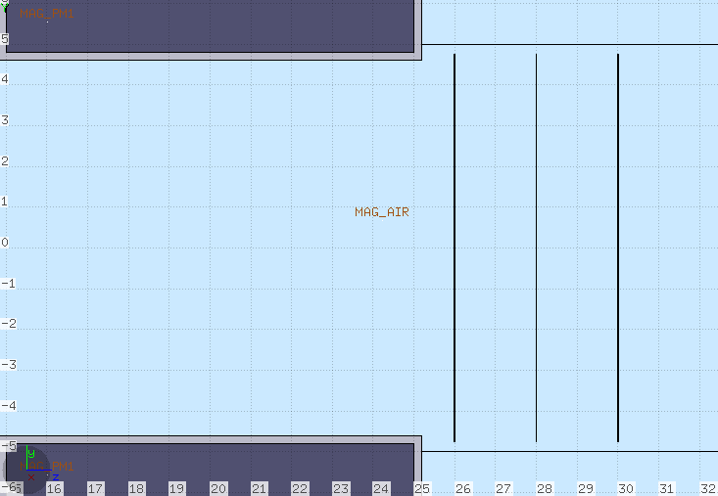
Microstrip Detector
DONE
3 planes of Silicon Microstrips
2 cm distance between planes
Strip pitch 125 μm
2 different configurations (see next slide)
TO DO
Distances between the planes
Number of layers (does the resolution on momentum improve if we add another, and maybe thinner, layer?)

Slide 9
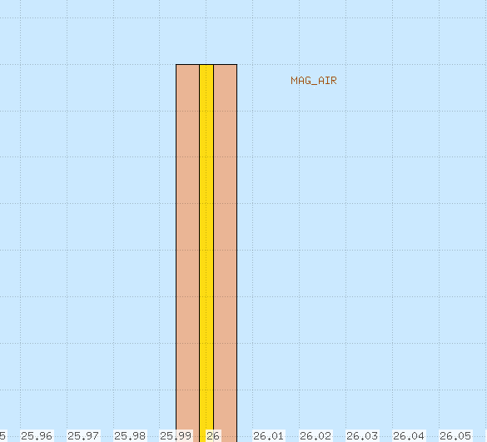
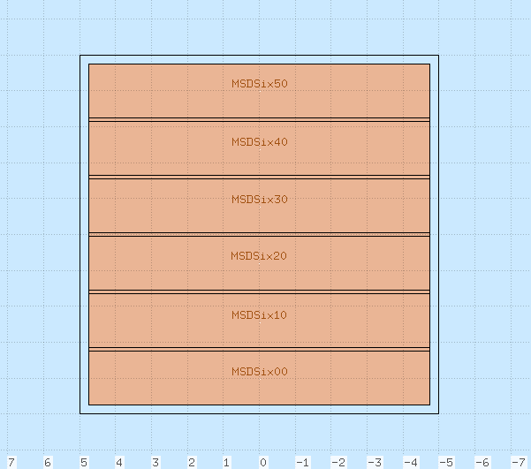
Microstrip Detector. Configuration 1
V13.0
DONE
Each plane: 2 layers of Silicon Microstrips (50 μm thick)
Interleaved with a Kapton foil (30 μm thick)
Bars 1.5x9 cm²
Insensitive regions between bars 1 mm
LGAD system
y
y
z
x
Thanks to Leonello

Slide 10
Microstrip Detector
80%
10%
V13.0
10%
Charge sharing: as the charge produced in a microstrip by ionizations drifts, it can partly be collected by the next strip
Charge sharing occurs in ~20% of the interactions
Charge sharing probability is a function of the distance from the nearest strips (see figure)
ONGOING
Implementation of charge sharing at reconstruction level
P
1
strip1
strip2
strip3
Thanks to Leonello

Slide 11
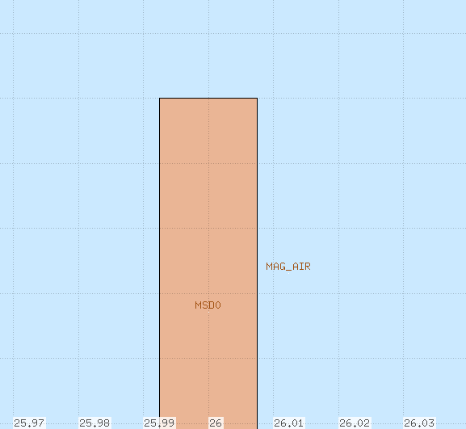
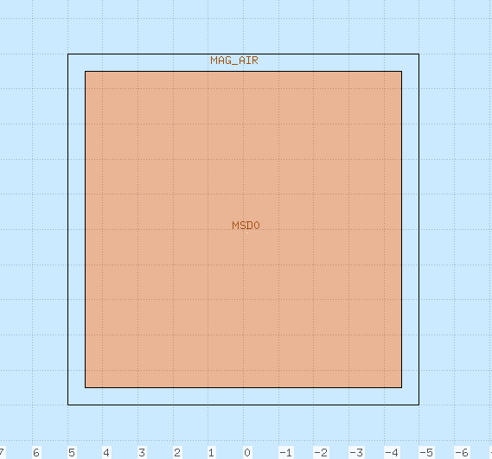
Microstrip Detector. Configuration 2
V13.1
DONE
Each plane: 1 single layer of Silicon Microstrips (150 μm thick)
No Kapton foil
No insensitive regions
No LGAD system
y
y
z
x
Thanks to Leonello

Slide 12
Magnets
DONE
The construction of two identical magnets is cheaper, so in V13 both magnets have an internal radius of about 5 cm
The magnets thickness (in red) has been enlarged to a more realistic value
TO DO
Overall final dimensions have still to be defined. In particular, the length in z has to be decided (compromise between cost and B dl) and also the distance between the magnets
Magnetic map is still approximated (when there will be a ~finalized geometry we will ask for a realistic one)
Warning: the financial estimates were evaluated for magnets shorter than in V12.4 (7 cm against 10 cm). What’s the impact?

Slide 13
Sub Versions
V13.0.0 and V13.1.0
V13.0.1 and V13.1.1
V12.4 design: magnet length = 10 cm
USED FOR CDR. Approximate Field map!!
Short magnet length = 7 cm (first design by C. Sanelli)
Realistic Field map calculation
The first digit instead refers to the MSD configuration

Slide 14
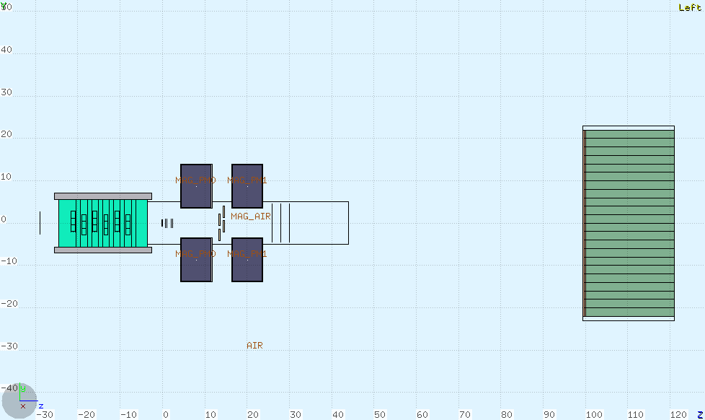
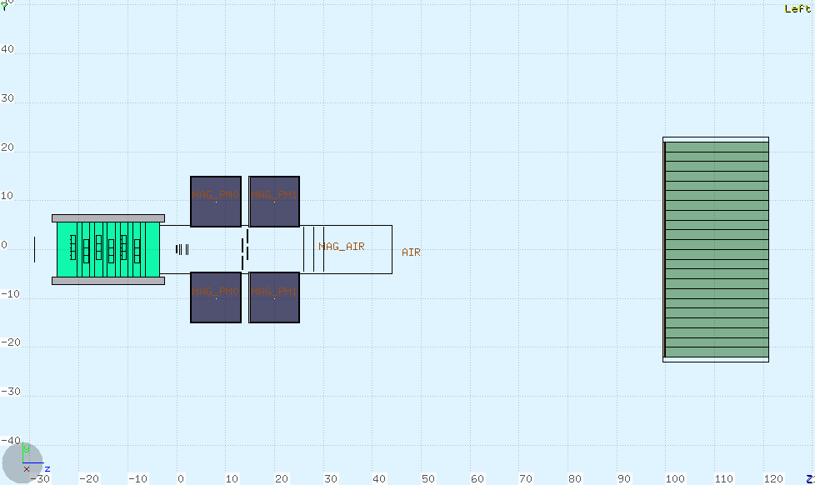
V13.0.1 and V13.1.1
V13.0.0 and V13.1.0

Slide 15
Test productions
On Tier3 in /gpfs_data/local/foot/Simulation
Subdirectories:
V13.0.0
V13.1.0
V13.0.1
V13.1.1
In each subdirectory: 16O_C2H4_200_1.root
10⁷ Oxygen primaries @200 MeV/u against a 2 mm C₂H₄ target: ~100k intelastic interactions on target
A first snapshot to evaluate the new setup. Probably more statistics is necessary. It can be produced shortly after an OK from the first checks

Slide 16
To be tested urgently
Possible worsening due to the more realistic Plume structure
Fragmentation probability
Momentum resolution: how much the reduced magnetic length contributes?
From Bologna Meeting: a lot of parameters have to be optimized and defined in order to be correctly reproduced in simulation:
Distance of vertex, calorimeter, ecc. from target
Distances between the PLUMEs and between the Microstrip Detector layers
Layout of the Microstrip Detector
Dimensions of the magnets
Distance between scintillator and calorimeter
Calorimeter shape (parallelepipeds o truncated pyramids) and dimension
Thickness of Scintillator (typical exsercise to be carried on with ad-hoc simulation)

Slide 17
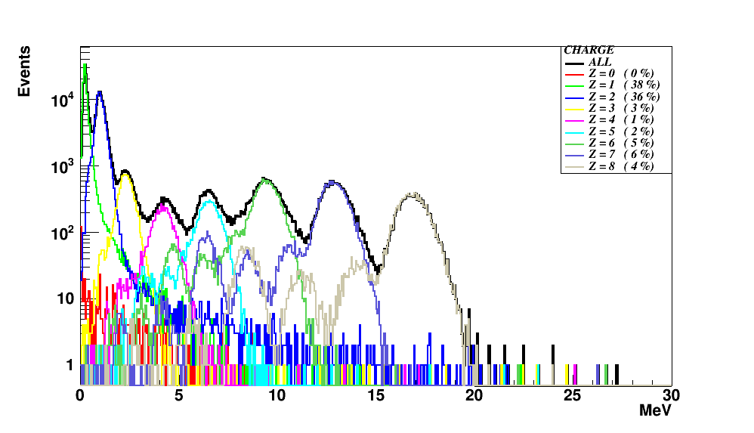
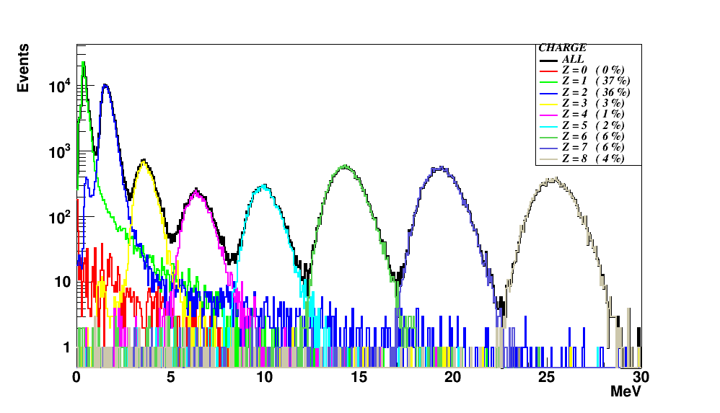
A first remark from a preliminary comparison between the two different MSD setup (V13.0.x vs V13.1.x)
R. Spighi

Slide 18
Very probable explanation
A naivety:
Perfect alignment of central dead region

Slide 19
Again from Bologna Meeting
In the reconstruction stage, we have to introduce:
Clustering in Inner Tracker and calorimeter
Scintillator luminous response and resolution dependence on the hit position
Provide a new event display adapted to the new geometry

Slide 20
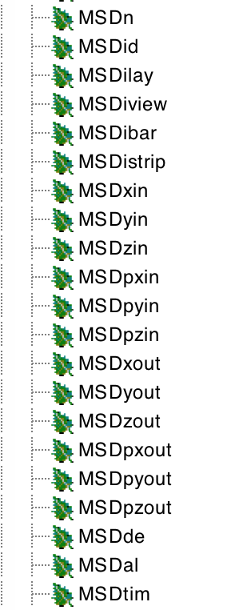
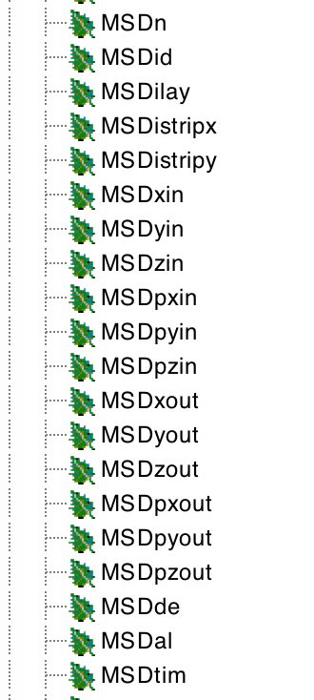
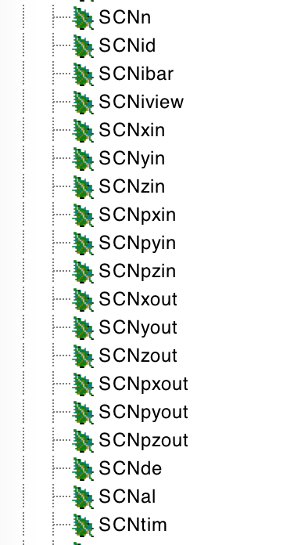
Root Technicalities: variable names
MSD in V13.1.x
MSD in V13.0.x
Notice the change
in name

Slide 21
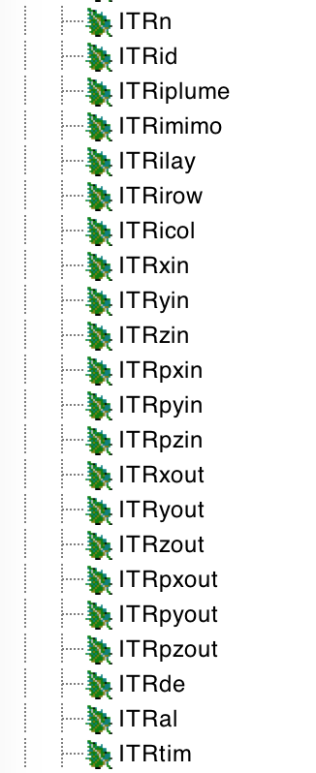
Root Technicalities: variable names
ITR (Plume)

Slide 22
Take Home Message
A lot of different configurations to prepare and test.
Which are the most urgent priorities? (in my mind the 1st is P resolution)
We need manpower, mostly to analyze simulated data for the moment, and enlarge the team, working in a coordinated way...
Now!

Slide 23
Thank you

