Slide 1


Highlights from the Pierre Auger Observatory
Charles Timmermans, on behalf of the collaboration

Slide 2
Content
The Observatory
The Cosmic Ray Spectrum
The Composition of Cosmic Rays
Photons
Topics covered in detail at this conference
The upgrade of Auger: AugerPrime

Slide 3
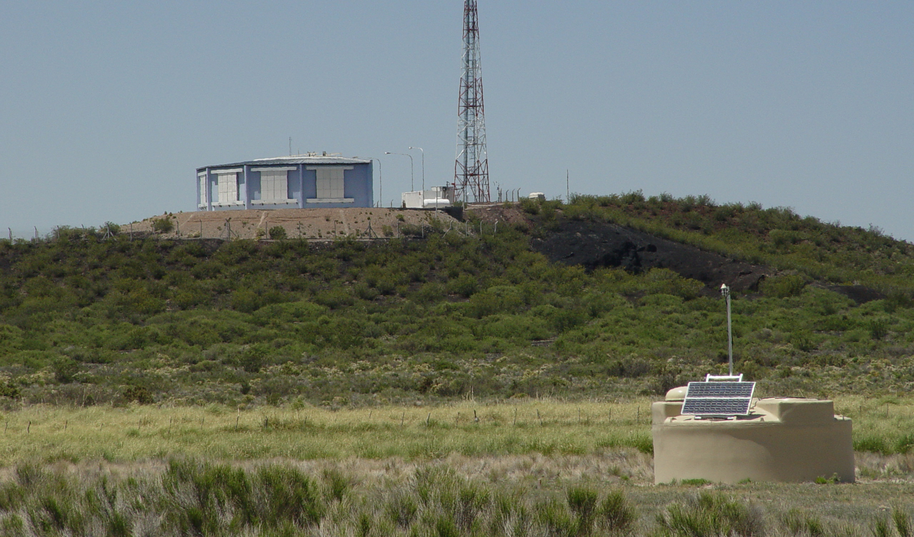

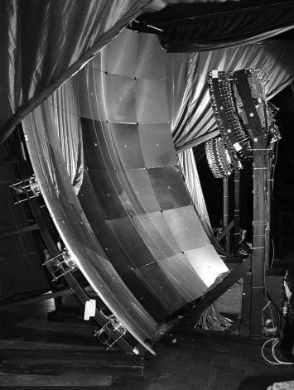
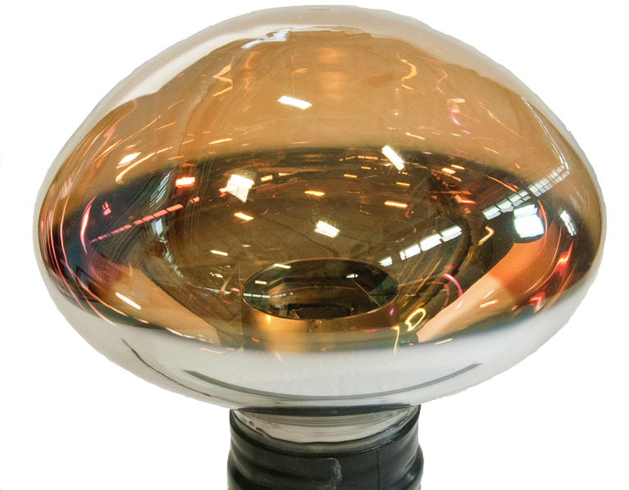
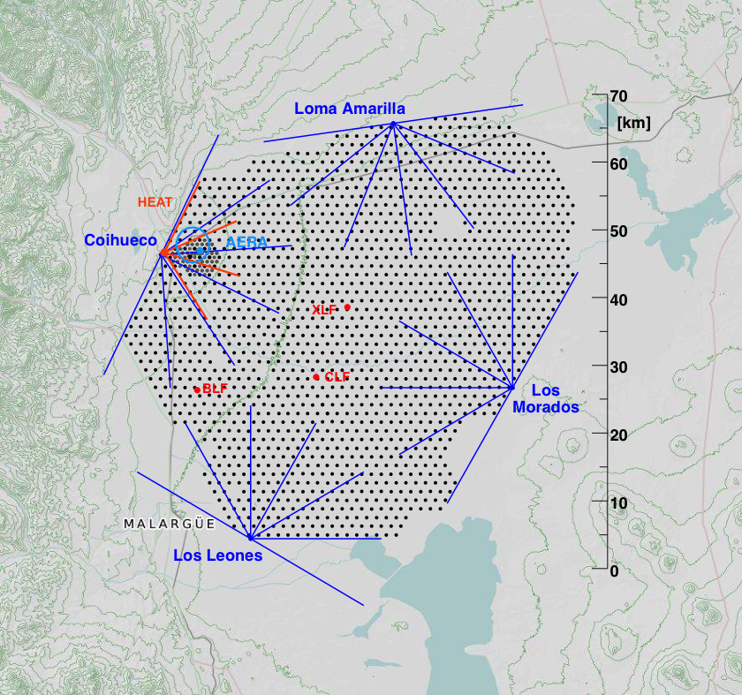
The Observatory
Auger 3000 km²

Slide 4
The Fluorescence measurement
v. de Souza, Vulcano 2018

Slide 5
Monitoring the Fluorescence Detector
See talk by Alberto Segreto
Friday 13:10

Slide 6
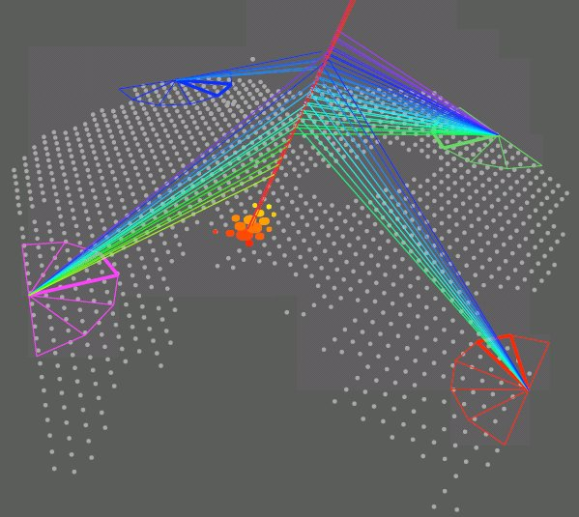
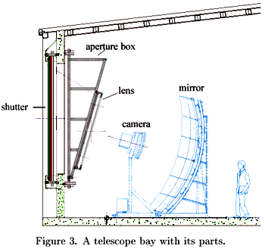
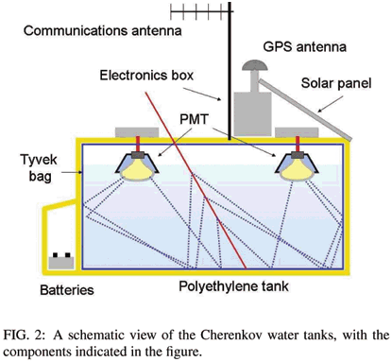
Hybrid detection with baseline Auger
State-of-the-art: FD
X_{max} using fluorescence light
σ (X_{max}) = 20 g/cm²
Only in dark nights
~10% duty cycle
SD measures only 24/7
tail of shower 100% Duty Cycle
X_{max}
fluorescence
mirror
camera
# particles

Slide 7
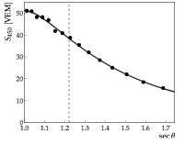
SD Energy Calibration
particle density at 1000 m
Infill: particle density at 400 m
Horizontal showers: Compare to expected muon profile at 10 EeV
M. Unger, SuGAR 2018

Slide 8
Exposure
M. Unger, ICRC 2017

Slide 9
The Cosmic Ray Spectrum
F. Fenu, ICRC 2017

Slide 10
Composition: The elongation rate
J. Bellido, ICRC 2017

Slide 11
Comparison to Telescope Array
See talk by Olivier Deligny
Today 11:35

Slide 12
Composition/Interactions: SD risetime
arXiv:1710.07249

Slide 13
Composition/Interactions: SD risetime
Problem: Muon content not well described in simulations
arXiv:1710.07249

Slide 14
Composition
Interactions:
SD observables
arXiv:1407.5919
arXiv:1604.00978
arXiv:1710.07249

Slide 15
Composition/Interactions: SD observables
Muon/Energy scaling required to get model in agreement with data
(Number of muons vs energy)
arXiv:1408.1421

Slide 16
Photon Searches
arXiv:1612.01517
Deep showers, small footprint, few stations

Slide 17
Photon Searches
Using a multivariate analysis (BDT) photon candidates are selected
arXiv:1612.01517

Slide 18
Photon Limits
Exotic models are excluded
First bite into proton-only GZK models
arXiv:1612.01517

Slide 19
Neutrinos
See talk by Michael Schimp
Thursday 17:50
M. Unger, ICRC 2017

Slide 20
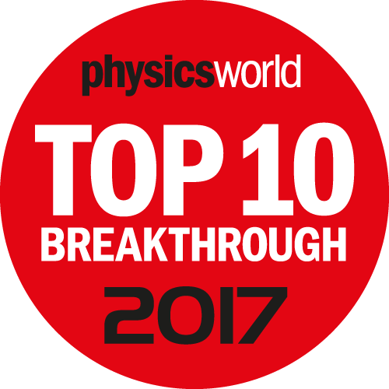
Origin of Cosmic Rays
See talk by Quentin Luce
Today 13:05
Science 357, 2017

Slide 21
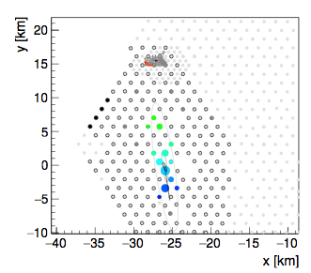
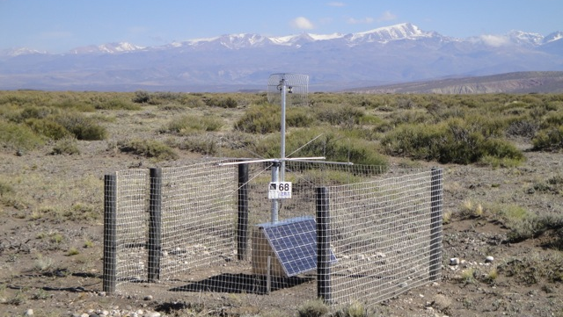
Radio Detection
See talk by Jörg Hörandel
Today 12:35
arXiv:1806.05386

Slide 22
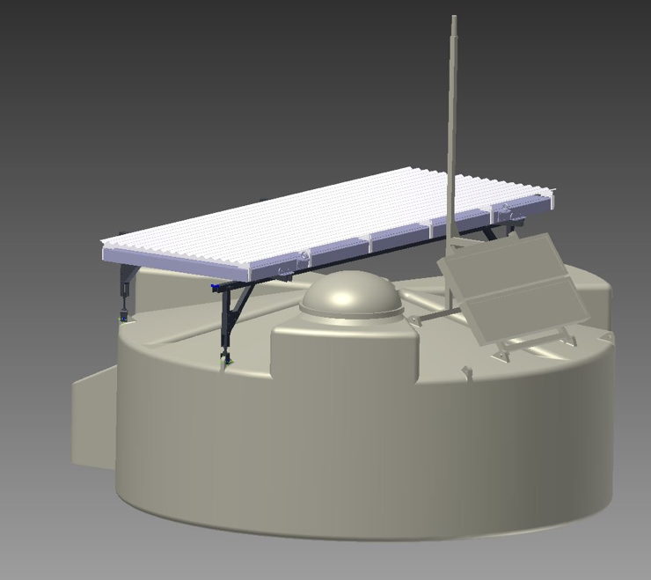
The Upgrade: AugerPrime
3.8 m2 scintillator on each tank
Upgrade of station electronics
Additional small PMT in WCD to increase dynamic range
Buried counters in 750-m array (AMIGA)
Increased FD uptime

Slide 23
Composition with AugerPrime
AugerPrime
AugerPrime
N
p
N
p
He
Fe
Fe
He
arXiv:1604.03637

Slide 24
Composition with AugerPrime: Expected performance
arXiv:1604.03637

Slide 25
AugerPrime
arXiv:1604.03637

Slide 26
Testing the performance of AugerPrime
M. Unger, ICRC 2017

Slide 27
Testing the performance of AugerPrime
M. Unger, ICRC 2017

Slide 28
Final Remarks
By the end of the year, more than 500 SSDs shipped
All modules produced by 2019
Data taking until 2025
In the meantime: Wonderful physics with data taken at the Auger Observatory

