Slide 1

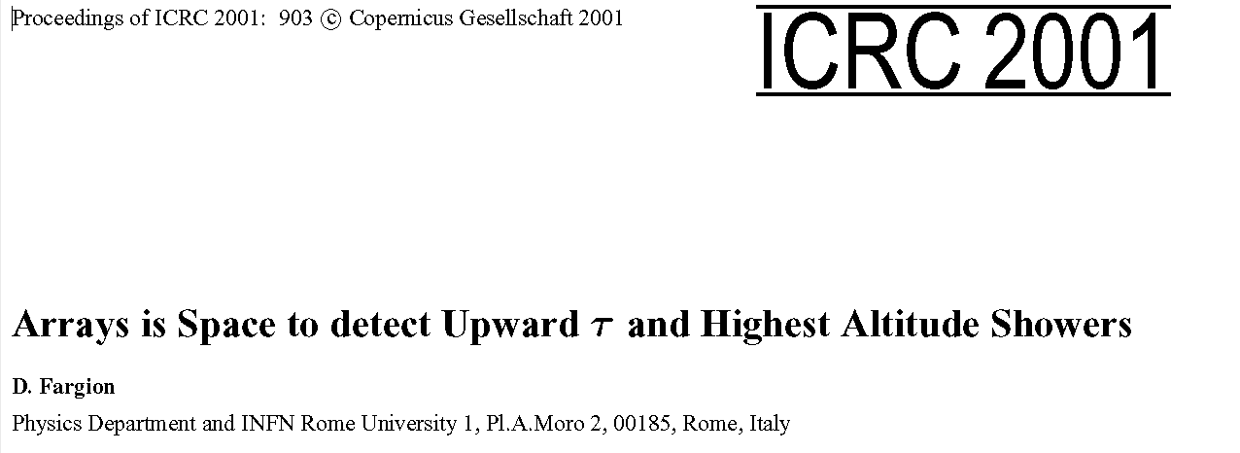
Tau Airshower
Astronomy in space
Presented by Prof. Daniele FARGION
CRIS 2018, 21 Jun 2018 : 12:20 →12:40

Slide 2
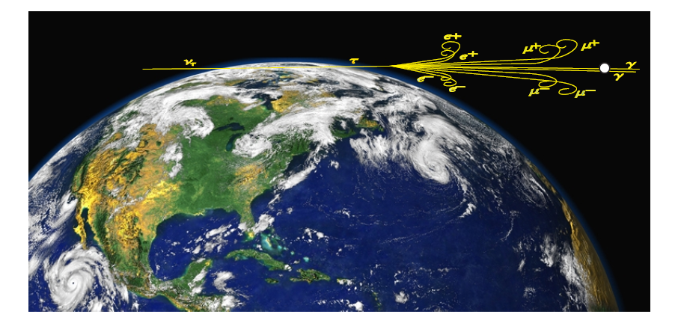
Tau Airshower into space

Slide 3

Neutrino Astronomy:
To be or not to be?
The atmospheric pollution by muon and electron neutrinos makes much noises in ICECUBE

Slide 4
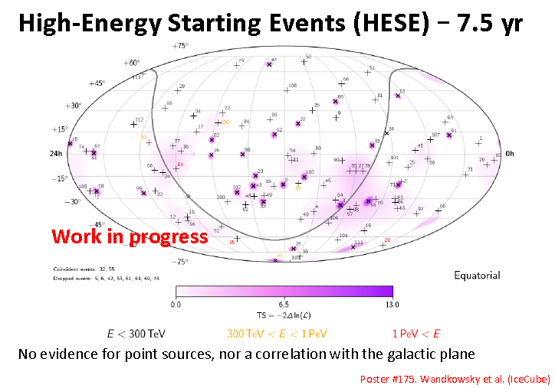
An absence of self clustering?
An absence of gamma – neutrino connection?

Slide 5
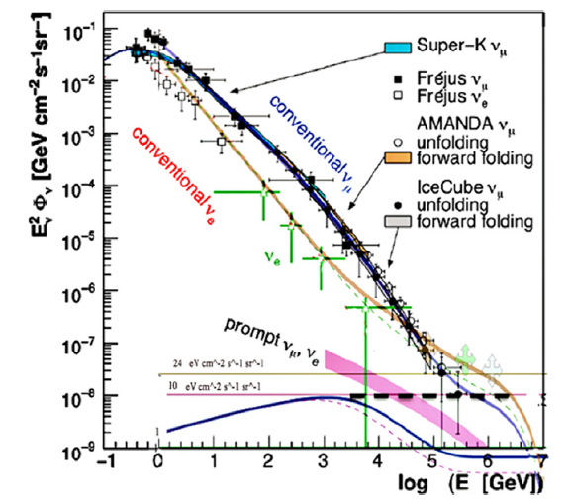
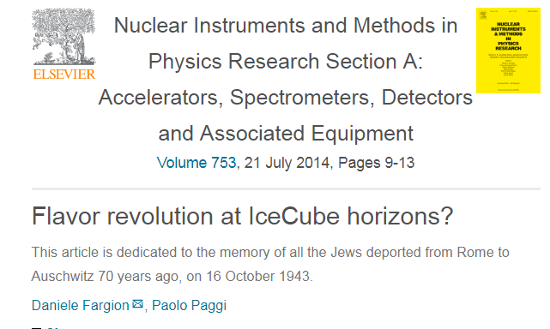
2013 : The ICECUBE revolution

Slide 6
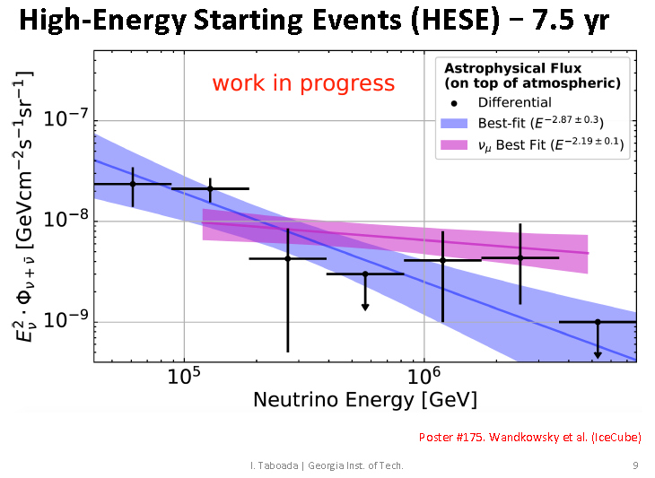
A Change of spectra index?
Also a PeVs cutoff?

Slide 7
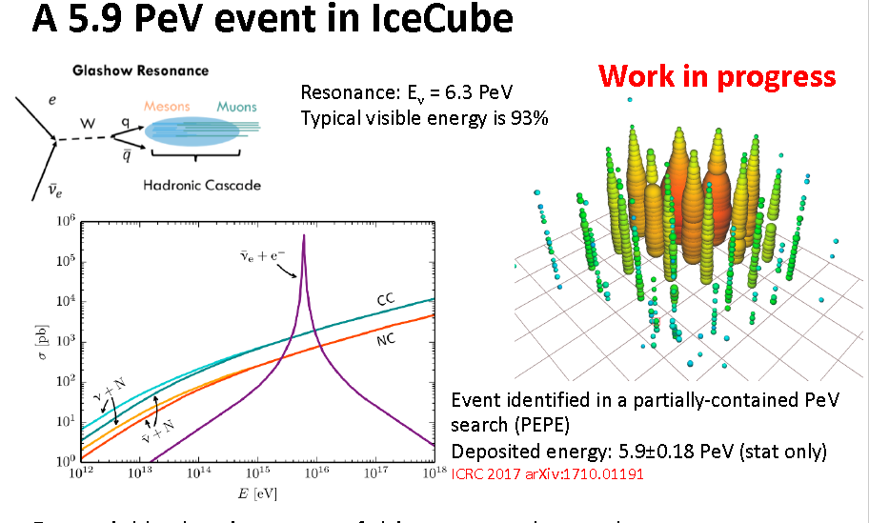
A final Glashow resonance ?

Slide 8
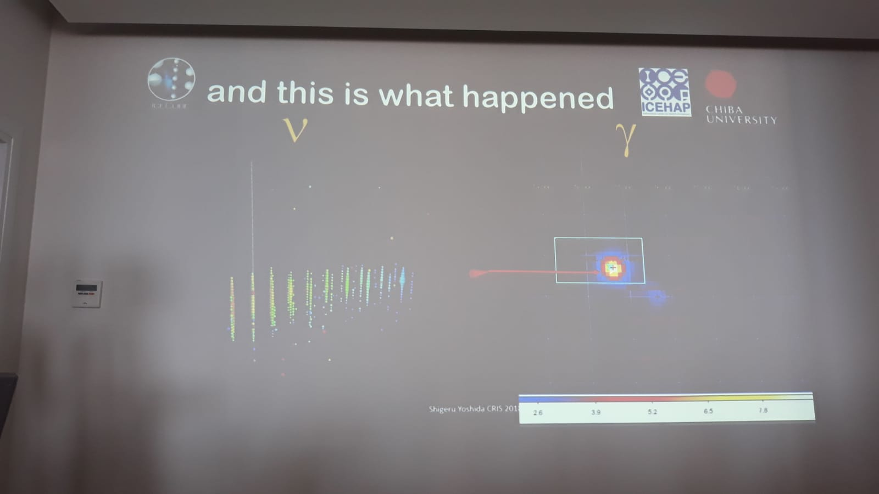
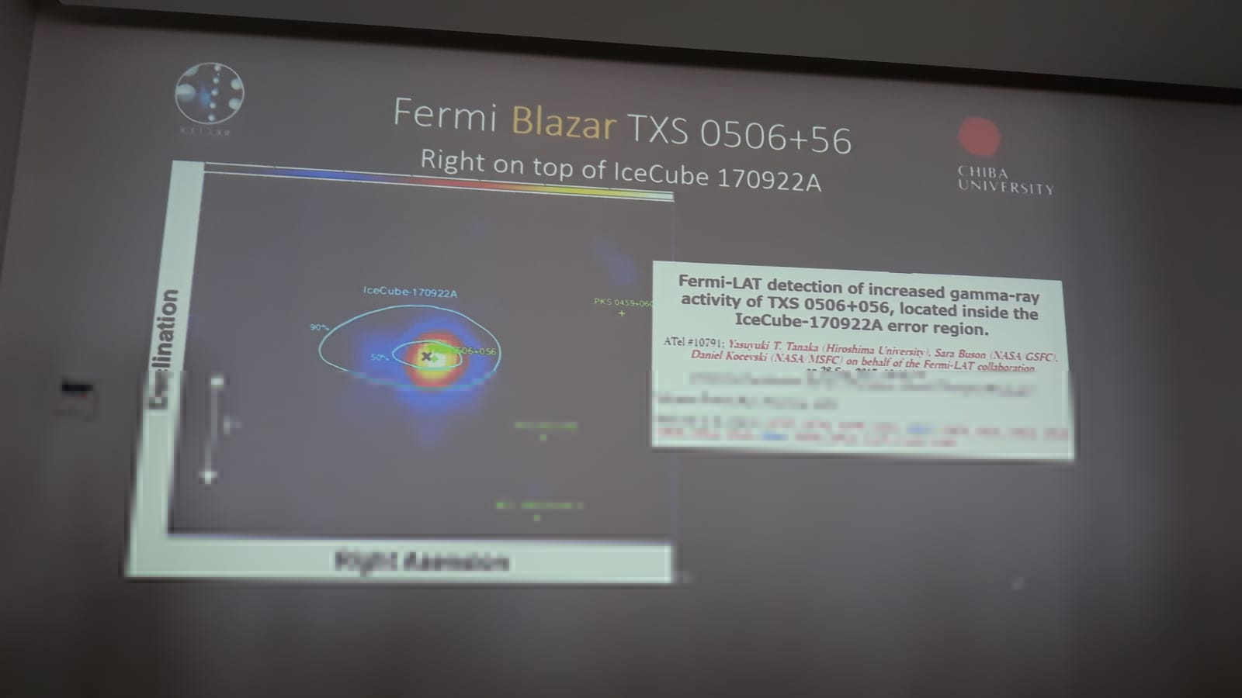
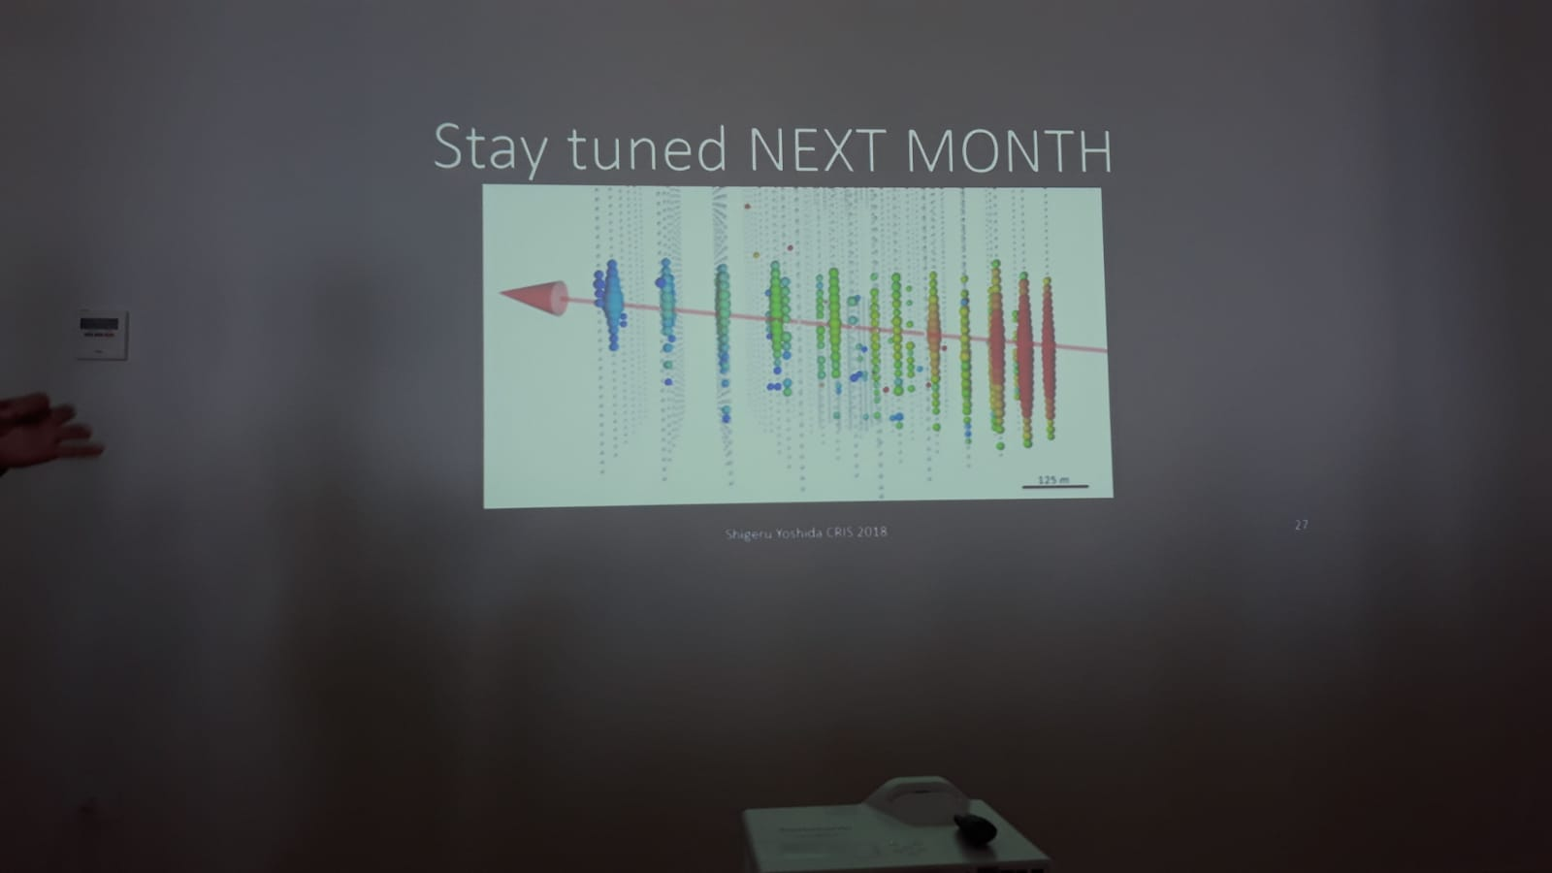
Maybe a final UHE neutrino and gamma correlated event on 23 sept 2017?

Slide 9
Tau : A pure certified
Neutrino Astronomy
Highest energy neutrino in ICECUBE (hundred TeV or PeVs) suggested since five years the birth of a Neutrino Astronomy.
However the possible pollution by atmospheric neutrino signals, in particular prompt charmed ones, might offuscate the ability to discover the main astrophysical UHE neutrino sources.
Indeed up to now no AGN or GRB or galactic sharp signal have been detected.

Slide 10
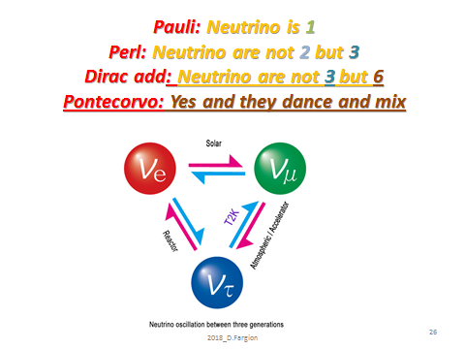

Slide 11
Muon neutrino at high energy
(TeVs) cannot oscillate to tau along Earth : But they must in astrophysics
Terrestrial Prompt Tau neutrinos almost absent
Therefore tau astronomy is noisefree

Slide 12
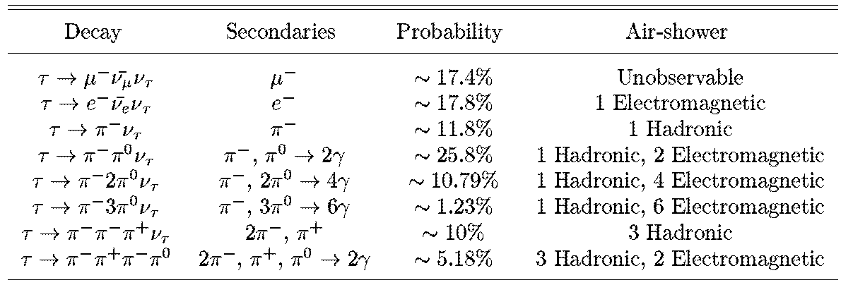
Tau airshower : a particle physics test

Slide 13
Why Tau Airshower is so foundamental?
PeVs-EeV neutrino are related to UHECR
Muons are polluted by atmospheric CR
Electron too are a little polluted by CR
Tau are only prompt and cannot (much) be in Earth atmosphere mixing or prompt noises
Tau neutrino guaranted by Cosmic mixing
Tau Airshower does not produce just 1 tracks
But tau airshower produce (PeV-> Million) (EeV -> Billions) secondaries in huge area (km square size) Huge natural amplifier at UHE energies. One signal is like km size area

Slide 14
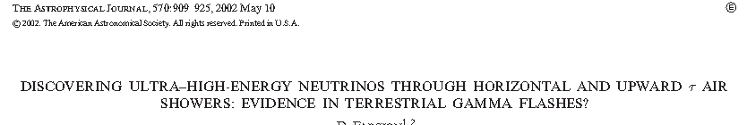
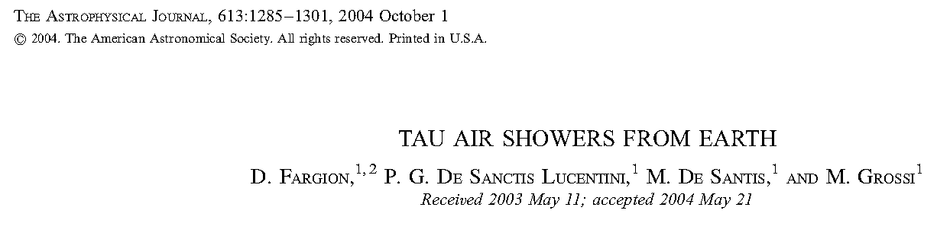
Tau from Earth, 15 years ago
1997: The Tau Role; Horizontal: 1999.
2000: Discovering Tau Airshower

Slide 15
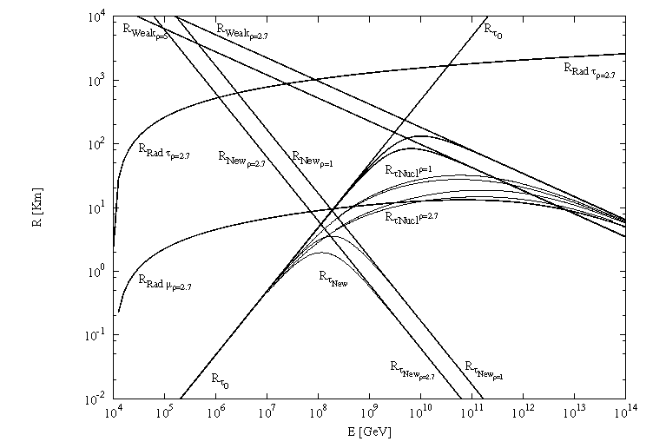
The UHE Tau Role winning muon track

Slide 16
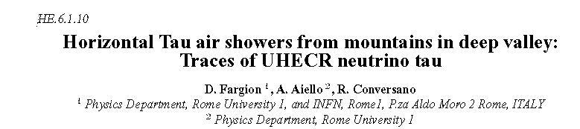
Tau became actual as soon as Kamiokande claimed a neutrino anomaly
(muon oscillated to tau)
ICRC 1999

Slide 17
Tau Airshower from the top of Mountains: ASHRA and MAGIC and maybe CTA from the Top Mountain
ETNA Muon Telescope array: PERFECT tau detector comparable at > 10 PeV as ICECUBE mass sr mass: THEY ARE HERE AND ARE ALIVE

Slide 18
Muon Telescope in ETNA
ALSO FOR TAUs airshower arXiv:1805.11612v1
The MEV project: design and testing of a new high-resolution telescope for Muography of Etna Volcano D. Lo Presti1,2, G. Gallo1,3,*, D.L. Bonanno 2 , G. Bonanno 4 , D.G. Bongiovanni 3 , D. Carbone 5 , C. Ferlito 6 , J. Imm`e 1 , P. La Rocca1,2 , F. Longhitano 2 , A. Messina 5 , S. Reito 2 , F. Riggi1,2, G. Russo1,2 , L. Zuccarello7,5
Each PS plane, therefore, is a matrix of N × N pixels, with N = 99. Let fi,j and bk,l be the pixels of front and back matrix, respectively, with i, j, k and l ranging from 1 to 99.

Slide 19
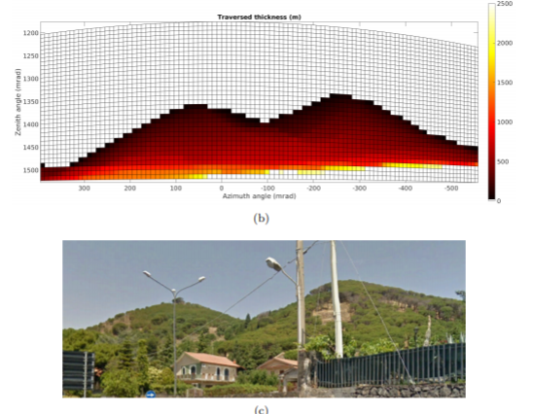
ALREADY tested: one year on 3000 meter on ETNA-→ COMPARABLE or even better than ICECUBE above 20 PEV energy

Slide 20
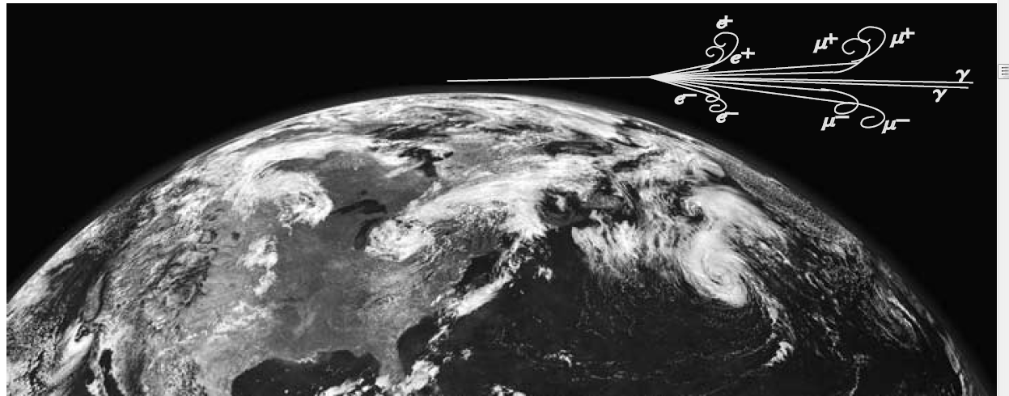
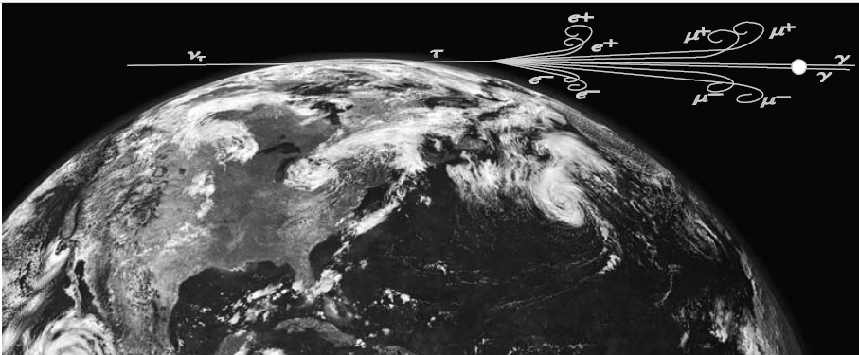
UHECR and Tau Airshower at horizons

Slide 21
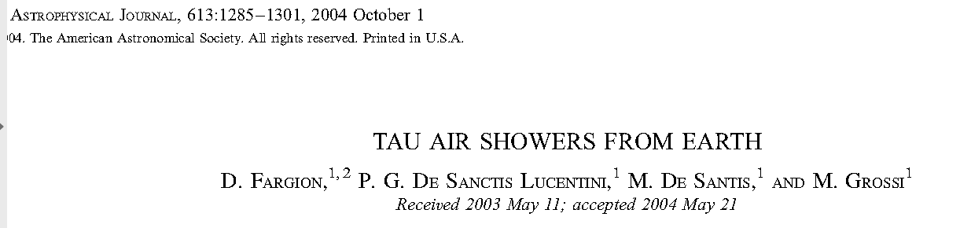
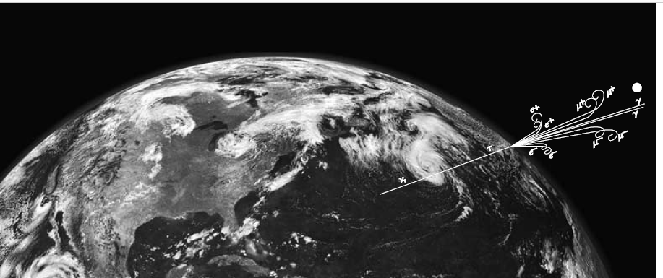
Tau escaping from Earth
Because Earth opacity, mostly PeV upward. EeV only horizontal

Slide 22
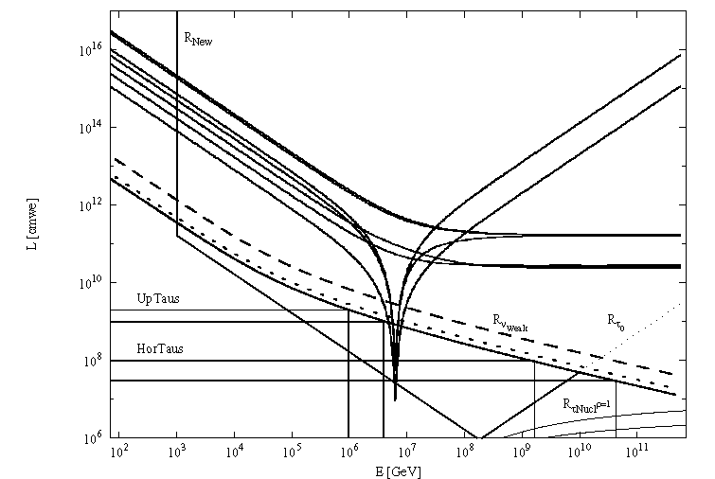
Uptaus and Hortaus

Slide 23
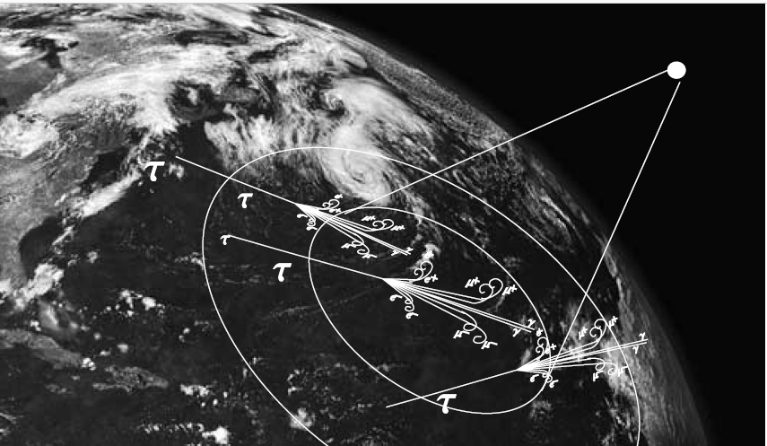
Euso Horizontal and Upward tau rare, mostly at Earth horizons

Slide 24
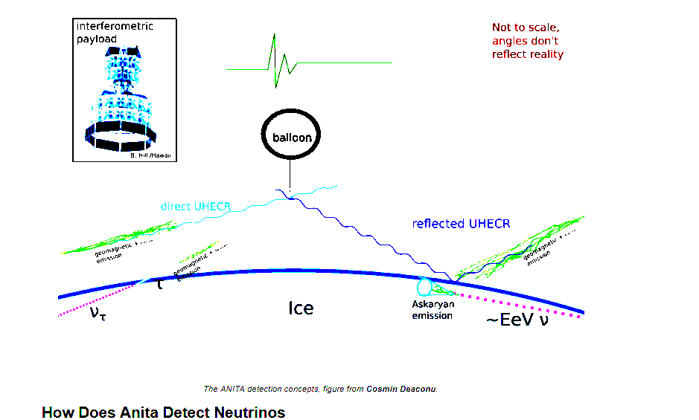
Anita and the 35 degrees upward radio event

Slide 25
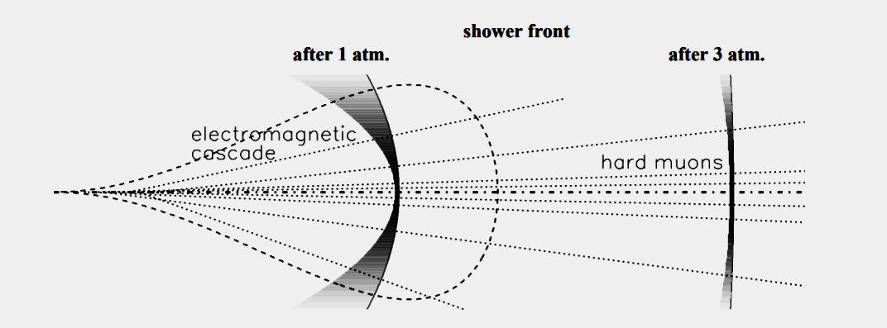
Auger detecting Tau by GD: young showers: Better Cherenkov from the space

Slide 26
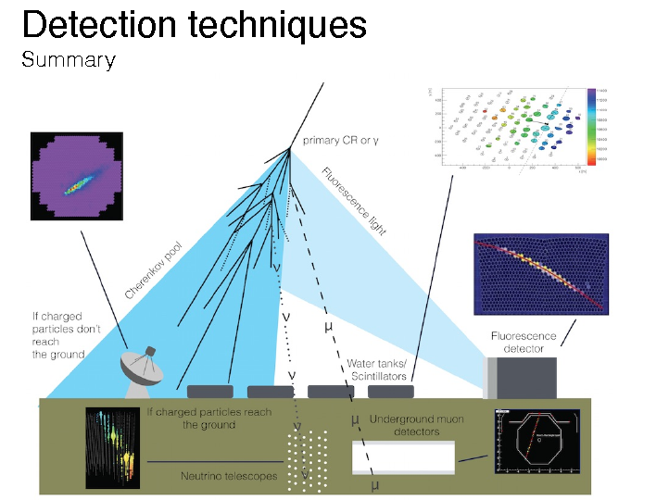
Fluorescence and Cherenkov lights

Slide 27
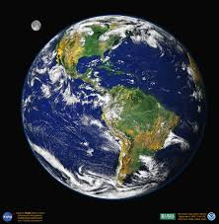
How to estimate the Upward Tau?

Slide 28
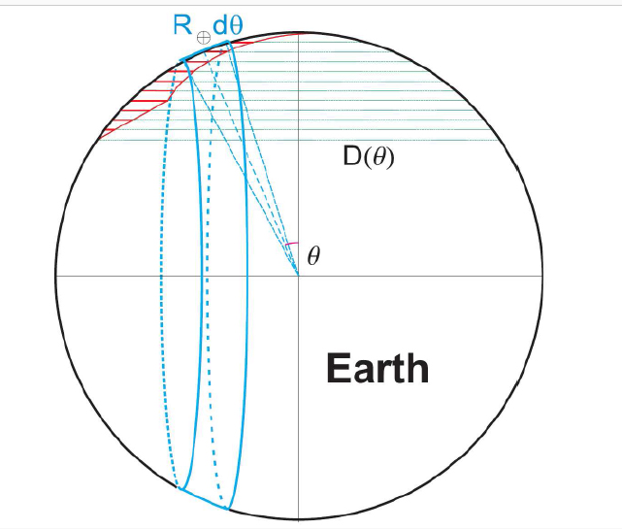
The Earth skin for skimming tau

Slide 29
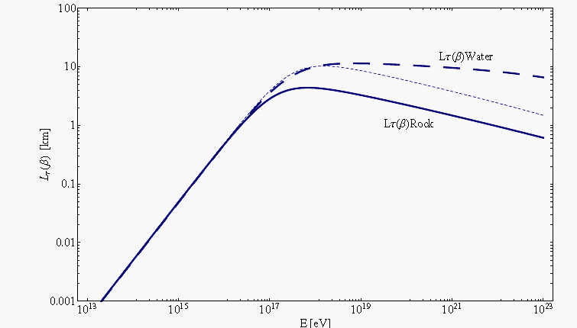
Tau Lenght propagation inside rock and water

Slide 30
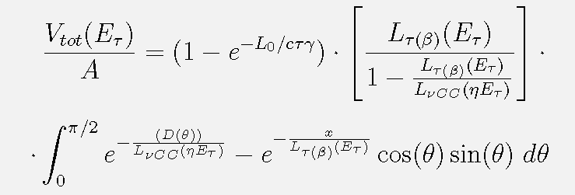
Effective volume for tau air-showering on Earth, with a finite atmosphere size

Slide 31
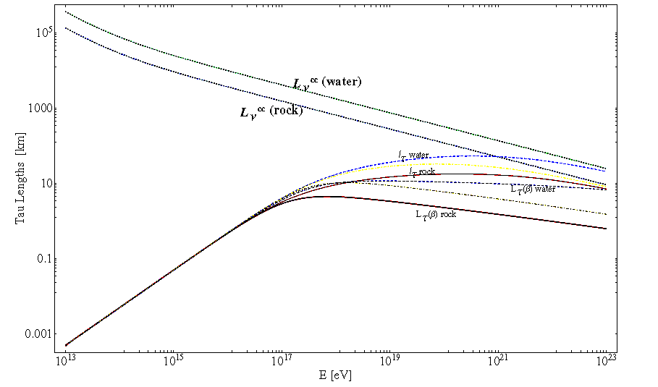

Penetrating Lenght L in water and rock

Slide 32
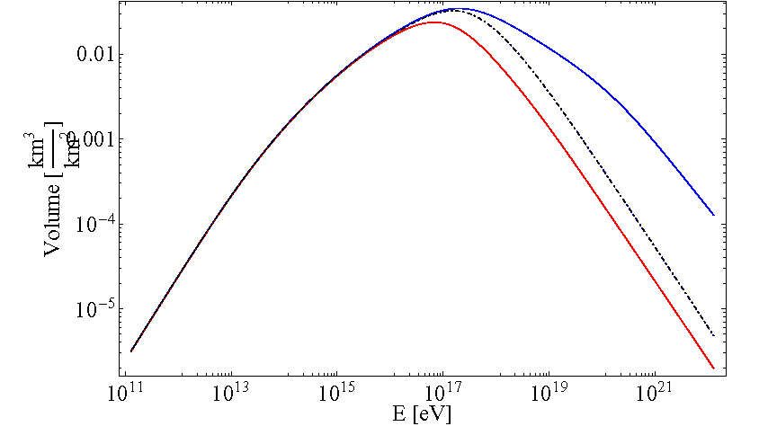
How much volume equivalent for each square km? Water win!

Slide 33
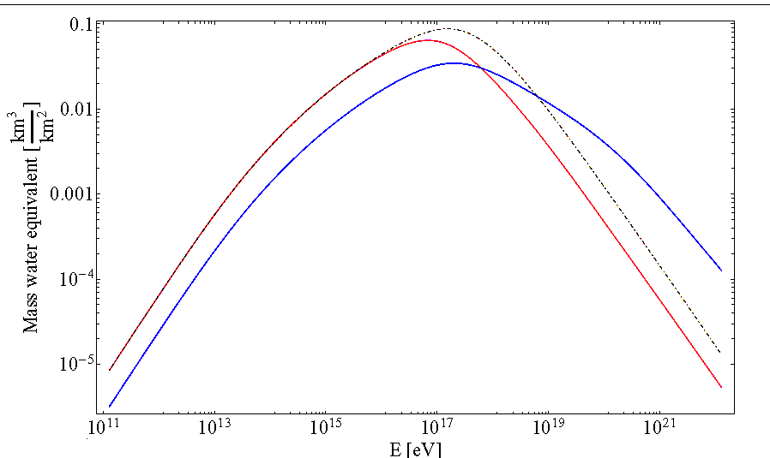
Mass equivalent for square km
Rock win and loose

Slide 34
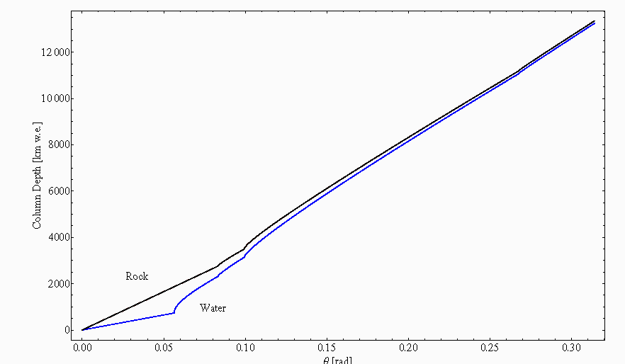
Internal and external Earth depth

Slide 35
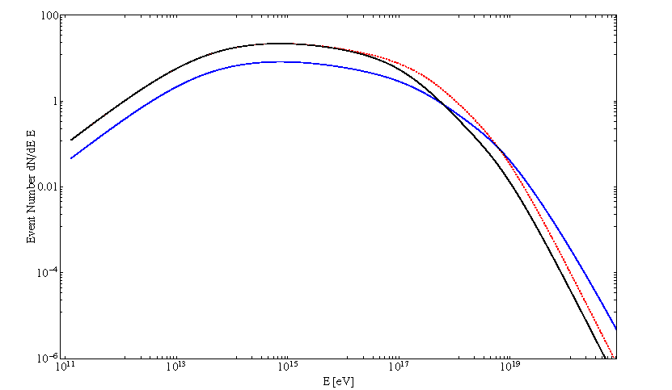
Number of upgoing Tau in Auger every 3 years for WB limit

Slide 36
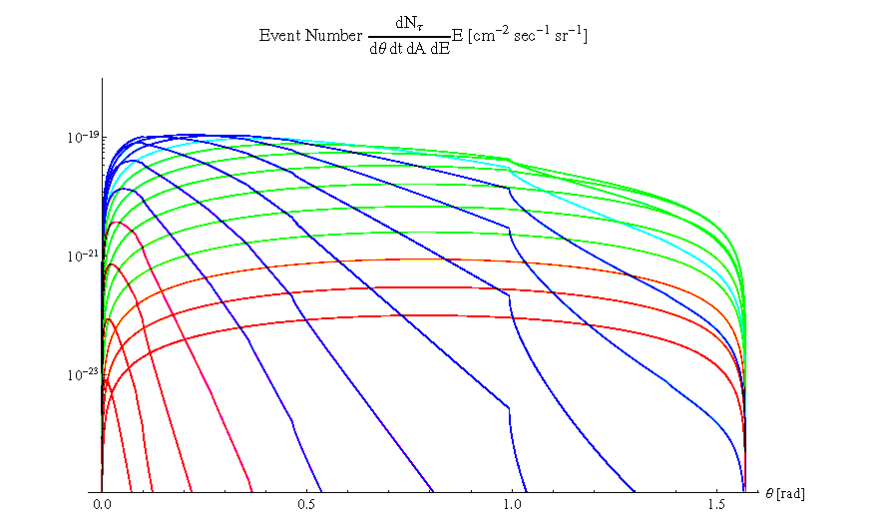
Differential event rate for energy and skimming angle 10 GeV eV up to 0.1 ZeV energy: tau rate for WB flux

Slide 37
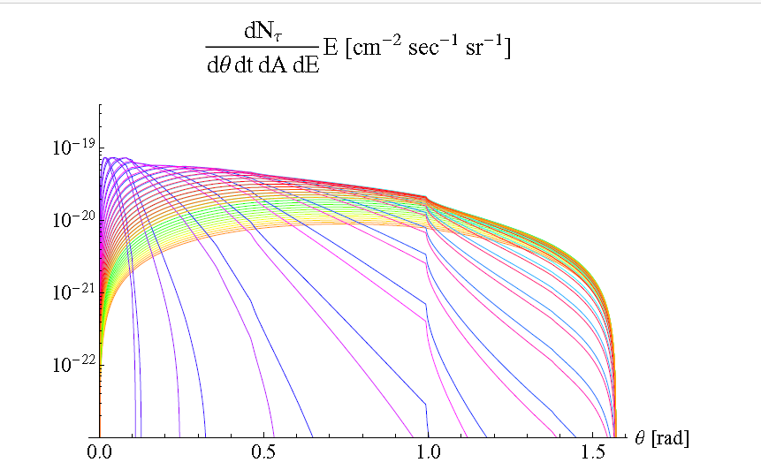
Resonant Glashow contribute

Slide 38
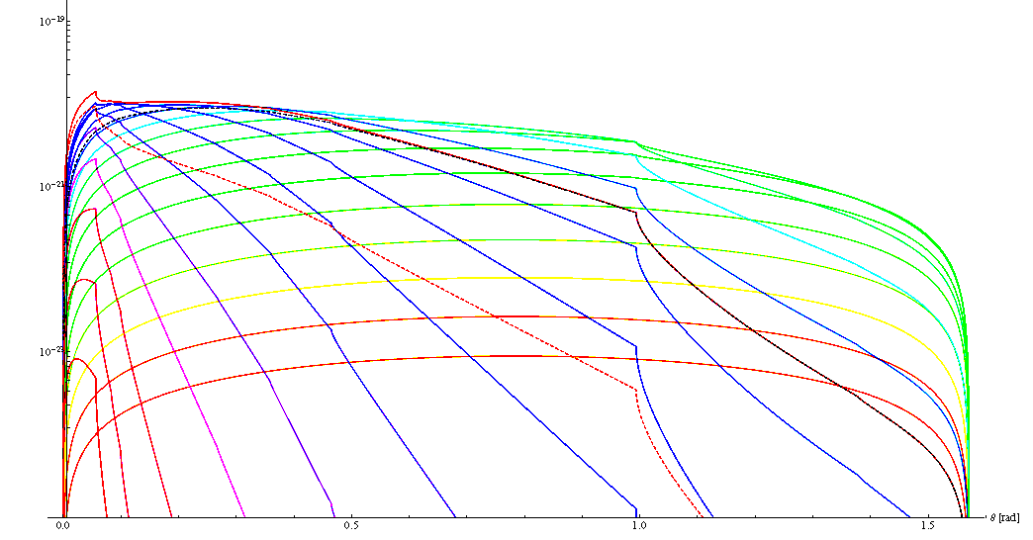
Both contribute united

Slide 39
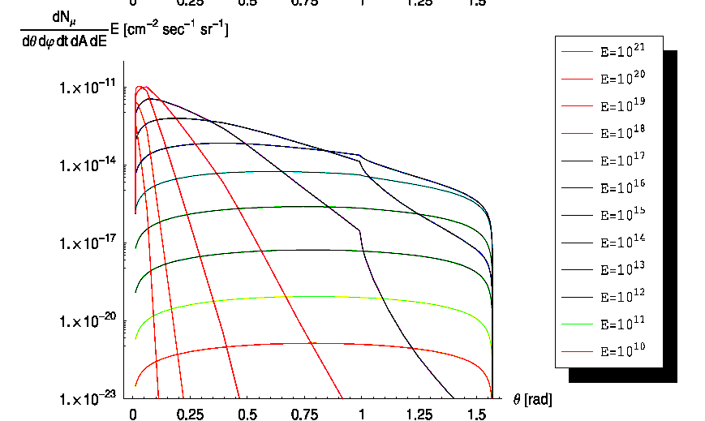
The muon rate by tau airshower ones

Slide 40
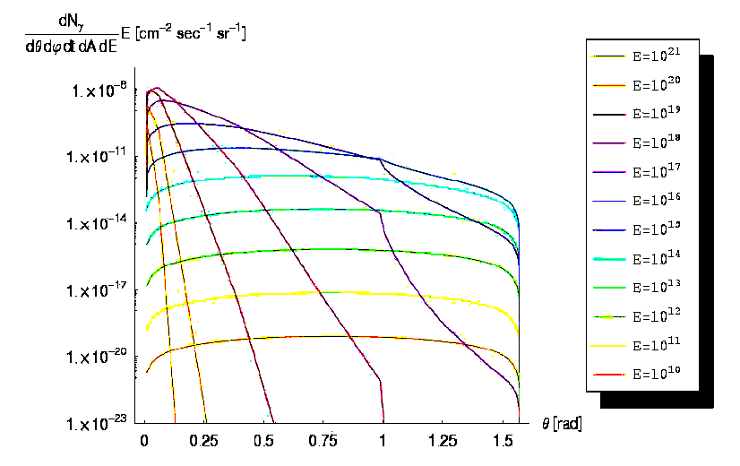
Gamma and electron pairs by tau airshower

Slide 41
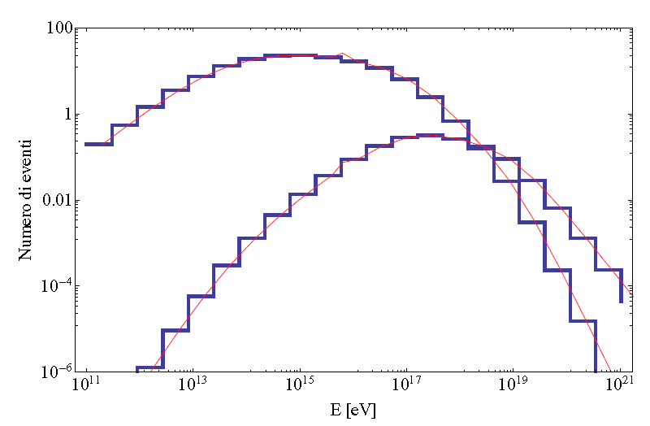
SD versus Fluorescence D event rate
FLUORESCENCE win above EeV in AuGER

Slide 42
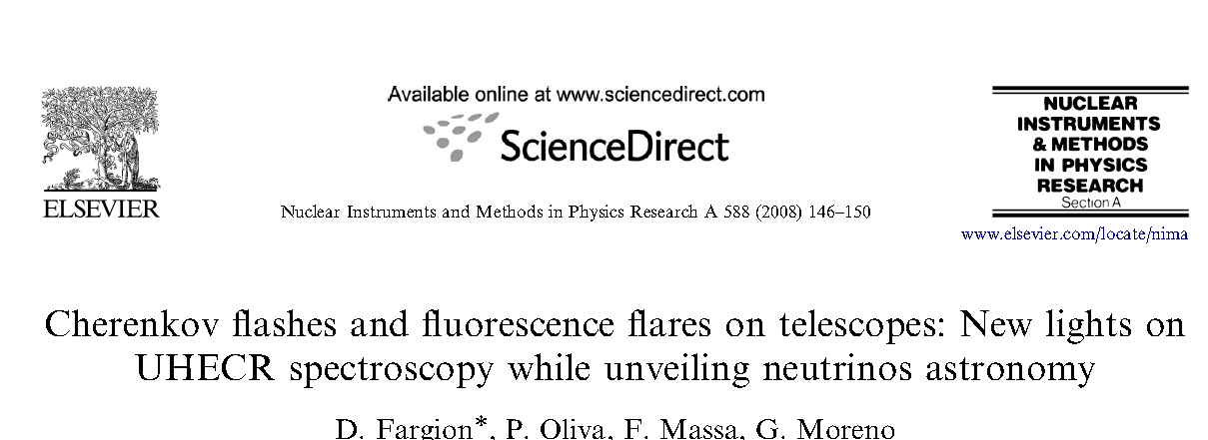
Cherenkov for Fluorescence taus

Slide 43
High ALTITUDE Horizontal Airshower
→ SPLITTED AIRSHOWERS
Geomagnetic field do split the airshower
In 3 or 5 independent jet like:
Electron pairs bent east west or up down making spiral corns or tails
Gamma in the center ..becoming again later a twin electron jet
Muon tracks make much much far away a weaker twin electron tails spiral jet

Slide 44
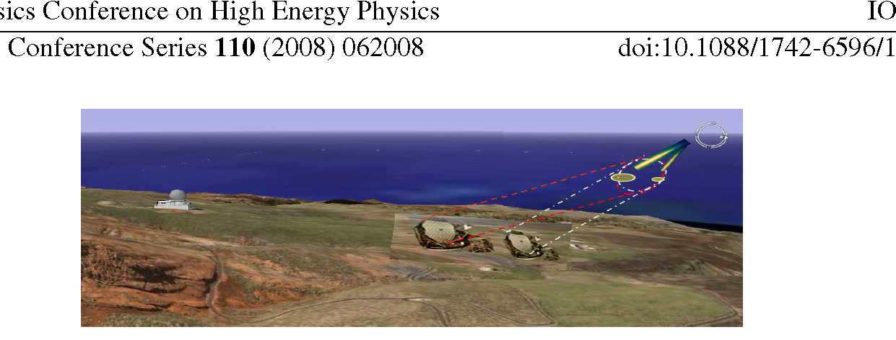
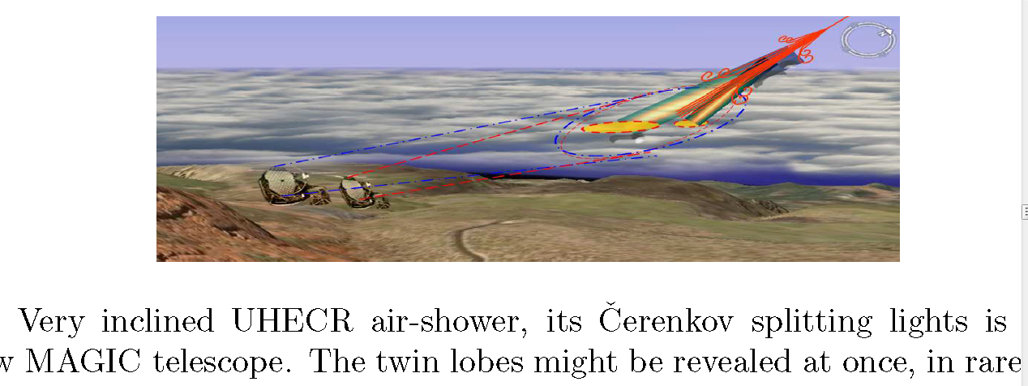
Magic proposal

Slide 45
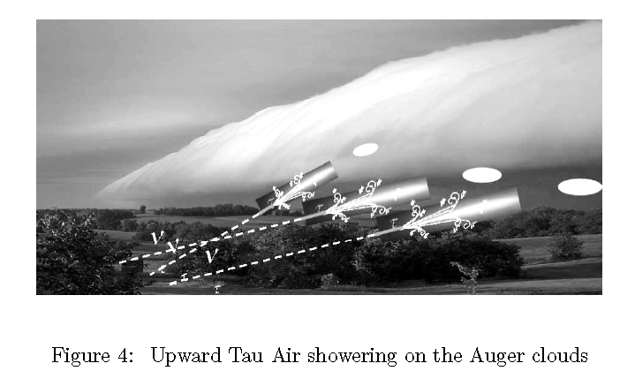
Taus on the clauds: A winning tool

Slide 46
Horizontal Tau airshower are in high altitudes
UHECR at high altitude at POEMMA
The high horizontal airshower are at 50-70 km altitudes, similar to TGF and sprites
The low atmosphere it is diluted and the airshower are bent by geo magnetic fields
They are split by terrestrial magnetic field
Larmor Radius =
122 km at GeV for
a Geomagnetic field
The UHECR and EeVs Tau airshower are hundred km long and splitted in corns making spiral tracks

Slide 47
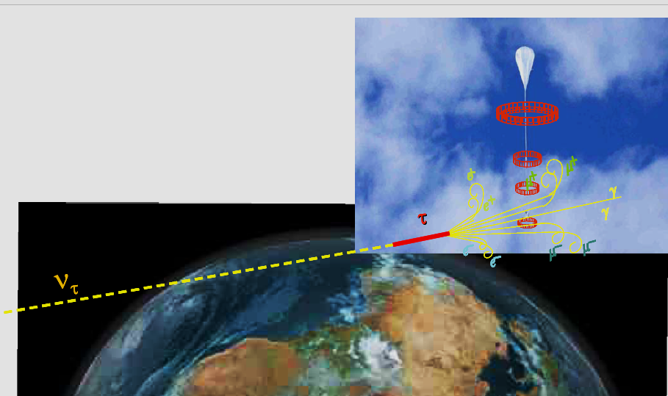
Upward Tau Airshower at array crown detectors: Crown vertical array

Slide 48
The Giant Radio Array for Neutrino Detection in China:
DIRECTIONAL BECAUSE GEOMAGNETIC FIELD it is directional too.
. The Giant Radio Array for Neutrino Detection (GRAND) is a planned array of ∼ 2·105 radio antennas deployed over ∼ 200 000 km2 in a mountainous site. It aims primarly at detecting high-energy neutrinos via the observation of extensive air showers induced by the decay in the atmosphere of taus. The instrument will also detect UHECRs

Slide 49
The apparent splitted fan airshower, observed on blaze front never on fluorescence side
The Cherenkov flashes
The vertical up-down bent pair component (for equatorial B)
The horizontal bending at magnetic poles
The consequent view: Sprites?
Elves? Terrestrial gamma flash:
What are the PeVs upward Taus: The Blue Jet?
Are UHECR and Tau the trigger in a giant Wilson room (the atmosphere) for TGF?

Slide 50
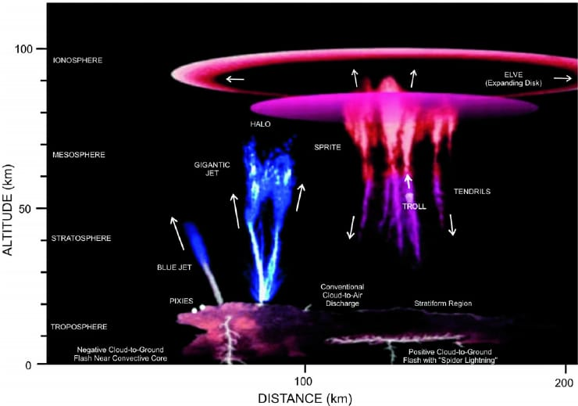

Slide 51
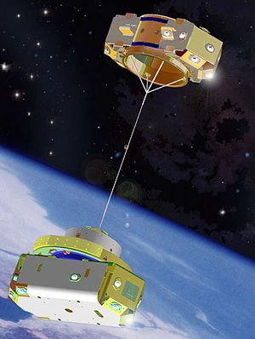
A better vertical (zenith) POEMMA geometry

Slide 52
Conclusions
The tau neutrino Astronomy it is beyond the edge
Anita might be observing one such a tau signal
Array detector as GRAND and ASHRA and POEMMA: may discover the tau signal among the High Altitude Hadron Airshower :
ETNA MUON S SEE ALSO TAU !!
From above looking below.
Splitted jet corns are the imprint. POEMMA;
They need a twin vertical (zenith) not horizontal twin satellite to disentangle UHECR from tau ones,

Slide 53
Oscar Wilde
We are all in the gutter
But some of us are watching the stars

Slide 54
The Earth is the sky of the sky or better to say the sky of the UHE tau
Thank you for the attention

Slide 56
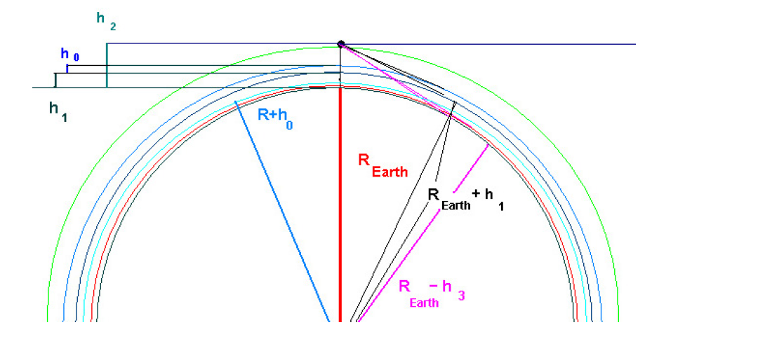
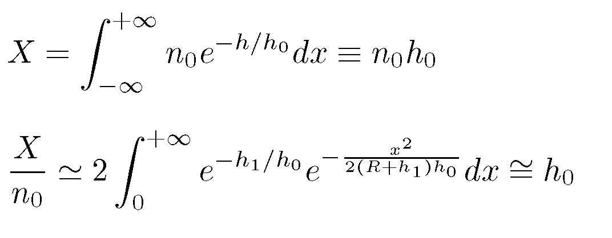
Horizons distance
2400 km; zenith angle: 22 degrees

Slide 57


Slide 58

Earth Opacity

Slide 59

Taus on clauds

Slide 60

Inner Earth by shadows in spectra

Slide 61
ICECUBE neutrino Astronomy?
Cosmic ray shine 4-5 order of magnitude above gamma sky because charged charges fly zig zag much time in sky
Therefore secondaries of CR hitting atmosphere are also more abundant that X-gamma sky, making atmospheric neutrinos noise thousand times more abundabt that gamma astronomical signals.
highest energy neutrinos are suppressed anyway. Recent 2013 ICECUBE detection of a tens-hundred thousand TeV signals seem to hint a neutrino astronomy.

Slide 62

UHE Tau Track may win the muon one

Slide 63

Terrestrial Gamma Flash and AGASA

Slide 64

EUSO SPB2 for tau

Slide 65

Slant depth

Slide 66

Hadron airshower keep mass UHECR

Slide 67

UHECR astronomy?

Slide 68

Glashow resonance

Slide 69

No clustering and isotropic

Slide 70
How ICECUBE claimed a discover?
ICECUBE ASTRONOMY: Why?

Slide 71

Change’… the flavor..2013-2018 more shower over tracks

Slide 72

Tau signal absent? 2 candidates?

Slide 73

UHECR and tau Airshower at high altitudes
TeVs

Slide 74

Tau upgoing from the Earth

Slide 75

Cascade shower are sudden more abundant..
Muon neutrino tracks are anyway more sharp

Slide 76

ASHRA array attempts

Slide 77

The finite atmosphere size bound to detect 10 EeV tau neutrinos

Slide 78

Deep Valley or Mountain chain
Both for ASHRA and GIANT

