Slide 1

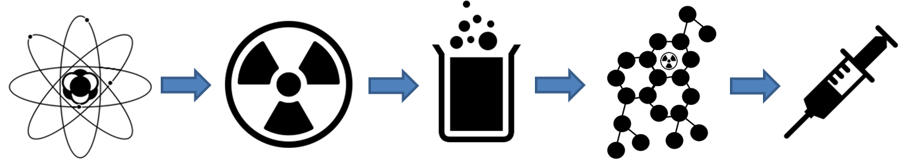
Stefano Corradetti
INFN – Laboratori di Legnaro

Slide 2
Status of the Project
Experimental activities
Stefano Corradetti
LNL January 2018

Slide 3
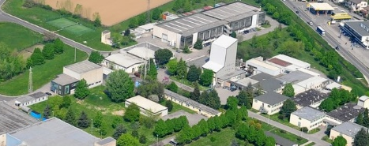
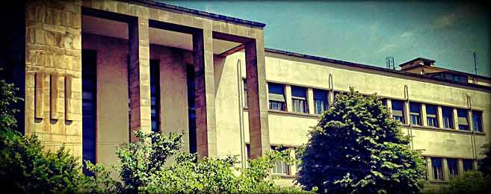
First experimental activities
Objective:
prove the possibility of producing a radionuclide for radiopharmaceutical applications with the ISOL technique in Legnaro
Choice of a suitable material for ion beams collection and production of the secondary targets;
Beam simulation with the SPES Front End;
Quantification of the ions on the secondary targets;
Purification processes development.
Stefano Corradetti
LNL January 2018

Slide 4
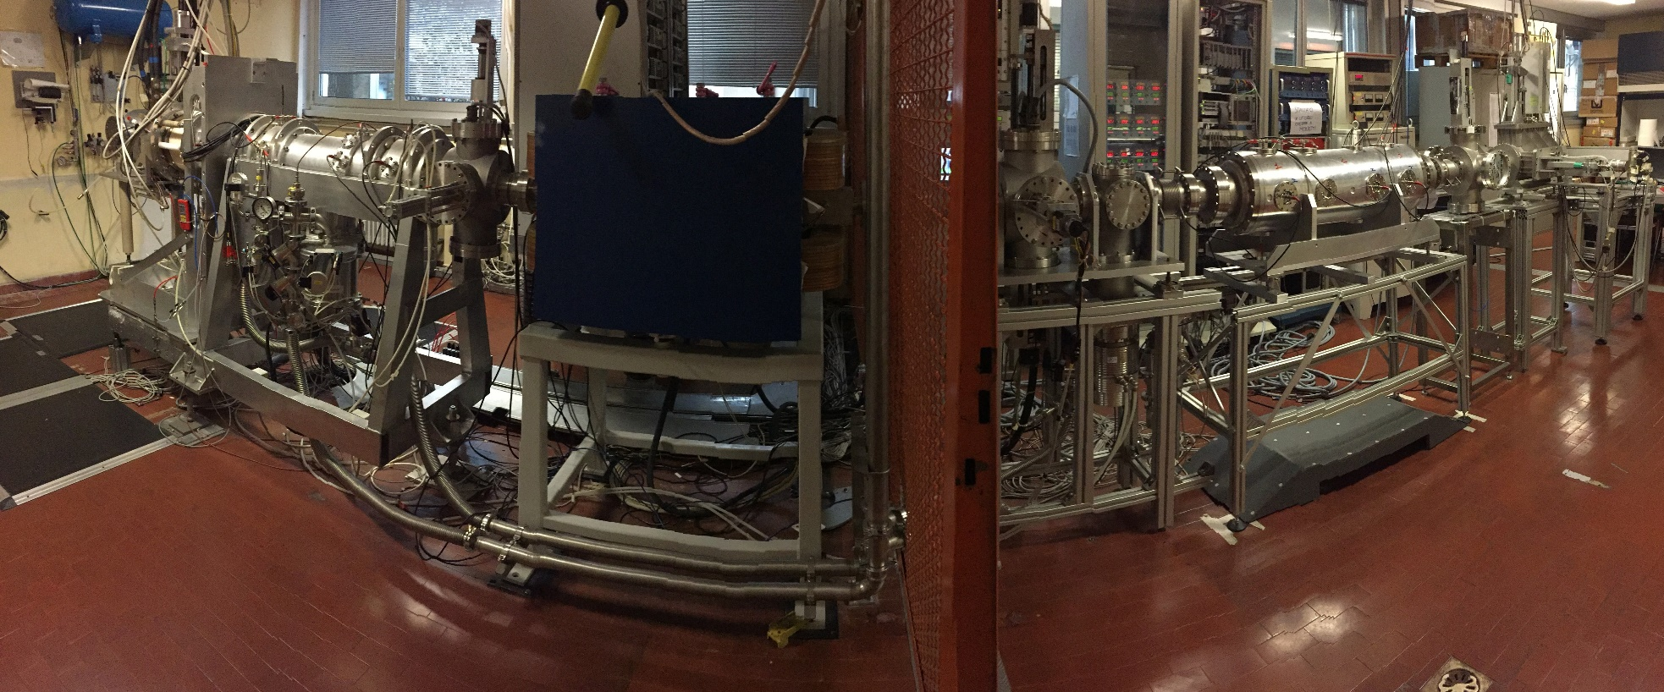
Test with the Front-End
accelerator at LNL
Stefano Corradetti
LNL January 2018

Slide 5
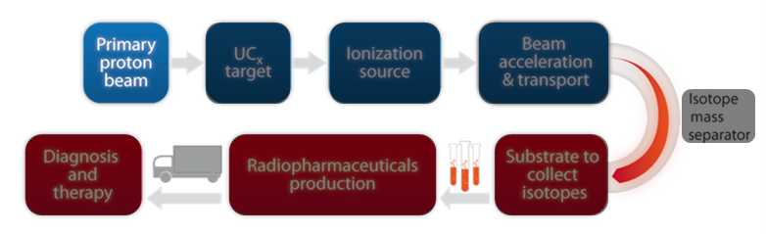
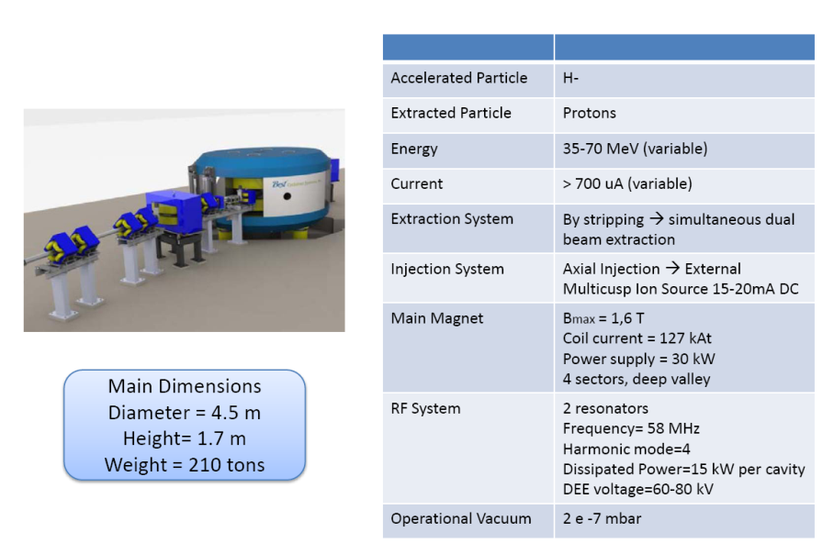
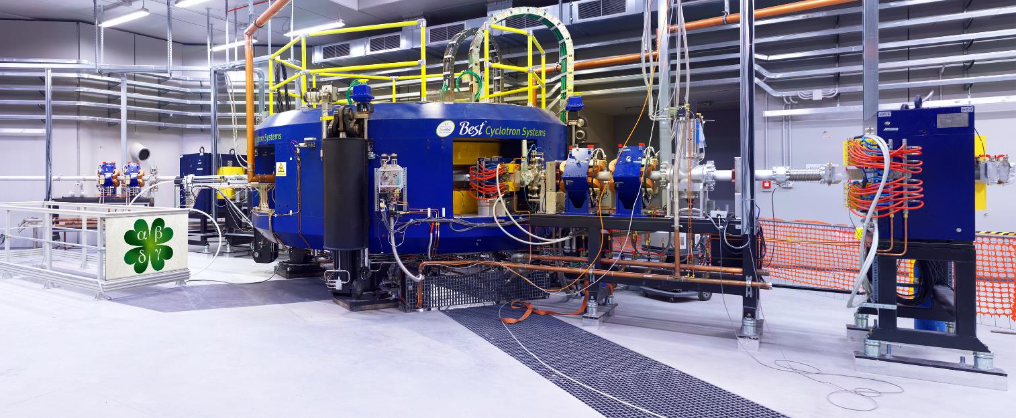
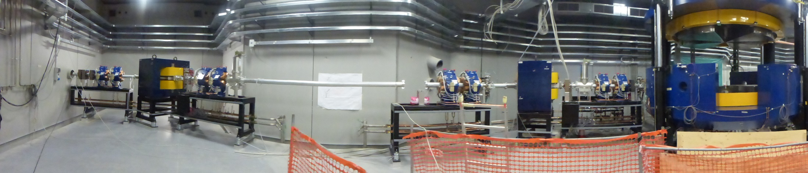
The proton driver
Commissioning concluded
Stefano Corradetti
LNL January 2018

Slide 6
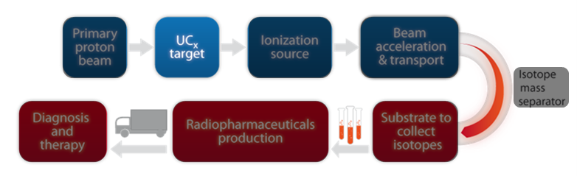
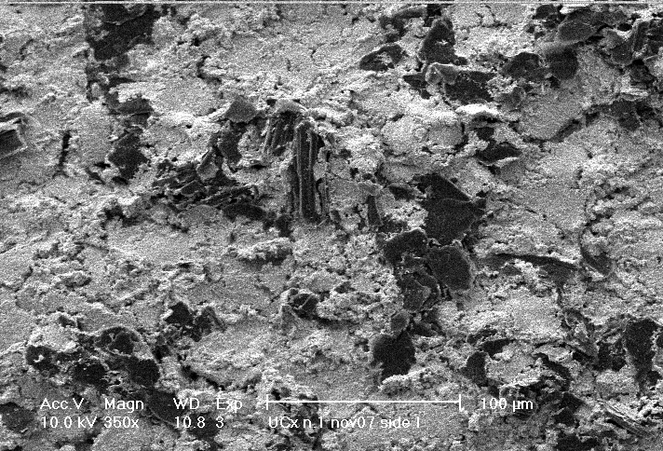
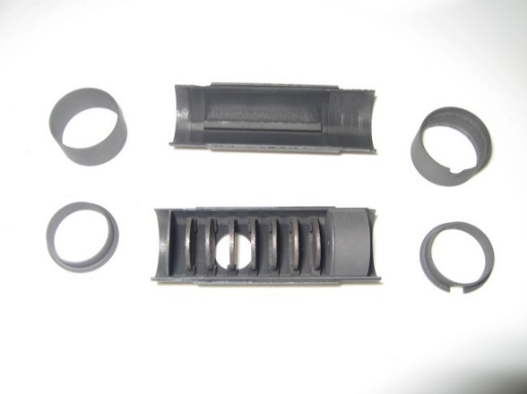
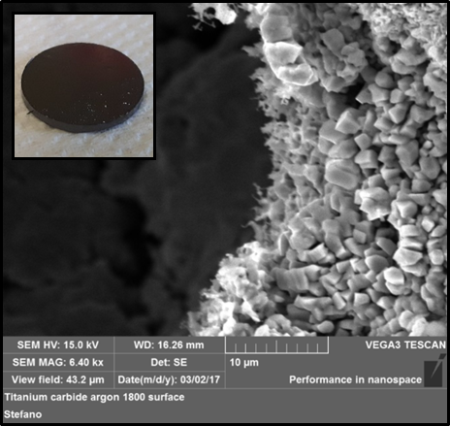
The production targets
UC_{x} target already developed and tested on-line!
Other targets under development for specific radionuclides production
UC_{x} target prototype
Porous titanium carbide (TiC)
 | Standard (graphite) | Low density (MWCNTs)
Density (g/cm³) | 4.25 | 2.59
Diameter (mm) | 12.50 | 13.07
Thickness (g/cm²) | 0.41 | 0.41
Calculated porosity (%) | 58 | 75
Stefano Corradetti
LNL January 2018

Slide 7
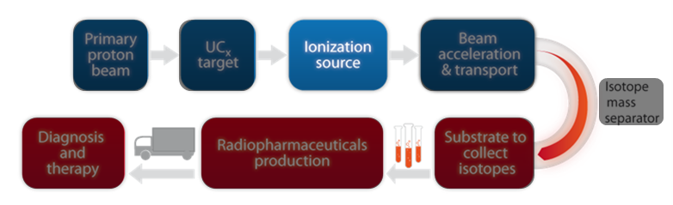
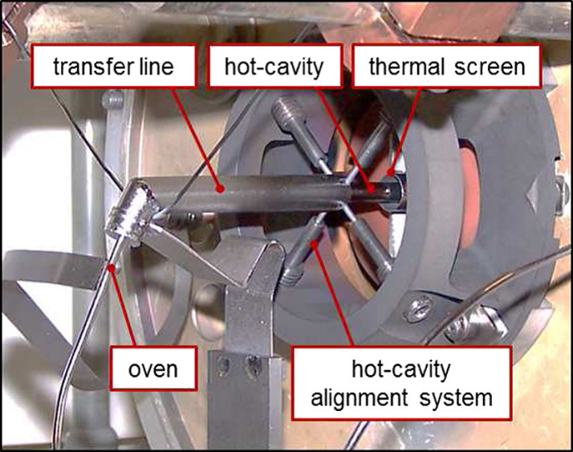
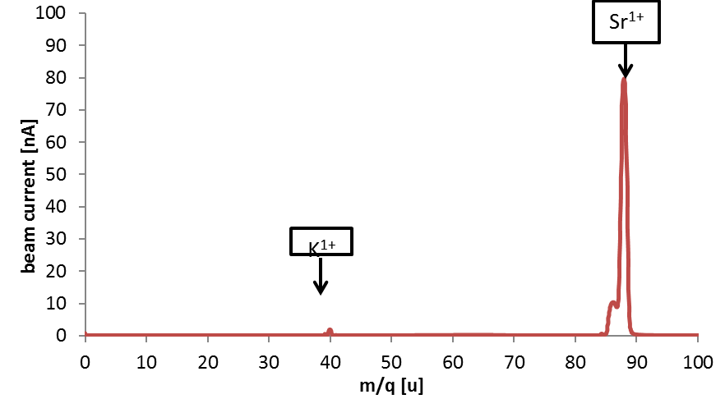
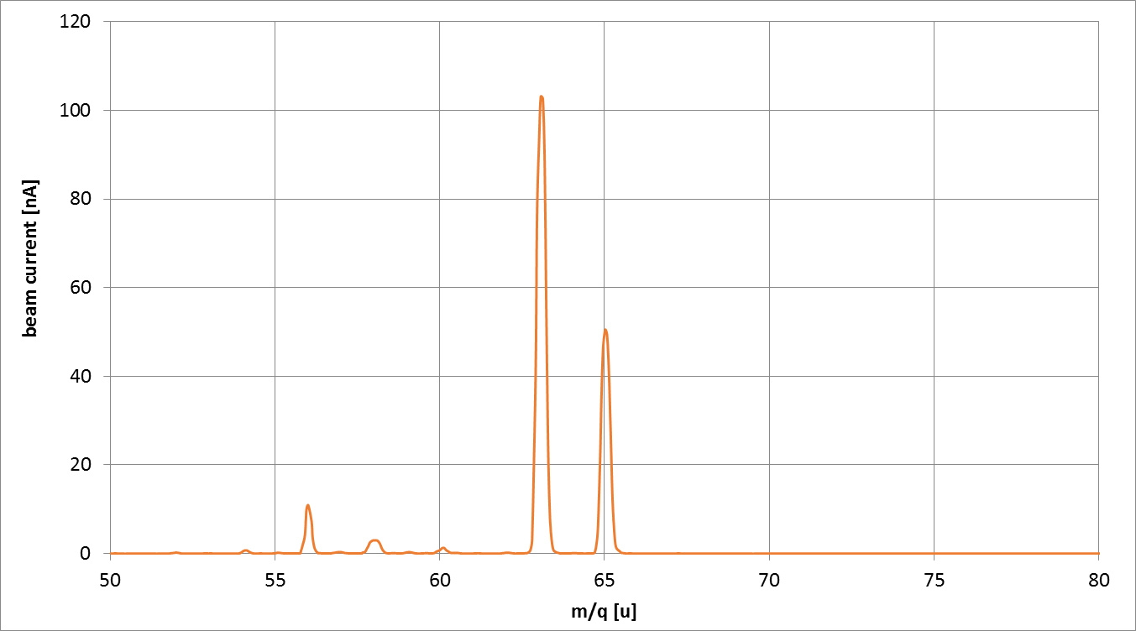
The ionization source
Surface Ion Source (SIS)
Ionized element | Desired radionuclide | Ionization source | Efficiency
Sr | ⁸⁹Sr, ⁹⁰Sr/⁹⁰Y | SIS | ~ 20 %
Y | ⁹⁰Y | PIS | ~ 1 %
I | ¹²⁵I, ¹²⁶I and ¹³¹I | PIS | ~ 20 %
Cu | ⁶⁴Cu, ⁶⁷Cu | PIS | ~ 10 %
Ag | ¹¹¹Ag | PIS | ~ 6 %
Plasma Ion Source (PIS)
⁶³Cu (~70%)
Strontium Mass Scan (SIS)
⁶⁵Cu (~30%)
Copper Mass Scan (PIS)
Stefano Corradetti
LNL January 2018

Slide 8
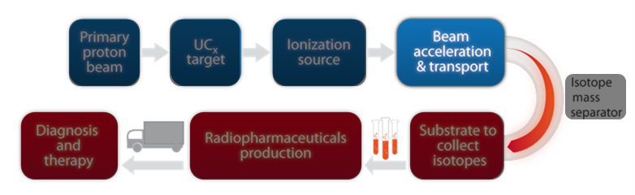
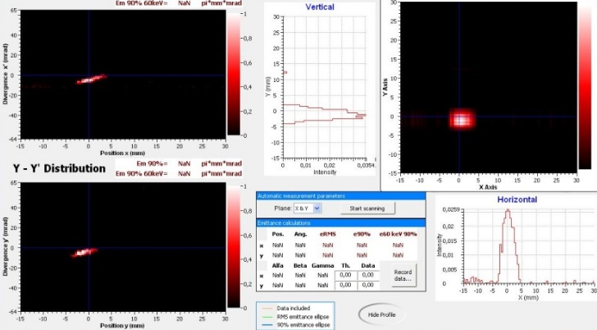
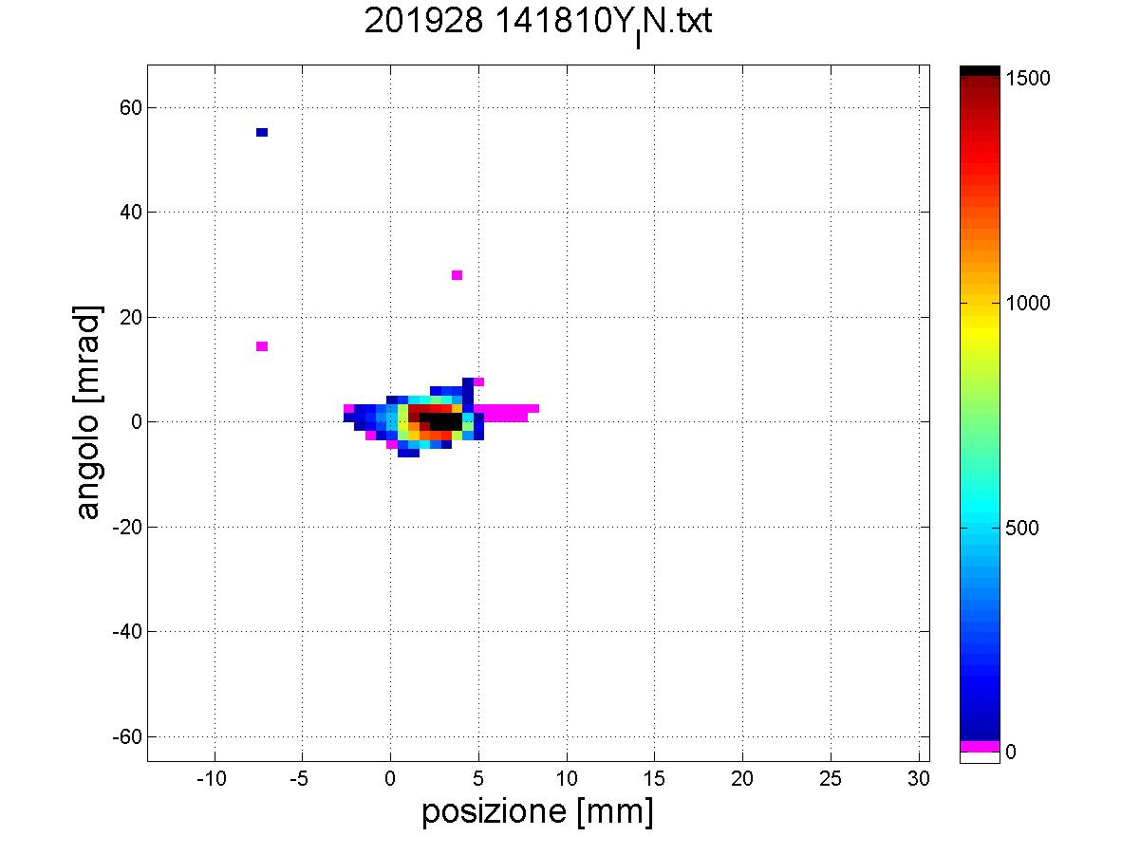
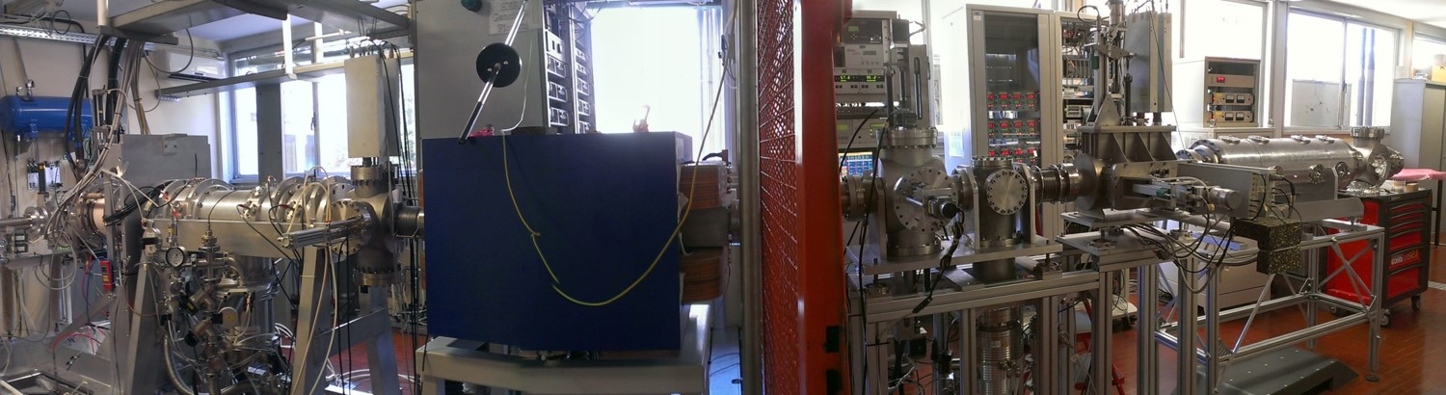
Beam acceleration and transport
Strontium and yttrium beams focalization
Electrostatic Triplets Quadrupoles and steereers system
Beam Transmission ~ 100%
Diagnostic boxes 1 and 2
(2 Faraday Cups and 2 Beam profilers)
Extraction -> 25 - 40 kV
Stefano Corradetti
LNL January 2018

Slide 9
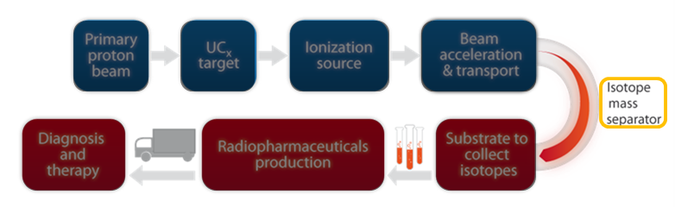
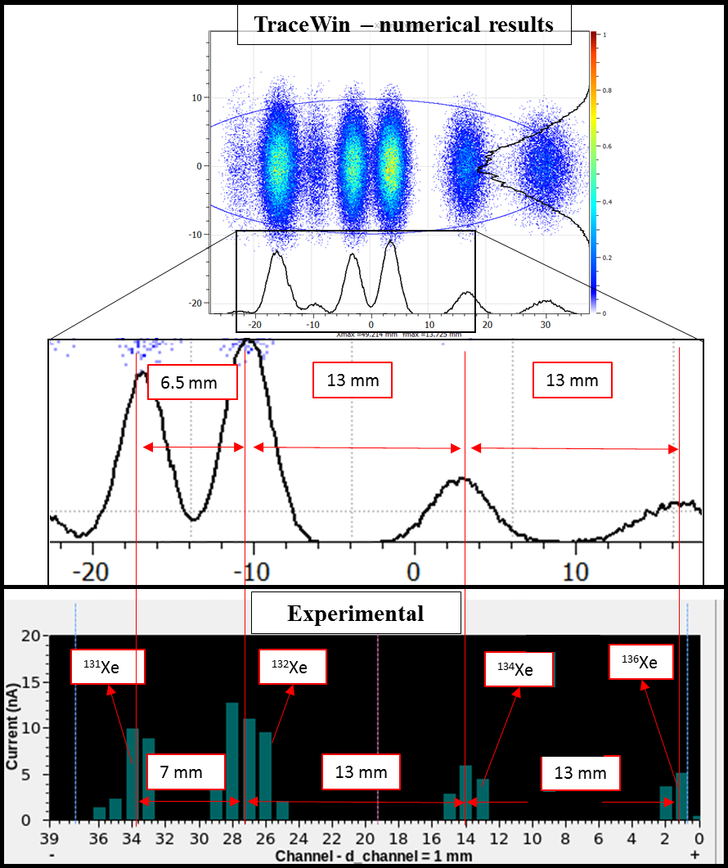
Isotope mass separator
Wien Filter
⁶³Cu (~70%)
⁶⁵Cu (~30%)
Natural Copper : Mass Scan
Stefano Corradetti
LNL January 2018

Slide 10
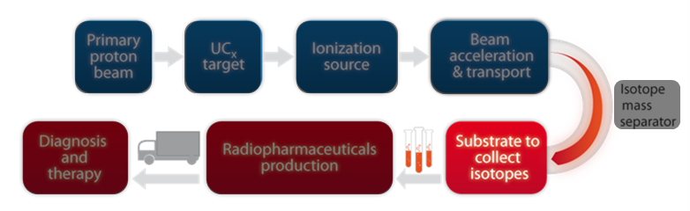
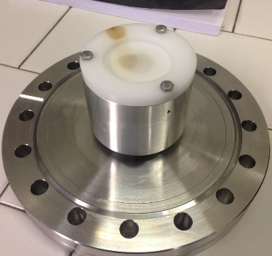
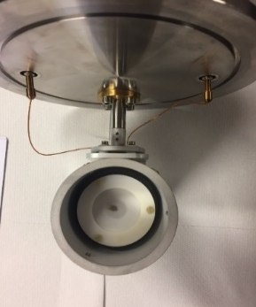
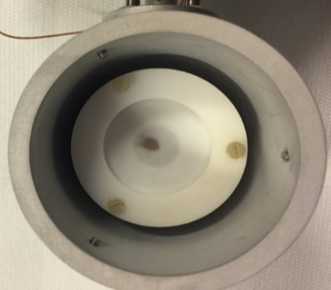
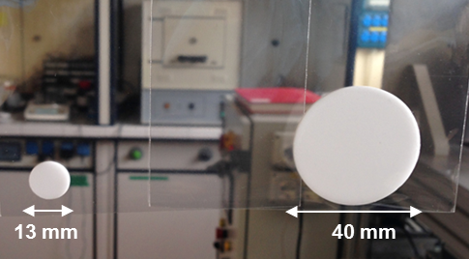
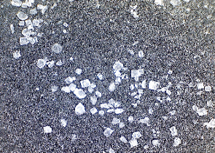
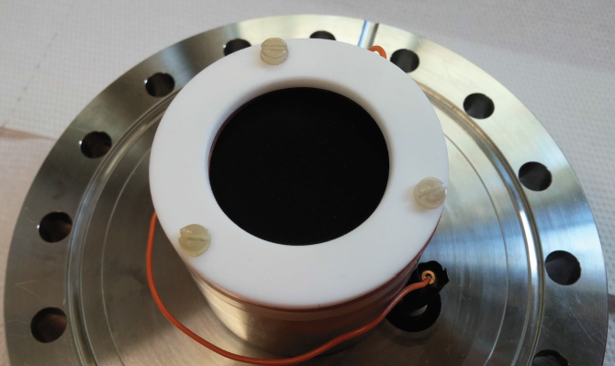
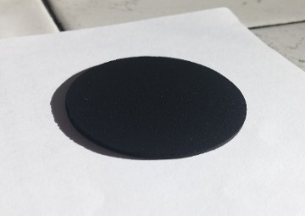
Substrates for isotopes collection
Sr¹⁺ spot on the substrate
Cu¹⁺ spot on the substrate
1) Sodium Chloride
For Sr, Y and Cu
Boiling point at 10⁻⁶ mbar
Sr ~ 500 °C
Y ~ 1500 °C
Cu ~ 1200 °C
2) Activated Carbon
For I₂
At 10⁻⁶ mbar I₂ -> gas
40 mm
Polyvinyl Alcohol (PVA)
as a binder
Stefano Corradetti
LNL January 2018

Slide 11
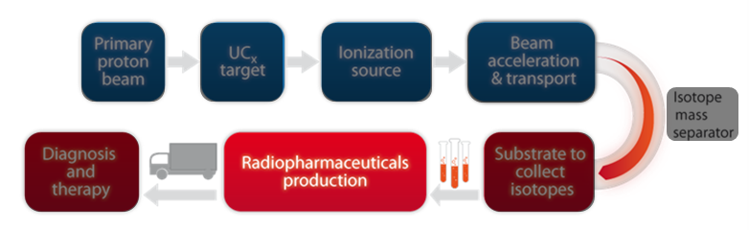
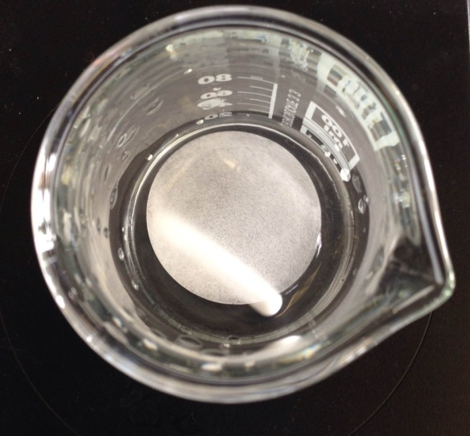
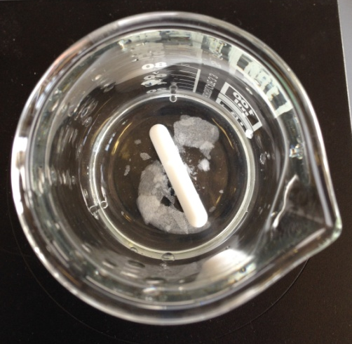
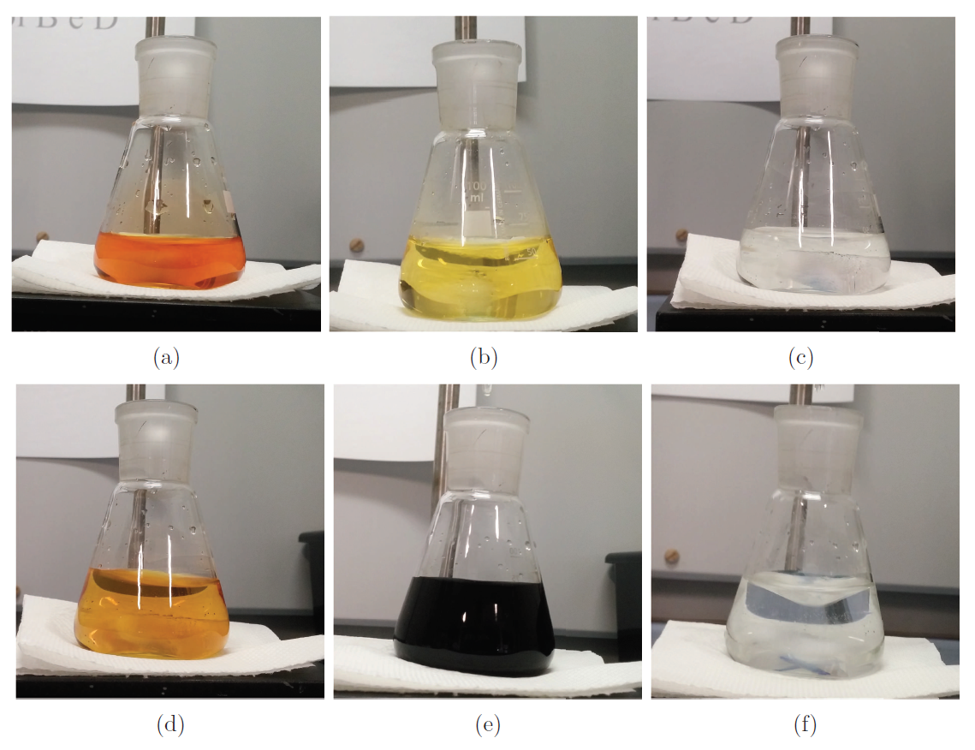
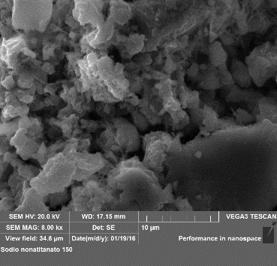
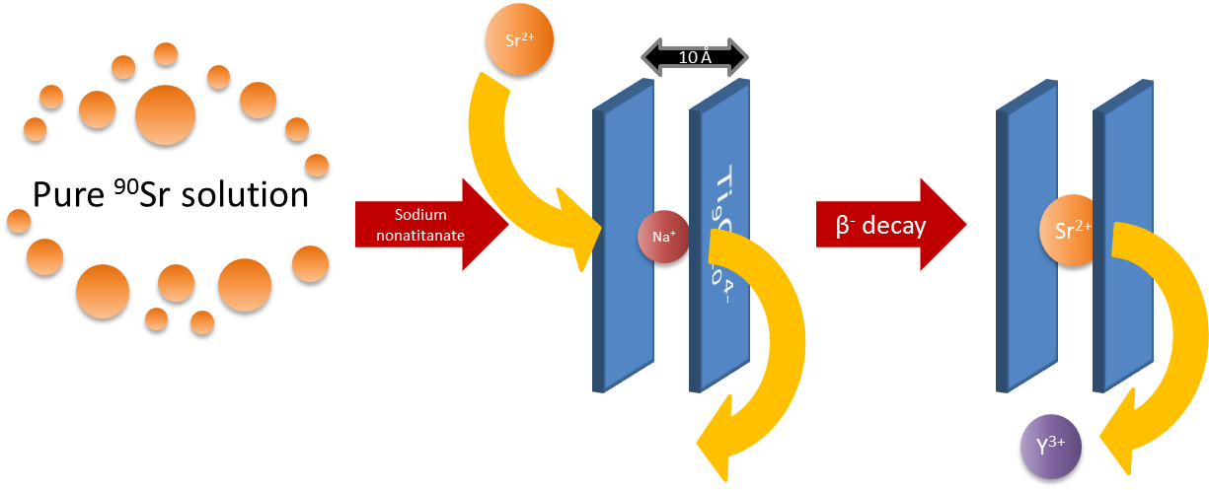
Isotopes purification
1) Irradiated substrates dissolution and quantification of the deposed atoms
HNO₃ 0.1 M
Sr²⁺, Y³⁺ or Cu²⁺ quantification
via GF-AAS or ICP-AES
Ongoing collaboration with UniPD-DSF and UniPD-DSC
Iodine titration
2) Development of purification processes
Example: Separation of ⁹⁰Sr from ⁹⁰Y for ⁹⁰Y purification
-> synthesis of an ion exchange inorganic material: sodium nonatitanate
Development of Seraparation Column for Y vs. Sr
Stefano Corradetti
LNL January 2018

Slide 12
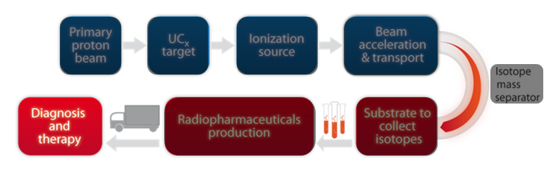
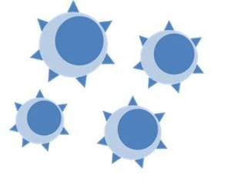
In vitro developments
1) Development of novel chelators for Ag⁺
Ongoing collaboration with:
TIFPA (Trento Institute for Fundamental Physics and Applications
DiSC (Department of Chemistry) UniPD
2) Development of new targeting agents
Radiolabeled molecule
Ongoing collaboration with:
DSF (Department of Pharmaceutical and Pharmacological Sciences)
Nuclear Medicine Unit Advanced Technology Department (Santa Maria Nuova Hospital Reggio Emilia – IRCCS)
Cancer cells
Novel molecules radiolabeled with innovative radionuclides as ¹¹¹Ag
Stefano Corradetti
LNL January 2018

Slide 13





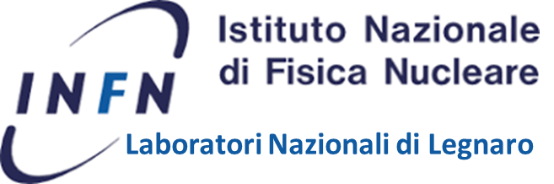


First new project derived from ISOLPHARM in collaboration with PSI
ISOLPHARM_AG
Stefano Corradetti
LNL January 2018

Slide 14


ISOLPHARM_AG

Slide 15
ISOLPHARM_Ag
Goals & organization
¹¹¹Ag
Promising radionuclide for therapy:
β⁻ emitter (average energy 360 keV)
Low percentage of associated γ-emission
Good decay properties!
Development of Ag-based radiopharmaceuticals
Task 1: physics and computing
Task 2: production of Ag⁺, purification and chelators development
Task 3: cellular targets studies and radiopharmaceutical development
Stefano Corradetti
LNL January 2018

Slide 16
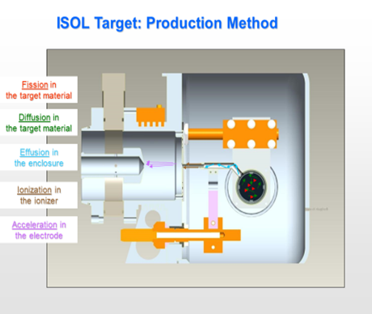
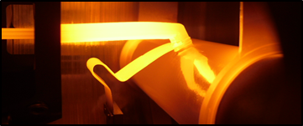
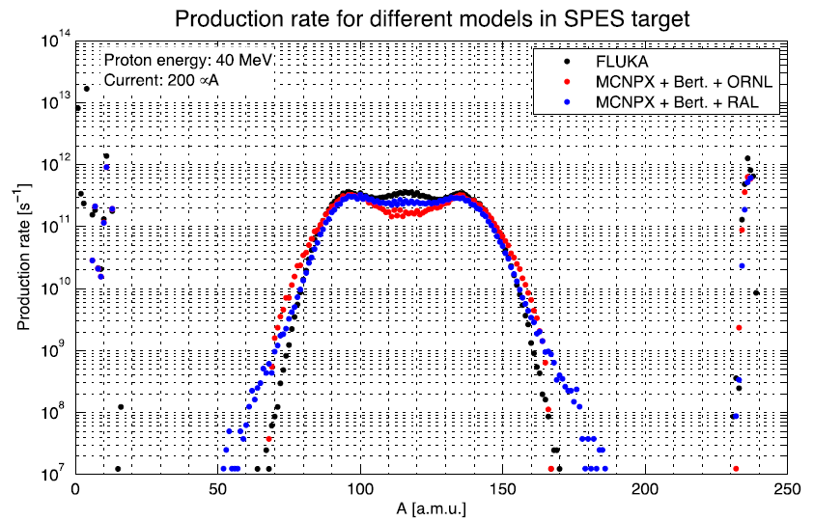
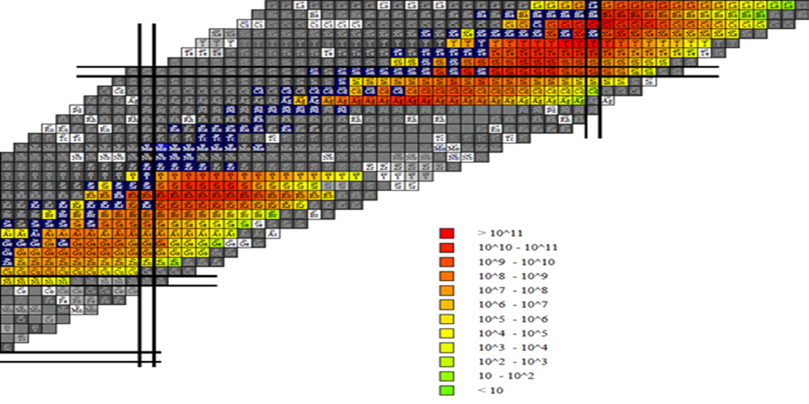
Task 1
Physics and computing
The computing task can be divided into two different case studies, where cloud computing can be an extremely useful tool to perform fast and efficient simulations, related to both the target production and release of radionuclides of interest
Activities of this task:
1. Simulation of radionuclides production in the Isolpharm target
2. Simulation of radionuclides release from the Isolpharm target
μ
Stefano Corradetti
LNL January 2018

Slide 17
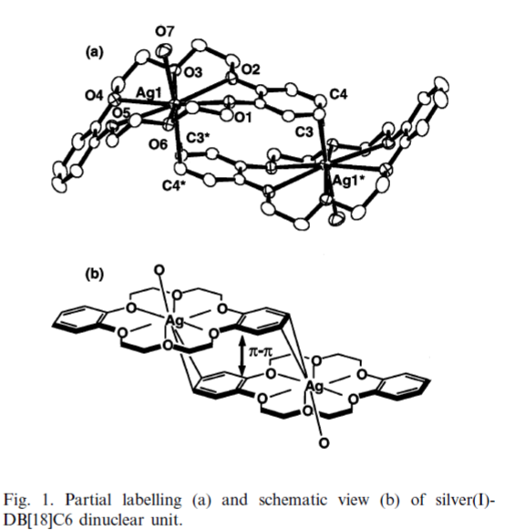
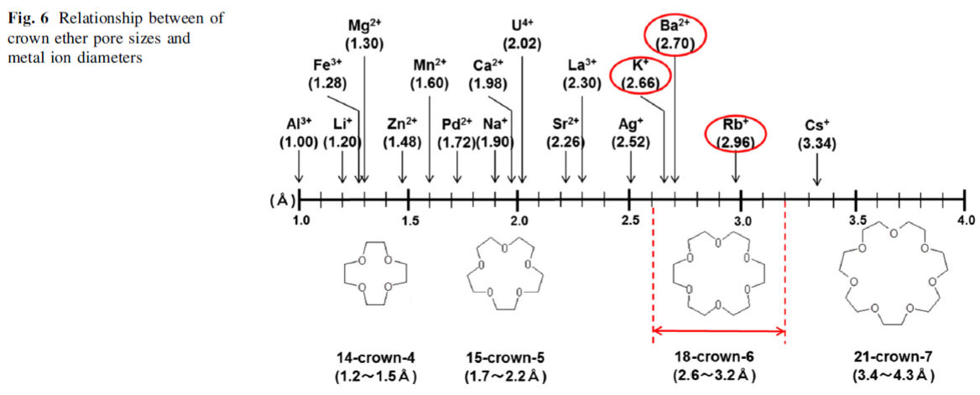
Task 2: activities at LNL, DSF and DSC
1) Ionization and acceleration of Ag⁺ using the SPES Front End in off-line modality, the production of the secondary targets for Ag⁺ deposition and the deposition studies
2) Synthesis of a resin for ¹¹¹Ag⁺ purification from ¹¹¹Cd²⁺
3) Development of chelators for Ag⁺ (collaboration with Proff. Pastore and Di Marco (DSC))
Stefano Corradetti
LNL January 2018

Slide 18
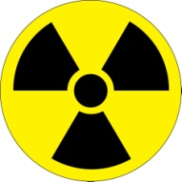
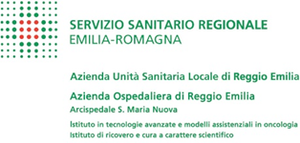


Task 3: activities at DSF
Chelator
Linker
Targeting Agent
Radionuclide
Cellular receptor
1) Cholecystokinin receptor (CCK2R and CCK2i4svR)
DSF objective: development of small molecule-based ligands.
Targeting agent: synthesis ongoing
Linker moiety (collaboration with Dr. Francesca Mastrotto)
Chelator
2) Calreticulin (CRT): a potential target for proton therapy combined with targeted radionuclide therapy
DSF objective: development of a targeting agent for CRT
Stefano Corradetti
LNL January 2018

Slide 19
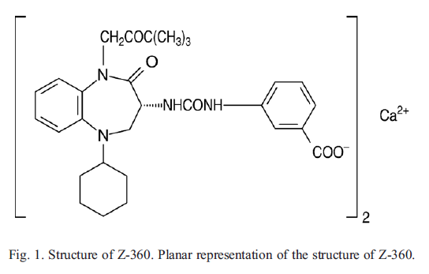
Cholecystokin receptor 2:
CCK2R
Membrane G protein coupled receptor
Physiological ligand: gastrin and cholecistokin
Physiological distribution: cerebral cortex, hypotalamus, stomach mucosa
Overexpressed as it is and its spliced variant (CCK2i4svR) in cancers of the pancreas, medullary thyroid, lung, breast and ovarian, GI tract and colon
Attractive candidate for targeted imaging and therapy of malignant disease
Z-360: small molecule with high binding affinity for CCK2-R and CCK2i4svR (Kd ~ nM, depending on the substituents)
Stefano Corradetti
LNL January 2018

Slide 20
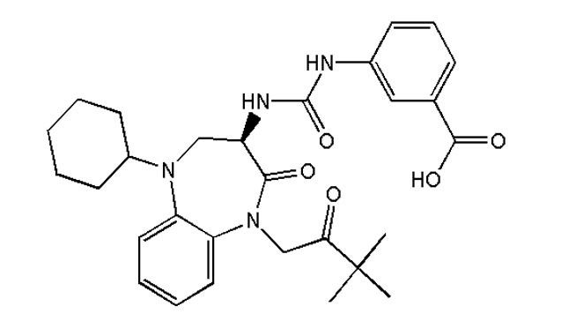
Targeting CCK2R
Linker
Targeting Agent
CCK2R
Choice of the best linker moieties:
- optimizing length
- optimizing hydrophilicity
Radiolabeling and in vitro studies -> collaboration with Reggio Emilia Hospital (IRCCS)
Stefano Corradetti
LNL January 2018

Slide 21
Calreticulin: a biological target
Increase the amount of surface exposed CRT depending on the dose and on the radiation type (photon and or particles)
Ionizing radiation
CRT lighthouse that could be used for targeting specific drugs and/or radionuclides.
Delivery of radionuclides in situ could help to overcome resistance problem or to target the high resistant cancer stem cells
Targeting Agent
Strategies:
Small molecules chemical library screening
Design of oligosaccharidic molecules
Other strategies?
Stefano Corradetti
LNL January 2018

Slide 22


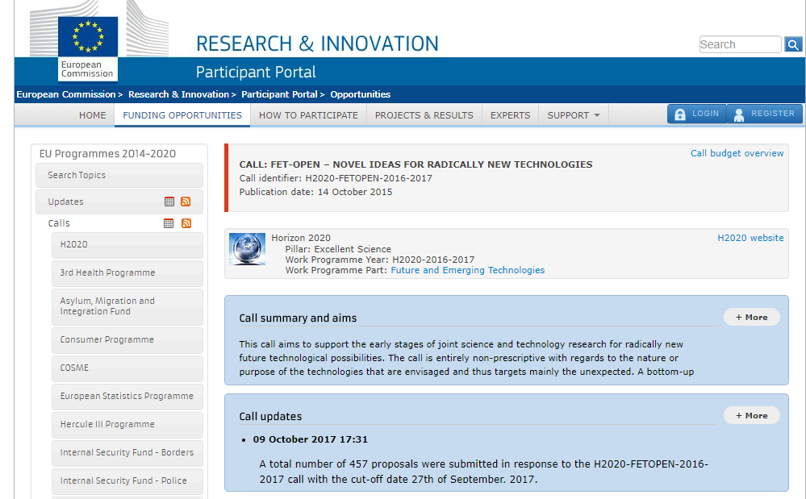
Collaboration with POLATOM and NCSR-DEMOKRITOS
Stefano Corradetti
LNL January 2018

Slide 23
FETOPEN-RIA Call
HORIZON 2020
FETOPEN-RIA 2016/17
FET: Future and Emerging Technologies
High risk, long-term, multidisciplinary, collaborative research
Novel and visionary thinking to open paths to new technologies
FETOPEN: Novel ideas for radically new technologies
Early stage joint science & technology research
Totally non prescriptive
FETOPEN-RIA: Research and innovation actions
Expected impact: initiating a new line of technology or kick-starting an emerging innovation eco-system
Stefano Corradetti
LNL January 2018

Slide 24
FETOPEN-RIA Call
High specific activity radiopharmaceuticals production using ISOL beams
FETOPEN-RIA requires the presence of at least three legal entities, situated in different countries (European or associated to Horizon 2020) and independent from one another. In case of more than three, there can be entities belonging to the same country.
Proposed work packages:
WP1 – Management: Organization and dissemination of the results (INFN)
WP2 – Study for radioisotopes production: target, ion source and beam transport development (INFN)
WP3 – Pharmaceutical form development (UNIPD)
WP4 – Radiochemistry (POLATOM)
WP5 – Radiopharmacy (NCSR)
Stefano Corradetti
LNL January 2018

