Slide 1



The Free-fall Experiment Results
Measuring subfemto-g acceleration noise in LISA Pathfinder and fN force variations on ground with torsion pendulum, in intermittent control mode.
Giuliana Russano on behalf of LPF collaboration
university of Trento and INFN-TIFPA
GRASS 2018
March 1-2, Padova

Slide 2
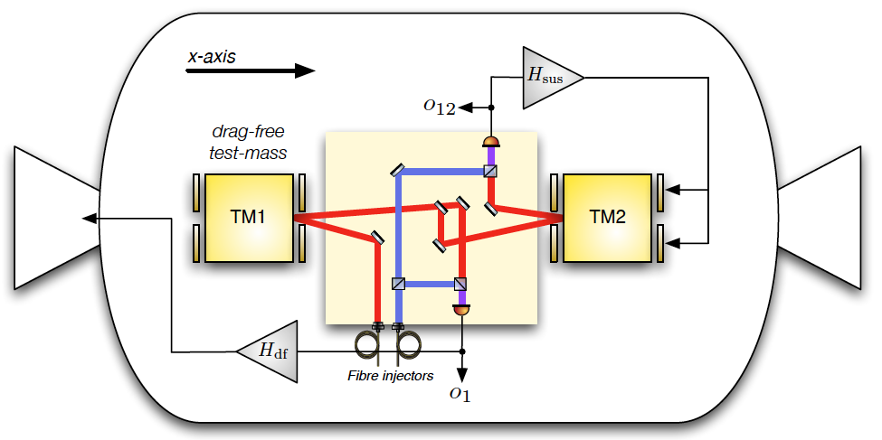
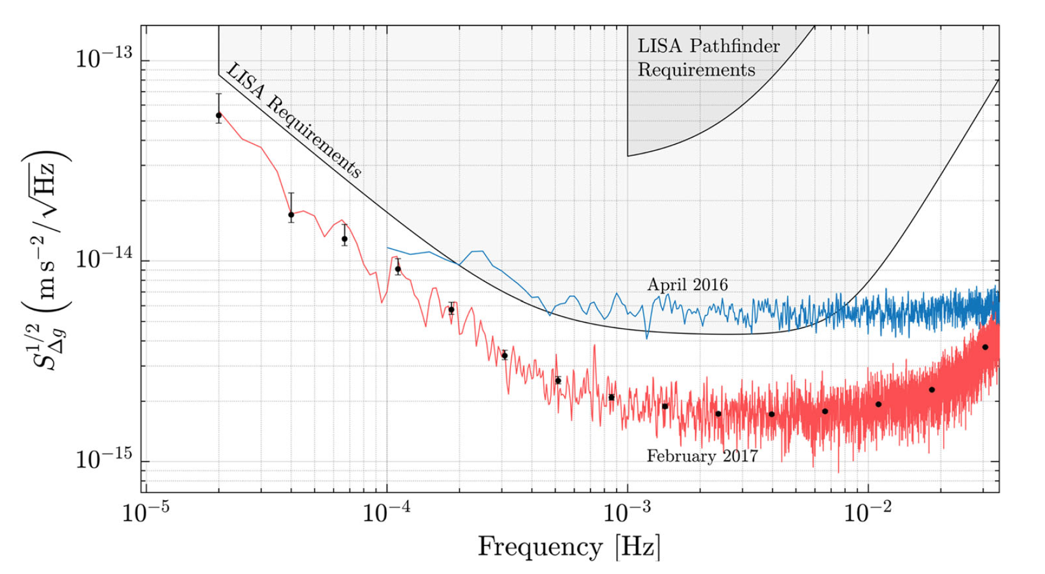
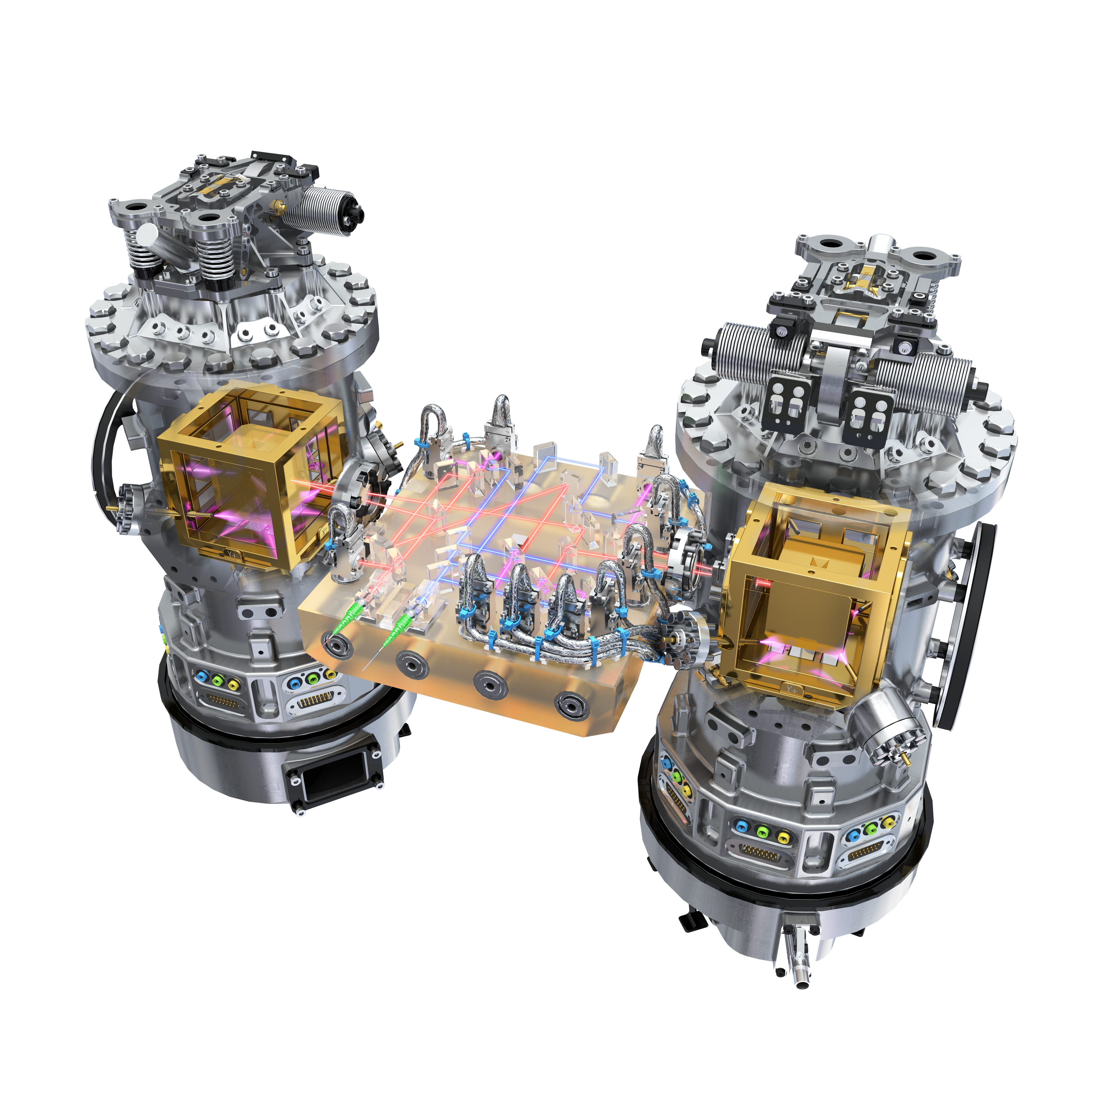
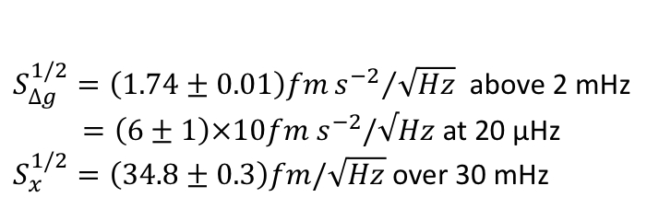

LISA Pathfinder, accelerometer mode on the road to LISA
Measured differential
acceleration noise
PRL 116 (2016) 231101
PRL 120 (2018) 061101
$$∆g= g_{2}−g_{1}$$
$S_{∆g}^{1/2}=\left(1.74±0.01\right)fm{s^{−2}}/{\sqrt{Hz}}$ above 2 mHz
$=\left(6±1\right)×10fm s^{−2}/√Hz$ at 20 μHz
$S_{x}^{1/2}=\left(34.8±0.3\right)fm/\sqrt{Hz}$ over 30 mHz
Readout noise
Notes:
The objective is that of measuring the parasitic random forces that the(SC), and its space environment, would exert on a
test-mass of the kind to be used in a space-based (GW) observatory such as LISA. Performed with hardware of the final GW obs.
A factor 5 below the expected and limited by Brown. Noise from the gas damping
To achieve this objective LPF SC carries two TM's, in no mechanical contact with any of the SC parts, and measures their relative acceleration along the line joining their centers that we take as the x –axis.

Slide 3
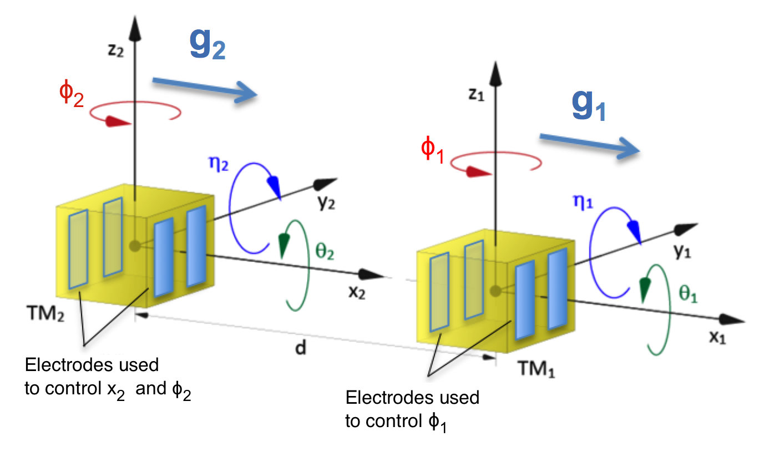
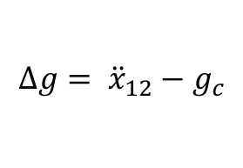
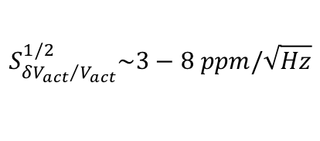
LPF standard control mode
TM1 reference frame for drag free
TM2 electrostatic suspension
COMMANDED
COMPENSATION FORCE
$$∆g= {\ddot{x}}_{12}−g_{c}$$
Need for actuator calibration
Voltage noise of the actuator introduces an extra force noise in the lower band
$$S_{{δV_{act}}/{V_{act}}}^{1/2}\sim 3−8 ppm/\sqrt{Hz}$$
@ 1 mHz
Notes:
TM2 electr susp in order to balance the difference in the grav field produced by the SC in the TM position Any static difference in force between TMs can push them away… we know what is commanded then the electrost.contr. force must be calibrated (to know the real) and subtracted from the data series. Any in band fluctuation in the electronics actuation circuitry induces a fluctuation in the feedback force necessary to compensate the Dg_DC and that scales as the applied voltage

Slide 4
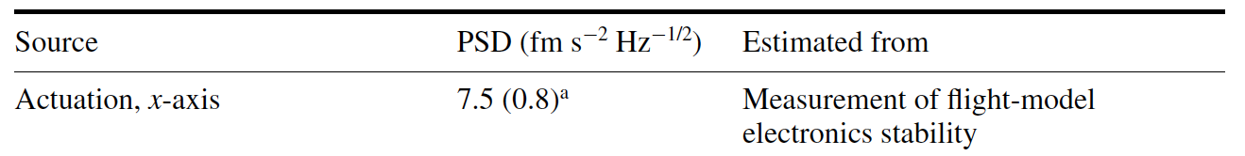
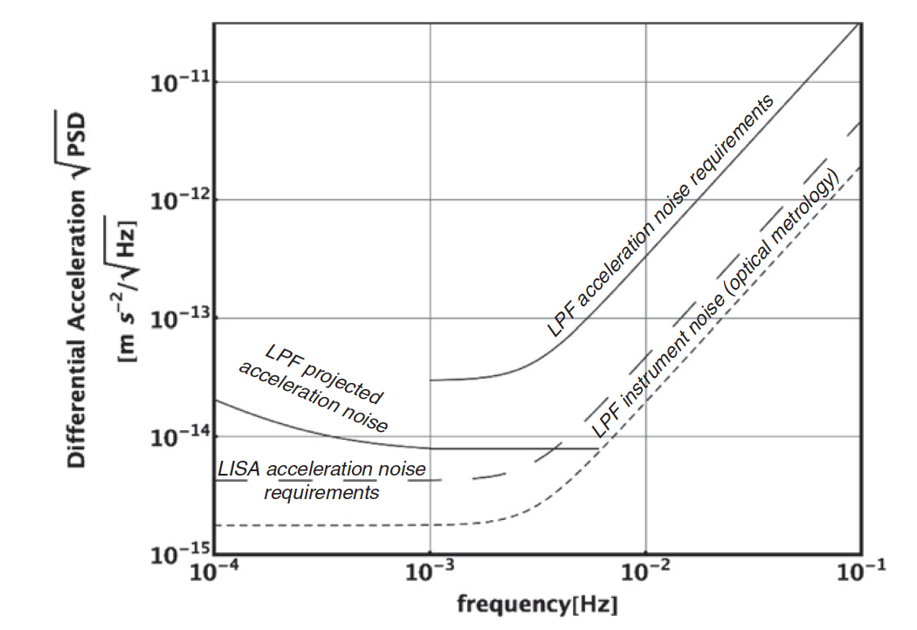
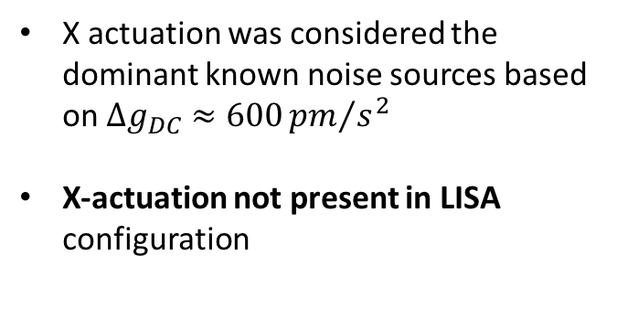
Pre-flight X-axis actuation noise
X actuation was considered the dominant known noise sources based on $Δg_{DC}≈600{pm}/{s^{2}}$
X-actuation not present in LISA configuration
DESIGNED A MEASUREMENT
FREE OF ACTUATION

Slide 5

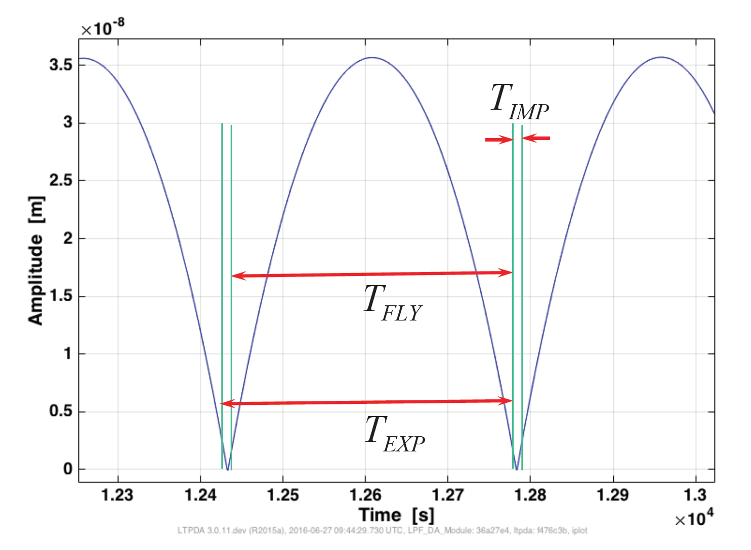
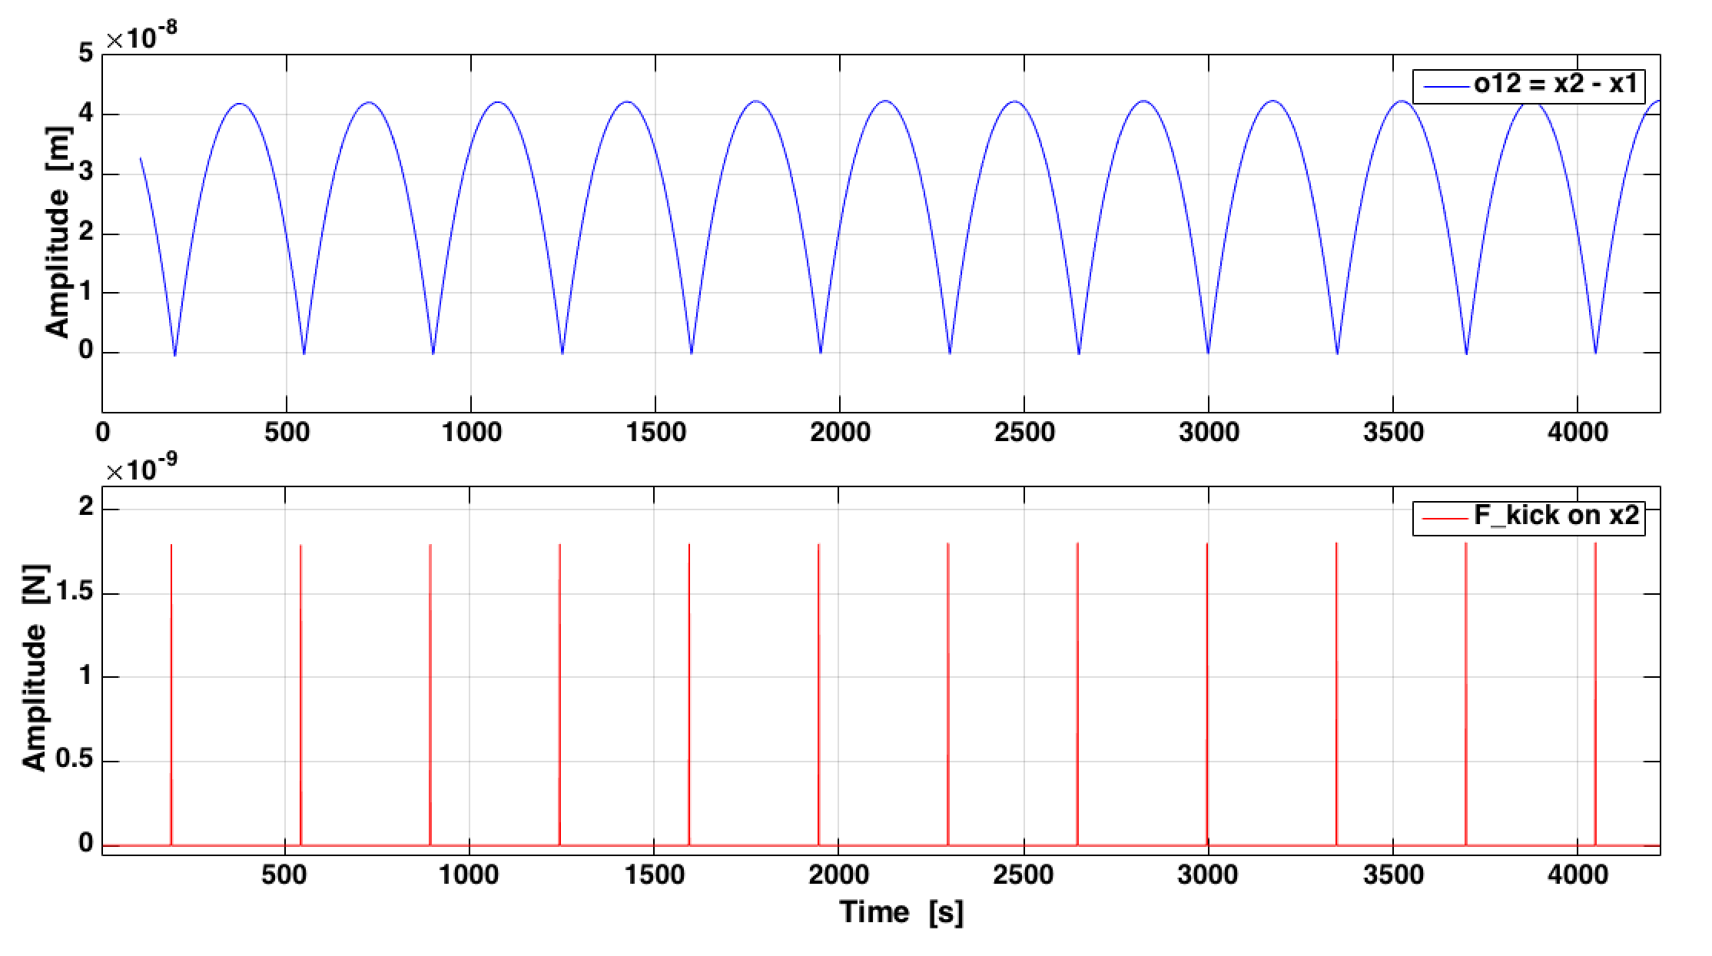
Free-fall control mode
X axis
SC gravity
SC gravity
SC gravity
Compensation force
Compensation force
Actuate <1% of time
Free phase
Actuate <1% of time
Experiment configuration:
T_{exp} = 350.2 s
f_{exp} ≈ 2.85 mHz
T_{fly} = 349.2 ÷ 345.2 s
T_{imp} = 1 ÷ 5 s
Notes:
the TM is set into motion by a pulse of force opposite to the direction of the local gravity, so that it can performs a full parabolic (in time) flight cycle and get back to its original position ready for the next cycle.

Slide 6
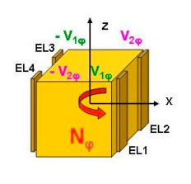
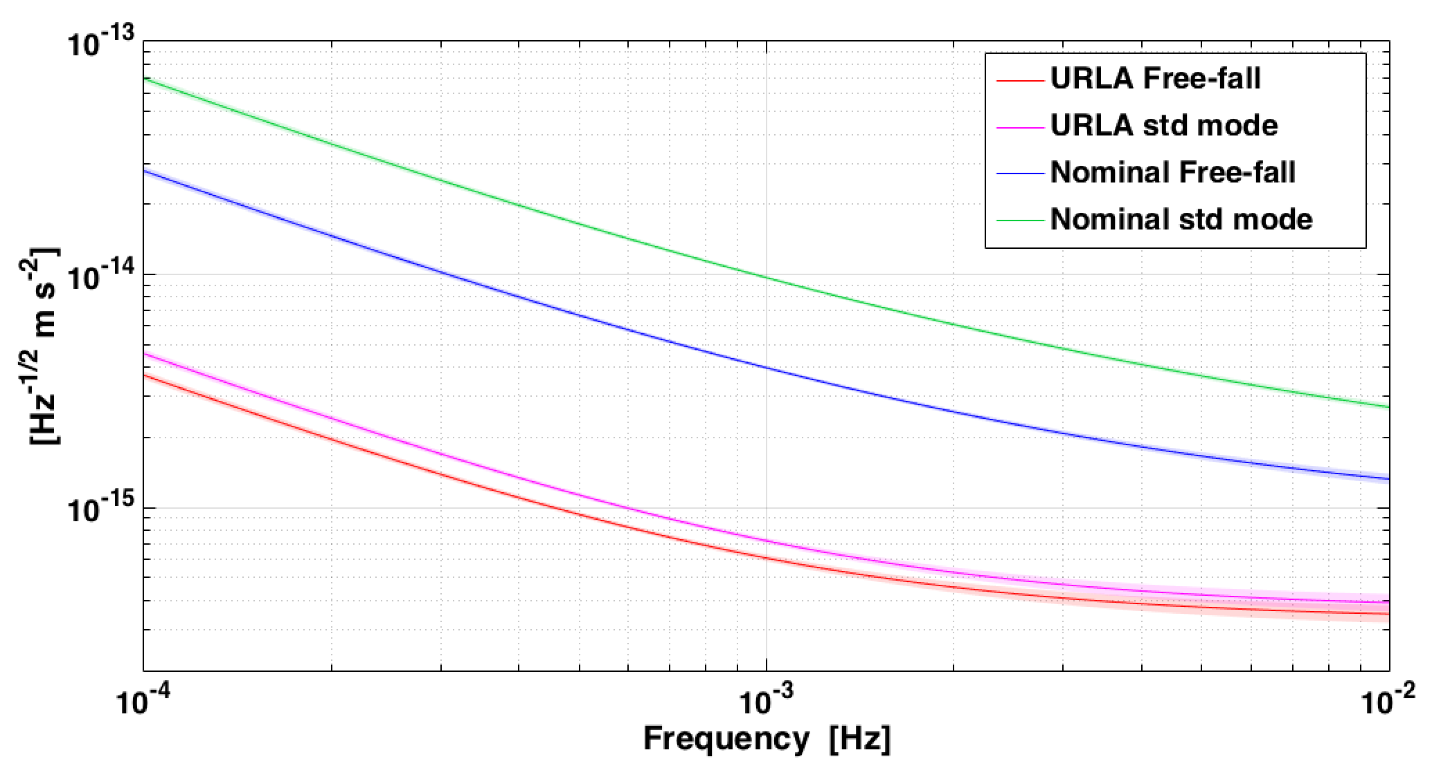
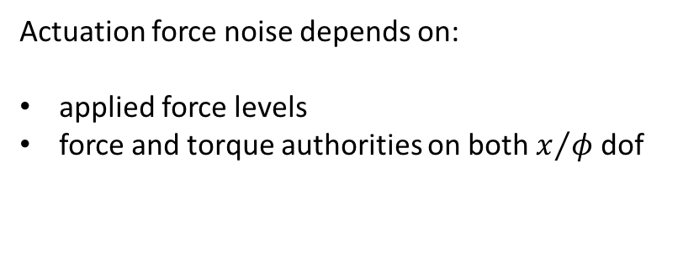
Actuation Authority configuration
Actuation force noise depends on:
applied force levels
force and torque authorities on both $x/φ$ dof
Predicted actuation noise in different authority configurations
Science mode in Nominal (x/ϕ)
Nominal: F_{max x2} = 2200 pN ,
N_{max ϕ2} = 10.4 pN m
URLA: F_{max x2} = 50 pN,
N_{max ϕ2} = 1 pN m
√S_{Δg} [m s⁻² Hz ^{-1/2}]
Free-Fall in Nominal (ϕ)
Science mode in URLA (x/ϕ)
Free-Fall in URLA (ϕ)
Notes:
Remove noise from actuation gain fluctuations

Slide 7
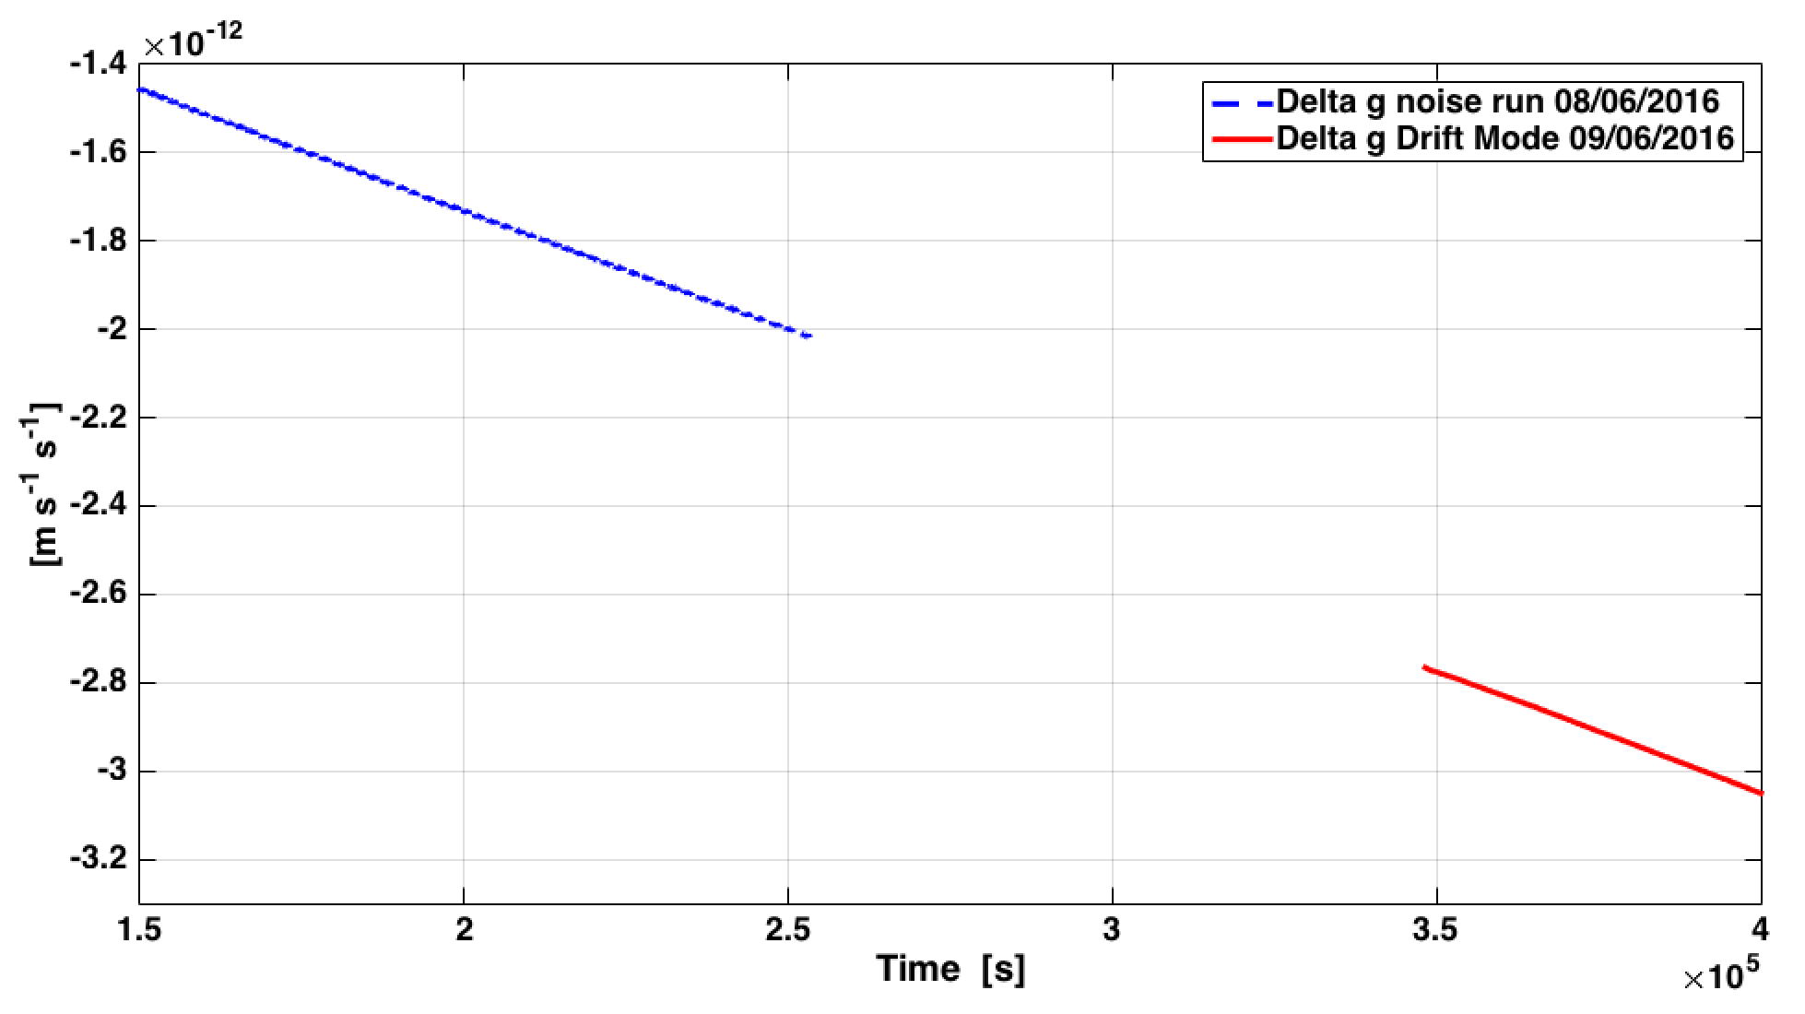
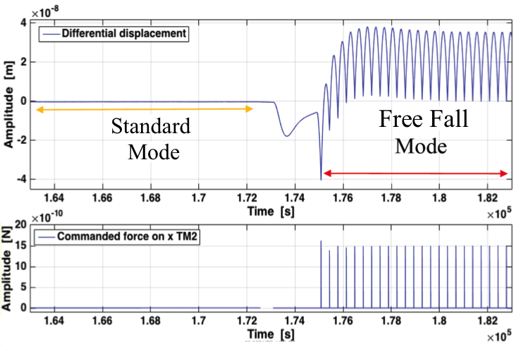
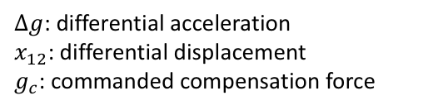
FF vs standard noise run
Delta g
$∆g\left(t\right)= {\ddot{x}}_{12}\left(t\right)+ω_{2}^{2}x_{12}(t)+∆ω^{2}{(x}_{1}−x_{SC})−{λg}_{c}\left(t\right)$ $−{\dot{g}}_{0}t−∆g_{DC}$
$∆g$: differential acceleration
$x_{12}$: differential displacement
$g_{c}$: commanded compensation force
Stiffness
terms
Compensation force
Constant
DC term
Drift in time
Δx ~ 50 pm
Δx ~ 35 nm
Standard Mode
Free-Fall Mode
Δg [m s⁻²]
Δg predicted ~ 600 pm/s²
F_{cmd} ~ 3 pN
F_{kick}~ 1.5 nN
Notes:
High dyn range in displacem and velocity can amplify errors from readout non linearity and timing errors

Slide 8
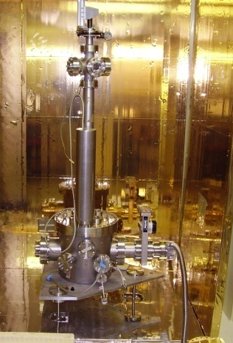
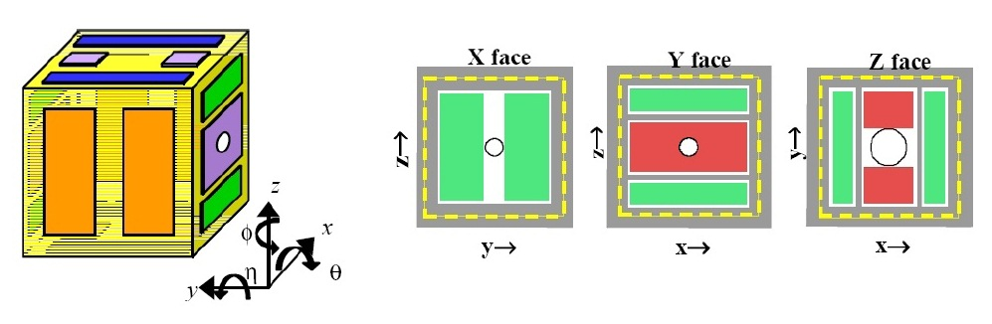
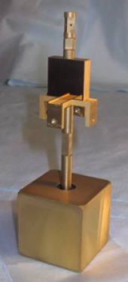
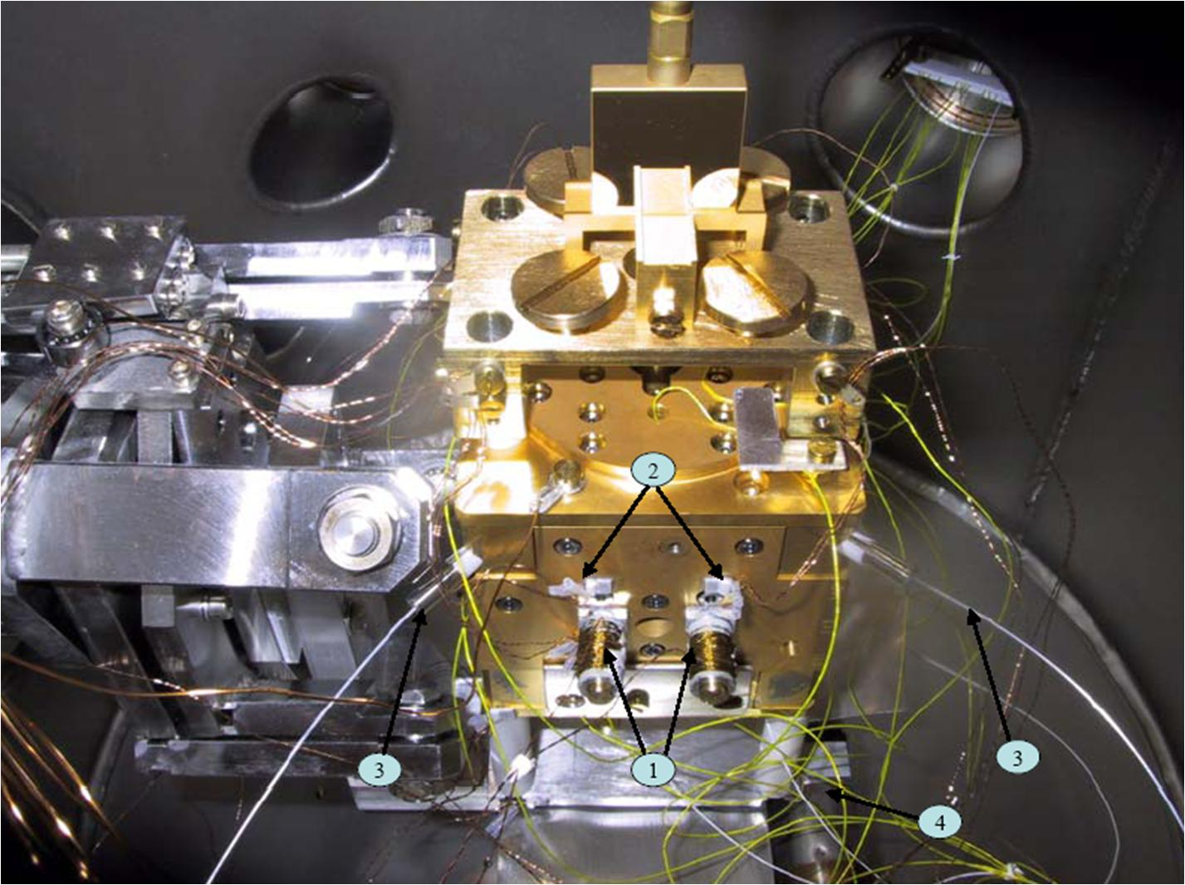
Free-fall mode on ground
LISA Pathfinder-prototype GRS
Capacitive gaps of 4 mm on X faces
(2.9 mm Y, 3.5 mm Z)
Audio frequency actuation
  x electrodes, 10 V → 20 nN authority for N_{φ}
1 m lenght silica fiber
50 μm size
1TM pendulum
sensitive to torques around Z-axis (N_{φ})
Period T0 ~ 490s, energy decay time
τ~2 year (Q~10⁶)
torque noise < 1 fN m /Hz^{1/2} at mHz frequencies
Notes:
AC 20 nrad Hz^{-1/2} above 1 mHz

Slide 9
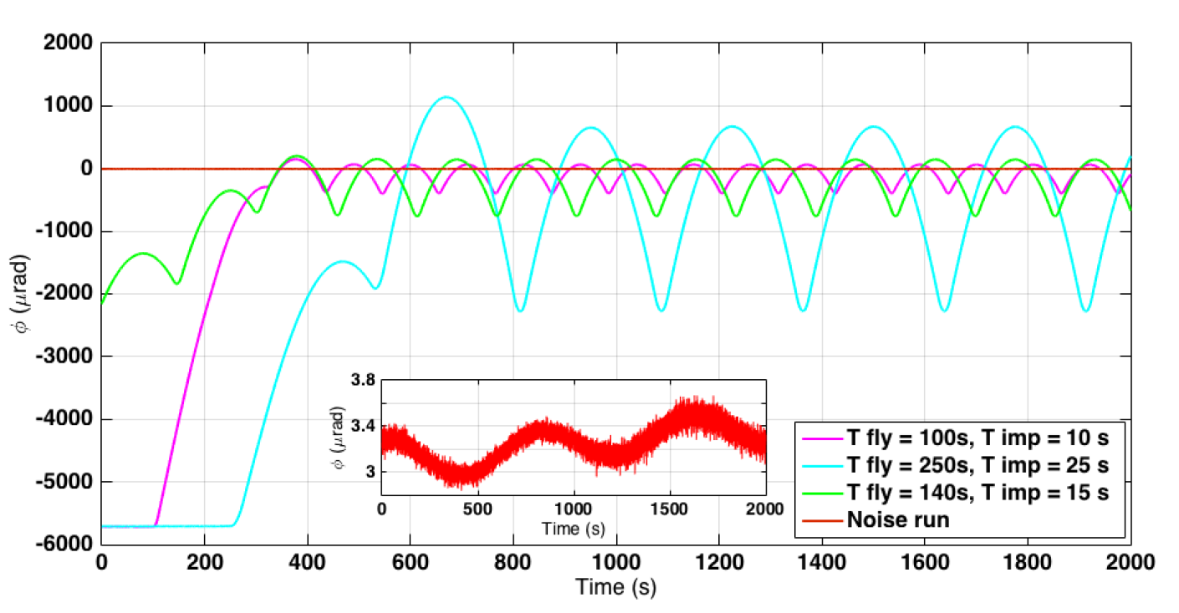

Free-fall mode on ground
Mimic LPF differential gravitational forces that must be compensated in orbit as external torques acting on the suspended test mass.
LPF differential DC gravitational acceleration
Pendulum
DC torque
$$N_{DC}=−Γ∆φ$$
Compensate with constant DC actuation of with free fall
Rotate pendulum of an angle Δφ ≈ 2 mrad

Slide 10


LPF vs Torsion pendulum
LPF | Torsion Pendulum
Negative stiffness | T0 ≈ 830 s (electrostatically softened)
(budget) Differential actuation force to compensate self gravity difference | Applied DC actuation torque, needed to center TM (can choose as desired)
$$∆g(t)={\ddot{x}}_{12}+ω_{2}^{2}x_{12}+∆ω^{2}(x_{1}−x_{SC})$$
$$N\left(t\right)=I\ddot{φ}+Iω_{0}^{2}φ+γ\dot{φ}$$
$$ω_{2}^{2}≈−{10}^{−6}s^{−2}$$
VARIABLE!
VARIABLE!
F/2
F/2
F/2
Free-fall mode actuation performed on different electrodes
F/2
Notes:
Flexible, max displ TP 10 micron, author 200 pNm
Omega1 and 2 are the force gradients per unit massin the nominal TM positions in terms of the natural harmonc oscillator angular freq. (dominated by electrostatic and local gravitation)

Slide 11
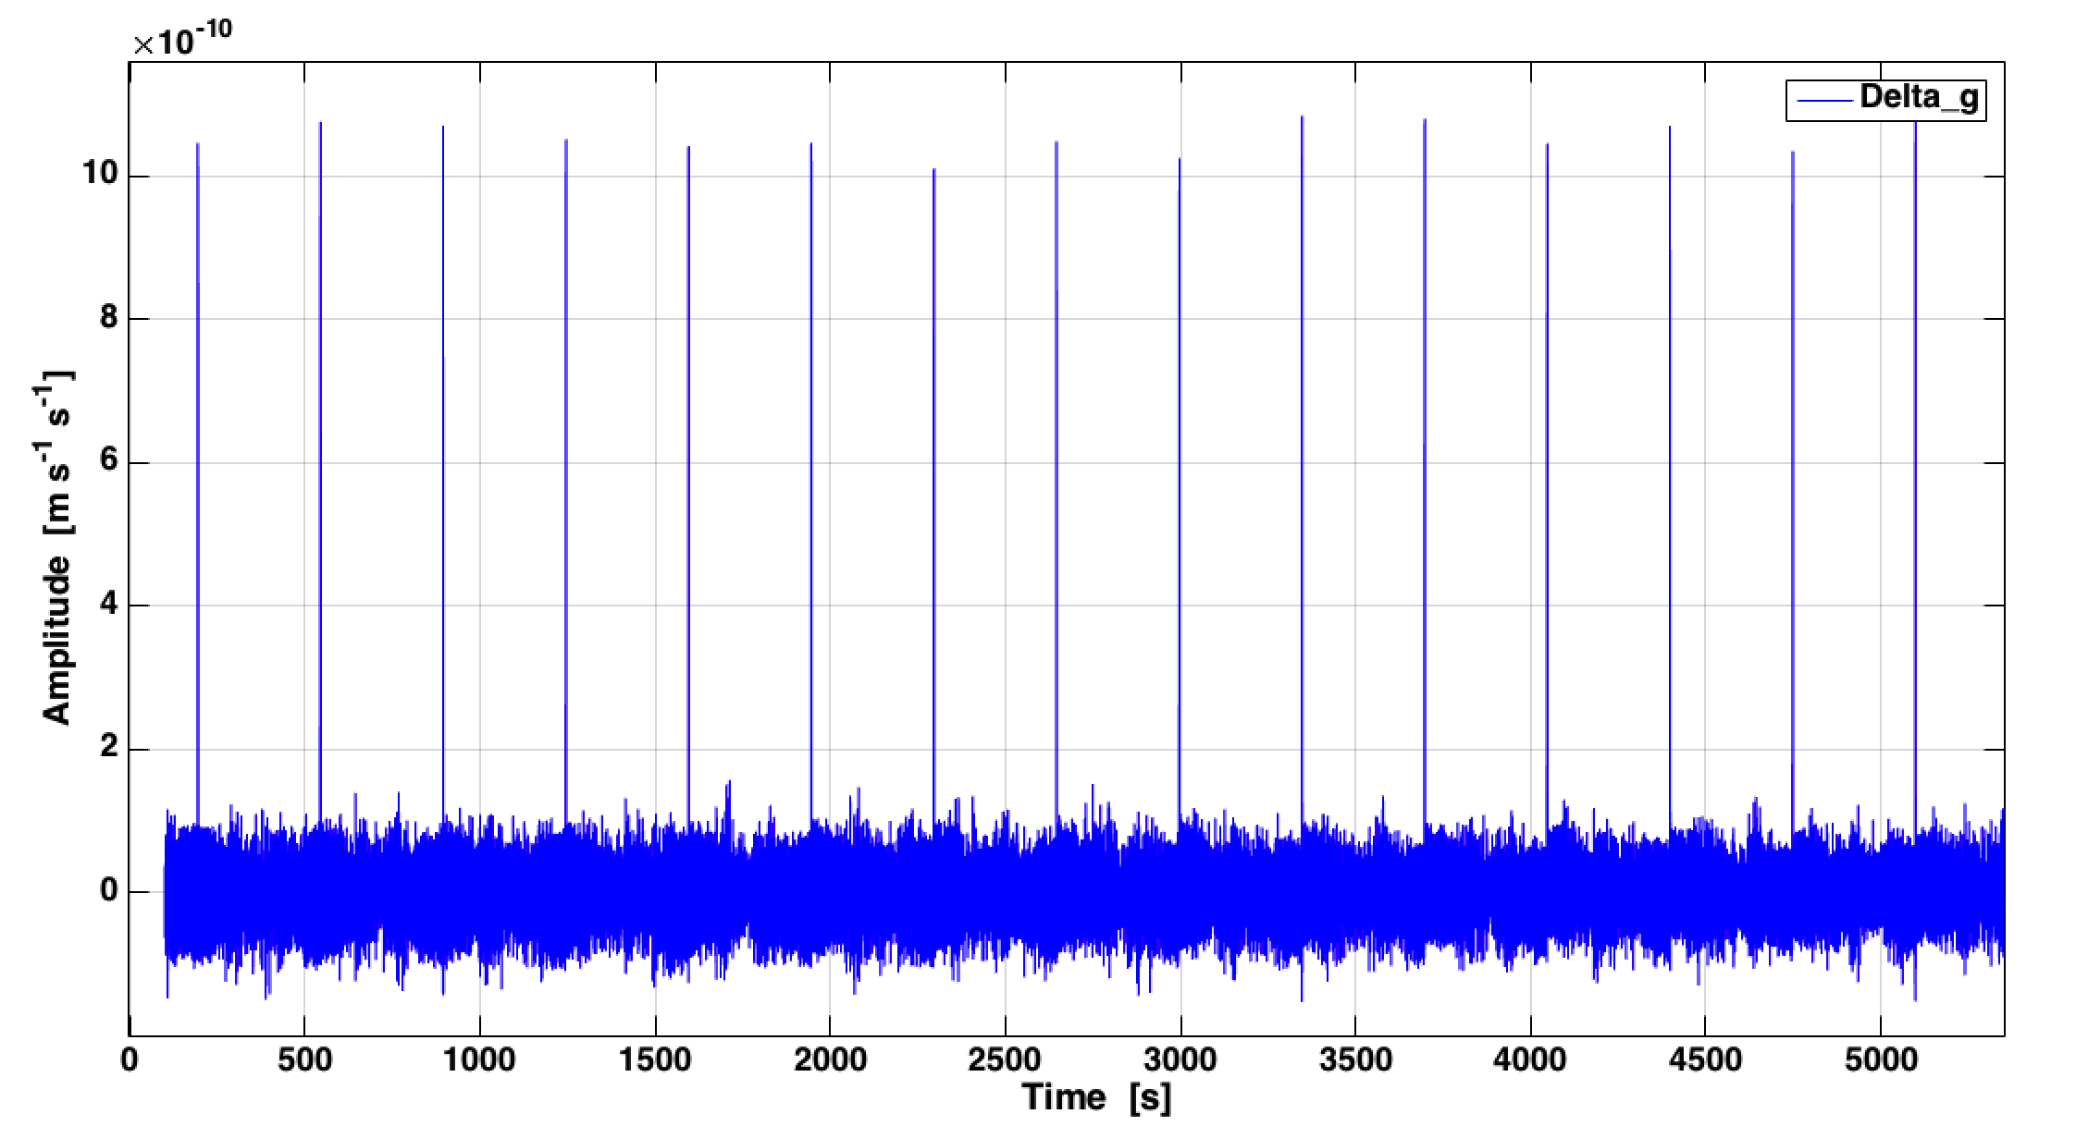
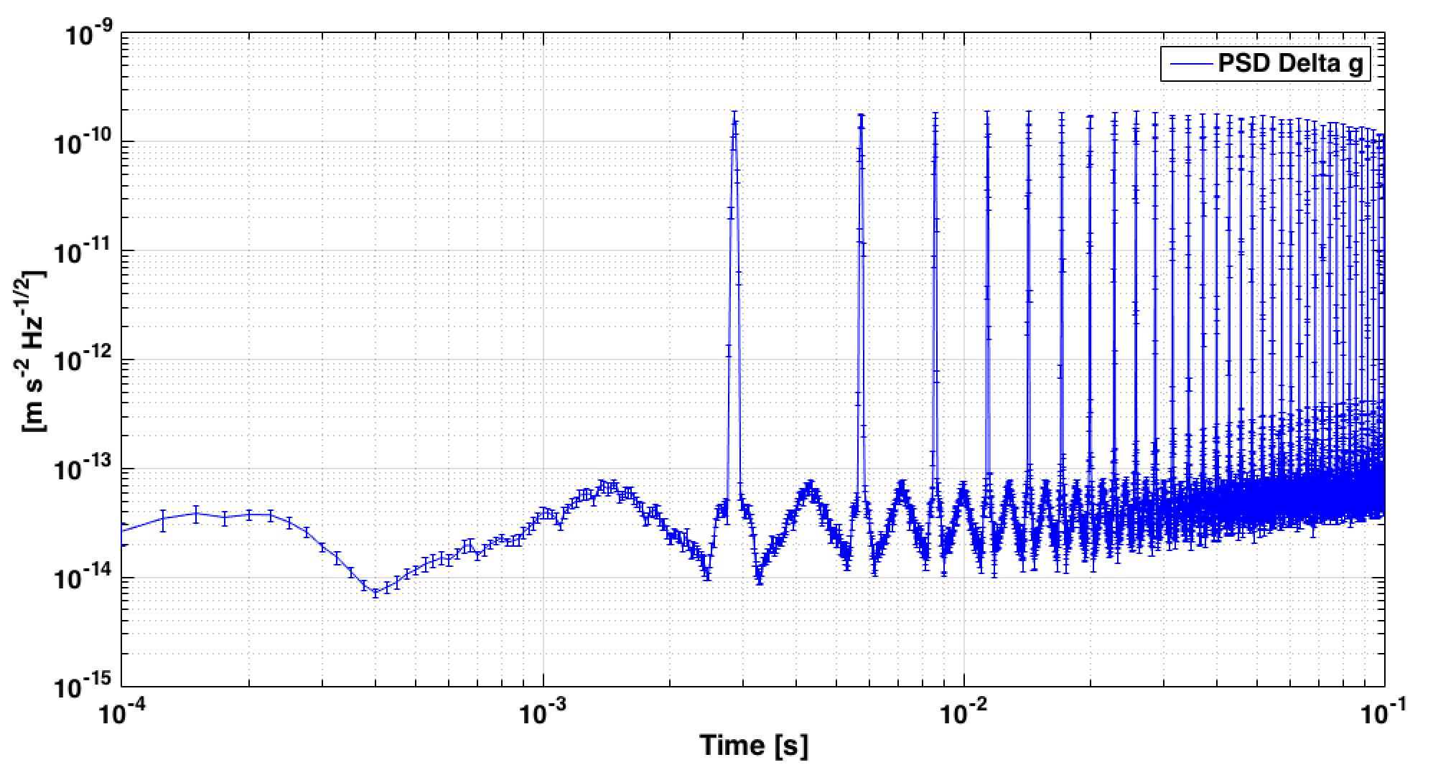
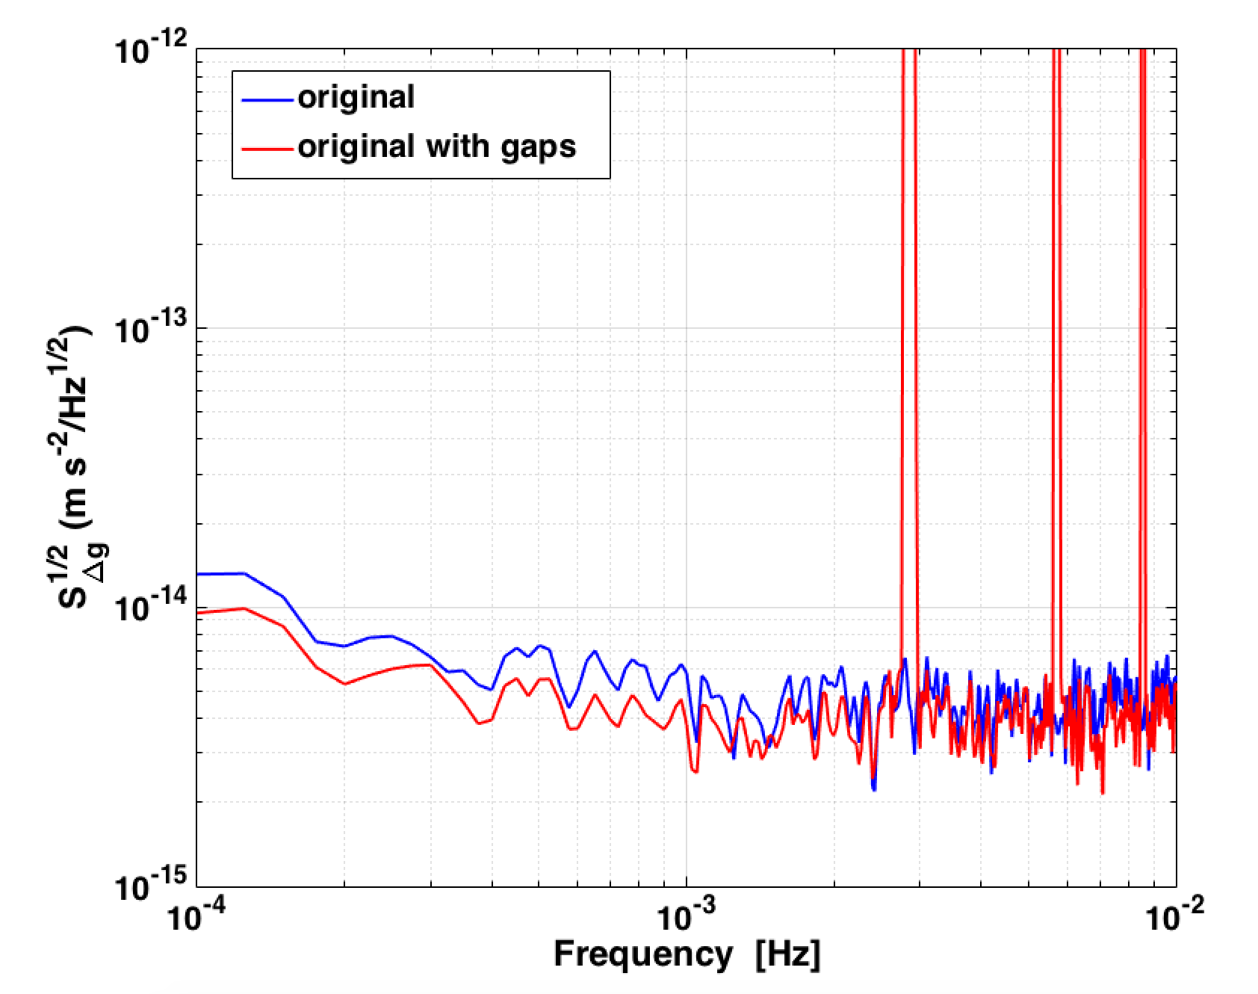
Data analysis challenge
Spectral estimation:
Kicks with high noise configuration
peaks at multiple of frequency repetition of the experiment
Discard kicks in the data series → GAPS
spectral leakage and bias
affect low-frequency part
Δg [m s⁻²]
Time [s]
Notes:
calculate analytically the bias of the PSD data by searching for the optimal shape of the spectrum that, through the action of the spectral windows and data gapping, reproduces, within the errors, the real data.

Slide 12
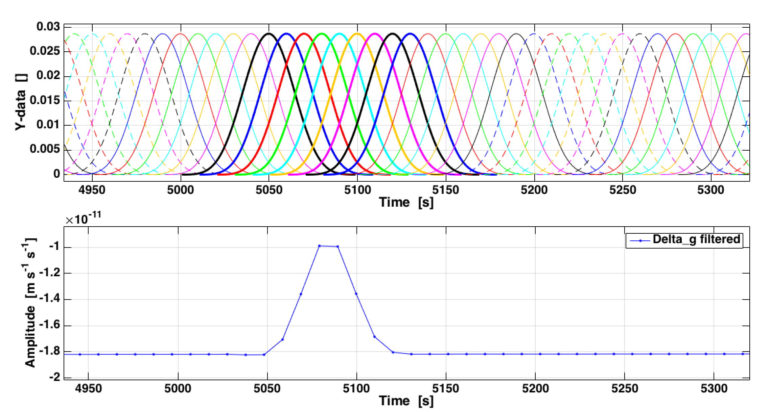

BH low pass and gap zero approach
Δg or N(t) estimation
Set to zero
n_{gap} = n_{tot} – n_{keep}
Evaluate the spectrum
BH low-pass filter
PSD correction for bias and BH transfer function
$$∆g\left(t\right)= {\ddot{x}}_{12}\left(t\right)+ω_{2}^{2}x_{12}+∆ω^{2}x_{1}−{\dot{g}}_{0}t−∆g_{DC}$$
$$N\left(t\right)=I\ddot{φ}+Iω_{0}^{2}φ+γ\dot{φ}$$
  filtering and downsampling
    n_{tot} per T_{exp} , n_{keep} per T_{fly}
    T_{samp} = T_{exp} / n_{tot}
    BH window,
Δg [m s⁻²]

Slide 13
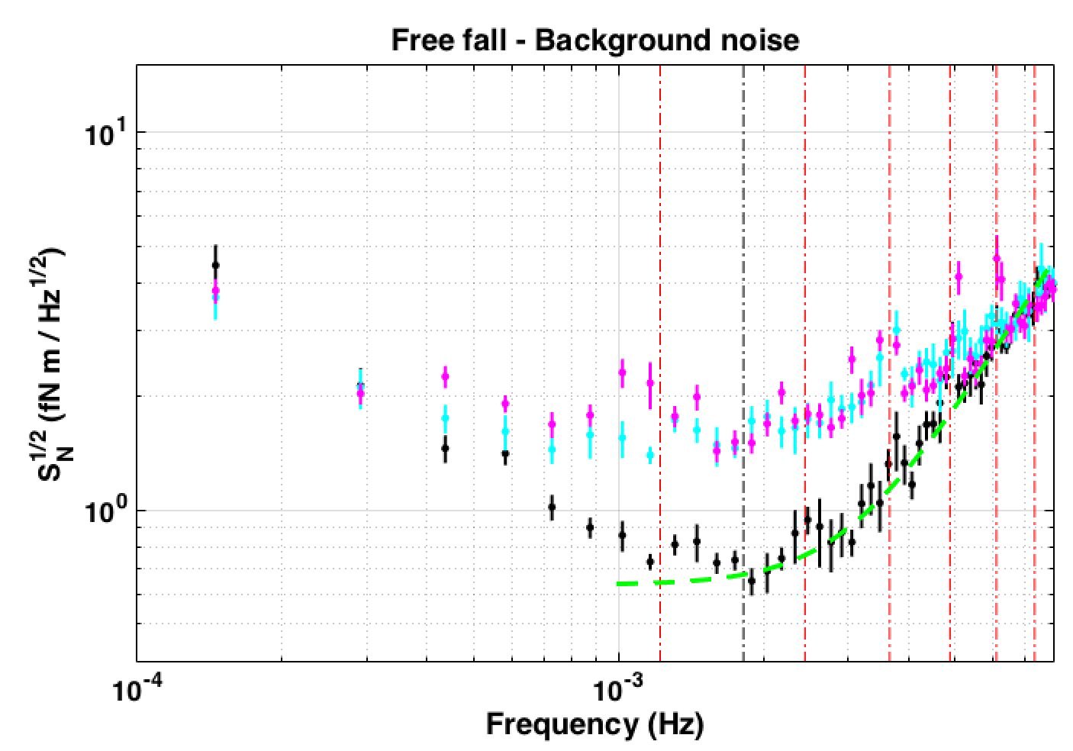
Torsion pendulum free-fall results
Torque noise
2 fN m Hz^{-1/2} @ 1 mHz
→ 100 fm s-2 Hz-1/2 acceleration noise
DC torque 10 pNm
Excess noise:
  Aliasing due to analysing gapped data (cyan)
  Aliasing of time stamping and missed sample issues in autocollimator data
MAGENTA: free-fall (BHGZ)
CYAN: Continuous (BHGZ)
BLACK: Continuous (std. no gap)
GREEN: LPF original requirements
Russano et al. CQG 35 (2018) 035017
Notes:
Dyamic range issues: Timing issues irrelevant in the continuous actuation data but give significant displacement noise in ff data because of several order of magnitude increase in the angular velocities --> peaks

Slide 14
Preliminary results: Nominal
Confirmation of noise reduction in absence of x-actuation in Nominal authority
Agreement with model prediction
Very short run, 20 h
PRELIMINARY
Notes:
Where we exaggerate the force

Slide 15
Preliminary results: URLA
Standard mode and free-fall consistent at 1𝛔 level
ϕ-control still present in URLA
upper limit for LISA (γ_{ϕ} ~ 1.2 nrad/s²)
Confirmation of actuator calibration accuracy
LPF results consolidated
PRELIMINARY
x-ϕ control
ϕ control
Notes:
Phi contr is dominant in our model of low freq but the excess noise is still under investigation

Slide 16
Conclusion
Free-fall implementation successful on-ground and in-flight
Torsion pendulum measurement limited by dynamic range issues and aliasing in gapped data
In-flight independent measurement of low frequency acceleration noise
Effectively reduction of noise in absence of x-actuation with high force configuration (Nominal)
Notes:
control maintained stable over the mission, different authority and designs
Readout and calibration depends only on interferometric differential motion measurement

Slide 17
Thank you!

