Slide 1
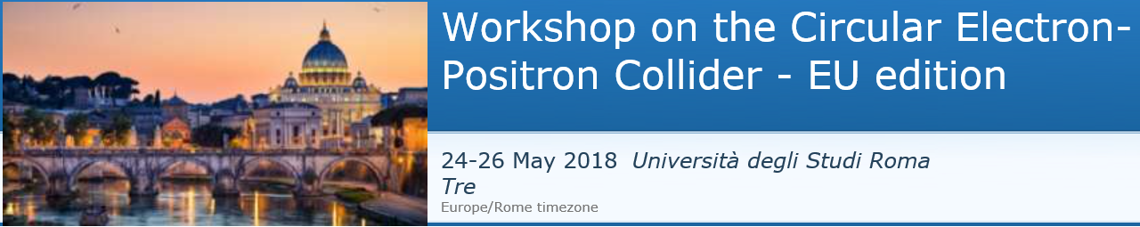
Progress of the HTS & HFS Magnet R&D for Future High-energy Accelerators
Qingjin XU
Institute of High Energy Physics (IHEP),
Chinese Academy of Sciences (CAS)
May 25 2018

Slide 2
Contents
SPPC Magnet Design Scope
Domestic Collaboration Towards HTS SPPC
Conceptual Design of the 12T IBS Dipole Magnet
High Field Dipole Magnet R&D
fabrication and test of the 1st model dipole magnet
plan for the 2nd model dipole
CERN-China HL-LHC Collaboration
Summary

Slide 3
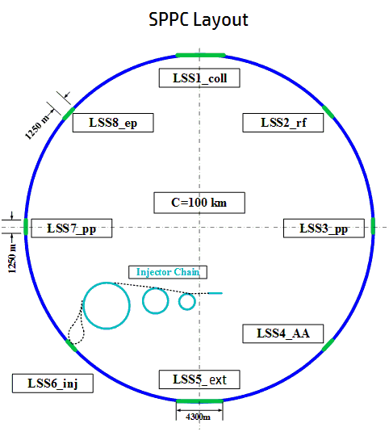
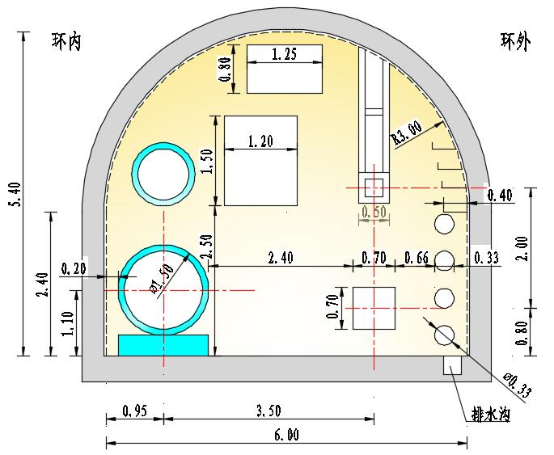
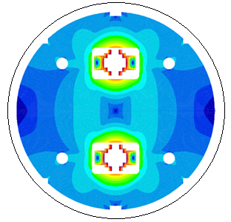
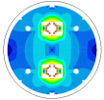
SPPC Magnet Design Scope (V201701)
SPPC
100 km in circumference
C.M. energy 70-150 (Upgrading) TeV
Timeline
Pre-study: 2013-2020
R&D: 2020-2030
Eng. Design: 2030-2035
Construction: 2035-2042
Main dipoles
Field strength: 12~24 (Upgrading) Tesla
Aperture diameter: 40~50 mm
Field quality: 10⁻⁴ at the 2/3 aperture radius
Outer diameter: 650-900 mm in a 1.5 m cryostat
Tunnel cross section: 6 m wide and 5.4 m high
6-m Tunnel for CEPC-SPPC
Conceptual design of the SPPC 12-T magnet with IBS and common coil configuration
SPPC collider
CEPC booster
CEPC collider

Slide 4
SPPC Magnet Design Scope
Baseline design
  Tunnel circumference: 100 km
  Dipole magnet field: 12 T, iron-based HTS technology (IBS)
  Center of Mass energy: >70 TeV
  Injector chain: 2.1 TeV
Upgrading phase
  Dipole magnet field: 20 -24T, IBS technology
  Center of Mass energy: >125 TeV
  Injector chain: 4.2 TeV (adding a high-energy booster ring in the main tunnel in the place of the electron ring and booster)
Development of high-field superconducting magnet technology
  Starting to develop HTS magnet technology before applicable IBS wire is available
  ReBCO & Bi-2212 and LTS wires be used for model magnet studies and as options for SPPC: stress management, quench protection, field quality control and fabrication methods
Top priority: reducing cost!
Instead of increasing field
Make IBS the high-field “NbTi”
Conductor in 10 years!

Slide 5
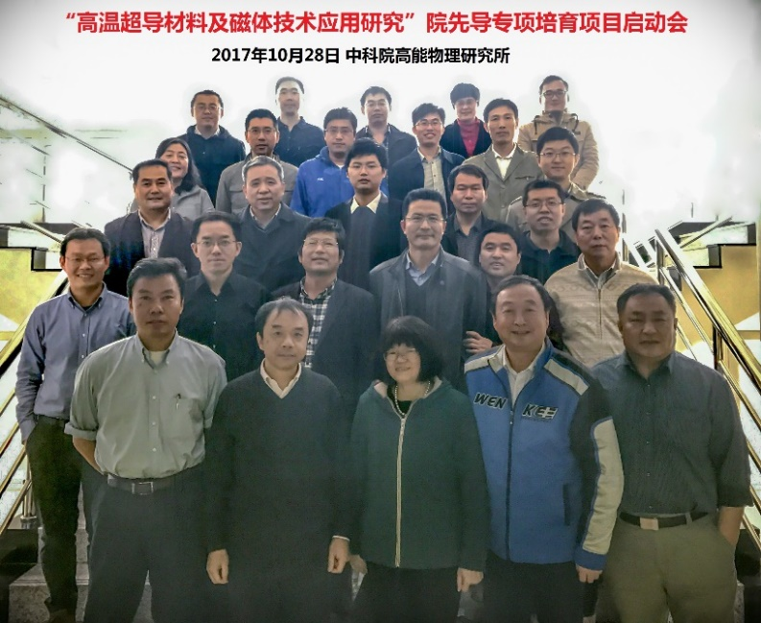
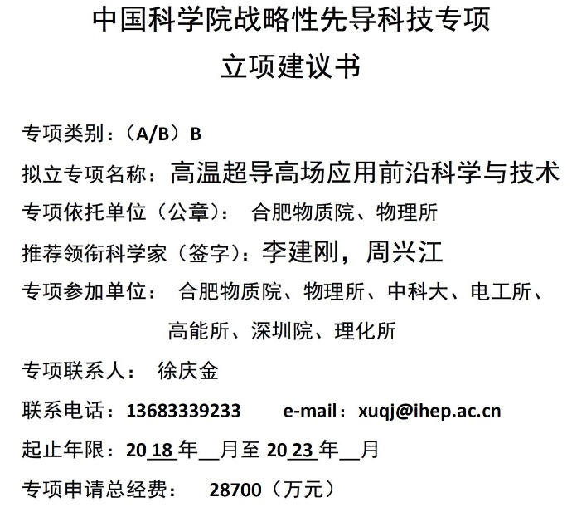
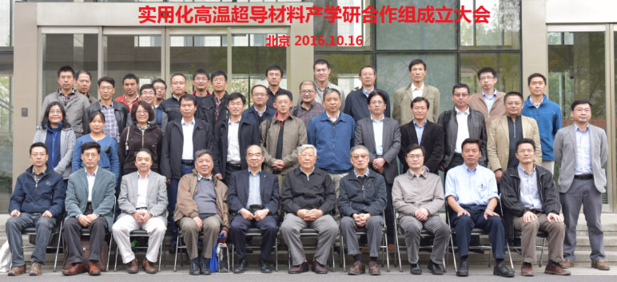
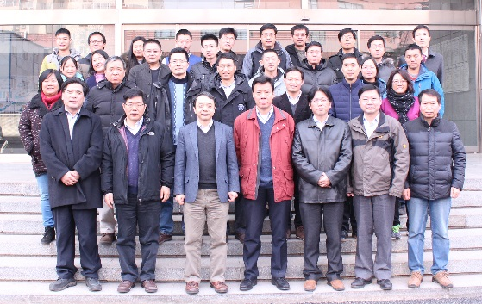
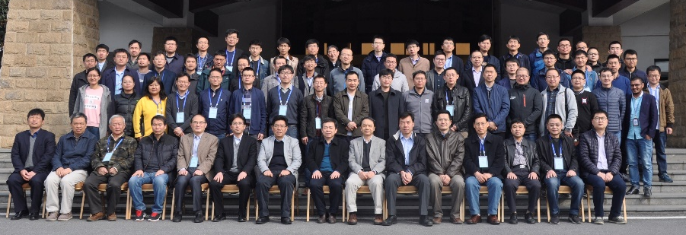
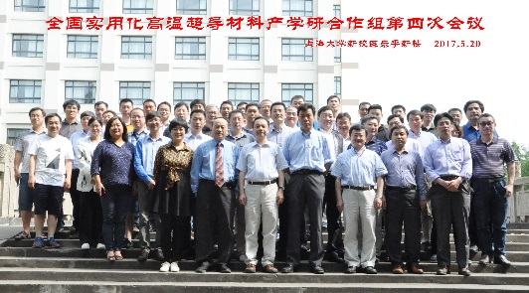
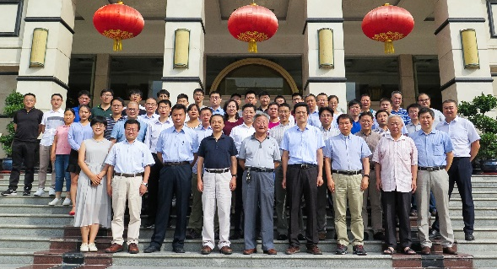
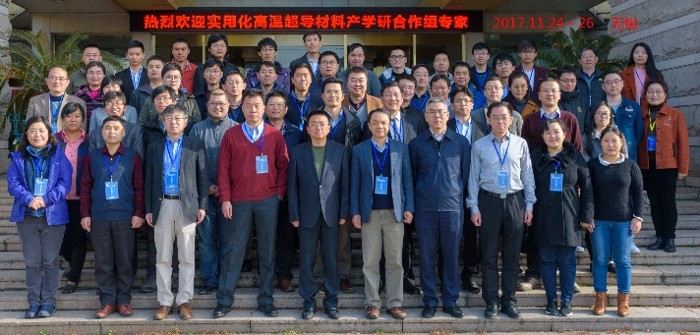
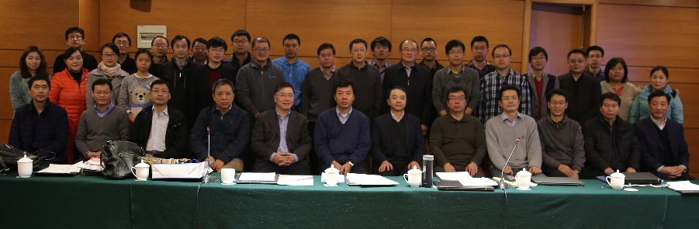
Domestic Collaboration for HTS R&D
“Applied High Temperature Superconductor Collaboration (AHTSC)” formed in Oct. 2016.
Including 18 institutions and companies in China. Regular meeting every 3 months.
Goal：
1) To increase the J_{c} of iron-based superconductor (IBS) by 10 times, reduce the cost to 20 Rmb/kAm @ 12T & 4.2K, and realize the industrialization of the conductor;
2) To reduce the cost of ReBCO and Bi-2212 conductors to 20 Rmb/kAm @ 12T & 4.2K;
3) Realization and Industrialization of IBS magnets and SRF cavities.
Working groups：1) Fundamental sciences study; 2) IBS conductor R&D; 3) ReBCO conductor R&D; 4) Bi-2212 conductor R&D; 5) Performance evaluation; 6) Magnet and SRF technology.
Proposal for
Strategic Priority Research Program
of Chinese Academy of Sciences (CAS)
Science and Technology Frontier Research
for High Field Applications of High Temperature Superconductors
Ranked No. 1 in 7 candidates
by Academic Committee of CAS !

Slide 6
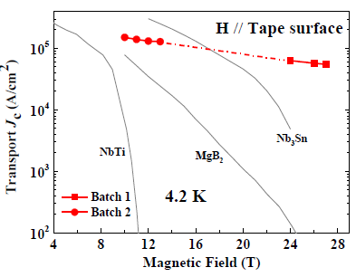
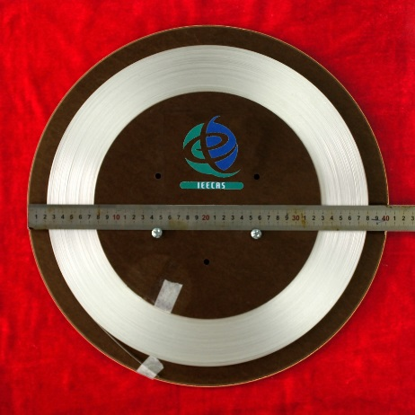
Progress on IBS wires
Supercond. Sci. Technol. 31 (2018) 015017
Y. Ma (IEECAS) et al.
Latest transport property of IBS tape (2017):
Short tape (~4 mm wide, 0.3 mm thick):
I_{c}~423 A (J_{c}>1450 A/mm²) @ 4.2 K, 12 T
100 meter long tape:
J_{c}>200 A/mm² @ 4.2 K, 12 T
Key steps to the application
115 meter long 7-core tape
IEEE TAS 27 (2017) 7300705

Slide 7
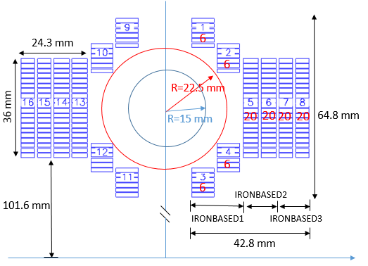
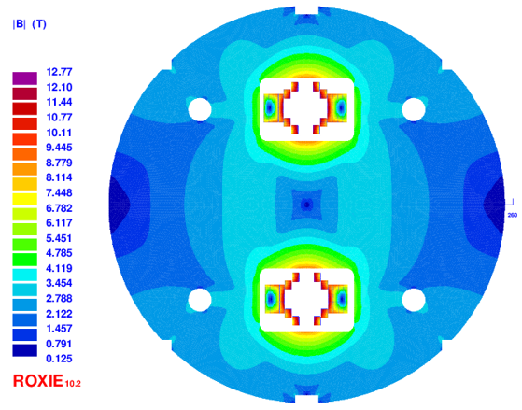
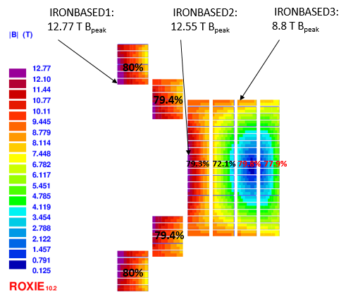
The 12-T Fe-based Dipole Magnet
Yoke OD
500mm
I_{o}=9500A
Design with expected J_{e} of IBS in 2025
Strand | diam. | cu/sc | RRR | Tref | Bref | Jc@ BrTr | dJc/dB
IBS | 0.802 | 1 | 200 | 4.2 | 10 | 4000 | 111
The required length of the 0.8 mm IBS is 6.1 Km/m
For 100-km SPPC, 3000 tons of IBS is needed
Target cost of IBS: 20 RMB (~2.6 Eur) /kAm @12 T

Slide 8
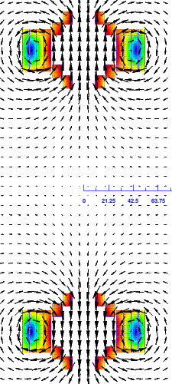
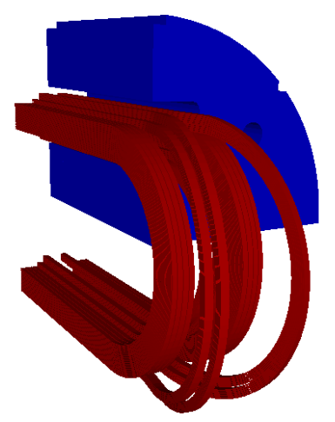
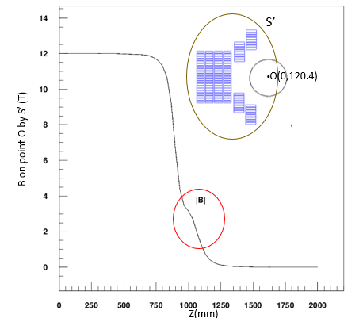
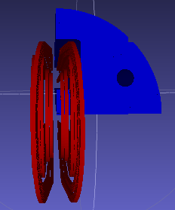
The 12-T Fe-based Dipole Magnet
Field quality in the aperture
<3*10⁻⁴ within 2/3 bore
(ROXIE simulation results)
Field quality | 2D with R_{f}= 13.3mm | 3D with R_{f}= 8/13.3 mm
b3 | 0.45 | 0.79/1.91
b5 | 1.01 | -0.65/-2.24
b7 | 0.46 | 0.08/0.67
b9 | -0.27 | -0.13/-0.22
a2 | 3.53 | -1.00/-2.31
a4 | 0.49 | -0.46/0.69
a6 | 0.33 | 0.26/2.49
a8 | 0.58 | -0.12/0.84
a10 | 2.23 | 0.06/2.18
Flare ends

Slide 9
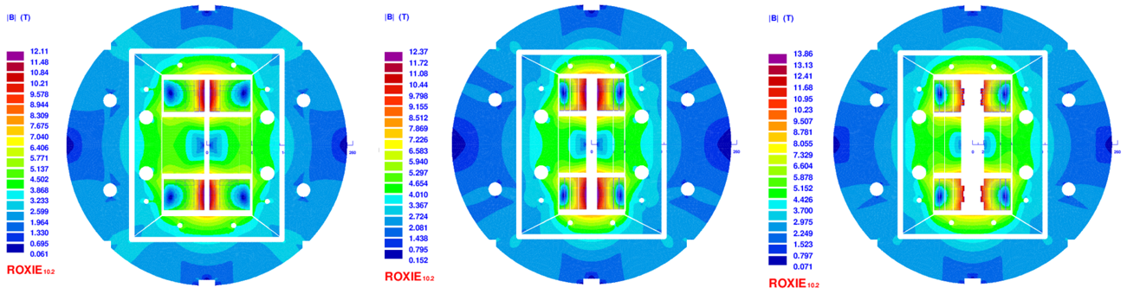
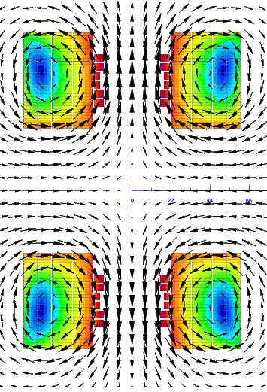
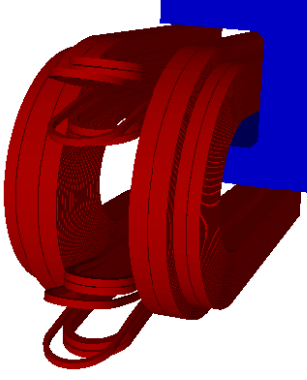
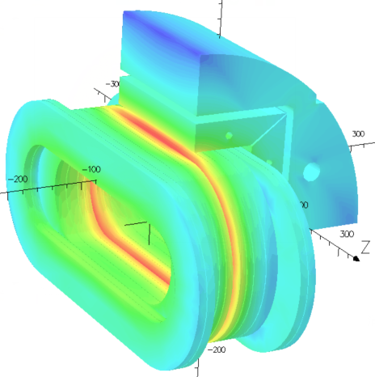
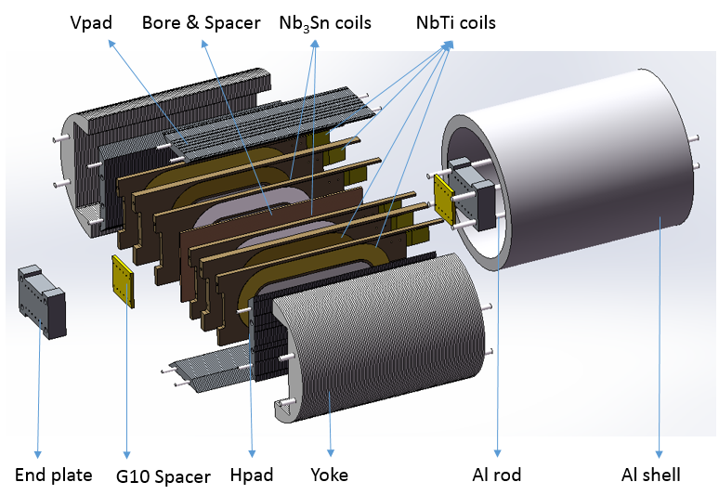
R&D of 12T Twin-aperture Dipole Magnet
R&D Roadmap for the next 10~15 years
NbTi+Nb₃Sn, 2*ф10 aperture
Nb₃Sn+HTS, 2*ф20 aperture
All HTS, 2*ф40 aperture
Magnetic flux distribution
3d coil layout
3D magnetic field distribution
Components and assembly

Slide 10
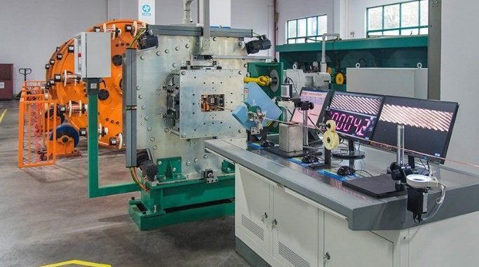
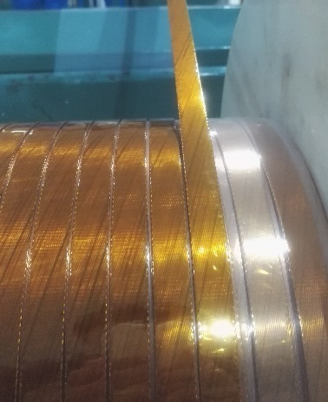
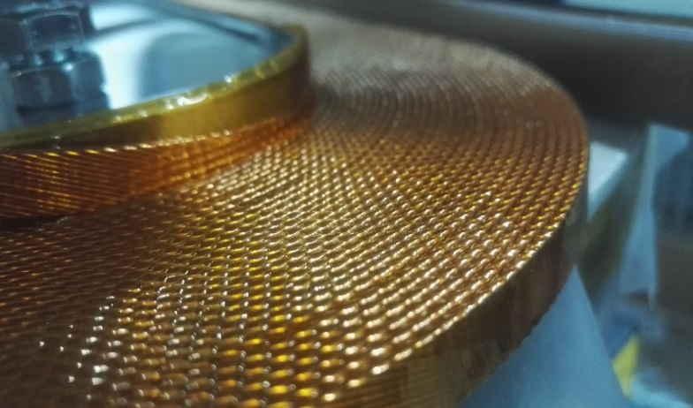
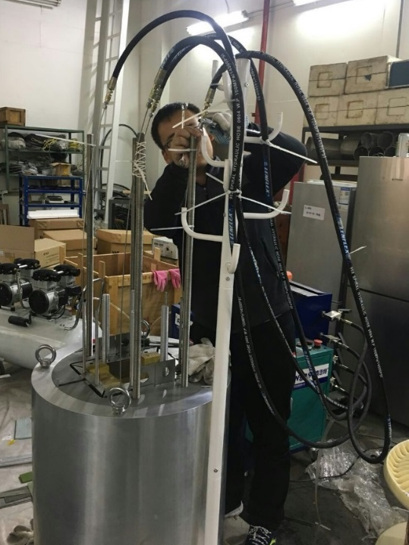
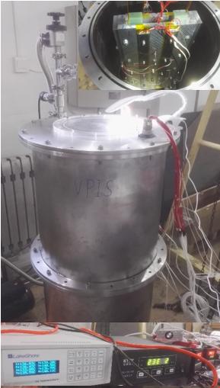
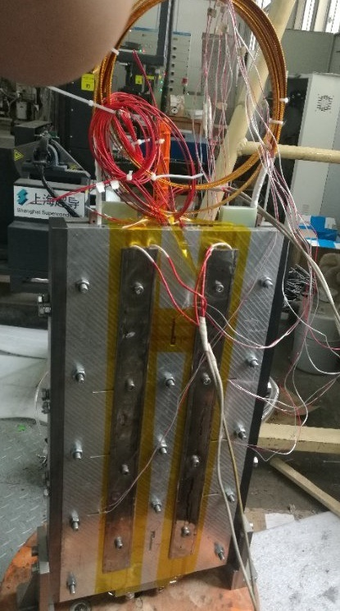
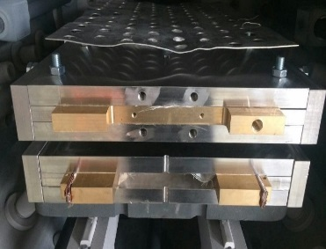
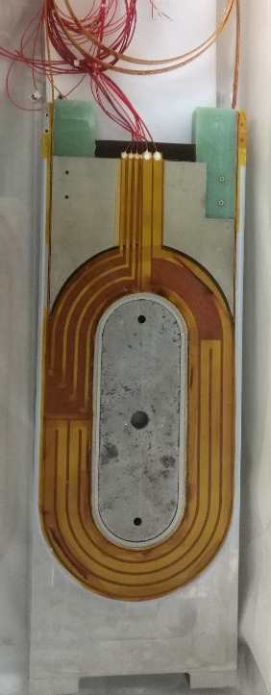
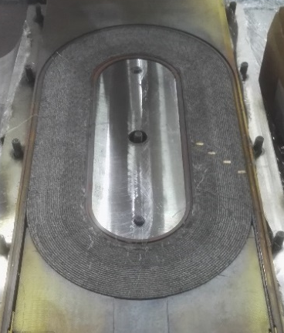
R&D of 12T Twin-aperture Dipole Magnet
Fabrication of the 1st model dipole magnet (NbTi+Nb₃Sn)
Cabling Coil winding HT VPI Magnet assembly Test
Cabling Machine
Rutherford Cable
Coil Winding
Impregnated
Coil
Magnet Assembly
VPI
VPI Coil Package
Heat Reaction

Slide 11
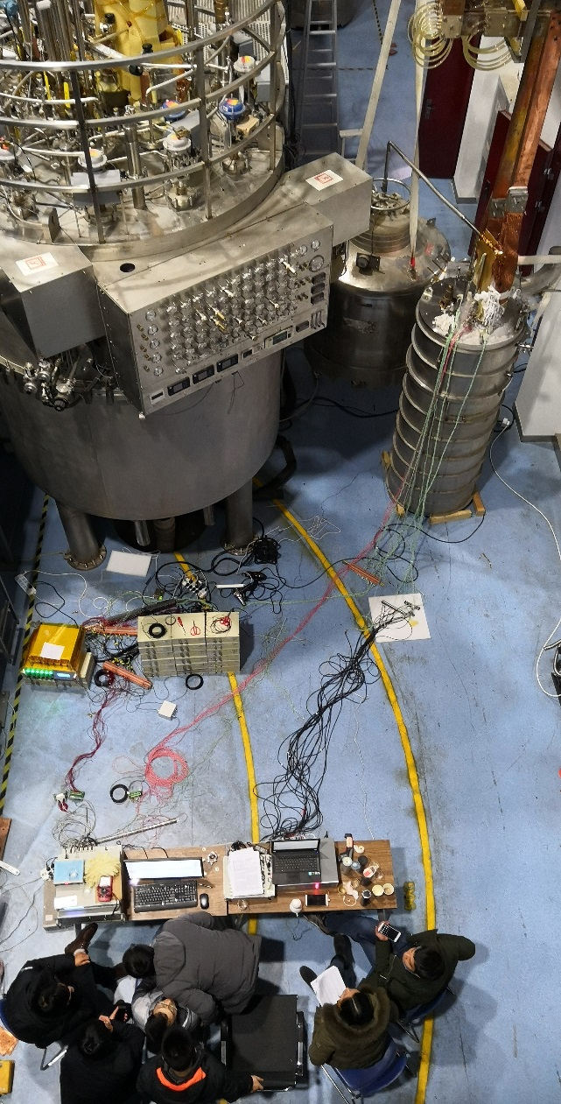
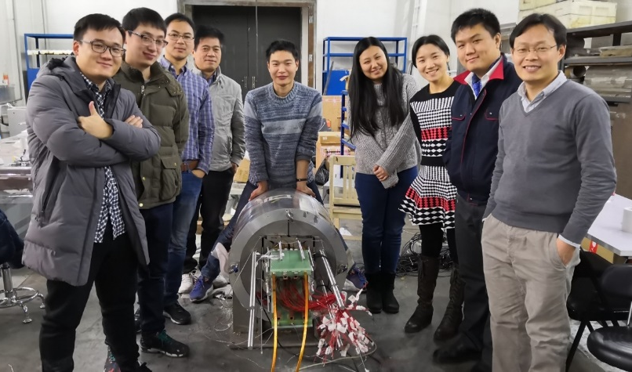
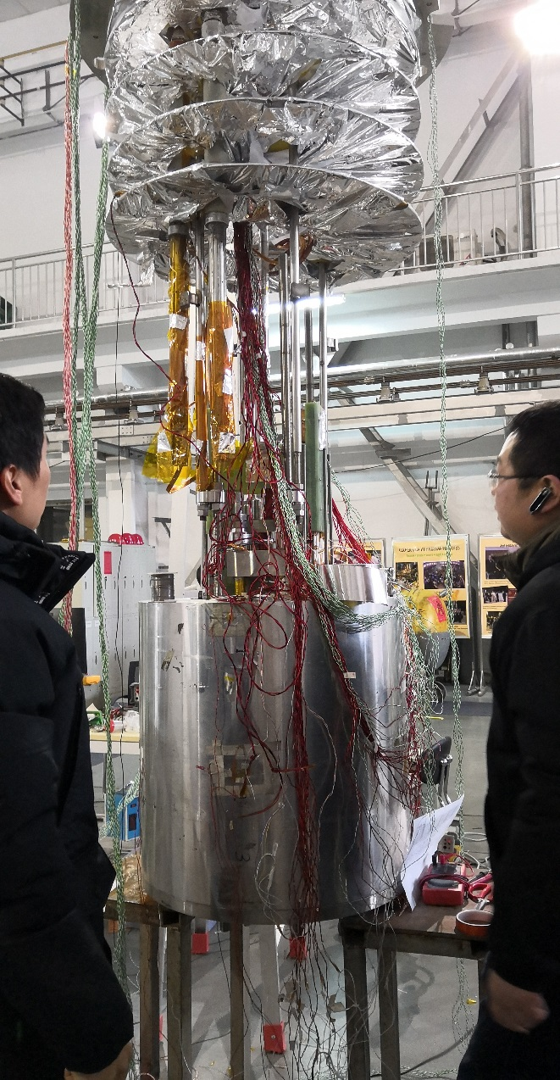
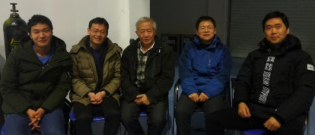
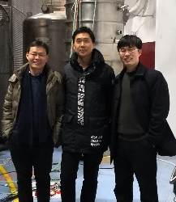
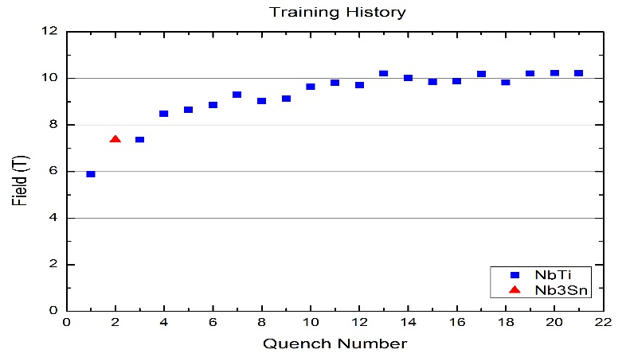
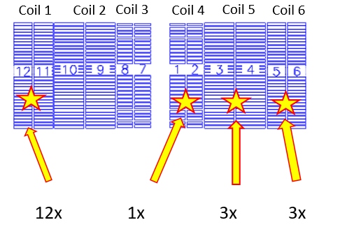
R&D of 12T Twin-aperture Dipole Magnet
1st test result of the 1st high-field dipole magnet in China Feb. 2018
Magnet fabrication @ Beijing
10.2 T @ 4.2 K dipole field
in two apertures
(Performance limited by NbTi coils)
Magnet under test @ Hefei
Test system setup @ Hefei

Slide 12
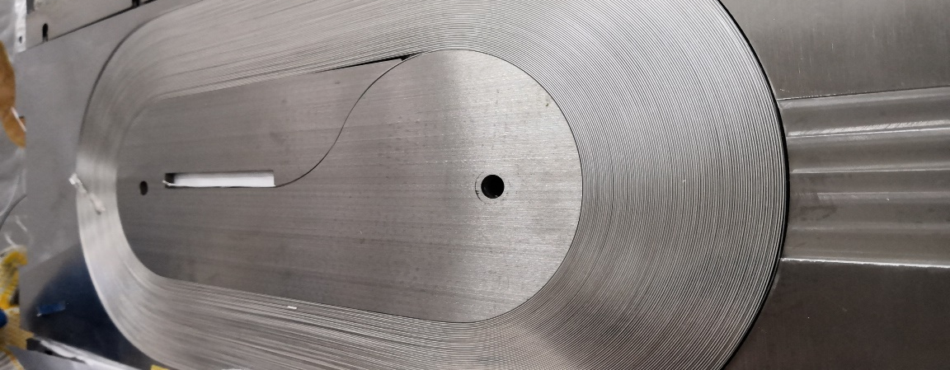
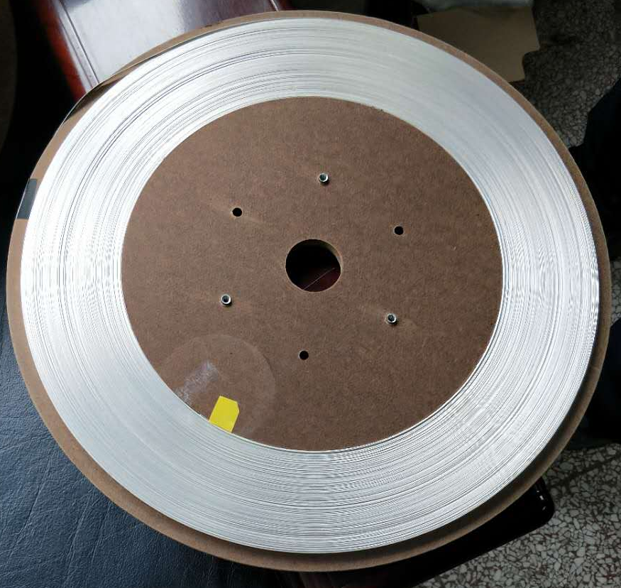
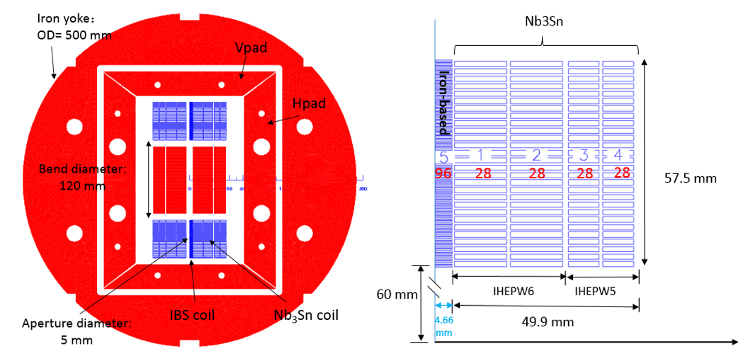
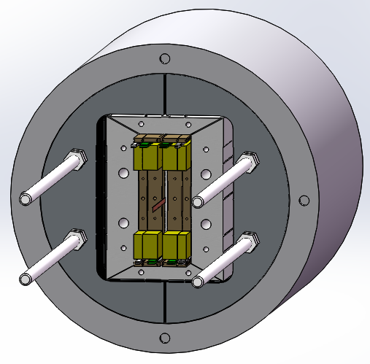
R&D of 12T Twin-aperture Dipole Magnet
Next step：Replace NbTi coils with new Nb₃Sn coils to further increase the field，and insert the IBS coil to test its high field performance.
2*100m IBS tapes
IBS coil
IEECAS
2nd model dipole magnet(Nb₃Sn+IBS)

Slide 13

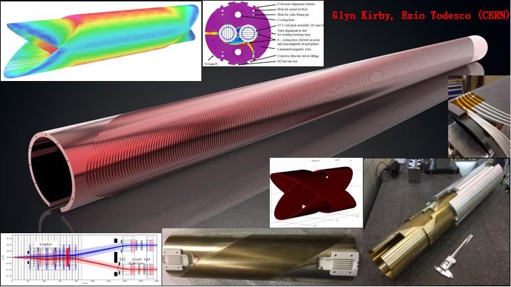
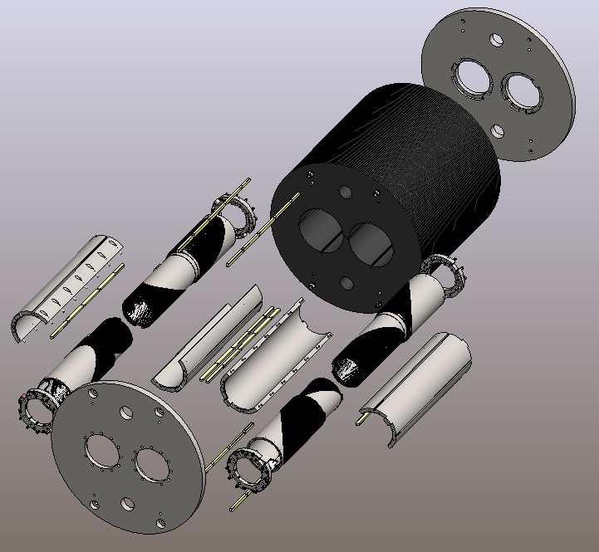



CERN & China Collaboration
Making 12 units CCT corrector magnets for HL-LHC before mid 2021
A 0.5m model magnet to be fabricated and tested by May or June 2018
0.5m model magnet
China Version
0.5m model magnet
CERN Version
0.5m model magnet China Version

Slide 14
Summary
SPPC design scope: 12 T IBS magnets to reach 70TeV with 100 km circumference. Upgrading phase: 20~24 T IBS magnets to reach 125~150 TeV.
Strong domestic collaboration for the advanced HTS conductor R&D: Make IBS the High-T_{c} and High-Field “NbTi” conductor in 10 years!
R&D of high field magnet technology: 1st model dipole (NbTi+Nb₃Sn) reached 10.2 T @ 4.2 K in two apertures; 2nd model dipole (Nb₃Sn+IBS) to be fabricated and tested soon.
CERN & China Collaboration: Making 12 units CCT corrector magnets for HL-LHC before mid 2021.

Slide 15

Thanks for your attention!

