Slide 1
Higgs physics at Circular Electron-Positron Collider
Yaquan Fang (IHEP) on behalf of
the team of CEPC Higgs physics
Workshop on the Circular Electron-Positron Collider
Università degli Studi Roma Tre
May 24-26, 2018

Slide 2
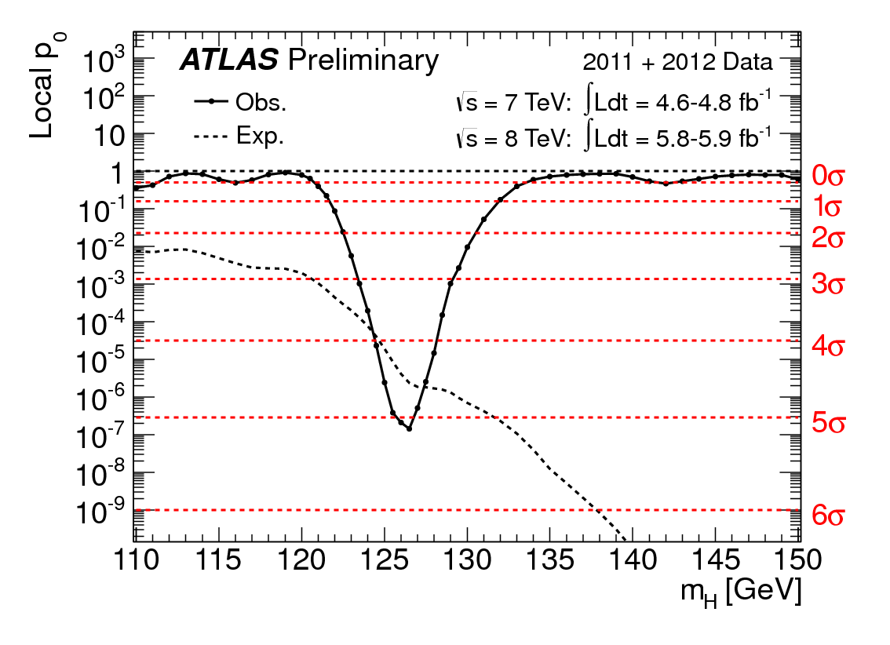
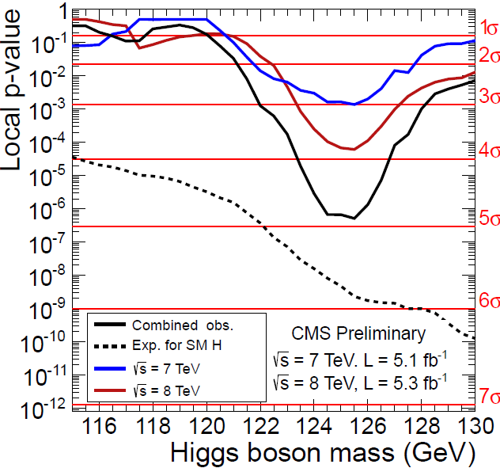
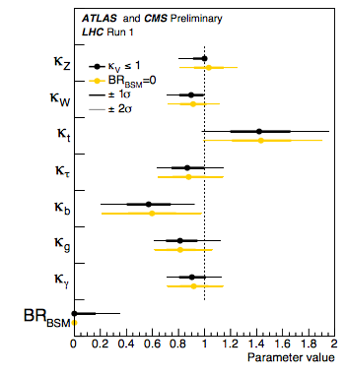
Motivation
The discovery of Higgs in 2012 is a milestone of particle physics.
The further measurements of the properties of the particle confirm it is SM Higgs.
The precision of Higgs measurement is important since the new physics (NP) could introduce a deviation (∆~cν²/M_{NP} ²) which is proportional to 1/M_{NP}².
With LHC, some systematics shows the bottleneck, e.g. theoretical sys. , for the precise measurements of the Higgs coupling etc…
A lepton collider Higgs factory can provide a direct measurement of the Higgs xsection.

Slide 3
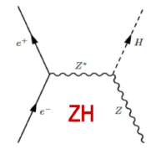
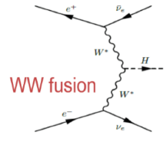
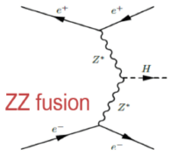
Higgs related physics at e⁺e⁻ collider
With the increase of the energy, different Higgs related physics can be explored at e⁺e⁻ collider.
With the energy around 240 GeV, ZH as well as ww/zz fusion can be intensively studied.
the dominant production is from HZ, the WW/ZZ fusions contribute a few percent of the total cross-section.

Slide 4
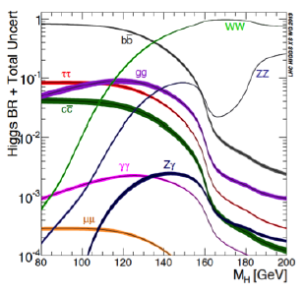
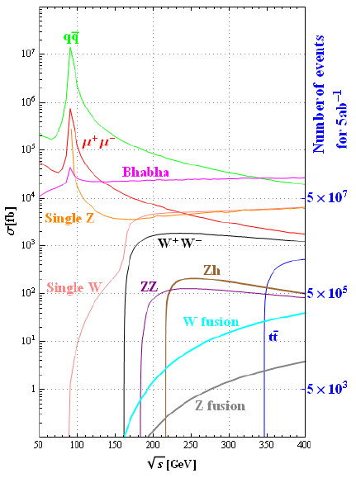
SM Higgs decay branching ratio, Bkg process
e⁺e⁻ collider provides a good opportunity to measure the jj,
invisible decay of Higgs.
For 5 ab⁻¹ data with CEPC, 1M Higgs, 10M Z, 100M W are produced.

Slide 5
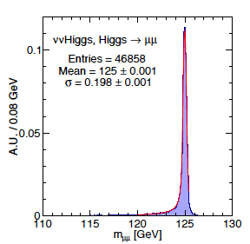
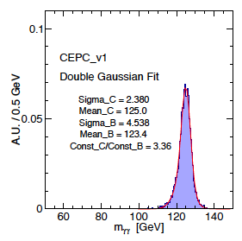
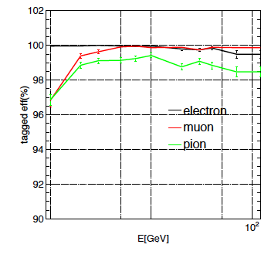
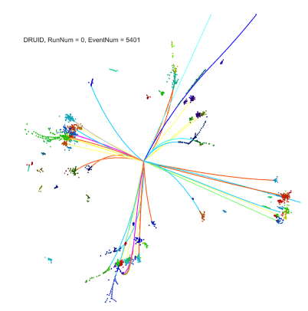
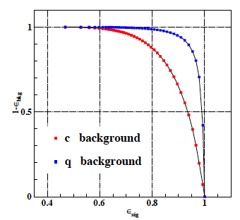
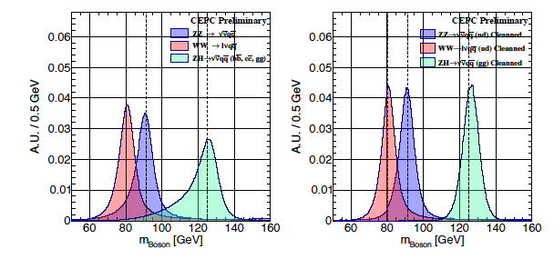
Performance (CEPC_v1)
Recon. and ID eff.
Reliable Particle recon.,
ID and fake rejection
Good mass resolution of
Higgs (more can be found in
Performance talks)
Manqi’s talk tomorrow

Slide 6
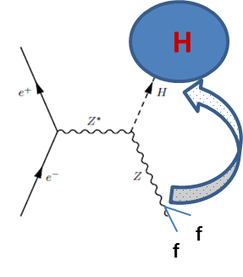
Direct measurement of Higgs cross-section
For this model independent analysis, we reconstruct the recoil mass of Z without touching the other particles in a event.
The M_{recoil} should exhibit a resonance peak at m_{H} for signal; Bkg is expected to smooth.
The best resolution can be achieved from Z(→e⁺e⁻, μ⁺μ⁻).

Slide 7
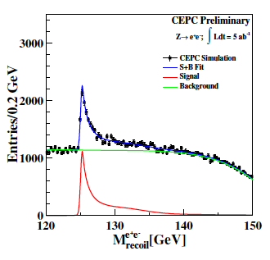
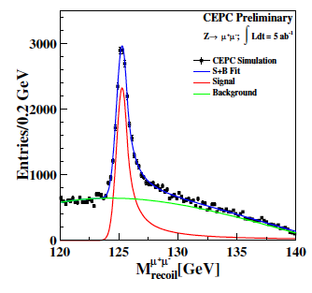
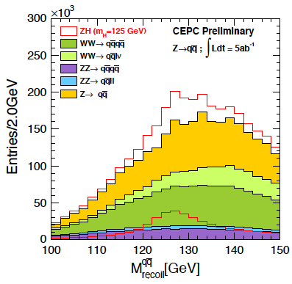
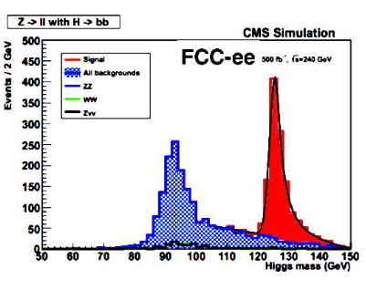
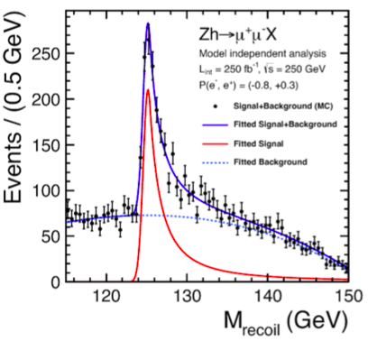
Direct measurement of Higgs cross-section
∆σ/σ=2.1%
∆σ/σ=0.65%
∆σ/σ=0.9%
The combined precision with three channels is ∆σ/σ=0.5%
Similar sub-percent level for ILC/FCC-ee
ILC

Slide 8
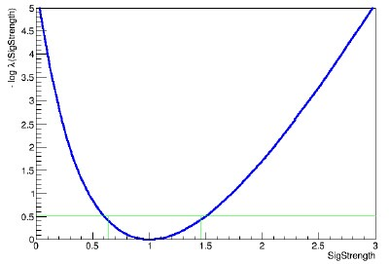
Measurements of (σ▪Br)/(σ▪Br) and ∆Br/Br
1. A likelihood L(ϴ) is built :
f
Shape info.
for the discriminating
Variables considered.
2. A profile likelihood ratio λ(μ) (μ signal strength in our case: σ▪Br) is constructed to estimate the parameters of interest:
If the likelihood ratio follows a χ² distribution,
the significance can be approximately computed as
sqrt[-2*log(λ)] with μ=1;
Similarly, one can scan μ (Minuit) and the error of μ is the
distance of x-axis between μ=1 and the point on the curve
corresponding to –log(λ)= 0.5.
For the measurement of Br, the uncertainty from total
xsection obtained from previous page is incorporated
into the fit.
A simultaneous fit to different channels is implemented to take
into account the correlations.
3.
-Δμ
+Δμ

Slide 9
Measurement of Higgs width
Method 1: Higgs width can be determined directly from the measurement of σ(ZH) and Br. of (H->ZZ*)
But the uncertainty of Br(H->ZZ*) is relatively high due to low statistics.
Method 2: It can also be measured through:
These two orthogonal methods can be combined to reach the best precision.
Precision : 5.1%
3.1%
Precision : 3.7%
Precision : 3.3%

Slide 11
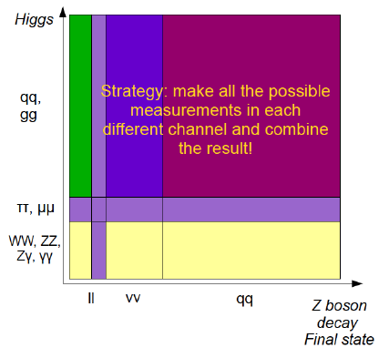
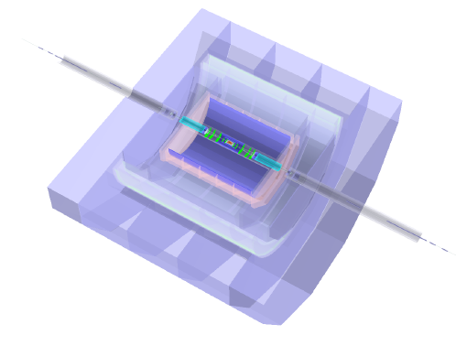
Higgs analyses toward CEPC CDR
Much more channels
with full simulated
samples
CEPC_V1: 250 GeV/3.5T,…
CEPC_V4: 240 GeV/3T,….

Slide 12
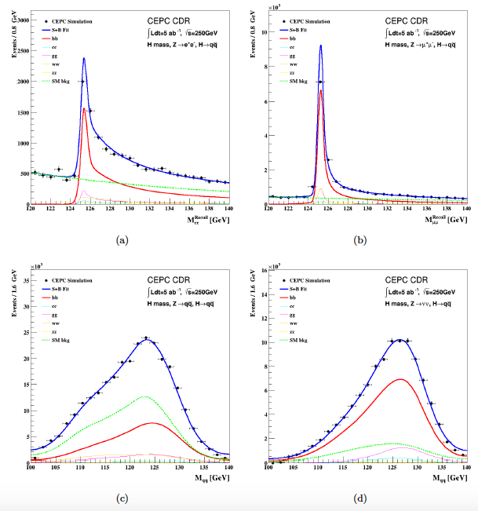
Measurement of ∆(σ▪Br)/(σ▪Br ) of ZH(jj)
$$B_{likeness}=\frac{b_{j1}b_{j2}}{b_{j1}b_{j2}+(1−b_{j1})(1−b_{j2})}$$
See more at Yu Bai’s talk tomorrow:
The analysis has migrated from fitting on the Z recoil mass of as a discriminating variable to on the flavor-tagging (2-D fit with B-likeliness & C-likeliness); The method of 3-D fit will be more effective.
The combined precisions of for the measurement of H->bb,cc,gg for CEPC are 0.3%, 3.2%, 1.5% respectively.

Slide 13
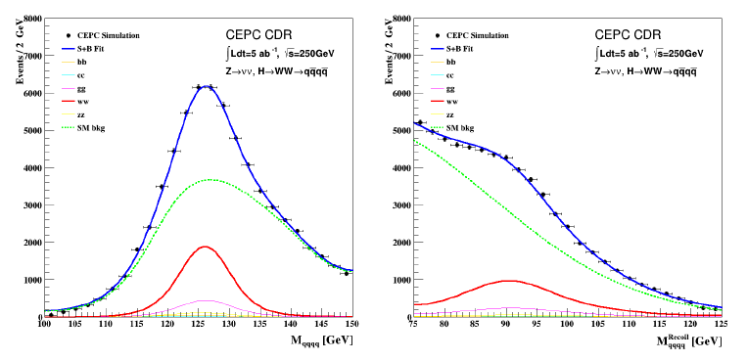
Measurement of ∆(σ▪Br)/(σ▪Br ) of ZH(WW*)
Full sim.
Leptonic
Full sim.
See more at Tong Li’s talk tomorrow
This channel is necessary for the Higgs width measurement.
Hadronic, Leptonic and semi-leptonic decays of W bosons can be used in the analyses.
Considering its complicate final states, MVA technique can be implemented to further suppress bkg.
The most dominant one is Z(->vv)H(->4j) and the combined expected precision is 1.2%.

Slide 14
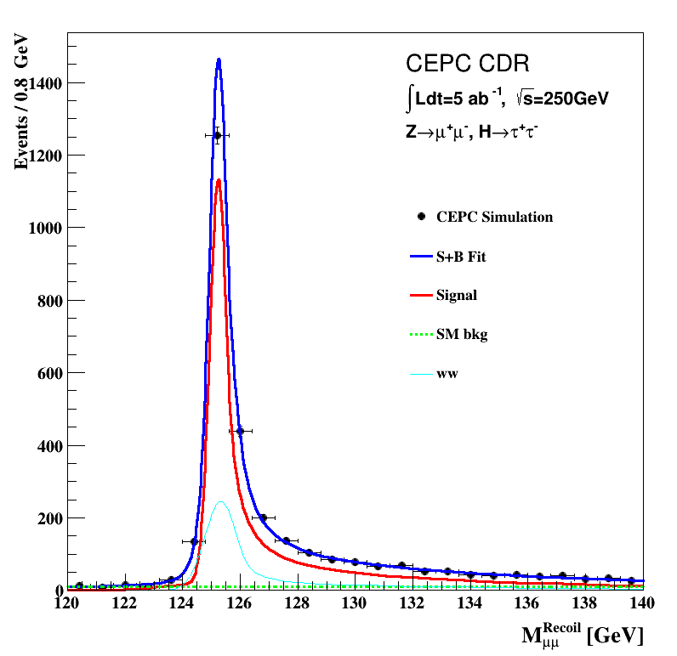
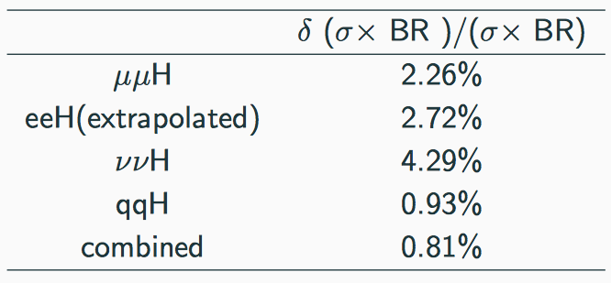
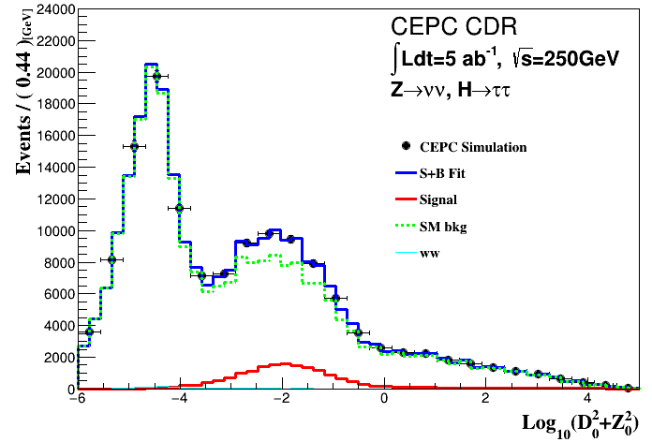
Measurement of ∆(σ▪Br)/(σ▪Br ) of ZH(ττ)
Develop LICH to identify tau.
Signal and ZH events(Main WW) share the same shape
use $\log_{10}{(D_{0}^{2}+Z_{0}^{2})}$ fit to separate signal from bkgs.
Impact parameter, Distance from beam spot
See more detail at Dan Yu’s talk tomorrow:

Slide 15
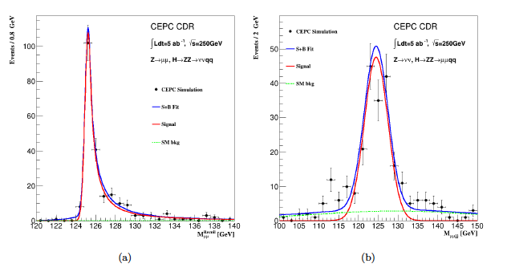
Measurement of ∆(σ▪Br)/(σ▪Br ) of ZH(ZZ*)
3 final Z, one off-shell.
The results of Pre_CDR are extrapolated from the FCC-ee
Now we have 3 channels studied
Need more manpowers to exploit the other sub-channels.
Anomalous coupling studied.
See more at Yanyan Gao’s talk.

Slide 16
Measurement of ∆(σ▪Br)/(σ▪Br ) of ZH(γγ)
Z(->ee)H(->γγ) is not considered due to large bkg from Bhabha process.
A mixed fast ((Z->ll)H(->γγ)-full (Z(->qq)H->γγ) simulated signal samples used in the analyses.
The combined expected precision is 8.1%.
See more at Fangyi Guo’s talk tomorrow

Slide 17
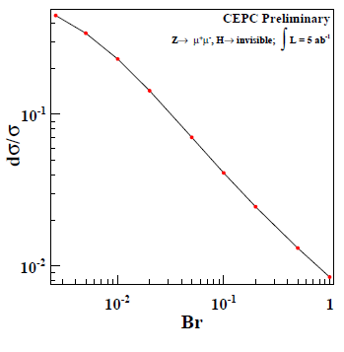
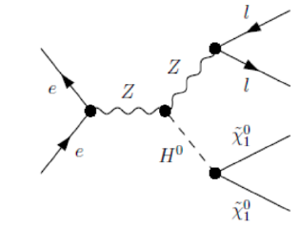
Measurement of the invisible decay of Higgs
Invisible can be produced e.g. by the invisible decay of Higgs,NMSSM,2HDM+singlet…
The recoil mass method provides a chance to have the direct measurement.
Precision of invisible decay as a function of Br.
(0.5% for FCC-ee)
See more at Xin Shi’s talk tomorrow

Slide 18
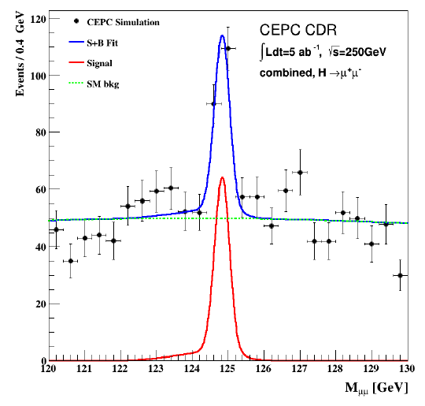
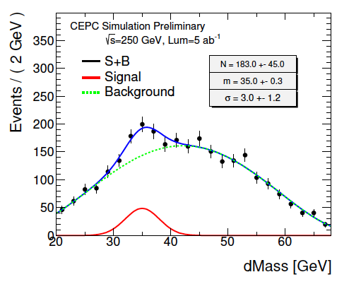
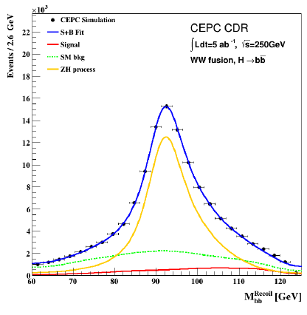
Higgs rare decays and ww-fusion
See more detail at Hao Liang’s talk about ww fusion
H->μμ
See more detail at Kaili Zhang’s talk about H->μμ
ww fusion (ννH->bb)
H->Ζγ
The expected precision is 15.9% for H->μμ.
The process of Z(->νν)H(->Zγ->qqγ) is studied and dMass=M_{qqγ}-M_{qq} is used.
The expected precision is 21%, 4σ with 5 ab⁻¹ for CEPC
For WW fusion:
the Z(->vv)H->bb is the irreducible bkg.
2D fit on polar angle and recoil mass is used.
Expected precision is 3.1%

Slide 19
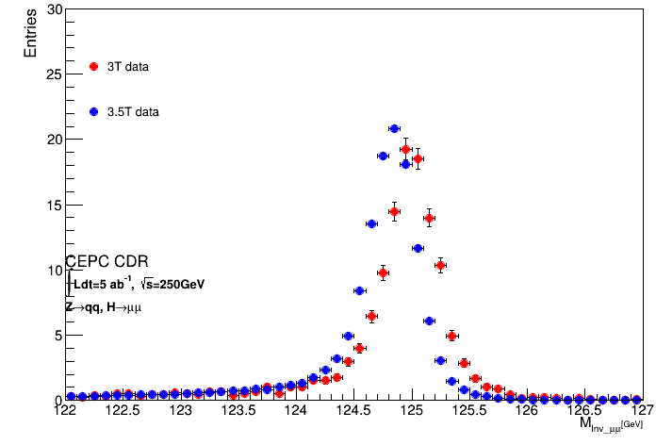
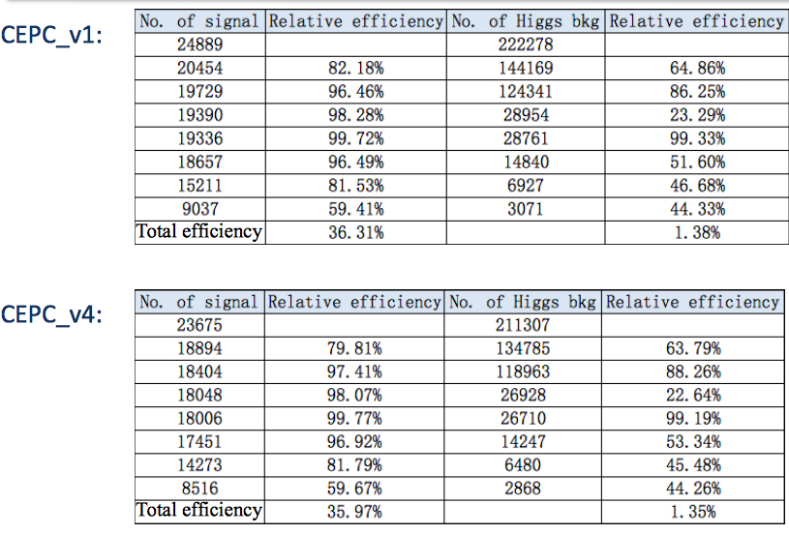
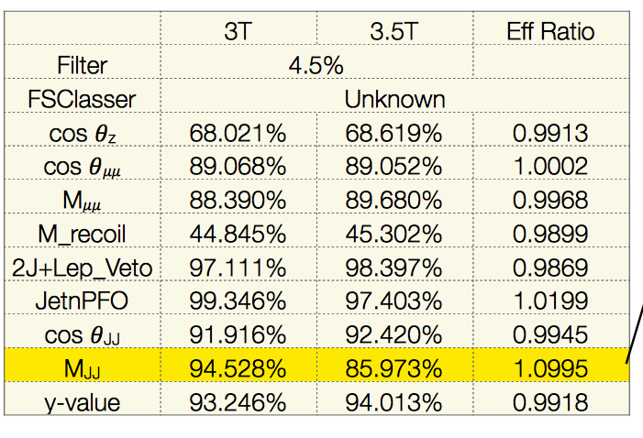
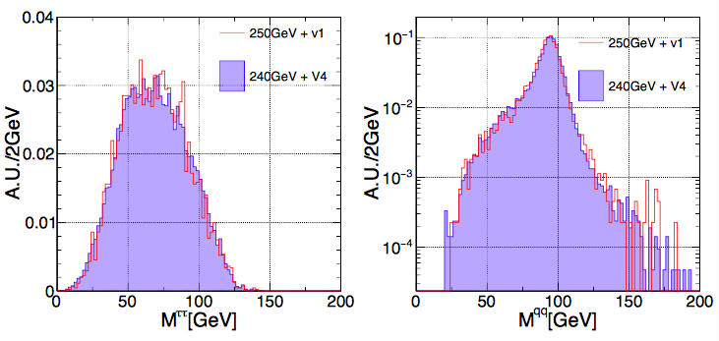
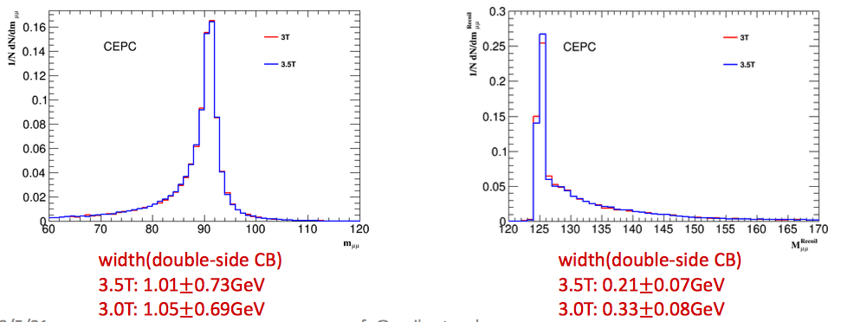
Ongoing study for CEPC: from 3.5T/250 GeV to 3T/240 GeV
Z(->μμ)H(->jj)
Z(->qq)H(->μμ)
0.2 GeV shift
Sqrt(s)=250 GeV
Z(->νν)H(->ww*->4j)
Z(->μμ)H(->γγ)
Sqrt(s)=240 GeV
Z(->qq)H(->ττ)

Slide 20
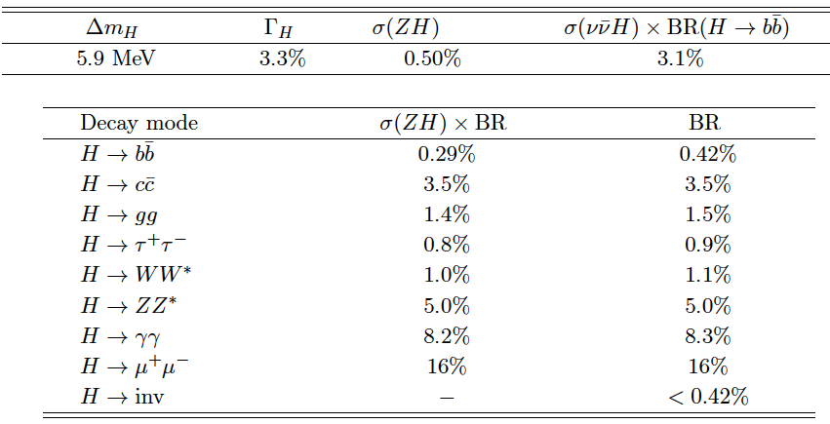
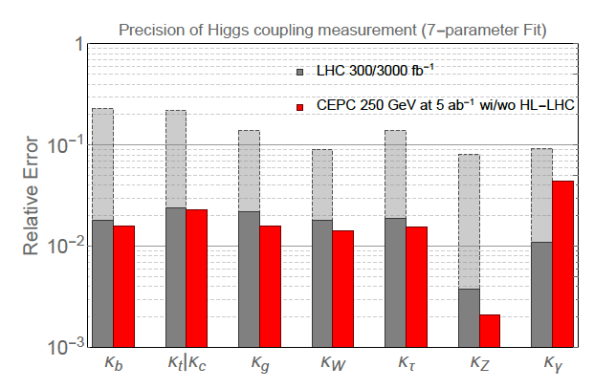
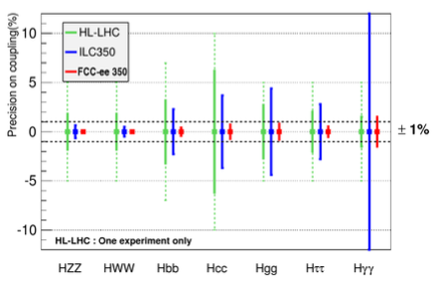
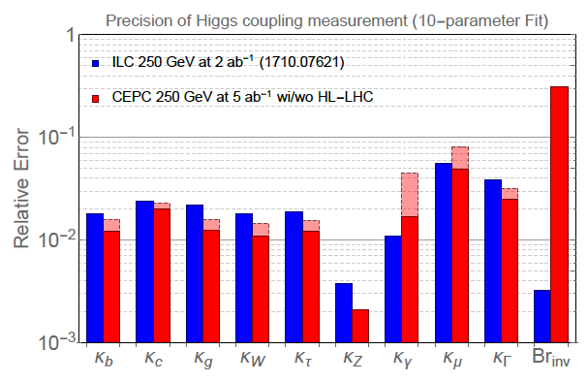
Summary of the precision for the measurement of Higgs
With combination of σ▪Br of ννH(→bb) /Br(H->bb)/Br(H->ww) and the direct measurement, one can obtain the decay width of Higgs with the precision at ~3%.
The measurement of Br is done by introducing the uncertainty of xsection of ZH from the direct measurement around sub-precent level.
Most precisions are a few percent or lower (bb, invisible), allowing us to be sensitive to BSM deviation
In comparison with HL-LHC, e⁺e⁻ machine is expected to have much better performance in the measurements of the coupling constants .

Slide 21
Channels (now 36)
Manpowers now (or people interested) :
H->bb,cc,gg Yu Bai (Southeast Univ.),Chunhui Chen (Iowa)
H->γγ Fangyi Guo (IHEP)
H->ττ Dan Yu (IHEP), Xin Chen (Tsinghua)
H->μμ Kaili Zhang (IHEP), Haifeng Li & Boqun Liu(Shandong)
H->WW Tong Li & Lianliang Ma(Shandong)
Nikos Rompotis (Liverpool)
H->ZZ Ryuta Kiuchi (IHEP), Xin Shi(IHEP)
Shih-Chieh Hsu & Alex Schuy (Washington)
Zhuoni Qian (Pittsburgh), Yanyan Gao (Liverpool)
WW fusion Hao Liang (IHEP)
H->Invisible Xin Shi & Maoqian Jing (IHEP)
H->Zγ Weiming Yao (LBNL)
Combination : Kaili Zhang (IHEP), Jin Wang (Syndney)
Interpretation: Liantao Wang (Chicago), Shufang Su (Arizona)
Tao Han (Pittsburgh), Tao Liu(HKUST),
Zhen Liu (Fermilab), Jiayin Gu(DESY),
Weekly Meetings on Thursday night (9pm, Beijing) towards
Higgs white paper and contribution to CDR
cepc-physics@maillist.ihep.ac.cn
Coordinators for the efforts:
Jianming Qian (Michigan), Yaquan Fang (IHEP)
Gang Li (IHEP), Manqi Ruan (IHEP)
Signal |  | Observed | Who takes charge | Last update |  | Signal |  | Observed | Who takes charge | Last update
Z | H |  |  |  |  | Z | H
H->qq |  |  |  |  |  | H->WW
ee | bb | 21441 | Baiyu | 2017.7 |  | μμ | μvμv | 52 | Libo | 2017.4
 | cc | 983 |  |  |  |  | evev | 36
 | gg | 2965 |  |  |  |  | evμv | 105
μμ | bb | 29771 |  |  |  |  | evqq | 663
 | cc | 1514 |  |  |  |  | μvqq | 717
 | gg | 4380 |  |  |  | ee | μvμv | 44
qq | bb | 176478 |  |  |  |  | evev | 22
 | cc | 8256 |  |  |  |  | evμv | 81
 | gg | 25244 |  |  |  |  | evqq | 612
vv | bb | 69820 |  |  |  |  | μvqq | 684
 | cc | 3029 |  |  |  | vv | qqqq | 9022
 | gg | 9522
H→γγ |  |  |  |  |  | H->ZZ
ll | γγ | 90 | Feng | 2015 |  | vv | μμjj | 190 | Yuqian | 2016.9
vv |  | 328 |  |  |  | μμ | vvjj | 209
qq |  | 828 | Yitian | 2017.4 |  | ee | vvjj | 72
H→ll |  |  |  |  |  | H->Invisible
μμ | ττ | 2113 | Dan | 2017.7 |  | qq | vvvv | 291 | MoXin | 2017.7
qq |  | 36024 |  |  |  | ee |  | 13
nn |  | 12478 |  |  |  | μμ |  | 24
Inc. | μμ | 47 | Zhenwei | 2016.8
More manpowers are needed
and welcome !!!

Slide 22
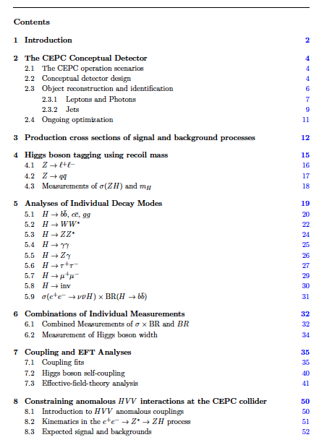
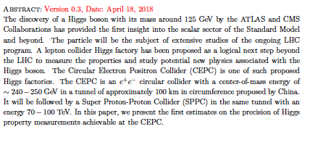
Status of the Higgs white paper

Slide 23
Conclusion and outlook
The study of the Higgs physics based on CEPC_v1 samples is close to be completed.
Much more full simulated samples have been analyzed.
Correlations between different channels have been taken into account.
Couplings (κ, EFT) have done
The studies on CEPC_v4 samples are still ongoing.
More manpowers are needed.
Higgs physics white paper is mostly done and the contribute for CDR will come soon.
A mini-workshop on June 26-27 will be organized to discuss the future analysis strategies for the CEPC Higgs physics.

Slide 24
Backup slides

Slide 25
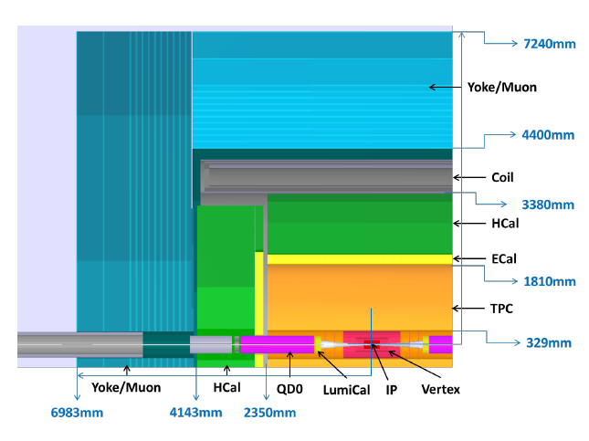
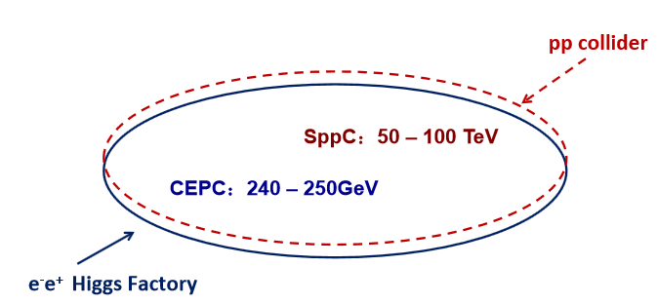
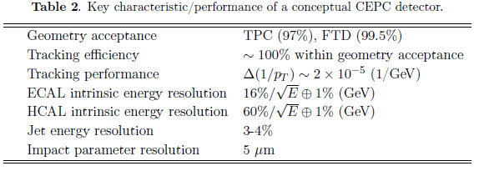
CEPC
A CEPC (phase I )+ Super proton-proton
Collider (SPPC) was proposed
Ecm ~240-250 GeV, Lum 5 ab⁻¹ for 10 years

Slide 28
Explanation for difference from pre-CDR to CDR
(5ab⁻¹) | Pre_CDR | Combined
$$σ(ZH)$$ | 0.51% | 0.50%
$$σ\left(ZH\right)∗Br(H→bb)$$ | 0.28% | 0.28%
$$σ\left(ZH\right)∗Br(H→cc)$$ | 2.2% | 3.5%
$$σ\left(ZH\right)∗Br(H→gg)$$ | 1.6% | 1.4%
$$σ\left(ZH\right)∗Br(H→WW)$$ | 1.5% | 1.0%
$$σ\left(ZH\right)∗Br(H→ZZ)$$ | 4.3% | 5.0%
$$σ\left(ZH\right)∗Br(H→ττ)$$ | 1.2% | 0.8%
$$σ\left(ZH\right)∗Br(H→γγ)$$ | 9.0% | 8.1%
$$σ\left(ZH\right)∗Br(H→μμ)$$ | 17% | 16%
$$σ\left(vvH\right)∗Br(H→bb)$$ | 2.8% | 3.1%
$${Br}_{upper}(H→inv.)$$ | 0.28% | 0.42%
$$σ\left(ZH\right)∗Br(H→Zγ)$$ | \ | 4σ(21%)
bb,cc,gg: Due to flavor tagging algorithm, The template gives b/c likeness, updated algorithm has less cc candidate events left.
WW: more subchannels studied and ZH bkg contribution.
ZZ: The extrapolation in Pre_CDR from FCC-ee too optimistic.
$ττ:$ $τ$ finding algorithm updated.
$γγ:$ different estimation from full/fast simulation.
$vvH:$ consider the correlation
$H→invisible:$ Pre_CDR studied an exotic decay $H→χ_{1}χ_{1}$ and assuming 200fb⁻¹. Now we study the upper limit of $H→ZZ→νννν.$

Slide 30
k measurement : current precision

Slide 31
 | 2
 | 0.103%
 | 0.029%
 | 1
 | 0.11%
 | 6
 | 0.12%
 | 1.36%
 | 0.59%
 | 4.17%
 | 0.71%
 | 0.62%
Your suggestions, for what assumptions shall we set,
are always welcome.

Slide 32
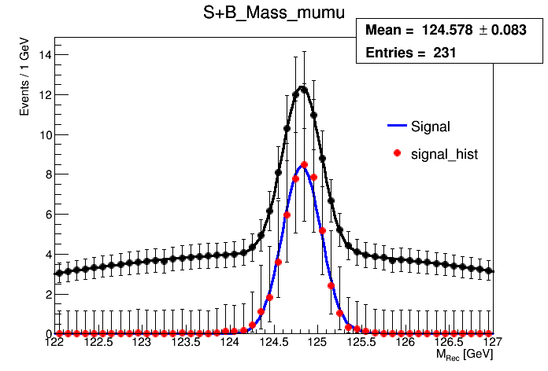
 | CDR | Mine
 | 17% | 14.50%

Slide 33
Manqi’s summary on LHEP 2017

Slide 34
From measurements to EFT
Chris Hays, Oxford

Slide 35
EFT basis

Slide 36
vs EFT
Jiayin Gu

Slide 37
“12-parameter” framework in EFT

Slide 38
the Importance of Combining all Measurements

Slide 39
self-coupling

