Slide 1
Preliminary study of HTS option for CEPC detector magnet
Ning Feipeng
On behalf of magnet team
Institute of High Energy Physics
2018.05.25

Slide 2
Outline
What is HTS?
Which HTS conductor is suitable for CEPC detector magnet?
Why give a HTS option?
The introduction of HTS option for CEPC detector magnet
Next to do

Slide 3
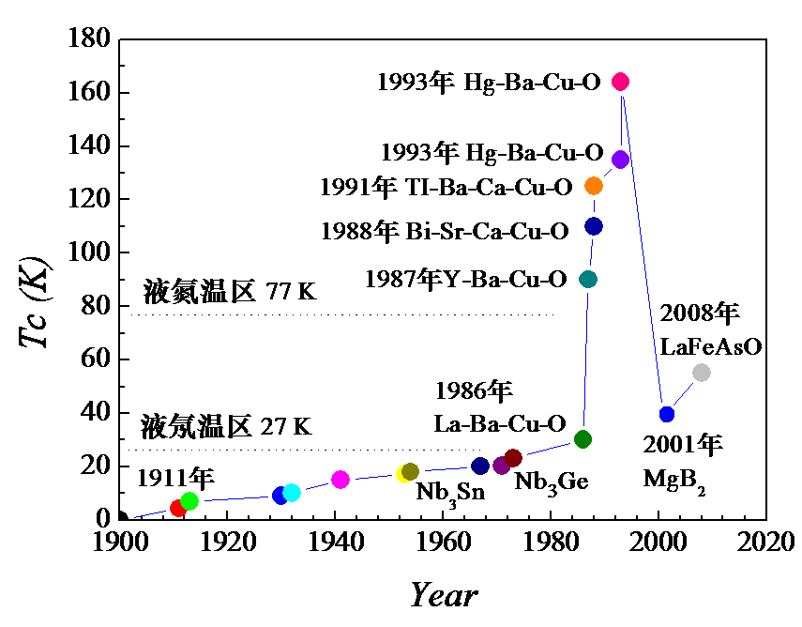
What is HTS
HTS (High Temperature Superconducting)
  Usually refers to the superconductors with critical temperature greater than 77 K (liquid Nitrogen temperature) .
  Since 1987, very short history.
  Three products: Bi-2223,Bi-2212,YBCO(Yttrium barium copper oxide)
Liquid Nitrogen
Liquid Neon

Slide 4
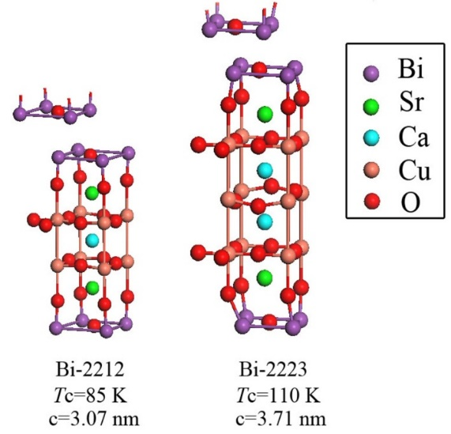
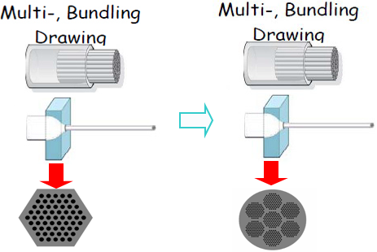
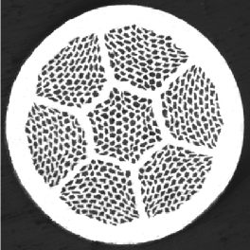
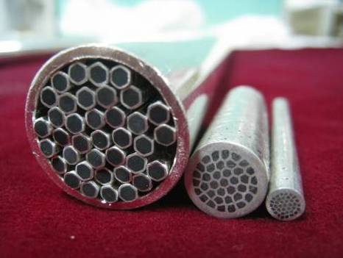
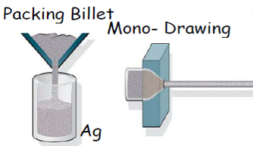
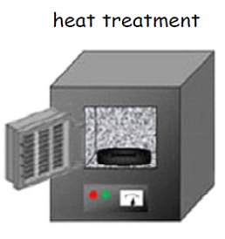

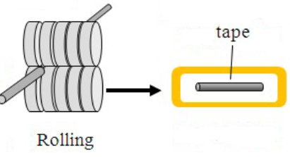
What is HTS
Bi-2223: Bi₂Sr₂Ca₂Cu₃O₁₀, Tc=110 K, Tape
Bi-2212: Bi₂Sr₂CaCu₂O₈, Tc=85 K, Round wire
Powder-in-tube method
Bi-2212
Bi-2223

Slide 5
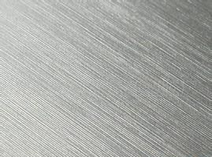




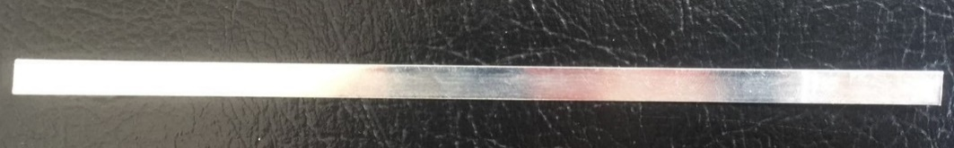
What is HTS
YBCO:
  Yttrium Barium Copper Oxide, YBa₂Cu₃O₇ , Tc=90 K, Tape
  produced by coating method (CCC - coated conductor composite): using chemical deposition or physical coating methods coating a layer of YBCO superconducting film on the hastelloy substrate.
Hastelloy
Substrate
Al₂O₃
Y₂O₃
MgO
Seed Layer
CeO₂
Cap Layer
(Y,Gd)BCO
Superconducting Layer
Ag
Overlayer
Amorphous Layer
Architecture of YBCO superconductor from SSTC

Slide 6
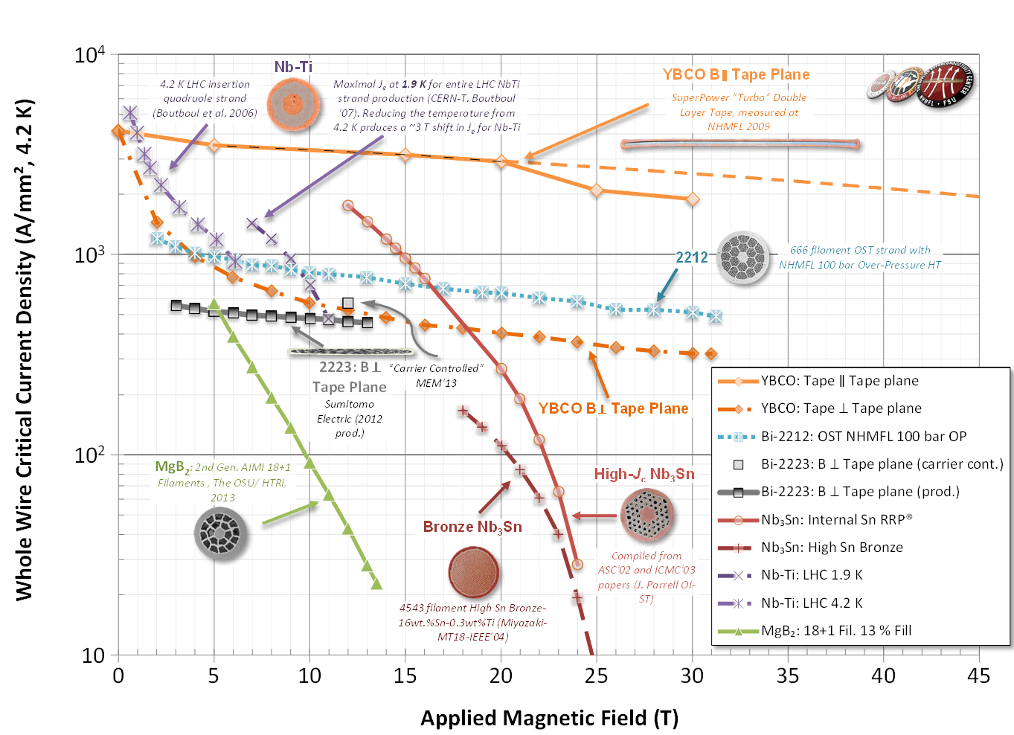
Which HTS conductor is suitable for CEPC detector magnet?
Bi-2223
Bi-2212 √
YBCO √

Slide 7
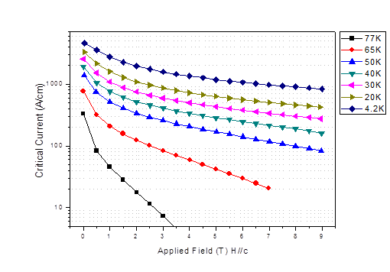
Which HTS conductor is suitable for CEPC detector magnet?
Comparison of three kinds of HTS tape or wire.
Bi-2212 and Bi-2223
YBCO
The main material is stainless steel, so the cost will decrease a lot in the future.
The cost will not decrease a lot in the future because of the usage of Ag tube.
Bi-2212 is very fragile after heat treatment.
Usually use the process of wind before heat treatment, but need a huge oven.
Bi-2212 suits for small magnet.
We preliminary choose YBCO for the HTS plan of CEPC detector magnet.

Slide 8
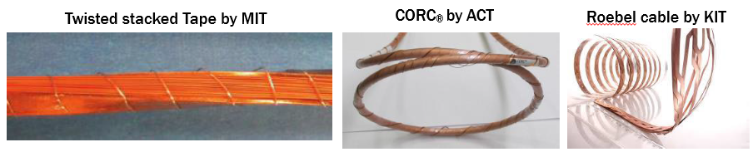
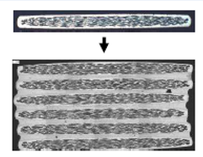
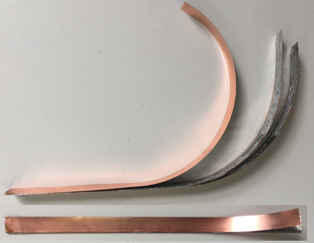
Which HTS conductor is suitable for CEPC detector magnet?
Which YBCO cable is suitable for CEPC detector magnet?
HTS stack cable
or
Why do we need to study high temperature superconducting cable. Its advantages are:
1. Increase the reliability of the coil, when one wire or a few wires of the cable quench, other wires can also shunt the current of the cable;
2. The cable has a lower demand for power supply;
3. Less demand of the single length of HTS wire.
We are doing:
I) YBCO cable research. Develop YBCO stack cable and study its performance.
II) Study the winding process of YBCO coils.
III) Prototype HTS coil development.
Soldered together with Sn

Slide 9
Why give a HTS option?
Compared with low temperature superconducting (LTS), the high temperature superconducting (HTS) detector has the following highlights:
1. Three YBCO suppliers in China;
2. It is possible YBCO cost performance 10 times cheaper in 5 years, cost maybe comparable with the LTS magnet in the future;
3. Working at a relatively high temperature (20 K), cooling get easier ;
4. More stability, HTS magnet not easy to quench ;
5. HTS is not affected by irradiation;
6. Push the development of full HTS high field solenoid magnet .

Slide 10
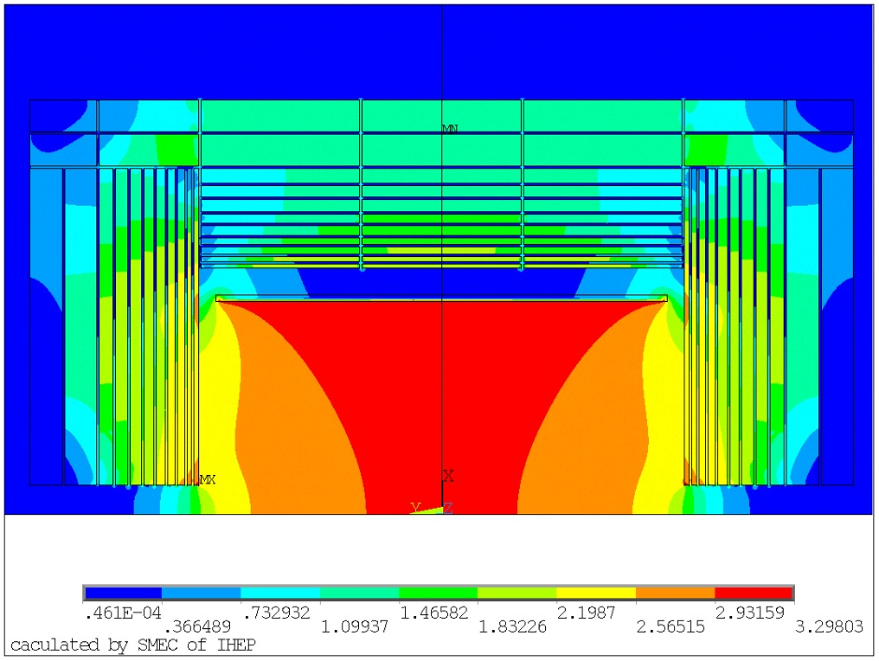
The introduction of HTS option for CEPC detector magnet
Parameters of CEPC detector magnet based on YBCO stack cable:
Central magnetic field | 3 T | Working current | 7970 A
Maximum vertical field on cable | 2.7 T | Ampere-turns | 20*10⁶
Inner diameter of coil | 3.6 m | Inductance | 38.36 H
Outer diameter of coil | 3.7 m | Stored energy | 1.2 GJ
Length of the coil | 7.5 m | Operating temperature | Less than 20 K
Magnetic field distribution

Slide 11
The introduction of HTS option for CEPC detector magnet
Cost estimation
Magnetic field | Ic@20K
2.7 T | >900
3 T | >800
The calculation based on YBCO stack cable.
Each cable contains 12 tapes, and each tape carries 664 A at about 20 K. The cable carries 7970 A.
There are 5 layers and 500 turns.
Need 12mm wide tape 685 km, if do not consider the cost of cable, the YBCO tapes will take about 200 million Yuan at present.
 | HTS tape | LTS cable
cost | 200 million | 60 million
Typical critical current value of SSTC tapes , calculated from hysteresis loop, Provided by SSTC

Slide 12
The introduction of HTS option for CEPC detector magnet
What are the advantages of working at 20 K?
1. Material property:
2. Cooling station:
Materials | Specific heat J/(kg*K) |  | Heat conductivity W/(m*K)
 | 4.2K | 20K | 4.2K | 20K
Cu | 0.1 | 7.7 | 320 | 1250
Stainless steel | 1.6 | 13.8 | 0.1 | 2.2
1100 Al | 0.3 | 8.9 | 55 | 283
Kapton | 1.3 | 60 | 0.01 | 0.05
G10 | 2 | 50 | 0.08 | 0.16
800 W | 4.2 K | 20 K
Electricity consumption | 315 kW | 130 kW
Cost (yuan) | 16 million | 3.5 million
Provided by CSIC Pride (Nanjing) Cryogenic Technology Co., Ltd.

Slide 13
Next to do
Continue YBCO cable research. Develop the YBCO stack cable and study its performance, study other HTS cables.
Study the quench detection, transmission and protection of the HTS magnet.
Develop the prototype of HTS detector magnet.
The baseline is also LTS.

Slide 14
Thanks
Ning Feipeng
Institute of High Energy Physics, CAS ningfp@ihep.ac.cn

