Slide 1
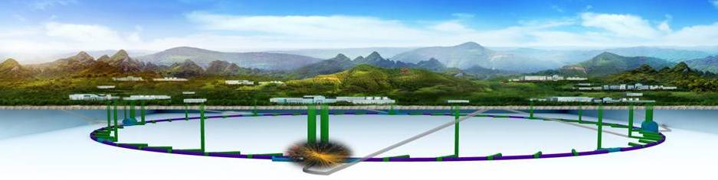
Accelerator Summary
Yunlong Chi
Workshop on the Circular Electron-Positron Collider - EU edition
26/05/2018

Slide 2
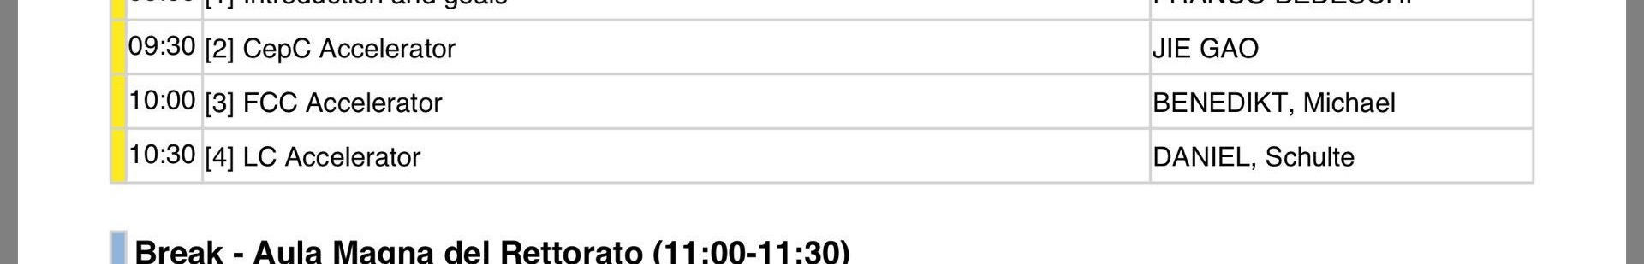
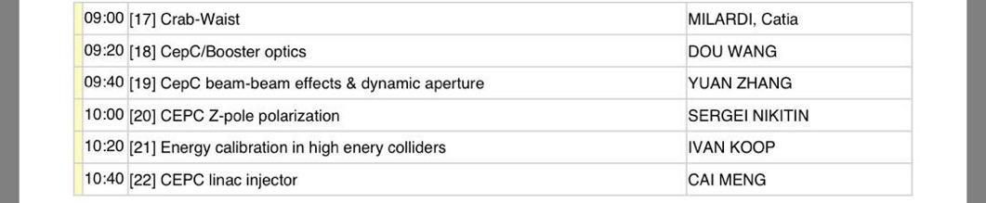
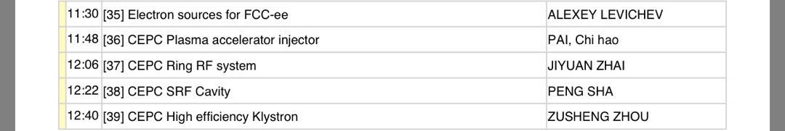
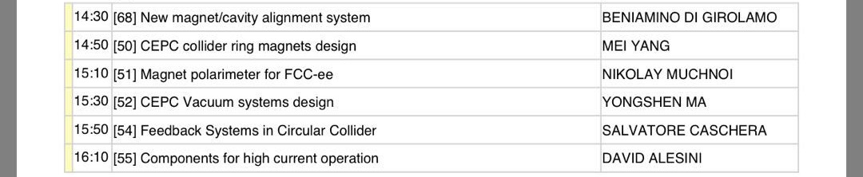
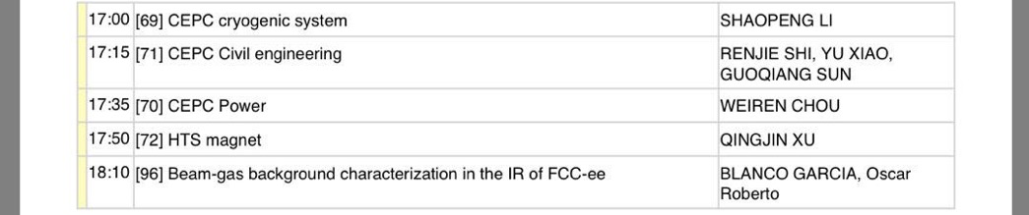
25 Talks (3 plenary + 22 parallel )

Slide 3
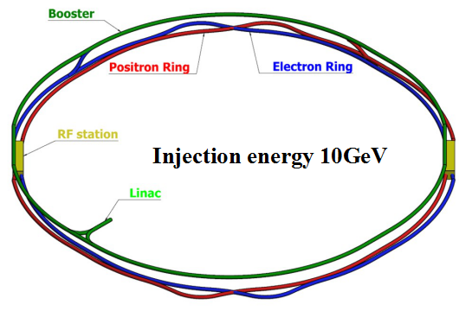

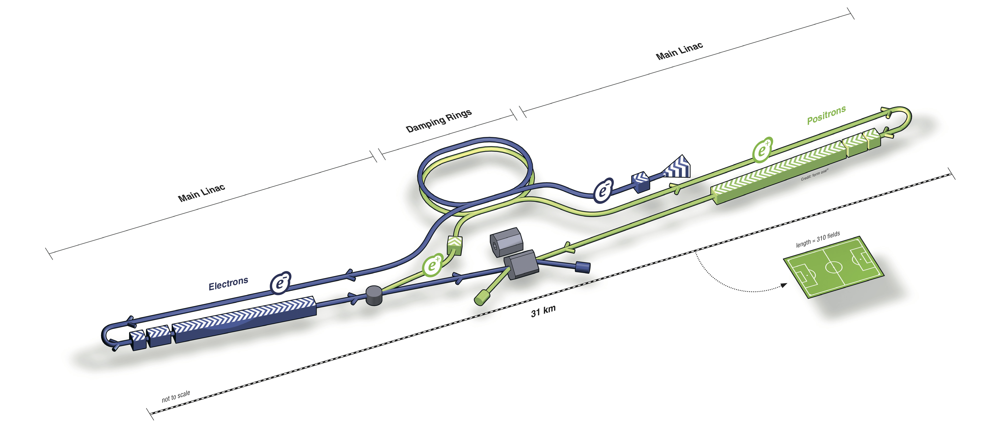
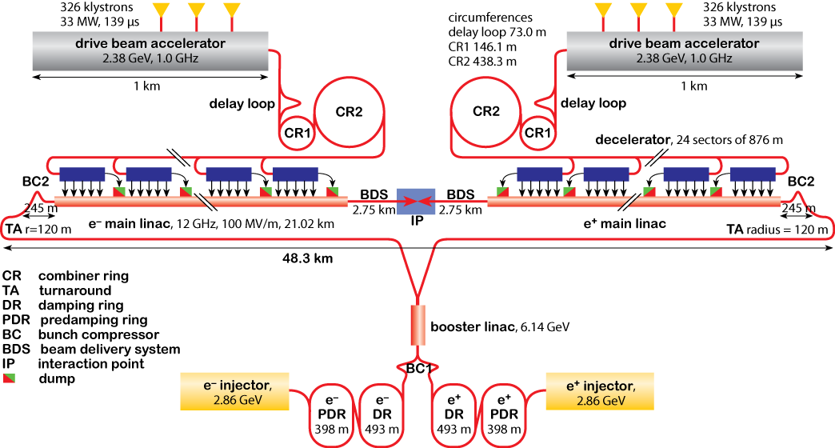
Two Circular Collider
Two Linear Collider

Slide 4
CEPC CDR Parameters
 | Higgs | W | Z
Number of IPs | 2
Energy (GeV) | 120 | 80 | 45.5
Circumference (km) | 100
SR loss/turn (GeV) | 1.73 | 0.34 | 0.036
Half crossing angle (mrad) | 16.5
Piwinski angle | 2.58 | 4.29 | 16.4
N_{e}/bunch (10¹⁰) | 15 | 5.4 | 4.0
Bunch number (bunch spacing) | 242 (0.68us) | 3390 (98ns) | 8332 (40ns)
Beam current (mA) | 17.4 | 88.0 | 160
SR power /beam (MW) | 30 | 30 | 5.73
Bending radius (km) | 10.6
Momentum compaction (10⁻⁵) | 1.11
β_{IP} x/y (m) | 0.36/0.0015 | 0.36/0.0015 | 0.2/0.0015
Emittance x/y (nm) | 1.21/0.0031 | 0.54/0.0016 | 0.17/0.004
Transverse σ_{IP} (um) | 20.9/0.068 | 13.9/0.049 | 5.9/0.078
ξ_{x}/ξ_{y}/IP | 0.031/0.109 | 0.0148/0.076 | 0.0043/0.04
V_{RF} (GV) | 2.17 | 0.47 | 0.054
f _{RF} (MHz) (harmonic) | 650 (216816)
Nature bunch length σ_{z} (mm) | 2.72 | 2.98 | 3.67
Bunch length σ_{z} (mm) | 3.26 | 3.62 | 6.0
HOM power/cavity (kw) | 0.54 (2cell) | 0.47(2cell) | 0.49(2cell)
Energy spread (%) | 0.1 | 0.066 | 0.038
Energy acceptance requirement (%) | 1.52
Energy acceptance by RF (%) | 2.06 | 1.47 | 0.76
Photon number due to beamstrahlung | 0.29 | 0.16 | 0.28
Lifetime due to beamstrahlung (hour) | 1.0
Lifetime (hour) | 0.67 (40 min) | 2 | 4
F (hour glass) | 0.89 | 0.94 | 0.99
L_{max}/IP (10³⁴cm⁻²s⁻¹) | 2.93 | 7.31 | 4.1

Slide 5

FCC-ee collider parameters
parameter | Z | WW | H (ZH) | ttbar
beam energy [GeV] | 45 | 80 | 120 | 182.5
beam current [mA] | 1390 | 147 | 29 | 5.4
no. bunches/beam | 16640 | 2000 | 393 | 48
bunch intensity [10¹¹] | 1.7 | 1.5 | 1.5 | 2.3
SR energy loss / turn [GeV] | 0.036 | 0.34 | 1.72 | 9.21
total RF voltage [GV] | 0.1 | 0.44 | 2.0 | 10.9
long. damping time [turns] | 1281 | 235 | 70 | 20
horizontal beta* [m] | 0.15 | 0.2 | 0.3 | 1
vertical beta* [mm] | 0.8 | 1 | 1 | 1.6
horiz. geometric emittance [nm] | 0.27 | 0.28 | 0.63 | 1.46
vert. geom. emittance [pm] | 1.0 | 1.7 | 1.3 | 2.9
bunch length with SR / BS [mm] | 3.5 / 12.1 | 3.0 / 6.0 | 3.3 / 5.3 | 2.0 / 2.5
luminosity per IP [10³⁴ cm⁻²s⁻¹] | >200 | >25 | >7 | >1.4
beam lifetime rad Bhabha / BS [min] | 68 / >200 | 49 / >1000 | 38 / 18 | 40 / 18

Slide 6
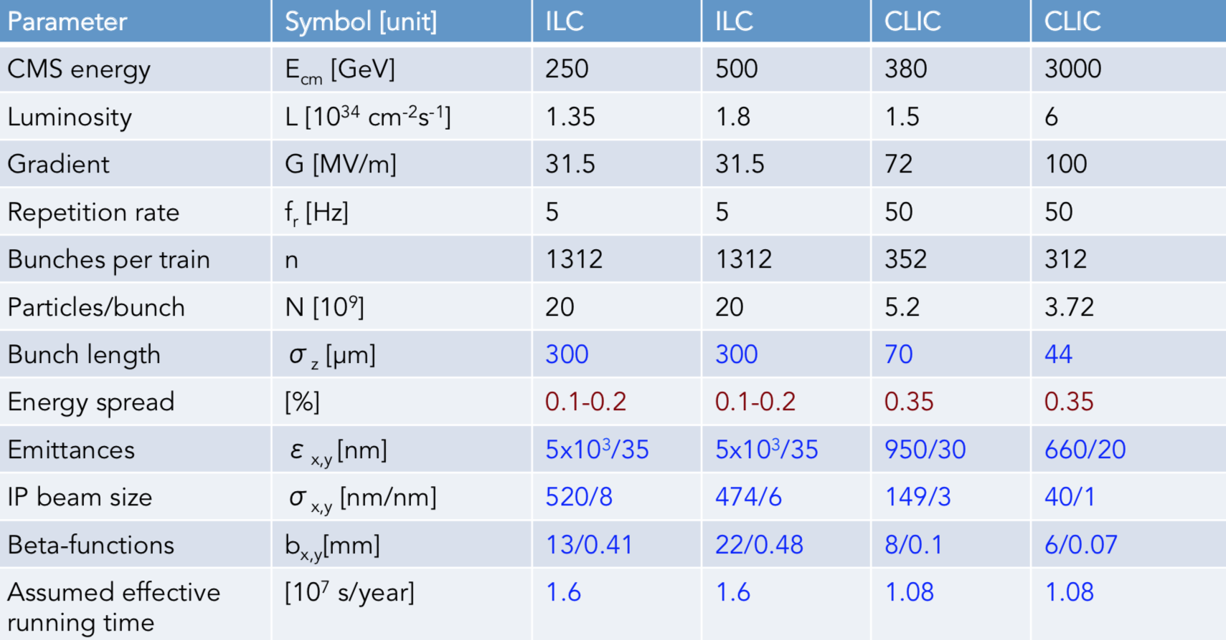
LC design parameters

Slide 7
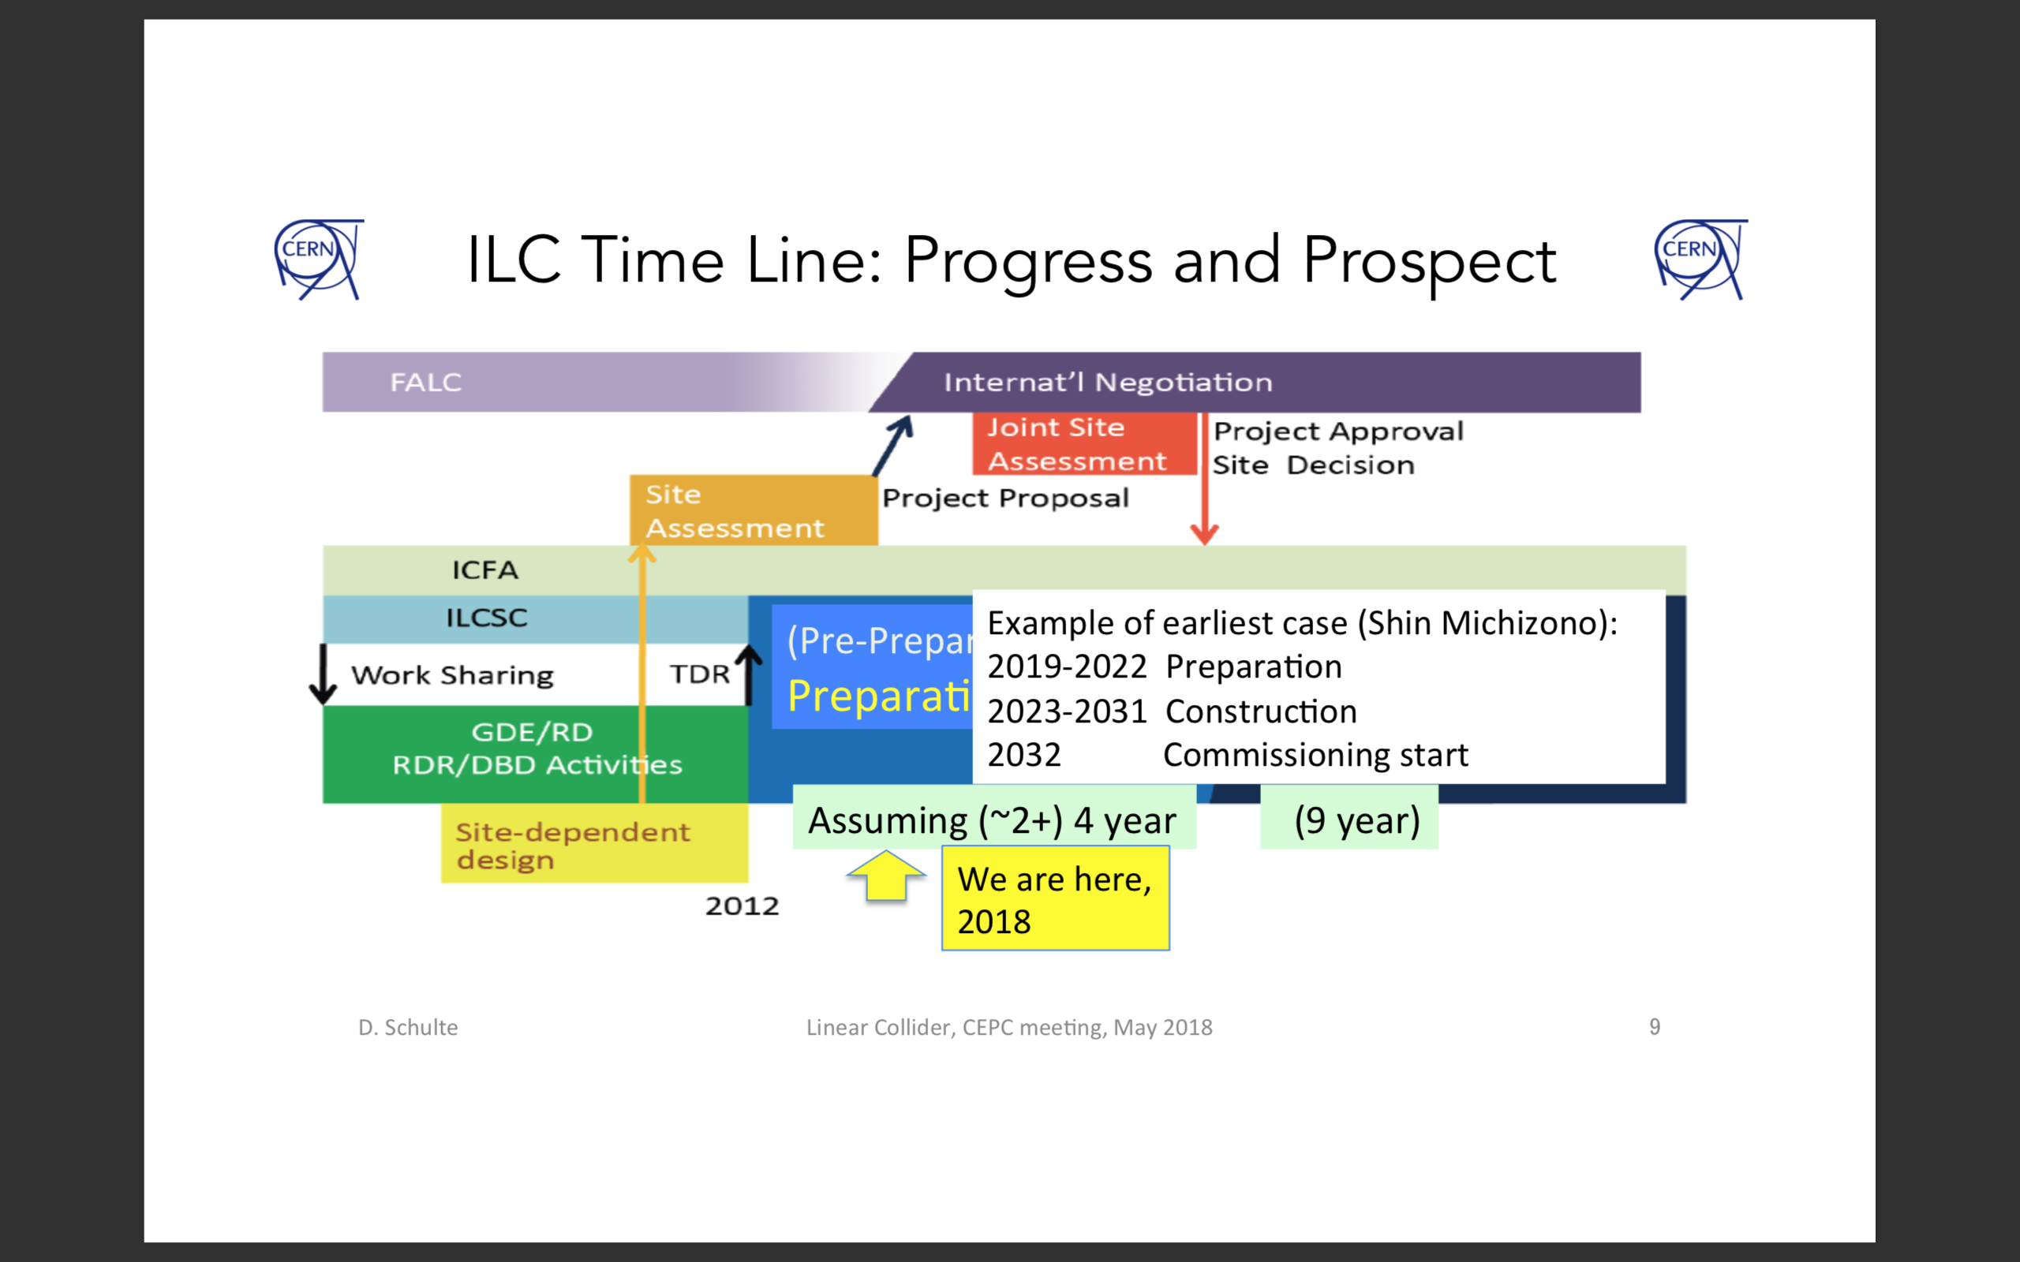
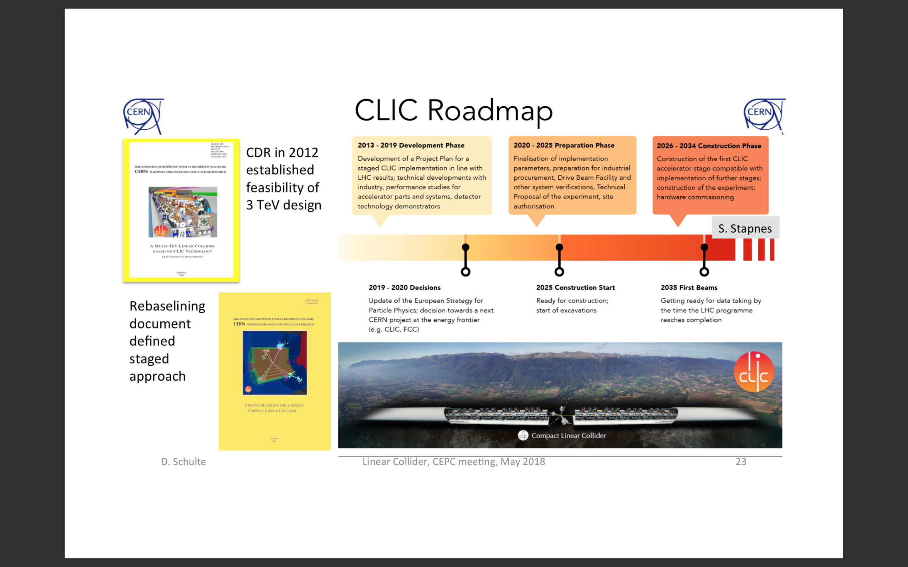
Time schedule

Slide 8
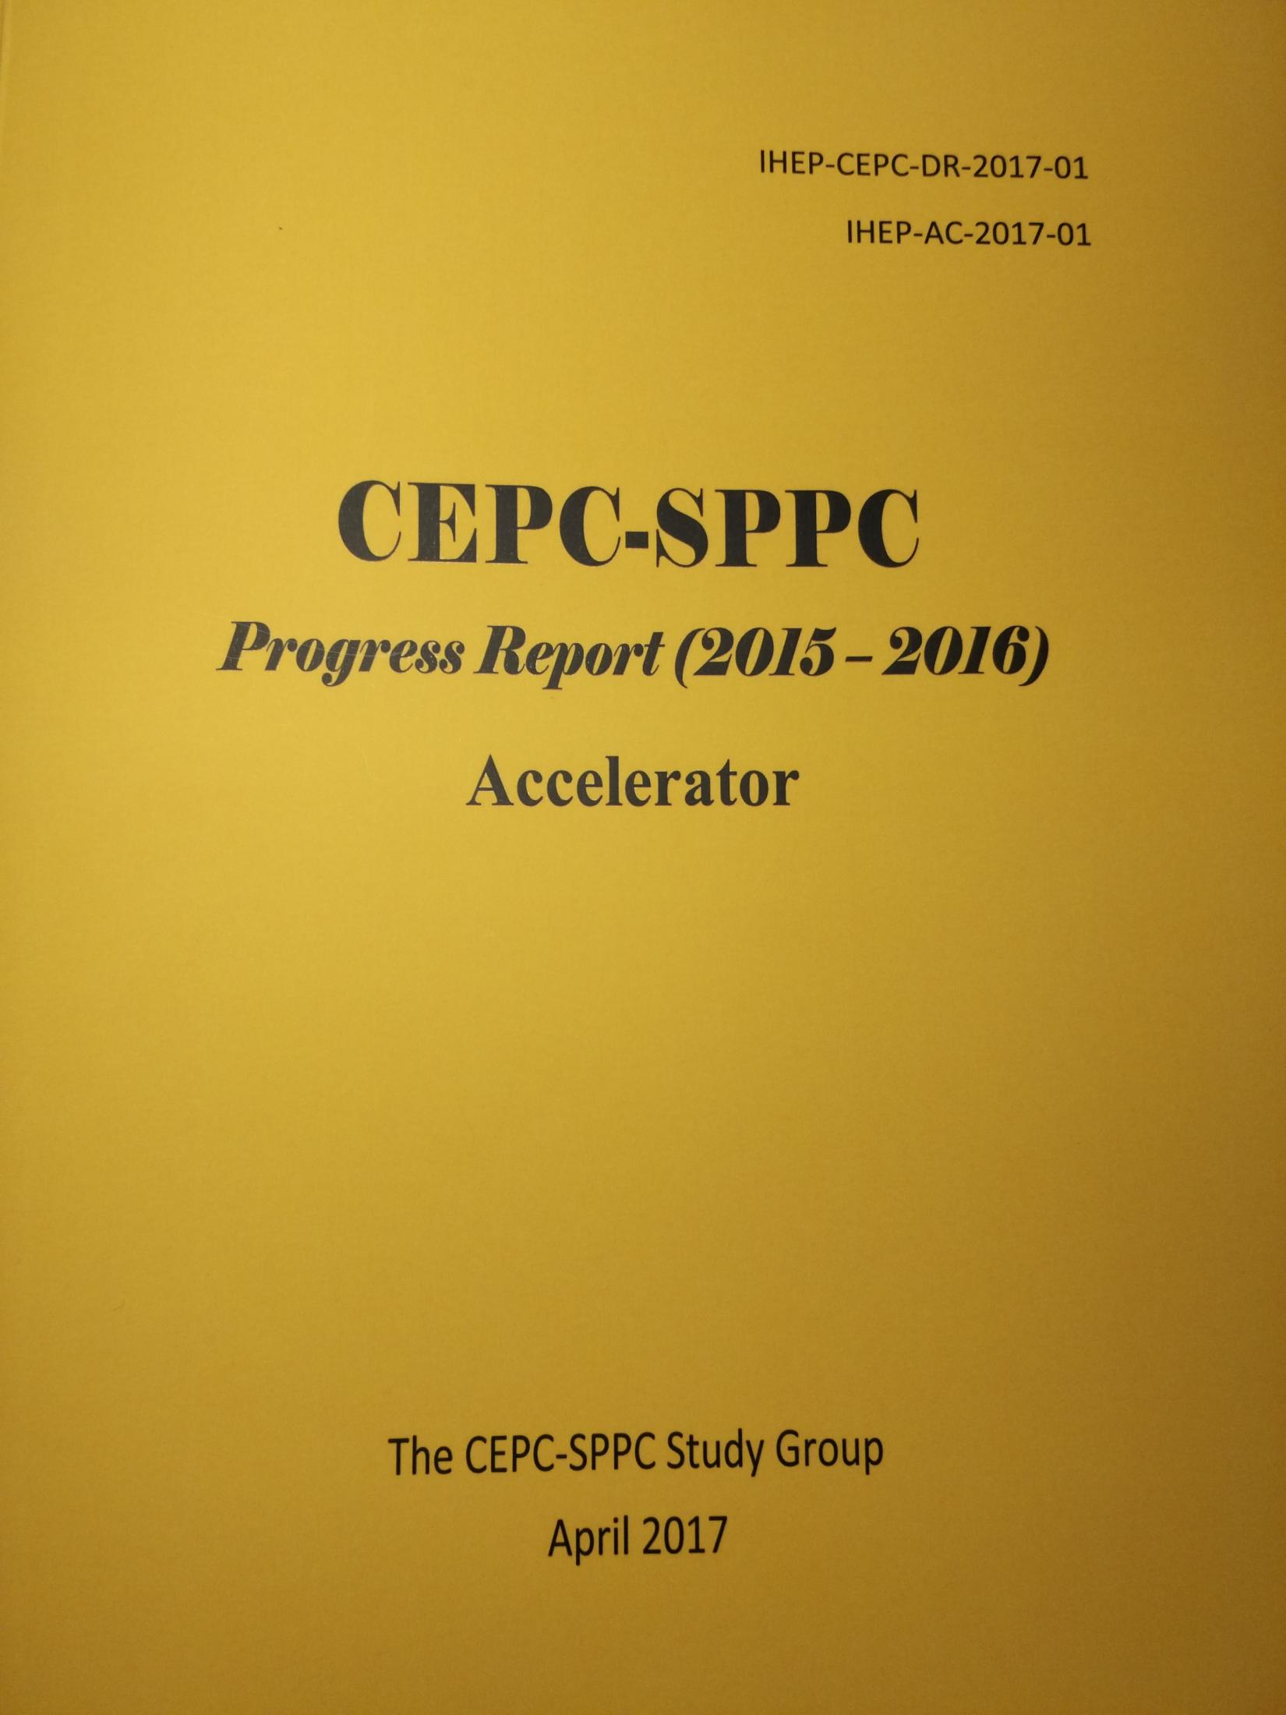
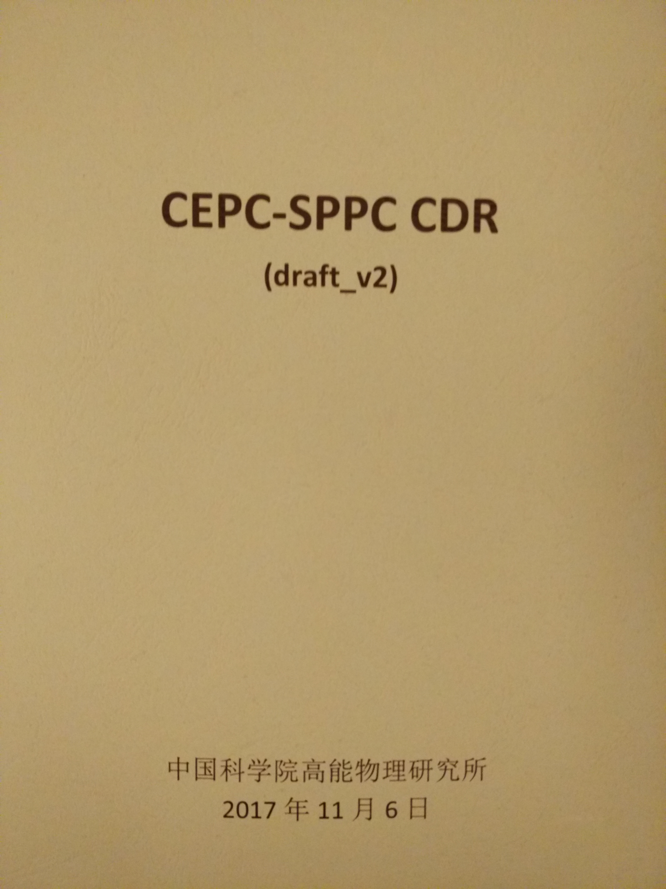
http://cepc.ihep.ac.cn
CEPC-SppC from Pre-CDR towards CDR
March 2015
April 2017
Nov 2017
CEPC-SppC CDR
Preliminary Draft during
CEPC-SppC Mini review
CEPCSppC baseline and alternative
decision processe recorded
CEPC-SppC CDR will be printed before May 2018

Slide 9
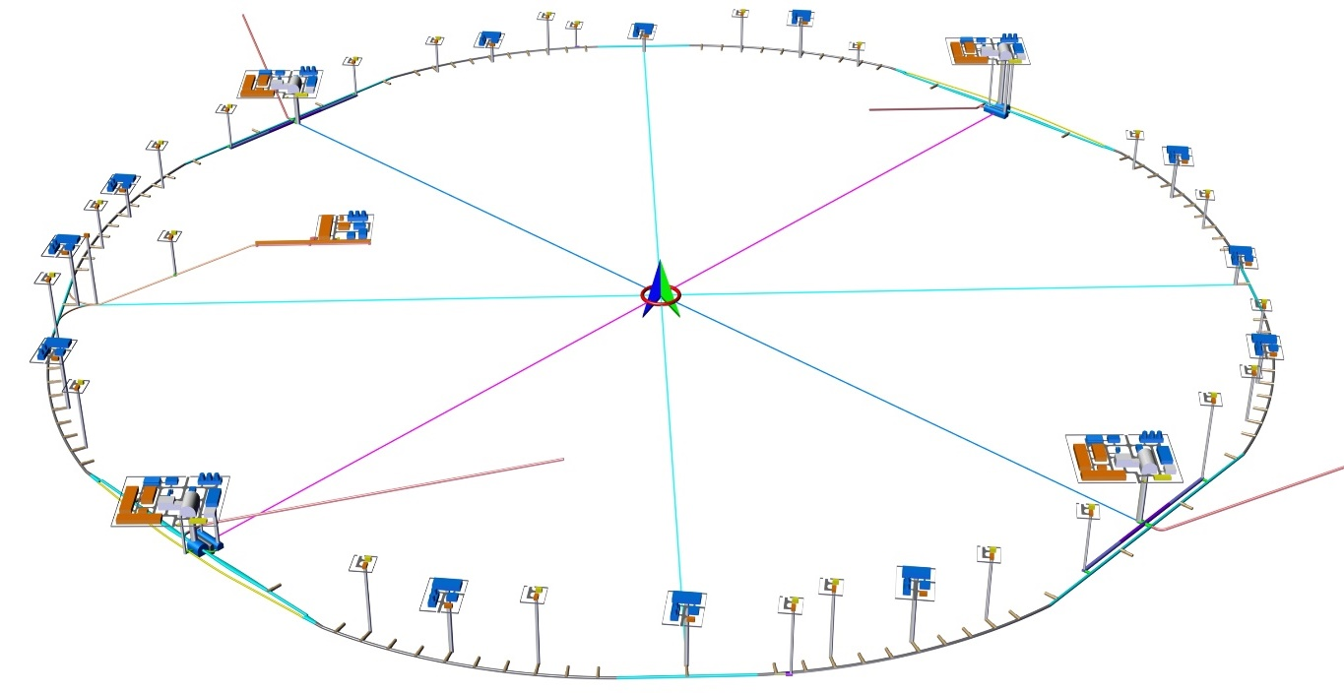
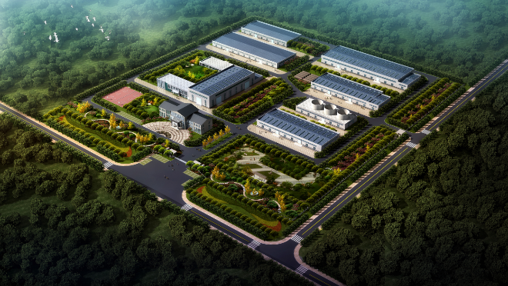
CEPC Tunnel General Layout
Yu Xiao
3.24km
3.32km
LSS4
IP4
1.20km
IP1
LINAC
1.20km
BTL
LSS1
LSS3
1.20km
IP3
IP2
3.24km
3.32km
10.2km
L=99.67km
LSS2
1.20km

Slide 10
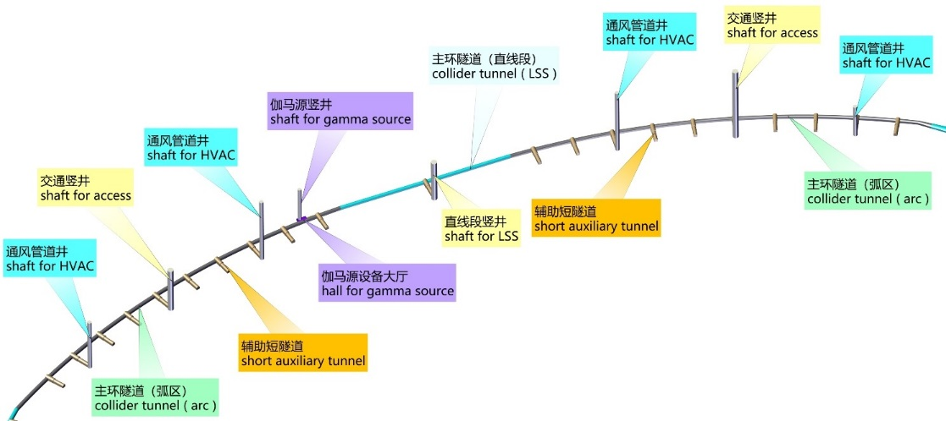
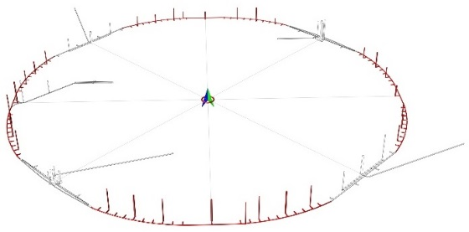
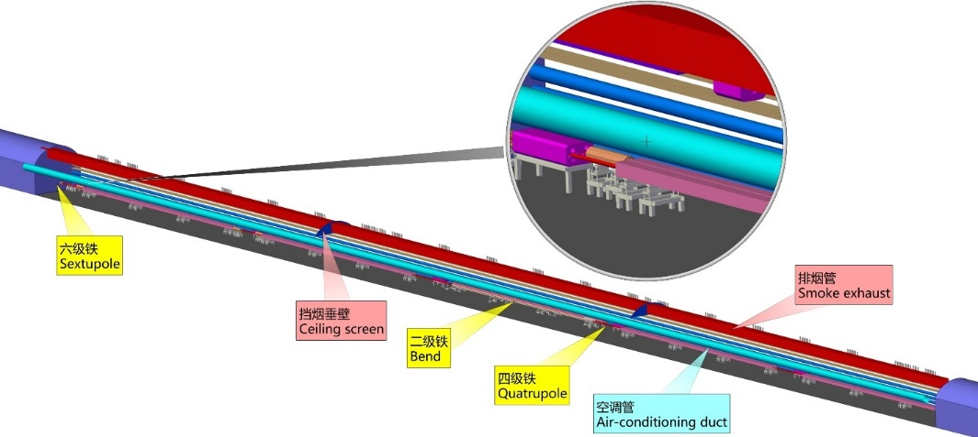
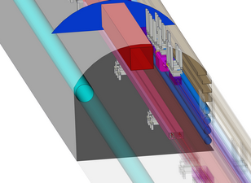
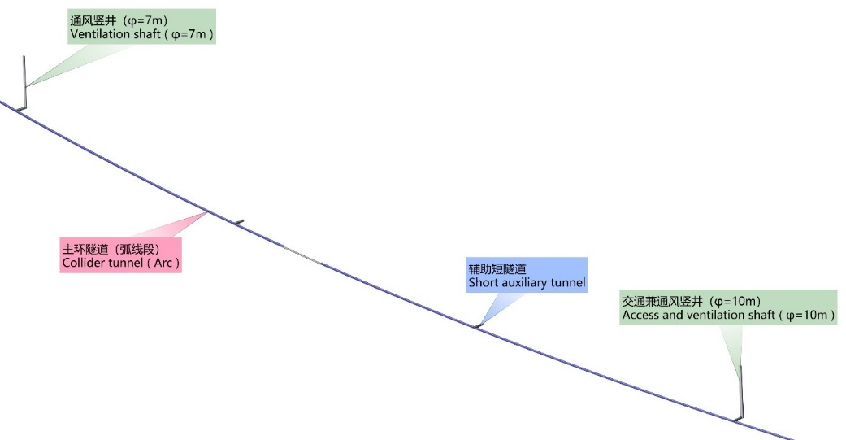
Yu Xiao
Collider ring tunnel and short auxiliary tunnel
主环隧道典型剖面
Typical cross section of collider tunnel

Slide 11
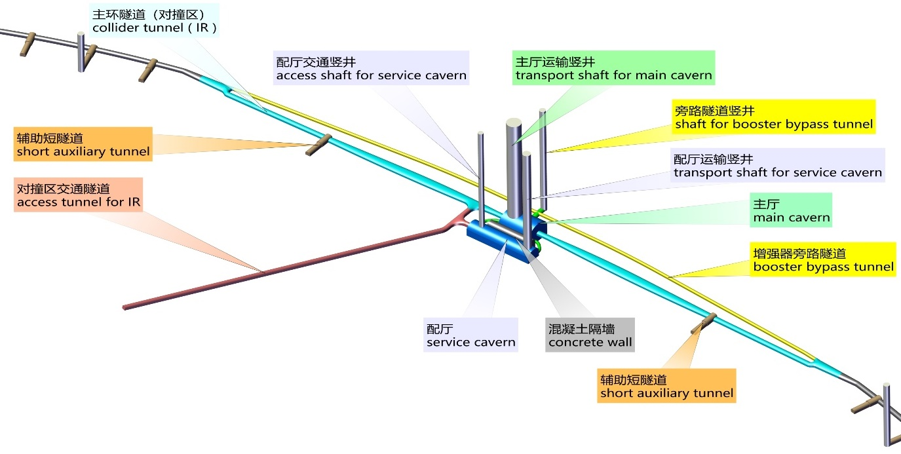
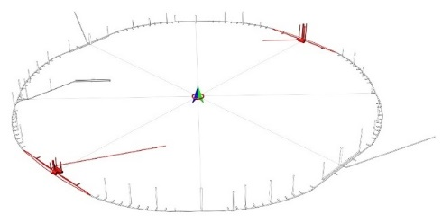
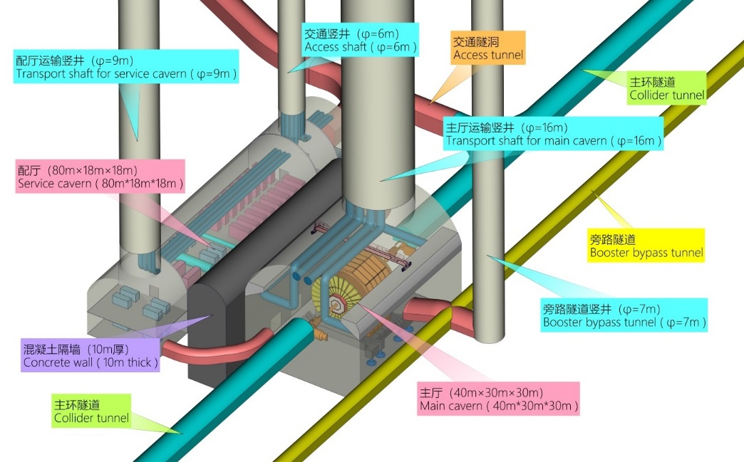
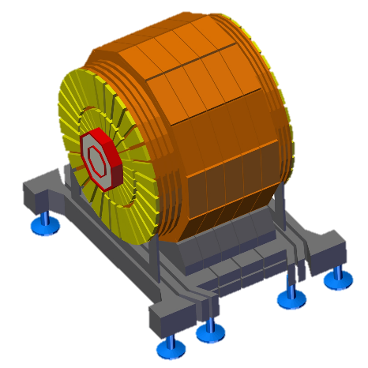
IP1 / IP3
Yu Xiao
3.32km
6.0~11.4x4.5
3.02km
3.5x3.5
Main detector
主探测器

Slide 12
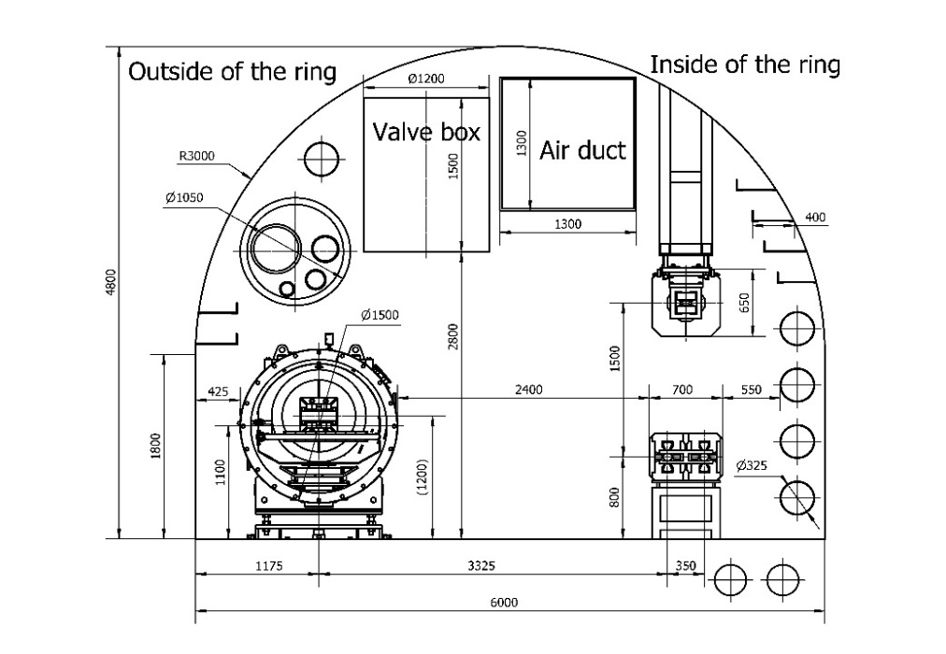
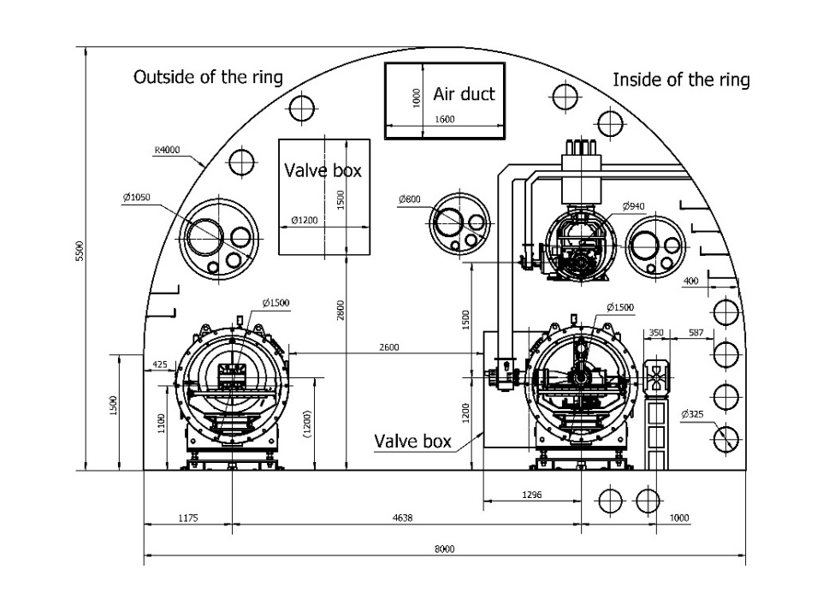
CEPC-SppC Tunnel Cross Sections
Jianli Wang
Tunnel cross section at arc-section
  Width: 6,000 mm. Height: 4,800 mm.
Tunnel cross section at RF-section
Width: 8,000 mm. Height: 5,500 mm.

Slide 13

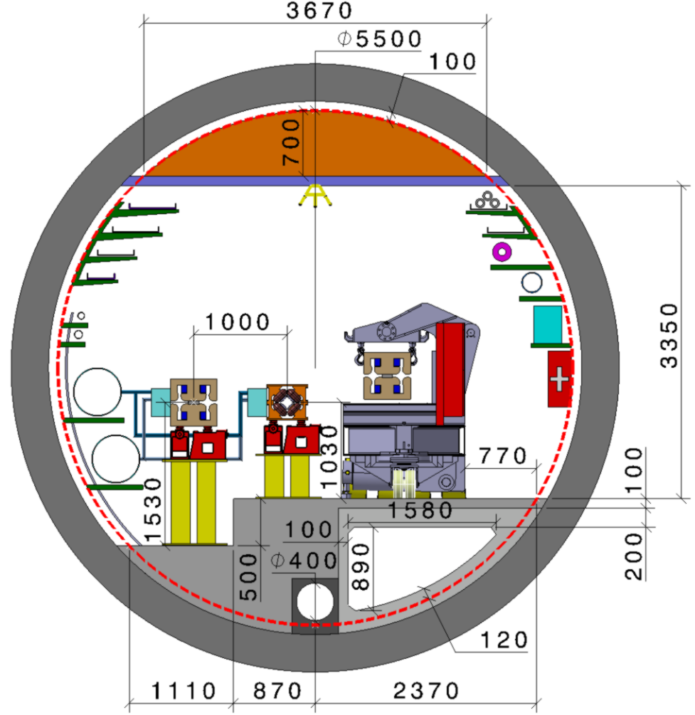
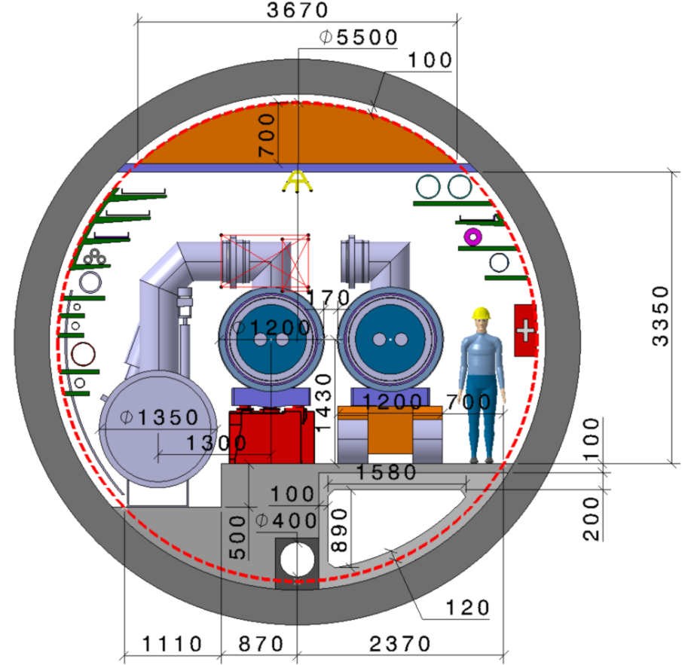
FCC – tunnel integration in arcs
  FCC-ee FCC-hh
  5.5 m inner diameter

Slide 14
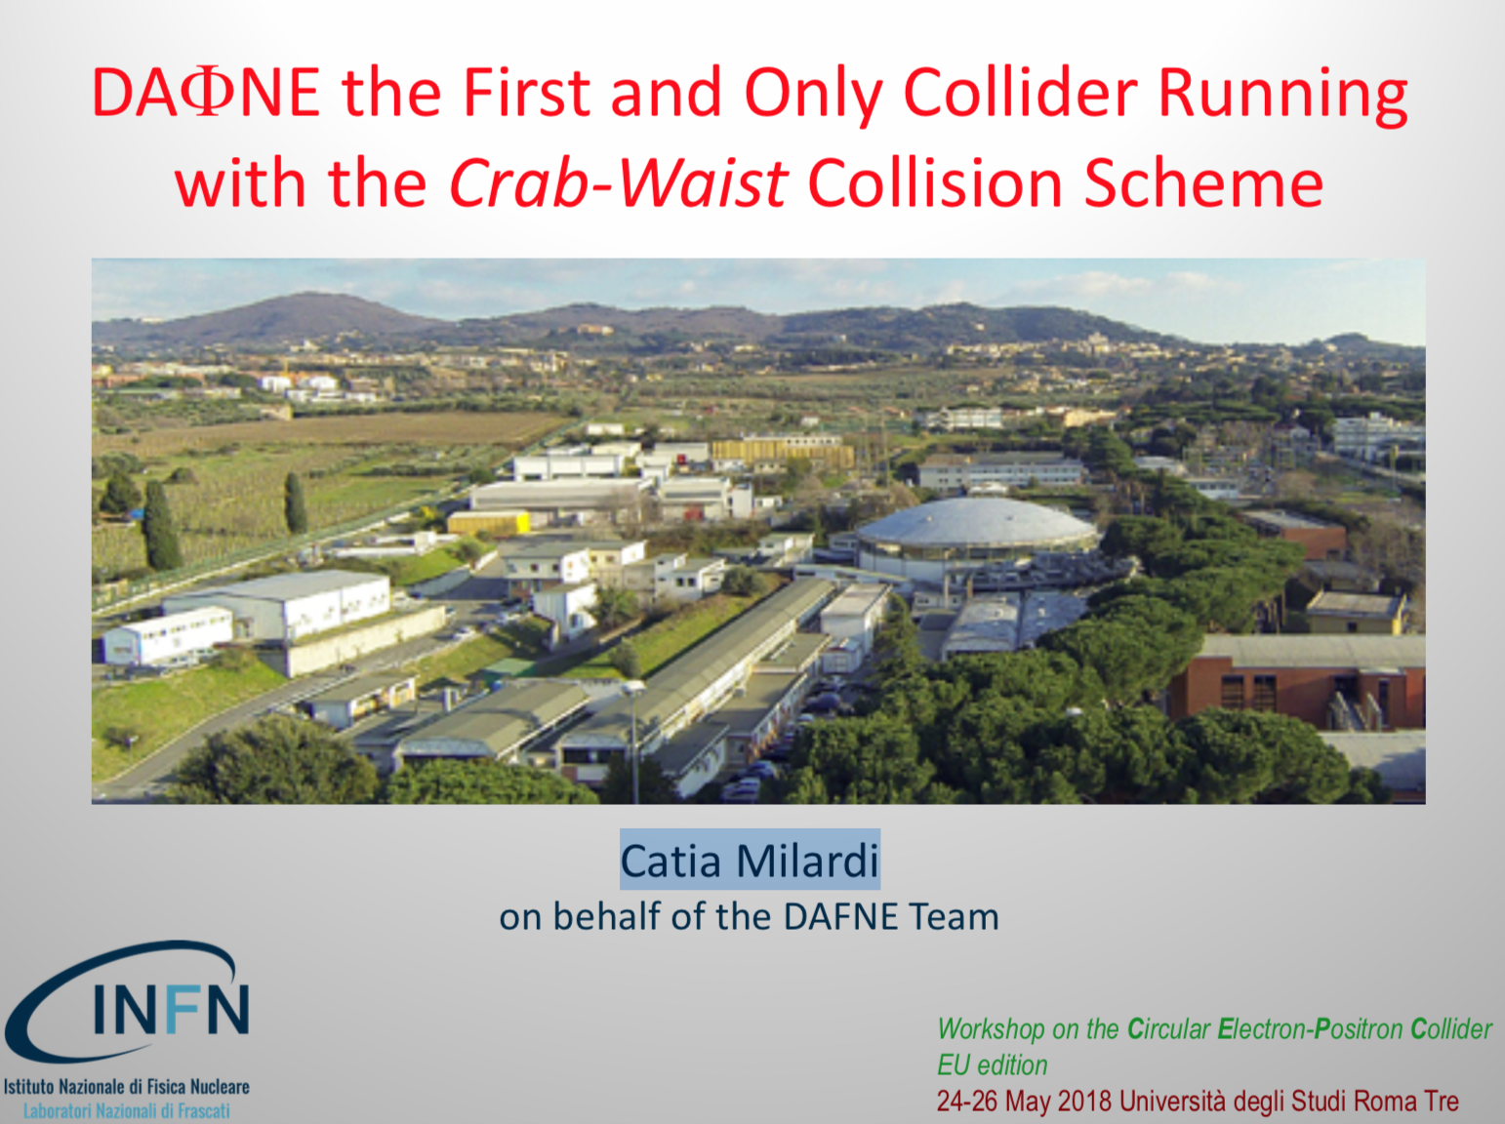
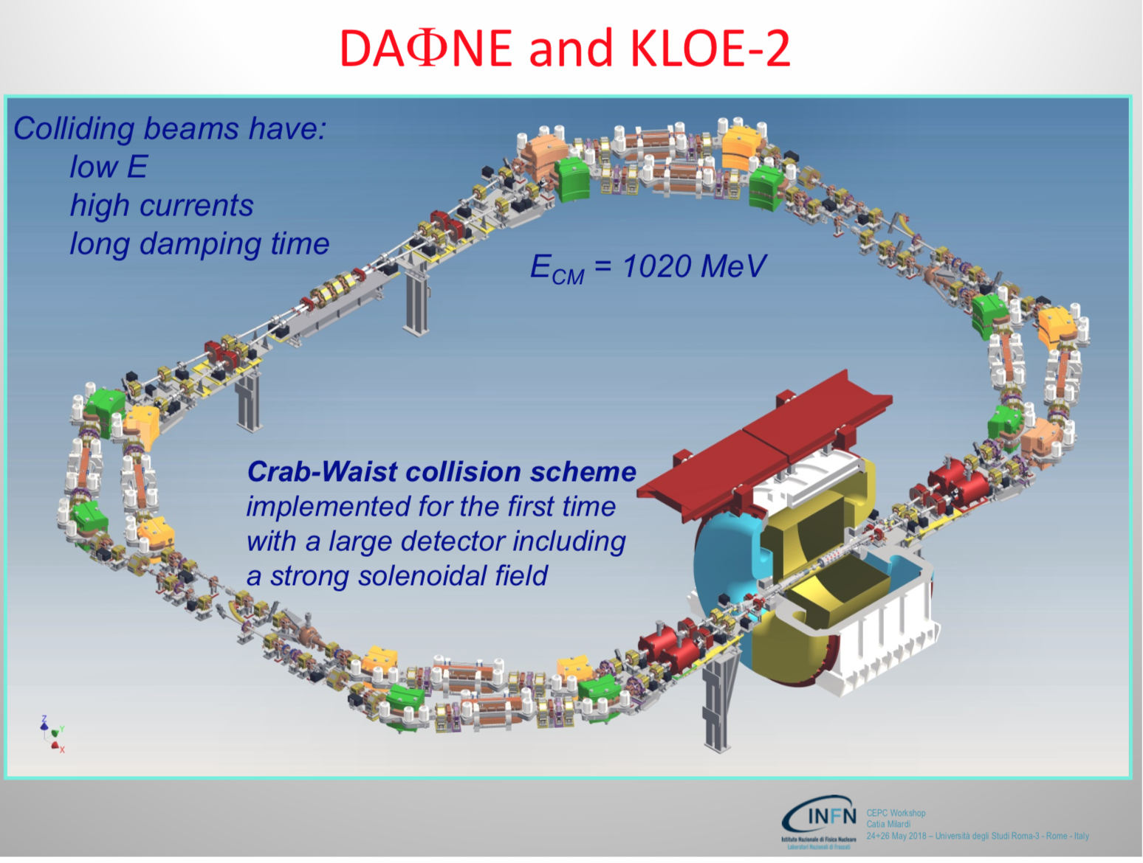
Catia Milardi

Slide 15
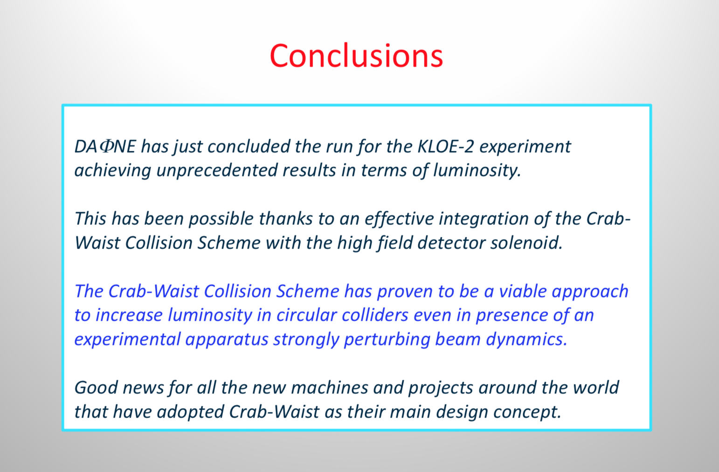
Catia Milardi

Slide 16
Effect of energy spread increase on polarization
Sergei A. Nikitin
Equilibrium polarization degree in region of Z-pole vs spin tune in two cases of wiggler mode
|w_{k}|=10⁻³
B₊=0.5 T
energy spread σ_{γ}=9.9e-4
spin tune spread σ_{ν}=0.103
B₊=0.6 T
energy spread σ_{γ}=1.25e-3
spin tune spread σ_{ν}=0.128

Slide 17
Tracking-based method to calculate F^{ν}
Sergei A. Nikitin
Compare these two graphs!
Attention!
z stands for y!
S.A. Nikitin. Talk at 20th Intern. Spin Physics Symposium (SPIN 2012), 17-22 Sept. 2012, Dubna, Russia
Cross-checking OK!

Slide 18
CEPC Z-pole polarization Summary
Sergei A. Nikitin
Depolarization effect of quantum fluctuations in presence of vertical closed orbit distortions
at CEPC has been estimated taking into account modulation of spin frequency by
synchrotron oscillations. Resonance harmonic amplitude is input parameter
Spin harmonic amplitude of vertical closed orbit distortion sources at Z-pole should be corrected to level £ 10⁻³ to ensure 50% equilibrium polarization degree
If this is done, it is possible to reach polarization in range (6-10)% in 45 GeV CEPC in time of (2-4) hours using, for instance, ten shifter magnets with moderate characteristics
Sensitivity of spin motion disturbances to transverse field imperfections is determined through Spin Response Function which has been calculated in two ways
At 45 GeV, expected harmonic amplitude of closest integer spin resonance calculated at typical magnitudes of misalignment (50 μm, 3⋅10⁻⁴rad) is about 3 times larger than desirable one. Correction of resonance harmonics (k= 103 and k= 104) is needed. Similar problem was successfully solved at LEP

Slide 19
Electron sources for FCC-ee
A.E. Levichev
Project | Beam charge | Normalized Injector emittans | Energy spread
SuperKEKB | 5 nC | ~20 mm mrad | 1%
C-τ Factory | 3 nC | ~10 mm mrad | 0.1%
FCC | 6.5 nC | ~6 mm mrad | 0.08%
1. Beam charge, normalized beam emittance and energy spread are depended on the electron gun design.
2. High beam charge is needed => large area of the photocathode => beam emittance increasing
3. Ultra low energy spread is necessary => short beam longitudinal size
4. Normalized emittance of the injector is not too low, but taking into account the lengths of the linacs and possible errors of the real devices, low beam emittance of the e-gun can be useful.
The new ideas of the e-gun design and the cathodes material are required
A. Levichev, A.E.Levichev@inp.nsk.su 2018 Workshop on the Circular Electron-Positron Collider 2

Slide 20
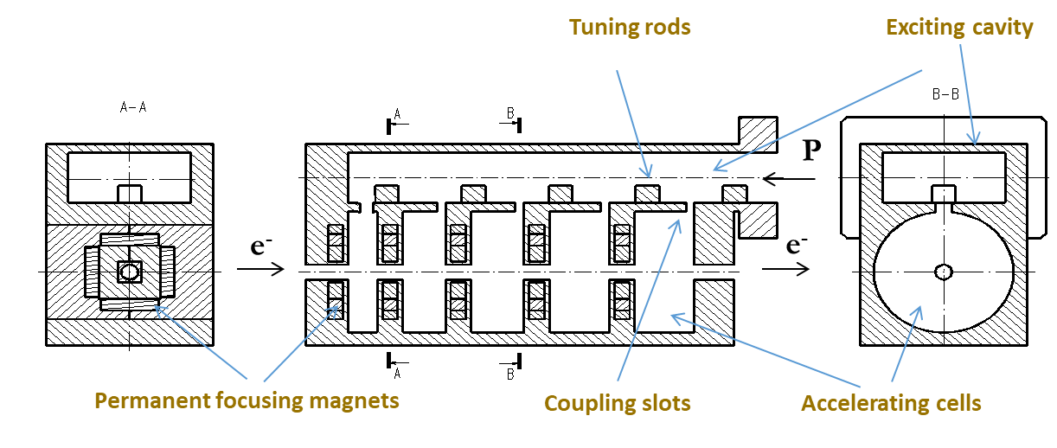
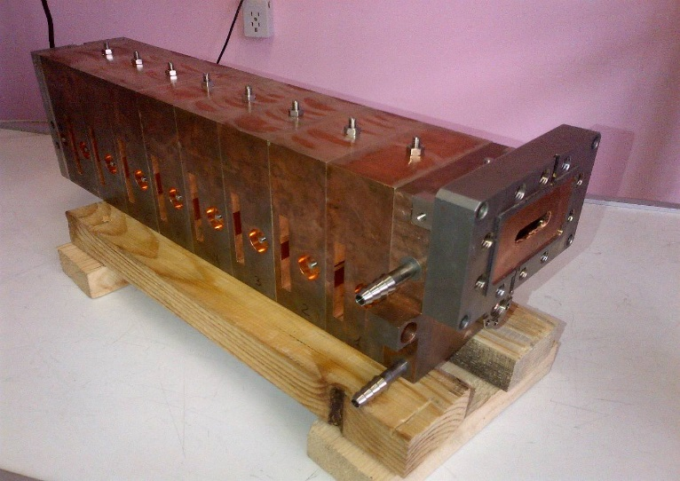
A.E. Levichev
Suggestion
RF gun based on the parallel coupled accelerating structure (PCAS)
Features:
Parallel RF power feeding.
Cavities are not connected with each other by RF power: process in one cavity doesn’t influence on every cavities
Organization of the free electric field distribution along the structure can be obtained by changing the individual coupling slot
In order to develop accelerating structure only one accelerating cells have to be calculated due to absence of the cavities connection by electromagnetic field
Aperture of the structure is defined by only beam motion and can be considerably reduced
Design of the structure allows using internal permanent focusing magnets.
A. Levichev, A.E.Levichev@inp.nsk.su 2018 Workshop on the Circular Electron-Positron Collider 6

Slide 21
A.E. Levichev
Conclusion
The design of parallel coupled accelerating structure allows using the permanent focusing magnets and create the strong magnetic field along the cavities and save the beam size.
The travelling tube aperture can be decreased as significantly as it allows the beam dynamics.
This design of the RF gun allows us to consider the cavities as independent. The length and field amplitude can be tuned separately for every cavity.
Preliminarily results of beam dynamic simulations gave reason to hope that this construction is acceptable solution for high charge generation.
The prototype of the accelerating structure based on new design with parallel coupling between the cavities have been produced in BINP with operating frequency of 2450 MHz and successfully tested.
It is currently planned to perform tests the new parallel coupled accelerating structure with 2856 MHz .
Ir5Ce cathode is developed
The work function of the cathode is measured. According to this measurements (2.4 eV), the green laser can be used for tests with the cathode
In plan
Stress tests with the cathode
Measuring of the quantum efficiency of the cathode
RF gun production
A. Levichev, A.E.Levichev@inp.nsk.su 2018 Workshop on the Circular Electron-Positron Collider 20

Slide 22
High Energy CEPC Injector Based on Plasma Wakefield Accelerator
Presenter Chih-Hao Pai
Tsinghua University
Workshop on the Circular Electron-Positron Collider
May 25, 2018
Rome, Italy
Notes:
I am here to present

Slide 23
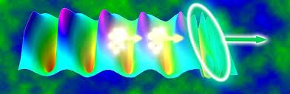
Chih-Hao Pai
High Energy CEPC Injector Based on Plasma Wakefield Accelerator
Laser or beam Pulse
Trailing beam
Wake
Huge gradient (~100GV/m) + Tiny structures (~10-100um)
T. Tajima and J. M. Dawson PRL (1979) LWFA
P. Chen, J. M. Dawson et.al. PRL (1983) PWFA
Notes:
Intense laser or particle beam
2 special features: H+T

Slide 24
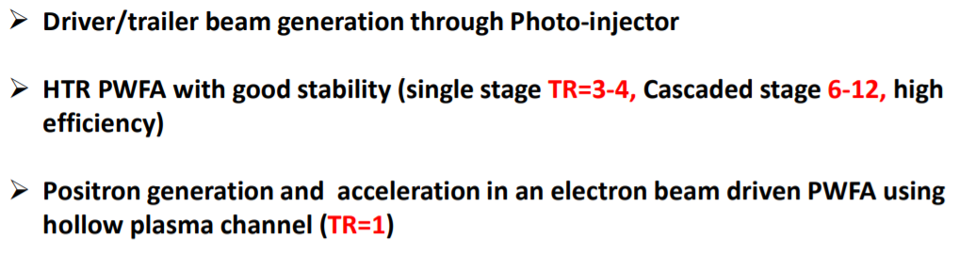
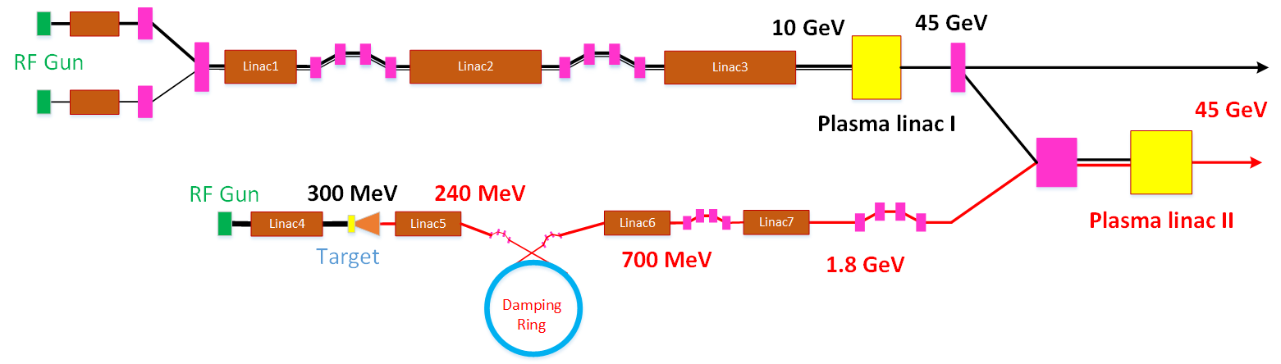


Overall Concept Design CEPC injector
Chih-Hao Pai
$$e^{−}$$
$$e^{+}$$
1.3GeV
3.4GeV

Slide 25
PWA Summary
Chih-Hao Pai
e-/e+ acceleration to 45 GeV in HTR PWFA with single stage TR=3.5 is possible (10GeV electron beam driver)
e-/e+ acceleration to 100 GeV level in Cascaded HTR PWFA with TR=10 is possible (10GeV electron beam driver with higher charge)
Energy spread of 0.2% could be achieved by post processing using a plasma dechirper
Preliminary experimental tests could be performed in near future at FACETII of SLAC

Slide 26
CEPC Collider Ring SRF System
Jiyuan Zhai
Collider parameters: 20180330 | H | W | Z
SR power / beam [MW] | 30 | 30 | 16.5
RF voltage [GV] | 2.17 | 0.47 | 0.1
Beam current / beam [mA] | 17.4 | 87.7 | 460
Bunch charge [nC] | 24 | 19.2 | 12.8
Bunch number / beam | 242 | 1524 | 12000
Bunch length [mm] | 3.26 | 5.9 | 8.5
Cavity number (650 MHz 2-cell) | 240 | 2 x 108 | 2 x 60
Idle cavities on line / ring | 0 | 12 | 60
Cavity gradient [MV/m] | 19.7 | 9.5 | 3.6
Q₀ for long term operation | 1.5E10 | 1.5E10 | 1.5E10
Input power / cavity [kW] | 250 | 278 | 275
Klystron power [kW] (2 cavities / klystron) | 800 | 800 | 800
HOM power / cavity [kW] | 0.57 | 0.75 | 1.94
Optimal Q_{L} | 1.5E6 | 3.2E5 | 4.7E4
Optimal detuning [kHz] | 0.2 | 1.0 | 17.8
SRF parameters and layout established in view of high Higgs priority, low construction cost and upgradability.
Beam cavity interaction issues are challenging but manageable:
FM and HOM CBI, parking cavities
HOM power of different fill patterns, parasitic loss
Gap RF transient, issues for Higgs on-axis injection
FM and HOM impedance and power, heat load
Gradient (stored energy) as high as possible
Input coupler power limit 300 kW (high risk)
Keep power level and RF distribution
HOM power per cavity limit 2 kW
Input coupler variable
Revolution frequency: 3 kHz (FM CBI)

Slide 27
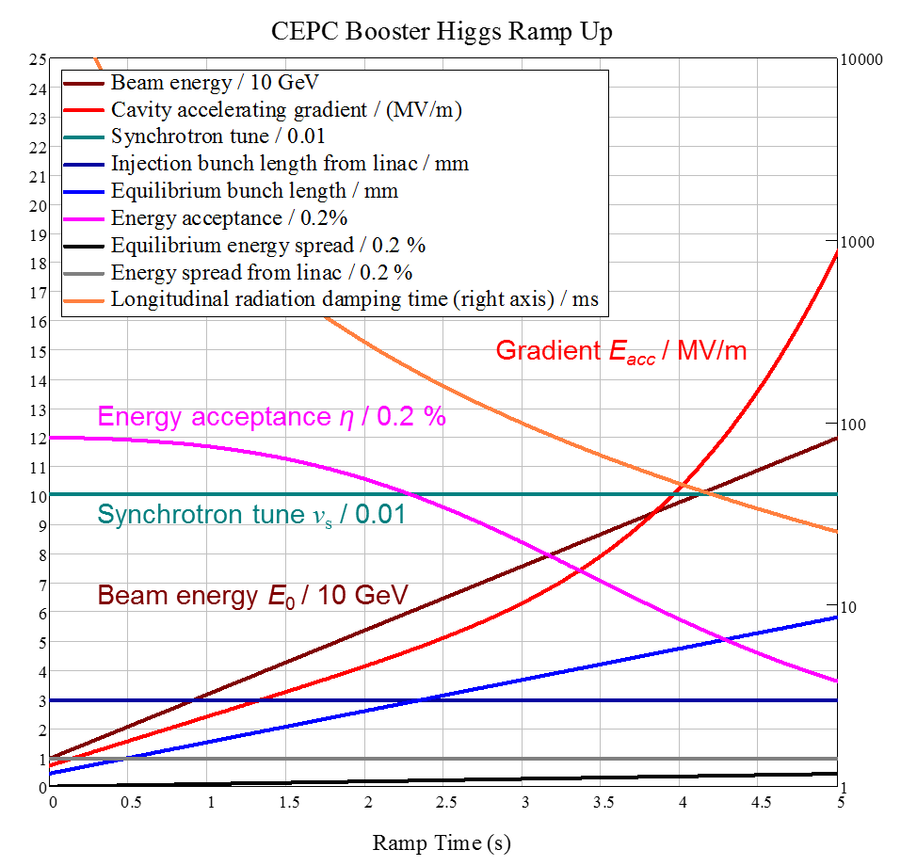
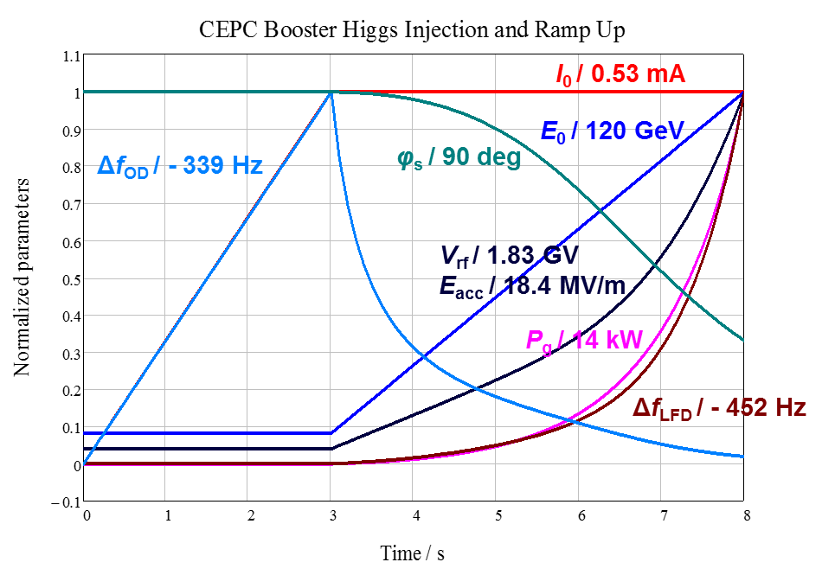
CEPC Booster SRF System
Jiyuan Zhai
10 GeV injection | H | W | Z
Extraction beam energy [GeV] | 120 | 80 | 45.5
Bunch number | 242 | 1524 | 6000
Bunch charge [nC] | 0.72 | 0.576 | 0.384
Beam current [mA] | 0.52 | 2.63 | 6.91
Extraction RF voltage [GV] | 1.97 | 0.585 | 0.287
Extraction bunch length [mm] | 2.7 | 2.4 | 1.3
Cavity number in use (1.3 GHz TESLA 9-cell) | 96 | 64 | 32
Gradient [MV/m] | 19.8 | 8.8 | 8.6
Q_{L} | 1E7 | 6.5E6 | 1E7
Cavity bandwidth [Hz] | 130 | 200 | 130
Beam peak power / cavity [kW] | 8.3 | 12.3 | 6.9
Input peak power per cavity [kW] (with detuning) | 18.2 | 12.4 | 7.1
Input average power per cavity [kW] (with detuning) | 0.7 | 0.3 | 0.5
SSA peak power [kW] (one cavity per SSA) | 25 | 25 | 25
HOM average power per cavity [W] | 0.2 | 0.7 | 4.1
Q₀ @ 2 K at operating gradient (long term) | 1E10 | 1E10 | 1E10
Total average cavity wall loss @ 2 K eq. [kW] | 0.2 | 0.01 | 0.02

Slide 28
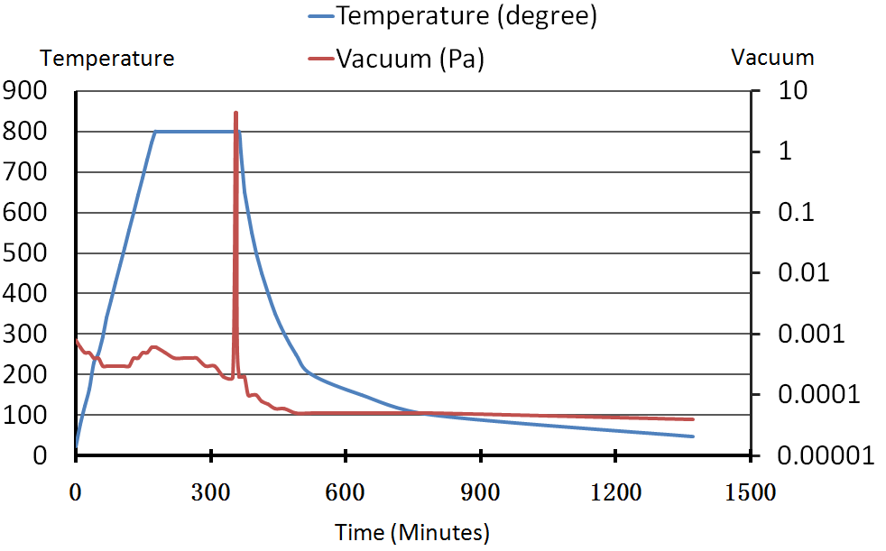
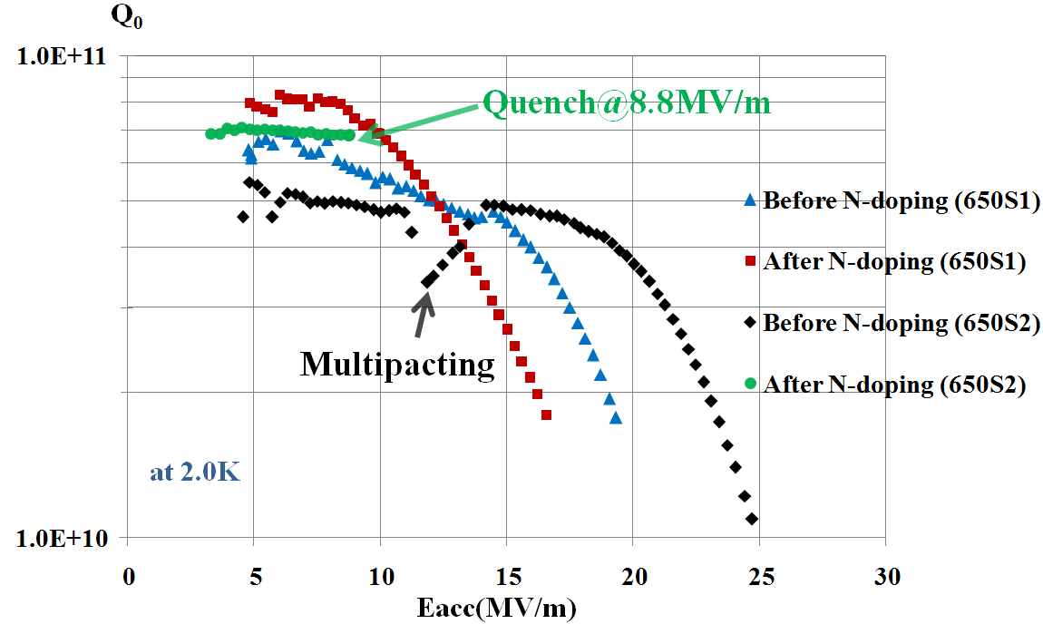
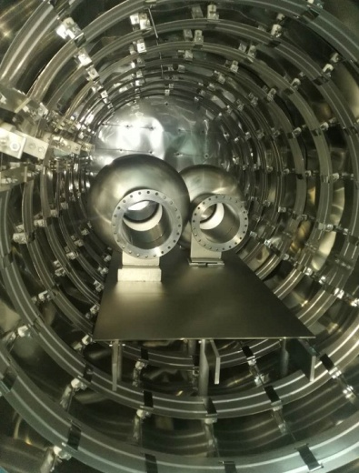
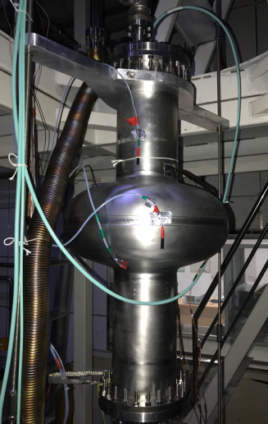
N-doping research
Peng Sha
After N-doping, Q₀ increased obviously at low field for both 650MHz 1-cell cavities.
650S1: Q₀=7e10@Eacc=10MV/m. But Q₀ decreased quickly at high field (>10 MV/m) because of no BCP/EP after N-doping.
650S2: Quench at Q₀=6.9e10@Eacc=8.8MV/m.
Vacuum and temperature curve during N-doping
Vertical test results of 650 MHz 1-cell cavities
N-doping of 650MHz 1-cell cavities
Vertical test of 650MHz 1-cell cavity

Slide 29
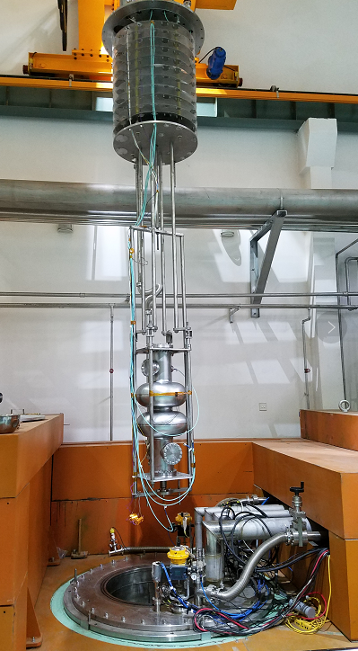
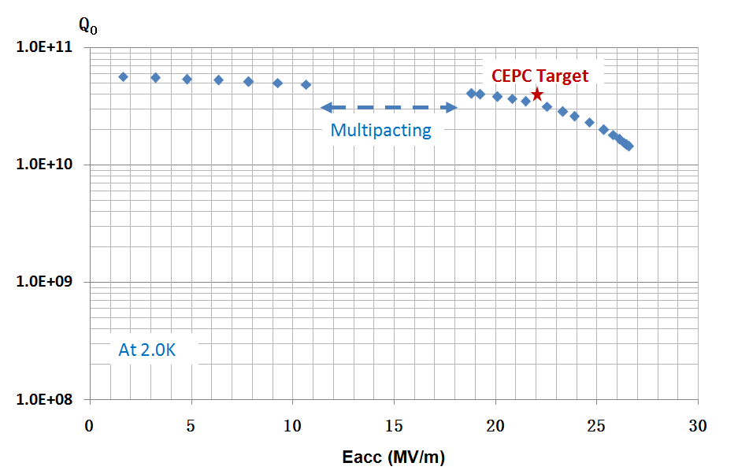
Vertical test of CEPC 650 MHz 2-cell Cavity
Peng Sha
Vertical test result: Q₀=4.0E10@19.2MV/m，which is close to the CEPC target (Q₀=4.0E10@22.0MV/m).
Next, the CEPC target will be achieved by N-doping and EP, etc.
Vertical test of CEPC 650MHz 2-cell cavity

Slide 30
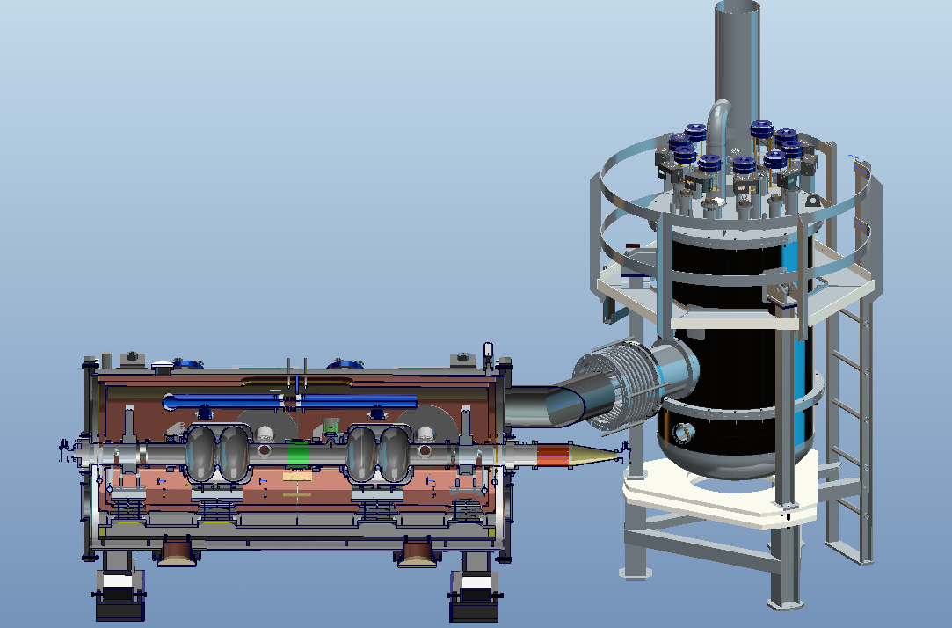
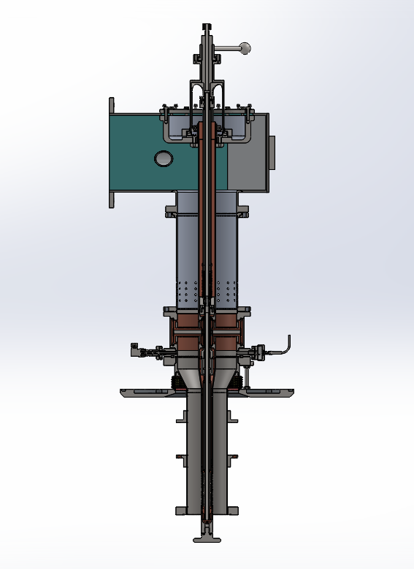
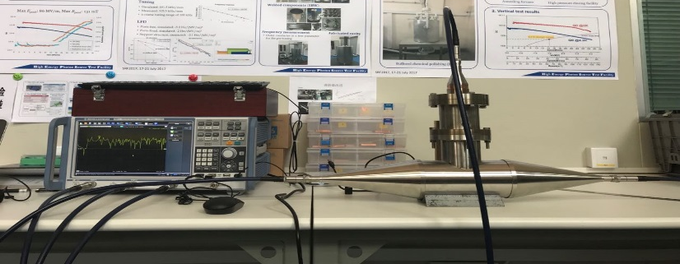
Test Crymodule of CEPC 650 MHz SRF
Peng Sha
Design of the test cryomodule is underway, which consist of two 650MHz 2-cell cavities and other components.
The assembly will be finished in the middle of 2019.
Test of HOM coupler
Design of main coupler is finished

Slide 31
650MHz High Efficiency Klystron R&D plan
Zusheng Zhou
FY 2016: done
  Finalize the gun and the collector design of the 1st conventional klystron prototype (UHFKP8001, Ultra High Frequency band Klystron Prototype with 800kW output power)
  Initialize the dynamics design of the UHFKP8001
FY 2017: done
  Finalize the interaction section and coil design of the UHFKP8001
  Preliminary mechanical design of the UHFKP8001
FY 2018: being carried out
  Finalize the mechanical design and fabrication of the UHFKP8001
  Infrastructure construction for the klystron brazing, baking and testing
  Finalize the interaction section design of the 2nd high efficiency klystron prototype (UHFKP8002)
  Design of the new gun and the new collector for the UHFKP8002

Slide 32
650MHz HEK R&D plan
Zusheng Zhou
FY 2019
  High power test of the UHFKP8001
  Finalize the mechanical design and fabrication of the UHFKP8002
  Finalize the interaction section design of the 3rd high efficiency klystron prototype (UHFKP8003), reuse the gun and the collector design for the UHFKP8002
FY 2020
  High power test of the UHFKP8002 (>75% efficiency to be expected)
  Finalize the mechanical design and fabrication of the UHFKP8003
FY 2021
  High power test of the UHFKP8003 (>80% efficiency to be expected)
  More klystron prototypes or klystron industrialization

Slide 33
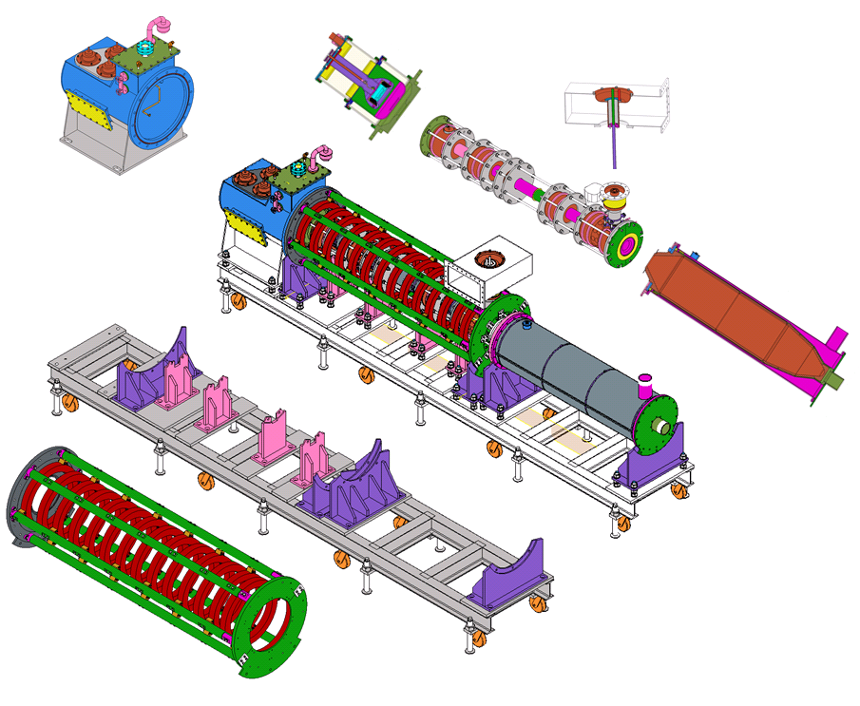
Mechanical design for 1st Prototype
Zusheng Zhou
Mechanical design achieved (L×W×H: 5.12m×0.87m×1.56m)
The manufacture of the UHFKP8001 will be completed this year and then the high power test will be started at the beginning of next year.
Main parameters | Goal
Frequency (MHz) | 650
Vk (kV) | 81.5
Ik (A) | 15.1
Perveance (µP) | 0.65
Efficiency (%) | >60
Saturated gain (dB) | >45
Output power (kW) | 800
1dB bandwidth (MHz) | ±0.5
Brillouin magnetic field (Gs) | 106.7
Reduced plasma wavelength(m) | 3.47
N cavities | 6
Normalized drift tube radius | 0.63
Normalized beam radius | 0.41
Filling factor | 0.65

Slide 34
Design of the Collider magnets
Mei Yang
Dual dipole magnet
  1 turn two turns.
Dual quadruple magnet
  large cross section to reduce power consumption
Single aperture sextuple magnets

Slide 35
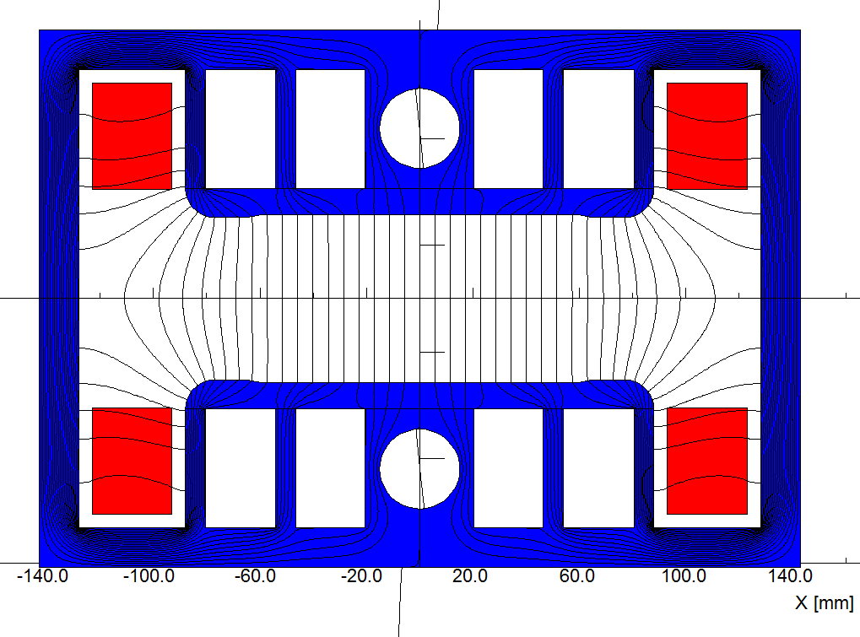


Design of the Booster magnets
Mei Yang
Booster Low field dipole magnet (31Gauss ~ 390Gauss )
  Iron dominated frame
    Core is diluted in two directions.
    Laminations with iron and Aluminum.
  Hollow coil frame
    Cosθ type coils with iron shielding.
    Flat top and bottom: adjust the field quality.

Slide 36




Low-power low-cost design for FCC-ee magnets
Twin-dipole design with 2× power saving
16 MW (at 175 GeV), with Al busbars
twin F/D quad design with 2× power saving
25 MW (at 175 GeV), with Cu conductor
first 1 m prototype
first 1 m prototype

Slide 37





CEPC Vacuum chamber and RF bellow for storage ring
Yongsheng Ma
Electron ring
Positron ring
A vacuum in the lower than 3×10⁻⁹ Torr for ring
Aluminum vacuum chamber (Drawing)
(elliptic 75×56, thickness 3, length 6000)
Copper vacuum chamber (Drawing)
(elliptic 75×56, thickness 3, length 6000)
Function of the bellows module : allow thermal expansion of the chambers and for lateral, longitudinal and angular offsets due to tolerances and alignment,
Providing a uniform chamber cross section to reduce the impedance seen by beam.

Slide 38



NEG coating of the inside chamber
Yongsheng Ma
NEG coating suppresses electron multipacting and beam-induced pressure rises, as well as provides extra linear pumping. Direct Current Magnetron Sputtering systems for NEG coating was chosen.
The NEG coating is Ti, Zr, V, Hf alloy, deposited on the inner surface of the chamber through sputtering.
Coating Facility DCMS
NEG coating for HEPSTF has reached the project`s aim
The film lifetimes with a thickness of 100 nm will be experimented.
Vacuum Distribution
NEG coating pump
Ion sputtering pump
Oleg. B. Malyshev

Slide 39



FCC-ee arc vacuum prototyping & integration
Vacuum chamber cross section: 70 mm ID with ”winglets” in the plane of the orbit (SuperKEKB-like);
The chambers feature lumped SR absorbers with NEG-pumps placed next to them.
Construction of chamber prototypes in coming months and integration with twin magnets

Slide 40

Accelerator components for high current operation
high beam current EFFECTS
David Alesini
I_{wall}
High intensity particle beams are source of:
Pulsed (RF) currents on the pipe surfaces
Heating
Sasha Novokhatski, Mini Workshop, Diamond, January 30, 2013
I_{wall}
E_{gap}
Wakefields (beam-accelerator components interaction)
Discharges
Instabilities
synchrotron radiation
σ_{y}
Electron clouds (from positive charges)
Degradation of beam quality
σ_{z}

Slide 41
CONCLUSIONS
David Alesini
1- The present generation of lepton factories has been very successful achieving or even exceeding their design luminosities. One of the main important ingredients to reach this results was the stable collision of very intense multibunch beams.
2- This has become possible due to careful design of the low impedance vacuum chambers components and devices to cope with beam instabilities.
3- The proper design of all these machine components is one of the key issue for the success of future particle colliders.

Slide 42

Consideration of CEPC Cryogenics
Shaopeng Li
Booster ring:
1.3 GHz 9-cell cavities, 96 cavities
12 cryomodules
3 cryomodules/each station
Temperature: 2K/31mbar
  Collider ring:
650MHz 2-cell cavities, 240 cavities
40 cryomodules
10 cryomodules/each station
Temperature: 2K/31mbar

Slide 43
Weiren Zhou
CEPC Power Consumption – CDR
Table A3.9:
Wall plug efficiency = 23%

Slide 44
Weiren Zhou
FCC-ee
FCC-ee

Slide 45
Weiren Zhou
Power Summary
Future colliders, either circular or linear, require hundreds MW of power.
Circular ones more so because of synchrotron radiation.
But circular ones provide higher luminosity and more IPs, so the power per unit luminosity is actually lower.
The power suckers are RF and magnet.
Klystron efficiency is the key to reduce RF power.
2-in-1 design reduces magnet power by half
Quadrupole is the main consumer of power. Optimization between construction cost and operation cost has been carried out, but may have room for further improvement.
To make CEPC greener, permanent magnets will be employed in the two linac-booster transfer lines (similar to the Fermilab MI-8 line).
The required wall plug efficiency (23%) for CEPC is a tall order.
Innovative thinking and ideas are welcome.

Slide 46









HTS R&D for SppC
Qingjin Xu
“Applied High Temperature Superconductor Collaboration (AHTSC)” formed in Oct. 2016. Including 18 institutions and companies in China. Regular meeting every 3 months.
Goal：
1) To increase the J_{c} of iron-based superconductor (IBS) by 10 times, reduce the cost to 20 Rmb/kAm @ 12T & 4.2K, and realize the industrialization of the conductor;
2) To reduce the cost of ReBCO and Bi-2212 conductors to 20 Rmb/kAm @ 12T & 4.2K;
3) Realization and Industrialization of IBS magnets and SRF cavities.
Working groups：1) Fundamental sciences study; 2) IBS conductor R&D; 3) ReBCO conductor R&D; 4) Bi-2212 conductor R&D; 5) Performance evaluation; 6) Magnet and SRF technology.
Proposal for
Strategic Priority Research Program
of Chinese Academy of Sciences (CAS)
Science and Technology Frontier Research
for High Field Applications of High Temperature Superconductors
Ranked No. 1 in 7 candidates
by Academic Committee of CAS !

Slide 47







R&D of 12T Twin-aperture Dipole Magnet
Qingjin Xu
1st test result of the 1st high-field dipole magnet in China Feb. 2018
Magnet fabrication @ Beijing
10.2 T @ 4.2 K dipole field
in two apertures
(Performance limited by NbTi coils)
Magnet under test @ Hefei
Test system setup @ Hefei

Slide 48




R&D of 12T Twin-aperture Dipole Magnet
Qingjin Xu
Next step：Replace NbTi coils with new Nb₃Sn coils to further increase the field，and insert the IBS coil to test its high field performance.
2*100m IBS tapes
IBS coil
IEECAS
2nd model dipole magnet(Nb₃Sn+IBS)

Slide 49
Worldwide FCC Nb₃Sn program
5400 mm²
3150 mm²
Main development goal is wire performance increase:
J_{c} (16T, 4.2K) > 1500 A/mm² →50% increase wrt HL-LHC wire
Reduction of coil & magnet cross-section
~1.7 times less SC
~10% margin
HL-LHC
~10% margin
FCC ultimate
After only one year development, prototype Nb₃Sn wires from several new industrial FCC partners already achieve HL-LHC performance
Conductor activities for FCC started in 2017:
Bochvar Institute (production at TVEL), Russia
KEK (Jastec and Furukawa), Japan
KAT, Korea
Columbus, Italy
University of Geneva, Switzerland
Technical University of Vienna, Austria
SPIN, Italy
University of Freiberg, Germany
  In addition, agreements under preparation:
  Bruker, Germany
  Luvata Pori, Finland
Notes:
New slide from Davide.
Showing that conductor development is launched at international level, Russia, Japan, (Korea and Europe in preparation)
Underline importance of that development as main cost driver for the hadron collider machine.

Slide 50








16 T dipole design activities and options
H2020
Swiss contribution
Cos-theta
Common coils
Canted
Cos-theta
Blocks
INFN
CIEMAT
LBNL
CEA
PSI
FNAL
Short model magnets (1.5 m lengths) will be built from 2018 – 2022
Russian 16 T magnet program launched by BINP recently.

Slide 51











15 T dipole demonstrator (US-MDP)
Iron Laminations
AL I-Clamps
StSt Skin
End Plates
Fillers
Axial Rods
All coil parts, structural components and tooling are available at FNAL
Coil fabrication and the work with mechanical structure are in progress
First magnet test in September 2018

Slide 52







16 T ERMC construction at CERN
Aluminum shell
Coil fabrication
  Winding of the first coil has been completed
  Preparation for reaction on-going
  All tooling for coil production ready
Magnet yoke
First ERMC coil winding
Magnet assembly
  components and tooling ready
  Dummy assembly to characterize the structure behavior on-going.
Coil Reaction Tool
Coil Impregnation Tool
Dummy coils
Axial rods

Slide 53


Thank you all speakers
&
Thank you for your attention.

