Slide 1




Feedback Systems in Circular Colliders
A. Drago – S. Caschera
INFN Frascati
Workshop on the Circular Electron-Positron Collider
24 - 26 May 2018, Roma3 University, Italy.

Slide 2
Topics
Preliminary comments and requirements
Instability growth rates
Lepton collider feedback legacy: standard design, option A
Lookup table to process to reduce computational effort: option A-1
Feedback performance limits
How to bypass the performance limits: scalable and innovative designs
2nd proposed design: multiple feedback, option B
3rd proposed design: “feedforwarding” multiple feedback, option C
Conclusion

Slide 3
Preliminary comments
In this talk the feedback systems for CEPC are going to be evaluated looking to the proposal done for another 100 Km lepton collider: FCC-ee at CERN, in Europe.
The bunch by bunch feedback systems for FCC-ee could be designed on the basis of the accumulated experience working on lepton circular colliders in the last two decades.
Along the past years a common way to approach these systems has been carried on for PEP-II, KEKB, DAFNE, and, later, for SuperB and SuperKEKB.
Nevertheless the advance of the technology as well as the very high performance required by CEPC and FCC-ee specifications recommend to evaluate improved project scenarios.

Slide 4
Basics ideas
Common problems and limits have been discussed in the past years between the feedback teams to find the more convenient solutions.
It must be noted that feedback systems for circular light sources are only apparently very similar, nevertheless they have to cope with different issues, performance requirements and beam currents.
Having in mind the approach developed for the previous lepton colliders, what is needed to damp the beam oscillations in CEPC or FCC-ee is getting the position displacement (transverse and longitudinal) of each bunch in every turn, and, after computing the correction signal, applying it to the selected bunch as soon as possible.
The feedback systems could be designed to work in time domain without considering in detail which modes are acting in the ring but only taking care the worst modal growth rate.
Of course bunch by bunch systems asks for a design that is mainly digital.

Slide 5
Feedback main blocks
PU (Pick up): a large frequency bandwidth (2-4 GHz) and a very good beta to increase the SNR.
AFE (Analog Front End): basically designed around custom pcb comb filters at 4*RF (Hor, Ver) or 6*RF (Long). The same scheme was implemented for SuperB (even if installed at DAFNE) and SuperKEKB.
DPU (Digital Processing Unit): same unit for all the feedback type (H,V,L), warning about the number of processing channels that is very high. See next slides.
ABE (Analog Back End): for transverse feedback systems, it will work in base band, so usually it only needs a level adapter (pre-amplifier stage with splitters). For the longitudinal systems: as in the previous designs, a double modulation is proposed, both AM and QPSK.
PA (Power Amplifiers) : it is necessary to identify models with required bandwidth (different for transverse and longitudinal) and with 500W/2kW power. They could be commercially available (though expensive). The pulse response must be very sharp to avoid crosstalk between adjacent bunches. The frequency bandwidth shall be >RF/2 (>325 MHz for CEPC, >200 MHz for FCC-ee).
KI (Kicker): cavity type kicker for longitudinal plane and stripline type kickers for transverse planes, as in the previous e+/e- colliders. High beta requested. Bandwidth according to the power amplifier ones.

Slide 6
Remarkable differences
From a feedback system point of view, there are differences between CEPC and FCC-ee that have to be underlined:
CEPC RF frequency is 650 MHz, higher than FCC-ee RF frequency whose value is 400 MHz.
This fact has at least two important consequences: the CEPC harmonic number should be round 200k, that is 40% higher than the FCC-ee one, as well as the feedback sampling frequency will be higher for the CEPC feedback systems.
Furthermore we do not have or know results from any impedance model of the CEPC vacuum chamber: the instability growth rate, an important parameter to determine precisely the feedback system performance is needed.
Also number and pattern of colliding bunches could be most likely different in the two mentioned colliders.

Slide 7
Other general requirements
Before to discuss how to proceed to approach the different cases, there are some preliminary requirements to consider:
a very good beta function is needed at pickups to increase the SNR parameter of the bunch position signals to be processed.
Also a good beta at the kicker is required to have the best performance by the voltage applied to each bunch.
As for the fractional tune value, it is important to note that if it is too small (<.10), the correction signal computing will become slower, because more acquisitions are necessary to fill the response filter.

Slide 8
FCC-ee instability growth rates as foreseen by the impedance model (but without considering e-cloud effects)

Slide 9
Three design cases
Going to FCC-ee or CEPC design and looking to what we foresee about the beam dynamics, three possible cases can be considered:
Case A → slow or fast instabilities (growth rates slower than 10 revolution turns).
Case B → very fast instabilities (growth rates up to 3 revolution turns)
Case C → extremely fast instabilities (growth rates around 1-2 turns or even less).

Slide 10
Case A: design option A
Considering mixed analog and digital technologies designed, developed and used in the recent past to realize feedback systems, only the case A could be faced through the well-known approach. Various feedback system components are still commercially available for this scenario.
Nevertheless the present feedback systems are able to process up to few thousands of buckets. As a consequence new and more powerful processing units have to be built to cope with a very high harmonic number (of the order of 100k).
Another possible issue can rise due to the possible very low frequencies of the modes to be damped. Kickers and power amplifiers feeding the correction signal must have the appropriate bandwidth. Moreover, they have to be checked carefully their working at low frequencies. Power amplifiers with these features should be commercially available.
This “standard” feedback design is foreseen to have a damping rate of 10 revolution turns as the accumulated experience in other circular colliders has shown.

Slide 11
Case A: design option A-1
Usually all the bucket signals are acquired and elaborated even if they are empty. This is to make simpler and faster the real time computation.
In case of control of a reduced number of stored bunches, it can be convenient to modify the usual processing strategy by introducing a lookup table to process only the injected bunches: option A-1
Note that adding a look-up table makes more complicated the DPU design. Nevertheless this effort would be rewarded by less computational efforts.

Slide 12
Case B: design option B
Case B, that considers instability growth rates up to 3 revolution turns, requires a different control scheme to be implemented. Indeed only one feedback system does not guarantee to manage the necessary power for damping action.
The experience done at DAFNE in 2007 where two separate feedback systems were installed on the same horizontal plane as reported in the next slide, clearly highlights that the feedback damping rate is limited mainly by the noise entering in the loop from the pickup.
High beam current makes worse the SNR leading to the feedback saturation.
Moreover saturation or excess of feedback gain can induce enlargement of the bunch dimension. This effect is more dangerous in the vertical plane and it can be also amplified by the kick given by beam-beam collisions.
Implementing four systems spaced by a distance of a quarter of CEPC main ring can bypass the gain saturation limit with the goal to achieve a feedback damping rate of the order of 10/4=2.5 revolution turns.

Slide 14
Option B
→ Beam →

Slide 15
Case C: design option C
Finally the case C, where the instability growth rate is of the order of 1-2 turns or even less, needs a very different design scheme. In fact, the previous control scheme is not able to satisfy new control specifications.
To achieve a faster damping rate it is necessary to apply the correction signal earlier than what occurs in the previous scheme (where voltage kicks occurs every one revolution period).
Again four feedback systems are necessary but it’s not sufficient.
In this case, the way to control instabilities with adequate performance consists of putting the kicker with a distance of a quarter of the ring downstream the relative feedback pickup.
The correction signal has to arrive to the kicker as soon as the bunch passes through it to make feedback action more effective. This is possible whether the chord connecting pickup and kicker points is considered as the correction signal path, thanks to a simple geometric property. In fact, a chord of a circle is shorter than the associated arc where the particle bunch passes).

Slide 16
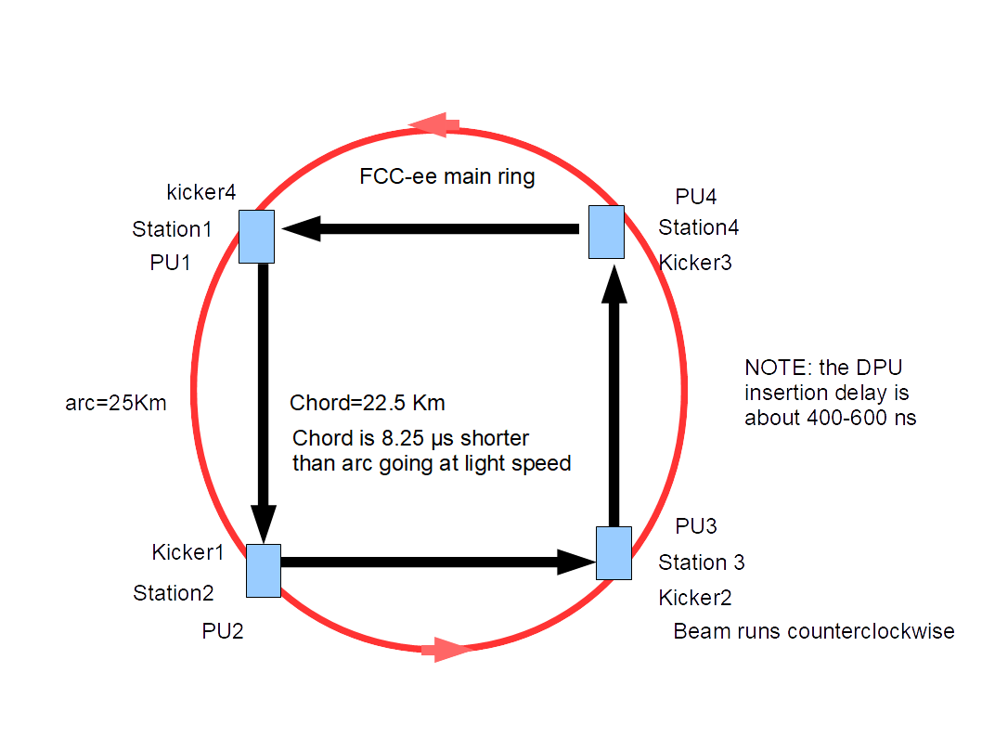
proposed feedback scheme for Option C
← Beam ←

Slide 17
Option C
In order to implement option C, a signal transmission system with propagation speed close to the light speed is needed.
RF communication system can been considered even if optical fiber-based transmission systems may be offering more robustness to noise and flexibility from a practical point of view.
A new technology, the hollow optical fiber transmission, seems in this moment the state-of art solution to achieve the goal.
By implementing this technique, the feedback damping rate should be able to up to be effective in 0.625 revolution turns (10/4/4=0.625).

Slide 18
Option C
A signal transmission system with propagation speed close to the light speed is needed, though it’s not sufficient. Indeed the correction signal has to be transmitted in digital and not in analog format → at least 16 bits every 2 ns.
This requirement asks to a modification of the usual feedback system architecture that has to be split in two parts.
The first one before the optical link (composed of the pick-up, analog front end, ADC-DPU implementing a FIR or IIR filter, timing, bunch labeling, digital transmitter).
The second part after the digital transmission stage (composed of the receiver, timing, decoder, DAC, analog back end, power amplifiers and kicker).

Slide 19
Conclusions
Three control schemes with different complexity level designs are presented in this proposal in order to damp instability growth rates slower than 10 revolution turns (option A or A-1), or up to 3 revolution turns (option B) or even slightly faster than 1 revolution turn (option C). The latter case requires strong R&D efforts to implement the proposed innovative design.
The impact on the ring impedance is higher for B and C options. In fact, both options B and C need four cavity kickers and eight stripline kickers increasing consequently the ring impedance. On the contrary, the option A requires only one cavity kicker for the longitudinal case and two stripline kickers for the transverse planes ( 1 H + 1 V).
However every feedback (H,V,L) system can be implemented independently by the design option that is more adapt to cope with the related instability growth rate.

Slide 20
Thank you for your attention!

