Slide 1
Accelerator components for high current operation
David Alesini
(INFN, LNF, Frascati, Rome, Italy)

Slide 2
OUTLINE
1) Effects of high beam current on:
-beam stability and beam properties
-accelerator components
Design criteria (and examples) of particle accelerator components for high beam current operation:
cavities, kickers, scrapers, bellows
Design of particle accelerators components to control beam instabilities
    -feedbacks kickers
-electrodes for e-cloud suppression
-chamber geometries, treatments,…

Slide 3
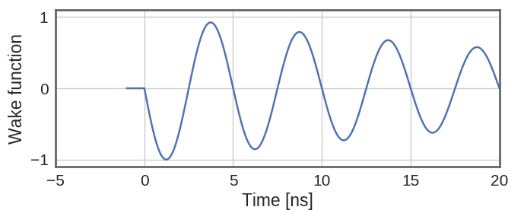
high beam current EFFECTS
I_{wall}
High intensity particle beams are source of:
Pulsed (RF) currents on the pipe surfaces
Heating
Sasha Novokhatski, Mini Workshop, Diamond, January 30, 2013
I_{wall}
E_{gap}
Wakefields (beam-accelerator components interaction)
Discharges
Instabilities
synchrotron radiation
σ_{y}
Degradation of beam quality
Electron clouds (from positive charges)
σ_{z}

Slide 4
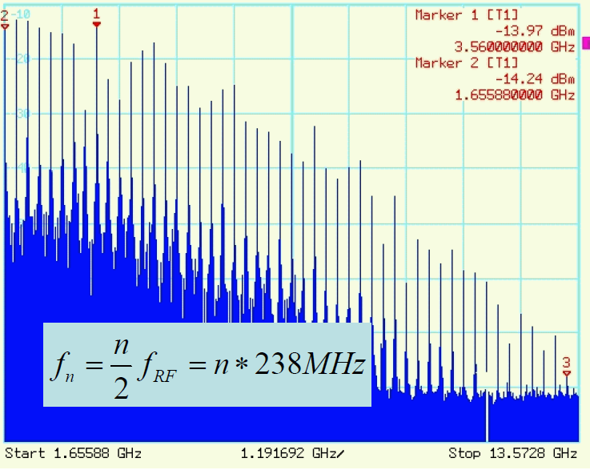
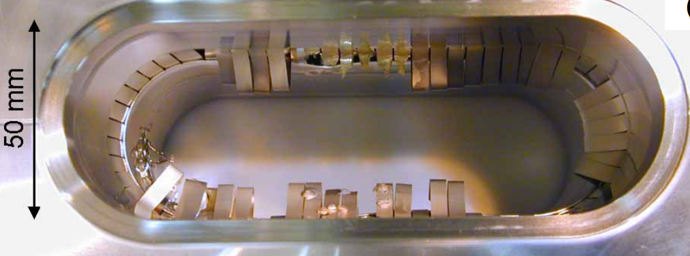
high current EFFECTS: DAMAGES OF COMPONENTS (1/2)
High intensity particle beams are source of:
Pulsed (RF) currents on the pipe surfaces
Heating
Wakefields (beam-accelerator components interaction)
The beam spectrum lines coupled with the beam coupling impedance of an HOM trapped in a device cause an heating proportional to the beam coupling impedance and I². The power released by the beam can easily reach the kW level!
(Sasha Novokhatski, Mini Workshop, Diamond, January 30, 2013)
RF fingers damage due to HOMs
Temperature oscillations due to trapped modes and RF contact variation with temperature
(Sasha Novokhatski, Mini Workshop, Diamond, January 30, 2013)
(Y. Funakoshi, Super B-Factory Meeting at LNF, Frascati , 2005)

Slide 5
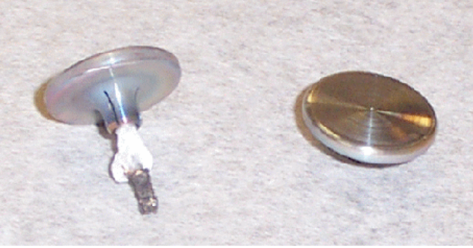
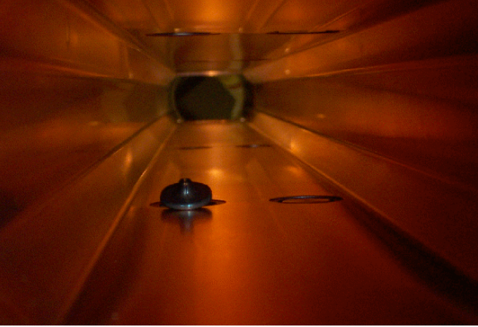
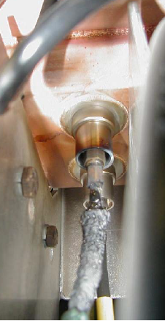
high current EFFECTS: DAMAGES OF COMPONENTS (2/2)
The high electric field generated by the beam electromagneic field at discontinuities can also exceeed the breakdown limits causing discharges
High intensity particle beams are source of:
Pulsed (RF) currents on the pipe surfaces
Heating
(Sasha Novokhatski, Mini Workshop, Diamond, January 30, 2013)
Wakefields (beam-accelerator components interaction)
Discharges
The beam induced e.m. field can also couple with pickups and feedthroughs causing heating of devices connected to the feedthrough and/or of the feedthrough itself (beam transfer impedance)
V_{out}
V_{out}
be
I beam
(S. Weathersby, ICAP09)

Slide 6
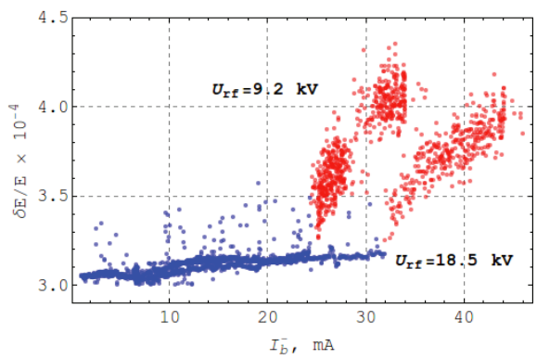
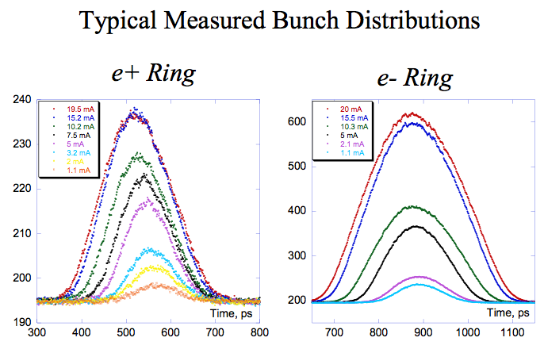
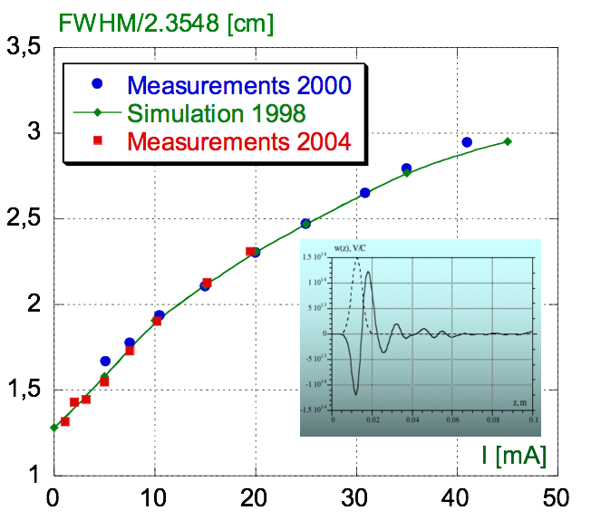
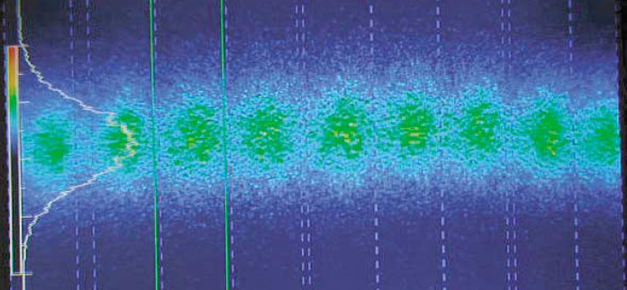
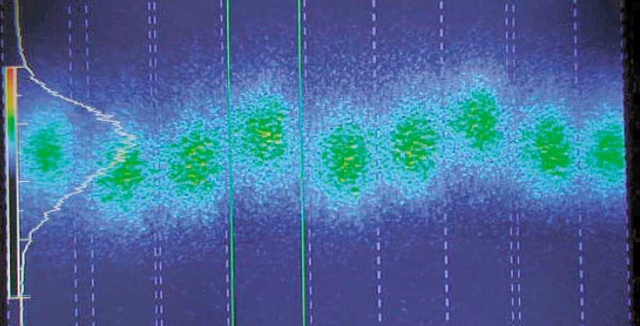
high current EFFECTS: INSTABILITIES AND DEGRADATION OF BEAM QUALITY
DAΦNE
Microwave instability observed in VEPP-2000.
DAΦNE
(Y. Rogovsky, RuPAC2016, THPSC060)
Wakefields (beam-accelerator components interaction)
(M. Zobov et al., e-Print: physics/0312072)
Short range wakefield generated by devices causes the bunch lengthening and above a certain threshold can generate microwave instabilities with increase of the bunch energy spread and beam dimensions
Long range wakefields and/or electron clouds can cause multibunch instabilities and beam oscillations
Instabilities
Time domain: images of stable and unstable positron bunches in CESR:
Degradation of beam quality
Electron clouds (from positive charges)
R. Holtzapple et al., PRST-AB 5, 054401 (2002)

Slide 7
OUTLINE
1) Effects of high beam current on:
-beam stability and beam properties
-accelerator components
Design criteria (and examples) of particle accelerator components for high beam current operation:
cavities, kickers, scrapers, bellows
Design of particle accelerators components to control beam instabilities
    -feedbacks kickers
-electrodes for e-cloud suppression
-chamber treatments

Slide 8
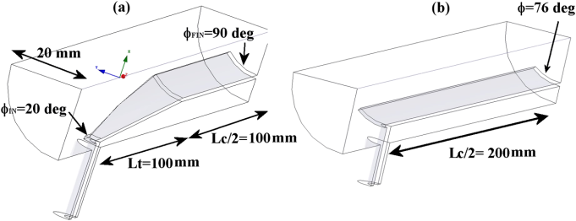
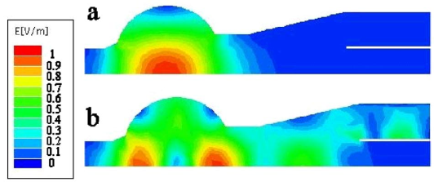
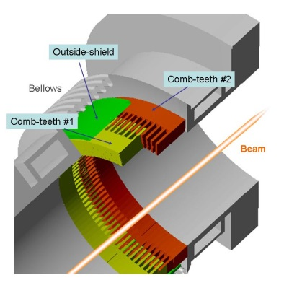
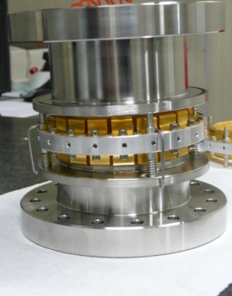
GUIDELINES FOR HIGH CURRENT ACCELERATOR COMPONENTS DESIGN
  1-Vacuum chambers and transitions as smooth as possible adopting, when possible, long tapers (smooth discontinuities)
  2-Insert damping systems for all HOMs trapped in the devices using absorbers in every region having discontinuity or gaps (bellows, valves, cavities…)
  3-Shield with RF contacts, when possible, all cavity-type discontinuities
  4-Improve the thermal and RF contact in case of sliding connections
  5-Insert cooling channels or cooling devices to dissipate the power released by the beam
  6-Carefully calculate/measure the beam coupling impedances and beam transfer impedances to evaluate the power dissipated into the devices and flowing into the feedthroughs.
Coupling impedance evaluation is nowadays mainly performed by 2D or 3D electromagnetic codes, which solve the e.m. problem in the frequency or in the time domain (HFSS, ABCI, MAFIA, CST Microwave Studio, GdfidL, ACE3P, …)

Slide 9
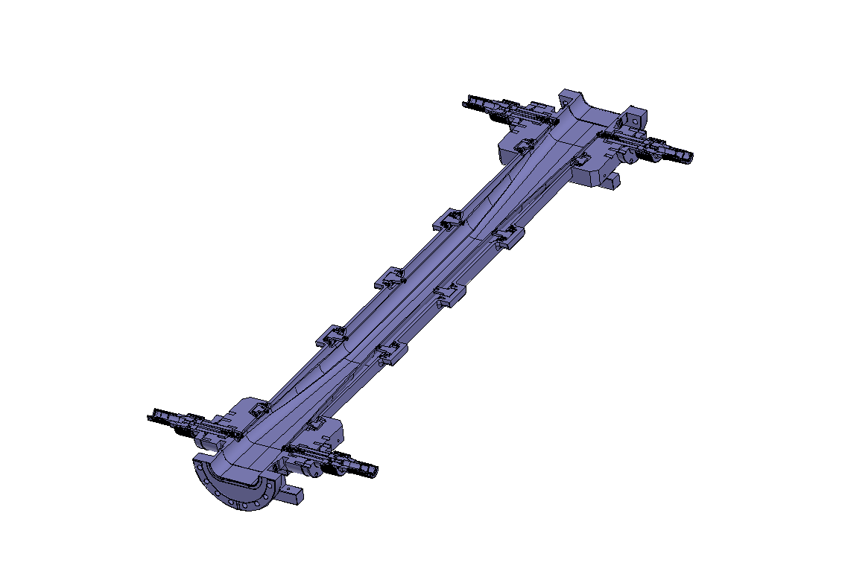
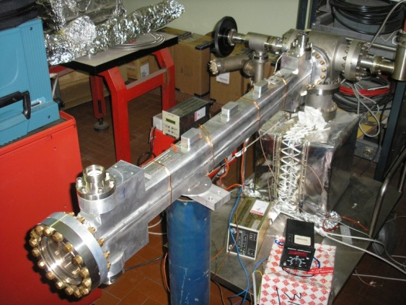
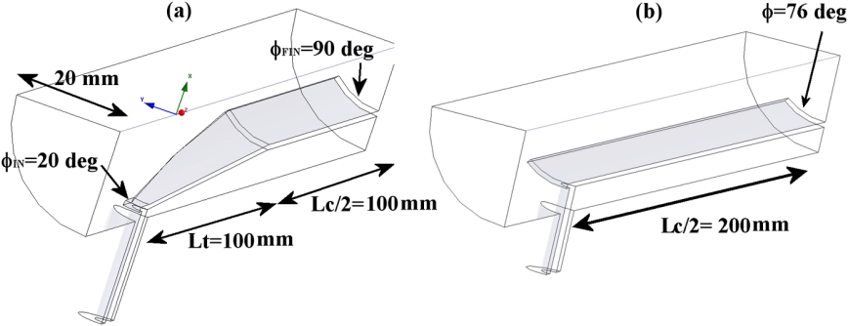
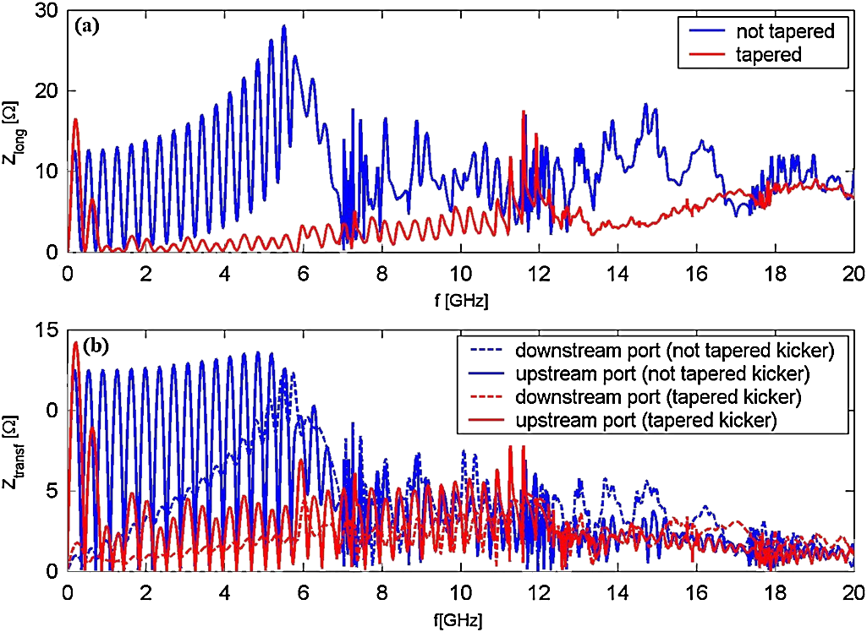
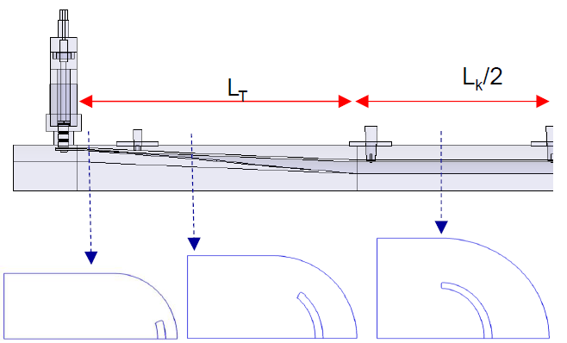
TAPERED DEVICES: NEW DAΦNE INJECTION KICKERS
The design of the new stripline injection kickers of the DAΦNE collider is a typical example of tapered structure realization. In this case the tapering has been done to simultaneously:
-reduce the longitudinal beam coupling impedance
-reduce the beam transfer impedance
-improve the uniformity of the deflecting field
-improve the matching of the fast pulse
Tapered vs untapered devices
Comparison of simulations between tapered and not tapered structure clearly shown the strong reduction of the impact of the device with respect to non tapered devices
D. Alesini et al., PRST-AB 13, 111002 (2010)
1m
beam
beam
Cross sections

Slide 10
GUIDELINES FOR HIGH CURRENT ACCELERATOR COMPONENTS DESIGN
  1-Vacuum chambers and transitions as smooth as possible adopting, when possible, long tapers (smooth discontinuities)
  2-Insert damping systems for all HOMs trapped in the devices using absorbers in every region having discontinuity or gaps (bellows, valves, cavities…)
  3-Shield with RF contacts, when possible, all cavity-type discontinuities
  4-Improve the thermal and RF contact in case of sliding connections
  5-Insert cooling channels or cooling devices to dissipate the power released by the beam
  6-Carefully calculate/measure the beam coupling impedances and beam transfer impedances to evaluate the power dissipated into the devices and flowing into the feedthroughs.
Coupling impedance evaluation is nowadays mainly performed by 2D or 3D electromagnetic codes, which solve the e.m. problem in the frequency or in the time domain (HFSS, ABCI, MAFIA, CST Microwave Studio, GdfidL, ACE3P, …)

Slide 11
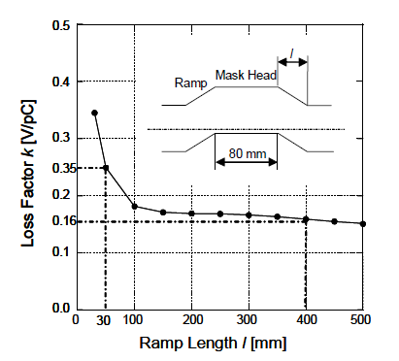
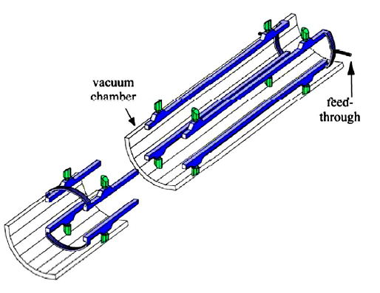
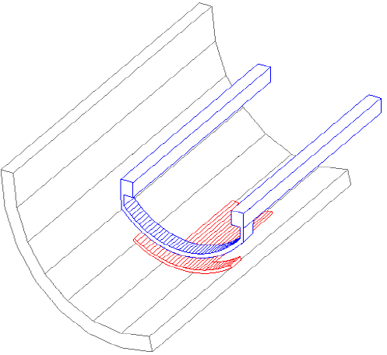
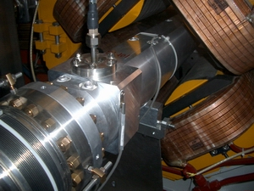
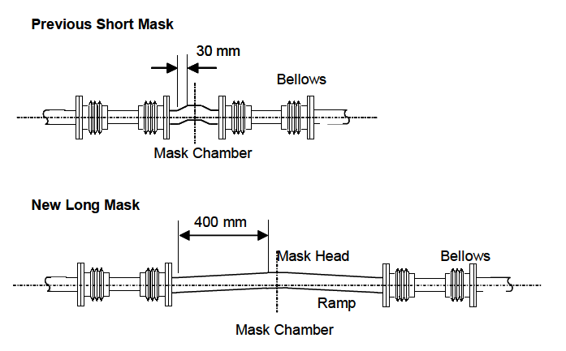
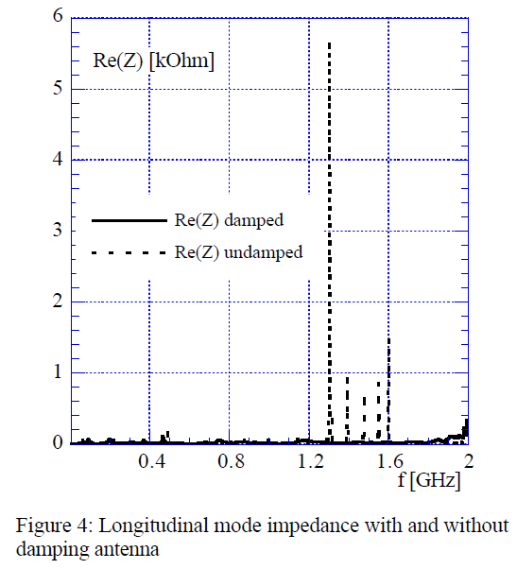
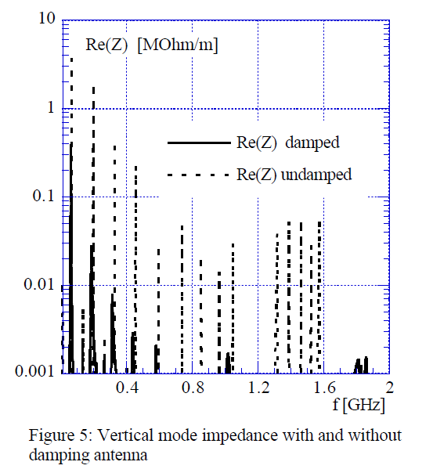
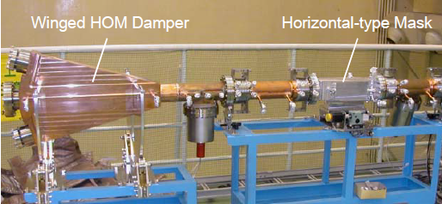
TAPERING AND HOM DAMPING
MASK/COLLIMATOR KEKB
DAMPING OF HOM IN DAΦNE OLD INJ. KICKERS
To protect the detector from damages by spent particles and to reduce the background noise movable mask (collimator) are inserted in the ring. The major problem is the excess heating of bellows just near the mask. Longer mask and HOM absorbers have been introduced to reduce the bellows heating due to excited modes that propagate into the chamber.
(D. Alesini et al., EPAC 2000)
1m
Antenna coupled to the HOMs and connected to an external RF load

Slide 12
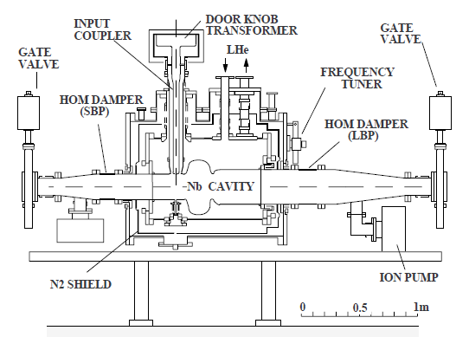
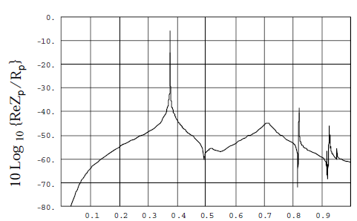
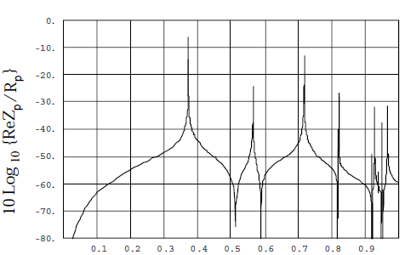
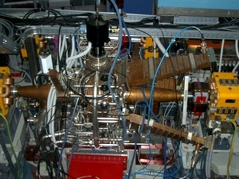
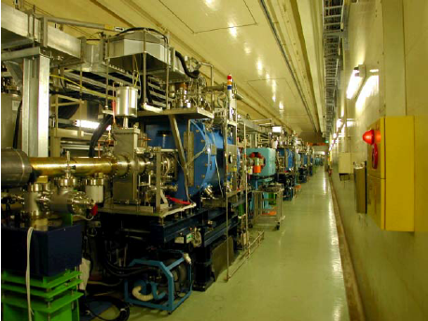
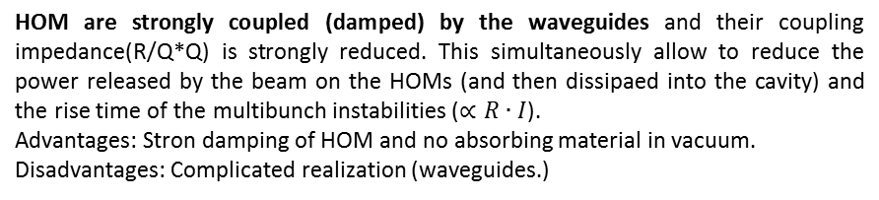
RF cavities: HOM DAMPING SYSTEMS
DAΦNE RF CAVITY (NC)
KEK B (SC)
HOM are strongly coupled (damped) by the waveguides and their coupling impedance(R/Q*Q) is strongly reduced. This simultaneously allow to reduce the power released by the beam on the HOMs (and then dissipaed into the cavity) and the rise time of the multibunch instabilities ($∝R∙I$).
Advantages: Stron damping of HOM and no absorbing material in vacuum.
Disadvantages: Complicated realization (waveguides.)
In this case the HOM propagate into the large pipe and dissipate on special absorbers rings.
Adv: relatively symple geometry and strong damping. Disadv.: Absorbing material direct exposed to the beam field (outgassing etc…).
T.Furuya et al., EPAC 06
S.Bartalucci et al., Part. Acc. 48 (1995) 213-237

Slide 13
GUIDELINES FOR HIGH CURRENT ACCELERATOR COMPONENTS DESIGN
  1-Vacuum chambers and transitions as smooth as possible adopting, when possible, long tapers (smooth discontinuities)
  2-Insert damping systems for all HOMs trapped in the devices using absorbers in every region having discontinuity or gaps (bellows, valves, cavities…)
  3-Shield with RF contacts, when possible, all cavity-type discontinuities
  4-Improve the thermal and RF contact in case of sliding connections
  5-Insert cooling channels or cooling devices to dissipate the power released by the beam
  6-Carefully calculate/measure the beam coupling impedances and beam transfer impedances to evaluate the power dissipated into the devices and flowing into the feedthroughs.
Coupling impedance evaluation is nowadays mainly performed by 2D or 3D electromagnetic codes, which solve the e.m. problem in the frequency or in the time domain (HFSS, ABCI, MAFIA, CST Microwave Studio, GdfidL, ACE3P, …)

Slide 14
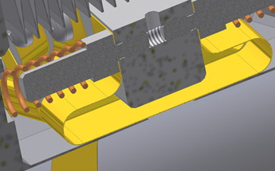
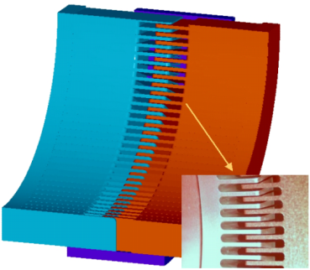
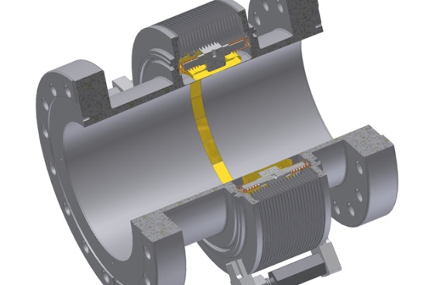
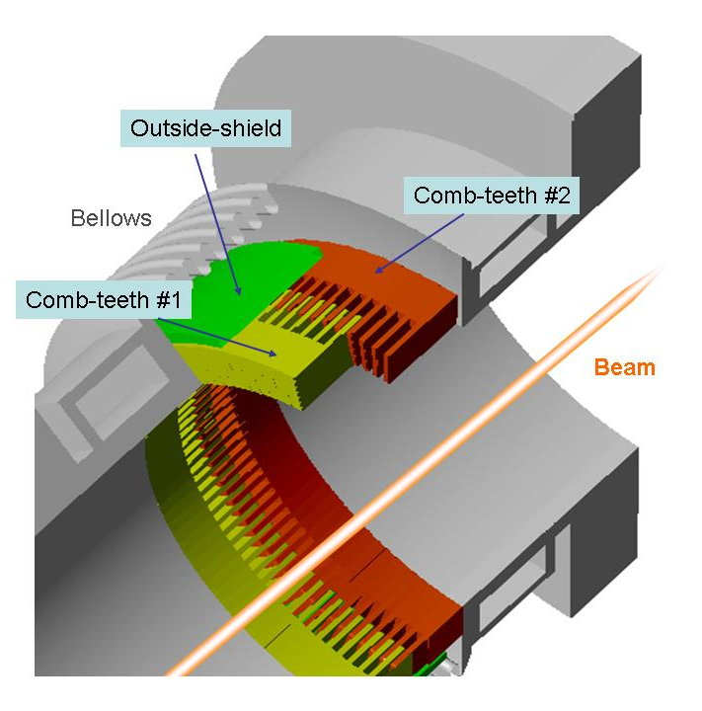
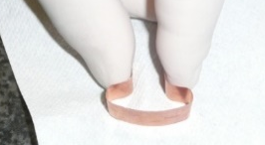
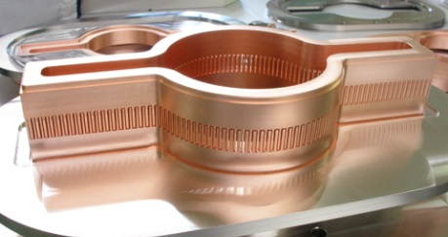
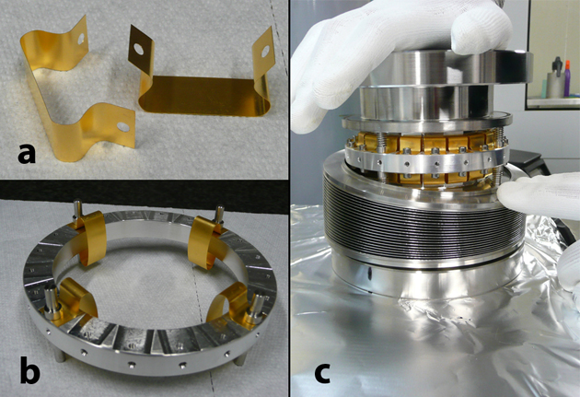
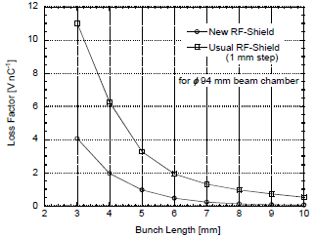
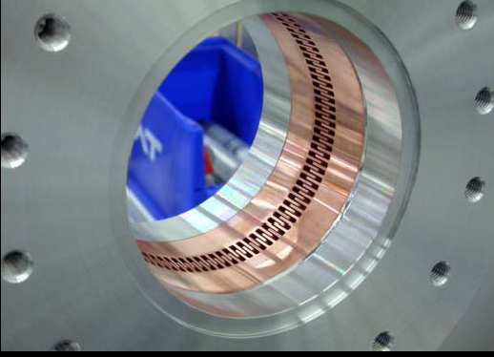

RF CONTACTS AND SHIELDING FOR BELLOWS AND VALVES
DAΦNE SHIELDED BELLOWS
SUPER-KEKB BELLOWS
The shield is composed of 20 omega shaped Be-Cu alloy of 0.15 mm thickness. The strips are gold-coated with a thickness of 10μm and bolted on a thick aluminium annular ring. The shape of the strips is preformed like an Ω. The aluminum ring supporting all the 20 omega strips is floating.
For the SuperKEKB collider the bellows RF shield is not a finger-type but the comb-type. Tooth are 1 mm width and have a radial thickness of 10 mm. About 100 teeth surround the inner surface of the chamber. Gap between each nested tooth is 0.5 mm. The thermal strength of the shield is much higher than before. The new RF-shield structure has a lower loss factor compared to the conventional one (1 mm step at inner wall). The RF-shield structure has been applied also for gate valves.
S. Tomassini et al., EPAC08
RF and thermal contact
Y. Suetsugu, Japan-Italy Collaboration Meeting "Crab Factories” 2008 (INFN-LNF) and PAC 2003

Slide 15
OUTLINE
1) Effects of high beam current on:
-beam stability and beam properties
-accelerator components
Design criteria (and examples) of particle accelerator components for high beam current operation:
cavities, kickers, scrapers, bellows
Design of particle accelerators components to control beam instabilities
    -feedbacks kickers
-electrodes for e-cloud suppression
-chamber treatments

Slide 16
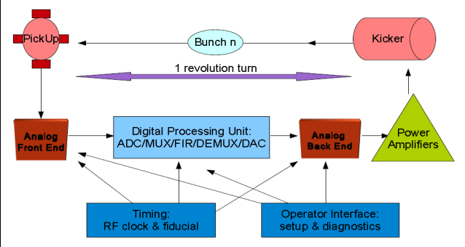
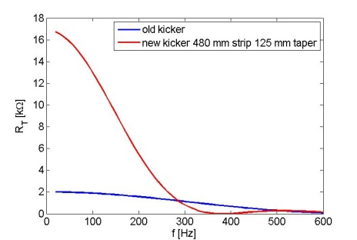
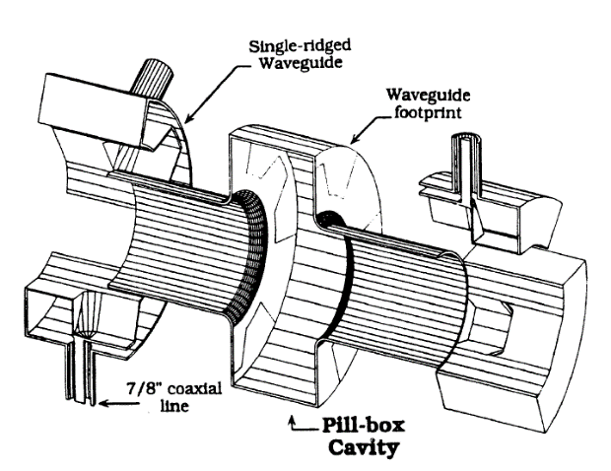
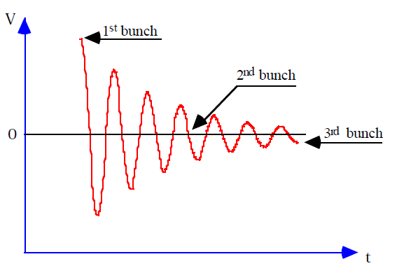
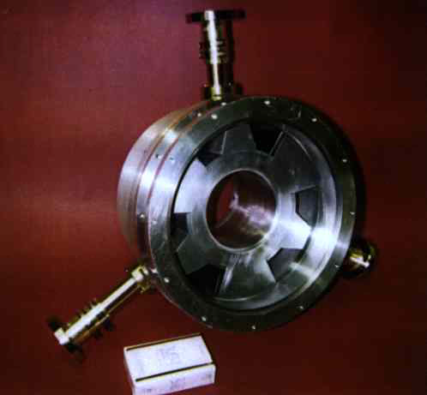
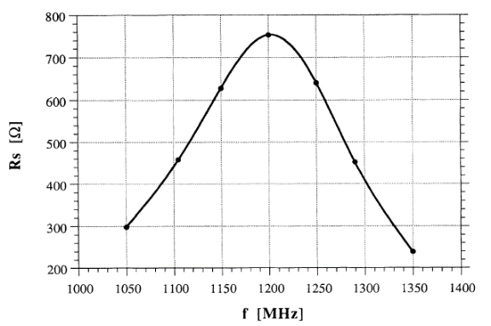
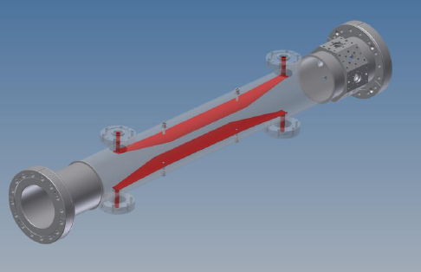


KICKERS FOR LONGITUDINAL AND TRANSVERSE FEEDBACKS
LONGITUDINAL KICKER DAΦNE
HOR. KICKER DAΦNE
R.Boni et al., Part. Acc. 52 (1996) 95-113
Courtesy A. Drago
  Heavily loaded pill-box cavity to have a large pass band (bunch-by-bunch kicking system ) and to damp all HOMs
The kicker has been modified to increase the shunt impedance at low frequencies to cope with the e-cloud instability. Tapered striplines have been adopted to to reduce the longitudinal and transfer impedance
This design is adopted for kickers in: DAFNE, KEKB, BESSY-II, PLS, HLS, TLS, ELETTRA/SLS, BEPC-II, KEK Photon Factory, Duke storage ring, PEP-II, SuperKEKB, DELTA, ELSA, ALS, Diamond, ESRF, LNLS-UVX, PETRA-III, MAX-IV…

Slide 17



DEVICES FOR E-CLOUD SUPPRESSION
The electron cloud instabilities are the most severe ones and among the principal factors limiting the performance of the lepton factories.
Different techniques have been implemented to mitigate the electron cloud effects: powerfull feedbacks, solenoids, particular bunch filling schemes with empty buckets, TiN coating, electrodes, grooves.
SuperKEKB (as example) uses almost all the know mitigation techniques.
SOLENOIDS
Very effective to effectively suppress both photoelectrons
and secondary electrons
ANTECHAMBER
Reduction rate: ~ 1/5 at high current region
GROOVES
Reduction rate: ~1/4 (two grooves at top and bottom)
TiN COATING
Increase of the resistive wall impedance
Y. Suetsugu, ECLOUD’10

Slide 18








DEVICES FOR E-CLOUD SUPPRESSION: ELECTRODES
SUPERKEKB
DAΦNE
Electrodes Inserted into the dipoles (8) and wiggler (4) chambers (not foreseen at the origin). They have a width of 50 mm, thickness of 1.5 mm and their distance from the chamber is about 0.5 mm (to reduce the beam coupling impedance).
The distance of the electrode from the beam axis is 8 mm in the wigglers.
Shapal (good thermal conductivity)
Y. Suetsugu, ECLOUD’10
Reduction rate: ~1/100
Very effective in wigglers
D. Alesini et al., IPAC10
D. Alesini et al., PRL 110, 124801 (2013)
Loss factor: ∼1.7×10¹¹ V/C
Electrodes should dissipate 7.8 W, or 112 W/m² would result in electrode heating under vacuum up to 50⁰-55⁰
Loss factor: ∼1.6x10⁹ V/C
Encountered problem: lost of insulations after few years of operation. Cause still under investigation

Slide 19
CONCLUSIONS
1- The present generation of lepton factories has been very successful achieving or even exceeding their design luminosities. One of the main important ingredients to reach this results was the stable collision of very intense multibunch beams.
3- This has become possible due to careful design of the low impedance vacuum chambers components and devices to cope with beam instabilities.
4- The proper design of all these machine components is one of the key issue for the success of future particle colliders.
THANKS TO
M. Zobov and M. Migliorati
All the authors from whom I took pictures, plots, informations…
AND YOU FOR YOUR ATTENTION!

