Slide 1
Energy calibration in high energy colliders I. Koop, BINP, Novosibirsk
CEPC workshop, Rome, 24-26 May 2018

Slide 2
Outline
Polarization study approach
Spin tracking code features
Self-polarization degree estimations
Resonant Depolarization problems
Conclusion.

Slide 3
Polarization specifics of CEPC and FCCee
Beam emittances in CEPC/FCCee are so small, that all resonances with the betatron frequencies are suppressed and their influence on the spin motion is negligible: $ν_{0}$·|$σ_{\text{y}\text{’}}$| ~ 2·${10}^{−5}$ (at E=80 GeV).
Therefore, only static vertical orbit distortions and the longitudinal magnetic fields with nonzero integrals can affect the spin motion!
Precession frequency modulation by the synchrotron oscillations is most important! The relevant parameter is: $ξ=ν_{0}{σ_{δ}}/{Q_{s}}$. One would prefer ξ < 1, means $Q_{s}$ as high as possible! LEP1: ${ Q}_{s}$=0.065, $σ_{δ}=0.0007$, $ξ=$1.07 - comfortable for beam energy E=45 GeV!
But $Q_{s}$=0.05, $ξ=2.4$ for base line parameters of FCC-ee at 80 GeV.

Slide 4
Spin tracking code algorithm
Spin perturbation:
It is localized at s=0.
Random jumps of relative energy deviation δ are localized also at s=0.
$w_{x}{(θ}_{k})=w_{0}+w_{DP}∙\cos\left(ν_{DP}θ_{k}\right),{ with θ}_{k}$=2π·k, ${ ф}_{x}{(θ}_{k})=$2π·$w_{x}{(θ}_{k})$
y
Spin precession around the
y-axis with $ν={ γa=ν}_{0}$(1+δ).
Radiation damping of δ is taken into account!
s=0
$w_{0}$ - simulates effects of orbit distortion
$w_{DP}$ - simulates the Depolarizer’s Impact
The code tracks the regular synchrotron and spin motion inside an arc $0$ < $θ$< 2π as:
${ δ}^{′′}+2λ{∙δ}^{′}+{Q_{s0}^{}}_{}^{2}$·δ=0 $Q_{s}=\sqrt{{Q_{s0}^{}}_{}^{2}−λ^{2}}{ ф}_{y}$ ($θ$)= $\int_{0}^{θ}{ν_{0}\text{.}\left[\text{1+}\text{δ}\text{(}θ\text{)}\right]dθ}$
$δ\left(θ\right)=$ $e^{−λθ}·\left[ δ\left(0\right)·\cos{{(Q}_{s}θ)}\text{+} ps\left(0\right)·sin{{(Q}_{s}θ)}\right]$
ps$\left(θ\right)=$ $e^{−λθ}·\left[−δ\left(0\right)·\sin{{(Q}_{s}θ)}\text{+} ps\left(0\right)·cos{{(Q}_{s}θ)}\right]$ ps($θ$) ≡ ${\left(δ^{′}(θ)+λ\text{δ}\text{ (}θ\text{)}\right)}/{Q_{s}}$
${ ф}_{y}$($θ$)= $ν_{0}θ\left\{1+\frac{δ\left(0\right)\left[{λ−λe}^{−λθ}·\cos{{(Q}_{s}θ)}\text{+}{Q_{s}e}^{−λθ}·sin{{(Q}_{s}θ)}\right]+ps\left(0\right)\left[Q_{s}−{Q_{s}e}^{−λθ}·\cos{{(Q}_{s}θ)}{−λe}^{−λθ}·sin{{(Q}_{s}θ)}\right]}{\left({Q_{s0}^{}}_{}^{2}+λ^{2}\right)θ}\right\}$
$ν_{0}=\overline{γ}a=\overline{E}($GeV)∕0.44064846, $ν_{0}$=181.55 at $\overline{E}=80 GeV.$ Resonances at :${ ν}_{0}=n+m·Q_{s}$

Slide 5
1. Equilibrium beam polarization degree simulation
The equilibrium polarization degree can be calculated as:
$P=92.6(\%)/(1+{τ_{ST}}/{τ_{dep}})$
where $τ_{ST}$ is the Sokolov-Ternov polarization time, while $τ_{dep}$ is obtained by the spin tracking code depolarization time.
The harmonic spin matching, if applied as at LEP and HERA, can minimize the strengths of two nearby integer parent resonances. But question: how small they can be made?
We rely on data from LEP at 61 GeV, where some polarization level, say about 6%, was observed (see R.Assmann et al. , “Spin dynamics in LEP with 40–100 GeV beams”, AIP Conference Proceedings 570, 169 (2001); doi: 10.1063/1.1384062).
This translates to our estimation of some residual uncompensated spin perturbation:
$w=0.0015$, which we will use as a reference value.

Slide 6
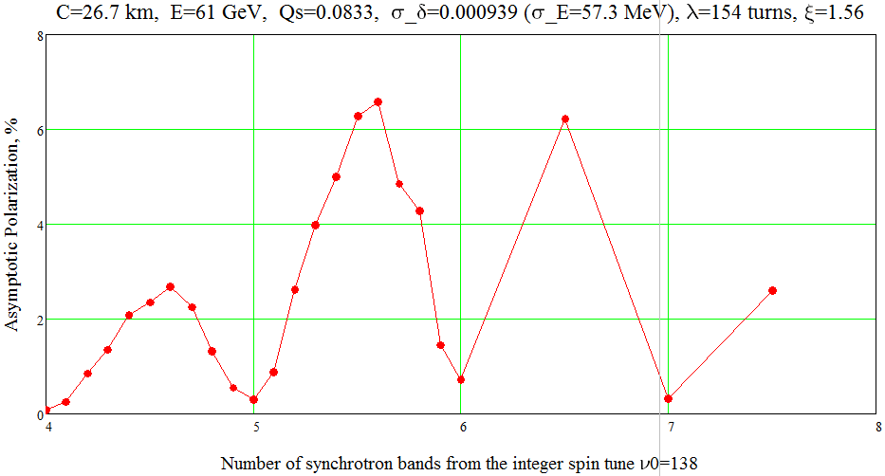
Simulating polarization for LEP at 61 GeV, Qs=0.0833
ν=138.5

Slide 7
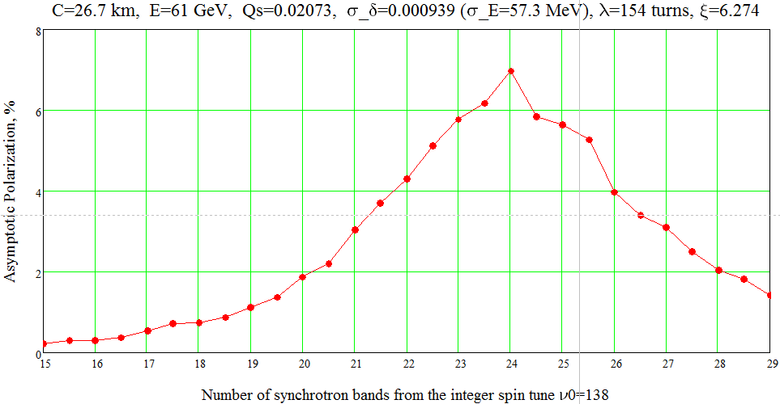
Equilibrium polarization for LEP at 61 GeV and Qs=0.02073
Here $w=0.0015$, $Q_{s}=0.02073.$ Dips at high m detunings $m·Q_{s}$ disappear! Remarkable that polarization is large near the half-integer spin tune values! Arc serves as Siberian Snake?
This agrees well with Eliana’s simulations!
ν=138.6
ν=138.4
ν=138.3
ν=138.5

Slide 8
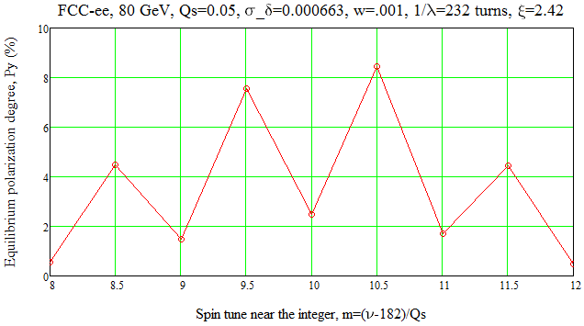
FCC-ee Equilibrium polarization degree: 80 GeV and Qs=0.05
ν=182.4
ν=182.6
ν=182.5

Slide 9
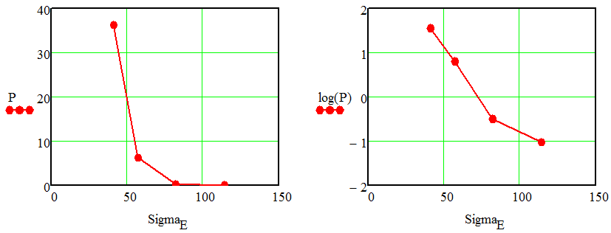
Polarization dependence on energy diffusion rate
Lessons from this study:
No strong influence of Qs on the attainable polarization level!
Only the value of the beam energy spread is really important.
Recommendation given from the LEP experience:
$σ_{E}<52 MeV$ is confirmed by these simulations.

Slide 10
Spin resonance width and new nonstandard RD technique
My spin tracking code has revealed dramatic increase of the width of the central resonance line at W threshold for chosen synchrotron tune value: Qs=0.05.
With such low synchrotron tune and, subsequently, too high value of the synchrotron modulation index ξ=ν₀σ_{δ}/Qs=2.4 a width of the central spectrum line becomes very large: Δν=±0.002. This corresponds to ΔE/E=±0.00001.
In such situation there is no any sense to scan the resonance monotonically – no sharp changes in the polarization degree are expected.
More reasonable is to do probing of the depolarization efficiency in few depolarizer’s frequency points around the center of a peak – then steps in polarization degree became quite visible. This idea was proposed by Alain Blondel and, seems, has been tested at LEP.

Slide 11
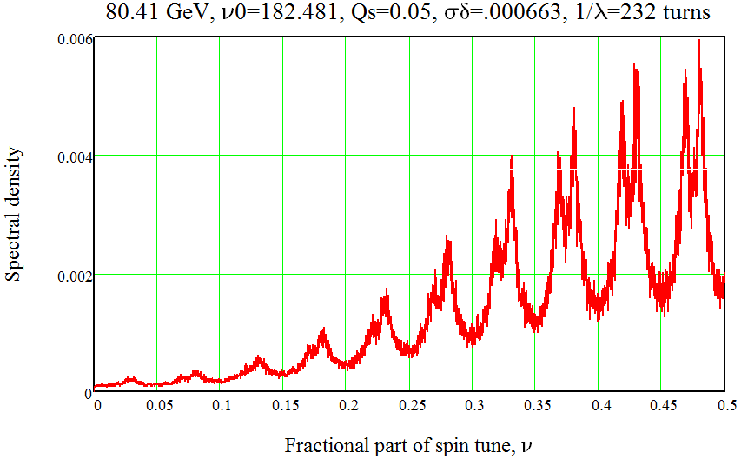
Spectrum of 80 GeV single particle spin motion
Spectrum of f$ree spin precession of single particle during 40000 turns. { Q}_{s}$=0.05.
Central peak ν=0.481
1-st side-band ν=ν₀ -Qs

Slide 12
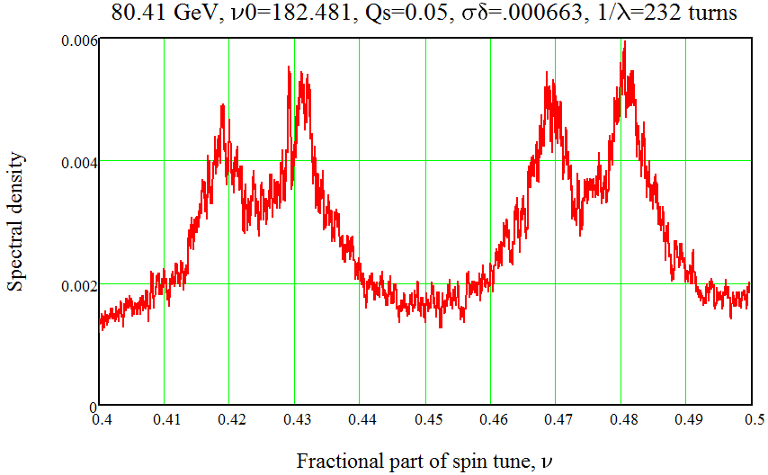
Zoom of spectrum of single particle spin motion
Spectrum of f$ree spin precession of single particle during 40000 turns. { Q}_{s}$=0.05.
Central peak ν=0.481
1-st order
side-band:
ν = ν₀ - Qs
2-nd order
side-band:
ν=2 - (ν₀ + 2·Qs)
1-st order side-band:
ν=2 - (ν₀ + Qs)

Slide 13
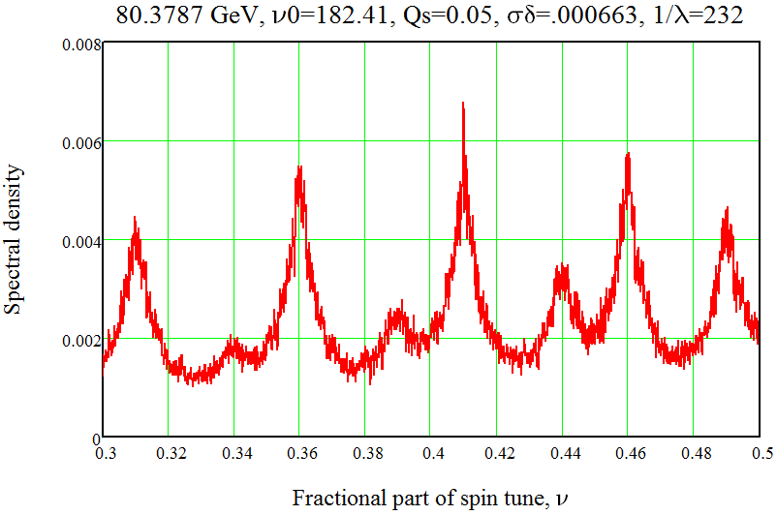
Spectrum for slightly shifted spin tune {ν₀}=0.41
Mirror symmetric the left and the right wings of the central line with this choice of {ν₀}. It is better to reduce a possible error in determination of the center of a peak!

Slide 14
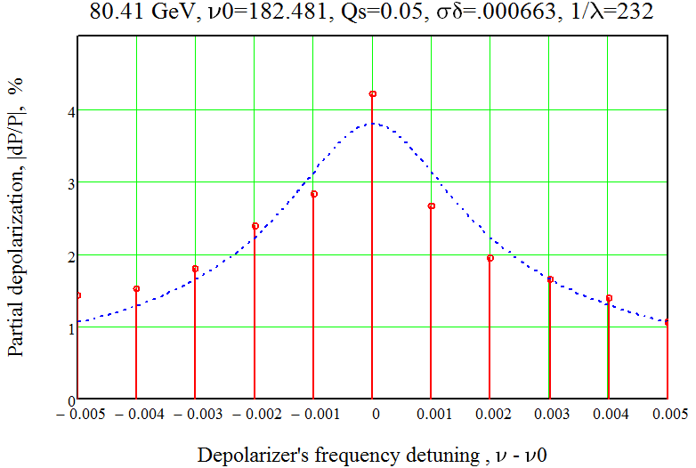
Partial depolarizations by 11 steps in depolarizers frequency
The left and the right wings of the central line are asymmetric due to too close proximity of 1-st order synchrotron side-band. This should be accounted when fitting to a model.
The presented here fit is symmetric – hence not fully correct – could be modified.

Slide 15
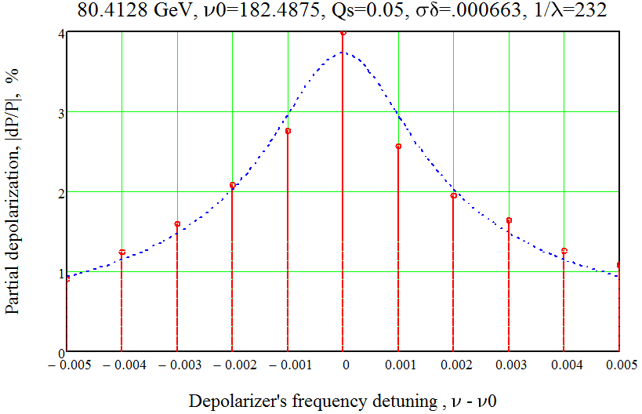
Partial depolarizations by steps when {ν₀}=0.4875
The left and the right wings became symmetric with this choice of fractional part of ν₀.

Slide 16
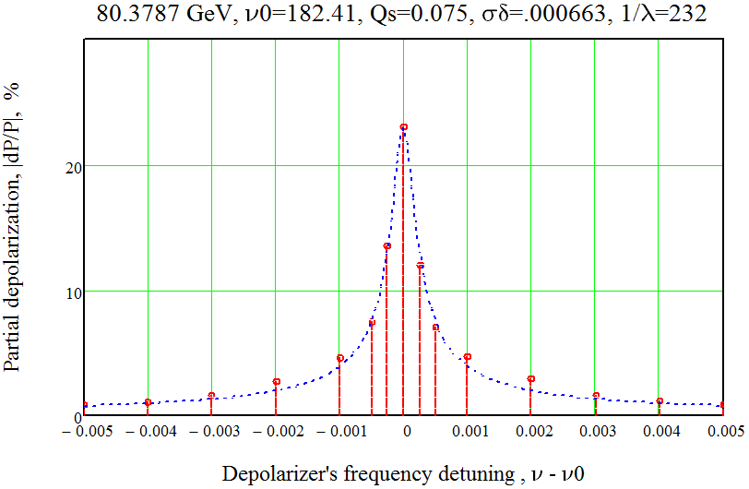
Partial depolarizations by steps with Qs=0.075, {ν₀}=0.41
The RD response with Qs=0.075 is 8 times more narrow in comparison with the case Qs=0.05
Δν=±0.00025

Slide 17
Spectrum line width scaling law
Line shape fitting function: f(ν)=A$\frac{∆}{\sqrt{∆^{2}+{(ν−ν0)}^{2}}}$ with parameters: A, Δ, ν0
Fit found by the tracking of the line width dependence on the synchrotron motion and beam parameters:
$∆=0.0035∙\frac{λ}{0.000686}$·${\left(\frac{ν0·σ_{δ}}{182.425∗0.000663}\right)}^{2.5}$·${\left(\frac{0.05}{Q_{s}}\right)}^{3}$ $∆=0.0035$ at E=80 GeV
For given accelerator without wigglers the energy dependence is very strong:
Δ $\sim$ $E^{8}$ because $λ\sim E^{3}$, $ν0$ $\sim$ E, $σ_{δ}$ $\sim$ E
Therefore, this effect plays important role only at W threshold and not at Z!

Slide 18
Conclusion
Spin tracking of a motion of a single particle reveals the dependence of the spectrum line width from the synchrotron tune and other beam parameters.
This width becomes very large for chosen synchrotron tune Qs=0.05 and standard RD procedure becomes not applicable.
The $discussed above new RD procedure \left(by steps\right) works well even$ in cases when a width of the spin resonance became very large. That is just a case with Qs=0.05.
Still the accuracy of a method needs to be studied further.
Second order terms in orbital motion also contribute to the line width (I.Koop, Yu.Shatunov, in proc. EPAC 1988, Rome, p.738-739). Will be evaluated later on.

Slide 19
Acknowledgments to: Alain Blondel, Eliana Gianfelice-Wendt and Yuri Shatunov for stimulating discussions! Thank you!

