Slide 1
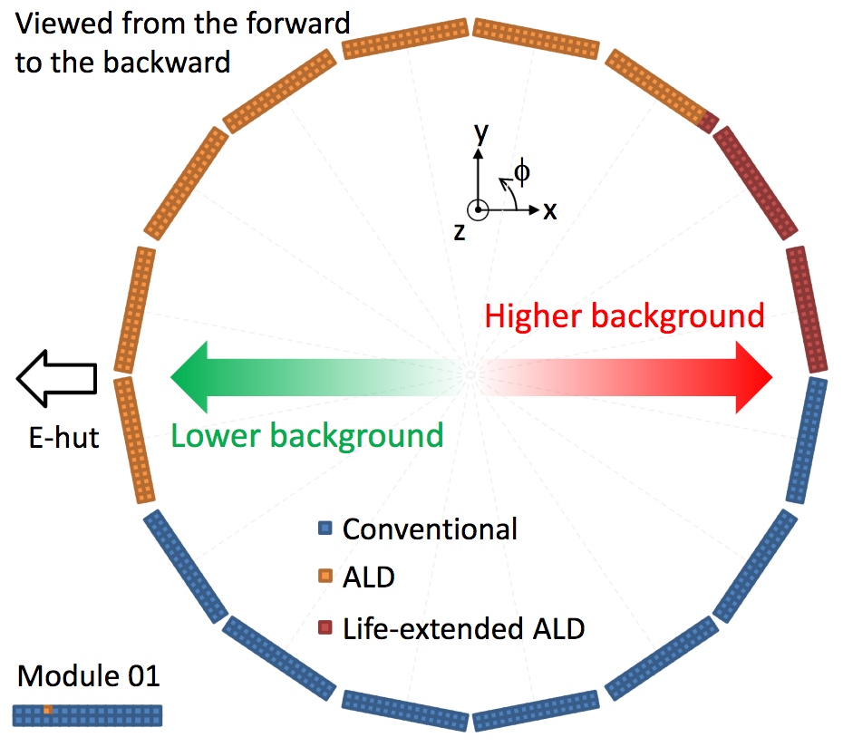
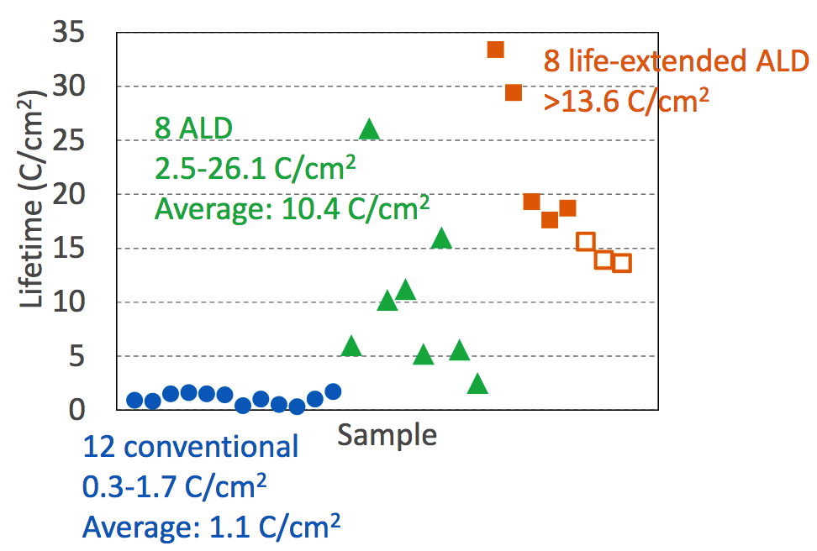
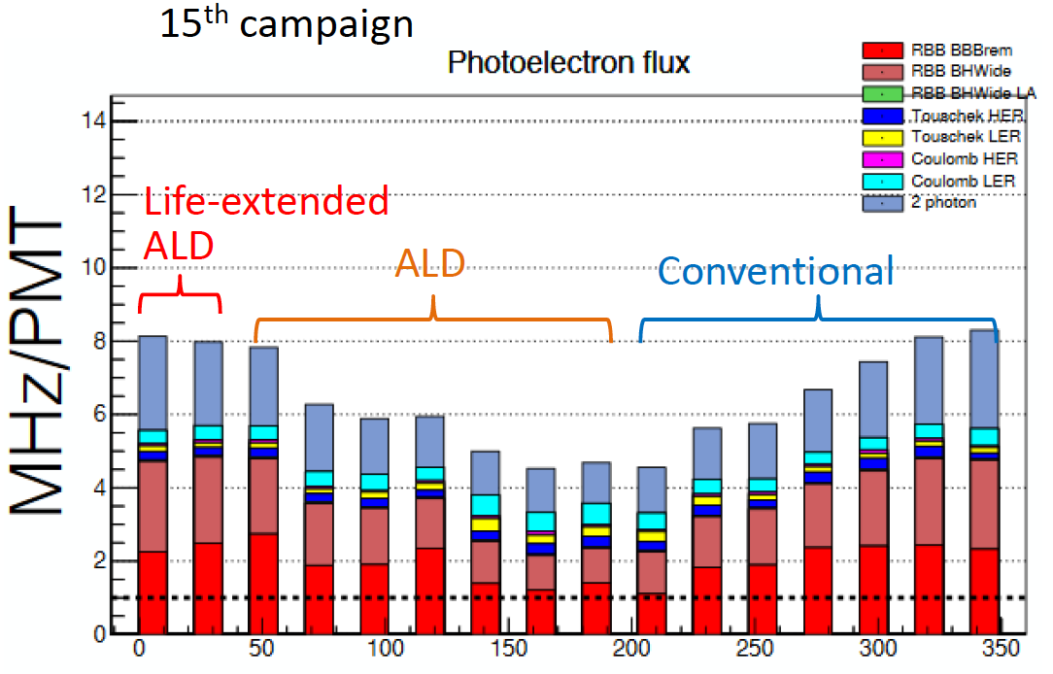
Activity: TOP upgrade
New
Liftime: QE = 80% QE(t=0)
ALD
Life-extended
ALD
S01
S09
S16
S10
Conventional
MCP-PMT
1 MHz/PMT at 5 10⁵ gain ➔ 1 C/cm² @ 50 ab⁻¹
4÷8 MHz/PMT ➔ 1.1 C/cm² @ 12÷6 ab⁻¹
S16
Integrated luminosity at the summer shutdown
2019: 0.18-0.33 C/cm² (2 ab^{–1})
2020: 0.72-1.33 C/cm² (8 ab^{–1})
2021: 1.52-2.82 C/cm² (17 ab¹)
2022: 2.69-4.98 C/cm² (30 ab–1)
2023: 3.76-6.97 C/cm² (42 ab–1)
S10
Φ (degrees)
Replace conventional MCP-PMT.

Slide 2
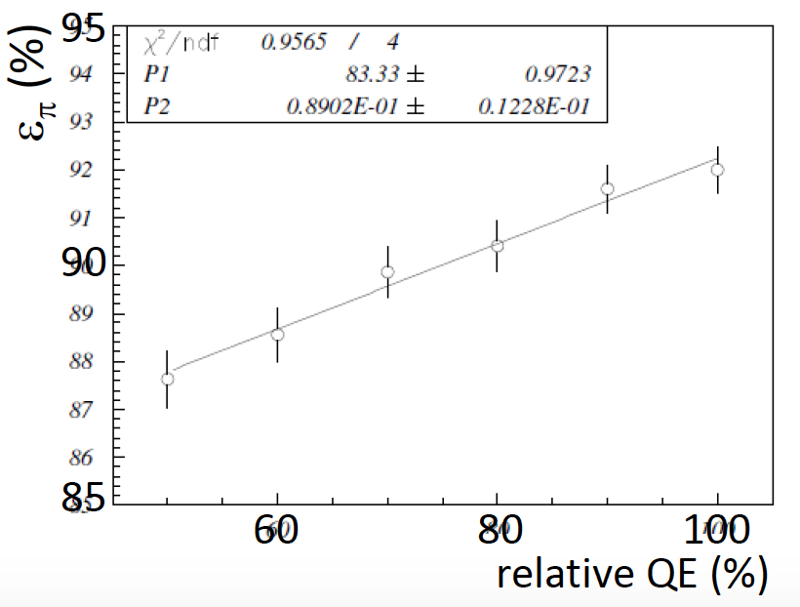
Activity: TOP upgrade
New
Simulation from B -> k π channel
QE: QE₀ -> 80% QE₀
ε_{π}: 92% -> 90%
1-ε_{π}: 8% -> 10%
1-ε_{π} / 1-ε_{π0} = 1.25
Loosing 20% of QE
produce increase of π / Κ separation inefficiency of 25%
2% decrease of π efficiency
is equivalent to
2% increse of K contamination

Slide 3
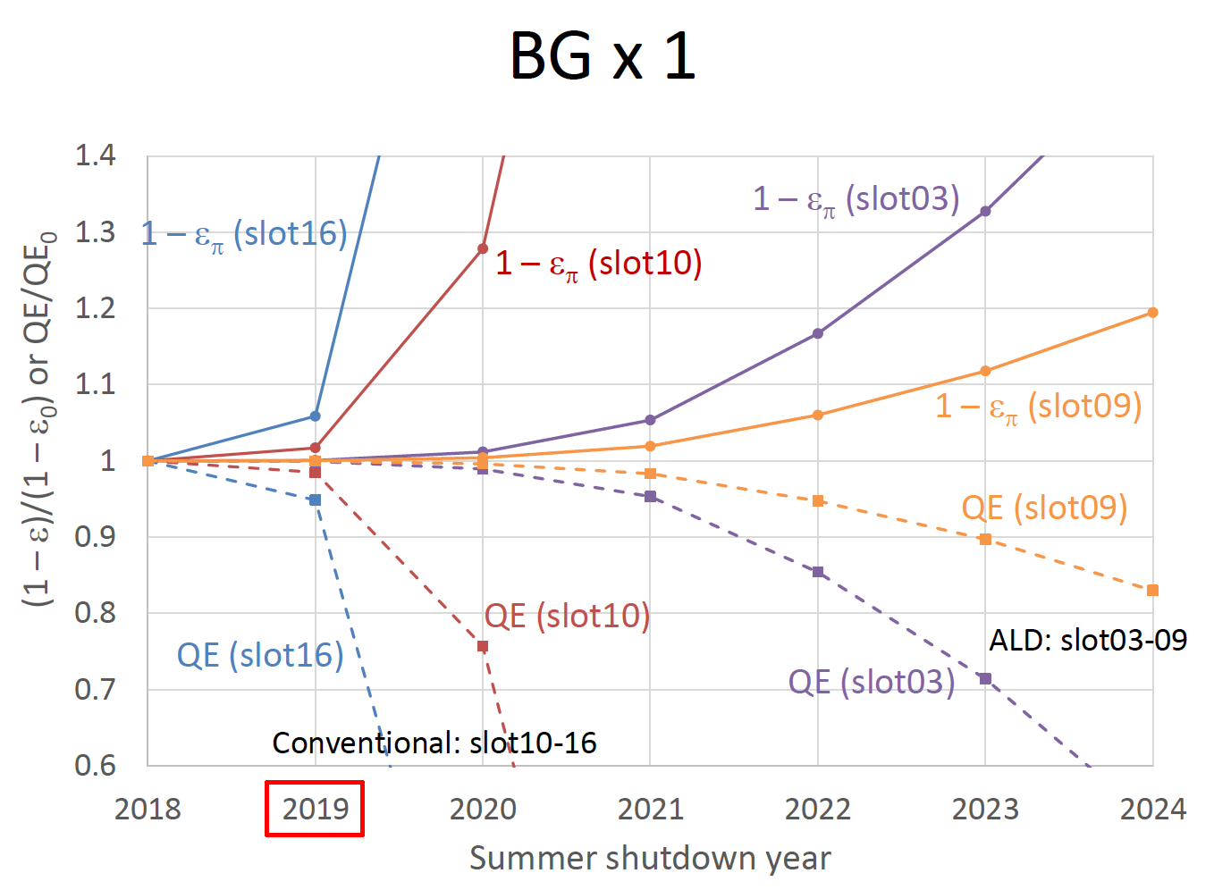
Activity: TOP upgrade
New
Baseline scenario

Slide 4
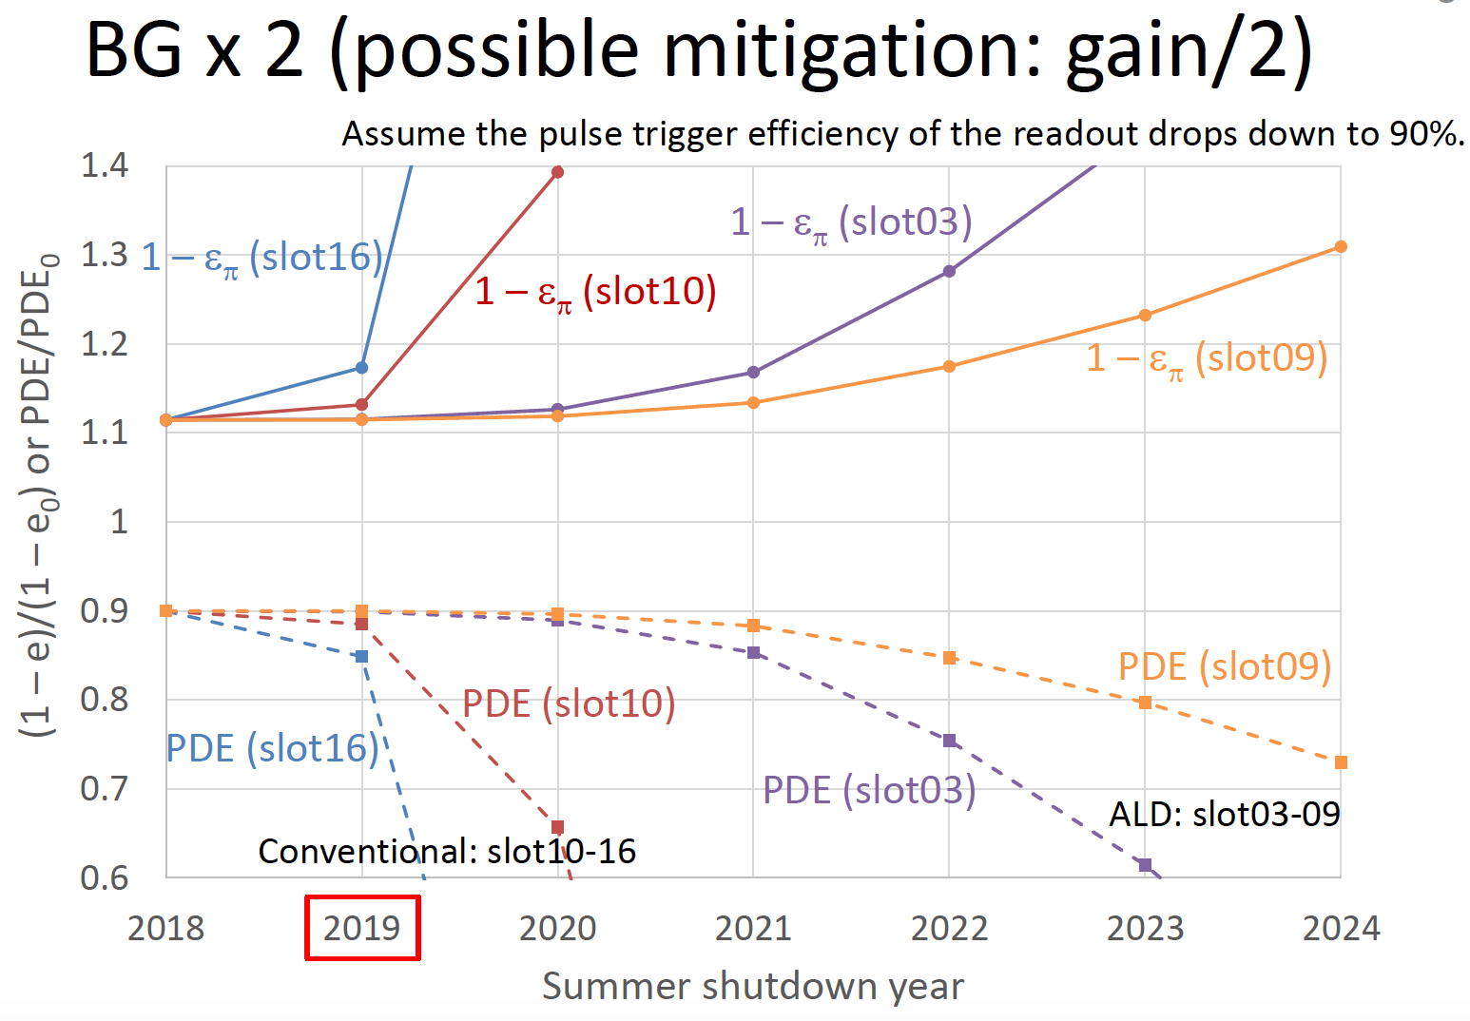
Activity: TOP upgrade
New
Pessimistic scenario

Slide 5
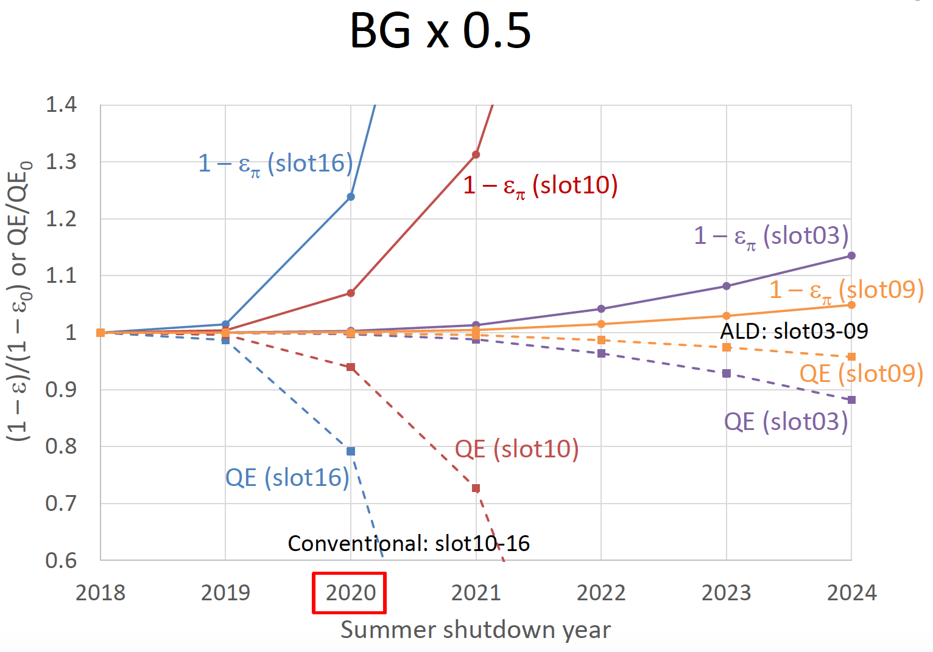
Activity: TOP upgrade
New
Optimistic scenario

Slide 6
Activity: TOP upgrade
New
Conventional MCP-PMTs to be replaced: 224
Total available MCP-PMTs for replacements: 63
Necessary additional order from now: 161 + spares
The current estimation time of the replacement is 2020 summer shutdown, which depends on the actual level of the beam background (current assumption is 5-8 MHz/PMT) and on the PMT gain (current assumption is 2.5 x10⁵).
Financial considerations:
We must order additional 180 PMT. The cost is 5 keuro / PMT
Nagoya can cover additional 60 PMT with the current budget expectation
We still miss funding for 120 PMT.
We propose to contribute for 50% of the uncovered budget (60 PMT ~ 2 modules)

Slide 7
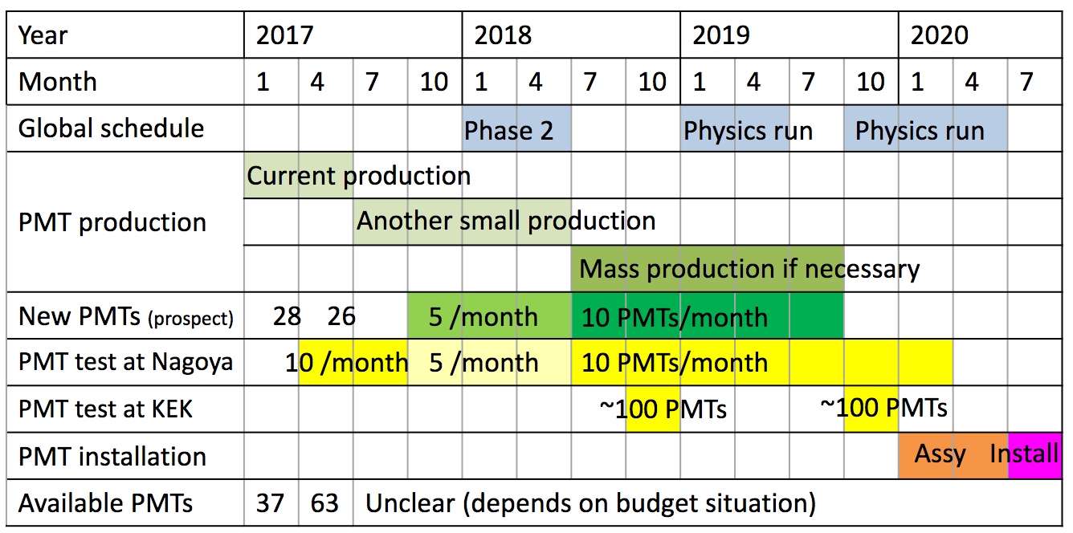
Activity: PMT test
New
Considering we must replace the conventional MCP-PMT the production of the
life-extended MCP-PMT is going on with a production rate of 5-10 PMT/month
63 ALD MCP-PMTs already produced ready to be tested.
@ Nagoya: PMT characterization (HV test, QE measurement)
@KEK: measurements with PMT inside magnetic field
We have been requested and we would like to contribute to the ALD MCP-PMT test
at Nagoya and KEK. There will be 1 m.u. of financial contribution from the Nagoya University

Slide 8
Report from referees

Slide 9
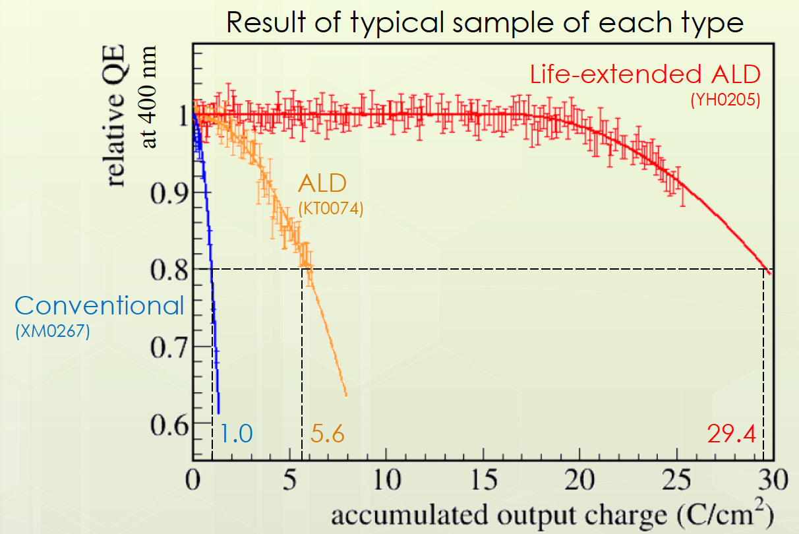
Additional material
Summer 2020 1 C/cm2 80% QE in the slot with the lower background (#10)
Summer 2021 2 C/cm2 0% QE “

