Slide 1

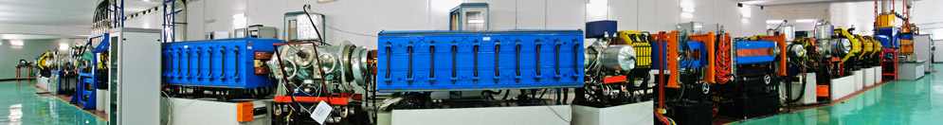
15th International Symposium on Nuclei in the Cosmos
Mass measurements of short-lived nuclei in CSRe
and its impact on some issues in stellar nucleosynthesis
Yu-Hu Zhang & CSRe mass measurement collaboration
CAS Key Laboratory of High Precision Nuclear Spectroscopy
Institute of Modern Physics, Chinese Academy, of Sciences
Lanzhou 730000, China
24-29 June 2018, LNGS ITALY

Slide 2
15th International Symposium on Nuclei in the Cosmos
Outline
1
Introduction to mass measurements in CSRe
2
Experimental details and brief results
3
Impact on some issues in rp- & νp-processes
4
Summary & perspectives

Slide 3
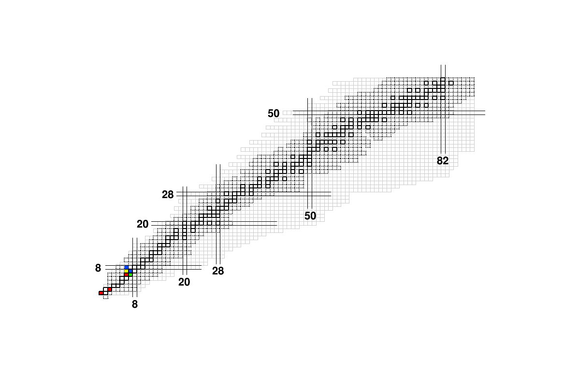
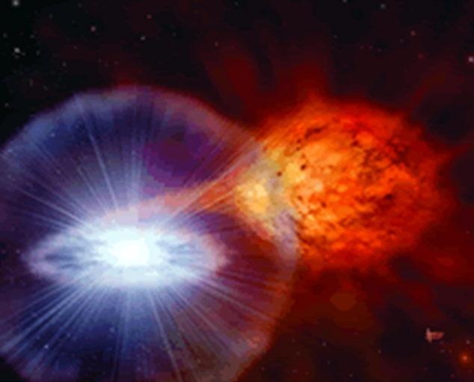
1. Introduction to mass measurements in CSRe
rp-process in X-ray burst
X-ray burst
Zr-Nb
Cycle
Waiting point ⁶⁴Ge,⁶⁸Se,⁷²Kr
Ca-Sc Cycle
Nuclear inputs: Masses, Half-lifes, Reaction rates
Notes:
X-射线爆是热门话题。已观察到上百个。可帮助我们认识中子结构。
爆发时，中子星吸积H/He，形成高温密环境，导致不可控热核反应，X-射线通量在几秒内突然变化。
该模型涉及大量短寿命原子核质量数量。这些数据的不确定性，影响模型预言的观察量。
精度<100 keV，相当多的核质量不达标。

Slide 4
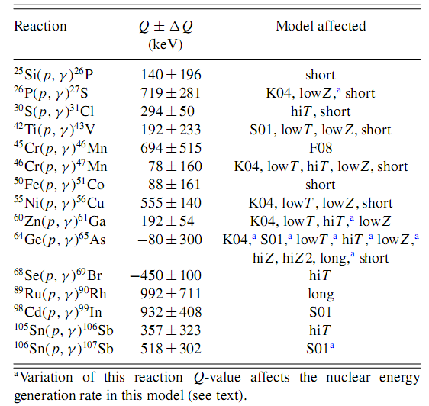
1. Introduction to mass measurements in CSRe
 Masses needed in modelling the rp-process
A. Parikh, et al., PRC79,045802 (2009),
and Prog. Part. Nucl. Phys., 69 (2013) 225–253
2) H. Schatz and W.-J. Ong, arXiv:1610.07596v1
⁴³V ⁴⁵Cr ⁴⁶Mn ⁴⁷Mn ⁵¹Co ⁵⁶Cu
⁷⁹Y
⁸¹Zr
⁸²Zr
⁸³Nb ⁸⁴Nb ¹⁰³Sn
Notes:
In the following, I shall pick up several new mass values obtained from our work, and try to connect them to the physics of current investigations. These concern with some issues in nuclear astro-physics and nuclear structure as outlined in this slide.

Slide 5
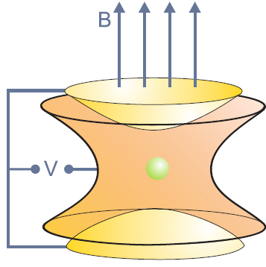
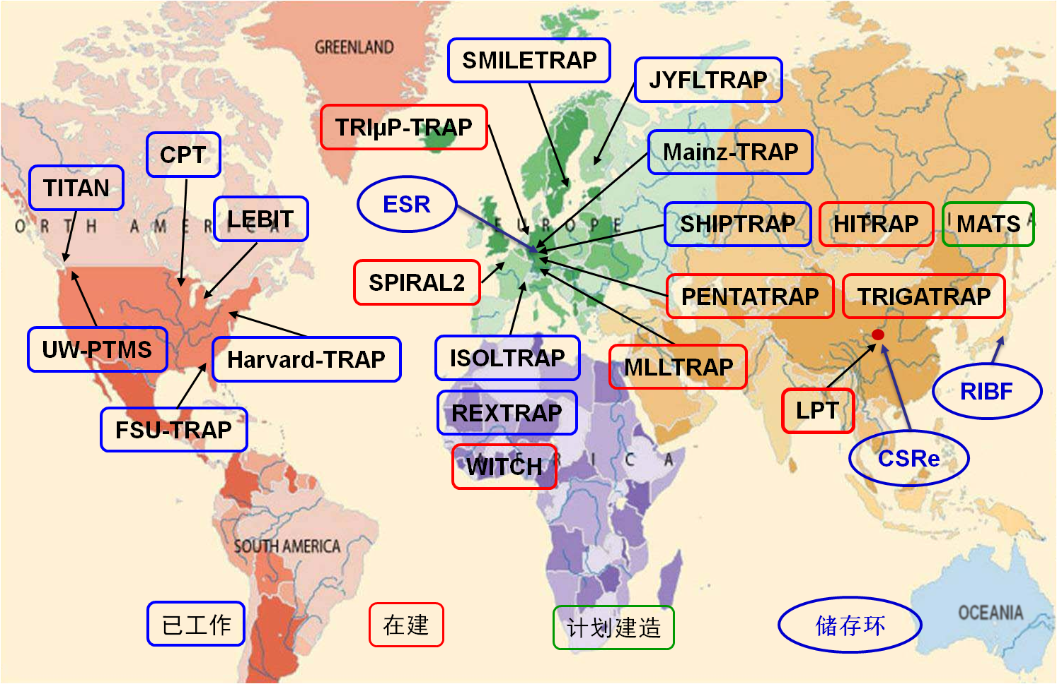
1. Introduction to mass measurements in CSRe
ESR
R³
CSR
Commissioned
around ~ 2008
Trap-based mass spectrometry:
Very high precision up to 10⁻¹¹ but limited by T_{1/2} and yield
Ring-based mass spectrometry:
Low production yield, short-lived
Notes:
In order to measure the atomic masses, different techniques and facilities have been developed worldwide. Here I would like to mention two kinds of mass spectrometry. On is penning-trap-based mass spectrometry, another is the storage-ring-based mass spectrometry. You know the very high-precison of 10 to -11 can be reached using penning-trap MS, this this technique is limited by the short life-time and low production yield for the exotic nuclei far from stability. These shortcomings can be overcome by using IMS at storage ring although the precision is somehow moderate. Since the commissioning of CSR, we set high-precison mass measurement for short-lived nuclei as one of the high priority programs at IMP.

Slide 6
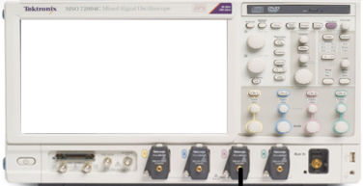
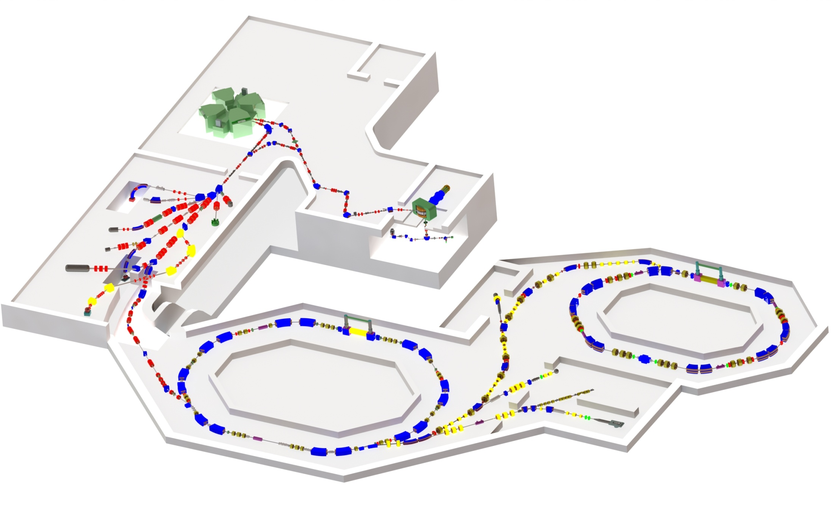
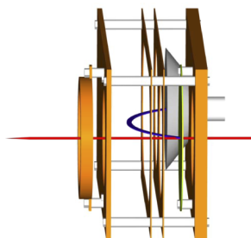
2. Experimental details and brief results
IMS Mass Measurements
CSRe
e-
MCP
C foil
TOF Detector
RIBLL2
CSRe
CSRm
TOF Detector
Target
10-15 mm ¹¹Be

Slide 7
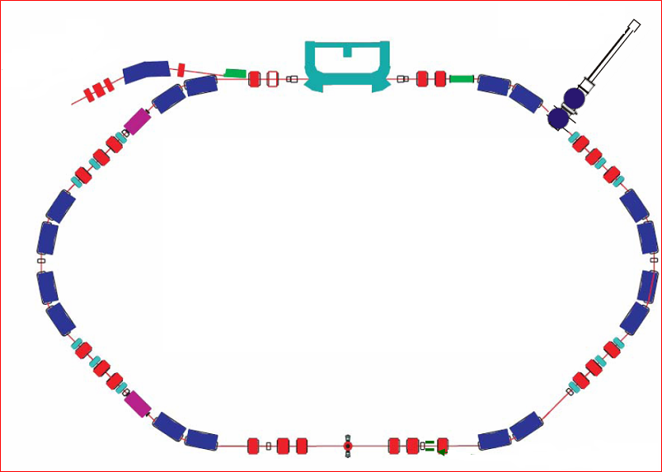
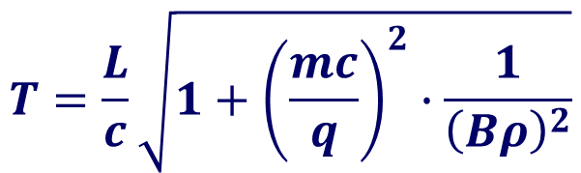
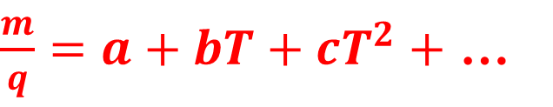
2. Experimental details and brief results
γ = γ_{t} = 1.3~1.4
ToF
Injection
$$T=\frac{L}{c}\sqrt{1+{\left(\frac{mc}{q}\right)}^{2}∙\frac{1}{{\left(Bρ\right)}^{2}}}$$
$\frac{m}{q}=a+bT+cT^{2}+$ …

Slide 8
2. Experimental details and brief results
γ = γ_{t} = 1.3~1.4
ToF
Injection
γ = γ_{t}
Isochronous mass spectrometry

Slide 9
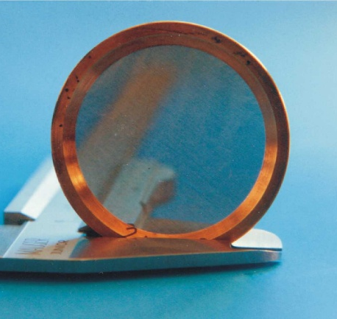
2. Experimental details and brief results
γ = γ_{t} = 1.3~1.4
ToF
Injection
20μg/cm²
High performance ToF

Slide 10
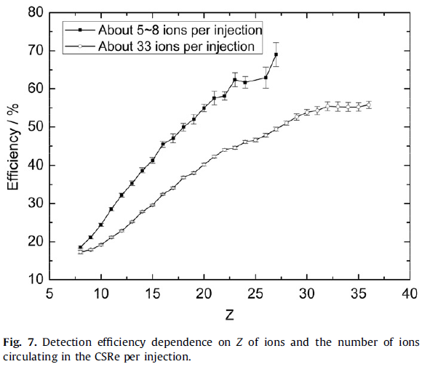
2. Experimental details and brief results
Continuous effort to improve the time resolution of ToF
Sigma=70 ps to 37 ps
Time resolution
Sigma = 37 ps
Efficiency
20%-70 %
B. Mei et al., NIM A 624, 109 (2010), X. L. Tu et al., NIM A 654, 213 (2011), W. Zhang et al., NIM A 756, 1 (2014)
Notes:
Therefore we made continuous efforts to improve the time resolution of our ToF detector which achieves up to 37 ps from the early value of 70 ps. To the extent of my knowledge, this might is the best of the world of the same kind of ToF. The detection efficiency is tested on-line to be ranged at 20% - 70% depending on the ion-species and ion number in each injection.

Slide 11
2. Experimental details and brief results
Beam: ⁷⁸Kr
Simultion.
Revolution
time spectrum
Exp.
CFD
technique
P2
Time Signals
in Oscilloscope

Slide 12
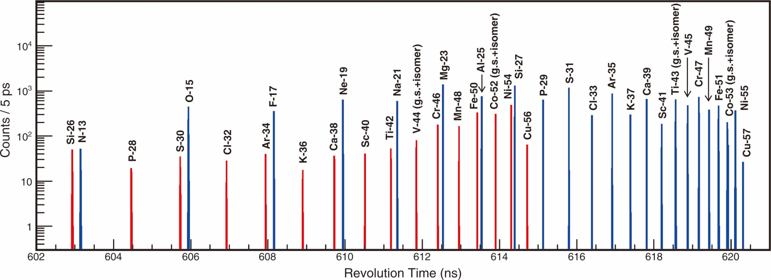
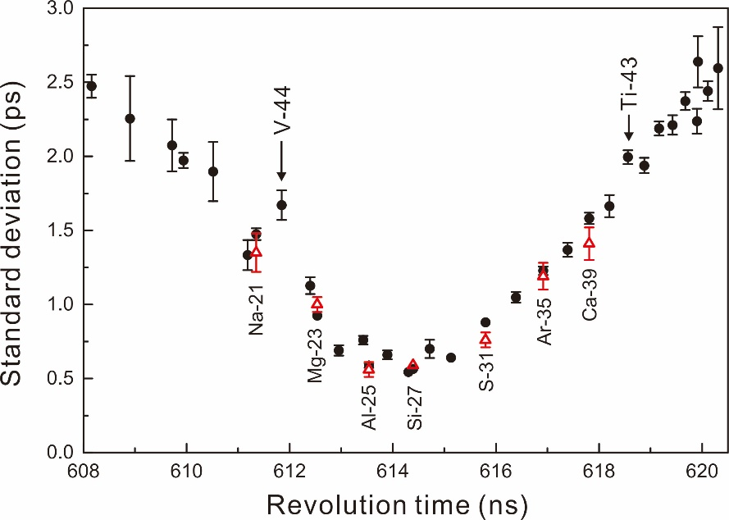
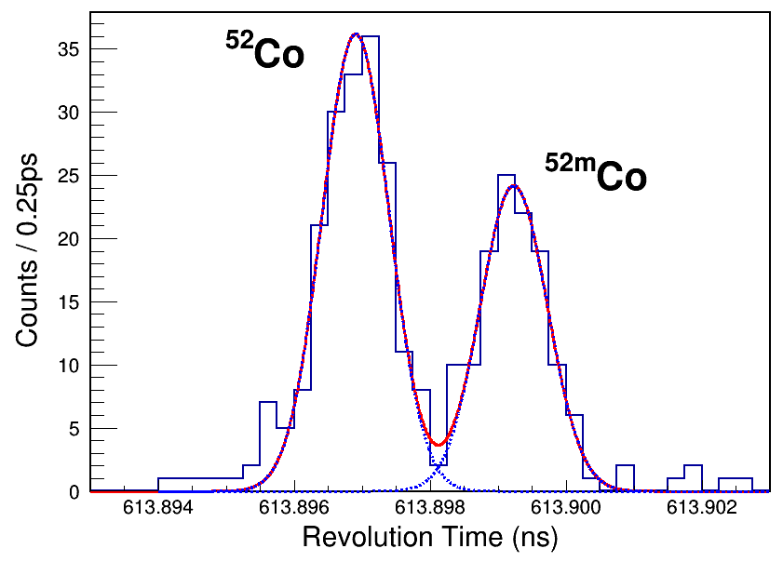
2. Experimental details and brief results
Beam: ⁵⁸Ni
Red: Tz= -1
Blue: Tz= -1/2
⁵²Co
1 ps 150 keV

Slide 13


2. Experimental details and brief results
⁸¹Zr
⁸³Nb
⁸²Zr
Beam: ¹¹²Sn
⁷⁹Y
${ME}_{CSR}−{ME}_{AME12}$ (keV)
${ME}_{CSR}−{ME}_{AME12}$ (keV)
⁸⁴Nb
Counts / 5ps
T (ns)

Slide 14
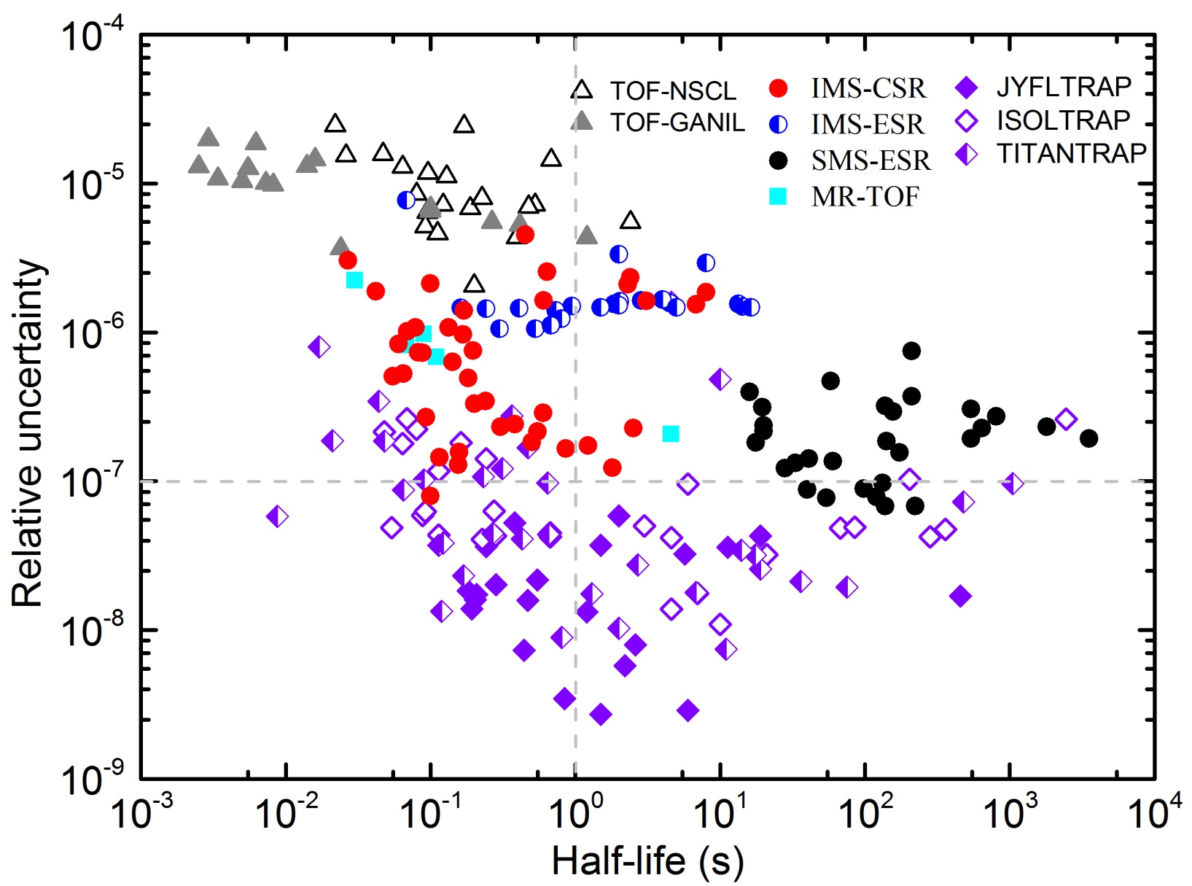
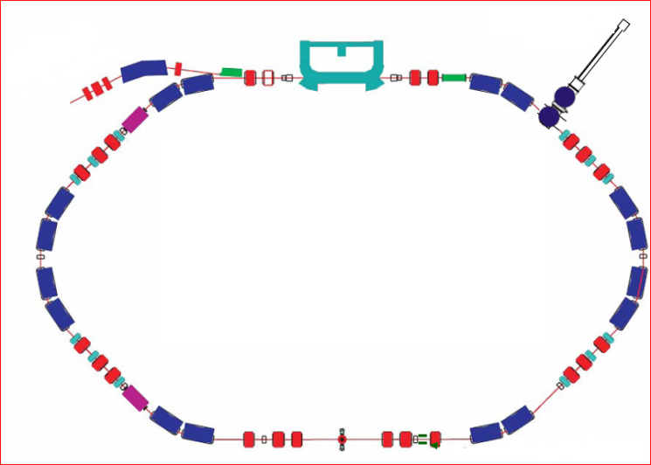
2. Experimental details and brief results
Precisions of new masses since 2010
Storage Ring

Slide 15
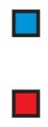
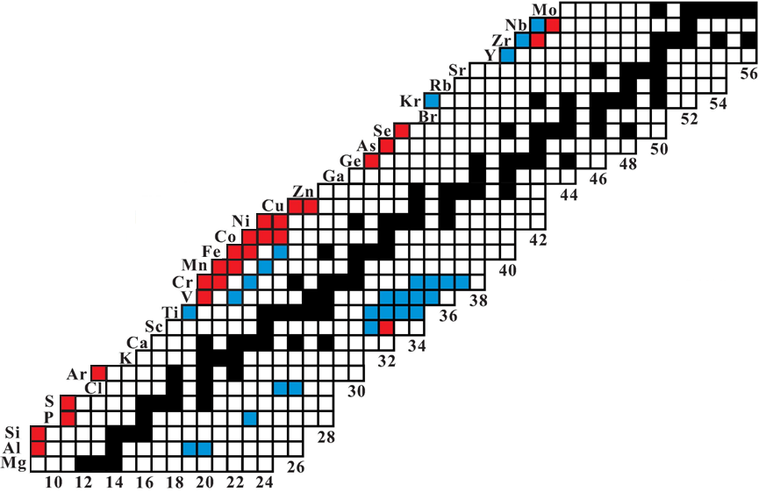
2. Experimental details and brief results
Primary beams: ³⁶Ar, ⁴⁰Ar, ⁵⁸Ni×3, ⁷⁸Kr ×2, ⁸⁶Kr, ¹¹²Sn×2
Nuclear Astrophysics
• ⁶⁵As: ⁶⁴Ge waiting point in rp-process
PRL 106, 112501 (2011)
• ⁴⁵Cr: Ca-Sc cycle in rp-process
Astrophys. J. Lett. 766, L8 (2013)
• ⁴³V: ⁴²Ti(p,γ )⁴³V rate in type-I XRB
PRC 89, 035802 (2014)
• ⁶⁵As: ⁶⁴Ge(p,γ)⁶⁵As & ⁶⁵As(p,γ)⁶⁶Se in XRB
Astrophys. J. 818, 78 (2016)
• ⁸²Zr: Zr-Nb cycle in rp-process &
Abundance of p-nucleus ⁸⁴Sr
Phys. Lett. B 781, 358 (2018)
Precision improved
Measured for the first time
Nuclear Stuctrue
• ⁵³Ni: Isospin Multiplet Mass Equation
PRL 109, 102501 (2012)
• ⁵¹Co: Isospin non-conserving forces
Phys. Lett. B 735, 327 (2014)
• ⁵³Sc: N=32 neutron magic number
CPC Vol.39, 104001 (2015)
• ⁵²Co: Identification of IAS & β+/EC decay
PRL 117, 182503 (2016)
• ⁵⁴Ni: CVC test in Standard Model
Phys. Lett. B 767, 20 (2017)
⁹⁴Ru: mass & half-life measurement
PRC 96, 031303(R) (2017)

Slide 16
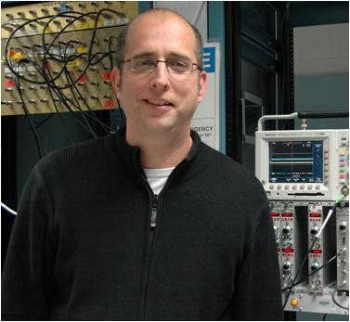
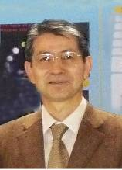




3. Impact on some issues in rp- & νp-processes
H. Schatz
(MSU)
S. Kubono
(Riken)
G. Martinez-Pinedo
(GSI)
A. Sieverding
(GSI)
S. Wanajo
(Riken)
X.D. Tang
(IMP)
 (p,γ ) reaction rates in the rp-process of type-I XRB
 waiting point nucleus ⁶⁴Ge in the rp-process
 Ca-Sc and Zr-Nb cycles in the rp-process
 Overproduction of p-nucleus ⁸⁴Sr in the νp-process
 Abundance ratio of ⁹²Mo/⁹⁴Mo in the νp-process
Notes:
In the following, I shall pick up several new mass values obtained from our work, and try to connect them to the physics of current investigations. These concern with some issues in nuclear astro-physics and nuclear structure as outlined in this slide.

Slide 17
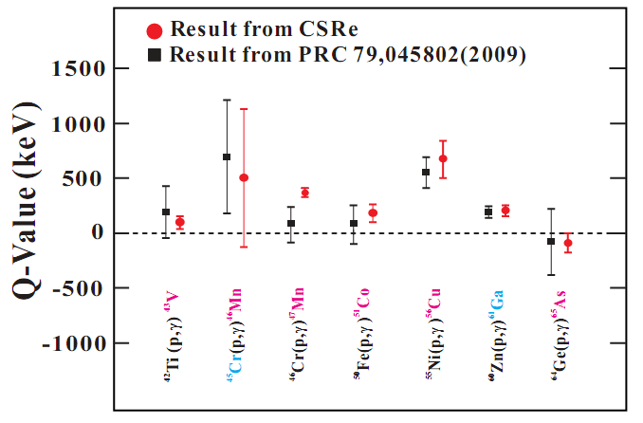
3. Impact on some issues in rp- & νp-processes
 (p,γ ) reaction rates in the rp-process of type-I XRB
A. Parikh, et al., PRC79,045802 (2009)
Prog. Part. Nucl. Phys., 69, 225 (2013)

Slide 18
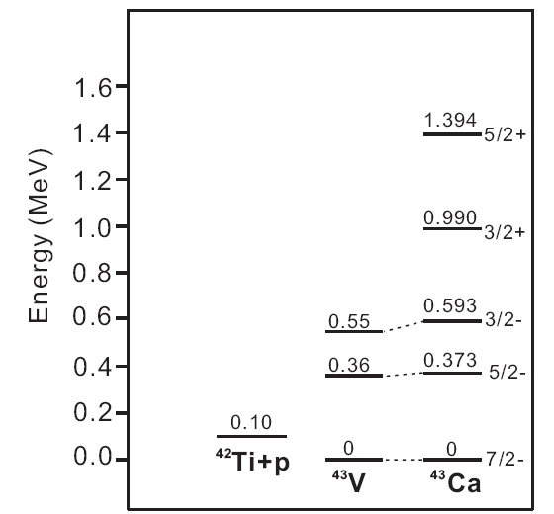
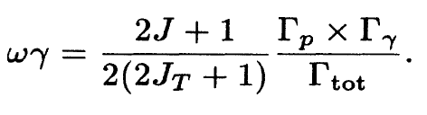
3. Impact on some issues in rp- & νp-processes
 (p,γ ) reaction rates in the rp-process of type-I XRB
⁴²Ti(p,γ)⁴³V, 3/2⁻
ωγ =5.98 X 10⁻⁶ (eV)
PRC52, 1078 (1995)
E_{r}

Slide 19
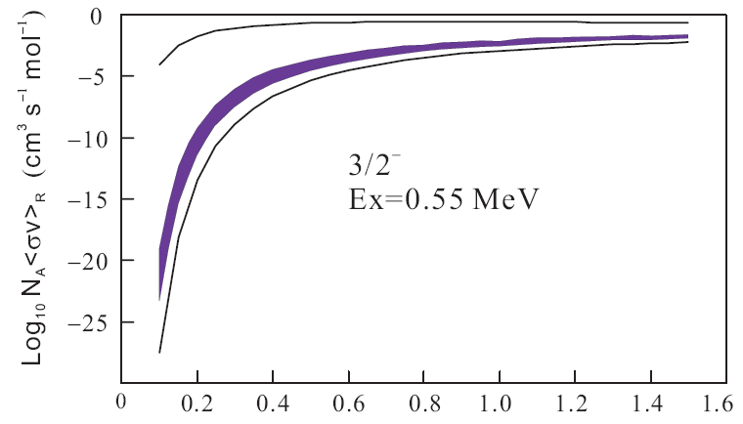
3. Impact on some issues in rp- & νp-processes
 (p,γ ) reaction rates in the rp-process of type-I XRB
⁴²Ti(p,γ)⁴³V
CSRe: Q＝100(43) keV
⁴⁶Cr(p,γ)⁴⁷Mn
AME03 Q＝208(233) KeV

Slide 20
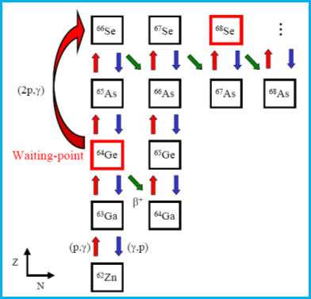
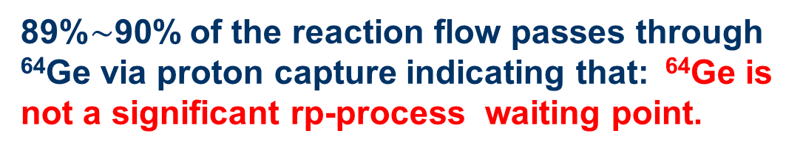
3. Impact on some issues in rp- & νp-processes
 Waiting point nucleus ⁶⁴Ge in the rp-process
X.L. Tu et al., PRL 106, 112501 (2011)
S_{p}(⁶⁵As) = −90 (85) keV
2σ
Light curve
1σ
Abundance
89%$\sim$90% of the reaction flow passes through ⁶⁴Ge via proton capture indicating that: ⁶⁴Ge is not a significant rp-process waiting point.

Slide 21
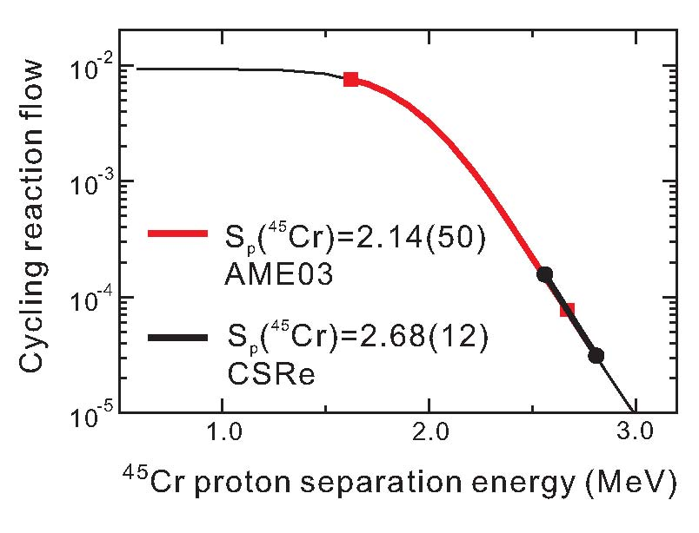
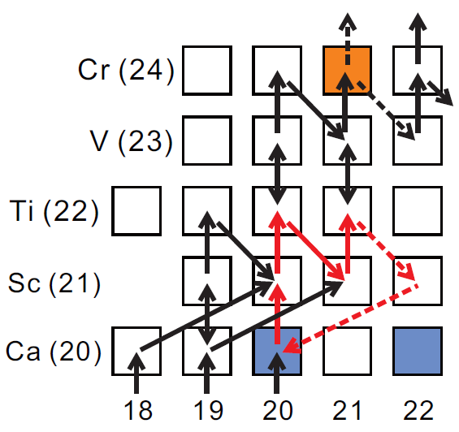
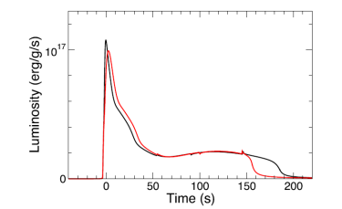
3. Impact on some issues in rp- & νp-processes
 Ca-Sc cycle in the rp-process of type-I XRB
X.L. Yan et al., ApJL 766, L8 (2013)
Ca-Sc cycle
2013: New mass of ⁴⁵Cr gives
2018: New mass of ⁴⁴V gives
New masses of ⁴⁵Cr & of ⁴⁴V + Net work calculations lead to the conclusion:
the predicted Ca-Sc cycle in x-ray burst may not exist

Slide 22
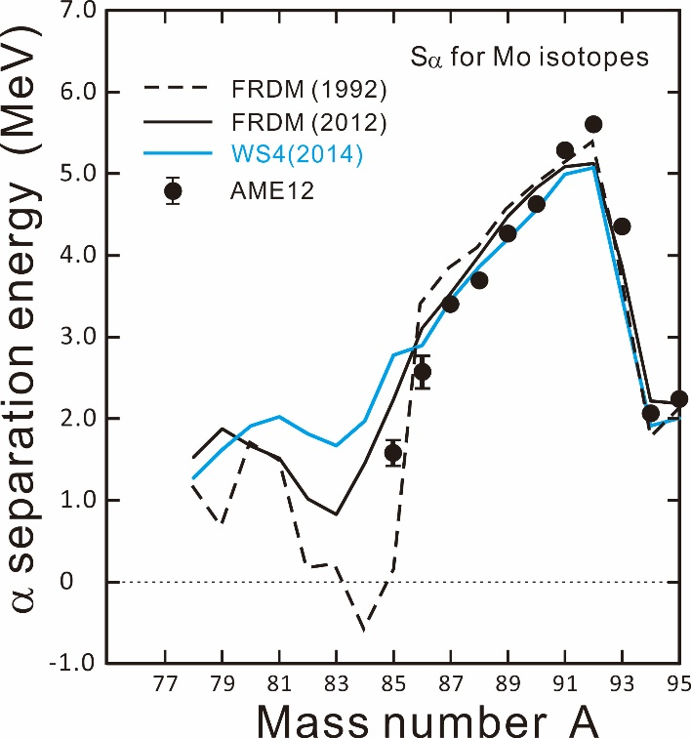
3. Impact on some issues in rp- & νp-processes
 Zr-Nb cycle in the rp-process of type-I XRB
Y.M. Xing et al., PLB 781, 358 (2018)
Zr-Nb cycle was proposed by H. Schatz et al, Phys. Rep. 294, 167 (1998) based on the FRDM mass prediction in 1992, which show a very low or even negative α separation energy of ⁸⁴Mo.
Zr-Nb cycle: ⁸³Nb(p,α)⁸⁰Zr
⁸⁴Mo(γ,α)⁸⁰Zr
^{85,86}Mo
^{85,86}Mo masses
from SHIPTRAP
E. Haettner et al,
PRL 106, 122501 (2011).
^{81,82}Zr
T=2 GK, ρ=10⁶ g/cm³

Slide 23
3. Impact on some issues in rp- & νp-processes
 Zr-Nb cycle in the rp-process of type-I XRB
Y.M. Xing et al., PLB 781, 358 (2018)
Zr-Nb cycle: ⁸³Nb(p,α)⁸⁰Zr
⁸⁴Mo(γ,α)⁸⁰Zr
^{85,86}Mo
S_{α} (MeV)
PRL 106 (2011)
^{81,82}Zr
Atomic Number A
No pronounced island of very low S_{α} for Mo isotopes
T=2 GK, ρ=10⁶ g/cm³

Slide 24
3. Impact on some issues in rp- & νp-processes
Favorable conditions for
the formation of Zr-Nb cycle:
E. Haettner et al, PRL 106, 122501 (2011)
Largest Q(p,α) favoring ⁸³Nb(p,α)⁸⁰Zr reaction
Smallest Sα(⁸⁴Mo) favoring ⁸⁴Mo(γ, α )⁸⁰Zr reaction
AME’12
Ex=3380 keV
⁸⁴Mo(γ,α)⁸⁰Zr
⁸³Nb(p,α)⁸⁰Zr
(β+)
⁸³Nb+p
Q(p,α)
Ex=1410 keV
⁸⁰Zr+α
Sα(⁸⁴Mo)
⁸⁴Sr
Zr-Nb cycle
Ex=0
⁸⁴Mo

Slide 25
3. Impact on some issues in rp- & νp-processes
Favorable conditions for
the formation of Zr-Nb cycle:
E. Haettner et al, PRL 106, 122501 (2011)
Largest Q(p,α) favoring ⁸³Nb(p,α)⁸⁰Zr reaction
Smallest Sα(⁸⁴Mo) favoring ⁸⁴Mo(γ, α )⁸⁰Zr reaction
AME’12
Ex=3691 keV
CSRe masses
Ex=3380 keV
⁸³Nb+p
Q(p,α)
Ex=2207 keV
⁸³Nb+p
Q(p,α)
Ex=1410 keV
⁸⁰Zr+α
⁸⁰Zr+α
Sα(⁸⁴Mo)
Sα(⁸⁴Mo)
Ex=0
Ex=0
⁸⁴Mo
⁸⁴Mo

Slide 26
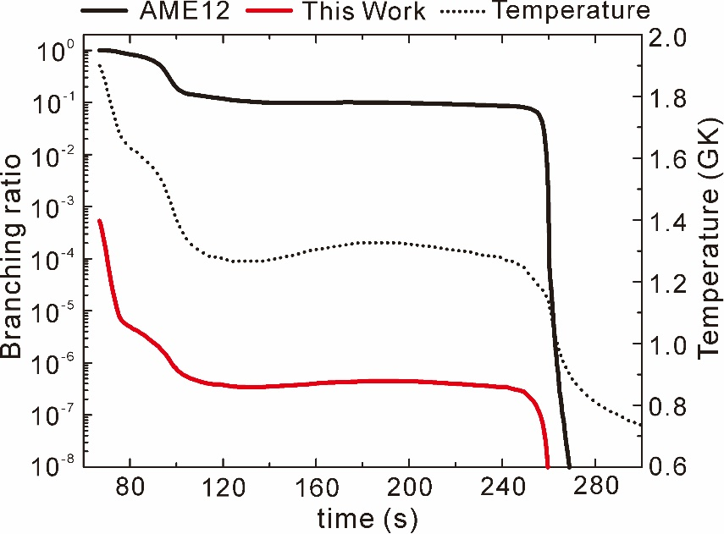
3. Impact on some issues in rp- & νp-processes
Zr-Nb cycling branching ratio is defined as the Flow of ⁸³Nb(p,α)+⁸⁴Mo(γ,α) divided by the flow of :
⁸³Nb(p,α)+⁸⁴Mo(γ,α)+⁸⁴Mo(p,γ)+⁸⁴Mo(β⁺)+⁸³Nb(β⁺)+⁸²Zr(β⁺)+⁸¹Y(β⁺)
⁸⁴Mo(γ,α)⁸⁰Zr
⁸³Nb(p,α)⁸⁰Zr
(β+)
⁸⁴Sr
Zr-Nb cycle
no Zr-Nb cycle exists in the rp-process !

Slide 27
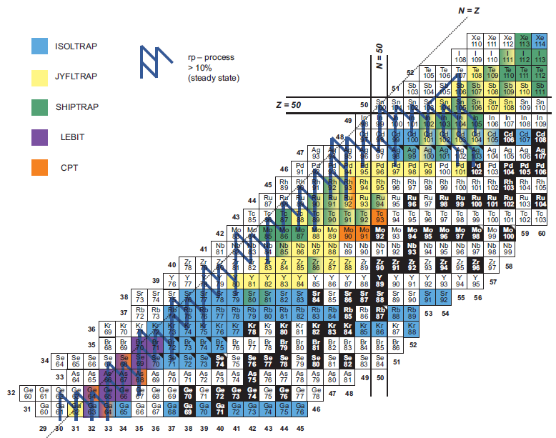
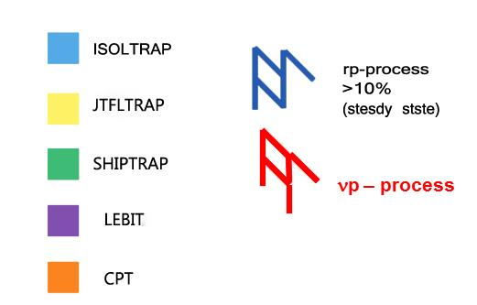
3. Impact on some issues in rp- & νp-processes
 Overproduction of p-nucleus ⁸⁴Sr in the νp-process
νp – process
CSRe
CSR primary beam:
¹¹²Sn³⁵⁺ @400MeV/u
p-Nuclides

Slide 28
3. Impact on some issues in rp- & νp-processes
 Overproduction of p-nucleus ⁸⁴Sr in the νp-process
Solar
⁸⁴Sr
Abundance ratio of ⁸⁴Sr/⁹⁴Mo is 0.544
⁹⁴Mo
Only produced in νp-process
Calculated abundance ratio of ⁸⁴Sr/⁹⁴Mo should be lower than the observed one
S. Wanajo, H.-T. Janka, and S. Kubono, The Astrophysical Journal, 729: 46 (18pp), 2011

Slide 29
3. Impact on some issues in rp- & νp-processes
 Overproduction of p-nucleus ⁸⁴Sr in the νp-process
C. Frohlich et al., PRL 96, 142502 (2006)
S. Wanajo et al., ApJ, 729:46 (2011)
⁸⁴Sr
S. Wanajo et al., ApJ, 729:46 (2011)
“Future precision measurements of both ⁸²Zr and ⁸³Nb are thus highly desired.”

Slide 30
3. Impact on some issues in rp- & νp-processes
 Overproduction of p-nucleus ⁸⁴Sr in the νp-process
⁸⁴Mo
⁸⁴Mo
Sp(⁸³Nb)=1759 keV
Sp(⁸³Nb)=1214 keV
Conclusion:
Sp(⁸³Nb) is reduced by 0.545 MeV, the (p,γ) reaction flow from ⁸²Zr to ⁸³Nb is suppressed because of the competition of (γ,p) reaction of ⁸³Nb. Then a reduction of ⁸⁴Mo, which is the precursor of ⁸⁴Sr, will lead to a less abundance of ⁸⁴Sr.
Y.M. Xing et al., PLB 781, 358 (2018)

Slide 31
4. Summary and perspectives
IMS becomes available in CSRe-Lanzhou and new masses have been obtained in the very neutron-deficient region below A=100.
Some issues in the studies of nuclear astrophysics and nuclear structure have been addressed.
3) In-ring decay is observed and partial half-life measured which shows
the capability of IMS at CSRe.
4) Mass measurement for the shortest state of 70 μs is achieved
5) We will develop and use a Double-ToF IMS technique, which may
further improve the precision of IMS in CSRe.

Slide 32
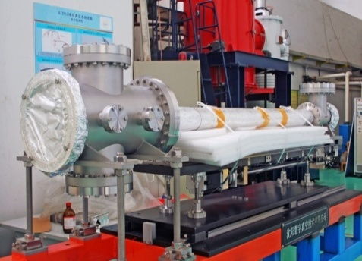
4. Summary and perspectives
Injection
Single ToF
Double-ToF IMS
Double-ToF Detectors
18 m ( 85 ns )
Notes:
In order to increase the accuracy and precisions of our measurement, we plan to install two ToF dectectors in the straight line of CSR.
This will allow us to extract the velocities of the ions stored make a further correction for the revolution time according to this formaula.

Slide 33
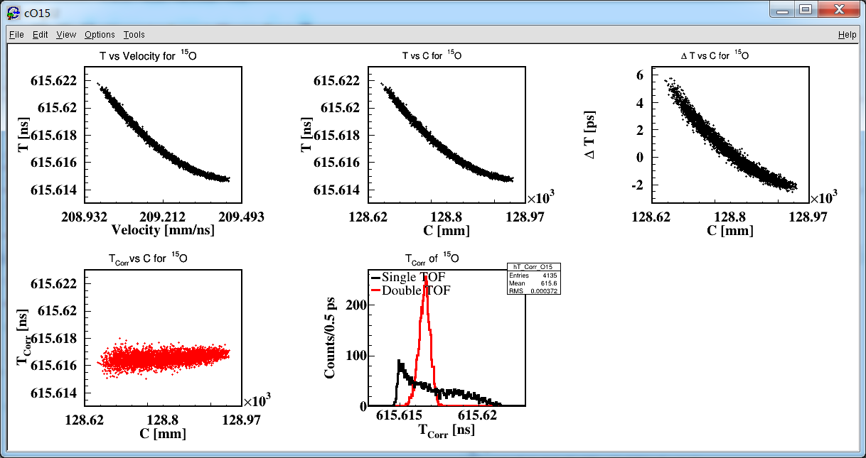

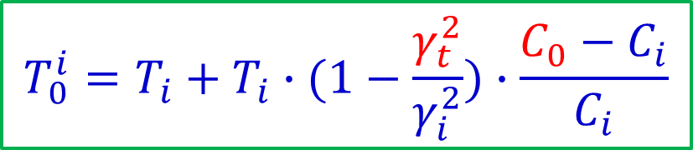

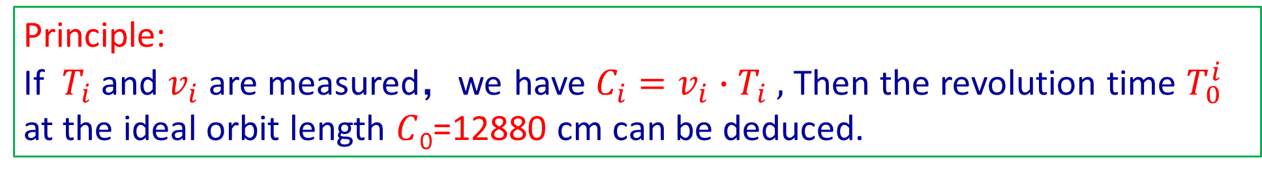
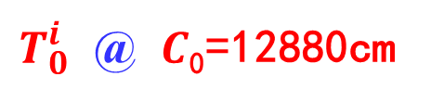
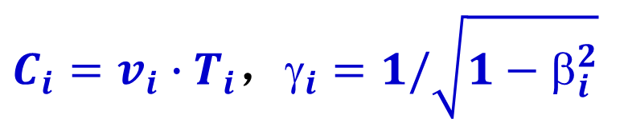
4. Summary and perspectives
Principle:
If ${ T}_{i}$and $v_{i}$ are measured，we have $C_{i}=v_{i}∙T_{i} ,$ Then the revolution time $T_{0}^{i}$ at the ideal orbit length $C$₀=12880 cm can be deduced.
$C_{i}=v_{i}∙T_{i}$，$_{i}=1/\sqrt{1−β_{i}^{2}}$
$$T_{0}^{i}=T_{i}+T_{i}∙(1−\frac{γ_{t}^{2}}{γ_{i}^{2}})∙\frac{C_{0}−C_{i}}{C_{i}}$$
Simulation
$$T_{i}$$
$T_{0}^{i}$ @ $C$₀=12880cm
$$T_{0}^{i}$$

Slide 34
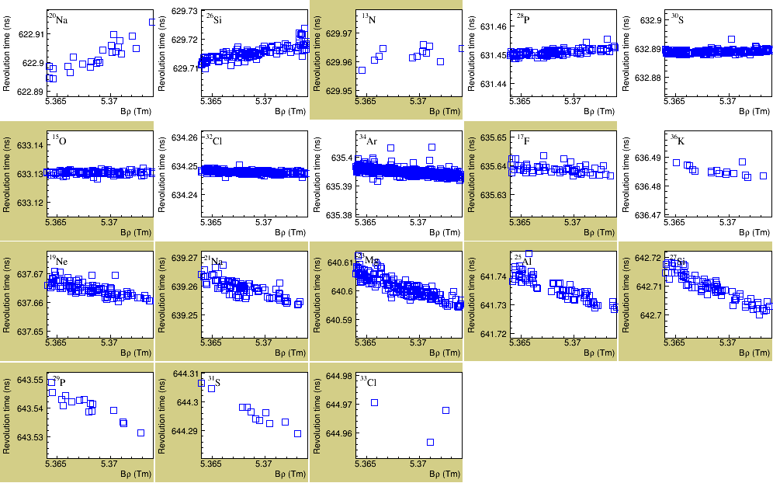
4. Summary and perspectives
$$Plot of{ T}_{i} vs orbit length for the 36Ar fragments$$
Without
velocity correction
34
2018/6/28

Slide 35
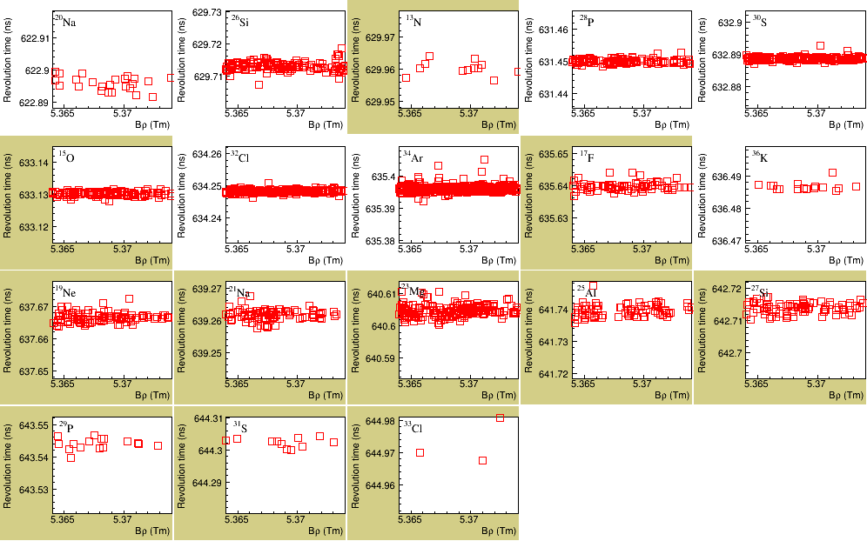
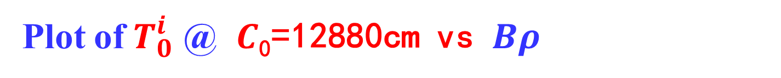
4. Summary and perspectives
Plot of $T_{0}^{i}$ @ $C$₀=12880cm vs $Bρ$
With
velocity correction
35
2018/6/28

Slide 36

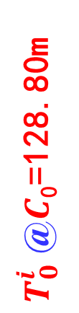
4. Summary and perspectives
$$Plot of{ T}_{i} vs orbit length for the 58Ni fragments$$
Without
correction
${ T}_{i}$ (ns)
Preliminary
With
correction
$T_{0}^{i}$ @$C$₀=128.80m
Orbit length(m)

Slide 37
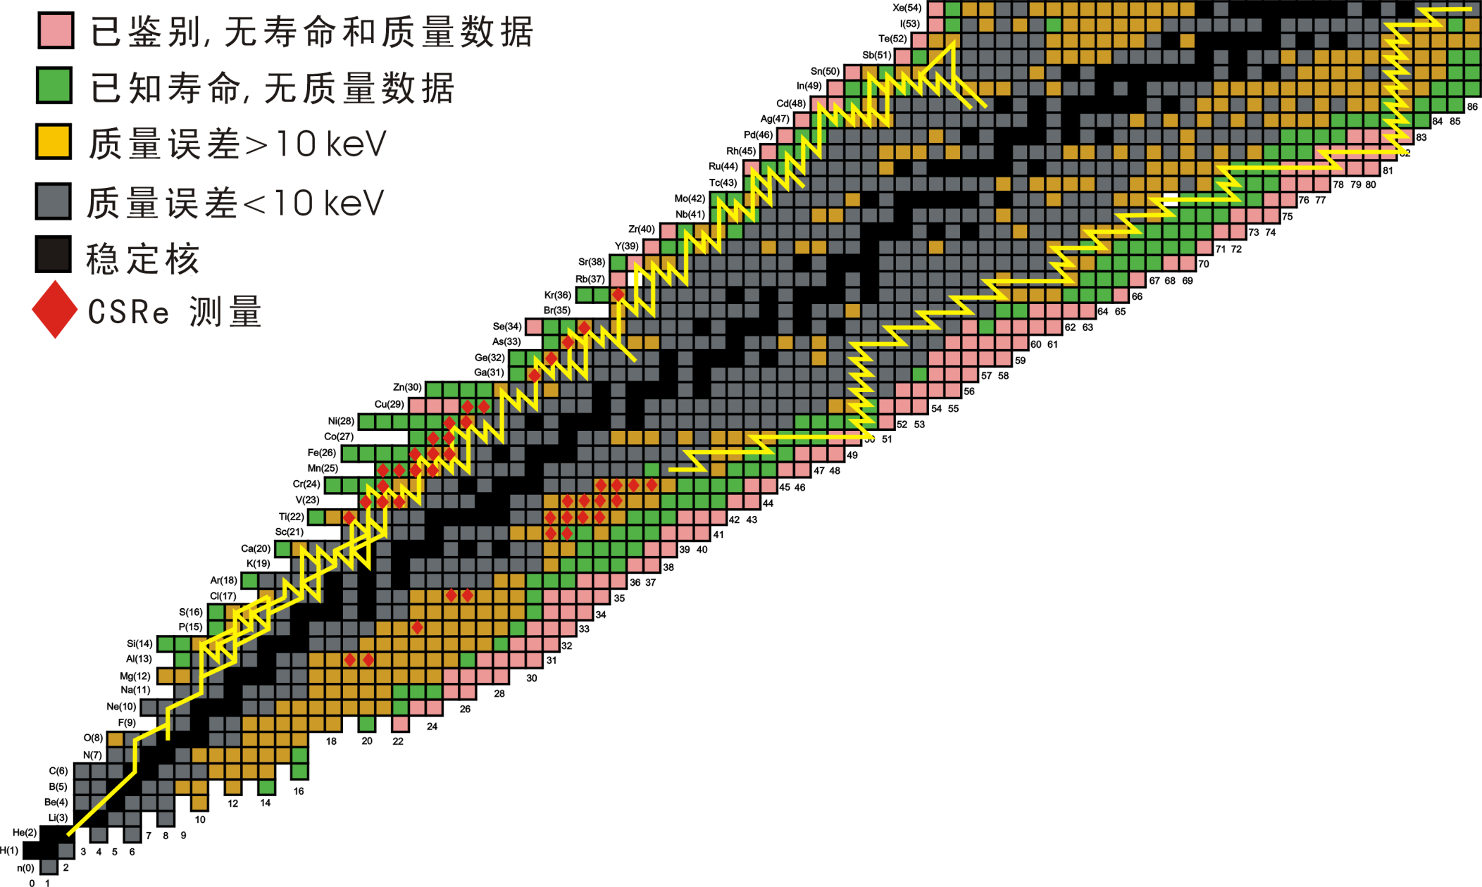
4. Summary and perspectives
Isospin symmetry, np parring,
rp- & vp-processes
New magic number, shell evolution, r-process
Techniques:
IMS, SMS and
Double ToF IMS

Slide 38

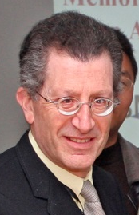










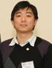


Thank you for your attention !
Yu. A. Litvinov
G. Audi
GSI
RIKEN
Domestic
MPIK
Orsay
MSU
H. Schatz
B. A. Brown
T. Uesaka
K.Blaum
B. H. Sun
F. R. Xu
Y. Sun
Notes:
We established an active international collaboration, including some famous or experienced scientists deeply involved in program. We have worked together on developing the experimental techniques and setups, conducting experiments, analyzing data, and publishing papers.

Slide 39
Thank you for your attention !
H. S. Xu Y. H. Zhang, X. L.Tu, X. L. Yan, M. Wang. X. H. Zhou,Y. J. Yuan, J. W. Xia,
J. C. Yang, X. C.Chen, G. B. Jia, Z. G. Hu, X. W. Ma, R. S. Mao, B. Mei, P. Shuai,
Z. Y. Sun, S. Kubono, S. T. Wang, G. Q. Xiao, X. Xu, Y. D. Zang, H. W. Zhao,
T. C. Zhao, W. Zhang, W. L. Zhan (IMP-CAS, Lanzhou, China)
Yu.A. Litvinov, S.Typel (GSI, Darmstadt, Germany)
K. Blaum (MPIK, Heidelberg, Germany)
Y. Sun (Shanghai Jiao Tong University, Shanghai, China)
Baohua SUN (Beihang University)
H. Schatz, B. A. Brown (MSU, USA)
G. Audi (CSNSM-IN2P3-CNRS, Orsay, France)
T. Uesaka, Y. Yamaguchi, (RIKEN, Saitama, Japan)
T. Yamaguchi (Saitama University, Saitama, Japan)
A. Ozawa (University of Tsukuba, Japan)
Yhzhang@impcas.ac.cn

Slide 40
3. Impact on some issues in rp- & νp-processes
 Abundance ratio of ⁹²Mo/⁹⁴Mo in the νp-process
the ⁹²Mo/⁹⁴Mo solar abundance ratio =1.57
vp process in the inner ejecta
of core-collapse supernovae
Y_{e} (electron fraction)=0.57,
 Sp(⁹³Rh)=1.64±0.1 MeV
J. Fallis et al., PHYSICAL REVIEW C 78, 022801(R) (2008)
Sp(⁹³Rh)=2.007±0.001 MeV

Slide 41
3. Impact on some issues in rp- & νp-processes
 Abundance ratio of ⁹²Mo/⁹⁴Mo in the νp-process
Searching for the long-lived isomer in ⁹³Rh
Qp = 2.007 MeV
⁹²Ru+p
(p,γ)↔(p,γ)
⁹⁴Pd
Isomer ?
1/2 -
9/2 +
⁹³Rh
⁹³Rh
⁹²Ru
⁹²Mo
⁹⁴Mo
K. Schmidt et al., EPJ. A 8, 303 (2000)
C. Weber et al., PRC 78, 054310 (2008)

Slide 42
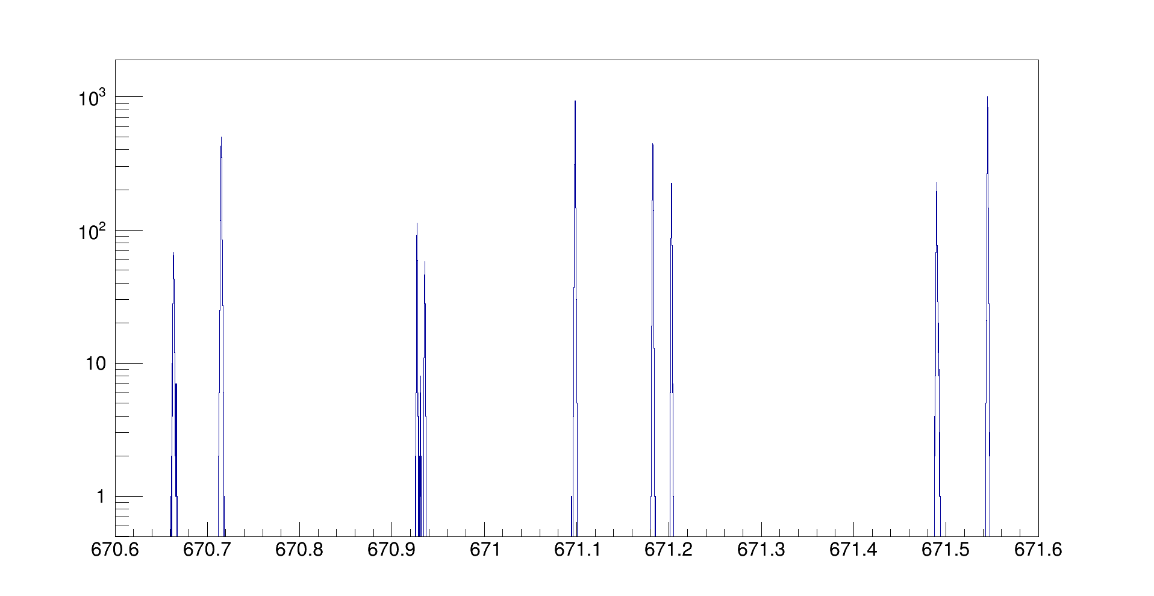
3. Impact on some issues in rp- & νp-processes
⁹⁷Ag
⁹⁵Pd
⁹³Rh
⁹¹Ru
πp_{1/2}
isomer
νp_{1/2}
isomer
πp_{1/2}
isomer
νp_{1/2}
isomer
?
⁶²Zn
⁶⁰Cu
⁶⁴Ga
³¹P
⁹¹Ru
^{95m}Pd(1/2⁻)
⁹³Rh
⁹⁷Ag
⁹⁵Pd
^{95m}Pd
counts/0.2ps

