Slide 1
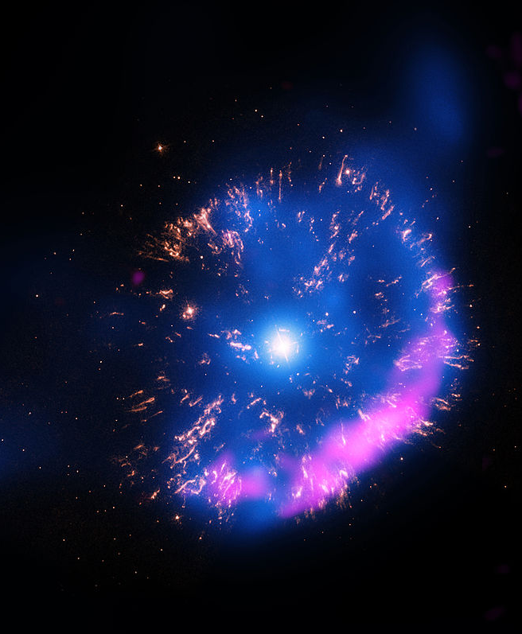
Inverse Kinematics Studies of ^{20,21}Ne(p,γ)^{21,22}Na Relevant to ²²Na Production in ONe Novae With DRAGON
Devin Connolly
Postdoctoral Research Fellow, DRAGON
Nuclei In the Cosmos
Assergi, L’Aquila, Italy
By X-ray: NASA/CXC/RIKEN/D.Takei et al; Optical: NASA/STScI; Radio: NRAO/VLA
https://commons.wikimedia.org/w/index.php?curid=38979121
By X-ray: NASA/CXC/RIKEN/D.Takei et al; Optical: NASA/STScI; Radio: NRAO/VLA - https://commons.wikimedia.org/w/index.php?curid=38979121

Slide 2
Outline
Astrophysical Motivation
Experimental technique
Analysis and Preliminary results

Slide 3
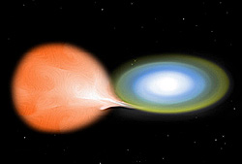
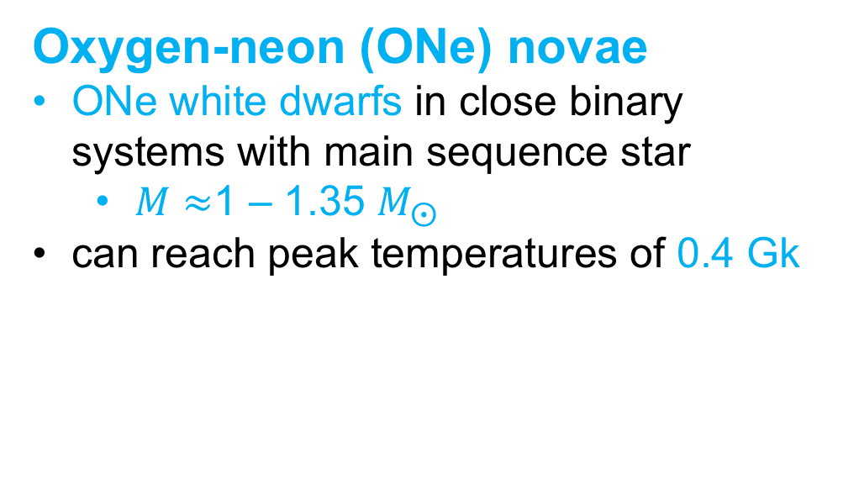
²²Na and
Oxygen-neon novae
Oxygen-neon (ONe) novae
ONe white dwarfs in close binary systems with main sequence star
  $M≈$1 – 1.35 $M_{⨀}$
can reach peak temperatures of 0.4 Gk
By NASA/CXC/M.Weiss - Diagram of a Nova type star
http://chandra.harvard.edu/photo/2001/v1494aql/ https://commons.wikimedia.org/w/index.php?curid=380534

Slide 4
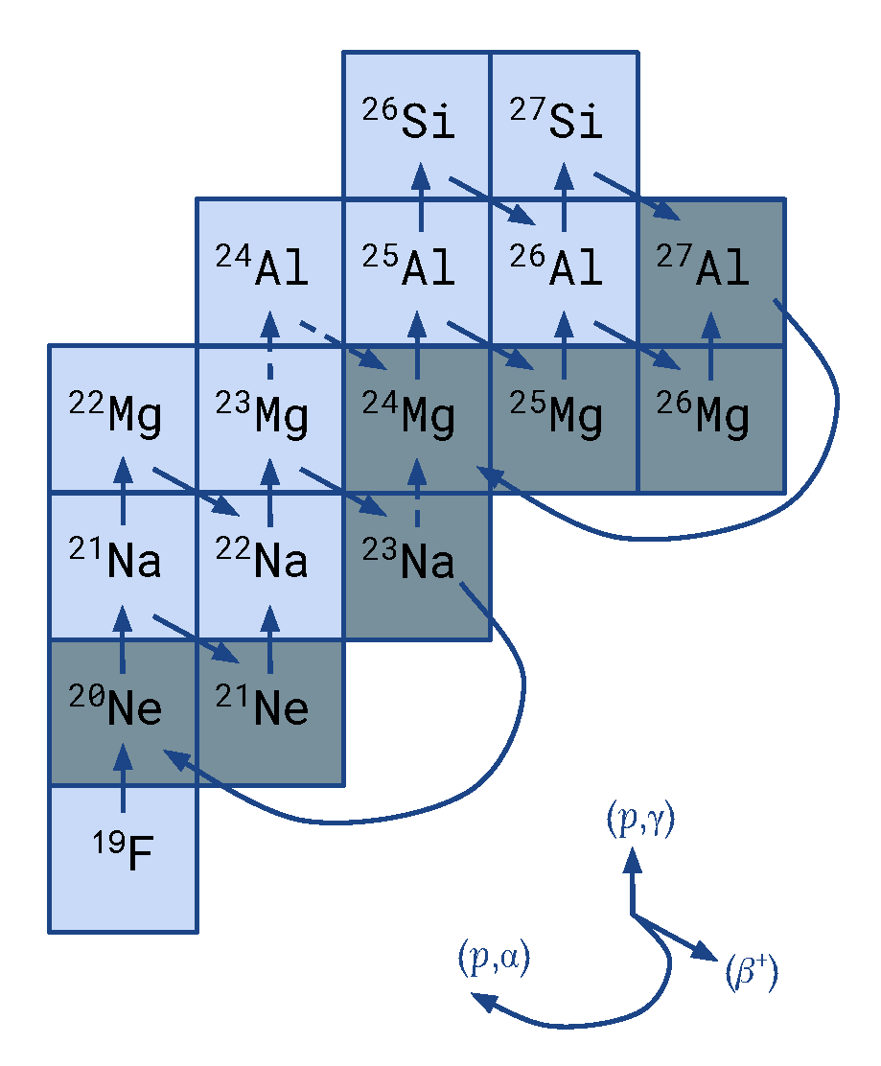
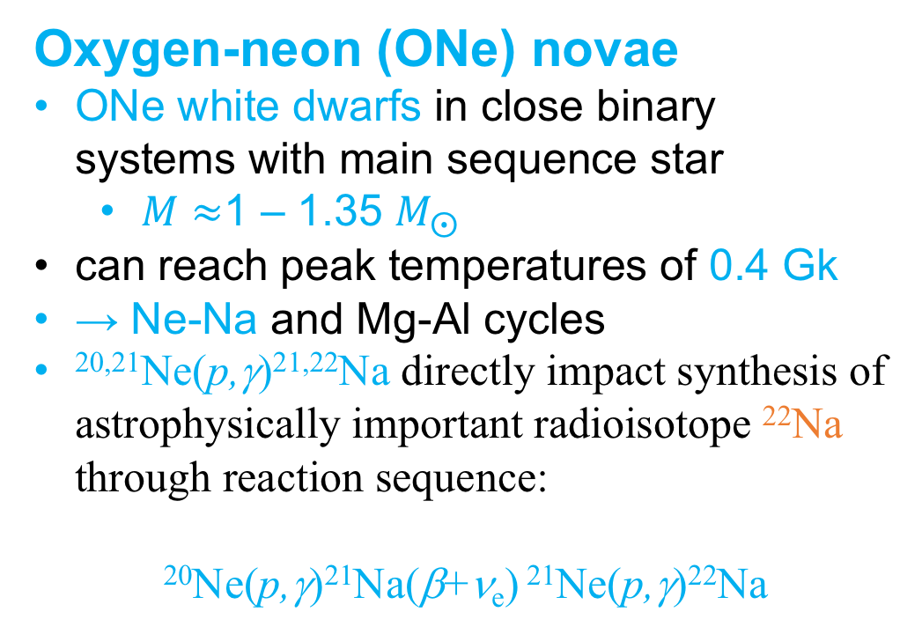
²²Na and
Oxygen-neon novae
Oxygen-neon (ONe) novae
ONe white dwarfs in close binary systems with main sequence star
  $M≈$1 – 1.35 $M_{⨀}$
can reach peak temperatures of 0.4 Gk
→ Ne-Na and Mg-Al cycles
^{20,21}Ne(p,γ)^{21,22}Na directly impact synthesis of astrophysically important radioisotope ²²Na through reaction sequence:
²⁰Ne(p,γ)²¹Na(β+ν_{e}) ²¹Ne(p,γ)²²Na
²²Ne
By NASA/CXC/M.Weiss - Diagram of a Nova type star
http://chandra.harvard.edu/photo/2001/v1494aql/ https://commons.wikimedia.org/w/index.php?curid=380534

Slide 5
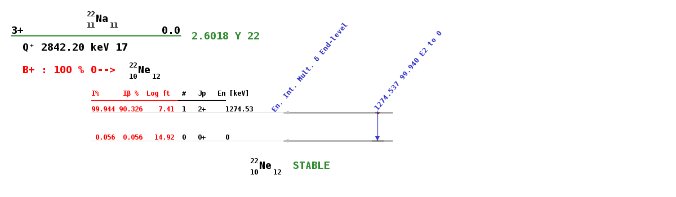
²²Na and
Oxygen-neon novae
https://www-nds.iaea.org/relnsd/vcharthtml/VChartHTML.html
²²Ne
By NASA/CXC/M.Weiss - Diagram of a Nova type star
http://chandra.harvard.edu/photo/2001/v1494aql/ https://commons.wikimedia.org/w/index.php?curid=380534

Slide 6
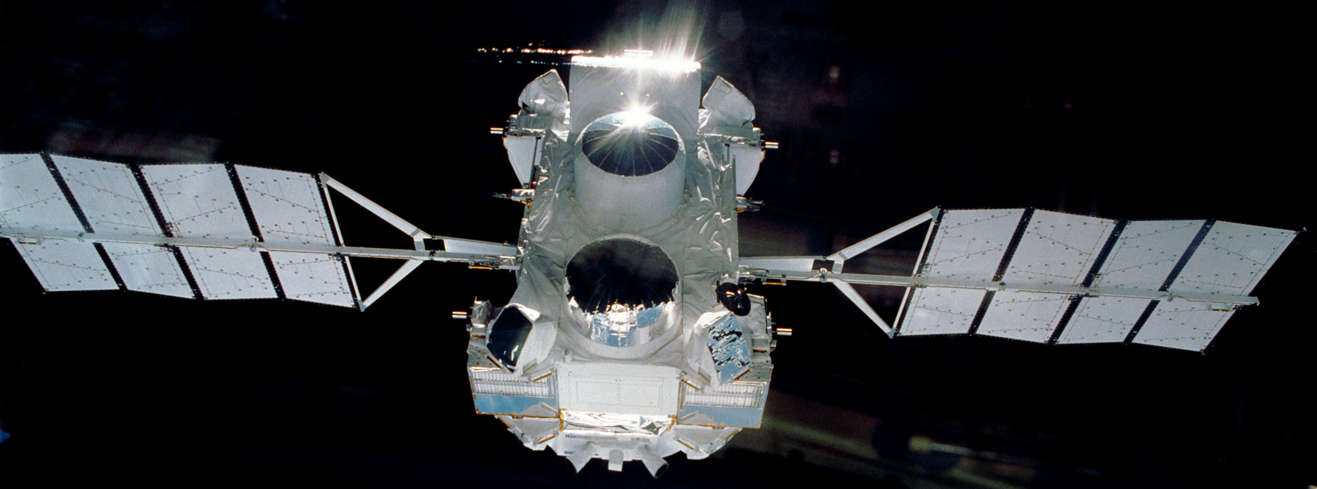
²²Na and
Oxygen-neon novae
https://www-nds.iaea.org/relnsd/vcharthtml/VChartHTML.html
²²Ne
By NASA/CXC/M.Weiss - Diagram of a Nova type star
http://chandra.harvard.edu/photo/2001/v1494aql/ https://commons.wikimedia.org/w/index.php?curid=380534
By NASA/Ken Cameron
https://commons.wikimedia.org/w/index.php?curid=48049410

Slide 7
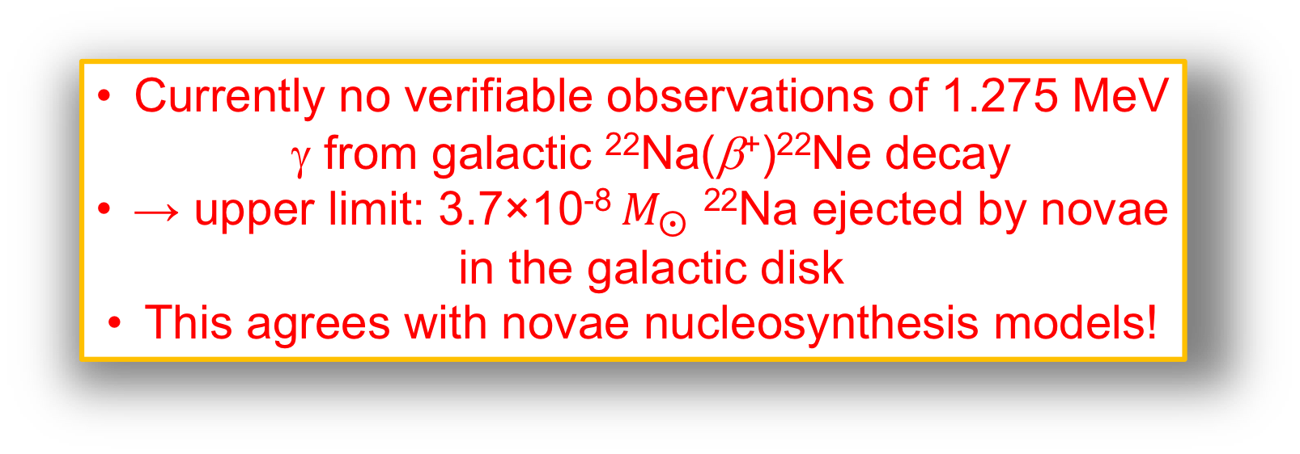
²²Na and
Oxygen-neon novae
Currently no verifiable observations of 1.275 MeV γ from galactic ²²Na(β⁺)²²Ne decay
→ upper limit: 3.7×10⁻⁸ $M_{⨀}$ ²²Na ejected by novae in the galactic disk
This agrees with novae nucleosynthesis models!
https://www-nds.iaea.org/relnsd/vcharthtml/VChartHTML.html
²²Ne
By NASA/CXC/M.Weiss - Diagram of a Nova type star
http://chandra.harvard.edu/photo/2001/v1494aql/ https://commons.wikimedia.org/w/index.php?curid=380534
By NASA/Ken Cameron
https://commons.wikimedia.org/w/index.php?curid=48049410

Slide 8
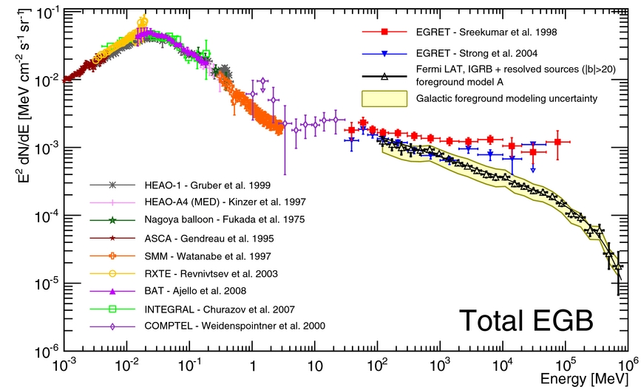
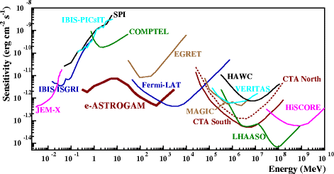
e-ASTROGAM
Next generation of space-based γ-ray observatories are expected to be sensitive to 1.275 MeV γ-rays from ONe novae
M. Ackermann et al 2015 ApJ 799 86
e-ASTROGAM expected to be factor of 29 more sensitive to 1.275 MeV line!
→ desirable to reduce rate uncertainties to probe underlying nuclear physics
The e-ASTROGAM Collaboration, De Angelis, A., Tatischeff, V. et al. Exp Astron (2017) 44: 25.

Slide 9
Previous Measurements
²⁰Ne(p,γ)²¹Na
Transition | σ_{exp} (μb)
DC→0 | < 0.012
DC→0.33 | 0.32±0.05
DC→1.72 | < 0.007
DC→2.43 | 0.63±0.07
Rolfs et al. measured DC cross sections in ²⁰Ne(p,γ)²¹Na at E_{p} = 1.05 keV using natural Ne gas target
C. Rolfs, W. Rodne, M. Shapiro, and H. Winkler, Nucl. Phys. A 241, 460 (1975).

Slide 10
Previous Measurements
²⁰Ne(p,γ)²¹Na
Transition | σ_{exp} (μb)
DC→0 | < 0.012
DC→0.33 | 0.32±0.05
DC→1.72 | < 0.007
DC→2.43 | 0.63±0.07
Rolfs et al. measured DC cross sections in ²⁰Ne(p,γ)²¹Na at E_{p} = 1.05 keV using natural Ne gas target
No direct measurements in astrophysically relevant energy range E_{c.m.} = 80 - 300 keV
C. Rolfs, W. Rodne, M. Shapiro, and H. Winkler, Nucl. Phys. A 241, 460 (1975).

Slide 11
Previous Measurements
²⁰Ne(p,γ)²¹Na
Transition | σ_{exp} (μb)
DC→0 | < 0.012
DC→0.33 | 0.32±0.05
DC→1.72 | < 0.007
DC→2.43 | 0.63±0.07
Rolfs et al. measured DC cross sections in ²⁰Ne(p,γ)²¹Na at E_{p} = 1.05 keV using natural Ne gas target
No direct measurements in astrophysically relevant energy range E_{c.m.} = 80 - 300 keV
C. Rolfs, W. Rodne, M. Shapiro, and H. Winkler, Nucl. Phys. A 241, 460 (1975).

Slide 12
Previous Measurements
²⁰Ne(p,γ)²¹Na
Transition | σ_{exp} (μb)
DC→0 | < 0.012
DC→0.33 | 0.32±0.05
DC→1.72 | < 0.007
DC→2.43 | 0.63±0.07
Rolfs et al. measured DC cross sections in ²⁰Ne(p,γ)²¹Na at E_{p} = 1.05 keV using natural Ne gas target
No direct measurements in astrophysically relevant energy range E_{c.m.} = 80 - 300 keV
²¹Ne(p,γ)²²Na
DRAGON commissioning suggested ωγ of E_{c.m.} = 258 keV resonance > factor 2 larger than previous values
C. Rolfs, W. Rodne, M. Shapiro, and H. Winkler, Nucl. Phys. A 241, 460 (1975).
S. Engel, Ph.D. Thesis

Slide 13
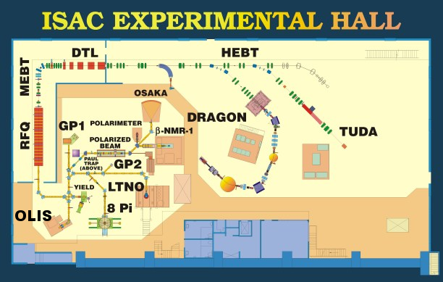
Experiment
ISAC-I
²⁰Ne from OLIS MCIS
²¹Ne from OLIS MWIS
accelerated up to 540 keV/u by ISAC-I accelerators (RFQ & DTL)
Delivered to DRAGON gas target
  I₂₀ = 4.6(7)×10¹² pps
  I₂₁ = 1.2(1)×10⁸ pps

Slide 14
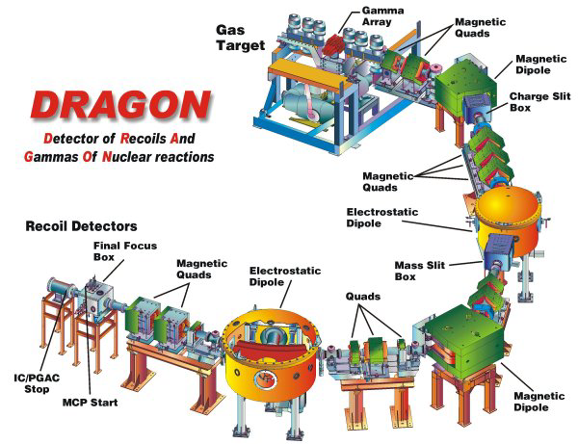
Experiment
3 main parts:
  Head
    Differentially-pumped windowless gas target
    High geometric efficiency BGO γ-ray array
      Detects prompt γ emissions of excited recoil nuclei
  Body
    High-suppression electromagnetic mass separator
    2 stages of separation (MD, ED, MD, ED)
  Tail
    Suite of heavy ion detectors
      Dual MCP for TOF
      DSSSD, IC, or Hybrid for E-loss / deposition

Slide 15
Analysis
Candidate recoils identified via TOF between coincident γ and heavy ion signals

Slide 16
Analysis
Candidate recoils identified via TOF between coincident γ and heavy ion signals
Gating on MCP TOF, RF correlation further discriminates recoils from unreacted beam

Slide 17
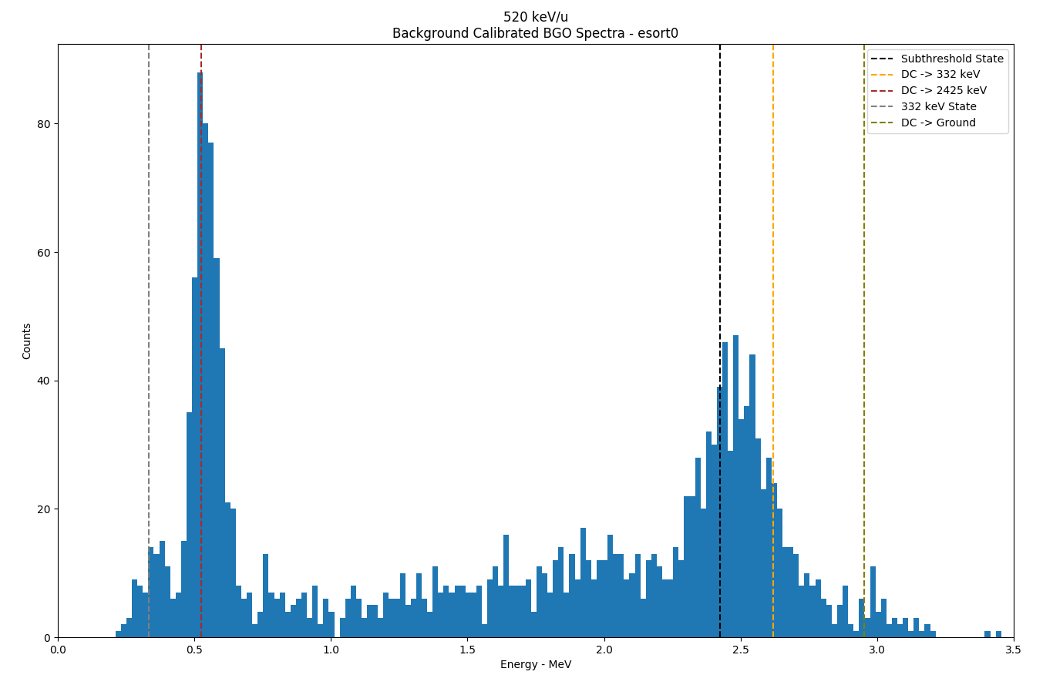
Analysis
Candidate recoils identified via TOF between coincident γ and heavy ion signals
Gating on MCP TOF, RF correlation further discriminates recoils from unreacted beam
→ BGO γ₀ spectra of recoils to estimate DC components
Fit peaks to estimate σ

Slide 18
Analysis

Slide 19
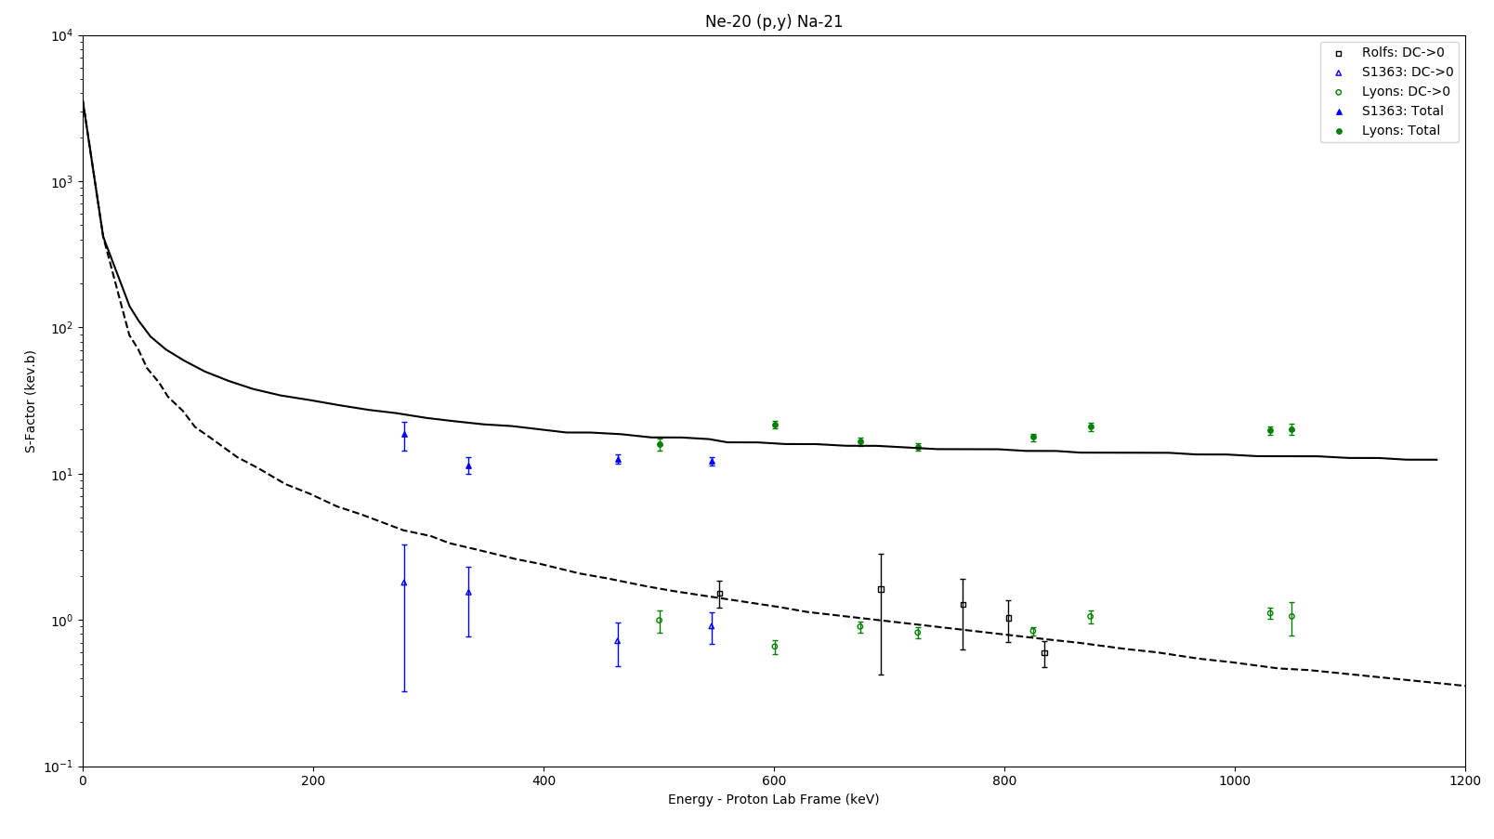

Astrophysical S-factor
$$S=Eσ(E)e^{2πη}$$
Preliminary
C. Rolfs, W. Rodne, M. Shapiro, and H. Winkler, Nucl. Phys. A 241, 460 (1975).
S. Lyons et al. Phys. Rev. C 97, 065802

Slide 20
Summary
^{20,21}Ne(p,γ)^{21,22}Na reaction rates impact ²²Na abundance in ejecta of ONe novae
^{20,21}Ne(p,γ)^{21,22}Na were directly measured with DRAGON:
  E_{cm} = 258 keV resonance in ²¹Ne(p,γ)²²Na
    DRAGON measurement agrees with previous literature values
  direct capture cross sections in ²⁰Ne(p,γ)²¹Na in the range
  E_{cm} = 256 – 518 keV
    Preliminary results imply reduced S-factor compared to Rolfs et al.
      → reduced subthreshold strength?
    Future: R-matrix analysis and reaction rate implications

Slide 21



Thank You!
D. Connolly¹, J. Karpesky², M. Lovely², C. Akers³,
D. S. Burke⁴, G. Christian⁵, B. Davids^{1,6}, J. Fallis⁷, A. Firmino⁸, U. Greife², U. Hager², D. A. Hutcheon¹, A. Rojas⁸, C. Ruiz^{1,9}
¹TRIUMF
²Colorado School of Mines
³Institute for Basic Science
⁴McMaster University
⁵Simon Fraser University
⁷Texas A&M University
⁸University of Alberta
⁹University of Victoria

Slide 22
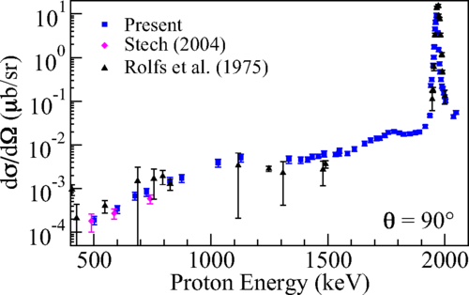
S-factor
S. Lyons et al. Phys. Rev. C 97, 065802

Slide 23
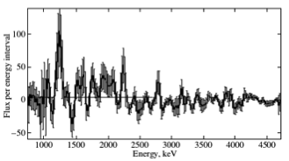
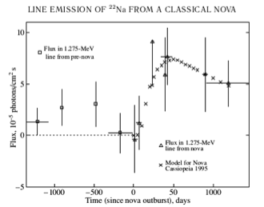
²²Na Detection?
Iyudin, A.F. Astron. Rep. (2010) 54: 611.

