Slide 1
The MariX FEL Preliminary 3d simulations
V. Petrillo, L. Serafini, F. Broggi, A. Bacci, M. Rossetti Conti, A. R. Rossi

Slide 2
FEL scheme

Slide 3
Imagine
…to want to project a FEL in the Angstrom’s.
What to do?
Take a linac, the longest and strongest possible, making, say, 3.5 GeV or more and an undulator, robust,
already tested with, say, 1.4 cm of period, align them, put transfer line, quadrupoles, diagnostics,
photon lines and try.
N_{ph}=1.35 10⁹

Slide 4
Desires and constraints (December ‘17)
Value of the wavelength (down to 2.5 Å)
Flux (10⁸-10⁹ photons per shot)
Coherence (transverse and longitudinal)
Final Energy of the electrons (last evaluation: <2.4 GeV)
Total length of the apparatus (?)

Slide 5
RB
Comparing different undulator technologies
KYMA 14 mm, 5 mm
Existing and tested
Radiabeam 7 mm 1.9 mm
Existing
KYMA 10 mm, ? 3-5mm
promised
K
Courtesy of Pino Dattoli

Slide 6
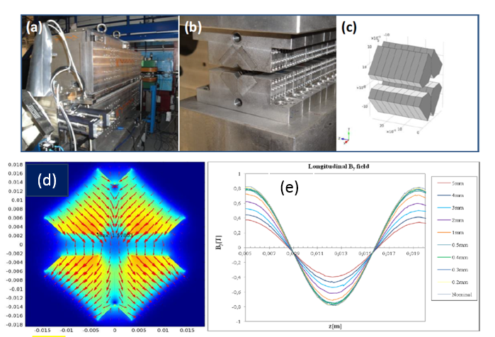
5mm
Undulator KYMA, existing and tested
4mm
p=7.82mm
Ciocci et al., 2015
SPIE
λ_{w}=14 mm
Gap=5 mm
B=1-1.1 T
a_{w}=0.7-0.8
Immediate Upgrade
λ_{w}=10 mm
Do we want a variable gap?
‘… la nostra determinazione di realizzare MariX non ha prezzo,…per tutto il resto c’è Mastercard’
We can have it!

Slide 7
RadiaBeam, existing and to be tested
Where could we test it? At SPARC! M.F. and P.D. agree.

Slide 8
What can we do with E<2.4GeV ? Not much.
Period | Wavelength | Gap | B peak | aw | gamma | E-Energy | ?
14 mm | 5 A | 5 mm | 0.76 T | 0.7 | 4567 | 2.33 GeV | OK
 |  | 3 mm | 1.1 T | 1.011 | 5320 | 2.72 GeV | NO
 | 2.5 A | 5 mm |  | 0.7 | 6459 | 3.3 GeV | NO
 |  | 3 mm | 1.1 T | 1.011 | 7527 | 3.85 GeV | NO
10 mm | 5 A | 5 mm | 0.4 T | 0.2628 | 3269 | 1.67 GeV | OK
 |  | 3 mm | 0.9 T | 0.5913 | 3673 | 1.87 GeV | OK
 | 2.5 A | 5 mm | 0.4 T | 0.2628 | 4623 | 2.36 GeV | OK
 |  | 3 mm | 0.9 T | 0.5913 | 5195 | 2.65 GeV | NO
7 mm | 5 A | 1.9 mm | 1.1 T | 0.5059 | 2964 | 1.51 GeV | OK
 | 2.5 A | 1.9 mm | 1.1 T | 0.5059 | 4193.21 | 2.14 GeV | OK

Slide 9
Working points at 5 Å
Period | Wavelength | aw | gamma | rho3d (10⁻³) | L_{gain} (m)
14 mm | 5 A | 0.7 | 4567 | 0.62572 | 1.0280
10 mm | 5 A | 0.2628 | 3269 | 0.23584 | 1.9481
 |  | 0.5913 | 3673 | 0.53037 | 0.8663
7 mm | 5 A | 0.5059 | 2964 | 0.4405 | 0.7301
The electrons (Gaussian ideal beam):
ε_{x} (mm mrad) | 0.5 | ε_{y} (mm mrad) | 0.5 | ΔE/E | 1-7 10⁻⁴
Q (pC) | 6-60 | I(kA) | 2.5 | Δτ_{beam}(fs) | 1-10

Slide 10
Three-dimensional simulations
Simulations have been done with GENESIS 1.3, released by S. Reiche.
3-D FEL code in the time dependent mode, with the best possible precision options.
In the non-paralellized version, on my PC, each run takes 5-12 hours.
For the cascade, more than 2 days.

Slide 11
Undulator KYMA 14 mm+FODO, matching
Period | Wavelength | aw | gamma
14 mm | 5 A | 0.7 | 4567
ε=0.5 μm
dB/dz (T/m) | ε(μm) | σ_{x}(μm) | σ_{y}(μm) | α_{x} | α_{y}
20 | 0.5 | 27.1 | 11.8 | 2.5 | -0.64
20 | 0.8 | 34.27 | 14.9 | 2.5 | -0.64

Slide 12
KYMA 14 mm, a_{w}=0.7 5 Å, ε=0.5 μm, energy spread
ΔE/E=2.510⁻⁴
ΔE/E=10⁻⁴
ΔE/E=510⁻⁴

Slide 13
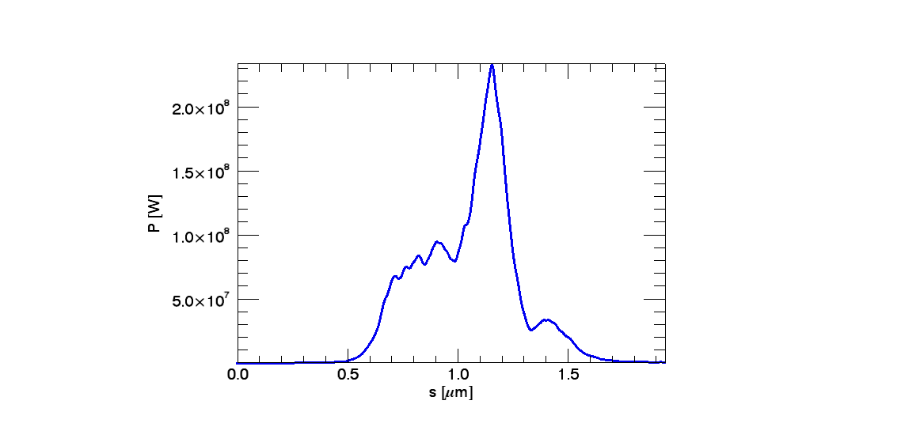
Growth KYMA 14 mm 5 A, power, ΔE/E=2.5 10⁻⁴

Slide 14
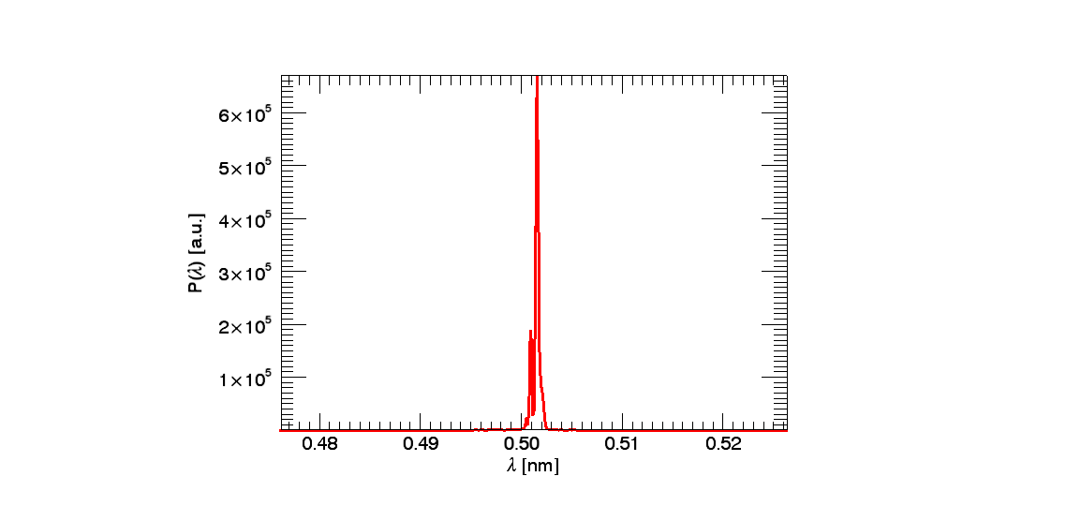
KYMA 14 mm 5 A, spectrum, ΔE/E=2.5 10⁻⁴

Slide 15
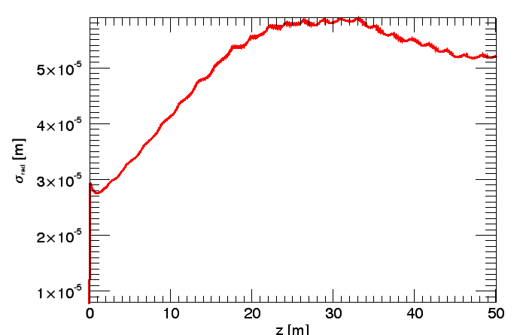
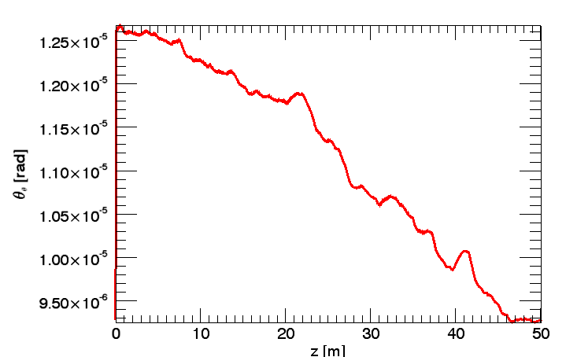
KYMA 14 mm 5 A, rad size and divergence
5 m
10 m
60 μm
110 μm
160 μm

Slide 16
KYMA 14 mm, summary
With the constraint at E<2.4 GeV, we can do only 5 Å
γ | ΔE/E | ε (μm) | N_{ph} | L_{sat}(m) | bw | Rad size(μm) | Div(μrad)
4567 | 1 10⁻⁴ | 0.5 | 4 10⁹ | 45 | 0.8 10⁻³ | 50 | 9
 | 2.5 10⁻⁴ | 0.5 | 2.2 10⁹ | 48 | 0.9 10⁻³ | 52 | 9.3
 | 5 10⁻⁴ | 0.5 | 1.2 10⁹ | 51 | 10⁻³ | 58 | 10.8
 | 2.5 10⁻⁴ | 0.8 | 1.9 10⁹ | 55 | 1.5 10⁻³ | 130 | 11

Slide 17
Undulator RadiaB+FODO, 5 Å, matching at ε=0.5 μm
Period | Wavelength | aw | gamma
7 mm | 5 A | 0.5059 | 2964
dB/dz (T/m) | ε(μm) | σ_{x}(μm) | σ_{y}(μm) | α_{x} | α_{y}
30 | 0.5 | 25 | 16.5 | 1.55 | -0.73
30 | 0.8 | 31.6 | 21 | 1.55 | -0.73

Slide 18
Growth RadiaB, 5 Å, energy spread
ΔE/E=10⁻⁴
ΔE/E=2.5 10⁻⁴
ΔE/E=5 10⁻⁴
ΔE/E=7 10⁻⁴

Slide 19
Growth RadiaB, 5 Å, emittance
ε=0.8 mm mrad
ε=0.5 mm mrad
L_{sat} (m)
Ν_{ph}
ε=0.5 mm mrad
ε=0.8 mm mrad
ΔE/E

Slide 21
RadiaB, 5 Å, power

Slide 22
RadiaB, 5 Å, spectrum

Slide 23
RadiaB, 5 Å, rad size and divergence
10 m
5 m
80 μm
130 μm
180 μm

Slide 24
Why so few electrons?
Q=6 pC
Q=60 pC

Slide 25
RadiaB, 7 mm, 5 Å , summary
γ | ΔE/E | ε (μm) | σ (μm) | N_{ph} | L_{sat}(m) | bw | Rad size | div
2964 | 1e-4 | 0.5 | 25-16.5 | 2.7 10⁹ | 27 | 10⁻³ | 35 | 8.2
 | 2.5 e-4 | 0.5 | 25-16.5 | 1.91 10⁹ | 42 | 1.3 10⁻³ | 40 | 10
 | 5 e-4 | 0.5 | 25-16.5 | 1.13 10⁹ | 45 | 1.5 10⁻³ | 45 | 11
 | 7e-4 | 0.5 | 25-16.5 | 0.94 10⁹ | 47 | 2 10⁻³ | 46 | 11.5
 | 1e-4 | 0.8 | 31-21 | 0.75 10⁹ | 44 | 1.2 10⁻³ | 45 | 11.5
 | 2.5 e-4 | 0.8 | 31-21 | 0.67 10⁹ | 46 | 1.8 10⁻³ | 46 | 12
 | 5 e-4 | 0.8 | 31-21 | 0.64 10⁹ | 47 | 2 10⁻³ | 47 | 12.5
 | 7e-4 | 0.8 | 31-21 | 0.6 10⁹ | 48 | 2 10⁻³ | 47 | 12.5

Slide 26
Working point RB at 2.5 Å
Period | Wavelength | aw | gamma | rho3d (10⁻³) | L_{gain} (m)
10 mm | 2.5 A | 0.2628 | 4623 | 0.12151 | 3.7812
7 mm | 2.5 A | 0.5059 | 4193.21 | 0.25694 | 1.2517
dB/dz(T/m) | ε(μm) | σ_{x}(μm) | σ_{y}(μm) | α_{x} | α_{y}
30 | 0.3 | 16.26 | 10.75 | 1.55 | -0.73
30 | 0.5 | 21 | 13.88 | 1.55 | -0.73
30 | 0.8 | 26.56 | 17.55 | 1.55 | -0.73

Slide 27
RadiaB, 2.5 Å, growth, energy spread and emittance
ε=0.5
ε=0.3
ε=0.8
ε=0.5
ΔE/E=0.7,1,2 e-4
ΔE/E=2 e-4
γ | ΔE/E | ε (μm) | Nph | L_{sat}(m) | bw | Size (μm) | Div(μrad)
4193 | 0.7e-4 | 0.5 | 4.6 10⁸ | 42 | 0.65 10⁻³ | 60 | 5.5
 | 1 e-4 | 0.5 | 4.4 10⁸ | 42 | 0.65 10⁻³ | 60 | 5.5
 | 2 e-4 | 0.5 | 4.4 10⁸ | 42 | 0.68 10⁻³ | 60 | 5.5
 | 2e-4 | 0.8 | 1.2 10⁸ | 44 | 0.8 10⁻³ | 62 | 5.7
 | 2e-4 | 0.3 | 2.2 10⁹ | 30 | 0.5 10⁻³ | 40 | 5

Slide 28
RB at 2.5 Å, emittance

Slide 29
RadiaB, 2.5 Å, power, ε=0.5 μm, ΔE/E=10⁻⁴

Slide 30
RadiaB, 2.5 Å, spectrum, ε=0.5 μm, ΔE/E=10⁻⁴

Slide 31
Diverg. and rad. size RB 2.5 Å, ε=0.5 μm, ΔE/E=10⁻⁴
10 m
5 m
60 μm
85 μm
116 μm

Slide 32
Problem with coherence
SASE single spike vs seeded pulse (here the pulses
are two)

Slide 33
High order harmonics generated in gases
25 nJ
12 nm

Slide 34
Seeding: double cascade with fresh bunch technique. Se7en
High Harmonics Generation in Gas: first attempt: 20 nanoJ at 12 nm, 60 pC
Wavelength 12 nm
L=12.5 m
Modulator 1
Und. Period 5 cm
a_{w}=3. γ=4567
e-Energy=2.3 GeV
Wavelength 1.71 nm
Seventh harmonics
L=15 m
Modulator 2
Und. Period 2.8 cm
a_{w}=1.24 γ=4567
e-Energy=2.3 GeV
Wavelength 0.231 nm
Seventh harmonics
L=
Radiator
Und. Period 0.7 cm
a_{w}=0.67 (maybe too large)
γ=4567 e-Energy=2.3 GeV
V
V
power
power
12 nm
7° harm
=0.244nm
7° harm
=1.71nm
3° harm
5°
harm
spectr
1.71nm
spectr

Slide 35
To be studied:
Dispersive section in the cascade with fresh bunch technique.
Self seeding: regenerative amplifier
pSASE
12 nm
1.71 nm
Disp sec few m
1,71nm
2.4 A

Slide 36
Conclusions and perspectives
Going down towards the Angstrom: Mission impossible
Start to end simulations: Desperately seeking a good electron bunch.
RadiaBeam undulators: a new hope?
KYMA: when?
Flux: 10⁸ on the target? What news from users?
Coherence: Mission impossible II
Needed young people, hard work and good ideas.

