Slide 1

M.A.R.I.X.
Multi-disciplinary Advanced Research Infra-structure with X-rays
WG6 - WG12 Status

Slide 2
WG6
Magnets – Power Supply

Slide 3
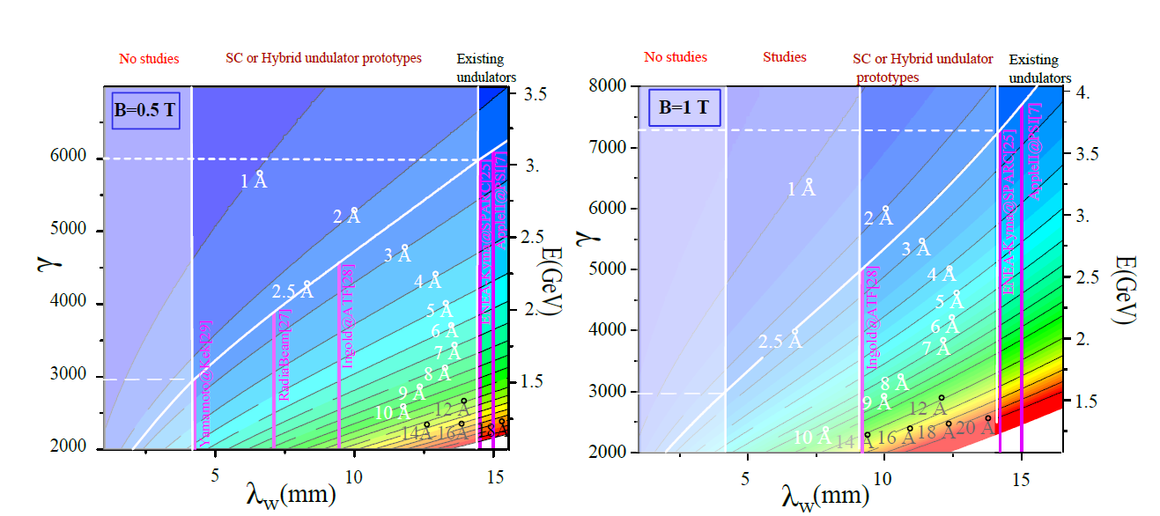
WG12
FEL undulators
Courtesy V. Petrillo

Slide 4
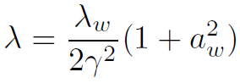
WG12
FEL undulators
In base alla criogenia la massima energia del fascio è di 2.3 GeV. Quindi, secondo la relazione
Con
Possibili ondulatori commerciali o quasi commerciali sono RADIABEAM o KIMA

Slide 5
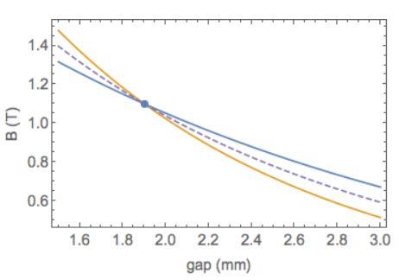
WG12
Ondulatore RADIABEAM

Slide 6
WG12
Ondulatore RADIABEAM
λ_{w}=7 mm
λ=2.5 x 10⁻¹⁰ m
Β=1 T γ=4120 (2.1 GeV) a_{w}= 0.47 K=0.66 g=2 mm g/λ_{w} =0.29
λ=5 x 10⁻¹⁰ m
Β=1 T γ= 2900 (1.48 GeV)
λ=2.5 x 10⁻¹⁰ m
Β=0.6 T γ= 3840 (2.0 GeV) a_{w}= 0.23 K=0.33 g=3 mm g/λ_{w} =0.43
λ=5 x 10⁻¹⁰ m
Β=0.6 T γ= 2710 (1.4 GeV)

Slide 7
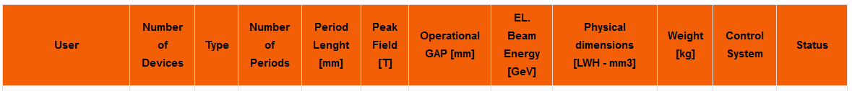
WG12
Ondulatore KYMA
gap= 5 mm
λ_{w}=14 mm
λ=5 x 10⁻¹⁰ m
Β=0.76 T γ=4567 (2.33 GeV) a_{w}=0.7 K=1. g=3 mm g/λ_{w} =0.357

Slide 8
WG12
Ondulatore KIMA2 (da definirsi)
λ_{w}=10 mm
gap=3 (B=0.9 T) - 5 mm (B=0.4 T)
(variabile)
λ=5 x 10⁻¹⁰ m
Β=0.9 T γ=3675 (1.88 GeV) a_{w}=0.6 K=0.84 g=3 mm g/λ_{w} =0.3
λ=5 x 10⁻¹⁰ m
Β=0.4 T γ=3270 (1.67 GeV) a_{w}=0.26 K=0.37 g=5 mm g/λ_{w} =0.5
λ=2.5 x 10⁻¹⁰ m
Β=0.4 T γ=4620 (2.36 GeV) a_{w}=0.26 K=0.37 g=5 mm g/λ_{w} =0.5

Slide 9
WG12
FEL undulators
RADIABEAM
KYMA2

Slide 10
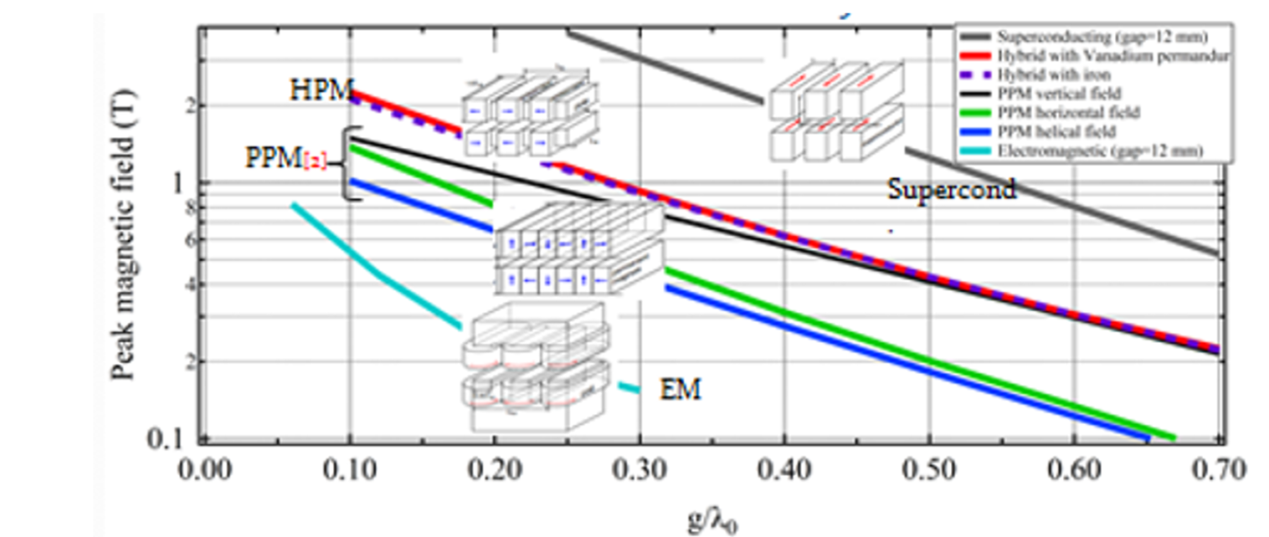
WG12
FEL undulators
RADIABEAM
KYMA
KYMA2
Picture from G. Dattoli

Slide 11
WG12
FEL undulators
Da qui risultano le seguenti traiettorie (calcolo classico, trascurate le perdite per radiazione etc.)
Omogeneità di campo richiesta +/- 1 mm.

Slide 12
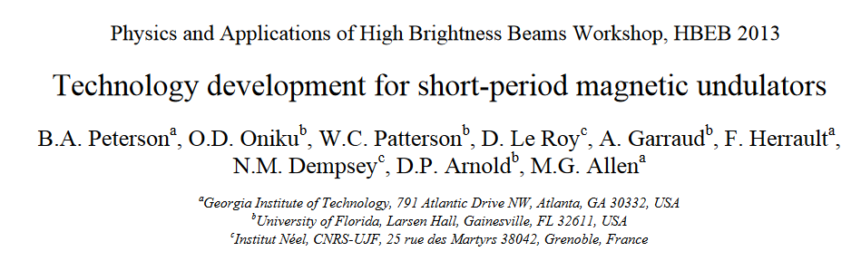
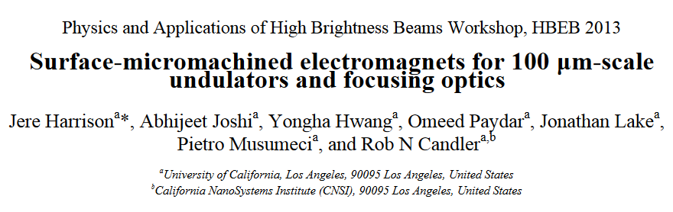

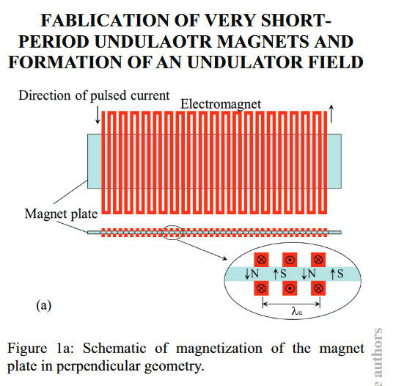
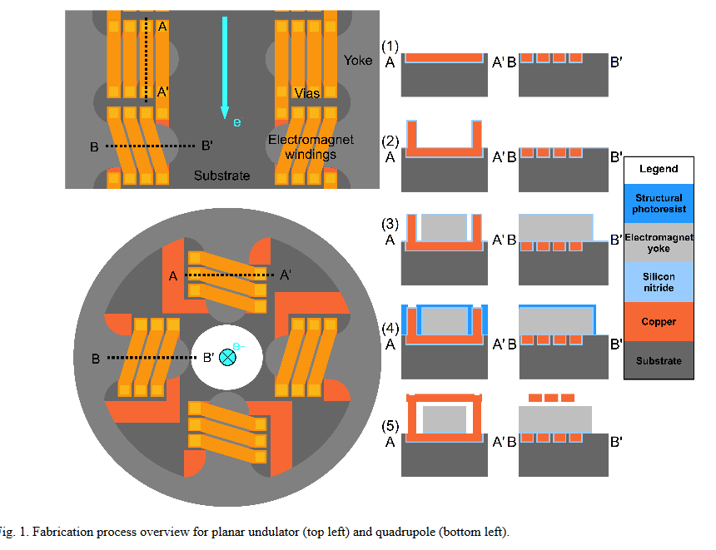
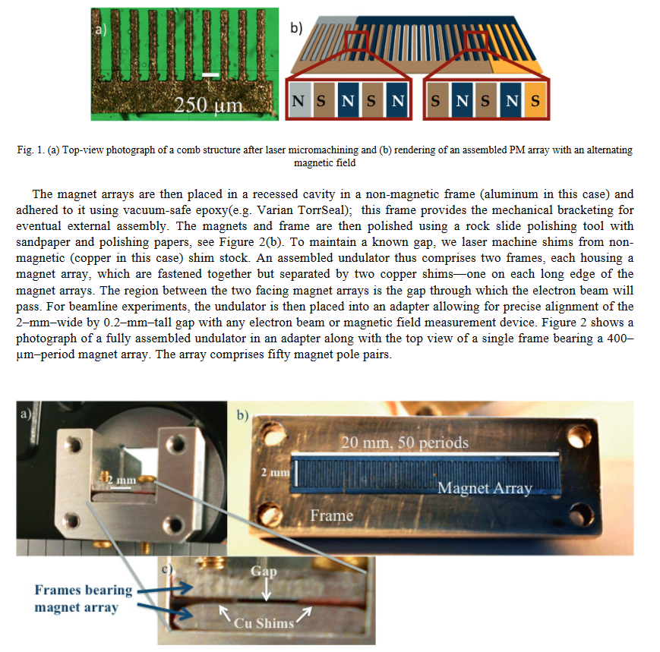
WG12
Exotic undulators
Plasma undulators - Etc.ect

