Slide 1
Searching for muon to electron conversion:
the Mu2e experiment at FERMILAB
S. Miscetti
Laboratori Nazionali di Frascati
on behalf of the Mu2e Collaboration
LNF Theory Seminars – 28 November 2017

Slide 2
Outline
The Physics
→CLFV processes in muon sector
→BSM: Conversion exp. vs MEG-II/mu3e
Description of Muonic Atom processes
Experimental technique
Detector Layout
Status of Mu2e experiment
Conclusions

Slide 3


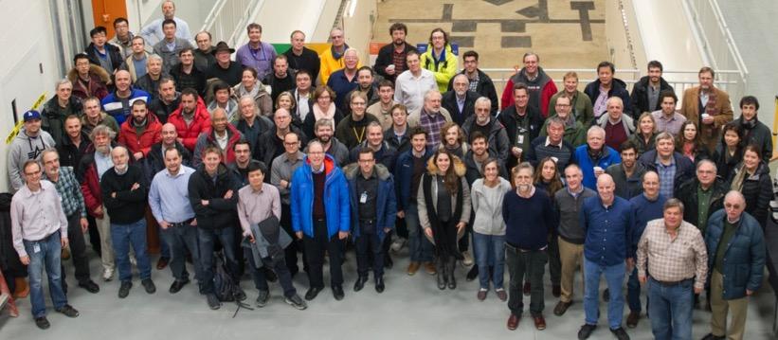






The Mu2e Collaboration
~230 Scientists from 37 Institutions
Argonne National Laboratory, Boston University, Brookhaven National Laboratory, University of California Berkeley, University of California Irvine, California Institute of Technology, City University of New York,
Joint Institute of Nuclear Research Dubna, Duke University, Fermi National Accelerator Laboratory,
Laboratori Nazionali di Frascati, University of Houston, Helmholtz-Zentrum Dresden-Rossendorf,
University of Illinois, INFN Genova, Lawrence Berkeley National Laboratory, INFN Lecce, University Marconi Rome, Institute for High Energy Physics Protvino, Kansas State University, Lewis University, University of Liverpool, University College London, University of Louisville, University of Manchester, University of Minnesota, Muons Inc., Northwestern University, Institute for Nuclear Research Moscow, Northern Illinois University, INFN Pisa, Purdue University, Novosibirsk State University/Budker Institute of Nuclear Physics, Rice University, University of South Alabama, University of Virginia, University of Washington, Yale University

Slide 4
Physics Program

Slide 5
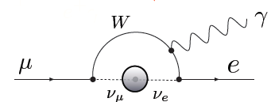
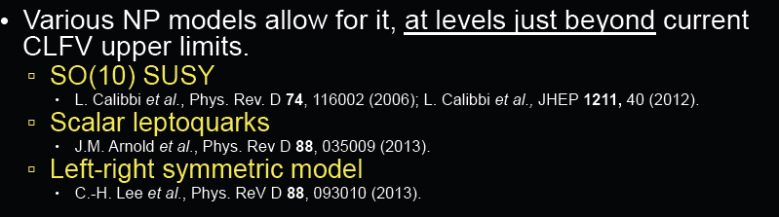
CLFV processes
Muon-to-electron conversion is a charged lepton flavor violating process (CLFV)
similar but complementary to other CLFV processes as μ→ eγ and μ → 3e.
The Mu2e experiment searches for muon-to-electron conversion in the coulomb field of a nucleus: μ⁻ Al → e⁻ Al
CLFV processes are forbidden in the Standard Model
→ Assuming neutrino oscillations they are allowed but ..
in practice BR(μ → eγ ) ~ 10⁻⁵⁴ …. they are negligible
New Physics could enhance CLFV rates to observable values
Observation of CLFV
is New Physics

Slide 6
An overview of some CLFV Processes
Process | Current Limit | Next Generation exp
τ → μη | BR < 6.5 E-8
τ → μγ | BR < 6.8 E-8 | 10⁻⁹ - 10⁻¹⁰ (Belle II)
τ → μμμ | BR < 3.2 E-8
τ → eee | BR < 3.6 E-8
K_{L} → eμ | BR < 4.7 E-12
K⁺ → π⁺e⁻μ⁺ | BR < 1.3 E-11
B⁰ → eμ | BR < 7.8 E-8
B⁺ → K⁺eμ | BR < 9.1 E-8
μ⁺ → e⁺γ | BR < 4.2 E-13 | 10⁻¹⁴ (MEG)
μ⁺ → e⁺e⁺e⁻ | BR < 1.0 E-12 | 10⁻¹⁶ (PSI)
μN → eN | R_{μe} < 7.0 E-13 | 10⁻¹⁷ (Mu2e, COMET)
(current limits from the PDG)
Most promising CLFV measurements use μ
→ large rates available for the beams
no needs of hadronic corrections in final states
Colliders/factories win when 3rd generation is involved, τ→μγ H → τ μ
Notes:
There is a global interest in pursuing discovery science via CLFV. This table summarizes for you’re the current limits from a variety of CLFV processes and future sensitivities. Among these various experiments, the most promising utilize muons – and among those the best sensitivity comes from muon-to-electron conversion.
We are not alone in pursuing discovery science via charged lepton flavor violation… Why? Well, we know quarks mix, we know neutrinos mix, so – to me (and many others) – it would be surprising if charged leptons didn’t mix. It’s a question then of “at what level” do they mix. These are FCNC, you have to work hard to suppress them. It turns out that in most BSM models CLFV effects are present at rates that some next generation experiments will be sensitive to. And in that regard the muon experiments really shine - MEG and muon-to-electron conversion in particular. MEG is searching for a muon decaying to e/gamma, released a new result last year, and is in the middle of an upgrade to improve another order of magnitude in the next few years. Muon conversion is being pursued by Mu2e here at Fermilab and a very similar experiment called COMET at JPARC in Japan.

Slide 7
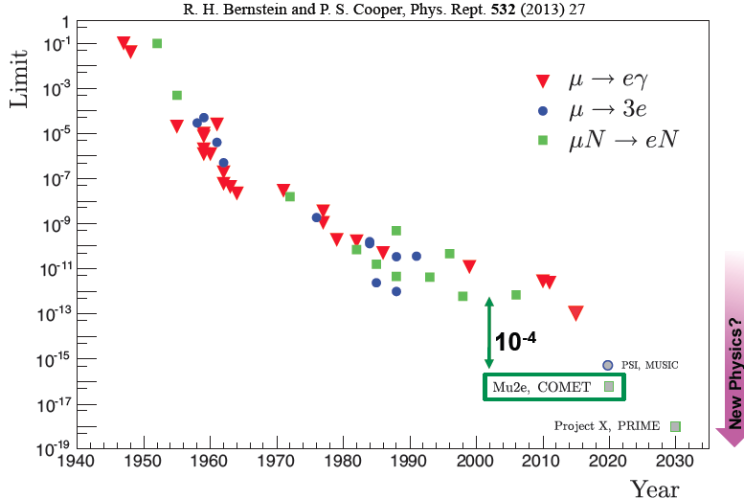


CLFV history for muons
MEG-Upgrade
Pip-2

Slide 8
Diagrams for CLFV muon processes
, Z, h
, Z, h
Loop terms
Contact or 4-lepton terms
CLFV rates and ratios are sensitive probes of underlying model

Slide 9
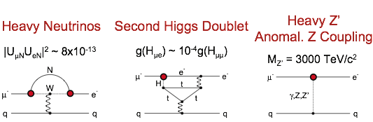
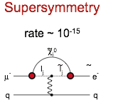
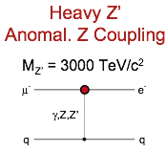
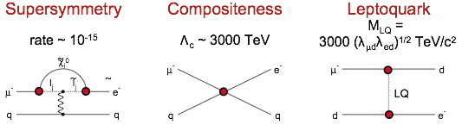
CLFV General Lagrangian
Models which can be probed also by μ→eγ searches
Loops
Direct coupling between quarks
and leptons, better accessed by μN→eN
Contact terms
μN → eN sensitive to wide array of New Physics models
Test of Physics BSM: Marciano, Mori, and Roney, Ann. Rev. Nucl. Sci. 58
M. Raidal et al, Eur.Phys.J.C57:13-182,2008
A. de Gouvêa, P. Vogel, arXiv:1303.4097

Slide 10
Lambda-k plane for CLFV in muon sector
𝜅 <<1: LOOP DOMINATED
𝜅 >>1: cONTACT DOMINATED
Mass scale discovery
up to ∼10k TeV,
significantly above the direct reach of LHC
Mu2e-II
Mu2e
Slightly better than MEG upgrade in loop-dominated physics
If SUSY seen at LHC → rate ~10⁻¹⁵
Implies O(40) reconstructed signal events with negligible background in Mu2e for many SUSY models.
8

Slide 11
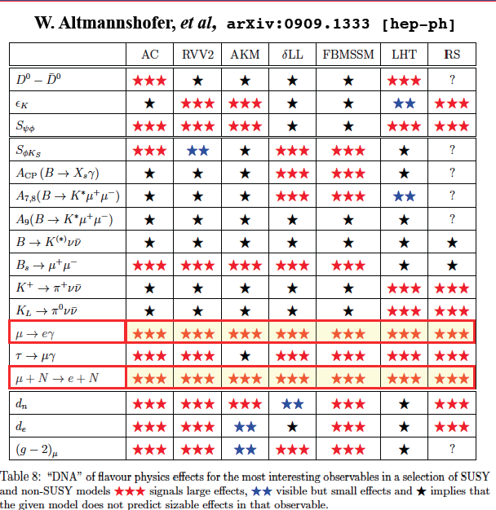
Are CLFV processes relevant ?

Slide 12
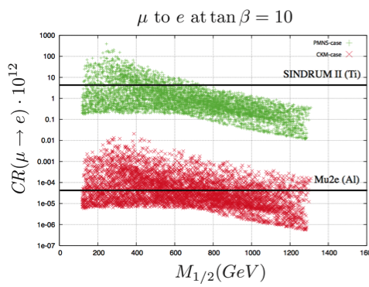
Specific Example: SUSY
SUSY GUT in an SO(10) framework
Probe SUSY through loops
If SUSY seen at LHC → rate ~10⁻¹⁵
Implies ~ 40-50 signal events with negligible background in Mu2e for many SUSY models.
~
μN → eN (tanβ = 10)
χ ⁰
Neutrino-Matrix Like (PMNS)
Minimal Flavor Violation (CKM)
μ
~
~
l_{i}
l_{j}
e
γ
current
q
q
CR(μ→ e) x 10¹²
Mu2e
PIP-2
M_{1/2} (GeV)
L. Calibbi et al., hep-ph/0605139
Complementary with the LHC experiments
while providing models’ discrimination

Slide 13
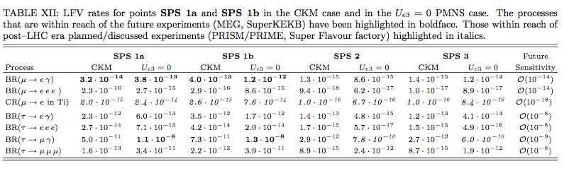
SUSY benchmark points vs LHC
These are SuSy benchmark points for which LHC has discovery sensitivity
Some of these will be observable by MEG-upgrade/Belle-2
All of these will be clearly observable by Mu2e

Slide 14
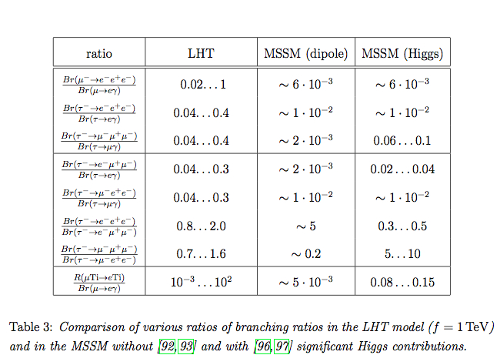
Other CLFV Predictions
M.Blanke, A.J.Buras, B.Duling, S.Recksiegel, C.Tarantino
arXiv:0909.5454v2[hep-ph]
Relative rates Conversions/MEG/mu3e are model dependent
Measure ratios will pin-down theory details

Slide 15
Specific example: Leptoquarks

Slide 16
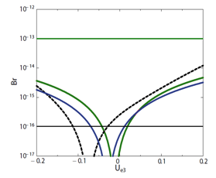
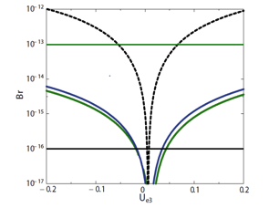
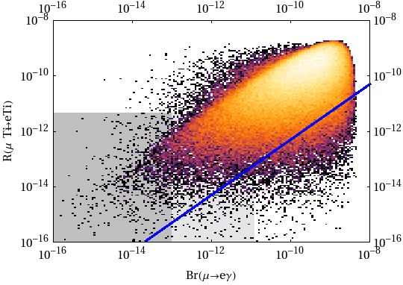
Specific example: Higgs Triplet e LHT
Higgs triplet model
Normal hierarchy
Inverted hierarchy
Dependence on neutrino mass hierarchy and θ₁₃
MEG
μN → eN
μ → eee
BR
M. Kakizaki et al.,
PLB566 (2003) 210
μ → eγ
Mu3e
Mu2e
U_{e3}
U_{e3}
Mu2e
MEG
Littlest Higgs with T-parity
Rμe in Tl
M. Blanke et al.,
Acta Phys.Polon.B41:657,2010
BR(μ → eγ)

Slide 17
Muon to electron conversion is unique
Muon to electron conversion is a unique probe for BSM:
Broad discovery sensitivity across all models:
→ Sensitivity to the same physics of MEG/Mu3e but with better mass reach
→ Sensitivity to physics that MEG/Mu3e are not
→ If MEG/Mu3e observe a signal, Mu2e/COMET do it with improved statistics.
Ratio of the BR allows to pin-down physics model
→ If MEG/Mu3e do not observe a signal, Mu2e/COMET have still a reach to do so.
In a long run, it can also improve further ( Mu2e-II) with the proton
improvement plan (PIP-2)
Sensitivity to Λ (mass scale) up to thousands of TeV beyond any current
existing accelerator

Slide 18
Primer of processes
and experimental
technique

Slide 19
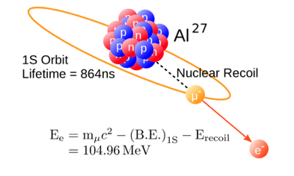
Experimental Technique
Low momentum μ beam (< 100 MeV/c)
High intensity “pulsed” rate
→ 10¹⁰/s muon stop on Al. target
→ 1.7 μsec micro-bunch
Formation of muonic atoms that can make a:
Decay In Orbit (DIO)
∼ 39%
Conversion Process
Nuclear capture ∼ 61%
Normalization factor
Dominant bckg
The conversion process results in a clear signature of a single electron,
CE, with a mono-energetic spectrum close to the muon rest mass

Slide 20
Mu2e Sensitivity
Design goal: single-event-sensitivity of 3 x 10⁻¹⁷
  Requires about 10¹⁸ stopped muons
  Requires about 10²⁰ protons on target
  Requires extreme suppression of backgrounds
Expected limit: R_{μe} < 8 x 10⁻¹⁷ @ 90% CL
  Factor 10⁴ improvement
Discovery sensitivity (5 SIGMA) : all R_{μe} > 1.9 x 10⁻¹⁶
  Covers broad range of new physics theories
in 3 years
running

Slide 21
Mu2e backgrounds
Intrinsic – scale with number of stopped muons
  μ Decay-in-Orbit (DIO)
  Radiative muon capture (RMC)
Late arriving – scale with number of late protons
  Radiative pion capture (RPC)
  π⁻ N → γ N’, γ → e⁺e⁻ and π⁻ N → e⁺e⁻ N’
  μ and π decay-in-flight (DIF)
Miscellaneous
  Anti-proton induced
  produce pions when they annihilate in the target ..
  antiprotons are negative and they can be slow!
  Cosmic-ray induced

Slide 22
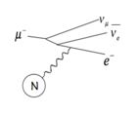
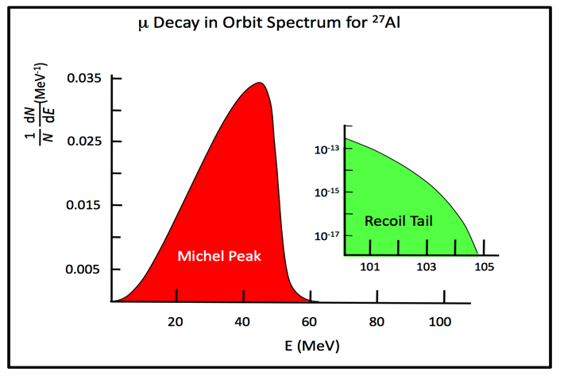
DIO background
The DIO background
is the most difficult one.
Electron energy
distribution from the
decay of bound muons
is a (modified) Michel
spectrum:
Presence of atomic
nucleus and momentum
transfer create a recoil tail
with a fast falling slope
close to the endpoint
To separate DIO
endpoint from
CE line we need a high
Resolution Spectrometer
Bound Michel Spectrum
(Econv - Ee)⁵
CE line
E_{e} (MeV)
Czarnecki et al., Phys. Rev. D 84, 013006 (2011) arXiv:1106.4756v2
21

Slide 23
Mu2e: Late Arriving Backgrounds
Backgrounds arising from all the other interactions which occur at the production target
  Overwhelmingly produce a prompt background when compared to τ_{μ}^{Al} = 864 ns
  Eliminated by defining a signal timing window starting 700 ns after the initial proton pulse
  Must eliminate out-of-time (“late”) protons, which would otherwise generate these backgrounds in time with the signal window
  out-of-time protons / in-time protons < 10⁻¹⁰

Slide 24
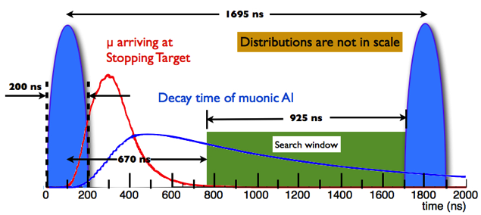
Beam structure → prompt background
Beam hits target
Prompt bkg like radiative pion capture
Mainly Decay In Orbit background
Next bunch
The trick is … muonic atomic lifetime >> prompt background
Need a pulsed beam to wait for prompt background to reach acceptable levels!
Fermilab provides the beam we need !

Slide 25
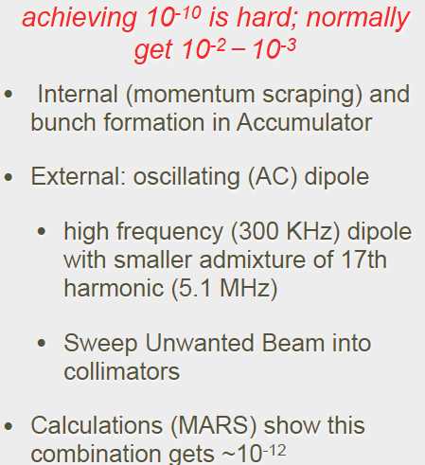
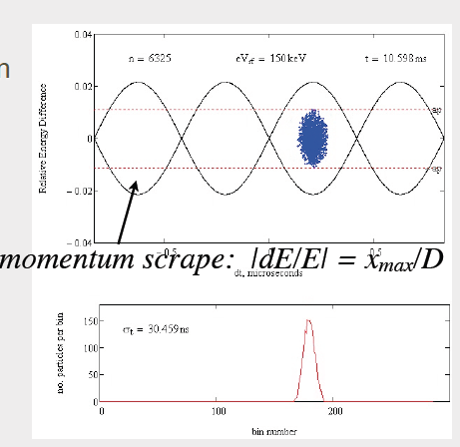
Out of Time proton → Extinction Method
Proton extinction between pulses → # protons out of beam/# protons in pulse
Momentum Scrape
Calculations based on accelerator models
that take into account collective effects
Shows that this combination gets ~ 10⁻¹²

Slide 26
Summary: keys to Mu2e Success
High intensity Pulsed proton beam
  Narrow proton pulses (< +/- 125 ns)
  Delayed window to eliminate prompt background
  Very few out-of-time protons (< 10⁻¹⁰)
Excellent detector
→ High CR veto efficiency (>99.99%)
→ Excellent momentum resolution (120 keV core)
→ Calorimetry for PID and track seeding
→ Thin anti-proton annihilation window(s)

Slide 27
Experiment Layout

Slide 28
Maximizing Muon Flux
World’s hottest muon source by using low power:
→ 8 GeV, 8 kW proton beam on a tungsten target
→ Soft pions confined with a solenoidal B field
→ Strong gradient to increase the yield through magnetic reflection
Concept by Lobashev and Djilkibaev
Sov.J.Nucl.Phys. 49, 384 (1989)

Slide 29
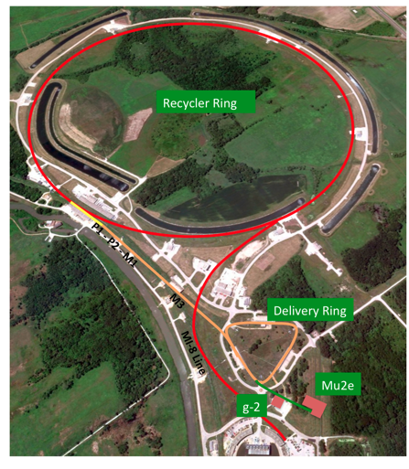
Accelerator Scheme
Mu2e will reuse much of the
Tevatron anti-proton complex
to produce muons:
8 GeV protons from the Booster (4x10¹² each 1/15 s)
Recycler divides proton batches into 4 smaller bunches
Delivery ring gets 1 out of 4 bunches from recycler
Mu2e gets the proton beam in bunches of 3x10⁷ protons every 1695 ns

Slide 30
Muon campus: g-2/Mu2e → rendering
Muon g-2

Slide 31
Muon campus: g-2/Mu2e → reality
DONE

Slide 32
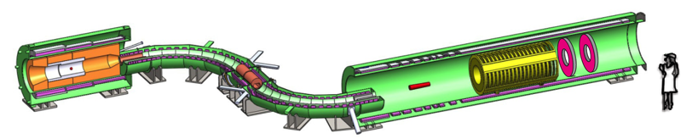

Muon Beam-line
Production Target / Solenoid (PS)
  8 GeV Proton beam strikes target, producing mostly pions
  Graded magnetic field contains backwards pions/muons and reflects slow forward pions/muons
2.5T
protons
1T
4.6T
2T
Heat and radiation shielding
Tungsten target.
Target, Detector and Solenoid (DS)
  Capture muons on Al target
  Measure momentum in tracker and energy in calorimeter
  CRV to veto Cosmic Rays event
Transport Solenoid (TS)
  Selects low momentum, negative muons
  Antiproton absorber in the mid-section

Slide 33
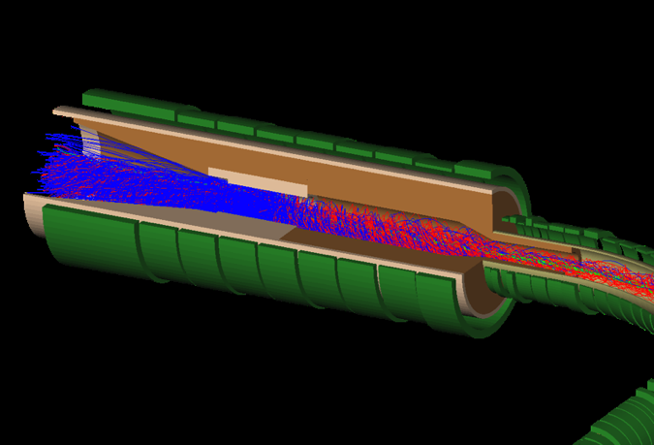
Production Solenoid
Protons enter opposite to outgoing muons:
This is a central idea to remove prompt background
Proton Target
Protons leave
through thin
window
Protons enter here
Proton Target
muons
exit
Pions
The magnetic field is graded from approximately 5.0 Tesla on the upstream side down to 2.5 Tesla at the entrance to the Transport Solenoid. This graded field captures pions, which spiral around in the field and decay into muons.

Slide 34
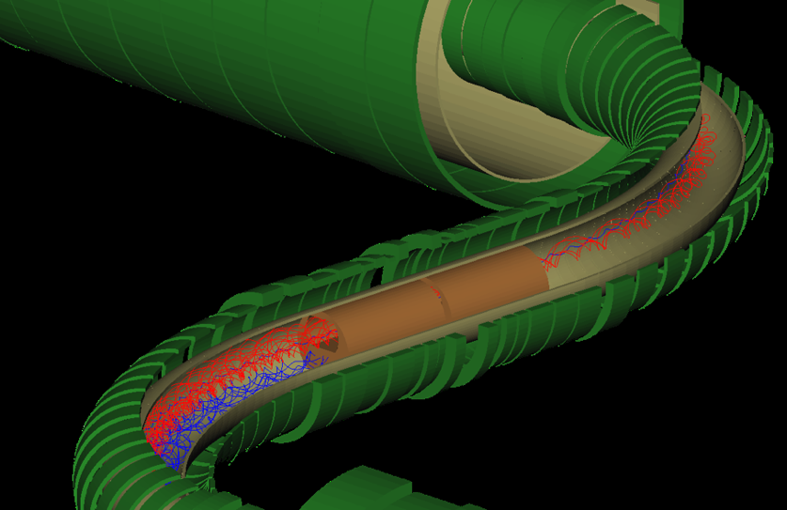
Transport Solenoid
Beam selection by:
curvature drift
collimators sign
momentum
collimators
occasional μ+
P-bar absorber
Pions
Curved solenoid eliminates transport of photons and neutrons

Slide 35
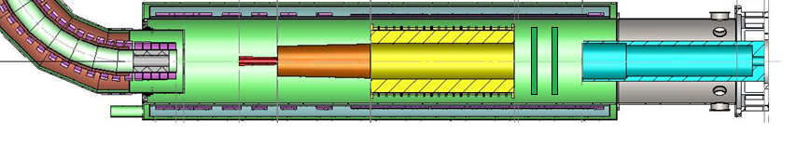
Detector Solenoid
Graded field “reflects” downstream a fraction of conversion electrons emitted upstream
muons
Proton Absorber
Muon Beam Stop
2T
1T
muon stopping target
17 Al foils; Aluminum selected mainly for the muon lifetime (864 ns) that matches beam structure.
EM Calorimeter
Tracker
Sensitivity goal → ~ 6 x 10 ¹⁷
stopped muons
3 year runs , 6 x 10⁷ sec →
10¹⁰ stopped muon/sec

Slide 36
Mu2e Solenoid Summary (1)
 | PS | TS | DS
Length (m) | 4 | 13 | 11
Diameter (m) | 1.7 | 0.4 | 1.9
Field @ start (T) | 4.6 | 2.5 | 2.0
Field @ end (T) | 2.5 | 2.0 | 1.0
Number of coils | 3 | 52 | 11
Conductor (km) | 14 | 44 | 17
Operating current (kA) | 10 | 3 | 6
Stored energy (MJ) | 80 | 20 | 30
Cold mass (tons) | 11 | 26 | 8
PS, DS is being built by General Atomics (USA)
TS is being built by ASG Superconducting (Italy) + Fermilab
Notes:
Ansaldo Superconductor Genova

Slide 37
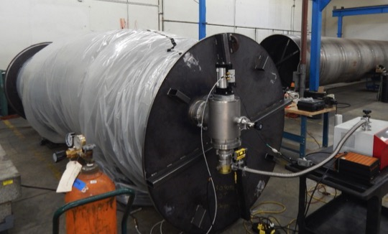
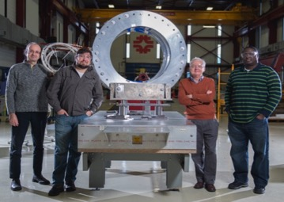
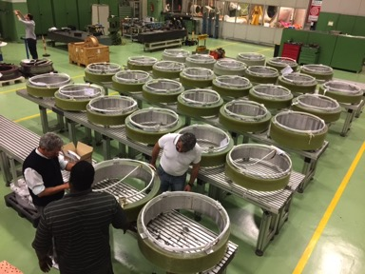
Mu2e Solenoid Summary (2)
75 km of superconducting cable procured and tested
Solenoid design completed
TS fabrication has begun at ASG Superconducting in Genova (Italy)
PS, DS fabrication started at General Atomic (USA)

Slide 38
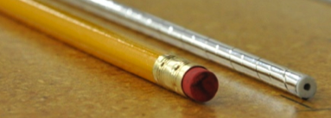
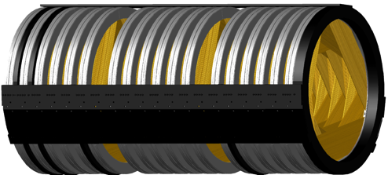

The Mu2e Tracker (1)
Detector requirements:
Small amount of X₀
σ_{p} < 180 keV @ 105 MeV
Good rate capability:
  20 kHz/cm² in live window
  Beam flash of 3 MHz/cm²
dE/dx capability to distinguish e⁻/p
Operate in B = 1 T, 10⁻⁴ Torr vacuum
Maximize/minimize acceptance for CE/DIO
Low mass straw drift tubes design:
5 mm diameter, 33 − 117 cm length
15 μm Mylar wall, 25 μm Au-plated W wire
80:20 Ar:CO₂ @ 1 atm
Dual-ended readout
Tracker Plane
Tracker Station:
2 rotated planes
Tracker:18 stations (>20k tubes)
panel
38 cm
70 cm
3.2 meters

Slide 39
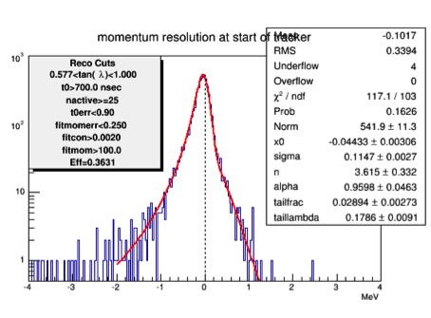
The Mu2e Tracker (2)
Full simulation
Cosmics, 8 channel prototype
Core width = 115 keV/c
High tail slope = 179 keV/c
High tail fraction = 2.9%
Transverse resolution
σ_{data} = 0.133 ± 0.022 mm
σ_{MC} = 0.102 ± 0.001 mm
P_{rec} – P_{tru} (MeV/c)
Well within physics requirements
Robust against increases in rate
Inefficiency dominated by geometric acceptance
Longitudinal resolution
σ_{data} = 42 ± 1 mm
σ_{MC} = 43 ± 1 mm

Slide 40
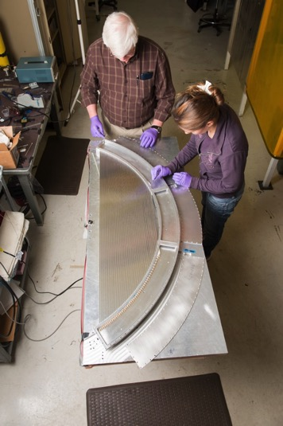
The Mu2e Tracker (3)
First pre-production prototype, with final design, recently built and being tested
Orders placed for final production
FEE prototypes tested successfully
Vertical slice test to be performed on fully instrumented panels with entire FEE chain

Slide 41
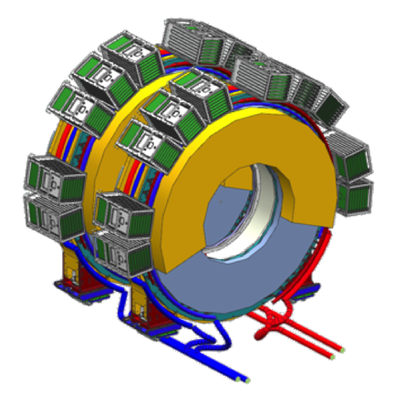
The Mu2e Calorimeter (1)
Calorimeter provides confirmation for CE and other crucial functions:
PID: e/μ separation
EMC seeded track finder
Standalone trigger
Requirements:
σ_{E}/E = 𝓞(5%) for CE
σ_{T} < 500 ps for CE
σ_{X,Y} ≤ 1 cm
High acceptance for CE
Fast (τ<40 ns)
Operate in 1T and 10⁻⁴ Torr
Redundancy in readout
Radiation hard: 90 krad photons and 3×10¹² n/cm²
EMC Design:
Two disks, R_{in}=374 mm, R_{out}=660 mm, 10X₀ length, ~ 75 cm separation
674+674 square x-sec pure CsI crystals, (34×34×200) mm³
For each crystal, two custom array (2×3 of 6×6 mm²) large area UV-extended SiPMs
Analog FEE directly mounted on SiPM
Calibration/Monitoring with 6 MeV radioactive source and a laser system

Slide 42
The Mu2e Calorimeter (2)
Small prototype tested @ BTF (Frascati) in April 2015, 80−120 MeV e⁻
3×3 array of (30×30×200) mm² undoped CsI crystals coupled to Hamamatsu MPPC
DAQ readout: 250 Msps CAEN V1720 Wave Form Digitizer
Good Data-MC
comparison
Small matrix, significant
leakage contribution
σ_{E} ~ 6.5% at 100 MeV
σ_{T} ~ 110 ps at 100 MeV

Slide 43
The Mu2e Calorimeter (3)
3×24 pre-production crystals tested → QA and Rad Hard OK → Production started
3×50 pre-production SiPMs tested → Production started
3×35 characterized, irradiation test up to 8.5×10¹¹ n_{1MeVeq}/cm², MTTF ≥ 6×10⁵ hours
Module0 built: Large EMC prototype (51 crystals, 102 SiPMs, 102 FEE boards)
with pre-productions and mechanics cooling systems similar to the final ones
  Test of integration and assembly procedures, test beam with 60-120 MeV e⁻
CsI Light Output
Module-0
Preliminary results Eres

Slide 44
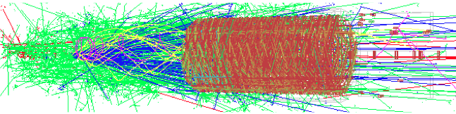
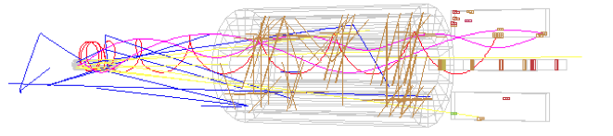
A typical Mu2e event: Calo track seeding
500 – 1695 ns window
± 50 ns around conversion electron
Search for tracking hits with time and azimuthal angle compatible with the calo clusters ( |ΔT| < 50 ns ) → simpler pattern recognition + higher efficiency

Slide 45
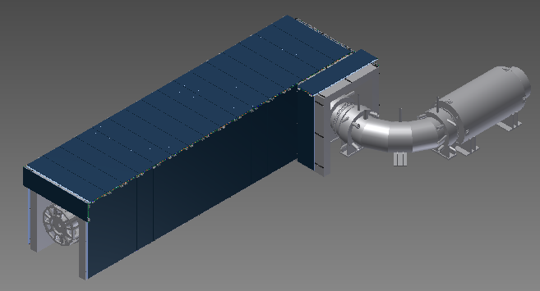
Mu2e Cosmic-Ray Veto (1)
Desired number of bkg: 0.05
Required CR veto inefficiency 10⁻⁴
PS
TS
Without the veto system, ~1 cosmic-ray
induced background event per day
Veto system covers entire DS and half TS

Slide 46
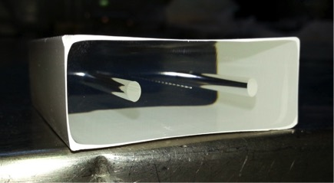
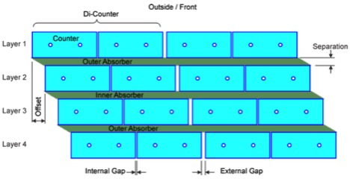
Mu2e Cosmic-Ray Veto (2)
Will use 4 overlapping layers of scintillator bars
  Each bar is 5 x 2 x ~450 cm³
  2 WLS fibers / bar
  Read-out both ends of each fiber with SiPM
  Have achieved ε > 99.4% (per layer) in test beam

Slide 47
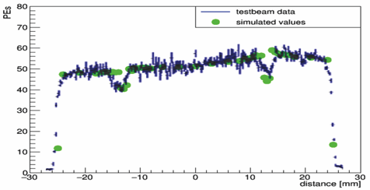
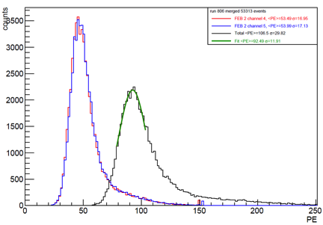
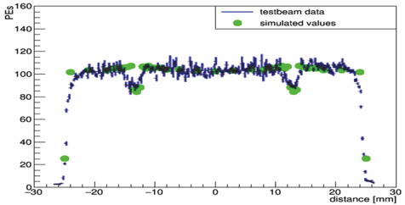
Mu2e Cosmic-Ray Veto (3)
MC well describes test beam data
Test beam results with beam centered on counter 1 m from readout end
One fibre readout
Both fibres readout
The single-plane requirement is ε > 99.5%
  yield of 66 photo-electrons at 1 m
  from readout end
Test beam results give 92 photo-electrons:
safety factor of ∼ 40%.

Slide 48
Mu2e Neutron Shielding
Several copious sources of neutrons
  Production target, stopping target, collimators
Lots of neutrons and subsequent photons
(from n- capture and activation processes)
  Generate false vetoes in CRV… if rate high enough becomes a source of significant dead-time
  Cause radiation damage to the read-out sensors and
  electronics (i.e. digitizers and SiPMs)
  Using HZDR P-ELBE for neutron damage characterization of EMD SiPMs.
  Radiation damage effort will continue with g-ELBE for dose irradiation and characterization of FEE/Digitizer electronics, SiPMs and Stopping Target Monitor detectors (HPGE)
  Other irradiation tests at medical facility in Chicago for neutrons
  Planned for SEU with charged hadrons ..

Slide 49
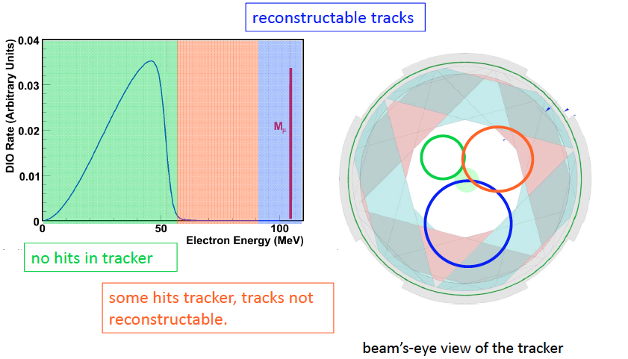
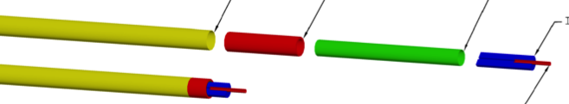
Basic reconstruction scheme
Straws: 5 mm diameter ; 15 μ metalized mylar wall (ground).
25 μm diameter W wire, Time division: σ ≈ 5 mm at straw center
1 m long. In vacuum of 10-4 Torr. No leaks.
Gas Mixture : 80/20 Ar/C02
BLIND TO Beam Flash and > 99% DIO

Slide 50
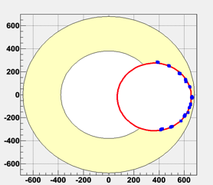
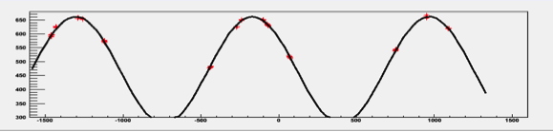
Simulation results on tracker
Pattern Recognition based on
BABAR Kalman Filter algorithm
No significant contribution of
mis-reconstructed background
Momentum resolution
core σ~120 keV
tail σ~180 keV (2.5%)
x-y view
Fit: Crystal Ball + exponential
r-z view

Slide 51
DIO/CE final count with simulation
Discovery sensitivity accomplished with three years of running and suppressing backgrounds to < 0.4 event total (50% cosmics, 35% DIOs)
R_{μe} < 8 × 10⁻¹⁷ @ 90% C.L.

Slide 52
Mu2e Expected Background
(assuming ~ 10 GHz muon stops, 6x10¹⁷ stopped muons in 6x10⁷ s of beam time)
scale with number of stopped muons
scale with number of late protons
Upper Limit on Rue < 8 x 10⁻¹⁷ @ 90% C.L.

Slide 53
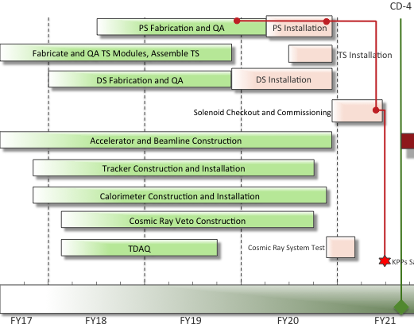
Mu2e Schedule
Three years run expected 2022-2025

Slide 54
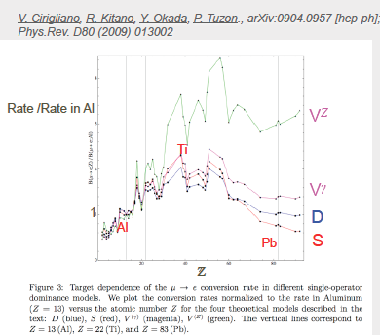
(What-Next?) Mu2e → Mu2e-II
Project-X re-imagined to match
Budget constraints:
PIP-2 plans:
1 MW at LNBF at start (2025)
2 MW at regime at LNBF
It can be used to deliver
a x 10 muons at Mu2e
Snowmass →Arxiv.1311.5278
Mu2e-2 → Arxiv.1307.1168v2.pdf
2) Depending on the beam
Structure available:
→ study Z dependence
if signal is observed
3) If no signal is observed
Use x 10 events in Mu2e-II
Some modifications of the
detector → BR < 6 x 10⁻¹⁸
MU2E-II workshop at Argonne : 8 Dec 2017
EOI in preparation → PAC FNAL summer 2018

Slide 55
Summary
The Mu2e experiment:
Improves sensitivity on u-e conversion by a factor of 10⁴
Provides discovery capability over wide range of New Physics models
Is complementary to LHC, heavy-flavor, dark matter, and neutrino experiments ….
Is progressing on schedule. It will begin commissioning at the end of 2020
Start discussing about Mu2e-II

Slide 56
Additional Material

Slide 58
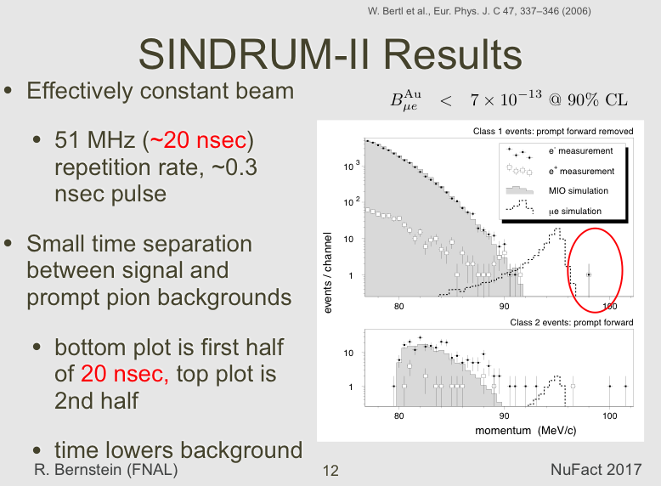

Slide 59
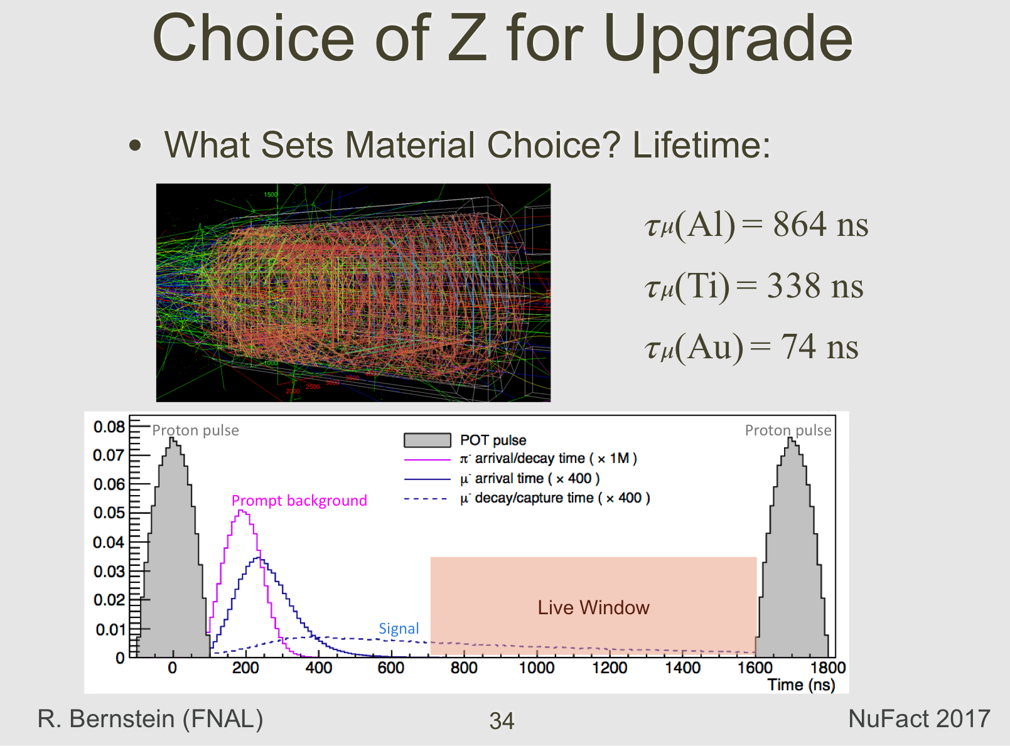

Slide 60


Slide 61
COMET vs Mu2e
Similar capabilities in physics reach
COMET designed to operate at 56 kW, Mu2e 8 kW
→ COMET will use all JPARC beam
→ Mu2e runs simultaneously with neutrino beam
Final bend after COMET stopping target efficiently transmits
conversion e- and provides rate suppression in detector.
  It does not transmit positrons (no μ⁻ N → e⁺ N )
COMET solenoids ~ 10 m longer than Mu2e
Higher beam → higher cost (solenoid shieldling, neutron shielding)
Longer solenoids carry “cost” in operation
COMET Phase-1 could be useful if successful to study background rate
COMET Phase-2 schedule …not yet official
Mu2e is fully approved → now looking for Mu2e-II (Next @ PAC 2018)
Great competition/collaboration → ALCAP @ PSI

Slide 62

World program: COMET

Slide 63


Slide 64


Slide 65
Mu2e: “fake” CE from CR events
A long MC production used to optimize the CRV geometry by generating the same amount of cosmics that will cross the detector in MU2E running period.
few events evaded the CRV, passing closely enough to the target, were tracked by the tracker and passed all reconstruction tracking criteria. They were all μ⁻ → rejected due to the combination of Calorimeter and tracking information : timing and E/p

Slide 66
Mu2e: Stopping Monitor

Slide 67

MEG UPGRADE parameters

Slide 69
MU3e: Beam line looks promising 10⁸u/sec, Magnet → 2019

Slide 70

MEG vs Mu3e
Mu3e decays test also values
of K larger than MEG but with
different (reduced) sensitivity
al large K with respect to Mu2e
Phase 1 Mu3e at PSI aims to 10⁻¹⁵
(approved)
Next phase aims to few 10⁻¹⁶
.. Schedule is not yet clear

