Slide 1
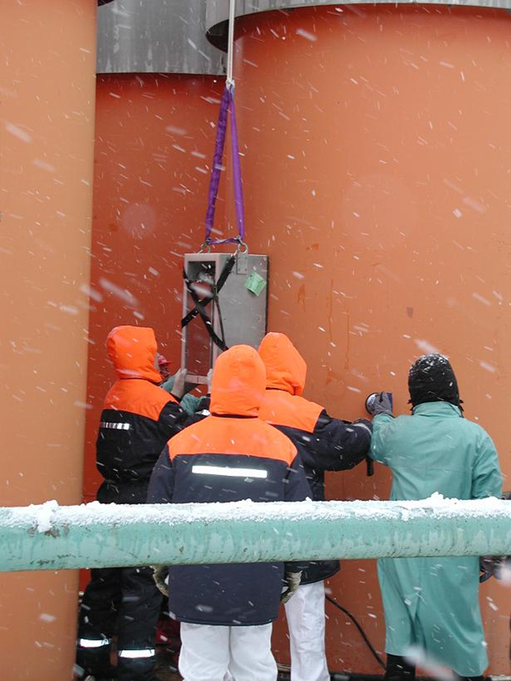
Reverification of full Spent Nuclear Fuel Containers
Subtitle
Alice Tomanin, Stefano Vaccaro
DG ENER – Euratom Safeguards Directorate
Luxembourg

Slide 2
Summary
Introduction
  Euratom treaty
  key figures on Euratom safeguards
Spent fuel strategies
    Interim Storage
    Final repositories
  verification at assembly level
  CoK on containers
    C/S + mointors
    What if CoK is lost?
Containers reverification
  present possibilities
    ultrasonic
    laser
    dual slab
  potential of muon tomography
    advantages
    unresolved issues
Conclusions

Slide 3
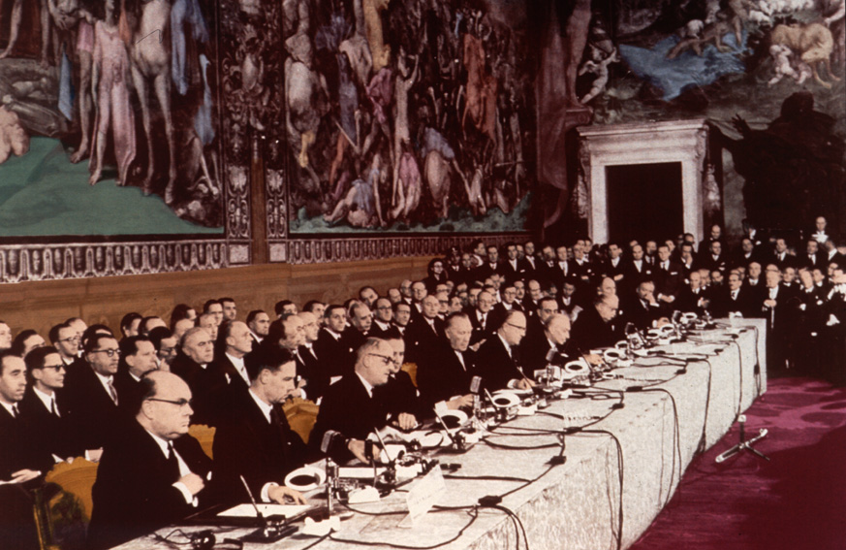
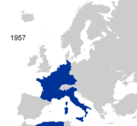



Treaties of Rome (EEC, Euratom)
25.3.1957 Signature of the treaty founding the
European Atomic Energy Community - Euratom
by Belgium, France, Germany, Italy, Luxembourg and The Netherlands

Slide 4
Legal Framework Euratom Treaty
Euratom treaty is binding European law
(and applies to ALL member states, including NWS UK&FR)
  ‘The Commission shall satisfy itself that
    nuclear material is not diverted from intended use’
    ‘obligations under international agreements are complied with’
    (-> NPT/IAEA; Infcirc 193 etc: enabling non-proliferation)
  Operators are obliged to
    Declare basic technical characteristics (design)
    Account for nuclear material (see Euratom regulation 302/2005)
  Commission has right to
    Send inspectors who ‘shall at all times have access to all places, data, persons…’
    Enforce: sanctions: warning, withdrawal of benefits, placement under administration, withdrawal of nuclear material

Slide 5
Safeguards Inspections Euratom Treaty
Ch VII
'Budget' refers to operational budget only;
excludes staff, office infrastructure
2015: 1197 inspections, 645 with IAEA

Slide 6
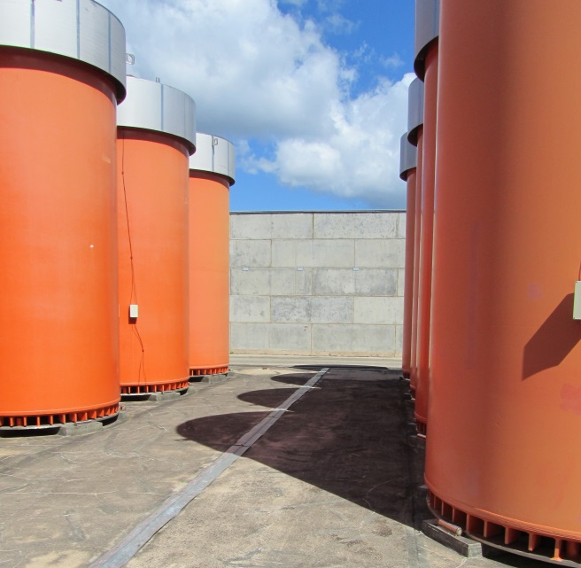
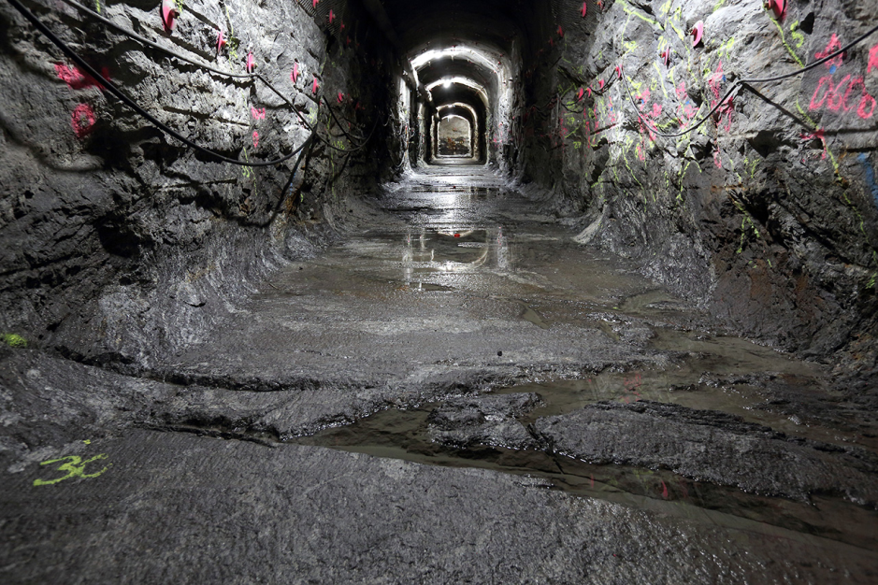
Back-end of Spent Fuel nuclear fuel cycle assemblies nuclear fuel cycle
Two disposal options
(non reprocessed fuel):
Interim Dry Storage (up to ~100 years)
Geological Final Disposal

Slide 7
NDA Verification at Assembly Level
Fork detector (widely used) with enhanced data evaluation, integrating measurement and simulation
Digital Cherenkov Viewing Device (DCVD): different principle, similar performance level as the Fork
Passive Gamma Emission Tomographer: highest performance instrument, almost ready for field use.

Slide 8
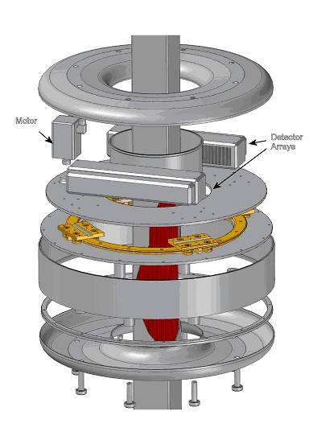
NDA development
Encapsulation Plants
Tomography
  Complementary to Fork detector
  Can confirm completeness of fuel assemblies
  Waiting for IAEA authorization (soon)
  Added neutron capability
  Equipped with 172 CZT detectors
  Cooperation SP to the IAEA with US/Sweden/Finland/EC
  Target: use at encapsulation facility

Slide 9
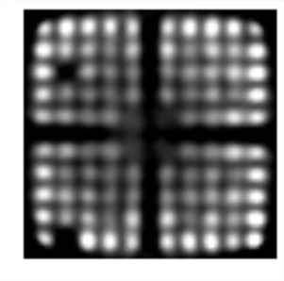
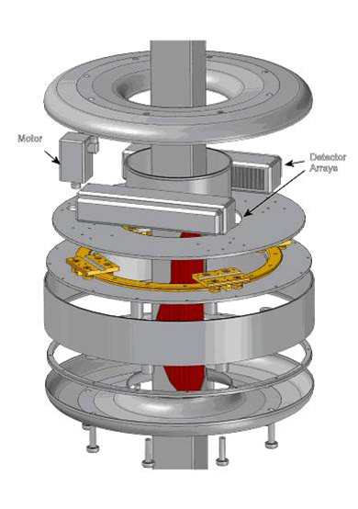
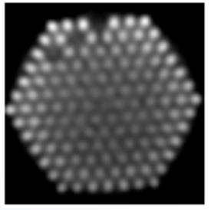
NDA development
Encapsulation Plants
BWR
VVER 440
PWR
Notes:
Complementary to Fork detector
Can confirm completeness of fuel assemblies
Waiting for IAEA authorization (soon)
Added neutron capability
Equipped with 172 CZT detectors
Cooperation SP to the IAEA with US/Sweden/Finland/EC
Target: use at encapsulation facility

Slide 10
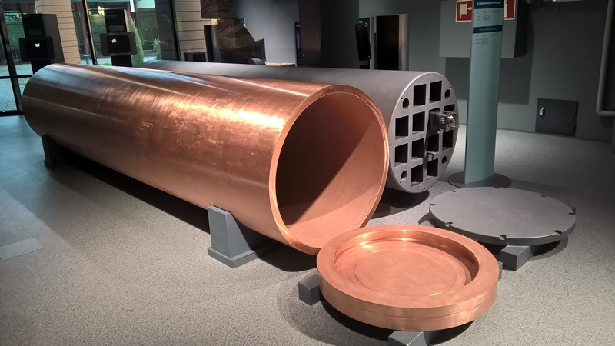
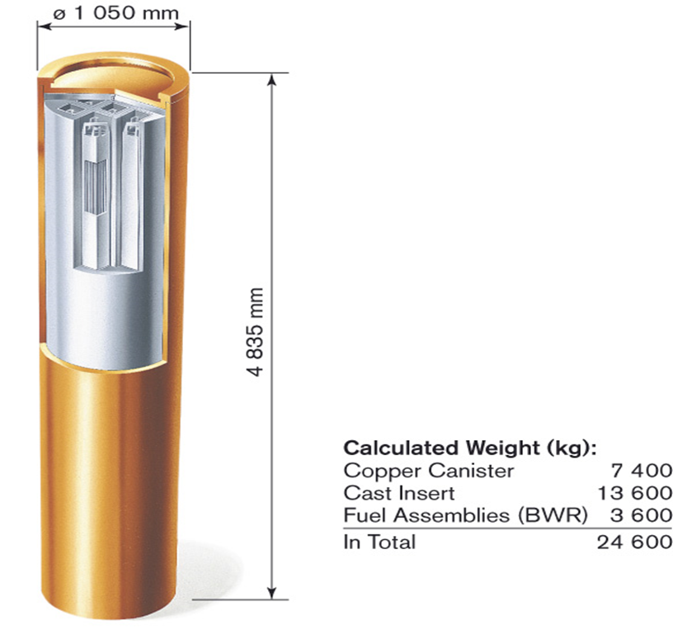
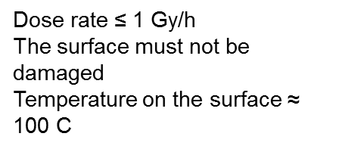
Geological Repository
Canisters

Slide 11
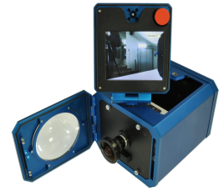
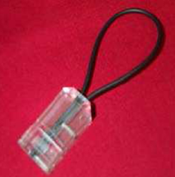
Once the container is closed and welded
CoK on containers
It is kept under Continuity of Knowledge (CoK)
  By sealing
  By surveillance
  By neutron/gamma monitoring the accesses
What if CoK is lost?

Slide 12
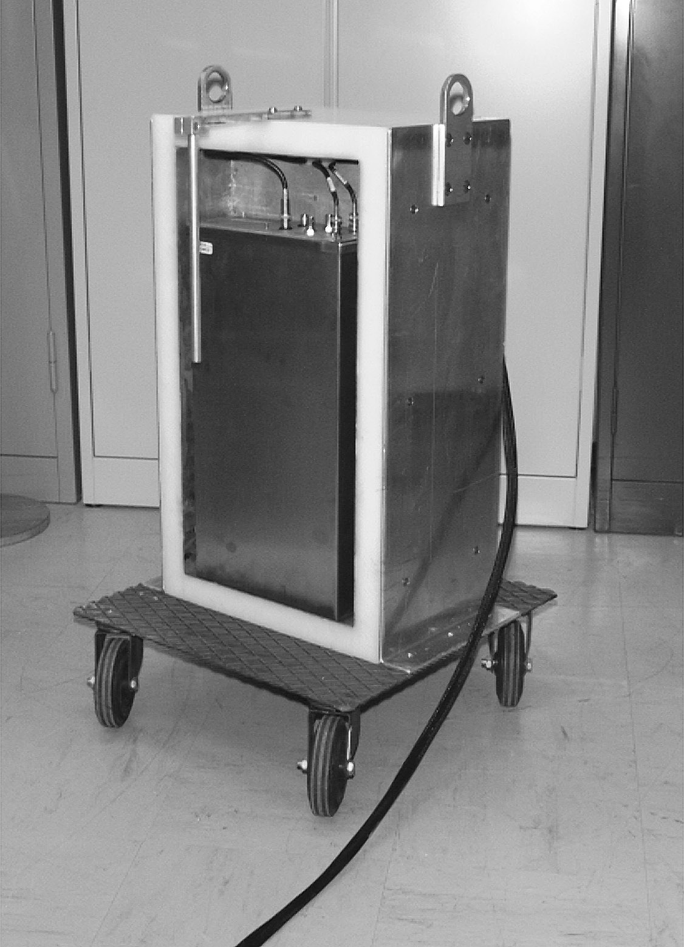

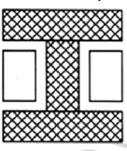
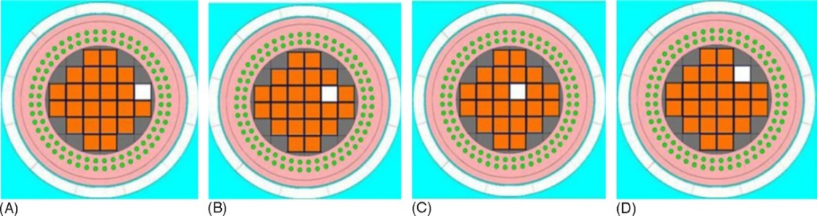
Containers re-verification without opening the lid
Current solution:
neutron emission fingerprint
  Issues: accuracy, dose, handling
  NOT good enough or AT THE LIMIT for one significant quantity of fissile material (goal quantity).
Improvements on CoK ruggedness
  Ultrasonic
  Laser
Peerani, Galletta, Nuclear Engineering and Design 237 (2007) 94–99

Slide 13
Containers re-verification without opening the lid
Are Muons a viable solution?
  Potential:
    suitable measurement time
    good acceptance from nuclear operators
  Issues: low Z resolution
    No possibility to distinguish between
    Pb, U or Pu
    Could be a limitation for replacement
    scenarios
However:
no technique is currently able to achieve the detection goal of one significant quantity missing
P. Checchia, Ispra 2017

Slide 14
Conclusions
The European Commission's safeguards system applies to containers of spent nuclear fuel assemblies
  NDA by assembly upon loading the container
  Seals and surveillance to maintain CoK
If CoK is lost, it needs to be re-estabilished:
  Timely
  Accurately
  Avoiding excessive burden to nuclear operators
Possible application of Muon tomography to the re-verification of closed spent fuel containers can be a potential way to detect 1 significant quantity (roughly 1 fuel assembly) of nuclear material missing.

Slide 15
Thank you for your attention

