Slide 1
INDIRECT METHODS AT n_TOF
F. Mingrone for the n_TOF Collaboration
GIANTS IX – Bologna, 5 October 2017

Slide 2

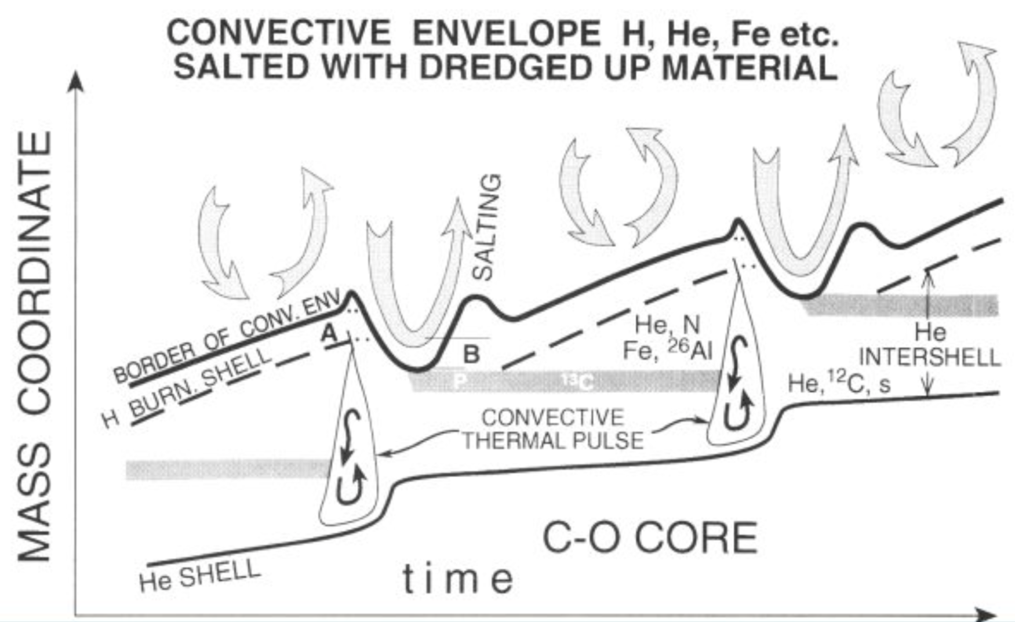





Nuclear reactions and neutrons: a delicate balance
Neutron sources:

Slide 3






Nuclear reactions and neutrons: a delicate balance
Neutron sources:
Neutron poisons:

Slide 4
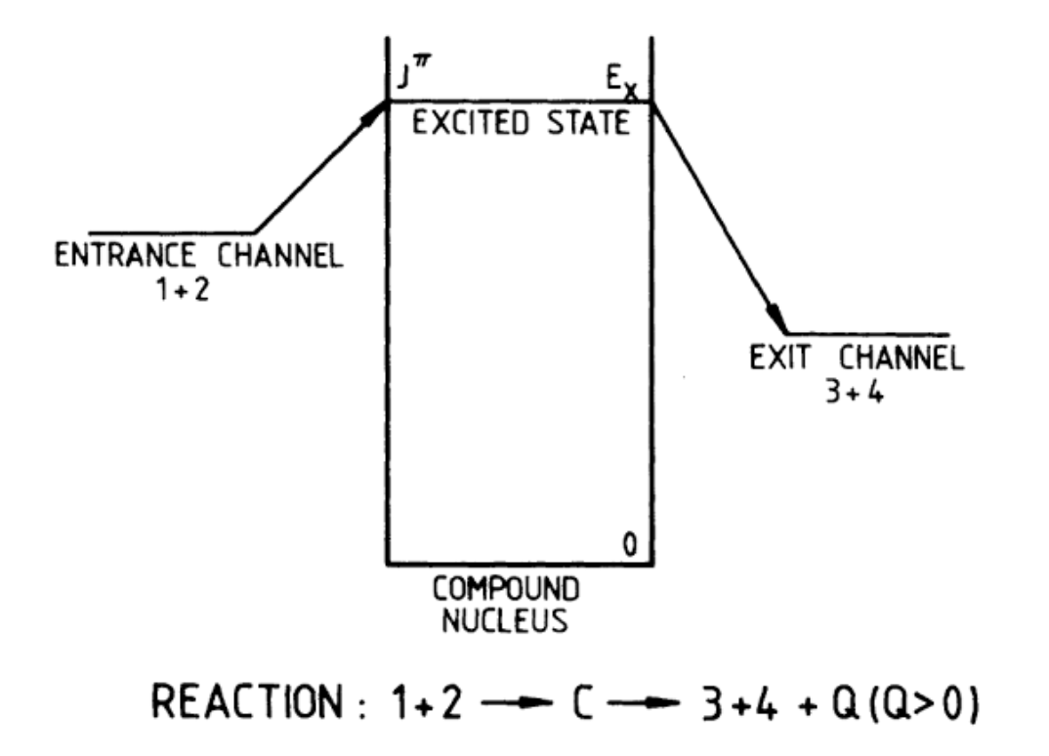
Nuclear data: Indirect approach
Direct measurements – although it remains the most important approach, it can suffer from experimental difficulties:
  Low cross section
  Background discrimination
  Low projectile energy (g low energy resolution)
Indirect methods – characterize the compound nucleus levels populating them through different entrance channels
  Trojan Horse Method (THM): e.g. reaction rates of BBN main reactions [1], -3 keV resonance parameters in ¹⁷O [2] and many more (talks by R.Spartà, M.L.Sergi, G.G.Rapisarda and G.L.Guardo)
  Indirect reactions: e.g. measurement of ²⁵Mg(n,γ) at n_TOF [3]
  Inverse reactions: e.g. measurement of ¹⁶O(n,α) at n_TOF
[1] R.G. Pizzone et al., IL NUOVO CIMENTO 39 C (2016) 363
[2] M. La Cognata et al., Phys. Rew. Letters 109, 232701
[3] C. Massimi et al., Phys, Letters B 768 (2017) 1-6

Slide 5



Indirect methods at n_TOF: the n_TOF facility
n_TOF: neutron Time Of Flight facility

Slide 6
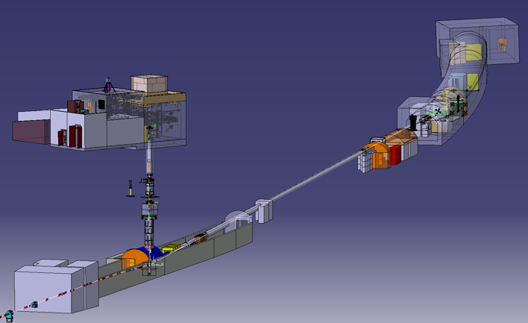






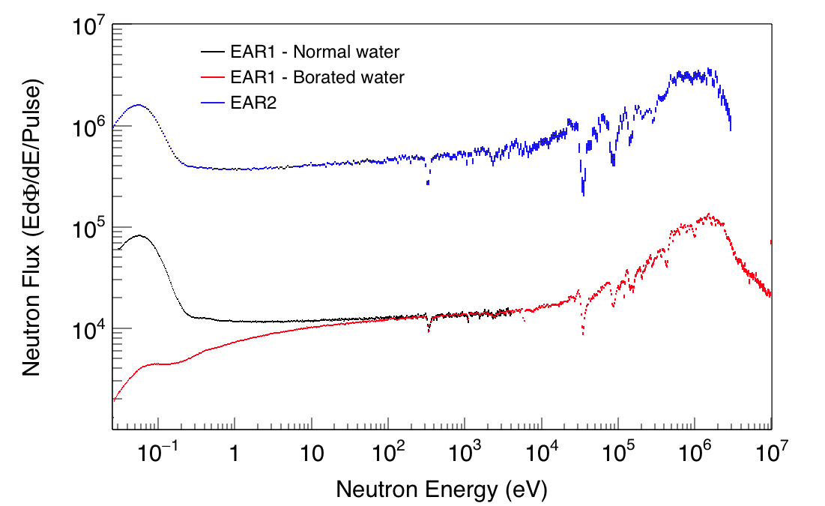




Indirect methods at n_TOF: the n_TOF neutron beam
2 beam lines (185 and 20 m)
2 experimental areas (EAR1 and EAR2), both Class-A lab
Some figures
 | EAR1 | EAR2
Wide energy range | thermal to 1 GeV | thermal to 300 MeV
High instantaneous neutron flux | 10⁵ n/cm²/pulse | 10⁶ n/cm²/pulse
Low repetition rate | < 0.8 Hz (1 pulse/2.4 s max)
High energy resolution | ΔE/E=10⁻⁴ (@10 keV) | ΔE/E=10⁻³ (@10 keV)
EAR2
EAR1
Collimators
Sweeping magnets
p-beam from PS
Pb spallation target

Slide 7
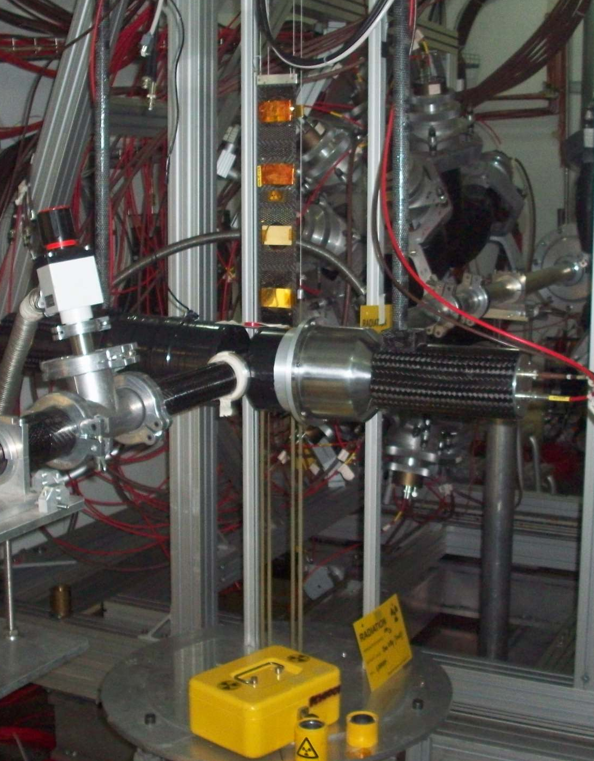
Indirect reactions at n_TOF: ²⁵Mg(n,γ)
Experimental method:
  Total energy detection combined with Pulse Height Weighting technique
  Low solid angle geometry with two C6D6 detectors
  High quality enriched metallic sample

Slide 8
Indirect reactions at n_TOF: ²⁵Mg(n,γ)
Experimental method:
  Total energy detection combined with Pulse Height Weighting technique
  Low solid angle geometry with two C6D6 detectors
  High quality enriched metallic sample
Improved cross-section:
  Low correlated uncertainties
  Combined R-matrix analysis of capture and transmission experimental data sets
  Precise information on J^{π} of ²⁶Mg levels
Also via 1⁺, 2⁻, 3⁺, … states
Only natural parity states (0⁺, 1⁻, 2⁺, …)

Slide 9
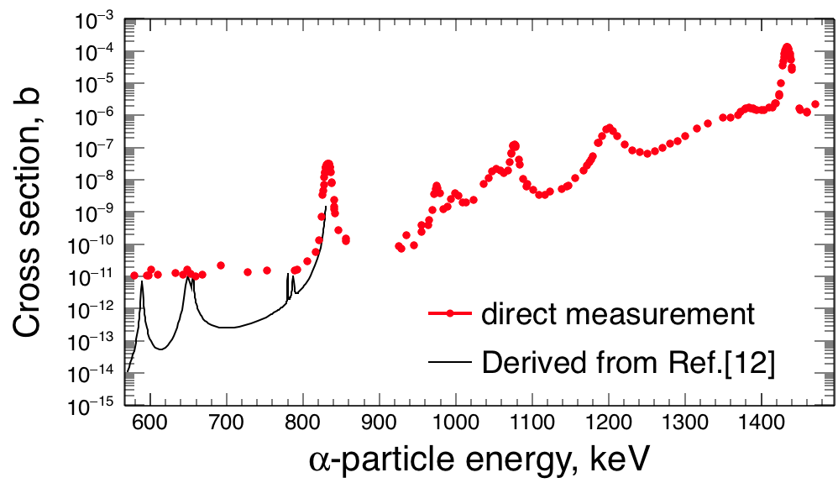
Indirect reactions at n_TOF: ²⁵Mg(n,γ)
Experimental method:
  Total energy detection combined with Pulse Height Weighting technique
  Low solid angle geometry with two C6D6 detectors
  High quality enriched metallic sample
Improved cross-section:
  Low correlated uncertainties
  Combined R-matrix analysis of capture and transmission experimental data sets
  Precise information on J^{π} of ²⁶Mg levels
Impact on the ²²Ne(α,n)²⁵Mg reaction rates:
  Access to states below the first measured α+²²Ne resonance
  New reaction rates combining (i) a-transfer reactions below n threshold, (ii) ²⁶Mg states characterization from ²⁵Mg(n,γ) measurement, (iii) direct measurement data above E_{α}=800 keV
[1]
[2]
[1] M. Jaeger et al., Phys. Rev. Lett. 87 (2001) 202501
[2] C. Massimi et al., Phys, Letters B 768 (2017) 1-6

Slide 10
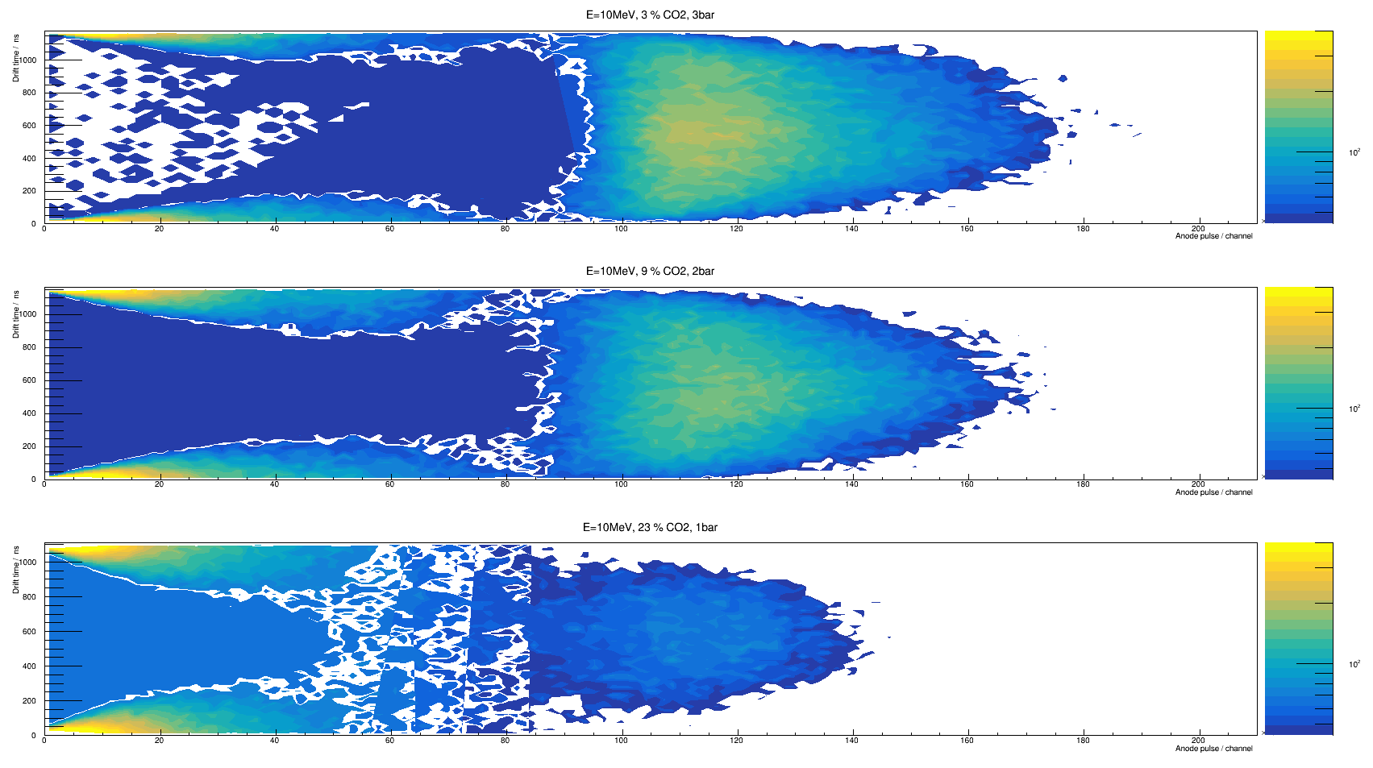
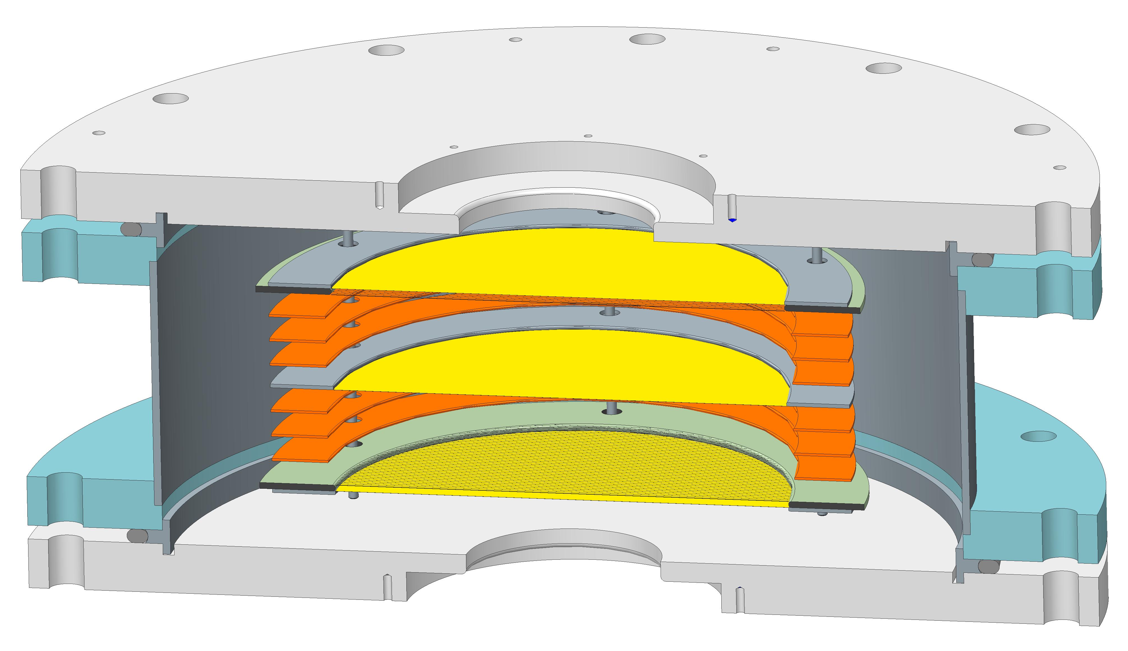
Inverse reactions at n_TOF: ¹⁶O(n,α)
Experimental method:
    Frisch grid ionization chamber
    Q-value of -2.215 MeV g low in-beam material to reach the high-energy region
    Low cross section g precise determination of the ¹⁶O content, maximize number of centers without losing low-energy αs (gaseous sample with CO₂)
courtesy of S.Urlass

Slide 11
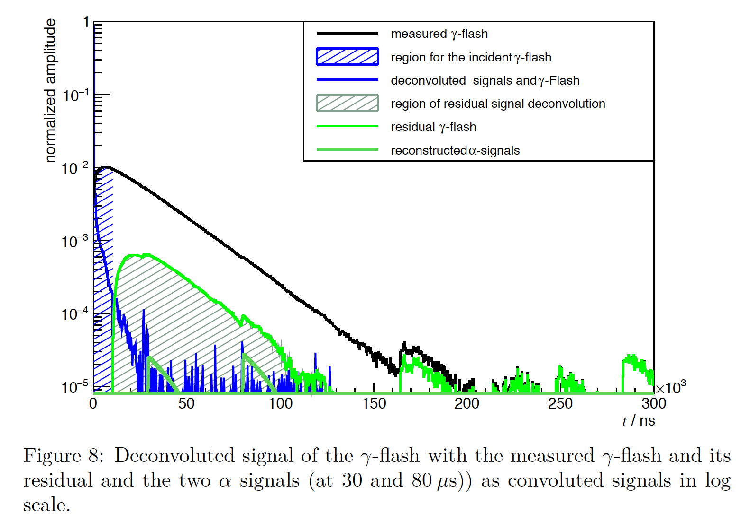
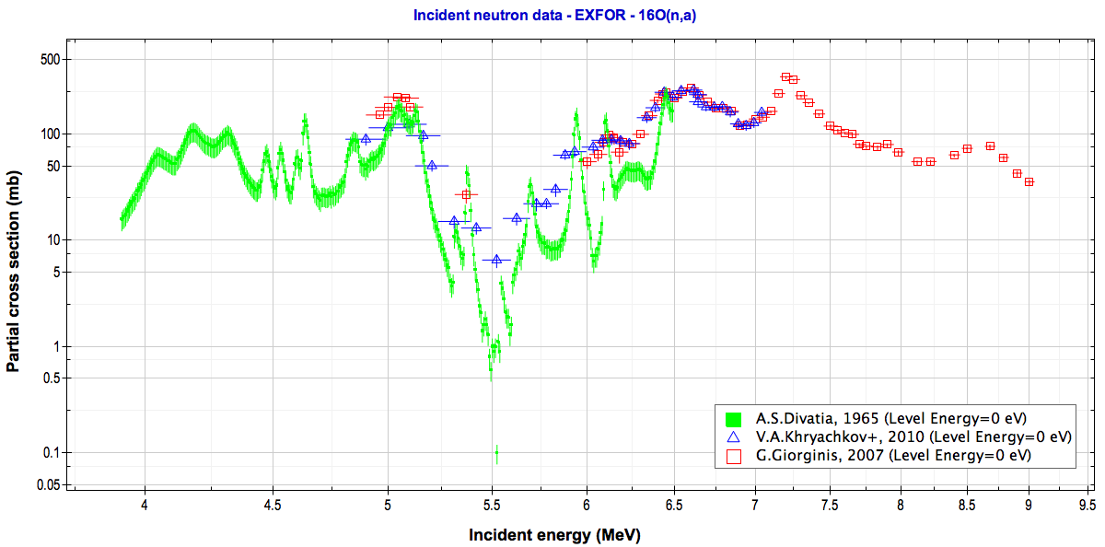
Inverse reactions at n_TOF: ¹⁶O(n,α)
Experimental method:
    Frisch grid ionization chamber
    Q-value of -2.215 MeV g low in-beam material to reach the high-energy region
    Low cross section g precise determination of the ¹⁶O content, maximize number of centers without losing low-energy αs (gaseous sample with CO₂)
Improved cross-section:
    Background subtraction (protons, αs from C) through 2D cuts and dedicated measurements
    Convolution-deconvolution method to treat the γ-flash in the very high energy region
courtesy of S.Urlass

Slide 12
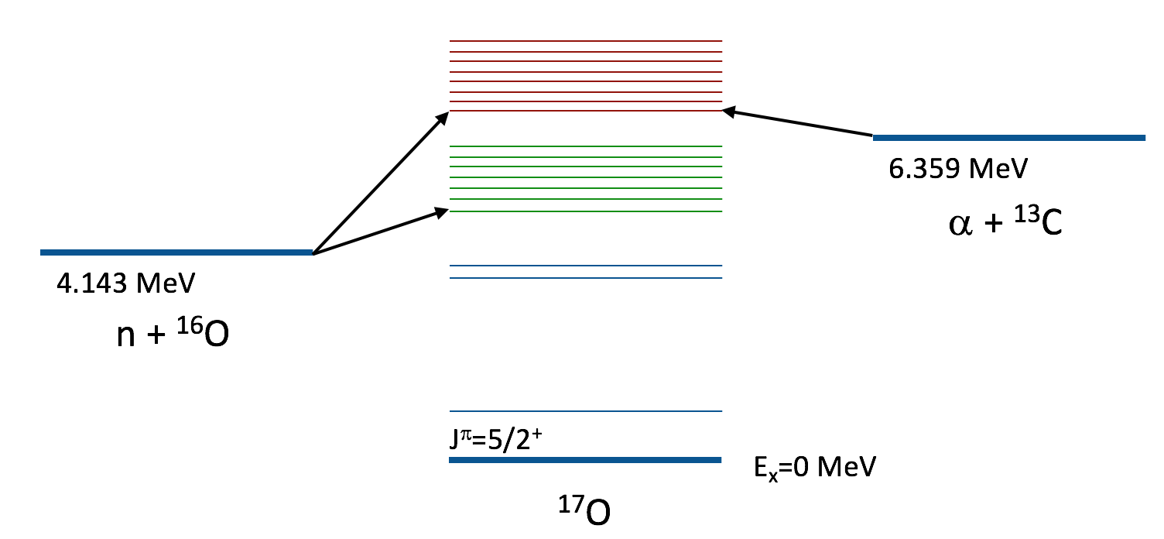
Inverse reactions at n_TOF: ¹⁶O(n,α)
Experimental method:
    Frisch grid ionization chamber
    Q-value of -2.215 MeV g low in-beam material to reach the high-energy region
    Low cross section g precise determination of the ¹⁶O content, maximize number of centers without losing low-energy αs (gaseous sample with CO₂)
Improved cross-section:
    Background subtraction (protons, αs from C) through 2D cuts and dedicated measurements
    Convolution-deconvolution method to treat the γ-flash in the very high energy region
Impact on the ¹³C(α,n)¹⁶O:
    Inverse reaction g the cross section can be calculated by applying the reciprocity theorem
    ¹⁷O levels below the α-threshold can be populated and characterized
    Very high energy resolution (ΔE/E=10⁻⁴ @10 keV) g RSA
Quantity | Literature
Lower neutron energy | 3.916 MeV – from ¹³C(α,n), Divatia 1966 4.898 MeV – from ¹⁶O(n,α), Khryachkov 2010, Giomataris 2007
Resonance parameters | Divatia, 1966 (inverse reaction) – 6 resonances from E_{n}=4.53 to 6.11 MeV Devis, 1963 (direct reaction, monoenergetic neutrons, DE/E=5E-3) – 19 resonances from En=5.05 to 8.66 MeV

Slide 13
Summary and conclusions
There is an interest in investigating the stellar neutron sources also through indirect methods
  Difficulties of direct measurements in the energy range of astrophysical interest
  Complementary information obtainable (e.g. sub-threshold resonances)
At the n_TOF facility at CERN it is possible to perform with very high energy resolution neutron-induced measurements involved in the production/destruction of neutrons in stars
The ²⁵Mg(n,γ) reaction cross-section has been measured, helping to improve the calculation of the ²²Ne(α,n) reaction rates thanks to the improved characterization of ²⁶Mg levels
The last feasibility tests for the ¹⁶O(n,α) reaction cross-section measurement are ongoing. Being the inverse reaction of the ¹³C(α,n) neutron source, it will help in gaining knowledge on the ¹³C(α,n) cross-section and on ¹⁷O levels close to and sub a-threshold
Future perspectives:
  (n,α) reactions on light nuclei
  (n,γ) reactions as neutron poisons

Slide 14
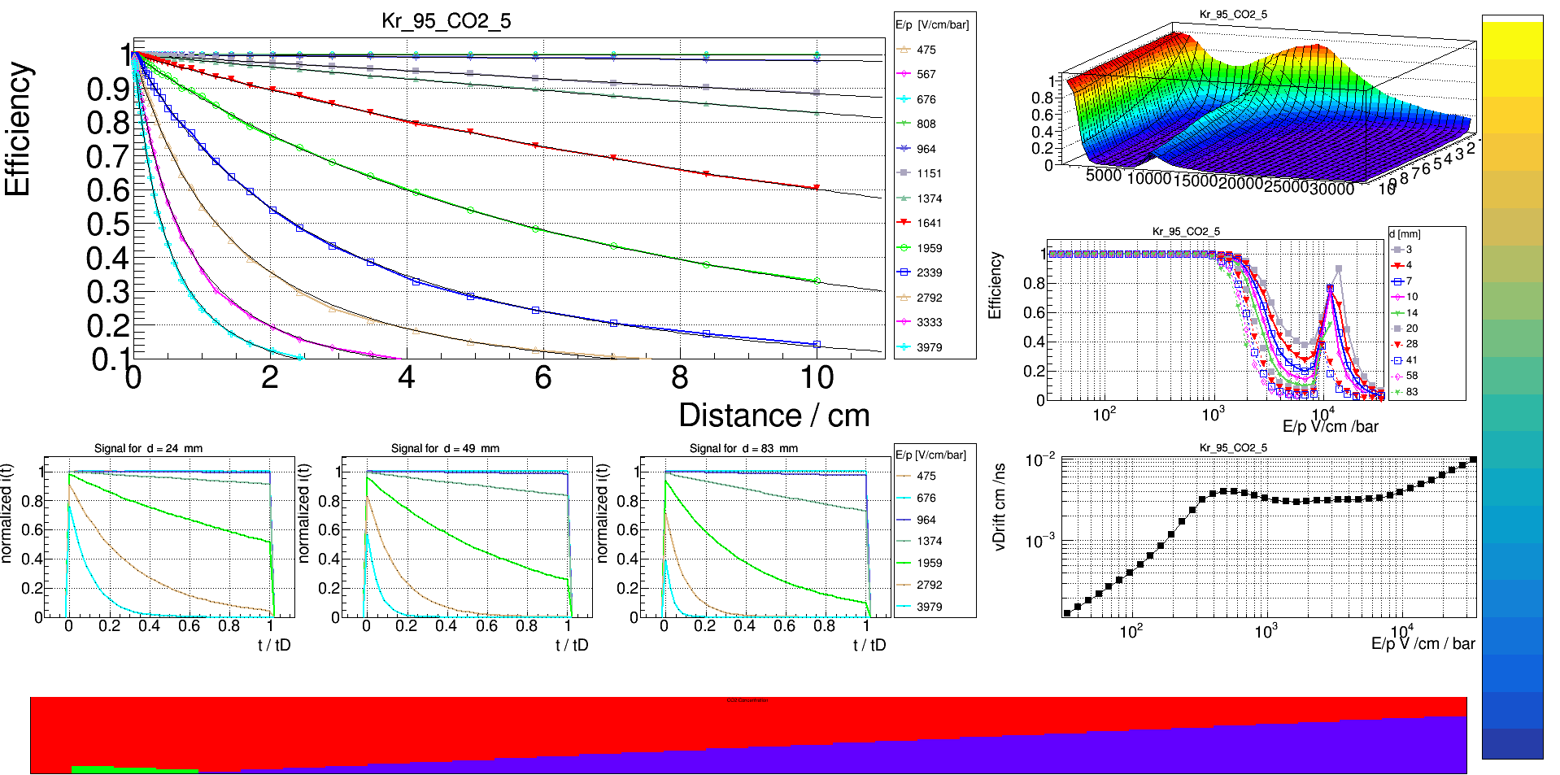
THANK YOU FOR YOUR ATTENTION
federica.mingrone@cern.ch

