Slide 2
DE 111 671 917

Slide 3
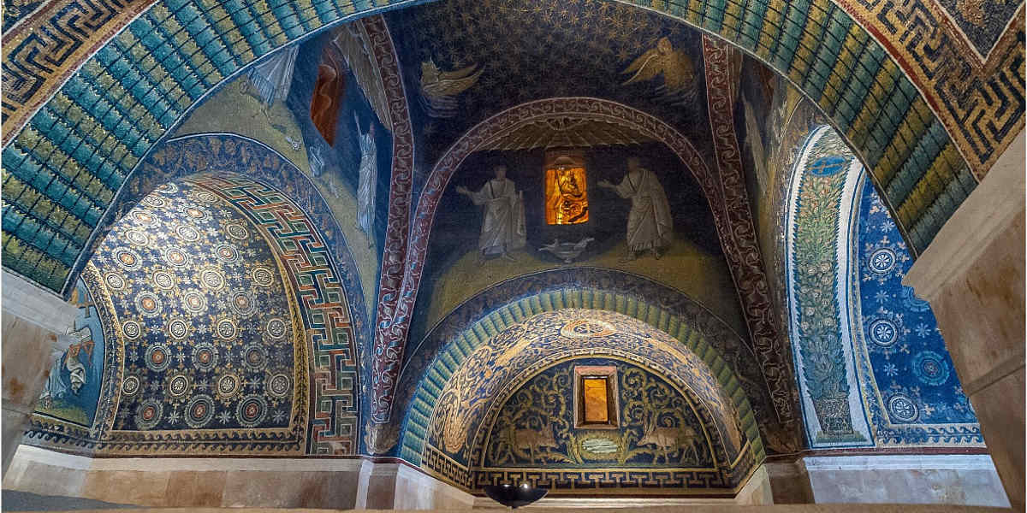
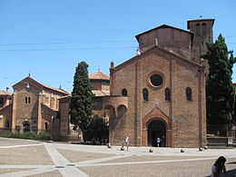
A tight day, we need your help to turn it into a Big Wednesday;
We have to keep the timetable for the plenary session (should end at 12 am). A light lunch will be served in the cloister. Then the parallel sessions must be concluded by 2.30 pm (sharp);
Excursion: There are three buses (you will find on the front window a sign: 1, 2, 3). You can catch the one you prefer
to Ravenna, but you have to catch THE SAME BUS for the return trip. This will allow to count the number of
people onboard and to check if someone is “lost in mission”.
The buses will leave at 2.35 pm in front of the conference venue and will be back at 7.30 pm in the same place.
The dinner will start at 8.30 pm at Palazzo Isolani (Piazza Santo Stefano). Don’t forget your ticket.
You can spend an hour visiting the magnificent S. Stefano church or going back to your Hotel.

