Slide 1
Nuclear structure studies via (collinear) laser spectroscopy at ISOLDE
Gerda Neyens
CERN (Switzerland) and KU Leuven (Belgium)
On behalf of the COLLAPS and CRIS collinear laser spectroscopy and RILIS in-source spectroscopy collaborations at ISOLDE-CERN

Slide 2
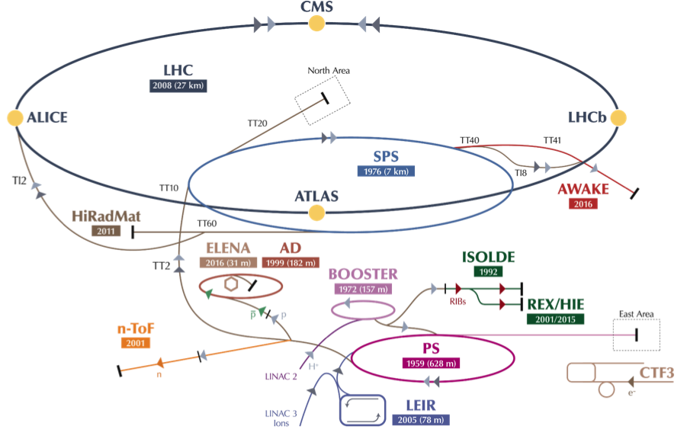
ISOLDE
CERN’s radioactive beam facility
Isotope Separator OnLine DEvice
The first ISOL facility worldwide for production of exotic radioactive nuclei
Oldest CERN experiment (> 50 years !)
Produces re-accelerated Radioactive Ion Beams (RIB’s) since 2001, up to 10 MeV/u
1.4 GeV protons from BOOSTER
(50% go to ISOLDE)

Slide 3
Isotopes produced at ISOLDE
Isotope = Z protons + N neutrons
The nuclear chart
~ 300 stable isotopes
~6000 isotopes predicted by theory
~3000 isotopes already discovered (blue area)
>1300 isotopes produced by ISOLDE
> 75 different elements …
Method of production: 1.4 GeV proton beam from PS booster sent onto a target
N=Z
Number of protons Z
Number of neutrons N

Slide 4
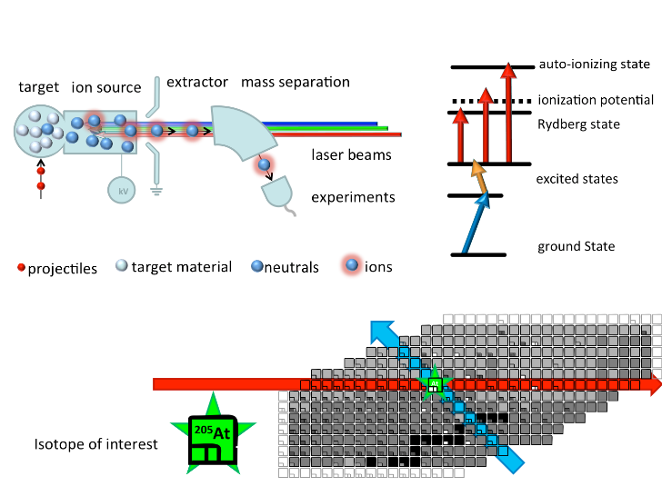

The ISOL method
Target bombarded with some energetic beam (proton, ions, photons…)
Ion source to ionize the exotic atoms (1+)
Mass separator to select species with a particular mass (isobars)
Proton beam
accelerated to
40-60 keV
Mass selection with dipole magnets
A=N+Z
Element selection

Slide 5

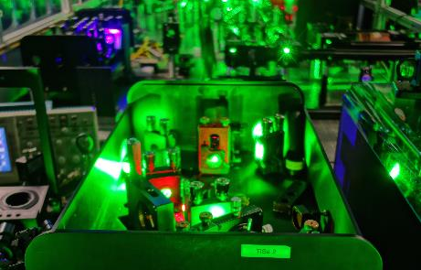
Ionization: RILIS
Resonance Ionization Laser Ion Source (since 1994)
Selective and efficient ionization of one particular element (e.g. Tin)
→ CAN ALSO BE USED FOR SPECTROSCOPY
Proton beam
Isotope Mass selection with dipole magnets
Isotope Element selection with lasers

Slide 6
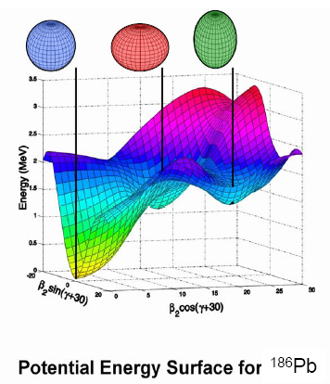
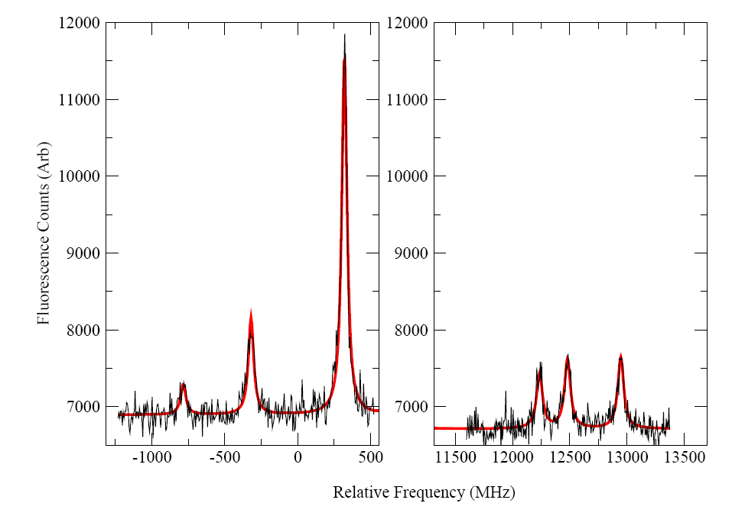

LASER SPECTROSCOPY measure the hyperfine structure (HFS) in a free atom/ion
Fine structure:
electron levels
with spin J
Example: atomic levels and HFS of ⁶⁷Cu
(nuclear g.s. spin I=3/2)
|I-J| < F < |I+J|
Hyperfine structure
F
3
μeV
3²P_{3/2}
2
ΔE ~ B
B = e Q V_{zz}
1
0
extract Q → shape
λ_{L}= 324.8 nm
(3.82 eV)
2
3²S_{1/2}
μB_{J}
= g B_{J}/J
ΔE ~ A
A=
extract g → wave function
IJ
1
Relative distances and peak heights: spin dependent
Need to resolve all HFS levels to measure the spin
Fluorescence photon counts
FWHM=60 MHz
Nuclear Spin I
-1000 -500 0 500 12000 13000
relative frequency (MHz)

Slide 7
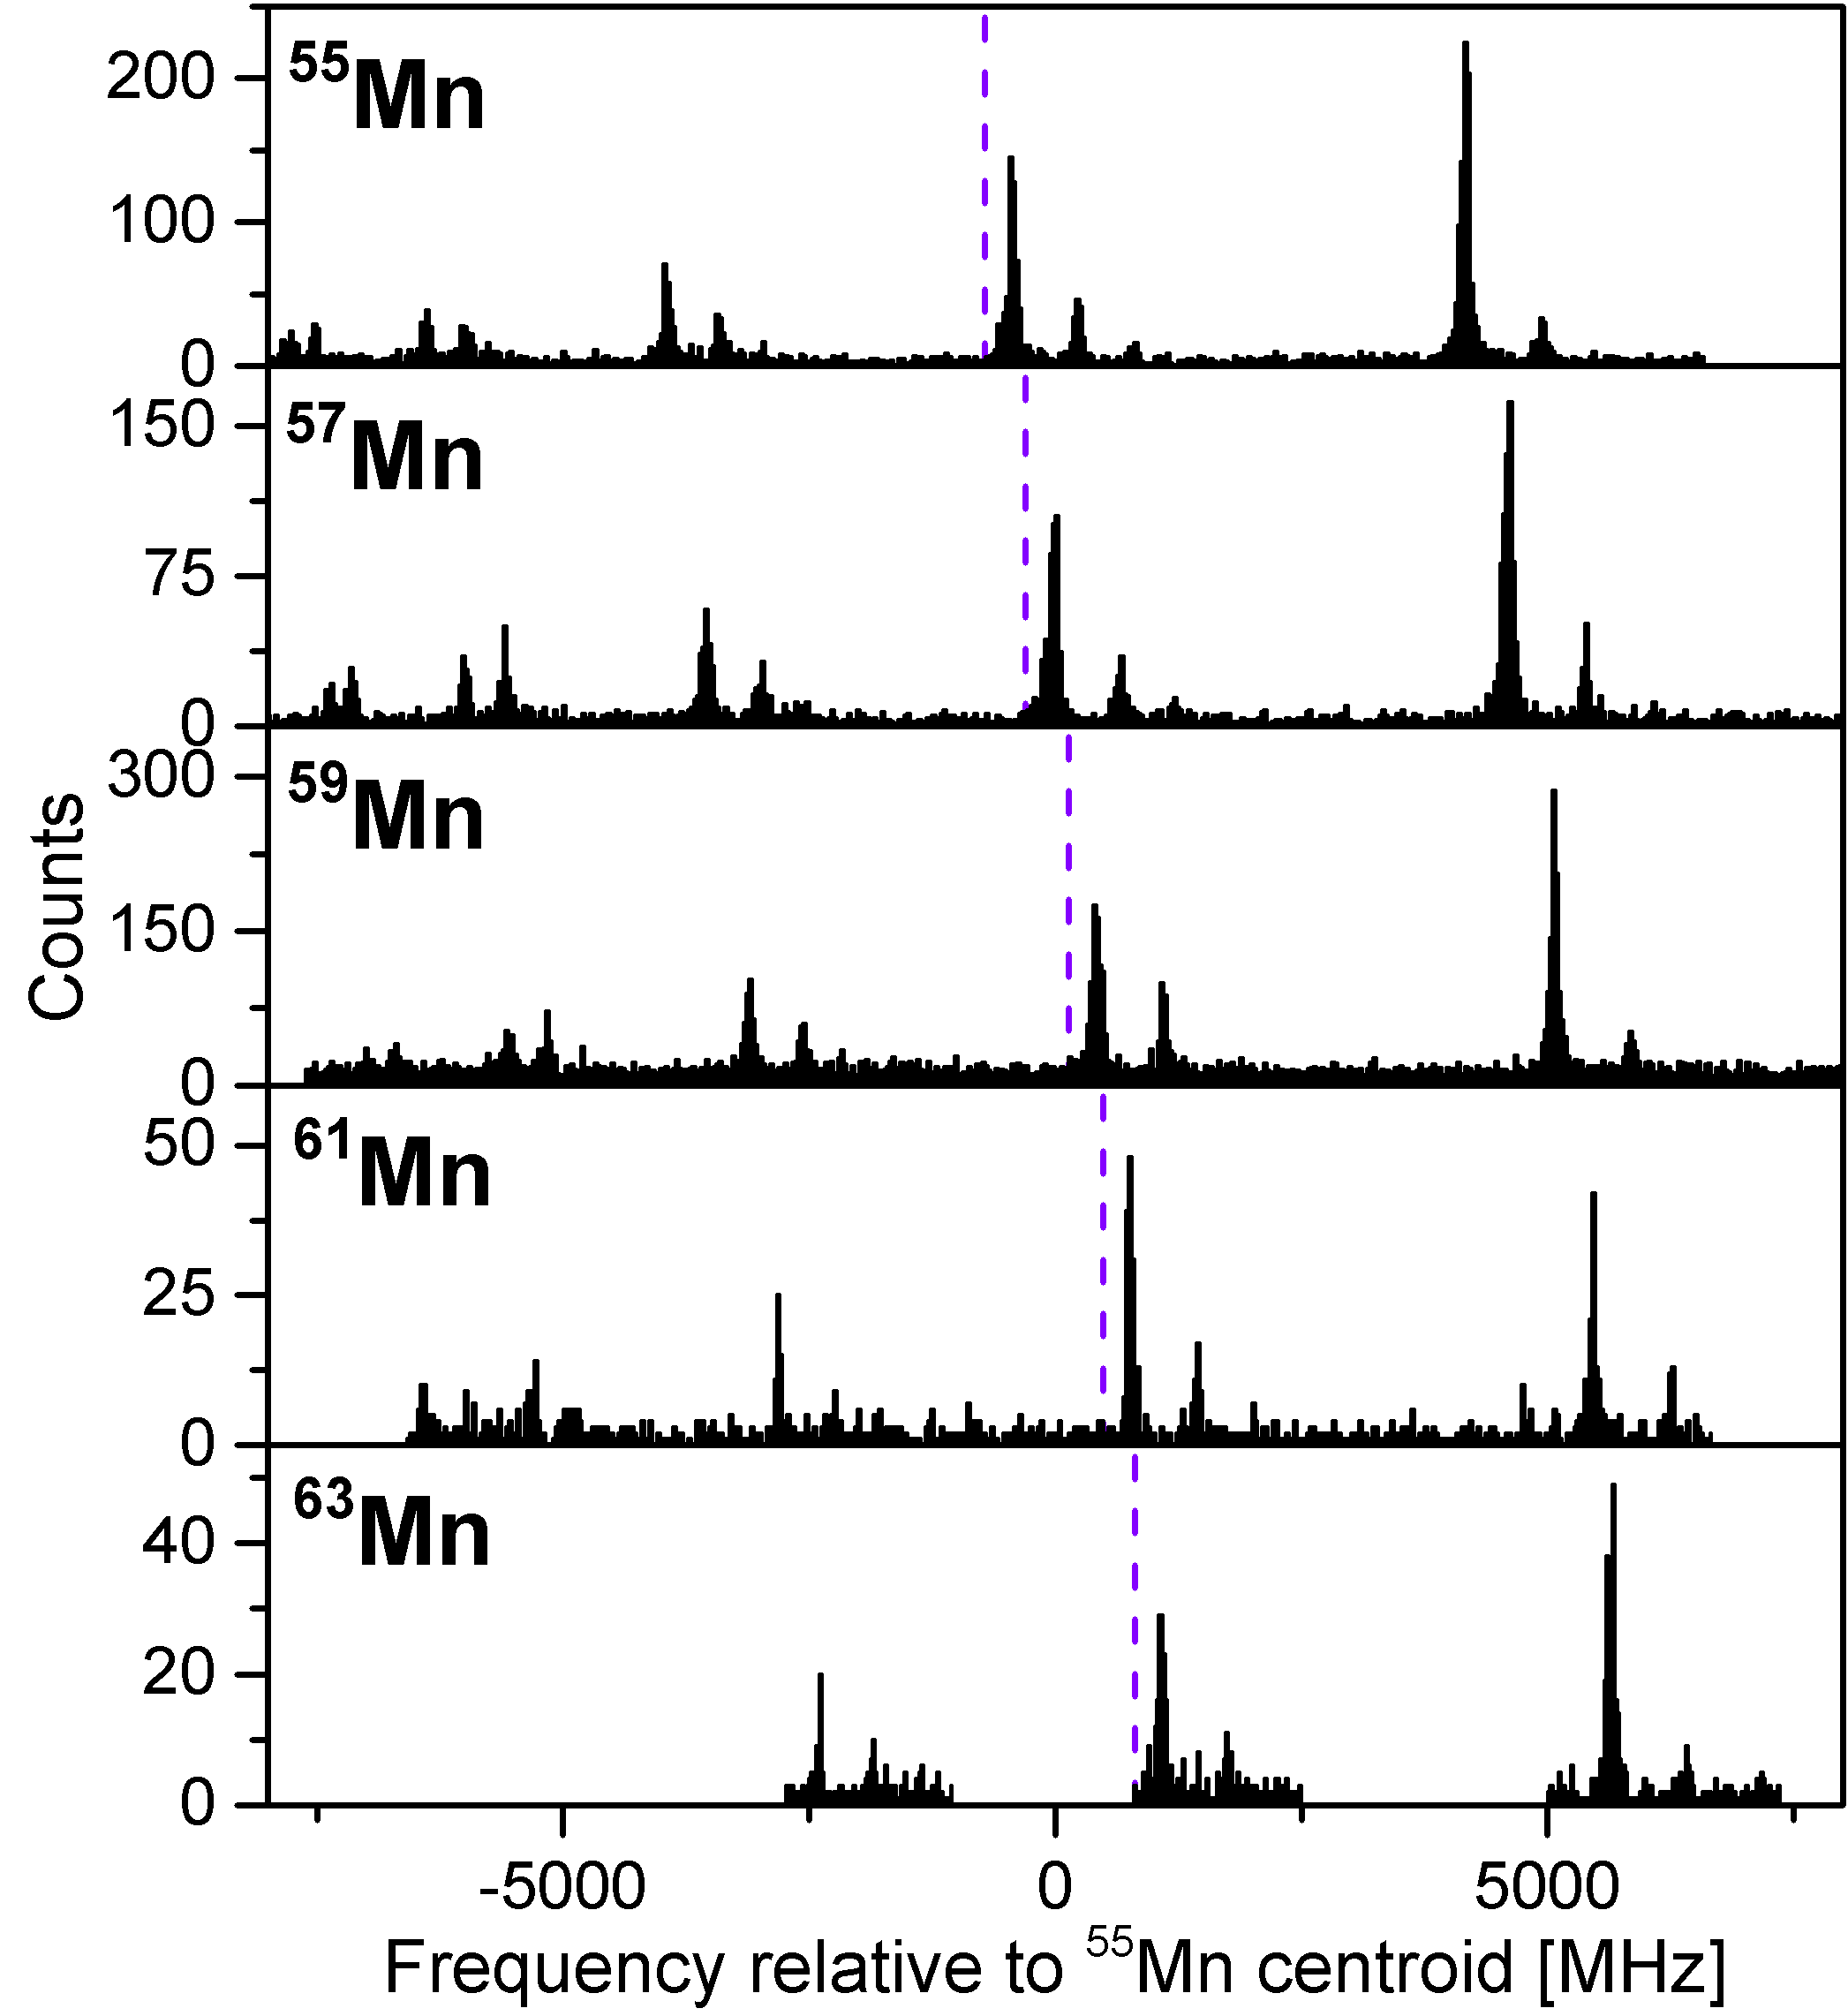
LASER SPECTROSCOPY
measure the hyperfine structure (HFS) in a free atom/ion
Isotope Shift: center of structure changes with neutron number
Charge radii δ⟨r²⟩

Slide 8
Spins, magnetic and electric moments, radii
Resonance Ionization Spectroscopy in RILIS
(used for efficient and selective production of exotic isotopes in the ion source)
- Highest sensitivity (< 1/s)
- Resolution limited due to Doppler broadening:
  in ion source: ~ 4 GHz
Collinear laser spectroscopy
Highest resolution (~ 15 - 60 MHz ~ natural linewidth)
Sensitivity:
  COLLAPS: uses bunched beam and fluorescence detection of photons: ~ 1000 ions/s
  K.T. Flanagan et al., PRL103, 142501 (2009)
  CRIS: uses bunched beam RIS + UHV in the laser-atom interaction: ~ 20 ions/s (so far)
  R.P. de Groote et al., PRL 115, 132501 (2015)

Slide 9
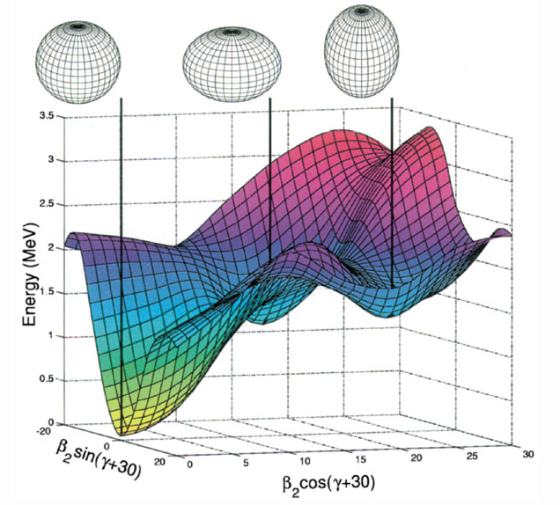
Selected physics examples
Measure fundamental nuclear properties to test state-of-the art nuclear theories
Evolution of single particle shell-model orbits
Shape coexistence
T. Otsuka et al, PRL 95, 232502 (2005)
T. Otsuka et al, PRL 104, 012501 (2010)
Energy of proton and neutron quantum orbits (SPE) depends on the number of protons/neutrons in the isotope !
→ MAGIC NUMBERS CAN CHANGE!
Nuclei can occur with different shapes at low excitation energies, e.g. spherical and deformed
¹⁸⁶Pb
Andreyev et al., Nature 405, 430–433 (2000)

Slide 10

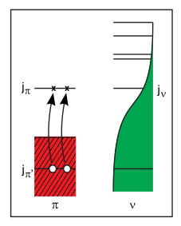
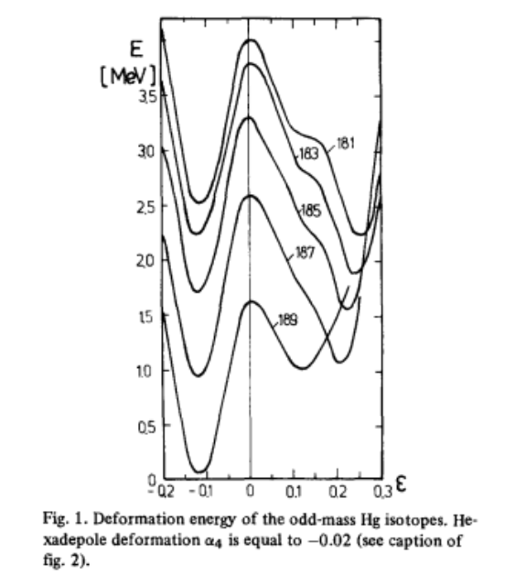
Shape coexistence in the chart of nuclei
Different types of shapes/deformation
at low excitation energy
Interplay between:
Stabilizing effect of closed shells
Residual nucleon-nucleon interaction enhanced mid-shell
K. Heyde and J. L. Wood,
Rev. Mod. Phys. 83, 1467 (2011).
¹⁸⁶Pb
Shell Model picture:
Coexistence of
“normal” and
“intruder” structures
Mean field picture:
Several minima
in energy surface
vs deformation

Slide 11
Shape coexistence in the chart of nuclei
K. Heyde and J. L. Wood,
Rev. Mod. Phys. 83, 1467 (2011).
Laser spectroscopy : an ideal tool to establish shape coexistence:
μ probes wave function (intruder?)
charge radius and Q probes deformation
No yet established along N=50

Slide 12
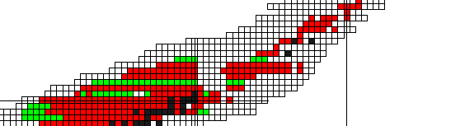
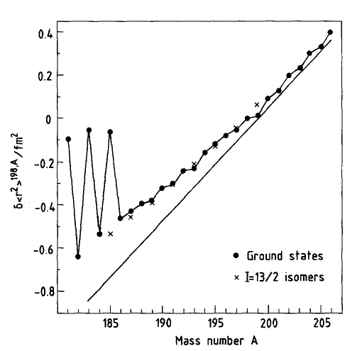
Shape coexistence in Hg isotopes
Hg: Z=80
Z=82
G. Ulm et al., Zeitschrift fur Physik A At. Nucl. 325, 247–259 (1986).
N=126
One of the first ISOLDE highlights
(discoverd early 80’s)
Unexpected staggering in the
Charge radii of neutron-deficient Hg
Δr = 0.7 fm !
Remained unexplained for many year!
More neutron-deficient: what happens ??
N=104
N=126

Slide 13
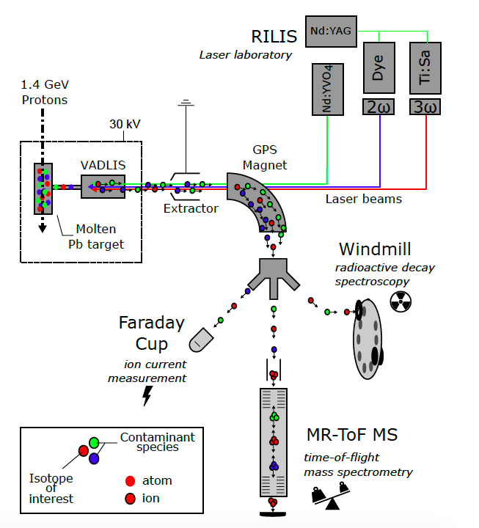
Experiment ISOLDE 2015
In-source resonance laser-ionization spectroscopy
(RILIS)
on 15 different mercury isotopes at ISOLDE, CERN
Combining detection in 3 different experimental stations

Slide 14
Hg mean square charge radii
B. Marsch, S. Sels, et al.
Nature Physics,
September 2018,
accepted
- Agreement with previously measured values
- End point of shape staggering observed
- Large Scale MCSM calculations for first time in this heavy mass region !
→ origin of the staggering is understood !

Slide 15
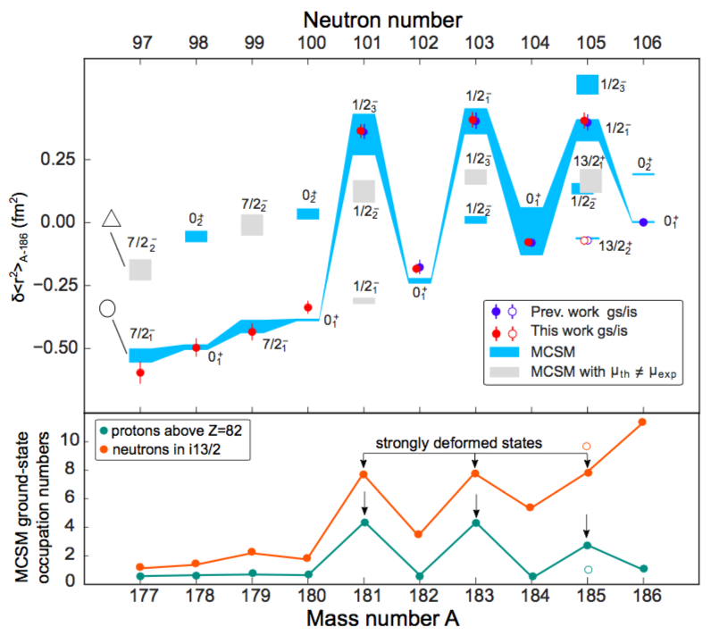
Hg mean square charge radii
Calc - MCSM: T. Otsuka, Y. Tsunoda et al.
B. Marsch, S. Sels, et al.
Nature Physics,
September 2018,
accepted

Slide 16
Shape coexistence (?) and intruder states along N=49
νs_{1/2}
νd_{5/2}
Long-lived (1/2+) isomers
N=50
νp_{1/2}⁻¹
νg_{9/2}⁻¹
Intruder states known in N = 49 isotones for more than 3 decades
K. Heyde et al., Physics Reports 102, 291 (1983)
Experimental evidence for shape coexistence is still missing!!

Slide 17
HFS of ⁷⁹Zn

Slide 18
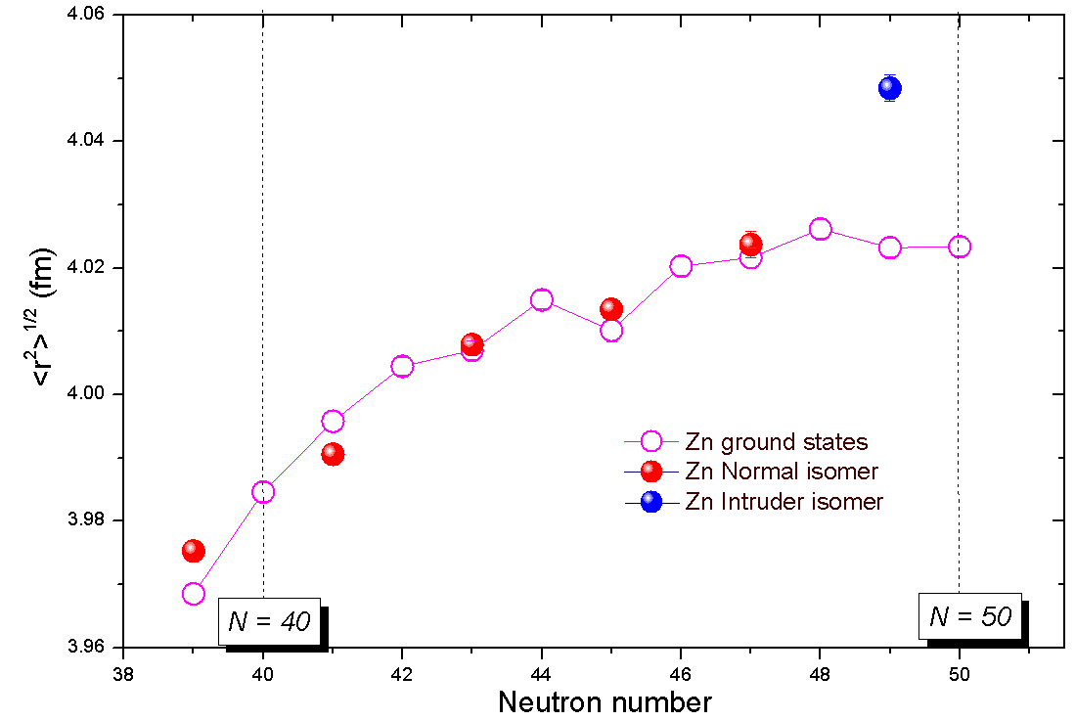
Shape coexistence in ⁷⁹Zn from magnetic moment and isomer shift
X.F. Yang et al., PRL 116, 182502 (2016)
Magnetic moment
→ evidence that the odd neutron is in the νs_{1/2} (intruder orbit)
Charge radii of Zn isotopes: significant increase in isomeric charge radius (~ 0.3 fm) wrt g.s.
Shape coexistence ?
Or due to neutrons excited into s_{1/2} ?
As explained in
Bonnard, Lenzi, Zucker,
PRL 116, 212501 (2016)

Slide 19
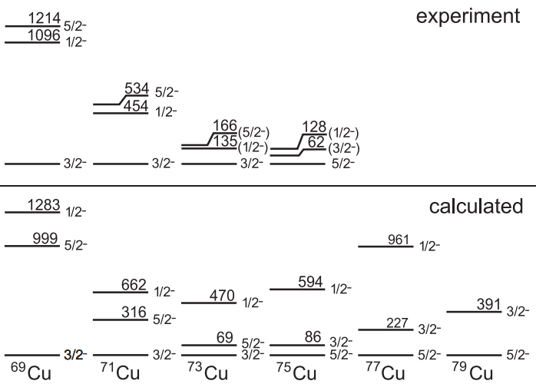
Evolution of proton orbits near Z=28
T. Otsuka et al, PRL 95, 232502 (2005)
Z=28
Cu (Z=29)
Ground states: the proton occupies the first quantum orbit above Z=28
Neutrons in νg9/2
Importance of model-independent
spin measurements → collinear laser spectroscopy
2001
2009
2017
5/2-
⁷⁷Cu

Slide 20
Inversion of the πf_{5/2} and πp_{3/2} levels in Cu
K.T. Flanagan et al., PRL 103, 142501 (2009)
^{71,73,75}Cu HFS
Model-independent spin determination:
5/2
⁷⁵Cu
RILIS
From magnetic moments:
→ Wave function dominated by proton in f5/2 orbit
⁷⁵Cu (N=46)
COLLAPS
R.P. de Groote et al., PRC96, 041302(R) (2017)
73,75,77Cu
CRIS

Slide 21
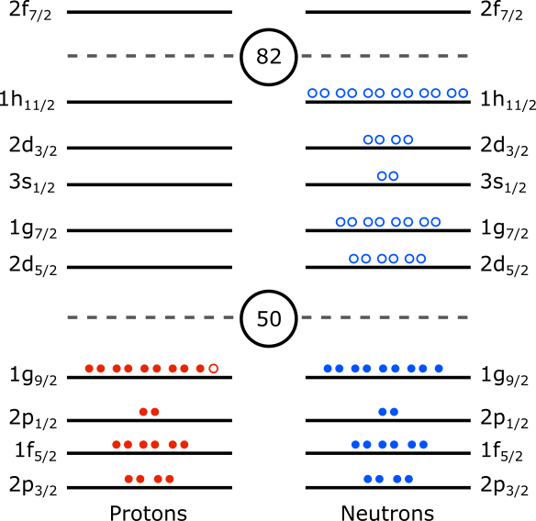
Evolution of neutron orbits along N=51 as between Z=40 and Z=50
T. Otsuka et al, PRL 104, 012501 (2010)
Neutron level ordering is changing as proton g9/2 is filled
Neutron orbits
Proton orbits
Sr Cd In Sn

Slide 22
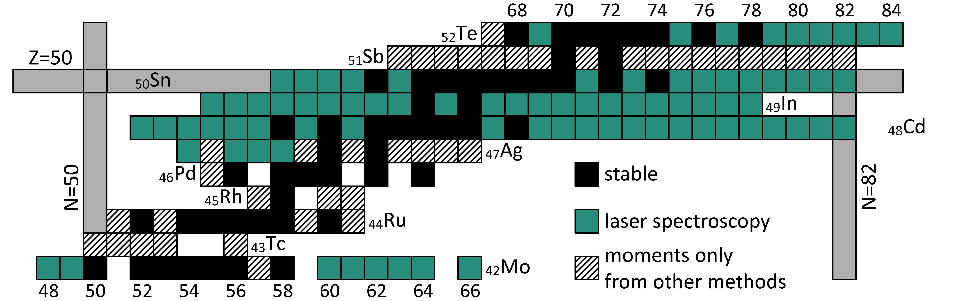
Spins, magnetic and quadrupole moments near Z=50
Recent ISOLDE experiments
CRIS
COLLAPS
₄₉In
Open physics questions:
Ordering of neutron single particle levels (Sn and Cd odd-N g.s. spins)
Onset of collectivity/deformation from N=50 to N=82 (quadrupole moments and charge radii)
How magic are 100,132Sn (magnetic moments and quadrupole moments)
Proton-neutron correlations
D.T. Yordanov and M.L. Bissell

Slide 23
Cd isotopes from N=52 to N=82
Probing neutron configurations and proton-neutron correlations
Cd: Z=48
even Cd isotopes: have spin I=0 (no moments, only charge radii)
odd Cd moments: spin and moments dominated by the odd neutron orbit
¹⁰⁰Cd to ¹³⁰Cd (from N=52 to N=82)
High-j h_{11/2} and low-j d_{3/2} and s_{1/2}
close in energy
→ spin isomers in n-rich Cd !

Slide 24
Spin assignments to low and high-spin states
119Cd
3 peaks in HFS ➔ g.s spin I=1/2 !
(Evaluated data tables gave wrongly I=3/2, based
Nuclear Data Sheets 110 (2009) 2945–3105)
6 peaks in HFS ➔ long-lived I=11/2 isomer
D.T. Yordanov et al., PRL 110, 192501 (2013)

Slide 25
Spin assignments to low and high-spin states
119Cd
3 peaks in HFS ➔ g.s spin I=1/2 !
(Evaluated data table give wrongly I=3/2 in
Nuclear Data Sheets 110 (2009) 2945–3105)
6 peaks in HFS ➔ long-lived (known) I=11/2 isomer
127Cd
6 peaks (bleu) ➔ spin I=3/2
6 peaks (grey) ➔ 11/2 spin confirmed !
129Cd
6 peaks (blue)➔ spin I=3/2
6 peaks (grey) ➔ 11/2 spin confirmed!
D.T. Yordanov et al., PRL 110, 192501 (2013)

Slide 26
Q-moments of the 11/2- states in odd-Cd
(h_{11/2} neutron holes)
D.T. Yordanov et al., PRL 110, 192501 (2013)
Linear behavior due to seniority ν=1
  (filling of the h11/2 orbital)
But in a much broader range than predicted by simple shell model!
For 1 unpaired neutron in the νh_{11/2} (ν=1) there are 6 isotopes of Cd following this linear trend.
Conclusion: n is not an integer, but rather the occupation probability of the odd (unpaired) neutron in the h11/2 orbital:
With this assumption, we find indeed n=1 in ¹¹¹Cd and n=11 in ¹²⁹Cd.

Slide 27
Spins and moments of 101-109Cd (no isomers)
All isotopes have spin I=5/2 !
→ Odd neutron in the νd5/2 orbital from N=53 to N=63 (isomer in 111Cd)
μ_{eff}(d5/2) = -1.15
μ_{Schmidt}(d5/2) = -1.91
Smaller experimental values wrt s.p. value point to mixing with neutrons in other orbits, coupled to proton 2⁺ pairs
N
Confirmed by LSSM Calculations with 88Sr core
D.T. Yordanov et al., PRC 98, 01303(R) (2018)
Z

Slide 28
CONCLUSIONS
Nuclear spins, moments and charge radii are complementary probes to study nuclear structure far from stability
Magnetic moments are sensitive to the nuclear wave function
Quadrupole moments are sensitive to core polarization and static deformation
Charge radii are sensitive to correlations and deformation
OUTLOOK:
More than 60 states investigated from 101In to 131In
(isomeric states in all isotopes !)
More than 20 states investigated from 103Sn up to 133Sn
(isomeric states in odd-even)

Slide 29
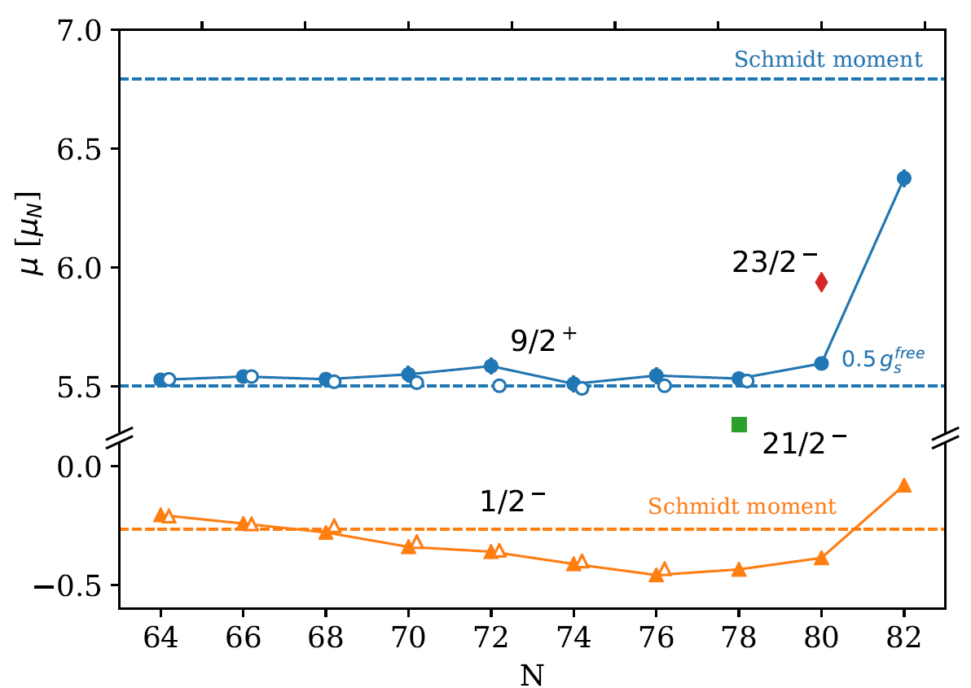
Indium isotopes from N=52 to N=82
Z=49 odd proton !
Odd-In ➔ proton hole wrt Z=50
- ground state: hole in πg_{9/2}: I = 9/2+
- long-lived isomeric state: hole in πp_{1/2}: I=1/2-
  CONFIRMED from their measured spin and magnetic moment
premiminary

Slide 30
Quadrupole moments: core polarisation
→ Quadrupole moment increases as neutrons are removed from the N=82 shell
Preliminary
Q(πg_{9/2}⁻¹)
→ Deformation stabilises around N=72
deformation
Data from N=64 to N=52 under analysis !
Decrease again towards N=50 ??

Slide 31
Spins and magnetic moments of 111-129Cd g.s and isomers
N=63
N=81
magnetic moments
Cd mass number
I=11/2 isomeric state from ¹¹¹⁻¹²⁹Cd (N=81), νh11/2
2d_{3/2}
I=3/2 g.s. from ¹²¹Cd up to ¹²⁹Cd dominated by νd3/2
I=1/2 g.s. from ¹¹¹Cd to ¹¹⁹Cd: mixed configurations
D.T. Yordanov et al., PRL 110, 192501 (2013)

Slide 32
Q-moments of the 11/2- states in odd-Cd
(h_{11/2} neutron holes)
D.T. Yordanov et al., PRL 110, 192501 (2013)
Linear behavior due to seniority ν=1
  (filling of the h11/2 orbital)
But in a much broader range than predicted by simple shell model!
For 1 unpaired neutron in the νh_{11/2} (ν=1) there are 6 isotopes of Cd following this linear trend.
Conclusion: n is not an integer, but rather the occupation probability of the odd (unpaired) neutron in the h11/2 orbital:
With this assumption, we find indeed n=1 in ¹¹¹Cd and n=11 in ¹²⁹Cd.

Slide 33
Long-lived states in the odd-odd Indium isotopes
In each isotope at least 3 long-lived states can be studied !
Note: some spins are in brackets !
N=63
N=69
N=81

Slide 34
g-factors: assign single particle configurations
1+
3+
5+
8-
Full symbols: this work
new data
Open symbols: literature
New data:
Confirmed all tentative spin assignments
  from N=69 (¹²⁰In) up to N=79 (¹²⁸In)
¹³⁰In: preliminary - to be investigated !

Slide 35
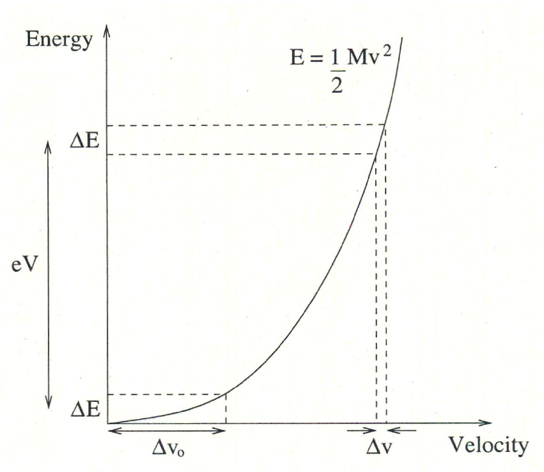
Collinear laser spectroscopy at ISOLDE
Review: J. Phys. G 44, 064002 (2017)
ion beam from ISOL-target: energy spread due to temperature
Doppler broadening of the HFS lines == GHz !
BUT: uncertainty on energy remains constant during acceleration
error on beam velocity decreases with increasing beam velocity:
δE=const=δ(¹/₂mv²)≈mvδv
Using an ion cooler (e.g. at Jyvaskyla)
Nieminen et al., PRL 88, 094801 (2002)
➔ energy uncertainty = few eV
Narrow Doppler line width
  ~ 30 MHz can be achieved
  with beam of 60 keV (+/- 2 eV)
Collinear == high resolution: 20-60 MHz
  can resolve all hyperfine peaks to extract I, μ, Q, δ<r²>

Slide 36

Collinear laser spectroscopy at ISOLDE
Review: J. Phys. G 44, 064002 (2017)
CRIS (since 2012)
COLLAPS (since 1978)
detect a resonantly excited ion
continuum
atomic excited state
Hyperfine splitting (100 MHz)
λ₂
laser photon (eV – 10⁸ MHz)
second step laser photon
detect fluorescence photons
excited state
Hyperfine splitting
atomic ground state
laser photon
λ₁
low background with bunched beams (few/s) since 2008
need few 1.000’s ions/s from ISOLDE
Atomic ground state
ultra-low background ( 1 event /10 min)
need few 10’s ions/s from ISOLDE
Collinear == high resolution: 20-60 MHz
  can resolve all hyperfine peaks to extract I, μ, Q, δ<r²>
B. Cheal et al., PRL 104, 252502 (2010)
P. Vingerhoets et al., PRC 82, 064311 (2010)
K.T. Flanagan et al., PRL 111, 212501 (2013)
R.P. de Groote et al., PRL115, 132501 (2015)

Slide 37
Inversion of the πf_{5/2} and πp_{3/2} levels in Cu
K.T. Flanagan et al., PRL 103, 142501 (2009)
^{71,73,75}Cu HFS
Model-independent spin determinations
Constrains nuclear theories
⁷⁵Cu
RILIS
COLLAPS
CRIS
⁷⁵Cu (N=46)
COLLAPS
R.P. de Groote et al., PRC96, 041302(R) (2017)
73,75,77Cu
I=3/2
I=5/2
CRIS
Ratio hyperfine parameters A_{u}/A_{l} = constant.
Ratio varies with spin used to fit spectra.

Slide 38
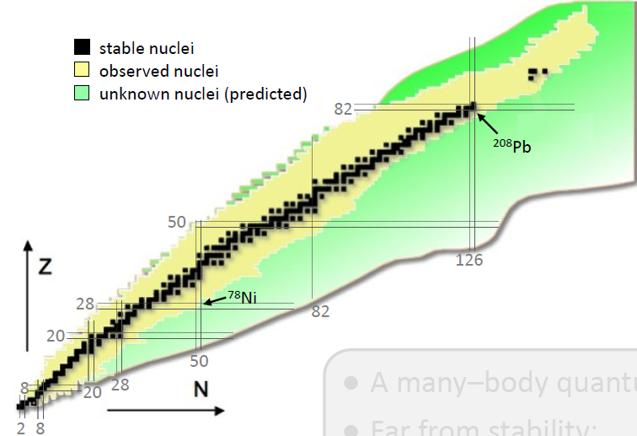
Collinear laser spectroscopy at ISOLDE
Review: J. Phys. G 44, 064002 (2017)
Main focus: regions along/near closed shells (magic numbers)
Fr, Ra
Shape coexistence
Octupole deformation
Fundamental symmetries
Cd, In, Sn, Sb
(Z=48, 49,50,51)
Shell evolution from
N=50 to beyond N=82
Ni, Cu, Zn, Ga, Ge (Z=28-32)
Shell structure around
Z=28 reaching ⁷⁸Ni
around Z=20 beyond N=32
Mn (Z=25)
K, Ca, Sc (Z=19, 20, 21)
40

Slide 39
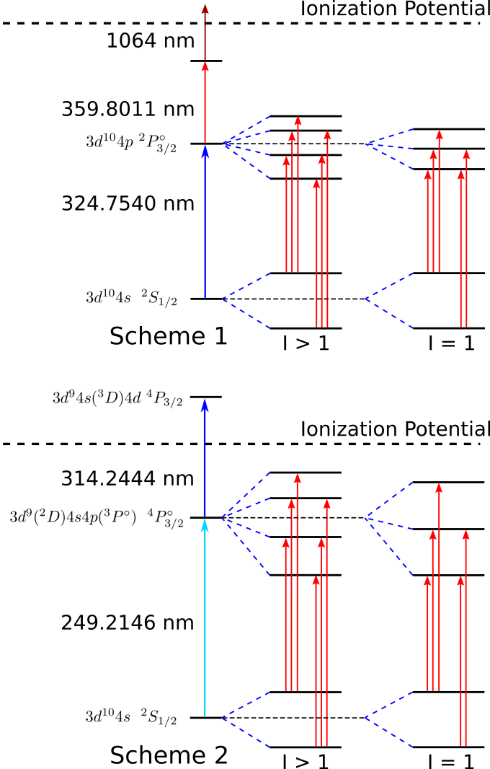
Collinear laser spectroscopy at ISOLDE
Review: J. Phys. G 44, 064002 (2017)
Photon detection
Ion detection
⁷²Cu
Collinear == high resolution: 20-60 MHz
  can resolve all hyperfine peaks to extract I, μ, Q, δ<r²>
B. Cheal et al., PRL 104, 252502 (2010)
P. Vingerhoets et al., PRC 82, 064311 (2010)
K.T. Flanagan et al., PRL 111, 212501 (2013)
R.P. de Groote et al., PRL115, 132501 (2015)

