Slide 1
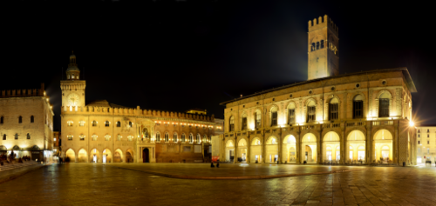
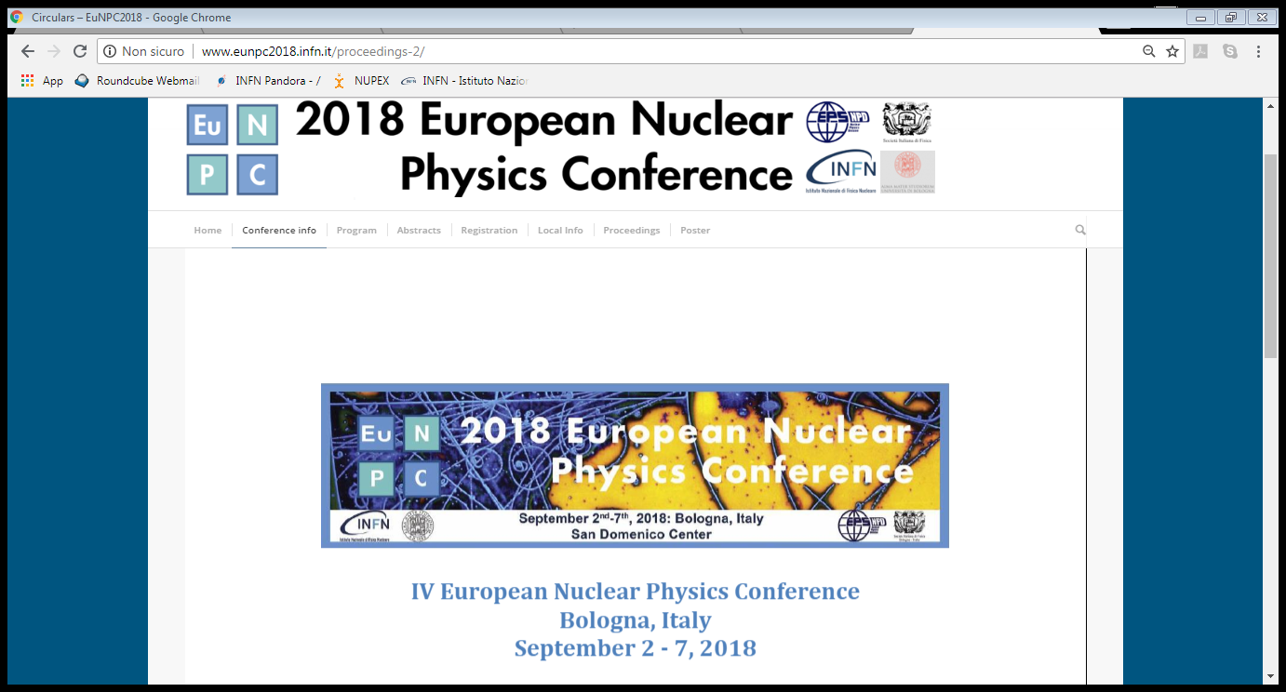
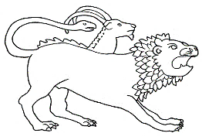
On the nature of the Pygmy Dipole Resonance in ⁶⁸Ni
N.S. Martorana ¹
Università degli Studi di Catania and INFN-LNS, Catania, Italy
martorana@lns.infn.it
On behalf of
CHIMERA-NEWCHIM Collaboration

Slide 2
Outline
EuNPC, Bologna, 2-7 September 2018
Motivation
Experiment
Data analysis
Results
Outlook
Conclusion

Slide 3
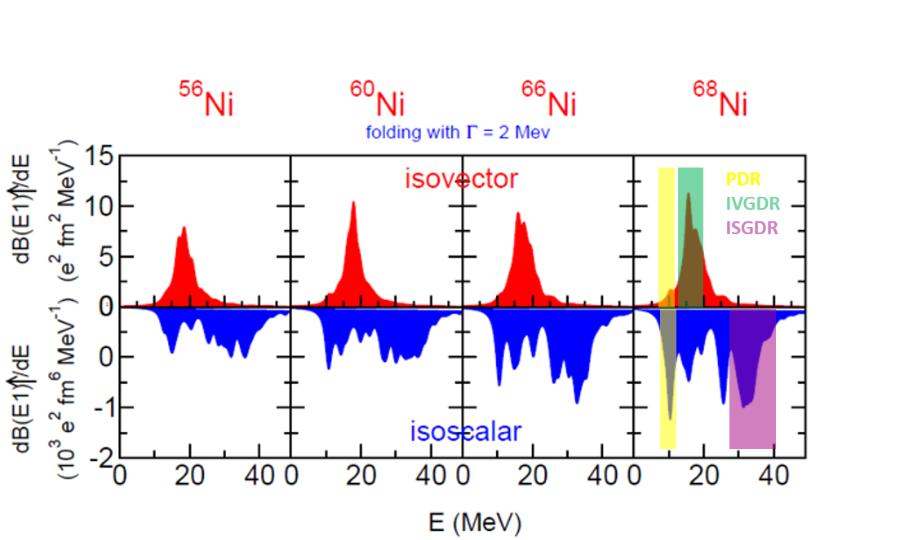
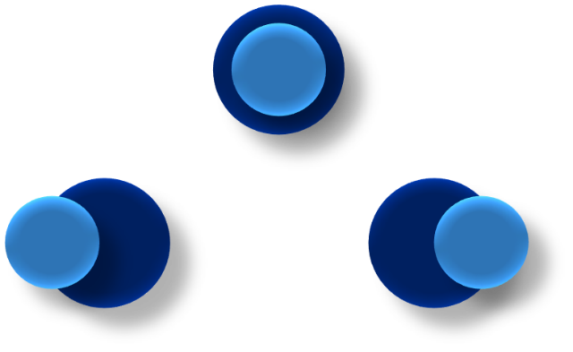
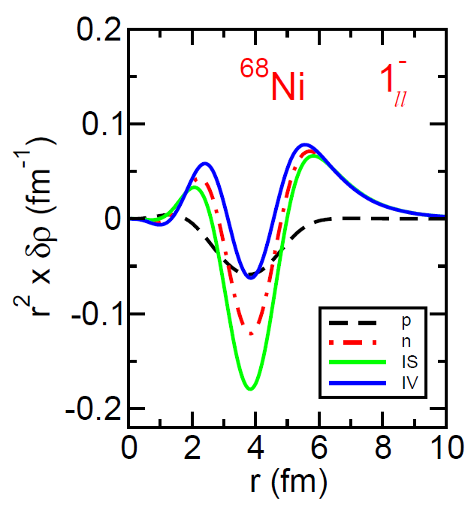
EuNPC, Bologna, 2-7 September 2018
As soon as the number of the neutrons increases a small bump becomes evident in both isoscalar and isovector response
Neutrons and protons transition densities are in phase inside the nucleus, and at the surface only the neutron part survives→ theoretical definition of the Pygmy Dipole Resonance (PDR)
At the interior the isoscalar part is much more pronounced than the isovector one, at the surface both have almost the same strength:
Isovector probe
PDR induced by virtual photon scattering or real photon scattering (D. Savran et al., Phys. Rev. Lett. 100, 232501 (2008))
Isoscalar probe
PDR induced by nuclear interaction between projectile and target (J. Endres et al., Phys. Rev. C 80, 034302 (2009))

Slide 4
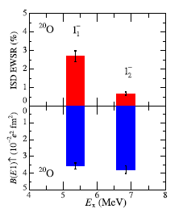
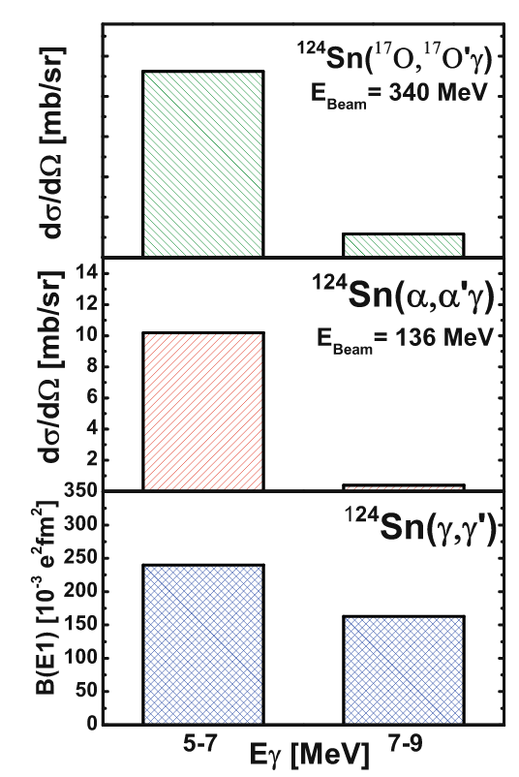
EuNPC, Bologna, 2-7 September 2018
Experiments performed on stable nuclei below the neutron emission threshold reveal a property known as isospin splitting
Measured EWSR (top) and B(E1) ↑(bottom) strength in ²⁰O
L. Pellegri et al., Phys. Lett. B 738, 519 (2014)
J. Endres et al., Phys. Rev. C 85, (2012) 064331
K. Govaert et al., Phys. Rev. C 57, 2229 (1998)
A. Bracco et al., Eur. Phys. J A 51 (2015)
N. Nakatsuka et al., Phys. Lett. B 768 (2017) 387–392

Slide 5
EuNPC, Bologna, 2-7 September 2018
Experiments performed on stable nuclei below the neutron emission threshold reveal a property known as isospin splitting
Measured EWSR (top) and B(E1) ↑(bottom) strength in ²⁰O
L. Pellegri et al., Phys. Lett. B 738, 519 (2014)
J. Endres et al., Phys. Rev. C 85, (2012) 064331
K. Govaert et al., Phys. Rev. C 57, 2229 (1998)
A. Bracco et al., Eur. Phys. J A 51 (2015)
N. Nakatsuka et al., Phys. Lett. B 768 (2017) 387–392
Only the low energy region of the PDR is populated by both isoscalar and isovector probes

Slide 6
EuNPC, Bologna, 2-7 September 2018
Experiments performed on stable nuclei below the neutron emission threshold reveal a property known as isospin splitting
Measured EWSR (top) and B(E1) ↑(bottom) strength in ²⁰O
L. Pellegri et al., Phys. Lett. B 738, 519 (2014)
J. Endres et al., Phys. Rev. C 85, (2012) 064331
K. Govaert et al., Phys. Rev. C 57, 2229 (1998)
A. Bracco et al., Eur. Phys. J A 51 (2015)
N. Nakatsuka et al., Phys. Lett. B 768 (2017) 387–392
Only the low energy region of the PDR is populated by both isoscalar and isovector probes
The higher part is excited mainly via electromagnetic interaction

Slide 7
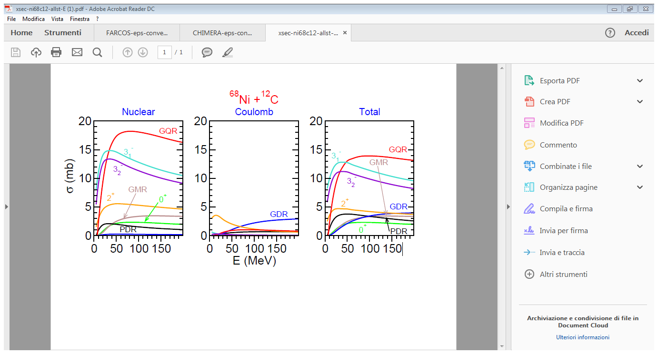
EuNPC, Bologna, 2-7 September 2018
It is interesting to investigate the PDR in the region above the neutron emission threshold and for unstable nuclei
⁶⁸Ni + Au → O. Wieland et al., Phys. Rev. Lett. 102, 092502 (2009)
⁶⁸Ni + Pb → D. M. Rossi et al., Phys. Rev. Lett. 111 242503 (2013)
⁶⁸Ni + ¹²C ( 75 µm) @ 28A MeV → N.S. Martorana et al., Phys. Lett. B 782 (2018)
Semi classical calculations show that at 28A MeV:
Most of the total inelastic PDR cross section ≈ 60 % is due to the pure nuclear interaction
Coulomb contribution amounts at 9 %
≈ 30 % is given by the interference between nuclear and Coulomb contributions
E (MeV A) Nuclear (mb) Coulomb (mb) Total (mb)
28 2.05 0.30 3.41
E.G. Lanza et al., Phys. Rev. C 79 (2009) 054615
E.G. Lanza et al., Phys. Rev. C 84 (2011) 064602
E.G. Lanza et al., Phys. Rev. C 91 (2015) 54606

Slide 8
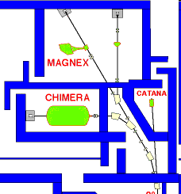
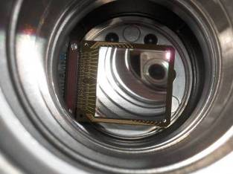
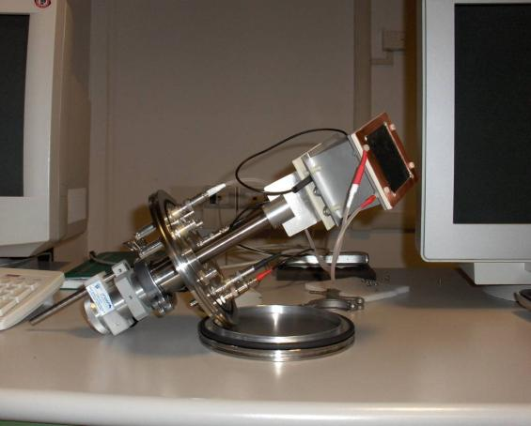
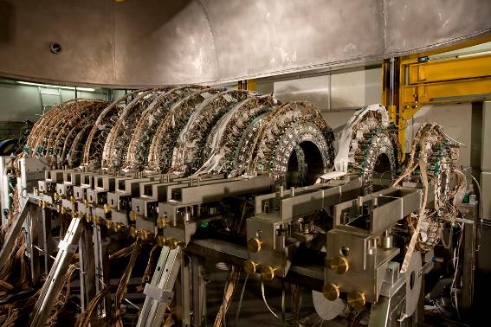
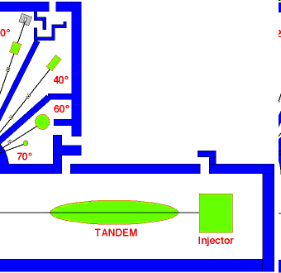
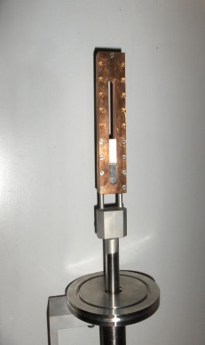
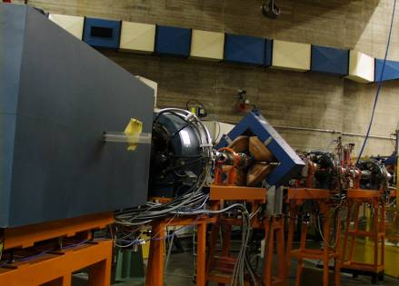
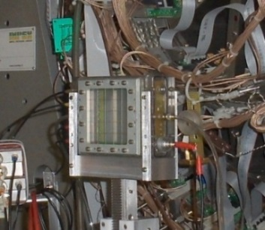
EuNPC, Bologna, 2-7 September 2018
Exotic beam produced using the FRIBs ( Flight Radioactive Ion Beams) facility at INFN-LNS (P. Russotto et al., Jour. Phys.: Conf. Ser. 1014 (2018) 012016)
⁷⁰Zn accelerated by CS at 40 A MeV
⁷⁰Zn + ⁹Be (250 µm)→ projectile fragmentation reaction→ production of the exotic beam
target and multidetectors
⁹Be
45° dipole respect to the beam direction
Standard tagging system→ MCP + DSSSD
(G. Cardella et al., Web of Conferences 117, 06008 (2016) NN2015)
PPAC to reconstruct the trajectory

Slide 9
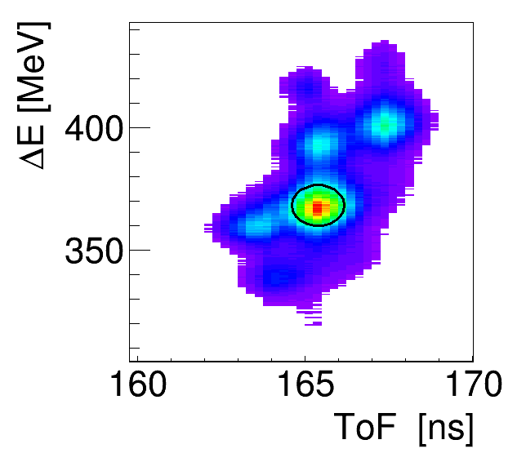
EuNPC, Bologna, 2-7 September 2018
Identification of the exotic beam→ ∆E-ToF method
Start of ToF→ MCP (43 mm x 63 mm, 700 µm ) mounted 12.9 m away from the DSSSD
Stop & ∆E → DSSSD (32x32 strips, 2 mm wide, 156 µm) mounted 2 m away from the ¹²C reaction target
1.44 ·10 ⁹ events of ⁶⁸Ni
8.8 ·10 ⁹ total events
⁶⁹Cu
⁶⁸Cu
⁶⁷Ni
⁶⁸Ni
⁶⁵Co
Standard tagging system→ MCP + DSSSD
(G. Cardella et al., Web of Conferences 117, 06008 (2016) NN2015)
PPAC to reconstruct the trajectory

Slide 10
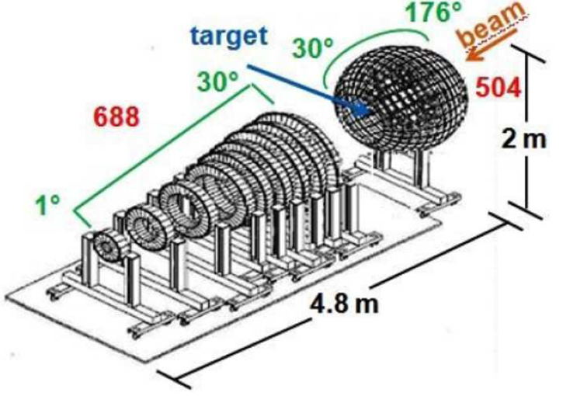
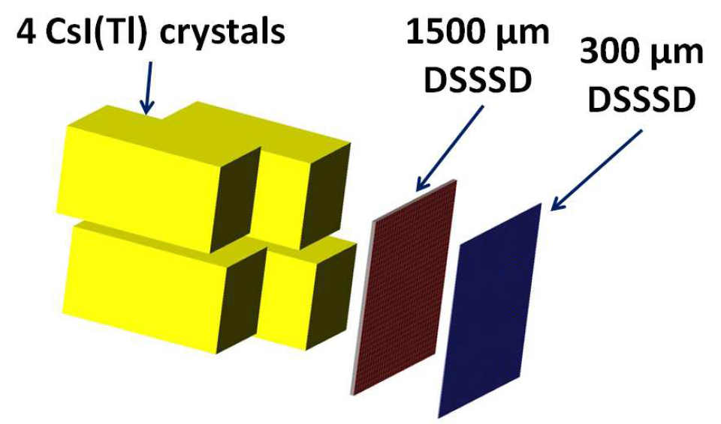
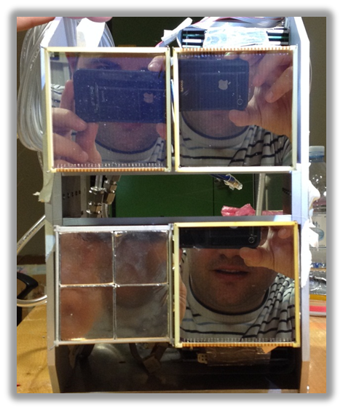
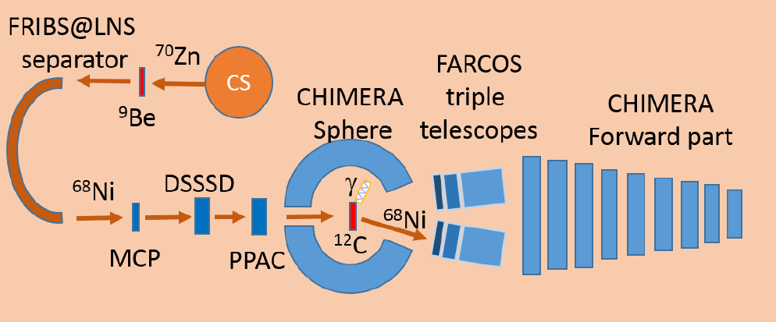
EuNPC, Bologna, 2-7 September 2018
CHIMERA multidetector and FARCOS array → ɣ decay channel of PDR
CHIMERA MULTIDETECTOR
FARCOS ARRAY
A . Pagano et al., Nucl. Phys. A 734 (2004) 504
E.V. Pagano et al., EPJ Web of Conferences 117, 10008 (2016) NN2015
L. Acosta al., Jour. Phys. Conf. Ser. 730 (2016) 012001
We use the CsI(Tl) to detect γ rays
We use FARCOS array ( ϑ _{LAB} ≈ 2-7 ° ) to detect ⁶⁸Ni as well as other heavy ion fragments
1192 telescopes
G. Cardella et al., NIM A799 (2015) 64-69

Slide 11
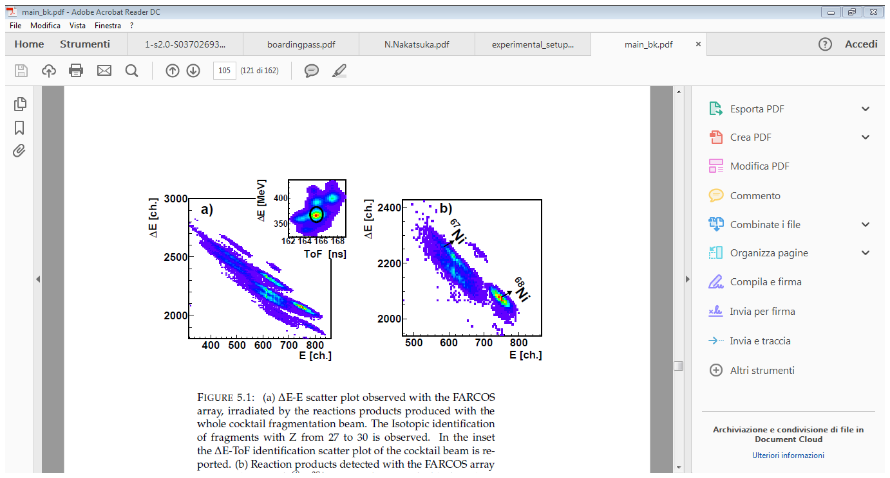
EuNPC, Bologna, 2-7 September 2018
γ decay channel of the PDR→ N.S. Martorana et al., Phys. Lett. B 782 (2018)
Reaction products detected with the FARCOS array
in coincidence with ⁶⁸Ni²⁸⁺ ions
We observe two main channels of reaction:
The ⁶⁸Ni- ⁶⁸Ni channel corresponds to the channel in which only γ-rays are emitted
The ⁶⁸Ni-^{66,67}Ni channel is due to the decay of the ⁶⁸Ni with neutrons emission
Due to the large energy spread (2 %) it is difficult from ion energy measurement to extract the excitation energy

Slide 12
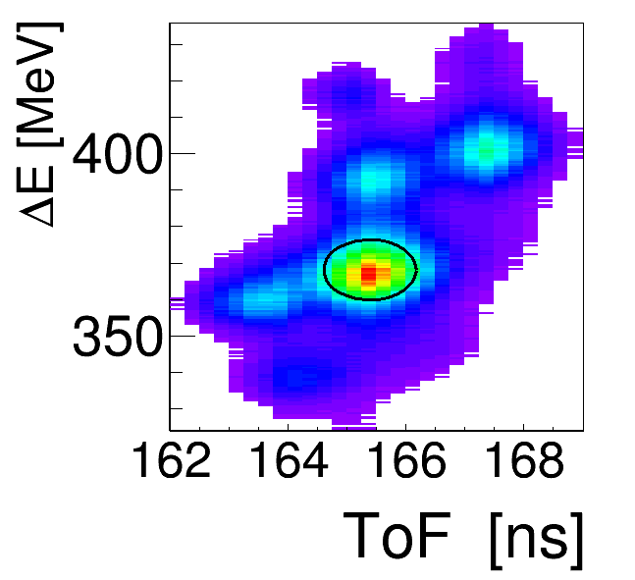
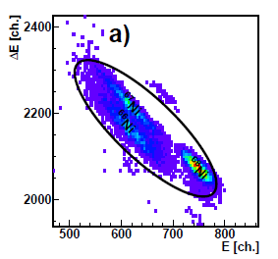
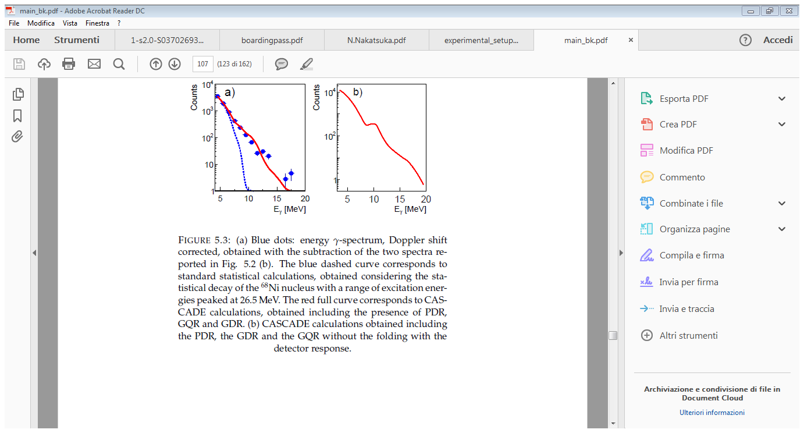
EuNPC, Bologna, 2-7 September 2018
γ decay channel of the PDR→ N.S. Martorana et al., Phys. Lett. B 782 (2018)
The PDR was evidenced by performing statistical calculations using the CASCADE code
F. Puhlhofer, Nucl. Phys. A 280 (1977) 267 – 284
I. Dioszegi, Phys. Rev. C 64 (2001) 019801
E * ≈ 26 MeV
Standard CASCADE calculation
PDR+GDR+ GQR contribution
Statistical calculations were folded with the CsI(Tl) response

Slide 13
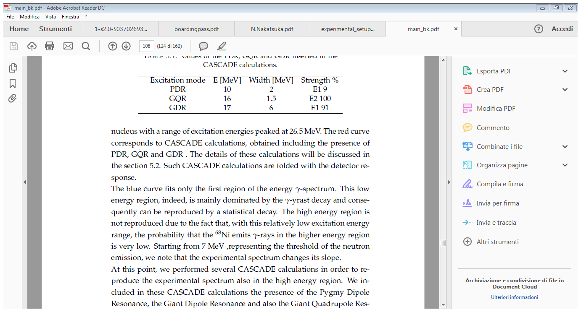
EuNPC, Bologna, 2-7 September 2018
γ decay channel of the PDR→ N.S. Martorana et al., Phys. Lett. B 782 (2018)
The PDR was evidenced by performing statistical calculations using the CASCADE code:
F. Puhlhofer, Nucl. Phys. A 280 (1977) 267 – 284
I. Dioszegi, Phys. Rev. C 64 (2001) 019801

Slide 14
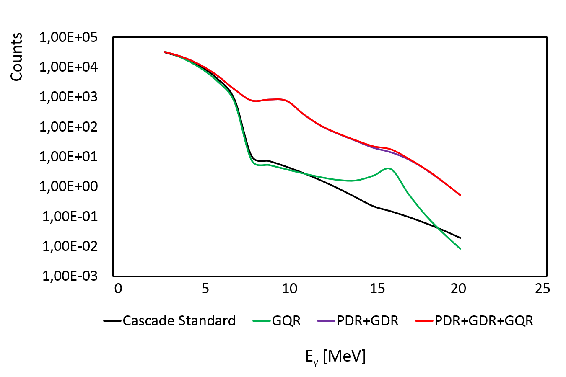
EuNPC, Bologna, 2-7 September 2018
γ decay channel of the PDR→ N.S. Martorana et al., Phys. Lett. B 782 (2018)
The PDR was evidenced by performing statistical calculations using the CASCADE code
F. Puhlhofer, Nucl. Phys. A 280 (1977) 267 – 284
I. Dioszegi, Phys. Rev. C 64 (2001) 019801

Slide 15
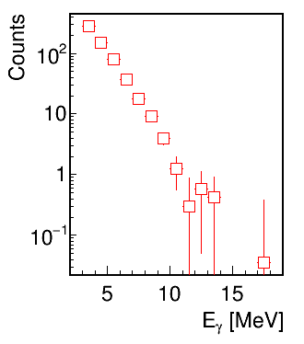
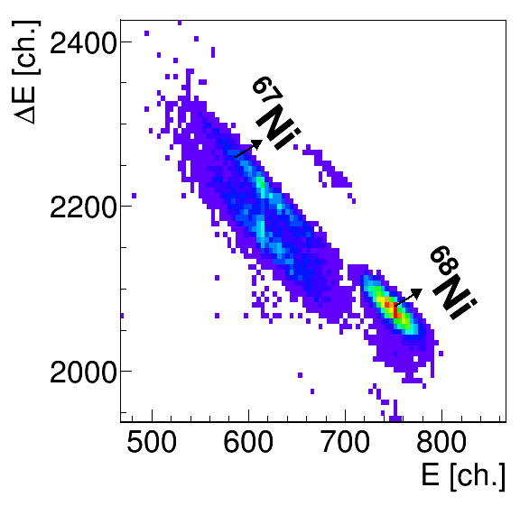
EuNPC, Bologna, 2-7 September 2018
The pygmy dipole resonance decays mainly via neutron emission→ at this low excitation energy if the system emits a neutron the residue excitation energy is low and the high energy ɣ -decay is inhibited
Evidence of the PDR can be obtained by comparing:
ɣ-rays energy spectrum in coincidence with ^{66,67}Ni channels

Slide 16
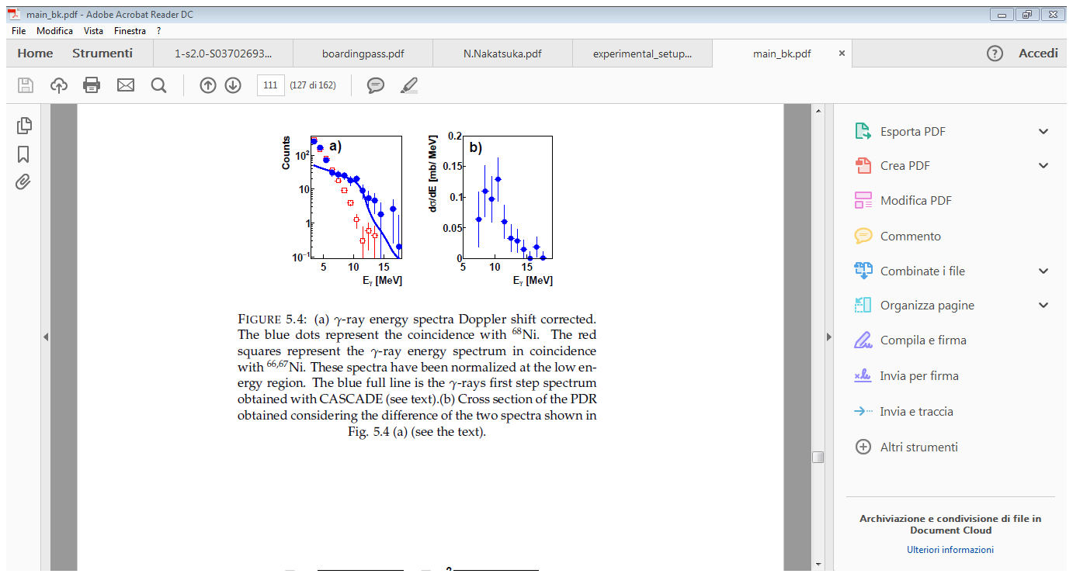
EuNPC, Bologna, 2-7 September 2018
The pygmy dipole resonance decays mainly via neutron emission→ at this low excitation energy if the system emits a neutron the residue excitation energy is low and the high energy ɣ -decay is inhibited
Evidence of the PDR can be obtained by comparing:
ɣ-rays energy spectrum in coincidence with ^{66,67}Ni channels
ɣ-rays energy spectrum in coincidence with ⁶⁸Ni channel→ the high energy ɣ decay hinders further particle emission
γ-rays first step spectra generated with CASCADE, namely with the γ-rays emitted as first particles in the decay process

Slide 17
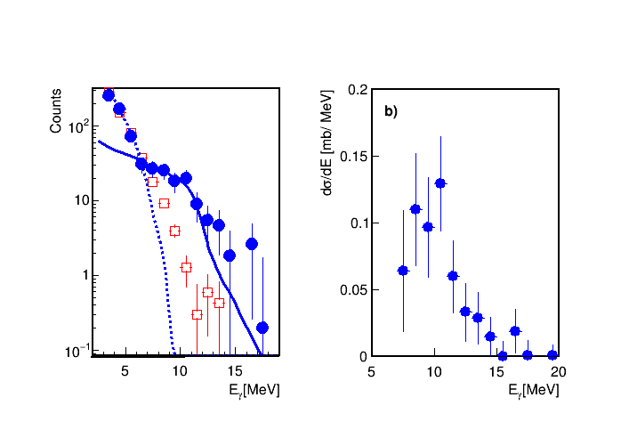
EuNPC, Bologna, 2-7 September 2018
The pygmy dipole resonance decays mainly via neutron emission→ at this low excitation energy if the system emits a neutron the residue excitation energy is low and the high energy ɣ -decay is inhibited
Evidence of the PDR can be obtained by comparing:
ɣ-rays energy spectrum in coincidence with ^{66,67}Ni channels
ɣ-rays energy spectrum in coincidence with ⁶⁸Ni channel→ the high energy ɣ decay hinders further particle emission
Standard CASCADE calculation

Slide 18
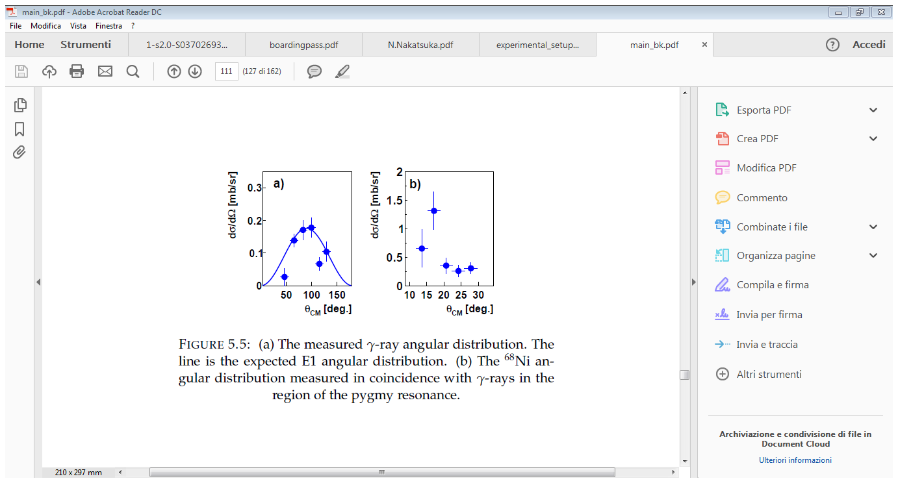
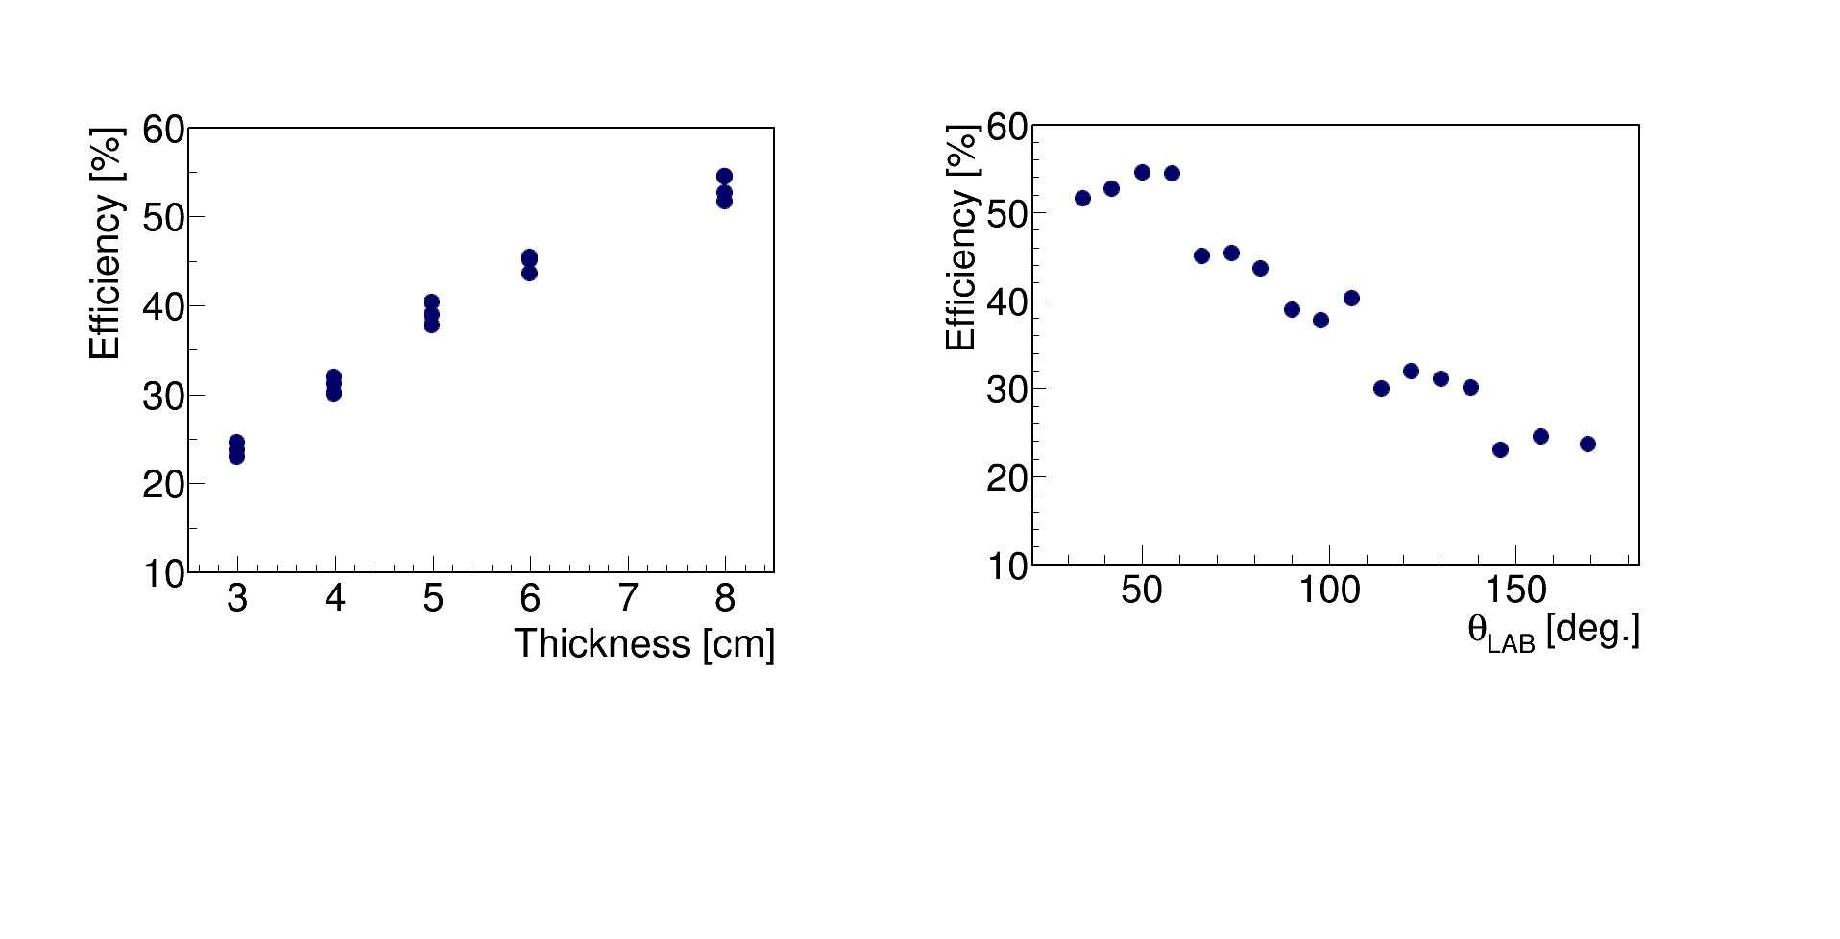
EuNPC, Bologna, 2-7 September 2018
It is important to extract the angular distribution of the emitted ɣ rays in the region of the PDR in order to prove the dipole character of the transition
Effective angular resolution is ± 8 °
γ-rays efficiency around 10 MeV computed with Geant4
Blue dots → angular distribution in the center of mass frame
Blue line → typical distribution expected for a dipole transition with a maximum at 90 °
Total experimental efficiency around 10 MeV →25 %

Slide 19

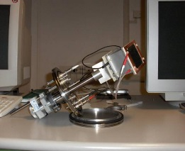
EuNPC, Bologna, 2-7 September 2018
Angular distribution of ⁶⁸Ni was obtained from the distribution of the events in the FARCOS strips
Position sensitive PPAC to check the trajectory
Parallel Plate Avalanche Counter mounted about 80 cm from the target, 1 mm space resolution
Blue dots→ ⁶⁸Ni angular distribution
The error is dominated by the angular straggling in the target and by the uncertainty in the beam trajectory → efficiency of 52 %
The beam divergence was of the order of ϑ ≈ 0.5 °

Slide 20
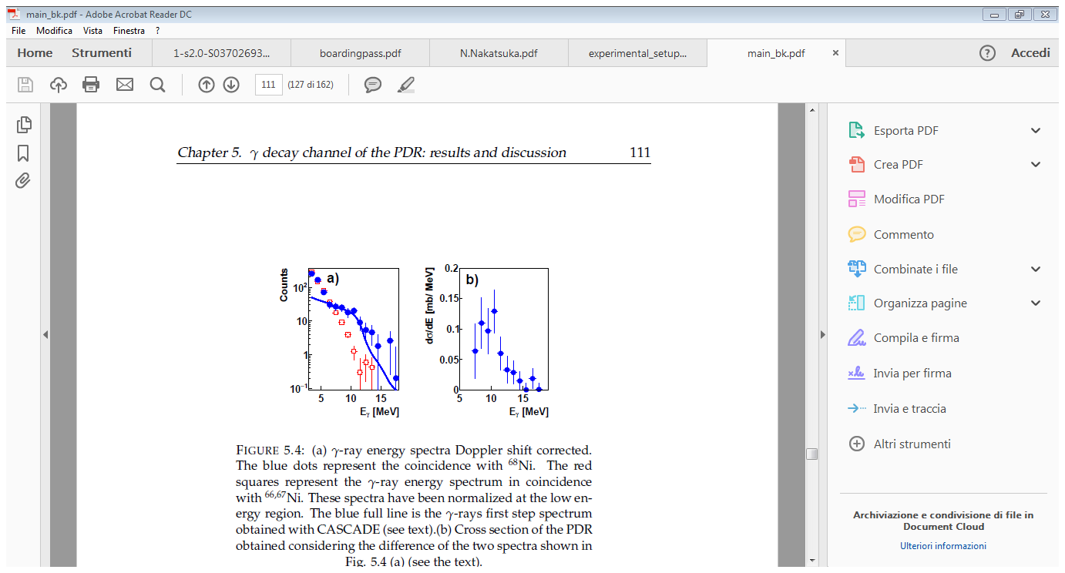
EuNPC, Bologna, 2-7 September 2018
γ decay channel of the PDR→ N.S. Martorana et al., Phys. Lett. B 782 (2018)
⁶⁸Ni detection efficiency→ 52 %
γ rays efficiency→ 25 %
Taking into account the total detection efficiency of ⁶⁸Ni and the detection efficiency of ɣ rays we obtained a cross section for the ɣ emission of σ_{ɣ} = 0.32 mb with the 18 % of statistical error

Slide 21
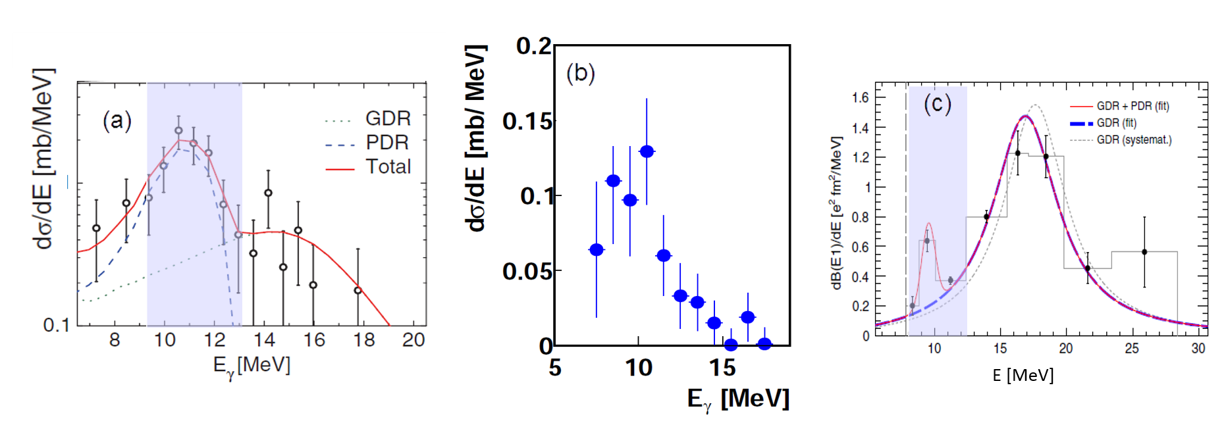
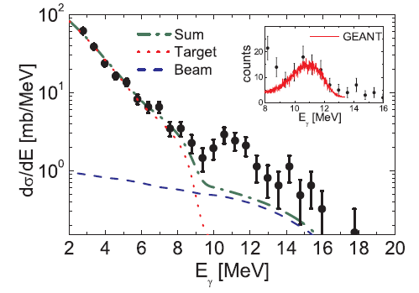
EuNPC, Bologna, 2-7 September 2018
Comparison between isovector and isoscalar probes:
The comparison with the experiment carried out at the GSI (*) does not show any significant difference in the shape of two distributions → This comparison seems to indicate that the isospin splitting is not observed for unstable nuclei above the neutron emission threshold
⁶⁸Ni+C
⁶⁸Ni+Au
N.S. Martorana et al., Phys. Lett. B 782 (2018)
O. Wieland et al., Phys. Rev. Lett. 102, 092502 (2009)

Slide 22
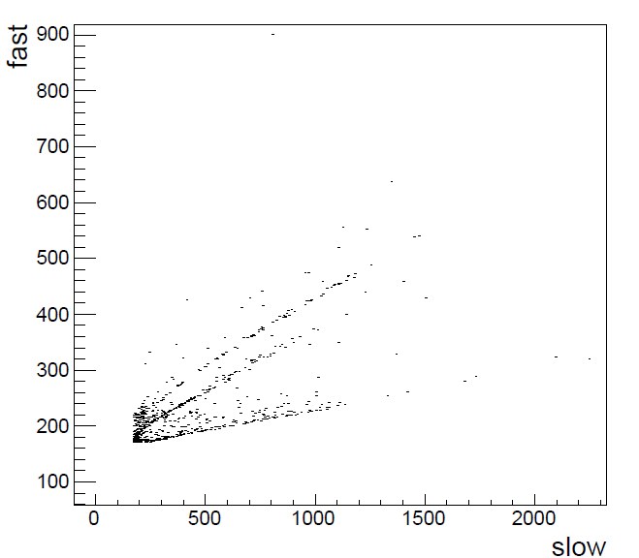
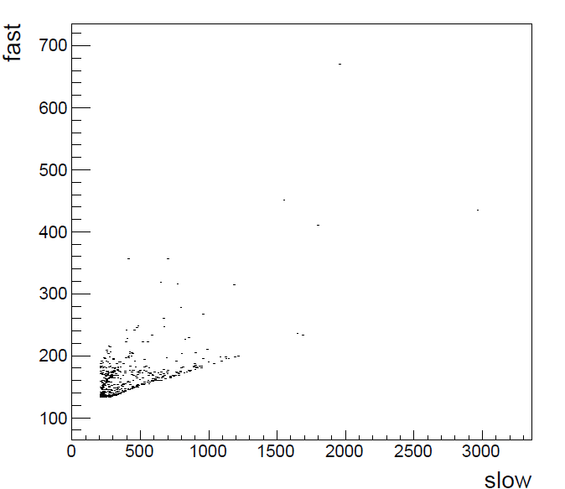
EuNPC, Bologna, 2-7 September 2018
Evaluation of the total cross section
FARCOS covers some of the forward telescopes of CHIMERA→ neutrons can be detected via (n,α) and (n, p) reactions on CsI(Tl) producing α and proton lines
φ= -90° not covered by FARCOS
φ=123° covered by FARCOS
(n,α) and (n,p)
Efficiency for neutrons is of the order of 5% - Taking into account that the PDR decays mainly (>95%) via neutron emission, we should have more n-⁶⁷Ni coincidences than ɣ-⁶⁸Ni coincidences - both decay channels will be measured at the same time

Slide 23
EuNPC, Bologna, 2-7 September 2018
Evaluation of the total cross section
FARCOS covers some of the forward telescopes of CHIMERA→ neutrons can be detected via (n,α) and (n, p) reactions on CsI(Tl) producing α and proton lines
φ= -90° not covered by FARCOS
φ=123° covered by FARCOS
(n,α) and (n,p)
Efficiency for neutrons is of the order of 5% - Taking into account that the PDR decays mainly (>95%) via neutron emission, we should have more n-⁶⁷Ni coincidences than ɣ-⁶⁸Ni coincidences - both decay channels will be measured at the same time

Slide 24
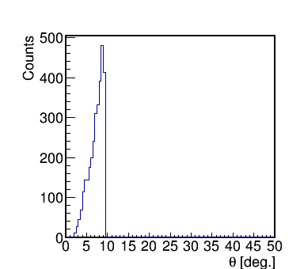
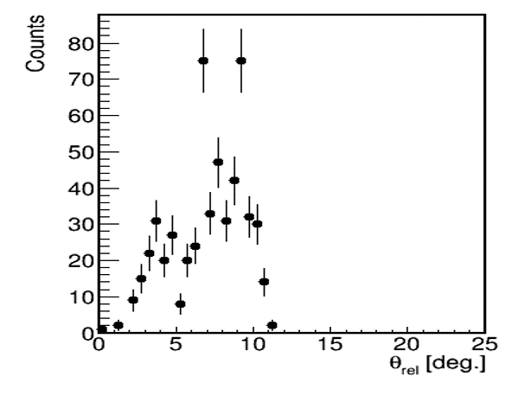
EuNPC, Bologna, 2-7 September 2018
Evaluation of the total cross section
Preliminary

Slide 25
EuNPC, Bologna, 2-7 September 2018
Conclusion
Observation of the Pygmy Dipole Resonance with an isoscalar probe on the ⁶⁸Ni isotope
We have shown that ¹²C is a good probe for isoscalar excitation
The γ-rays angular distribution shows the E1 character of the transition
The measured cross section is 0.32 mb with 18% of statistical error
The strength of the PDR amount at 9 ± 2 %
The comparison between isoscalar and isovector probes seems to indicate that the isospin splitting is not observed for unstable nuclei above the neutron emission threshold
Preliminary investigation about the neutron decay channel of the PDR
new experiments (during 2019) in order to excite the PDR by using both isoscalar and isovector probes to decrease possible systematic errors

Slide 26
N. S. Martorana ^{a,b}, G. Cardella ^{c}, E.G. Lanza ^{c}, L. Acosta ^{c,d}, M.V. Andrès ^{e} , F. Catara ^{c}, E. De Filippo ^{c} , S. De Luca ^{f},
D. Dell’Aquila ^{g}, B. Gnoffo ^{c}, G. Lanzalone ^{a,h} , I. Lombardo ^{g}, C. Maiolino ª , S. Norella ^{f}, A. Pagano ^{c} , E.V. Pagano ^{a,b} ,
M. Papa ^{c}, S. Pirrone ^{c}, G. Politi ^{b,c}, L. Quattrocchi ^{f}, F. Rizzo ^{a,b} , P. Russotto ^{c}, D. Santonocito ª, A. Trifirò ^{f}, M. Trimarchi ^{f}, M. Vigilante ^{g} and A. Vitturi ^{i}
ª INFN-Laboratori Nazionali del Sud, Via S. Sofia, 62, Catania, Italy
^{b} Dipartimento di Fisica e Astronomia, Università degli studi di Catania, Via S. Sofia,64, Catania, Italy
^{c} INFN-Sezione di Catania, Via S. Sofia 64, Catania, Italy
^{d} Instituto de Fisica, Universidad Nacional Autonoma de Mexico, Mexico City, Mexico
^{e} Departamento de FAMN,Universidad de Sevilla, Sevilla, Spain
^{f} Dipartimento MIFT, Università di Messina, Italy
^{g} INFN-Sezione di Napoli and Dipartimento di Fisica, Università Federico II, Napoli, Italy
^{h} Facoltà di Ingegneria e Architettura, Università Kore, Enna, Italy
^{i} Dipartimento di Fisica e Astronomia, Università G. Galilei, and INFN-Sezione di Padova, Padova, Italy
Thank you for your attention

Slide 27
EuNPC, Bologna, 2-7 September 2018
Comparison between isovector and isoscalar probes:
However, due to the limits of the low statistics and energy resolution of the measurements it is not possible to draw definite conclusions. Moreover, the role of multistep contributions to the population of the PDR, which is not present in the (α, α ’γ) experiments in stable nuclei, may modify the shape of the energy distribution.
⁶⁸Ni+C
⁶⁸Ni+Au
N.S. Martorana et al., Phys. Lett. B 782 (2018)
O. Wieland et al., Phys. Rev. Lett. 102, 092502 (2009)

Slide 28
(ISGMR) and (ISGQR) studied in the ⁶⁸Ni in M. Vandebrouck, et al., Phys. Rev. Lett. 113 (2014) 032504 and M. Vandebrouck, et al., Phys. Rev. C 92 (2015) 024316.
At 28A MeV, the cross section for the population of the ISGMR is very low and moreover this mode can not decay, at least at the ground state, by -rays emission; for these reasons we neglected this transition in the CASCADE calculation.
We also underline that while resonances must be explicitly inserted, standard accepted constant strengths of other transitions are included in CASCADE.

Slide 29
CHIMERA (Charge Heavy Ion Mass and Energy Resolving Array)
1192 Telescopes→ Silicon+ CsI(Tl) detectors→94 % 4π
Forward part→ 1°≤ θ ≤30 º ( 688 Telescopes→ 9 rings)
Backward part (sphere r= 40 cm)→ 30 °< θ≤176 º ( 504 telescopes →17 rings)

Slide 30
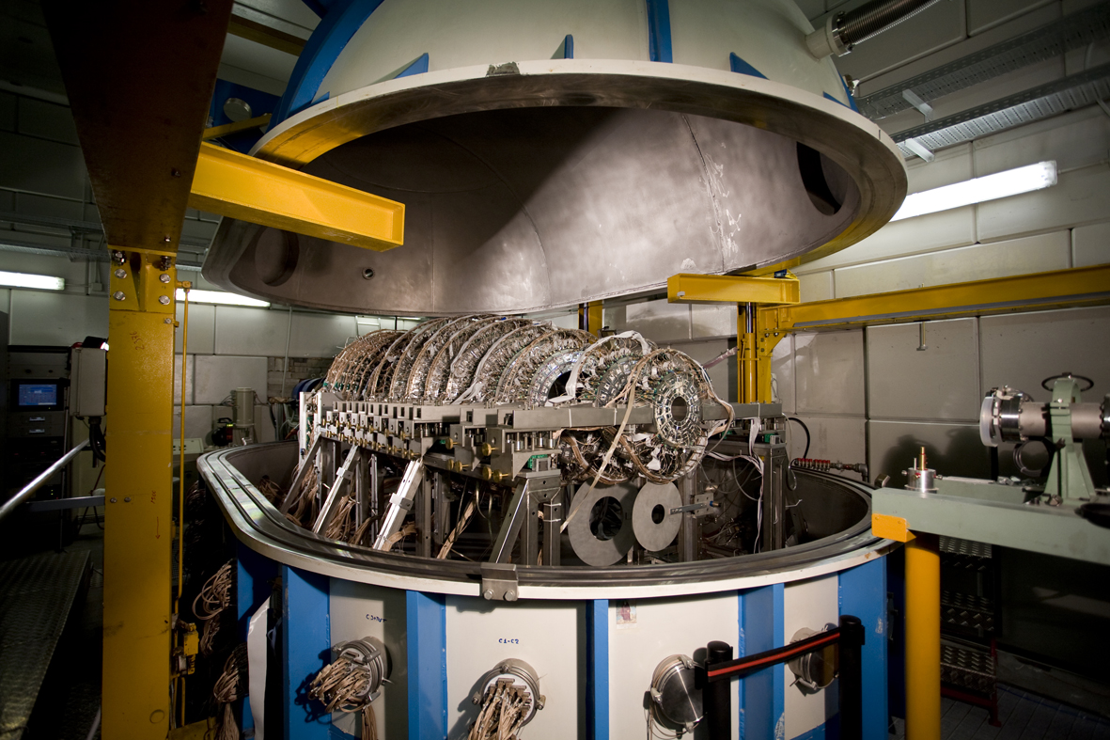
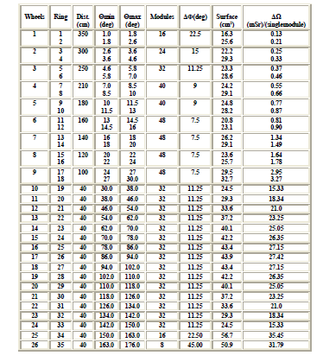
CHIMERA (Charge Heavy Ion Mass and Energy Resolving Array)

Slide 31
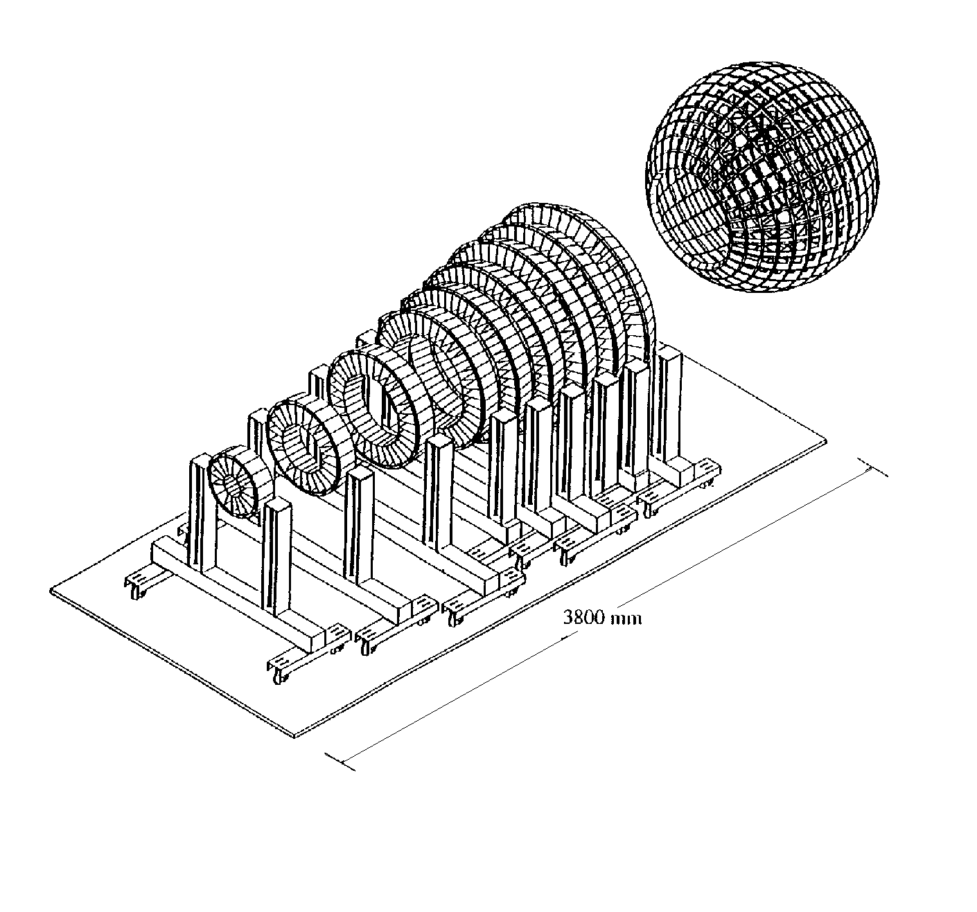
CHIMERA (Charge Heavy Ion Mass and Energy Resolving Array)
Granularity | 1192 telescopes Si (300μm) +CsI(Tl)
Geometry | RINGS: 688 telescopes 100-350 cm SPHERE: 504 telescopes 40 cm
Angular range | RINGS: 1°< θ < 30° SPHERE: 30°< θ < 176° 94% of 4π
Identification method | ΔE-E E-TOF PSD in CsI(Tl) PSD in Si (upgrade 2008)
Experimental observables and performances | TOF δt ≤ 1 ns δE/E LCP (Light Charge Particles) ≈ 2% δE/E HI (Heavy Ions) ≤ 1% Energy, Velocity, A, Z, angular distributions
Detection threshold | ≈ 1 MeV/A for H.I. ≈ 2 MeV/A for LCP

Slide 32
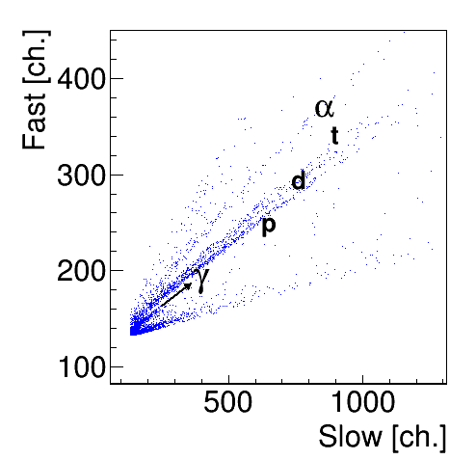

CHIMERA multidetector → ɣ decay channel of PDR
A . Pagano et al., Nucl. Phys. A 734 (2004) 504
We use the CsI(Tl) to detect γ rays
1192 telescopes
Pulse shape discrimination→ identification of γ rays
G. Cardella et al., NIM A799 (2015) 64-69

Slide 33
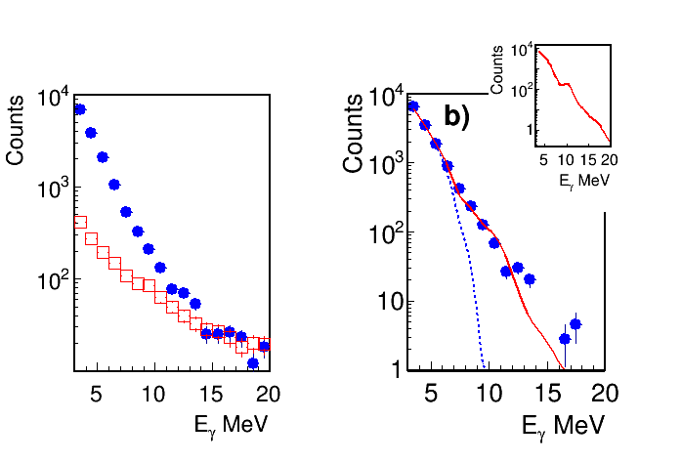
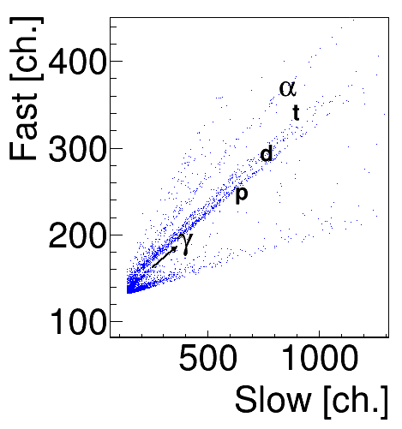
Identification of γ rays
We note the presence of -rays yield extending up to 20 MeV.
The most energetic -rays detected are essentially due to spurious coincidences.
This background has been evaluated moving the fast-slow cuts on both sides around the γ line→ red squares

Slide 34
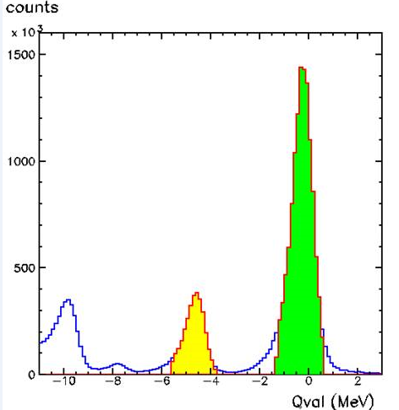
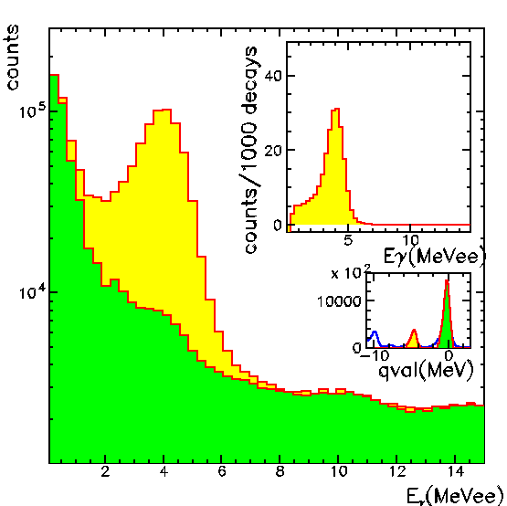
The energy calibration of CsI (Tl) of CHIMERA sphere→ p+ ¹²C, ¹⁹⁷Au, CH₂ @ 24 MeV and pulser signals
30° ≤θ≤78 °
Background can be evaluated collecting the same events, triggered by the detection of protons elastically scattered

Slide 35


We verified that we can extract angular distributions from such events → very useful to understand the multipolarity of the emitted γ-rays obtaining information about the spin of the observed resonance.
See also G. Cardella et al, Nuclear Instrument and Methods in Physics Research A799 (2015) 64-69

Slide 36

⁶⁸Ni as well as other heavy ion fragments were detected and identified using the FARCOS array
Good identification also thanks to the effect of the fragment separator
⁶⁸Ni
E.V. Pagano et al., EPJ Web of Conferences 117, 10008 (2016) NN2015
L. Acosta al., Jour. Phys. Conf. Ser. 730 (2016) 012001
FARCOS modules→ triple telescopes constituted by two stages of DSSSD 300 and 1500 µm thick, followed by four CsI(Tl) scintillators
∆E-E plot observed with the FARCOS array irradiated by reactions products produced with the fragmentation beam

Slide 37

Tagging standard system in order to get the event by event characterization of the exotic beam
Start signal of ToF→ Mylar 2 µm (∆t ≈200 ps)
43 mm x 63 mm 700 µm
The Stop of ToF is provided by the DSSSD with 32x32 strips, 2 mm width, 156 µm
Position sensitive PPAC to check the trajectory

Slide 38


The energy calibration of CsI(Tl) was useful to verify that the probability to produce γ rays from the decay of
¹²C is negligible in the region around 10 MeV
https://www.nndc.bnl.gov/chart/chartNuc.jsp

Slide 39


⁶⁸Ni decay
https://www.nndc.bnl.gov/chart/chartNuc.jsp

