Slide 1
MEASUREMENT OF THE DIFFERENTIAL CROSS SECTION OF NEUTRON SCATTERING ON DEUTERIUM IN THE NEUTRON ENERGY RANGE FROM 400 keV TO 2.5 MeV
Elisa Pirovano ^{(a)}, Luciano Canton ^{(b)}, Ralf Nolte ^{(a)}, Markus Nyman ^{(c)}, Arjan Plompen ^{(c)}
^{(a)} Physikalisch-Technische Bundesanstalt
^{(b)} Istituto Nazionale di Fisica Nucleare, Sezione di Padova
^{(c)} European Commission, Joint Research Centre - Geel
EuNPC
Bologna, 2-7 September 2018

Slide 2
n-d scattering differential cross section
in research:
to study the effect of introducing three-body forces in the nuclear potential models
for applications:
fast-neutron detectors, metrology, energy production
issues with the data below 3 MeV
experimental database:
angular distribution measurements scarce and partially inconsistent
especially at backward angles
evaluated libraries
proved to cause inconsistencies in criticality benchmarks

Slide 3
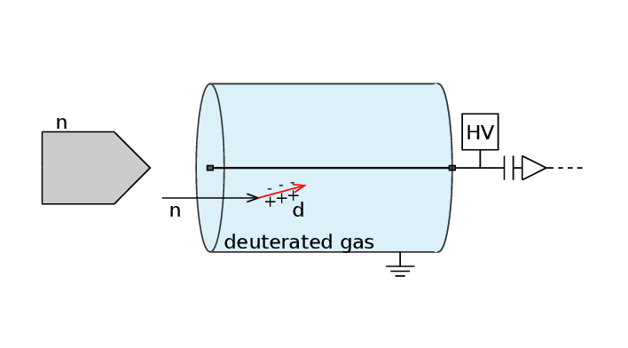
experimental setup
objective
measurement of the differential cross section at given neutron incident energies, below the break-up threshold
setup
monoenergetic neutron beam
proportional counter filled with deuterated gases
measurement
deuteron recoil energy distribution
proportional to the neutron scattering angular distribution
$$\frac{{dN}_{r}}{{dE}_{r,LAB}}=\frac{4π}{σ_{el}}\frac{1}{E_{r,LAB}^{MAX}}\frac{{dσ}_{el}}{{dΩ}_{CM}}$$

Slide 4
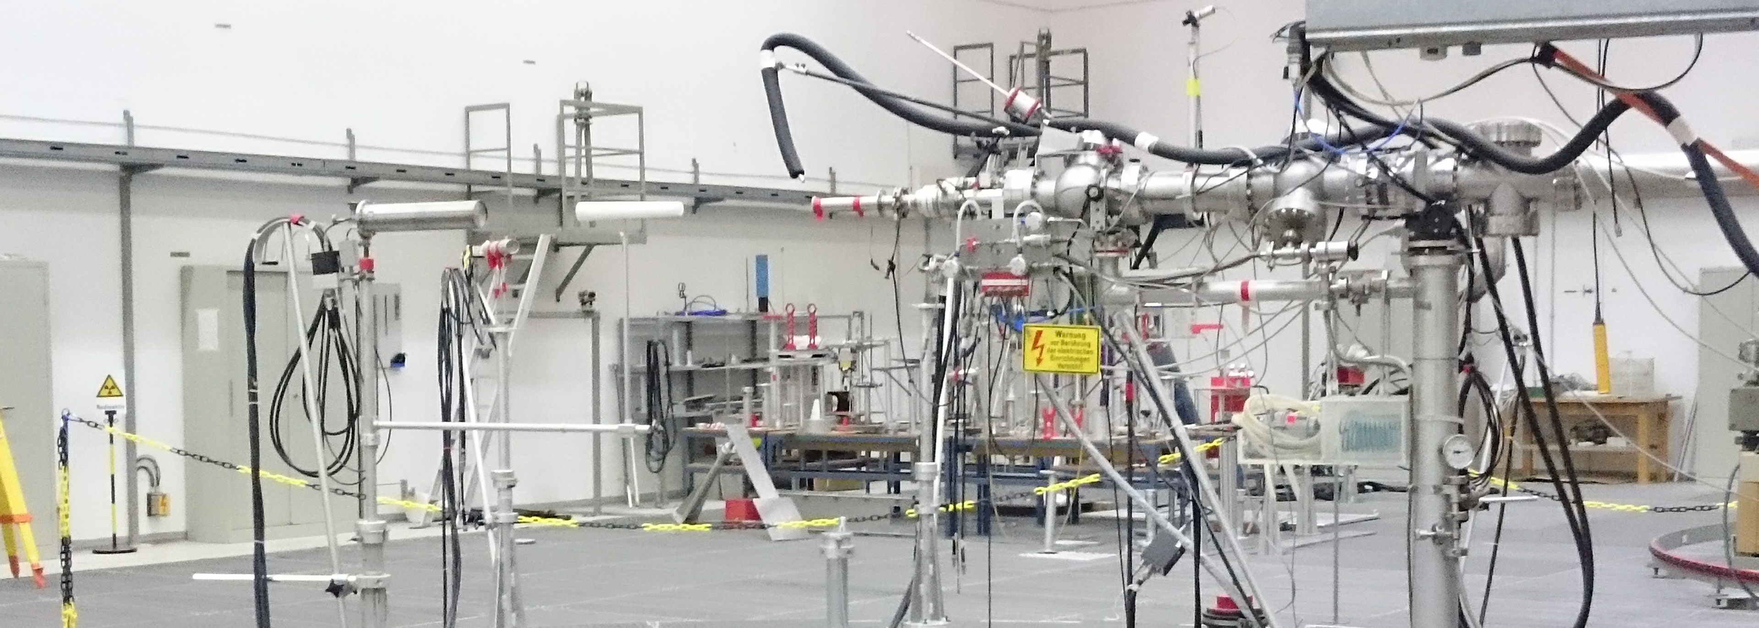
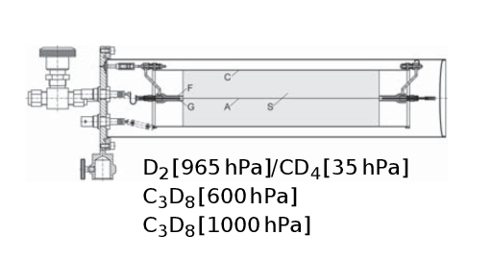
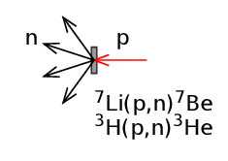
experimental setup
400 – 875 keV
measurement at the PTB VdG
quasi-monoenergetic neutrons via ⁷Li(p,n) or ³H(p,n)
energy range 400 keV – 2.5 MeV
different gas mixtures/pressures to limit the escape of recoil deuterons
875 – 2500 keV
D₂/CD₄ C₃D₈ 600 hPa C₃D₈ 1000 hPa | neutron energy: | 400 – 625 keV 625 keV – 1.25 MeV 1.25 – 2.5 MeV

Slide 5
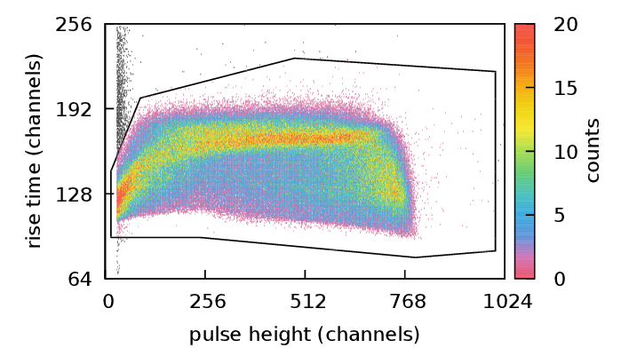
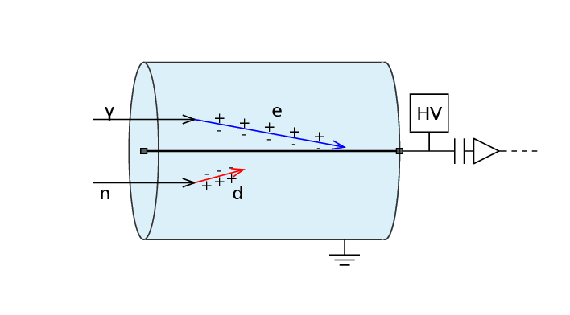
background components
photon background → rise-time discrimination
neutron room-return background → shadow-cone technique

Slide 6
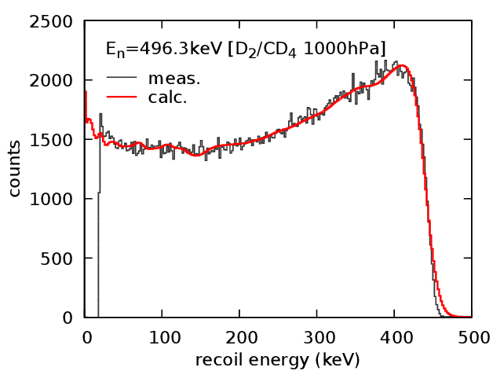
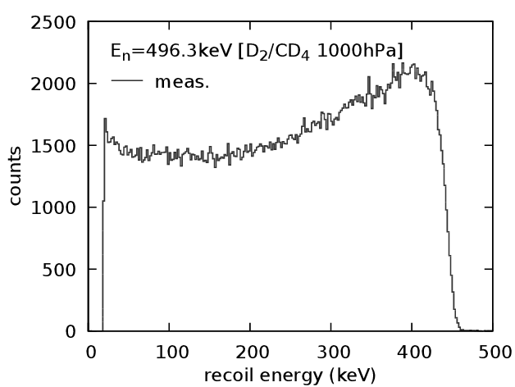
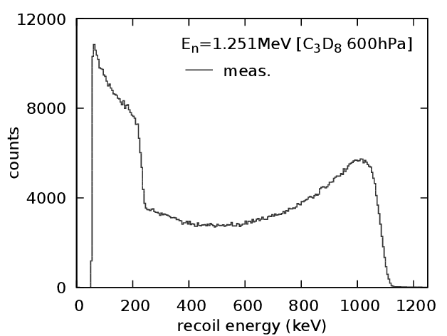
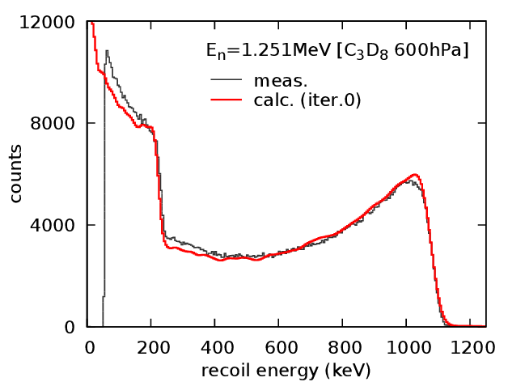
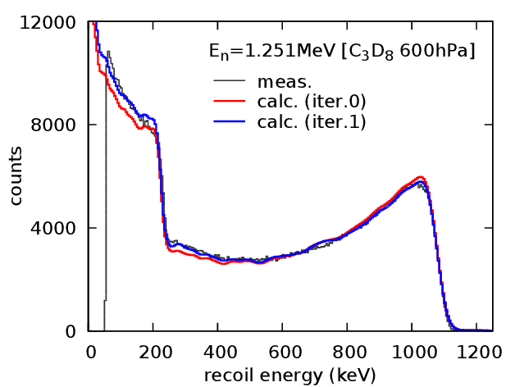
analysis of the recoil energy distributions
ENDF/B VII.1
analysis:
first guess of the differential cross section
dedicated Monte Carlo model:
→ n & d transport inside the detector
simulation of the deposited energy distribution
fit of the model to the data
(iterative procedure):
→ determination of the coefficients
of the Legendre expansion of dσ/dΩ

Slide 7
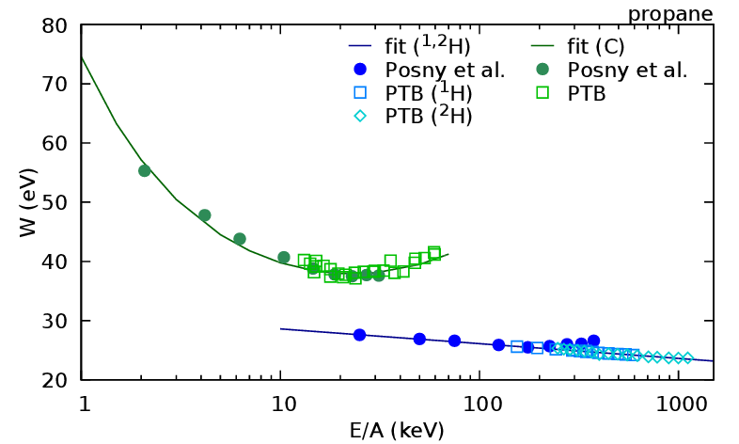
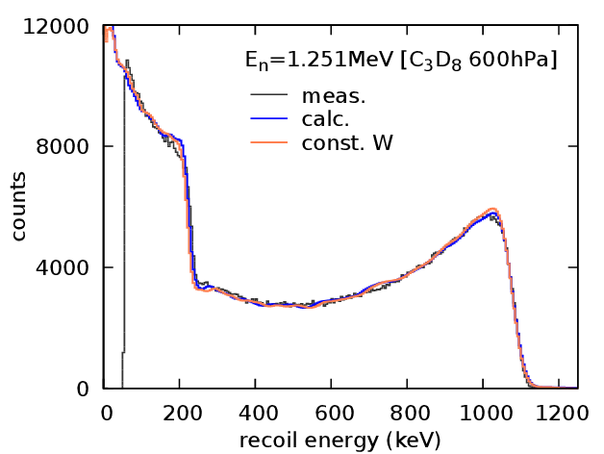
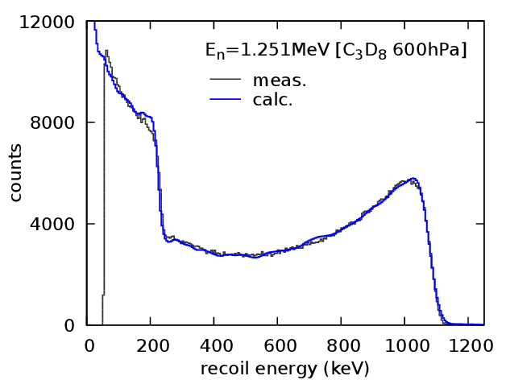
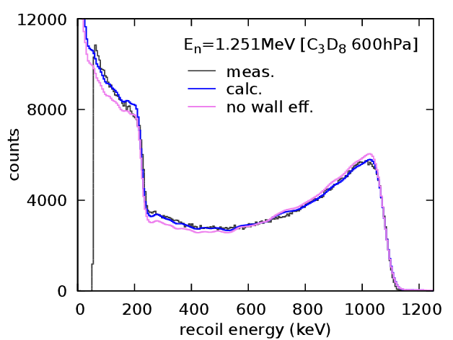
analysis of the recoil energy distributions

Slide 8
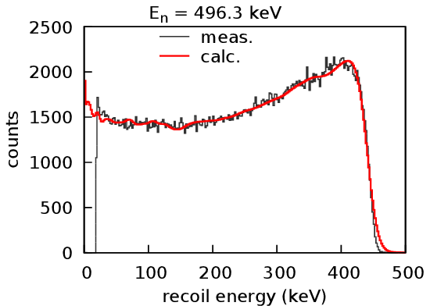
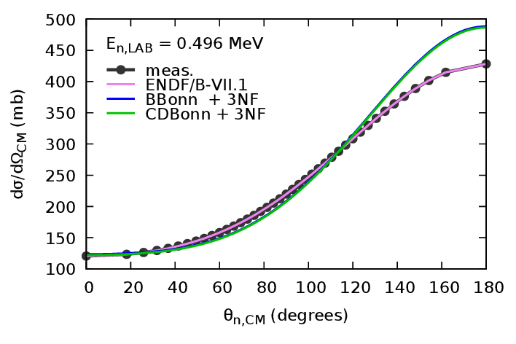
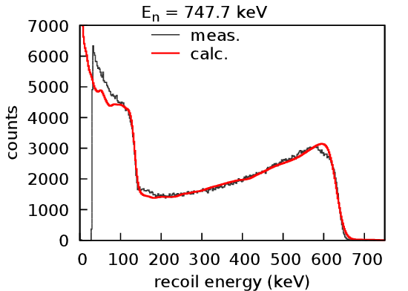
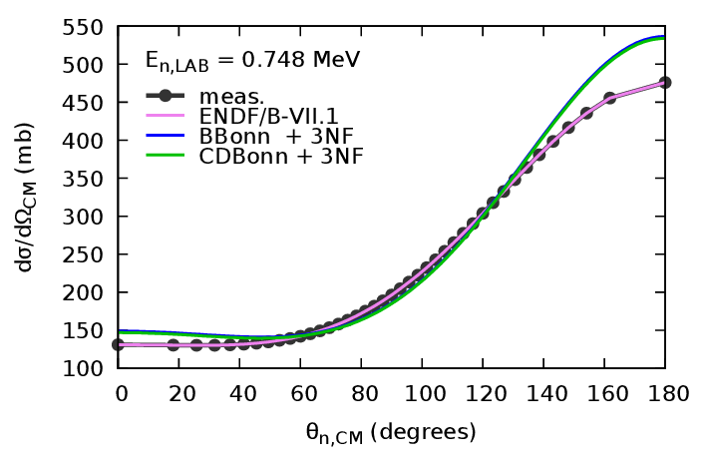
results
E_{n} ≤ 750 keV
results based on the ENDF/B VII.1 library compatible with the measurements

Slide 9
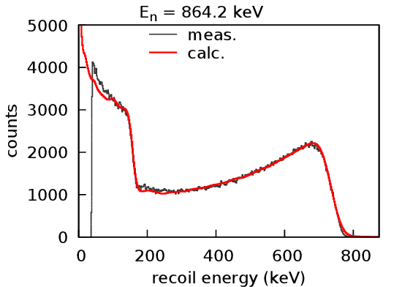
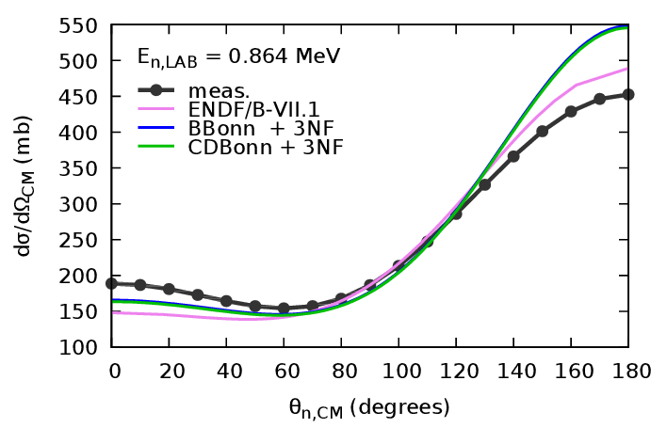
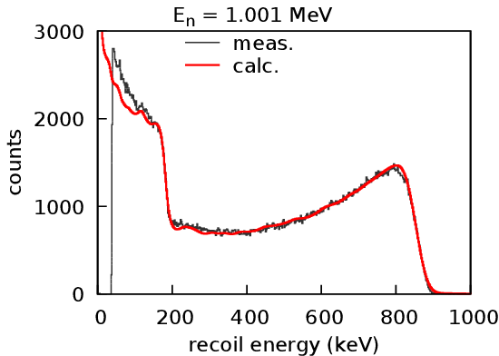
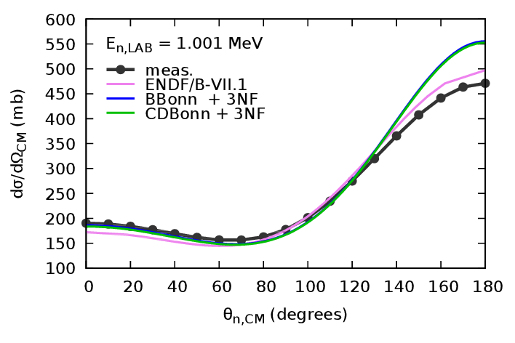
results

Slide 10
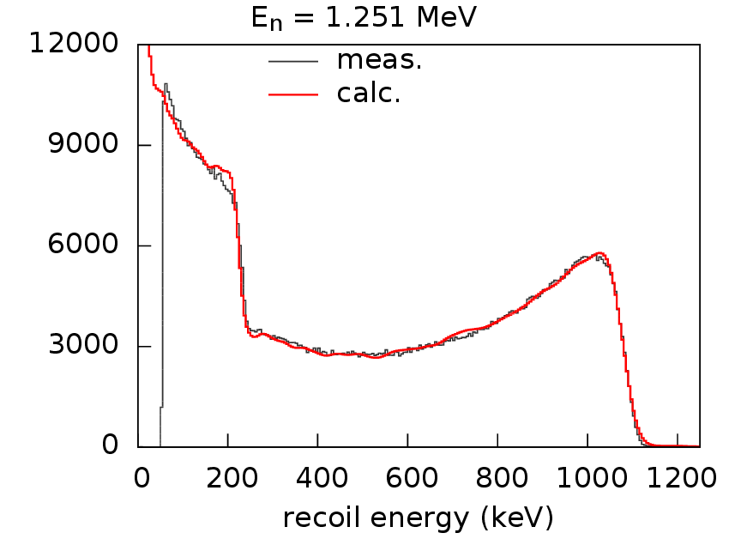
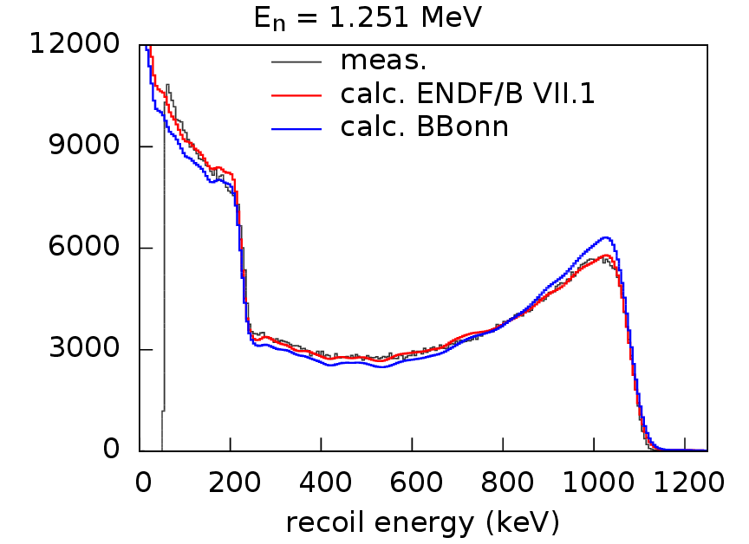
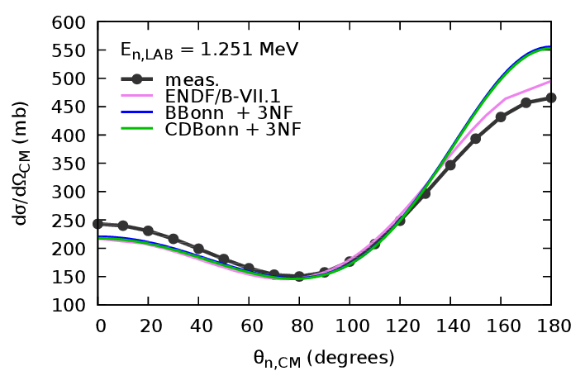
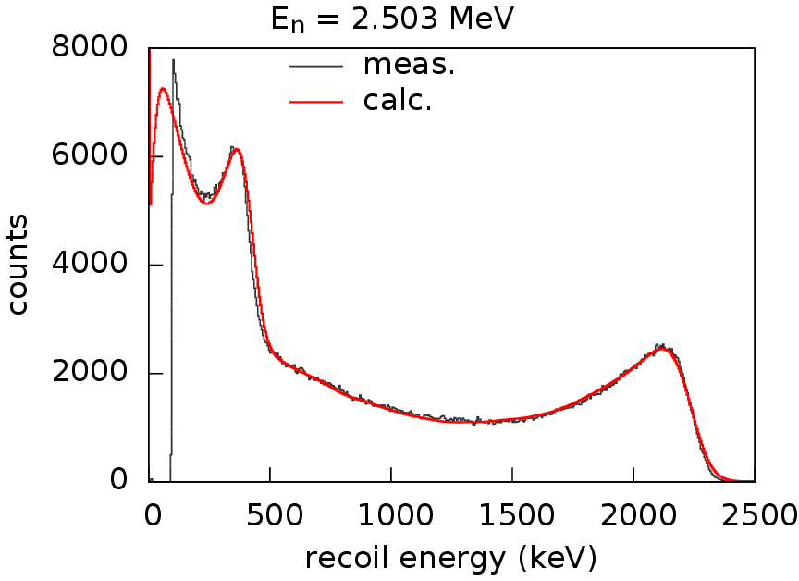
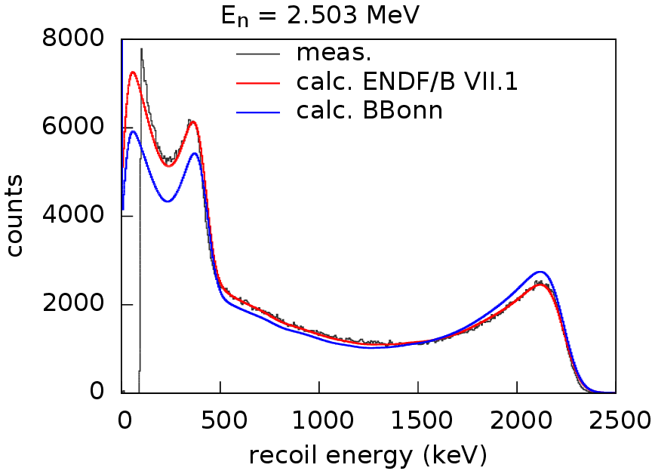
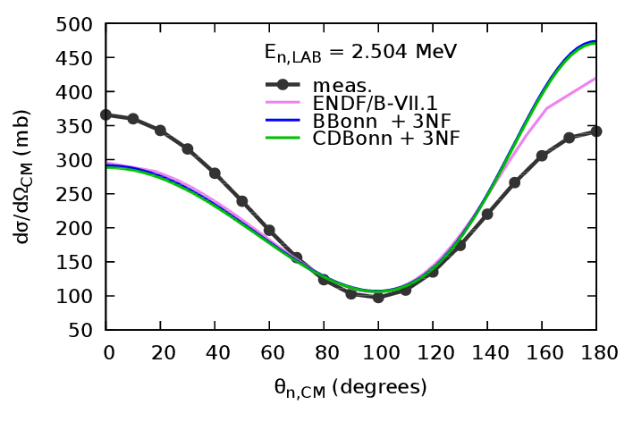
results

Slide 11
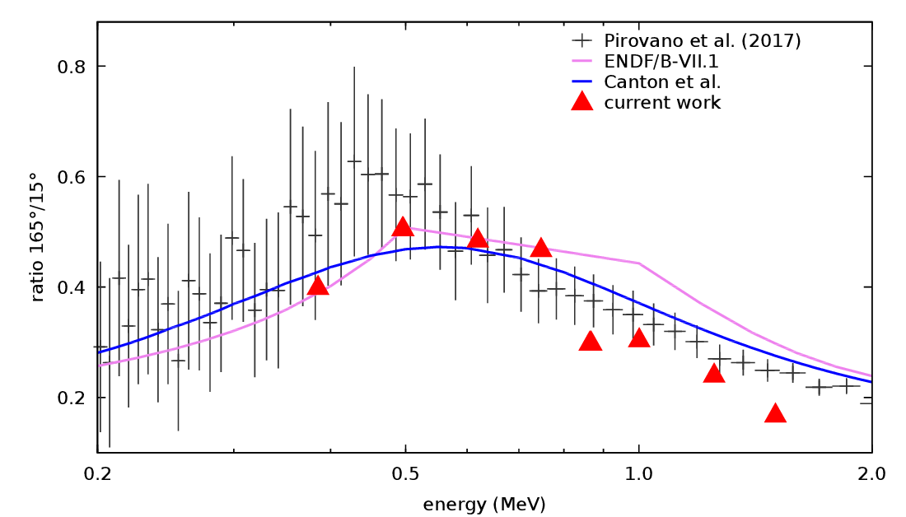
comparison with other measurements
$$\frac{{\left.\frac{dσ}{dΩ_{LAB}}\right|}_{θ=165}}{{\left.\frac{dσ}{dΩ_{LAB}}\right|}_{θ=15}}$$

Slide 12
conclusions
experimental results
differential cross sections over a large angular range
for neutron incident energies from 400 keV to 2.5 MeV
limitation: modelling the energy deposition process in the counting gas, especially propane
analysis of the uncertainties ongoing…
preliminary results:
below 750 keV: ENDF/B VII.1 evaluation reproduces the measurements
above: forward/backward asymmetry still not properly described

