Slide 1
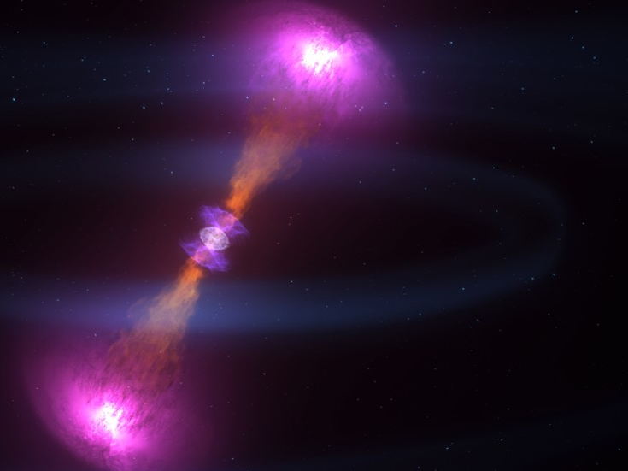
Risultati
dalle osservazioni
multimessaggero
M. Razzano
University of Pisa & INFN-Pisa
Pisa, 18 ottobre 2017
Notes:
27/01/16
1

Slide 2
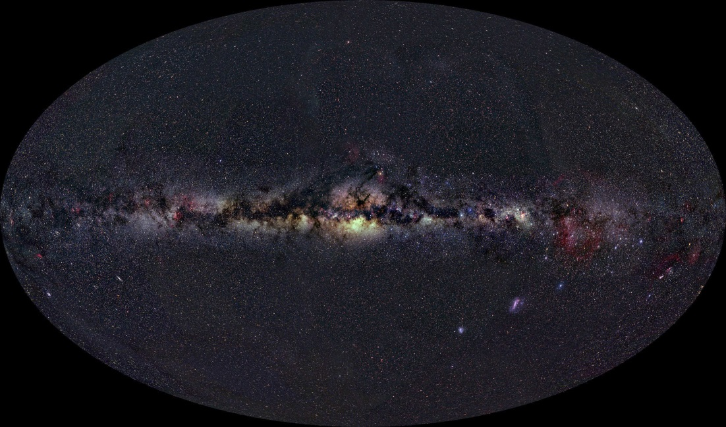
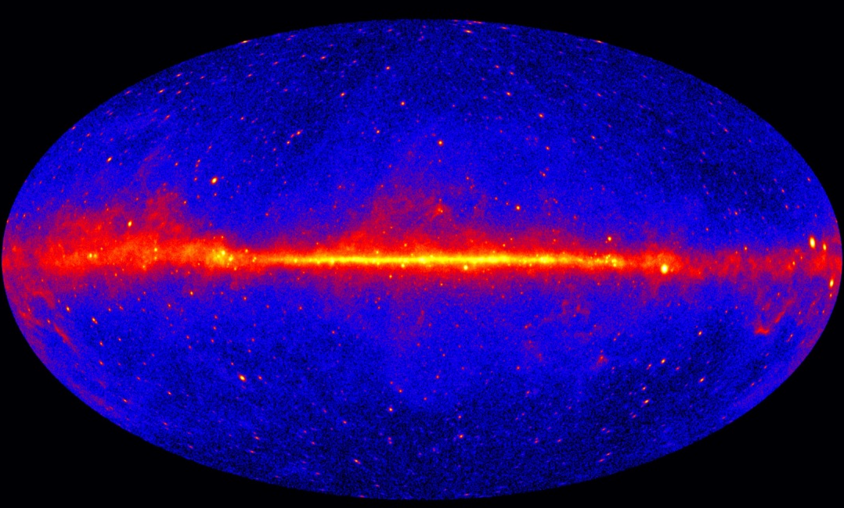
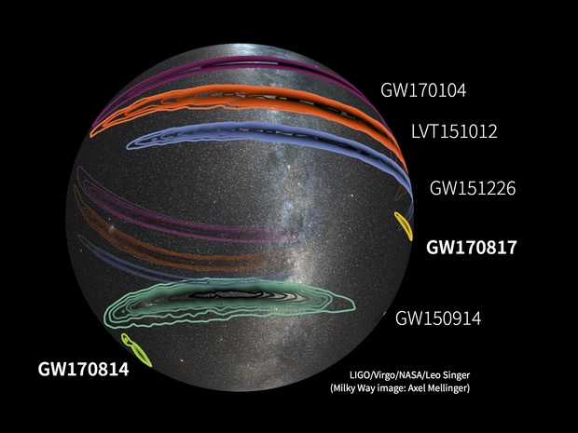
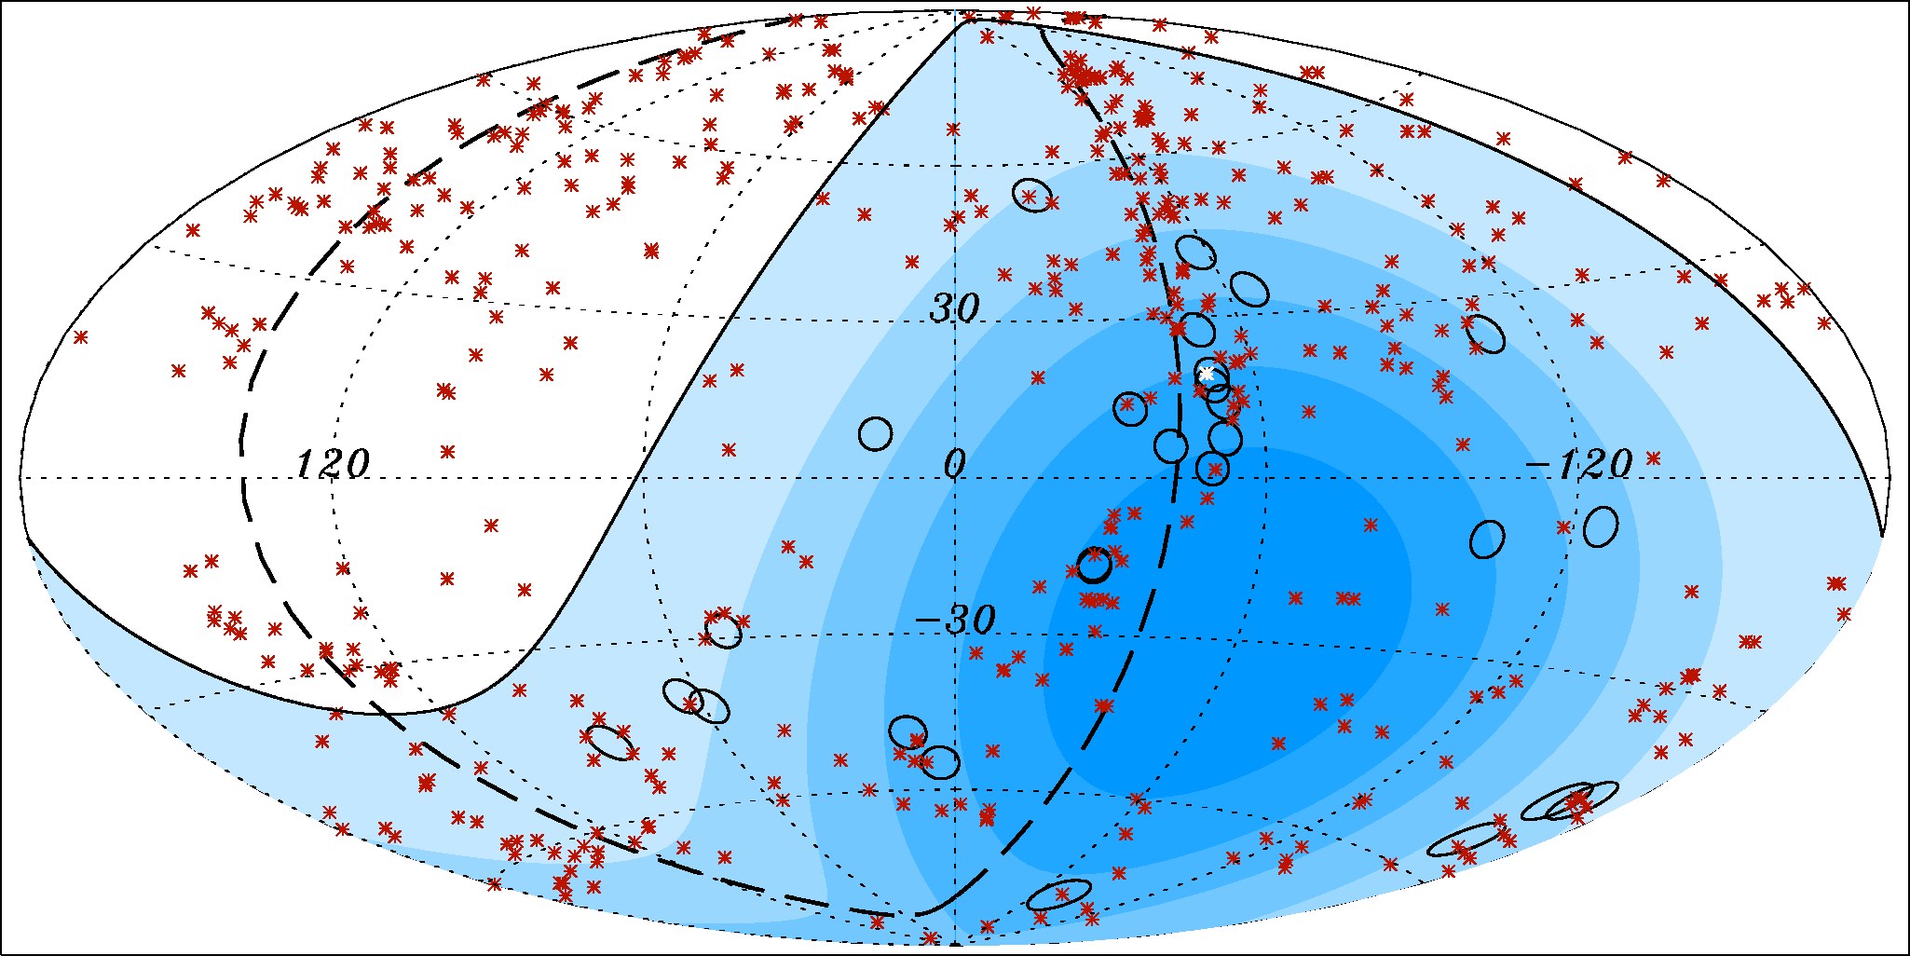
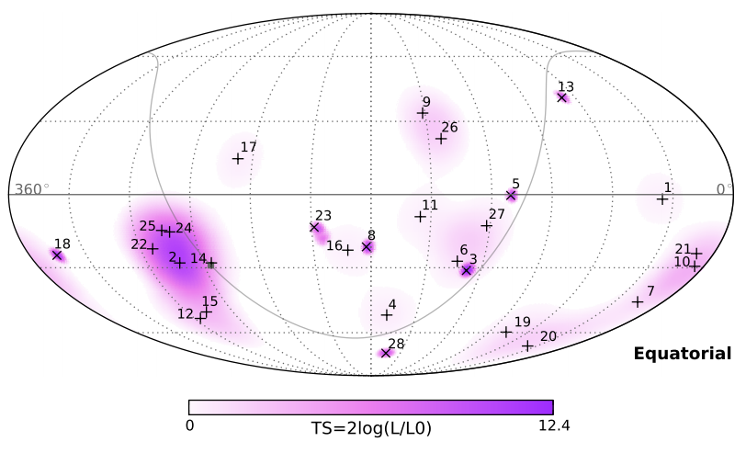
The multi-messenger sky today
Optical (APOD)
Gamma rays > 0.1 GeV (Fermi-LAT, 2013)
Cosmic rays > 57 Eev (Auger, 2007)
Neutrinos > 30 Tev (Icecube, 2013)
*
M. Razzano
Notes:
27/01/16
2

Slide 3
Multimessenger Science case: Gamma Ray Bursts
Short GRBs (<2 s)
believed to be associated with mergers
Long GRBs (>2 s)
Believed to be associated with core-collapse of massive star
2 sec
3rd GBM catalog
Narayana Bhat+, ApJS,223 (2016)

Slide 4
The follow-up strategy
Advanced Era (2015- )
Memorandum of Understanding (MoU) that regulates the follow-up activities
>90 team, > 200 instruments
Detection from GW pipelines → quick meeting (follow-up “advocates”+experts)
→ Alert !
Alerts sent to astronomers via LVC GCN (covered by MoU)
Broadband coverage (EM+neutrinos)
M. Razzano
Notes:
27/01/16
4

Slide 5
Timeline of the GW170817 discovery
12:41:06 UTC : onboard Fermi-GBM trigger
12:14:20 UTC : Automatic Fermi Gamma-ray Coordinates Network (GCN)
~12:47 UTC : low-latency GW pipeline detection on LIGO Hanford
Detected time 12:41:04 (1.7 sec before Fermi GRB)
13:21:42 UTC : First alert sent from LIGO/Virgo
17:54:51 UTC: First LIGO-Virgo skymap
Error region ~31 deg²
Distance 40 Mpc
23:54:40 UTC: Refined LIGO-Virgo skymap
Error region ~34 deg²
M. Razzano
Notes:
27/01/16
5

Slide 6
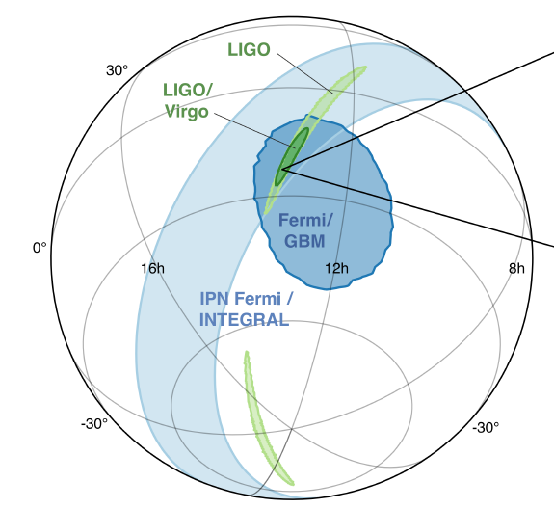
Sky localization
LIGO: 190 deg²
Fermi GBM: 1100 deg²
LIGO
+
Virgo
=
31 deg²
Fermi GBM
+
INTEGRAL SPI (Interplanetary Network)
Additional constraints
See Niccolo’s talk
M. Razzano
Notes:
27/01/16
6

Slide 7
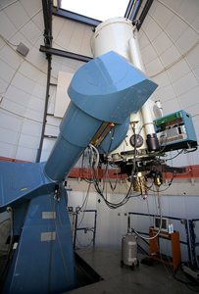
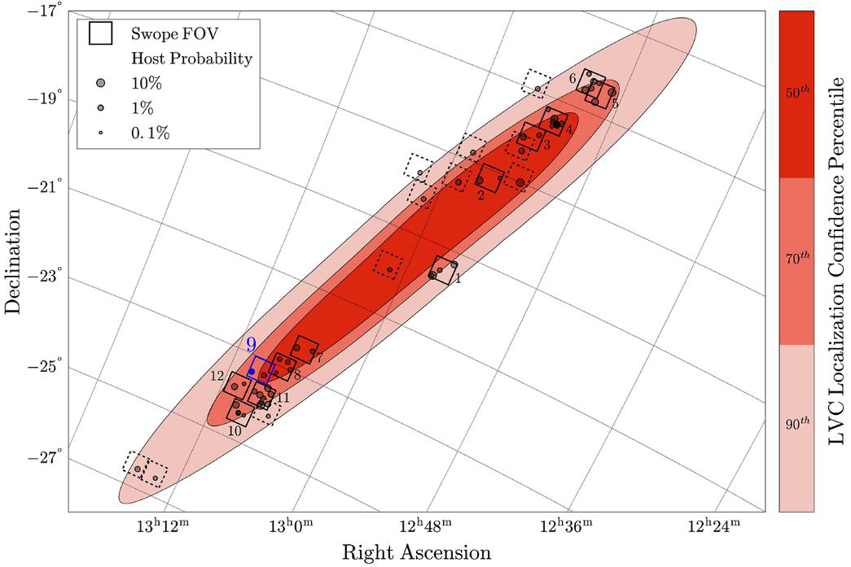
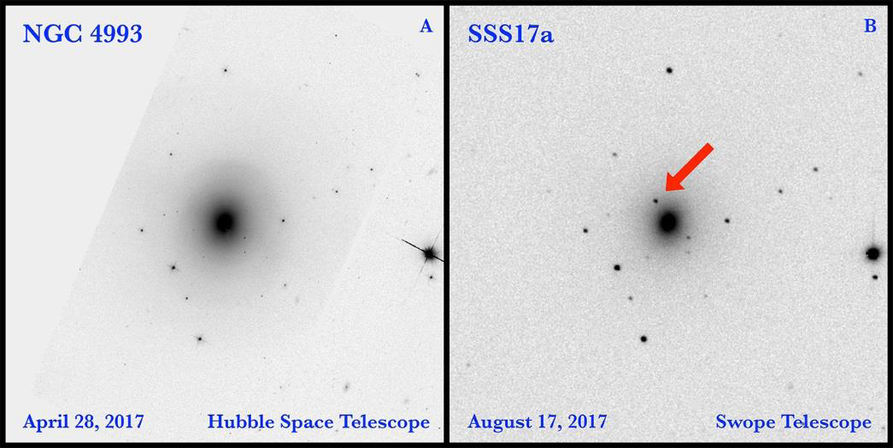
The optical transient
One-Meter, Two-Hemisphere (1M2H) team
1-m Swope telescope, Las Campanas (Chile)
Observation at t₀+10.8 hr
mag(i) ~17
Names SSS17a
later AT2017gfo
ESO 508 cluster at 40 Mpc
(Coulter et al. 2017)
M. Razzano
Notes:
27/01/16
7

Slide 8
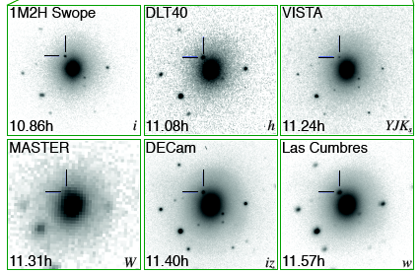
The fab six
(Coulter et al.
(Coulter et al. 2017)
(Yang et al. 2017)
(Tanvir et al. 2017)
(Lipunov et al. 2017)
(Allam et al. 2017)
(Accavi et al. 2017)
M. Razzano
Notes:
27/01/16
8

Slide 9
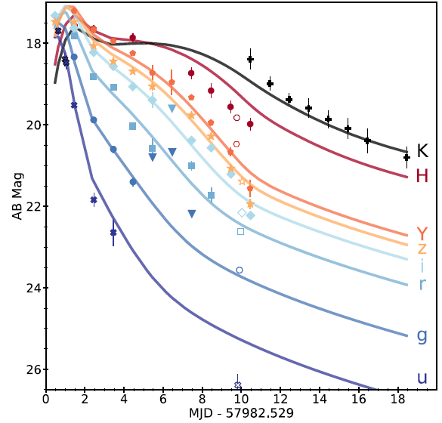
Broadband follow-up: UV, optical, IR
Next days Follow-up observations to rule out chance coincidences
Photometry using DECam, HST, Gemini-south, Swift, from IR to UV
Cowperthwaite et al. 2017
M. Razzano
Notes:
27/01/16
9

Slide 10
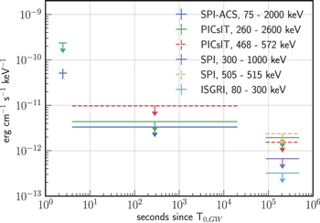
Broadband follow-up: gamma rays
Gamma rays probe highly relativistic processes
Many high-energy facilities online (IPN)
Fermi GBM+Fermi LAT
AGILE
INTEGRAL
HXMT
CALET
AstroSat
HESS
HAWC
INTEGRAL upper limits
(Savchenko et al, 2017)
M. Razzano
Notes:
27/01/16
10

Slide 11
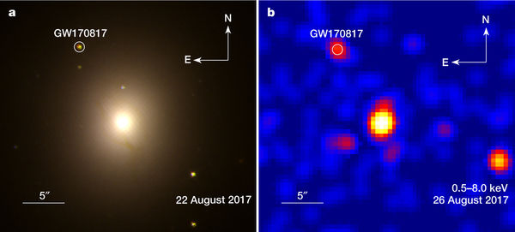
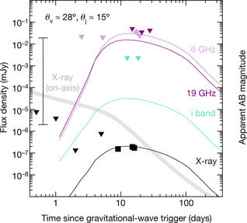
Broadband follow-up: X-rays
No detections until t₀+9 days
First detection by Chandra (Troja et al., 2017)
Emission up to t0+15 days
Now too close to the Sun
M. Razzano
Notes:
27/01/16
11

Slide 12
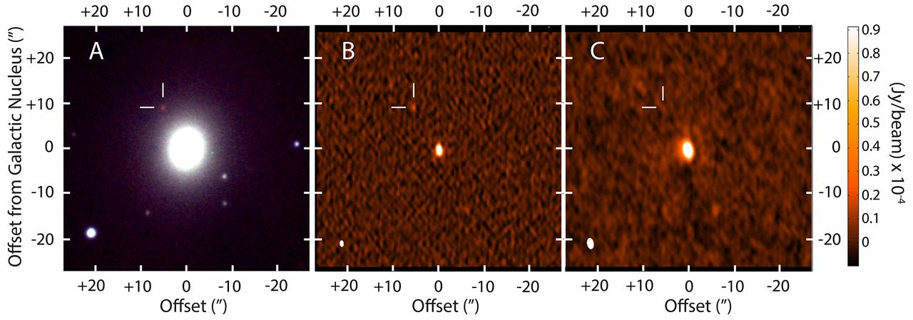
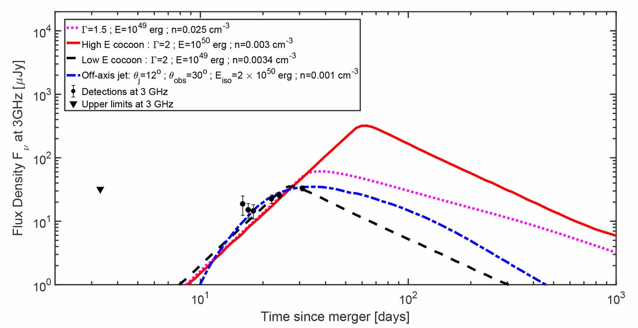
Broadband follow-up: radio
First detection at t₀+16 days by VLA, confirmed by ATCA
6 GHz image @VLA
Consistent with cocoon or off-axis emission
Hallinan et al 2017
M. Razzano
Notes:
27/01/16
12

Slide 13
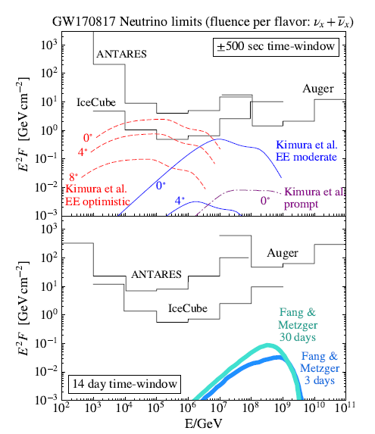
Broadband follow-up: neutrinos
Icecube
ANTARES
Pierre Auger Observatory
No detection
Upper limits computed
Albert et al 2017
M. Razzano
Notes:
27/01/16
13

Slide 14
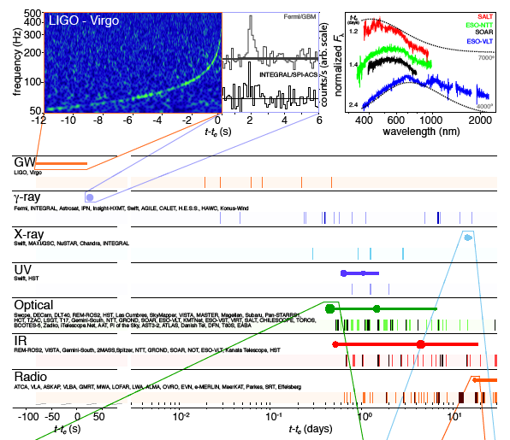
The big picture
Abbott et al 2017
M. Razzano
Notes:
27/01/16
14

Slide 15
Credits: NASA GSFC/CI Lab
M. Razzano
Notes:
27/01/16
15

Slide 16
Grazie per l’attenzione !
More details in Abbott et al, 2017, ApJL 848,2
Notes:
27/01/16
16

Slide 17
Conclusions
GW and photons provide complementary information
Multimessenger observations extremely promising
Multimessenger approach is key to study the most extreme objects in the Universe
Natural laboratories to probe fundamental physics
Transients (e.g. GRBs)
Also, other sources (e.g. neutron stars)
GW170817 provided a first successful multimessenger story
Great synergy and coverage
>70 teams involved, EM+neutrinos
Kilonova counterpart discovered
Help constrain emission and progenitor models
Present & Future
Not just BBH: what about BH-NS systems?
...and supernovae?
...and the unexpected?
More details in Abbott et al, 2017, ApJL 848,2 (our “capstone” paper)
Notes:
27/01/16
17

Slide 18
Why the multimessenger astronomy?
NASA
Providing a deeper insight into the most extreme events in the Universe
Exploring the nature of their progenitors (mass, spin, distance..) and their environment (temperature, density, redshift..)
Accessing complementary information:
EM → emission processes, acceleration mechanisms, environment
GW → mass distribution
Neutrinos → hadronic/nuclear processes, etc.
How? Rely on precise (arcmin/arcsecond) localization
Identify an EM counterpart
Pinpoint host galaxy of a merger
NASA
NASA
LIGO
M. Razzano
Notes:
27/01/16
18

