Slide 1
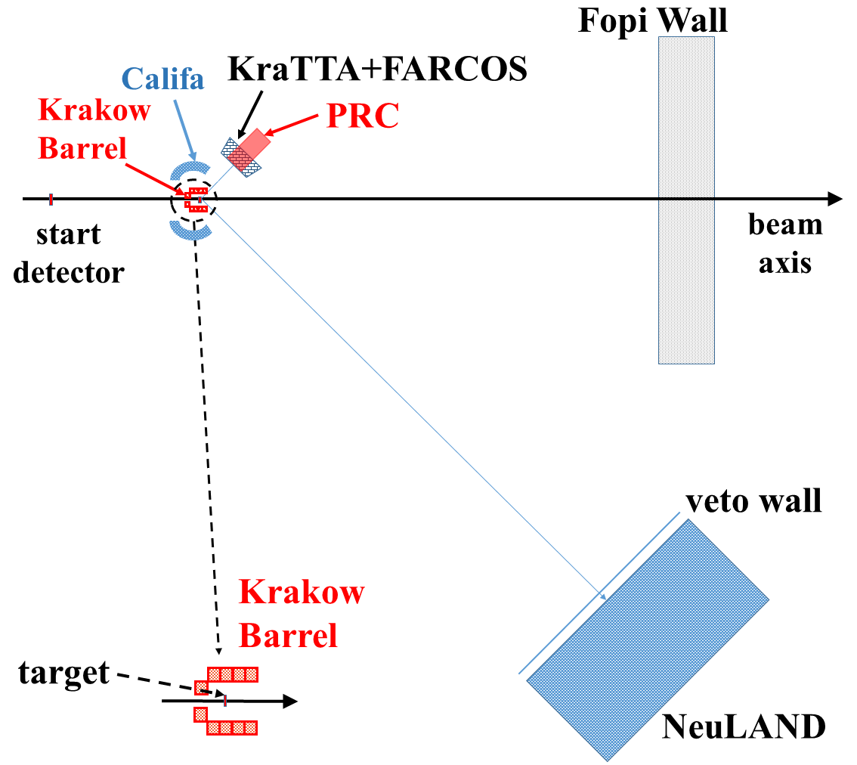
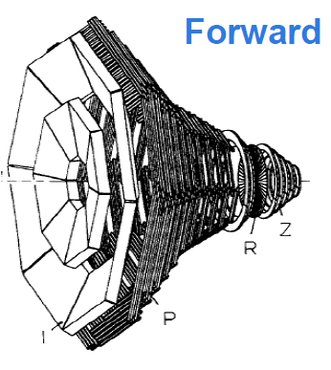
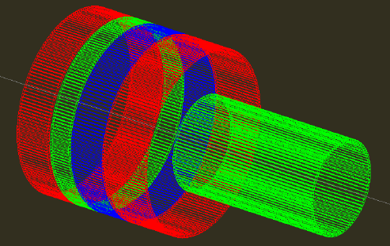
A starting point discussion for DAQ and trigger problems in the AsyEos-II experiment
set-up for the ASY-EOS II experiment
KraTTA (Si-Si-Csi-CsI-Si):
Flows and yields of LCP at mid-rapidity
FARCOS (2xDSSSD-CsI):
LCP at mid-rapidity
(high angular resolution)
Califa (CsI):
LCP at target-rapidity
Pion Range Counter (stack of plastics):
π⁺ and π⁻ at mid-rapidity
FOPI forward wall (plastics): charged particles forward emitted for reaction plane and centrality determination
Forward
Wall
Problem: several devices controlled by different DAQ Envisaged: a common trigger for all subsystems, a common DAQ supervisor (probably the local DAQ (MBS ?) Consequence: handle trigger timing, busy logic, shared dead-time, timestamping/event counter, on-line or off-line merging for all DAQ
Notes:
<number>

Slide 2
A remind of DAQ in the old AsyEos experiment: an easier contest
CHIMERA DAQ server
Optical link
chimera
MBS is a DAQ based on a real-time system with data-flow based on TCP/IP sockets
6U
9U
TITRIS
V2718
V2718
V2718
VME
VME
Titris Bus
MBS: Multi Branch System
Titris: 48 bit, 50 MHz (20 ns) GSI timestamp VME module
TCP/IP
RIO3
TITRIS
TRIVA
Scalers Land TofWall Krakow Array (digital) MicroBall
MBS Receiver
Trigger bus
Time ordering,sorting, Data storing Global on-line analysis
Event builder MBS
Remote DAQ servers

Slide 3
Integration of GET electronics in R³B DAQ ?
Neuland : MBS or MBS derived with new software backend (interfacing TAMEX/PADI front-end). All new electronic front-end is indeed MBS compatible
Farcos → GET Electronics
PRC → ?
Kracow new detectors: hit channels + triggers, (GET Electronics . . . ?)
MBS systems could be syncronyzed with the «White Rabbit» timestamping (developed at GSI by N. Kurz) system (up to 200 MHz for distributed trigger system within 1Km distance). But what about GET compatibility ? (GET is a relatively closed system, to be integrated with foreign systems it requires in general new dedicated hardware . . . .
GET should be integrated with the local GSI (or R³B modified) DAQ system.

Slide 4
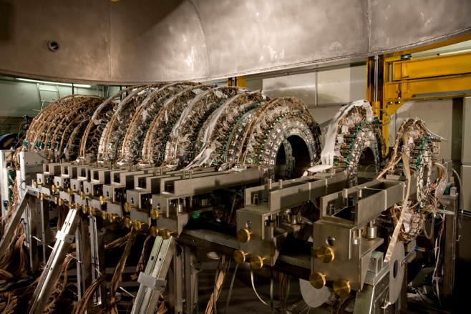
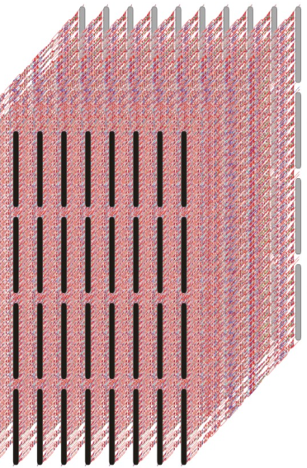
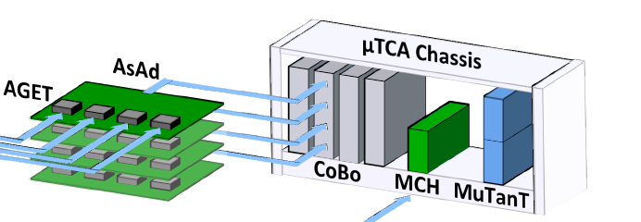
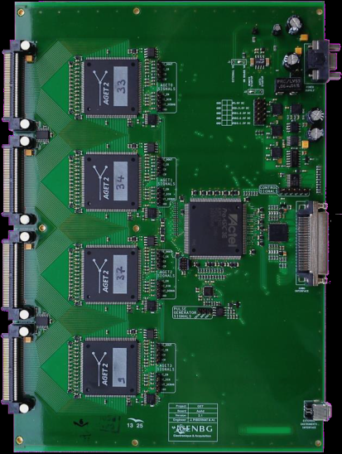
CHIMERA CSI / FARCOS to GET
PA to Dual-Gain modules
1/10 Gb Networks to server(s)
Chimera CsI:
8 ASAD → 2 CoBo (<2k signals)
Farcos (5 modules):
14 ASAD → 4 CoBo (<4k signals)
1 µTCA crate
1 Mutant (three levels trigger)
Computer farm + Storage (disk server) + 10Gb data / 1Gb switch slow control
AsAD board
Input
CoBo(s) read and reduce data from the the AsAd front-end up to 4 AsAd(s), 1024 channels
FPGA
AGET
VHDCI cable to CoBo
ADC
Notes:
<number>

Slide 5
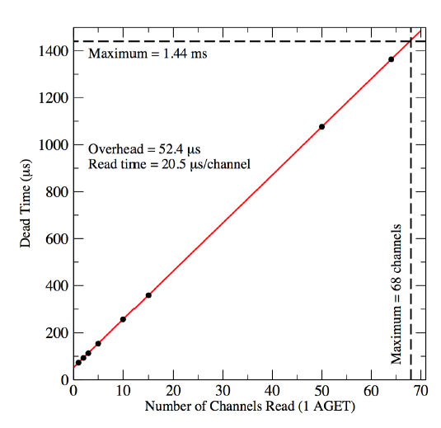
CHIMERA CSI / FARCOS to GET
Dead Time in GET: mainly determined by the ADC readout fixed frequency (25 MHz) of the 512-cell Switch Capacitor Array where analog signals are sampled and stored
AsAD board
FPGA
Input
AGET
VHDCI cable to CoBo
ADC
E. Pollacco et al. NIM A submitted

Slide 6
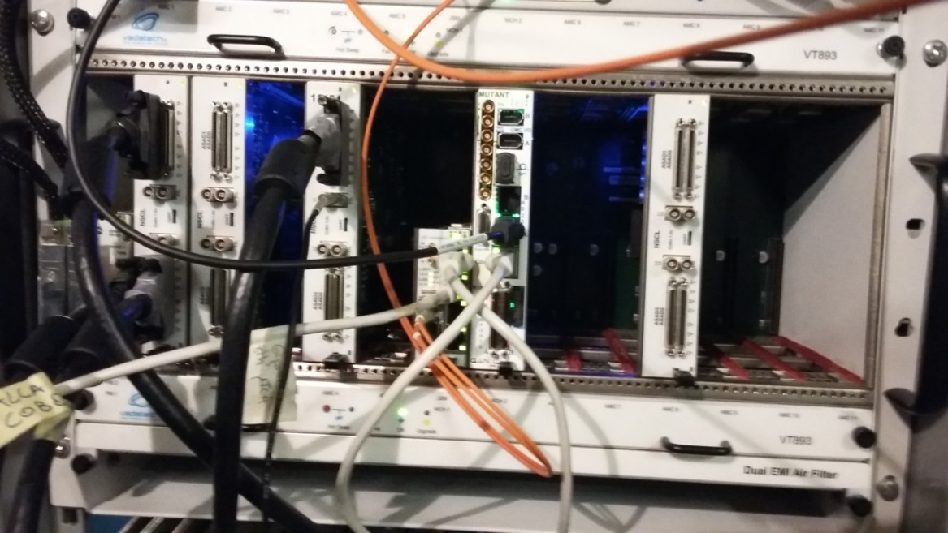
MuTanT (The Multiplicity Trigger and Time) provides a 3 level trigger system: L0 (external trigger), L1 (multiplicity trigger) and L2 (user defined trigger) and clock alignment with the CoBos. In principle MuTanT can be syncronized with external data acquisitions by means of dedicated cards (CENTRUM, BEAST developped at GANIL). Timestamp synchronization (100 MHz,14 bit) compatibility with GSI devices is not assured and should be discussed.
Chimera coupling with VME DAQ is done by using a Common Trigger and Event Counter (EC).
µTCA
VME
Accepted Trigger to L0
GET Mutant
CoBo
Mutant
Dead time
Busy
MCH
10 Gb data
Gates generations for analog VME
common trigger + event-number + shared dead-time

Slide 7
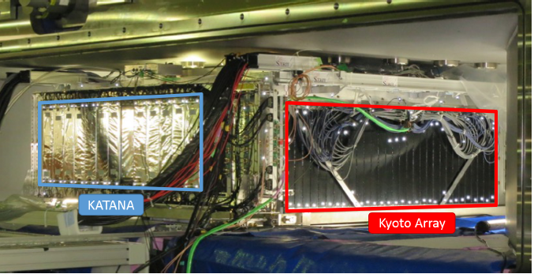
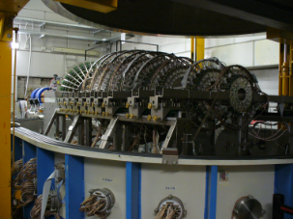
Two examples :
The Sπirit TPC inside the SAMURAI magnet at RIKEN (seen with some ancillary detectors) was used in 2016 with GET electronics front-end and DAQ coupled with other devices and the NeuLAND* detector system for neutron detection.
Narval-RCC is the DAQ supervisor for the different integrated acquisitions
In the Gamma-Hoyle experiment at LNS (October 2017) CsI detectors in the Sphere are readout by GET system and Si detectors (+ CsI forward part) by the VME analog front-end.
Narval-RCC is the DAQ supervisor for the different integrated acquisitions
It can be interesting to discuss some aspects of these two different cases
*Neuland used with old Tacquila front-end

Slide 8
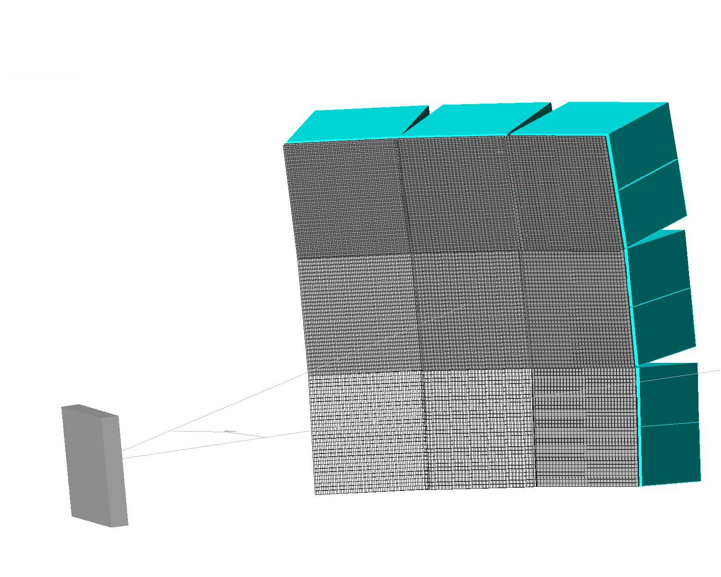
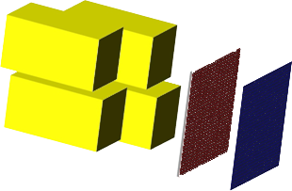
GET + CHIMERA DAQ COUPLING (a brief overview)
Acquisition node servers
FARCOS
Eth.
GET
ELECTRONIC CONTROL CORE
µTCA BUS
DATA CATCHING & FILTERING
OFF-LINE MERGER
STORAGE
CsI GET
CHIMERA
ELECTRONIC CONTROL CORE
Eth.
Silicon FEE
VME BUS
We use «NARVAL» as supervisor for both CHIMERA and GET data acquisitions
based on the concept of generic Actors
written in OO language ADA with C++ interface
Data flow: TCP/IP
Run Control Core and GUI interface based on Java (GANIL) Main contributions from Chimera: Developments in new front-end electronics (PA and dual gain modules) , VME DAQ - GET Coupling, Data Analysis software for CoBo(s) and VME and a general MERGER

Slide 9
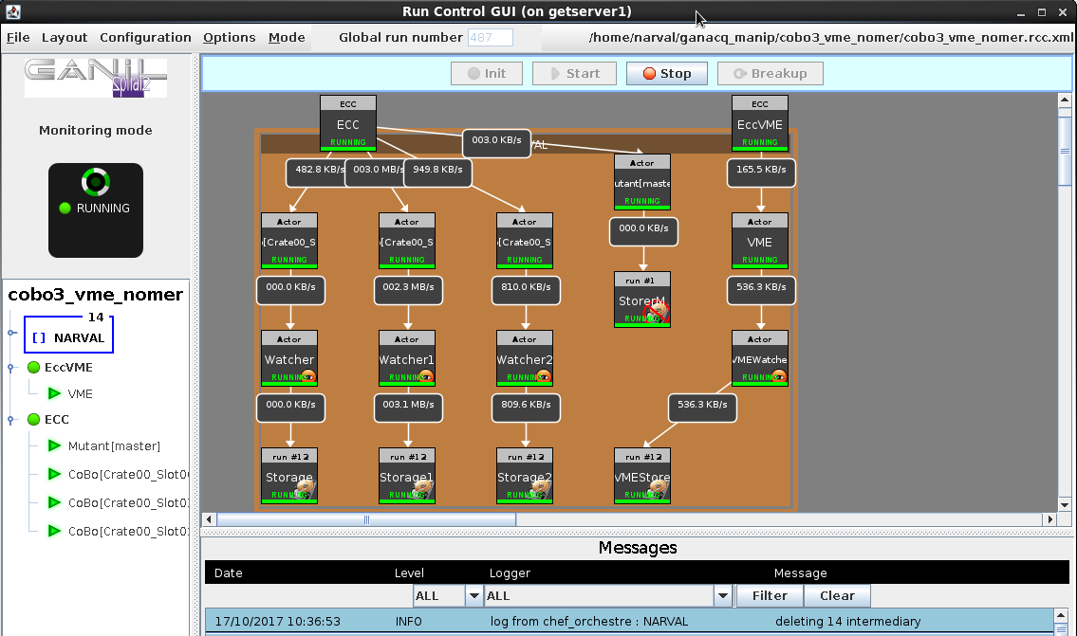
CHIMERA: Narval + Ganil-RCC handles GET and Chimera VME
CoBo(s) Get Server
Slow control
MuTanT
VME DAQ Server
CoBo(s) data catcher
Data
STORAGE (individual for each device)
COBO0
COBO1
COBO2
VME
Data frames are a sequence of events with a fixed size header (MFM) and data of variable length (as in MBS but with a different standard)
Note: no DAQ Embedded Merger

Slide 10
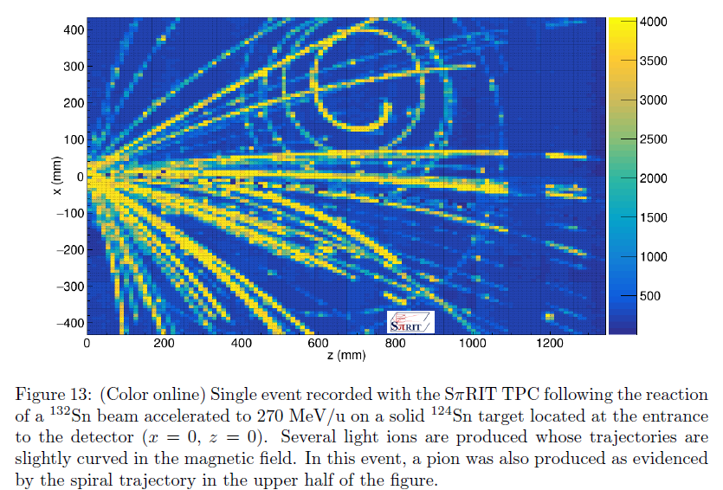
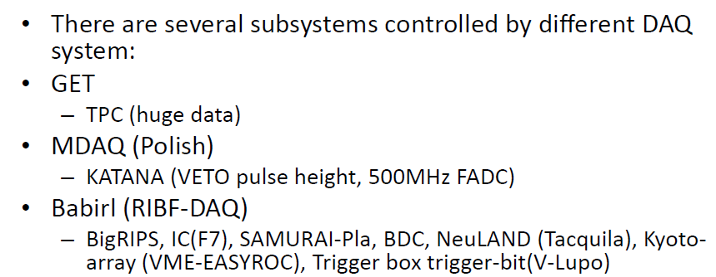
Transport 2017 MSU
Mizuki Nishimura
132Sn + 124Sn 108Sn + 112Sn 124Sn + 112Sn 112Sn + 124Sn ~300 MeV/u

Slide 11
Sπirit: Narval + Ganil-RCC handles GET, Riken RIBF DAQ (Babirl) handling NeuLand and other devices, and Main Trigger Box (GTO)
Courtesy: Aki Isobe
12 CoBos + 1 Babirl + 1 Mdaq (Crakow Catana array)
BUT remind that:
In a R³B experiment at GSI
the DAQ supervisor should be MBS-DAQ or derived
as in the AsyEos experiment
Note: no DAQ Embedded Merger

Slide 12
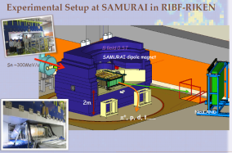
Data merging and on-line and offline analysis
Solution in the Sπirit experiment (Aki Isobe)

Slide 13
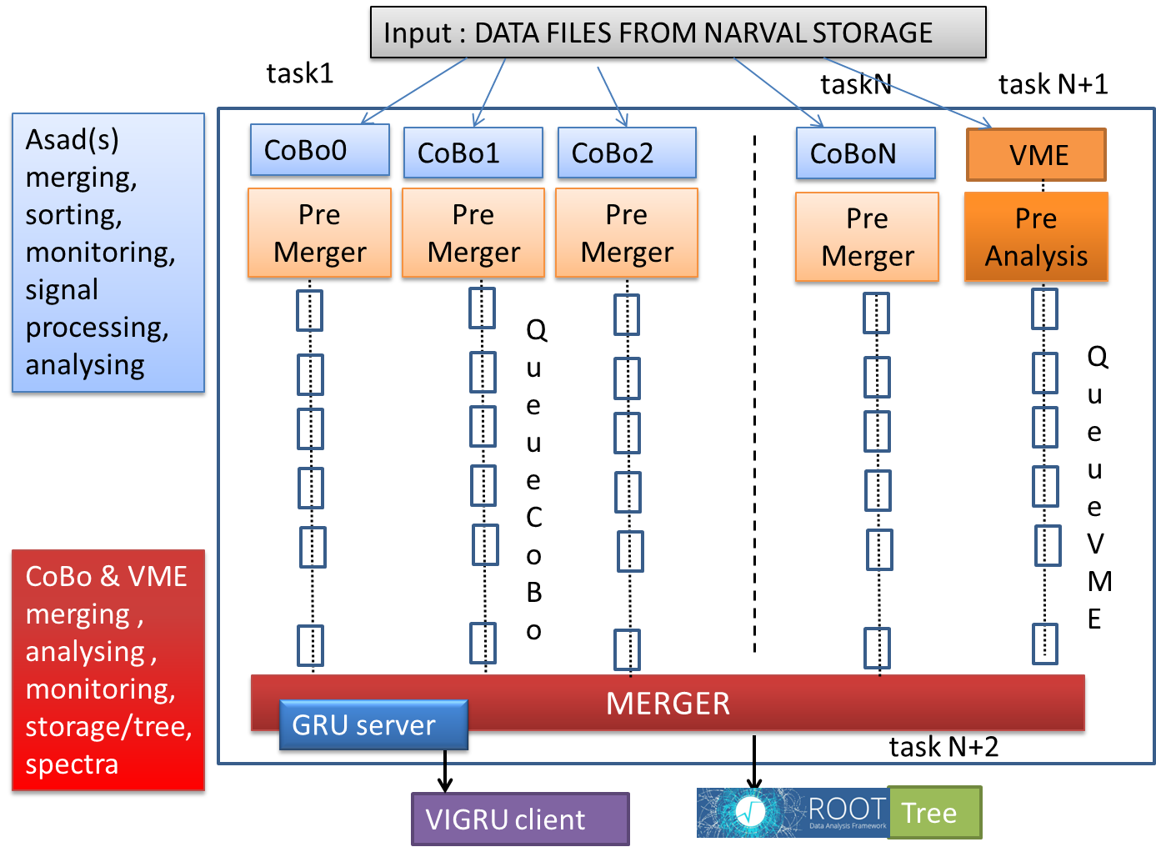
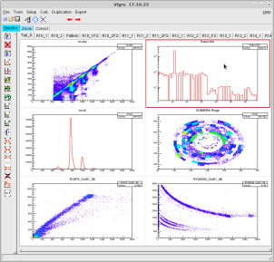
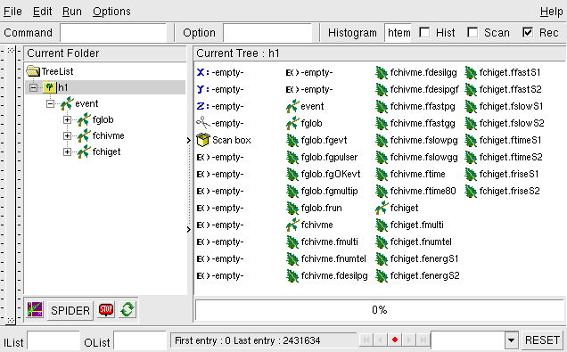
Solution for CHIMERA/GET: Event Building «offline» MERGER

Slide 14
CHIMERA/GET event building «offline» MERGER
Alpha + ¹²C@16 A.MeV
Gamma-Hoyle experiment 2017
Testing data correlation
AGET Pattern
GET
VME
Multiplicity trigger analog signal (VME)
Chimera Ring Si- Timing
Pattern
«On-line» data monitoring with the Merger
ΔE Si(VME)
Fast-Slow (GET)
CsI - GET

Slide 15
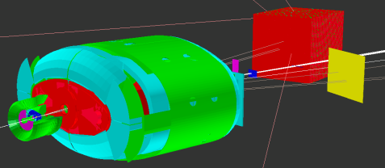
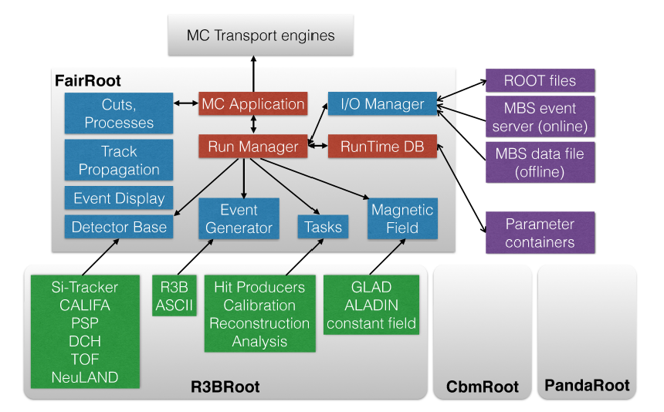
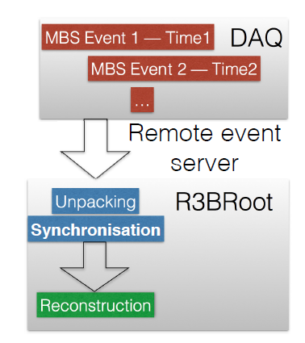
But: Remind that in a R³B environment at GSI we have, with «high probability», to work and adapt our data unpacking and analysis to the FairRoot (and derived R3BRoot) environment . . . . . .
R3B-Root
Dmytro Kresan et al 2015 J. Phys.: Conf. Ser. 664 082021

Slide 16
No Conclusion: This is a starting point discussion . . . . . . . . .

Slide 17
FINE

Slide 18
THE AGET ASIC in the ASAD board
Sampling frequency up to 100 MHz
Readout/Trigger µTCA crate
Internal pulser
Pulser
discriminator
DISC
1.2 Gb flow
HIT
Reg.
CoBo
Ana. Mem. SCA
64
analog
channels
12 bit
ADC
PAC
Filter
Mulx
c510
c511
c0
c1
c.
ci-2
ci+2
ci-1
ci+1
ci
Trigger
Mutant
Trigger
FPGA
c510
c511
c0
c1
c.
ci-2
ci+2
ci-1
ci+1
ci
512-sample
analog memory. Switched capacitors array
10 Gb flow
Dual Gain
PAC
Custom pre-amplifiers
for Chimera Csi or Farcos DSSSD
VHDCI cable to CoBo
AGET
256 + (16 FPN) input channels
See: E.C. Pollacco et al. Submitted to NIM A (2017)

Slide 19
Some definitions . . . and numbers (CHIMERA + FARCOS)
AGET: Asic for GET – 64 analog channels (+4 FPN) - 512 cells/channel
ASAD: AGET Support for Analog to Digital – 4 AGET
COBO: COllection BOard – 4 ASAD - 1024 digital channels
MUTANT: MUtiplicity, Trigger ANd Time ( 3 trigger levels)
MicroTCA: Micro Telecommunications Computing Architecture
MCH: Carrier Hub with 10 Gb and 1 Gb ethernet link
µTCA
Chimera CsI:
8 ASAD → 2 CoBo (<2k signals)
Farcos (5 modules):
14 ASAD → 4 CoBo (<4k signals)
1 µTCA crate
1 Mutant (three levels trigger)
Computer farm + Storage (disk server) + 10Gb/1Gb switch
CoBo
Mutant
MCH
10 Gb data
Chimera DAQ crate

Slide 20
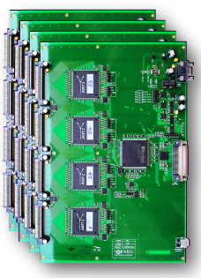
Why a new front-end electronic ?
The final FARCOS array constituted by 5 modules (20 telescopes, in the final project) needs the readout of about 4k channels.
CHIMERA CsI(Tl) front-end (1192 detectors) is now obsolete, in particular the amplifiers and the VME QDCs for CsI fast-slow component integration (more than 15 years old technology).
Our choice was to develop a first stage front-end circuit for FARCOS (including new ASIC pre-amplifiers) and new dual-gain modules coupled to a compact hardware architecture covering digitalization and signal readout, syncronization and trigger functions . All these last aspects are covered by the GET project.
Consequences → digital DAQ for Farcos and CHIMERA (CsI) + Analog DAQ (Silicons)
Upgrade of the CHIMERA front-end for CsI(Tl) (in progress….)
GET Project
R&D Financed 75% (France)
25% (USA)
Project supervisor: E. Pollacco

Slide 21
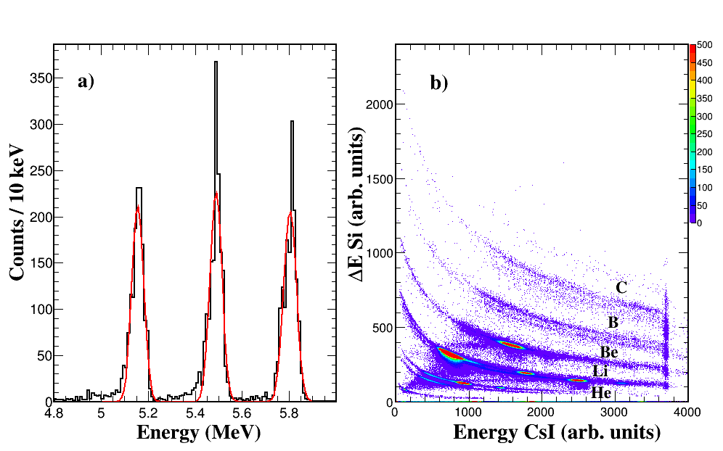
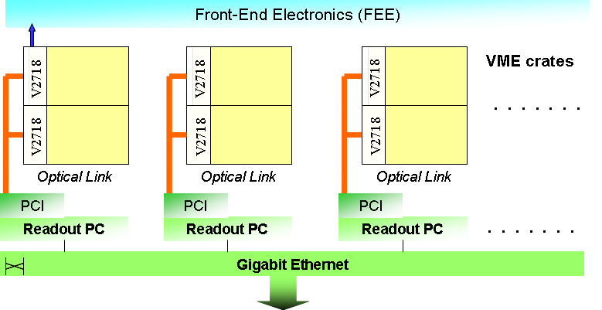
Fragmentation beams (primary 55 A.MeV ¹⁸O) on plastic target
3 peaks α source 50 Ms/s
GET-DAQ
Ring 2 2mV/MeV PA
Chimera - DAQ
Chimera – Analog DAQ
Standard CHIMERA preamplifier used in the silicon stage (2 mV/MeV) [Chimera, ring 2E]
The signals are digitized at a frequency of 50MHz
Both signals Si/CsI are shaped with a 1µs shaping time in the SKF filter stage of AGET chips.
Better isotopic resolution obtained with GET.
Note the CHIMERA CsI fast component signal saturation → dual gain (DG) module needed (as well for FARCOS silicon strips)
Notes:
<number>

Slide 22
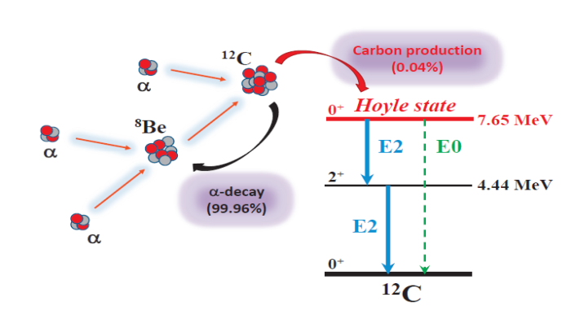
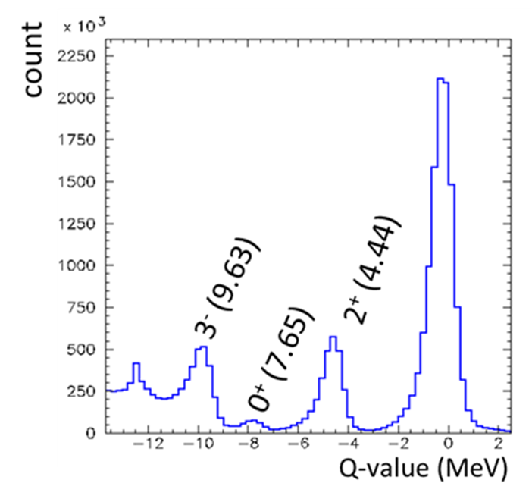
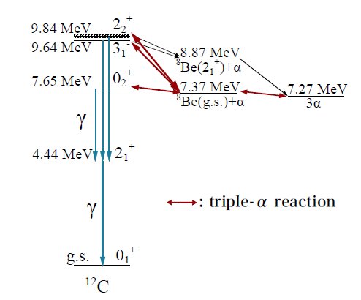
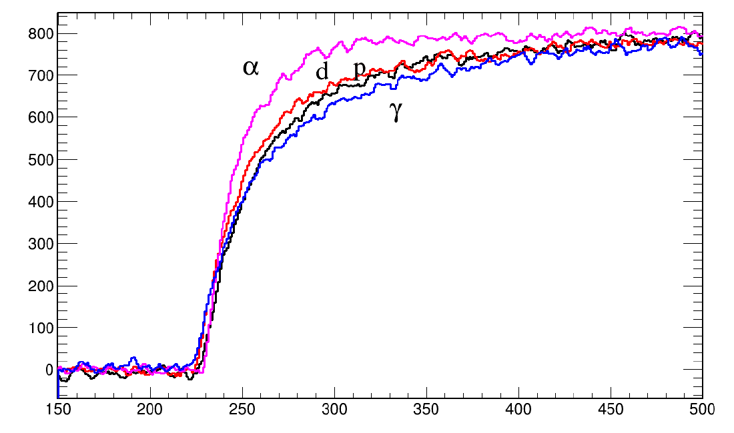
The GAMMA experiment: search of the γ-decay branching ratio of the Hoyle state and first excited 3⁻ level of ¹²C by α (60 MeV) + ¹²C reaction
spoke: G. Cardella)
p+¹²C @24 MeV
¹²C+ α + γ_{5.2} + γ_{4.44}
¹²C+ α + γ_{3.21}+γ_{4.44}
The proposed method: CHIMERA is able to see the 4 fold coincidence (scattered alpha + recoiling carbon + γ-γ coincidence with good efficiency
CsI(Tl) particle discrimination seen with GET

Slide 23
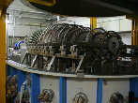
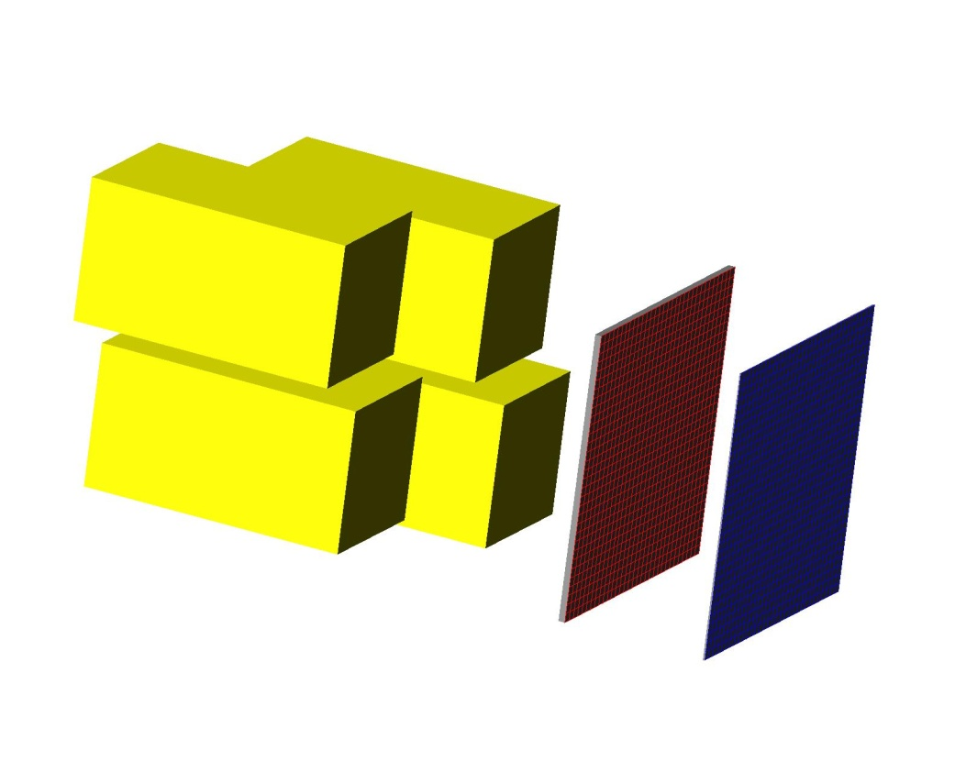
Collaboration for Farcos project and Chimera upgrade
L.Acosta^{1,8}, L.Auditore⁴, C.Boiano⁵, G.Cardella¹, A.Castoldi⁵, M.D’Andrea¹, E. De Filippo¹,D.Dell’Aquila⁶, S. De Luca⁴, F. Favela¹, F.Fichera¹, L.Francalanza⁶, N.Giudice¹, B.Gnoffo¹, A.Grimaldi¹, C.Guazzoni⁵, G.Lanzalone^{2,7}, F.Librizzi¹, P. Litrico², I.Lombardo⁶, C.Maiolino², S.Maffesanti⁵, N.Martorana², A.Pagano¹, E.V.Pagano^{2,3}, M.Papa¹, T.Parsani⁵, G.Passaro², S.Pirrone¹, G.Politi^{1,3}, F.Previdi⁵, L.Quattrocchi⁴, F.Rizzo^{2,3}, P.Russotto¹, G.Saccà¹, G.Salemi¹, D.Sciliberto¹, A.Trifirò⁴, M.Trimarchì⁴, M.Vigilante⁶
1-INFN Sezione di Catania
2-INFN LNS
3-Dipartimento di Fisica e Astronomia Università di Catania
4-INFN_gr. Coll. Messina and Dipartimento di Fisica Università Messina
5-INFN- Sezione di Milano and Politecnico di Milano
6-INFN-Sez. di Napoli and Dipartimento di Fisica Università di Napoli Federico II
7-Università Kore Enna
8-Instituto de Física Universidad Nacional Autónoma de México, México D. F. 01000

